Slide 1
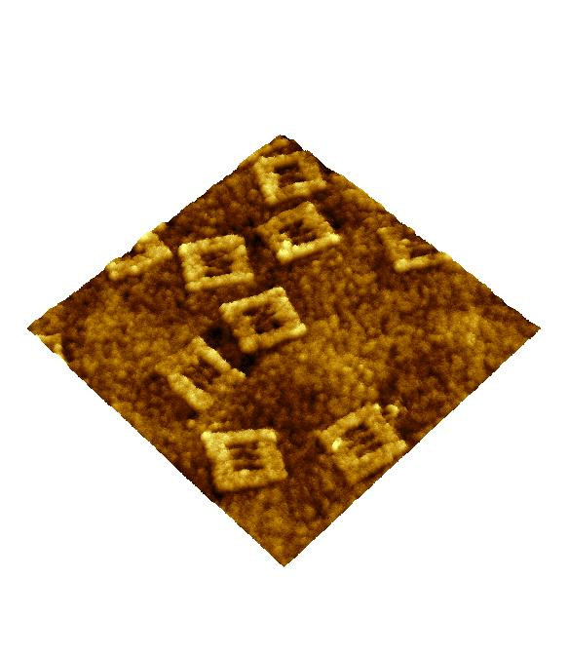

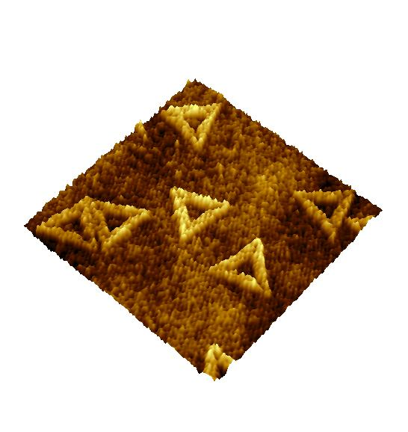
Ion Collisions with
DNA Origami Nanostructures
Leo Sala, Jaroslav Kočišek
J. Heyrovsky Institute of Physical Chemistry
of the Czech Academy of Sciences
Dolejškova 2155/3, 182 23 Prague 8, Czech Republic
*leo.sala@jh-inst.cas.cz, kocisek@jh-inst.cas.cz

Slide 2
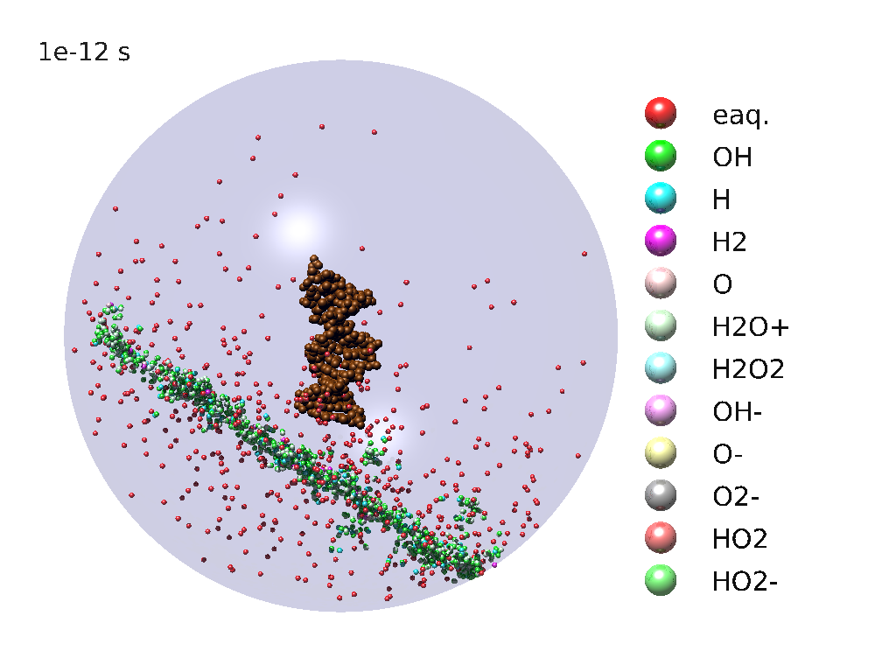
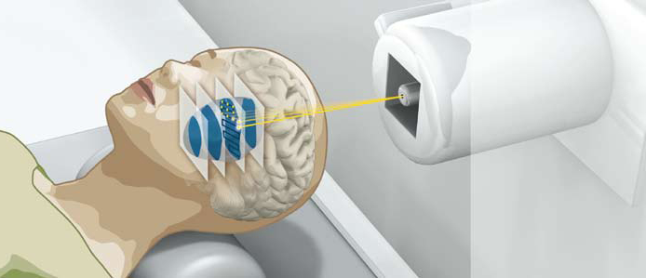
Motivation: cancer radiotherapy
DNA damage mechanisms
Radiosensitization: exploit damage mechanisms to improve sensitivity to radiation
Štěpán, Davídková, et al., RADAMOL biophysical tool
- 2 MeV alpha particle passing through water sphere cotaining a short DNA oligomer
Image: https://newscenter.lbl.gov/2010/10/18/ion-beam-therapy/
Radiat. Phys. Chem. 128, 2016.
Eur. Phys. J. D 68, 2014.

Slide 3
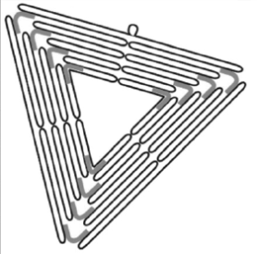
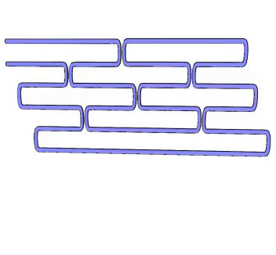

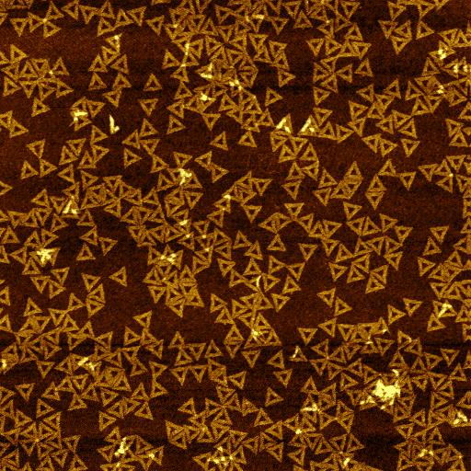
DNA origami nanostructures
TAE/Mg²⁺ buffer (pH~8)
Oligonucleotide
staple ~32 nt
207 oligos (staple strands)
22-43 nt
Single-stranded DNA
scaffold
7249 nt
Heat to 90°C
Cool down to 10°C (-0.7 °C min⁻¹)
Rothemund, Nature 440, 2006
Facile synthesis
High yield
Stable*
3x3 μm²
Source: S. Douglas, UCSF
Source: B. Hogberg, Karolinska Institute

Slide 4
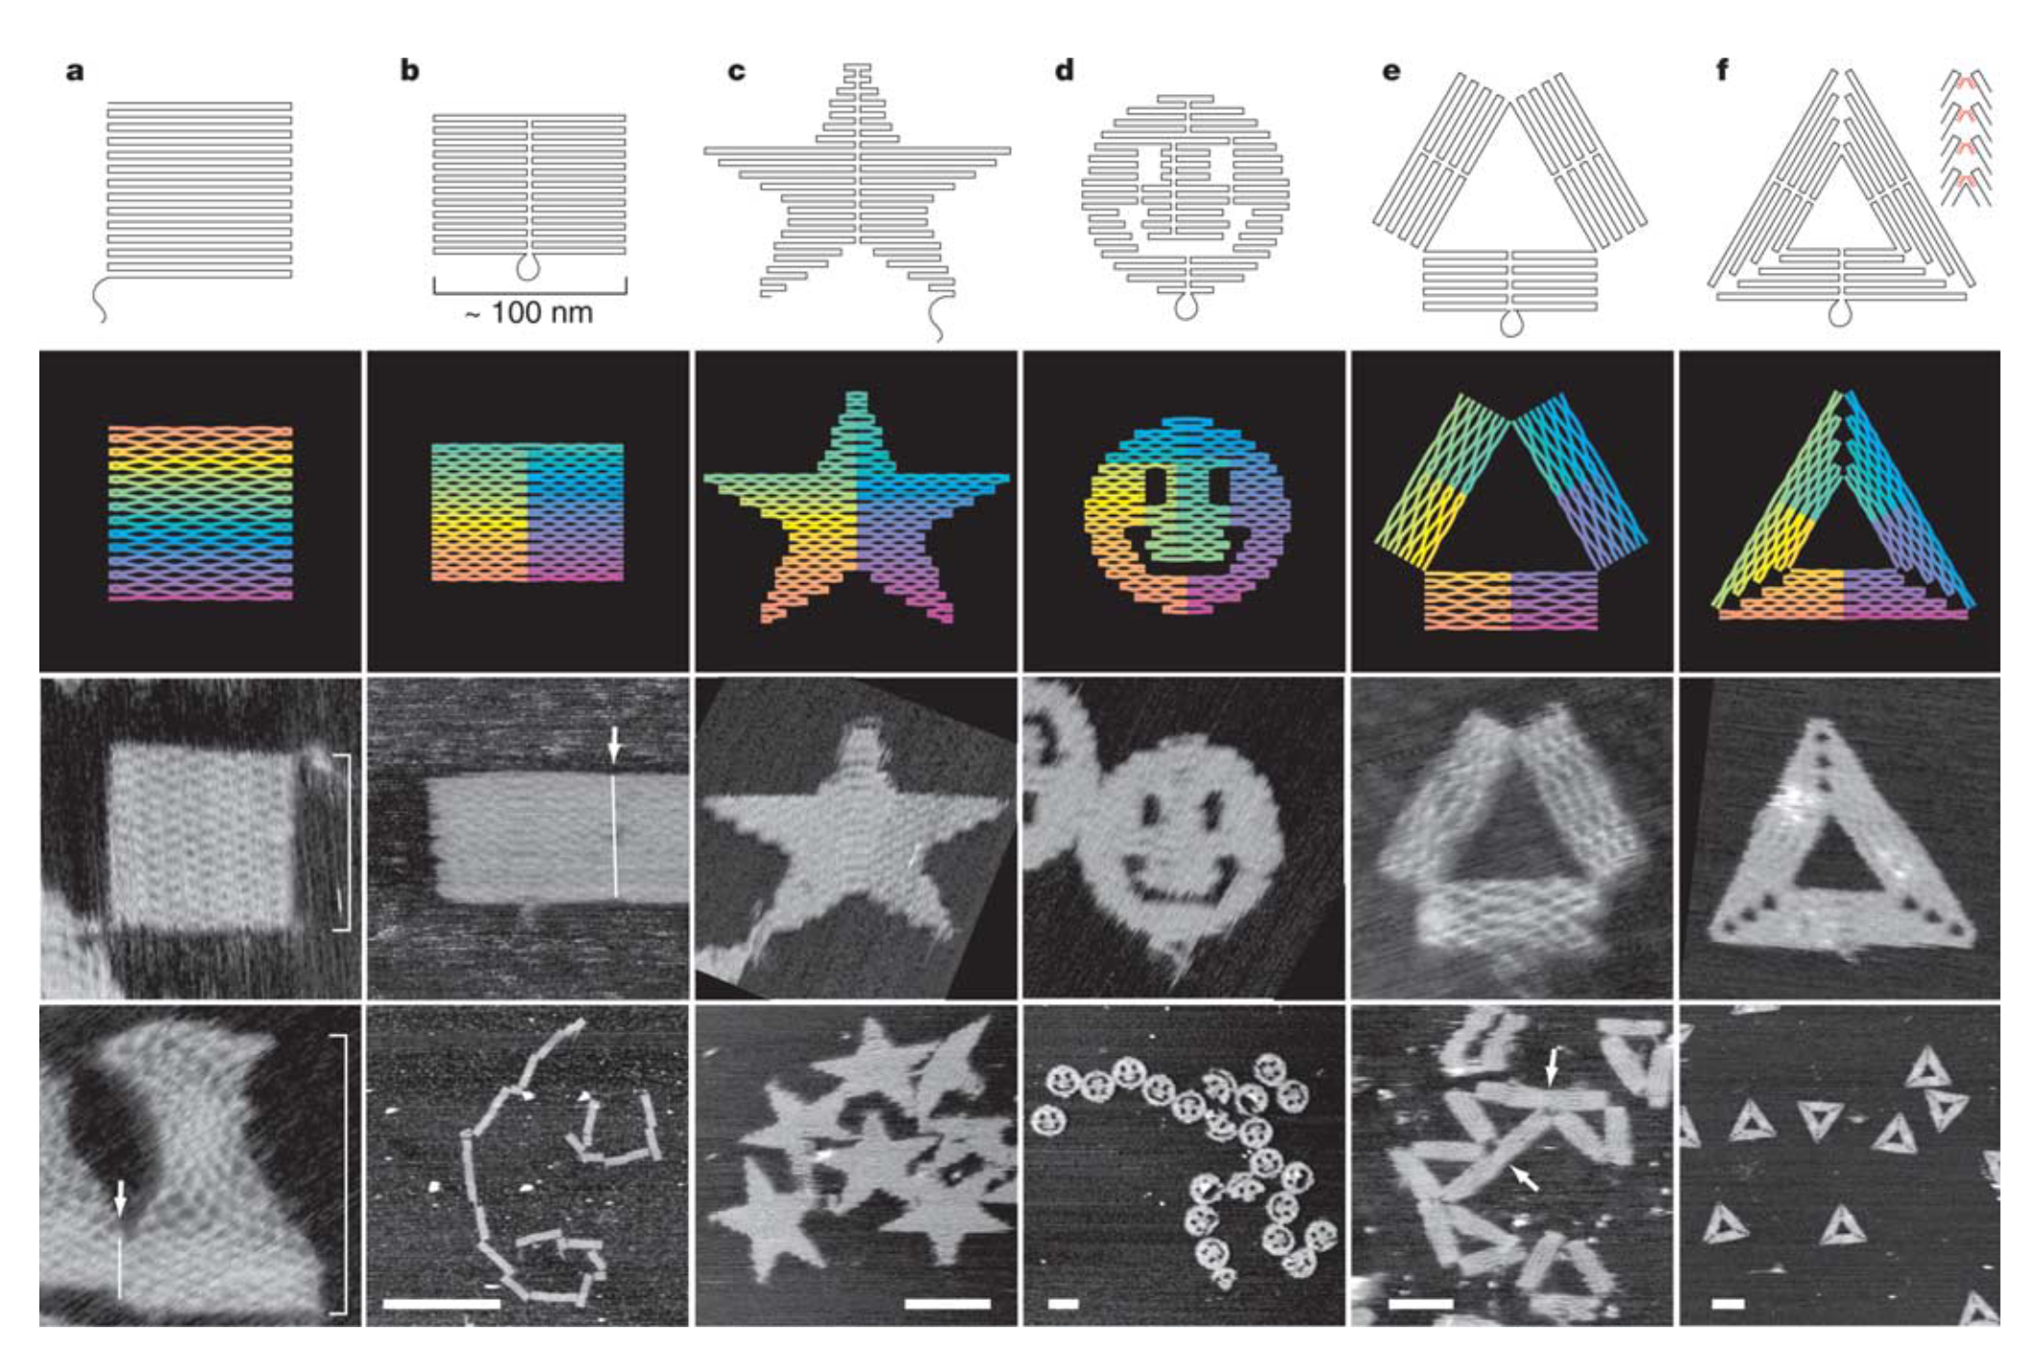
DNA nanotechnology
Nadrian C. Seeman
J. Theor. Biol. 99, 1982
Paul K. Rothemund
Nature 440, 2006
DNA Origami Nanostructures
1
Strict base pairing
A…T
C…G
2
Holliday junctions
Wang et al., Scientific Reports 6, 2016

Slide 5
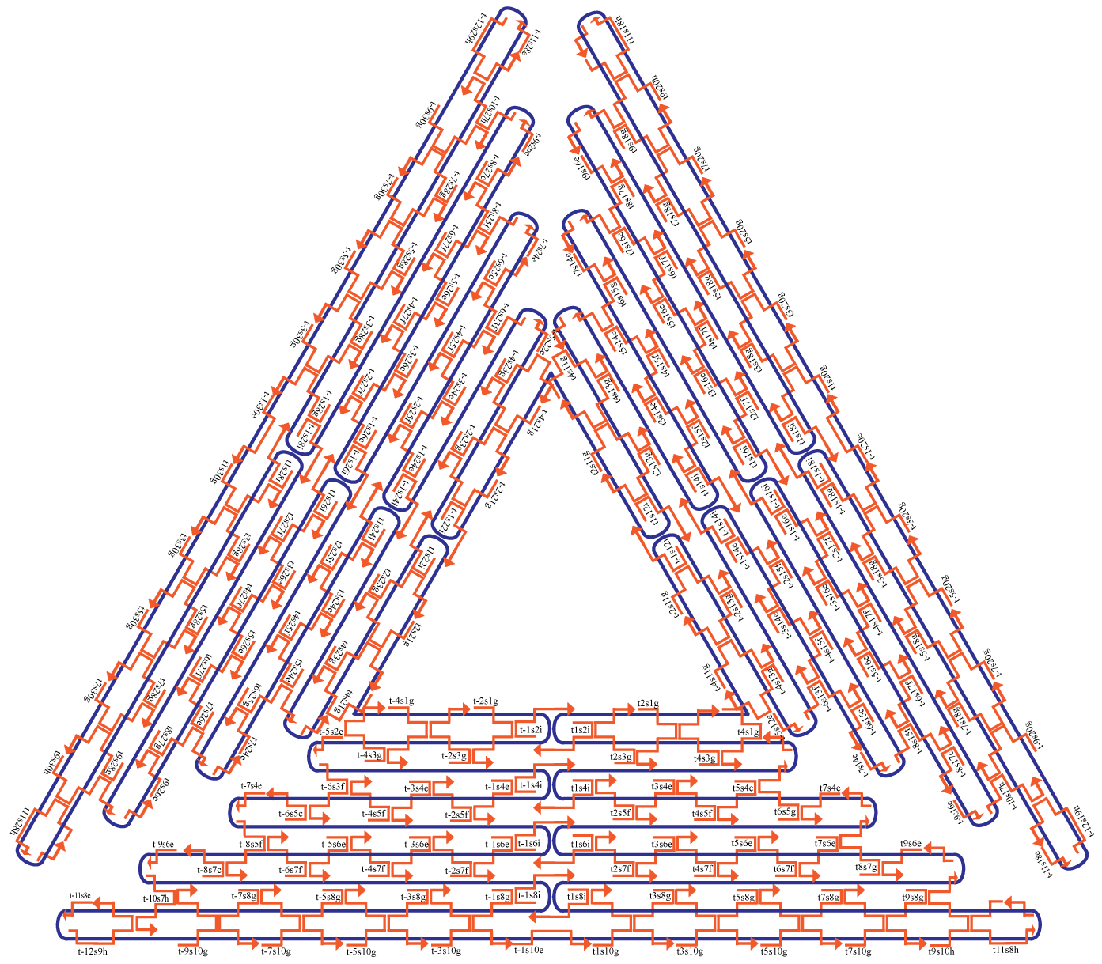
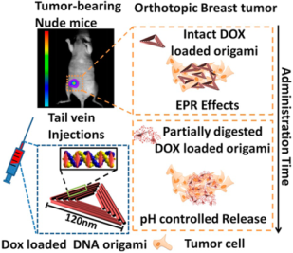
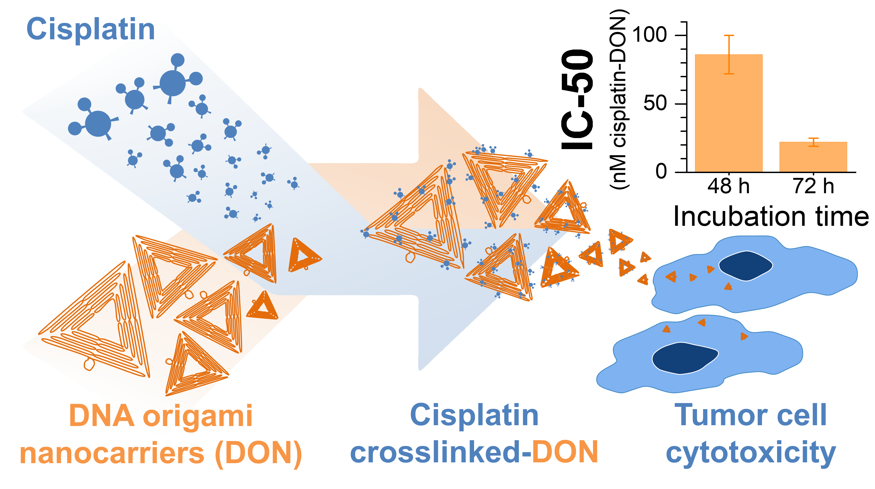
DNA origami nanostructure applications
Uniquely addressable and functionalizable sites
Drug delivery for cancer chemo-radiotherapy/diagnostics
120 nm
Dass et al., J. Phys. Chem. C 125, 2021
Sala et al., ACS Appl. Nano 5, 2022.
Zhang et al., ACS Nano 8, 2014.
5

Slide 6
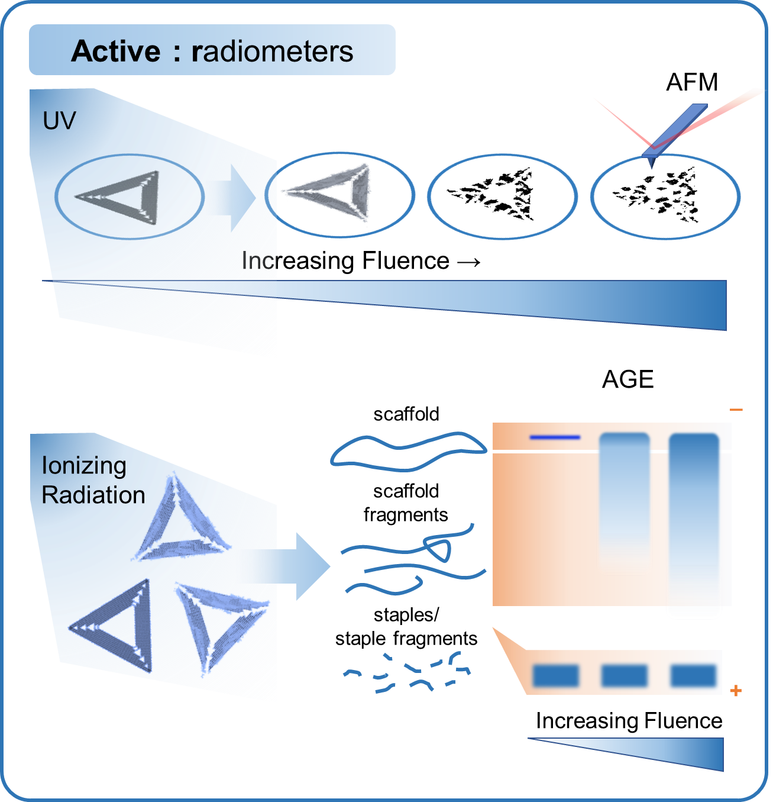
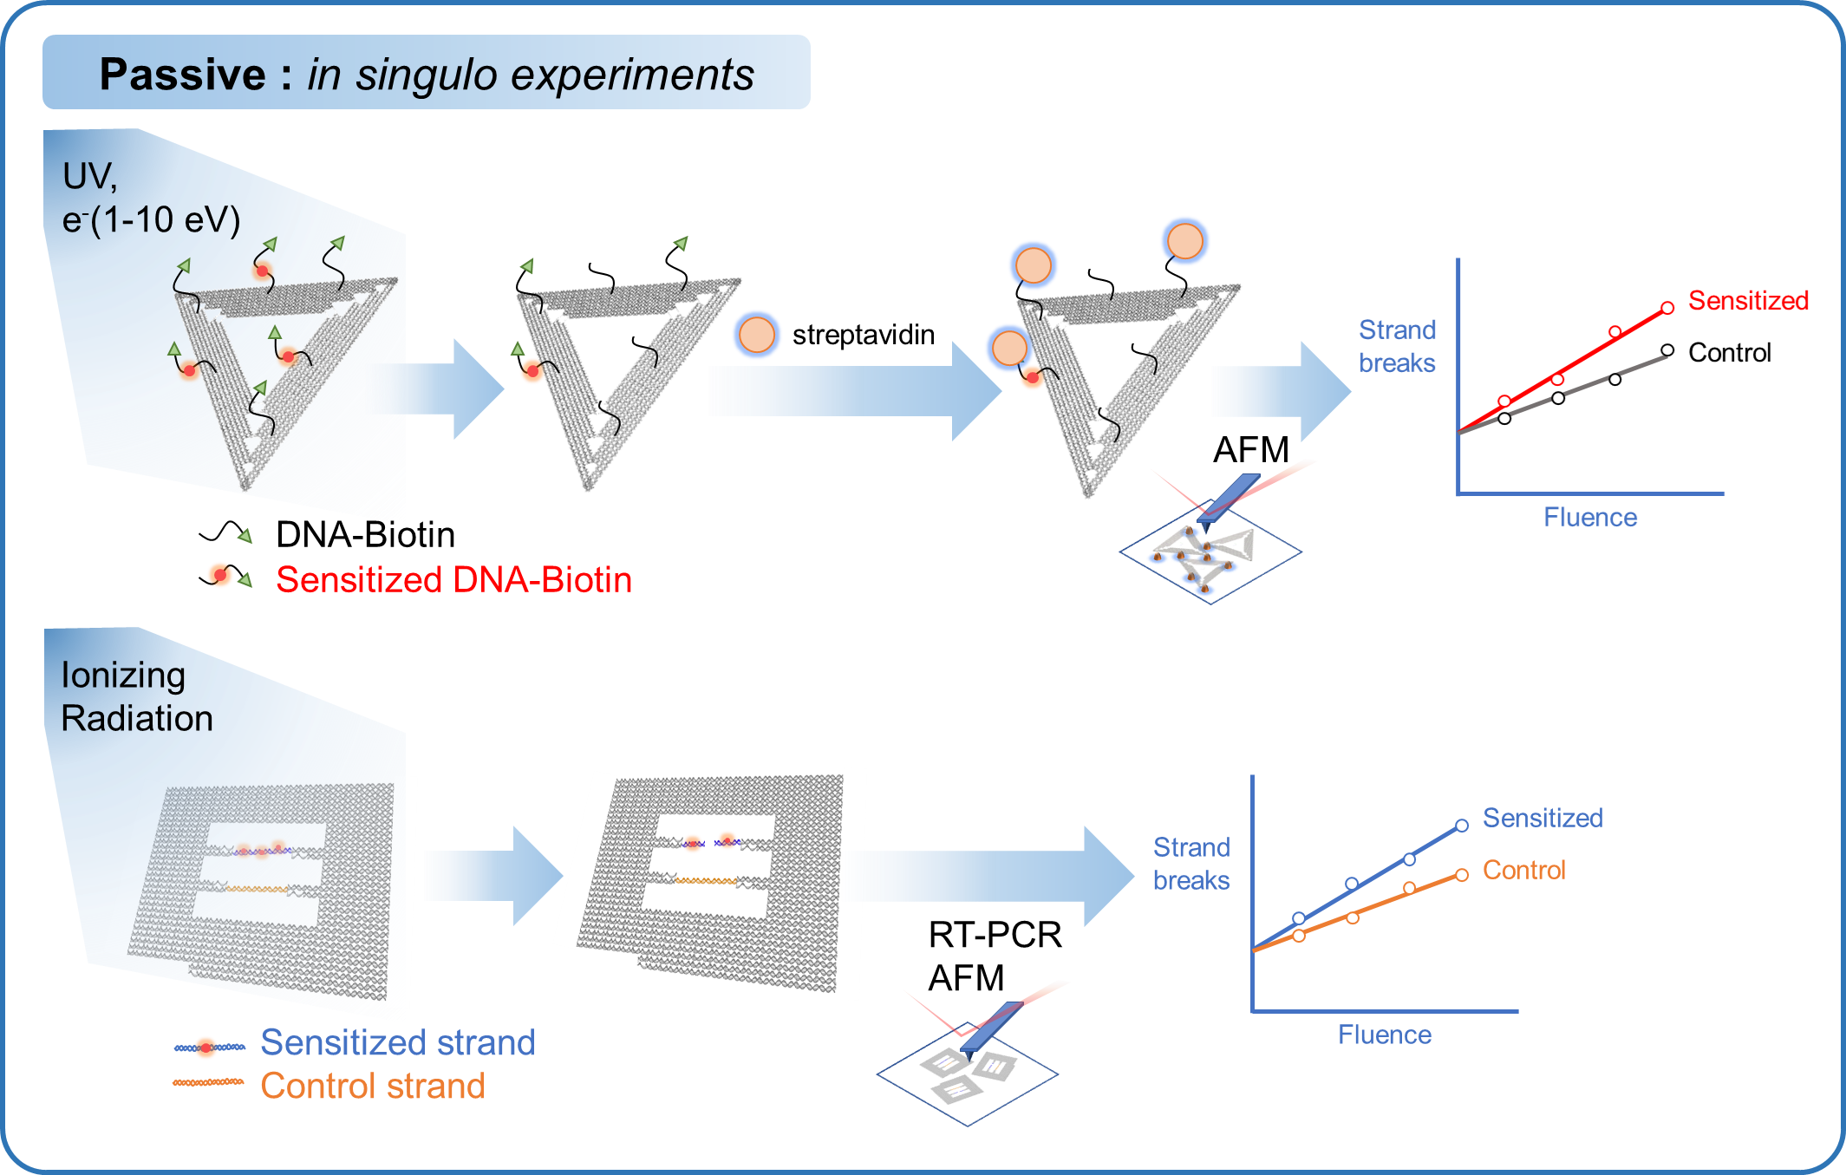
Use of DNA origami nanostructures for studies of radiation damage
UV: Fang et al., JACS 142, 2020.
Sala et al., J. Phys. B: At. Mol. Opt. Phys. 56, 2023
Gamma rays and proton beams:
Sala et al., Nanoscale 13, 2021.
Nanotriangles:
Keller, A., Bald I. et al., ACS Nano 6, 2012.
Schürmann R., Bald I. et al., Angew. Chem. 56, 2017.
Nanoframes:
Sala et al., JPC Lett. 13, 2022.

Slide 7
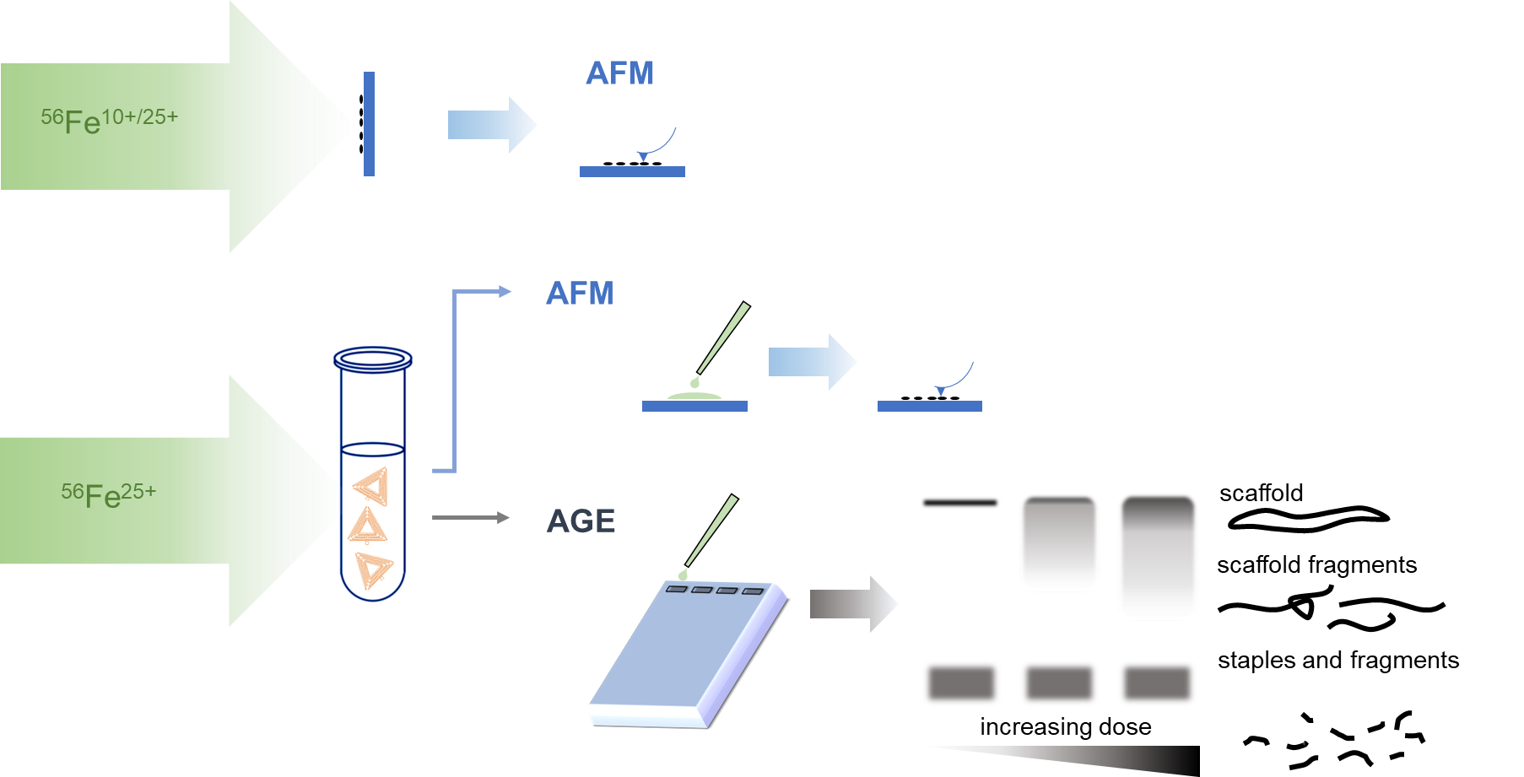
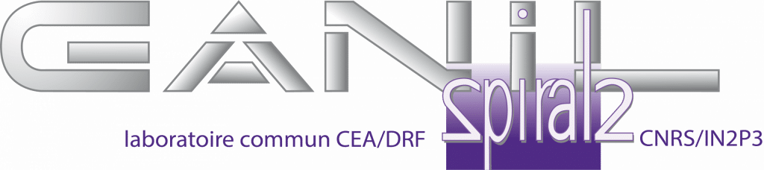
Fe beam irradiation of DNA origami
GANIL
Grand Accélérateur National d’Ions Lourds
D1-IRABAT
⁵⁶Fe²⁵⁺ (60 MeV u⁻¹)
Flux: 10⁷-10⁸ ions cm⁻²
Environment: air, solution
IRRSUD
⁵⁶Fe¹⁰⁺ (0.7 MeV u⁻¹)
Flux: 10⁹ ions cm⁻²
Environment: vacuum
Alain Mery - IRABAT
Volaine Vizcaino - IRABAT
Alicja Domaracka – IRRSUD
Philippe Budouch – IRRSUD
Hermann Rothard - IRRSUD
https://www.ganil-spiral2.eu/

Slide 8
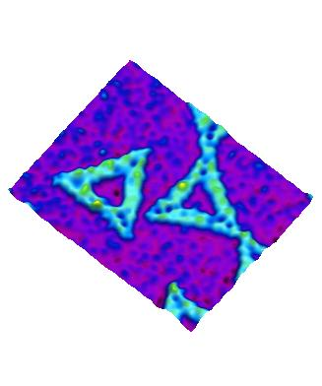
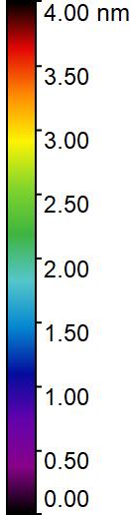
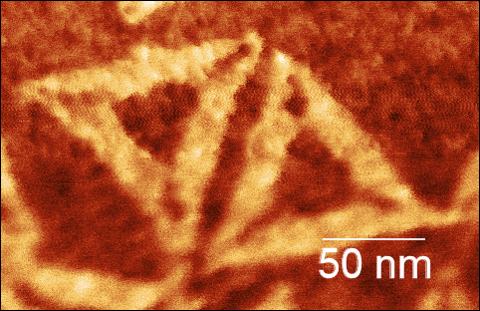
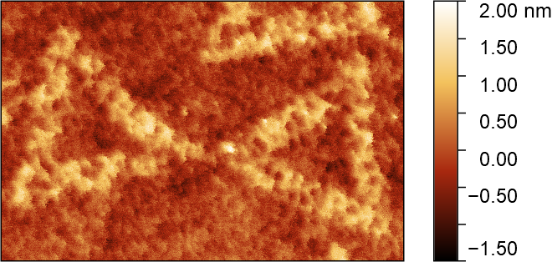
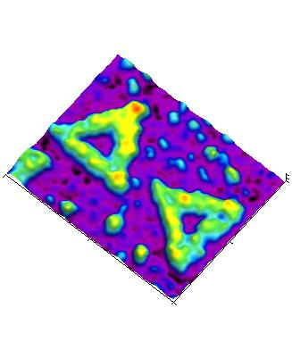
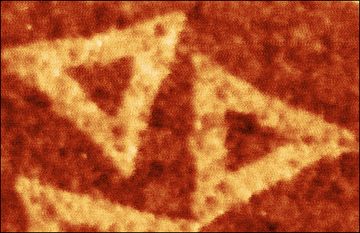
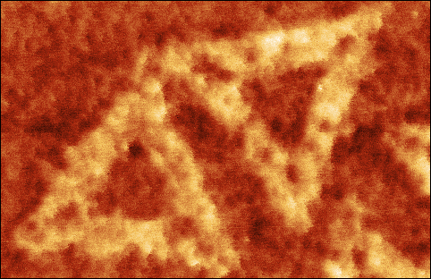
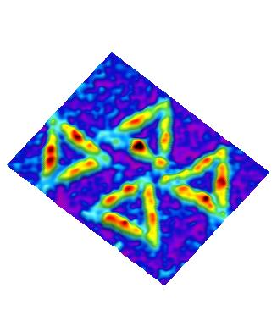
Fe beam irradiation of dry DNA origami
Fe¹⁰⁺ 0.7 MeV/u
Vacuum
Fe²⁵⁺ 60 MeV/u
Air
Fluence
(x10¹² ions cm⁻²)
0
1
5
10
Fluence
(x10¹¹ ions cm⁻²)
0
5
6.6

Slide 9
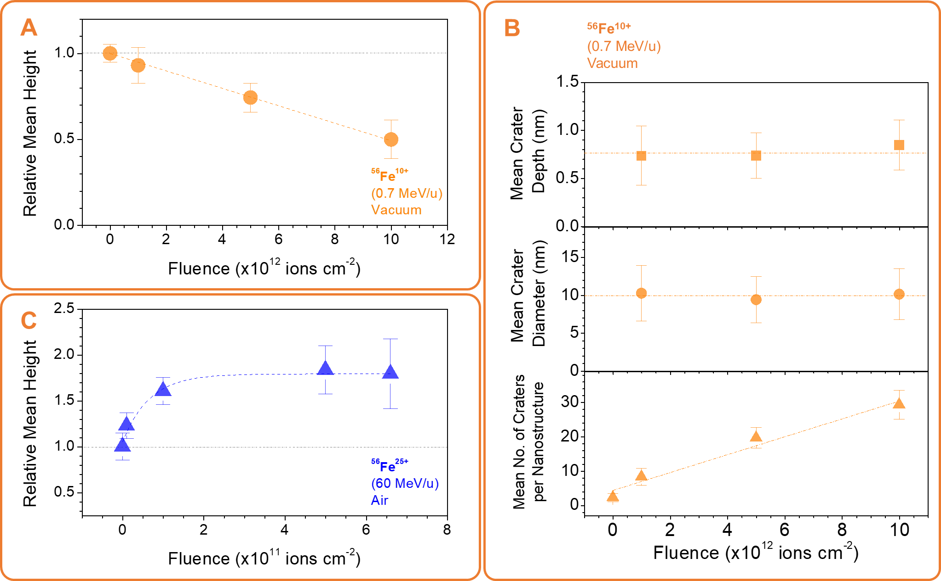
Height changes and crater formation of Fe irradiated DNA origami

Slide 10
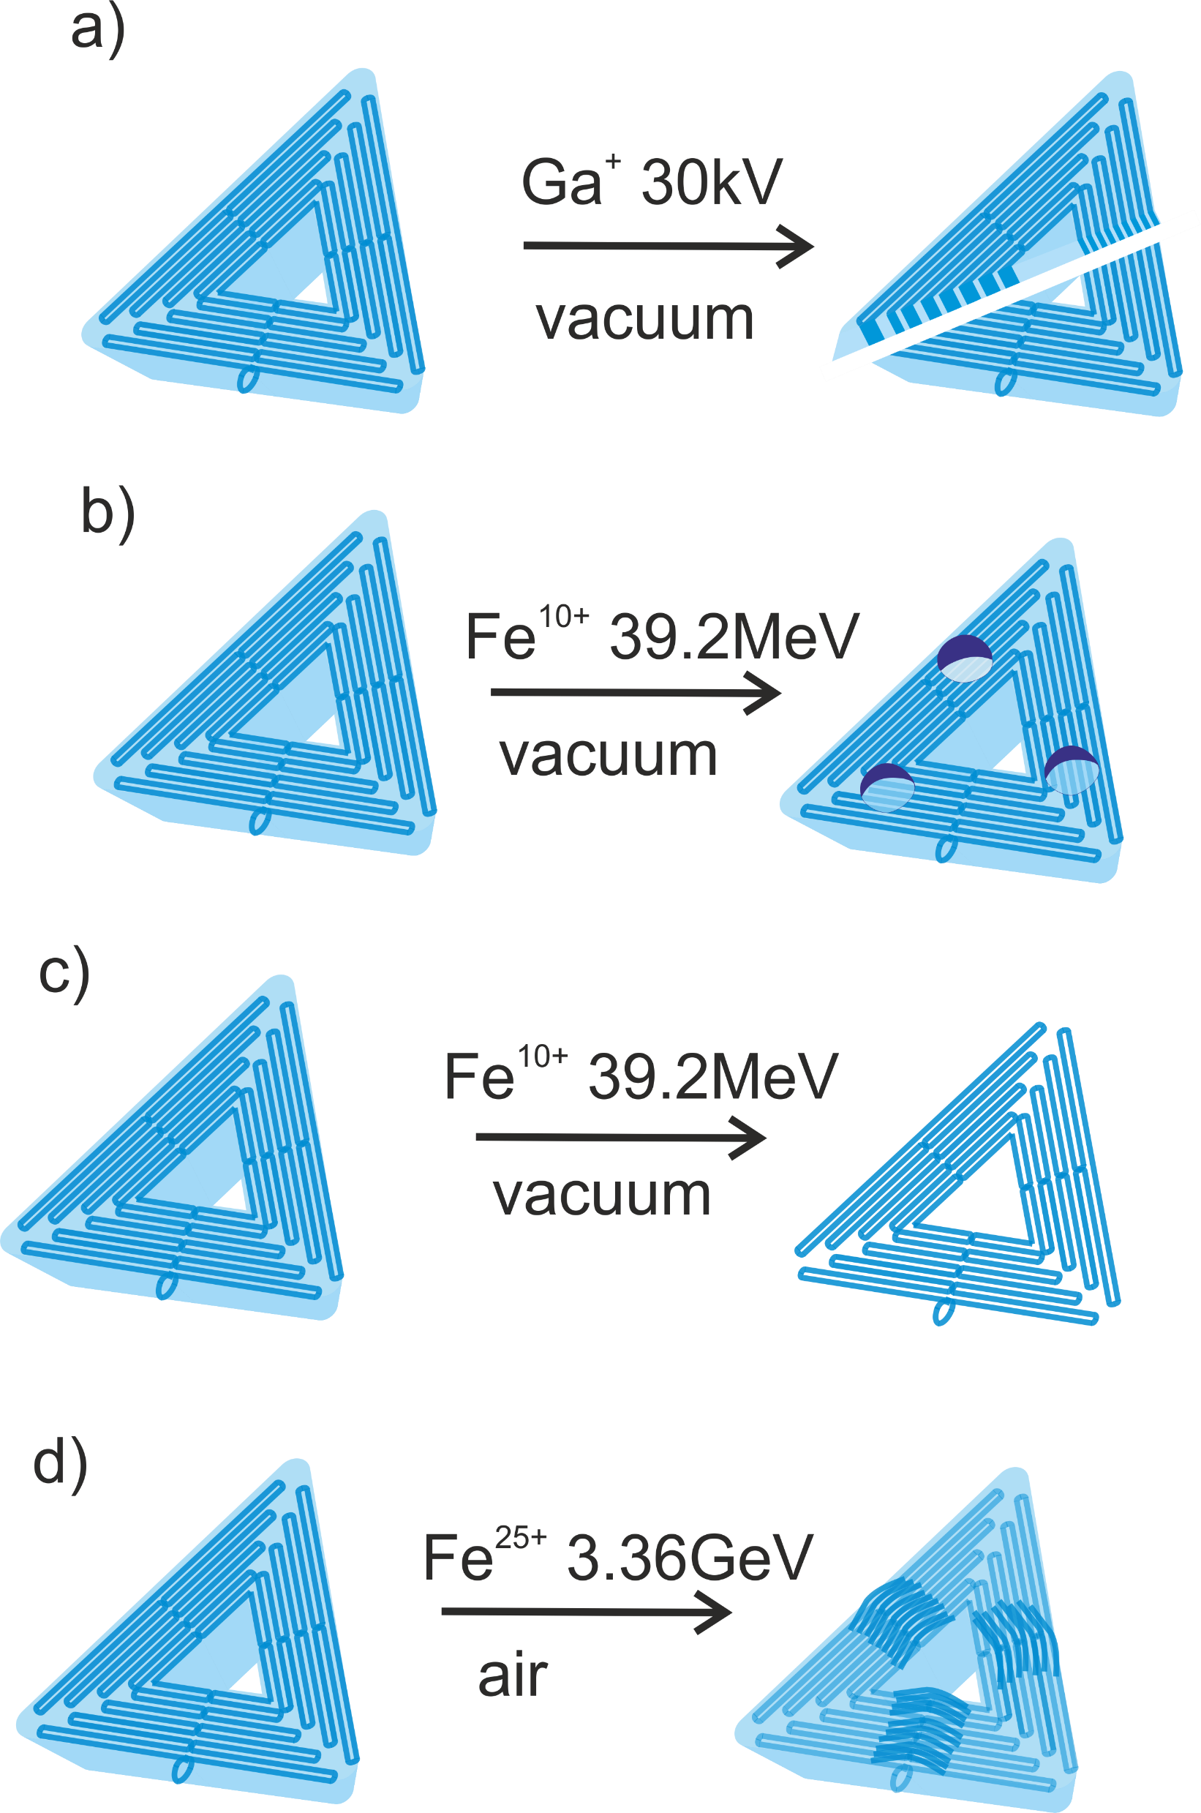
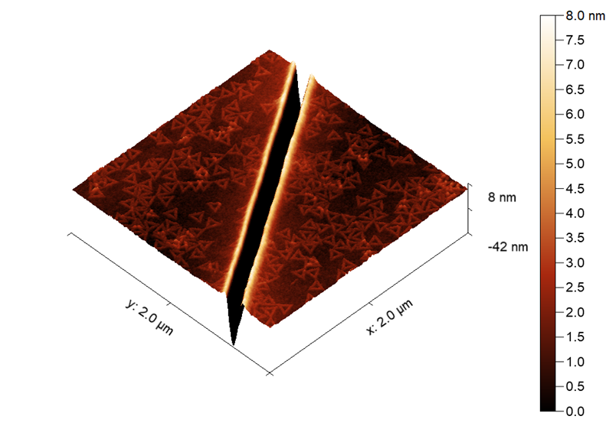
Summary: irradiation on dry DNA origami
FIB-etched DNA-origami-deposited
Si substrate
Crater formation
Height reduction
In dry state, DNA origami nanostructures maintain their overall structure after high energy ion beam processing
Implications: substrates for ion beam nanolithography
Height enhancement

Slide 11
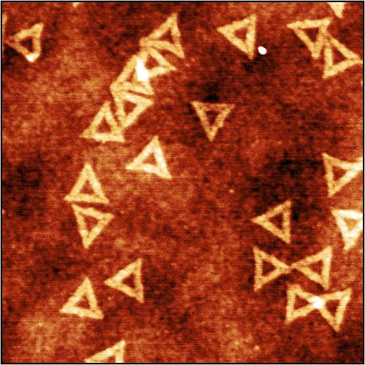
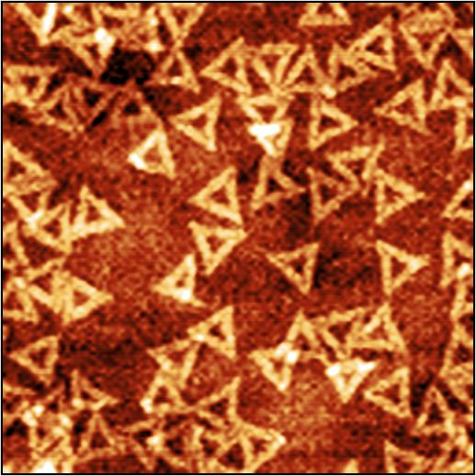
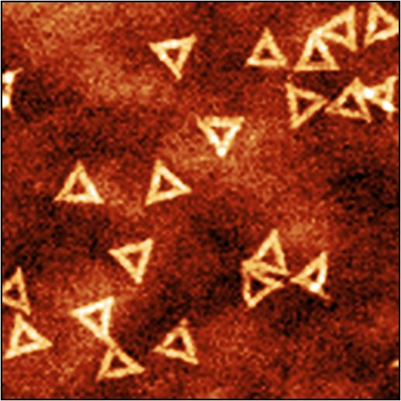
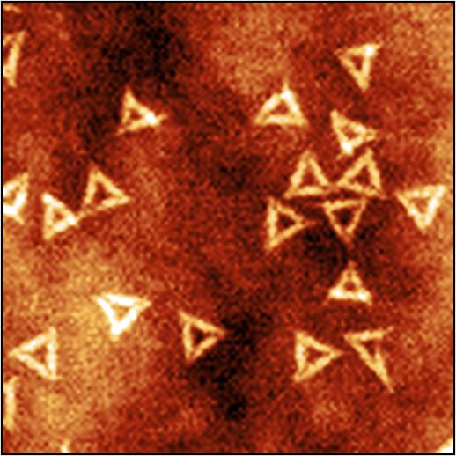
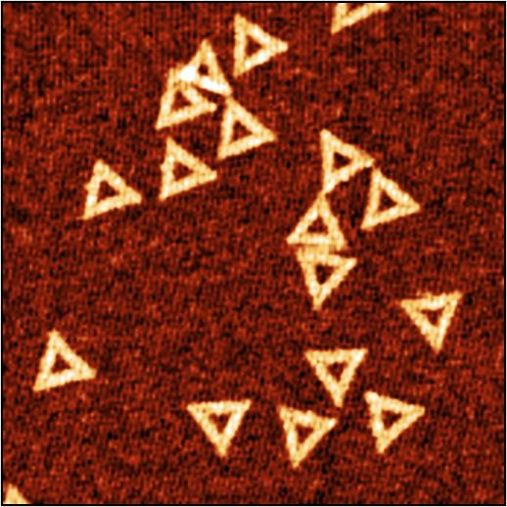
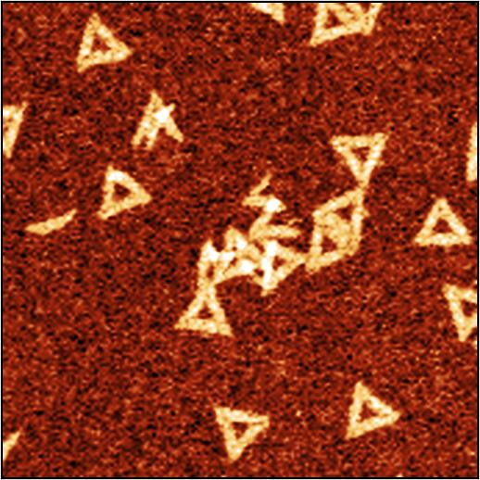
AFM images of irradiated DNA origami nanostructures in solution
γ ⁶⁰Co (1.2 MeV)
γ ⁶⁰Co (1.2 MeV)
p+ (30 MeV)
Fe²⁵⁺ (60 MeV/u)
1 μm
0 Gy
200 Gy
0 Gy
200 Gy
0 Gy
200 Gy
Single-stranded poly-T corner extensions are more susceptible to damage
120 nm
Fragmentation of nanostructures can occur with high energy ion beams (probably those along or at the vicinity of the particle track)

Slide 12
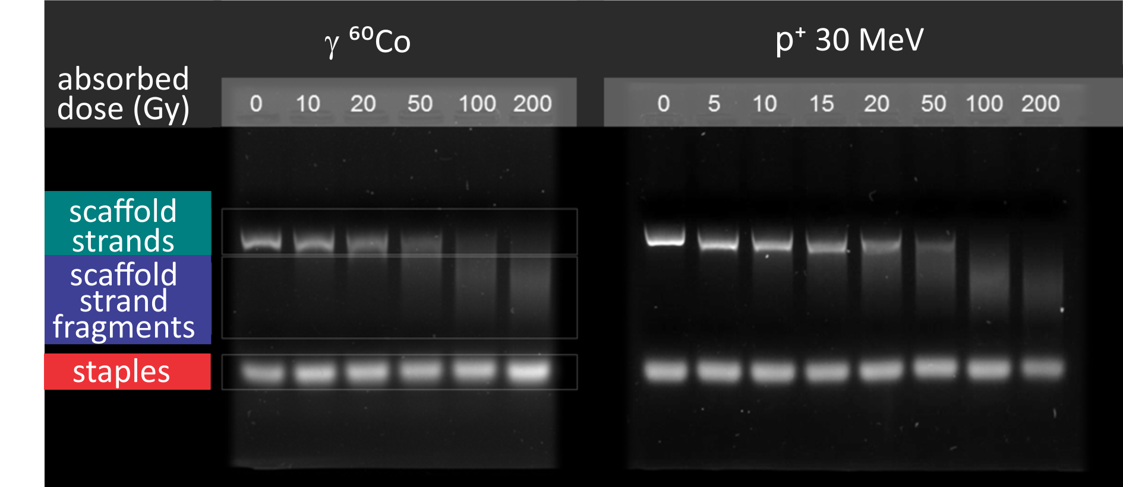
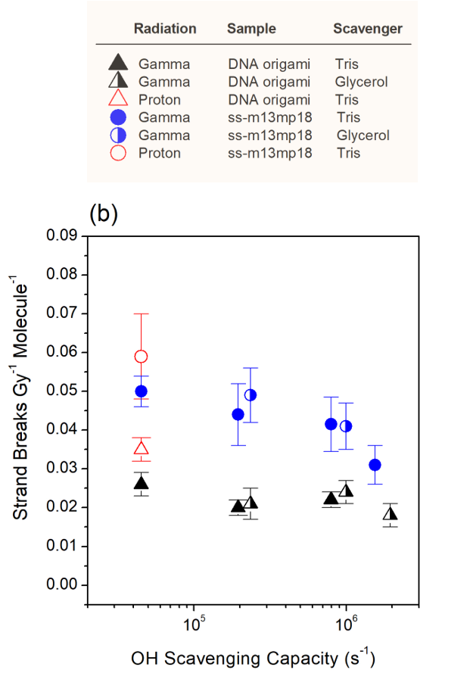


Results: radiation damage to DNA origami nanostructures in solution
Strand break analysis by gel electrophoresis
$$I_{S, Norm}=\frac{I_{S}}{I_{S}+I_{SF}}$$
● free scaffold
$$I_{S,Norm}=I_{0}e^{−μ_{SB}D}$$
Free scaffold DNA is more sensitive to OH radicals compared to DNA origami
dsDNA M13mp18 in H₂O: 0.38 SB Gy⁻¹ molecule⁻¹ > 10x
Folding of the scaffold → protective effect
Protective effect → accessibility to OH radicals in the folded structure (?)
▲ origami
Sala et al., Nanoscale 13, 2021.

Slide 13
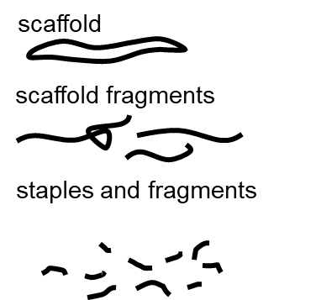
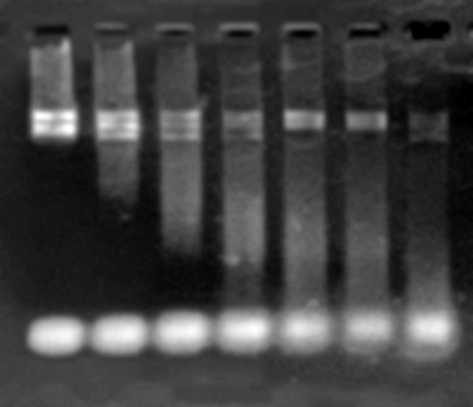
Electrophoresis of Fe beam irradiated DNA origami in solution
Radiation
Fe²⁵⁺ (60 MeV/u)
200 Gy
Dose (Gy)
0 10 50 100 200
1 μm

Slide 14
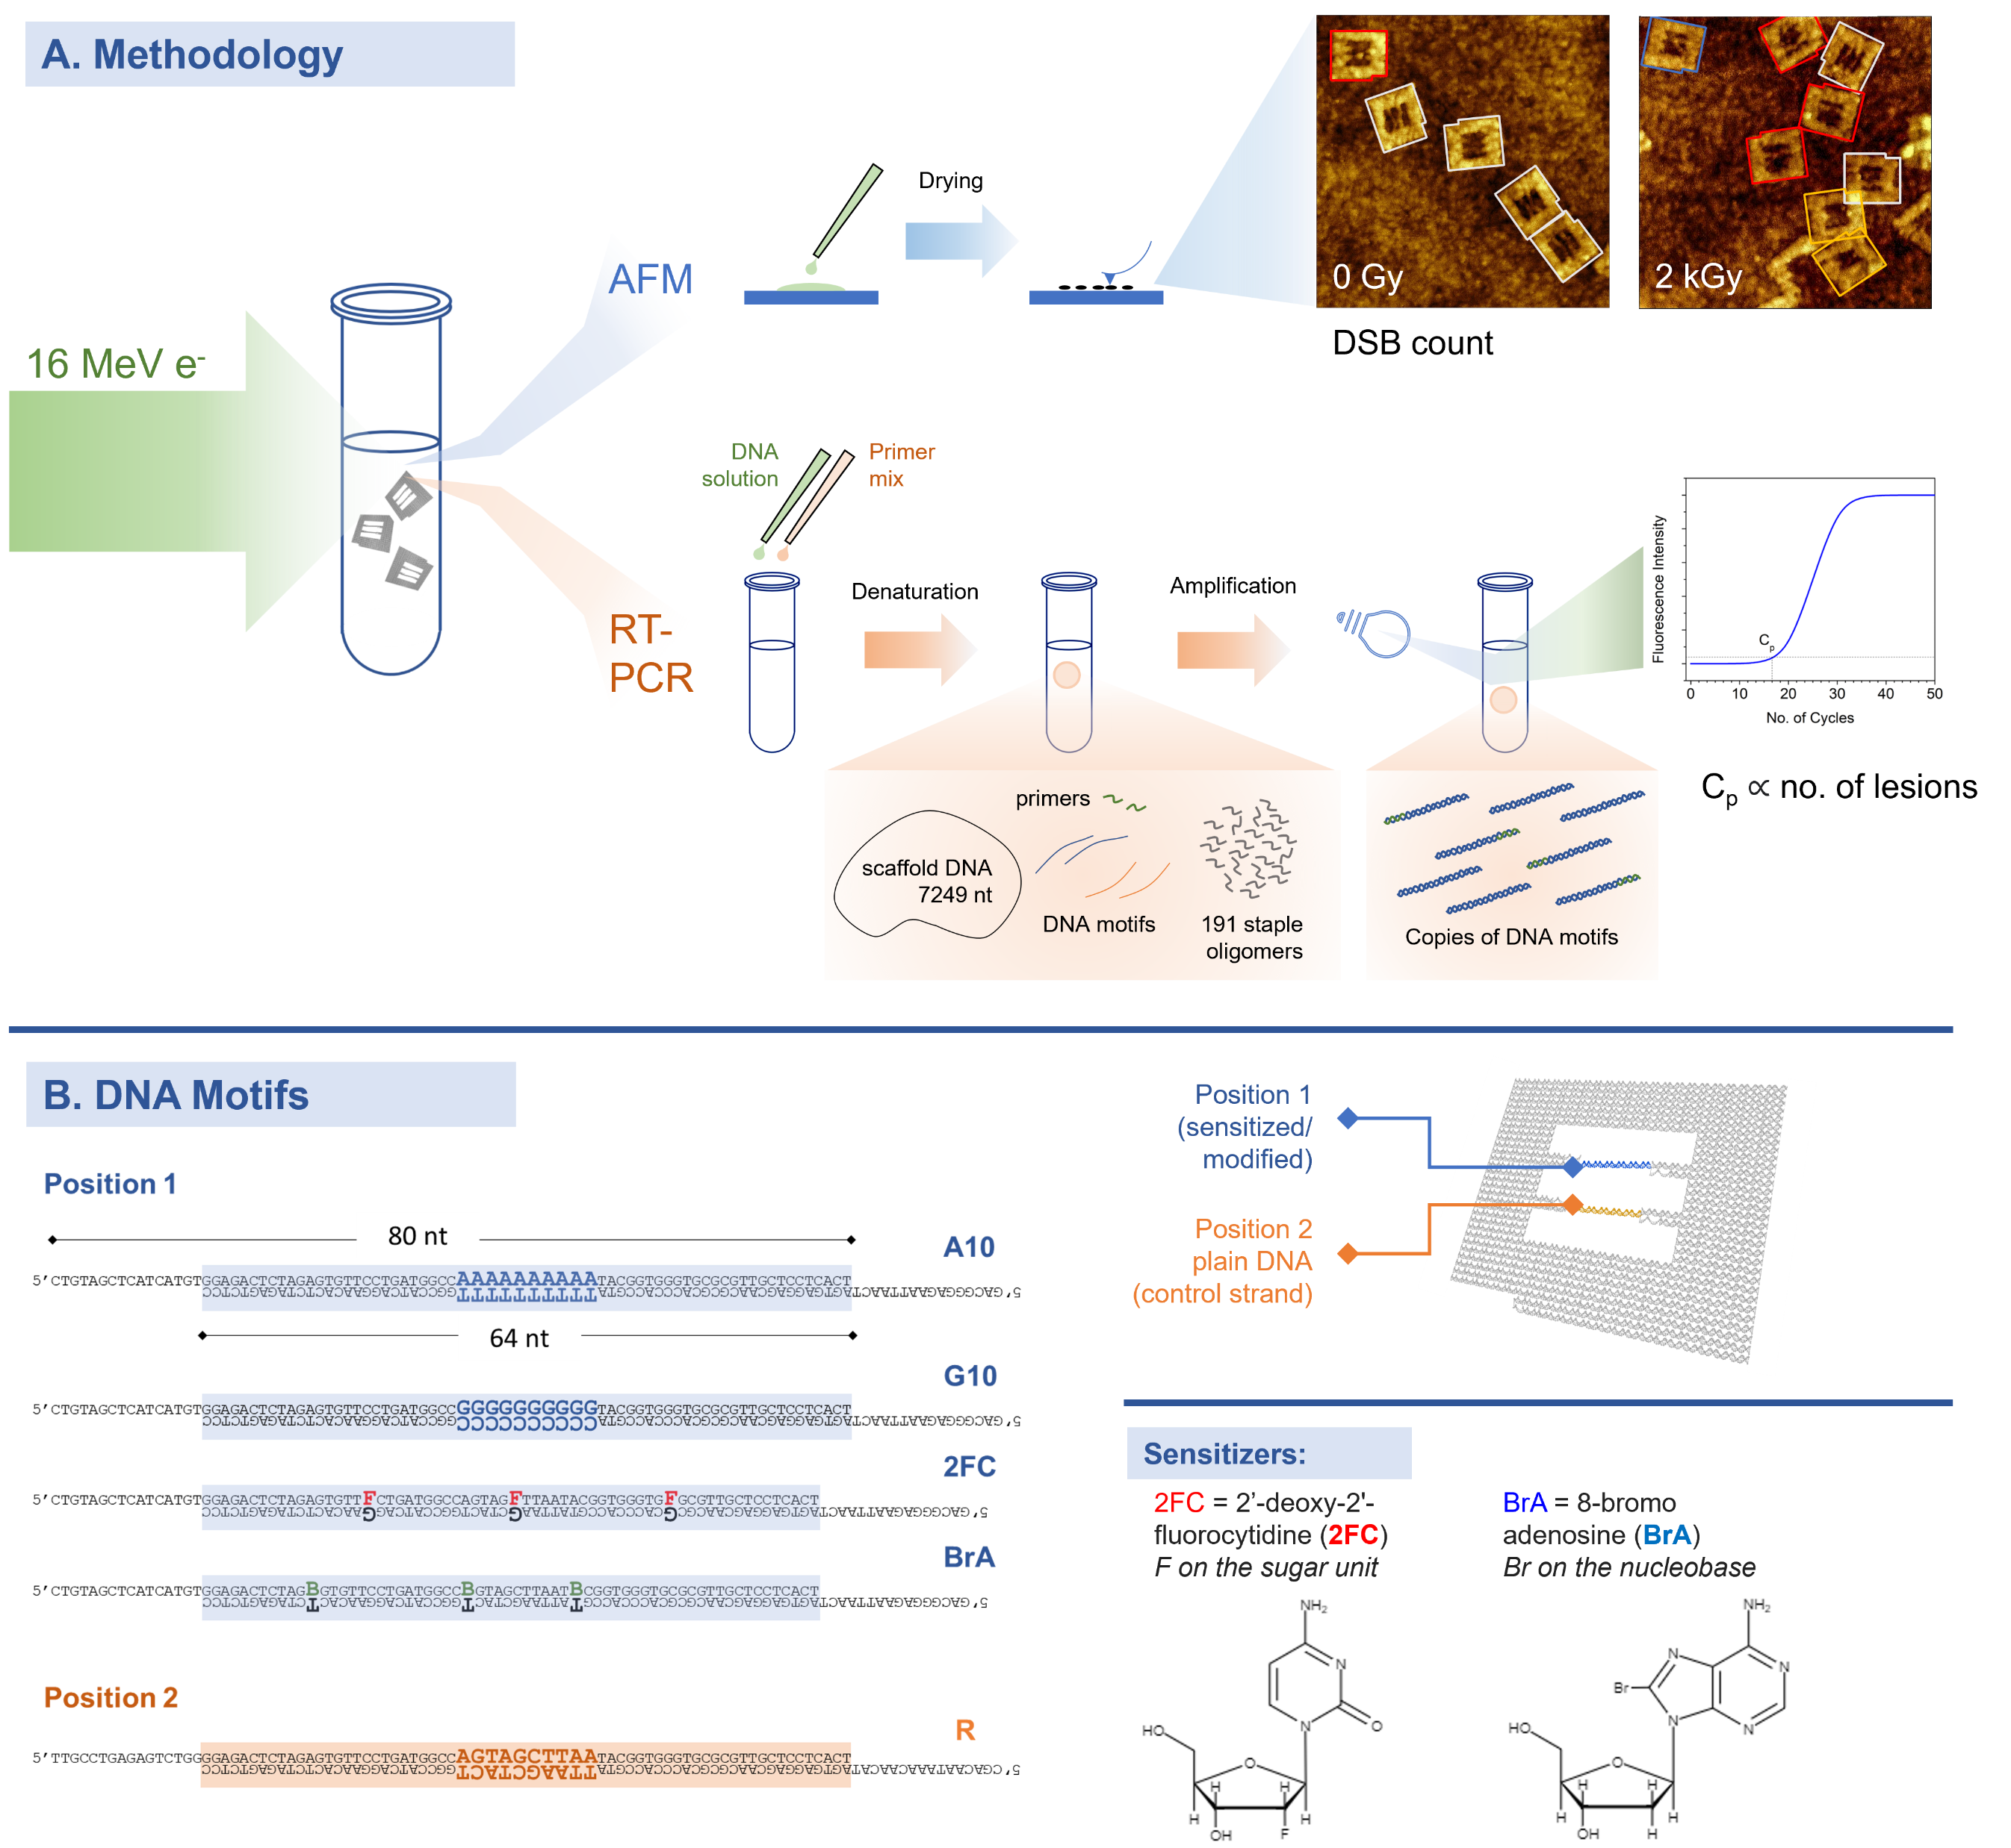

DNA frames: platforms to study radiosensitization
Sala et al., JPCL 13, 2022
RT-PCR:
Institute of Molecular
Genetics (Prague)
Jana Šachová

Slide 15
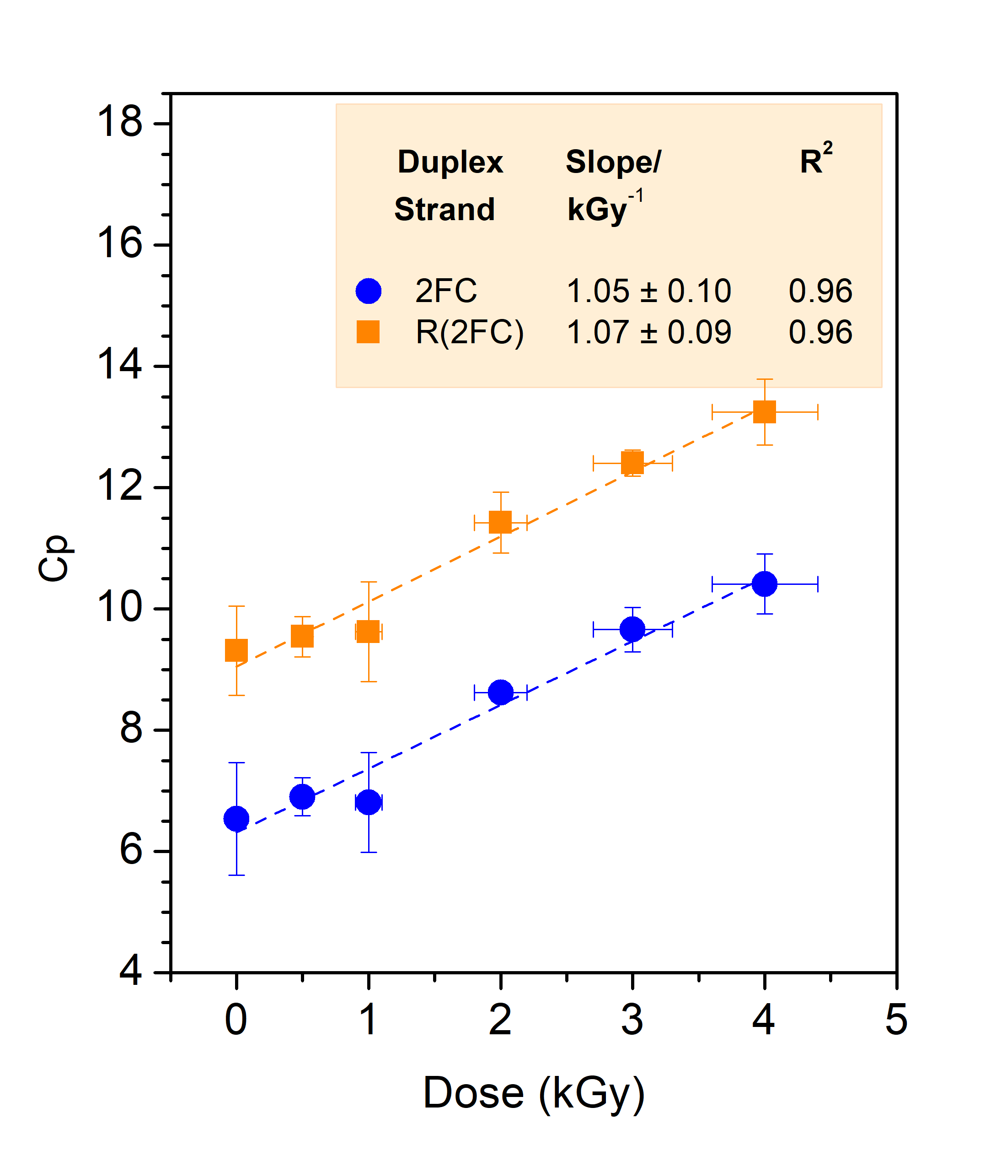
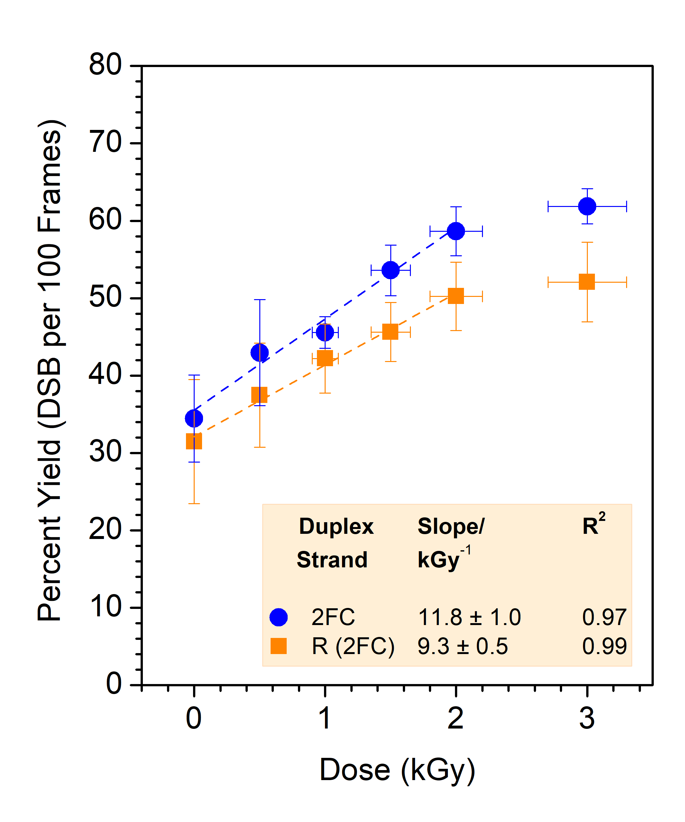
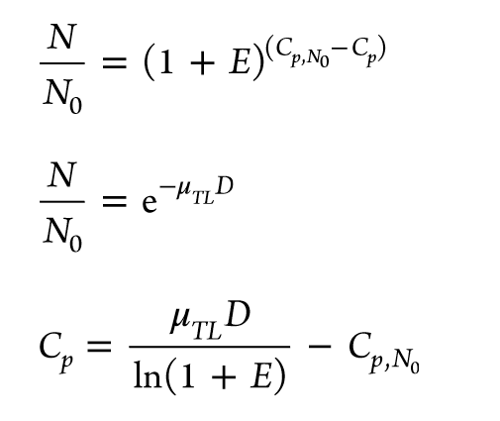
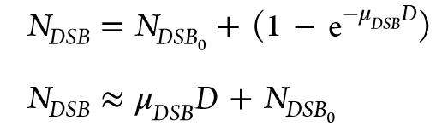
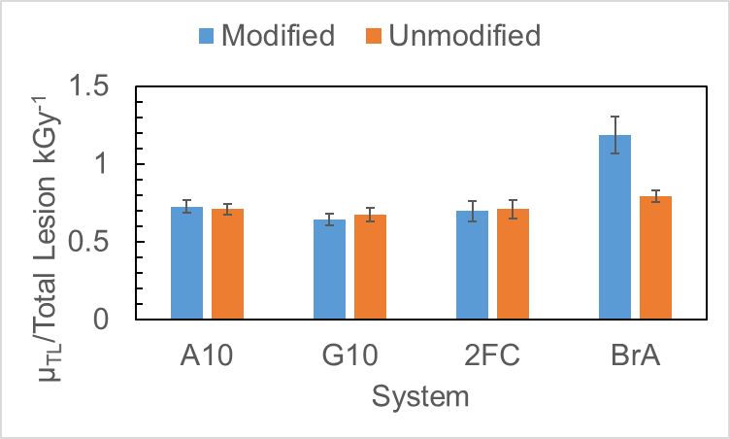
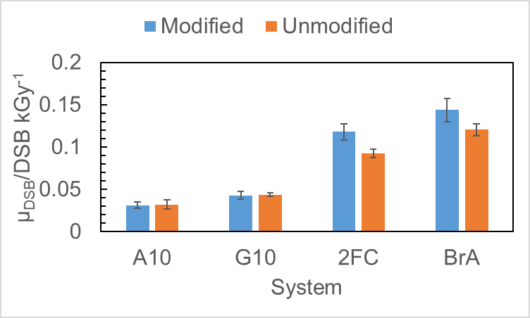
MeV e⁻ irradiation: effect of DNA sequence, radiosensitizer
EF_{BrA}: ~1.5
EF_{BrA}: ~1.2
Fluorinated sugar: leads to DSB
Brominated nucleobase: enhancement to DSB and total strand breaks
More GC or AT:
Undetectable effect
Proximity effects:
Additional damage to unsensitized strand
EF_{BrA}: ~1.3
Total lesions : RT-PCR
DSB : RT-PCR

Slide 16
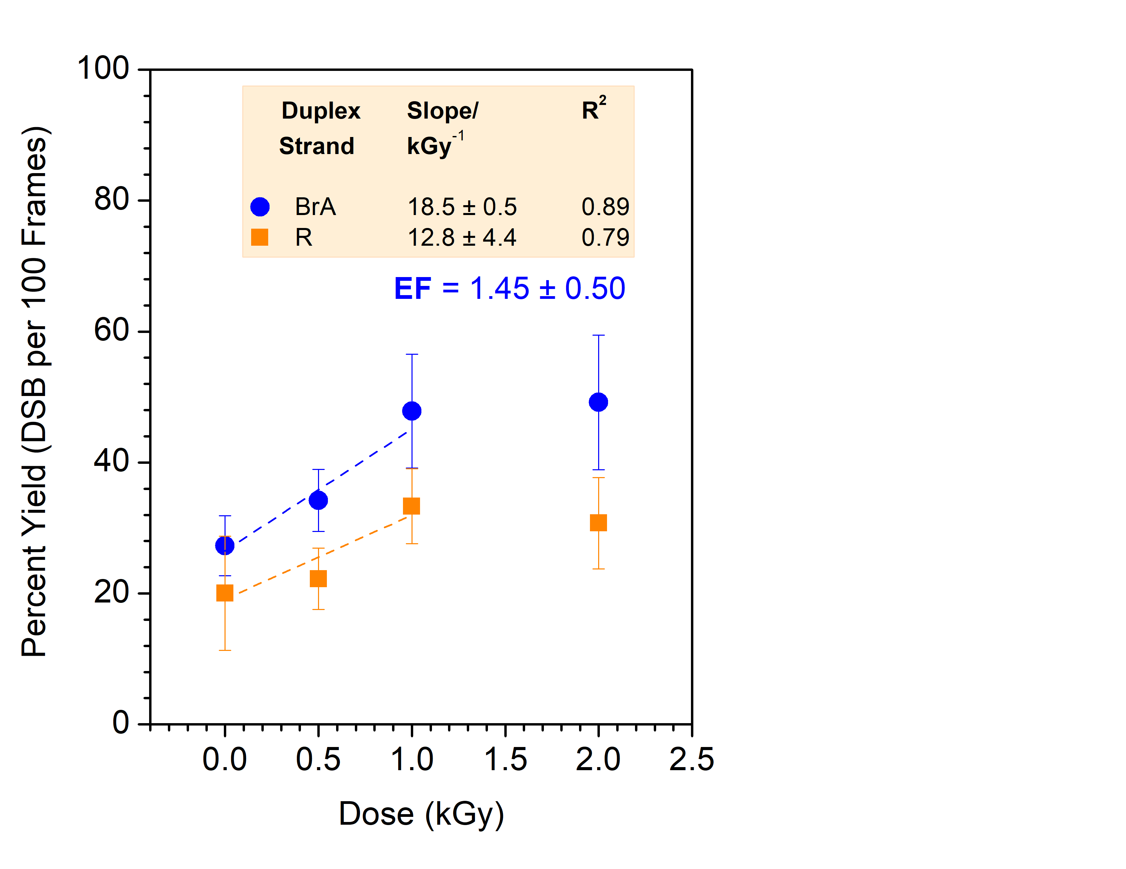
GeV Fe²⁵⁺ irradiation: bromoadenine-sensitized strand
Brominated nucleobase: enhancement to DSB
Proximity effects may be apparent - needs comparison to control sample with unsensitized strands in both positions

Slide 17
Summary: irradiation in bulk H₂O
High stability of DNA origami nanostructures under ionizing radiation (including ion beam) exposure
promising substrates to study nanoscale ion beam damage and radiation to DNA and allows to study usually inaccessible effects:
  DNA secondary structure
  DNA sequence
  Radiosensitization mechanisms
  Ion beam characteristics
Ion-induced shockwaves
I Friis, A. Solov’yov et al., Phys Rev E 104, 2021.

Slide 18
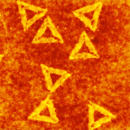
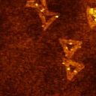
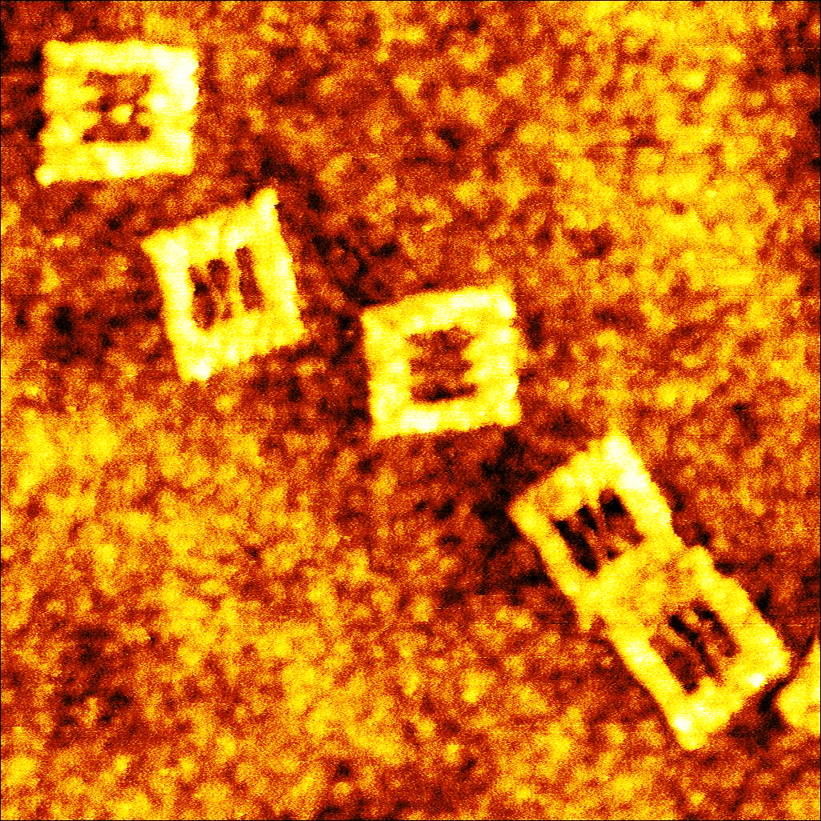
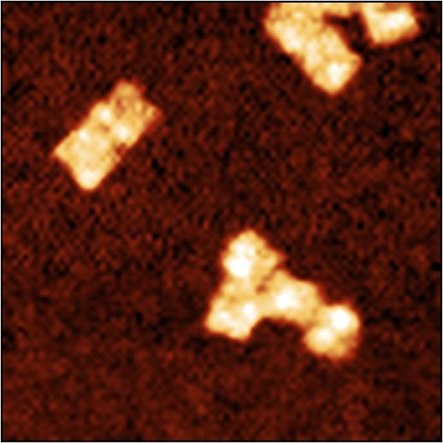
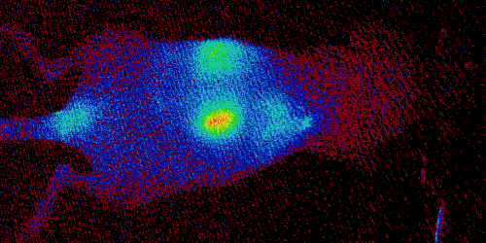
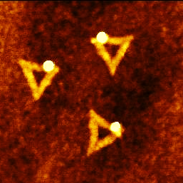





Our DNA origami portfolio and existing collaborations
DNA origami nanosubstrates/
molecular breadboards
UV lasers
Excimer (193 nm)
OPO lasers (220 – 1000 nm)
Michal Farnik
Jozef Rakovsky
Ionizing radiation sources:
Nuclear Physics Institute (Prague) CIMAP/GANIL (Caen)
Marie Davidková Alicja Domaracka
David Chvátil Alain Mery
1-55 MeV proton beams (Cyclotron U-120M) Volaine Vizcaino
⁶⁰Co gamma source H. Rothard, P. Bodouch
1-25 MeV electrons (Microtron MT-25) MeV ions
UV
IR
250 nm
AFM
Nanocarbon Group
Otakar Frank
Fluorescent
DNA origami for In vivo Imaging
CAPI
Ludek Sefc
Jan Pankrac
Double-layer
Tiles
SaV-biotin
RT-PCR:
Institute of Molecular
Genetics (IMG Prague)
Michal Kolář
Jana Šachová
DNA origami carriers for radiosensitizers
Au
Np
Cisplatin
Cross-linked
QD
tagged
In vitro assays:
Institute of Biophysics (Brno)
Tomáš Perečko
Martin Falk
TEM with EDX,
Cryo-TEM:
IMG Prague
Microscopy Center
Vlada Filimonenko
Dominik Pinkas
12x12x22 nm
Gold nanoparticles and
DNA origami for plasmonics
Heyrovsky Institute (Prague)
Vladimira Petrakova
100 nm

Slide 19



Acknowledgments
CARAT Reg. No. CZ.02.1.01/0.0/0.0/16_026/0008382
Operational Programme Research, Development and Education
Czech Science Foundation, project no. 19-01159S and 21-26601X
project RADIATE 21002436-ST
J. Heyrovsky Institute
Molecular Dynamics and Clusters Group
Jaroslav Kočišek Agnes Zerolová
Juraj Fedor Hlib Lyshchuk
Michal Fárník Jozef Rakovský
Miloš Ranković Ondřej Votava
Pamir Nag and the rest of the group for moral support
University of Potsdam – Hybrid Nanostructures Group
Ilko Bald João Ameixa
Kenny Ebel
CAS-DAAD grant no 19-02

Slide 22




Results: radiation damage to DNA origami nanostructures
AFM count of damaged structures
Structures are more sensitive to higher LET damage (protons): ~2x more in dry samples; ~1.3x more in solution
Dry vs solution: 4-6x enhancement
Sala et al., Nanoscale 13, 2021.

Slide 23


Irradiation of Dry Samples in Vacuum

Slide 24





DNA radiation damage mechanisms: multiscale phenomena
DNA sequence
DNA secondary structure
Proteins/enzymes
DNA repair mechanisms
e⁻
in situ spec. or imaging
Ionizing Radiation/UV
ex situ analysis:
AFM, TEM/SEM
AGE
qPCR
UV-Vis
DNA nanosupports

Slide 25


DNA radiation damage mechanisms: multiscale phenomena
Environment effects:
molecular fragmentation suppression
add’l reaction/relaxation pathways
Kocisek et al, JPCL 7, 2016 (T and U bases)
Kocisek et al, JPCB 122, 2018 (dCMP)
Cells
e⁻
Plasmids and low energy electrons
Boudaiffa et al., Science 287, 2000.
In vitro and in vivo assays + radiotherapeutic ion beams
(i.e. gemcitabine + carbon ions against pancreatic tumor)
Sai et al., Oncotarget 287, 2000.
Choi et al. J. Nanobiotechnol 18, 2020
Potential Radiosensitizers:
Nucleotide Analogues:
Phosphodiester bond cleavage by low energy electrons
Kopyra et al, PCCP 14, 2012.
5-Nitro-2,4-Dichloropyrimidine: Luxford, Kočišek, et al., IJMS 21, 2020.
Nimorazole:
Meißner, Kočišek, et al., Nat. Commun. 10, 2019.

Slide 26



Radiation sources
Gamma irradiation
Proton irradiation
In solution
(direct + indirect effects)
c = 20-30 ng/µL = 4-6 nM DNA
V = 60-80 µL
V_{a} = 12 µL (10 µL for gel electrophoresis, 2 µL for AFM)
in solution
dry
H₂O phantom
U-120M Cyclotron
Marie Davidková
Nuclear Physics Institute
Rez, Czechia
⁶⁰Co
1.17
1.33 MeV γ
Dry
(direct effects)
c_{soln} = 20-30 ng/µL
A_{Si} = 0.6 cm²
c_{coverage} = ~30-40 triangles µm²
p+
Dose rates:
0.067 Gy s⁻¹
0.83 Gy s⁻¹
d
d = 3.35 cm
D/t = 0.045 Gy∙s⁻¹
~2 m
Vysin et al., Radiat Environ Biophys 24, 2015.
High energy electron irradiation
Microtron MT25
1-25 MeV e⁻
David Chvátil
Dispersion: tens of keV
Pulsed beam
3.5 µs length
Rep. rate: 423 Hz,
Max. current: 30 µA
Dose rate:
~6-15 Gy s⁻¹
Golunova et al., Biomacromolecules 16, 2015.

Slide 27

Radiation sources
High Energy Ion Beam Irradiation
GANIL
Grand Accélérateur National d’Ions Lourds
⁵⁶Fe²⁵⁺ (60 MeV u⁻¹)
Flux: 10⁷-10⁸ ions cm⁻²
LET: 850 MeV mm⁻¹
(Dose rate: 0.1-8.8 Gy s⁻¹)
CIMAP
Alain Mery
Volaine Vizcaino
Alicja Domaracka
https://www.ganil-spiral2.eu/
Cyclotron source
Fe²⁶⁺

Slide 28
Irradiation of plain DNA origami nanostructures
Sala et al., Nanoscale 13, 2021.

Slide 29

Proof of concept: DNA origami nanoframes for DNA radiosensitization studies
Sequence effects
Conformation (secondary structure) effects
Endo et al., JACS 32, 2010.
Sala et al., JPCL 13, 2022.
Endo et al., JACS 9, 2015.

