Slide 1
Etat des lieux des activités MI2I
WP1.3: Technologie 28nm
Samuel Mannen (LPC Clermont-Ferrand)
Mohsine Menouni (CPPM/IN2P3/Aix-Marseille Université)
ANF Nano-électronique - Centre d'Oléron
6 October 2022

Slide 2
Outline
Introduction
The context of the 28nm design work
28 nm activity at CPPM and the design of a first 28 nm prototype chip

Slide 3
Introduction : Pixels for the future trackers
Future generation of pixel readout circuits for inner detectors
  Higher position accuracy : a few μm resolution with smaller pixels)
  Low power consumption and low material budget
  High speed - Tens of Gbps data transfer rates
  Increased temporal resolution
  Ultra-severe radiation levels (TID and SEE)
Increase of the instantaneous luminosity → Increase of the pile up
  Run2 : 40 pile up interactions in ATLAS (per bunch crossing)
  HL-LHC : 200 pile up interactions in ATLAS
  FCC hh : 1000 pile up interactions
  Accurate time measurement (a few tens of ps) allows for improved 4-D tracking algorithms to separate the peaks of the traces
Standard 28 nm CMOS process
  Good compromise between integration density and tolerance to ionizing radiation
  Potential candidate to succeed the 65nm CMOS node for hybrid pixels development

Slide 4
The context of the 28nm design work
CERN EP R&D WP5: CMOS Technologies
Timing group with CERN : R&D towards high-time resolution sensor
INFN : TIMESPOT, FaLaPHEL → IGNITE
RD53 collaboration : A high interest for a future replacement of the inner layers (phase 3) of the HL-LHC detectors (ATLAS and CMS) around 2035
AIDAinnova Project (28nm + HVCMOS) accepted, started 2021
Master Project IN2P3 : DICE « Développements de pIxels pour les taux de Comptage et niveau de radiations Extrêmes » accepted and started 2021
  Hybrid and monolithic pixels
  Initiated by Marlon Barbero (CPPM)
  Can be extended to other projects involving IN2P3 laboratories
https://indico.cern.ch/event/1127562/contributions/5026556/attachments/2512967/4320206/2022.09.14_ASIC-Support_news_and_EP-WP5_developments.pdf
https://indico.cern.ch/event/1127562/contributions/4904915/attachments/2511642/4317255/presentation_28nm.pdf

Slide 5
The progress
Discussions have been initiated at the IN2P3 institute to identify laboratories potentially interested in CMOS 28 nm design
A first zoom meeting organized 24-25 January 2022 (organized by Luigi and Francesco)
  Presentations done by CERN et INFN
  Indico link : https://indico.in2p3.fr/event/26030/
  Participating labs
    CPPM involved in RD53 collaboration interested in 28 nm for the next pixel upgrades
    LPC-Clermont: Analog neural networks (PhD Thesis funding from Auvergne region)
    LPNHE, LPSC, IP2I : are showing a certain interest
CERN 3-way 28nm NDA being signed for the whole IN2P3
CPPM has signed a first NDA through IMEC
  Design kit minimal
  Design of a first 28 nm prototype chip
    Circuit for SEU/SET testing
    Ring Oscillator for TID qualification
    Analog block : Fast charge amplifier

Slide 6
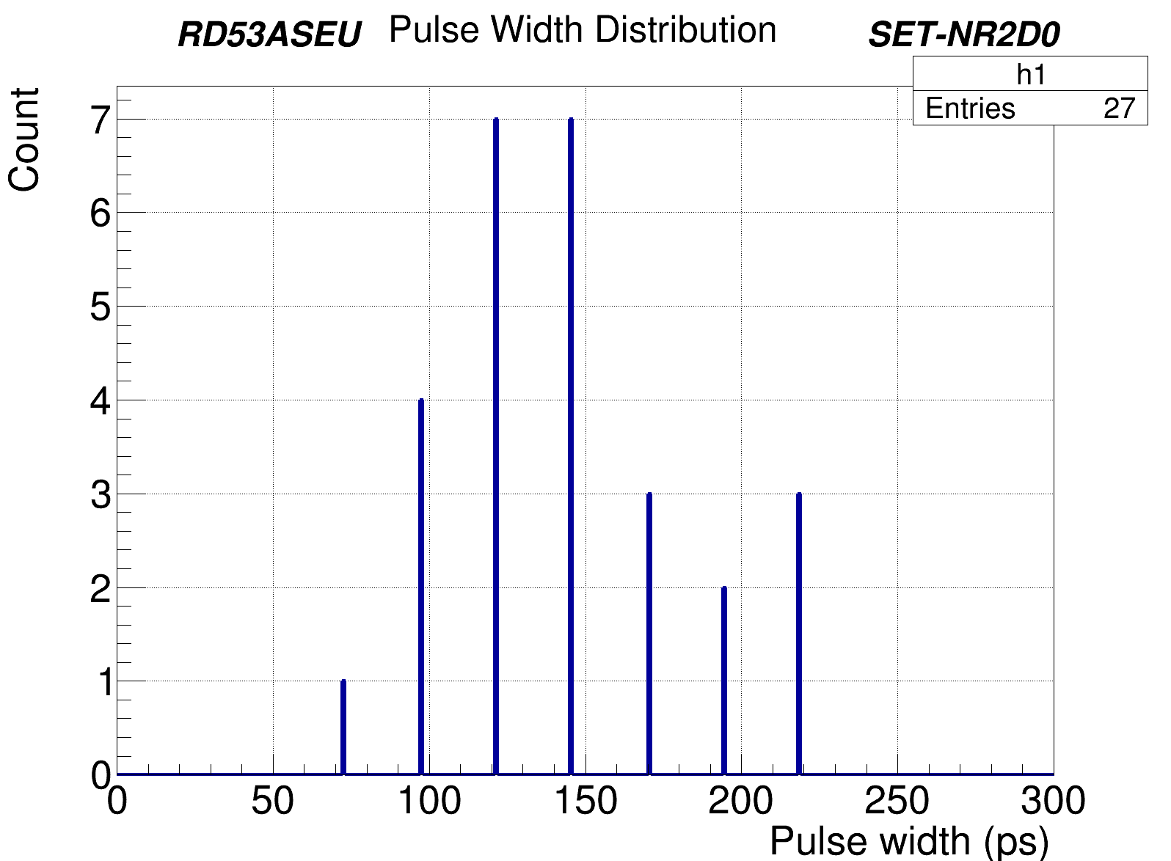
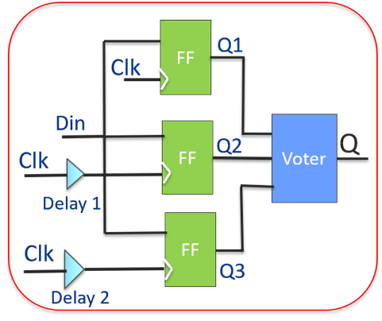
SEE/SET Testing
SET sensitivity increases with process advance
  Propagation through combinatorial logic and generate SEU in memories
  Sensitivity increases with speed
These test structures will allow to characterize the 28 nm concerning SET
Objectives :
  Measure the SET cross section
  Measure the SET pulse with a good
  resolution < 20 ps
Allows as example to define the delay to be imposed
for the triplication with time mitigation
SEU tolerant design with
temporal Mitigation

Slide 7
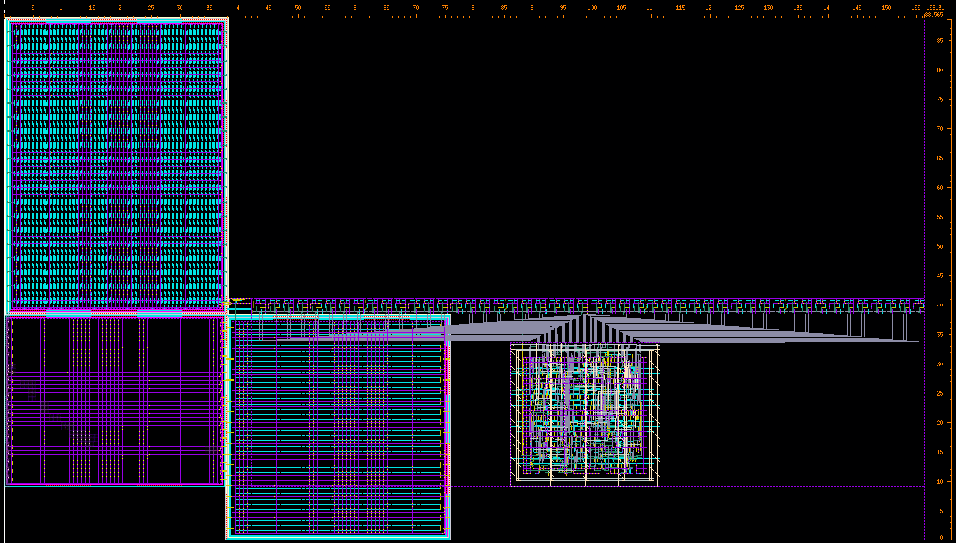
SET Bloc
31 SET sub blocs
  24 target cells SVT (7T, 9T, 12T)
  7 target cells LVT, HVT
  1 MUX 4to1
  1 calibration input per sub bloc
  96 delay cells (13ps/cell) for measurements
6 inputs / 13 outputs
Signal | E/S | description
RSTb | E | Initialization
Sel<2:0> | E | Target cell selection
LOAD | E | Load data’s in latches
CK | E | clock
Cal, Pulse | E | External gene. (50 ps – 1ns)
SHIFTOUT | S | Shift register output
TRIGOUT | S | Trigger output
SET sub-bloc synoptic
Target cell 7T
SET width measurement
Target Cells
Target cell 9T
DEL95
DEL98
DEL10
TRIGGER
DEL0
DEL
DEL
DEL
DEL
DEL~13 ps (resolution)
Target cell 12T
Cal, pulse
D
Q
D
Q
D
Q
D
Q
E
E
E
E
TARGET 12T
Sel<2:0>
TRIGOUT
D
QN
90 µm
DELAY
TRIGGER
SHIFTOUT
CDN
D
Q
D
Q
D
Q
D
Q
TARGET 7T
TARGET 9T
SR
RSTb
LOAD
CK
190 µm
Denis Fougeron
Layout example for INVD4 cell

Slide 8
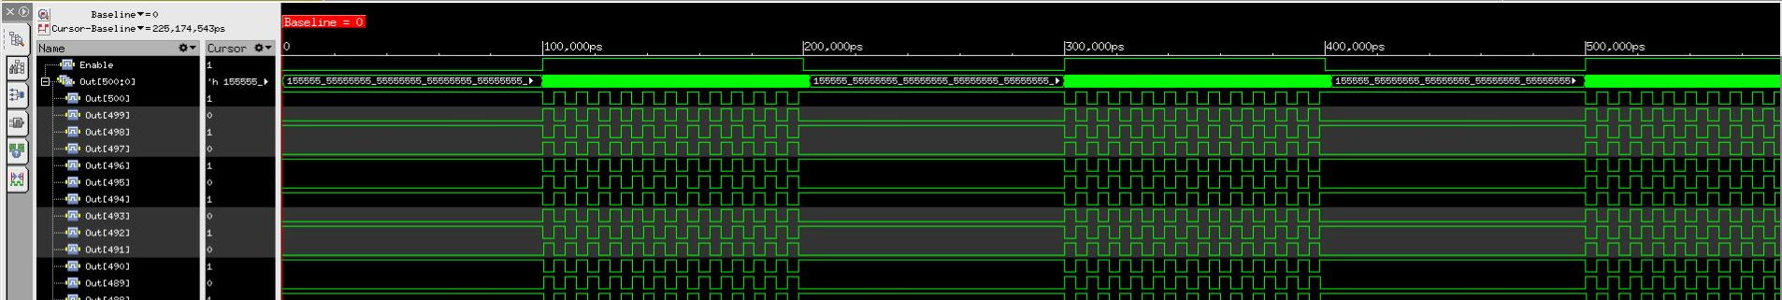
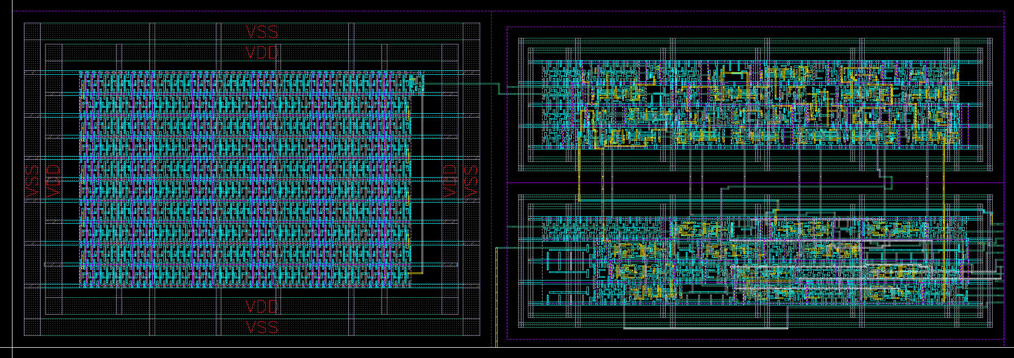
Ring Oscillator Design
Study of the effect of TID on the performance of digital standard cells
Timing of combinatorial or sequential cells
Leakage currents and static power
Effects of device size on TID tolerance
Design based on the digital flow
96 Rosc sub-bloc
  Cell size (7T, 9T,12T)
  Driving (D0, D2, D4)
  SVT, LVT, HVT
start/stop
enable
Ring Osc
12-bit counter
resetb
clock
12-bit shift register
output
load/shiftb
ROsc sub-bloc synoptic
Basic cells | Frequency (MHz)
INVD0 | 154
INVD2 | 222
NAND0 | 118
NAND2 | 143
NOR0 | 111
NOR2 | 139
40 µm
Counter
12 µm
Shift register
Ring Oscillator
Simulation
Manual layout
Synthesis

Slide 9
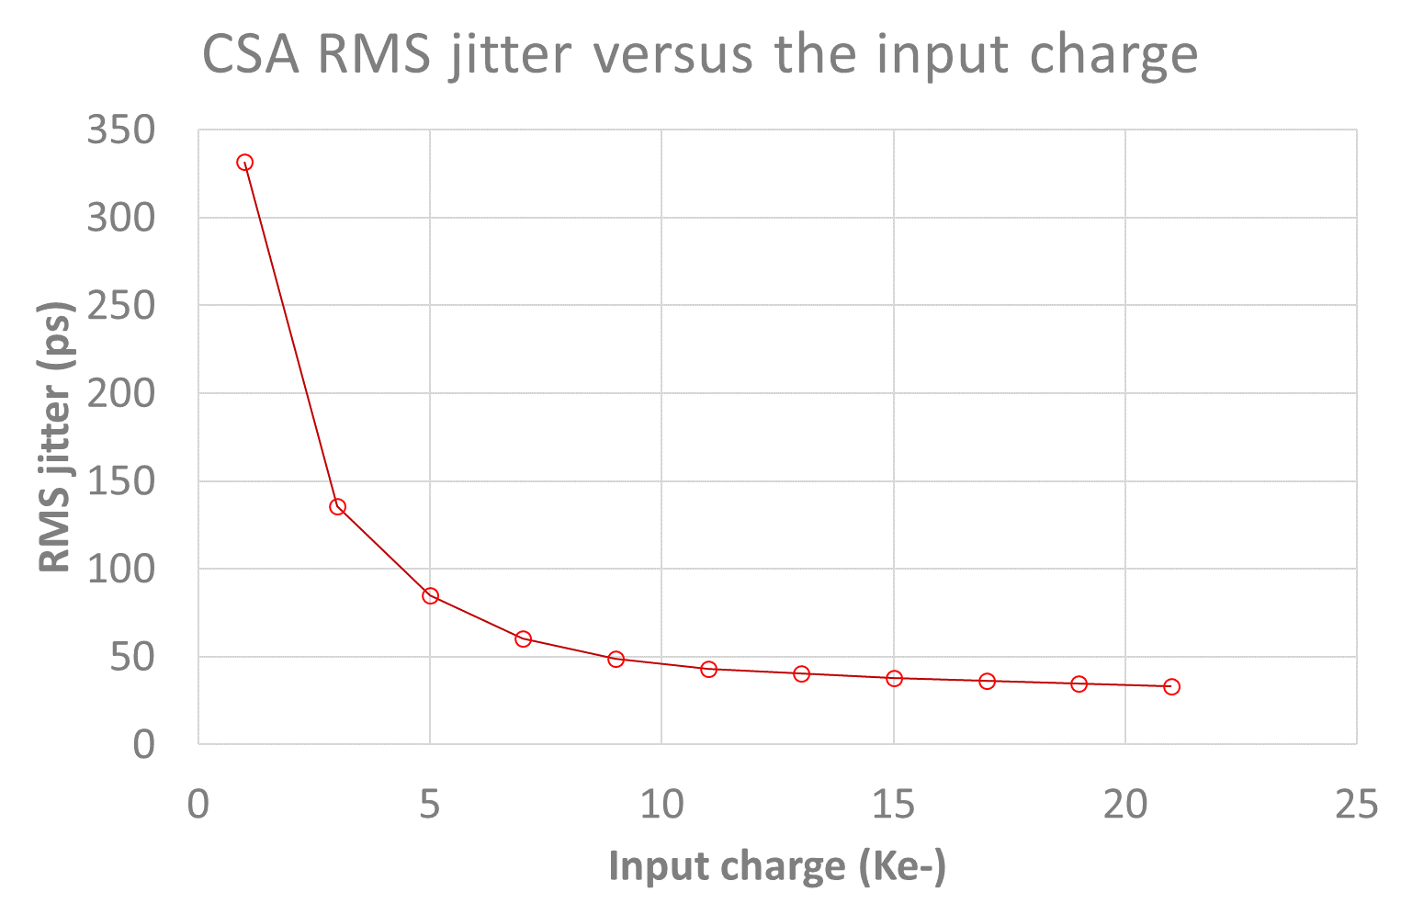
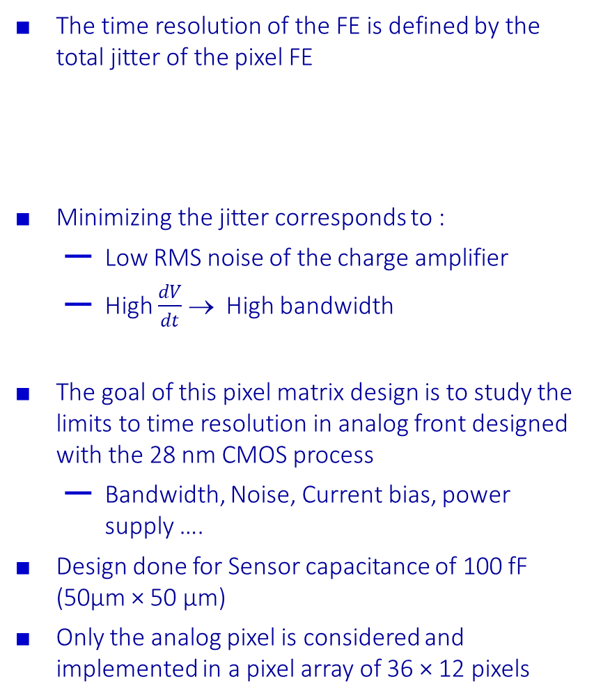
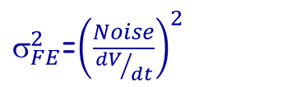
Analog FE pixel prototype
The time resolution of the FE is defined by the total jitter of the pixel FE
Minimizing the jitter corresponds to :
  Low RMS noise of the charge amplifier
  High $\frac{dV}{dt}$ → High bandwidth
The goal of this pixel matrix design is to study the limits to time resolution in analog front designed with the 28 nm CMOS process
  Bandwidth, Noise, Current bias, power supply ….
Design done for Sensor capacitance of 100 fF (50µm × 50 µm)
Only the analog pixel is considered and implemented in a pixel array of 36 × 12 pixels
 | High granularity | Ultra high granularity
Pixel size | 50µm × 50 µm | 25µm × 25 µm
Sensor capacitance | 100 fF | < 50 fF ??
Time resolution | < 50 ps RMS | < 50 ps RMS
Consumption (pixel) | <20 µA | <5 µA
Threshold | < 600 e- | <600 e-
Hit rate | 8 GHz/cm² | 8GHz/cm²
Hit rate (pixel) | 20 kHz | 5 kHz
TID | 2-4 Grad | 2-4Grad
$_{total}^{2} =_{sensor}^{2}$+ $_{Landau}^{2}$+ $_{FE}^{2}$
$_{FE}^{2}$=${\left(\frac{Noise}{{dV}/{dt}}\right)}^{2}$
Jitter simulations

Slide 10
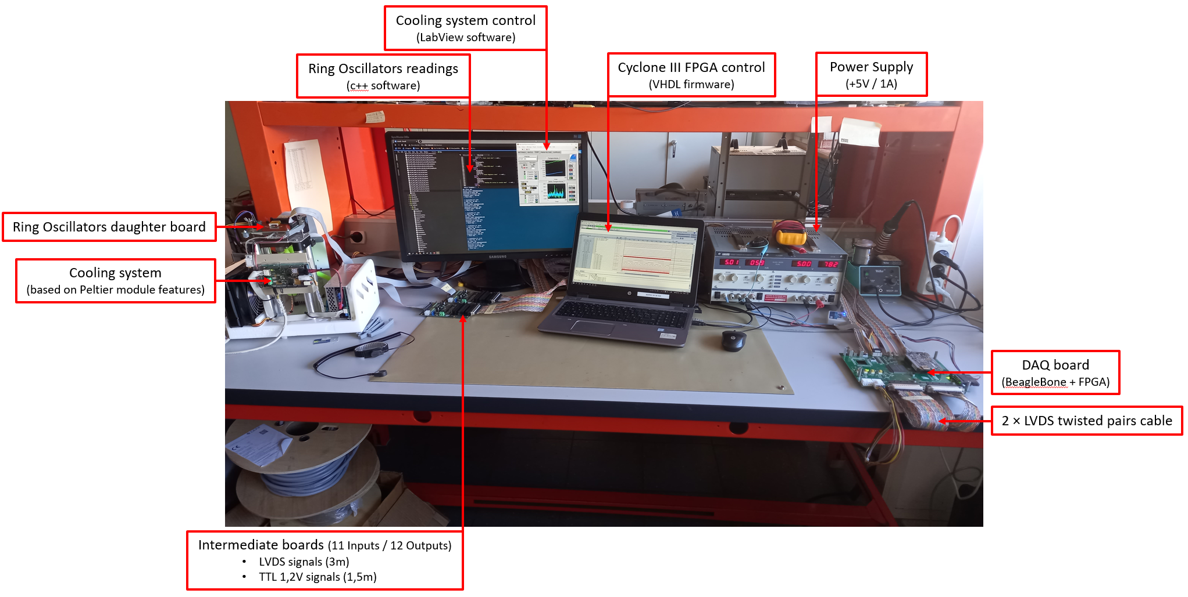
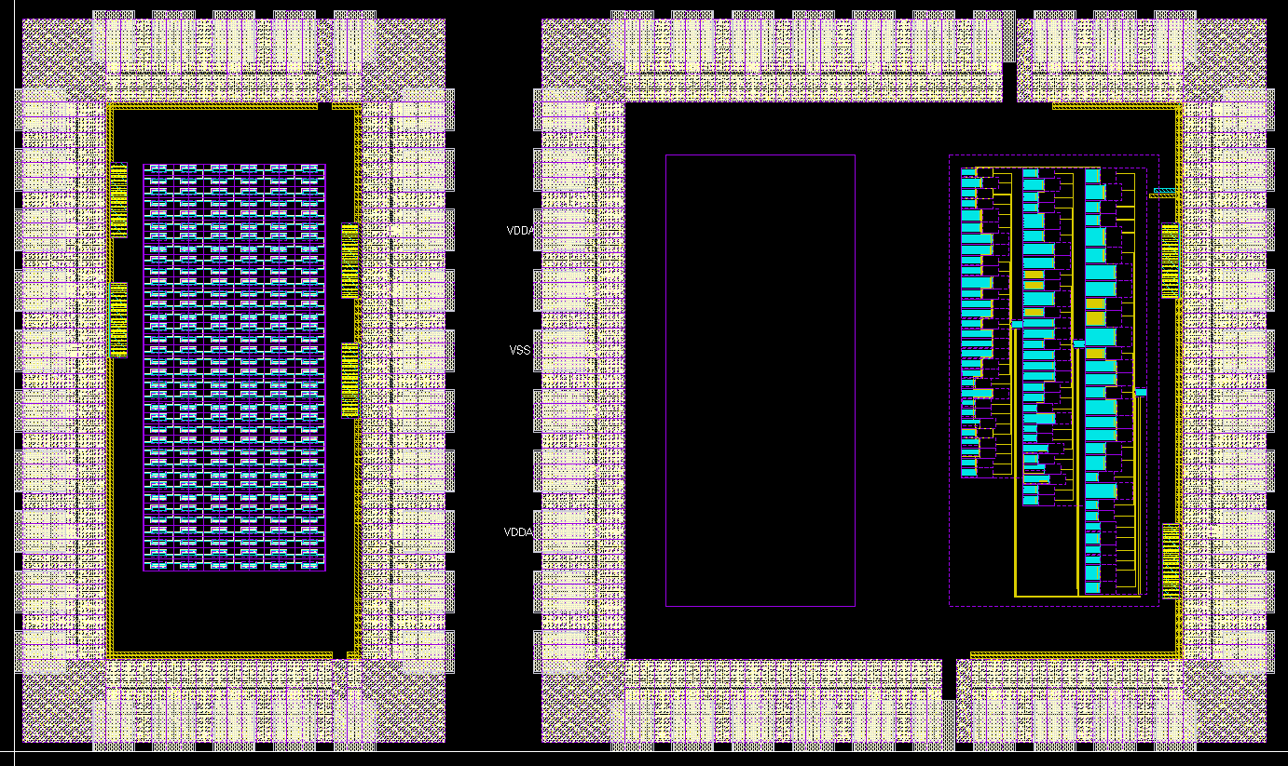
Perspectives
Different test structures designed and will be tested
  SET Testing structures
  Ring oscillators for TID tolerance test
  Small pixel array (analog part)
Mini@sic of 2 mm x 1 mm
Submission expected October 26
We are using the basic design kit from IMEC
  28 nm HPC+
  No difficulties for the analog design at transistor level
  Lot of time and efforts to develop a methodology for digital design with using the digital flow
So we are looking forward to the access to the CERN 3-way 28nm NDA
The test set-up is already prepared for ring oscillators and SET blocs
To be prepared for pixel array testing
  Functional tests Q1-2023
  Irradiation test (TID + SEE) Q2-2024
Pixel array
SET design
ROsc design

Slide 11
  Thank you for your attention
  Thank you for your attention

