Slide 1
gLite deployment and operation toward the KEK Super B factory
http://indico.in2p3.fr/conferenceDisplay.py?confId=2804
Updates related on Grid since last meeting in November 2008
FJPPL Workshop at CCIN2P3/Lyon
February 17th 2010
Go Iwai, KEK/CRC
go.iwai@kek.jp
Agenda of last meeting can be found at http://kds.kek.jp/conferenceDisplay.py?confId=2387

Slide 2
Outline & Introduction
Resource & Ops Stats
JP-KEK-CRC-02 has been fully upgraded and certified in March 2009
As a part of Central Information Service (CIS)
Higher availability & more robustness
Xen-based VM technologies are widely supported in whole site
Storage
HPSS works as the backend disk of SE
Still using DPM
~10TB initial capability
Should be upgraded on VO-demand basis
~200US$/1TB/tape
CPU
300kSI2K:10WNs x 8CPUs x ~4kSI2K
~3 times improved than previous site performance
Integration with unused resources in Belle Computing System (BCS)
JP-KEK-CRC-01
CE/RB based on gLite-3.0/SL3X has been decommissioned in Oct 2009.
Still not yet deployed news
Up in FY2009 hopefully
Central service
VOMS.kek.jp has been migrated with newer machine and up on VOMS.cc.kek.jp
VO specific report
Belle/Belle2: Active
ILC

Slide 3
Resource & Ops Stats at KEK

Slide 4
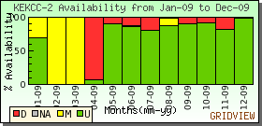
SD & Opens Tickets for A Year Between Jan 2009 and Dec 2009
Ticket-ID | Date | Last Update | Info
54305 | 2009-12-23 | 2009-12-23 04:41 | SAM *BDII-check* failed on kek2-bdii.cc.kek.jp@JP...
53382 | 2009-11-18 | 2009-11-20 06:59 | SRMv2 problem(s) detected for kek2-se.cc.kek.jp (J...
51727 | 2009-09-23 | 2009-09-28 04:21 | SRMv2 problem(s) detected for kek2-ce01.cc.kek.jp ...
48238 | 2009-04-28 | 2009-05-14 06:52 | CE problem(s) detected for kek2-ce02.cc.kek.jp (JP...
45143 | 2009-01-12 | 2009-01-15 09:11 | sBDII problem(s) detected for rls03.cc.kek.jp (JP-...
CIS upgrade works in progress
5 tickets were opened, and solved all
561 hours in 5 SDs and 6 unscheduled downtimes
2 months SD for CIS upgrade works is exclusive
Certification process

Slide 5
CPU Stats for A Year Between Jan 2009 and Dec 2009
33,410 CPU hours (-63%)
33,410 CPU hours / 54,025 jobs (normalized by 1kSI2K)
Usually idle state in 2009 due to silent from Belle community
ILC is the heaviest consumer for us
54,025 submitted (+72%)

Slide 6
Read/Write from/to Storage Devices in last 7 months
Read size in GB
2.0 TB
Also ILC is the heaviest consumer for storage services
2.0 TB of files has been readout
4.2 TB of files has been stored
Also strong
Written size in GB
4.2 TB

Slide 7
Recent Changes in VOMS
VOMS.kek.jp has been shutdown on 2nd Oct 2009, end of validity of its host certificate.
Migrated to voms.cc.kek.jp, which supports ppj, naokek, cdfj, belle, belle2, and g4med VO
Validity of proxy cert is extended up to 7days, i.e. 168hours
MyProxy does not work properly without special settings
User enrollment
e.g. https://vomrs.cc.kek.jp:8443/vo/belle/vomrs
VOMS
VOMRS
voms.kek.jp
VOMS
voms.cc.kek.jp
DMZ
GRID-LAN

Slide 8
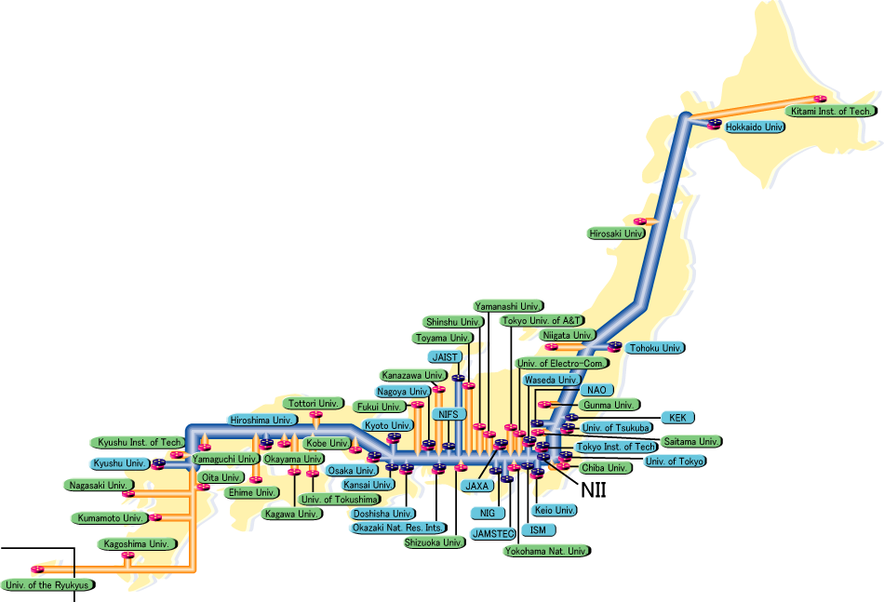
Logical Network Connection Focused on Grid
Univ.
Grid
SINET
Both for domestic & international institutes
Univ.
Grid
Facility
Site
Univ.
Grid
Univ.
Grid
Service
Univ.
Grid
Univ.
Grid
VO-Central Service
Generic Service at Grid Level
VOMS
VOMRS
CA
VOMS
KEK-1
gLite
KEK-2
gLite
BCS
LFC
SRB
MCAT
SRB-DSI
CD-1
NAREGI
HSM
CD-2
NAREGI
Intranet
DMZ
GRID-LAN
CC-GRID
VO-Specific Service

Slide 9
Resource Scale
BCS
VOMS
VOMRS
SRB
KEK-2
gLite
Storage service (DPM)
~10TB with HPSS as backend storage
Except for HSM through SRB-DSI
Not published information by Glue
Computing service
System A: As a part of Central Information System (CIS)
System B: Recycle-use of old blades in Belle Computing System (BCS)
MCAT
LFC
HSM
System B
System A
 | # of nodes | # of cores | Memory size (GB/core) | OS | Middle | SPEC (kSI2K speed)
System A | 10 | 80 | 2 | Redhat EL 4.x (x86_64) | gLite 3.1 | ~300 3 times improved before upgrade in March 2009
System B | 250 | 500 | 0.5 | Scientific Linux 4.x (x86_64) | gLite 3.1 | ~800

Slide 10
Recent Works Integration of BCS and CIS (Still working in progress!)
BCS
SRB
MCAT
MT Ops Room @ South Bldg. of CRC
HSM
10G x 2
(1) Done: BW upgrade construction
1st Machine Room @ North Bldg. of CRC
(2) In progress
1Gx12
SRM-SRB
CE
CE
CE
CE
SRB-DSI
(GridFTP)
(3) Half up!
SRB
KEK-2
gLite
HSM
Existing computing resource
192 nodes ~ 1,536 cores ~ 4.6 MSI2K

Slide 11
Summary Table of CPU Resources
Legend
Up
Down or Unseen to LCG
 | # of nodes | # of cores | Memory size (GB/core) | OS | Middle | SPEC (kSI2K speed)
System A CIS | 10 | 80 | 2.0 | Redhat EL 4.x (x86_64) | gLite 3.1 | ~300
System B Old BCS | 250 | 500 | 0.5 | Scientific Linux 4.x (x86_64) | gLite 3.1 | ~800
System C BCS | 96 | 768 | 0.5 to 1.0 Upgrade in plan | Redhat clone 4.x (x86_64) | gLite 3.1 | ~2,500
System D BCS | 96 | 768 | 0.5 | Redhat clone 5.x (x86_64) | gLite 3.2 | ~2,500
Total | ~452 | ~2,000 |  |  |  | ~6,000

Slide 12
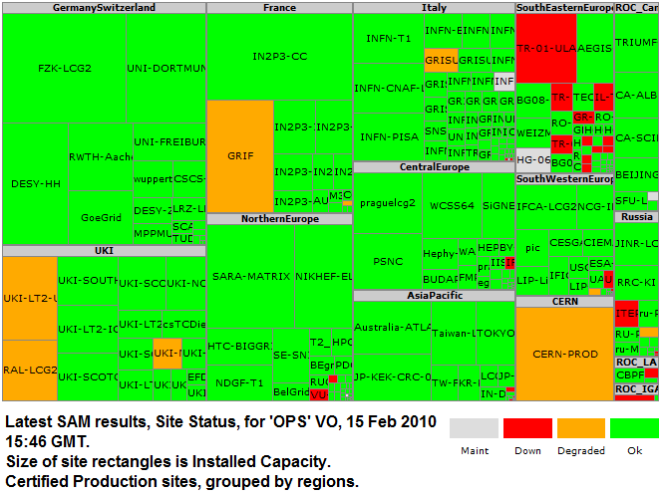
Resource Scale – LCG Infrastructure
4,740 of 20,941 kSI2K
2,500kSI2K joins rest of half rack in Feb 2010
http://gridmap.cern.ch

Slide 13
Ongoing works but up soon (1)
 | # of nodes | # of cores | Memory size (GB/core) | OS | Middle | SPEC (kSI2K speed)
System A CIS | 10 | 80 | 2.0 | Redhat EL 4.x (x86_64) | gLite 3.1 | ~300
System B Old BCS | 250 | 500 | 0.5 | Scientific Linux 4.x (x86_64) | gLite 3.1 | ~800
System C BCS | 96 | 768 | 0.5 to 1.0 Upgrade in plan | Redhat clone 4.x (x86_64) | gLite 3.1 | ~2,500
System D BCS | 96 | 768 | 0.5 | Redhat clone 5.x (x86_64) | gLite 3.2 | ~2,500
Total | ~452 | ~2,000 |  |  |  | ~6,000
System B is being retired from LCG and relocated for next activities
100 of 250 nodes for evaluation of ISF, a product of Platform Computing Corporation
150 of 250 nodes for evaluation of NAREGI-LSF adaptor

Slide 14
Ongoing works but up soon (2)
To expose HSM to Grid
SRB-DSI to bridge SRB inside BCS
Just for GridFTP access, not for SRM and LFC
To enable access with logical file name, e.g. lcg-xxx lfn://logical-file-name
SRM-SRB for Site URL, e.g. srm://srm.kek.jp/
SRB-DSI for Transfer URL, e.g. gridftp://disk.kek.jp/
A bit behind of schedule

Slide 15
VO Specific Report
Belle
Belle2 (New)
ILC

Slide 16
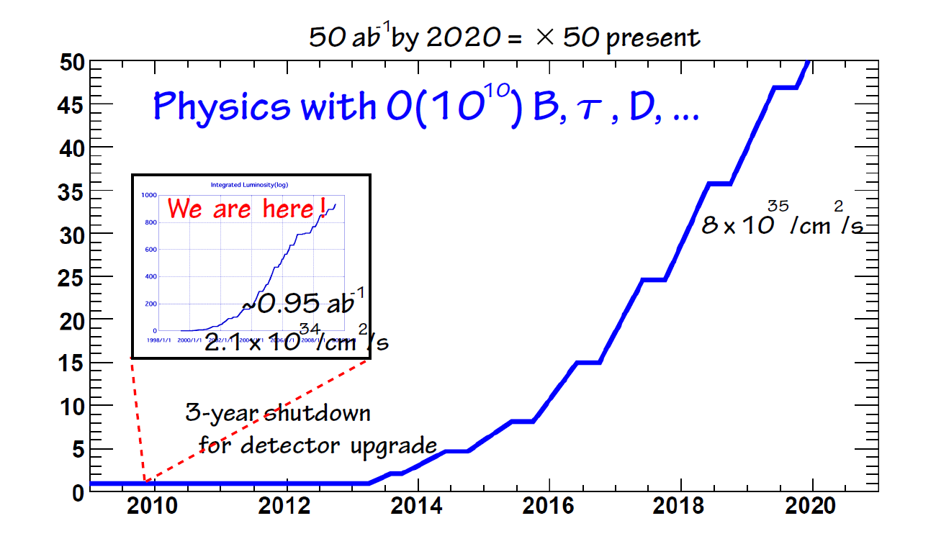
News
Belle2.org has been recently registered in CIC toward Belle2 experiment
Still not launched as an official name though
Thanks to Rolf Rumler for his support
Current computing model and software in Belle has been established 10 years ago.
Users even in outside of KEK traditionally logon PC farm and submitting their jobs.
Brand-new computing model toward Belle2 is being discussed in collaboration with a view to using Grid (and Cloud supplementarily) model.
Highly possible that main infrastructures will be LCG.
Time and gLite-compatibility is key subject
Beam commissioning in Q1 of 2013
All software must work within Q1 of 2012 earlier
Huge amount of data handling is also a key over the distributing computing infrastructures
Slides and figures are given by T. Hara (Co-chair of comp. modeling group)

Slide 17
Some metrics to estimate B2 computing resources
Sorry! A couple of slides, which show metrics to estimate computing resources for T0 of B2, are removed because those are not yet able to be placed on public places.

Slide 18
Summary
Ops Stats
Storage:
Read: 2TB in last 7 months
Write: 4TB in last 7 months
CPU:
ILC colleagues are the heaviest consumer in 2009
Resource upgrade
+2.5MSI2K in Dec 2009
+2.5MSI2K by Mar 2010
Storage service
Integration with SRM and HSM in BCS
In operation by the end of FY2009 (Mar 2010)
Belle2.org has been launched toward Belle2 experiment
Resources estimation, computing model (could be tier structure), and operational model is now being discussed

Slide 19
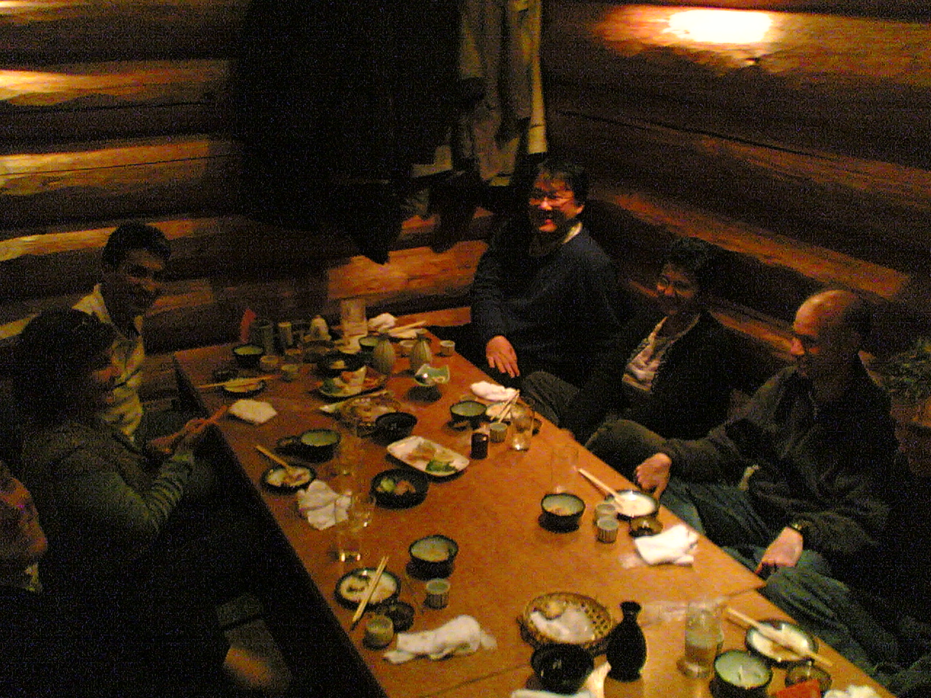
Thank You
Taken at “Sun-kitchi” on last meeting held at Tsukuba on 28th November 2008
Gratefully thanks for this memory

