Slide 1
Grid related activities at KEK
Takashi Sasaki

Slide 2
Outline
Strategy
Grid deployment
LCG
NAREGI
R&D
Renkei, e-Science
Future plans

Slide 3
Strategy
LCG/gLite for the e-Science infrastructure for HEP experiments, e.g. ILC, Belle and BelleII
NAREGI for groups at universities and super computing
NAREGI is the Japanese the e-Science infrastructure
10PFlops super computer at Kobe
10 PFlops will be realized by June 2012
Operation in production starting in April 2013
A half year delay due to the budget cut
R&D in the collaboration with people in ICT
iRODS for experiments at J-PARC
SRB is still running for Belle

Slide 4
SINET4
Upgrade on the academic network in Japan operated by National Institute of Informatics (JFY2011-)
Backbone will be gradually upgraded from 40Gbps to 120Gbps
CWDM+dark fibers
1-40Gbps connection to the end points
International connection
Gradually upgraded
10Gbos to 20Gbps between NY and TKO
622MbpsX2-> 2.4Gbps for Asian countries

Slide 5
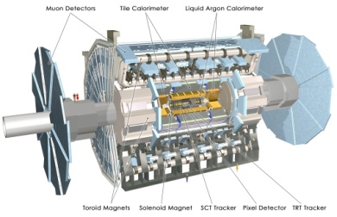
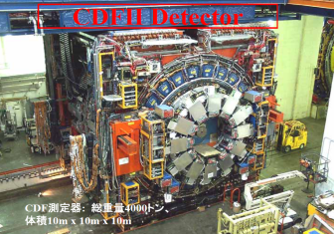
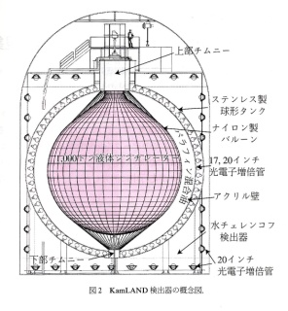
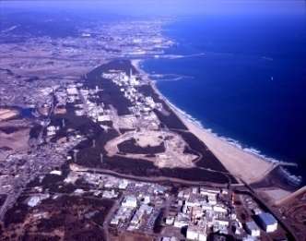
High Energy Physics in Japan
Major High Energy Activities in Japan
Active Experiments
Belle Experiment at KEK
KamLAND at Kamioka
CDF at FermiLab/USA
ATLAS and ALICE at LHC
PHENIX at BNL
Under construction
J-PARC
T2K Experiment at Tokai and Kamioka
Future Plan
SuperB Factory
International Linear Collider (ILC)
HEPnet-J: High Energy Phy
KEK provides the network facility, NEPnet-J,
on the SINET3 (NII)。
ATLAS at LHC
CDF at FNAL
KamLand
Tokyo Metropolitan U.
SuperKamiokande
Kamioka
RIKEN
Tohoku U.
Niigata U.
Osaka U.
Kanazawa U.
J-PARC
Shinshu U.
JAEA Tokai
Okayama U.
Kyoto U.
Nagoya U.
Hiroshima U
Kobe U.
KEK
Nara Women U.
Tsukuba U.
Osaka city U.
ICRR/Tpkyo
Waseda U.
U. Tokyo
Tokyo Inst. of Tech.
KEK BELLE
SuperSINET nodes
SINET nodes

Slide 6
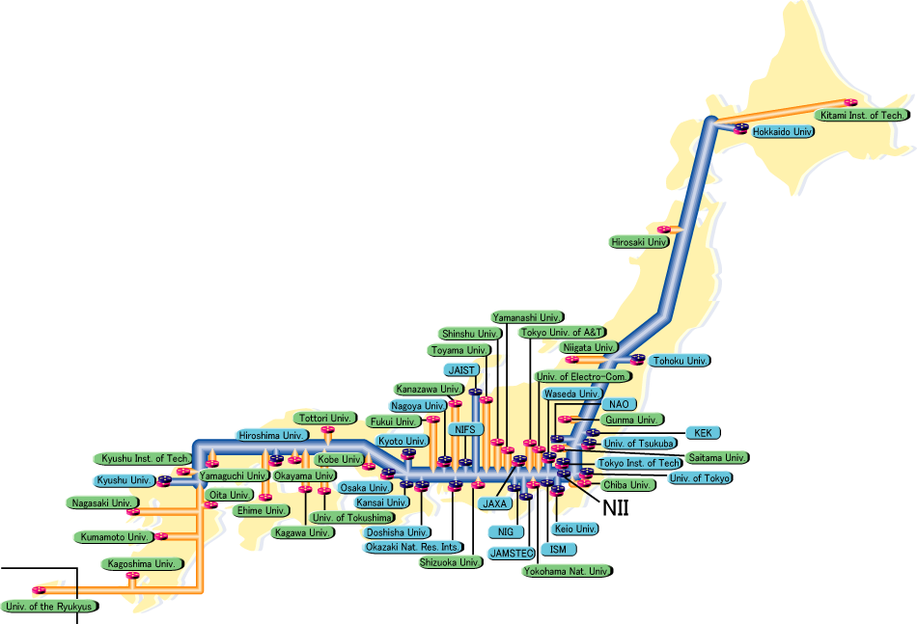
GRID federation of Japanese HEP+
LCG/gLite federation
Tohoku, Tsukuba, Nagoya, Kobe, Hiroshima-IT and KEK
NAREGI federation
NAOJ, Hiroshima-It, NII and KEK
JAXA will join soon
SINET3: 20Gbits/sec backbone
Nagoya Univ.
Nagoya Univ.
NAOJ
Tohoku Univ.
Tohoku Univ.
Kobe Univ.
Kobe Univ.
KEK
KEK
Univ. of Tsukuba
Hiroshima IT
Univ. of Tsukuba
Hiroshima IT
Tokyo tier-2
Hiroshima tier-2

Slide 7
Virtualization of computing nodes
We have started the evaluation of Platform ISF
Share the same nodes with gLite and NAREGI
Different experiment groups want different software set with different version including Linux kernels
Licensing costs will be the problem
HEP wide negotiation including LSF?

Slide 8
RENKEI
RENKEI: REsource liNKage for E-science
Funded by MEXT directly during JFY2008-2011
Lead by Prof. Ken Miura at NII
NAREGI is the code middleware
Develops a necessary technologies to establish an e-Science community based on Grid technologies
KEK is developing an API to absorb the differences of Grid middleware

Slide 9
(4) APIs for Multi Grid Middles
e.g. NAREGI, LCG, …

Slide 10
Grid interoperability
Sub-group2 covers Grid interoperability
NAREGI side
GIN to PGI
Job exchange among the different Grid middleware

Slide 11
NAREGI
NAREGI is the Japanese e-Science Infrastructure developed by NII mainly
Small groups at Japanese universities will have the benefit to use NAREGI because they expect the assistance from their computing centers
LCG operation is very cost consuming in human resource

Slide 12
SAGA
Simple API for Grid Applications
Job handling and file handling
Absorbs middleware differences at the API level
Grid and also clouds
KEK is working with the C++ implementation while CC-IN2P3 is working with Java implementation
Who we can converge?
KEK wants Python interface

Slide 13
Python library
We provide command and library in Python
Why we like Python, not Java?
We felt the difficulties with Java
Many VMs are running on the same machine
Memory cunsumption
Very sensitive to the version

Slide 14
RNS
Remote naming service
Middleware independent file catalogue will be provided
Developed in the sub-group 2 in the RENKEI project
Junctions
Other RNS servers can connect as sub-trees
Higher availability and performance
EPR: End Point Reference
Metadata
URI of physical file location

Slide 15
RNS: Resource Namespace Service
/EXP
MC
RAW
DST
data
data
file1
file2
file1
file2
file1
file2
file3
Hierarchical namespace management that provides name-to-resource mapping
Basic Namespace Component
Virtual Directory
Non-leaf node in hierarchical namespace tree
Junction
Name-to-resource mapping that interconnects a reference to any existing resource into hierarchical namespace
EPR: End Point Reference
EPR2
EPR1
gsiftp://cc.in2pr.fr/…..
gsiftp://desy.de/…..
http://www.ogf.org/documents/GFD.101.pdf

Slide 16
Current status
Following SAGA adaptors are implemented in C++
NAREGI adaptor
Job adaptor + Gfarm adaptor has been implemented
RNS adaptor
PBS and torque
Other adaptors are also developed or under development in C++
Globus
LSF
Cloud : Amazon EC2, goolge
gLite
Python interface
Python commands are under design and a proto-type has been implemented
Demonstrated at SC2010

Slide 17
Python
SAGA-C**
OGF standard
gLite
NAREGI
RNS
iRODS
PBS/torque
LSF
cloud
globus

Slide 18
Simple Python example
1: import saga
2: import sys
3: argvs = sys.argv
4: argc = len(argvs)
5: try:
6: # Create a Job Description
7: js url = saga.url(argvs[1])
8: job service = saga.job.service(js url)
9: job desc = saga.job.description()
10: job desc.executable = ’./test.sh’
11: job desc.working directory = ’$HOME/workdir’
12: job desc.candidate hosts = (argvs[2],)
13:
14: # Submit a job
15: my job = job service.create job(job desc)
16: my job.run()
17:
18: except saga.exception, e:
19: print ”SAGA Error: ”, e

Slide 19
FKPPL+FJPPL possible joint activities
CC-IN2P3, KISTI and KEK have the mutual relationship between either of two laboratories
Establishing the three points collaboration will be beneficial for everybody
FKPPL
FJPPL
KEK-KISTI MoU (BelleII)

Slide 20
KISTI-KEK
NAREGI deployment
KISTI will introduce a full set of NAREGI soon
Belle-II
KISTI will a tier-1 center
KISTI has started to make the replica of the current Belle data
Bio-medical
Geant4 based simulation
Cancer treatment

Slide 21
Future plans
SAGA-Python commands and libraries will be implemented
Web services

