Slide 1
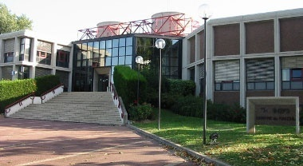
News and computing activities at CC-IN2P3
FJPPL Meeting at CC-IN2P3

Slide 2
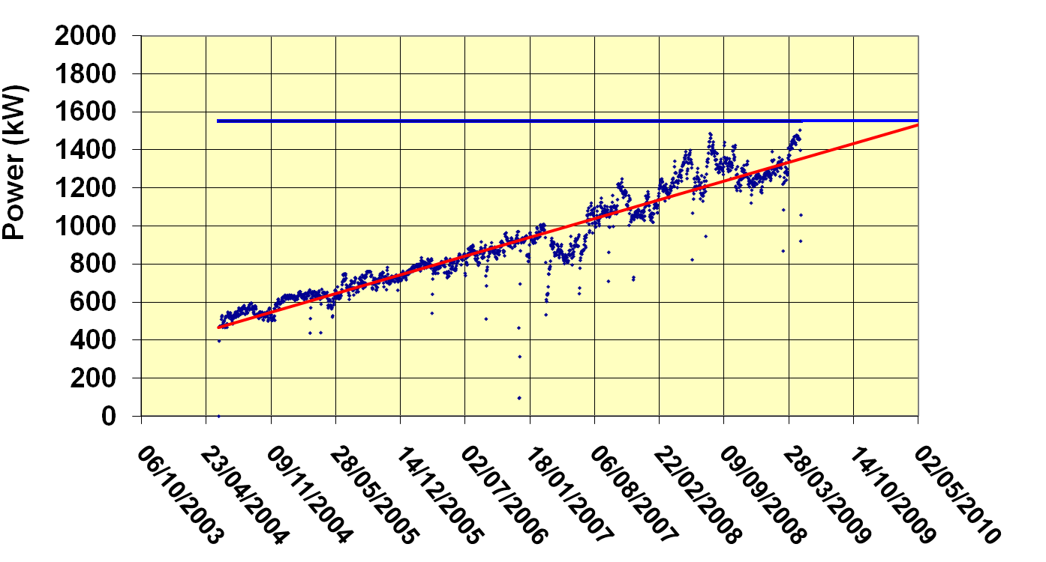
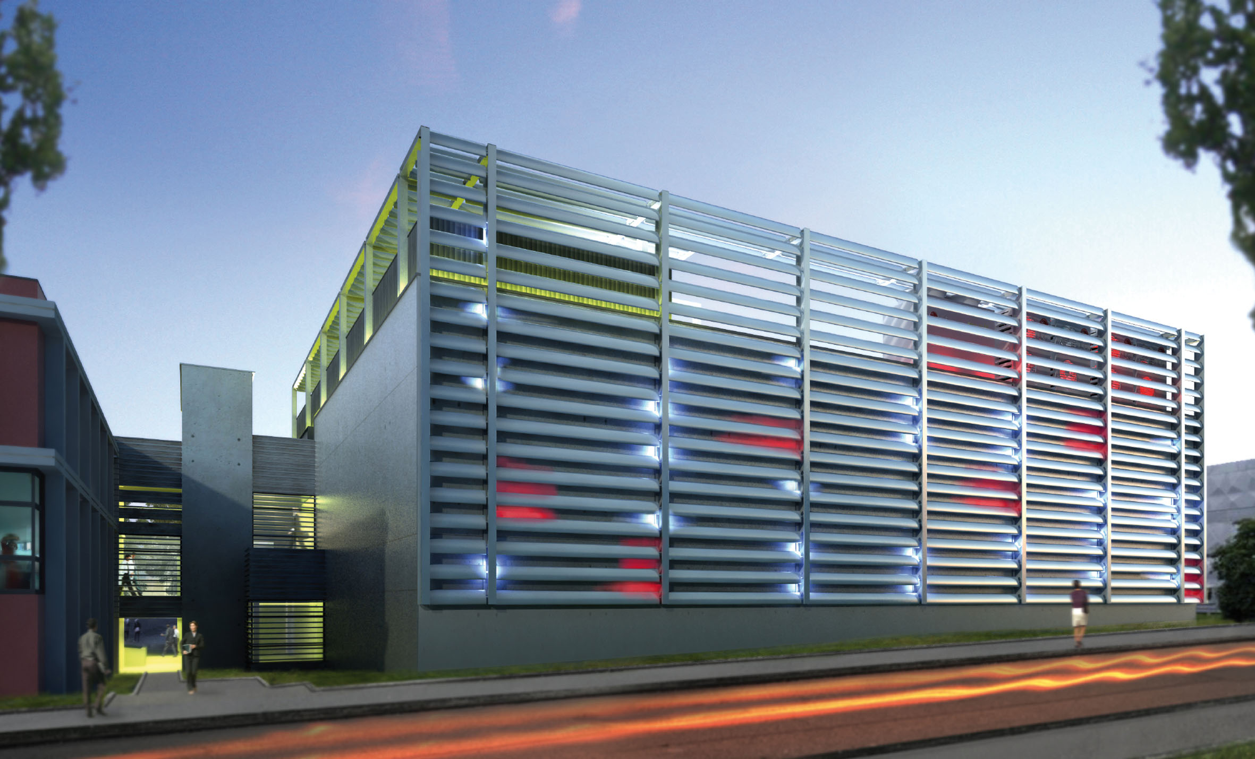
The infrastructure issue … … is solved
Slope: 500W / day
The building of the new computer room will start very soon
We expect to get it by early 2011

Slide 3
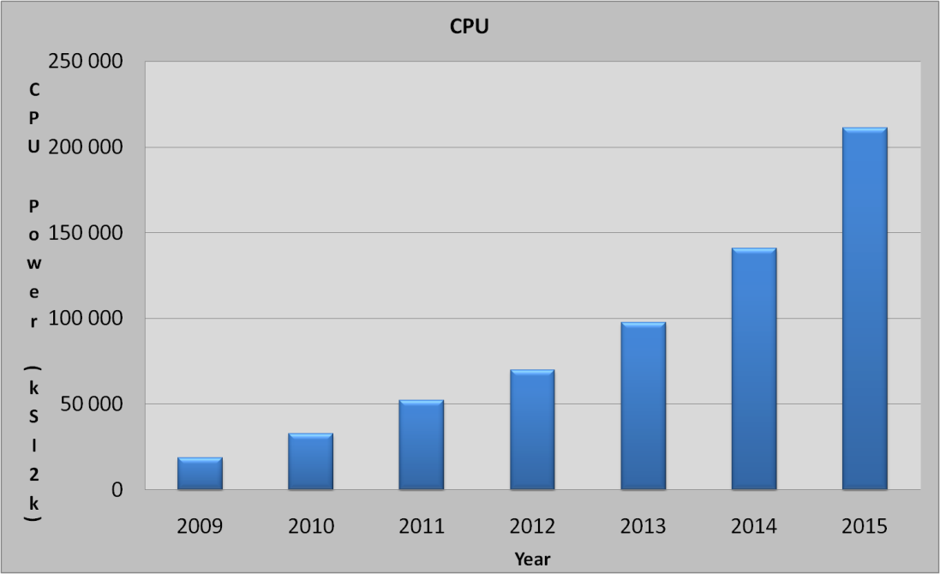
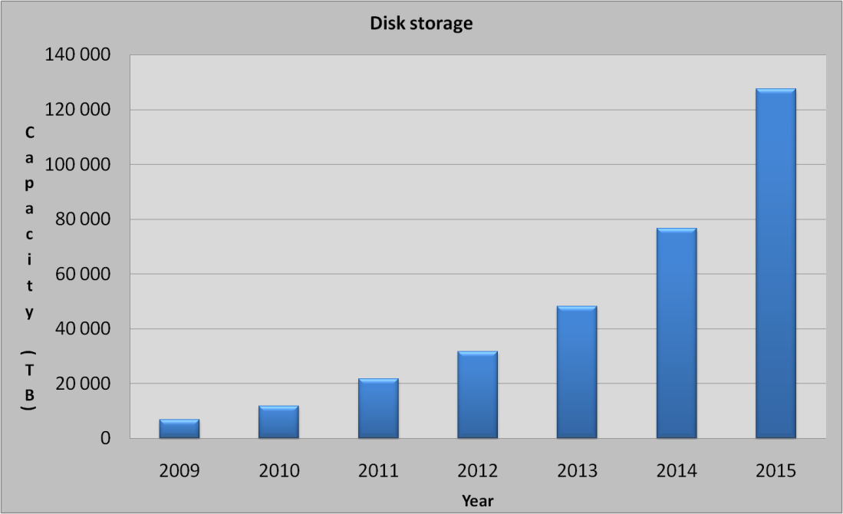
Capacity of new computer room
We have built a simple computing model with the following ingredients:
Serve ~40 groups with "standards needs"
Fulfill LHC computing commitments and provide first class analysis capability
Expect a very significant growth of the Astroparticle community needs (LSST for instance)
Add some services

Slide 4
New computer room
Assume Moore law is still valid
Extrapolate up to 2019
indicated power is for computing only
power for cooling has to be added
End up with:
2011
50 racks
600 kW
2015
125 racks
1.5 MW
2019
216 racks
3.2 MW
On top of the existing computer room (1 MW)
Due to budget constraints the new computer room will have to start with a limited power
➔ Modular design – Easily scalable
Chilled water and electricity distribution is designed for the 2019 target value
Equipment: transformers, chillers, UPS etc… will be added later

Slide 5
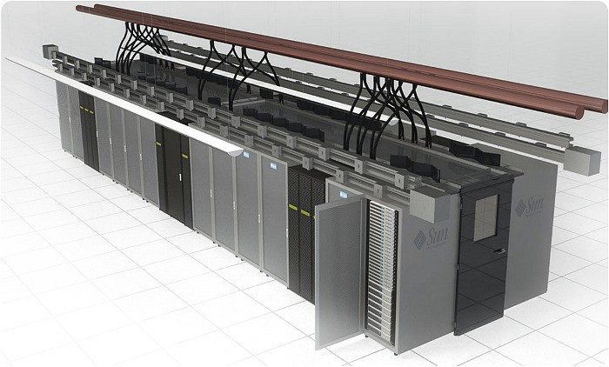
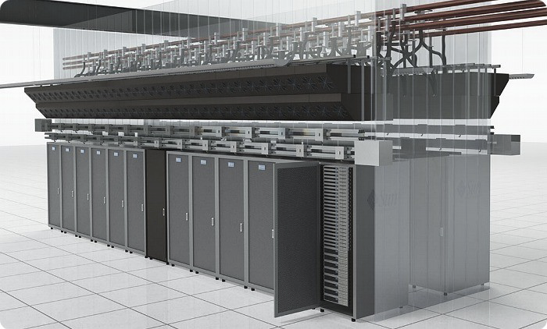
Design consideration
The 2 storey building will be devoted to computing equipment (no offices)
First storey: Services (UPS, Chillers, etc.) - 900 m²
Second Storey: Computer room - 900 m²
We decided to give up with raised floor
Every fluids will come from the top: Chilled water – Power – Network

Slide 6
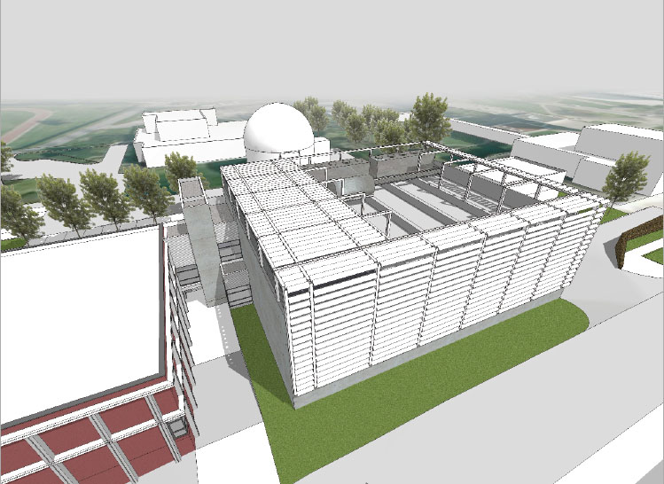
Inverted beams
Chillers on the roof
Pumps
Connection between old and new computer room + elevator

Slide 7
Analysis farm
We are setting up a prototype analysis farm for LHC experiments
PROOF based
I/O intensive
Fast turn around to speed up analysis code development
Blade center + 16 DELL blades – 16 Thread / blade – 3 Go / Thread
2 10 Gb/s network cards (blade interconnection and iSCSI storage
3 SAN crates iSCSI Dell EqualLogic PS 6010XV – 20 TB
16 600 Go 15 000 RPM SAS disks
Connection to xrootd server
The idea is to test this setup with different configurations and to compare to other analysis farms – Requires help from experiments
The system will be extended once we have a satisfactory configuration

Slide 8
New batch system
We have decided to stop developing our own batch system (BQS) and to migrate to a new product
A task force is working in order to propose a new batch system.
Extensive comparison work
Review of the systems adopted in other sites
Choice has been restricted to 2 products:
SGE
LSF
Then we will proceed to the migration…
The final choice will be done early March

Slide 9
Grid future strategy
EGEE → EGI in a couple of months
NGI : France Grille is being setup
8 partners
CC-IN2P3 will continue to play a central role in grid operation
At EGI level – Grid operation portal
At NGI level
We would also like to promote JSAGA work
Leverage JSAGA work to improve grid accessibility

Slide 10
Ideas…
Integration of grid and cloud framework
Well… I still have to figure out what is exactly the cloud model for particle physics
Create a France – Asia Virtual Organization / Grid
Support for AIL applications
Training
Could support both NAREGI and gLite

Slide 11
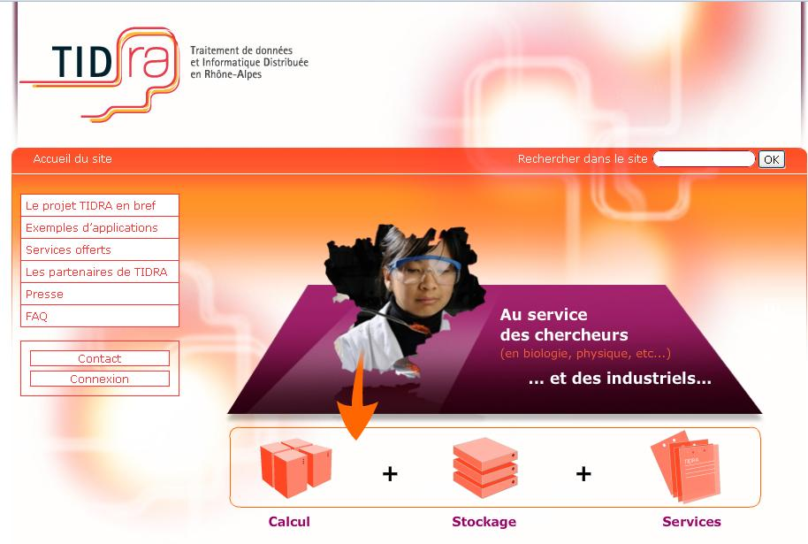
Grid future strategy
TIDRA is a regional grid oriented toward data treatment
Annecy
Grenoble
Lyon
Open to any regional scientific application
Easy access is crucial…
… and difficult to setup !
Hope to open it to industrial world

