Slide 1
STRONG-2020: Project Review Virtual Access Frank Maas (Johannes Gutenberg Universität Mainz)

Slide 2
Virtual Access
New tool in hadron physics community
Web based:
Access to software for the analysis of experiments in hadron physics
Link between theory and experiment: correction and interpretation
Access for a large users community
Open-access to computer codes
Documentation
Cloud based computing resources
Acts as a seed activity and multiplication by and for a large users community
Guidance and Advice from International Assessment Board

Slide 3
Virtual Access
Heavy Ion collisions: VA1-NLOAccess (WP10)
Nucleon structure: VA2-3DPartons (WP11)
Support for various work packages in STRONG2020
IMPACT:
Fits to experimental data: CERN, BNL, Jlab,
Design of new experiments: Electron Ion Collider in US and China
Study of phenomenological sensitivity for new ideas

Slide 4
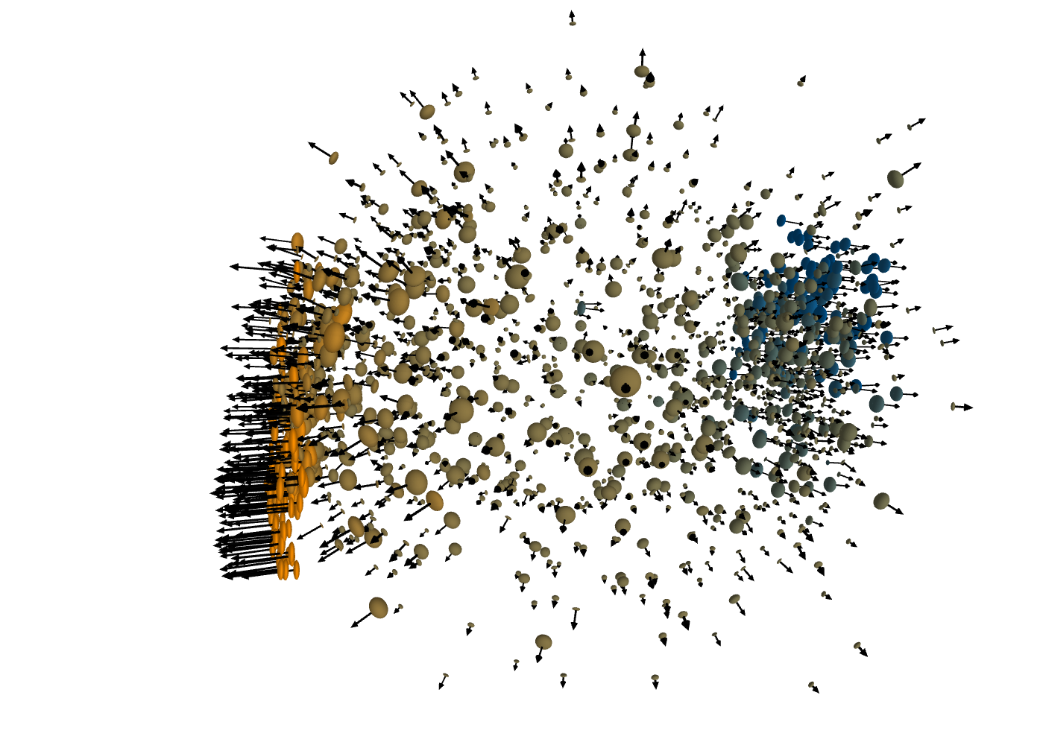
VA1-NLOAccess (WP10)
Relativistic heavy ion collisions
Objectives: Web based access to automated tools to evaluate heavy ion collisions observables: production rates or kinematical properties - of scatterings involving hadrons.
Achievements in second year:
Update of IT resources
Usage of modern programming languages and compilers like PYTHON
Continuous development and modernisation of main program codes
Monte Carlo event generator for collider studies: MADGRAPH5aMC@NLO,
Amplitude calculation for bound states of heavy quarks: HELAC-ONIA
General purpose Feynman diagramm calculation: FDC
Steady Access during Pandemic, deliverable reports D10.1 and D10.2

Slide 5
VA1-NLOAccess (WP10)
Relativistic heavy ion collisions
Objectives: Web based access to automated tools to evaluate heavy ion collisions observables: production rates or kinematical properties - of scatterings involving hadrons.
Achievements in second year:
Increase of registered users to about 250 users world wide, substantial participation of Master- and PhD-students
More than 40 international oral presentations, tutorials, master classes and hands-on training
Several published review articles based on NLOAccess
Regular meetings of the International Assessment board
More than 3000 runs on cloud services provided by NLOAccess
Users from Europe: 56,68%; Asia: 20.65%; North America: 18.62%; Africa; South America; and Oceania

Slide 6
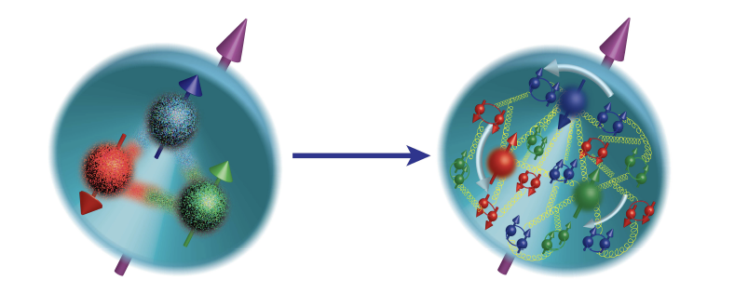
VA2-3DPartons (WP11)
Spatial structure of proton and neutron
Objectives: Development of a new combined framework to extract generalized (GPDs) and transverse momentum dependent (TMDs) parton distributions, with higher order fixed and twist corrections, from fits to experimental e-p and p-p data.
Achievements in second year:
Update of PARTONS web page
Usage of modern programming languages and compilers like PYTHON
Extension of fitting procedures for experimental data and observables
Steady Access during Pandemic, deliverable reports D11.1 and D11.2

Slide 7
VA2-3DPartons (WP11)
Spatial structure of proton and neutron
Objectives: Development of a new combined framework to extract generalized (GPDs) and transverse momentum dependent (TMDs) parton distributions, with higher order fixed and twist corrections, from fits to experimental e-p and p-p data.
Achievements in second year:
Access from Europe, US and China: Ab out 800 registered users
VA2 is vital for the development of the next generation large scale projects like the EIC in the US and the EICC in China
Many presentations and publications based on 3DPartons

Slide 8
Virtual Access
Virtual Access established as a new tool in hadron physics community
Vital for the analysis of existing experiments
Substantial and important contribution for the design and exploration of new facilities
A widely used tool, needs to be maintained in a sustained way

