Slide 1
Readout architecture
Jean Soudier
Working with: Frederic Morel, Jerome Baudot

Slide 2
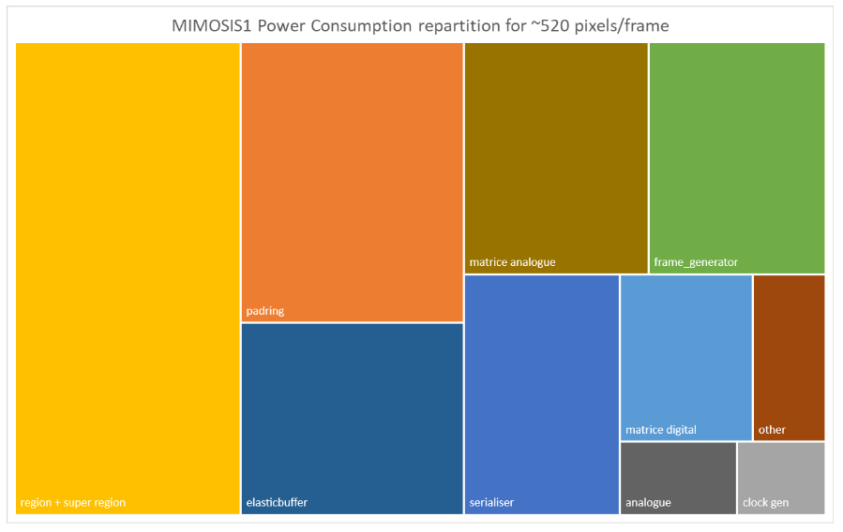
Review of some sensors
ALPIDE
6 MHz/cm²
50 mW/cm²
29x27 μm²
512x1024 pixels
MIMOSIS
7 MHz/cm²
70 mW/cm²
30x27 μm²
1024x512 pixels
MOSS
100 MHz/cm²
20 mW/cm²
18 or 22,5 μm²
1280x576x10 pixels
Upgrade
Upgrade
Notes:
Increase of surface detection > multiple reasons (%x0, power, resolution,…)
Asynchronous circuits

Slide 3
General synchronous / asynchronous communication review
Asynchronous communication
Peripheral 1
Peripheral 2
Request
Acknowledge
DATA
Synchronous communication
Clock
Peripheral 1
Peripheral 2
DATA

Slide 4
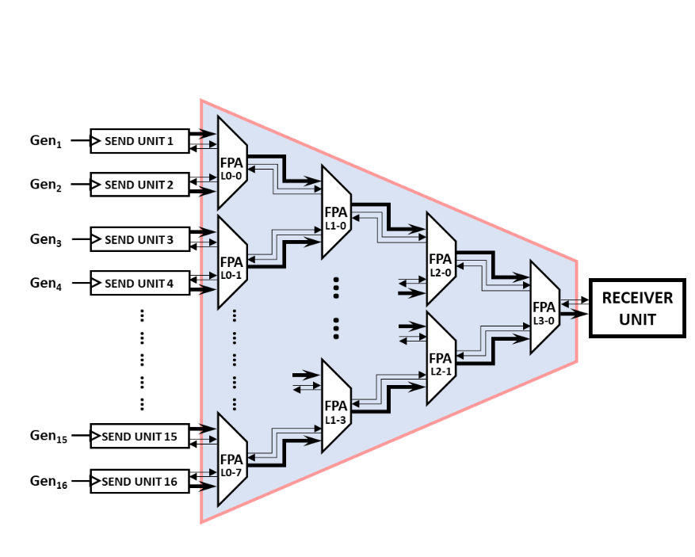
Asynchronous arbiter (Fixed Priority Arbiter)
Classical topology view
Column of pixels
1
2
3
Serialized
Notes:
Send unit = pixels
Receiver unit = serial transmission

Slide 5
Possible applications and adaptations: I) Topology
Case 1: readout inter pixel column (MIMOSIS like)
Case 2: readout out of the matrix (MOSS like)
Zoom on a 2x2 pixels integration
6 μm
33 μm
6 μm
Single column (a)
Line
22,5 μm
Centralizer (b)
Column
Centralizer (b)
Analog circuit
Readout circuit
Notes:
- Purple = matrix ; yellow = readout circuit
Case 1: fast readout, need low power & small area
Case 2: more space, can consume more, is equal or slower

Slide 6
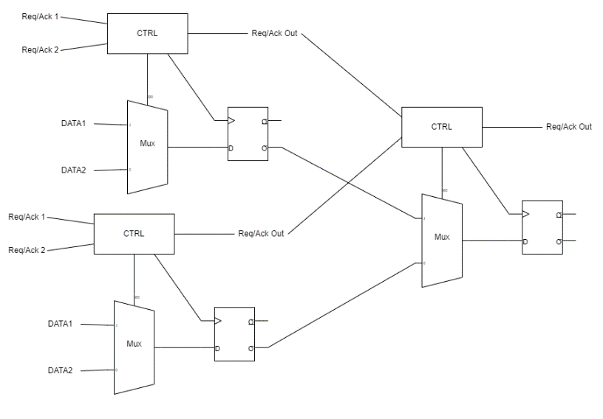
II) Possible size adaptations (area improuvements on a 4 to 1 arbiter)
Option a: 3 arbiter of 2 bits cascaded
Option b: 1 arbiter of 4 bits (15% area reduction)
Notes:
CTRL, memory, switch
Take POWER, AREA and TIME => memory
15% reduction

Slide 7
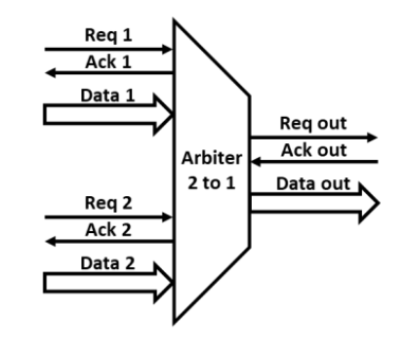
III) Possible function adaptations (priority function improuvements, when both request)
Option a: fixed priority arbiter (FPA)
Option b: toggle priority arbiter (TPA)
Notes:
Fixe, Dynamix (toggle) => memory, depend on data load

Slide 8
Summary of applications and adaptations
Case 1a: readout inter pixel column (MIMOSIS like)
Case 1b and 2: readout out of the matrix (MOSS like)
Criteria | Criticity | Implication
Area | +++ | -Fixed priority -Large ctrl bus -Slow reading
Power consumption | ++
Reading time | +
Criteria | Criticity | Implication
Area | + | -Dynamic priority -Small control bus -Big area
Power consumption | ++
Reading time | +++

Slide 9
Results and interpretation (on 1024 pixels, fixed priority, bus of 2 bits)
Design | Nb pixels | Shift reg included ? (0) | Area [μm²] [22,5 x nb pixel x μm] | Power [μW] | Reading time [ns]
TPA estimate | 1024 | No | 88980 (1a) | 2 (2a) | 11 ns (3)
TPA layout | 1024 | No | 311430 (1b) 13,52 | ? | ?
MOSS estimate | 1024 | Yes | 135504 | 1419 | 25 ns
MOSS estimate | 1024 | No | 19290 | X
MOSS layout | 320 | Yes | 149760 20,8 | 300 (2c)
MOSS layout | 1024 | Yes | 479232 (1c) 20,8 | X
(0) shift register used for readout outside matrix
(1a) missing clock buffers
(1b) linearized from MOSS by 3,5 (ratio between estimate and layout)
(1c) linearized from pixels numbers
(2a) C gate not caracterized in power and missing clock buffers
(2c) for 1 hit instead of 6
(3) Possible idea of delay
-> Work to do
Zoom on a 2x2 pixels integration
6 μm
33 μm
6 μm
22,5 μm
- Study for case 1 to find the minimal pixel pitch
- Centralizer and case 2 will be sutied later
Notes:
Routing won’t be done
17x8,5 um, 2 factor (35% in 16->1)
C gate, 2 gate peer controler
MOSS is about 300 uW

Slide 10
Tanks you for your attention
Notes:
Merci pour votre attention, je suis prêt à répondre à vos questions.

Slide 11
Back-up: area utilisation
22,5 μm
20 μm
16,5 μm
6 μm
13,2 μm
6,8 μm
1024
pixel
1024
pixel
1024x22,5
= 23040 μm
1024x20
= 20480 μm
Total reading area
23040x16,5 = 380160 μm²
Total reading area
20480x13,2 = 270336 μm²

