Slide 1
SDHCAL

Slide 2
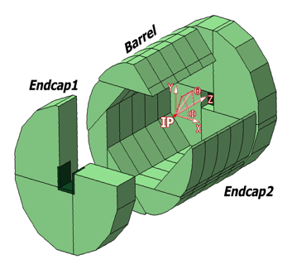
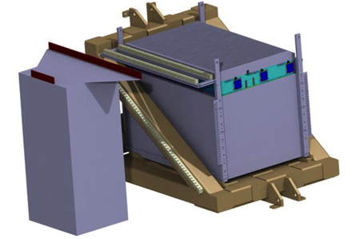
SDHCAL
The SDHCAL concept is based on exploiting Gaseous Detectors high granularity potential
Semi-digital readout was proposed to mitigate the saturation problem allowing better energy reconstruction
Power-pulsed electronics, possible in ILC, eliminates the need of active cooling
Self-supporting mechanical structure servs as absorber increasing the compactness of the HCAL.
The structure proposed for the SDHCAL :
is very compact with negligible dead zones
Eliminates projective cracks
Minimizes barrel / endcap separation
(services leaving from the outer radius)
Goals
SDHCAL Technological Prototype should
be as much as possible similar to the ILD module
and able to study hadronic showers
Challenges
-Homogeneity for large surfaces
-Thickness of only few mms
-Lateral segmentation of 1 cm X 1 cm
-Services from one side
-Embedded power-cycled electronics
-Self-supporting mechanical structure

Slide 3
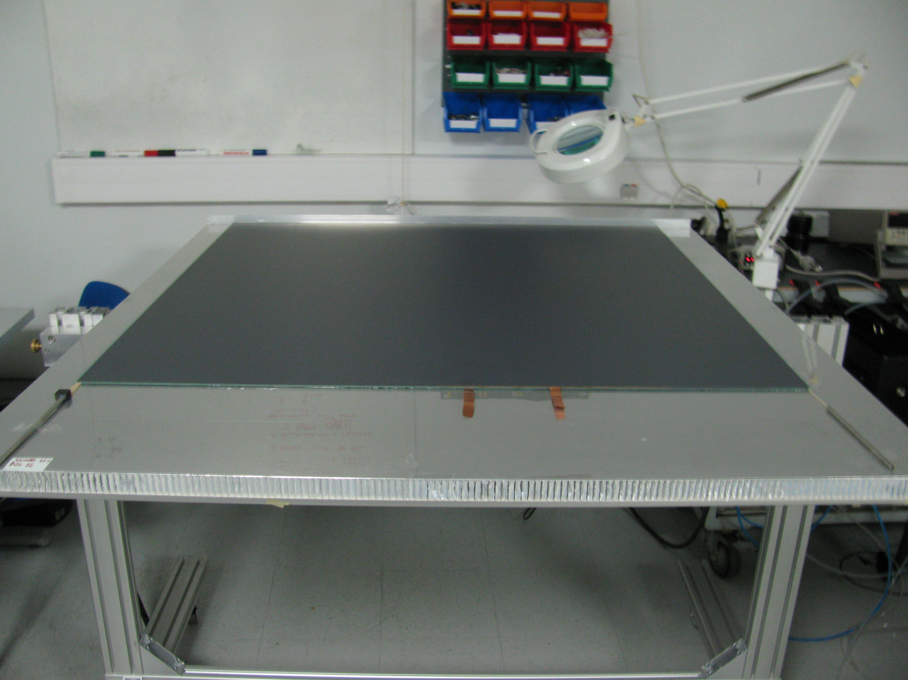
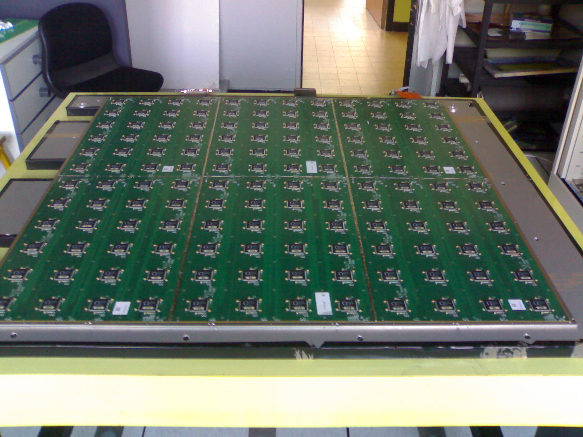
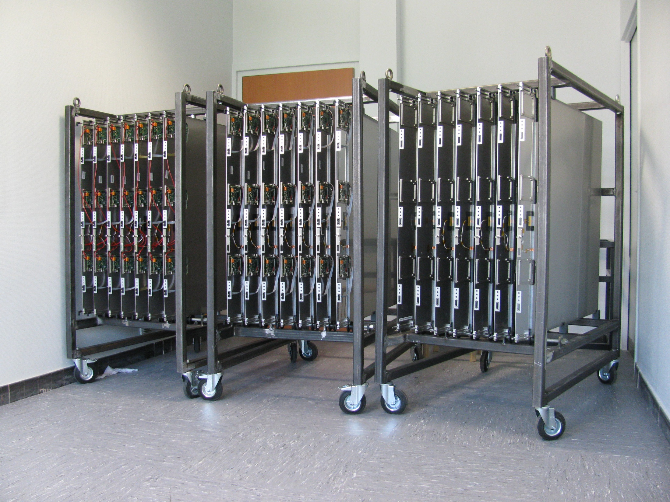
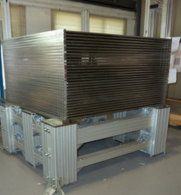
SDHCAL prototype construction
10500 64-ch ASIC were tested and calibrated using a
dedicated robot (ASICs layout : 93% ).
310 PCBs were produced, cabled and tested.
They were assembled by sets of six to make 1m² ASUs
170 DIF, 20 DCC were built and tested.
50 detectors were built and assembled with
their electronics into cassettes.
Self-supporting mechanical structure.
DAQ system using both USB and HTML
protocol was developed and used.
Full assembly took place at CERN.
IP2I, LAPP, LLR, OMEGA
CIEMAT, LLN, Gent
French contribution was essentially funded by
ANR-Blanc DHCAL
Spain: Mechanical structure
Belgium: Services

Slide 4
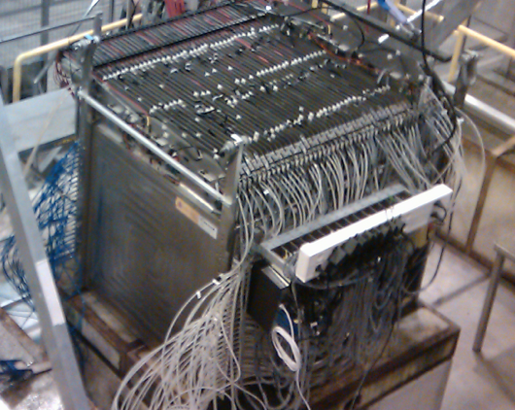
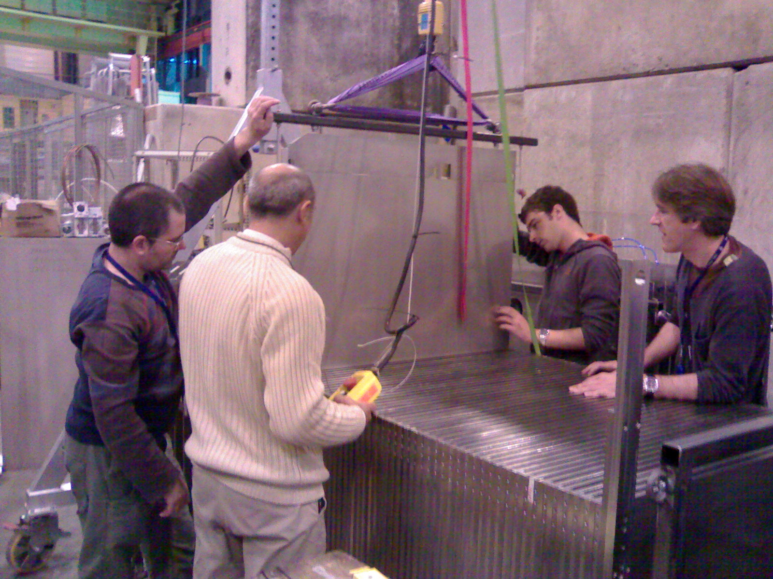
SDHCAL prototype construction
Completed in 2011 and tested in 2012
10500 64-ch ASIC were tested and calibrated using a
dedicated (ASICs layout : 93% ).
310 PCBs were produced, cabled and tested.
They were assembled by sets of six to make 1m² ASUs
170 DIF, 20 DCC were built and tested.
50 detectors were built and assembled with
their electronics into cassettes.
Self-supporting mechanical structure.
DAQ system using both USB and HTML protocol
was developed and used.
Full assembly took place at CERN.
48 layers (-6λ_{I})
1 cm X 1 cm granularity
3-threshold, 500000 channels
Power-Pulsed
Triggerless DAQ system
Self-supporting mechanical structure
R. Kieffer PhD thesis
Y. Haddad PhD thesis
Published: JINST 10 (2015) P10039

Slide 5
SDHCAL performance
Triggerless
Time-based clustering
The SDHCAL prototype was exposed to hadron, muon and electron
beams in 2012, 2015 , 2018 and 2022 on PS, H6 and H8 -SPS lines.
Power-pulsing using the SPS spill structure was used to reduce the
power consumption.
Self-triggering mode is used but external trigger mode is possible
The threshold information helps to improve on the energy rec.
by better accounting for the number of tracks crossing one pad
New data were taken in 2015, 2016 and 2017 with an improved DAQ system
Noise rate
Efficiency
Multiplicity

Slide 6
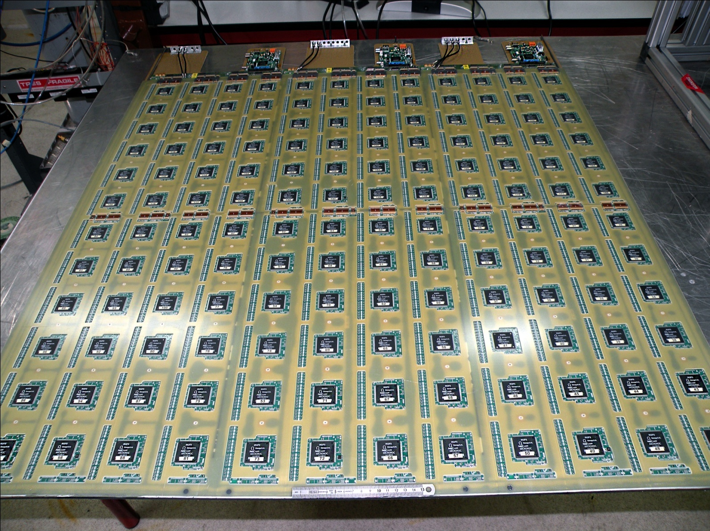
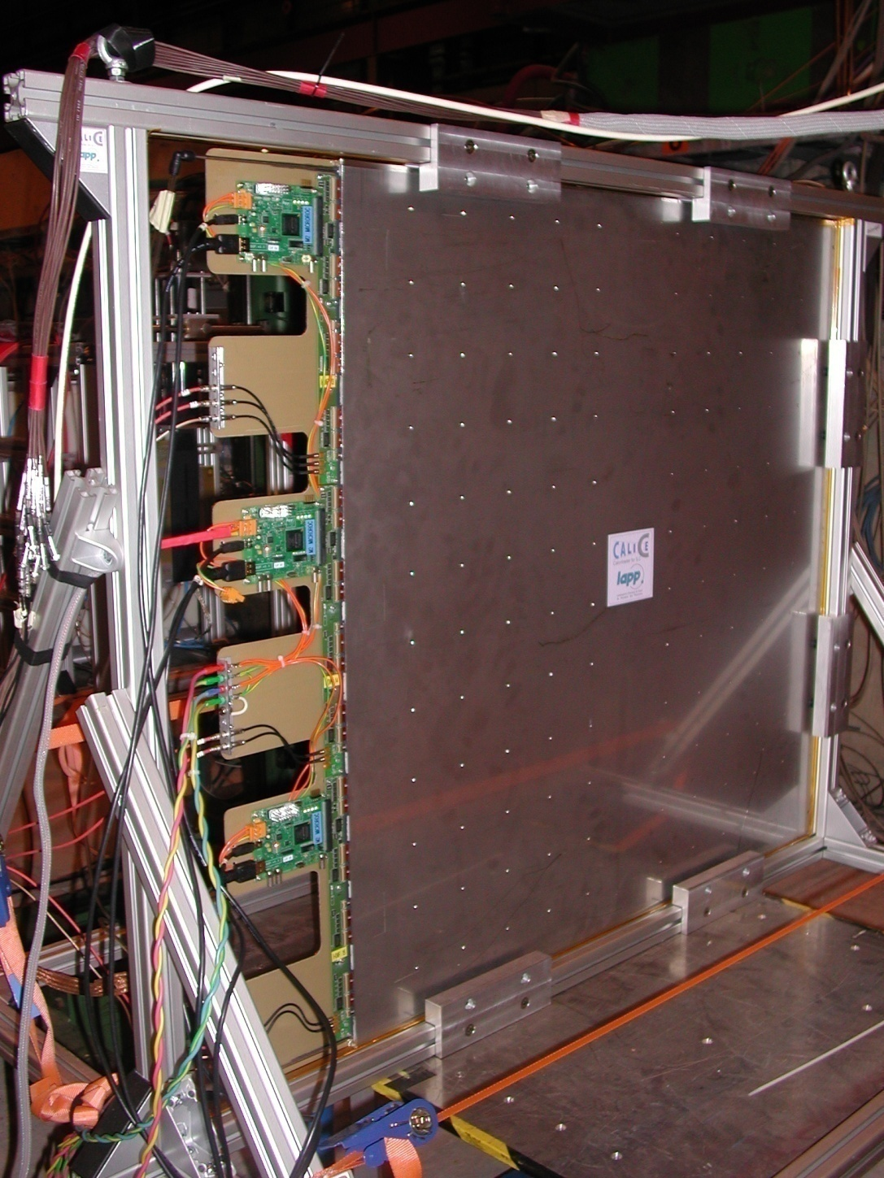
In addition, within the ANR-Blanc, 4 units of SDHCAL-MM 1m x 1m each were produced, tested in a muon beam. The 4 units of SDHCAL-MM were then inserted in the SDHCAL-RPC prototype replacing the RPC units #10, 20, 35 and 50
LAPP

Slide 7
Beam test results
The SDHCAL was the first technological prototype developed within the CALICE collaboration.
Beam tests at CERN allowed us
to validate the concept
to better understand its different components (GRPC, Front-End and Back-End electronics)
to continuously improve on the DAQ system to obtain the best performances

Slide 8
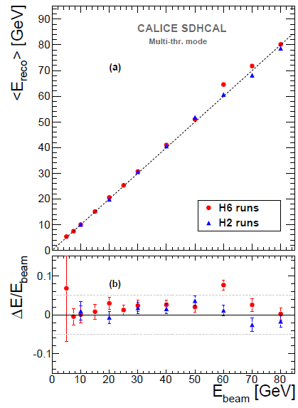
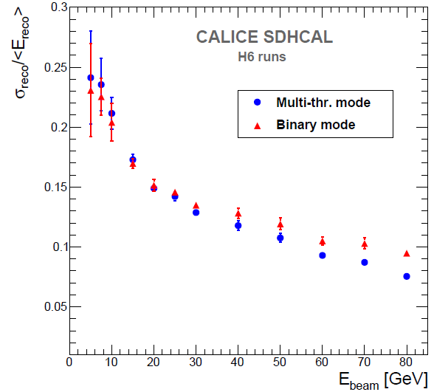
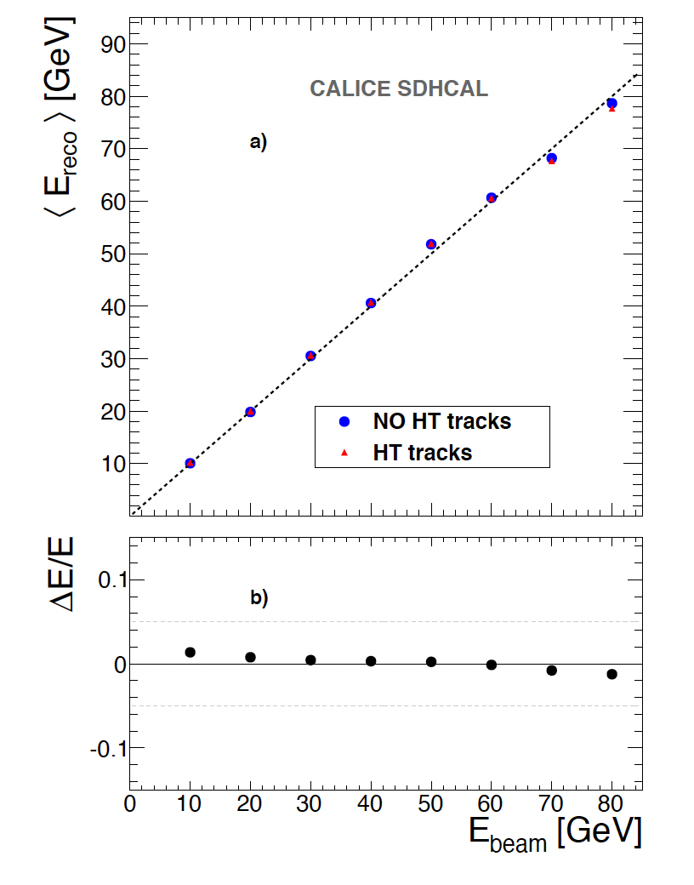
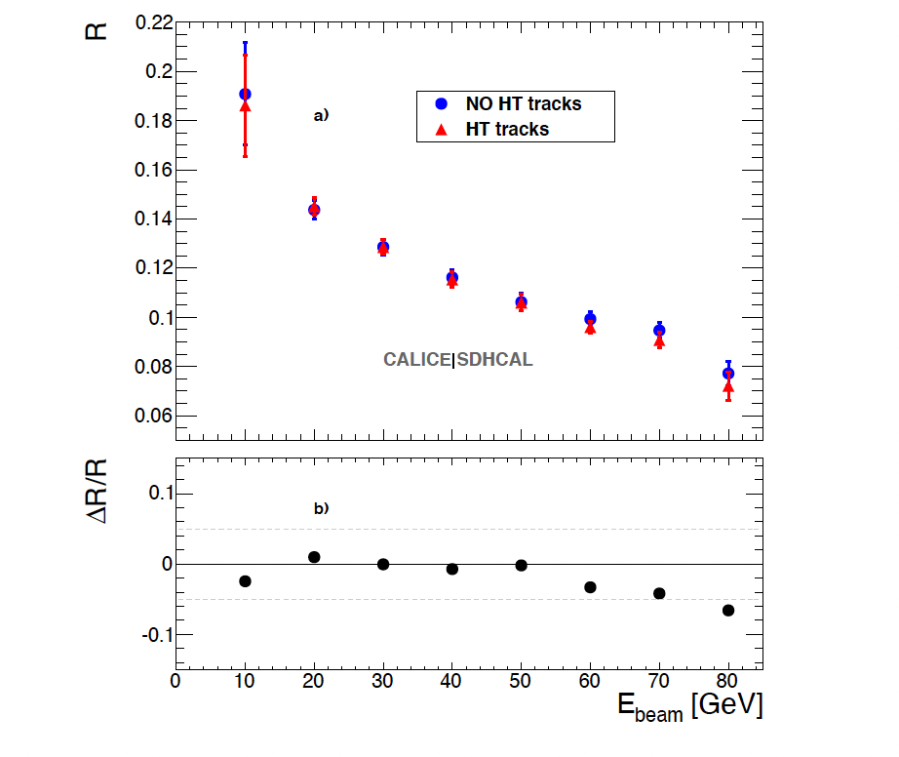
Energy reconstruction
N₁= Nb. of pads with first threshold <signal < second threshold
N₂ = Nb. of pads with second threshold <signal < third threshold
N₃ = Nb. of pads with signal> third threshold
E_{rec =} α (N_{tot}) N₁ + β (N_{tot}) N₂ + γ (N_{tot}) N₃
α , β , γ are quadratic functions of
They are computed by minimizing :
N_{tot} = N₁ + N₂ + N₃
χ²= (E_{beam}-E_{rec})²/E_{beam}
Hough-Transform
Track segments reconstruction using 3D-Hough Transform helps to apply different treatment to the hits of these segments.
JINST 11 (2016) P04001
E_{rec =} α (N_{tot}) N’₁ + β (N_{tot}) N’₂ + γ (N_{tot}) N’₃ + c N_{HT}
N_{tot} = N’₁ + N’₂ + N’₃+ N_{HT}
In addition track segments will be used as in-situ calibration and monitoring tools
JINST 12 (2017) P05009

Slide 9
Particle Identification
The high granularity of SDHCAL allows one to discriminate different kinds of particles (pions, electrons and muons)
JINST 15 (2020) P10009

Slide 10
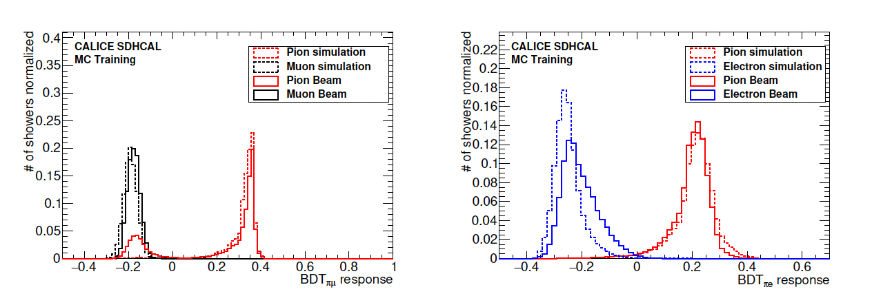
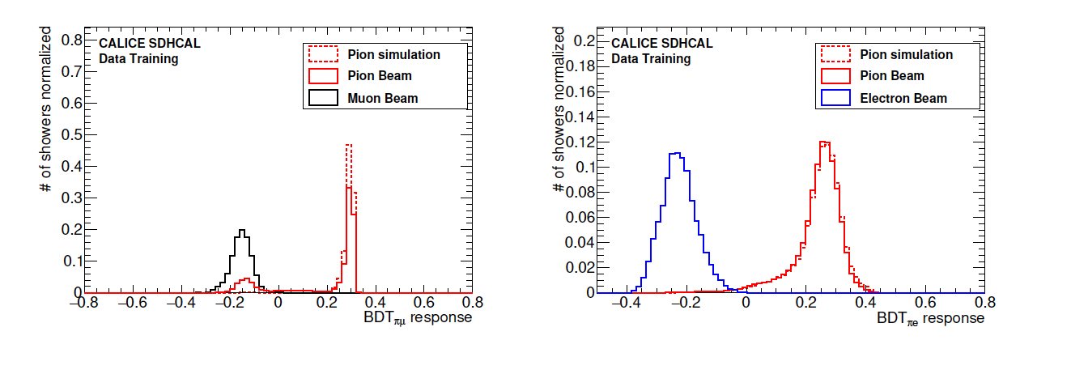
Particle Identification
The high granularity of SDHCAL allows one to discriminate different kinds of particles (pions, electrons and muons). The discrimination power is well exploited using MVT (BDT in our case)
Electron and muon rejection > 99%
B. Liu PhD thesis
JINST 15 (2020) P10009

Slide 11
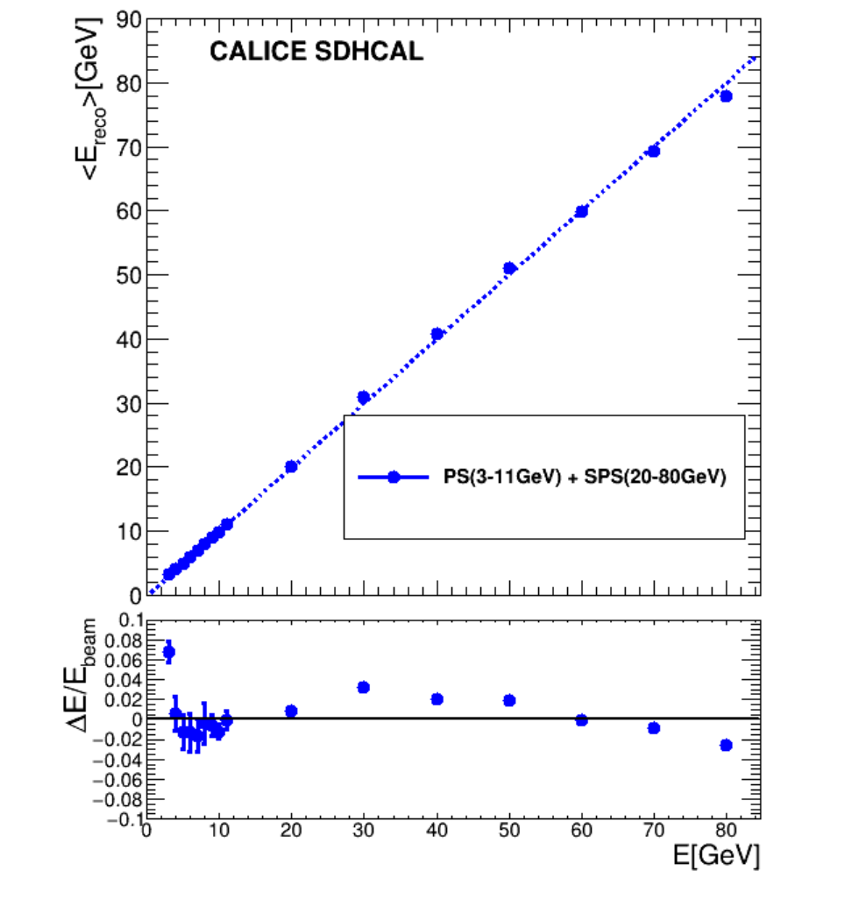
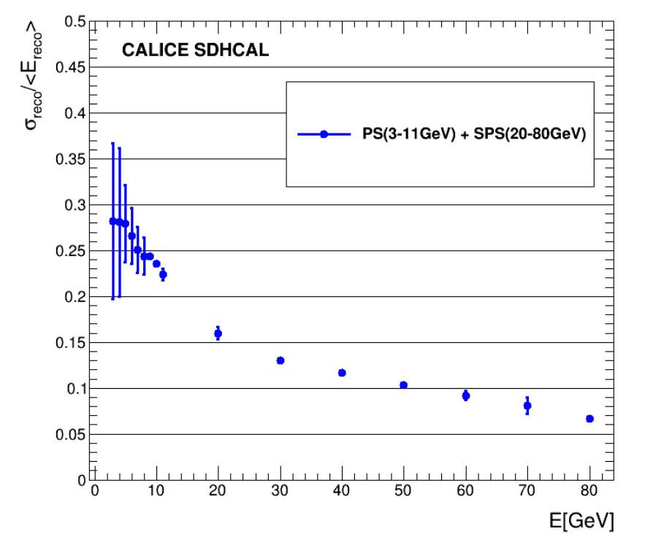
Particle Identification & Energy reconstruction
The BDT-based PID technique was also applied to the PS (3-80 GeV) samples
Linearity
Resolution
JINST 17 (2022) P07017

Slide 12
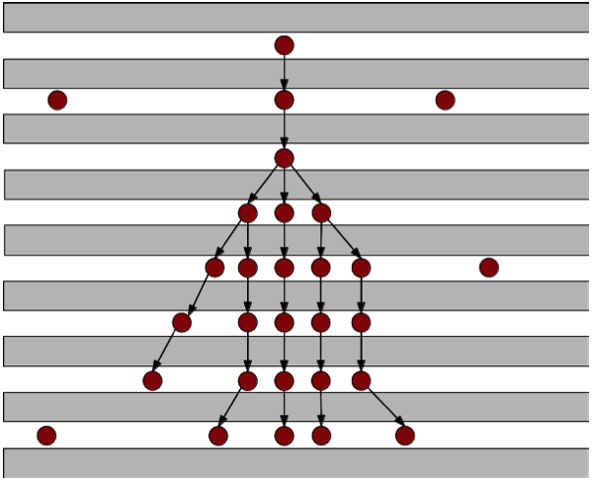
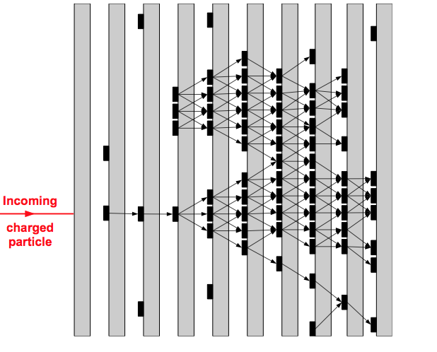
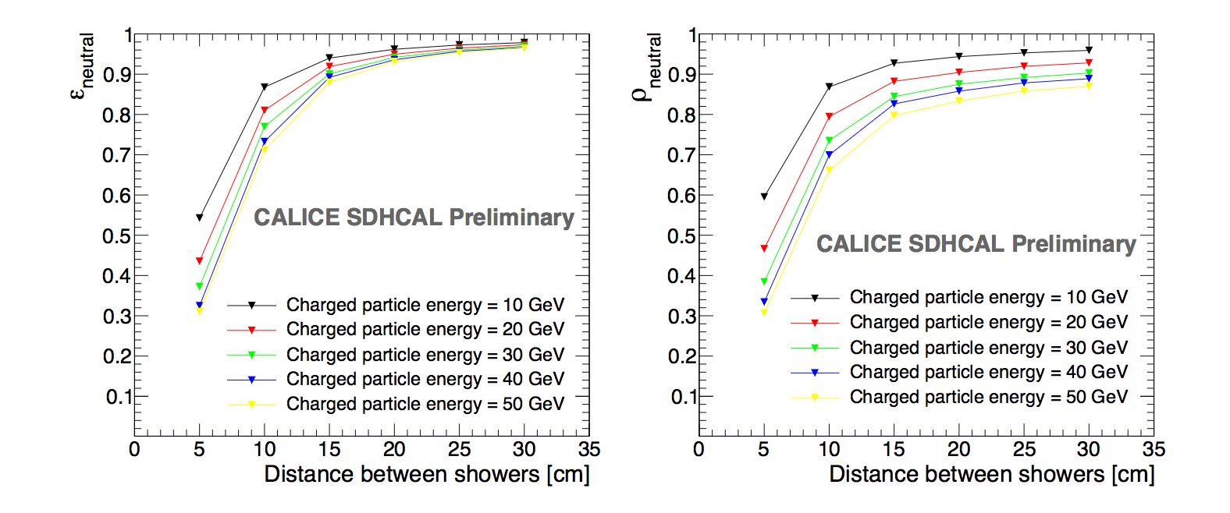
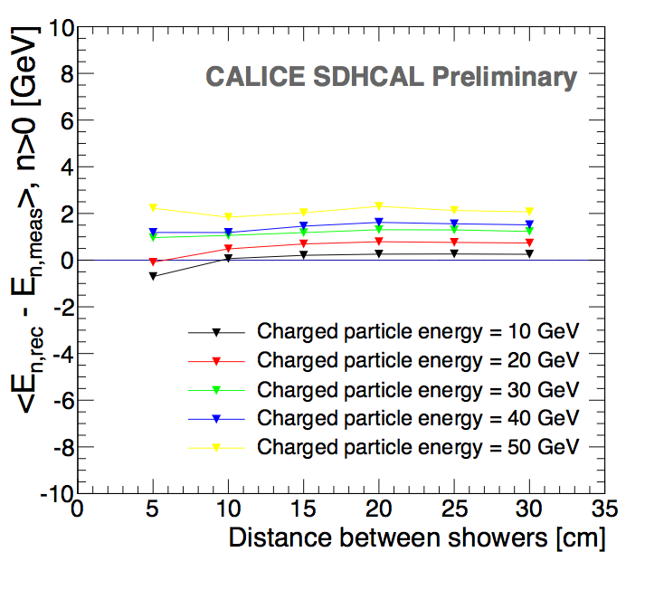
Shower separations
ArborPFA, April algorithms:
they connect hits and then their clusters using distance and orientation information
then user tracker information (momentum)
to improve on the correction
Efficiency
ΔE
Purity
1 neutral of 10 GeV
1 neutral of 10 GeV
1 neutral of 10 GeV
CALICE note CAN054
R. Eté PhD thesis
L. BO (LIO postdoc)

Slide 13
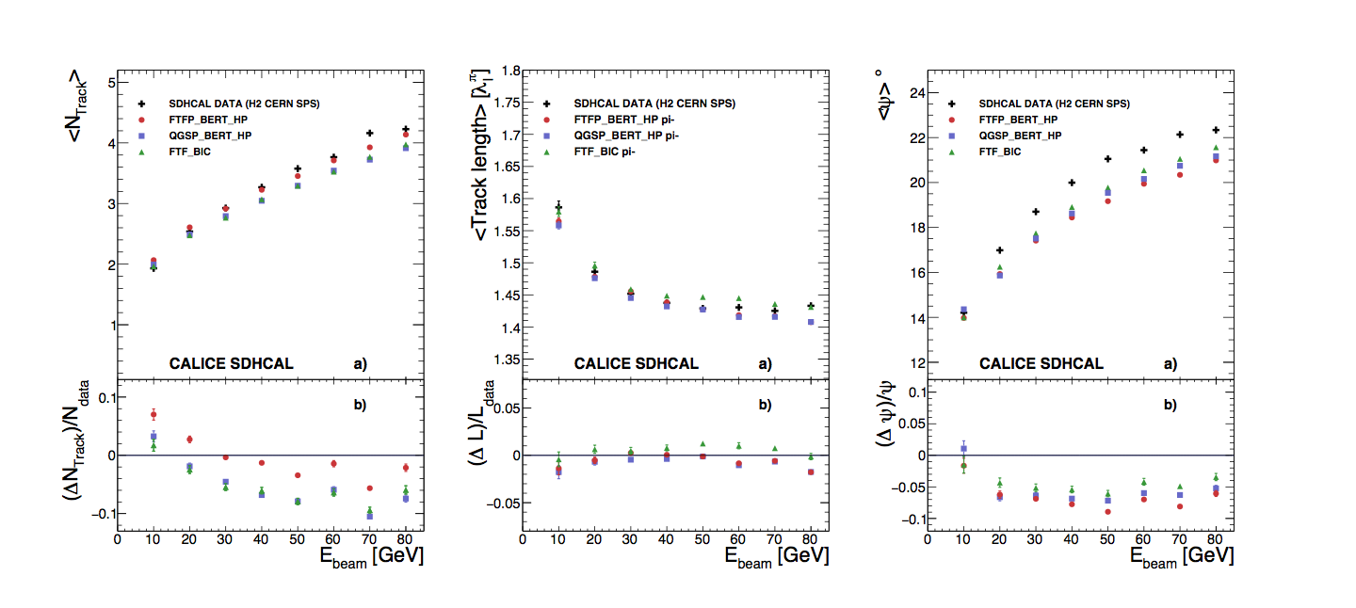
Hadronic shower studies
The high granularity of SDHCAL provides an excellent probe of hadronic showers.
Studies of these showers using SDHCAL allow the discrimination of many models.
A complete digitization of the SDHCAL prototype was developed before using the simulation models.
A. Steen PhD thesis
Strong collaboration with GEANT4 Collaboration
(Alberto Ribon defended his HDR in our University)
JINS 17 (2016) P06014

Slide 14
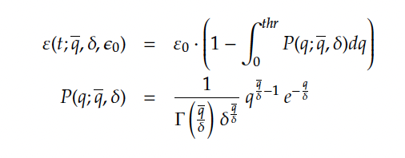

Further improvements on the energy reconstruction
Detector homogeneity
The homogeneity of the detector response is important to achieve better energy reconstruction
CALICE SDHCAL Preliminary
H2/2018
A new calibration method based on varying the thresholds rather than the electronic gain was found to be powerful. Muon runs with different thresholds Thr1: 0.1-0.42 pC, Thr2: 0.4-5, Thr3:4.7-24) and efficiency and multiplicity were measured for each value. The values of the three thresholds of each ASIC were fixed to obtain same multiplicity (first threshold) and the same efficiency for thr2 and thr3.

Slide 15
Further improvements on the energy reconstruction
Detector homogeneity
The homogeneity of the detector response is important to achieve better energy reconstruction
CALICE SDHCAL Preliminary
H2/2018
CALICE SDHCAL Preliminary
H2/2018

Slide 16
Further improvements on the energy reconstruction
Detector homogeneity
The homogeneity of the detector response is important to achieve better energy reconstruction
CALICE SDHCAL Preliminary
H2/2018
Before
After
1.4%
3.9%
G. Garillot PhD thesis

Slide 17
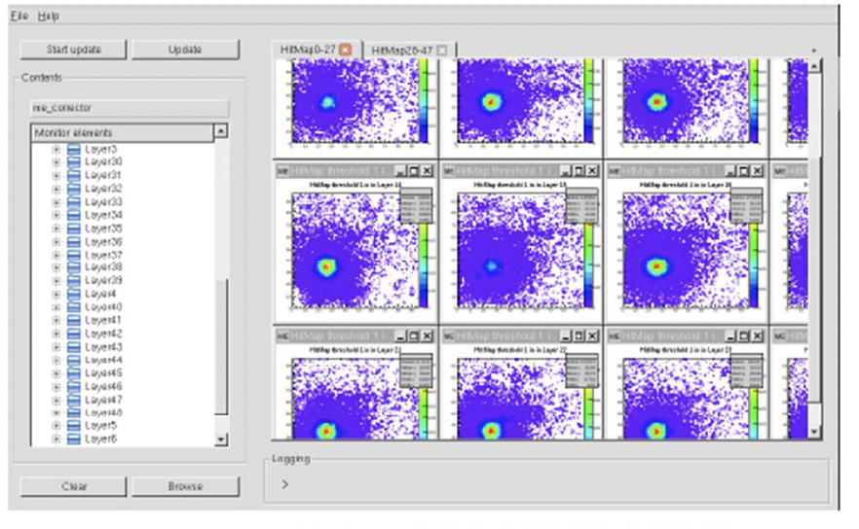
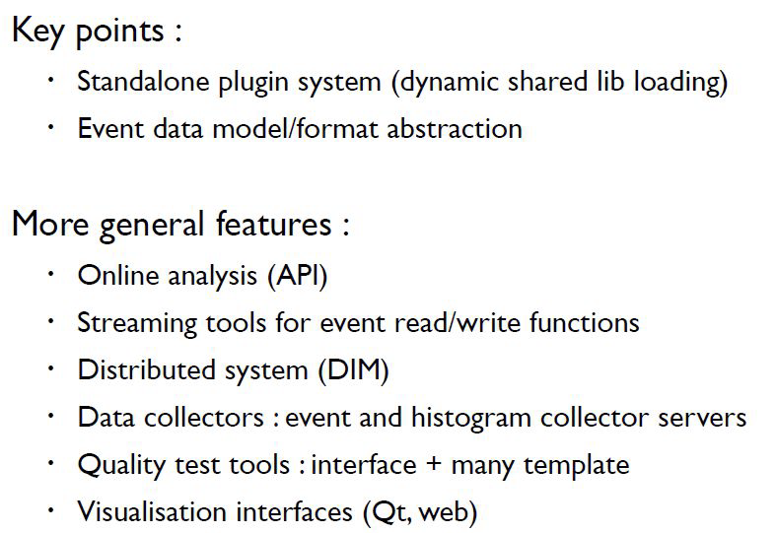
Monitoring system
A monitoring system (DQM4HEP) developed for the SDHCAL (R. Eté&A. Pingault)
It allows to control
-GRPC efficiencies
-GRPC noise map
-SlowControl (HV, LV, T, P..)
The monitoring system is used by other groups (AHCAL)

Slide 18
SDHCAL R&D towards the future Higgs Factory
ILC, CEPC, FCCee
Large SDHCAL module
Timing SDHCAL
High rate capability

Slide 19
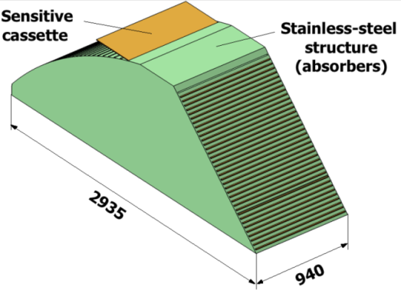
Large SDHCAL module
Detectors as large as 3m X 1m need to be built
Electronic readout should be the most robust with
minimal intervention during operation.
DAQ system needs to be upgraded to deal with many chips
Mechanical structure to be similar to the final one
A full description of the SDHCAL with DD4HEP framework
GRPC
Glass Resistive Plate Chambers
SDHCAL
ILD Module
Goal: to build new prototype with a few but large GRPC with the new components
This goal was defended within the CALICE collaboration and the European project AIDA which provides the essential part of the funding to achieve this project.

Slide 20
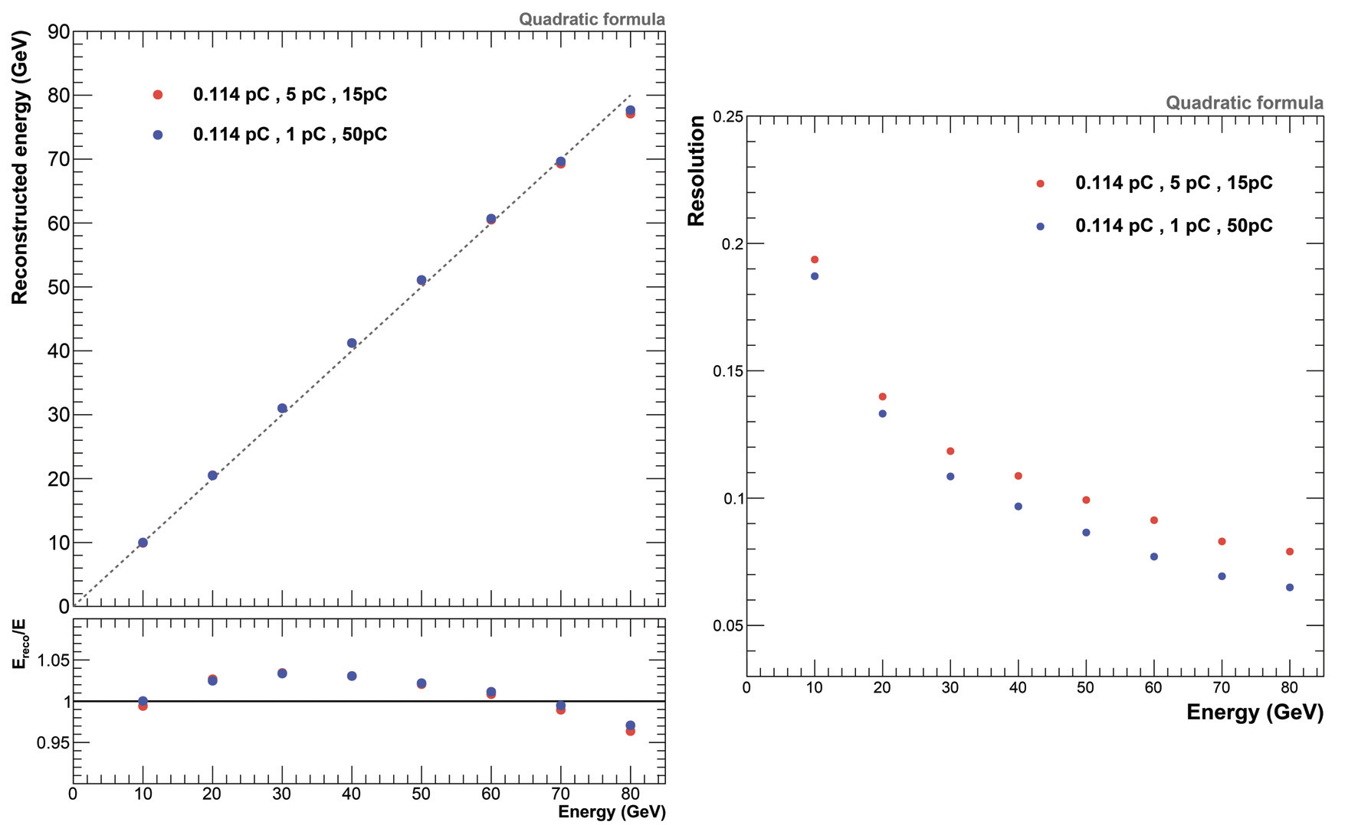
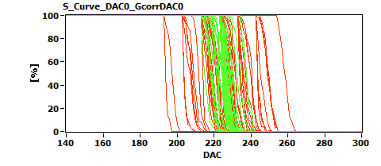
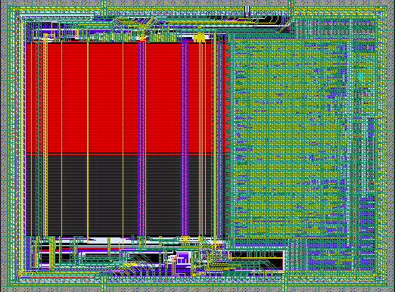
Large SDHCAL module
HARDROCR3 main features:
  Independent channels
  Zero suppress
  Extended dynamic range (up to 50 pC)
  I2C link with triple voting for slow control parameters
  packaging in QFP208, die size ~30 mm²
  Consumption increase (internal PLL, I2C)
  800 ASICs were produced
H3B TESTED : 786, Yield : 83.3 %
6,3 mm
4,7 mm

Slide 21
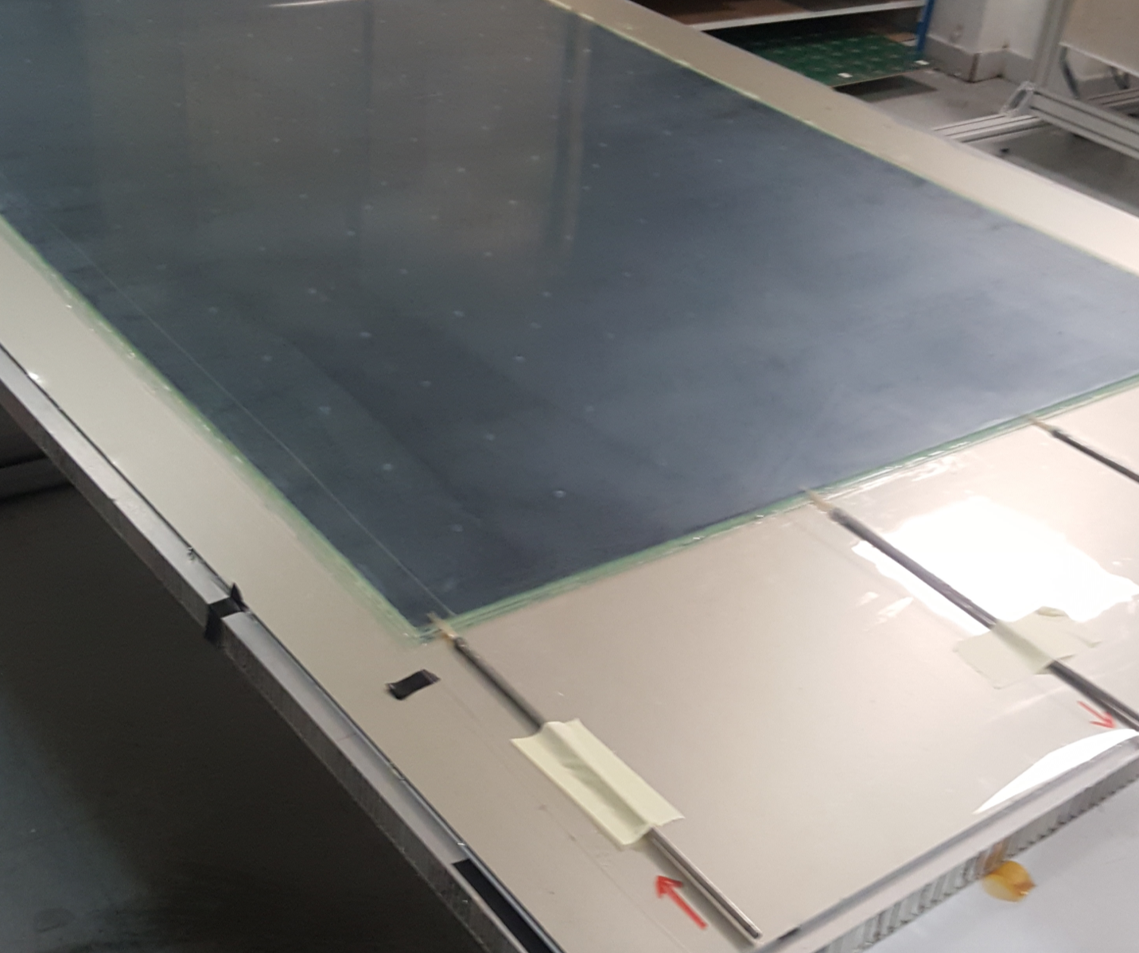
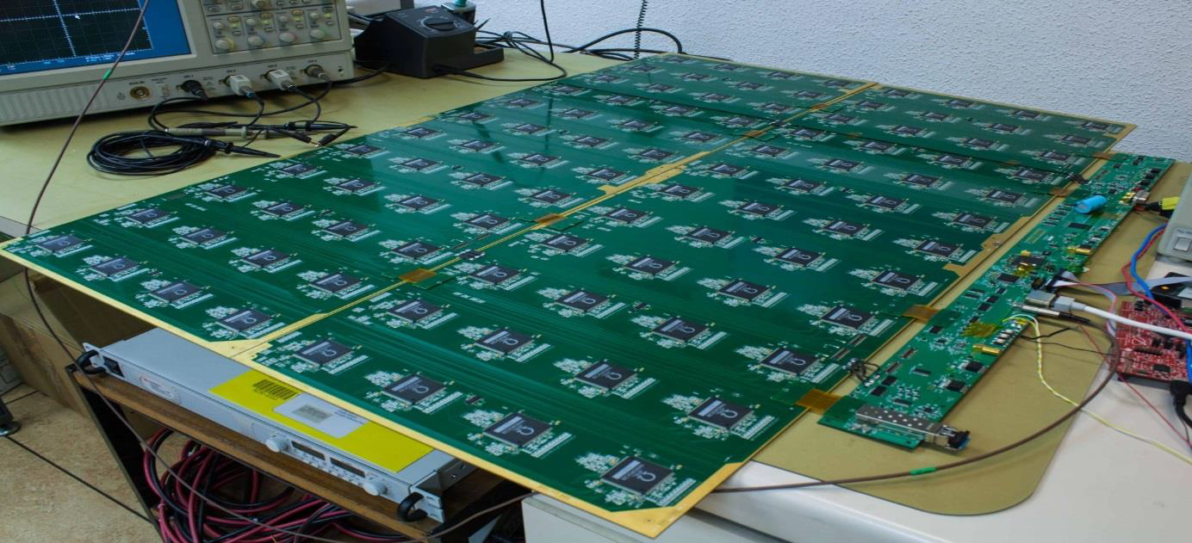
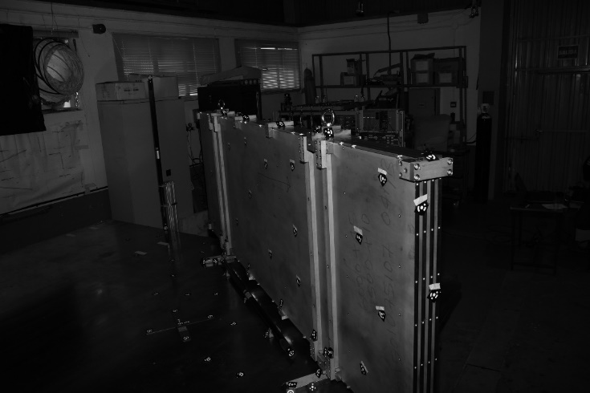
Large SDHCAL module
12 long PCB hosting each 48 ASICs were produced as well as the inter-connecters ( to cover up to 4 M²)
by IP2I
5 DAQ boards (DIF) conceived and built by CIEMAT
A mechanical structure to host 4 detectors ( as large as 3 m) with a self-supporting structure (Electron Beam welding was used to minimize the dead zones) produced by CIEMAT
A few large GRPC (2 m x 1 m) detectors were produced with a new gas distribution system at IP2I and
Improved Master card to communicate with DIFs was conceived and produced by IP2I.
100 cm
33 cm
To finish this work , an electronics engineer is needed to take over the work of CIEMAT engineers.
This will allow us to validate the concept and test it (few papers are expected)

Slide 22
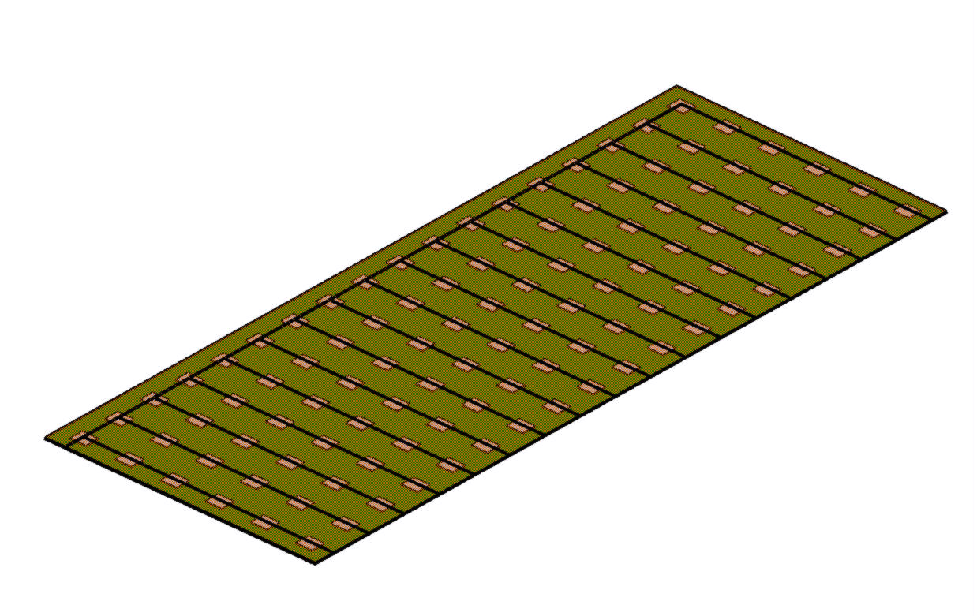
Large SDHCAL module
SDHCAL power consumption and cooling
The duty cycles of CEPC/FCCee are different from that of ILC and no power pulsing is possible.
The power consumption is therefore increased by a factor of 100-200 with respect to ILC and active cooling is needed.
Lyon and Shanghai groups worked on a simple cooling system for SDHCAL based on using water circulating into copper pipes
0.8 mW/chips with power pulsing → 80 mW/chips without power pulsing
0.5 m
108 chips
Rectangular section tubes : 2x1 mm
1.5 m
Copper plate over: 1.5 mm
Flow out
symmetry
PCB plate under: 1.4 mm
Flow in

Slide 23
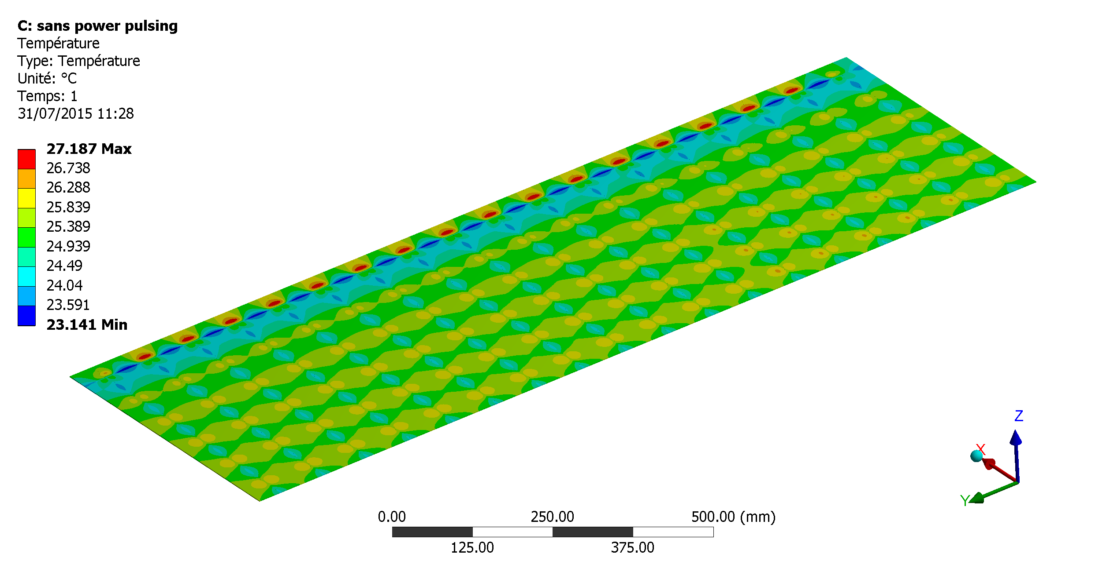
Large SDHCAL module
SDHCAL power consumption and cooling
The duty cycles of CEPC/FCCee are different from that of ILC and no power pulsing is possible.
The power consumption is therefore increased by a factor of 100-200 with respect to ILC and active cooling is needed.
Lyon and Shanghai groups worked on a simple cooling system for SDHCAL based on using water circulating into copper pipes
0.8 mW/chips with power pulsing → 80 mW/chips without power pulsing

Slide 24
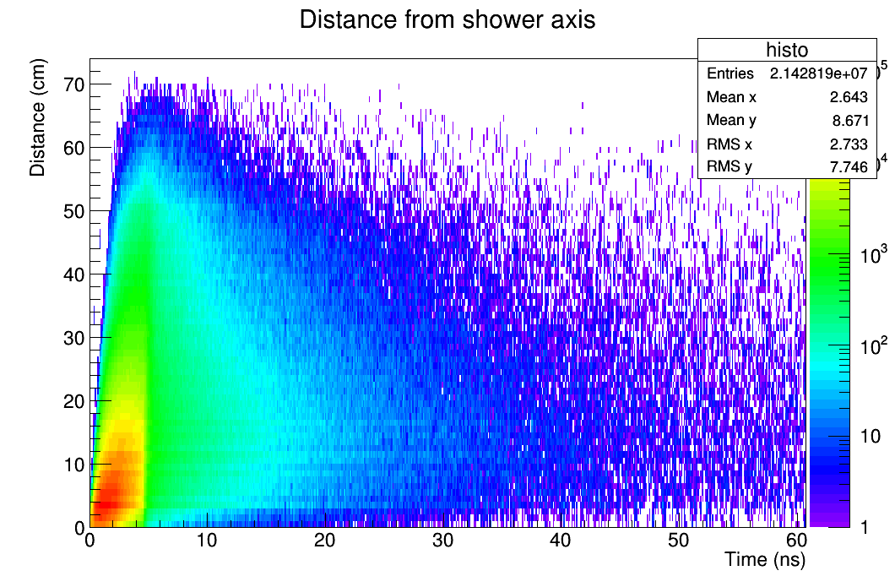
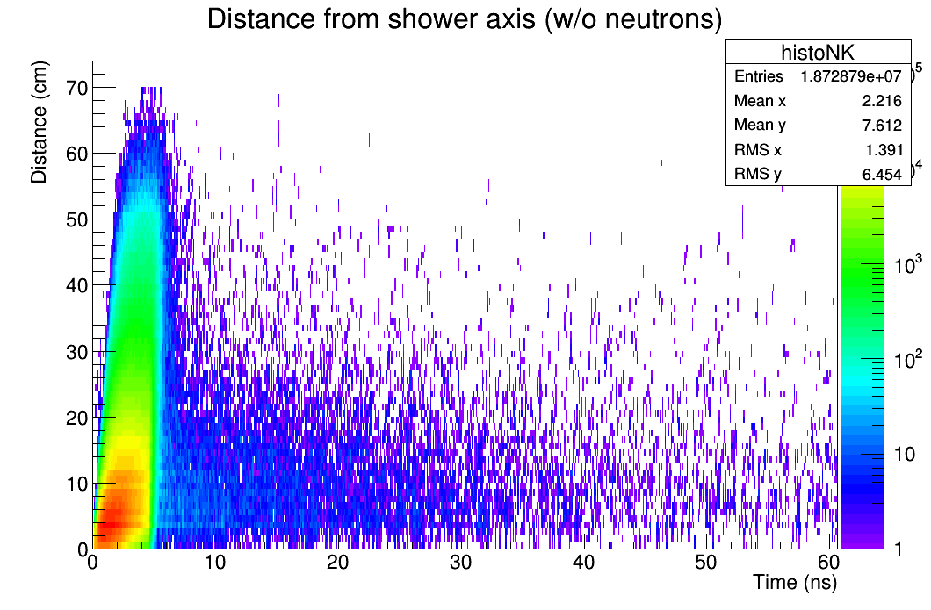
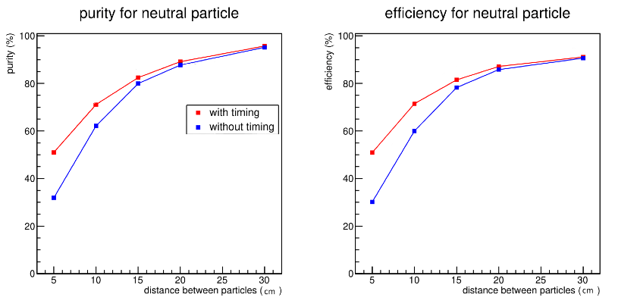
T-SDHCAL
In addition to PileUp issues, time information is useful for
1) Identifying delayed neutron → better hadronic energy reconstruction
Without neutrons
2) Powerful tool for PFA
Separating 2 particles : a charged (30 GeV) and a neutral (10 GeV) PFA algorithm developed by IP2I (C. Devanne, M2)

Slide 25
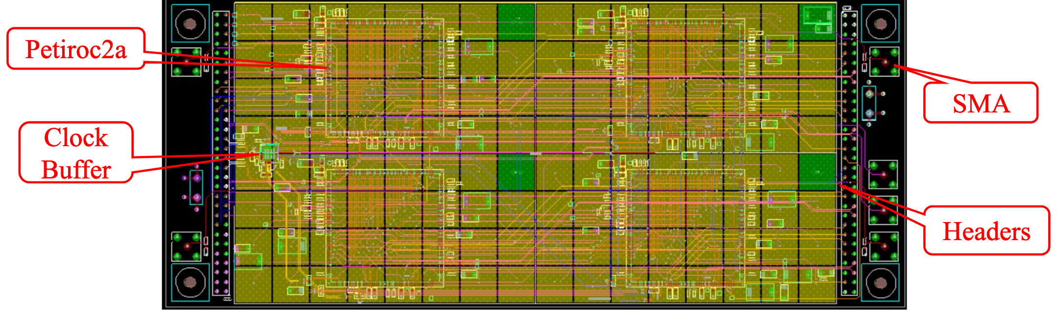
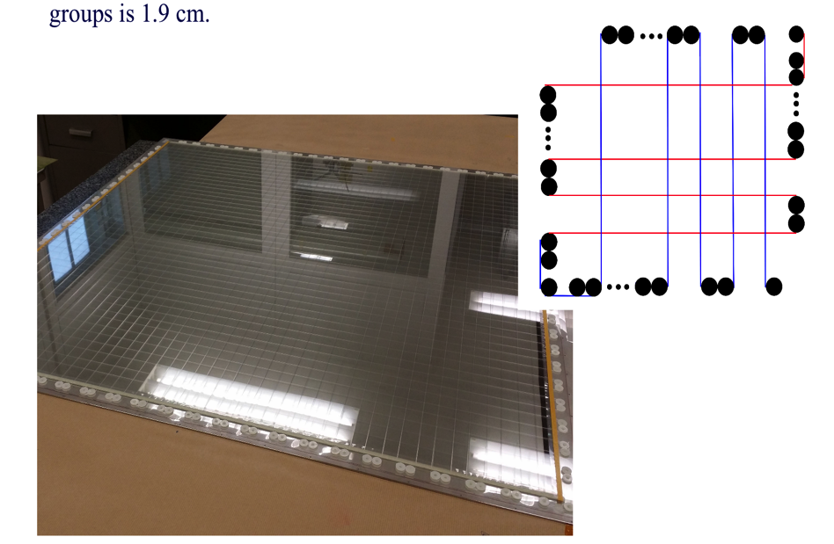
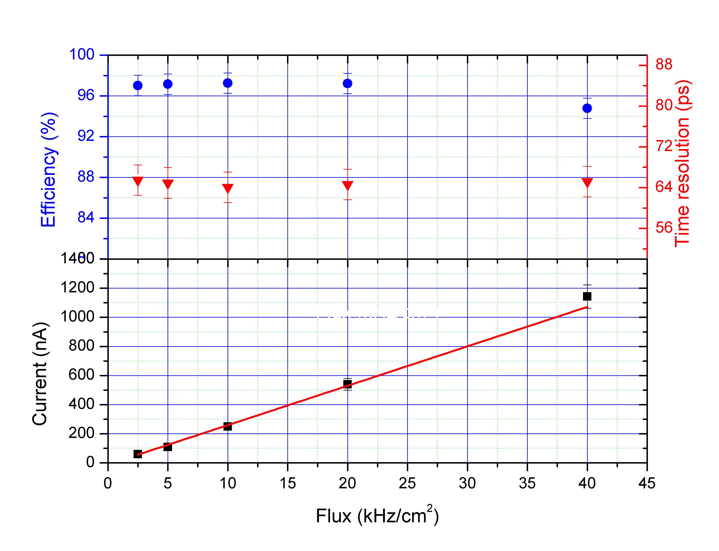
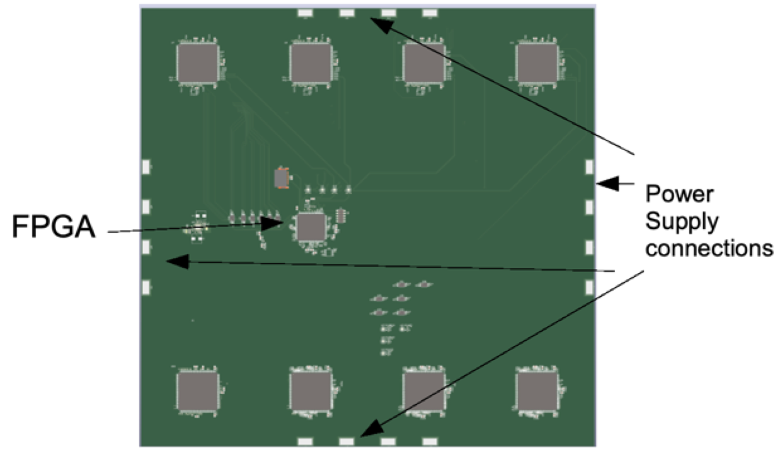
T-SDHCAL
Goal: replace a few layers of SDHCAL by MRPC equipped with time measurement (PETIROC)
Collaboration with GWNU (S. Korea) and Shanghai (China), Ghent (Belgium) and CIEMAT (Spain) within CALICE and AIDAInnova
MRPC have been produced (IP2I & GWNU). A new method developed by IP2I allows the production of such detectors to be
greatly simplified
A small board hosting 4 PETIROCs conceived and produced (SJTU with the help of IP2I and OMEGA).
A middle board hosting up to 12 PETIROC has been conceived (IP2I).
In the two cases the internal TDC of PETIROC will be used to validate the concept but an external TDC will be probably needed
to cope with the high rate sin future Higgs factory.

Slide 26
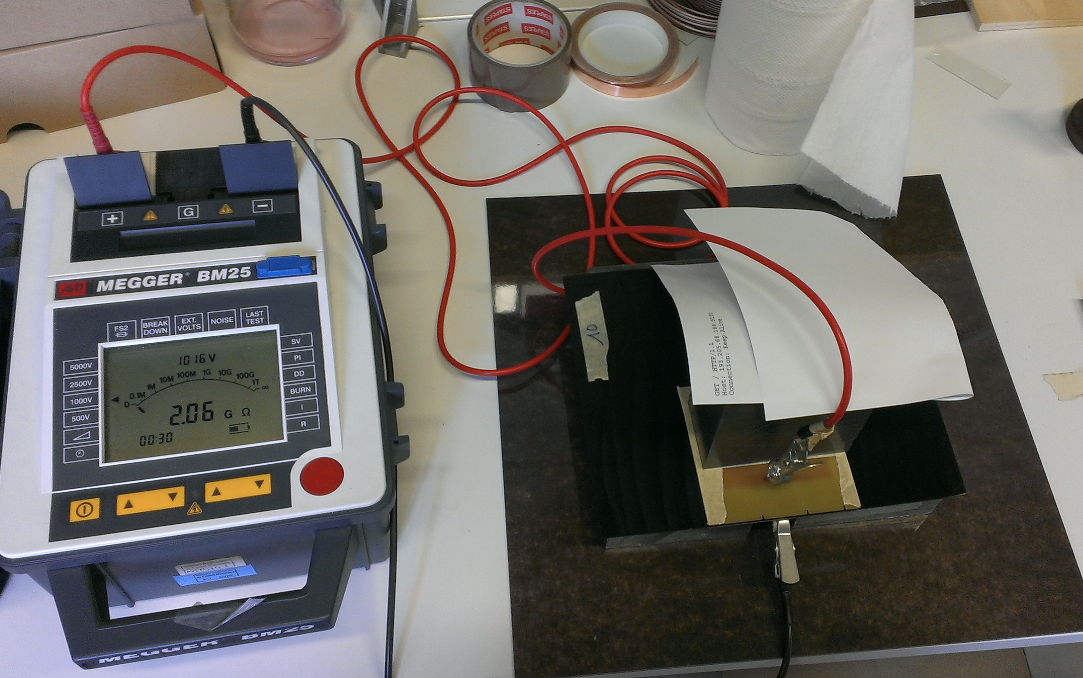
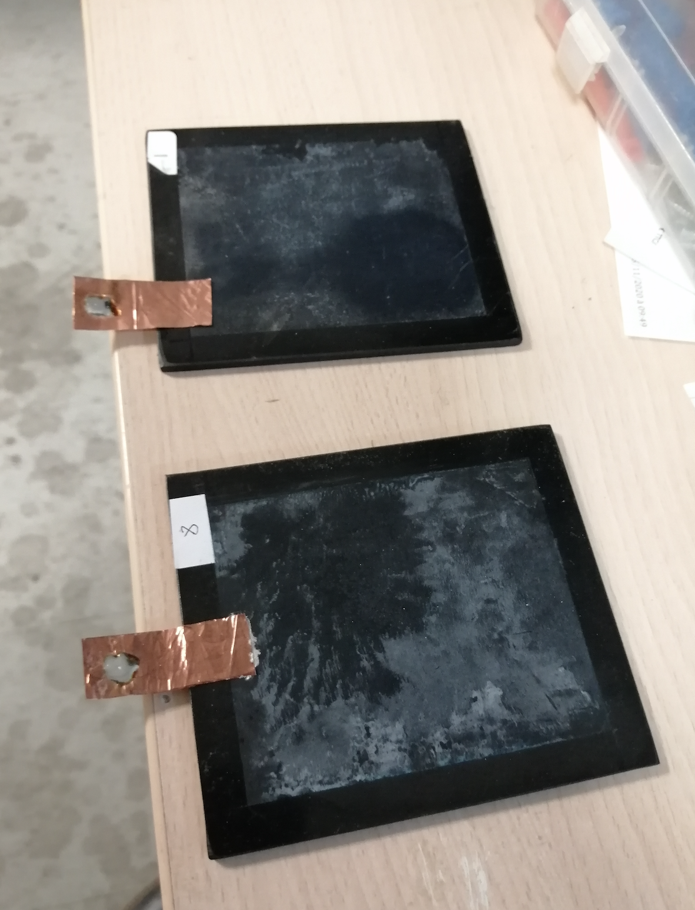
High-Rate capability
RPC is low-rate capability detector due to the resistive nature of the electrodes. The capability could be increased by developing low resistivity materials. Our R&D started within the CMS-mu upgrade project
Resistive material development benefited from AIDA2020 and LABEX LIO
PVdF and PEEK are very stable and chemically inert thermoplastic
-New kind of PVdF developed by IP2I with the help of PolyOne (Germany). Doped with CNT we achieved a bulk resistivity of 10¹¹⁻¹² Ω.cm
-New charged PEEK developed with the help of Krefine (Japan).
Doped with BC a bulk resistivity of 10⁸⁻⁹ Ω.cm was achieved.
A few small detectors were made using doped PVdF plates of 2-3 mm thickness.
An excellent efficiency is obtained with cosmic but resisitivity is not low enough for high rate.
Plates made with charged PEEK were produced
but homogeneity issues are still there.
More efforts need to be made to finalize this material.
MRPC has the advantage of timing with respect to MPWD

Slide 27
SDHCAL TRL
SDHCAL for ILC
We have shown that we master the process of fabrication of the different components of the SDHCAL and to operate them efficiently
Still we need to demonstrate that
SDHCAL concept is efficient when going to larger module estimated TRL: 6
SDHCAL for FCCee/CEPC
SDHCAL without timing: Active cooling study should be finalized and a simple prototype built to validate it.
High-Rate RPC for the Endcap region are needed. Resistive materials to be finalized
estimated TRL: 4
SDHCAL with timing:
The concept of using timing in SDHCAL is attractive and several elements but many efforts on the readout electronics level are still missing
SDHCAL concept is efficient when going to larger module estimated TRL: 3

Slide 28
SPIN-OFF

Slide 29
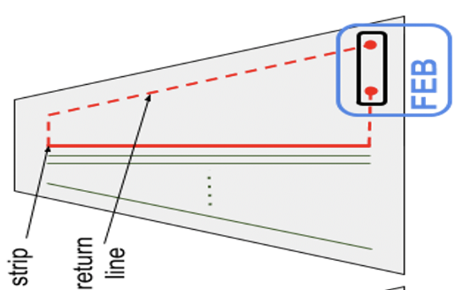
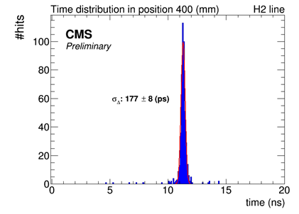
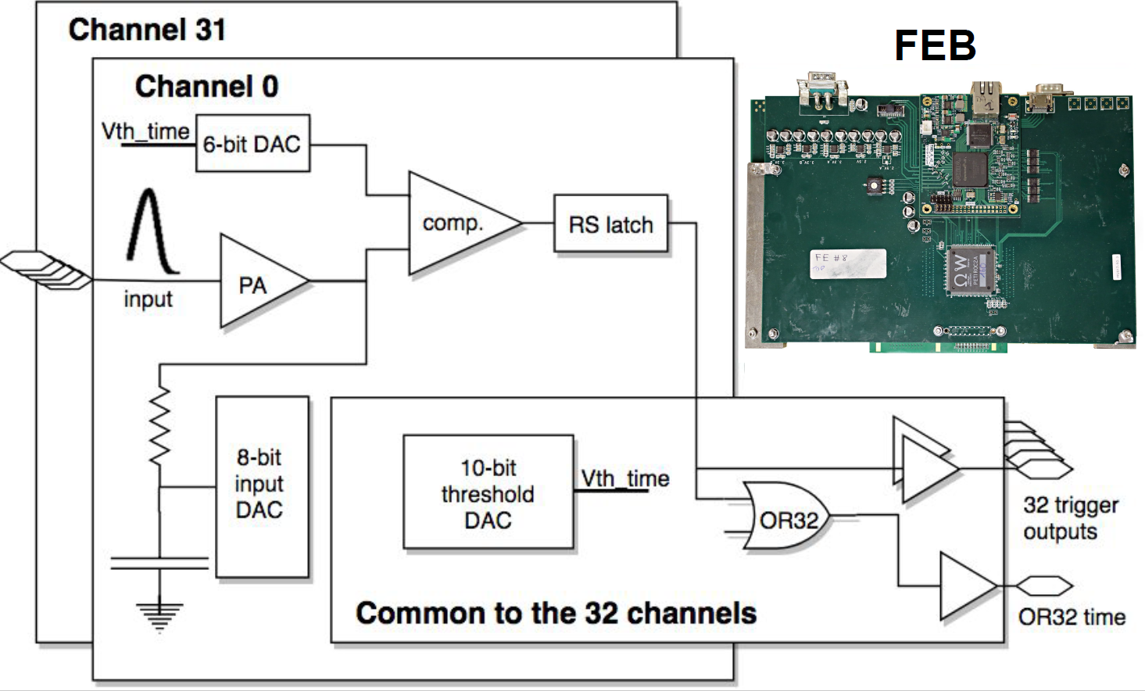
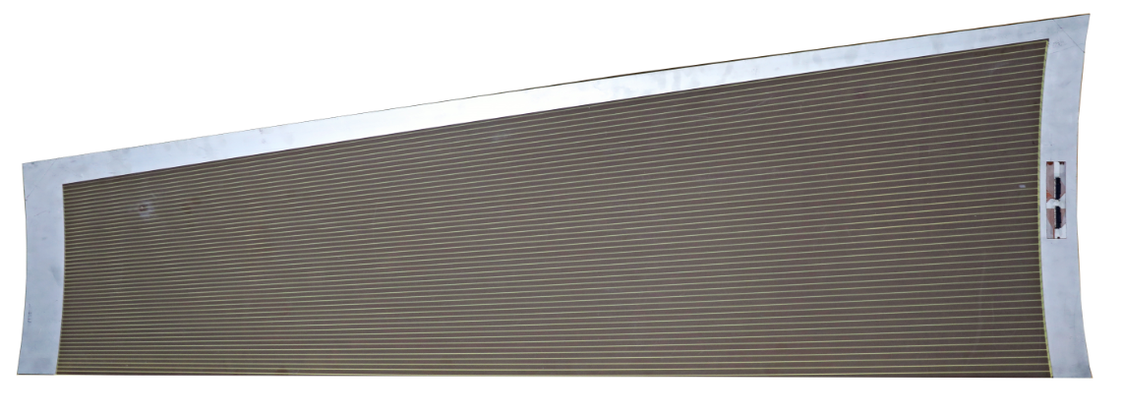
CMS-mu upgrade project:
We proposed the iRPC upgrade project after havig accumulated a huge amount of expertise on the RPC detectors but also on the readout electronics and the DAQ.
The concept of 2D-based readout proposed by IP2I is the corner stone of the iRPC project.
The R&D activities initiated by the IP2I used the SDHCAL readout systems to demonstrate the concept Work Collaboration on timing between IP2I an d OMEGA allowed to validate completely the 2D time-based concept
The project was approved by CMS and is now in an advanced construction stage

Slide 30
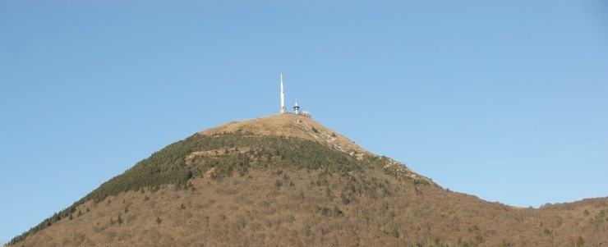
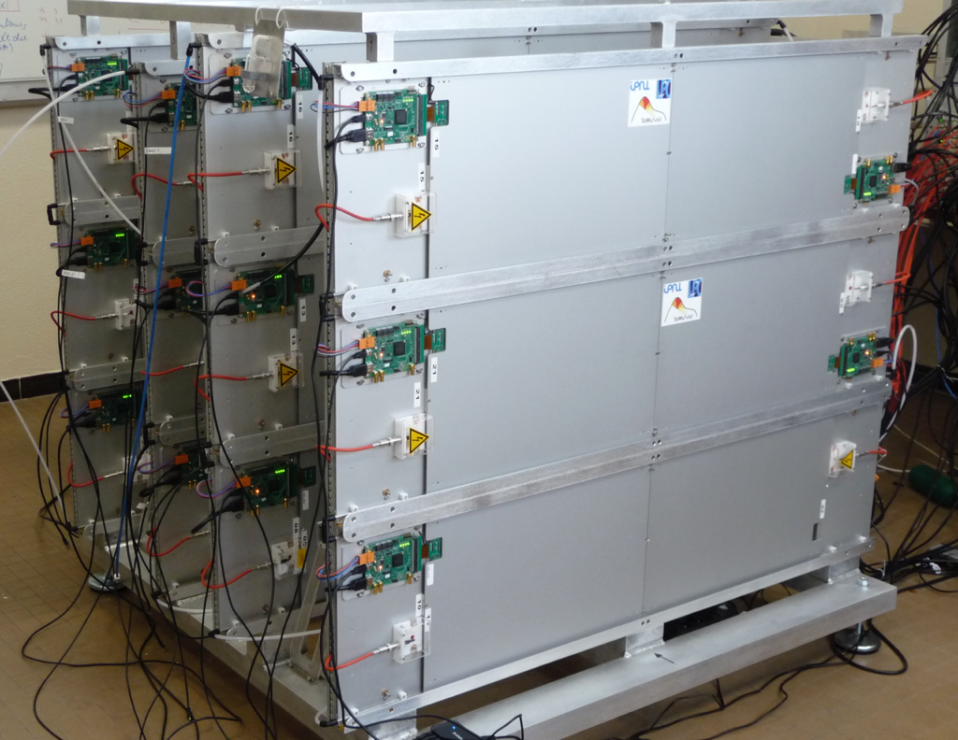

TOMUVOL:
Precise muon tomography needs precise detectors. The SDHCAL technology with its excellent granularity was used to study Puy-de-Dome structure within the TOMUVOL project (funded by the Auvergne region) was built and operated by the CALICE groups of IP2I and LPC
TOMUVOL

Slide 31







Large muon detectors & tail catchers:
R&D funded by PULSALYS (SATT) in view of home security application.
PCT/EP2018/053561
Woven strips: interconnected pads using strips along three directions. Electronic channels number : NXN → 3 N

Slide 32
Funding from IN2P3:
Average of 30 k €/year since 2012 and one postdoc (3 years)
300+150= 450 k€
Funding other than IN2P3:
Source | amount (k€)
ANR | 420
LABEX LIO | 150 (postdoc)+10 =160
AIDA | 50+30
AIDA2020 | 40+ 30 (overhead)
Auvergne | 100 (postdoc) +50 = 150
SATT | 50 (CDD)+30 = 80
Total | 960 k €

Slide 33
Conclusion
-SDHCAL prototype has proved the validity of the technology
-SDHCAL is one of the two baselines of the ILD-ILC
-SDHCAL is the baseline for CEPC
-SDHCAL could be proposed for FCCee but this requires to complete R&D on
-large area detector instrumentation
-timing
- high rate capabilities
SDHCAL technology benefited several other projects:
-iRPC
-Tomuvol
-home security application
During 12 years of R&D
-7 PhD
-7 papers on SDHCAL and many other conference papers
-40 talks in international conferences and workshops

Slide 34

To synchronize several DIFs, a new DAQ board is being developed. It contains:
-1 FPGA (cyclone10LP) with 12x5 LVDS links
-Microprocessor (PIC32MZ) interfaced with TCP/IP and with the FPGA for
high level operations ( calibrations..etc)
Our goal is to have all the readout chain functional by the end of 2021.

