Slide 1
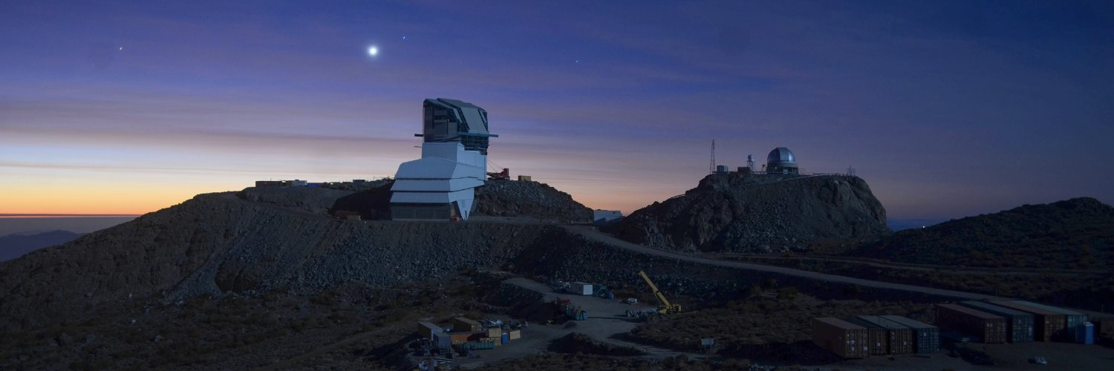
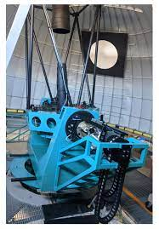
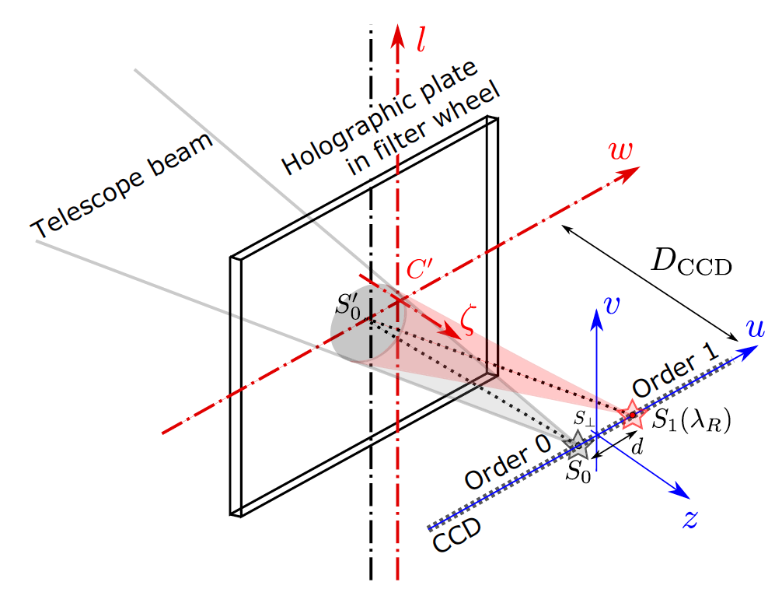
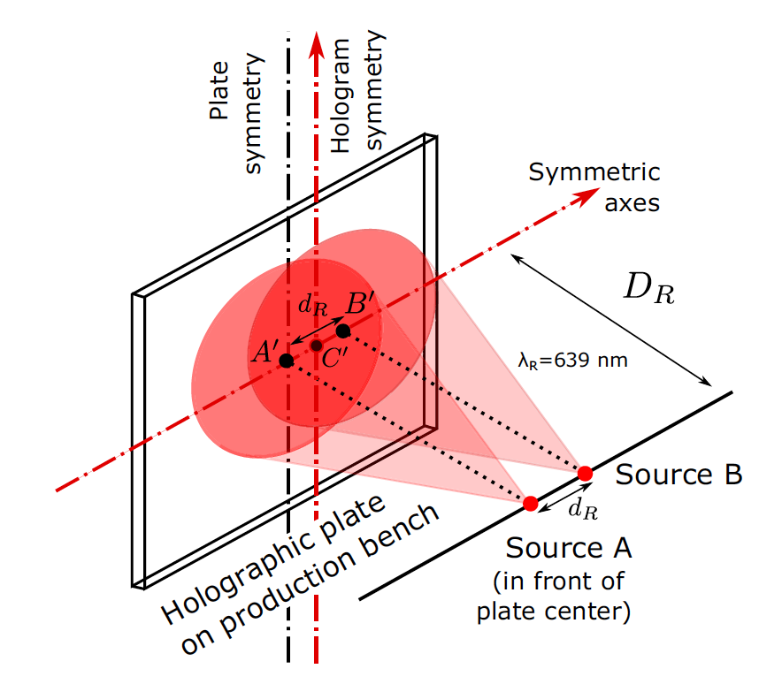
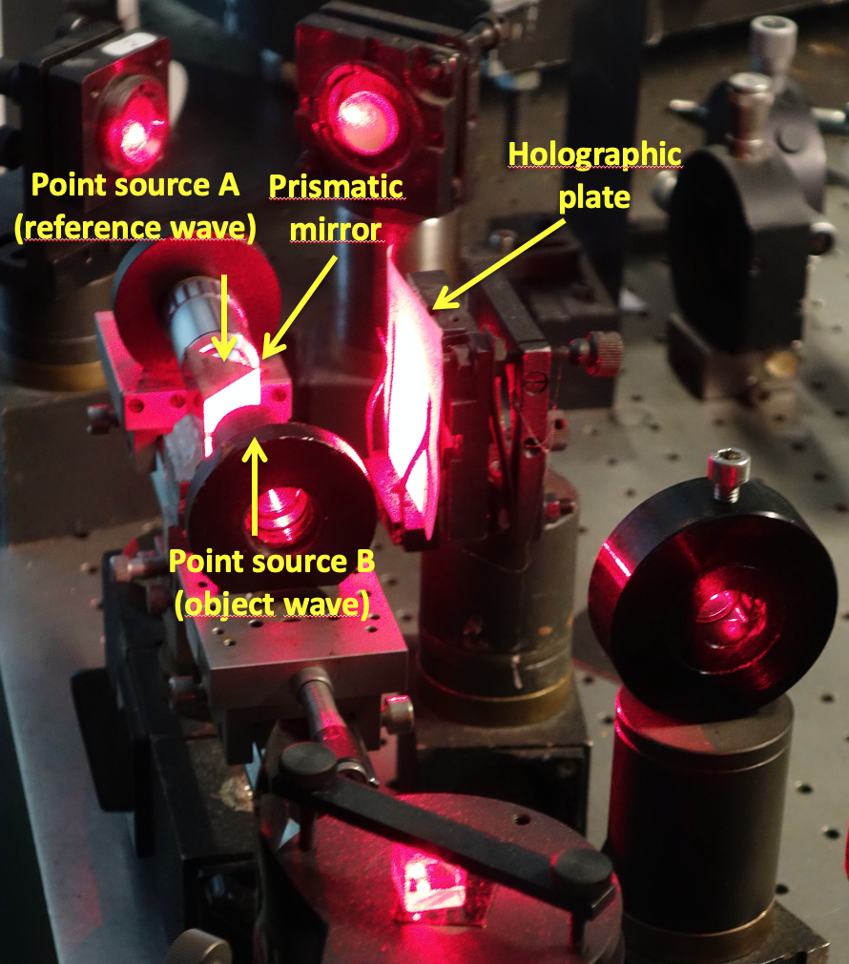
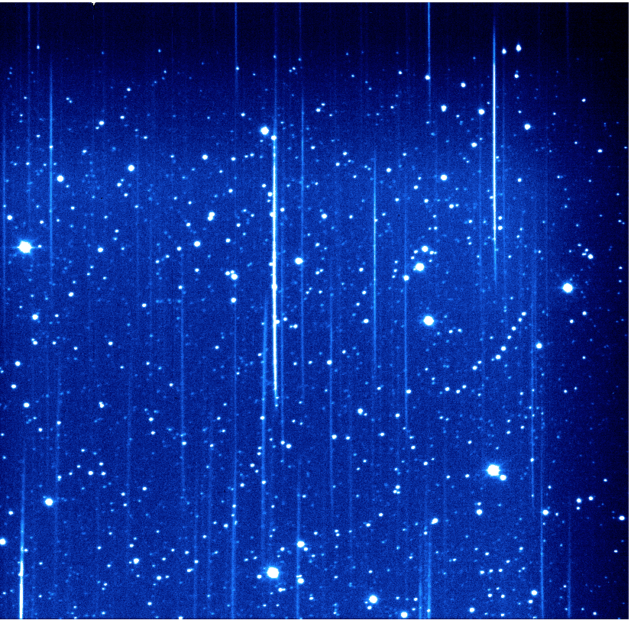
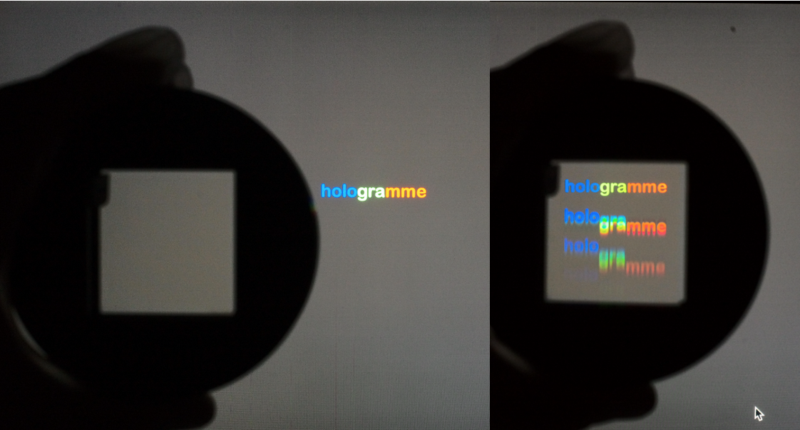
Main Telescope
Auxiliary Telescope
Le telescope auxiliaire (AuxTel)
D. Boutigny, S. Dagoret-Campagne, J. Chevalier, L. Le Guillou, M. Moniez, J. Neveu, M. Rodriguez-Monroy
+ Observing team (Patrick, Merlin, Tiago, Craig, Erik, Ioana, Alysha & others)
Rubin-LSST France, LPNHE, 30 nov. 2022
Use as disperser
Hologram recording
AuxTel
Notes:
Ne pas rentrer dans les détails

Slide 2
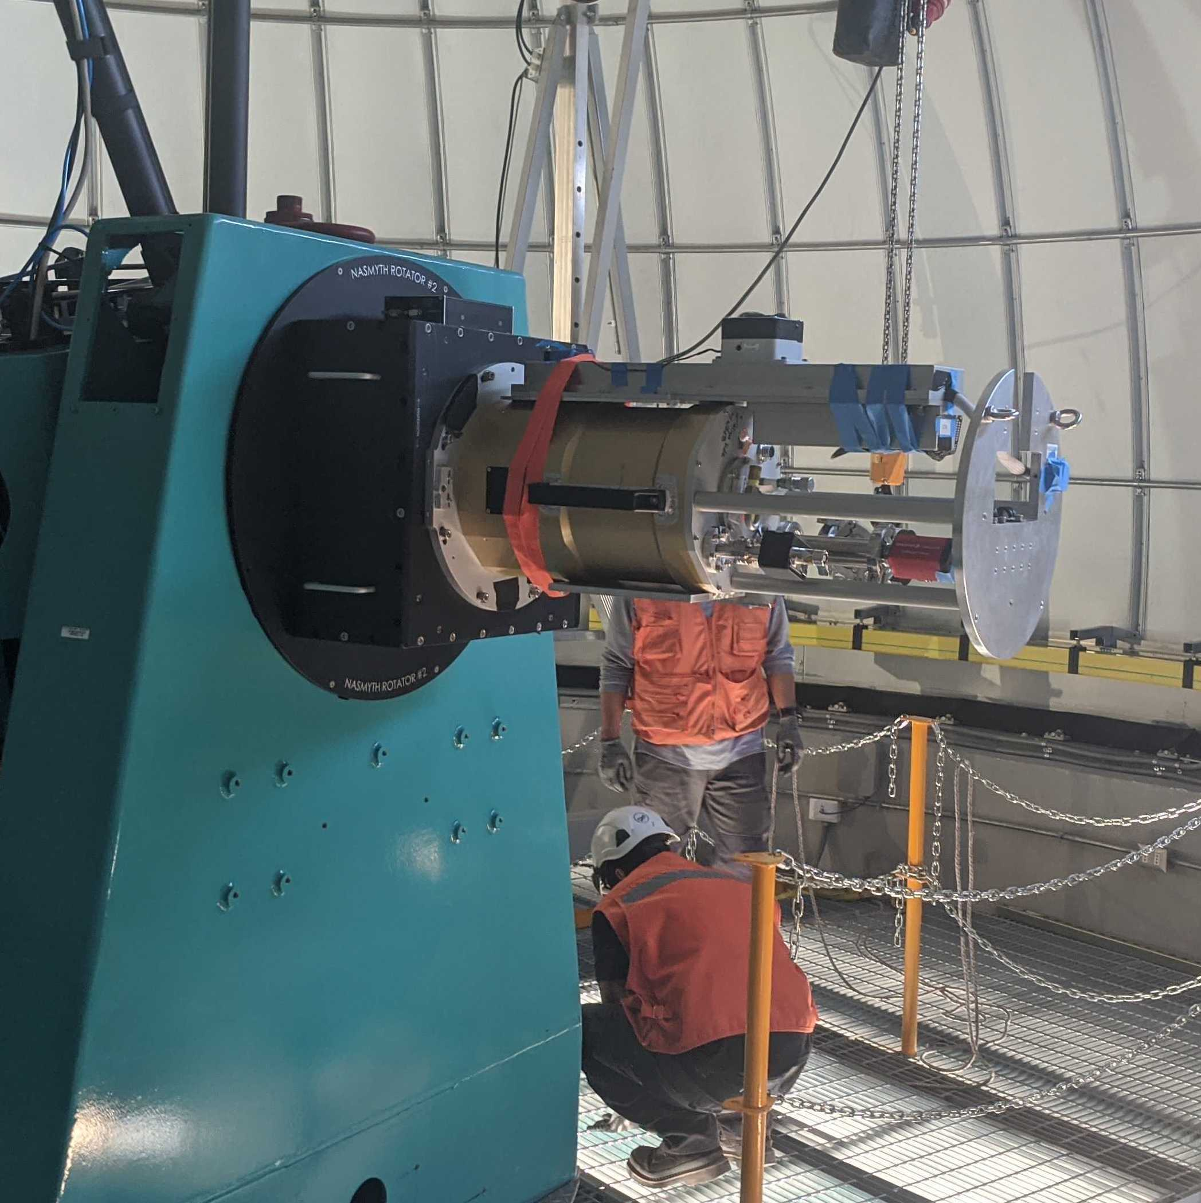
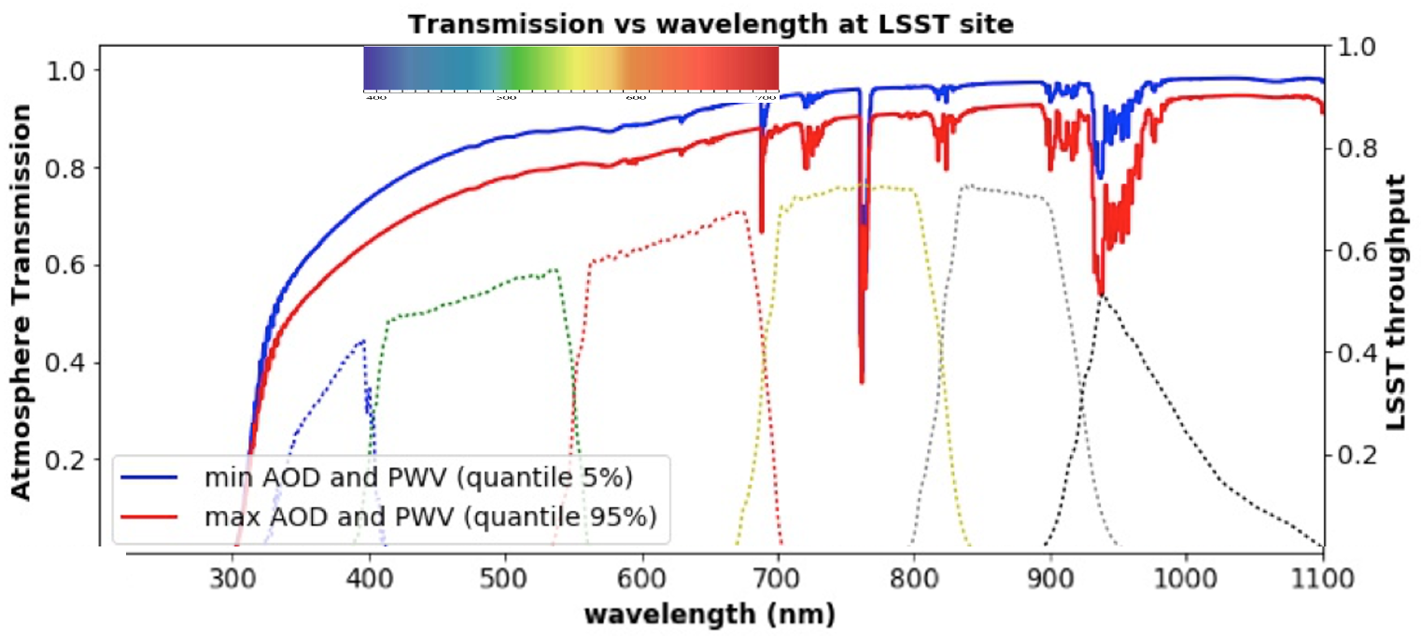
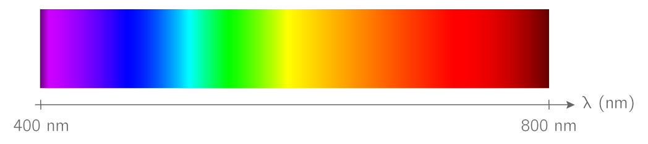
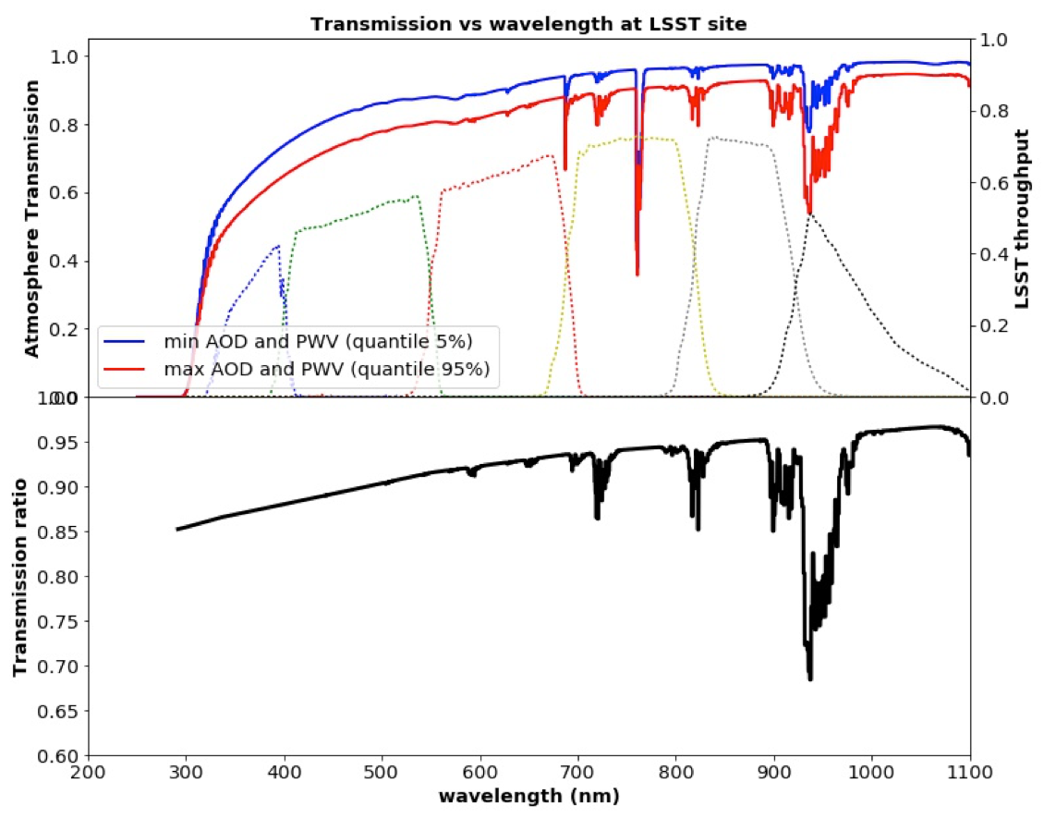
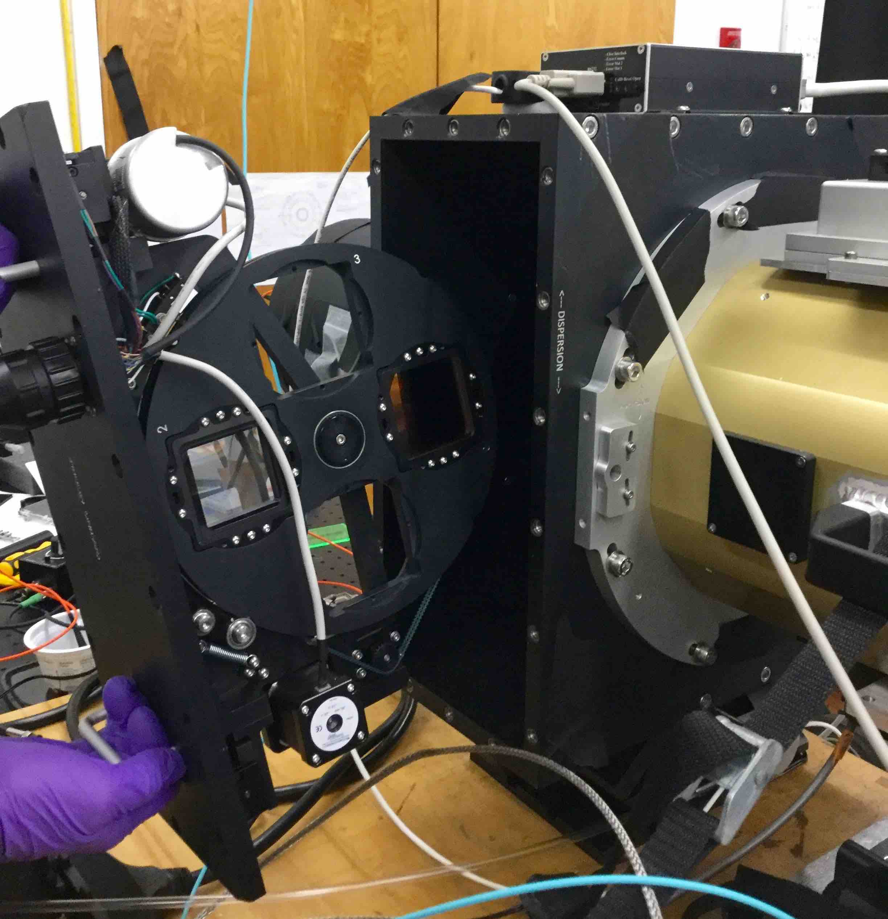
AuxTel spectrograph mission: measure the atmospheric transmission to derive the expected fluxes for each object under standard atmospheric conditions
Estimate colour corrections, as functions of the atmospheric conditions and of the object UGRIZY in every LSST field
Example below
- Constant airmass, constant O₂ and O₃. No cloud
- Change only : H₂O (PWV), Aerosols
AuxTel spectrometer
Aerosol/no aerosol
Wet/dry

Slide 3
Some facts about AuxTel
- D = 1.20m, f/D = 18, f = 21.6m
- Depth of focus 1 arcsec (10 pixels) for 1.8mm change in distance (small aperture).
- Secondary mirror (M2) Obturation: 0.3m
- Total collection area : S= 1.06 m² (taking into account M2 obturation)
- Plate scale: 105µm/arcsec -> about 10 pixels/arcsec.
- Field of view : 6.3 Arcmin.
- Distance entrance window-CCD : 63.85mm. Light beam diameter at this distance : 3.55mm
- Distance disperser-CCD: about 191.4mm (tilted). beam diameter at this distance : 10.6mm
- Distance filter-CCD : 229mm (tilted).
- Saturation (no filter, no disperser, assuming seeing of 1’’): M_{sat}=13.35+2.5Log₁₀(Texp/30s)

Slide 4
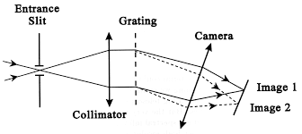
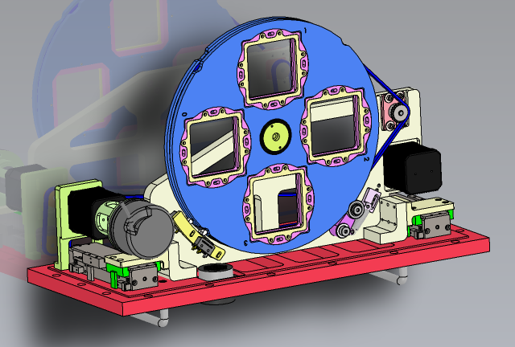
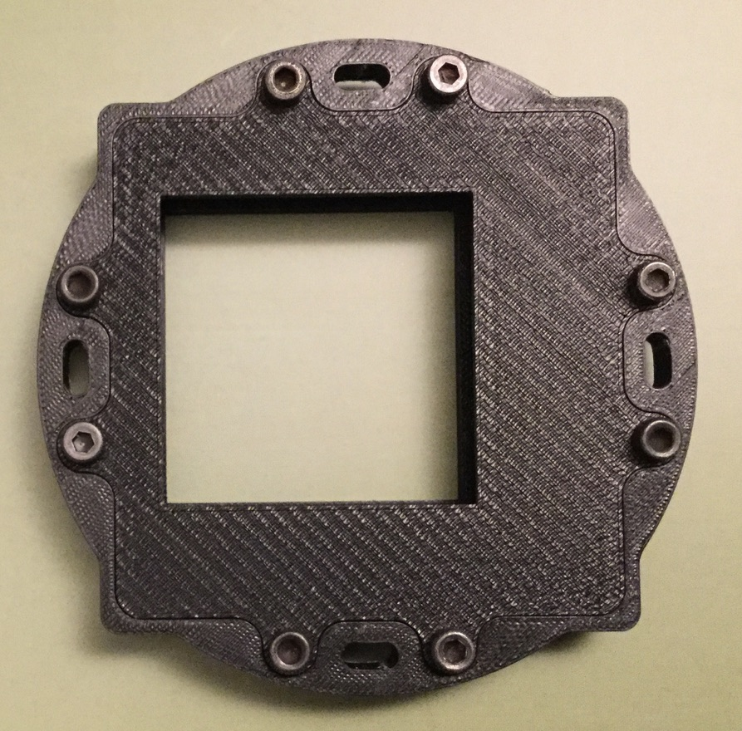
Our spectrograph is slitless equiped with an Holographic Optical Element
Incident beam here
Spectrum
+
Dispersion
Slitless allows
- fast positioning
- spectrophotometry
Limits: sky+stellar background
low resolution (seeing limited)
Phase hologram (dispersion+focus functionalities)
- Excellent focus for all λ with convergent beam -> nominal resolution
- More light -> better s/n
CCD

Slide 5
Our spectrograph is slitless equiped with an Holographic Optical Element
Incident beam here
Spectrum
+
Dispersion
Slitless allows
- fast positioning
- spectrophotometry
Limits: sky+stellar background
low resolution (seeing limited)
Phase hologram (dispersion+focus functionalities)
- Excellent focus for all λ with convergent beam -> nominal resolution
- More light -> better s/n
CCD

Slide 6
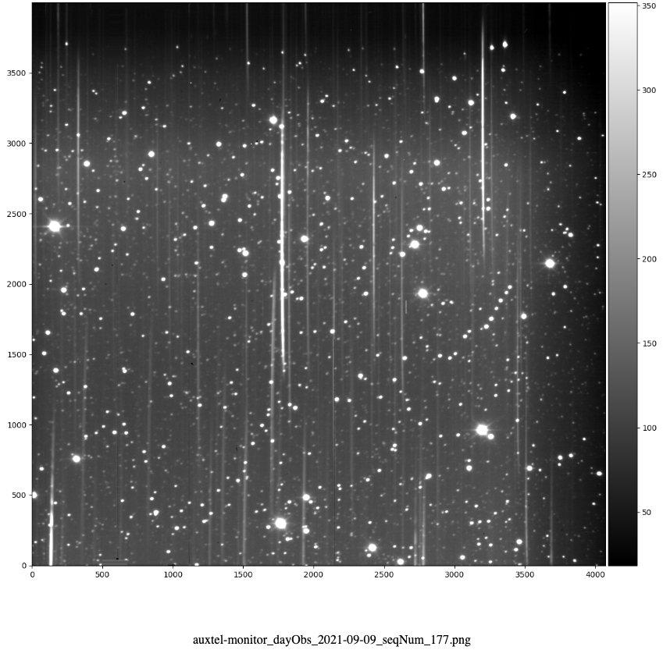
How does it look like?
hologram dispersion
Atmospheric dispersion (x20)

Slide 7
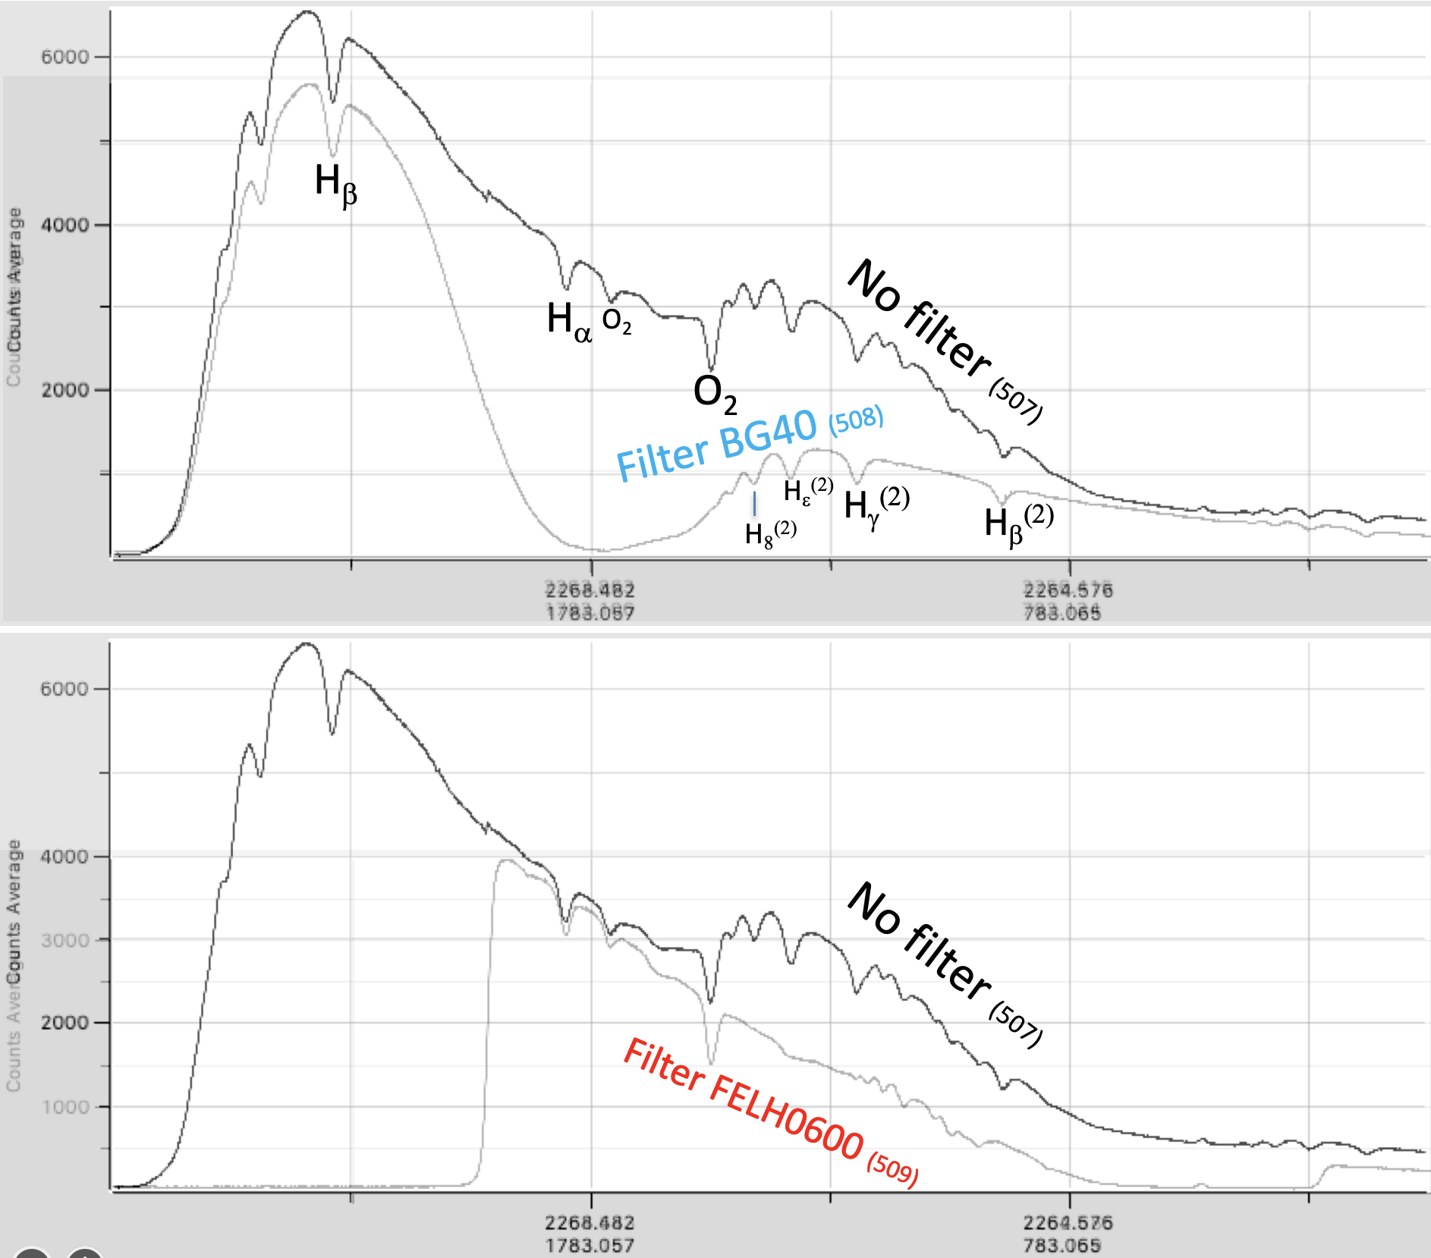
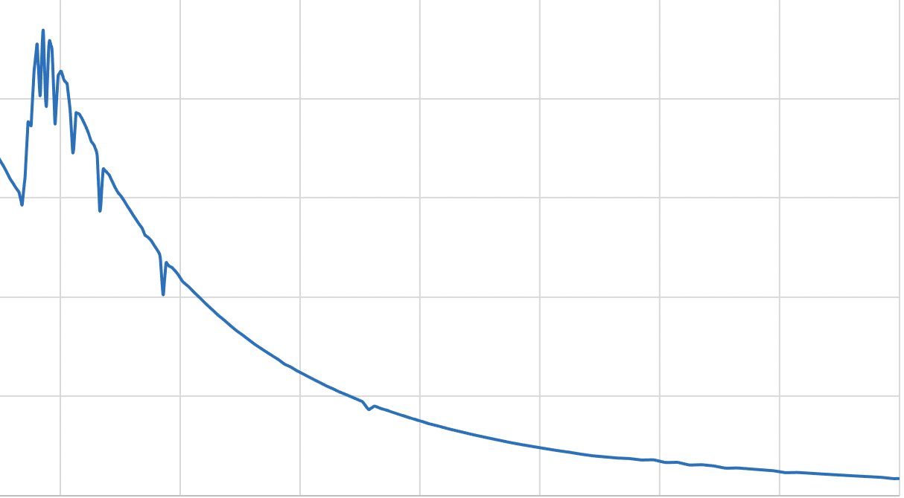
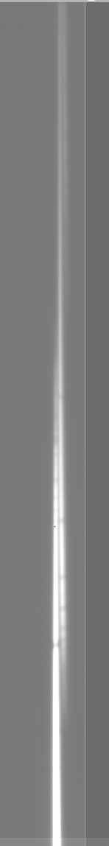
Data available (since 16 feb. 21)
Spectrum extends from ~ 342nm to 1100nm
Dispersion: 2.73 pixels/nm
Resolution: R = λ/Δλ > 200 (seeing limited)
O(1000) spectra for
- Commissioning
Geometry
Resolution study
Transmission
2nd/1rst order : finalization
Bouguer lines: finalization for global telescope throughput
- With various
  CALSPEC standards
  atmospheric conditions
- with/without blocking filters
- but not that many with good quality
->The best nights up to now seem to be 30th june and end sept. 2022.
We need to acquire data in the largest domain of atmospheric Conditions.
Raw extraction (1^{rst}+2nd orders superimposed)
Out of atm. SED
Order 1
Order 2
Order 3
O₂
Out of atm. SED

Slide 8
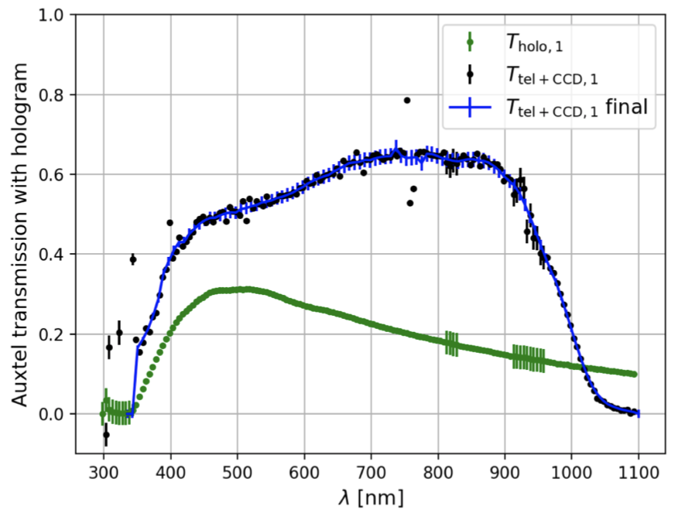
Operations for measuring atmosphere transmission
Use a spectrophotometric standard measured out of atmosphere (CALSPEC)
τ_{atm}(λ,z) = φ (λ,z)_{instrumental} /φ(λ)_{SED-HST}
-> in magnitude (for diffraction order p):
m_{p}(λ,z)_{instrumental} = m(λ)_{SED-HST} - 2.5logT_{p}(λ) + A_{atm}(λ).z
T_{p}(λ) = τ(λ)_{telescope} . τ_{p}(λ)_{disperser} . ε_{CCD}(λ)
τ_{Telescope} x ε_{CCD}
τ_{Hologram}
(1rst order)

Slide 9
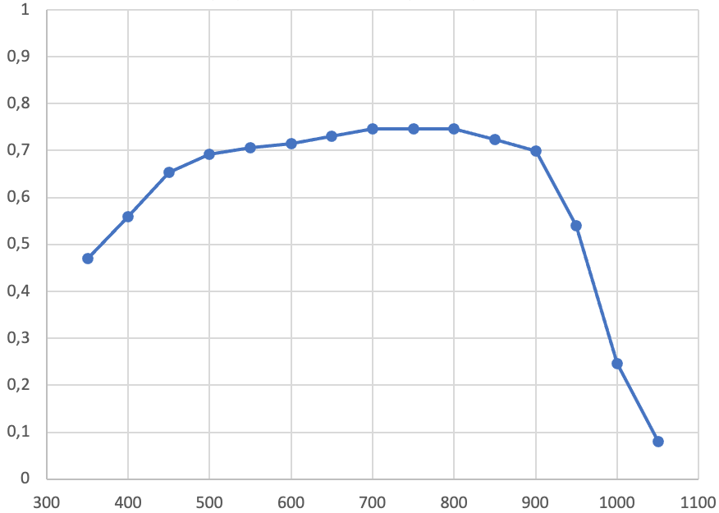
Operations for measuring atmosphere transmission
Use a spectrophotometric standard measured out of atmosphere (CALSPEC)
τ_{atm}(λ,z) = φ (λ,z)_{instrumental} /φ(λ)_{SED-HST}
-> in magnitude (for diffraction order p):
m_{p}(λ,z)_{instrumental} = m(λ)_{SED-HST} - 2.5logT_{p}(λ) + A_{atm}(λ).z
T_{p}(λ) = τ(λ)_{telescope} . τ_{p}(λ)_{disperser} . ε_{CCD}(λ)
Computed from lab. measurements
τ_{Telescope} x ε_{CCD}
τ_{Hologram}
(1rst order)

Slide 10
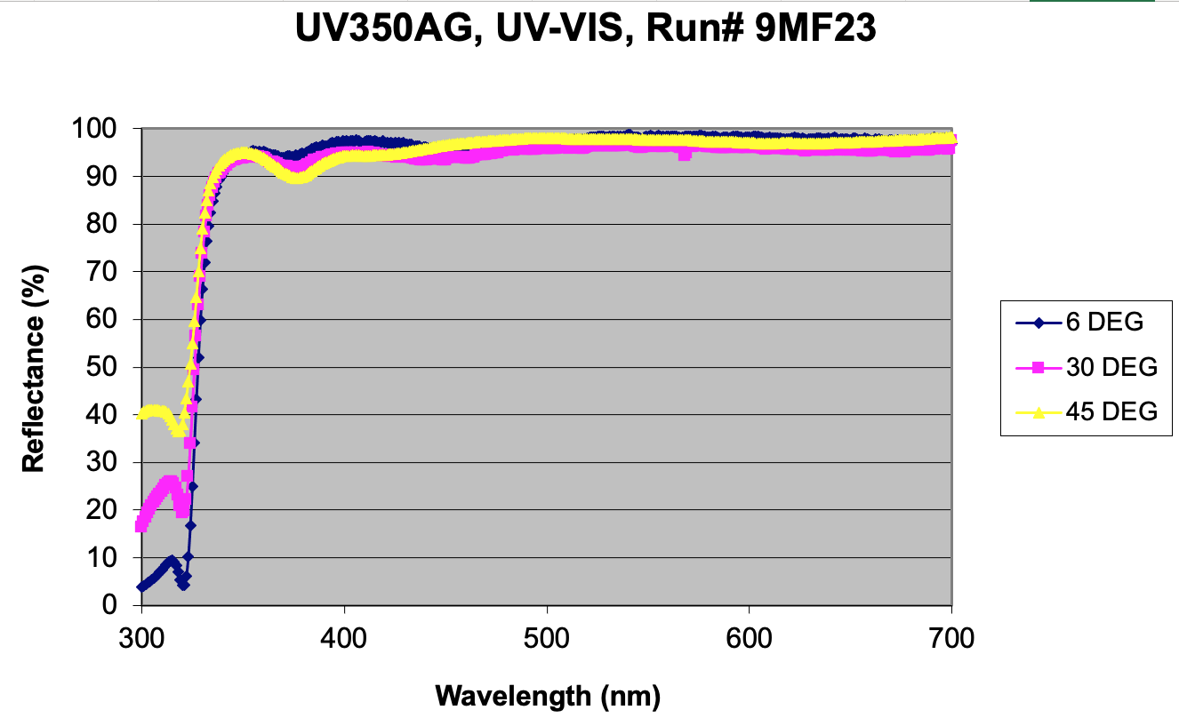
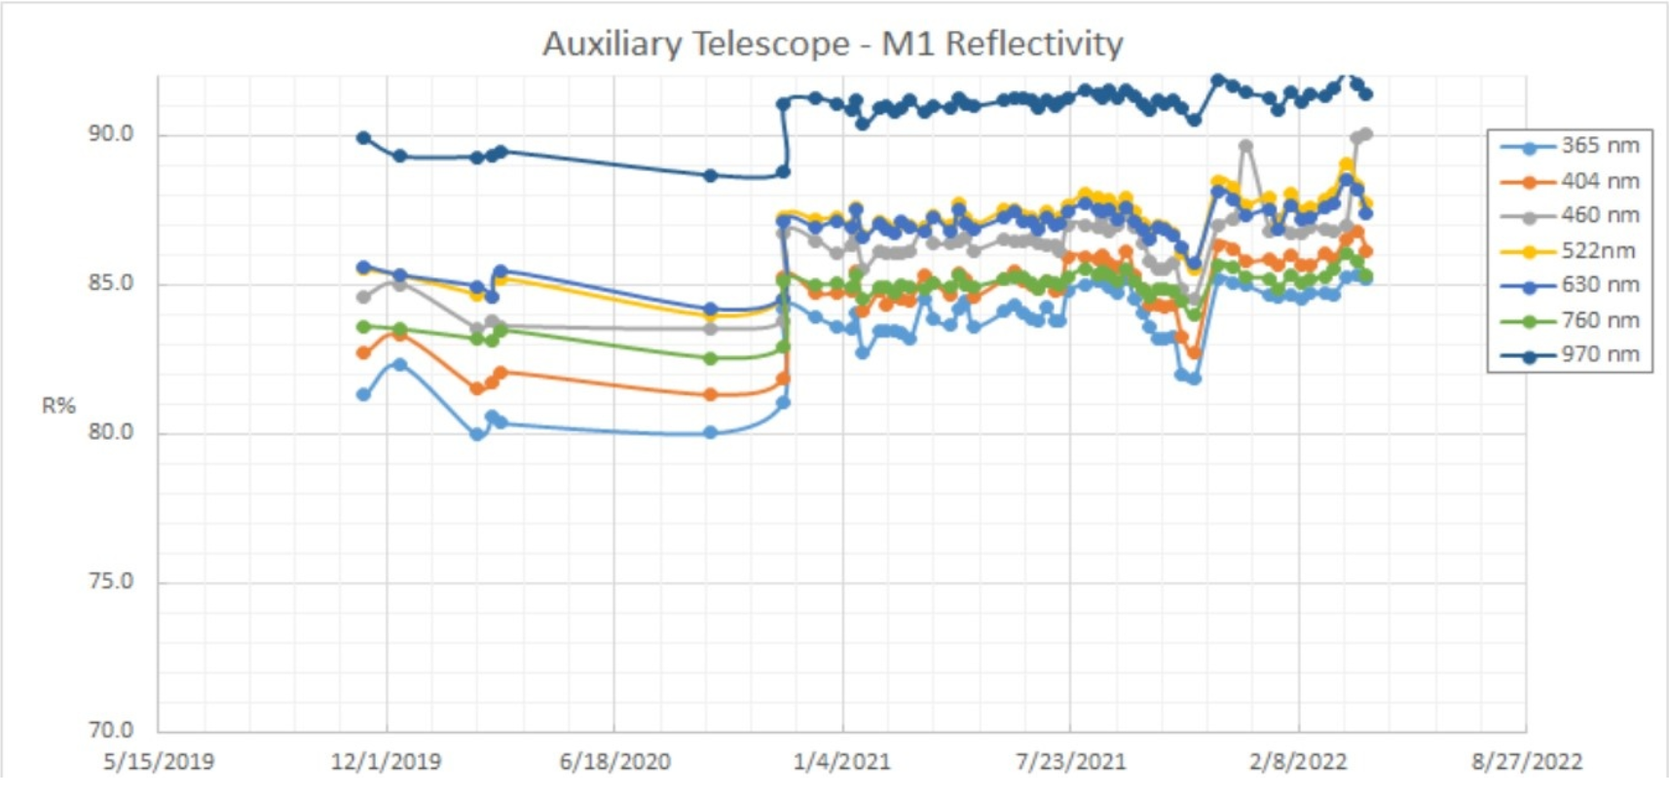
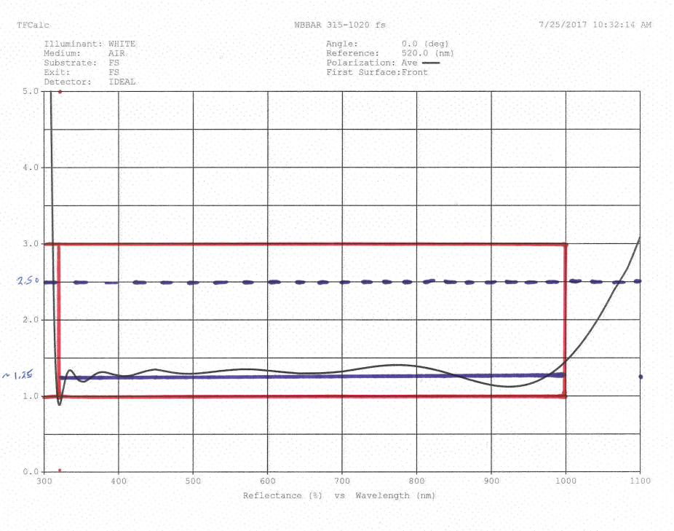
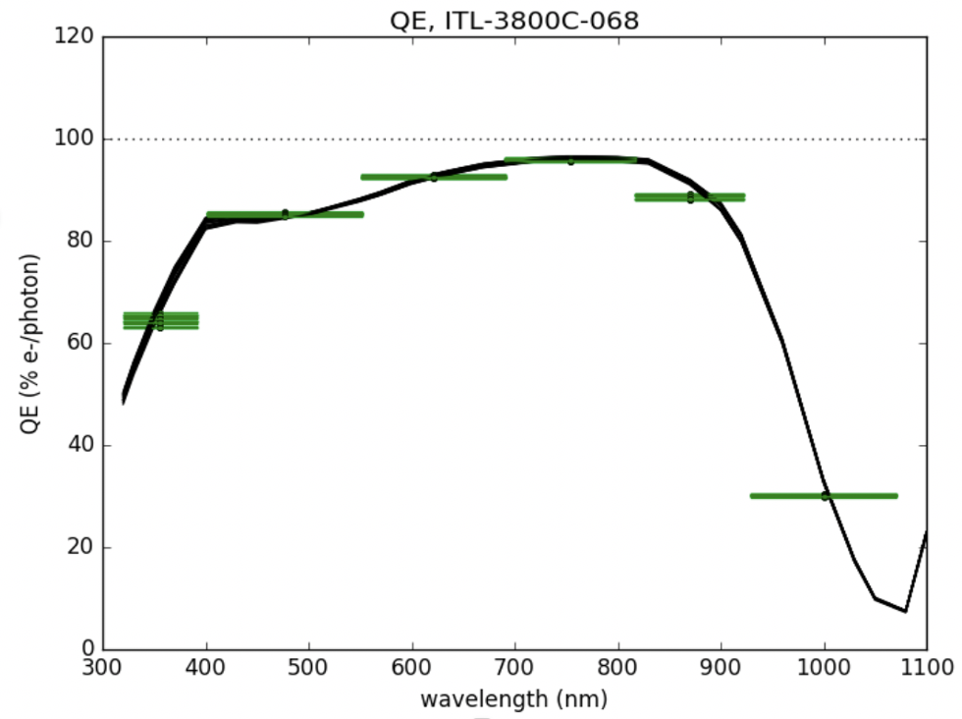
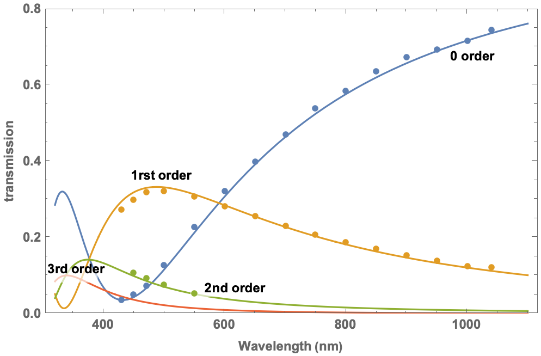
Ingredients of throughput
M2-M3 reflectivity vs λ (theoretical)
M1 reflectivity vs date (measured)
Loss at window entrance/exit
Hologram transmission
(measured/modelized)
CCD efficiency (measured)

Slide 11
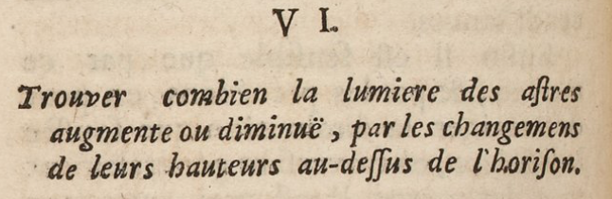
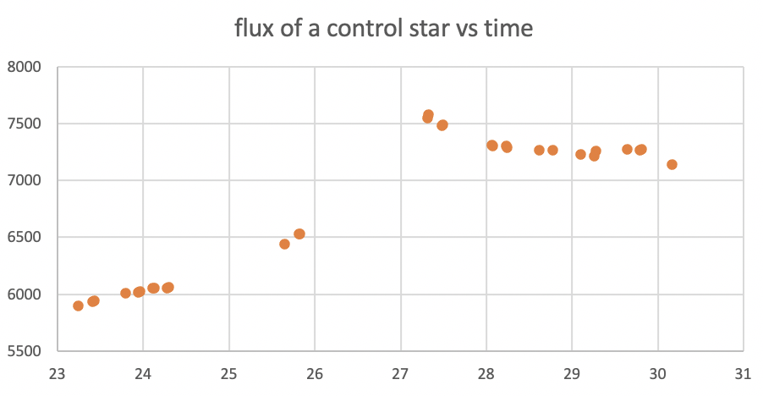
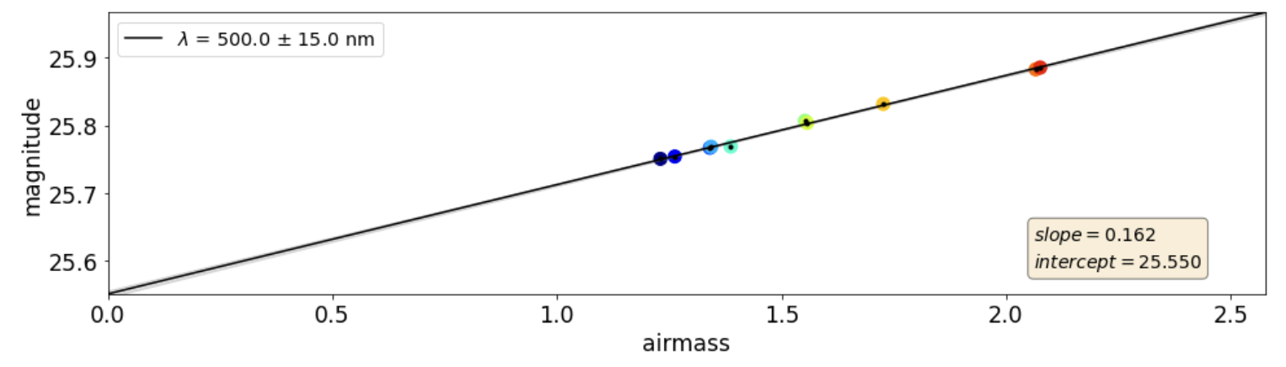
Throughput is estimated with Bouguer lines technique (1729)
Example in band [485-515]nm (1rst order)
Series of instrumental magnitudes
- of the same source
- for various aimasses (here 1.23 - 2.1)
- during a period with stable atmosphere
Extrapolation of the line to airmass=0
-> get magnitude OUT OF ATMOSPHERE
-> compare with HST spectrum
-> deduce system throughput in the band
30 june 2022
Only end of night used
(low+stable absorption)
Several measurements duplicated
(and almost identical)
per airmass

Slide 12
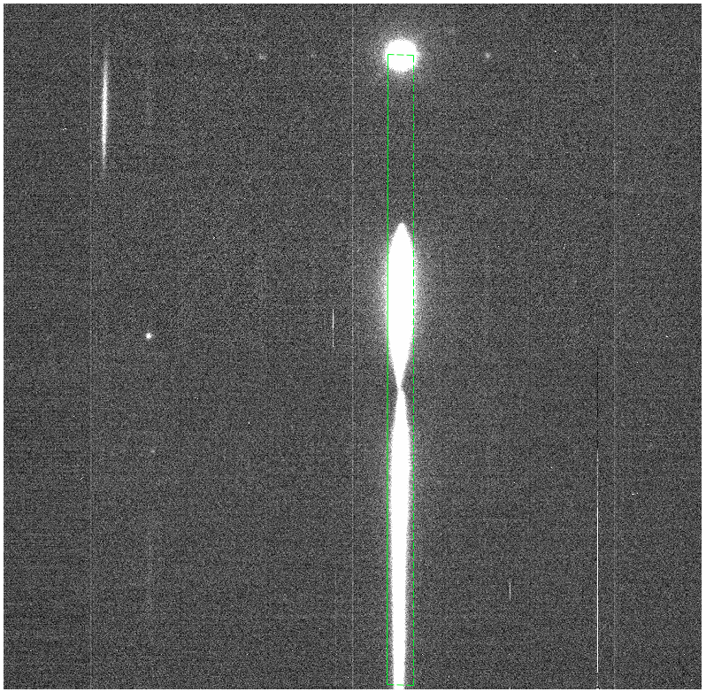
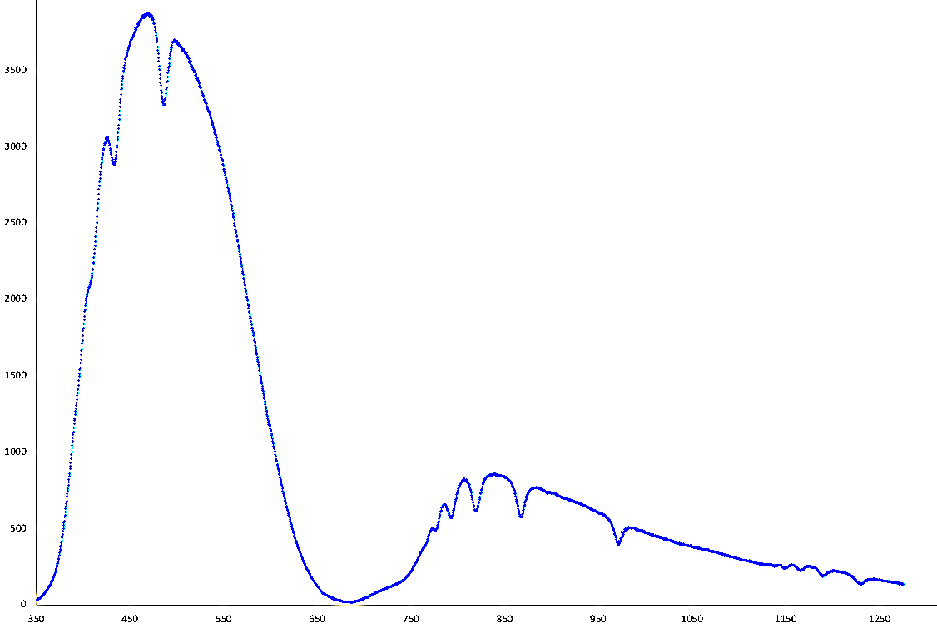
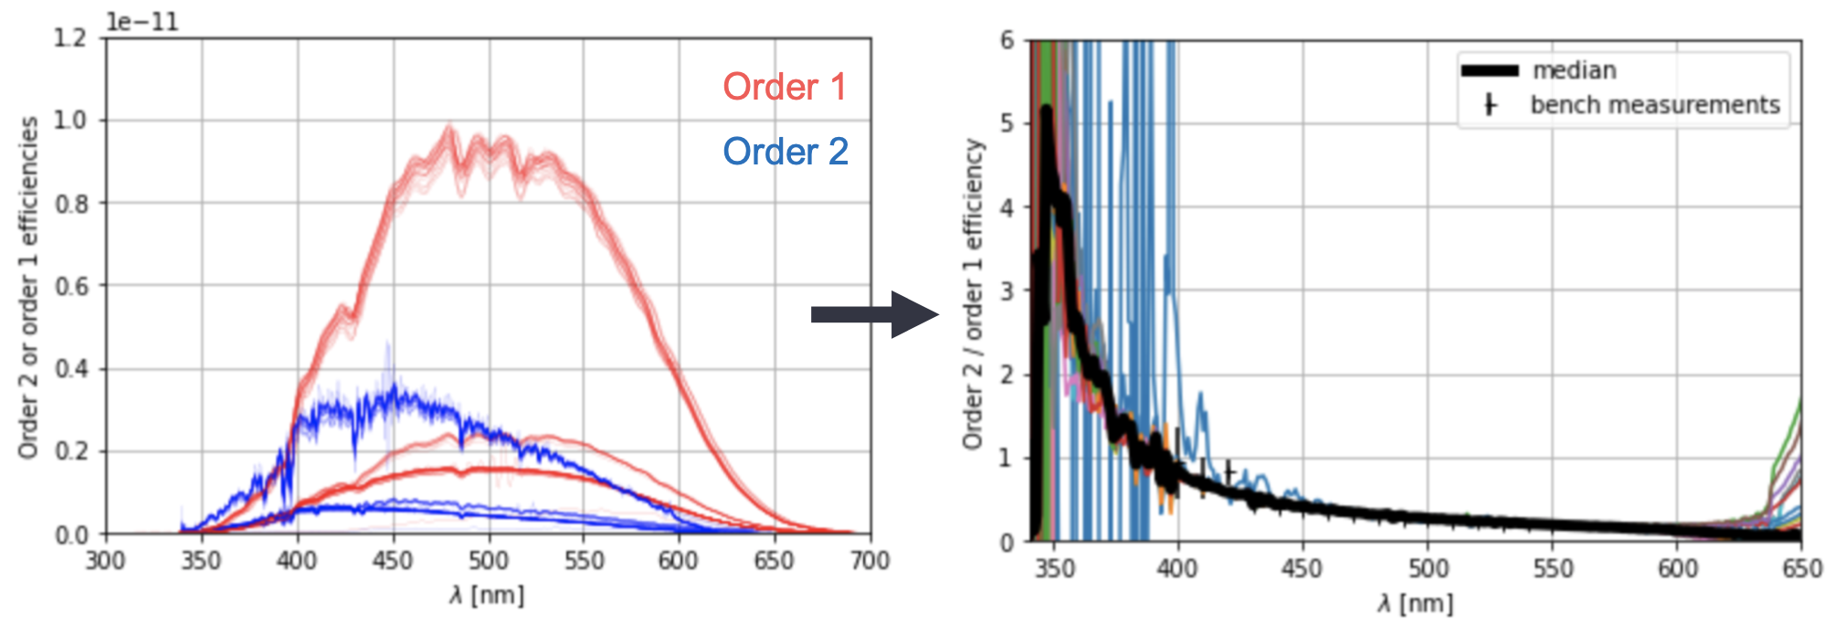
Determination of 2nd order/1rst order
Use spectra with blue filter (125)
Extract separately orders 1 and 2
Compute ratio
Order 1
Projection
Order 2

Slide 13
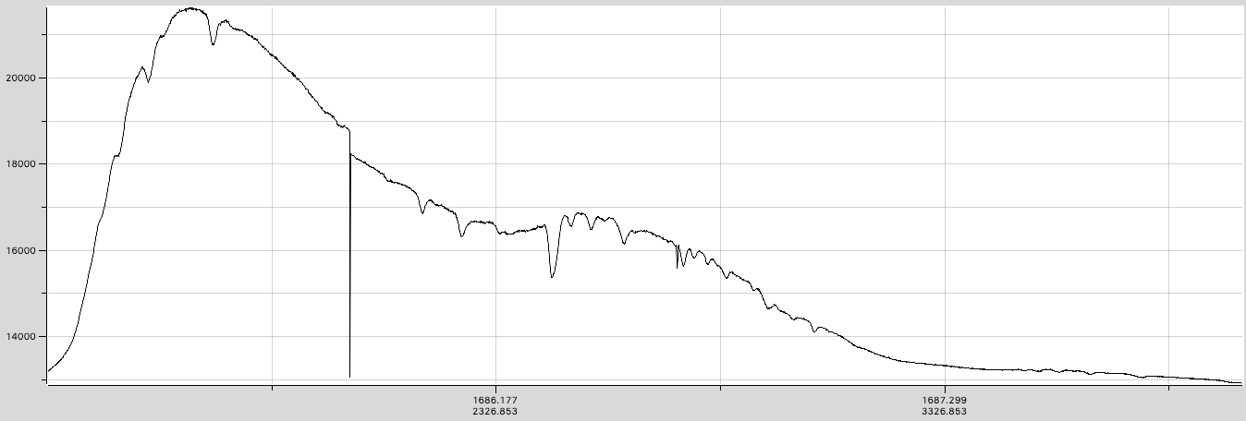
Spectroscopic reduction: état de l’art
SpecTractor operational tool for spectrum extraction
  Forward modelling, taking into account every instrumental effect:
    dispersion law, PSF(λ), focus, 1rst+2nd orders, atmospheric dispersion…
  Separation of 1^{rst} and 2nd diffraction orders now satisfactory
From RAW

Slide 14
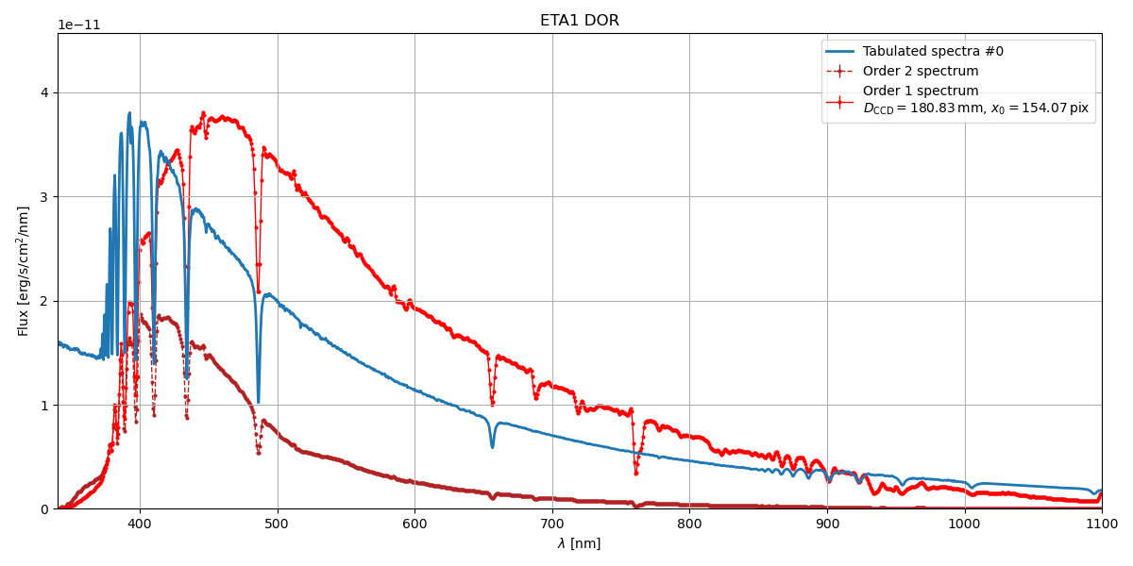
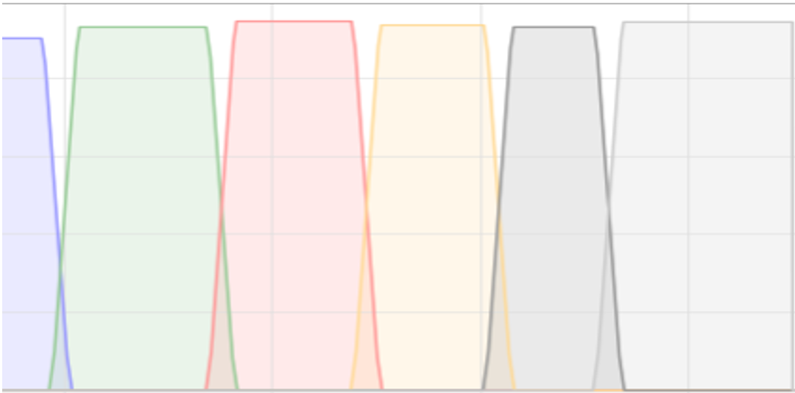
Spectroscopic reduction: état de l’art
SpecTractor operational tool for spectrum extraction
  Forward modelling, taking into account every instrumental effect:
    dispersion law, PSF(λ), focus, 1rst+2nd orders, atmospheric dispersion…
  Separation of 1^{rst} and 2nd diffraction orders now satisfactory
To REDUCED
- 1
U
G
R
I
Z
Y
H_{β}
H_{α,β,γ etc.} stellar lines
O₂, H₂0 atmospheric absorption bands
1st order
Flux [erg/s/cm²/nm]
Filter transmission
- 0.5
HST spectrum
H_{α}
O₂
H₂O
O₂
H_{δ}
H₂O
H_{ε}
H_{γ}
2nd order
H₂O
- 0

Slide 15
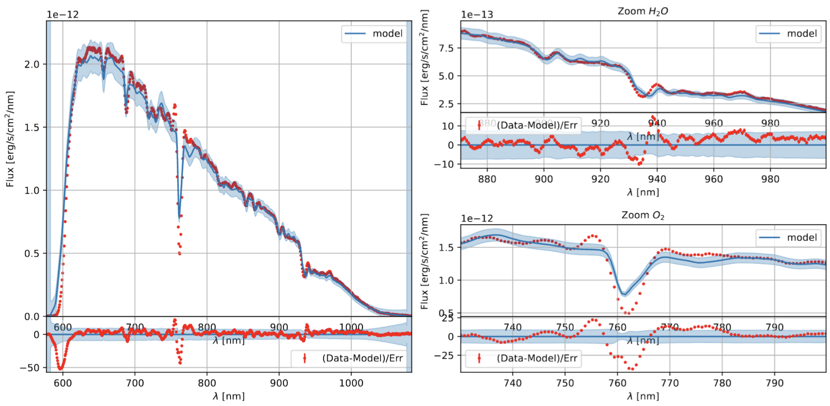
Extraction of atmospheric parameters
After knowing the telescope/hologram/(filter) throughput:
Find atmospheric parameters (LibRadTran) from fit of data with model
  Ozone, aerosols, and PWV=4.55+/-0.03 (Precipitable Water Vapor)
H₂O
H₂O_{(A)}
H₂O_{(B)}
H₂O

Slide 16
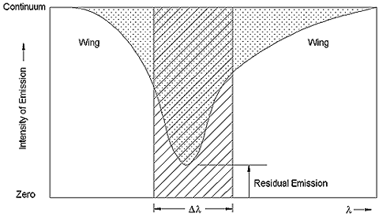
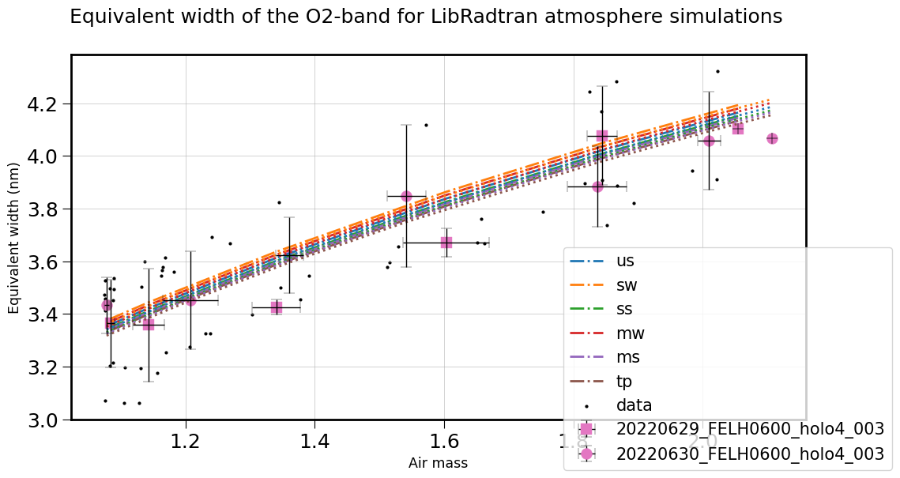
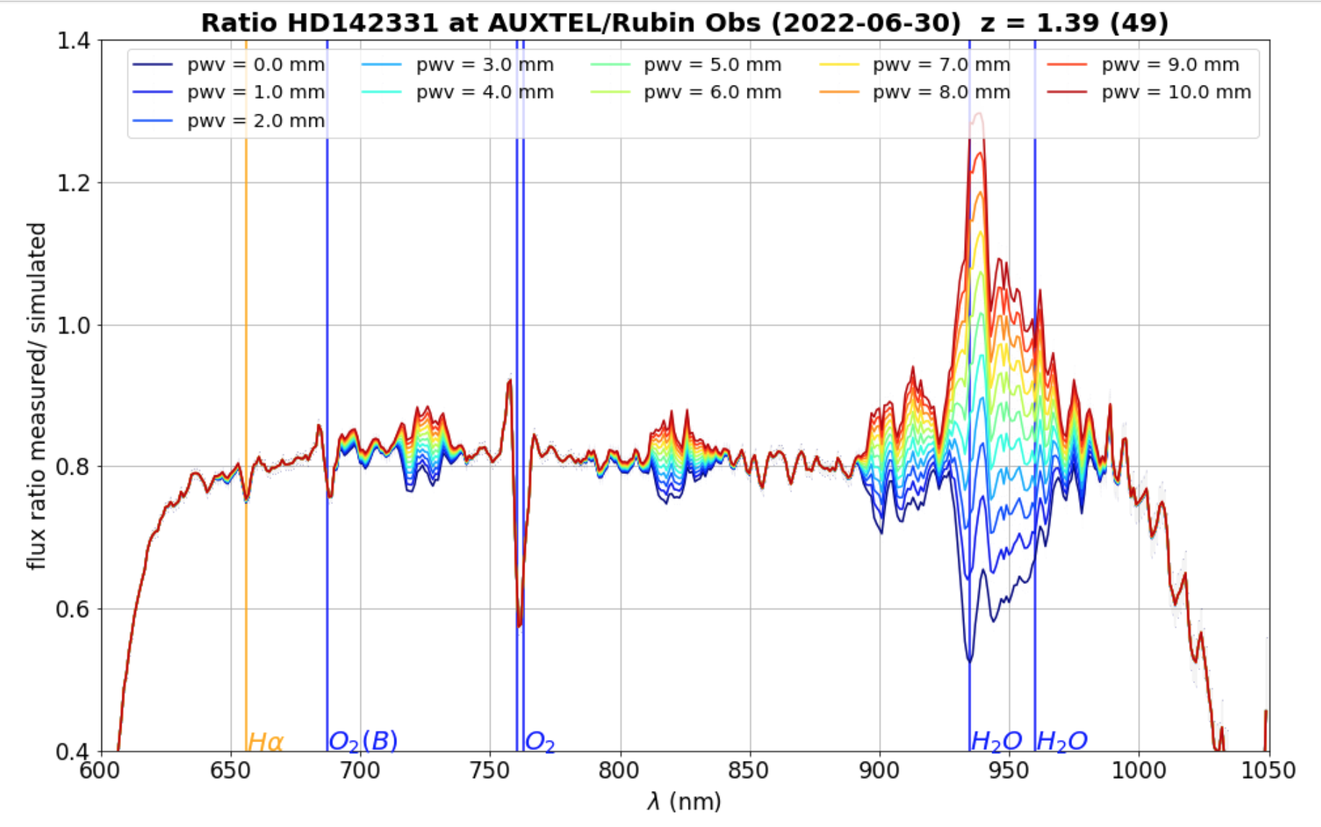
Control tool : EQW(O₂) should depend only on airmass x pressure
EQW definition
After checking EQW(O₂), we will measure
EQW(H₂O_{(A)}) and EQW(H₂O_{(B)})
H₂O_{(A)}
H₂O_{(B)}

Slide 17
Next steps / work in progress
We have now a kind of hygrometer
- Ultimate check by comparing dispersion of measurements after/before correction
We also need to measure aerosols
- Difficulty: no sharp feature
- We have sensitivity (comparison before/after culmination, same airmass shows variations)
- Test using multiband filters with spectro
Special flat-fielding
- derived from standard flat-field
- Obtained through special telescope operations
From atmospheric parameters to color corrections
Color changes induced by water vapor
Color changes induced by aerosols

Slide 18
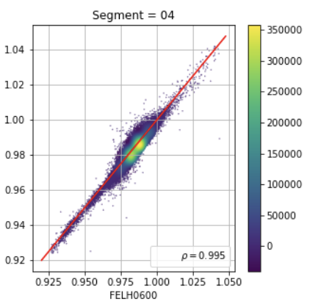
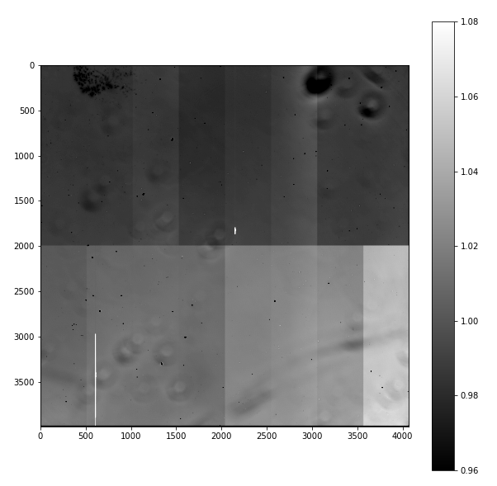
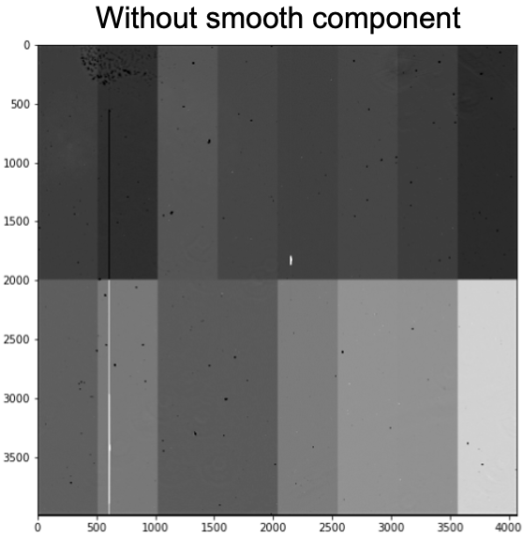

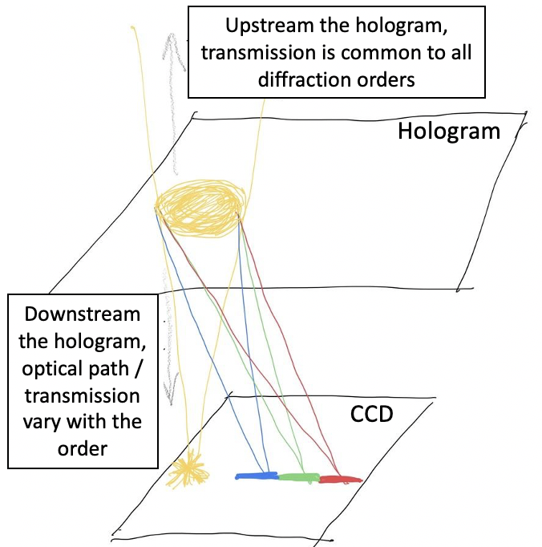
Flat-fielding in spectroscopy
Flat-fielding is not standard for spectroscopy
  Ultimately, the CBP will be the best tool
  In the meanwhile,we use approximations :
    Keep only fluctuations due to camera window + CCD (dust & pixel-to-pixel gain variations)
    spatial and wavelength efficiencies factorize
  drifting star to produce a special flat-field to be tested
Blue flat pixel value
Red flat pixel value
Normal flat FELH0600
flat after filtering slow variations due to upstream optics

Slide 19
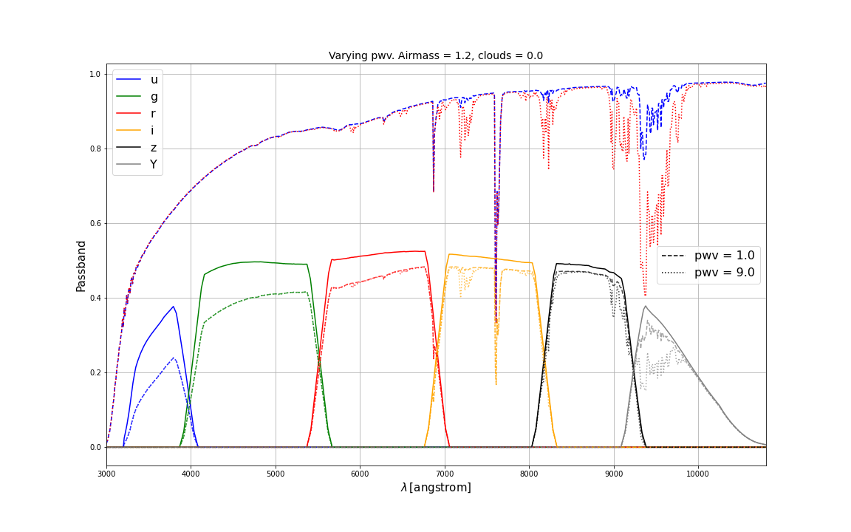
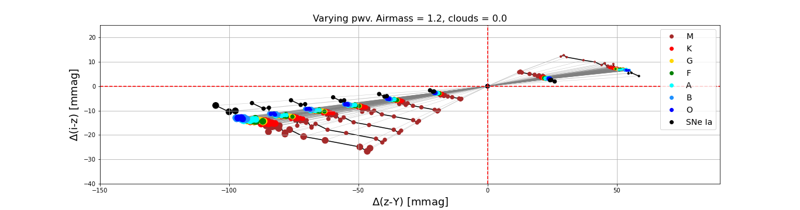
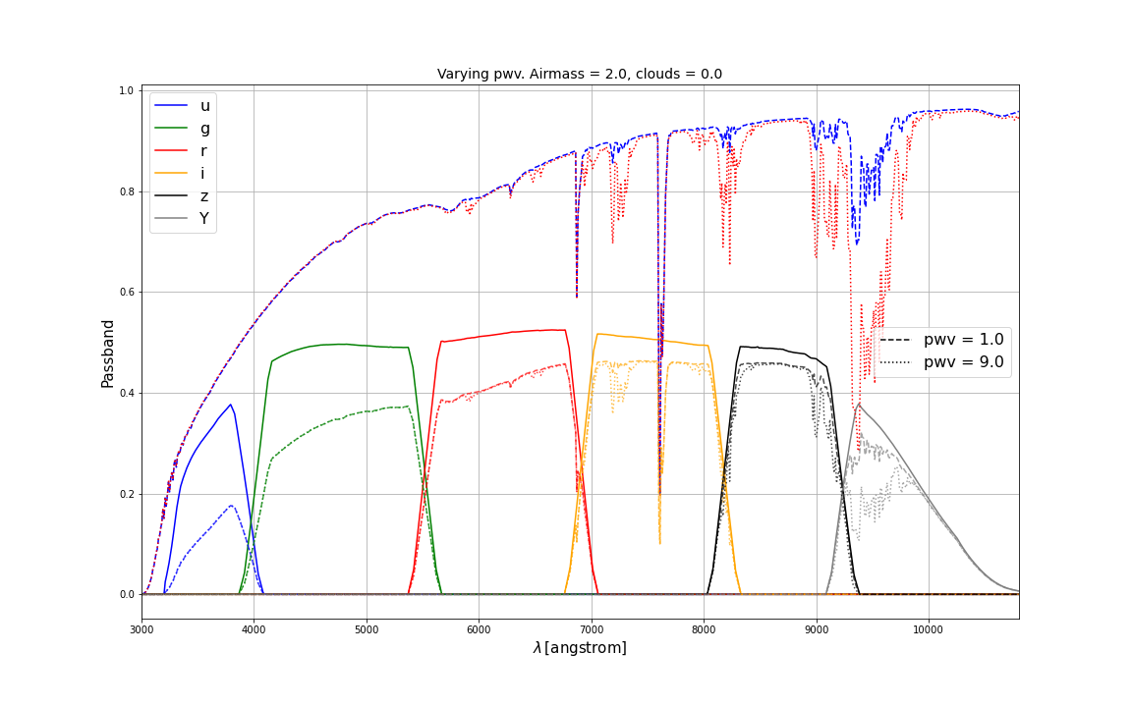
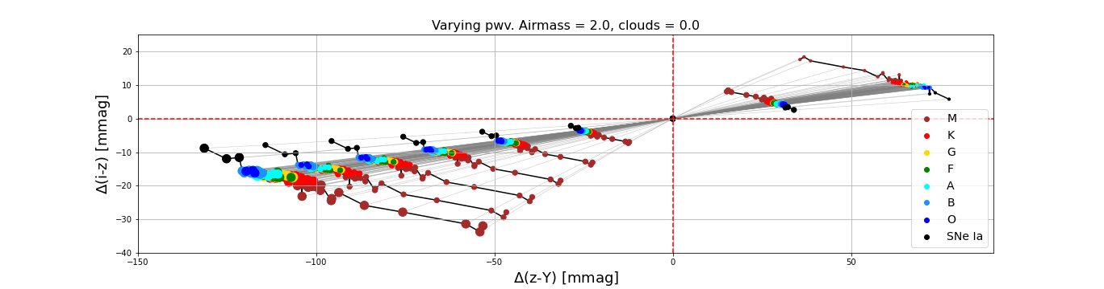
Color changes due to water vapor
PWV=1mm
2
4
3
6
5
8
7
9
Color variations follow: Scalar(PWV)xVector(type)

Slide 20
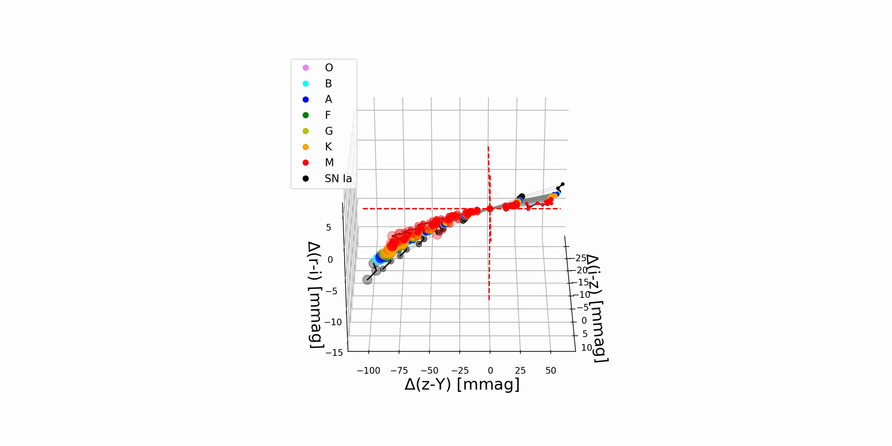
Color changes due to water vapor
Impact of PWV on colors
- mainly (i-z) and (z-y)
- described by Scalar(PWV)xVector(type)
- with type linked to (ugrizY)
Impact of aerosol on colors
- mainly (u-g) and (g-r)
- work in progress

Slide 21
COMPLEMENTS

Slide 22
Spectrograph commissioning results
Objectives of the spectrograph commissioning:
Short term: characterize the spectrograph
- Geometry -> done
- Spectrograph resolution R > 200 within [342, 1100]nm : limited by the seeing (as expected); 2x better for the second order -> ex. H9 absorption line (@383nm) clearly visible. -> OK
- Software: SpecTractor⁽¹⁾ operational, constantly improving -> work in progress
- Checked the equivalent width (EQW) properties -> OK
- Telescope throughputs of 1rst and 2nd orders holographic disperser⁽²⁾ with Bouguer lines -> work in progress, near to end (needs one « ideal » photometric night to consolidate).
- + a faint V=11.3 standard gives « enough » signal in 30s for spectroscopy
Long term: Estimate colour corrections, as functions of the airmass, atmospheric conditions and the object UGRIZY in every LSST field -> work in progress (Martin Rodriguez-Monroy)
  Either with an atmospheric model established from the follow-up of standards throughout the night
    -> Check the predictivity of the model versus airmass AND versus azimuth
  And / or with simultaneous measurements near the LSST field (needs secondary standards and observation strategy to « follow » LSST)
    -> Rely on GAIA DR of spectra
(1) Paper in preparation (2) MNRAS 506, 5589–5605 (2021). 2nd paper in preparation.

Slide 23
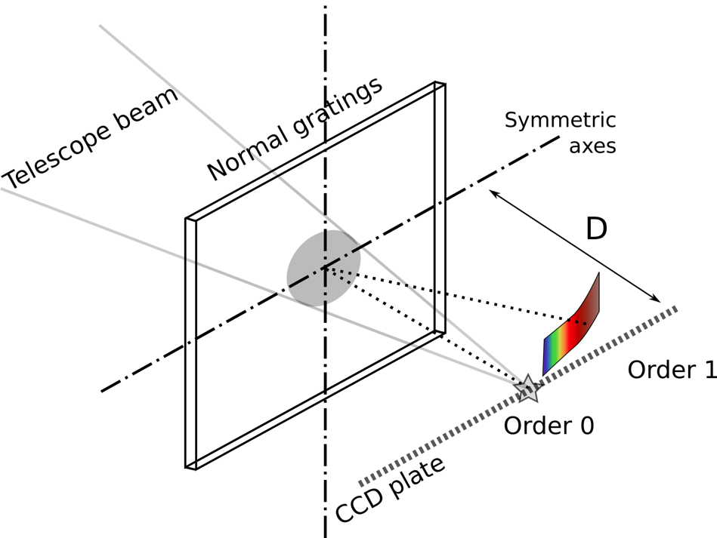
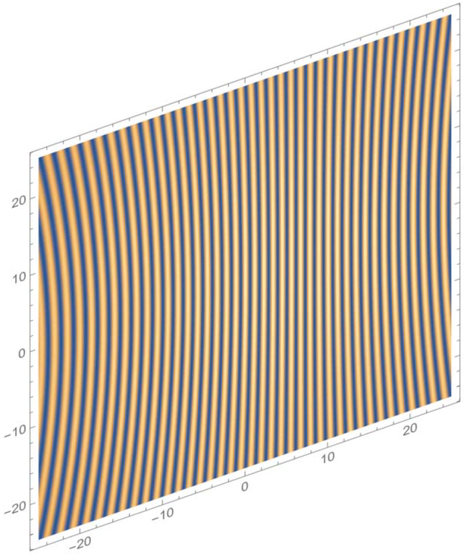

Hologram for AuxTel
Goal : measure atmospheric parameters by extracting spectrum of standards
Constraints
  Easily switch imager / spectro.
  Incident beam perpendicular to CCD-plane
  Converging beam (not parallel)
Usual gratings:
  Strong defocus due to optical path variations with the diffraction angle
  Distorsion when used with a converging beam
Holographic grating:
  forced focus on the focal plane at all wavelengths: 0th and 1rst order at same focus
  No distorsion by design of hologram

Slide 24



Holographic element characterization
Geometry: 2 scans (wide and fine meshes); changing position of the 0 order star
Determination of the nominal zero order position (1750, 300) -> determined with
< 0.5 mm precision
Transmission is found constant within >1mm from nominal position
Good focus along the full λ [342-1100]nm scale -> one of the main improvements w/r Ronchi grating
Transmission efficiency -> up to 3x more than Ronchi (depending on λ)
Shows the dispersion direction if zero order is here

Slide 25




Estimating a lower limit of resolution, using narrow emission lines of
Planetary nebula Hen 2-113
-> lower limits on R=λ/Δλ (because extended object)
-> focus OK for all λ
star
star
R α 200
(seeing/object size limited)
star
star
star
Hologram, Texp=60s
R α 100
(seeing/object size limited)
spectrum from
le Bertre et al. 1989, A&A, 225, 417
H_{𝜸}
H_{𝞫}
OII
SIII
SIII
400
500
600
H⍺
700
CII
O₂
800
900
434 nm
656 nm
O₂
953 nm
486 nm
762 nm
907nm
967 nm
486 nm
656 nm
762 nm

Slide 26

Transmission efficiency model vs test-bench measurements
Transmissions:
Model (lines)
Data (points)
Caracteristic curve of holographic emulsion
λ=400nm
λ=639nm
λ=1000nm
UV transmissions measured on sky (Bouguer lines): in progress
Phase delay profile of holographic grating

Slide 27


Variability of the atmospheric transmission
(Stubbs et al. PASP, 119: 1163–1178, 2007)
Photometrists use photometric quality nights and narrow band filters
  No cloud
  Low humidity
  Low aerosols
LSST wants to use all nights with wide band filters
  Few clouds (grey absorption)
  Humidity (affects I & Z)
  Aerosol (affects U & G)
After correcting for Airmass:
O₂, O₃, rayleigh can be extracted
Then determine H₂O and aerosol

Slide 28




Auxtel : First estimates of atmospheric parameters
Atmospheric absorption lines
EQW depends on atmosphere
O₂ atm. absorption lines
O₃ atm. absorption bands
H₂O atm. absorption bands
Stellar lines
EQW independent on atmosphere
Variation of EQW for atmospheric lines illustrates sensitivity to atmospheric parameters (EQW)
H_{γ}
H_{β}
H_{α}
H₂O
(720nm)
O₂
(760nm)
H₂O
(820nm)
data/simu(LibRadTran) for several hypothesis (PWV)
H₂O
H₂O
H₂O
EQW definition
  ‘’fit’’ H₂O :
  PWV ~ 3.2mm

Slide 29
Atmospheric studies
Objective of the AuxTel calibration:
Estimate colour corrections to vector (UGRIZY)_{LSST} for each object, as a function of
- the atmospheric parameters (airmass, PWV, τ_{VAOD} ) -> the baseline
- or the directly measured atmospheric transmission function
T_{atm}(λ, RA, Dec) synchroneously within the LSST field
What are the orders of magnitude of the corrections ?
From simulation: atmospheric fluctuations induce typically less than 10mmag (max. ~30mmag @ airmass=2 for cold stars) residual colour variations per airmass after removing grey common absorption
-> Correction precision δC needs to be such that:
0.010 x δC < wanted resolution
i.e. δC=50% for 5mmag / 10% for 1mmag

Slide 30

Characterizing the AuxTel throughput with Bouguer lines to measure separately order1 and order 2 transmissions versus λ
Spectrum extraction software (SpecTractor) needs the global throughput of the system for each diffraction order p:
T_{p}(λ) = τ(λ)_{telescope} . τ_{p}(λ)_{disperser} . ε_{CCD}(λ)
-> Obtained by the ratio of instrumental out-of-atmosphere flux to HST reference flux (as a function of λ)
If constant atmospheric conditions, instrumental magnitude@λ follows a Bouguer line in airmass z:
m_{p}(λ,z)_{instrumental} = m(λ)_{SED-HST} + A_{atm}(λ) . z + 2.5.Log[T_{p}(λ)]
At a given λ, extrapolating the line from the series of m_{p}(λ,z)_{instrumental} to z=0 airmass gives out-of-atmosphere instrumental magnitude and allows to deduce the throughput from:
m_{p}(λ,0)_{instrumental} = m(λ)_{SED-HST} + 2.5.Log[T_{p}(λ)]
Series of m_{p}(λ,z)_{instrumental}
λ
Slope depends on λ
Requirements
-> (at least) one photometric night (i.e. stable atmosphere) to obtain long series of spectra.
-> The same star needs to be measured during the same night in the widest airmass domain.
-> large # of measurements allows better determination of the slopes and of z=0 extrapolation.
Extrapolated m_{p}(λ,0)_{instrumental}
z

Slide 31



Measurement of Bouguer lines
Example of a
Bouguer line
HD142331 trajectory in airmass
Only end of night used
(low+stable absorption)
Instrumental magnitude vs airmass
Out of atm.
SED
Measured
spectra
Spectra integrated in bins of 30 nm width
Extrapolated out of atmosphere instrumental magnitudes in narrow [30nm] bandwidth
Notes:
The night is not photometric, however we convince ourself that the the second part of the night have lower absorption and seems for stable.
The we remains with few usable exposures to construct Bouguer lines.
Top right : this is and example of Bouguer line, but the chi2 per degree of fredoom is above 6.
Bottom right : this is the set of Bouger lines from which one can reconstruct the Throughputs.

Slide 32

Sky background has spectrum depending on the position on CCD

Slide 33


Factorization of the wavelength dependence
Idea:
Evaluate spatial correlation between flats with different filters
See if can factorize out the wavelength dependency on the flats:
  = out of focus artifacts (vignetting, dust on optical components) = slow pixel to pixel variation (real space) or low spatial frequency (Fourier space)
  = focused artifacts (dust on the CCD, pixel surface variations) = fast pixel to pixel variation or high spatial frequency
  We examine the hypothesis of
If ~ true, then we could preliminary use a single flat for spectra reduction
How can we test this?
  By examining the ratio of flat images at different wavelengths (with different filters)

Slide 34



Factorization of the wavelength dependence: pixel correlation
⍴ = 0.96
Relative dispersion of ratio
ADU Relative dispersion

Slide 35
Establishing correction procedures
We did predictions from simulations, based on parametrization with (z, PWV, VAOD). But O₃ , O₂ and cloud absorption (grey) can also be parameters.
The methods have to be systematically checked for every atmospheric situation:
  Predictability of the correction in (airmass, azimuth)
  Needs observation of CALSPEC standards through entire nights (to estimate atm. parameters) AND various fields in (airmass, azimuth) containing standards to test the prediction. « ronde des standards ».
Alternative: directly measure atm. transmission in the same direction than LSST, using secondary spectrophotometric standards measured out of atmosphere by GAIA.
We checked that spectra of stars as faint as M=10 are measurable in 30s with s/b>100

