Slide 1










Altiroc2-3:
Power distribution issues
Laurent Royer, pour laTeam Altriroc
Journées des Métiers de l’Electronique @IN2P3- 13 juin 2023

Slide 2
Sommaire
0. Le détecteur HGTD
Eléments à considérer pour la distribution des alimentations
Distribution d’alimentation pour le numérique
Plan de masse pour l’analogique
Distribution d’alimentation pour les TDCs
Conclusion

Slide 3
Sommaire
0. Le détecteur HGTD
Eléments à considérer pour la distribution des alimentations
Distribution d’alimentation pour le numérique
Plan de masse pour l’analogique
Distribution d’alimentation pour les TDCs
Conclusion

Slide 4
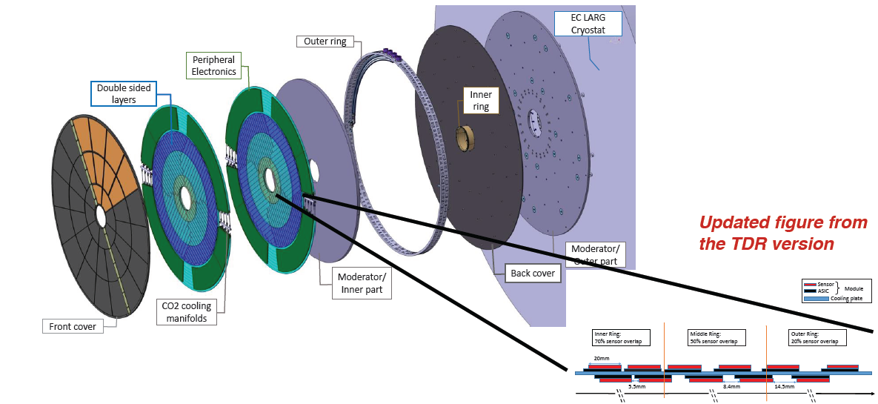
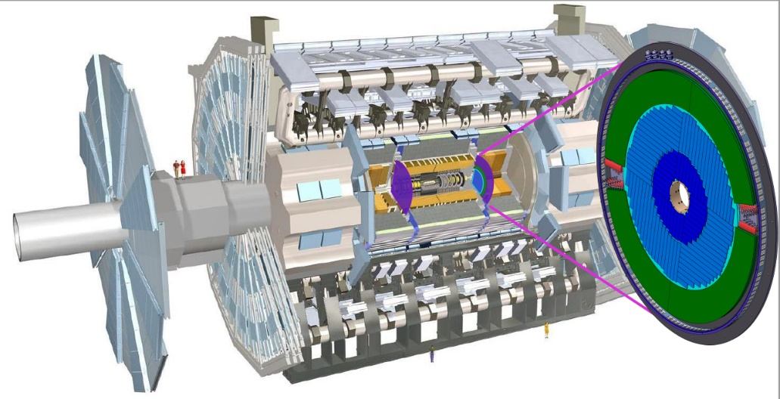
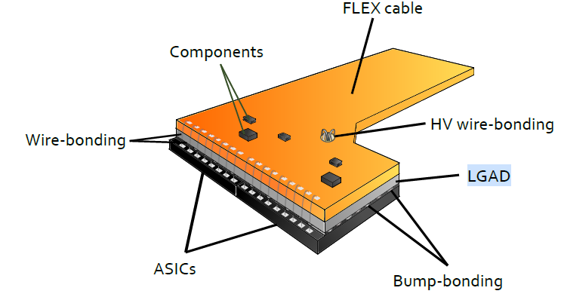
HGTD detector in one slide
Nouveau détecteur Atlas pour l’upgrade phases-II (2026)
  Two double sided layer per endcap with CO2 cooling at -30°C
  Active area: 120mm < R < 640mm
  Sensor: Low Gain Avalanche Detector (LGAD)
  Pixel size 1.3x1.3 mm² (Cd ~4 pF)
  225 channels / ASIC
  8000 4x2 cm² modules made of a LGAD sensor flip-chipped to two ASICs
  Number of channels: 3.59 M
    Pixel time measurement if above threshold and in a 2.5 ns window centred on BC
    Up to 10 % occupancy. Read on trigger accept
    Luminosity measurement : provide the number of hits per ASIC in two windows per BC

Slide 5
Sommaire
0. Le détecteur HGTD
Eléments à considérer pour la distribution des alimentations
Distribution d’alimentation pour le numérique
Plan de masse pour l’analogique
Distribution d’alimentation pour les TDCs
Conclusion

Slide 6
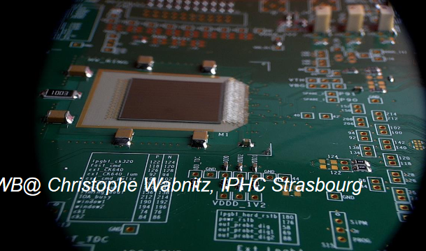
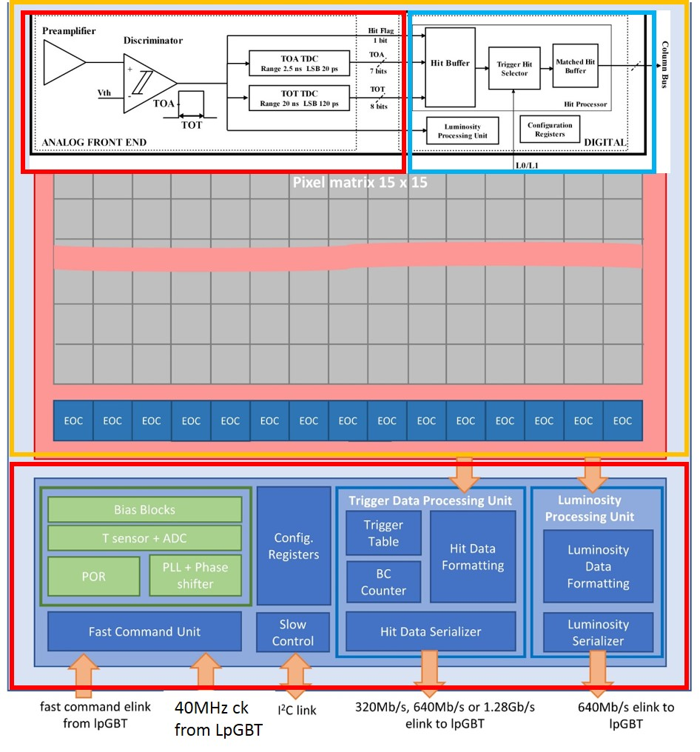
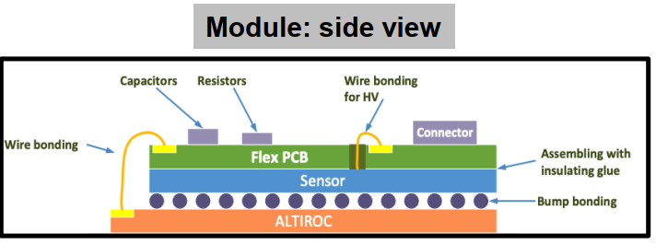
Key elements for power distribution in Altiroc (1/2)
Geometry:
  Readout channels distributed over a 15 x 15 matrix
  Large die area: 22 x 20 mm²
  Only one side powering
Great on-chip electronic activity:
  Many embedded signal and data processing for each channel : preamp., discri., 2 TDCs, 19-bit 1534-cell SRAM, FIFO, I2C registers, …
  Many additional embedded blocks at periphery level: PLL, DLL, PS, DACs, BG, FIFO, encoding, serializer, I2C slave & registers, ...
  Many digital blocks triplicated
  … but occupancy “limited” to ≈ 10%
Technology parameters (TSMC 130nm):
  Power supp. voltage: 1.2V
  7+1 metal layers available for routing
    M2-M6: ≈ 60 mΩ/
    M7: ≈ 6 mΩ/
    AP: ≈ 12 mΩ/
Altiroc2 elec. blocks diagram
single side wire bonding

Slide 7
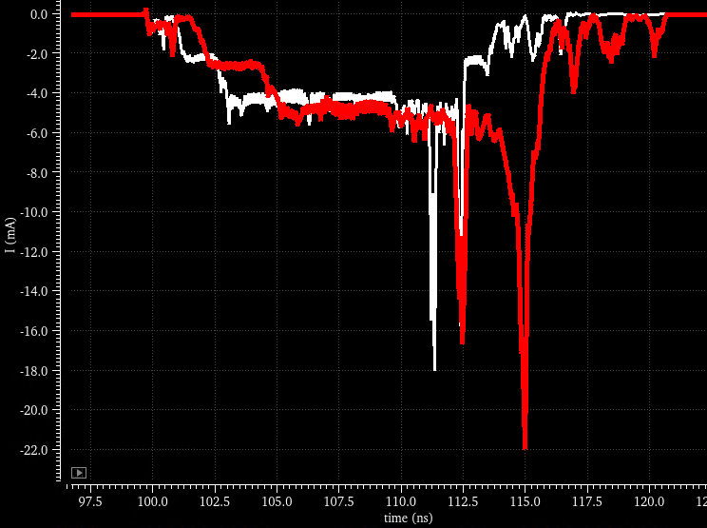
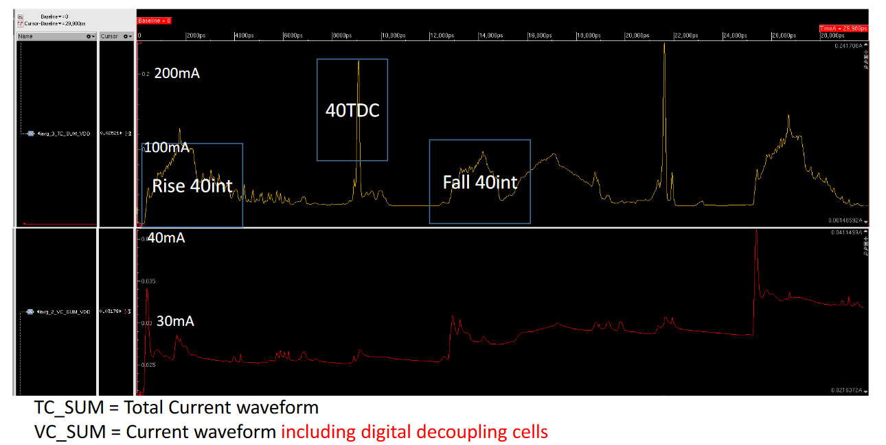
Key elements for power distribution in Altiroc (2/2)
Power consumption:
  Power consumption depends on occupancy
    Average currents estimation (worst case)
      Digital part: 600mA rms max
      Analog part: 400mA rms max
    Dynamic currents:
      TDCs: 6 to 12 mA per TDC during conversion + larger peaks at end of conv.
      Digital Vdd @column: up to 40mA peak with decoupling cells
Current of ToT during conversion
➔ 1.2W @1.2V
Schematic
Extracted
10 mA
ToT TDC

Slide 8
Sommaire
0. Le détecteur HGTD
Eléments à considérer pour la distribution des alimentations
Distribution d’alimentation pour le numérique
Plan de masse pour l’analogique
Distribution d’alimentation pour les TDCs
Conclusion

Slide 9
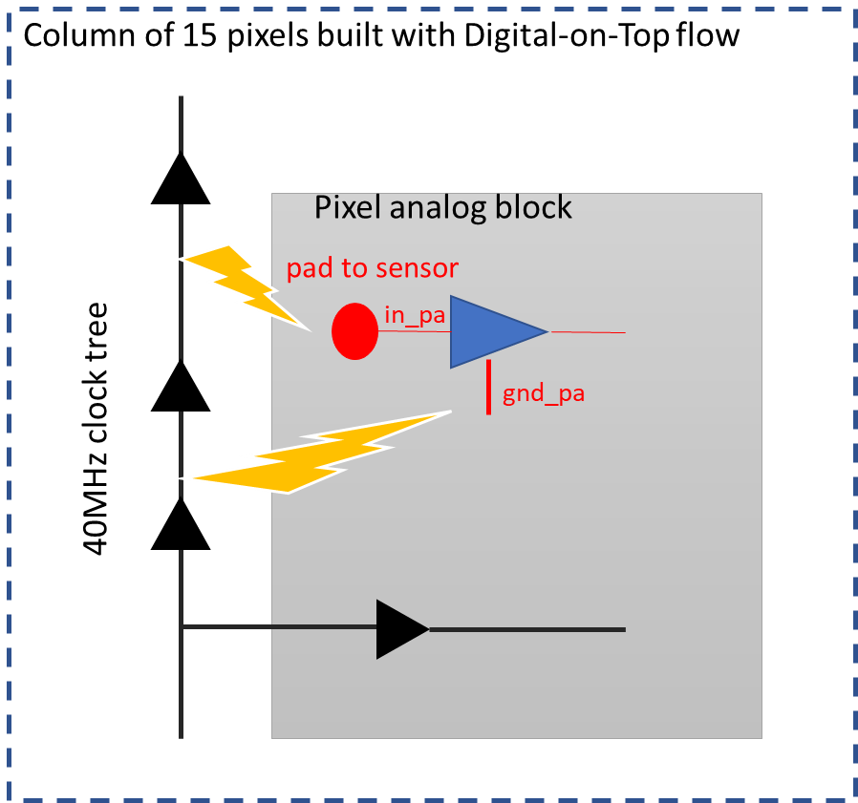
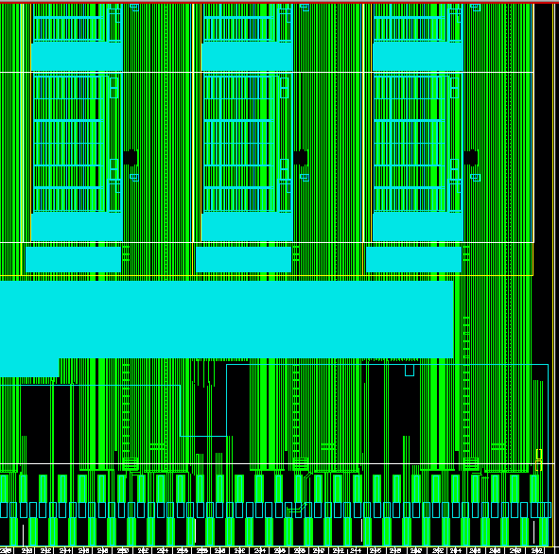
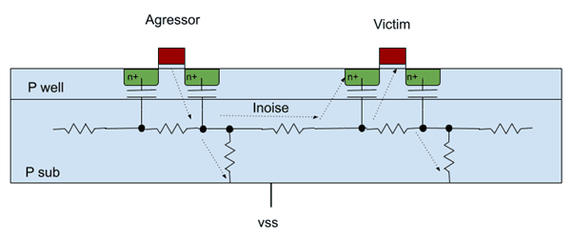
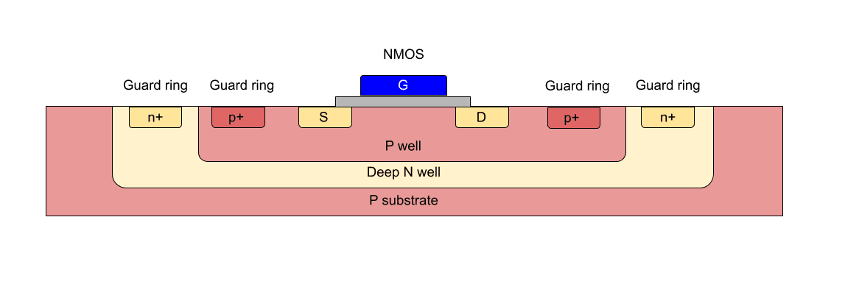
Digital power distribution
Digital noise coupling
In Altiroc, jitter (= noise) is a key issue (see Maxime’s talk)
To limit the digital-to-analog noise coupling
  Separation of analog and digital power supplies
  Analog blocks inside deep Nwell isolation “box”
  Digital drop limited to 15% of Vdd (±90mV)
    optimized power routing inside digital blocks, along the columns, at the top floorplan … but limited area for M7 routing
    voltage drop analysis required
M7 density
col12
col13
col14
Deep Nwell isolation

Slide 10
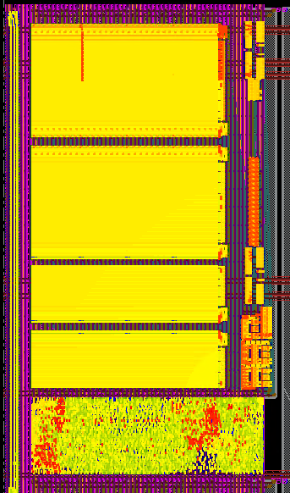
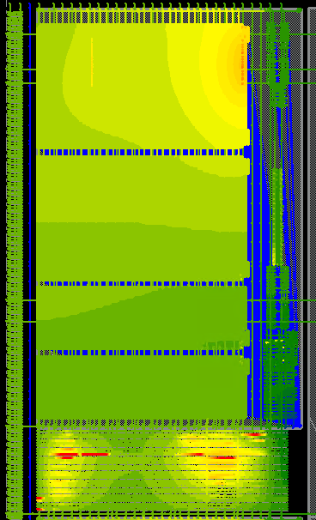
https://asicsupport-community.web.cern.ch/t/voltus-fi-emir-pvs-flow-step-by-step/159Power Grid View (PGV)
Voltage drop of Digital power inside blocks
Detailed Power-Grid-View (PGV) on SRAM
Example of voltage drop analysis of the SRAM (Alexandre S.):
  SRAM is a digital block but fully analog designed
  Large and power-consuming block inside the pixel
  Extraction of its dynamic power consumption with Virtuoso
  Power-grid analysis with Voltus
    Tap current and Voltage drop “map views”
    The most active aeras visible in red
SRAM
SRAM
Tap Current
Voltage drop
credit: Aleandre Soulier@LPC

Slide 11
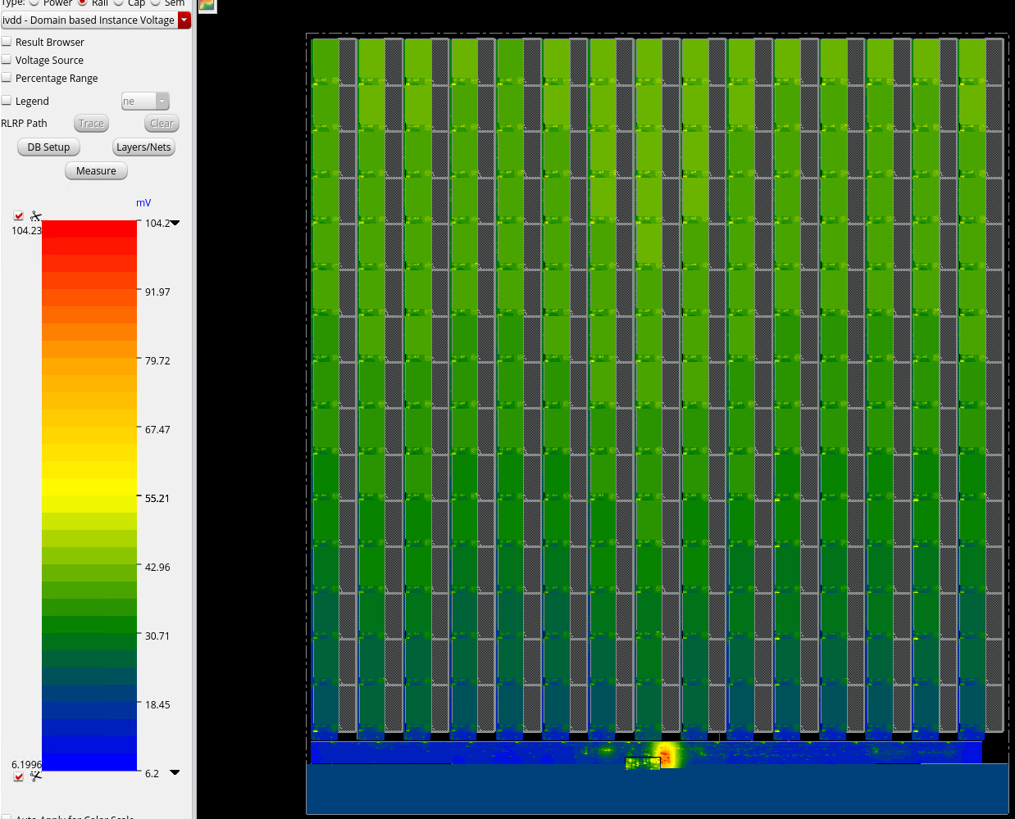
Digital power distribution in the chip
Detailed Power-Grid-View (PGV) on SRAM
Voltage drop analysis on digital power, full chip (Alexandre S.):
  Conditions of analysis: Trigger, 225 SRAMs Wr/Rd, Lumi On
  Fixed some local drop issue following previous results
  cumulated max Vdrop = 104mV (< ±90mV) located inside peri.
  Vdrop < 50mV inside matrix
Cumulated Vdrop VDD+VSS
!! “Tough negotiations between analog (Gisèle) and digital (Alexandre) to share available space for routing !!
credit: Aleandre Soulier@LPC

Slide 12
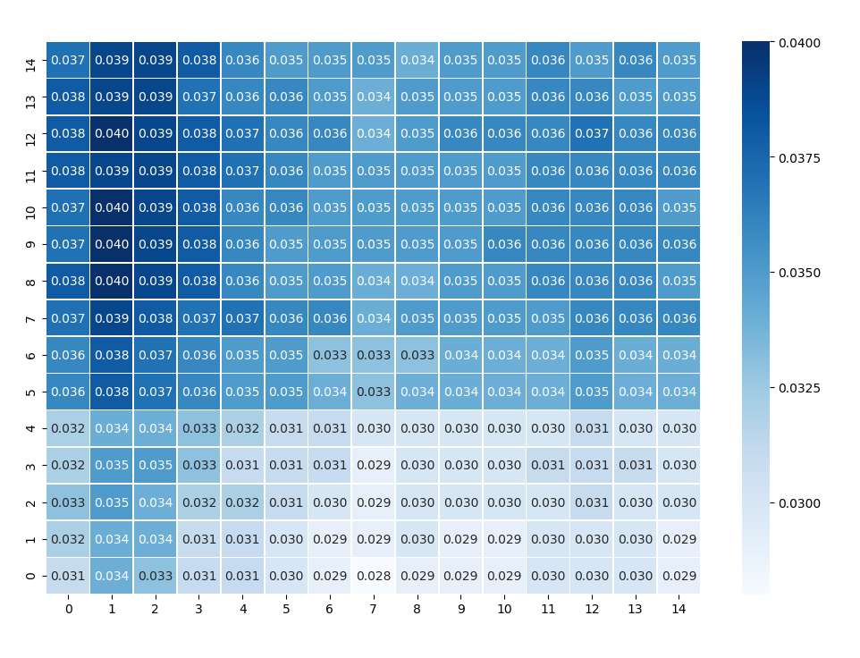
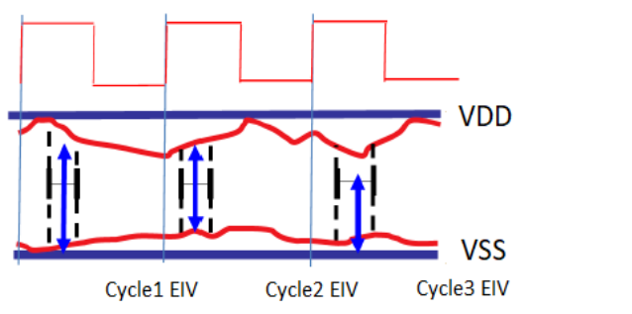
Jitter induced by IR drop inside clock tree (Gianmario B)
Digital activity → current spikes → delta-V on clock buffers → jitter → impact on time resolution of ToA
Digital activity is not something predictable, it ranges from BEST CASE to WORST case → also delta-T will not be predictable!
Ex:
  1st hit can arrive when we don’t have activity at all in the ASIC
  2nd hit can arrive when we have a lot of activity going on in the ASIC (ex: previous trigger processing, transmission of data, distribution of trigger to pixels, etc etc)
Jitter (ns) = arrival time with no activity – arrival time with high activity
See talk/paper @TWEPP 2023
gianmario.bergamin@cern.ch
credit: Gianmario Bergamin @Cern
credit: Gianmario Bergamin @Cern

Slide 13
Sommaire
0. Le détecteur HGTD
Eléments à considérer pour la distribution des alimentations
Distribution d’alimentation pour le numérique
Plan de masse pour l’analogique
Distribution d’alimentation pour les TDCs
Conclusion

Slide 14
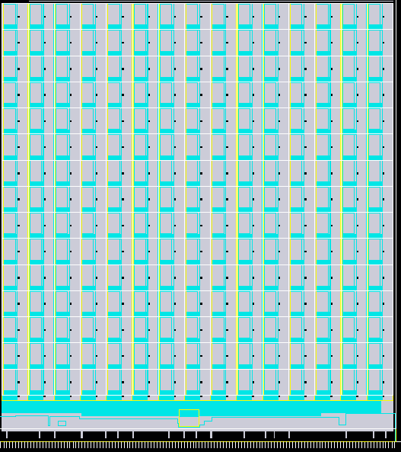
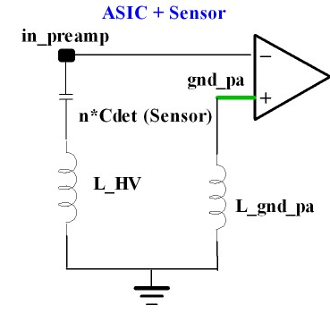
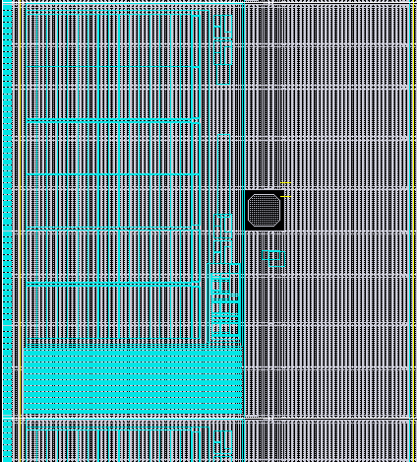
Analog grounding
Low impedance analog power grounding (gnd_pa) is a key issue for noise/timing performance
full gnd_pa ground plan grid for the matrix using AP metal layer + M7 vertical rails
Noise on gnd_pa amplified x20
(Nathalie S.M)

Slide 15
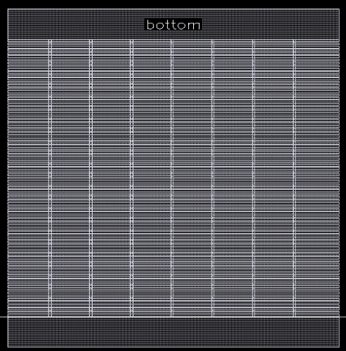
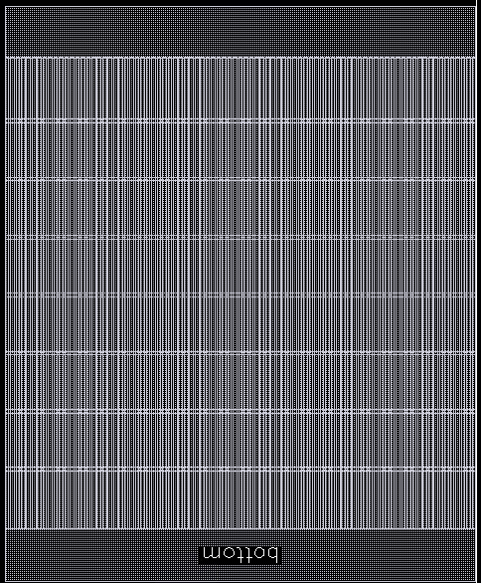
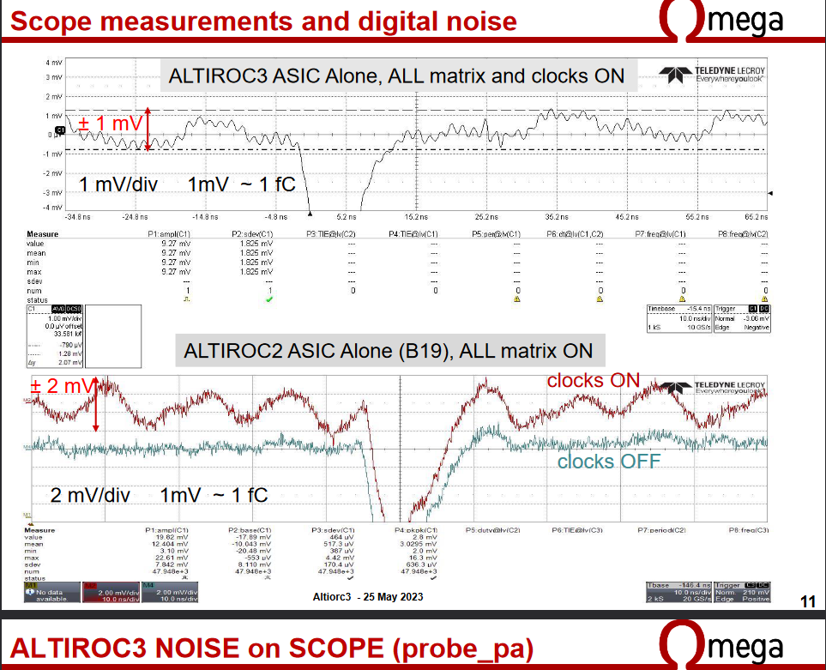
Analog grounding
Simulation of the AP resistance along the column:
  Altiroc2 version: 15* 233 mΩ
  Altiroc3 version (90° rotation): 15* 50mΩ
Alti3 vs Alti2: reduction of digital noise at the output of preamp. (preliminary result)
  lower gnd_pa impedance along the column
  limited Vdrop on digital power supp.
  Deskewed 40MHz clock
90° rotation of the AP grid
credit: Nathalie Seguin-Moreau@Omega

Slide 16
Sommaire
0. Le détecteur HGTD
Eléments à considérer pour la distribution des alimentations
Distribution d’alimentation pour le numérique
Plan de masse pour l’analogique
Distribution d’alimentation pour les TDCs
Conclusion

Slide 17
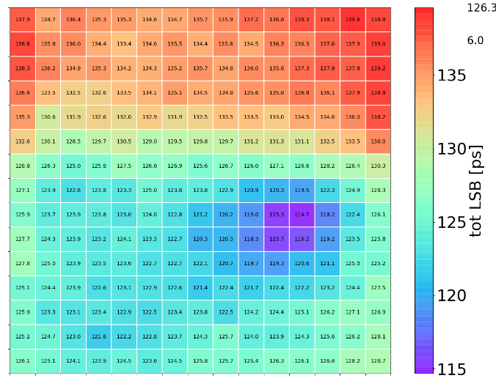
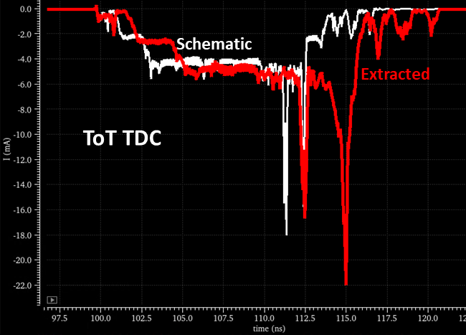
Altiroc2: variation of TDCs LSB
Dispersion of ToT LSB over the matrix
(injection in all pix of each column)
Variation of LSB for each column vs number of cols injected
credit: Nikola Makovec
1 to 15 pix. of the first column
credit: Nikola Makovec @IJCLab
Dispersion of LSB from bottom to top of the matrix
Variation of ToT LSB with occupancy
2 -
Power voltage drops during conversion

Slide 18
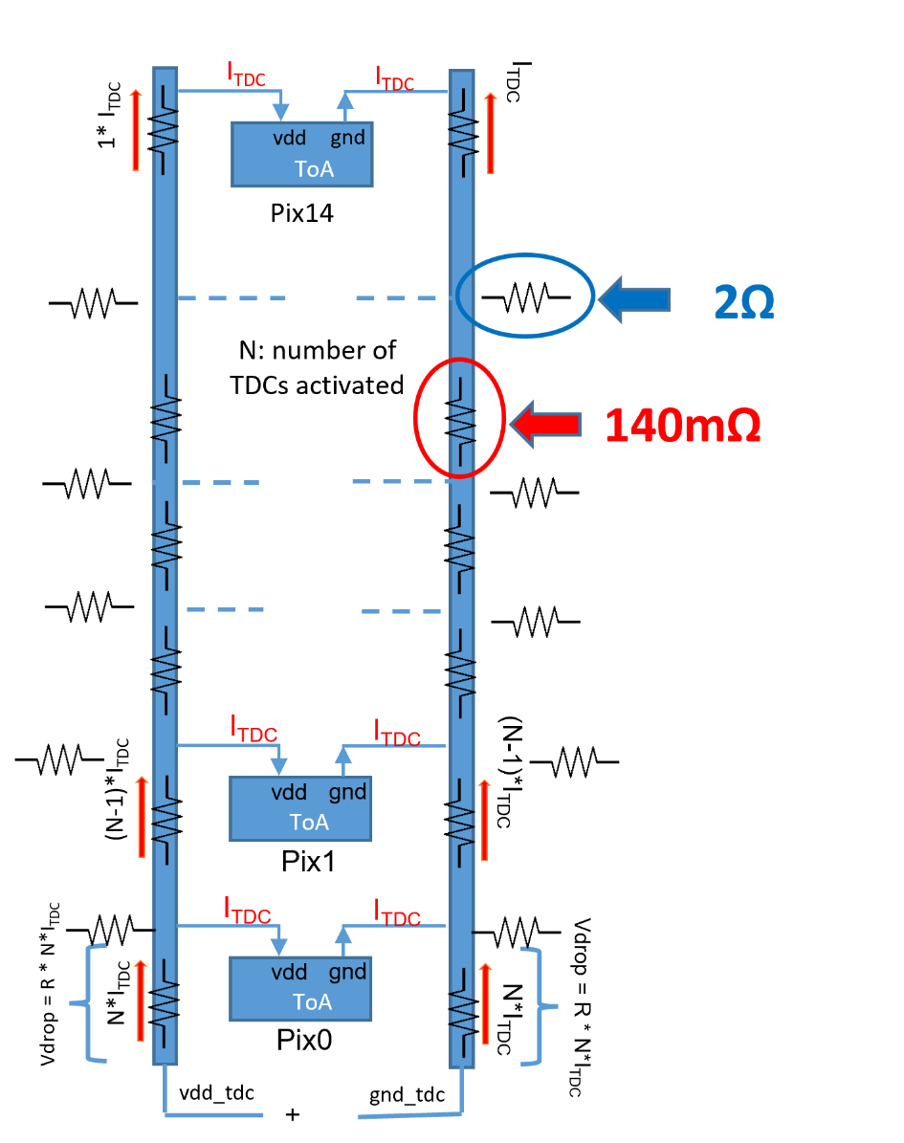
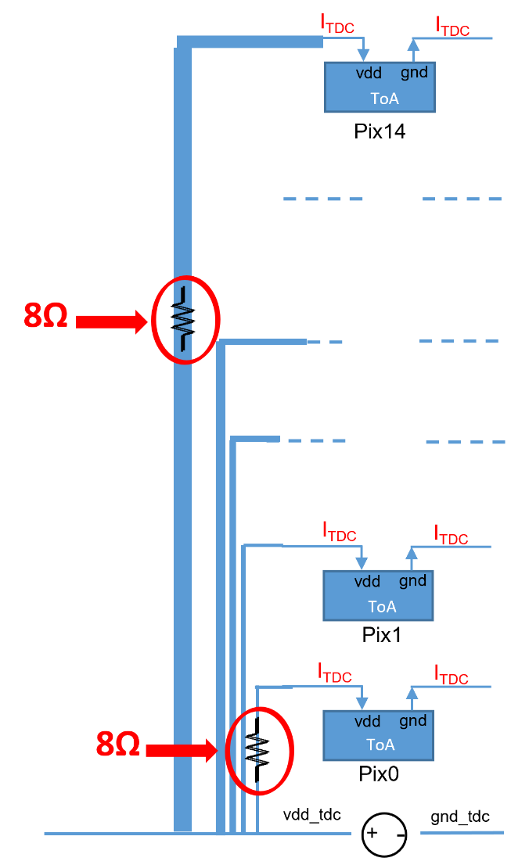
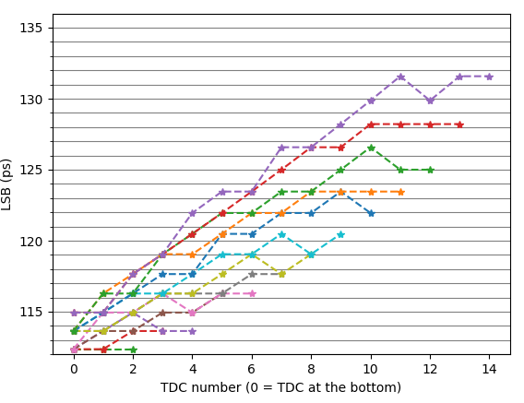
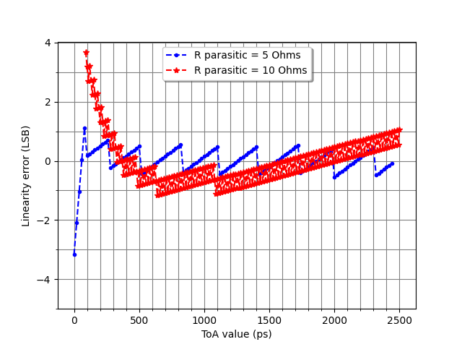
Power voltage distribution for TDCs
Altiroc2
Altiroc3
Altiroc2: common power supply distributed over the matrix → effect of voltage drops reproduced by simu.
Altiroc3:
  dedicated power rails for each TDC
  increase of the votage drop but constant
  increase of the area for TDCs power rails (685 vs 330 µm) → reduction of the digital part
  dedicated power pads for each columns
  → increase of number of pads, 2 rows needed

Slide 19
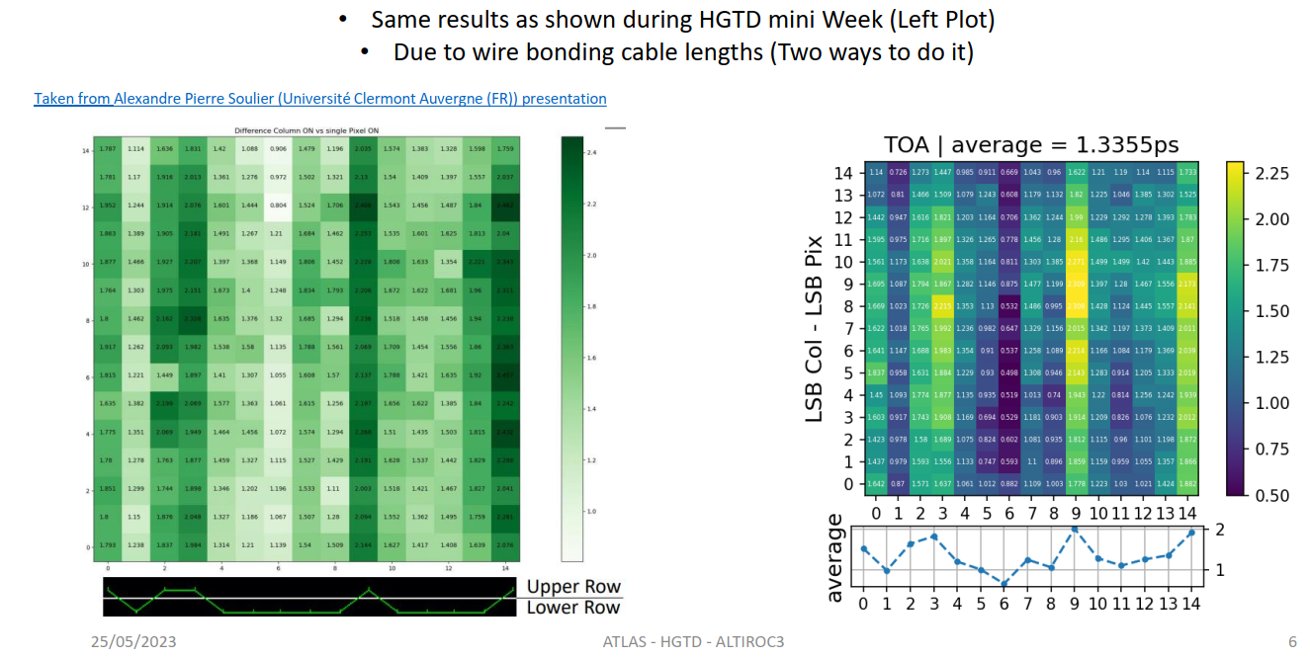
Power voltage distribution for TDCs in Alti3
Despite separated power rails, TDCs LSB is sill impacted by activity inside the column !
Difference of LSB value
column ON vs single pixel ON
credit: Salah El Dine Hammoud @IJCLab

Slide 20
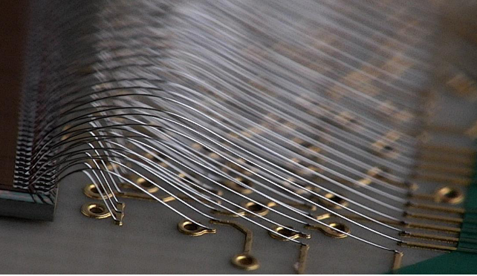
Power voltage distribution for TDCs in Alti3
Elec. resistance of wires between ASIC pads and PCB pads (thanks Christophe W. @IPHC) :
  - Lower pads row:
  1250um (loop height 500um) --> 125 mΩ
  2750um (loop height 500um) --> 275 mΩ
  - Upper pads row:
  4450um (loop height 800um) --> 445 mΩ
  5950um (loop height 1050um) --> 595 mΩ
credit: Christophe Wabnitz @IPHC
Upper row
Lower row
PCB
ASIC
Values of these resistances introduced in simulation
sensitivity of LSB to occupancy in column reproduced ( )
≈ 1ps for short WB and ≈ 2ps for long WB
Small variations between columns with same WB length not understood
Variation with occupancy limited to 5 pix/col estimated to ≈ 0.4ps

Slide 21
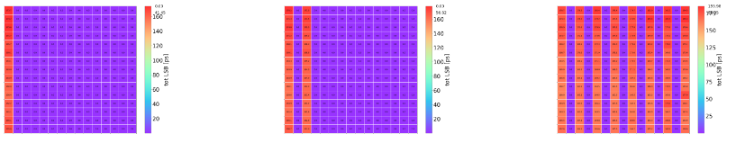
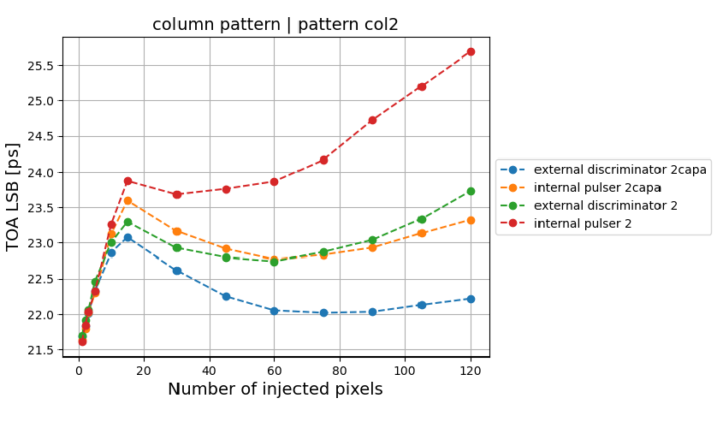
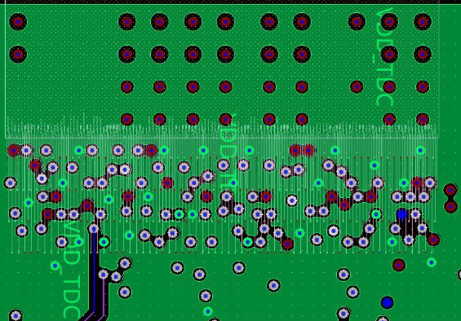
Power voltage distribution for TDCs in Alti3
Injection patter:
  1) cumulated injection in the pixels of the first column “one by one”
  2) injection into the next columns
  Always ToA LSB of pix0 observed
4 cumulated effects:
  slope 1: voltage drop with resistance of wire bonds
  slope 2: variation of reference voltages ?
  slope 3: voltage drop on PCB ?
  + effect of type of injection
Slope 2 not yet clearly reproduced by simulation
1)
2)
2)
pix0
1
gnd tdc on PCB (Pierrick D.)
3
2
credit: Salah El Dine Hammoud @IJCLab
credit: Pierrick Dinaucourt @OMEGA

Slide 22
Sommaire
0. Le détecteur HGTD
Eléments à considérer pour la distribution des alimentations
Distribution d’alimentation pour le numérique
Plan de masse pour l’analogique
Distribution d’alimentation pour les TDCs
Conclusion

Slide 23


Conclusion
La distribution des alimentations dans et autour d’un ASIC reste un enjeu majeur pour nos développements de circuits intégrés.
Altiroc cumule beaucoup (trop!) de contraintes pour assurer le niveau de performance (jitter) visé.
Les analyses IR Drop incontournables pour les alimentations numériques et analogiques.
Mesures et simulations reste LE couple indissociable pour comprendre le fonctionnement de l’ASIC sur table, et améliorer.
… de laisser partir un chip sans analyse IRDrop !!
ALTIROC

Slide 24
ALTIROC3 ASIC – Design organization
ALTIROC3 design: 7.4 FTE
    IN2P3/OMEGA Palaiseau: ASIC global architecture, Floorplan, analog and top level simulations, UVM verif - 2.2 FTE (was 1.8 FTE for Altiroc2), F. Dulucq, G. Martin-Chassard, A. Mgazli, C. de La Taille, M. Morenas, N. Seguin-Moreau, P.Dinaucourt (PCB)
    IN2P3/LPC Clermont: digital blocks (synthesis, place and route, simulation), layout, mixed-signal simulations and UVM verification – 2.2 FTE (was 1.8 FTE for Altiroc2) , N. Arveuf, L. Royer, A. Soulier, R. Vandaele
    IFAE Barcelona: Digital part architecture, digital blocks design (RTL codes) – 0.8 FTE R. Casanova
    CERN/CHIPS: digital blocks (RTL, synthesis, place and route, simulation) and UVM verification - 2 FTE G. Bergamin, S. Scarfi
    SLAC : design for R&D only. TDC and DLL parts blocks. Design and simulations - 0.1 FTE B. Markovic
    SMU Dallas: design for R&D only. Phase shifter (design and simulations). - 0.1 FTE D. Gong, X. Huang, J. Ye
ALTIROC2 characterization and testing : 5.5 FTE
    Prototypes : IFAE (1 FTE), IJCLab (2.5 FTE), LPC (0.5 FTE), IHEP (0.5 FTE), OMEGA (0.5 FTE) and USTC (0.5 FTE)

Slide 25
Backup

Slide 26
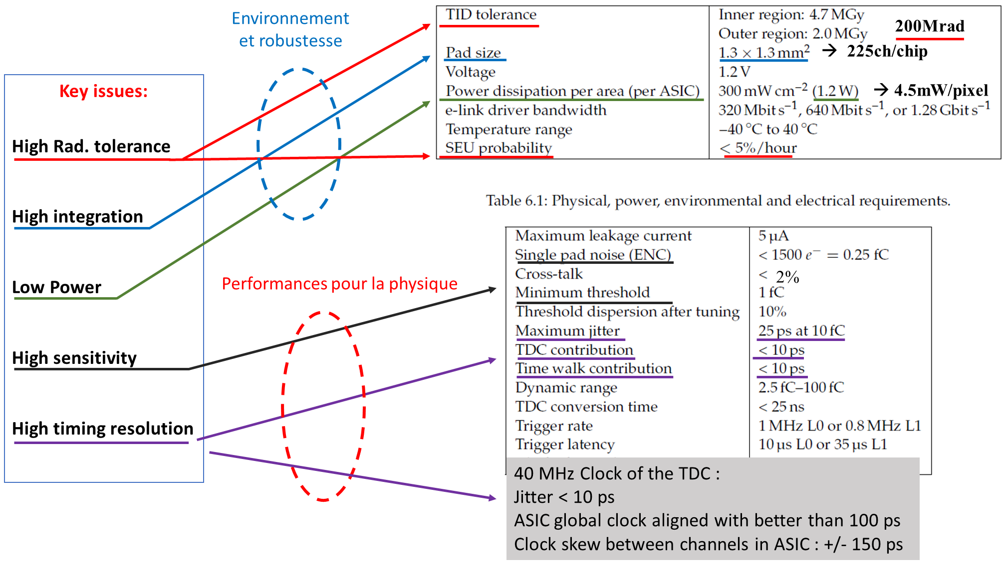
HGTD detector in one slide

Slide 27
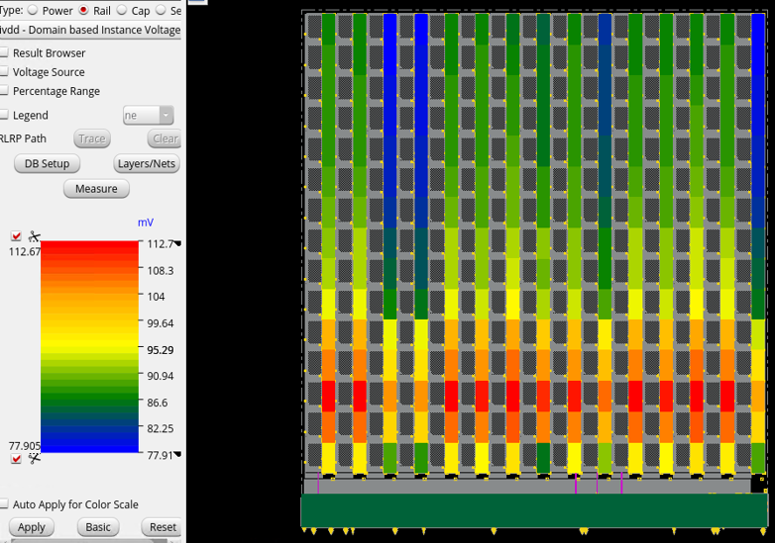
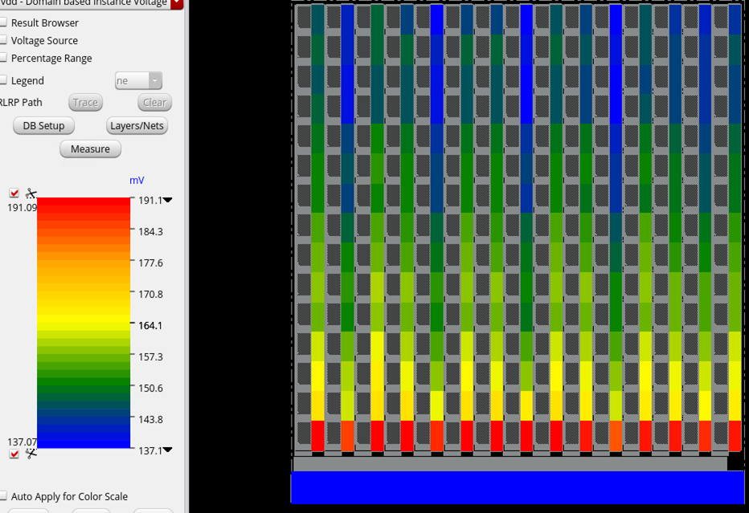
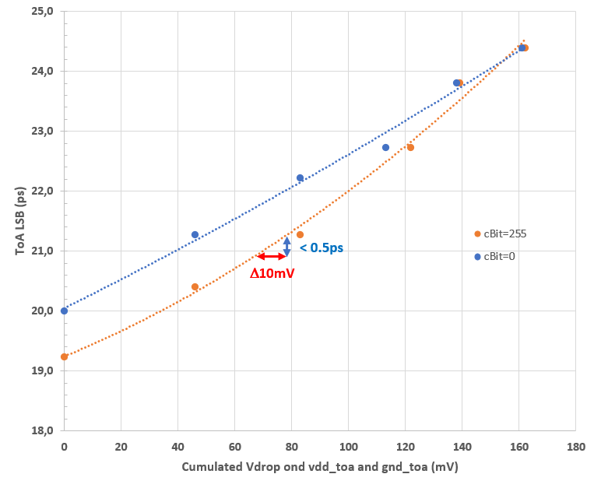
Power voltage distribution for TDCs in Alti3
TOA
TOT
Réduction Vdrop limitée par la place disponible pour le routage M7
Vdrop indépendant de l’activité sur la colonne
  ToA: 78mV à 113mV →ΔLSB ≈ 1ps
  ToT: 137mV à 191mV →ΔLSB ≈ 3ps → optimisation possible ?
Simulation LSB du ToA vs Vdrop

Slide 28
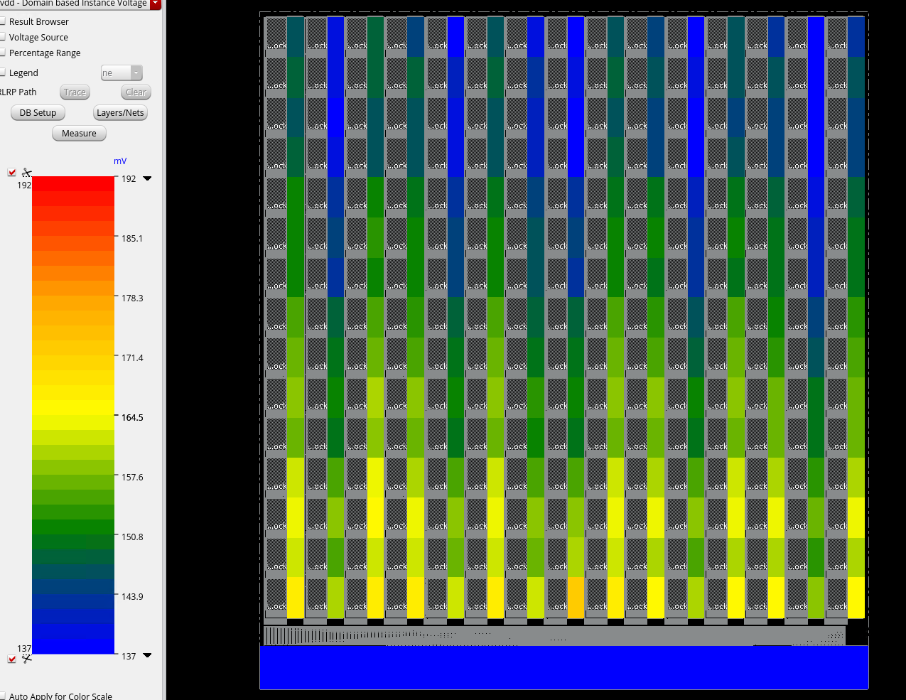
Power voltage distribution for TDCs in Alti3
TOA
TOT
Avant
Après
Alexandre
(analyse)
→ Réduction du drop de 20mV
Gisèle
(modification)
Laurent
(évaluation)
Analyse « impossible » à faire sous Virtuoso
Pas si simple à mettre en œuvre sous Voltus
Simulation LSB du ToA vs Vdrop

