Slide 1









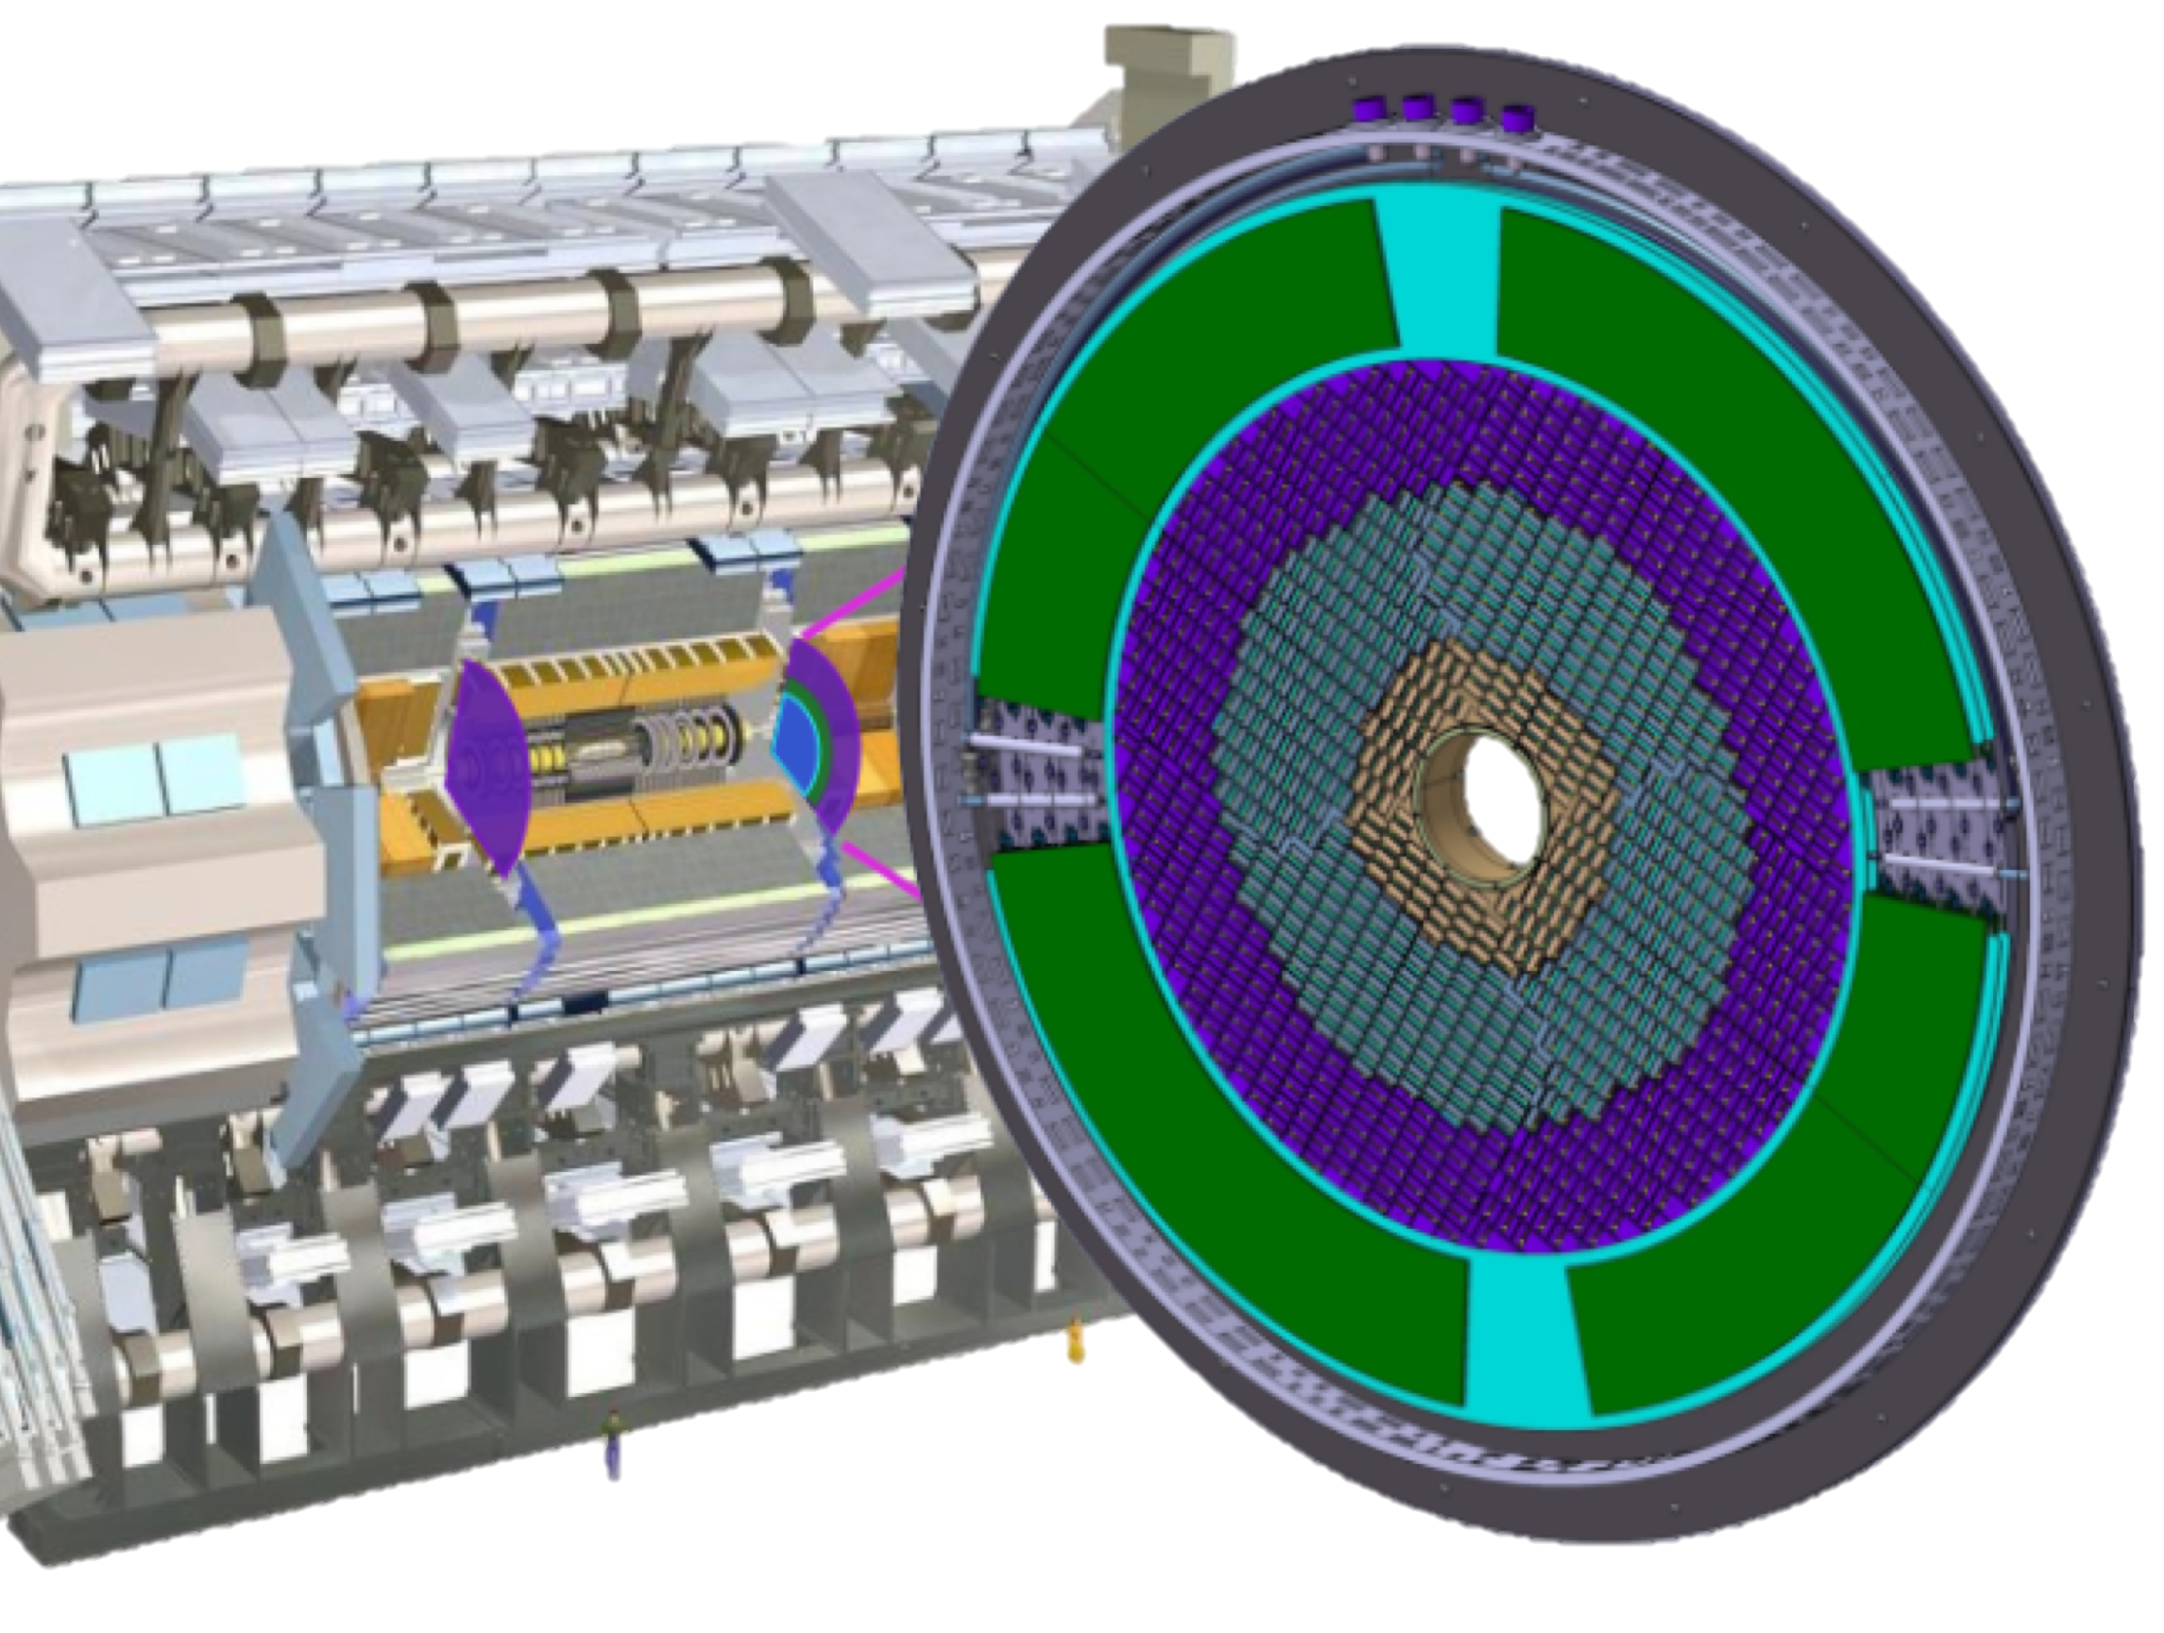


2 wheels
ALTIROC2
Maxime Morenas/OMEGA on behalf of ATLAS HGTD collaboration
Journées des métiers de l'électronique de l'IN2P3 et de l'IRFU
Performance of an LGAD readout ASIC
for ATLAS HGTD picosecond MIP timing detector

Slide 2
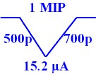
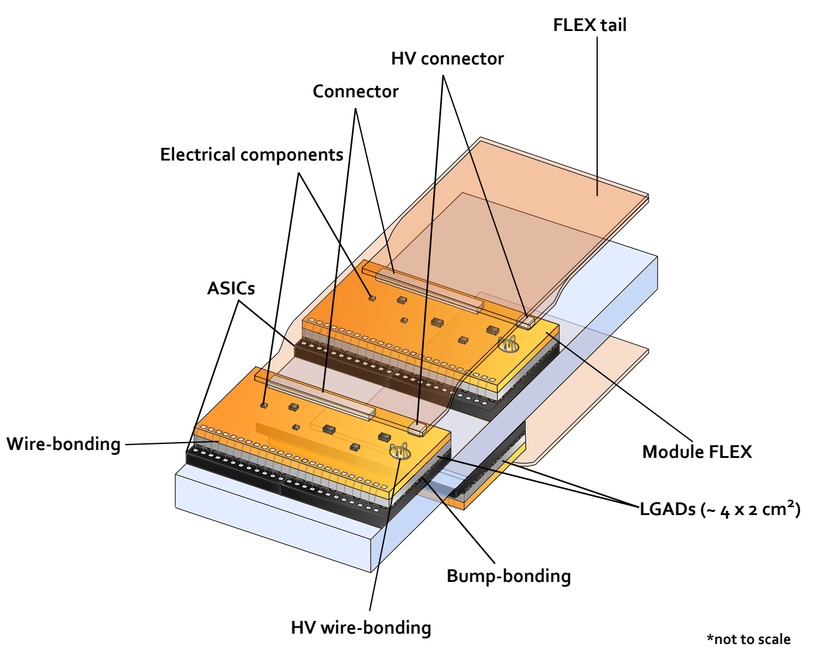
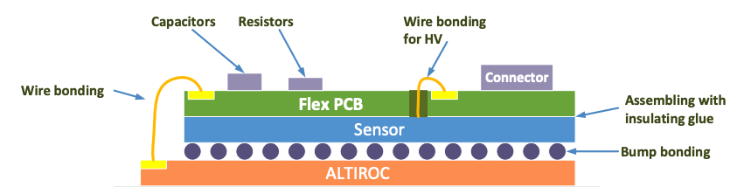
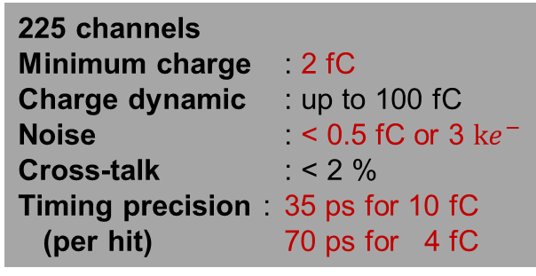
High Granularity Timing Detector in HL-LHC
LGAD sensor
1.3 x 1.3 mm²
Thickness = 50 µm
Cd = 4 pF
ASIC’S REQUIREMENTS
225 channels
Minimum charge : 2 fC
Charge dynamic : up to 100 fC
Noise : < 0.5 fC or 3 $ke^{−}$
Cross-talk : < 2 %
Timing precision : 35 ps for 10 fC
(per hit) 70 ps for 4 fC
TOA TDC
Resolution : 20 ps
Measurement window : 2.5 ns
Conversion time : < 25 ns
TOT TDC
Resolution : 120 ps
Dynamic range : 20 ns
Conversion time : < 25 ns
Calibration LGAD-like injection :
Range : 0 – 100 fC
Rise time : 0.5-1.5 ns
Radiation tolerance
TID : 2 MGy w/SF=2,25
NIEL : 2.5 10¹⁵ n_{eq}/cm² w/SF=1.5
SEE : 10¹⁵ n_{eq}/cm² w/SF=1.5
SEU rate : < 5 % per hour
ASIC power dissipation < 1.2 W
Per channel :
Analog very front-end : < 2 mW
TDC : 0,5 mW at 10 % occupancy
Digital : < 2 mW
Luminosity : Number of hits per bunch crossing for 2 time windows

Slide 3
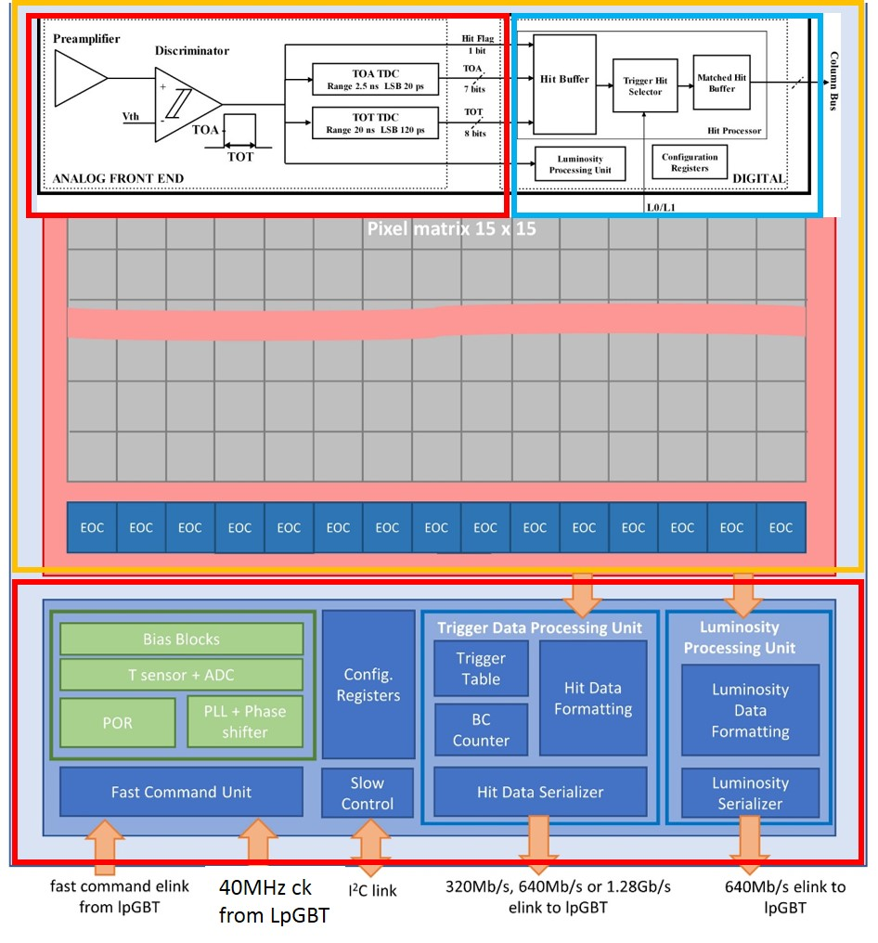
ALTIROC’s architecture
Analog front-end pixel
Digital part of the pixel
Matrix
15 x 15 channels
TSMC 130 nm
End Of Column
Luminosity process unit
320 Mbit/s fast commands decoder
Trigger Processing unit
Hit data transmission up to 1,28 Gbps
Slow Control
PLL
phase shifter
calibration pulser
Periphery
ATLAS HGTD Electronics – JME Caen – 13th June, 2023

Slide 4
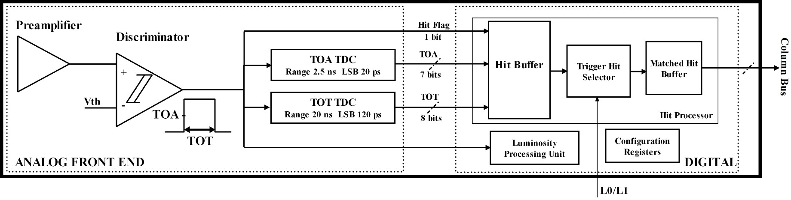

Comparing analog front-end to another timing/tracking pixel ASIC
Ratio minimum charge detectable over detector capacitance
  Altiroc: Qmin/Cd ~ 500 µV with Cd ~4 pF (1300 x 1300 µm²) and Vth min = 2 fC
  Timepix4: Qmin/Cd > 2 mV with Cd ~ 50 fF (50 x 50 µm²) and Vth min=0,1 fC
Preamp BW
  Altiroc: 1 GHz
  Timepix4: ~ 20 MHz
Power dissipation / technology / size
  Altiroc: 300 mW/cm2 + techno CMOS 130 nm + 225 channels
  Timepix4: 600 mW/cm2 + techno CMOS 65 nm + 229k pixels
C_{d}: sensor cap ( ~4 pF)
t_{d}: LGAD drift time, 600 ps
Q_{in}: MIP charge ( 10 fC at start, 4 fC at end)
e_{n}: noise spectral density of input trans.
$σ_{jitter}=\frac{N}{dV/dt}$ = $\frac{e_{n}C_{d}}{Q_{in}}\sqrt{t_{d}}$
TDC bin
  Altiroc: 20 ps
  Timepix4: 200 ps
ATLAS HGTD Electronics – JME Caen – 13th June, 2023

Slide 5
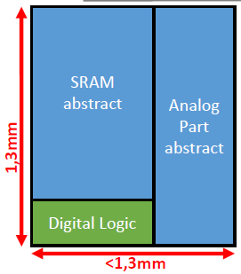
A challenging integration of the digital functionalities in 130 nm
Hit buffer: SRAM 1536 x 19 bit = Depth of about 38 µs
  Circular buffer to store timing data for each bunch-crossing, until a L1 trigger arrives
  Data = TOT and TOA bits, only in case of hit to save power ; with zero suppress.
Trigger Hit Selector:
  Each received trigger associated to a trigger tag
  If data stored in Hit buffer related to received trigger, TOA/TOT data + trig tag stored into Matched Hit Buffer
Matched Hit Buffer: 32 positions FIFO
  Control Unit: looks for data related to a trigger event when requested by the End Of Column
  Matched flag handled through a priority OR chain. Pixel at the top of the column with highest priority
  Synchronous readout at 40 MHz
Luminosity process unit
  checks if hits are within 2 programmable windows
I2C configuration registers
  Altiroc2 pixel: SRAM Latency of 38.4 µs to cope with 0.8 MHz readout bandwidth
ATLAS HGTD Electronics – JME Caen – 13th June, 2023

Slide 6
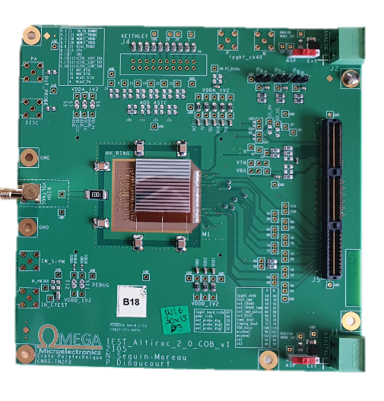
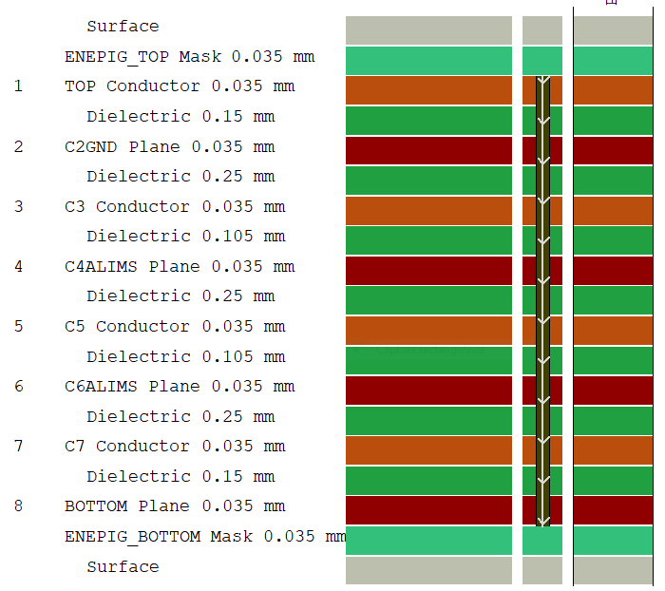
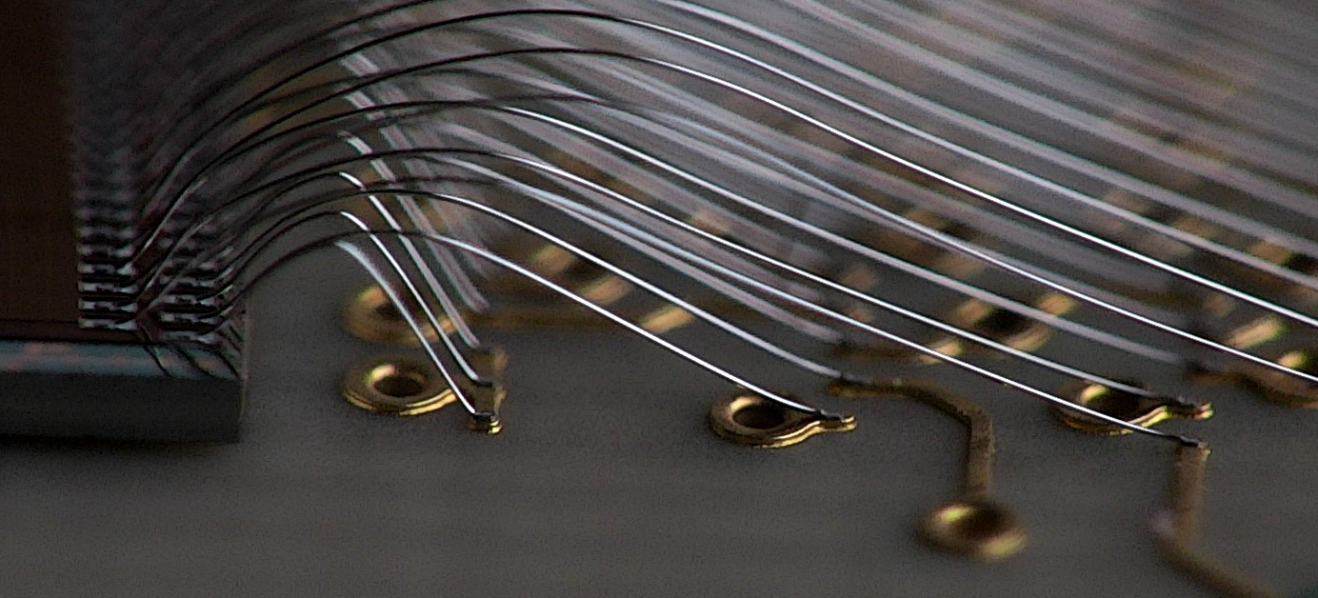
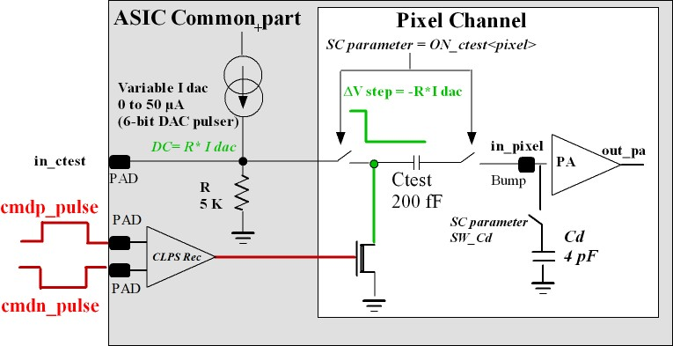
Testbench for ALTIROC2
Setup = ASIC board (ASIC alone or bump bonded onto sensor) + interface board + FPGA board
Front-end calibration : charge injection (0 up to 50 fC) using ASIC internal calibration pulser, controlled by the FPGA, synchronous to 40 MHz clock, ASIC alone: Cd=3,5 pF can be set by SC to mimic sensor capacitor
ALTIROC2 bump bonded onto an HPK LGAD
Wirebonding Altiroc3
Christophe Wabnitz (IPHC)
2 cm
Designed by Pierrick Dinaucourt (OMEGA)
ATLAS HGTD Electronics – JME Caen – 13th June, 2023
6

Slide 7
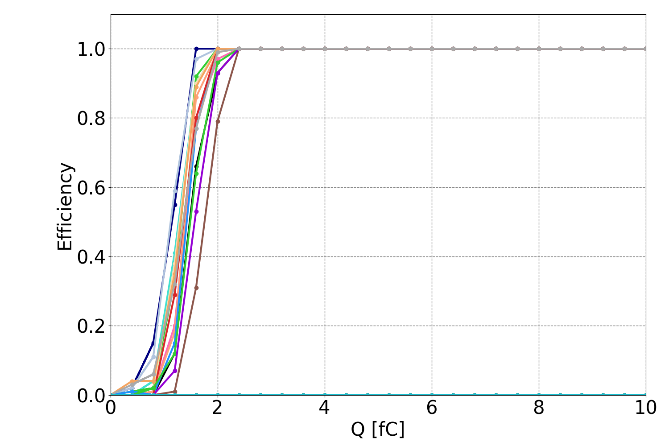
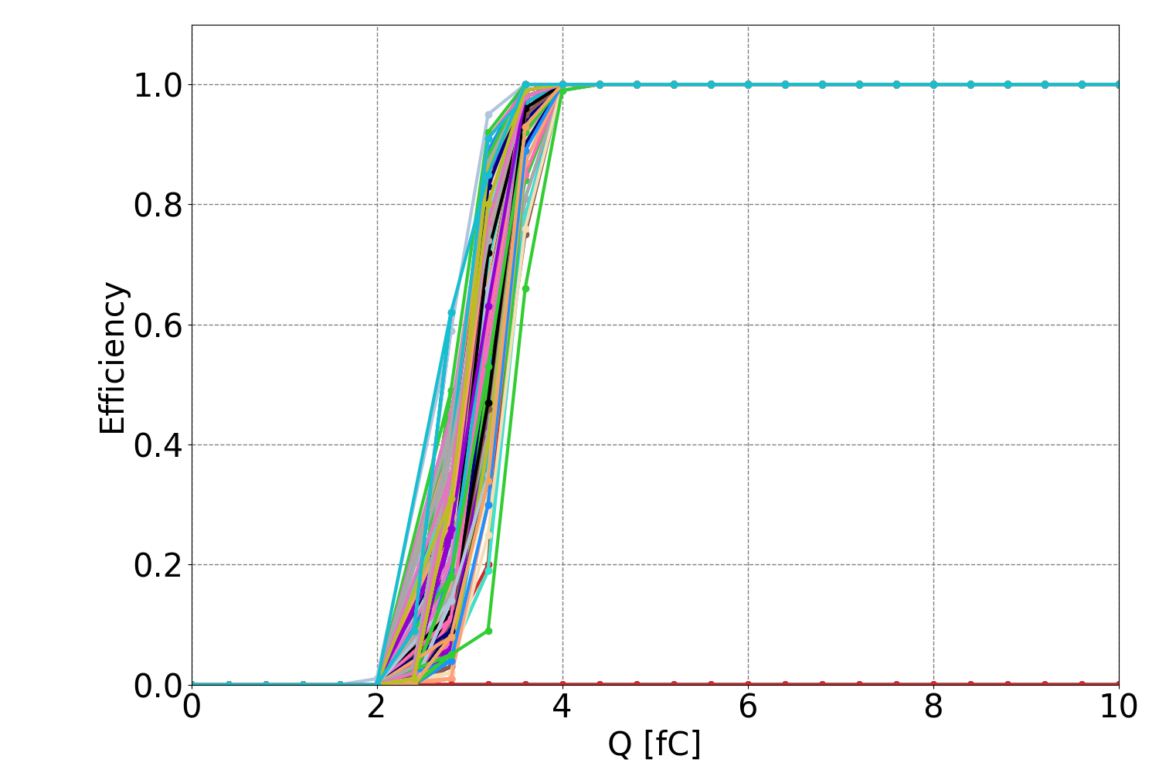
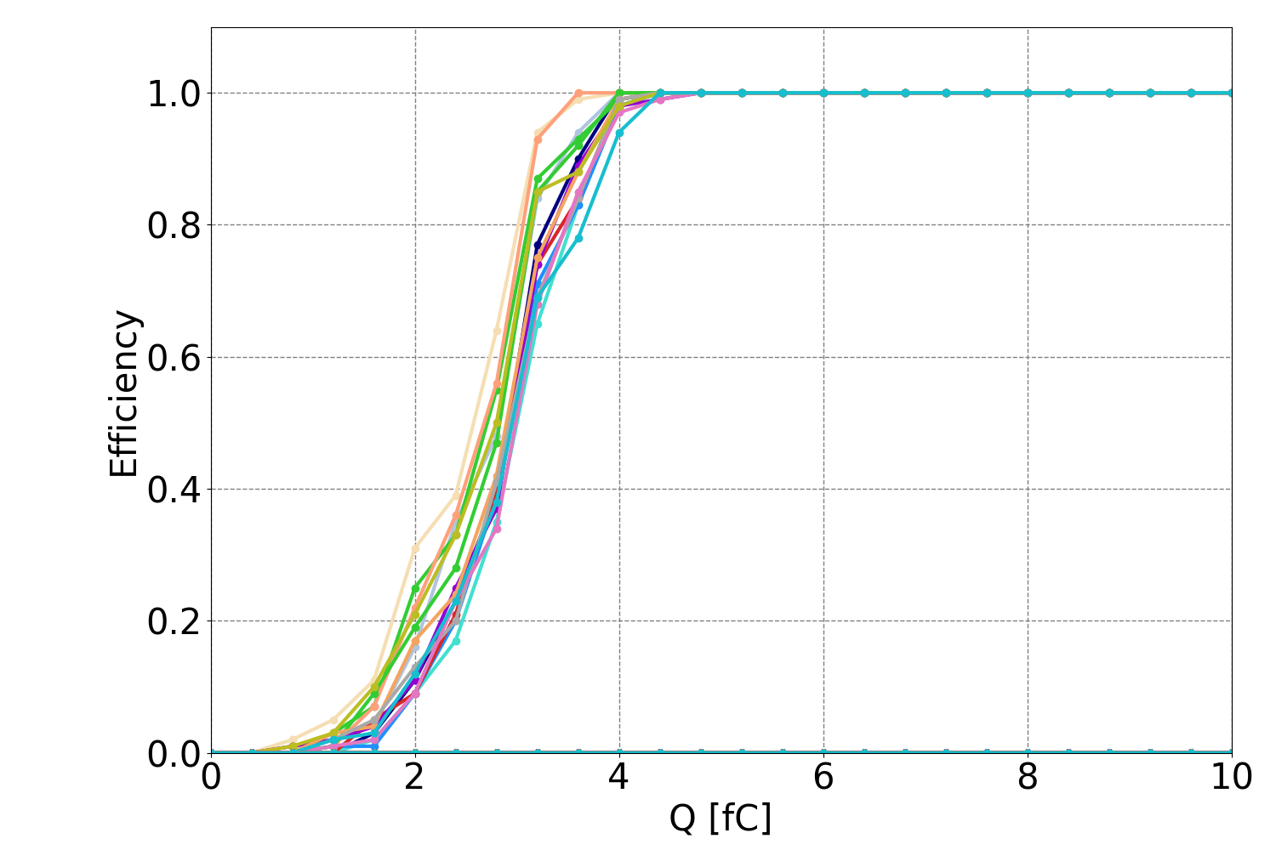
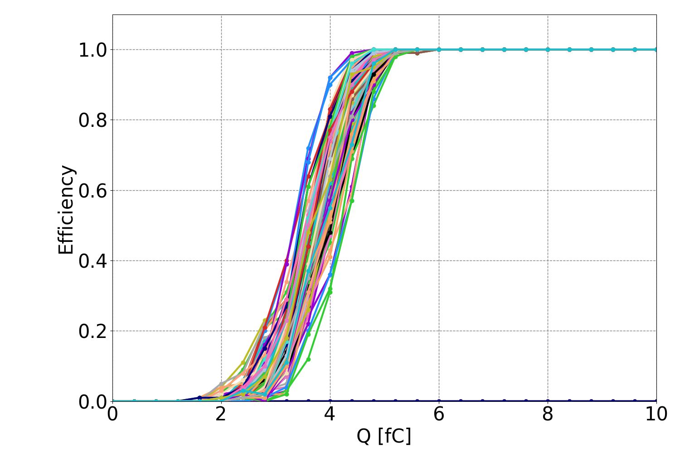
What is the minimum detectable charge ? (Median at 50%)
ASIC alone
irradiated up to 200 Mrad
ATLAS HGTD preliminary
ATLAS HGTD preliminary
All digital ON
15 pixels enabled
All digital ON
All pixels enabled
Qmin = 1.4 fC
Qmin = 3.1 fC
ATLAS HGTD preliminary
ATLAS HGTD preliminary
ASIC + LGAD
(unirradiated)
Targeted
minimum
charge
All digital ON
15 pixels enabled
All digital ON
All TZ pixels enabled
Qmin = 2.9 fC
Qmin = 3.8 fC
Transimpedance
preamplifier results
Thresholds aligned at 3.2 fC
ATLAS HGTD Electronics – JME Caen – 13th June, 2023

Slide 8
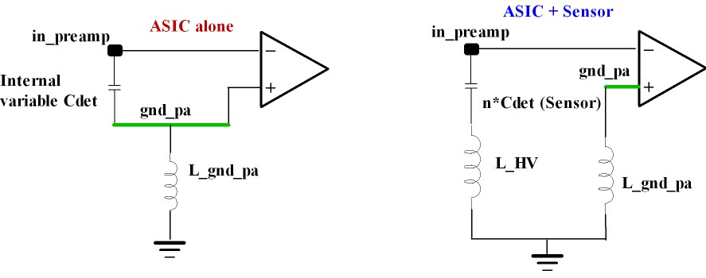
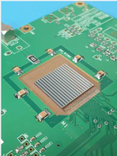
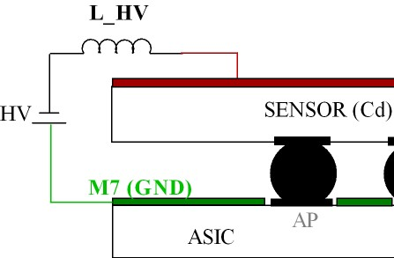
Sensor effect on noise
One channel
Can this parasitic inductance be hidden from the preamplifier ?
Noise on analog gnd amplified x1 “common mode”
ASIC alone = favourable situation
Noise on gnd_pa amplified x20
“differential mode”
Digital noise injected on the preamplifier ground gets amplified only when the impedance between the detector capacitance and the non-inverting preamplifier input is not zero : when the sensor is connected !
ATLAS HGTD Electronics – JME Caen – 13th June, 2023

Slide 9
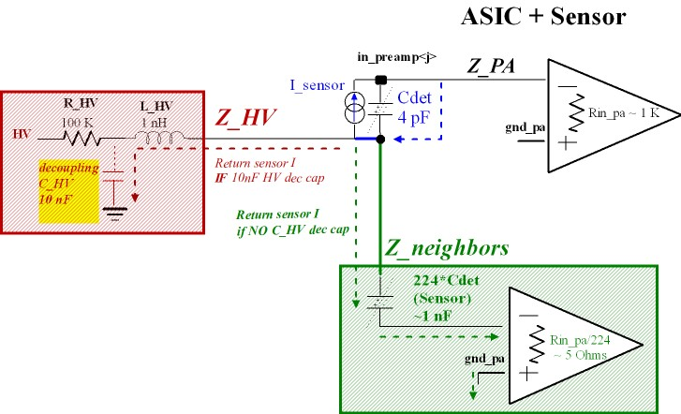
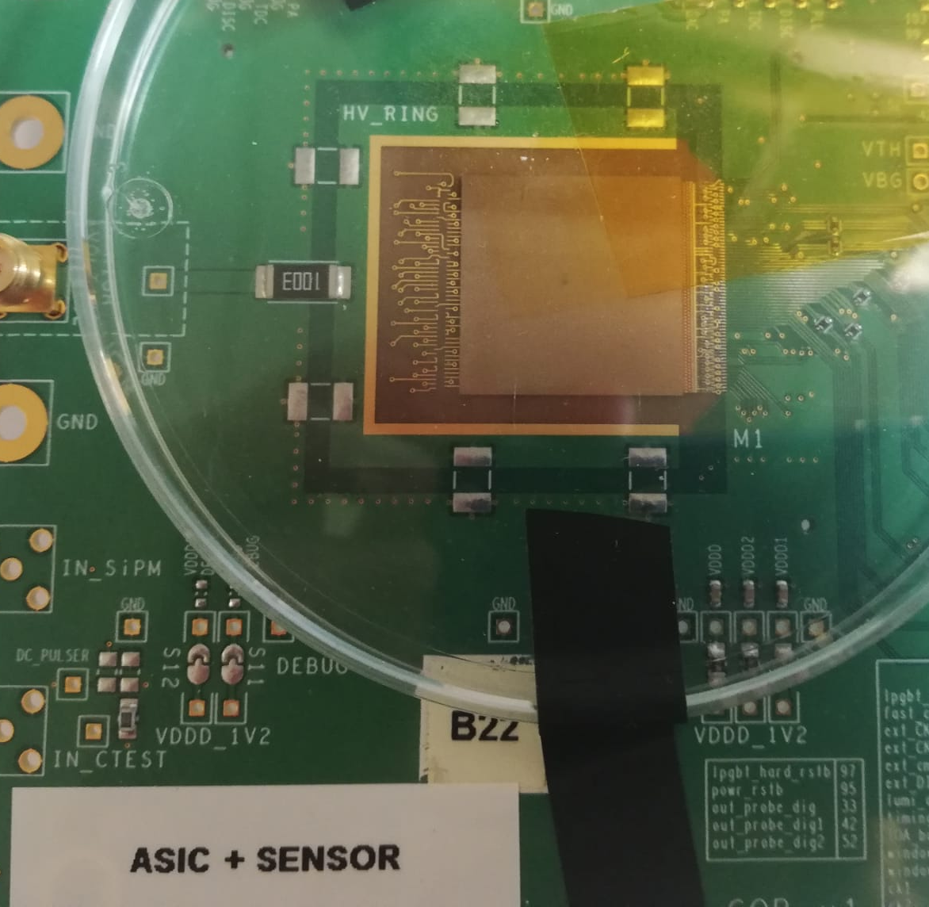
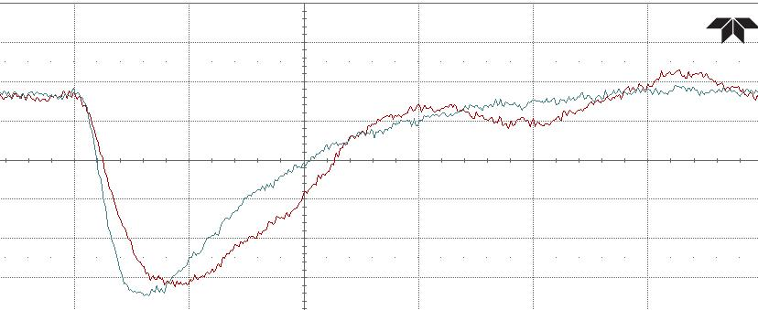
Effect of HV decoupling : where is the AC current flowing back to ground ?
Multiple channels
10 nF HV decoupling capacitor adds 50% more noise on a TZ output.
Without HV decoupling capacitor
With HV capacitor
Bump likely digital coupling inside the asic
amplified by the HV capacitor
ATLAS HGTD Electronics – JME Caen – 13th June, 2023

Slide 10
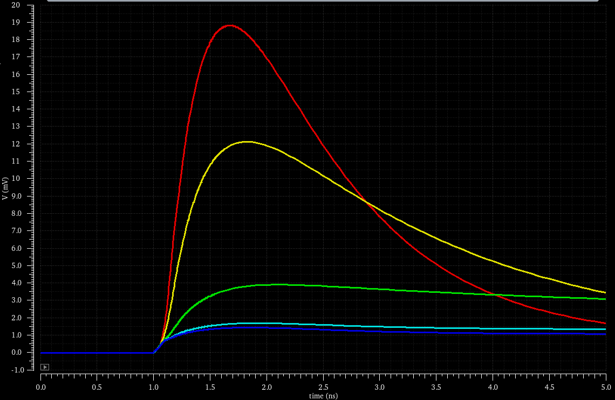
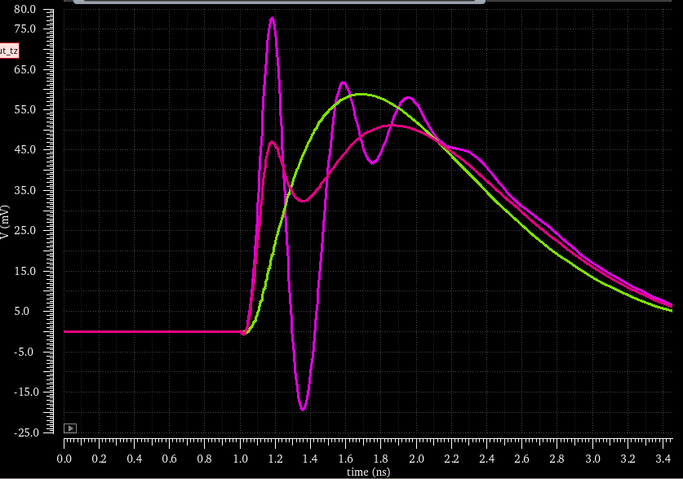


Optimal HV impedance is very different for 5x5 and 15x15 sensor
Noise amplified by PA as signal
HV resistance :
  varied from 0 to 1kOhm
  Effect on gnd_pa noise amplification
    Goes from 20 to 1
    ~1 for R>100 Ohm
  Current return ensured by the 224 spectator channels
    Was not the case with smaller sensor
HV parasitic inductance :
  Effect of 10 nH in HV
  1 channel, 25 channels, 225 channels
  = Altiroc0/Altiroc1/Altiroc2
Altiroc2 doesn’t suffer from HV parasitic inductance !
Noise x20 when $R_{HV}=0 Ω$
Noise x1 when $R_{HV}=1 kΩ$
Pulse
1 channel
225 channels
25 channels
ATLAS HGTD Electronics – JME Caen – 13th June, 2023

Slide 11
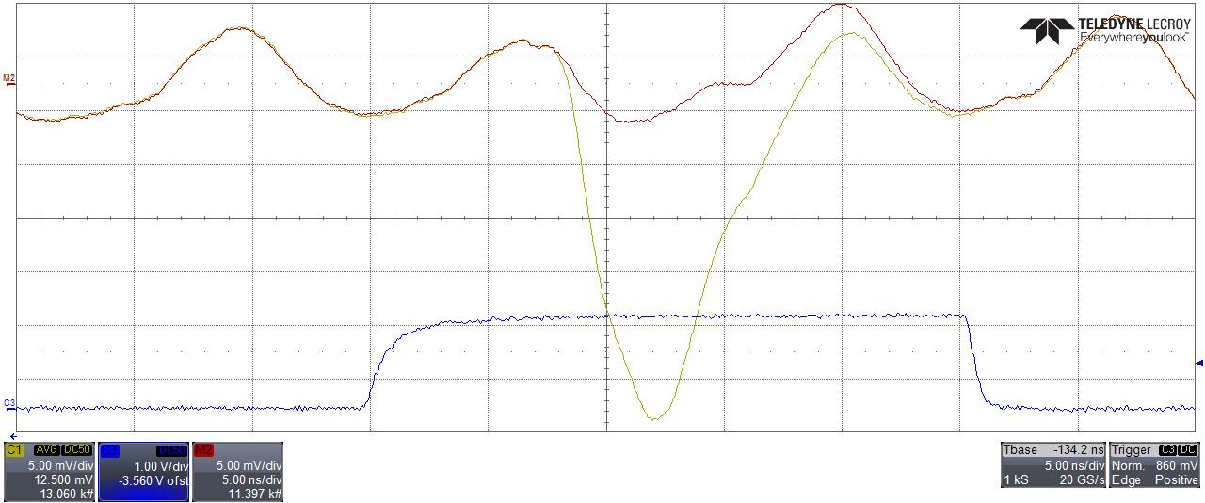

Fighting against digital activity
Probing one
transimpedance preamplifier :
20 fC injected
Signal = 30 mV
ASIC+HPK LGAD biased at -80V (B16)
Scope trigger
(FPGA calibration)
Signal aligned with noise bump
No signal injected
Noise = ± 5 mVpp
40 MHz
Digital clock couples on preamplifier gnd input : induces a noise ripple ~ 3 fC = our limit !
Minimum threshold obtained aligning the signal with the noise bump.
Preamplifier
output baseline :
(exaggerated)
Signal amplitude seen by the discriminator reduces : “hidden” inside the noise ripple !
ATLAS HGTD Electronics – JME Caen – 13th June, 2023

Slide 12
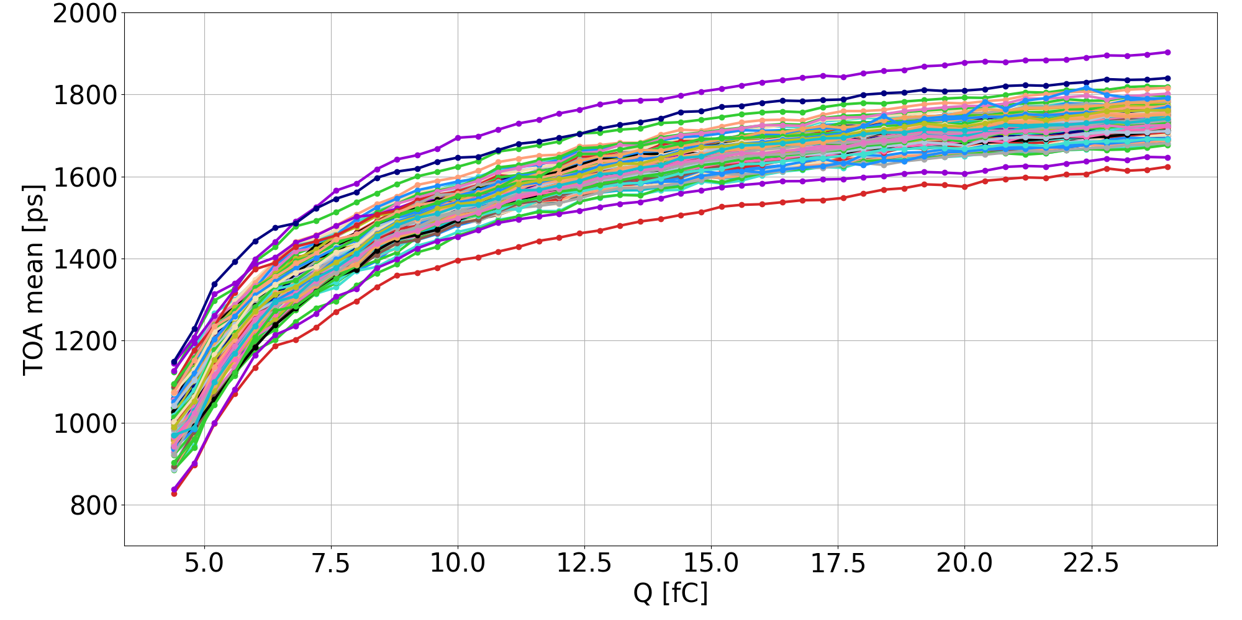
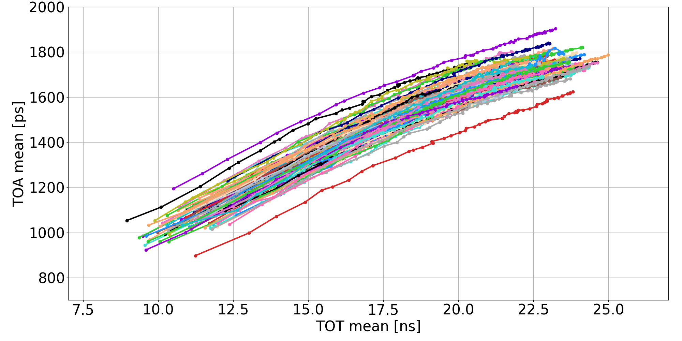
Correcting time-of-arrival timewalk with time-over-threshold
ASIC+HPK LGAD biased at -80V (B16) All TZ ON
TOA versus charge
TOA versus TOT
ATLAS HGTD preliminary
Time-walk = ~750 ps
ATLAS HGTD preliminary
Time-walk = convolution of the preamplifier rise time (300 ps) with LGAD rise time (600 ps)
Skew between bottom and top of the column pixel : due to clock tree distribution
Offline time-walk correction using TOT
ATLAS HGTD Electronics – JME Caen – 13th June, 2023

Slide 13
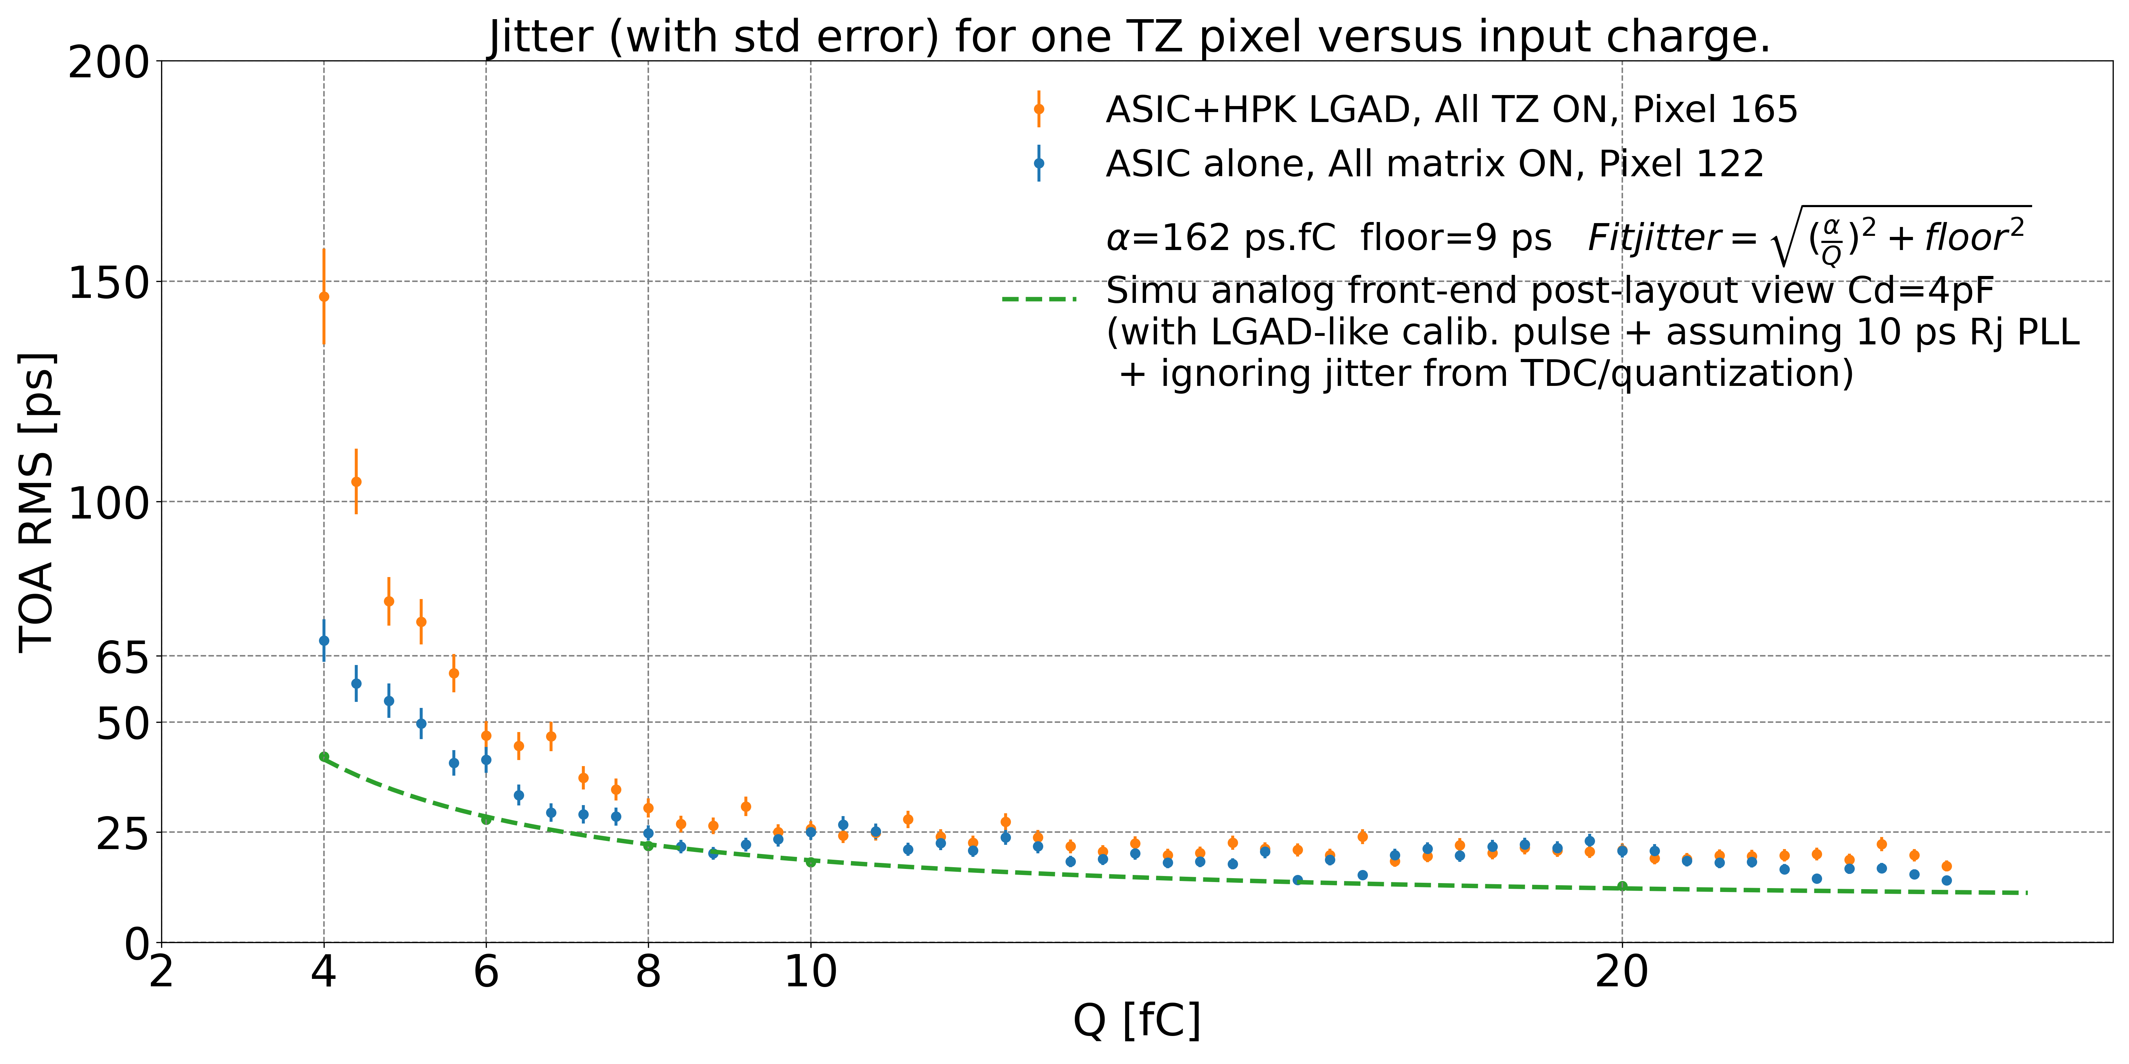
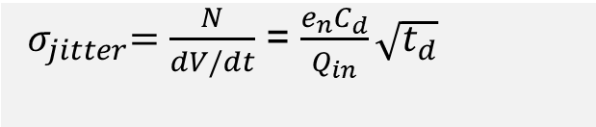
Comparing measured time-of-arrival jitter with simulation
ATLAS HGTD preliminary
${ σ}_{jitter}=\frac{N}{dV/dt}$ = $\frac{e_{n}C_{d}}{Q_{in}}\sqrt{t_{d}}$
C_{d} : sensor cap
t_{d} : LGAD drift time, 600 ps
Q_{in} : MIP charge (10 fC at start, 4 fC at end)
e_{n} : noise spectral density of input trans.
ATLAS HGTD Electronics – JME Caen – 13th June, 2023

Slide 14
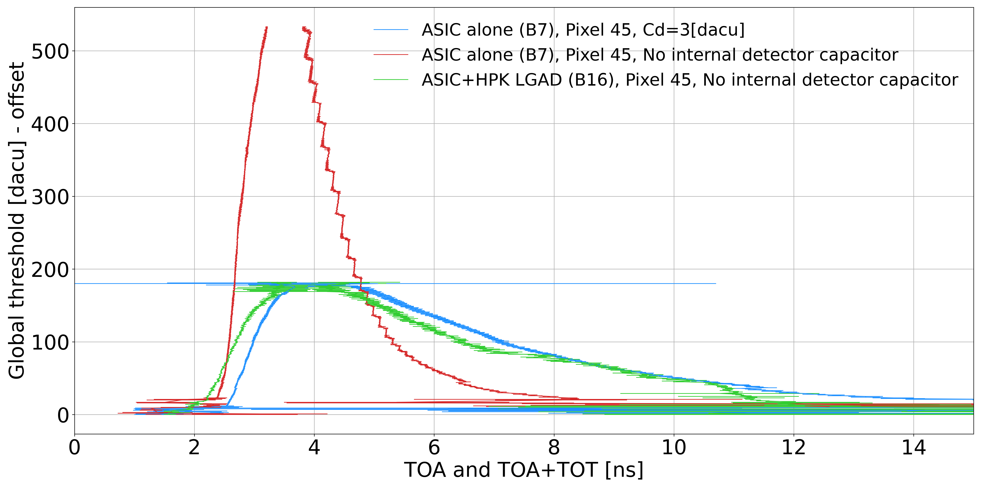
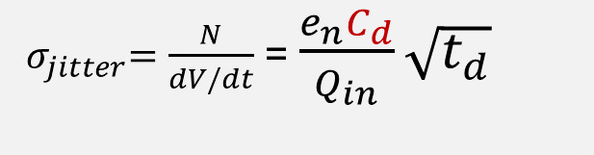
Is the internal detector capacitance equivalent to an LGAD’s ?
ATLAS HGTD preliminary
${ σ}_{jitter}=\frac{N}{dV/dt}$ = $\frac{e_{n}C_{d}}{Q_{in}}\sqrt{t_{d}}$
C_{d} : LGAD capacitance
ASIC alone without detector capacitance
ASIC alone with detector capacitance
ASIC + sensor
with
calibration pulse
Pulse reconstruction of a voltage preamplifier, between ASIC alone and ASIC + sensor :
Showing same amplitude & falling edge decay time → the internal LGAD-like capacitance corresponds to 3.5 pF.
Showing slightly slowly rising time → partially explains worst jitter with sensor.
ATLAS HGTD Electronics – JME Caen – 13th June, 2023

Slide 15
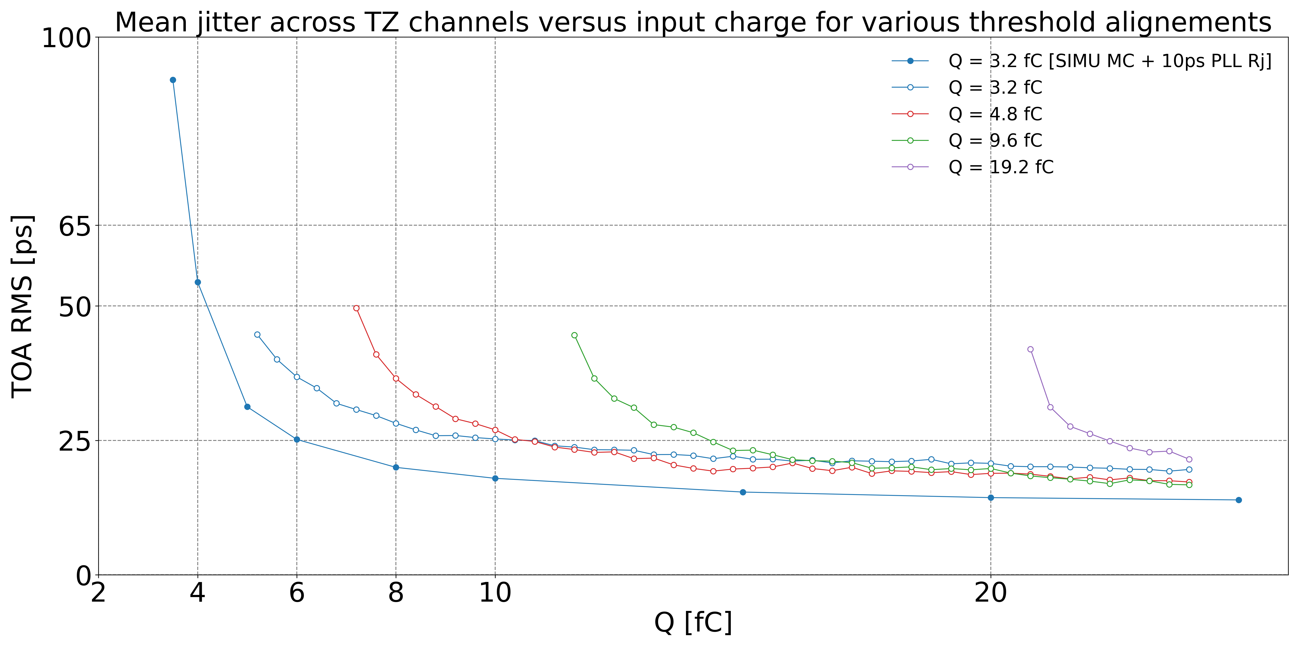
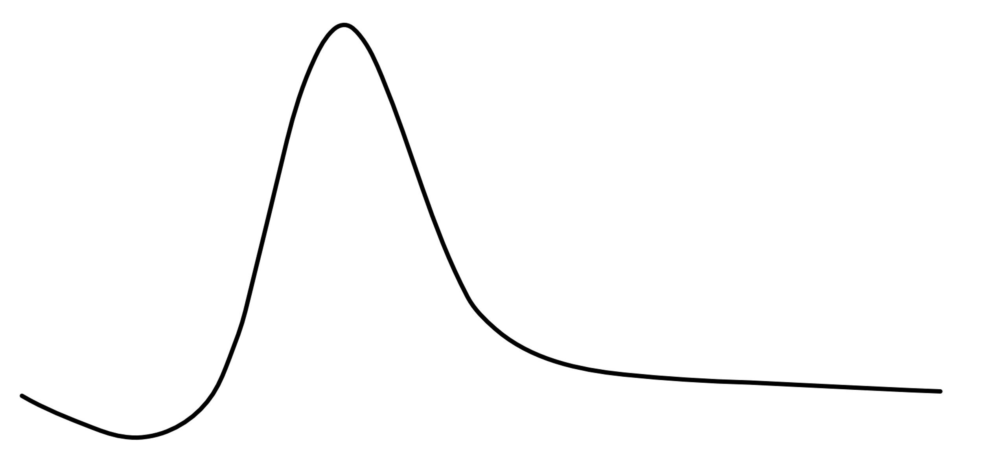


Jitter depends on the charge, but also on the discriminator thres.
ATLAS HGTD preliminary
Simulation
Lower slope, worst jitter
Amplitude
Thresholds aligned
at 3,2 fC
Higher slope, better jitter
Thresholds aligned
at 4,8 fC
Thresholds aligned
at 9,6 fC
Thresholds aligned
at 19,2 fC
Time
Threshold trade-off to maximise pulse slope (dV/dt), thus minimize jitter.
ATLAS HGTD Electronics – JME Caen – 13th June, 2023

Slide 16
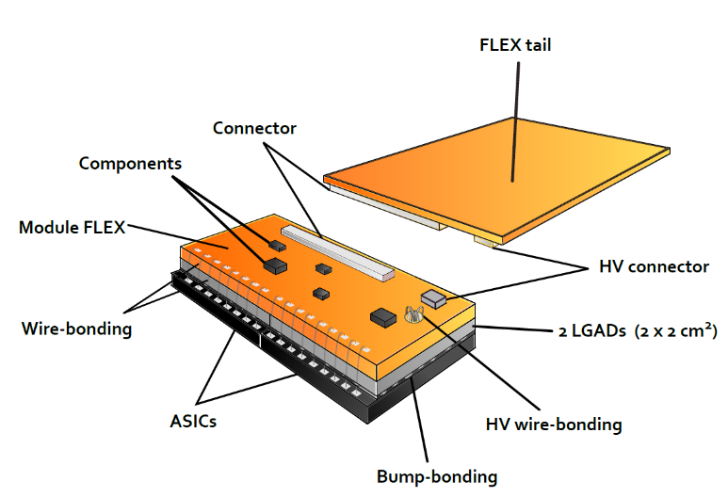
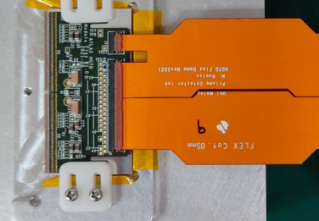
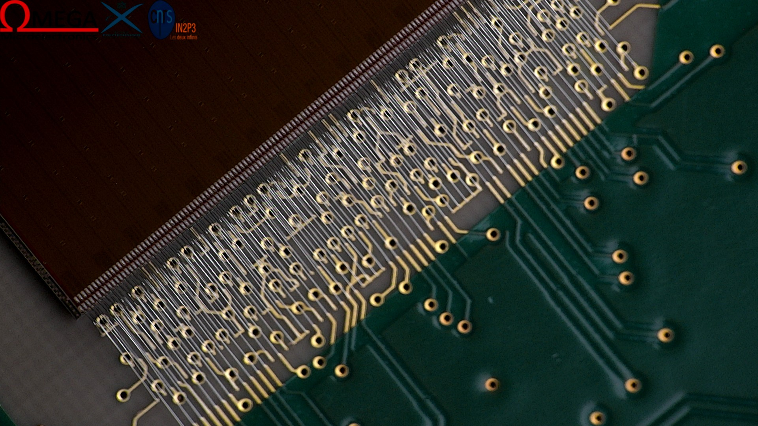
Conclusions
ALTIROC2 : first 225 channels full matrix LGAD readout chip with 1 GHz preamplifier
with 4 pF detector capacitance : new territory in HEP !
Analog performance demonstrated with ALTIROC2 are encouraging !
  Very useful to understand system issues with sensor
  First assembled module has given similar performances than full ASIC testboard
  Jitter (ASIC+sensor) ~ 25 ps at 10 fC with calibration pulse
  Vth (ASIC+sensor) can be set at ~3 fC
  Testbeam results show degraded jitter around 50 ps (~ 20 fC injected by an HPK LGAD)
  Difficulties to correct from timewalk with TOT due to digital coupling
ALTIROC3 is currently under test with improvements :
  Leveraging on bunch crossing synchronicity, using highly skewed digital logic to reduce couplings on analog
  Analog performances relies on floorplan (power distribution, grounding, IR drops, deepNwell) to minimize coupling between analog and digital power domains.
  Fully triplicated digital logic for SEE hardness
ATLAS HGTD Electronics – JME Caen – 13th June, 2023
16

Slide 17
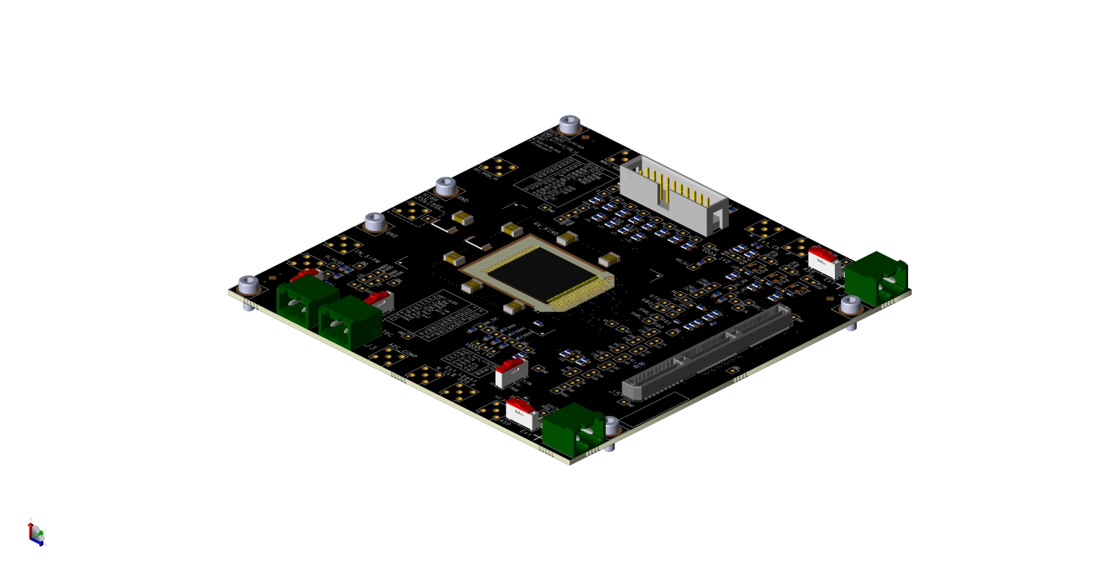
Backup
ATLAS HGTD Electronics – JME Caen – 13th June, 2023
17

Slide 18
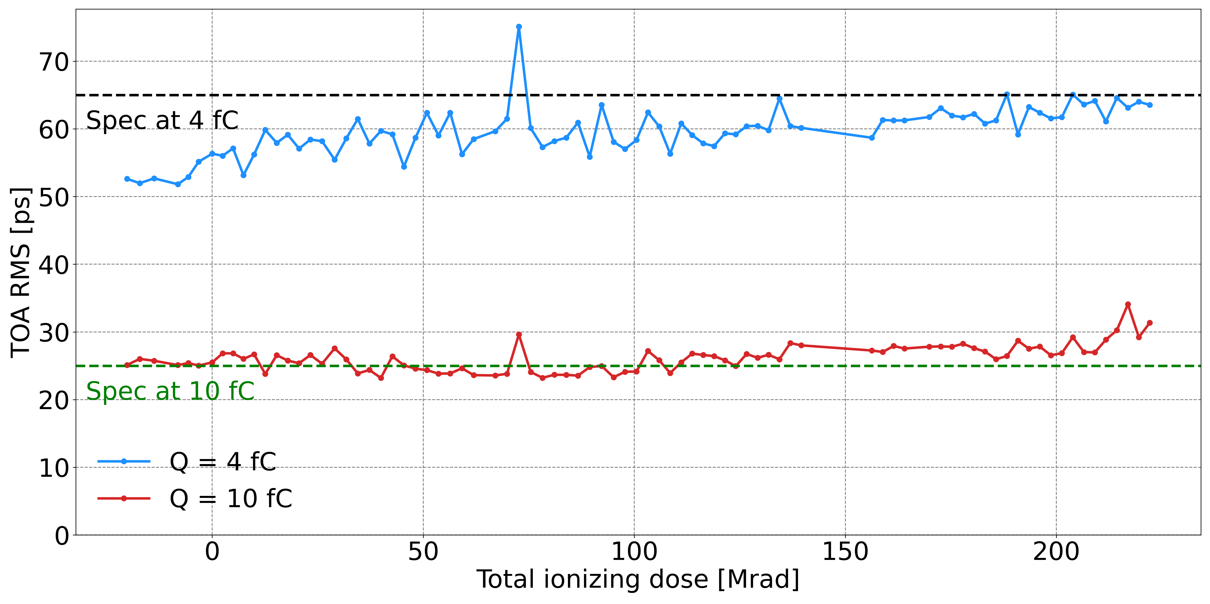
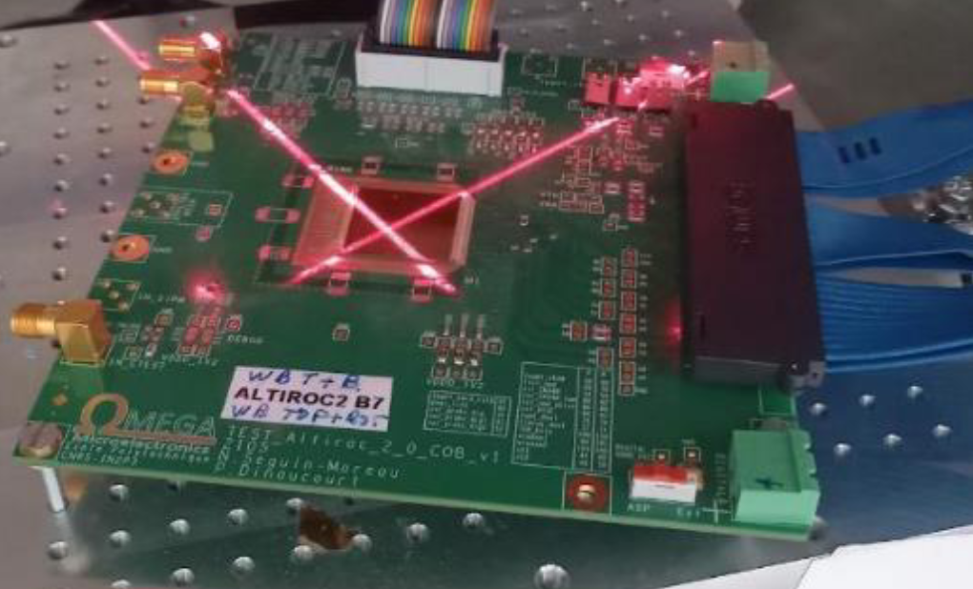
Jitter stability under TID irradiation
ASIC alone (B7) Pixels ON : Col 7 (VPA) or 8 (TZ)
TID : 220 Mrad
Dose rate : 3 Mrad/h
Temperature : 22°C
ATLAS HGTD preliminary
All DC values and TDC bin remain constant along irradiation.
ATLAS HGTD Electronics – JME Caen – 13th June, 2023

Slide 19
TOA TDC Architecture : Vernier Delay Line
TOA TDC
Resolution: 20 ps
Range: 2.5 ns
7 bits
TDC Power consumption : 0,5 mW @ 10% occupancy
Simplified Block Diagram
Time-to-Digital Converter (TDC)
2.5ns Measurement Window
2.5ns
120ps
120ps
120ps
120ps
120ps
STOP (rising edge of signal of 40 MHz) propagates in the Fast Delay Line
Delay of one cell = 120 ps
1
F1
2
F2
3
F3
4
F4
128
F128
Event
Detection
STOP
Q1
Q2
Q3
Q4
Q128
Clock
1
2
3
4
128
START (rising edge of the discriminator) signal propagates in the Slow Delay Line
Delay of one cell = 140 ps
STOP
START
S1
S2
S3
S4
S128
140ps
140ps
140ps
140ps
140ps
START
0
Q1
Q1
Q2
Q2
Q3
Q3
Q4
Q128
Q128
ToA
Bin1
Bin2
Bin3
Bin4
Bin128
Differential shunt capacitor voltage-controlled delay cells
START pulse comes first and initializes the TDC operation. STOP pulse follows the START with a delay that represents the time interval to be digitalized.
At each tap of the Delay Line, STOP signal catches up to the START signal by the difference of the propagation delays of cells in Slow and Fast branches: i.e. 140ps – 120ps = 20ps (LSB).
The number of cells necessary for STOP signal to surpass the START signal represents the result of TDC conversion
Cycling configuration used in order to reduce the total number of Delay Cells.
TDC range is equal to 128 * 20 ps = 2.56 ns
ATLAS HGTD Electronics – JME Caen – 13th June, 2023

