Slide 1
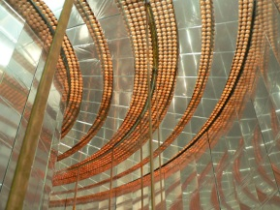
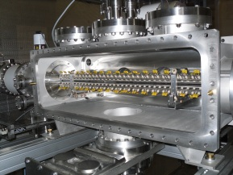
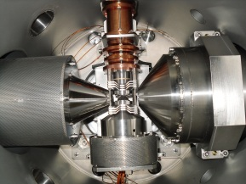
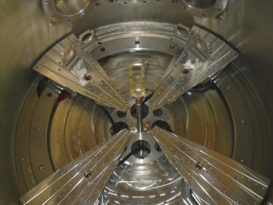
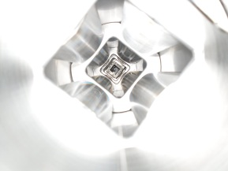
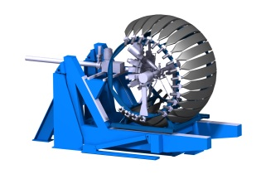
FASTER
Fast Acquisition SysTem for nuclEar Research
Assemat Julian, Carniol Benjamin,
Chaventré Thiérry, Cussol Daniel,
Fontbonne Cathy, Fontbonne Jean-Marc,
Harang Julien, Hommet Jean, Ingouf François,
Langlois Jérome, Poincheval Jérome,
David Etasse

Slide 2
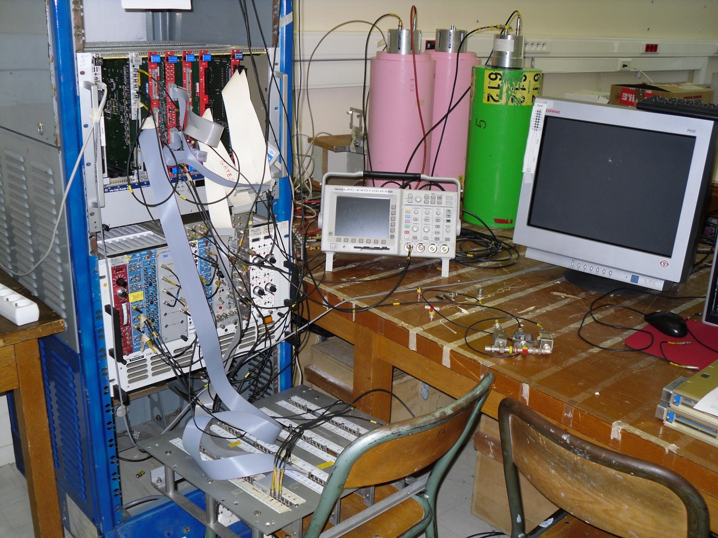
Abstract
Abstract
2023-06-14@JME Caen, David Etasse

Slide 3
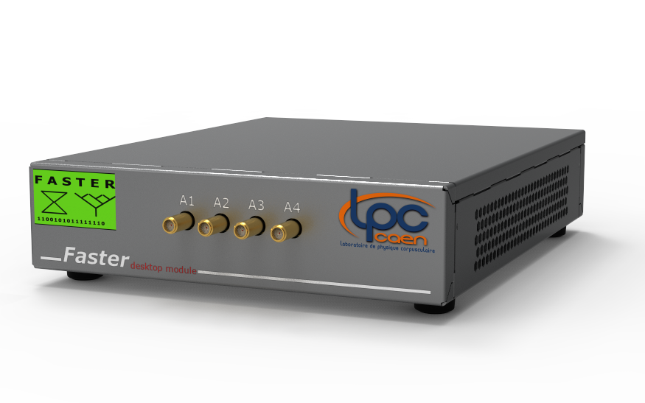
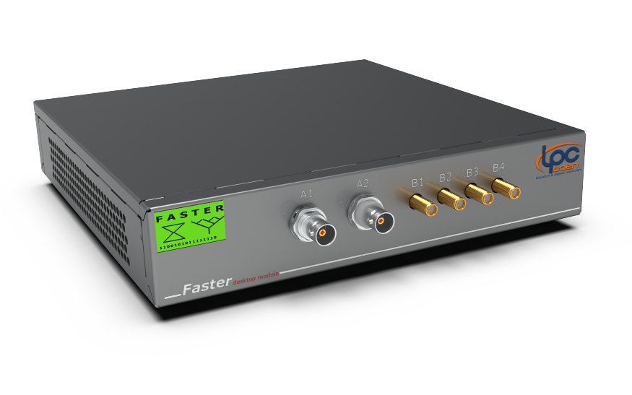
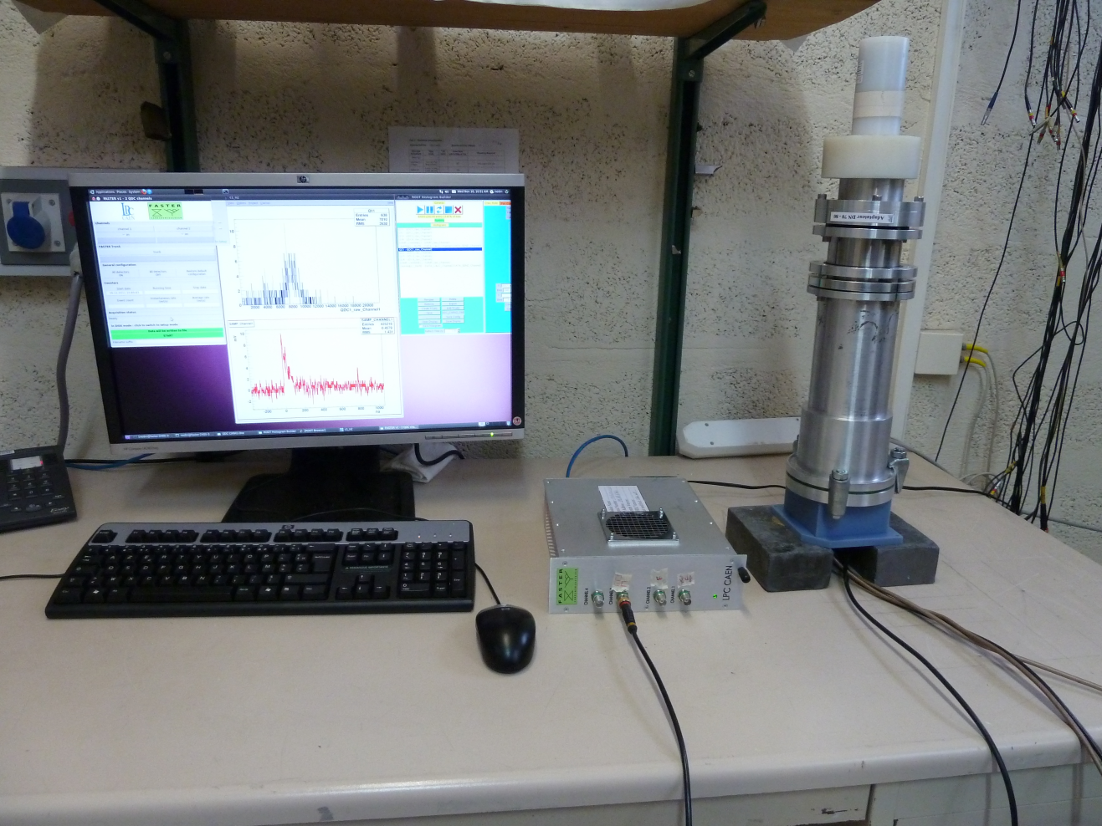
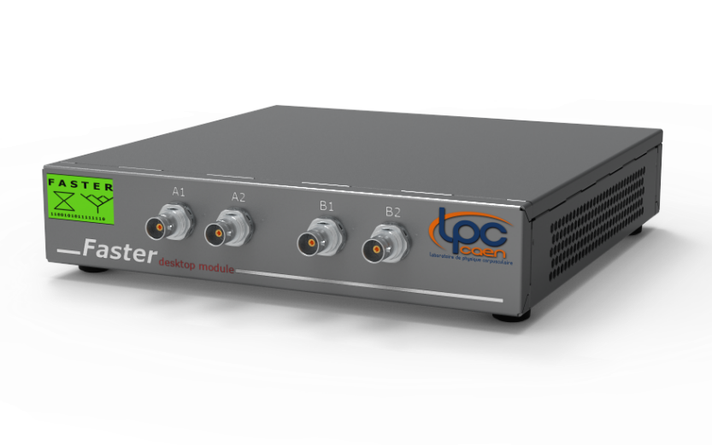
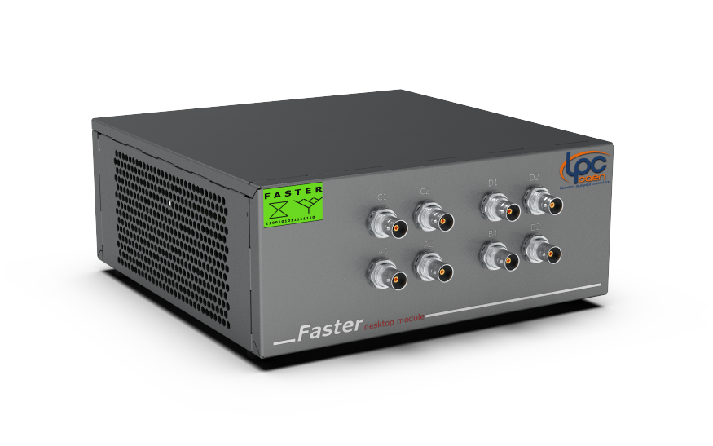
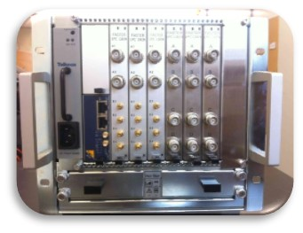
Abstract
Abstract
2023-06-14@JME Caen, David Etasse

Slide 4
Abstract
Abstract
The aim of FASTER is to build a new digital acquisition system with the following constraints:
Ensuring at least real time function such as charge, amplitude and time measurements using digital technologies,
Use of the most recent commercial components,
Use of all modern acquisition techniques (digitalization, data time stamping, serial bus)
Use of commercial chassis,
Build an adaptable and modular system which can fulfill small size experiments (1 or 2 detectors) requirements as well as much larger experiments (few hundreds of detectors) requirements.
2023-04-13@MTCA_DAY SACLAY, David Etasse

Slide 5
Agenda
Agenda
FASTER-V2
FASTER-V2 OVERVIEW
FASTER-V2 SOFTWARE
FASTER-V2 REAL TIME ALGORITHMS
FASTER-V3
FASTER-V3 OVERVIEW
FASTER-V3 HARDWARE
SUMMARY
2023-06-14@JME Caen, David Etasse

Slide 6
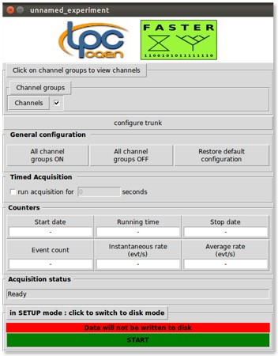
FASTERv2 Overview
FASTERv2 Overview
Offline Analysis
RHB
Real Time Algorithms
Modular Electronic
Ubuntu repository
Based on Root
2023-06-14@JME Caen, David Etasse

Slide 7
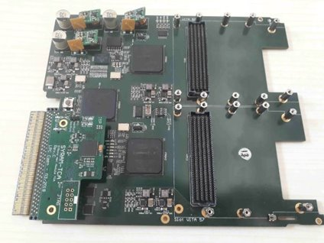
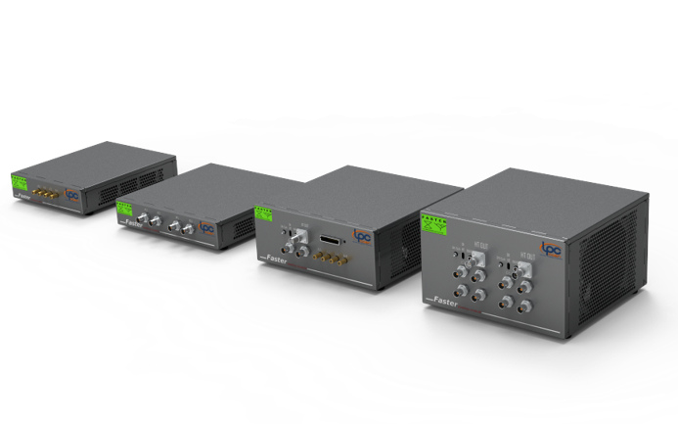
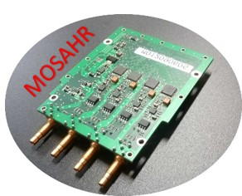
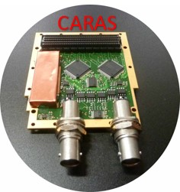
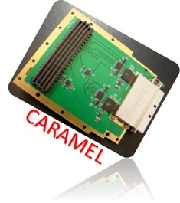
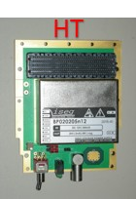
FASTERv2 Overview
FASTERv2 Overview
STANDALONE SYSTEM
MULTI-CHANNEL SYSTEM
4 FADC (125MHz@14bits)
±1V, ±2V, ±5V, ±10V input range
25 MHz Bandwidth
2 FADC (500MHz@12bits)
±1V input range
±1V input adjustable Offset
100 MHz Bandwidth
DDC316 from TI
32 channels
I-TO-V conversion front end
3pC to 12 pC (full scale)
Integration time range from 10us to 10 ms
ISEG BPS-Serie - 4W
± 500 V to ± 6 KV
2023-06-14@JME Caen, David Etasse

Slide 8
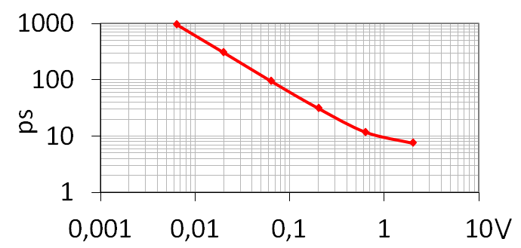
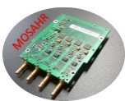
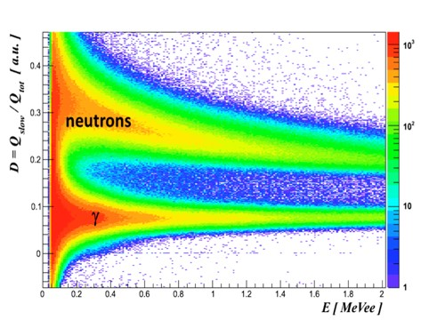
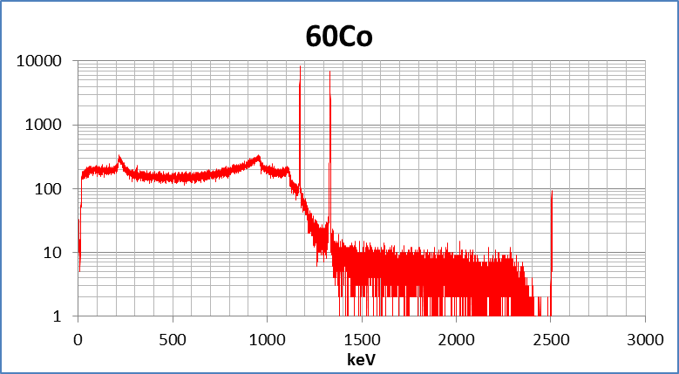
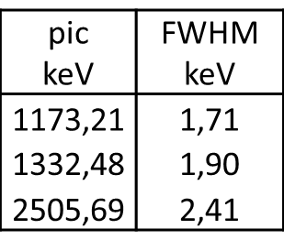
Real Time Algorithms
Real Time Algorithms
FASTER-CRRC4
FASTER-TRAPEZ-TDC
FASTER-QDC-TDC_{HR}
FASTER-QT2T
FASTER-RF
FASTER-SCALER
FASTER-SAMPLER
FASTER-ELECTROMETER
FASTER_HV
Time resolution VS signal amplitude
Demon detector, CARAS board,
FASTER-QDC-TDC_{HR}
⁶⁰Co
HPGe detector, MOSAHR board, FASTER_ADC
2023-06-14@JME Caen, David Etasse

Slide 9
Software
Software
Offline Analysis
Ubuntu 20.04 and 22.04 LTS 64 bits
ADA, C and Python
Software trigger multi levels
Faster repository on LPC Server
sudo apt_get install fasterv2
Update the software and the FIRMWARE at the same time
Offline analysis package
List of available packages
fasterv2, fasterac, rhb,
faster-rhb-xxx-demo (xxx=qdc, crrc4, trapez, rf, …… )
Ubuntu repository
2023-06-14@JME Caen, David Etasse

Slide 10
Agenda
Agenda
FASTER-V2
FASTER-V2 OVERVIEW
FASTER-V2 SOFTWARE
FASTER-V2 REAL TIME ALGORITHMS
FASTER-V3
FASTER-V3 OVERVIEW
FASTER-V3 HARDWARE
SUMMARY
2023-06-14@JME Caen, David Etasse

Slide 11
Summary
Summary
FASTERv2 is a digital modular acquisition system from the electronic front end to the histogram builder software developped at LPC.
FASTERv2 is very easy to install, to use with great performances.
FASTERv2 is able to perform the main nuclear functions with a set of hardware very reduced.
FASTERv2 is wireless ☺.
FASTERv2 is designed to handle medium size experiment (from one to few hundred channels).
FASTERv2 in few numbers
- 80 Systems used (~400 Modules),
- 12 Chassis, 50 Modules (December 2023),
- 2 M€,
- 3.5 FTE,
- 20 Laboratories , 3 Universities
2023-06-14@JME Caen, David Etasse

Slide 12
Agenda
Agenda
FASTER-V2
FASTER-V2 OVERVIEW
FASTER-V2 SOFTWARE
FASTER-V2 REAL TIME ALGORITHMS
FASTER-V3
FASTER-V3 OVERVIEW
FASTER-V3 HARDWARE
SUMMARY
2023-06-14@JME Caen, David Etasse

Slide 13
FASTERv3 Overview
FASTERv3 Overview
Increase number of channels per board,
Decrease Cost per channel,
Increase flexibility,
Ubuntu LTS 64 bits,
C, C++ and Python,
First release in 2024-2025.
2023-04-13@MTCA_DAY SACLAY, David Etasse

Slide 14
FASTERv3 Overview
FASTERv3 Overview
FASTER-V3
A New real time, digital acquisition platform
Same real time FPGA algorithms as FASTER-V2
+
User algorithms
+
News digitizers (16bits@125 Msps-> 10bits@5 Gsps)
+
TimeD synchronisation
+
Epics compatible
2023-06-14@JME Caen, David Etasse

Slide 15
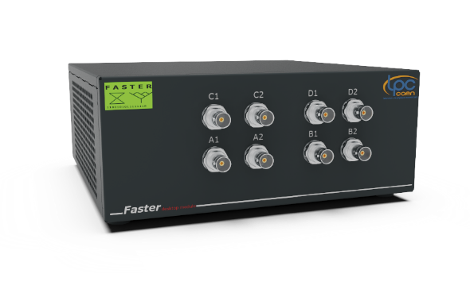
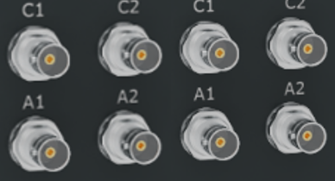
FASTERv3 Overview
FASTERv3 Overview
DAQ
Server
(FPGAs)
FASTERv2
DAQ
Client
1 Gbe
DAQ
Server
(CPU and FPGA)
FASTERv3
DAQ
Client
10 Gbe
2023-06-14@JME Caen, David Etasse

Slide 16
FASTERv3 Overview
FASTERv3 Overview
FASTERv3
DAQ Client
DAQ Server
HDMI
USB (2/3)
2023-06-14@JME Caen, David Etasse

Slide 17
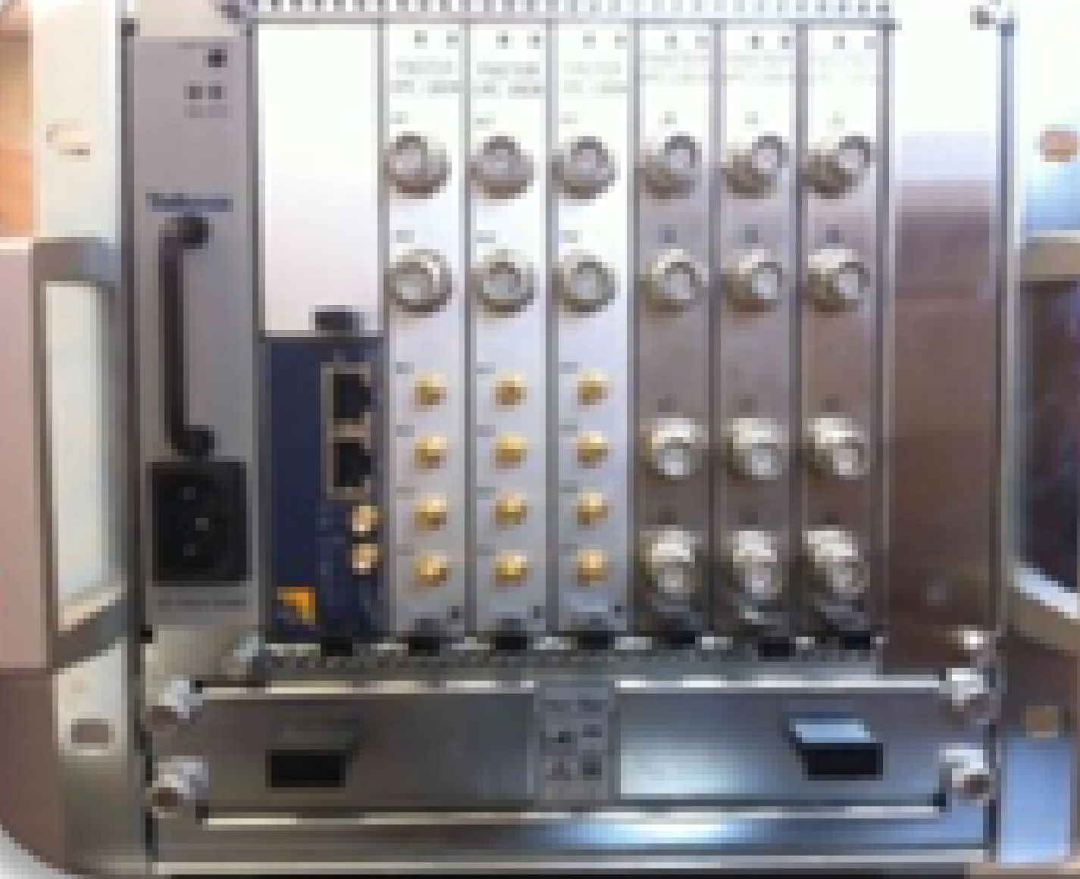
FASTERv3 Overview
FASTERv3 Overview
TimeD Compatible
Multi
DAQ Server
DAQ Client
2023-06-14@JME Caen, David Etasse

Slide 18
Agenda
Agenda
FASTER-V2
FASTER-V2 OVERVIEW
FASTER-V2 SOFTWARE
FASTER-V2 REAL TIME ALGORITHMS
FASTER-V3
FASTER-V3 OVERVIEW
FASTER-V3 HARDWARE
SUMMARY
2023-06-14@JME Caen, David Etasse

Slide 19
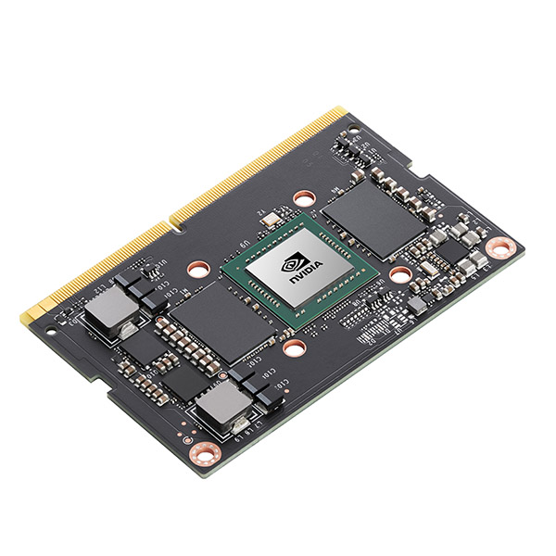
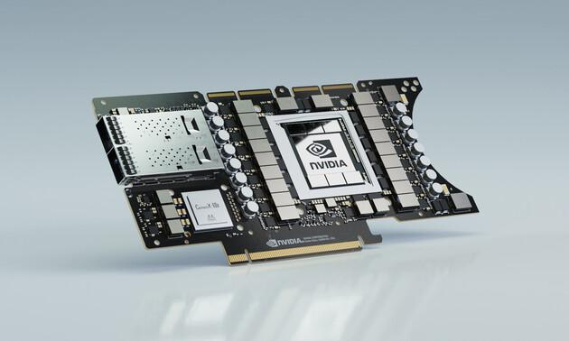
FASTERv3 Hardware
FASTERv3 Hardware
Software
Environnement
- Ubuntu 20.04
- Cuda 10
- PyTorch
- TensorFlow
- TensorRT
- C/C++
2023-06-14@JME Caen, David Etasse

Slide 20
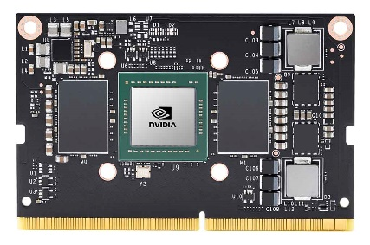
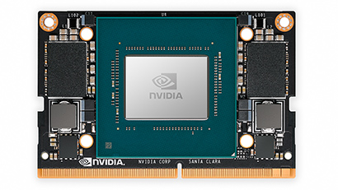
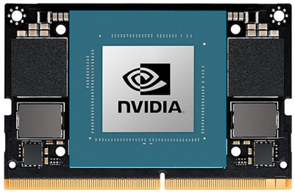
FASTERv3 Hardware
FASTERv3 Hardware
 | Jetson TX2 NX 4GB 2017 | Jetson Xavier NX 16GB 2020 | Jetson Orin NX 16GB 2023
AI Performance | 5 TOPS | 21 TOPS | 100 TOPS
Power | 7.5- 15 W | 10 W | 15 W | 20 W | 10W - 25W
Cost (HT) | 188 € | 549 € | 663 €
2023-06-14@JME Caen, David Etasse

Slide 21
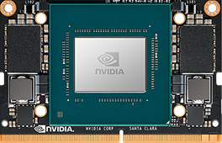
FASTERv3 Hardware
FASTERv3 Hardware
260 SO-DIMM DDR4 9.2H
MCH
1/10 Gb/s Ethernet
and
40 Gb/s Ethernet
Or
PCIe 4x Gen3
POWER
2023-06-14@JME Caen, David Etasse

Slide 22
FASTERv3 Hardware
FASTERv3 Hardware
260 SO-DIMM DDR4 9.2H
MCH
1/10 Gb/s Ethernet
and
40 Gb/s Ethernet
Or
PCIe 4x Gen3
POWER
2023-06-14@JME Caen, David Etasse

Slide 23
FASTERv3 Hardware
FASTERv3 Hardware
AFX2000
Quad Analog Front-End with 5GSPS ADC Resolution up to 16-bit and BW up to 300MHz
POWER
SPI bus
AFX2000
SCALINX
42 LVDS LANES
40 DATA
1 DFRM
1 DCLOCK
2 FADC (500MHz@12bits)
±1V input range
±1V input adjustable Offset
100 MHz Bandwidth
INPUT SHAPING
PLL
2023-06-14@JME Caen, David Etasse

Slide 24
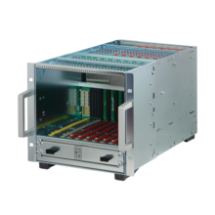
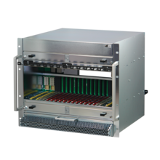
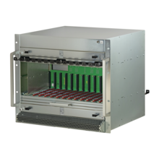
FASTERv3 Hardware
FASTERv3 Hardware
7 Double Mid-Size AMC Modules
3 FASTER-v3 modules (7 FASTER-v2)
48 Channels (28 CARAS, 56 MOSAHR )
24 CPU Cores@2Ghz, 3072 GPU Cores@918Mhz, 96 Tensor Cores
300 TOPS
48 GB RAM
3 TB SSD Pcie- Gen4
12 Double Mid-Size AMC Modules
6 FASTER-v3 modules (12 FASTER-v2)
96 Channels (48 CARAS, 96 MOSAHR )
48 CPU Cores@2Ghz, 6144 GPU Cores@918Mhz, 192 Tensor Cores
600 TOPS
96 GB RAM
6 TB SSD Pcie- Gen4
12 Double Full-Size AMC Modules
12 FASTER-v3 modules (12 FASTER-v2)
192 Channels (48 CARAS, 96 MOSAHR )
96 CPU Cores@2Ghz , 12288 GPU Cores@918Mhz, 384 Tensor Cores
1200 TOPS
192 GB RAM
12 TB SSD Pcie- Gen4
2023-06-14@JME Caen, David Etasse

Slide 25
Agenda
Agenda
Thank you for Your Attention
2023-06-14@JME Caen, David Etasse

