Slide 1



HKROC: an integrated front-end ASIC to readout photomultiplier tubes for large neutrino experiments
Journées des Metiers de l’electronique de l’in2p3 et de l’IRFU
Caen 13-15 Juin 2023
Selma Conforti– conforti@in2p3.fr
Ecole Polytechnique – CNRS

Slide 2
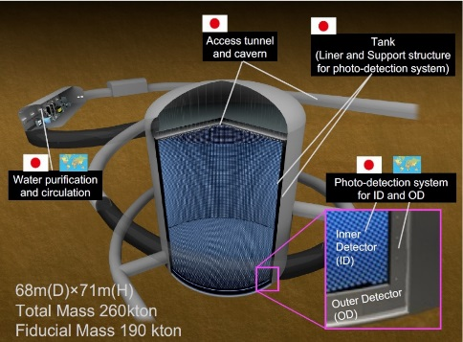
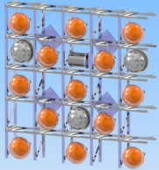
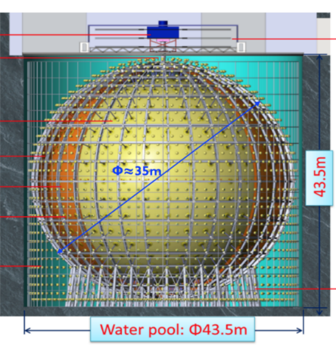
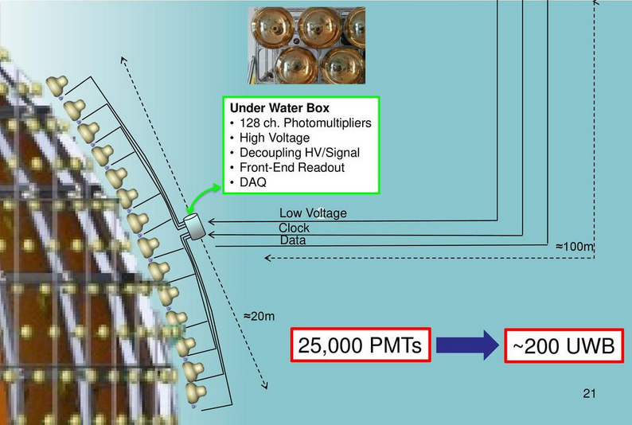
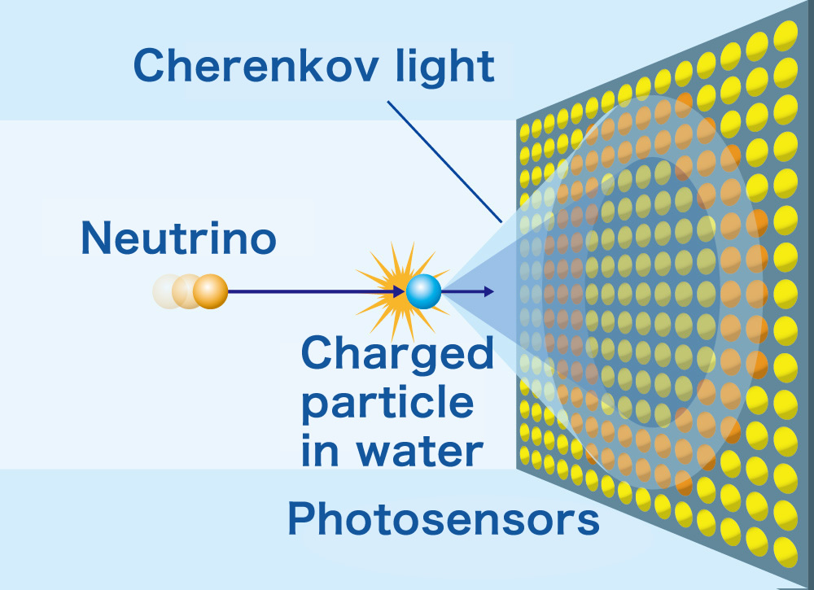
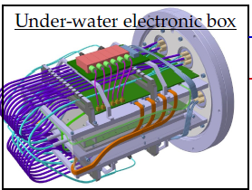
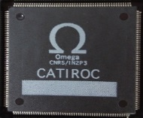
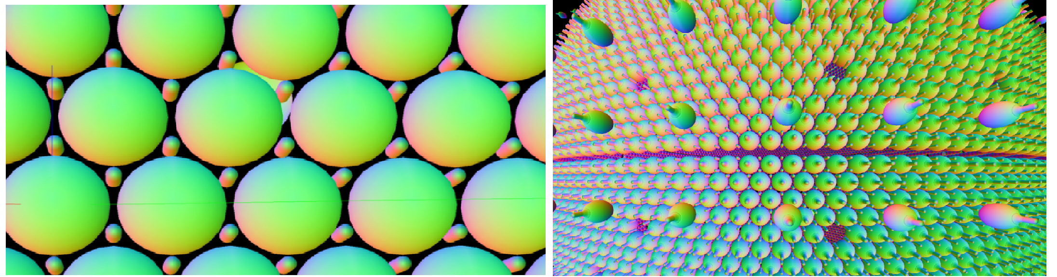
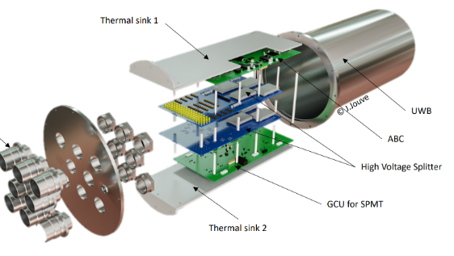
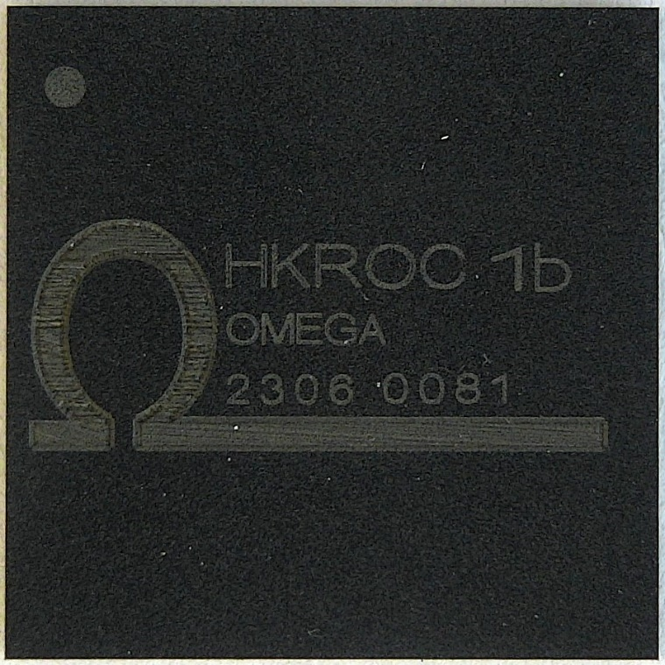
Future neutrino detectors
Next-generation neutrino experiments using a large number of photomultiplier tubes (PMTs) are currently under design and construction like Hyper-Kamiokande in Japan (water Cherenkov detector) or Juno in China (Liquid-scintillator Cherenkov detector), SNO+ Canada (Liquid-scintillator Cherenkov ), etc
Larger detectors → to improve the neutrino interactions → Neutrinos week interaction → Neutrinos with a very small mass ( 10⁻³⁶ kg)
Larger number of photodetectors
Larger number of electronics and cables
Extra Costs
Hyperkamiokande
JUNO
18,000 20” LPMTs
26,000 3” SPMTs
20,000 20” PMTs
Ready in ~2027
Ready in 2025
68 m
71m
Le système JUNO-Small PMT
et la carte ABC 128 voies
de lecture de photomultipliers 3
Abdel Rebii
15 juin 2023, 09:30

Slide 3
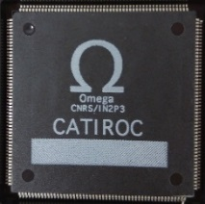
Requirements Neutrino experiments
Omega expertise in ASIC for Cerenkov detectors
Typical requirements for neutrino Cerenkov experiments |  | CATIROC | HKROC
Multichannel read-out | Large number of PMTs To reduce number of electronics boards | 26,000 3” SPMTs (Juno) 16 channels 8 CATIROC ASICs (200 boards) | 20,000 20” PMT (Hyperk) 36 channels
Independents channels | The signals arrive random in the asic chs | 16 independent channels | 36 independent channels
Auto-triggers channel @ Low trigger threshold | All the PMTs signals above a threshold are detected | TH @ 1/3 of p.e. Good 1 p.e. detection | TH @ 1/6 of p.e. (0.33 pC) Good 1 p.e. detection
Charge information (large charge dynamic range) | Cerenkov ring reconstruction (Supernova signals) | Charge dynamic range 0 to 64 pC . Photons counting (Juno) | Charge dynamic range 0 to 2500 pC. (Resolution 0.2 pC for Q < 20 pC)
Time-stamp | Cerenkov ring reconstruction | resolution ~ 170 ps rms < 1ns required | resolution ~ 150 ps rms 300 ps required at 1 p.e.
High frequency hit rate | Supernova signals | 100 kHz/ch + 16 rigger outputs | 1 MHz/ch (required)
AMS 350 nm
TSMC 130 nm
2500 ASICS
For Juno exp.

Slide 4

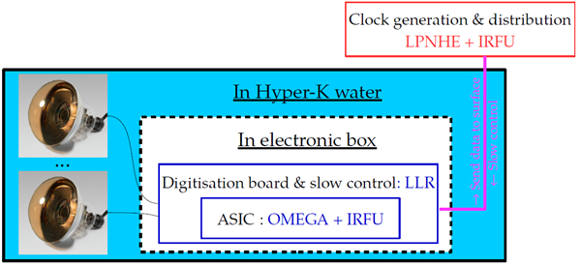

HyperK R&D: HKROC ASIC
Started R&D September 2020:
Design of a front-end board for the charge and the time measurements (“Digitizer”) for the Hyper-Kamiokande experiment:
→ Omega developed the ASIC HKROC in TSMC 130 nm node
→ 3 solutions in competition (QTC-Japan, Discrete-Italy, HKROC-France)
HKROC Layout started in March 2021 and submitted in August 21
  Designed in few months → FLOORPLAN at Omega
Receive chip in January 2022.
Provide tested chip by end of June 2022
Very good work of 3 French laboratories: LLR-OMEGA-CEA (200 pages of technical report to be submitted to the HYPERK collaboration) → HYPERK Digitizer Review decision September 22

Slide 5



From HL-LHC to the HKROC ASIC
HKROC was developed in
6 months
HGCROC for the endcap calorimeter – Phase II
Starting point is the existing ASIC used for CERN-CMS experiment
HGCROC
6M of Silicon channels
(+ 240k of SiPM)
Only minor changes
in analog/mixed part
(Analog part, PLL, ADC, TDC)
Radhard (200 Mrad)
Low Power (15 mW per chn)
Precise timing (25 ps)
Based on HGCROC,
HKROC is versatile,
low-power
and fully integrated solution
for large neutrino experiments
New data processing, easy to handle (triggerless mode, new readout scheme)
Total of 150k ASICs needed
Pre-prod this year
Project started in 2017
many years of expertize & tests!!

Slide 6

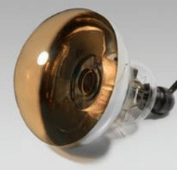
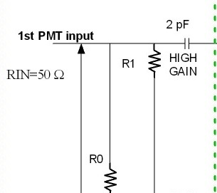
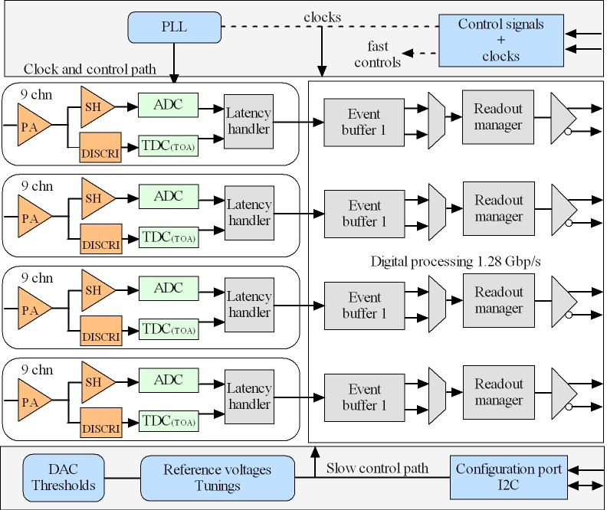
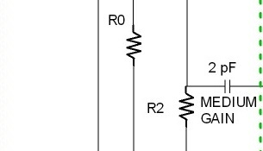
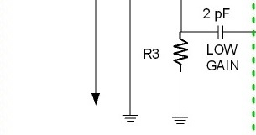
HKROC main features
HKROC is 36 channels ASIC in TSMC 130 nm node
Charge measurement with 3 gains (up to 2500 pC)
  12 PMTs with High, Medium and Low gain
  Or 36 PMTs with one gain
Integrated timing measurements (25 ps binning)
Readout with 4 high speed links (1,28 Gb/s)
HKROC is a waveform digitizer with auto-trigger
10-bit TDC (designed by the CEA IRFU group in Saclay)
10-bit SAR ADC (designed by AGH in Krakow)

Slide 7
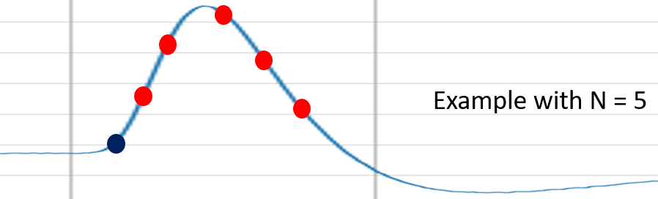
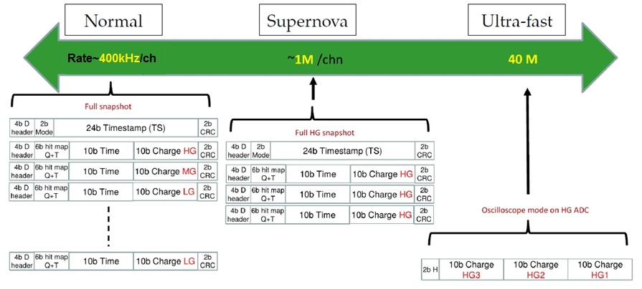
HKROC: waveform digitizer with auto-trigger
HKROC is waveform digitizer working @ 40 MHz
  Number of charge sampling points from 1 to 7
  Fast channel for precise timing (25 ps binning)
  Charge reconstruction algorithm in FPGA
    5% resources of a modern XILINX FPGA
Trigger (Time)
Normal
mode
Supernova
mode
High speed
mode
Rate 400 k /chn
~1M /chn
40 M
When using 3 gains / PMT (high, medium, low)
  Hit rate capability up to 400 kHz / PMT
  Increased up to 1 MHz by focusing on high gain
    Dynamic selectable by the user
  Average values only limited by readout speed
Full snapshot
HG snapshot
Oscilloscope mode
Only ADC charge

Slide 8
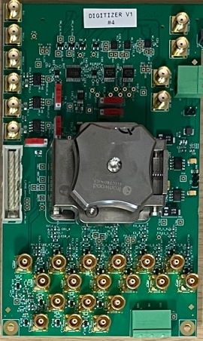
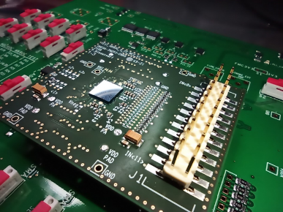
Timeline and hardware
HKROC0
2021/12
HKROC0-BGA
(x80) - 2022/06
HKROC1b-BGA
(x80) - 2022/12
HKROC1 production
(x4000) - 2023/04
HKROC-based acquisition system paper
2023/09
Mezzanine daughter board
Acquisition board
Acquisition board with reconstruction
2023/07
2021
2022
Will be sent in production
in the next months
LLR
OMEGA
LLR
Naked HKROC
on mezzanine
Packaged HKROC
with acquisition board
Packaged HKROC with charge reconstruction FPGA

Slide 9
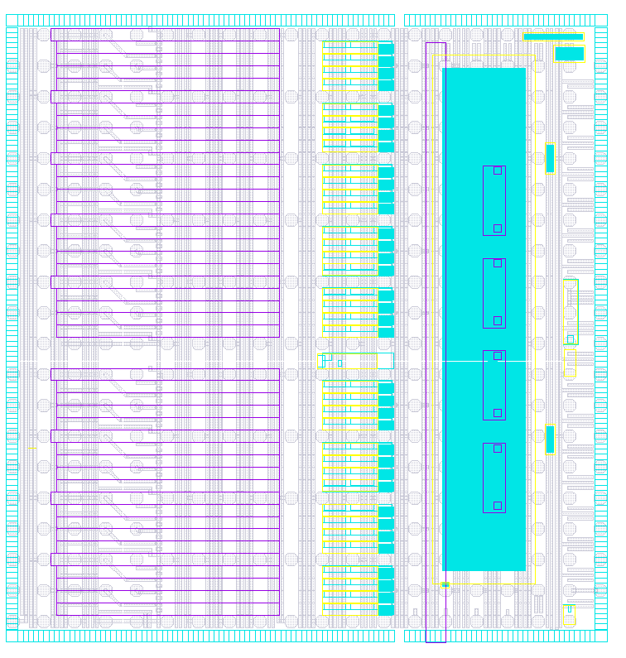
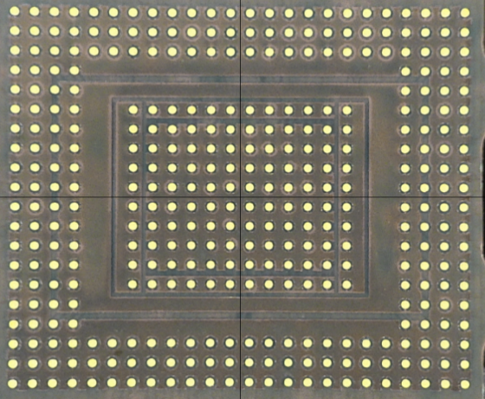

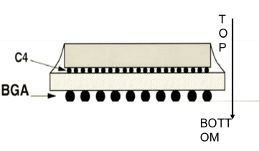
HKROC0 testbench
HKROC was submitted with an IMEC MPW on August 21 (TSMC130 nm)
Back from production → January 2022
A dedicated test-board.
CHIP on a mezzanine board mounted directly through a flip-chip process (Hybrid SA).
Mezzanine mounted on a mother board connected to “ Xilinx Kintex UltraScale FPGA KCU”
  C4-bumps processing
  by TSMC (FAB14)
  (~330 bumps)
High redundancy to ↓ risk of mistakes
Three test-benches in parallel:
OMEGA, LLR, CEA
TSMC foundry
Packaging
company
Similar testbench to HGCROC to be compatible with existing KCU105 test system from CMS

Slide 10
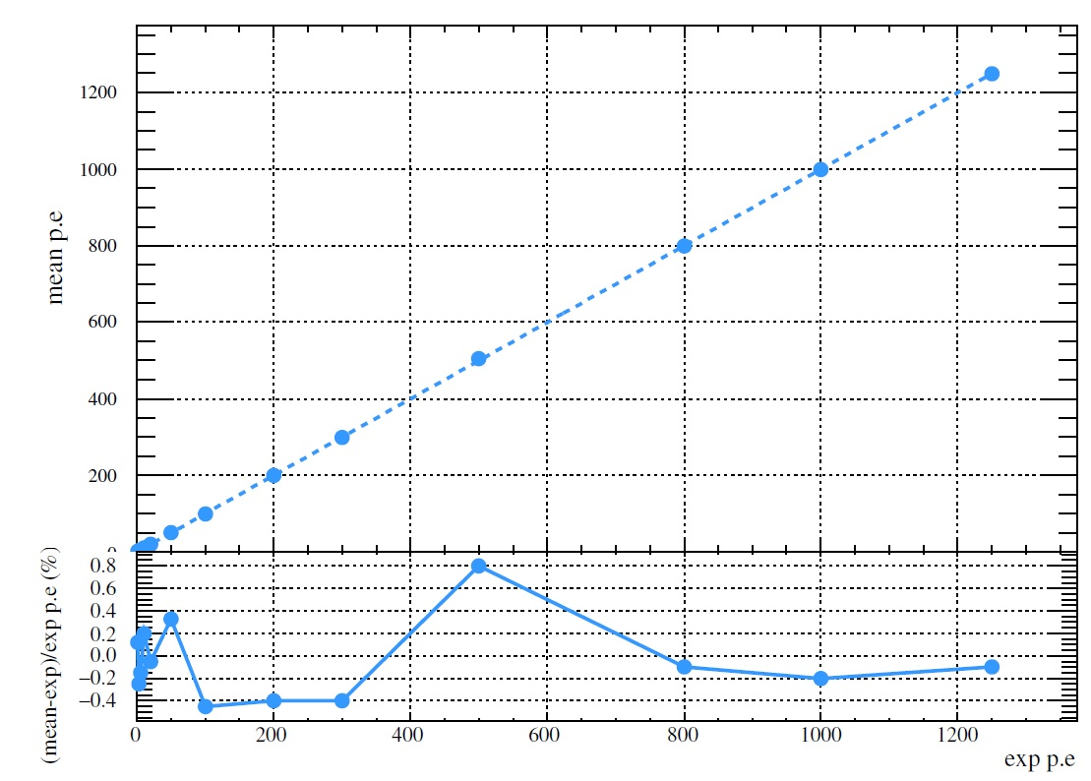
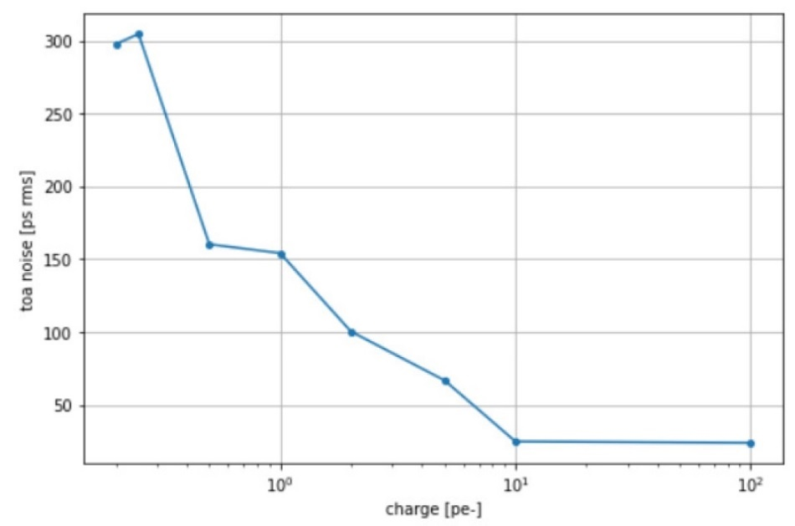
Main experimental results with HKROC0 – Charge and Time
Measurement with the full chain (analog + digital and reconstruction)
  Signal auto-triggered with threshold
1250 p.e. (2500 pC)
300 ps
LG linearity
1 p.e.
150 ps
25 ps
Threshold (pe)
10 pe
LG linearity well within ±1%
TDC characterization with 1/6 p.e. threshold
TDC resolution :
150 ps rms @ 1 p.e
≤ 25 ps rms @ 10 p.e
0.2 p.e.
Charge resolution :
< 0.1 p.e (200 fC) at ≤ 10 p.e
< 1 % otherwise
Charge linearity < ±1% from 1 to 1250 p.e. (2500 pC) across the 3 gains

Slide 11
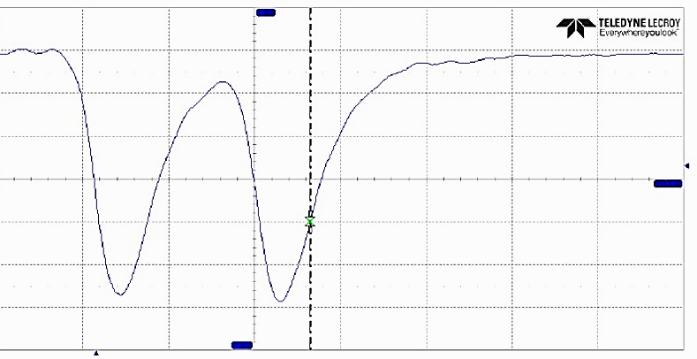
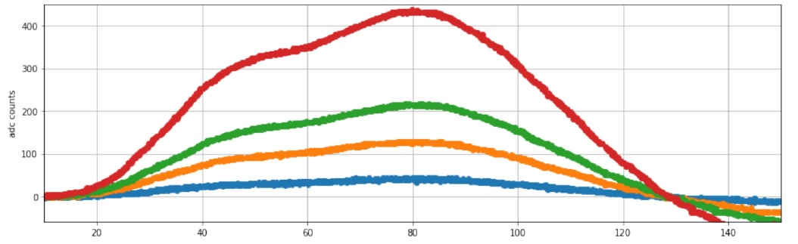
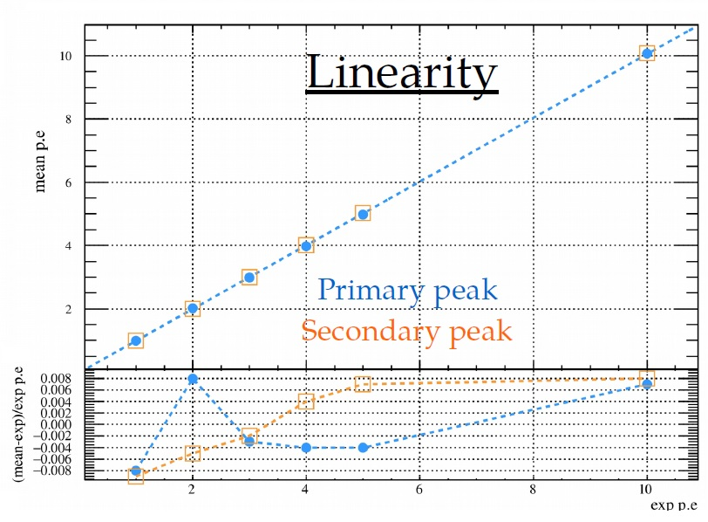
Main experimental results with HKROC0 - Pile-up
Measurement with 2 events separated by ~30 ns (full chain: analog, digital and reconstruction)
  Signals auto-triggered at 1/6 of p.e. (internal programmable threshold)
Primary peak
Secondary peak
10 p.e.
30 ns
5 p.e.
1 p.e.
3 p.e.
30 ns
1 p.e.
Internal signal after slow shaping
10 p.e.
Charge reconstruction algorithm of the two peaks
Good linearity of reconstructed pile-up events
We can reconstruct both peaks properly !
1 p.e.
< ± 1%

Slide 12
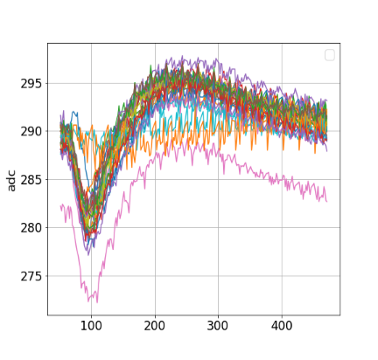
Improvements with HKROC1b crosstalk
HKROC 1b submitted in july22 to fix very minor modifications
“Diffuse crosstalk”, observed in measurement in all channels with a large input signal (~ 800 p.E.).
Main sources of crosstalk:
The PA bias, the shaper references and the input calibration block common to the 36 chs
HKROC0 measurements
HKROC1b measurements
Reduction of the crosstalk of large signal on other channels
Mean value
3 ADC units
Mean value 10 ADC units
Reduction of x3
(1 pe is ~ 30 ADCu)

Slide 13
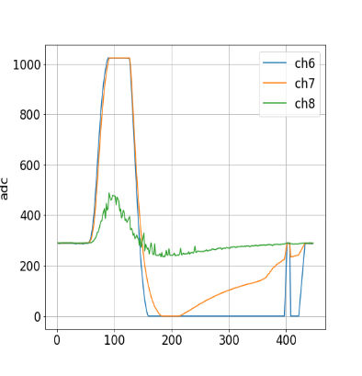
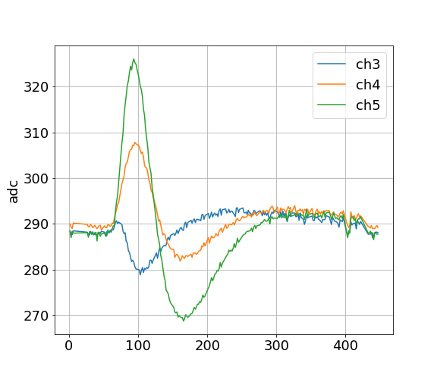
Packaging and acquisition board improvements
“Close” crosstalk: on 2 closer channels (~40 ADCu on LG and ~ 20 ADCu on MG)
Not observed in simulations (schematic and postlayout) →Probably on the board!
HKROC0 flip-chip coupling map by injecting large charge (> 900 pe)
Acquisition board 2021 with mezzanine
HKROC0
PMT 7
injection
LG
PMT 6
Crosstalk
PMT 6
MG
Inject PMT 7
Verify others
HG
HG
MG
LG

Slide 14
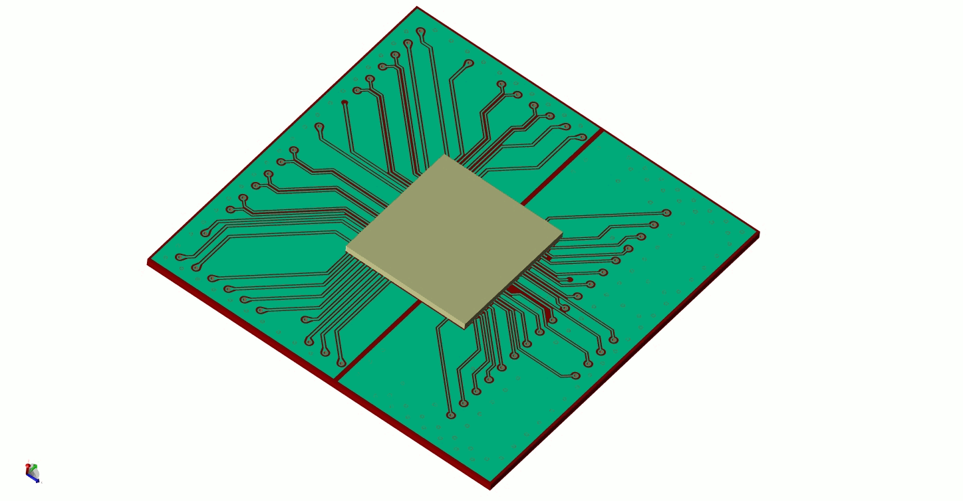
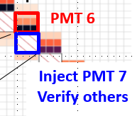
Packaging and acquisition board improvements
Huge work on BGA substrate and PCB with focus on suppressing HG coupling
  BGA substrate with 3 PMT gains splitted in 2 layers (A batch of HKROC0 packaged in BGA)
  Acq. board 2022: 3 PMT gains split into 2 layers
Developed
By Omega
Pierrick Dinaucourt
HKROC1b BGA coupling map by injecting large charge (> 900 pe)
Acquisition board 2022 with socket for BGA packaging
HKROC1b
~ 2%
~ max 10%
PMT 6
LLR
Inject PMT 7
Verify others
ONLY in the MG channel
that is in the HG layer
Acq. board 2022

Slide 15

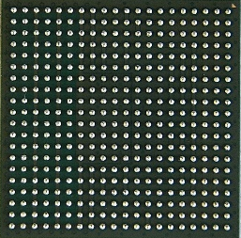
Conclusion
HKROC is a versatile ASIC able to readout PMT
  Time measurement with a precision at 150 ps at 1 p.e.
  Charge measurement with a linearity of 1% (up to 2500 pC)
  Low power consumption (10 mW per channel, 30 mW if three gains used)
  Hit rate up to ~40 MHz with an average from 100k to 1M (fast mode)
Production in April 2023 (quantity 4000)
  3000 HKROC1c with few improvements
  1000 HKROC1b
  Packaged is a BGA (new substrate version) with 0.8 mm pitch (400 balls)
  Acquisition board under study to reduce the Close crosstalk
Provide a full HKROC-based solution (ASIC + board) to the community
  HKROC: Auto-triggered waveform digitizer!!!!!
HKROC0
2021/12
HKROC0-BGA
(x80) - 2022/06
HKROC1b-BGA
(x80) - 2022/12
HKROC production
(x4000) - 2023/04
HKROC-based acquisition system paper
2023/12
Mezzanine daughter board
Acquisition board
We are here
Acquisition board with reconstruction

Slide 16
Potential projects
Water Cherenkov Test Experiment @ CERN (WCTE):
WCTE is a small scale water Cherenkov detector which will be commissioned over 2022 and 2023, with the aim to be placed in the T9 beam area in CERN.
The WCTE will be a test bed for future water Cherenkov technologies.
DOI 10.5281/zenodo.6784532

Slide 17
Backup

Slide 18
HKROC operating modes
HKROC has “three operating modes”: normal, supernovae and ultra-fast.
Each mode has a different triggering rate capability and a specific readout format.
SUPERNOVA MODE:
DATA FRAME for 9 chs:
4 words of 32bits
NORMAL MODE:
DATA FRAME for 9 chs:
10 words of 32bits
ULTRA FAST MODE:
DATA FRAME for 9 chs:
1 words of 32bits

Slide 19
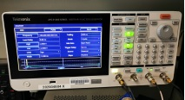
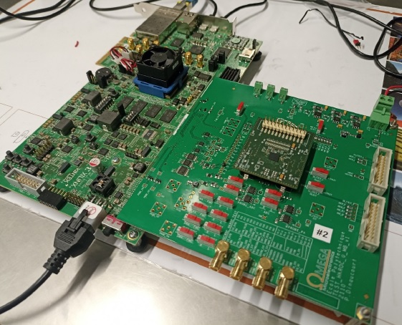
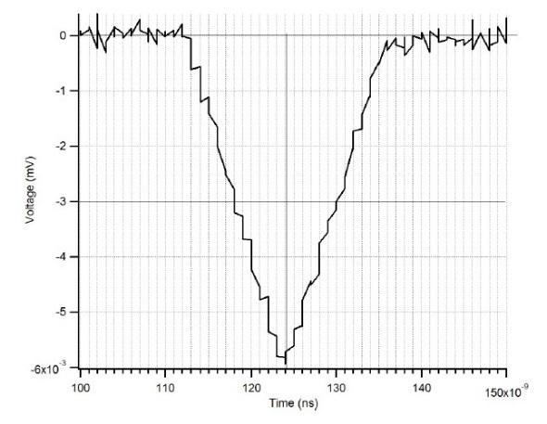
HKROC testbench
HKROC has been received in January 2022
A dedicated test-board used to test the ASIC performances. It is placed on a mezzanine board
mounted directly through a flip-chip process. The mezzanine is mounted on a mother board
that is connected to a test board “ Xilinx Kintex UltraScale FPGA KCU”
Three test-benches in parallel:
OMEGA, LLR, CEA
12ns of FWHM width
6mV
1 p.e.
ASIC Power Consumption: 40 mW/PMT
Board Power Consumption: 3.2 W

Slide 20
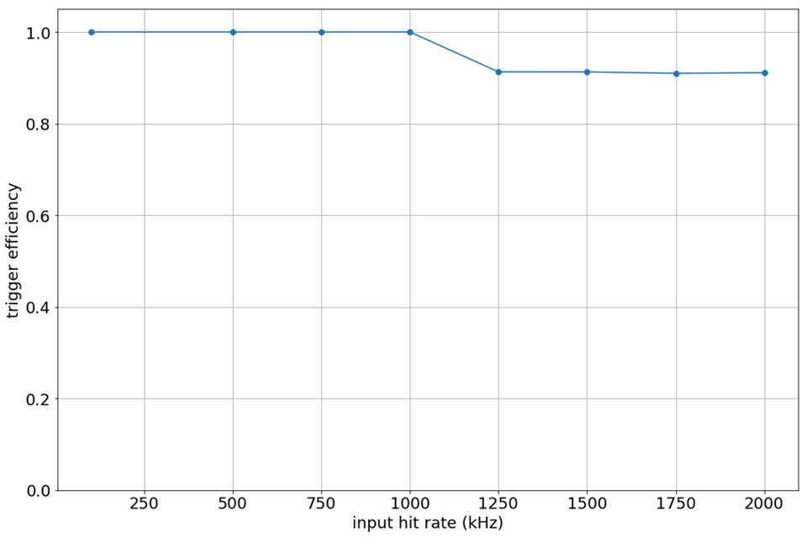
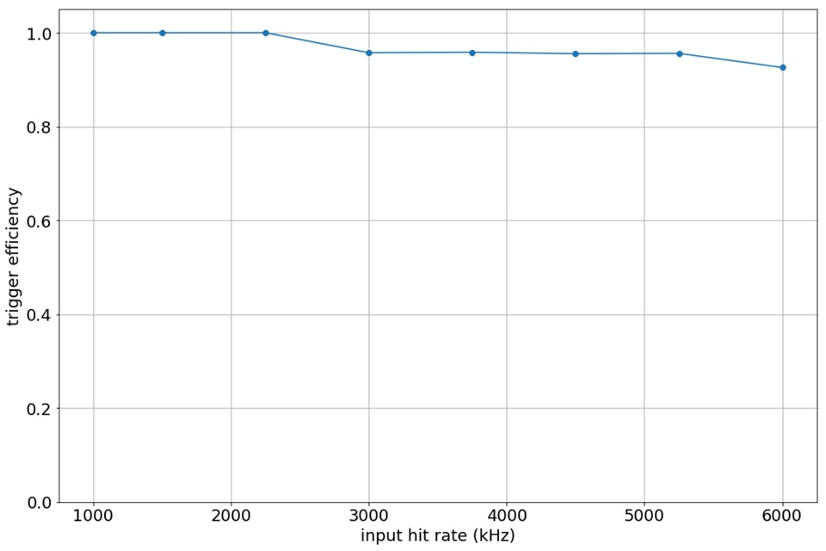
HKROC Trigger rate measurements
FAST hit rate (~ 1MHz) required for close Supernova signals (~ 1 p.e.)
Normal mode:
Super Nova mode
100% at 1 MHz one ch
100% at 2.2 MHz one ch
1 PMT channel →
3 HKROC channels tested in Normal Mode:
100% Trigger efficiency up to 415 kHz 3 chs
1 PMT channel →
3 HKROC channels tested in SuperNova Mode:
100% Trigger efficiency up to 950 kHz 3 chs
The HKROC saturation naturally appears when the chip internal memory is full. The chip has one independent memory for each read-out link at 1.28 Gb/s, which gather 3 PMTs.

Slide 21
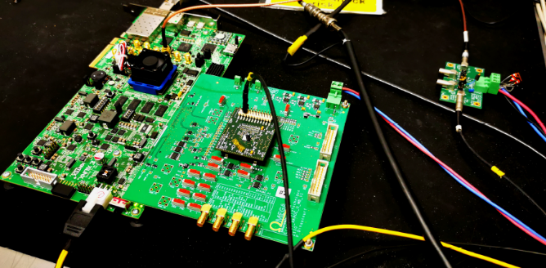
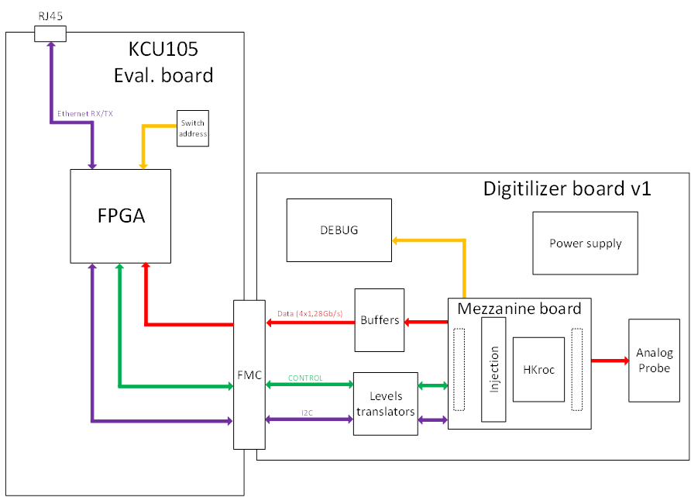
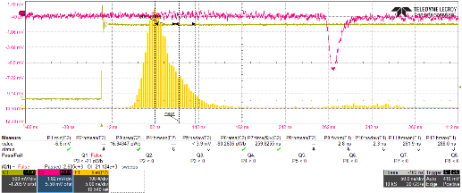
PMT testbench
Connected Hamamatsu R12680 PMT to HKROC illuminated by a PILAS 402 nm laser diode
FPGA/DAQ
trigger
420 nm
Laser pulse
Optical
PMT HV set to have the 1 p.e peak amplitude at -6 mV
Charge calibrated
TTS : FWHM= 2.8 ns, σ= 1.2 ns

Slide 22
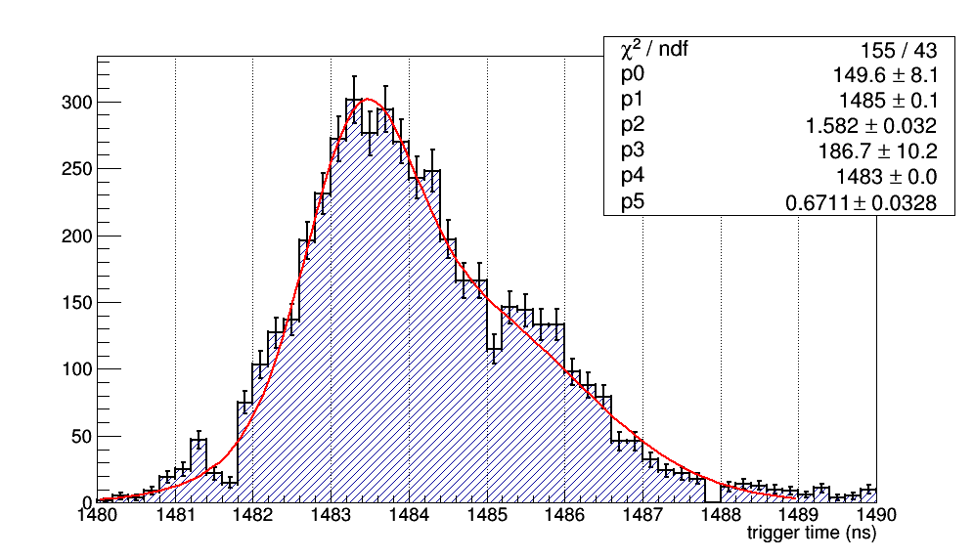
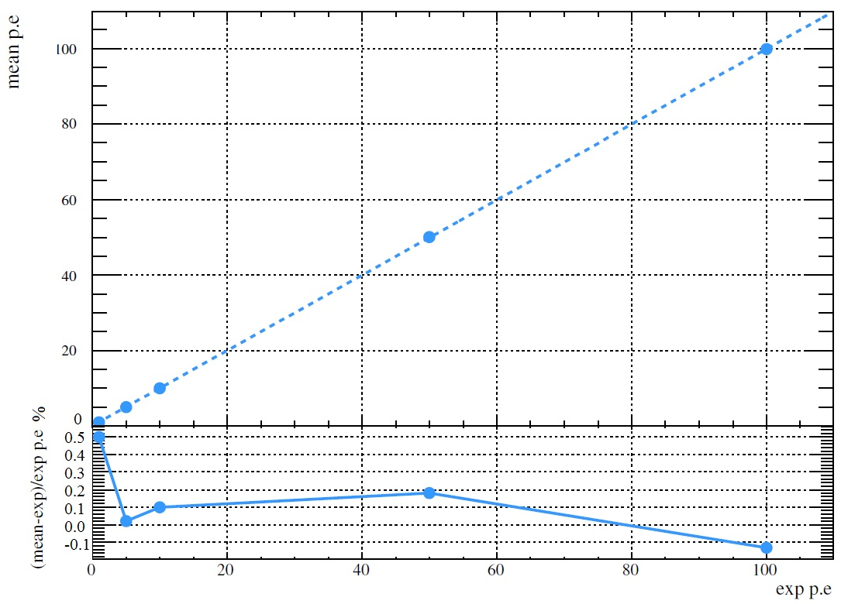
PMT measurements
Trigger time distribution for events having charge ≤ 1.5 p.e : FWHM of 2.6 ns
Excellent agreement with the 2.8 ns found for the PMT only
Digitizer does not degrade the PMT time resolution !
The charge linearity is ≤ ±1%
Exact same behavior than with the function generator.

