Slide 1



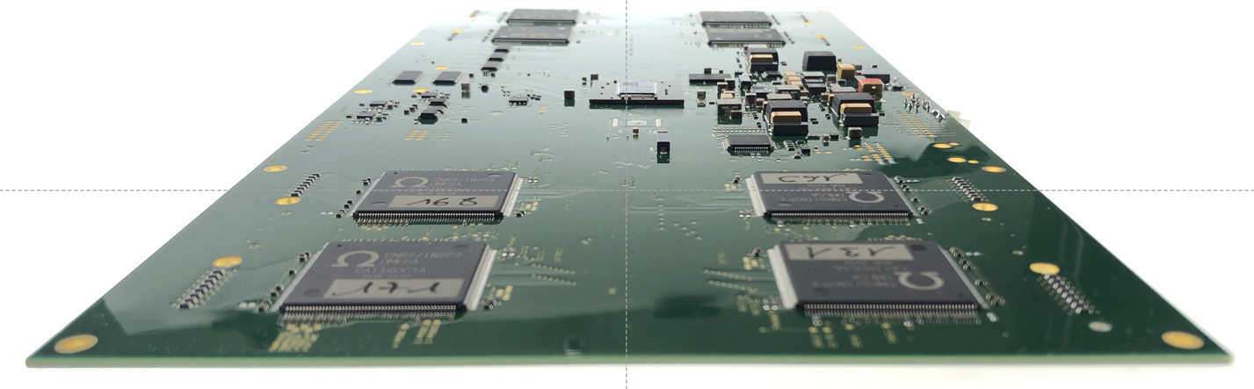
JUNO sPMT ABC Front-End Board
C. Bordereau, C. Cerna, T. Chabaud, F. Druillole, P. Hellmuth, C. Huss,
L. Labit, P. Perrot, A. Rebii
On behalf of SPMT group
LP2IB, University of Bordeaux/ IN2P3

Slide 2
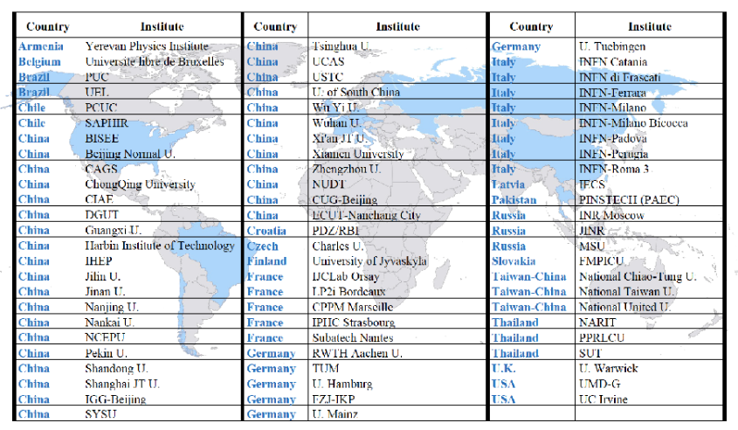
JUNO Experiment: International cooperation
694 physicists mainly from China and Europe, 77 institutes including 5 at IN2P3

Slide 3

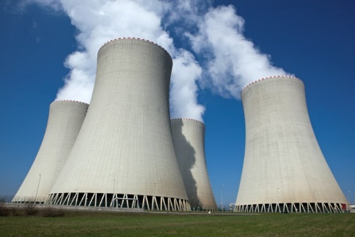
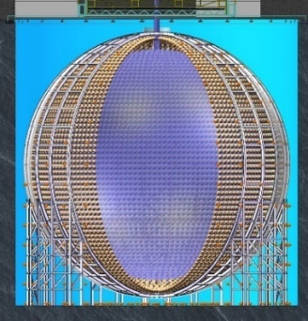
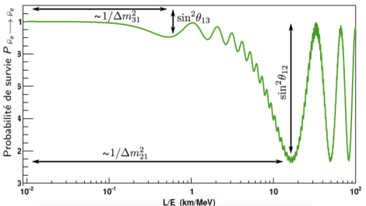
JUNO Experience : Goal
Determine the order of neutrino masses using electron antineutrinos emitted from two nuclear power plants in China
Oscillation des neutrinos
Base de vol ~53 km
Réacteurs nucléaires
(~10²¹ ν/s/GW)
Détecteur JUNO
Precision measurement (<1%) of 3 neutrino oscillation parameters
Measurement of solar neutrinos, Supernova neutrinos , geo neutrinos, …
Oscillations
rapides
Daya Bay
D. Chooz
RENO
Oscillations
lentes
JUNO

Slide 4
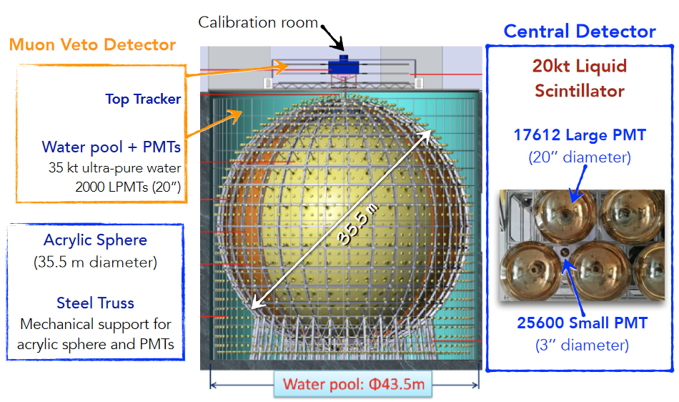
JUNO Experience : Detector

Slide 5
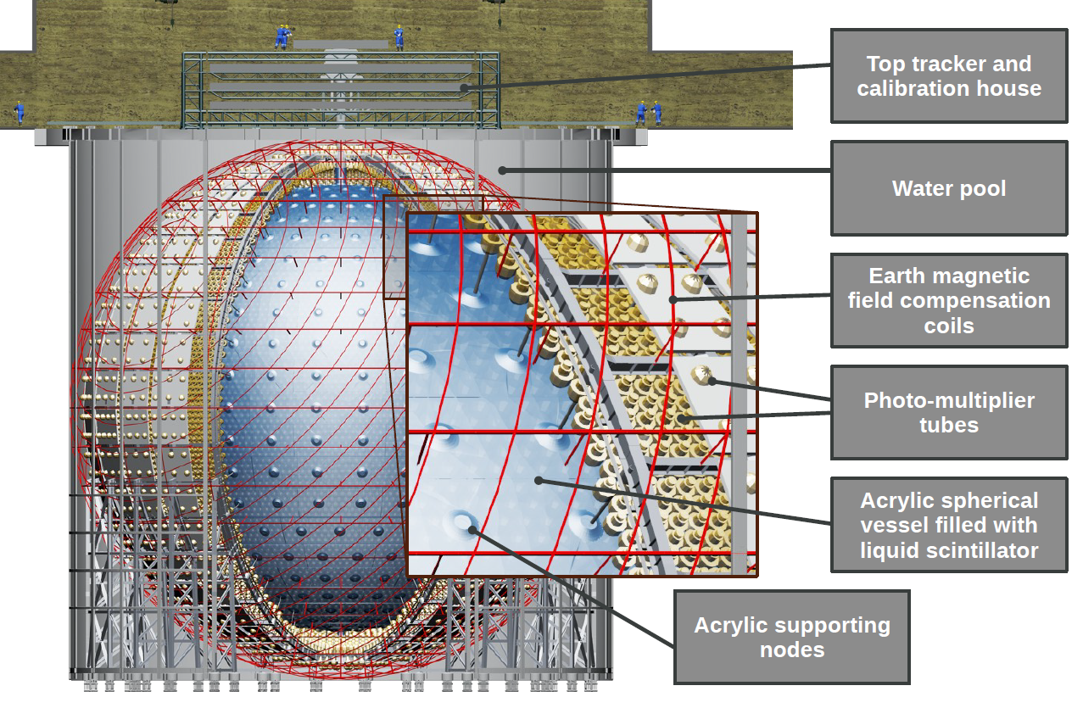

JUNO Detector Performance
Detect 100,000 neutrinos in 6 years of data collection → 20,000 tons of liquid Scintillator (LS) in a sphere with 35 m diameter
Energy resolution of 3%/√E(MeV)
  → System of 18000 PM 20’’ and 26000 PM 3’’ (78% angular coverage) to detect ~1500 photoelectrons / MeV

Slide 6
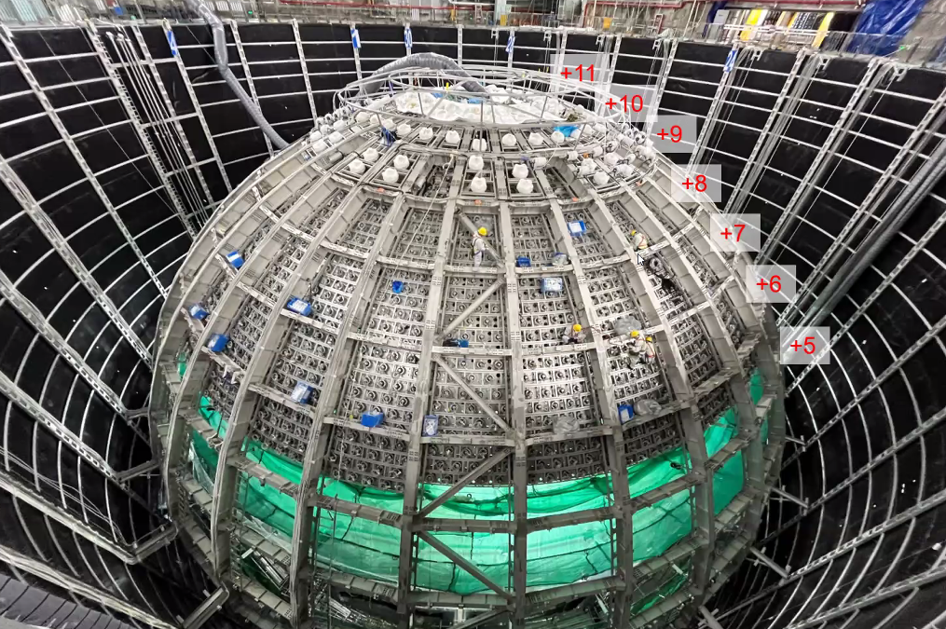
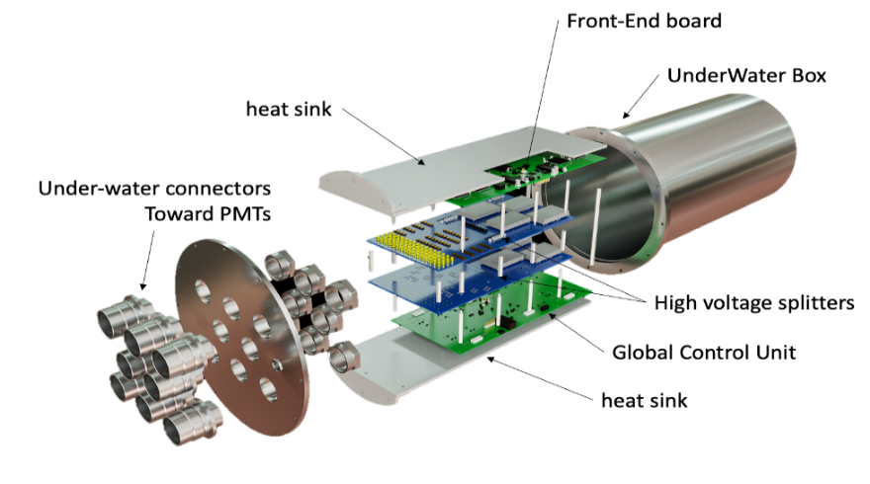
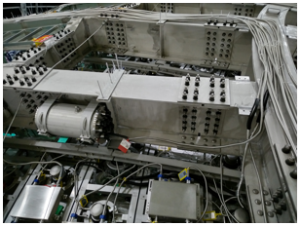
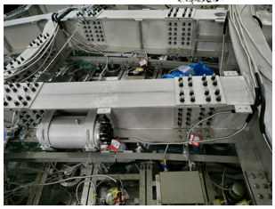
JUNO sPMT Project
JUNO – SPMT : (FRANCE, CHINA, CHILE)
  PMTs:
    25 600 photomultipliers 3’’
      CHINA (HZC)
  Electronic
    Front End Electronics for sPMTs
      France: IN2P3
    High Voltages Splitters
      Chile
    Global Control Modules
      China
  Mechanical
    200 UWB (Under Water Box)
      France , Chile, China
2nd UWB
1st UWB
Notes:
JUNO, est à ce jour le plus grand détecteur neutrinos au monde, et qui sera implanté en chine pour la mesure des paramètres d’oscillation de neutrinos artificiels type électron produit par deux réacteurs EPR.
L’instrument de ce projet, est une sphère acrylique, immergée dans de l’eau pure dans laquelle il y aura un liquide scintillant. Sur cette sphère seront fixé 17000 photomultiplicateurs 20 pouces ou LPMT et 25 600 pm 3 pouces SPMT
On distingue ainsi deux projets sur le même instrument : JUNO LPMT et JUNO SPMT
C’est SPMT sont regroupés en paquet de 128 avec une électronique Front End dédiée, c’est la contribution française à ce projet.

Slide 7
JUNO sPMT : ABC Block Diagram
JTAG Connector
SPI
Flash
DDR3
Mem
1Gbytes
Operational
GCU
JTAG Interface
In progress
JTAG Switsh
JTAG
DDR3
Memory
Management
Voltages
Currents
ADC
Ext. Trigger &
Inspection
Temperature & humidity Sensor
Monitoring
GCU
Interface
GCU
Interface
Slow control signals
Slow Ctrl
CATIROC 0
From HVSplitters
SAMTEC
CATIROC 1
Trigger
Manager
&
DDS
Calibration
USB
Interface
In_Calib
USB 2.0
FTDI 2232H
SAMTEC
Data signals
CATIROC 7
Data Capture
40 Mhz
Kintex 7
325T-FFG625
Local
Clock
ABC

Slide 8
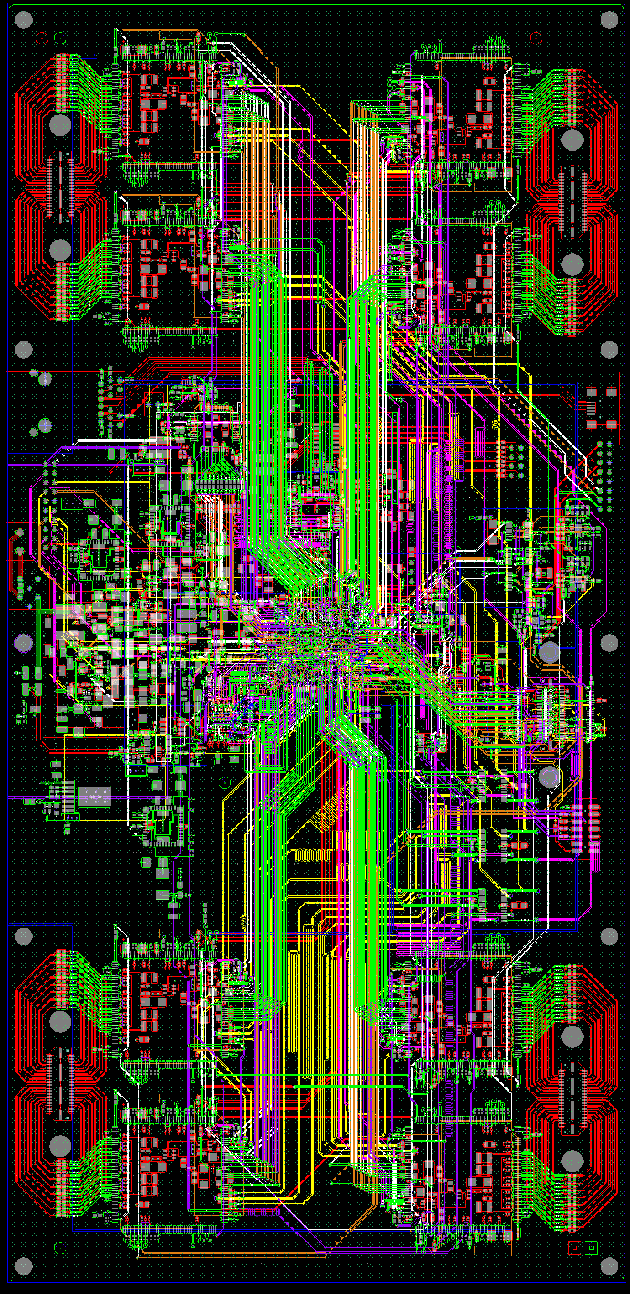
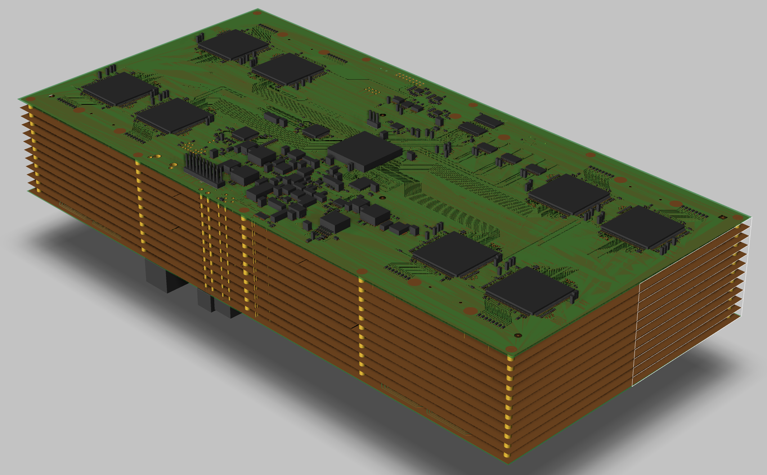
JUNO-SPMT : ABC PCB Overview
12 Layers
  5 Powers plans
compatible with IPC standards
  IPC 7351, IPC 2222, IPC 2221
  IPC 4101
1902 Components
  CMS technology
45 differential pairs
Layer | Thickness (µm) | Single impedance | Differential impedance
1 | 45 | 50 | 100
3 | 18 | 40,50
4 | 18 | 40,50
6 | 18 | 40,50
8 | 18 | 40,50 | 80,100
10 | 18 | 40,50 | 80,100
12 | 45 | 40,50

Slide 9




ABC Production and Tests at FEDD company
PCB Manufacturing
PCB control
review by
Boards serialization:
Cleaning & steaming
ISO9001
ISO13485
EN9100
IPCA600: printed circuits
IPCA610: card wiring
IPCA620: wired cabling
Components
provisioning
Components control review
CMS and feedThrough
Components soldering
Burning Test
Takaya test
Functional tests
Visual inspection
BGA X Ray Inspection
Placement Inspection
Automatic Optical Inspection
Test bench from LP2I
FPGA Programming
CATIROC ship slow control
All interfaces verifications
Functional performances
DAQ test
  Pedestal noise
  Charge injection
  HG/LG verification
  Trigger verif.
  Coarse/Fine Time verif.
220 ABC boards produced
June’21 → Jan’22
Tropicalization
Coating
Final Quality Control
Packaging shipping

Slide 10
LP2IB Combined test bench
128 3’’ JUNO PMTs
Control Power and readout of ABC through GCU (V1.1)
Control and power of HV Splitter boards (V0.3.2) through GCU
JUNO grounding scheme policy

Slide 11
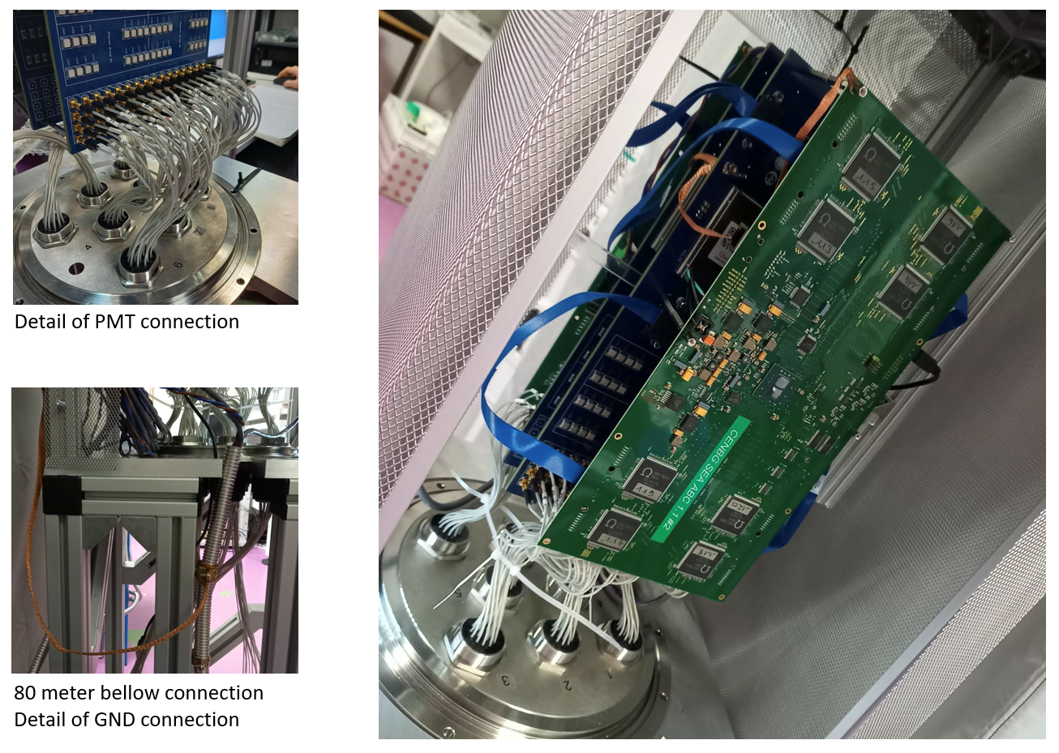
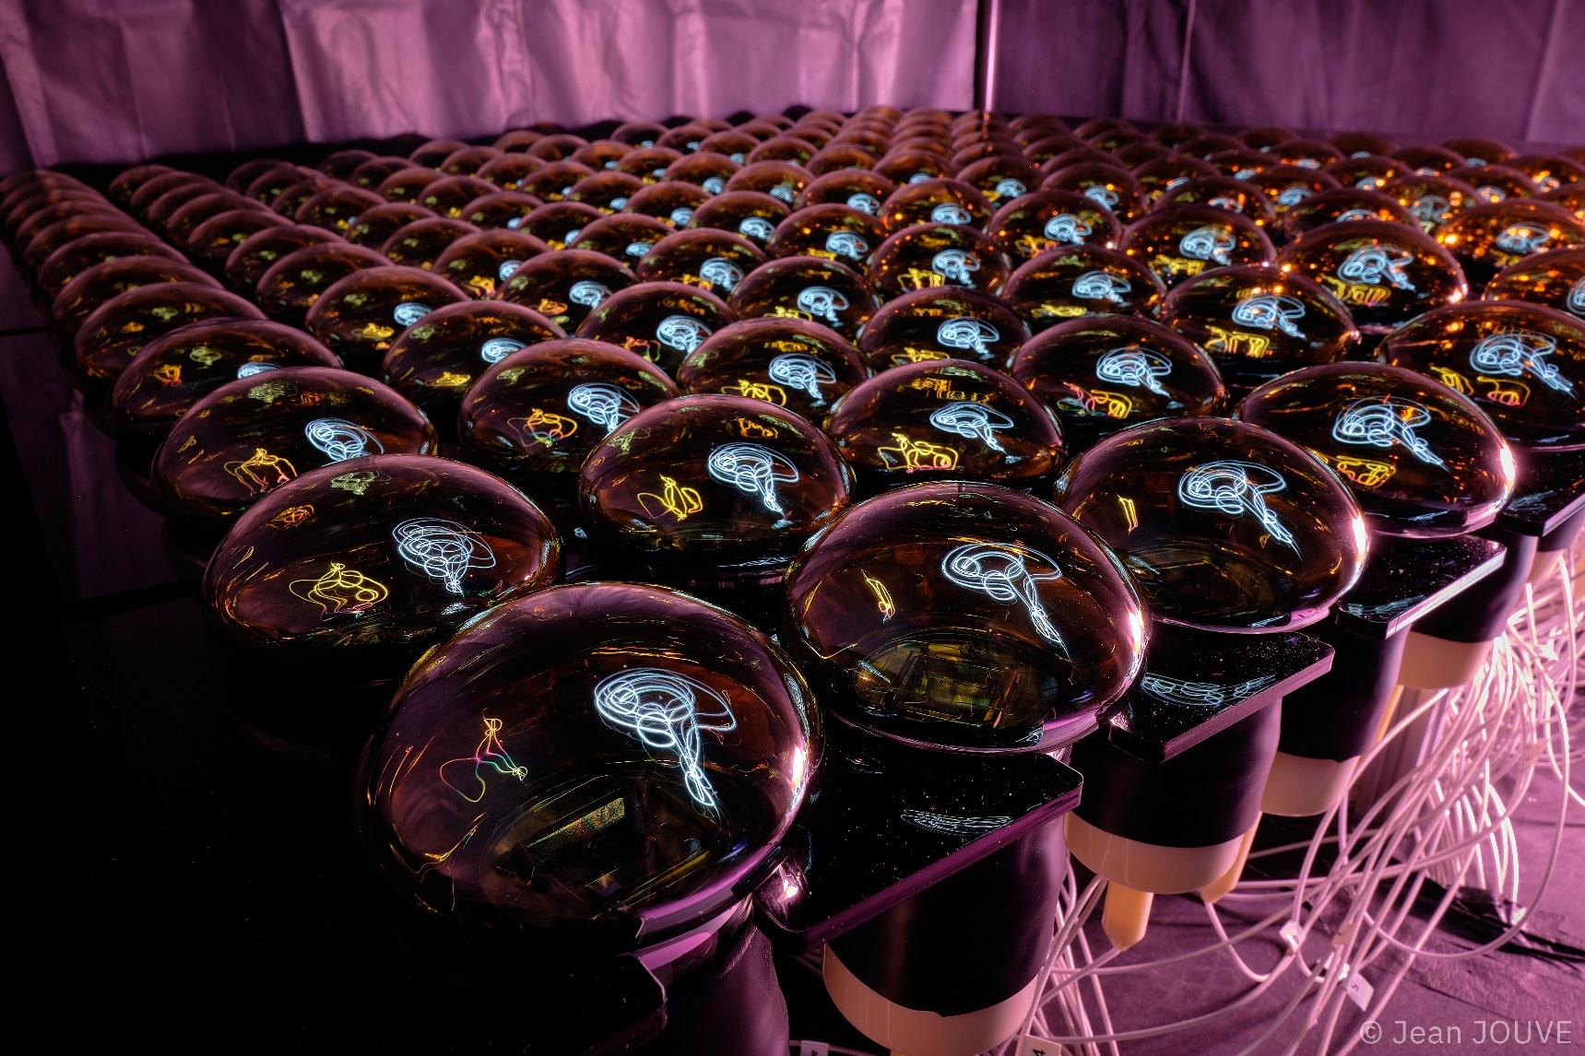
LP2IB Combined test bench
128 JUNO 3’’ PMTs in a dark room

Slide 12
Acceptance and calibration test sequence
Sequence step by step and deliverable
Pedestal measurement in High Gain
HV OFF/ON
Pedestal measurement in Low Gain
HV OFF/ON
Installation and ABC powered
S-curve and
threshold tuning
→ Control of the current (~0.5-0.6 A)
→ HG Mean_{channel}
→ HG Sigma_{channel}
→ LG Mean_{channel}
→ LG Sigma_{channel}
→ Nominal trigger thresholds_{Asic}
PMT measurement
In Dark Rate mode
@ nominal HV and nominal thresholds
HV variation from 1100 to 1400 V by step of 50 V
LED ON
@ nominal HV
→ Charge Resolution
→ Dark Rate
→ HG/LG verification and rough charge calibration
→ Fine charge calibration parameters in HG with SPE
All the sequence lasted ~25’ and was fully automatized

Slide 13
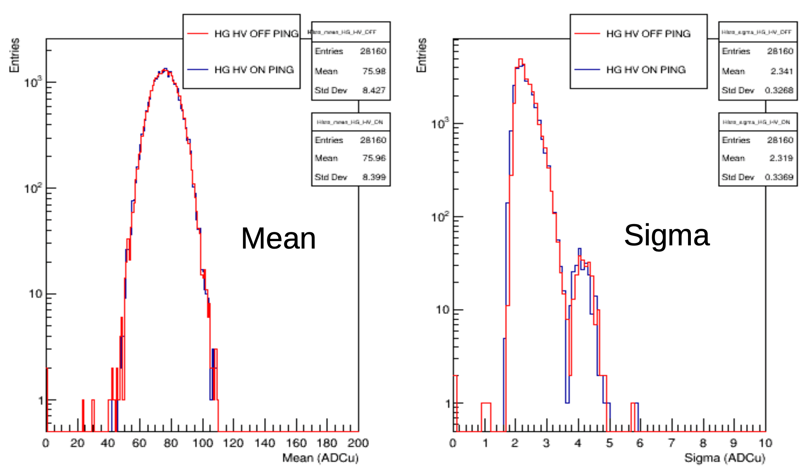
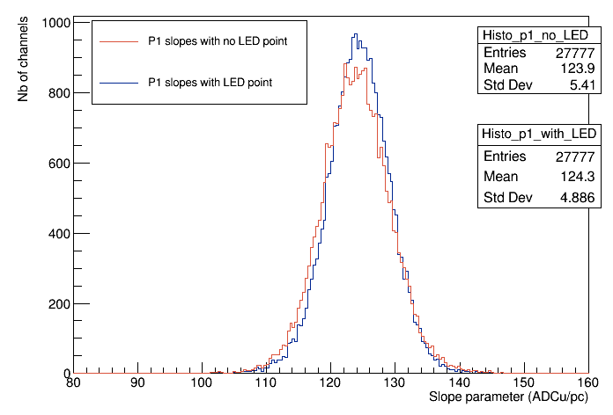
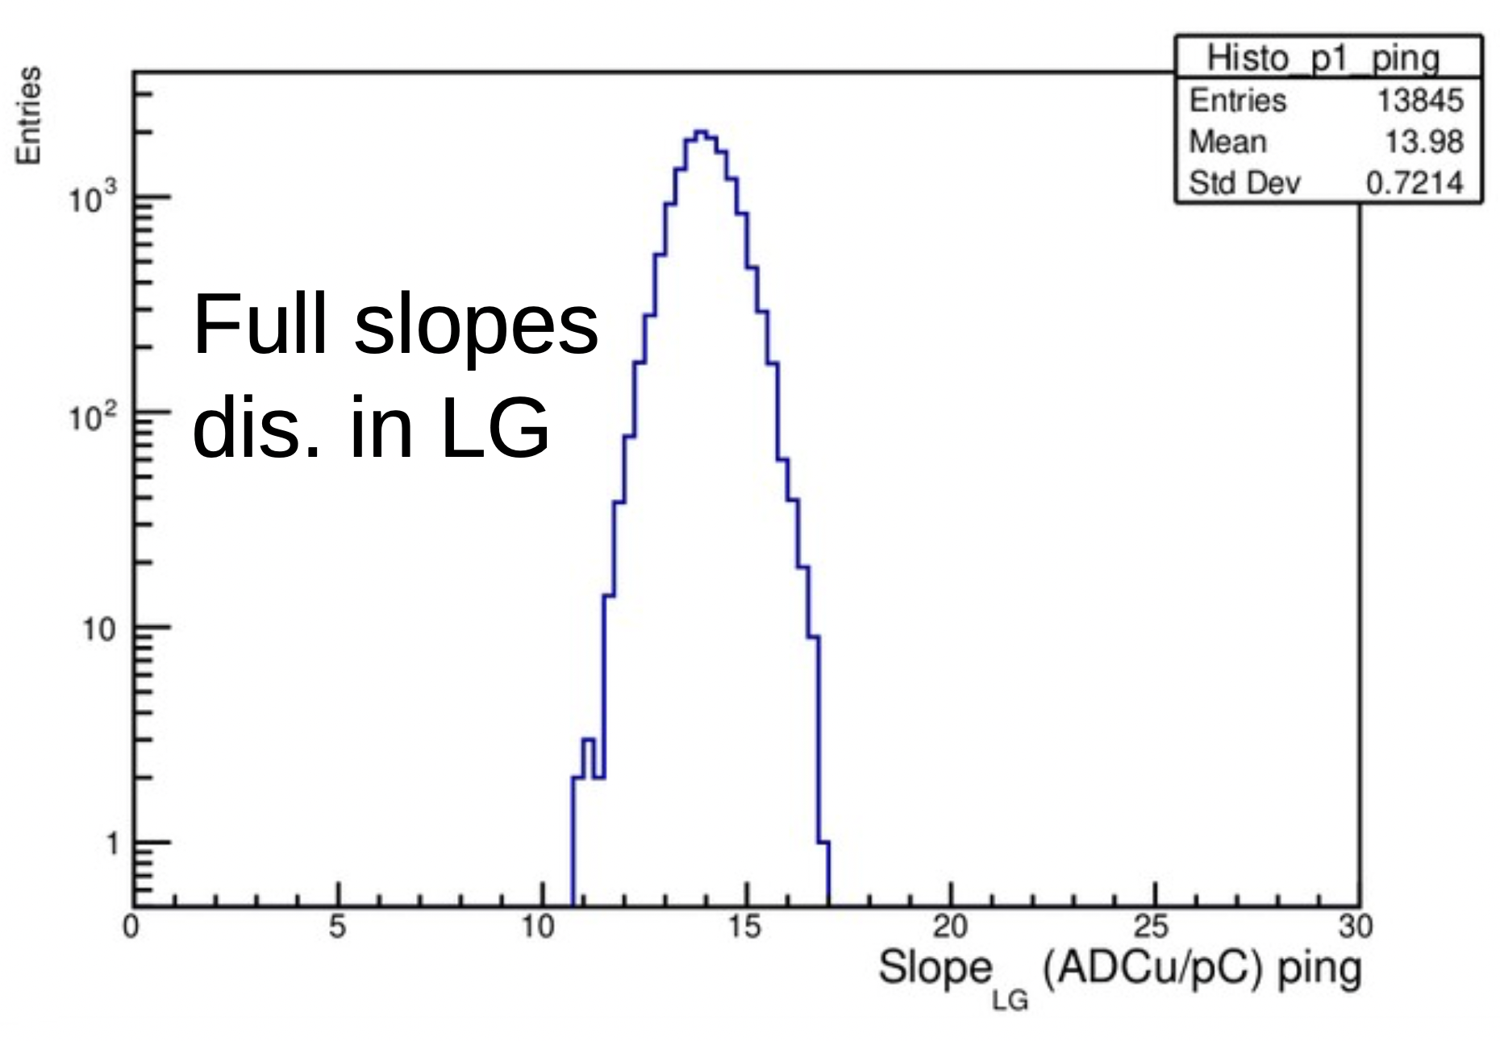
ABC readout front-end board performances from production
Mean and sigma pedestal distributions
Calibration parameters in High Gain
SPE + LED
High Gain range [1/3 - 10] PE @Gain 20
Low noise achieved
  ～4% PE / <1% PMT resolution
Calibration slope in Low Gain
LED only
Front-End boards parameters delivered for integration
Low Gain range [10 - 150] PE @Gain 20

Slide 14
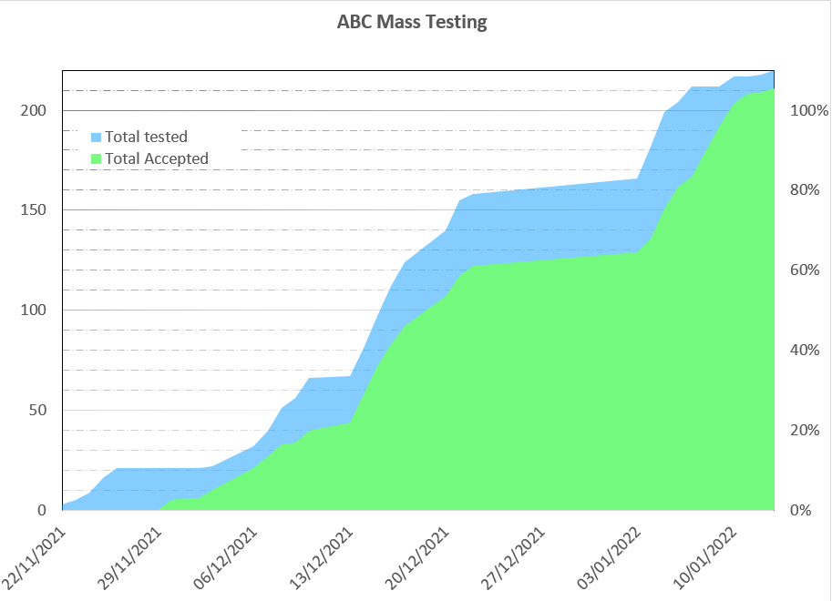
ABC mass testing: summary
220 ABC front-end boards have been produced, delivered and tested
212 have been accepted for the SPMT system (96.4%)

Slide 15
JUNO-SPMT ABC Firmware Progress
ABC Firmware 1.0 (2021-2022): deployed for PMT testing and UWB integration
ABC Firmware 2.0: Q/T data stream
  perfectly fits CATIROC performances
ABC Firmware 3.0: Q/T + Discriminator Data Stream (DDS)
  Trigger width gives information on the charge
  (allows to recover charge of hits triggered during
  charge integrator dead-time)
  First measurement: DDS principle is working !
  To be finalised and delivered in 2023
CENBG

Slide 16

ABC Firmware 1.0
IPBus
Master
Ethernet link
Memory
WR
SPI Slave
SPI Master
Catiroc Slow
Control
Signals
SCLK[7..0]
SPI Write
RD
DOUT[7..0]
@
SELECT
DOUT
DIN
RST
SPI Bus
IPBus
FIFO
GCU
Event Builder
GCU
Interface
16 bits
Custum
protocol
Catiroc data streaming
Synchro-nisation
Deserializor
72
128 channels Registers
RD
EMPTY
Catiroc Triggers
Evt TS
« Event Header » generator
Triggers
Handler
HitRegister
Top_Data_Capture
ABC

Slide 17

ABC Firmware 2.x
IPBus
Master
Ethernet link
Memory
WR
SPI Slave
SPI Master
Catiroc Slow
Control
Signals
SCLK[7..0]
SPI Write
RD
DOUT[7..0]
@
SELECT
DOUT
DIN
RST
SPI Bus
IPBus
FIFO
SPI Read
DIN[7..0]
8
GCU
Event Builder
GCU
Interface
block_data_Capture #0
16 bits
Custum
protocol
64
Catiroc data streaming
block_data_Capture #0
Blocks Readout
RD
EMPTY
block_data_Capture #0
Data capture is done in a parallel mode
ABC

Slide 18
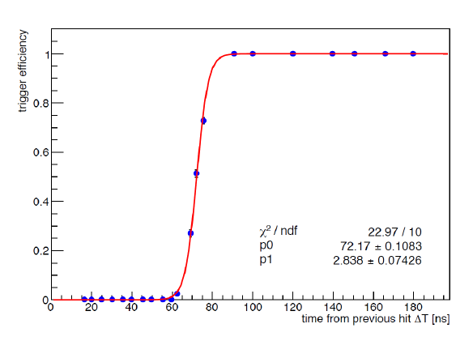
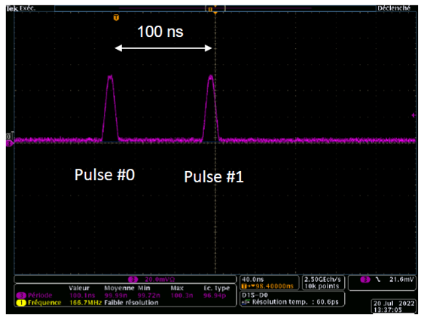
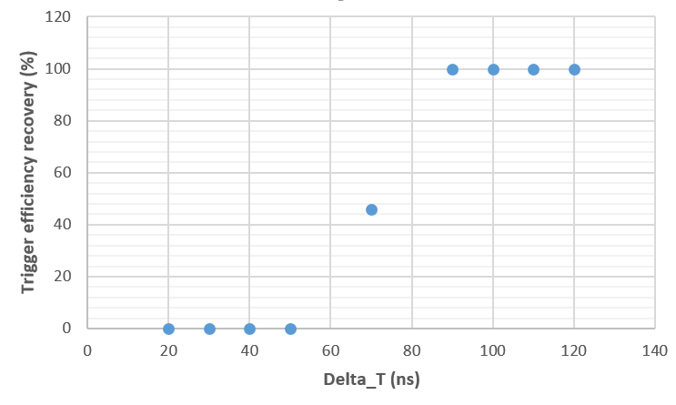
Catiroc trig. deadtime vs Firmware 2.x deadtime
Catiroc trigger deadtime : due to trigger processing in analog part of circuit
Using ABC board and firmware 2.0 with pulse generator in burst mode in the same channel
Δt < 60 ns
1 signal
Δt > 90 ns
2 signals
the curve of the trigger efficiency is not affected by the Firmware 2.0
No additionnal deadtime added by the firmware 2.0
Δt < 60 ns
1 signal
Δt > 90 ns
2 signals

Slide 19
JUNO-SPMT ABC Remote Programming
Firmware structure
Install Master JTAG ON GCU Kintex7
  Dedicated firmware on GCU
FLASH
FLASH
JTAG Sp6 – K7
2. Configure ABC Kintex7 as Gateway for Flash programmer
  Dedicated firmware on ABC
TCK
Flash Programmer
JTAG MASTER
TDO
TMS
TDI
IPBUS
JTAG MASTER
TCK
ETH SWITCH
TDO
TMS
TDI
SPARTAN 6
KINTEX 7
KINTEX 7
3. Install ABC Flash Programmer on GCU Kintex
  Dedicated firmware on GCU
IPBUS
GCU
ABC
JTAG K7 – K7
4. Download a Bitstream to ABC Flash
  FPGA_Prog Software
The whole procedure is automated with Shell scripts, and can be applied to the 200 ABC boards of the experiment

Slide 20
The End

