Slide 1
OBELIX sensor for VTX of BELLE 2
Journée des métiers électroniques – Strasbourg 07/06/2023

Slide 2
Outline
VTX Requirements
Monopix2 architecture
Monopix 2 performances & issues
Obelix modification
Preliminary plan
Conclusions

Slide 3
BELLE II program & detector

Slide 4
Current VTX

Slide 5
VTX Concept

Slide 6
VTX sensor requirements

Slide 7
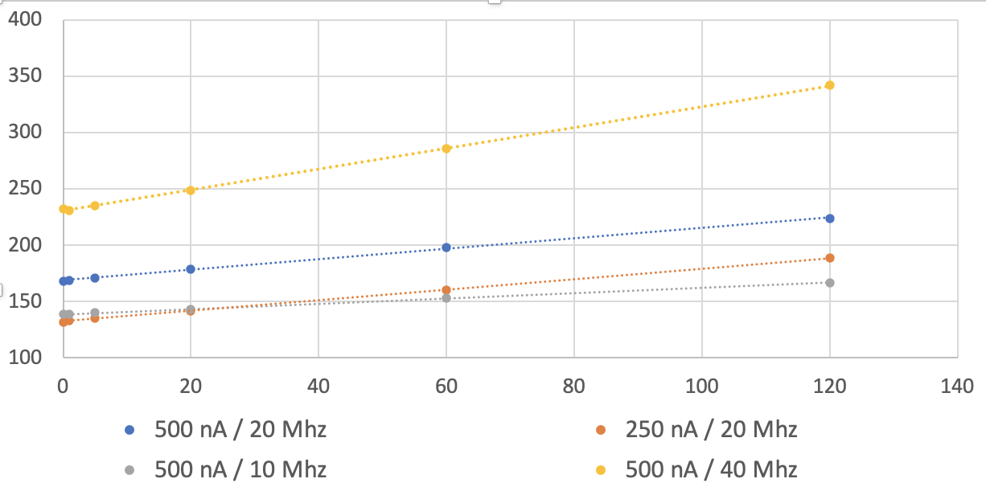
VTX power consumption estimation
Average total power per area computed assumption: 19 ms @ given hit-rate + 1ms @ max hit-rate (120 MHz/cm²)
Layer 3,4,5
Layer 2
Layer 1
Average total area power mW/cm²
limit
Hit rate MHz/cm²

Slide 8
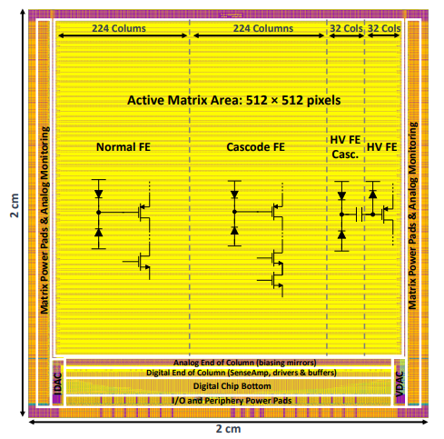
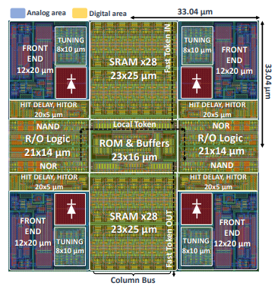
MONOPIX 2 - MATRIX
17mm
17mm
17mmx17mm active area
512x512 pixels of 33.04x33.04 µm²
4 pixel flavours + 2 columns for Analog Monitoring
Column drain architecture
24-bit data per double column including : 7-b Leading Edge (LE) + 7-b Falling Edge (FE) + 10-b address
Full custom in-pixel digital
3-bit Threshold Tuning per Pixel
Lateral powering with horizontal power drop compensation by distributing End of Column DAC
Analog On Top integration
Kostas Moustakas thesis (https://cds.cern.ch/record/2782279?ln=fr)

Slide 9
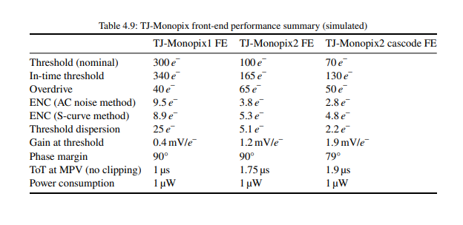
MONOPIX-2 PIXEL PERFORMANCES
Monopix2 pixels flavours
Kostas Moustakas thesis (https://cds.cern.ch/record/2782279?ln=fr)
Base-line option for Obelix

Slide 10
Analog aspect issue
Bonding Fragilities:
Important power pads number (~400 pads)
Long distance from chip edge (up to 1mm)
Bonding pads close to the metal top routing (<6µm)
Coupling between digital & analogue
Pixels threshold oscillating at amplifier frequency and correlated to BCID clock
Pixel with low threshold are trigged by flush signal
Limitation of injection dynamic due to injection buffering (source follower)

Slide 11
BCID Crosstalk
DAC Unit ~10electronC

Slide 12
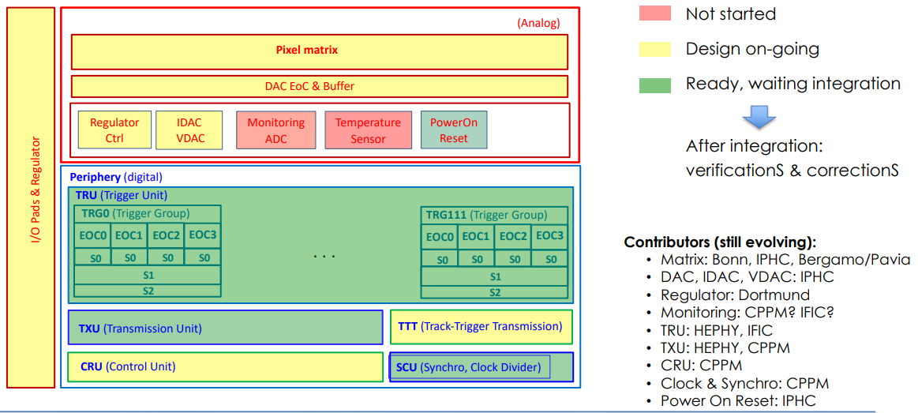
OBELIX SENSOR
Matrix size: 464x896 pixels
Timestamp résolution : ~50ns
Up to 10µs trigger latency
Power < 1.5 W
TID tolerance: 100kGy/year
NIEL tolerance: 5x10¹³n_{eq}/cm²/year
Hitrates up to 120 MHz/cm²

Slide 13
OBELIX – PIXEL MATRIX & ANALOG PERIPHERY
Total width = 30040 µm
PIXEL MATRIX (BONN, IPHC, CPPM, BERGAMO/PAVIA)
Increase matrix size from 512x512 pixels to 464x896 pixels
Introduce LDO for Analog & Digital power supplies to reduce the non-active side width from 600µm to ~270µm
Add direct analog output to first & last column for monitoring & debugging
Rearrange double column layout for better compatiblity with Digital on Top (DoT) integration flow
ANALOG PERIPHERY (IPHC, DORTMUND, IFIC-Valencia, CEA)
Rearrange EoC DAC layout for integration
Increase the dynamic range of the in-pixel threshold tunning
Increase injection dynamic from ~1k6e⁻ to ~2k4e⁻ for ToT calibration
Add internal DAC & buffer for SRAM end-column sens-amplifier bias (Extenal biasing in MONOPIX2)
Possibility of implementing 12-bit ADC monitoring
LVDS TX & RX layout adaptation
Power-on Reset (Yavuz Degerli - CEA)
Pixel matrix 4.5 cm²
~70 mW/cm2
Active Matrix Area 464x896 pixels
Total width = 18860 µm
1800 mW/cm2
1800 mW/cm2
Periphery 1cm2
~260 mW/cm2
3400 µm

Slide 14
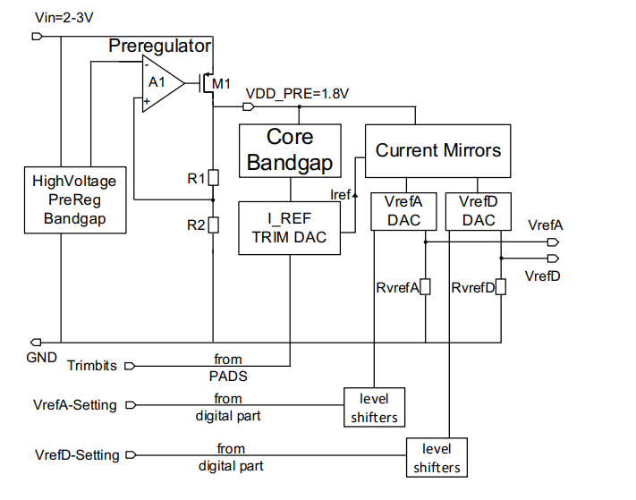
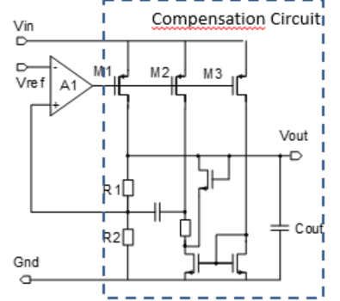
OBELIX – Power management
LDO_Ref
On-chip LDO allows to compensate the voltage drop on VTX ladder.
Input voltage = 2V – 3V
Iload_max = 500mA@20mv
Vout = 1.8 +/- 0.05mV
Obelix’s matrix is powered from lateral side => the pass transistor is stretched over the matrix size in order to minimize the death area
Pre-regulator is implemented to generate low precision output voltage (VDD_PRE) from high voltage tolerence bandgap. VDD_PRE will power the reference block that allows to generate LDO reference voltage.
Pre-regulator & LDO
michael.karagounis@fh-dortmund.de

Slide 15
OBELIX – New features

Slide 16
OBELIX – New features

Slide 17
OBELIX – New features

Slide 18
OBELIX – New features

Slide 19
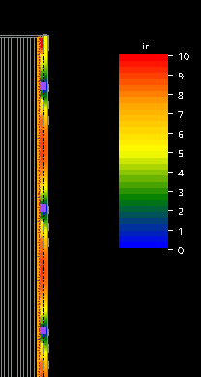
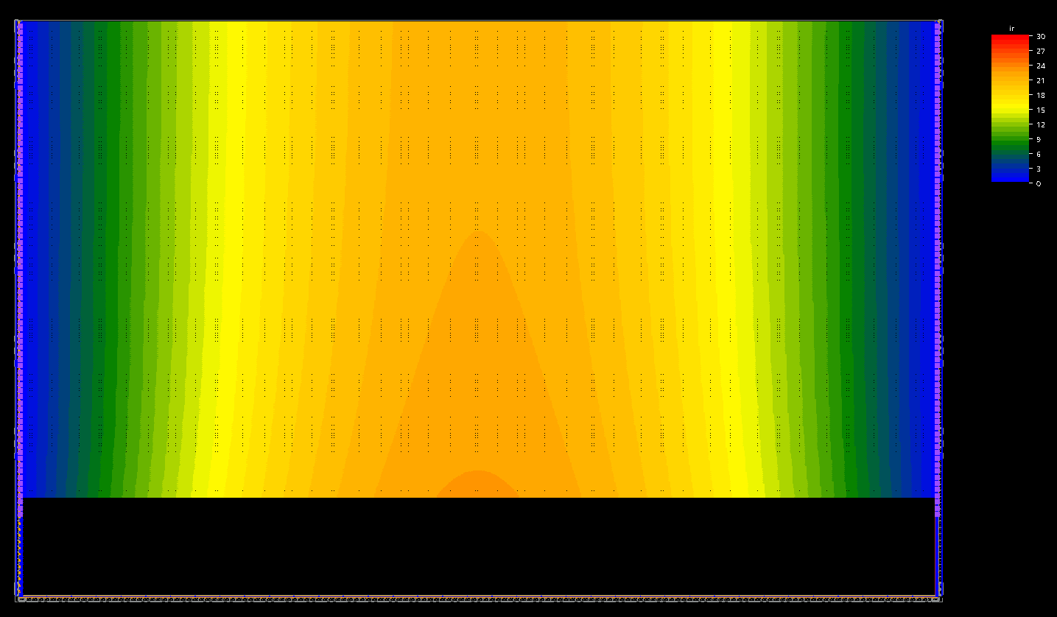
OBELIX - FLOORPLAN
Digital on Top integration :
Early IR-Drop analysis
Flexible implemenation with early surface estimation
VINA IR drop (0-10 mV)
VDDA IR drop (0-30 mV)
IRDrop Analysis with 2x 80 LDO pass transistor distributed over lateral side

Slide 20
OBELIX - FlOORPLAN

Slide 21
Conclusions
Obelix is inherited from Monopix2 with modifications:
Top integration by Digital on Top to better ancicipate IR-Drop, area estimation & flexible implementation
Increase matrix size for larger active area
Reduction of lateral non-active area & analog power pad number by implementing LDO regulator
Increase of the in-pixel tunning dynamic range to better compensate the threshold dispersion
Implementation of monitoring ADC
New digital features for triggers management

