Slide 1
Implémentation de SOC RISC-V dans Protium

Slide 2
Outline
Introduction
RISC-V global overview
Two different architectures
Implementation in Protium
Conclusion

Slide 3
Introduction
What is RISC-V?
  It is a Instruction Set Architecture (ISA)
  It is based on established Reduced Instruction Set Computer (RISC) principle
  It is s provided under royalty-free open-source licenses
When it has started?
  18th May 2010
  First Silicon in 2011 (FDSOI 28nm from STM)
  RISC-V Foundation was formed in 2015
  Based on computer architecture ideas that date back at least 40 years

Slide 4
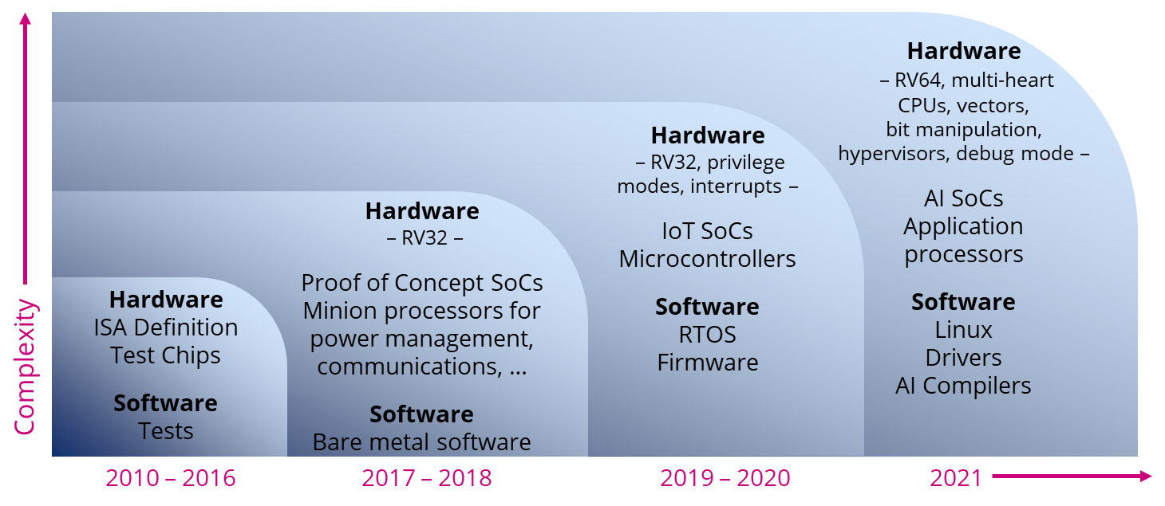
Historical overview

Slide 5
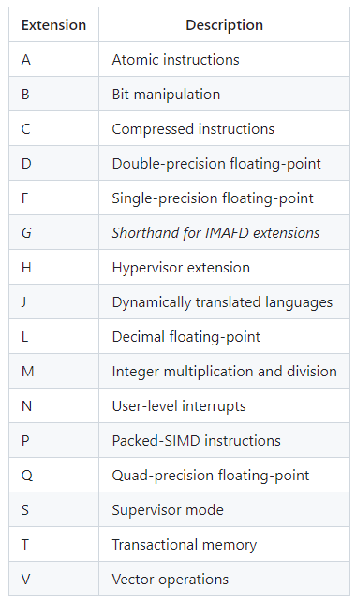
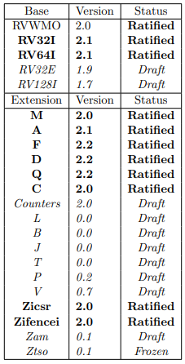
Extensions
Base ISA variant:
  32, 64 or 128 bits address space
  The I extension is the only mandatory
  The E extension is a reduce set of I for embedded (16 registers instead of 32)
Several RISC-V extension exist:
  Allows fitting the architecture to your needs
  Support of non-standard extension:
    Free portions of the encoding space are guarantee

Slide 6
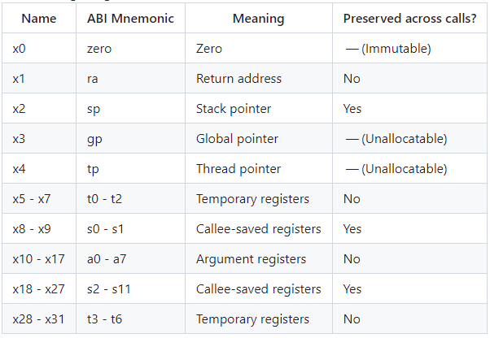
Integer registers
Except in rv32e there is 32 integer registers
  The x0 is hard codded to 0
  The other usage are by convention

Slide 7
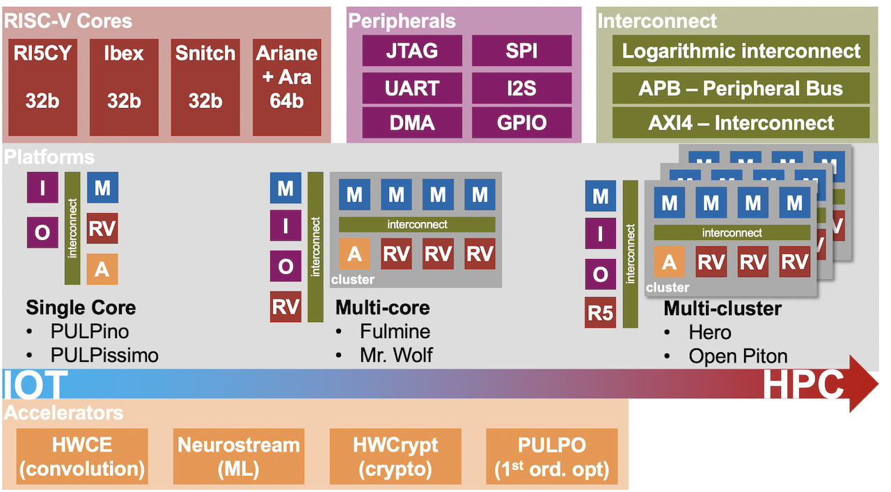
Pulp platform
Several RISC-V cores:
  32 or 64 bits address space
  Different pipeline stages
Complete systems
Wide sort of peripherals
SolderPad license
  Non-exclusive
  No-charge
  Royalty-free
  Irrevocable
Support of Hardware Processing Engine
Rich toolset

Slide 8
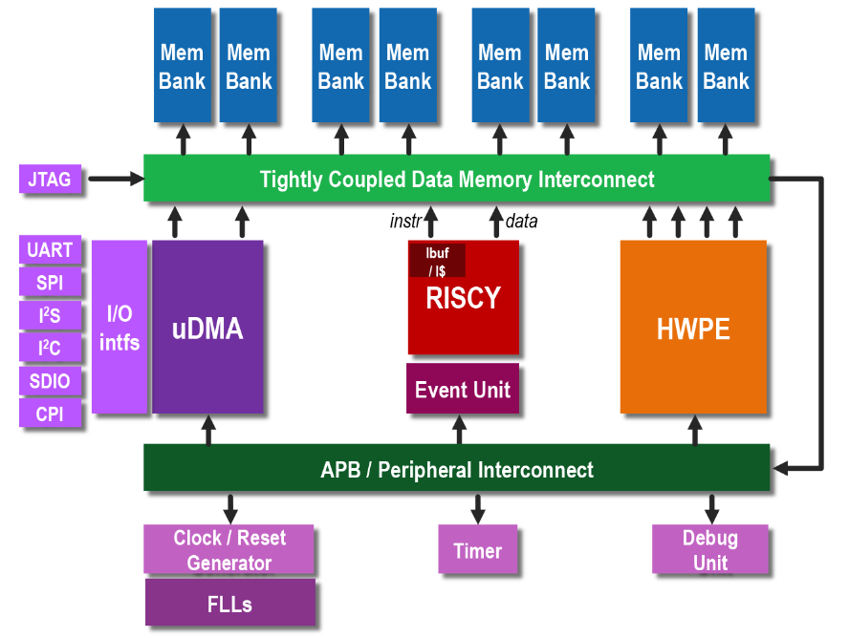
Pulpissimo
Single-core platform
Either the RI5CY core or the Ibex one
Autonomous Input/Output subsystem (uDMA)
Software Development Kit
RISCY is a RV32IMC[F] with some specific extensions
Ibex highly configurable core
  See lowRISC company for more details
Stage M2 2022
Willy Perrin

Slide 9
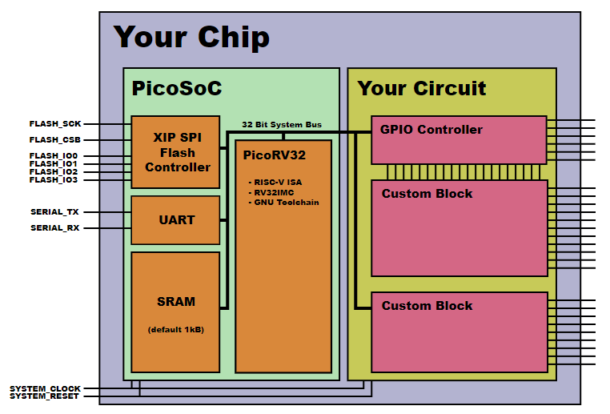
PicoRV32
Goal: Auxiliary processor for FPGA/ASIC
  High Fmax ➔ ease timing closure
  Small area
RV32I[M][C]
  A RV32E implementation is also possible
Three variations:
  Simple native memory interface
  Wishbone master interface
  AXI-4 Lite master interface
Stage M2 2023
Corentin Antony

Slide 10
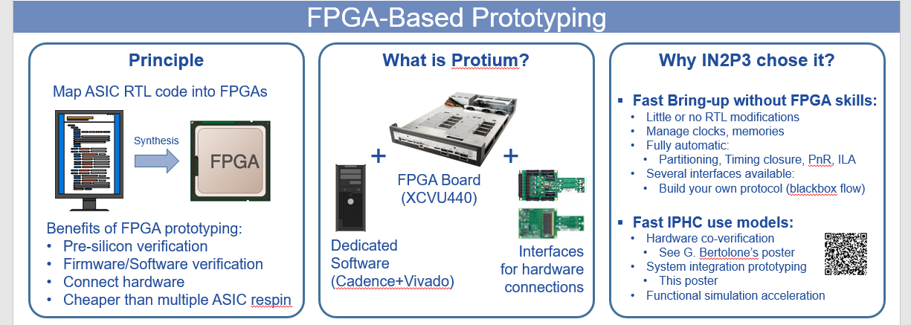
Protium platform

Slide 11
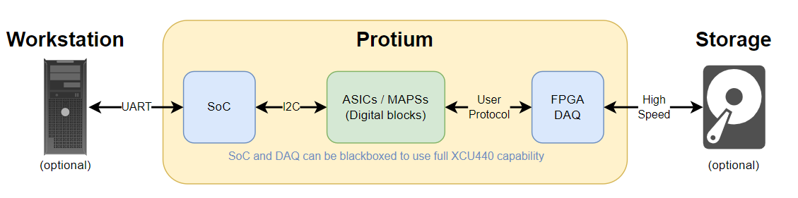
Why RISC-V in protium
Co-development:
  Full chain verification
  Software and hardware validation
  External hardware optional
SoC usage:
  Versatile device to configure ASIC
  Fast reconfiguration (C compilation)
  No need to PNR the system
  Increase Protium interactivity
First steps for future implementation of RISC-V in our designs:
  Smart sensor with fast auto-test and calibration capabilities
  Not for computing in first intention

Slide 12
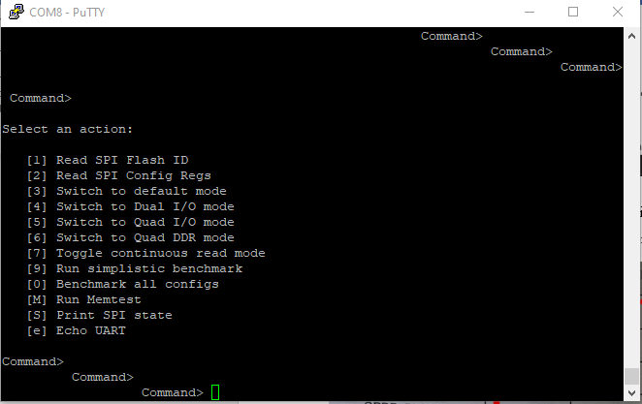
Results
Pulpissimo
  CPU is working
  Difficulties with modules due to complex SystemVerilog bus interfaces
PicoRV32
  First communication through UART
  Blackbox mode is ongoing

Slide 13
Conclusion
RISC-V will come soon in particle physics designs
  Mainly not for computing ➔ power
  Most probable for supervision
RISC-V landscape is large
  Easy to find something suitable for your needs
  Difficult to choose the best fitted
We succeed to implement it in Protium
  Can enhanced the Protium platform
  First step before ASIC version

