Slide 1
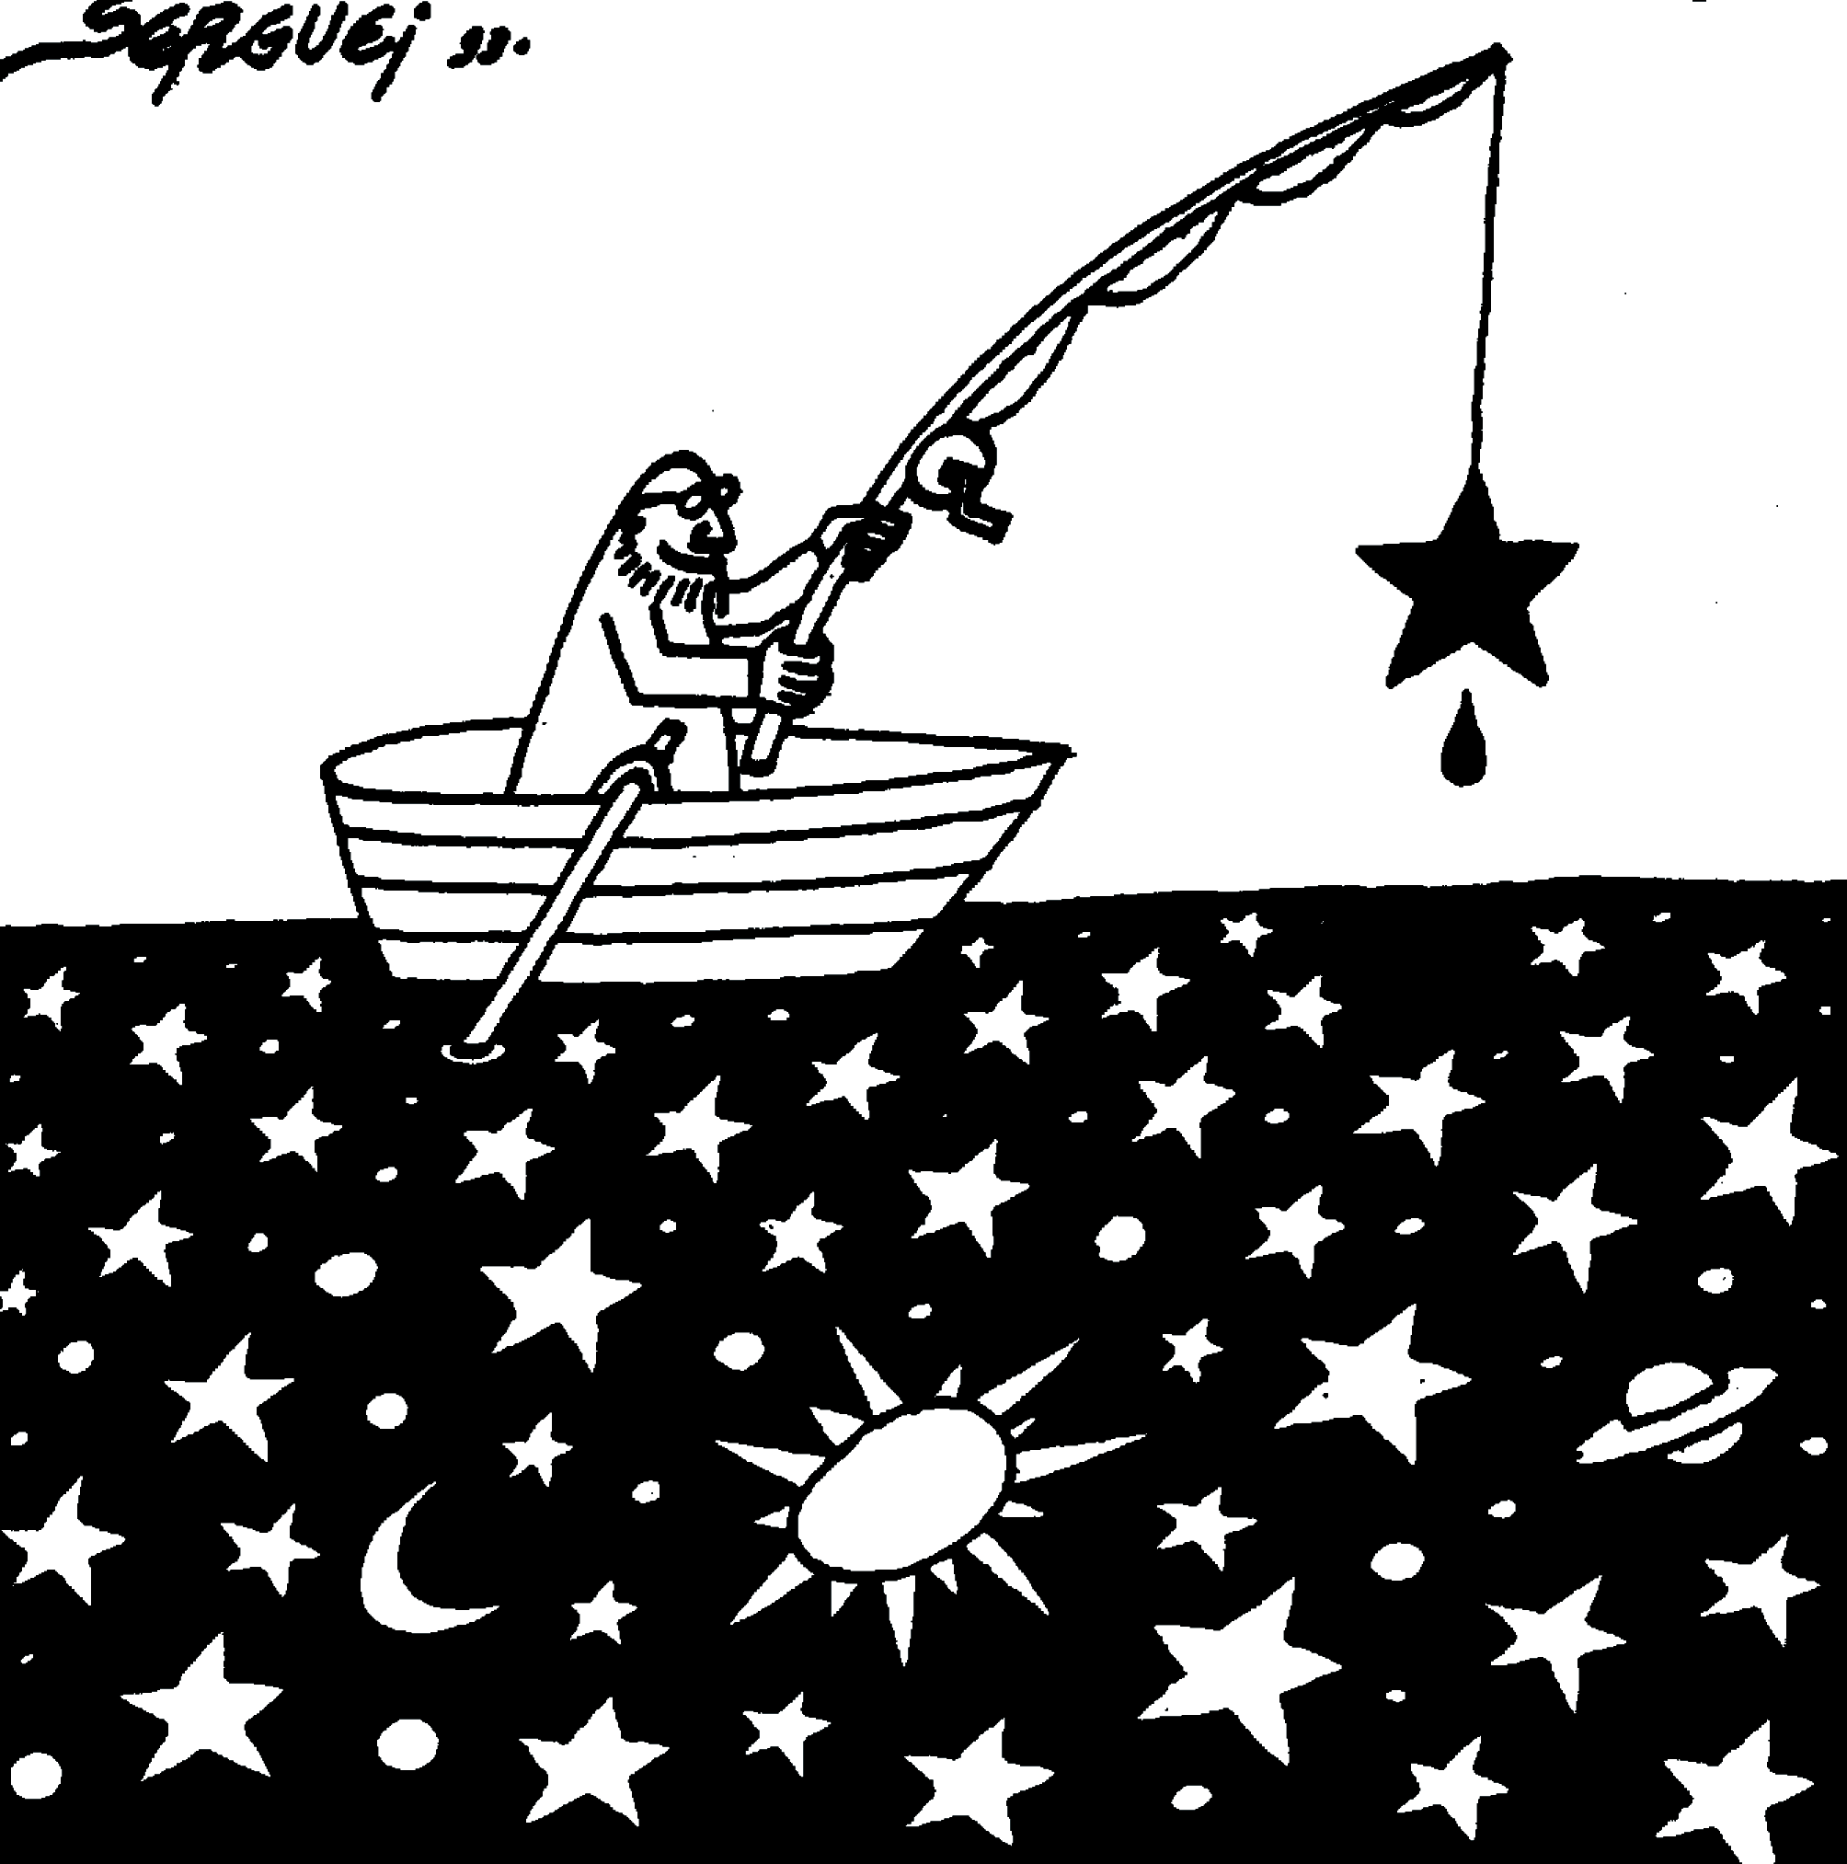
New limits from microlensing on Galactic Black Holes in the mass range 10.M⊙ < M < 1000.M⊙
Marseille, 19 sept. 2022
Tristan Blaineau
Marc Moniez
IJCLab-IN2P3
T. Blaineau et al., 2022, A&A, 664, A106

Slide 2
Gravitational microlensing effect
R_{E} = Einstein radius
t_{E} = Einstein duration
u₀ = impact parameter
t₀ = minimum approach time

Slide 3
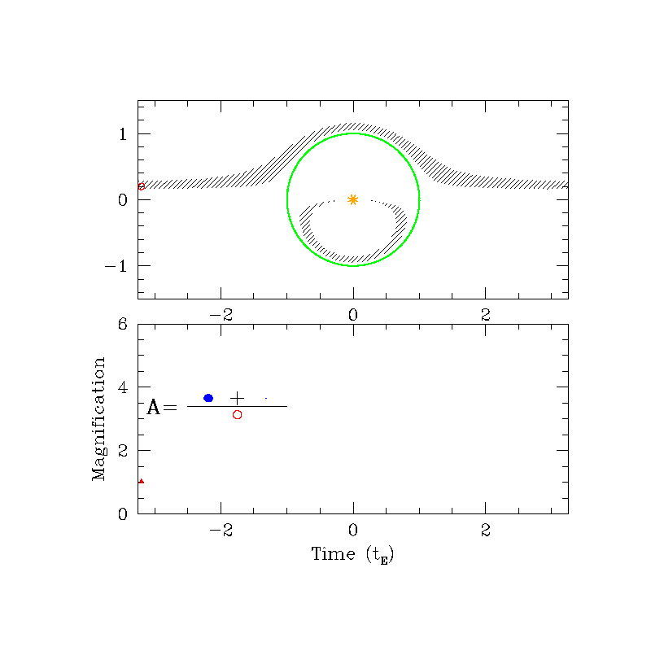
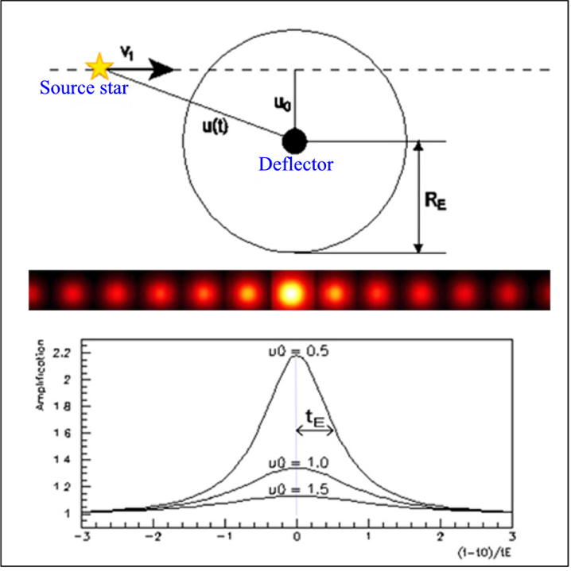
Description of a microlensing event
Point-lens, point-source, rectilinear relative motion
Light curve characteristic:
    Symmetric
    Achromatic
    Singular ( ~1 evt / 10⁶)

Slide 4
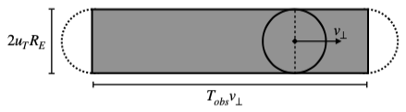
Probability/rate of microlensing events
The optical depth τ
- probability for a star to be behind an Einstein disk at a given time (Amplification > 1.34)
- disk surface α R_{E}² α M_{lens}
τ α Σ M_{lens}
  total mass of the probed structure
The number of events with u₀<R_{E} in T_{obs}
α surface swept by Einstein disks
=> N_{events} α Σ_{lens}R_{E} . V_{T} . N_{star} . T_{obs}
Surface covered by a lens during T_{obs}

Slide 5
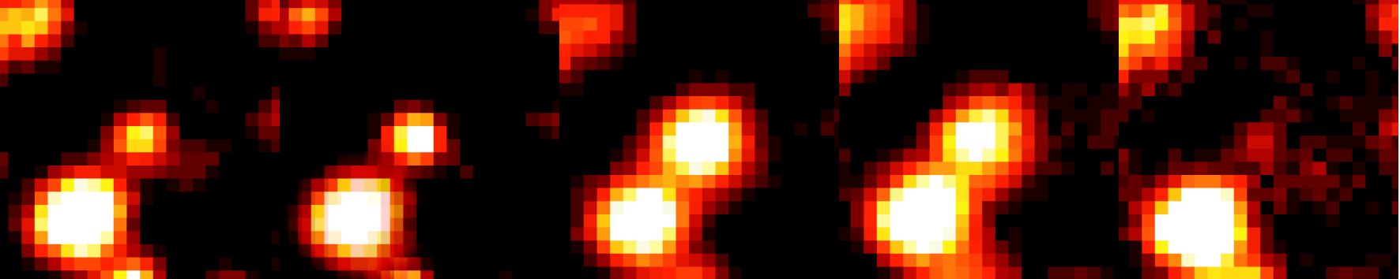
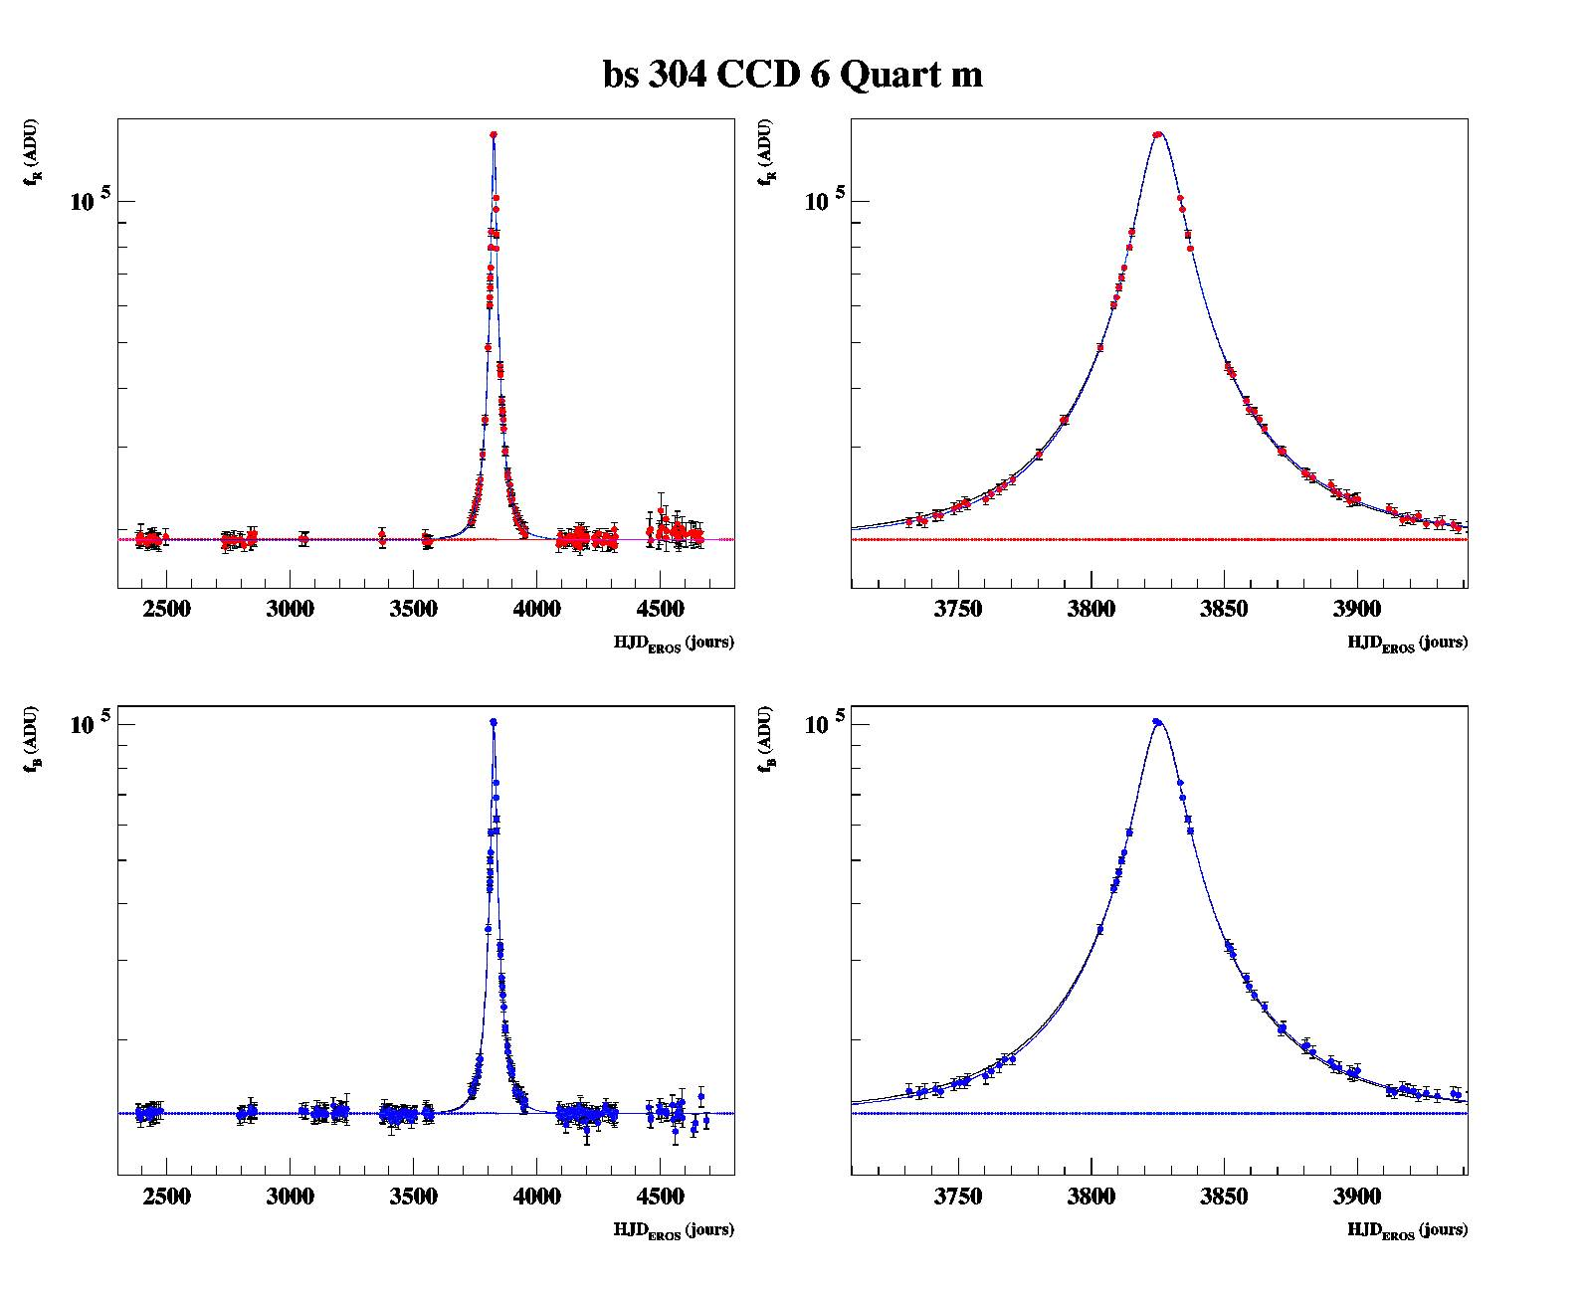
Example of a real candidate
high S/N

Slide 6
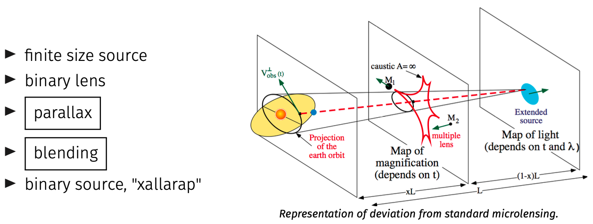
Beyond point source point lens rectilinear microlensing (PSPL)
u₀
depends on A_{max}
t_{E}
t₀

Slide 7
u₀
depends on A_{max}
The microlensing observables
t_{E}
t₀
  Simple events (point-source, point-lens, constant v_{T})
    Event by event Einstein radius crossing time t_{E}
    Statistical information from a series of events:
      optical depth τ and t_{E} distribution
      -> Constraints on total (visible + hidden) mass
      -> Constraints on lens mass function
      -> Constraints on relative obs/lens/source kinematics
  Non-standard events
    Parallax, Xallarap, extended source, multiple lens/sources… -> extra-information on distance, mass, velocity
    Not considered here for statistical studies

Slide 8
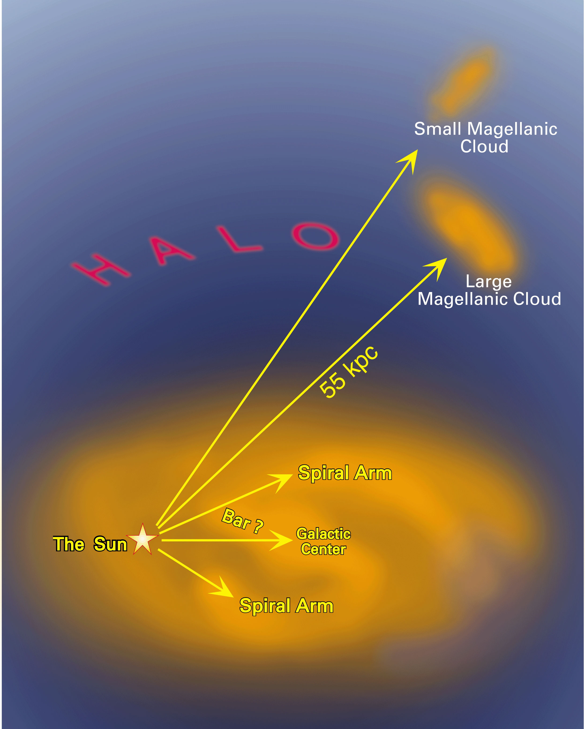
Main targets monitored since 1990’s
Magellanic Clouds => probe hidden matter in halo (τ_{LMC} ~ 4.7x10⁻⁷)
Galactic center => probe ordinary stars as lenses in disk/bulge (τ_{GC} ~ 2.10⁻⁶)
Spiral arms
=> probe ordinary stars in disk, bar + hidden matter in thick disc (τ_{GSA} ~ 5.10⁻⁷)
M31
Notes:
MEGA project? Centre galactique: cusp vs core

Slide 9
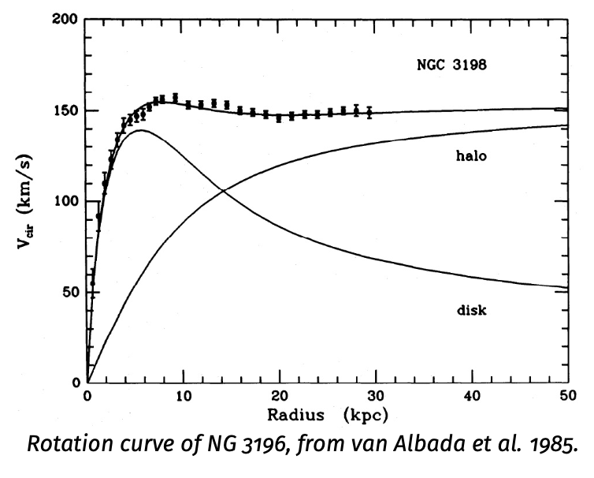
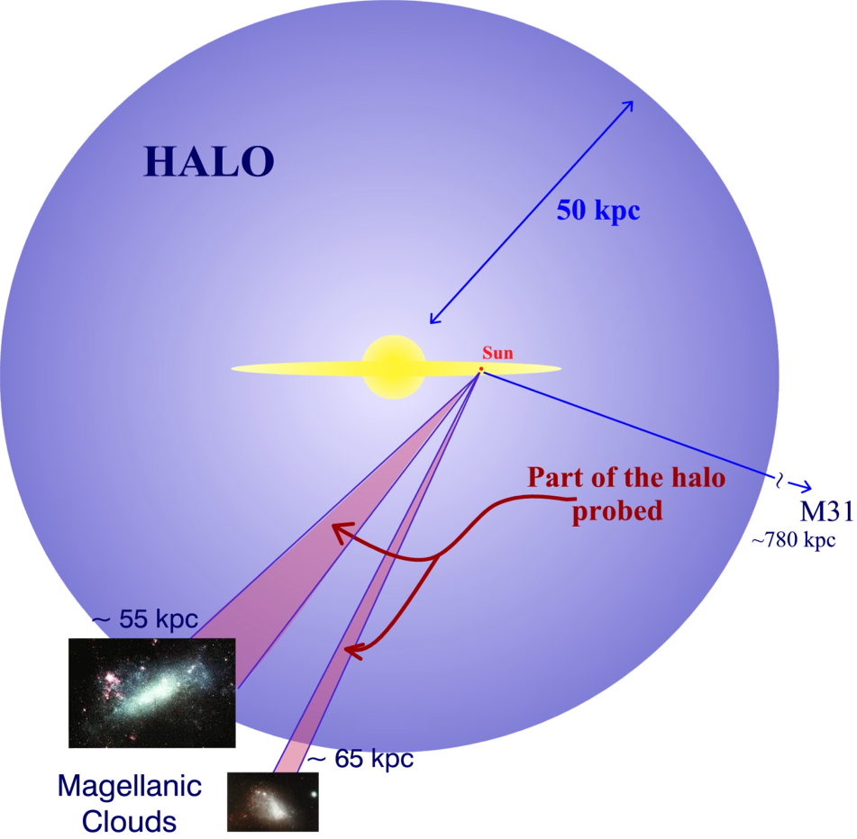
Initial motivation for microlensing searches (90’s): contribution of compact objects to the galactic halo
Sub-stellar mass or invisible stellar mass baryonic objects
Others (accreted particles)
If extended object, it should be transparent or with occultation radius < R_{E} ~ 1AU to be a lens
  Includes black holes and non baryonic massive objects

Slide 10
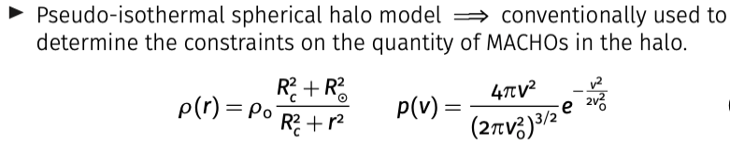
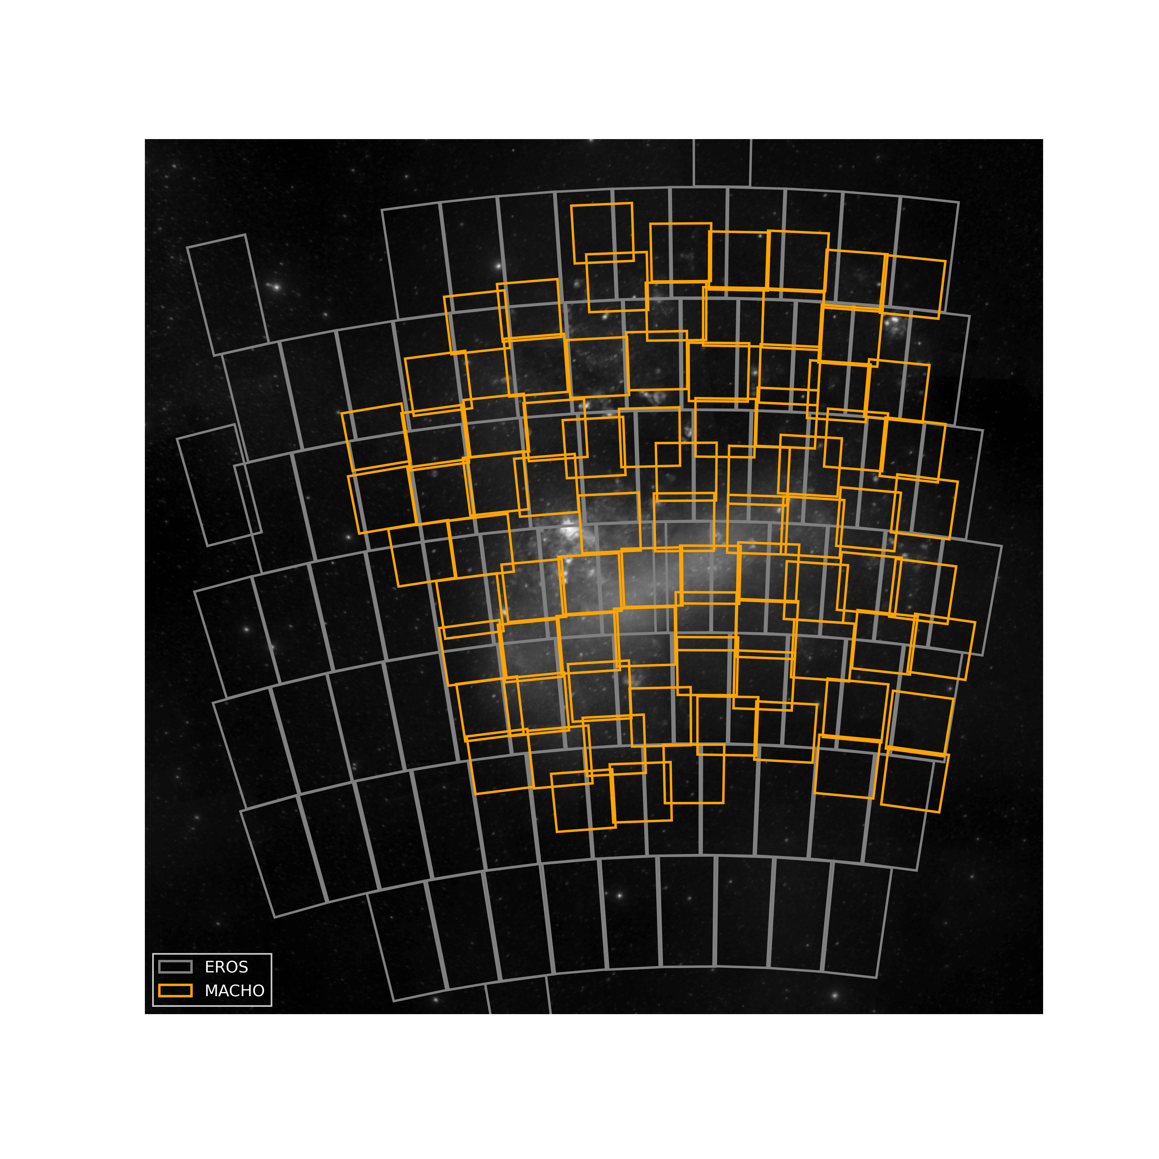
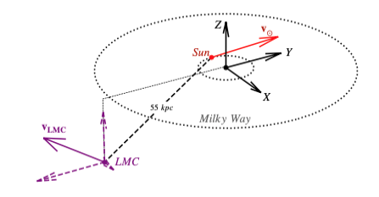
The Large Magellanic Cloud is monitored for microlensing since the 1990s’
-> search for massive compact objects within the galactic DM halo
At this epoch: sub-stellar and stellar mass objects
u₀
depends on Amax
t_{E}
t₀
ρ₀ = 0.0079 M_{sun}/pc²
R_{C} = 5 kpc
R_{sun} =8.5 kpc
D_{LMC} = 49.5 kpc
v₀ =155 km/s
v_{sun} , v_{LMC} …
τ ~ 4.7 x 10⁻⁷
<t_{E}> ~ 63days (M_{lens}/M_{sol})^{1/2}

Slide 11
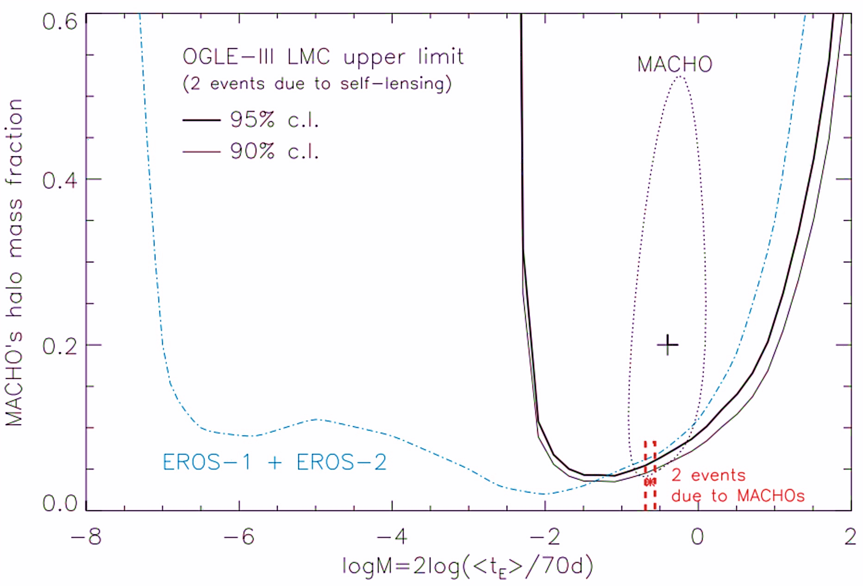
Before GW-Era (2017)
Milky way halo: constraints from LMC microlensing
~ 80 events expected in all surveys if 100% halo @0.4M_{sol}

Slide 12
Before GW-Era (2017)
Milky way halo: constraints from LMC microlensing
Objects within this mass range contribute for less than 20% of the halo
10⁻⁷M_{sun}
10.M_{sun}

Slide 13
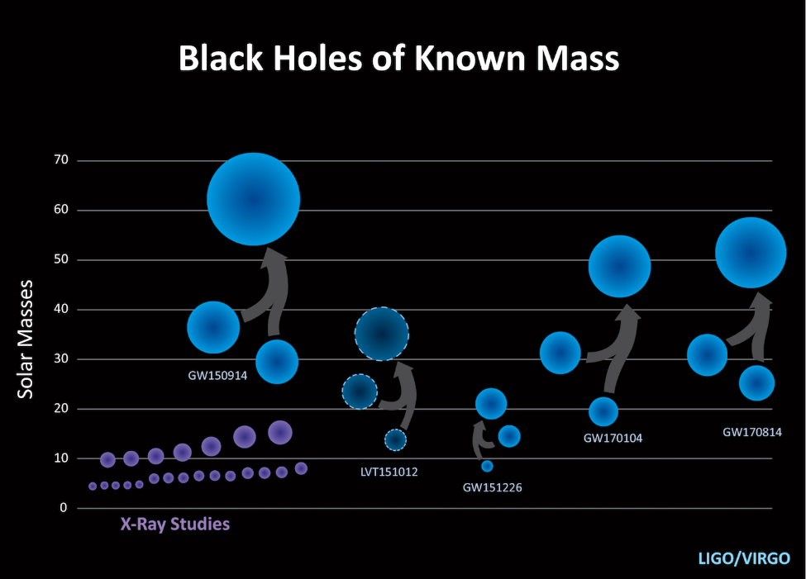
GW-Era (post-2017)
Detected black holes are just heavier
2018
Objects within this mass range contribute for less than 20% of the halo
10⁻⁷M_{sun}
10.M_{sun}

Slide 14
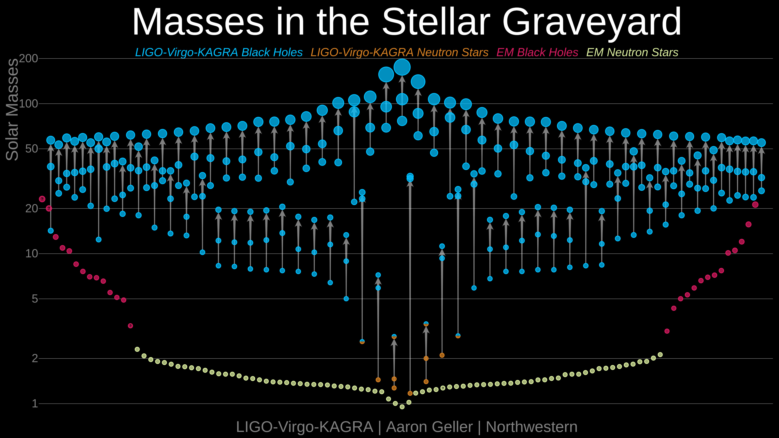
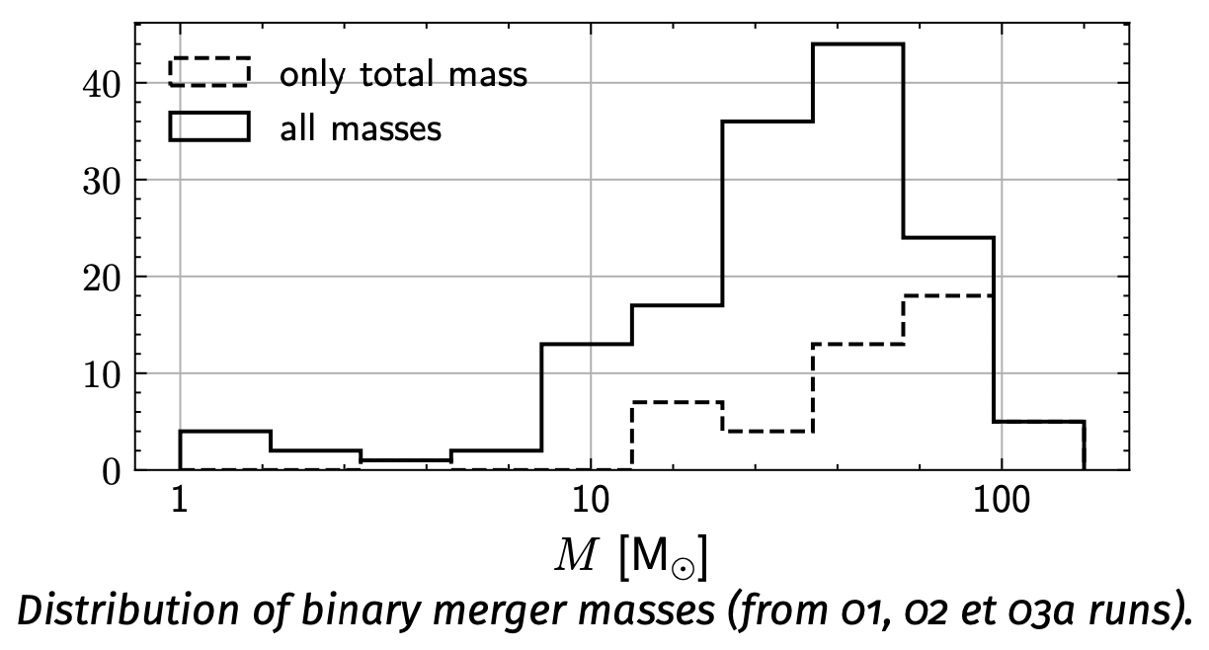
Year 5 GW-Era
Detected black holes are just heavier
Objects within this mass range contribute for less than 20% of the halo
10⁻⁷M_{sun}
10.M_{sun}

Slide 15

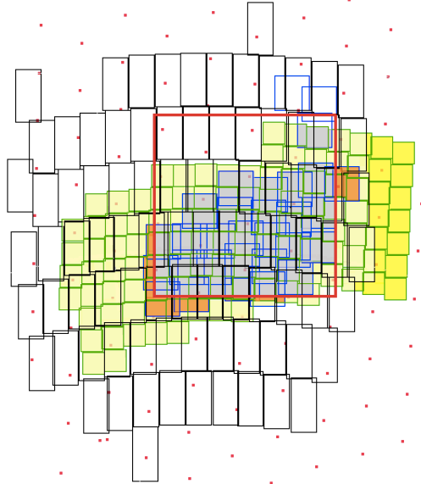
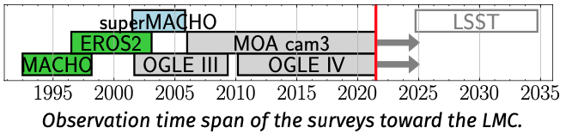
Search for very long events with joined data analysis: MEMO project (A&A 618, L4 (2018)
Heavy lenses produce long duration events
(~ 2yrs for 100M_{sun} lens)
Detection efficiency of the past surveys vanishes for such durations, because:
Limited duration T_{obs} of each survey (3-8yrs)
Observations/Analysis optimized for light lenses
19 yrs
30 yrs
MoaErosMachOgle combined light-curves provides much more extended light-curves.
Here only the combination of EROS2 and MACHO has been performed
24 yrs
28 yrs
Fields monitored within the
Large Magellanic Cloud

Slide 16
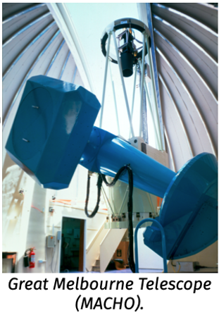
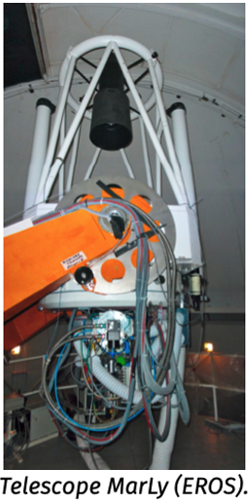
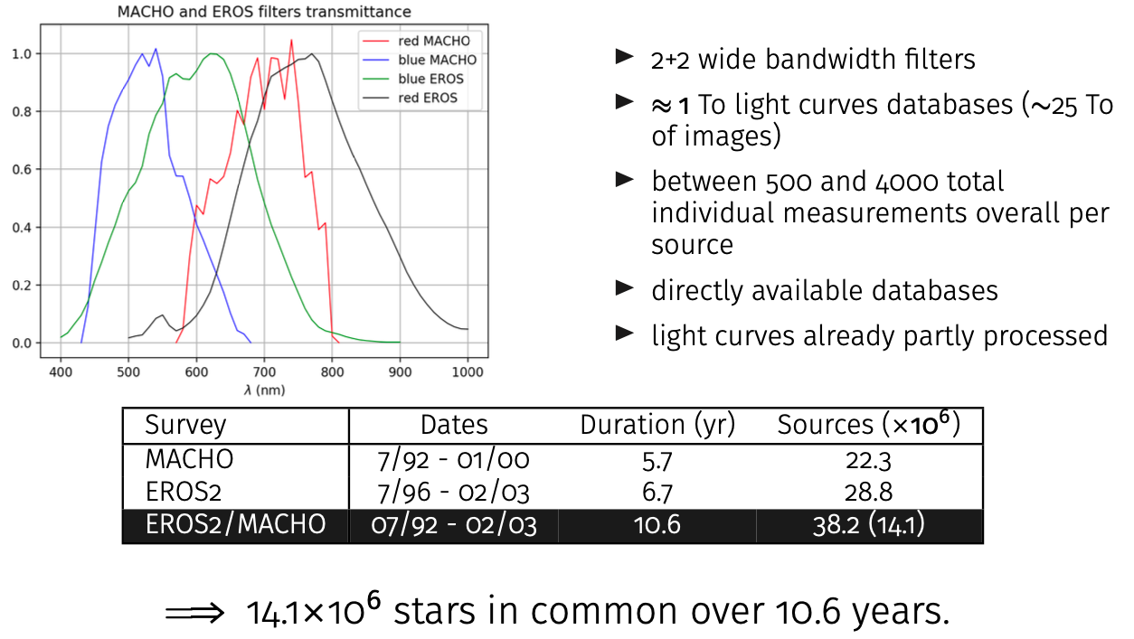
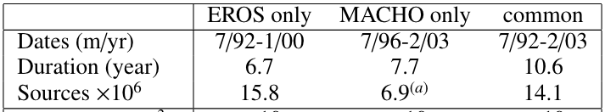
EROS2 and MACHO
Microlensing surveys towards the LMC
MACHO
1.27m telescope in Australia
2 cameras with dichroic
4 CCD 2Kx2K pixels each
Field of view: 0.5 deg²
Monitored 82 fields (39 deg²)
EROS2
1m telescope in Chile
2 cameras with dichroic
8 CCD 2Kx2K pixels each
Field of view: 1 deg²
Monitored 88 fields (88 deg²)
LMC fields
7/96-2/03 7/92-1/00

Slide 17
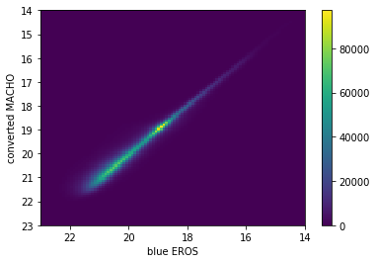
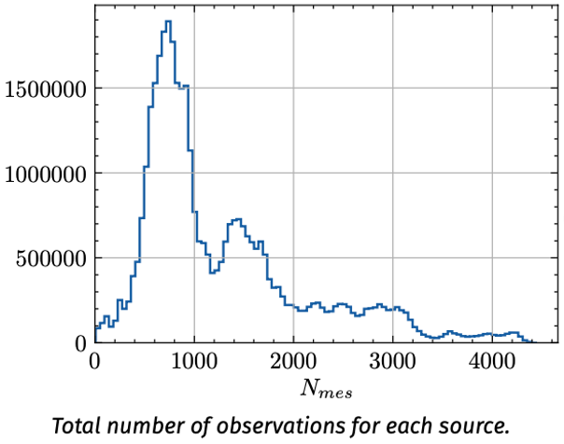
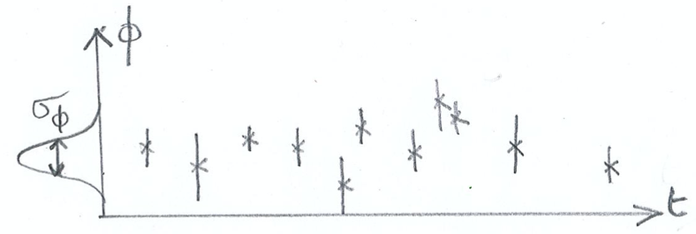
Association, cleaning
Cross-identification of the EROS-MACHO catalogs (using GAIA)
  To better than 0.1 arcsec in (α,δ)
  To photometric accuracy in flux
Improved cleaning
  problematic measurements removed
  -> 3% in MACHO; 1% in EROS
  Keep light-curves with > 200 points
Homogenize photometric uncertainties
  Sometimes underestimated by MACHO
  Overestimated by EROS for faint stars
  Global normalization of errors
<N_{obs}> ~ 1300
per source
After renormalization:
<error> ~ point-to-point dispersion

Slide 18
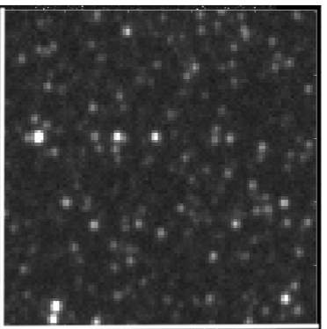
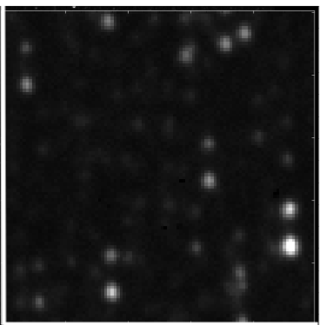
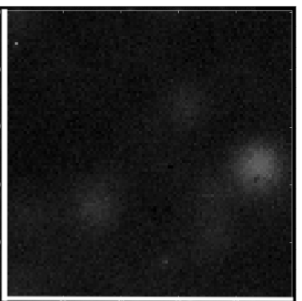
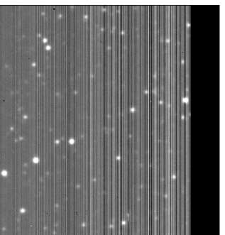
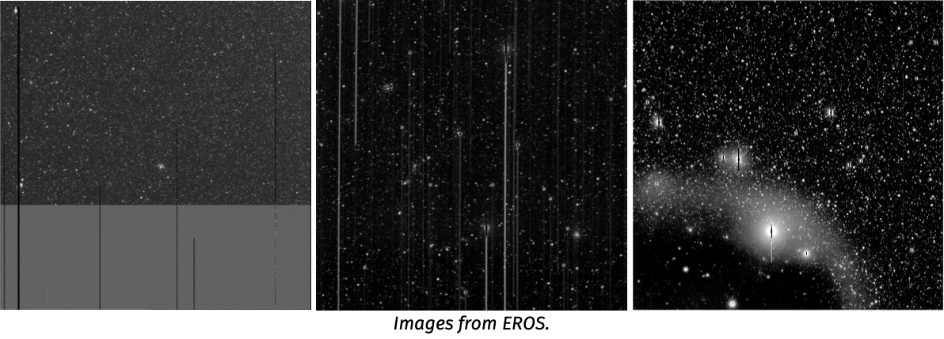
Cleaning low quality images/measurements
Images from MACHO
Good
Bad guiding
defocused
readout
readout
Bad guiding
Condensation (?)
Cleaning: 3% of Macho and 1% of EROS measurements removed

Slide 19
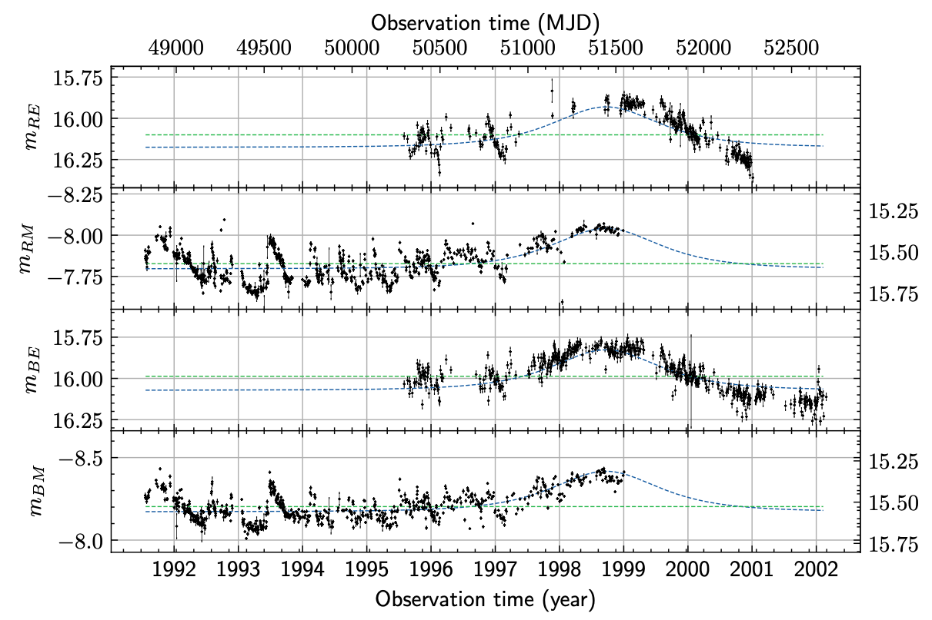
Combined light-curves
Red-EROS
Red-MACHO
Blue-EROS
Blue-MACHO

Slide 20
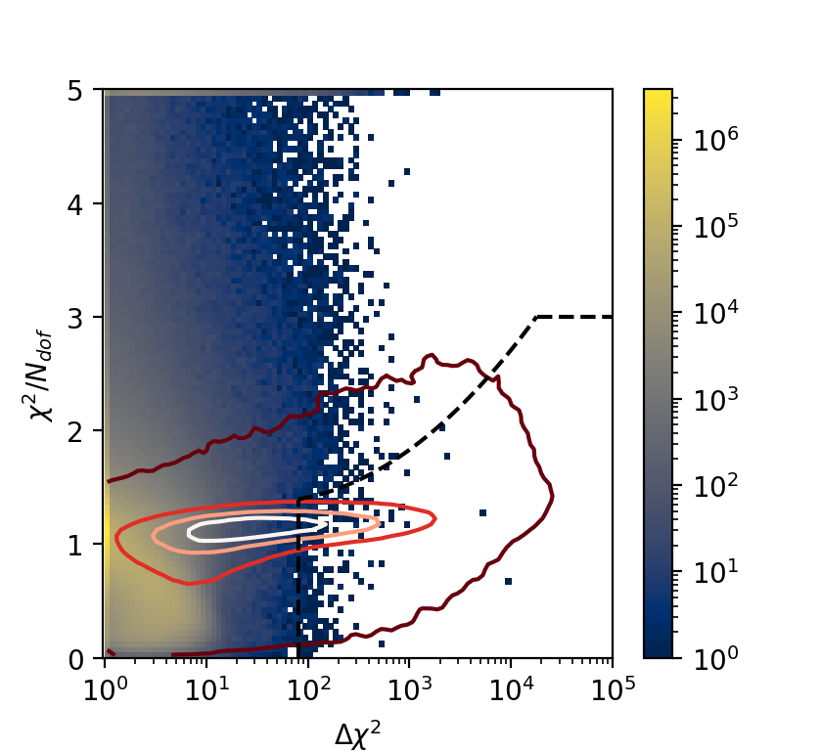
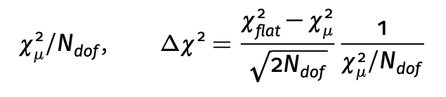



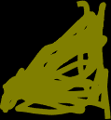
Discriminant analysis
u₀
depends on A_{max}
t_{E}
t₀
Based on the comparison of the χ² of a constant fit and a microlensing fit, simultaneous to the 4 light-curves.
- Constant fit (flat) : 4 parameters, 1 mean flux/colour.
Microlensing fit (μ) : 7 parameters, common u₀, t₀, t_{E}, 1 base flux/colour (could be more than 4 when adding OGLE/MOA)
Goodness of μlensing difference (flat – μlensing)
Data
Require long events and well contained
100 days < t_{E} ^{fitted} < T_{obs} /2 ~ 2000 days
T_{start} + 200 days < t₀^{fitted} < T_{end}
Simulation
selection

Slide 21
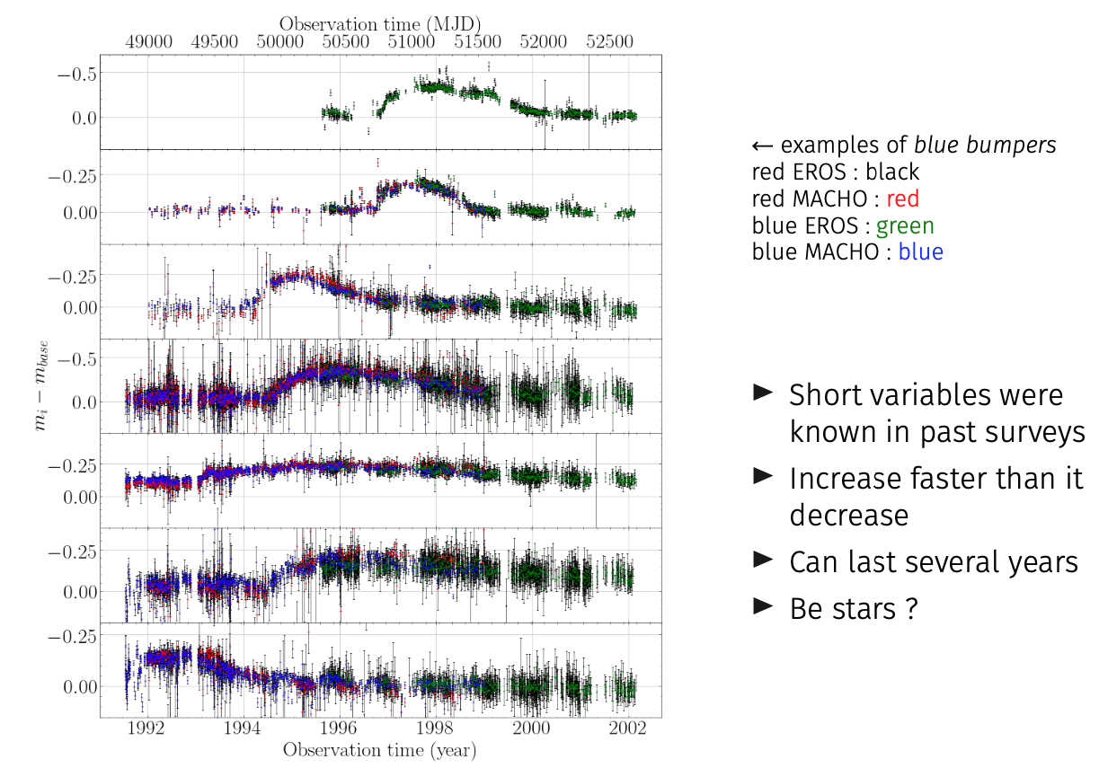
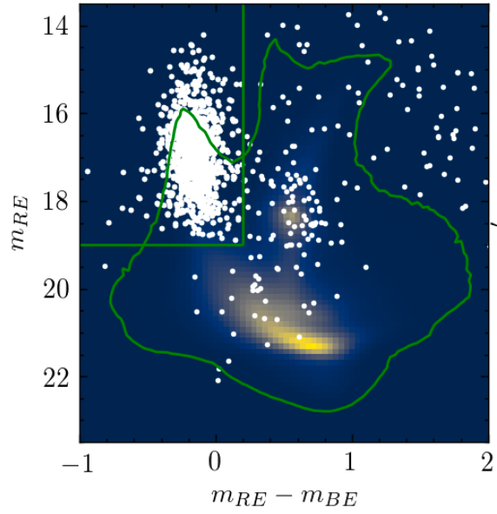
Main remaining artefacts (known)
Blue bumpers (Be stars)
Require larger fitted magnification for candidates in the blue bumper CMD zone:
u₀ ^{fitted} < 0.9 (corresponds to Amp. > 1.38)

Slide 22
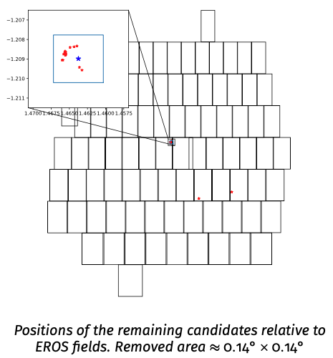
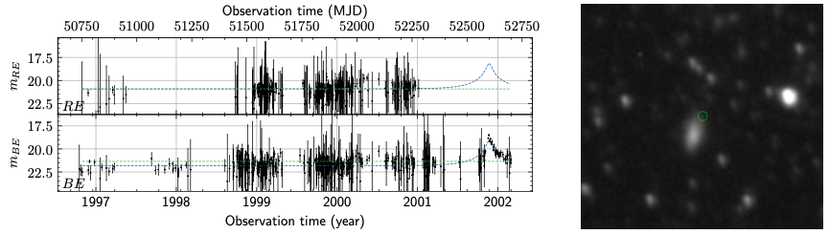
Other known artefacts
SN1987A echoes
  Diffusion of the light emitted by the SN, superimposed on a monitored star
  Remove a small patch of sky
One QSO (catalogued)
One YSO (Young Stellar Object – variable, catalogued)
One clear SN (host galaxy catalogued)

Slide 23
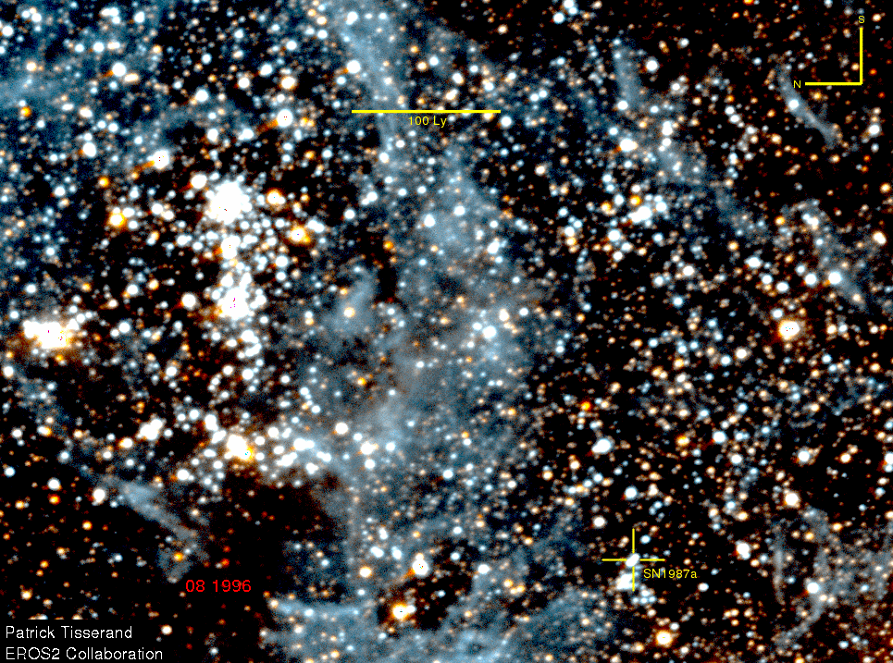
SN1987A echoes
Diffusion of the light emitted by the SN superimposed on a monitored star
Vary with time (expansion) -> brightness seems to vary
Remove a small patch of sky
A well known artefact

Slide 24
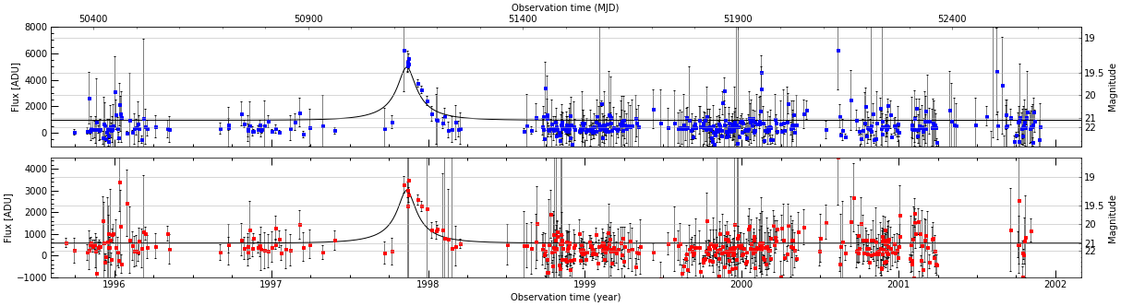
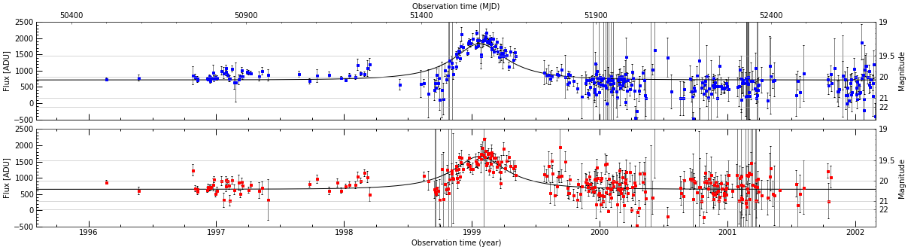
Candidates: only 2
u₀
depends on Amax
t_{E}
t₀
u₀=0.19, t_{E}=106 days.
Asymmetric, large magnification, 0.6’’ shift from min to max.
-> probably SNII-L or P
u₀=0.41, t_{E}=183 days.
Suspicious variations outside main peak.
We cannot formally reject these « low quality » candidates without using more criteria (and losing efficiency)
-> We chose to keep them for exclusion limit computation
-> with negligible impact

Slide 25
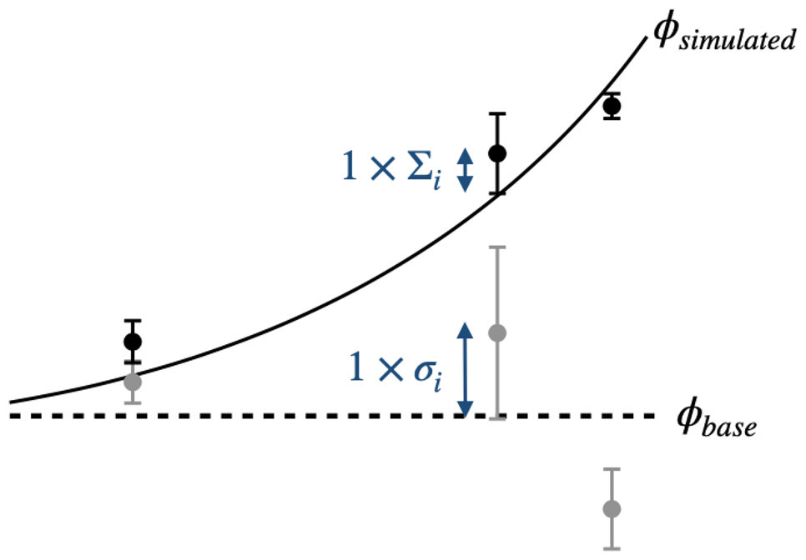
Efficiency estimates
Mathematically, microlensing detection efficiency is zero (infinite range of gravitation)
It’s a matter of definition -> define efficiency as the ratio of detected events to generated events
  With uniform impact parameter u₀ < 1 (typically)
  With uniform max. mag. time t₀ during the observed period
  For a given source population (bright, red giants...)
    Resolved sources or not (Differential Image Analysis)
Simulated microlensing according to
the halo parameters are applied to
real light-curves (grey->black points)
-> Then subjected to the same analysis

Slide 26
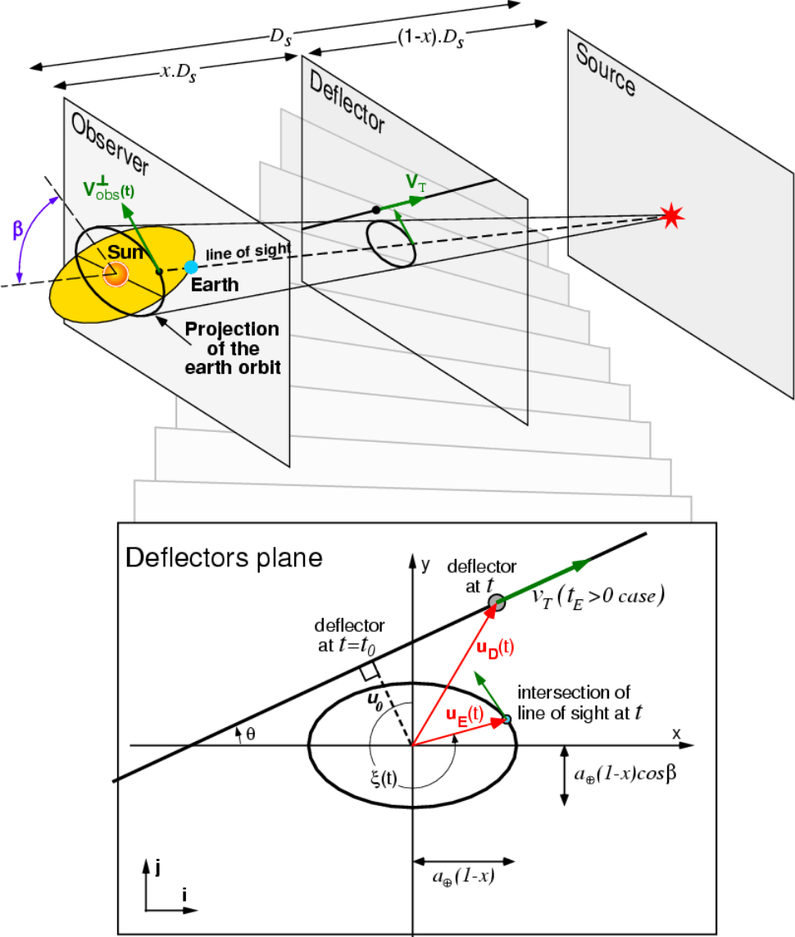
Does parallax complicate the search for long events ?
- Due to Earth orbiting, apparent trajectory of the lens w/r line-of-sight is an hypocycloid
- u(t) (and magnification) shows modulations with 1 year caracteristic time
In the worst scenario (thick disk), less than 7% of events could be missed by a simple search algorithm.
(Blaineau & Moniez A&A 636, L9, 2020)
-> We neglect this effect in the search, but simulate it in the efficiency calculation

Slide 27
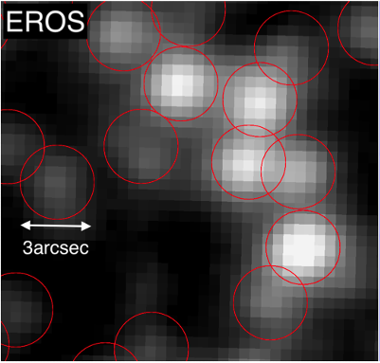
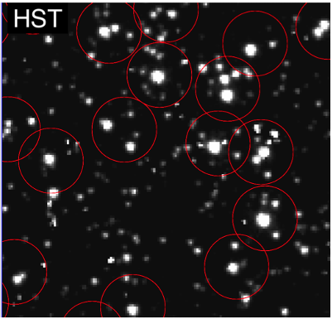
u₀
depends on Amax
Expected signal from the standard halo (S model)
t_{E}
t₀
Simulation based on the observed (stable) light-curves modified by simulated microlensing according to the standard DM halo :
Preserves the initial deviations from the base flux
Takes into account the variation of photometric precision with the flux
MACHO or EROS objects are blends of several stars
Use HST images to infer the content of MACHO and EROS objects
Microlensing simulated on each component
=> Resulting light curve = microlensed + other components’ light
New: Blend in binary systems (not resolved by HST in LMC) ?
For microlensing by heavy lenses (long time scale, large R_{E}):
- Using GAIA database, we estimate < 7% of the sources are binaries separated by >50AU, inducing blend effect for long duration events (to be published) - binaries closer than 50AU are ~ identically magnified by a large Einstein disk.
-> Binarity unresolved by HST can be neglected (conservative)

Slide 28
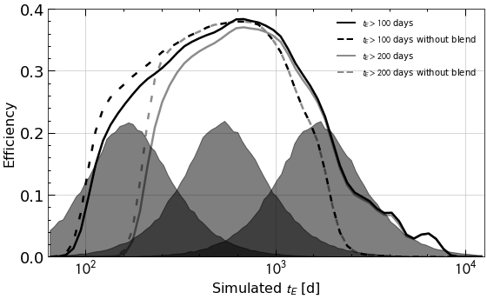
Expected signal
from the standard dark matter halo (S model)
Simulation
Simulated microlensing are applied to real light-curves according to the halo parameters
(incl. complications such as blending)
# events depends on
Halo model for compact objects
Spatial distribution
-> derive optical depth to LMC
τ ~ 4.7x10⁻⁷
Velocity distribution
Mass distribution (here δ(Μ))
-> derive t_{E} distribution
Mean detection efficiency
Estimated as a function of t_{E}
# events proportional to
T_{obs}
N_{star in LMC} = 0.95 x N_{star catalog}
(< 5% Milky Way stars –from GAIA data)
Final correction: max 10% of events can escape detection because they are exotic (double lens…)
With
t_{E} >200 days
Distributions of t_{E}
for lenses of fixed mass
10.M_{sol}
100.M_{sol}
1000.M_{sol}
All selected events from simulation
simulated events with u₀ < 1 and t₀ in T_{obs}
ε =

Slide 29
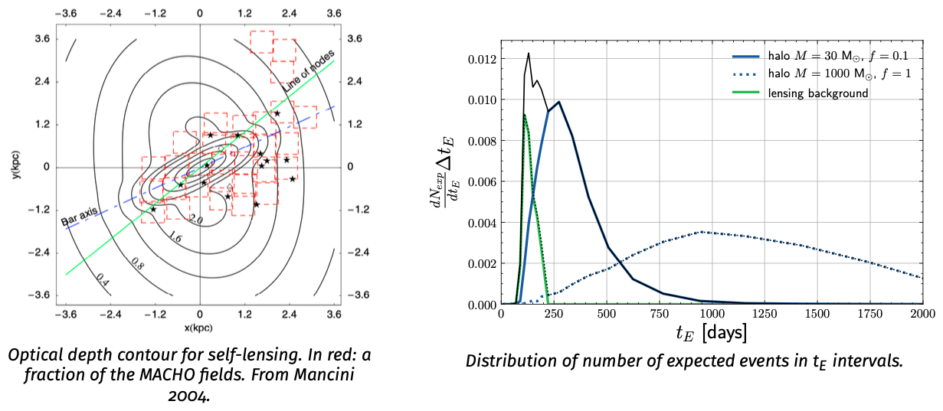
Non halo microlensing background
Stars in the Milky Way disk: uniform over all fields
Stars in LMC (self-lensing): concentrated around the LMC bar
Estimated and adapted to our efficiency from Calchi-Novati & Mancini 2011
Total lensing background: 0.64 (with 100 < t_{E} < 200days)

Slide 30
Exclusion limit (T. Blaineau et al. 2022, A&A 664, A106)
Expected events from the standard halo
This analysis:
36.8x10⁶ LMC stars; 10.6 years
  ~ 0.64 events expected
  from LMC self-lensing+disk
  (with 100 < t_{E} < 200 days)
  2 candidates selected
  Likelihood analysis to find 95% CL exclusion limit
If we further require t_{E} > 200 days
  0 events expected
  from self-lensing+disk
  0 event selected
  Poissonian analysis:
  3 events excluded at 95%CL
High mass exclusion unchanged
t_{E} > 100 days
Total
EROS
EROS+MACHO
MACHO
t_{E} > 200 days
t_{E} > 200 days
Excluded at 95%CL
New limit

Slide 31
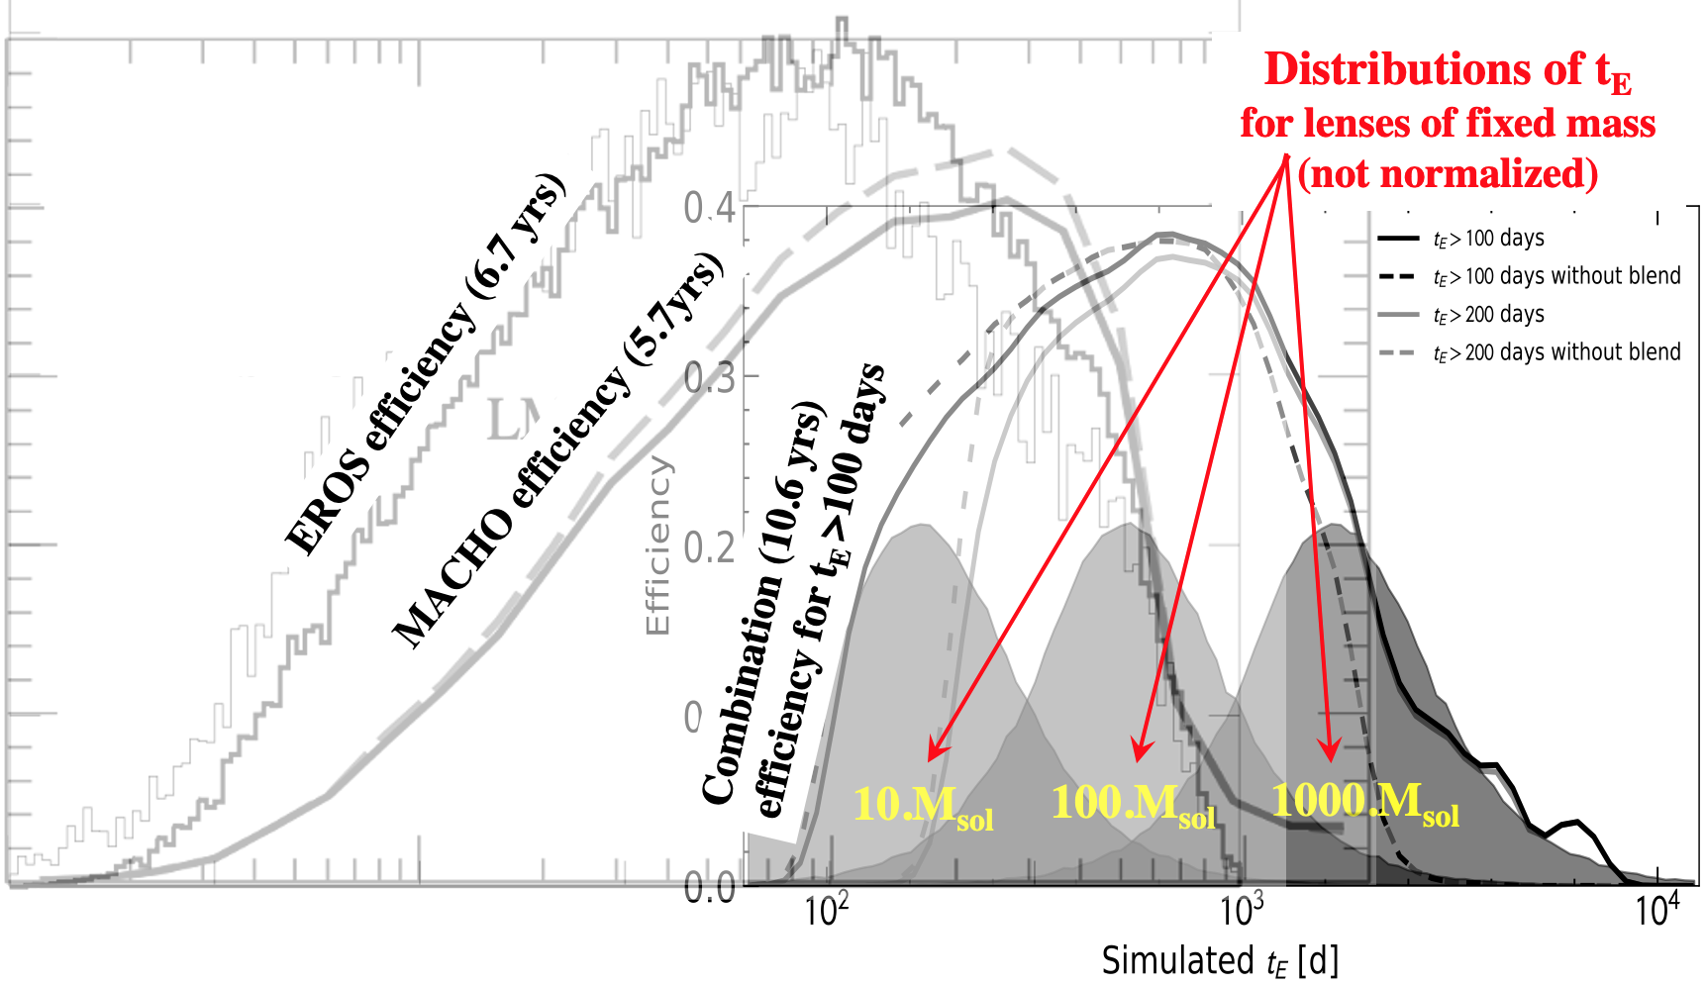
Several sources of gain
Previous analysis explicitely rejected long events
To have a long enough baseline / reject LPV
Here we use the 2 published catalogs
Cumulate EROS + MACHO statistics and time coverage
22.7 million sources monitored for 6.7 (EROS) or 7.7 (MACHO) years (not in common fields)
14.1 million sources monitored for 10.6 years (in common)
  For 1000.M_{sol} lenses, detection efficiency for these curves is x by ~ 4
  Contribute for 72% of the expected detections for a halo made of 1000.M_{sol} lenses

Slide 32
Conclusions, perspectives
Microlensing observations and the Galactic halo
  We have combined EROS2 + MACHO data towards LMC
  Objects with M < 1000.M_{sol} do not dominate the Galactic DM halo (@95%CL)
  Published in T. Blaineau et al., 2022, A&A, 664, A106 (on ArXiV since 02/22)
What about the black holes responsible for the GW?
  Do not constitute the Galactic DM
  In the visible structures of the Milky Way (end-point of IMF)? -> microlensing towards the Galatic Bulge and spiral arms
Perspectives
  Short term: do combined analysis from all databases (incl. MOA and OGLE)
  Make database ready for looking back in the case of emerging events
  Long term LSST
    10 year wide field monitoring from 2024
    Includes repeated observations towards Galactic plane + LMC/SMC
    Median repetition rate: 3 days between observations
    6 different filters
    Combine LSST with the historical surveys -> > 40 years

Slide 33
Complements

Slide 34
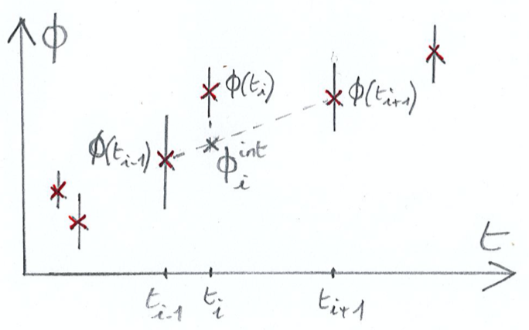

Correction of uncertainties
Average flux uncertainties should match the dispersion of flux measured for a constant star along the light curves
Flux uncertainties were
  underestimated by MACHO
  overestimated by EROS2 (for faint stars)
Renormalize errors to match point-to-point
variations for each passband
  -> balance contributions to χ² from:

Slide 35


Slide 36

Remaining artefacts (3)
Position in CMD diagram

Slide 37

Remaining artefacts (4)
Position in CMD diagram

Slide 38



Blending

Slide 39
Detection efficiency of microlensing: complication due to blending
Blending
a source monitored in a survey can be composed of several stars
  -> But only one is lensed
  Impacts Paczynski curve shape and reconstructed t_{E}
    ε(t_{E rec.}) differs from ε(t_{E generated})
  Changes the effective # of stars
    A minor (not catalogued) contributor to an object can emerge with microlensing, apparently increasing ε
The composition of the blend depends not only on the density of the sources but also on their clustering
  - Images from space telescopes provide true underlying luminosity function and includes spatial correlation between the blend components

Slide 40

Blending in LMC
HST shows what is behind an observed light-curve on Earth
A catalog object produced by a ground-based telescope is often a blend of several stars in crowded fields
Microlensing has to be simulated on each HST component and the resulting light curve is the sum of a magnified and a stable components
Is it sufficient?

Slide 41

EROS vs HST

Slide 42

EROS vs HST

Slide 43
EROS vs HST

Slide 44


We expect blending by very close neighbours not detected in HST
Random distribution
Number of neighbours at [r, r+Δr]
Should increase linearly with r for a random distribution
GAIA DR3 catalog of nearby stars shows clear excess w/r random for separation < 10000AU
Corresponds to < 0.1 arcsec angular separation in LMC

Slide 45

Quantifying the blending impact by very close neighbours not detected in HST
for t_{E} > 2yr event R_{E} > 50 AU
Extract the rate of binary as a function of projected separation
Random distribution
Integrated binary rate with separation ranging from abscissa [AU] to infinity
For microlensing by heavy lenses (> 20M_{sol})
- R_{E} > 50 AU -> only binaries separated by > 50AU have to be considered for blending
- < 7% of the sources are such binaries inducing classical or transition blend effect
closer binaries are identically magnified and can be considered as single sources
-> Negligible impact (conservative)

Slide 46

Expected signal from the halo?
Realistic simulation based on the observed light-curves modified by theoretical microlensing

Slide 47



Efficiency
OGLE (2015)
MOA
Averaged on a given source population (RG, all)
Depends on sampling and environment
Averaged on u₀, t₀ -> to obtain a Function of t_{E} only

Slide 48

Efficiency: complications
Blending: an object may contain light from several stars
  -> But only one is lensed
  Impacts Paczynski curve shape and reconstructed t_{E}
    ε(t_{E rec.}) differs from ε(t_{E generated})
  Changes the effective # of stars
    A minor (not catalogued) contributor to an object can emerge with microlensing, apparently increasing ε
    Images from space telescopes provides true underlying luminosity function and includes spatial correlation between the blend components
Contribution from non-standard events (binary lenses…)
  Generally not generated when estimating efficiency
  Can be statistically estimated (<10%)
High statistics needed for reliable use of efficiency (for τ estimates)
  ε is an average with large variations from event to event

