Slide 1






Laser Ablation ICPMS technique and potentialities - Status of the round table
Frédéric Perrot for WP2 group
LP2i Bordeaux / IN2P3-CNRS / University of Bordeaux
GDR DUPhy, 19-21 octobre 2022, Nantes

Slide 2
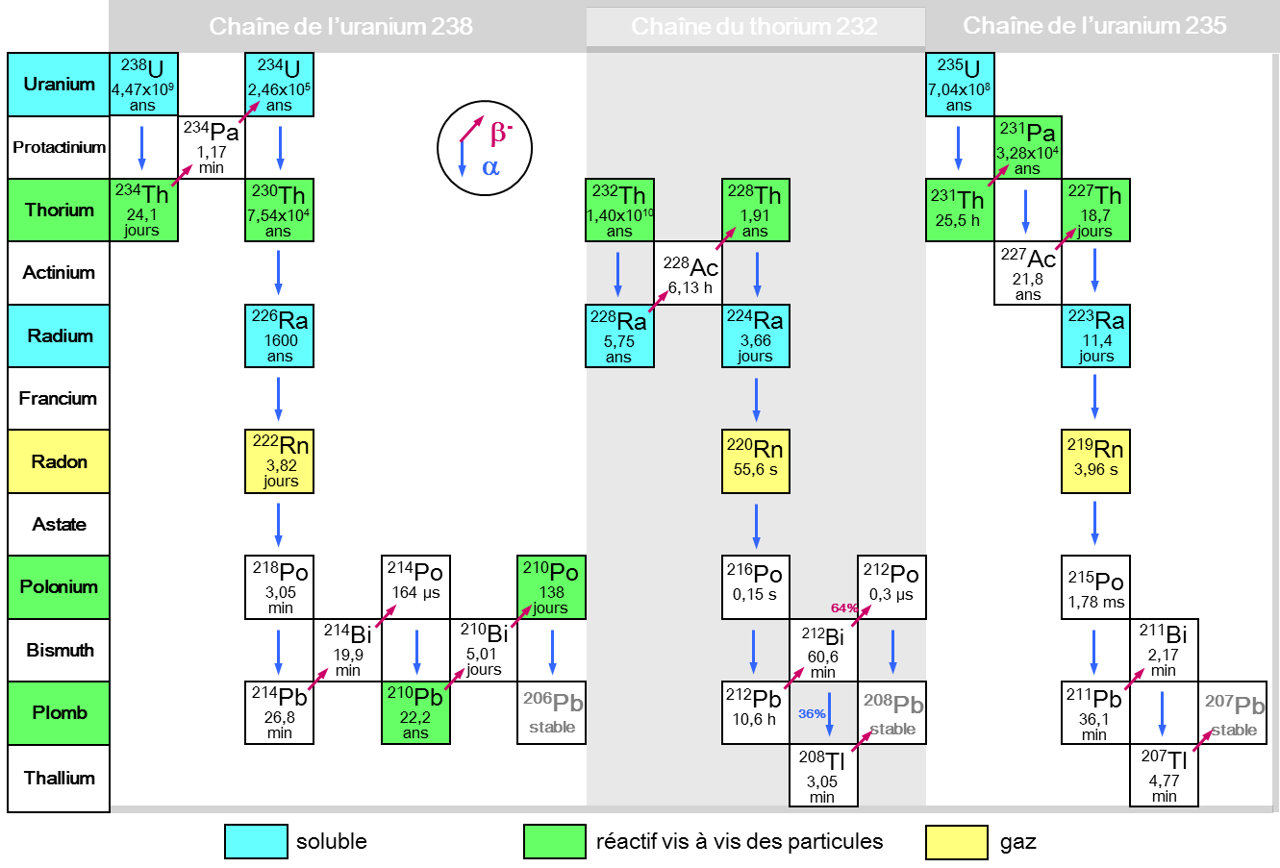
Natural radioactivity : our main ennemy!
Primordial radioactivity, cosmogenics, man-made radioactivity
Long-lived isotopes~10⁹ y (U/Th/K)
NAA, ICPMS, LA-ICPMS techniques
Medium and short-lived isotopes ≤10⁵ y (²²⁶Ra, ²²⁸Th, ²¹⁰Pb/²¹⁰Po, ⁶⁰Co…)
low background γ/α/β spectroscopy techniques
Gaseous isotopes (²²²Rn)
→ Dedicated techniques
→ Complementary techniques to screen all the critical materials for rare event experiments

Slide 3
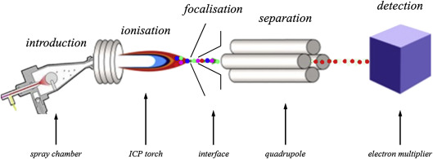
Principle of the ICP-MS technique
Inductively coupled plasma mass spectrometry (ICP-MS)
Sample liquid phase to formate aerosol in nebulizer
Introduction of aerosols into an argon plasma at T>6000 K
Ions extracted from the plasma into mass spectrometer region and detected by an electron multiplier sensor
→ Need to have very radiopure acids and vessels to achieve a very low blank

Slide 4
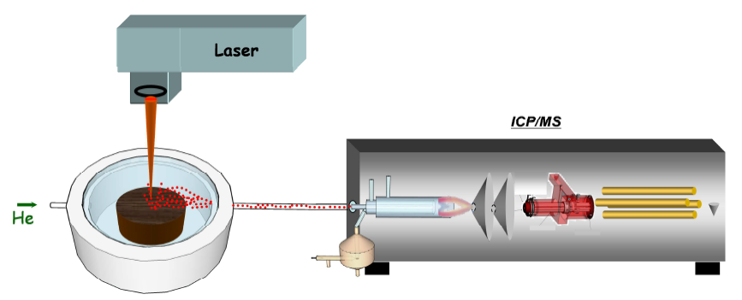
Principle of Laser Ablation ICP-MS
Concept: to replace the chemical preparation of a sample by using a laser in ablation mode
A laser to drill, an ICP-MS to count…
Main advantages of LA-ICPMS:
small risk of sample contamination
fast access to the spatial distribution of the U/Th radionuclides

Slide 5
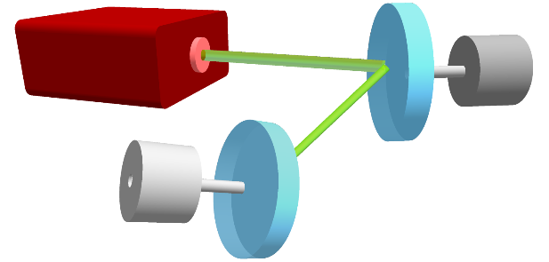
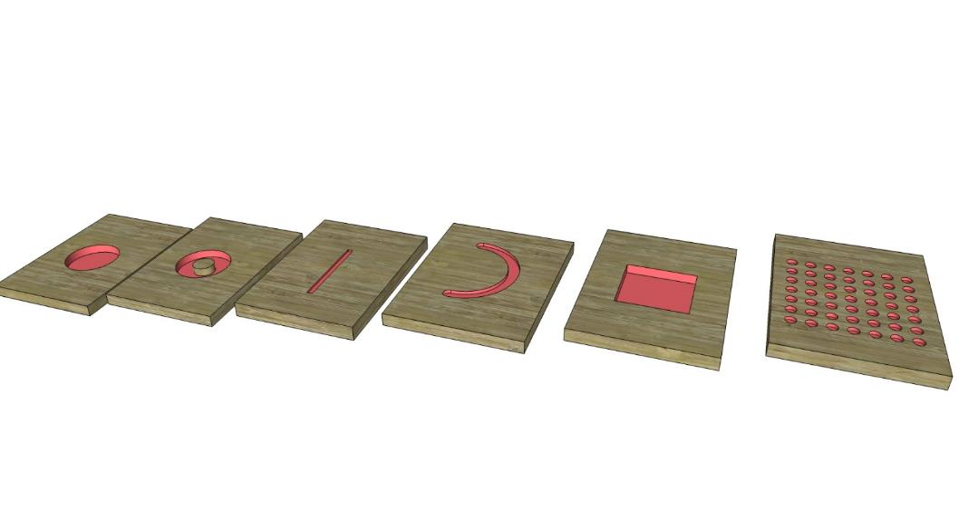
Shaping technique of the fs laser beam
Galvanometric
scanners
Possibility to move in 2D the sample and/or the laser beam in order to fit with the morphology of the sample
HR-fs LASER
Size of the beam ~10 µm
High repetition rate <100 kHz
Translation speed < 2 m/s
Single spot,
(5-200 µm)
1D scan
2D scan

Slide 6
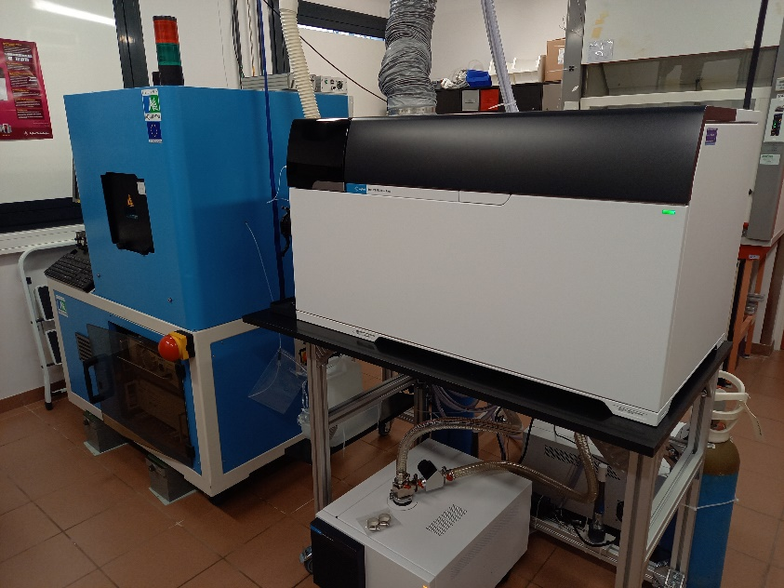
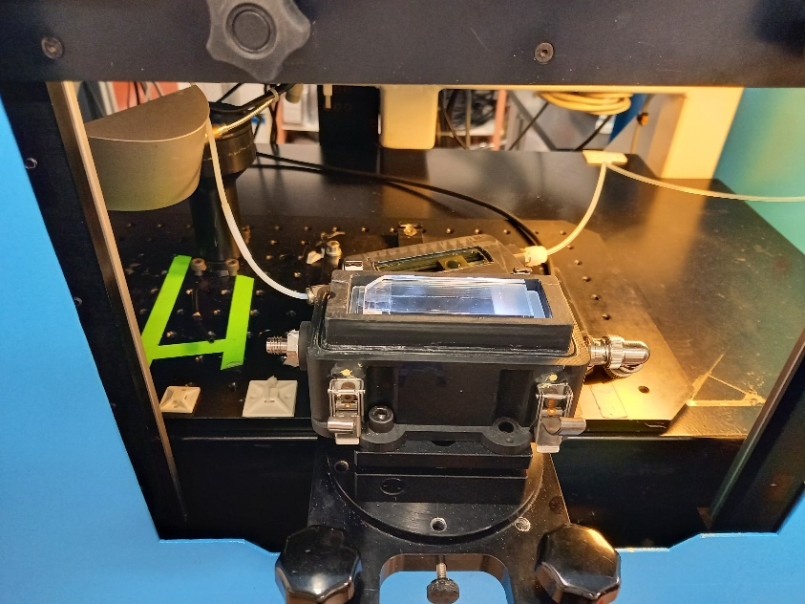
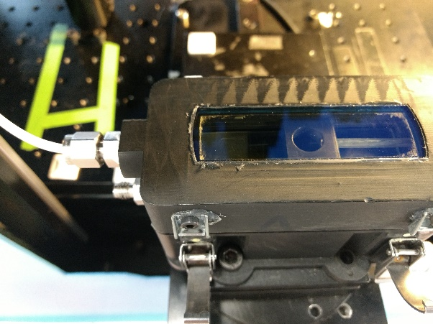

LA-ICPMS platform @IPREM Pau
IR or UV fs laser: ΔT=360 fs, f=400 Hz, E~15 µJ/pulse
Ablation chamber: rinsing time~500 ms
ICP-MS/MS (Agilent 8900)
Laser IR fs
Acrylic sample
ICP-MS/MS
Ablation cell

Slide 7
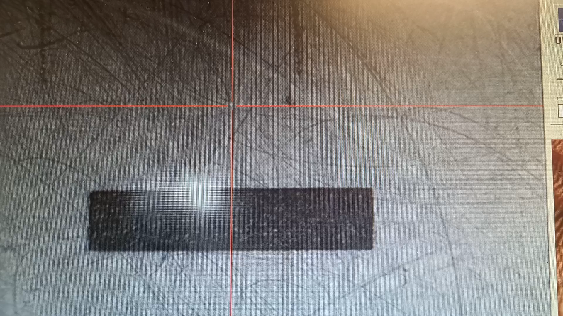
Ablation of acrylic sample

Slide 8
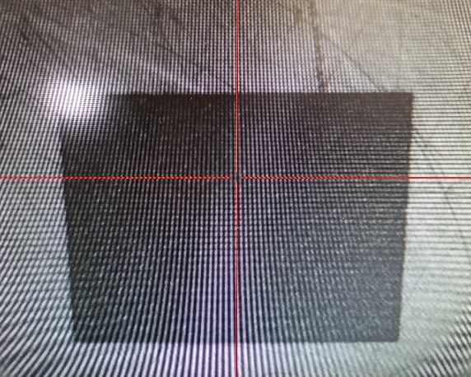
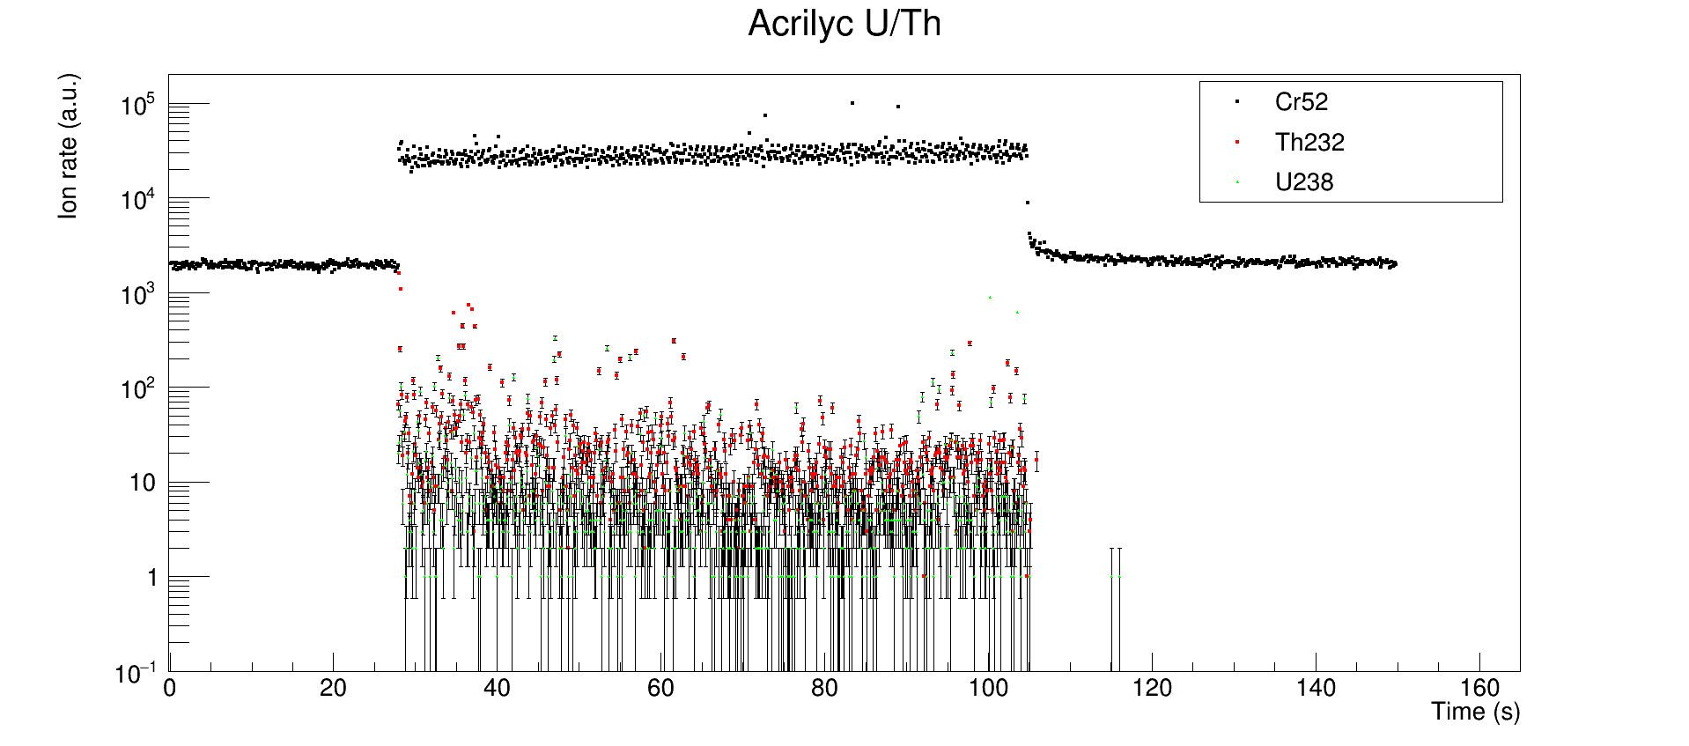
LA-ICPMS used for acrylic
Ablation of squares of 1x1 mm² to study the homogeneity of the U/Th surface contamination depending of the surface treatment
Acrylic sample
1 mm
¹²C
²³²Th
²³⁸U
Obtained in ~2 mn
25 mm
Laser OFF
Laser ON
Laser OFF

Slide 9
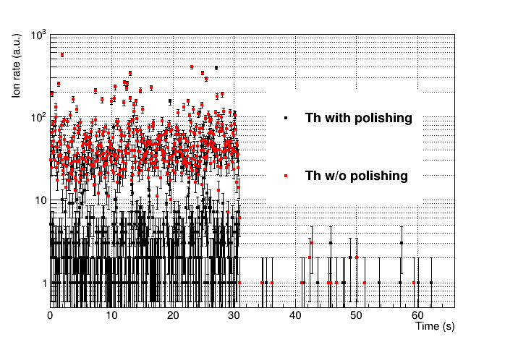
Effect of polishing/no polishing
Example of two acrylic samples measured:
one with polishing process applied on the top surface
one without polishing
²³²Th
w/o polishing
w polishing
One order
of magnitude
less ²³²Th !
→ very powerful tool to measure the U/Th contamination and to choose the best surface treatment of a given material

Slide 10
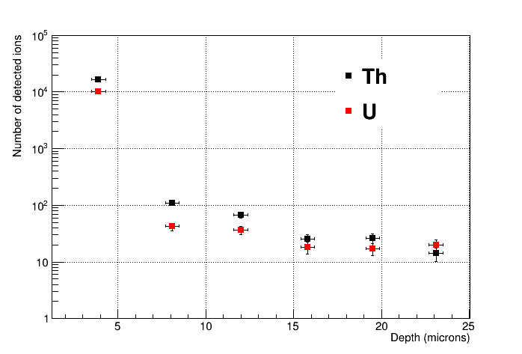
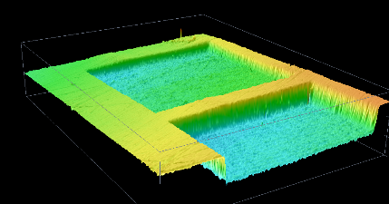
Depth profile of U/Th concentration
Laser
scans
Surfacic
contamination
Acrylic
600 µm
Several 2D laser scans
to explore the Z-axis
3D profile of acrylic sample by confocal microscopy
Bulk concentration
1 scan
4 µm depth
surface
2 scans
8 µm depth
→ U and Th contamination of the acrylic is located at the surface in the first micrometers
Good reproducibility of the ablated volume after several scans

Slide 11
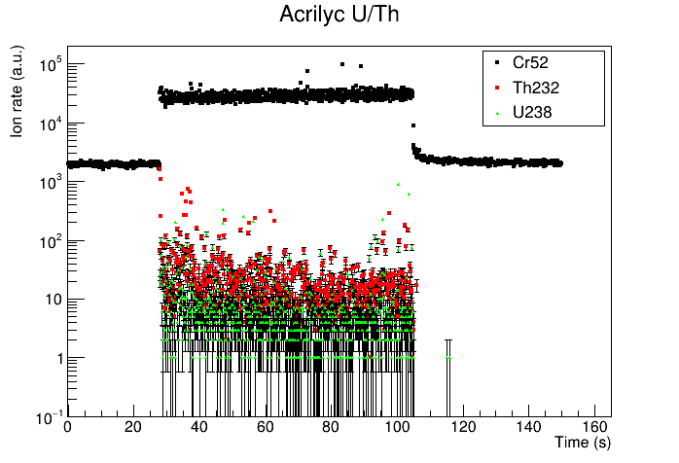
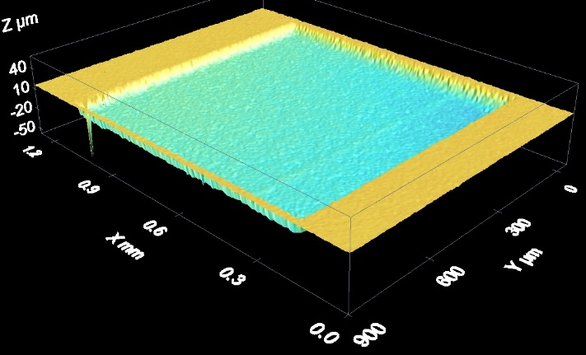
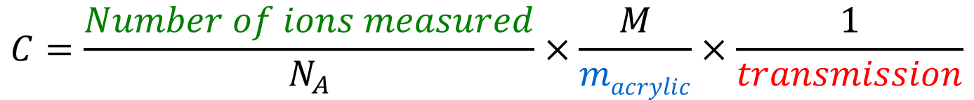
Quantification of U/Th concentration
Quantification of U/Th concentration C in g/g :
$$C=\frac{Number of ions measured}{N_{A}}×\frac{M}{macrylic}×\frac{1}{transmission}$$
Dedicated method to determine the ion transmission from ablation cell to ICPMS
Counting the total number of ions during laser ON
A posteriori measurement of the ablated volume by confocal microscopy

Slide 12
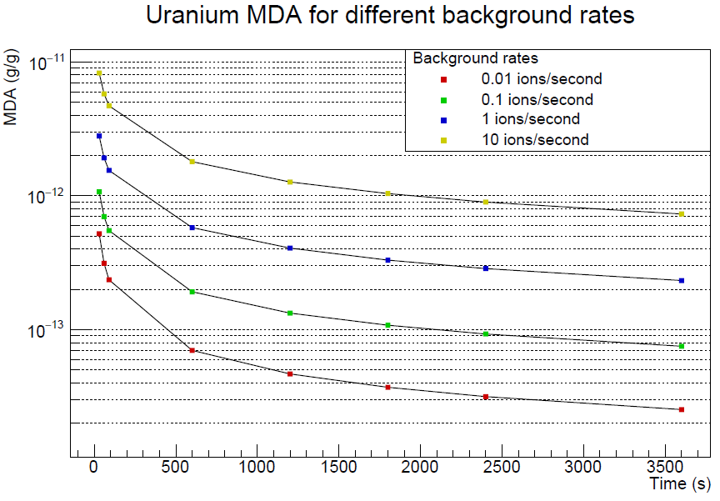
Sensitivity of LA-ICPMS technique
Assuming 0.2% efficiency, 2 µg/mn of ablated mass of acrylic
Minimum detectable activity in g/g vs time (proportionnal to mass) for different background rates
²³⁸U in acrylic
sub-10⁻¹² g/g level reached within 10 mn @ 1 ion/s bckg rate
10 mn
1 h
0.6x10⁻¹² g/g
sub-10⁻¹³ g/g level reached within 1 h @ 0.1 ion/s bckg rate
Opportunity to measure several samples per day at the sub-ppt level with LA-ICPMS !
0.08x10⁻¹² g/g

Slide 13
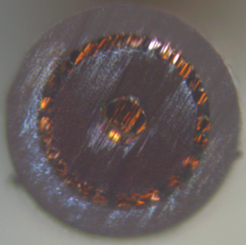
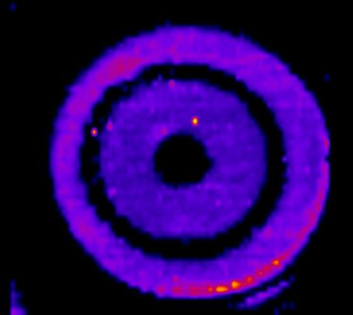
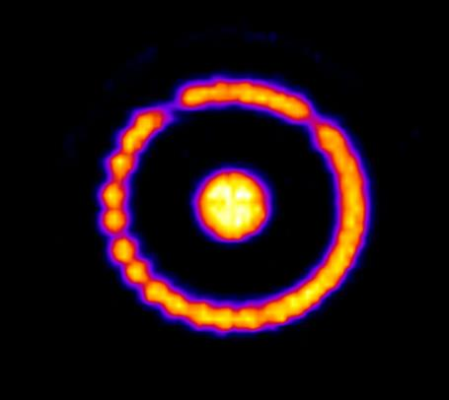
2D mapping of a µ-coaxial cable
µ-coaxial cable produced by the AXON company (France)
What is the U/Th mapping impurities on the section of the cable ?
²³⁸U
U contamination observed
in some of the copper wires
400 µm
¹³C
⁶⁵Cu

Slide 14
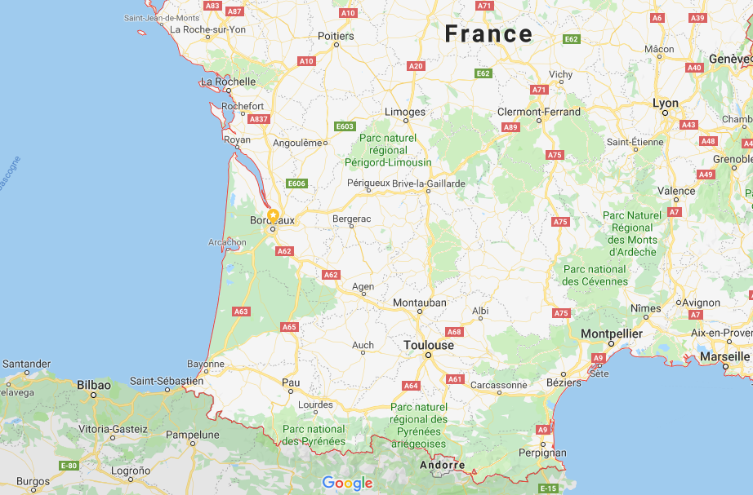

Collaboration between LP2i Bx & IPREM
2h driving
distance
Nouvelle Aquitaine region
Spain

Slide 15
Round table discussion summary
Christophe Pecheyran is the expert at IPREM Pau on LA-ICPMS in several fields (chemistry, environment, …)
He gave a talk at the 1st GDR DUPhy meeting on Nov. 2021: “Direct ultratrace and isotopic analysis in solids by femtosecond LA-ICPMS”
ESR-EquipEx+ application PLATTO (PLatform for elemental and isotopic ATTO-trace analysis) submitted in 2020 by LP2i Bordeaux/IPREM institutes to develop new instruments for several applications (including rare event experiments)
→ unfortunately not successful

Slide 16
Round table discussion summary
There is clearly an opportunity in France to develop the LA-ICPMS technique for our field (Dark Matter and Neutrino) taking advantage of the expertize at IPREM Pau
WP2 would like to push IN2P3 to have a 2 years CDD position to develop specific protocols at IPREM Pau to quantify U/Th bulk/surface contamination at sub-10⁻¹² g/g for several materials of interest

Slide 17
Summary
fs laser ablation ICPMS is a complementary technique to ICPMS
  No chemical preparation
  Fast analysis
  Spatial information for micro-analysis
Promising applications of LA-ICPMS technique
  A tool to select the best surface treatment
  A tool to test the surface homogeneity in U/Th of the sample
  A tool to map the U/Th concentration in 2D and 3D
  Achievable sensitivity at the sub-10⁻¹² g/g level with only few tens of µg (precise quantification methods still in development)
Need to request human ressources (CDD) to develop LA-ICPMS quantitative protocols for several materials with experts at IPREM

Slide 18
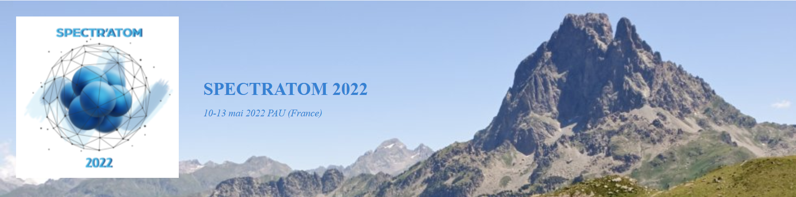
SPECTRATOM 2022 conference
Very important conference organized every 2 years in Pau around spectrometry techniques applied to several fields
Next one in 2024

Slide 19
Thank you for your attention

Slide 20
Backup slides

Slide 21
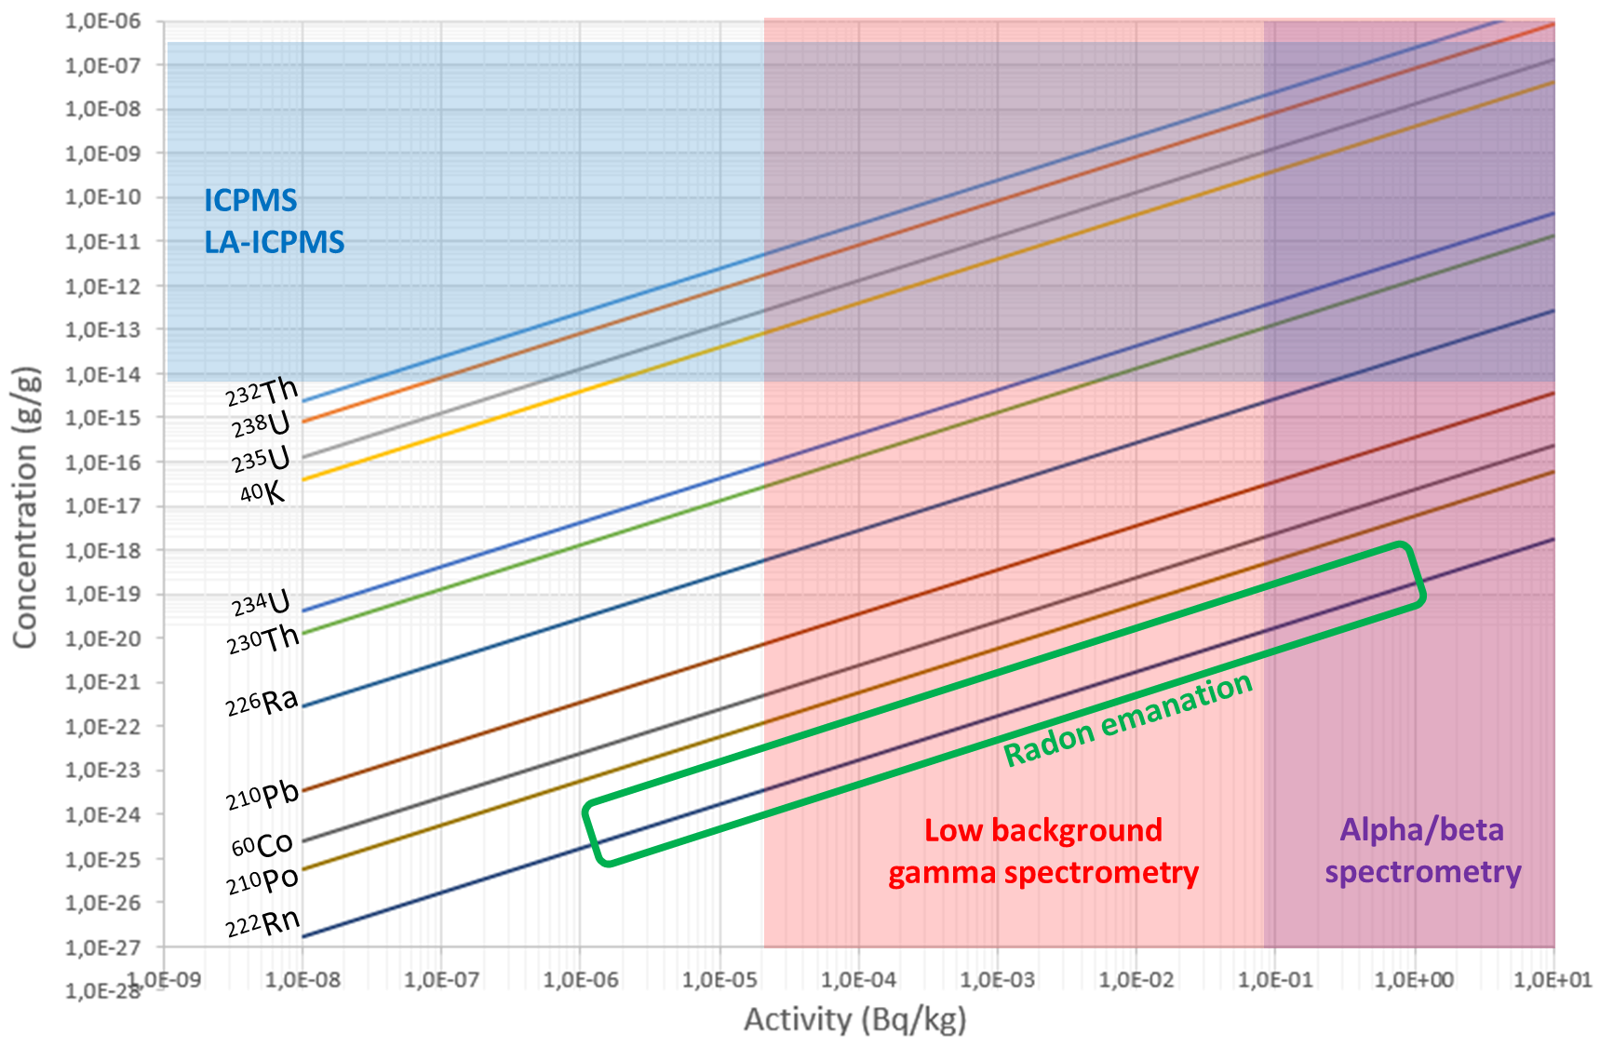
Mass spectrometry vs γ/α/β spectroscopy
Concentration vs Activity
Mass spectrometry: well-suited for long-lived isotopes to reach concentration <10⁻¹² g/g
Gamma spectroscopy: well-suited for short-lived isotopes to reach activity >10 µBq/kg

Slide 22
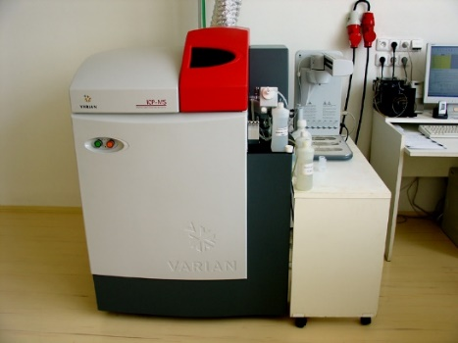
Sample preparation and sensitivity
Several equipments are needed for the pre-treatment of the sample without any contamination
Class 10000 clean room
Ultra-pure deionized water, nitric acid, microwave digestion, ultra-sonic cleaner…
it is critical to have ultra-clean vessel and acids for blank test in order to reach a sub-10⁻¹² g/g sensitivity for U/Th in critical materials
Not extensively developed in France for our field but several installation around the world (for example PNNL, USA)

Slide 23
Advantages of the UV fs LA-ICPMS
Alternative method to classical ICPMS
  Direct and fast analysis without chemical preparation
  Smaller risk of sample contamination
  Access to the refractory matrix samples
Poweful tool for micro-analysis
  Quasi non-destructive technique
  Micro-analysis from few µm to few 1000 µm
  2D mapping to study the homogeneity of a given surface
  High precision depth profile (sub µm)

Slide 24
Protocole de mesure et bruit de fond
Acrylique (C₅H₈O₂)_{n} → mesure de la masse 52 (¹²C+⁴⁰Ar) pour l’estimation de la quantité de matière ablatée
Dwell time : 10 ms (⁵²Cr), 52 ms (²³⁸U), 52 ms (²³²Th)
Laser ON pour la mesure de l’échantillon
Laser OFF pour la mesure du bruit de fond (effet mémoire)
excellents fonds !
²³⁸U: ~0,09 ion/s
²³²Th: ~0,06 ion/s
Laser OFF
Laser ON
Laser OFF

