Slide 1
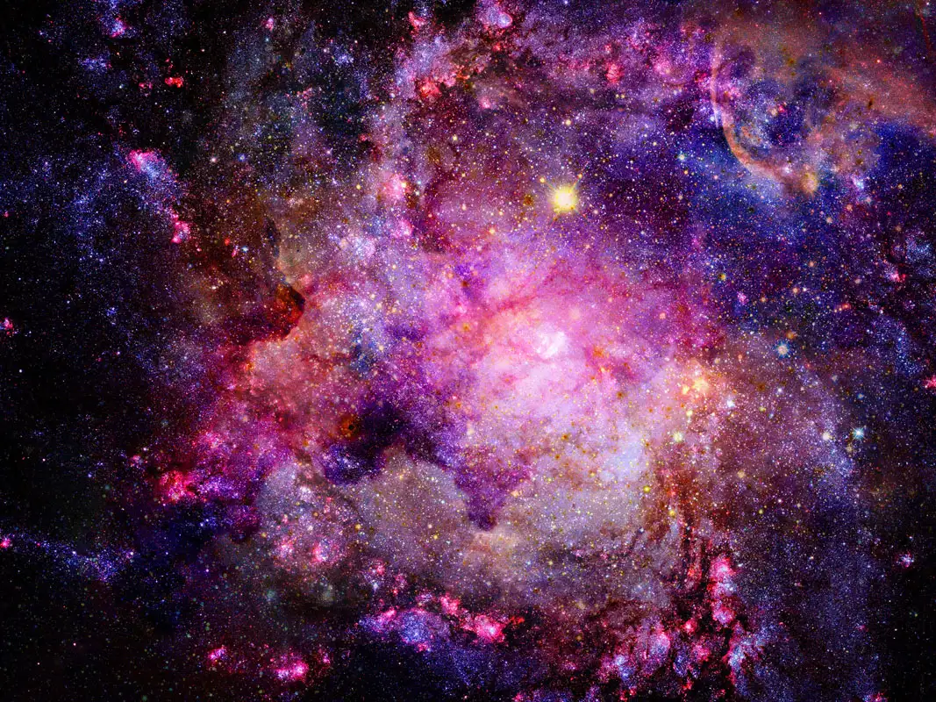
Neutrinos, Cosmological Phase-Transition and the Matter-Antimatter Asymmetry
$$ν$$
Rémi Faure IPhT (CEA, Saclay)
under the supervision of Stéphane Lavignac

Slide 2
Why is there no anti-workshop at « sehcuoH seL »? (pronunciation is left as an exercise to the reader)
Almost only particles are observed at all scales (no anti-particles)
The CMB gives us the ratio baryons/photons:
$$η_{B}≡\frac{n_{B}−n_{\overline{B}}}{n_{γ}}≃\frac{n_{B}}{n_{γ}}=6. {10}^{−10}≠0$$
Need for New Physics: Sterile Neutrinos

Slide 3
Outline
Motivating sterile Neutrinos
Phase-Transition
Tools and Results: Out-of-Equilibrium QFT

Slide 4
1. Motivating sterile Neutrinos: light neutrinos and asymmetry
$$ν$$

Slide 5
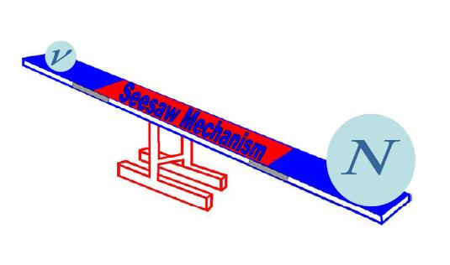
The Seesaw Mechanism
Light Standard Model neutrinos
Sterile Neutrinos
Figure by Shaaban Khalil

Slide 6
$N$: sterile Neutrinos
$φ$: Higgs field
$l_{α}$: lepton field, can be neutrino $ν$ or electron $e$
$L_{SM}$: Lagrangian of the Standard Model
The Neutrinos interact with the Standard Model
Violates CP symmetry
$$L=L_{SM}+ i\overline{N}γ^{μ}∂_{μ}N −M_{I}{\overline{N}}_{I}^{c}N_{I}+Y_{Iα}N_{i}{\overline{l}}_{α}\tilde{φ}+h.c.$$
Massive Neutrinos
Majorana mass $M$
Violates Lepton number

Slide 7
Sakharov conditions for generation of matter-antimatter asymmetry (1967):
Baryon/Lepton number violation
C and CP violation
Out-of-Equilibrium
Andreï Sakharov

Slide 8
2. Phase Transition: going out of equilibrium

Slide 9
$$L=L_{SM}+ i\overline{N}γ^{μ}∂_{μ}N −M_{I}{\overline{N}}_{I}^{c}N_{I}+Y_{Iα}N_{I}{\overline{l}}_{α}\tilde{φ}+h.c.$$
[Rosauro-Alcaraz (2021)]
[Huang, Xie (2022)]
$$L=L_{SM}+L_{S}+ i\overline{N}γ^{μ}∂_{μ}N −λ_{NS}^{I} S{\overline{N}}_{I}^{c}N_{I}+Y_{Iα}N_{I}{\overline{l}}_{α}\tilde{φ}+h.c.$$
$$M_{I}=λ_{NS}^{I} S$$
New interactions, new dynamics for the sterile sector

Slide 10
$$<S> =0 → <S> ≠0$$
Typically, the scalar field $S$ will experience a phase-transition.
A (strongly) first-order phase-transition can be more interesting for two reasons:
Specific gravitational wave signature.
Sudden change in the value of the field, which allows for non-equilibrium dynamics.

Slide 11
Standard Model
New sector
Temperature $T$
Bosons $(γ, W^{±},Z^{0},G)$
Sterile Neutrinos
Higgs
New scalar
Not in thermal equilibrium
Fermions
« Active » sector

Slide 12
False vacuum
$$<S> =0$$
$$M=0$$
True vacuum
$$<S>≠0$$
$$M≠0$$
Sterile Neutrino
SM fermion

Slide 13
During the phase-transition, the masses of the Neutrinos are time-dependent. All quantities will have an explicit time-dependence along the wall.
$$<S>\left(t\right)$$
$$M_{I}=λ_{NS}^{I}<S>\left(t\right)=M_{I}(t)$$

Slide 14
3. Tools and Results: Out-of-Equilibrium QFT
Thermal Leptogenesis
Low-scale Leptogenesis
Electroweak Baryogenesis
[Anisimov, Buchmüller, Drewes, Mendizabal (2010)]
[Drewes, Garbrecht, Gueter, Klaric (2010)]
[Lee, Cirigliano, Ramsey-Musolf (2005)]
…

Slide 15
Equilibrium QFT: Schwinger-Dyson Equation
$Σ$= self-energy
Free propagator
$$S^{−1}(x−y)={{iδ\left(x−y\right)γ}^{μ}∂}_{μ}−Σ(x−y)$$
Full propagator
Deviation due to interactions
$${{i γ}^{μ}∂}_{μ}S\left(x−y\right)−Σ⊗S\left(x−y\right)=δ\left(x−y\right)$$
(convolution)

Slide 16
Non-Equilibrium QFT: Schwinger-Dyson Equation
$Σ$= self-energy
$$S^{−1}(x−y,t)={{iδ\left(x−y\right)γ}^{μ}∂}_{μ}−Σ(x−y,t)$$
$${{i γ}^{μ}∂}_{μ}S\left(x−y,t\right)−Σ⊗S\left(x−y,t\right)=δ\left(x−y\right)$$
$t$-dependence: no longer time-translation invariant

Slide 17
Keldysh-Schwinger/CTP formalism
[Keldysh (1965)]
$$t_{1}→t_{2}: S^{<}, Σ^{<}$$
$$t_{2}→t_{1}: S^{>}, Σ^{>}$$
$$t=0$$
$$t_{1}$$
Real time $t$
$$𝒞$$
$$t_{2}$$
Initial value problem: we know the distribution only at $t=0 (<f\left|S\right|i>)$

Slide 18
$${{i γ}^{μ}∂}_{μ}S\left(x−y,t\right)−Σ⊗S\left(x−y,t\right)=δ\left(x−y\right)$$
$n_{L}^{}=$ asymmetry between leptons and anti-leptons = density of lepton number
$j^{μ}=−Tr\left(γ^{μ}S_{L}\right)=$ quadri-current associated with the lepton number
$$n_{L}^{}=j^{0}=−Tr\left(γ^{0}S_{L}\right)=i\int{dt_{1}}Tr\left(i γ^{0}∂_{0}S_{L}\right)$$
$=−\int{dt_{1}dt_{2}(Tr\left(Σ^{>}(t_{1},t_{2})S_{L}^{<}(t_{2},t_{1})\right)−Tr\left(Σ^{<}S_{L}^{>}\right))}$
[1]. « Quantum Leptogenesis I », Anisimov, Buchmuller, Drewes, Mendizabal https://arxiv.org/abs/1012.5821

Slide 19
Massive Sterile Neutrino
$$N_{I}$$
$$Y_{Jβ}$$
Active lepton
$$l_{α}$$
$$Y_{Iα}$$
$$k$$
Higgs
Two-loop self-energy $Σ_{k}$

Slide 20
Massless sterile Neutrino $N$
$$Y_{Jβ}$$
$$M_{I}(t_{6})$$
$$l_{α}$$
$$M_{I}(t_{5})$$
$$Y_{Iα}$$
$$k$$
$$M_{I}≪T$$
Higgs
(expansion in $M$)
Two-loop self-energy $Σ_{k}$

Slide 21
Final (comoving) asymmetry
Majorana masses of the heavy Neutrino states (violate lepton number)
$$Y_{L}^{α}=\frac{n_{L}^{α}}{s}∝\sum_{I,J}{\frac{Im\left(Y_{Iα}Y_{Jα}^{∗}{\left(YY^{†}\right)}_{JI}\right)}{{\left(YY^{†}\right)}_{II}{\left(YY^{†}\right)}_{JJ}} \frac{M_{I}^{2}}{T^{2}} ×phase space}$$
CP-violating term (differenciates particles and anti-particles)
Temperature of the phase transition (out-of-equilibrium process)

Slide 22
Casas-Ibarra parametrization
[Casas, Ibarra (2001)]
Observable at low-energy
$$Y≡\sqrt{M}R\sqrt{m}U_{PMNS}^{†}$$
$$R=\left(\begin{matrix}\cos{(ω)} & \sin{(ω)} \\ −\sin{(ω)} & \cos{(ω)}\end{matrix}\begin{matrix} 0 \\ 0\end{matrix}\right)$$
$$m=\left(\begin{matrix}m_{3} & 0 \\ \begin{aligned}0 \\ 0\end{aligned} & \begin{aligned}m_{2} \\ 0\end{aligned}\end{matrix}\begin{matrix}0 \\ 0 \\ { m}_{1}\end{matrix}\right)≃\left(\begin{matrix}|Δm_{atm}| & 0 \\ \begin{aligned}0 \\ 0\end{aligned} & \begin{aligned}|Δm_{sol}| \\ 0\end{aligned}\end{matrix}\begin{matrix} 0 \\ 0 \\ 0\end{matrix}\right)$$
(normal ordering)
Non-observable complex angle $ω$ (parameter)

Slide 23
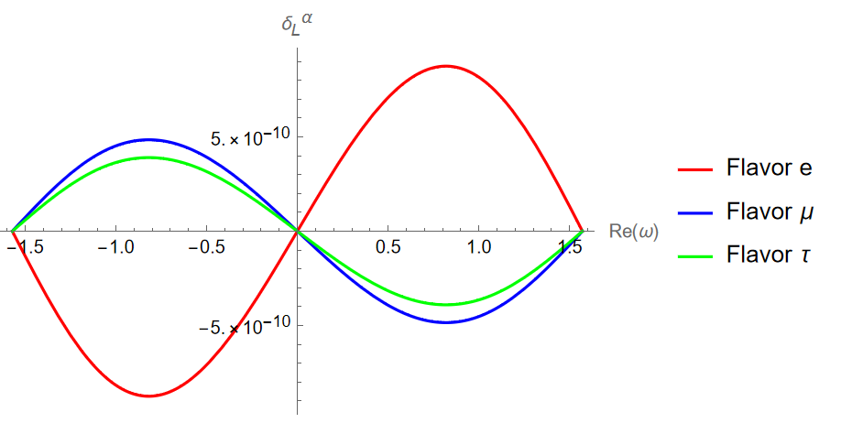
$$\frac{Im\left(Y_{1α}Y_{2α}^{∗}{\left(YY^{†}\right)}_{21}\right)}{{\left(YY^{†}\right)}_{11}{\left(YY^{†}\right)}_{22}} \frac{M_{2}^{2}−M_{1}^{2}}{T^{2}}≡$$
$$M_{1}=100 GeV$$
$$M_{2}=110 GeV$$
$$T={10}^{6}GeV$$
$$\sum_{α}{δ_{L}^{α}}=0$$
$Re(ω)$: real angle from the Casas-Ibarra parametrization
$Im\left(ω\right)=0$: only CP phase from PMNS, $δ=3π/2$

Slide 24
This work can be compared to a work by Pascoli, Turner and Zhou, who derived a lepton asymmetry from a varying Weinberg operator.
The coefficient of the operator is driven by a phase-transition.
$$L=L_{SM}+\frac{λ_{αβ}}{Λ}l_{α}H Cl_{β}H+h.c.=L_{SM}+\frac{λ_{αβ}(S)}{Λ}l_{α}H Cl_{β}H+h.c.$$
$λ^{0}→λ$ ,
$$m_{ν}^{0}→m_{ν}$$
(Active neutrino mass matrix)
[Pascoli, Turner, Zhou (2018)]

Slide 25
$$L=L_{SM}+\frac{λ_{αβ}}{Λ}l_{α}H Cl_{β}H+h.c.=L_{SM}+\frac{λ_{αβ}(S)}{Λ}l_{α}H Cl_{β}H+h.c.$$
Higgs
$$ν_{α}$$
$$λ_{αβ}/Λ$$
$$k$$
Two-loop self-energy $Σ_{k}$
[2]. « Leptogenesis via Varying Weinberg Operator: the CTP Approach», Turner, Zhou, https://arxiv.org/abs/1808.00470v2

Slide 26
(Active) neutrino mass matrix before and after the PT (CP and Lepton Number violation)
$v_{H}$: Higgs vev
$m_{ν}^{0}$: (active) neutrino mass matrix before PT
(parameter)
$m_{ν}$: (active) neutrino mass matrix after PT (measurable)
$$Y_{L}∝\frac{Im\left(Tr\left(m_{ν}^{0}m_{ν}^{∗}\right)\right)}{v_{H}^{4}}T^{2}×phase space$$
Final (comoving) asymmetry
Temperature of the phase transition (out-of-equilibrium process)
[2]. « Leptogenesis via Varying Weinberg Operator: the CTP Approach», Turner, Zhou, https://arxiv.org/abs/1808.00470v2

Slide 27
Comparison of both models
Asymmetry produced during the phase-transition (not via decay afterwards)
Right-handed Neutrinos are not decoupled in our scenario
Dependence on low-energy observables

Slide 28
Summary and conclusion

Slide 29
Work achieved
We consider an original scenario where the Majorana Neutrinos acquire their mass and produce an asymmetry during a single phase-transition.
We computed the asymmetry from first-principles (numerical work on progress).

Slide 30
$$ν$$
True vacuum
Thanks for your attention!

Slide 31
[Akhmedov, Rubakov, Smirnov (1998)]
Leptogenesis via neutrino oscillations (ARS)
[See for example Drewes, Garbrecht, Gueter, Klaric (2010)]
$$T_{osc}≡{\left(M_{Pl}ΔM_{2,1}^{2}\right)}^{1/3}$$
$M_{Pl}≃7×{10}^{17}GeV$ is the Planck Mass
$$T_{osc}={\left(7×{10}^{17}×\left({110}^{2}−{100}^{2}\right)\right)}^{1/3}GeV≃{10}^{7}GeV>T_{PT}$$
$$M_{1}=100 GeV M_{2}=110 GeV T_{PT}={10}^{6}GeV$$

Slide 32
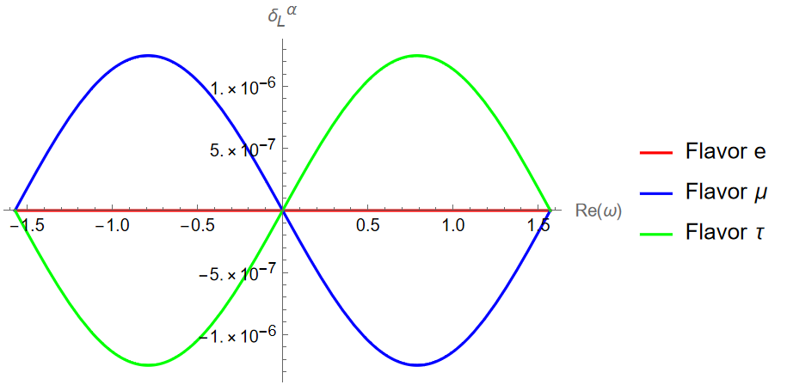
Normal ordering
$$α_{21}=0$$
$$α_{31}=2 π$$
$$δ=3 π/2$$
Inverted ordering

Slide 33
Further prospects
Reflection of Sterile Neutrinos on the wall of the bubbles
(ARS) Leptogenesis without Phase-transition with initial asymmetries – Washout of the asymmetries

Slide 34
The Weinberg operator could be derived from right-handed Neutrinos, if they decouple below some energy scale. The value of the Weinberg coefficient depends on the mass of these Neutrinos.
$$λ^{0}/Λ=Y^{T} M_{N0}^{−1}Y$$
$$λ/Λ=Y^{T} {\left(M_{N0}+λ_{NS}v_{S}\right)}^{−1}Y=Y^{T} M_{N}^{−1}Y$$

Slide 35
$Σ_{k,α}^{<}(t_{1},t_{2})=∫dt_{5}∫dt_{6}M_{I}\left(t_{5}\right)M_{I}\left(t_{6}\right)×Y_{Iα}(Y_{Iβ}^{∗}Y_{Jβ})Y_{Jα}^{∗}$
$$𝒞$$
$$𝒞$$
$$×\int_{p}{\int_{q}{\int{dt_{3}dt_{4}}S_{N,p}(t_{1},t_{3})S_{L,k}(t_{3},t_{4})S_{N,p}(t_{4},t_{2})×Δ_{H}Δ_{H}}}$$
$$𝒞$$
$$n_{L}^{α}=−\int{dt_{1}dt_{2}(Tr\left(Σ_{α}^{>}S_{L}^{<}\right)−Tr\left(Σ_{α}^{<}S_{L}^{>}\right))}$$
Propagators for the Higgs field
$$\sim −\iiint_{k,p,q}{\int{dt_{1}dt_{2}(Tr\left(Σ_{k,α}^{>}S_{L,k}^{<}\right)−Tr{\left(Σ_{k,α}^{>}S_{L,k}^{<}\right)}^{∗})}}$$

Slide 36
« $\text{phase} \text{space}$ » = six-dimensional time-integrals
+ three momentum-integrations
$I=\int_{0}^{∞}{dt_{1}}…\int_{0}^{∞}{dt_{6}}e^{−γ\left|t_{1}−t_{2}\right|}…e^{−γ|t_{6}−t_{1}|}$ $e^{−Γ(t_{1}−t_{2})}…e^{−Γ(t_{6}−t_{1})}$
$$×\cos{(k\left(t_{1}−t_{2}\right))}…\cos{(p\left(t_{6}−t_{1}\right))}$$
$=\int_{0}^{∞}{dt_{1}}\int_{−t_{1}}^{∞}{dy_{1}}…\int_{−\left(t_{1}+y_{1}+…\right)}^{∞}{dy_{5}}e^{−γ\left|y_{1}\right|}…e^{−γ|y_{5}|}$ $e^{−Γy_{1}}…e^{−Γy_{5}}$
$$×\cos{(ky_{1})}…\cos{(py_{5})}$$

Slide 37
Interferences between loops and the tree-level allow for a distinction between particles and anti-particles in the probabilities (square of the amplitude).
$${\left|𝓜\right|}^{2}={\left|𝓜_{0}+𝓜_{1}\right|}^{2}={\left|𝓜_{0}+𝓜_{1}^{odd}+𝓜_{1}^{even}\right|}^{2}={\left|𝓜_{0}\right|}^{2}+{\left|𝓜_{1}\right|}^{2}+𝓜_{0}𝓜_{1}^{odd∗}+𝓜_{0}𝓜_{1}^{even∗}+c.c.$$
CP conjugation
$${\left|\overline{𝓜}\right|}^{2}={\left|\overline{𝓜_{0}}+\overline{𝓜_{1}}\right|}^{2}={\left|𝓜_{0}^{∗}−𝓜_{1}^{odd∗}+𝓜_{1}^{even∗}\right|}^{2}={\left|𝓜_{0}\right|}^{2}+{\left|\overline{𝓜_{1}}\right|}^{2}−𝓜_{0}𝓜_{1}^{odd∗}+𝓜_{0}𝓜_{1}^{even∗}+c.c.$$

Slide 38
$$ν$$
$$ν$$
$$ν$$
$$ν$$
$$ν$$
$$ν$$
Quantum Interference
Mass of the sterile Neutrino $M=0$
$$M≠0$$

Slide 39
General scheme
Asymmetry in the active sector $(Δ_{α})$ is originally very small.
Solve for the sterile sector only (no « backreaction »)
Compute the source term.

Slide 40
Homogeneous and isotropic Universe
Scale factor = « Size » of the Universe
Its evolution is driven by the matter content
$$ds^{2}=dt^{2}−a{\left(t\right)}^{2}d{\vec{x}}^{2}$$
$$n_{h}=\int{d^{3}\vec{p}}f_{h}\left(\vec{p},t\right)=n_{h}\left(t\right)=n^{eq}+δn_{h}$$
$$f_{h}\left(\vec{p},\vec{x},t\right)=f_{h}(\vec{p},t)$$

Slide 41
Quantum Boltzmann Equation
« Backreaction » of the asymmetry in active sector
Hamiltonian: oscillations between different flavors
$$\frac{dδn_{h}}{dt}=−\frac{i}{2} \left[H_{vac}+H_{th},δn_{h}\right]−\frac{1}{2}\left\{Γ_{h},δn_{h}\right\}+\frac{1}{2}{\tilde{Γ}}_{α}𝒜_{αβ}Δ_{β}$$
Decay rate: scattering that suppresses Neutrinos
$$N$$
$$ν$$
$$φ$$
$Δ_{β}$ = asymmetry in the active sector for each flavor
$𝒜_{αβ}$= linear coefficients
$$\overline{\text{t} }$$
$$\overline{\text{b} }$$

Slide 42
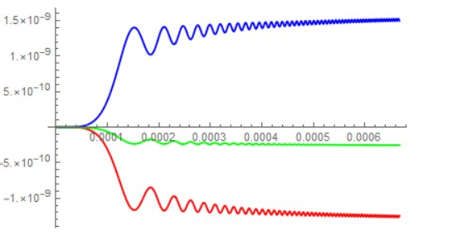
Example of an evolution of the asymmetry
$$Δ_{e}$$
$$T_{ref}/T$$
$$Δ_{τ}$$
$$M_{1}=50 GeV$$
$$Δ_{μ}$$
$$M_{2}=M_{1}+{10}^{−3}GeV$$

