Slide 1


Storage ring searches for EDM of charged particle
Philipp Schmidt-Wellenburg :: Scientist :: Paul Scherrer Institute
CP2023 in Les Houches

Slide 2
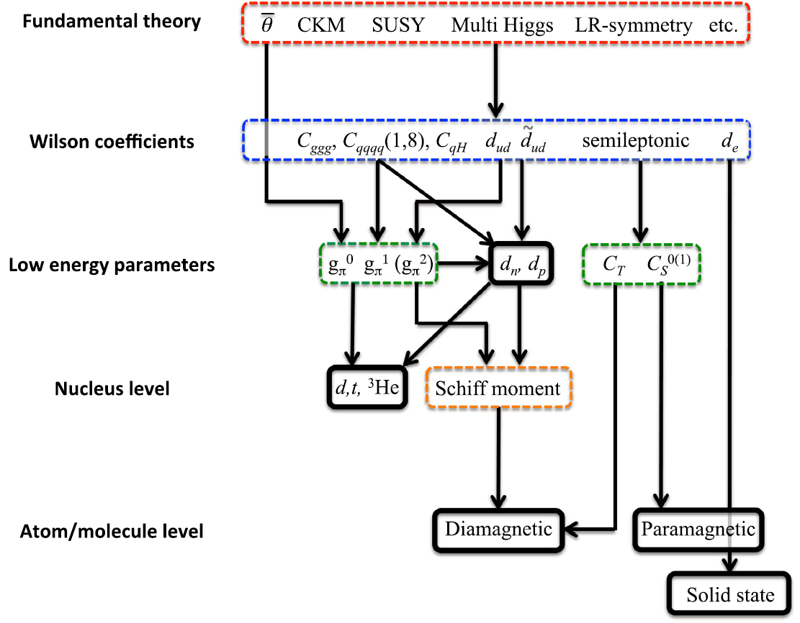
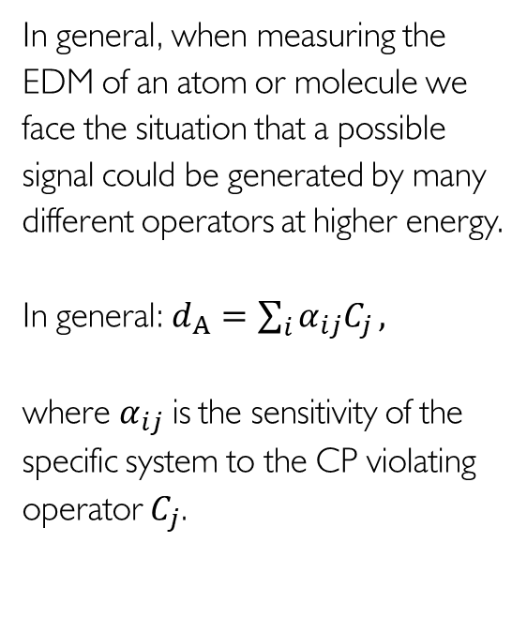

Complications when using atoms and molecules
In general, when measuring the EDM of an atom or molecule we face the situation that a possible signal could be generated by many different operators at higher energy.
In general: $d_{A}=\sum_{i}{α_{ij}C_{j}},$
where $α_{ij}$ is the sensitivity of the specific system to the CP violating operator $C_{j}$.
$$d_{μ},d_{τ}$$
[from Chupp et al., RMP91, 015001,2019]

Slide 3
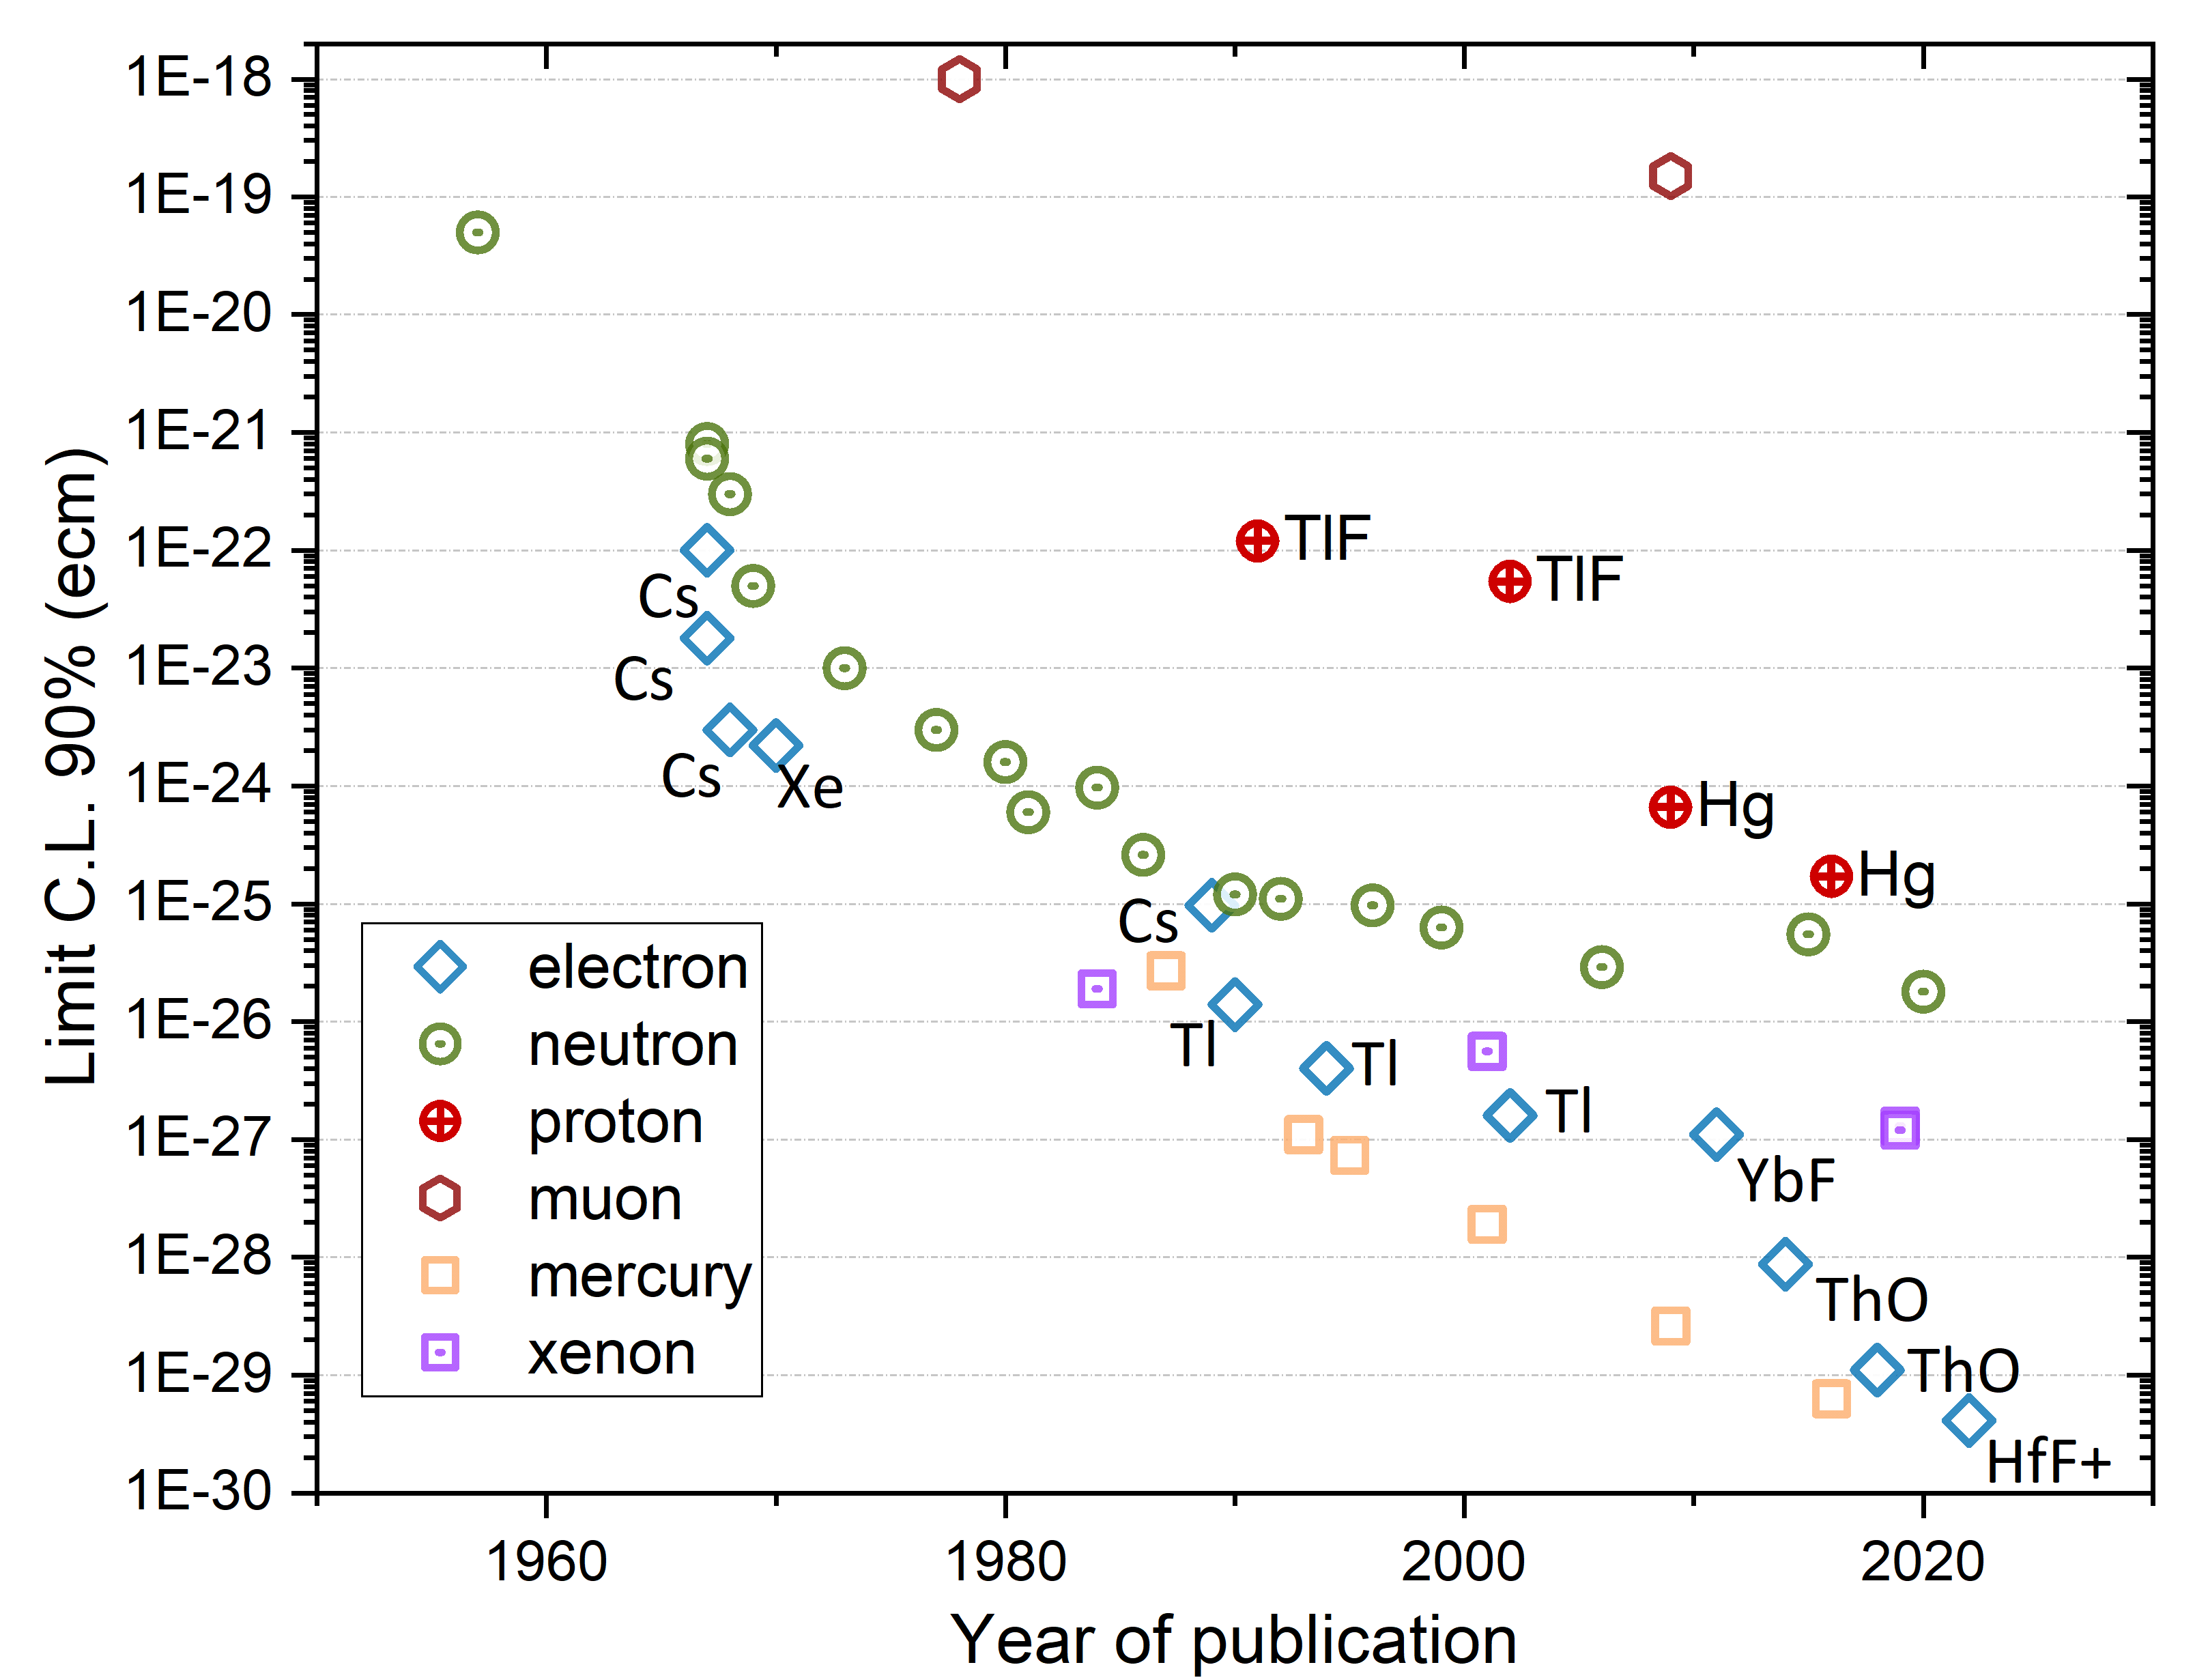
A not so brief history of EDM searches
Neutron
Electron
Muon
log(d) /ecm
log(d) /ecm
log(d) /ecm
-18
-20
-22
-24
-26
-28
-30
-32
-34
-36
-38
-18
-20
-22
-24
-26
-28
-30
-32
-34
-36
-38
-18
-20
-22
-24
-26
-28
-30
-32
-34
-36
-38
10¹⁸
10⁶
*Bennett et al.,PRD80(2009)052008
** Abel et al., PRL124(2020)081803
10⁸
Notes:
Searches for electric dipole moments started a long time ago in the 1950 when Ramsey and Purcell were first searching an EDM using a beam of neutrons.
Since then, the race to the bottom started.
Here on this graph I depicted for you the 90% limits versus the year of publication. In green the neutron, the blue diamonds are measurements on atoms and molecules extracting the EDM off the electron.
In yellow squares the impressive story of the mercury EDM. Lagging far behind is the muon, the only sizable search for an EDM of a particle in the second generation.
On the right side you see the expectation range for standard model EDM from the small imaginary phase of the CKM matrix in relation to the current limit.
The neutron still has another 6 orders of magnitude until they will hit the SM background. The electron another 9 order of magnitude, while the muon is today where Ramsey started 70 years ago and has another 18 orders of magnitude of legroom.

Slide 4
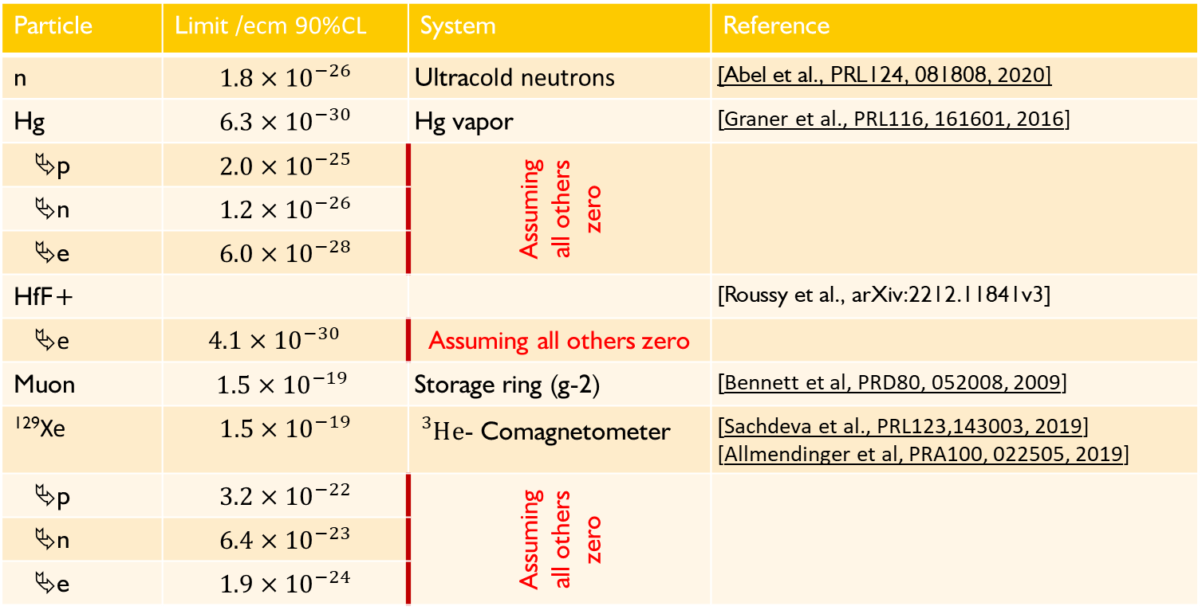
Only limits:
Particle | Limit /ecm 90%CL | System | Reference
n | $$1.8×{10}^{−26}$$ | Ultracold neutrons | [Abel et al., PRL124, 081808, 2020]
Hg | $$6.3×{10}^{−30}$$ | Hg vapor | [Graner et al., PRL116, 161601, 2016]
p | $$2.0×{10}^{−25}$$ | Assuming all others zero
n | $$1.2×{10}^{−26}$$
e | $$6.0{×10}^{−28}$$
HfF+ |  |  | [Roussy et al., arXiv:2212.11841v3]
e | $4.1×{10}^{−30}$ | Assuming all others zero
Muon | $$1.5×{10}^{−19}$$ | Storage ring (g-2) | [Bennett et al, PRD80, 052008, 2009]
¹²⁹Xe | $$1.5×{10}^{−19}$$ | ${}_{}^{3}He$- Comagnetometer | [Sachdeva et al., PRL123,143003, 2019] [Allmendinger et al, PRA100, 022505, 2019]
p | $$3.2×{10}^{−22}$$ | Assuming all others zero
n | $$6.4×{10}^{−23}$$
e | $$1.9{×10}^{−24}$$

Slide 5

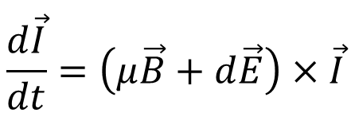
What can we do to measure only the EDM of the particle?
The generic idea of all EDM experiments:
Preparation of a spin polarized particle ensemble
Interaction with electric field
Measurement of evolution of angular momentum
$$\frac{d\vec{I}}{dt}=\left(μ\vec{B}+d\vec{E}\right)×\vec{I}$$
$$\vec{Ω}$$

Slide 6

















CP violation & edm
$$\vec{μ}=μ\vec{s}$$
$$\vec{d}=d\vec{s}$$
$$|\left.↑\right\rangle$$
$$|\left.↑\right\rangle$$
$$U=− \vec{μ}⋅\vec{B}$$
$$U=− \vec{d}⋅\vec{E}$$
$$ΔU=ℏω_{e}$$
$$|\left.↓\right\rangle$$
$$|\left.↓\right\rangle$$
$$B$$
$$E$$
T
T
$$|\left.↑\right\rangle$$
$$U=−\vec{μ}⋅\vec{B}$$
$$U=\vec{d}⋅\vec{E}$$
$$|\left.↑\right\rangle$$
$$B$$
$$E$$
Notes:
Symmetries and the breaking of symmetries are an important concept of all modern physics theories.
To better understand the violation of discrete symmetries by an EDM I have made this sketch of the energie levels of a spin-1/2 particle in a magnetic and electric field.
The left side every body is familiar with. It corresponds to the classical zeeman splitting in atoms. Depending on the spin of the particle the magnetic moment will lead to an increase or decrease in energy.
Similar on the right side, the electric dipole moment leads to a similar level splitting in the electric field.
Lets concentrate on the spin up state. [click]
Now we apply a Ti

Slide 7
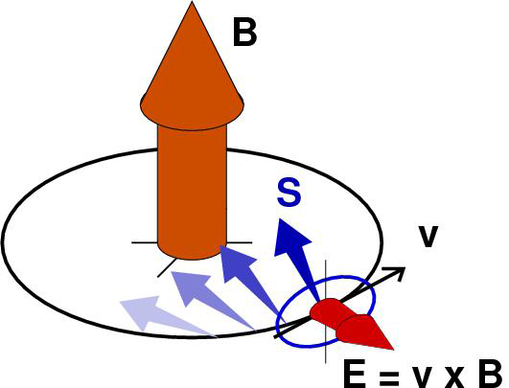




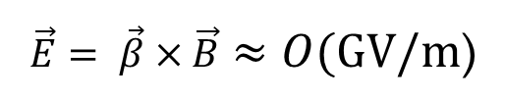
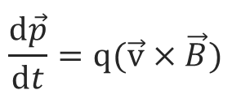
Measure the spin evolution in a storage ring
$$\vec{B}$$
For the moment assume $μ=0$
$$\frac{d\vec{s}}{dt}=d \vec{s}\left(\vec{β}×\vec{B}\right)$$
$$\frac{d\vec{p}}{dt}=q(\vec{v}×\vec{B})$$
$$\vec{s}$$
$$\vec{β}$$
$$\vec{E}= \vec{β}×\vec{B}≈O(GV/m\text{)}$$
The relativistic E-field in the rest frame of the particle
can be very large!

Slide 8
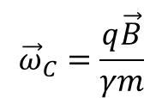
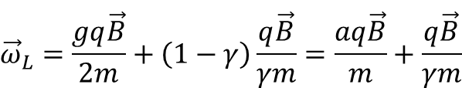


Lepton spin precession and motion in a B-field
Relativistic lepton spin precession in a perpendicular
magnetic field
$${\vec{ω}}_{L}=\frac{gq\vec{B}}{2m}+\left(1−γ\right)\frac{q\vec{B}}{γm}=\frac{aq\vec{B}}{m}+\frac{q\vec{B}}{γm}$$
$$a=\frac{g−2}{2}$$
Cyclotron frequency of a lepton in a perpendicular
magnetic field
$${\vec{ω}}_{C}=\frac{q\vec{B}}{γm}$$
Momentum
Spin
Measurement of the anomalous magnetic moment by observing relative precession
$${\vec{ω}}_{a}={\vec{ω}}_{C}−{\vec{ω}}_{L}=−\frac{q}{m}a\vec{B}$$

Slide 9
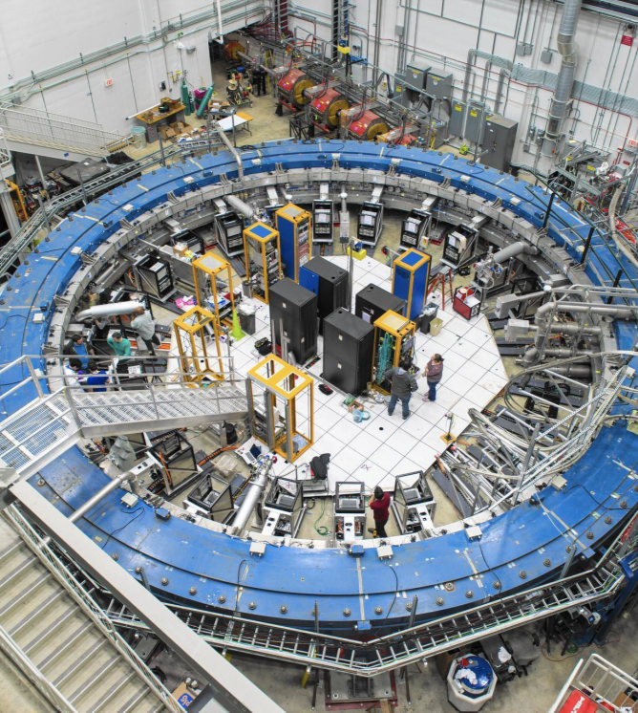


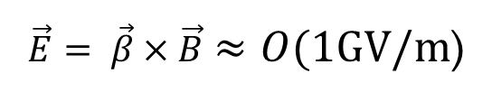
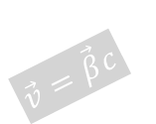
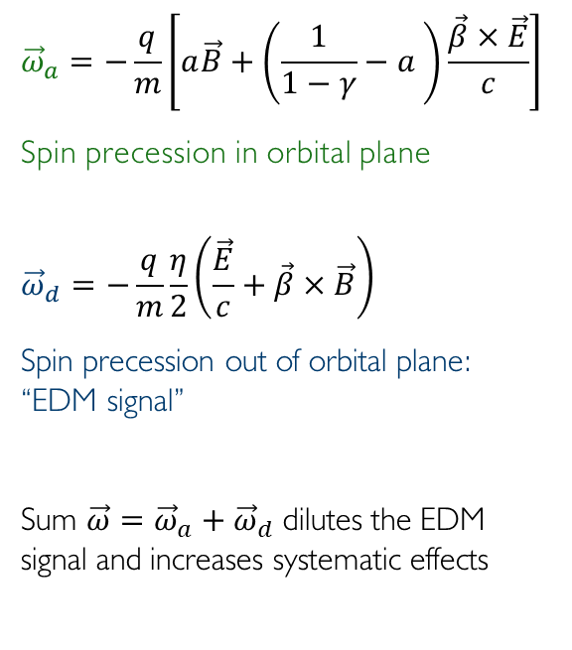

Spin precession in $\vec{B}$ and $\vec{E}$ fields of a storage rings:
$${\vec{ω}}_{a}=−\frac{q}{m}\left[a\vec{B}+\left(\frac{1}{1−γ}−a \right)\frac{\vec{β}×\vec{E}}{c}\right]$$
Spin precession in orbital plane
$${\vec{ω}}_{d}=−\frac{q}{m}\frac{η}{2}\left(\frac{\vec{E}}{c}+\vec{β}×\vec{B}\right)$$
Spin precession out of orbital plane:
“EDM signal”
Sum $\vec{ω}={\vec{ω}}_{a}+{\vec{ω}}_{d}$ dilutes the EDM
signal and increases systematic effects
$$\left(a=\frac{g−2}{2}\right)$$
$$\vec{B}$$
$$\left(η=\frac{4mcd}{qℏ}\right)$$
$$\vec{v}=\vec{β}c$$
$$\vec{E}= \vec{β}×\vec{B}≈O(1GV/m\text{)}$$

Slide 10
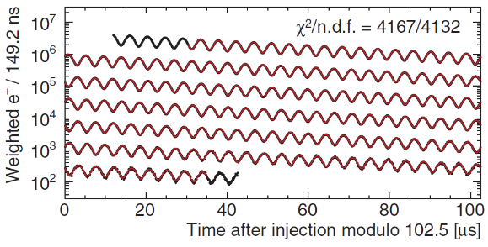




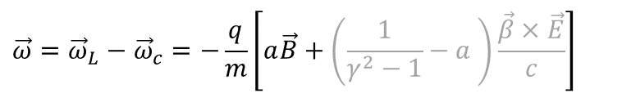
Muon dipole moments and frequencies
$$\vec{ω}={\vec{ω}}_{L}−{\vec{ω}}_{c}=−\frac{q}{m}\left[a\vec{B}+\left(\frac{1}{γ^{2}−1}−a \right)\frac{\vec{β}×\vec{E}}{c}\right]$$
g-2 term $ω_{a}$
B
$${\vec{ω}}_{a}$$
$$R=7.114 m$$
$$\vec{s}$$
[Abi et al., PRL126 141801(2021)]
Notes:
Many of you probably know about the g-2 measurement of the muon at Fermilab.
The principle physics are described in the equation. The difference between the Larmor frequency of the muon, essentially the precision due to the magnetic moment, and the cyclotron frequency of the muon moving in a magnetic and electric field.
The muon moves along its reference orbit perpendicular to the main magnetic field. Due to the small anomalous magnetic moment the difference is not exactly zero and one can observe the famous wiggle plot by measuring in the number of decay positrons per time.
The electric field is required for steering the muon inside the storage ring. By selecting the correct momentum the electric term can be set to zero and the observed oscillation frequency directly relates to the anomalous magnetic moment.
Now in the presence of a electric dipole moment the plane of oscillation tilts and one could observe a tiny vertical observation of the positron intensity, and the measured frequency would be a little bit larger.
The prospected sensitivity is about 10E-21 ecm for the EDM at Fermilab and JPARC.

Slide 11
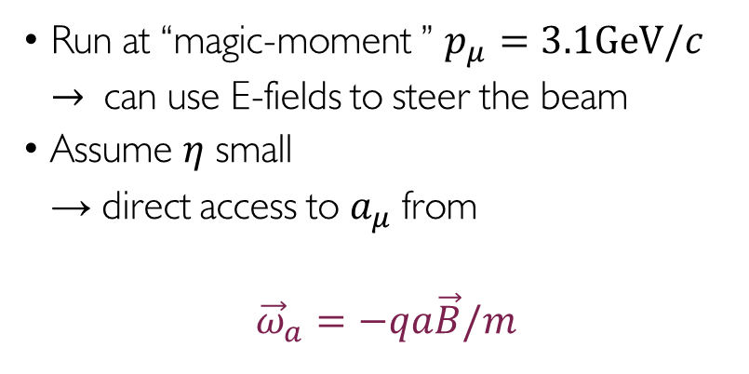
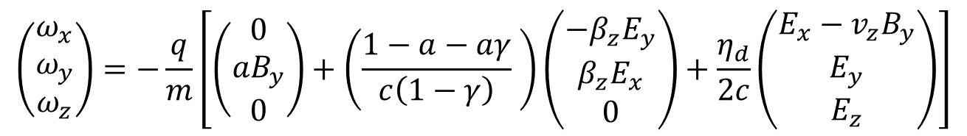
The g-2 experiment: measuring with magic momentum
$$\left(\begin{matrix}ω_{x} \\ ω_{y} \\ ω_{z}\end{matrix}\right)=−\frac{q}{m}\left[\left(\begin{matrix}0 \\ {aB}_{y} \\ 0\end{matrix}\right)+\left(\frac{1−a−aγ}{c\left(1−γ\right)} \right)\left(\begin{matrix}{−β}_{z}E_{y} \\ β_{z}E_{x} \\ 0\end{matrix}\right)+\frac{η_{d}}{2c}\left(\begin{matrix}E_{x}−v_{z}B_{y} \\ E_{y} \\ E_{z}\end{matrix}\right)\right]$$
Run at “magic-moment ” $p_{μ}=3.1GeV/c$
$→$ can use E-fields to steer the beam
Assume $η$ small
→ direct access to $a_{μ}$ from
${\vec{ω}}_{a}=−qa\vec{B}/m$
An EDM signal would be visible as up/down oscillation
Notes:
In the case of the g-2 experiment one has chosen a specific momentum for the muons of 3.1 GeV such that the relativistic E term drops out.
This has the advantage, that electric fields can be used for focusing and steering the muons in the storage ring.
Assuming that the EDM is very small also the second part drops out and the only observable is the oscillation of the spin in the orbital plane.
The current best limit for an EDM of the muon was also derived in this measurment. The searched for signal is a vertical nutation of the spin in addition.

Slide 12
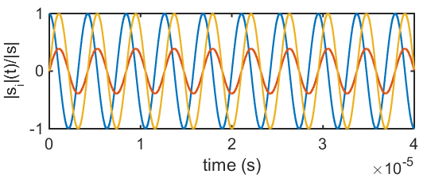

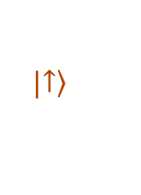
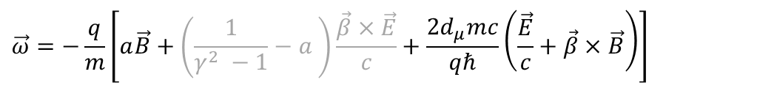








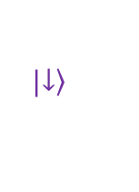
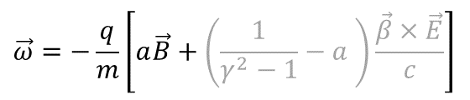

Muon dipole moments and frequencies
$$\vec{ω}=−\frac{q}{m}\left[a\vec{B}+\left(\frac{1}{γ^{2} −1}−a \right)\frac{\vec{β}×\vec{E}}{c}+\frac{2d_{μ}mc}{qℏ}\left(\frac{\vec{E}}{c}+\vec{β}×\vec{B}\right)\right]$$
$$\vec{ω}=−\frac{q}{m}\left[a\vec{B}+\left(\frac{1}{γ^{2}−1}−a \right)\frac{\vec{β}×\vec{E}}{c}\right]$$
g-2 term $ω_{a}$
EDM term $ω_{e}$
$$|\left.↑\right\rangle$$
$$U=−\vec{d}⋅\vec{E}$$
$$ΔU=ℏω_{e}=2dE$$
B
$${\vec{ω}}_{a}$$
$$\sqrt{{\vec{ω}}_{a}^{2}+{\vec{ω}}_{e}^{2}}$$
$$ζ$$
$$|\left.↓\right\rangle$$
$$R=7.114 m$$
$$E$$
$$ζ=\operatorname{atan}\left(\frac{2d_{μ}βcm}{a}\right)$$
$$\vec{s}$$
$${\vec{ω}}_{e}$$
FNAL* & JPARC**:
$$σ\left(d_{μ}\right)≈{10}^{−21}ecm$$
[*Chislett et al., EPJConf.118 01005(2016), Abi et al., PRL126 141801(2021), **Abe et al., PTEP053C02 (2019)]
Notes:
Many of you probably know about the g-2 measurement of the muon at Fermilab.
The principle physics are described in the equation. The difference between the Larmor frequency of the muon, essentially the precision due to the magnetic moment, and the cyclotron frequency of the muon moving in a magnetic and electric field.
The muon moves along its reference orbit perpendicular to the main magnetic field. Due to the small anomalous magnetic moment the difference is not exactly zero and one can observe the famous wiggle plot by measuring in the number of decay positrons per time.
The electric field is required for steering the muon inside the storage ring. By selecting the correct momentum the electric term can be set to zero and the observed oscillation frequency directly relates to the anomalous magnetic moment.
Now in the presence of a electric dipole moment the plane of oscillation tilts and one could observe a tiny vertical observation of the positron intensity, and the measured frequency would be a little bit larger.
The prospected sensitivity is about 10E-21 ecm for the EDM at Fermilab and JPARC.

Slide 13
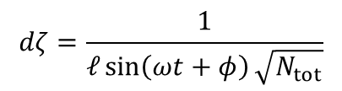

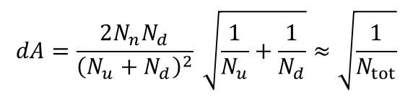
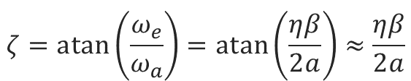
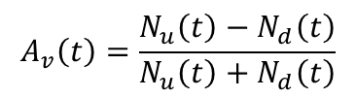
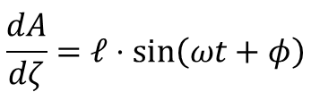

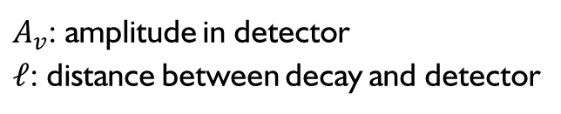
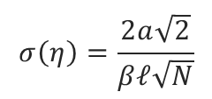
Statistical sensitivity of the g-2 EDM extraction
$$A_{v}\left(t\right)=\frac{N_{u}\left(t\right)−N_{d}\left(t\right)}{N_{u}\left(t\right)+N_{d}\left(t\right)}$$
$A_{v}$: amplitude in detector
$ℓ$: distance between decay and detector
$$A_{v}\left(t\right)=ζ⋅ℓ⋅\sin\left(ωt+φ\right)$$
$$dA=\frac{2N_{n}N_{d}}{{\left(N_{u}+N_{d}\right)}^{2}} \sqrt{\frac{1}{N_{u}}+\frac{1}{N_{d}}}≈\sqrt{\frac{1}{N_{tot}}}$$
$$\frac{dA}{dζ}=ℓ⋅\sin\left(ωt+φ\right)$$
$$dζ=\frac{1}{ℓ\sin\left(ωt+φ\right)\sqrt{N_{tot}}}$$
Time averaged sine
$$σ\left(η\right)=\frac{2a\sqrt{2}}{βℓ\sqrt{N}}$$
$$ζ=\operatorname{atan}\left(\frac{ω_{e}}{ω_{a}}\right)=atan\left(\frac{ηβ}{2a}\right)≈\frac{ηβ}{2a}$$
Statistical sensitivity depends only on $\sqrt{N}$

Slide 14
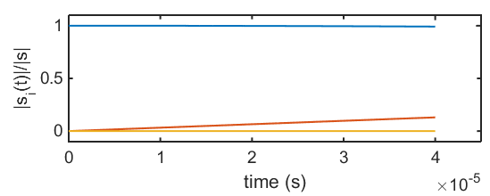



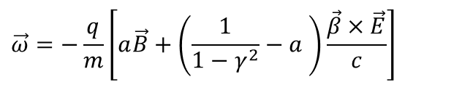


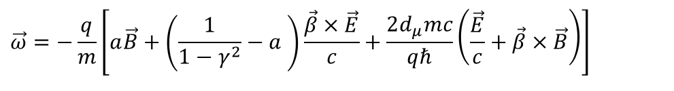

Muon dipole moments –freezing the spin at PSI
$$\vec{ω}=−\frac{q}{m}\left[a\vec{B}+\left(\frac{1}{1−γ^{2}}−a \right)\frac{\vec{β}×\vec{E}}{c}+\frac{2d_{μ}mc}{qℏ}\left(\frac{\vec{E}}{c}+\vec{β}×\vec{B}\right)\right]$$
$$\vec{ω}=−\frac{q}{m}\left[a\vec{B}+\left(\frac{1}{1−γ^{2}}−a \right)\frac{\vec{β}×\vec{E}}{c}\right]$$
g-2 term $ω_{a}$
EDM term $ω_{e}$
$$s_{z}$$
B
$$s_{y}$$
$$R=31 mm$$
$${\vec{ω}}_{e}$$
$$s_{x}$$
[*Farley et al,, PRL93 042001 (2004) ] ,
Notes:
To further increase the sensitivity to a muon EDM we propose to use the frozen-spin technique to measure the electric dipole moment.
By applying a well tuned electric field this entire term can be canceled and the spin exactly follows the momentum, essentially it is frozen to the momentum.
The only term present is the one of the electric dipole moment which leads to a precession of the spin around the radial axis like a bicycle going in a circle.
This in turn leads to a build up of a asymmetry of positron decays along and against the direction of the magnetic field, the signal we are searching for.

Slide 15
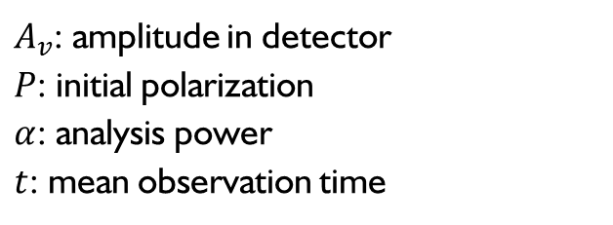

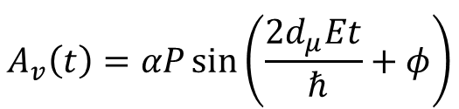
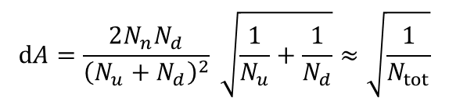
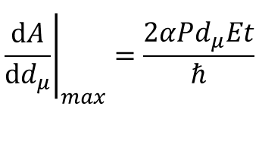
Statistical sensitivity of the frozen spin technique
$$A_{v}\left(t\right)=\frac{N_{u}\left(t\right)−N_{d}\left(t\right)}{N_{u}\left(t\right)+N_{d}\left(t\right)}$$
$A_{v}$: amplitude in detector
$P$: initial polarization
$α$: analysis power
$t$: mean observation time
$$A_{v}\left(t\right)=αP\sin\left(\frac{{2d}_{μ}Et}{ ℏ}+φ\right)$$
$$dA=\frac{2N_{n}N_{d}}{{\left(N_{u}+N_{d}\right)}^{2}} \sqrt{\frac{1}{N_{u}}+\frac{1}{N_{d}}}≈\sqrt{\frac{1}{N_{tot}}}$$
$$σ\left(d_{μ}\right)=\frac{ℏ}{2PE\sqrt{N}tα}$$
$${\left.\frac{dA}{dd_{μ}}\right|}_{max}=\frac{2αPd_{μ}Et}{ℏ}$$
Statistical sensitivity increases linear with E-field and observation time

Slide 16
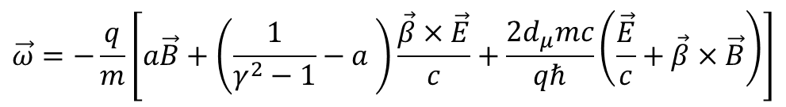
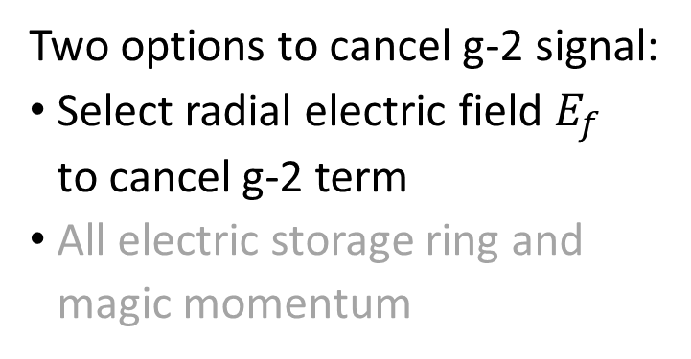
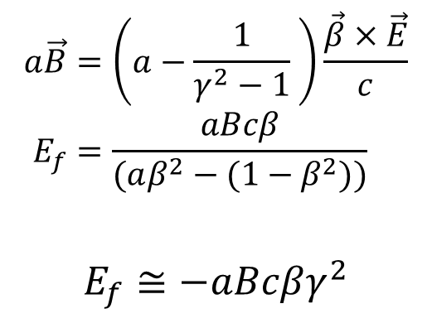
The frozen spin method
$$\vec{ω}=−\frac{q}{m}\left[a\vec{B}+\left(\frac{1}{γ^{2}−1}−a \right)\frac{\vec{β}×\vec{E}}{c}+\frac{2d_{μ}mc}{qℏ}\left(\frac{\vec{E}}{c}+\vec{β}×\vec{B}\right)\right]$$
Two options to cancel g-2 signal:
Select radial electric field $E_{f}$
to cancel g-2 term
All electric storage ring and magic momentum
$$a\vec{B}=\left(a−\frac{1}{γ^{2}−1} \right)\frac{\vec{β}×\vec{E}}{c} \\ E_{f}=\frac{aBcβ}{(aβ^{2}−(1−β^{2}))}$$
$$E_{f}≅−aBcβγ^{2}$$

Slide 17


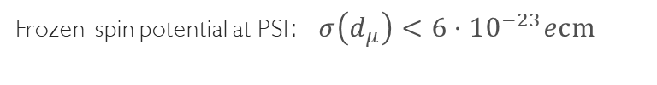
Muon dipole moments –freezing the spin at PSI
$$\vec{ω}=−\frac{q}{m}\left[a\vec{B}+\left(\frac{1}{1−γ^{2}}−a \right)\frac{\vec{β}×\vec{E}}{c}+\frac{2d_{μ}mc}{qℏ}\left(\frac{\vec{E}}{c}+\vec{β}×\vec{B}\right)\right]$$
$$\vec{ω}=−\frac{q}{m}\left[a\vec{B}+\left(\frac{1}{1−γ^{2}}−a \right)\frac{\vec{β}×\vec{E}}{c}\right]$$
g-2 term $ω_{a}$
EDM term $ω_{e}$
$$s_{z}$$
Frozen-spin potential at PSI:$σ\left(d_{μ}\right)<{6⋅10}^{−23}ecm$
B
$$s_{y}$$
$$R=31 mm$$
$${\vec{ω}}_{e}$$
E
$$s_{x}$$
set $E ≅aBcβγ^{2}$
Phase I: $σ\left(d_{μ}\right)<{3⋅10}^{−21}ecm$
[*Farley et al,, PRL93 042001 (2004) ] ,
Notes:
To further increase the sensitivity to a muon EDM we propose to use the frozen-spin technique to measure the electric dipole moment.
By applying a well tuned electric field this entire term can be canceled and the spin exactly follows the momentum, essentially it is frozen to the momentum.
The only term present is the one of the electric dipole moment which leads to a precession of the spin around the radial axis like a bicycle going in a circle.
This in turn leads to a build up of a asymmetry of positron decays along and against the direction of the magnetic field, the signal we are searching for.

Slide 18
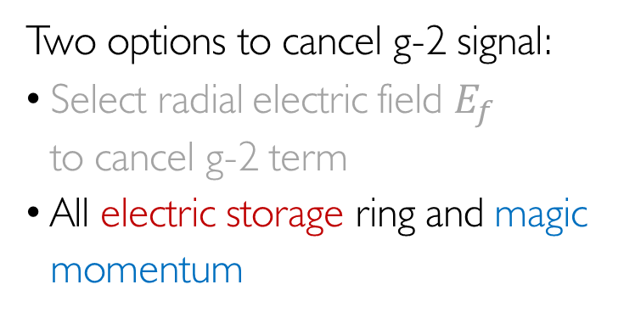
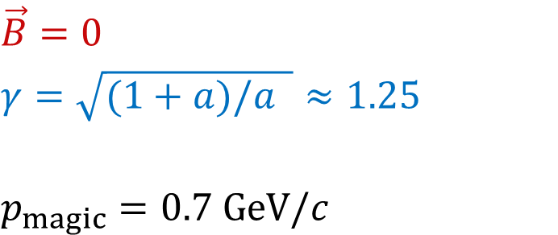

The frozen spin method
$$\vec{ω}=−\frac{q}{m}\left[a\vec{B}+\left(\frac{1}{γ^{2}−1}−a \right)\frac{\vec{β}×\vec{E}}{c}+\frac{2d_{μ}mc}{qℏ}\left(\frac{\vec{E}}{c}+\vec{β}×\vec{B}\right)\right]$$
Proton EDM search with $a_{P}=1.793$
Two options to cancel g-2 signal:
Select radial electric field $E_{f}$
to cancel g-2 term
All electric storage ring and magic momentum
$$\vec{B}=0$$
$$γ=\sqrt{(1+a)/a }≈1.25$$
$$p_{magic}=0.7 GeV/c$$

Slide 19



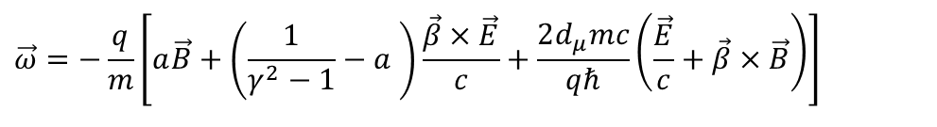
Muon dipole moments –freezing the spin at PSI
$$\vec{ω}=−\frac{q}{m}\left[a\vec{B}+\left(\frac{1}{γ^{2}−1}−a \right)\frac{\vec{β}×\vec{E}}{c}+\frac{2d_{μ}mc}{qℏ}\left(\frac{\vec{E}}{c}+\vec{β}×\vec{B}\right)\right]$$
EDM term $ω_{e}$
$σ\left(d_{μ}\right)≈{10}^{−29}ecm$*
$$s_{z}$$
$$s_{y}$$
$$R=127 m$$
$${\vec{ω}}_{e}$$
E
$$s_{x}$$
$E≈4.5MV/m$
[*arXiv:2205/00830v1] ,
Notes:
To further increase the sensitivity to a muon EDM we propose to use the frozen-spin technique to measure the electric dipole moment.
By applying a well tuned electric field this entire term can be canceled and the spin exactly follows the momentum, essentially it is frozen to the momentum.
The only term present is the one of the electric dipole moment which leads to a precession of the spin around the radial axis like a bicycle going in a circle.
This in turn leads to a build up of a asymmetry of positron decays along and against the direction of the magnetic field, the signal we are searching for.

Slide 20
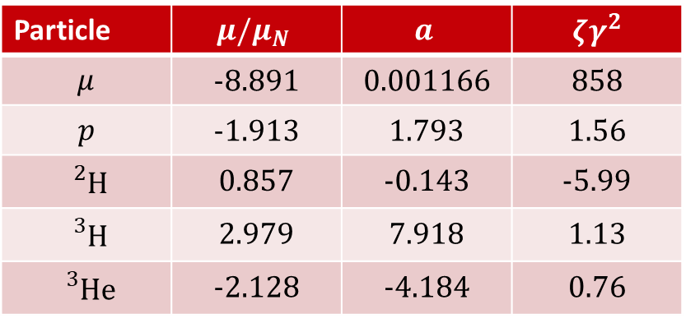
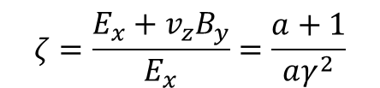
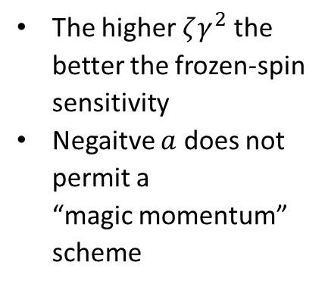
When to use which variant?
$$ζ=\frac{E_{x}+v_{z}B_{y}}{E_{x}}=\frac{a+1}{aγ^{2}}$$
Frozen-spin sensitivity:
Particle | $$μ/μ_{N}$$ | $$a$$ | $$ζγ^{2}$$
$$μ$$ | -8.891 | 0.001166 | 858
$$p$$ | -1.913 | 1.793 | 1.56
$${}_{}^{2}H$$ | 0.857 | -0.143 | -5.99
$${}_{}^{3}H$$ | 2.979 | 7.918 | 1.13
$${}_{}^{3}{He}$$ | -2.128 | -4.184 | 0.76
The higher $ζγ^{2}$ the better the frozen-spin sensitivity
Negaitve $a$ does not permit a
“magic momentum” scheme

Slide 21


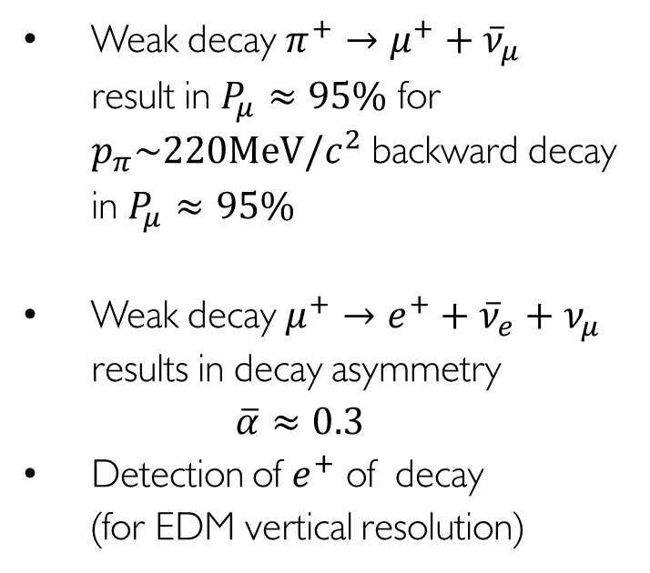














Muon polarization and analysis
Weak decay $π^{+}→μ^{+}+{\overline{ν}}_{μ}$
result in $P_{μ}≈95\%$ for $p_{π}\sim 220MeV/c^{2}$ backward decay in $P_{μ}≈95\%$
Weak decay $μ^{+}→e^{+}+{\overline{ν}}_{e}+ν_{μ}$
results in decay asymmetry
$\overline{α}≈0.3$
Detection of $e^{+}$ of decay
(for EDM vertical resolution)
$$\vec{s}$$
$$\vec{s}$$
$$π$$
$${\overline{ν}}_{μ}$$
$$μ^{+}$$
$$\vec{s}$$
$$e^{+}$$
$${\overline{ν}}_{e}$$
$$μ$$
$$ν_{μ}$$
$$e^{+}$$
$$\vec{s}$$
$$\vec{B}$$
$$μ$$
Notes:
Before coming to the result from this measurement of the g-2 and the search for a muon EDM, I would like to explain how kind nature was for polarizing and analyzing muons.
The polarization is a direct consequence of the V-A structure of the weak interaction. Hence, when a pion decays the spin is aligned with the momentum of the muon in the rest frame of the decay.
Similar we also profit for the analysis of the muon spin. In this case again the positron or electron is ejected in the same direction as the spin. These properties were then used to measure the oscillation frequency of the muons inside the storage ring.
On the inner side tracking detector for positron were setup to detect the positron preferentially ejected in the direction of the muon spin. While the muons were circulating around the closed orbit the spin rotates in the rest frame of the muon. Whenever the spin point into the direction of the detectors you detected a higher count rate.
To detect an EDM the positron detectors need a vertical resolution.

Slide 22
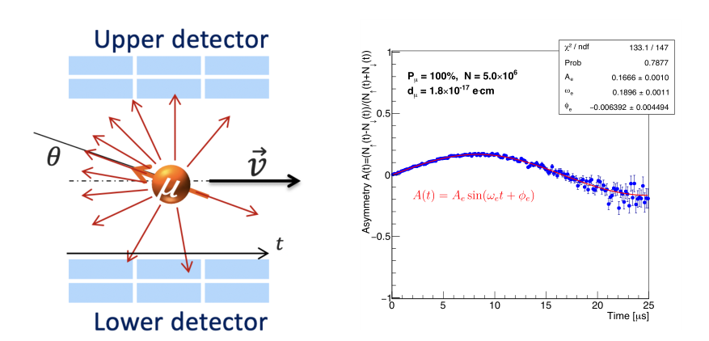

The general experimental idea for a muon EDM
B
If the EDM ≠ 0, then there will be a vertical precession out of the plane of the orbit
  An asymmetry increasing with time will be observed recording decay positrons
If the EDM = 0, then the spin should always be parallel to the momentum
asymmetry should be zero
$${\vec{ω}}_{e}$$
E
More details in talk by
Chavdar

Slide 23
Current storage ring EDM projects

Slide 24


An all electric storage ring to search for the pEDM
Magic momentum $p=\frac{0.7GeV}{c},$
$$E=8MV/m, ρ=50, ℓ=500m$$
$$τ_{c}>1000s$$
$$σ≈2×{10}^{−29}ecm$$
Polarimetry uses scattering on target
Systematic challenges:
Radial B-field $\left\langle B_{r}\right\rangle <10aT$
Can be detected by separation of CW and
CCW beams by 1pm
This requires BPM based on Squids resolving $1ft /\sqrt{Hz}$
Magnetic shield to reduce background field to $10nT−100nT$

Slide 25

Hybrid storage ring high priority in SNOWMASS
EDM physics is must do, exciting and timely, CP-violation, ~10³ TeV New-Physics reach, axion physics, DM/DE.
Hybrid, symmetric ring lattice and spin-based alignment. Minimized systematic error sources. Statistics and systematics of pEDM to better than 10⁻²⁹e-cm.
Simultaneous storage of clockwise and counterclockwise proton beams
Snowmass encouraged BNL and the srEDM collaboration to come up with a technically strong proposal for a storage ring proton EDM. BNL is currently funding the cost estimate of the storage ring EDM experiment

Slide 26



Hybrid SR
Replace electrostatic quadrupoles by
magnetic ones and use “quadrupole tuning”
to extrapolate to true EDM
CW and CCW within $0.1 μm$ for all
quadrupole strengths
Cost estimation currently at BNL
Circumference 500m
E-field 45kV/cm

Slide 27


Slide 28


Muon EDM @ FNAL
Muon EDM causes tilt in precession plane
Asymmetry in vertical decay angle of positrons
Vertical angle measured by tracking detectors
Momentum binned analysis for maximum sensitivity
Run 1 analysis still blinded. Assuming zero signal expecting limit of:
|d_{μ}| < 2.0 × 10⁻¹⁹e.cm (95% C.L.)
Still statistically limited in tracker analysis
Factor of ~10 improvement for statistics accumulated so far, with tracking improvements
Joe Price – on behalf of g-2 collaboration

Slide 29
EDM at FNAL
Data taking concluded
EDM analysis ongoing
First result expected in … years

Slide 30



Frozen-spin in a compact SR for beta-decay ions
Advantages compared to muon:
Much longer beta decay life time
Sensitive to QCD-theta term
Ideally magnetic momentum with $a≈a_{μ}$
Input from theory and nuclear physics needed to identify ideal isotop

Slide 31

JEDI – Jülich EDM Investigations
Measurement of Axions using deuterons
Cooler Synchrotron COSY @FZJ

Slide 32


First results: ALPS at JEDI

Slide 33

Conclusions
Storage rings exploiting the frozen-spin technique could provide a new window to CP violation manifesting in EDM of charged particles
At PSI a compact muon EDM experiment is being setup for demonstration
The international storage ring EDM collaboration proposed a new lattice for, e.g. BNL to search with a sensitivity of better than
$$σ\left(d_{p}\right)≈{10}^{−29}ecm$$

