Slide 1

Towards Open Science at
GSI
Andrew Mistry
Workshop on Open Science Practices in Nuclear Physics
06.12.22
CC-BY-SA 4.0

Slide 2
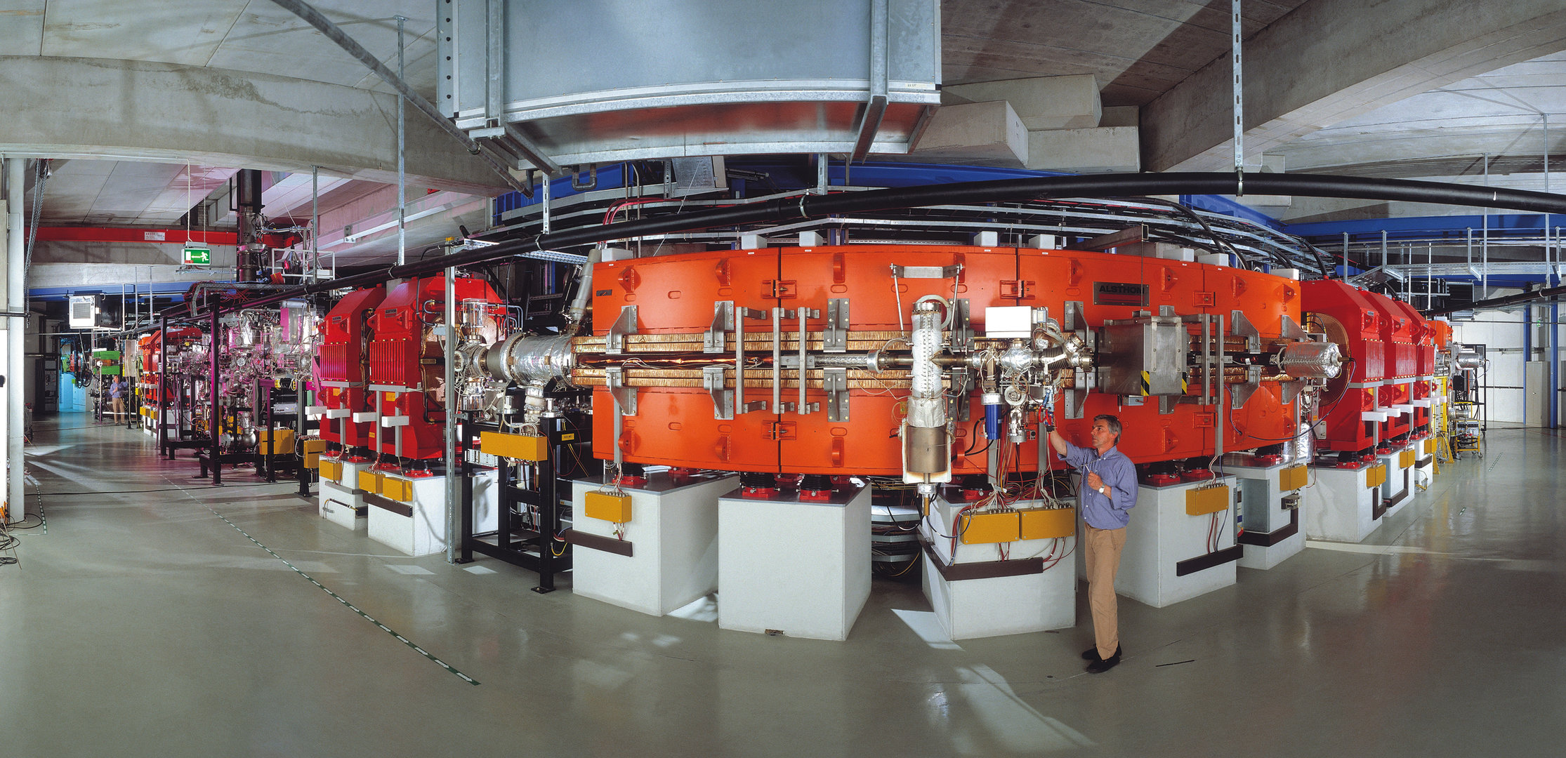
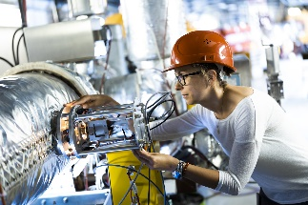
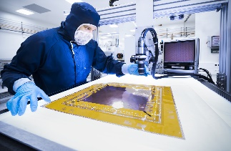
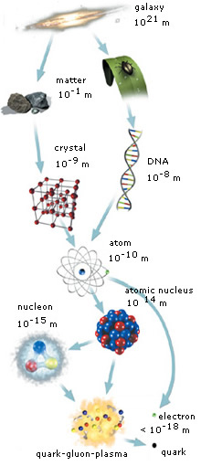
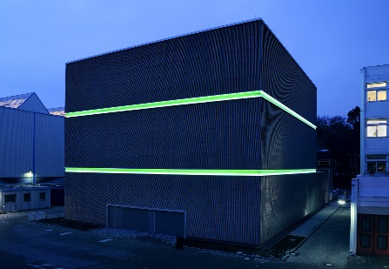
GSI Helmholtz Centre for Heavy-ion Research
Darmstadt, Germany: Heavy-ion accelerator laboratory: 1350+ employees + 700 external users
Founded in 1969
Elements H to U can be accelerated
Discovery of six new elements, many exotic nuclei
Development of a new cancer treatment
First stage injector for the FAIR facility
Experiments continuing (FAIR Phase-0)
Who we are
Research of interest:
Accelerator Physics
Detector Development
Atomic Physics
Nuclear and particle Physics
Plasma Physics
Biophysics
Materials Research
High-Performance Computing
Theoretical Physics
Past Successes
Future

Slide 3


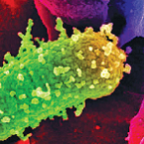

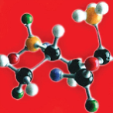

GSI- member of the Helmholtz association
  - Helmholtz: Facts and Figures
  18 Research Centres
  44,000 Employees
  17,000 Scientists & Engineers
  6,250 Doctoral Students
  Budget ca. 5.81 Billion Euro
  (including Third Party Funding)
  Largest Research Organization in Germany

Slide 4
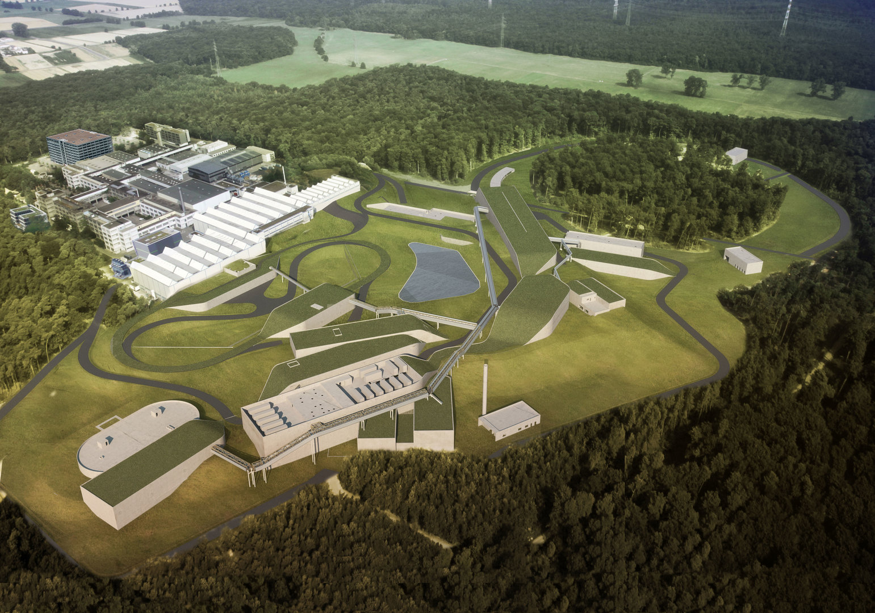
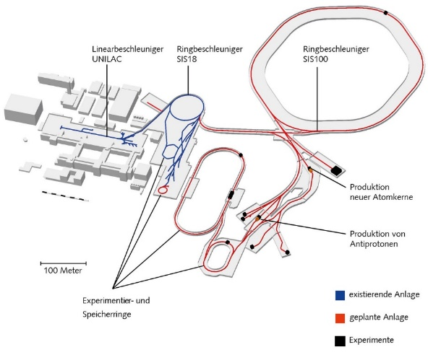
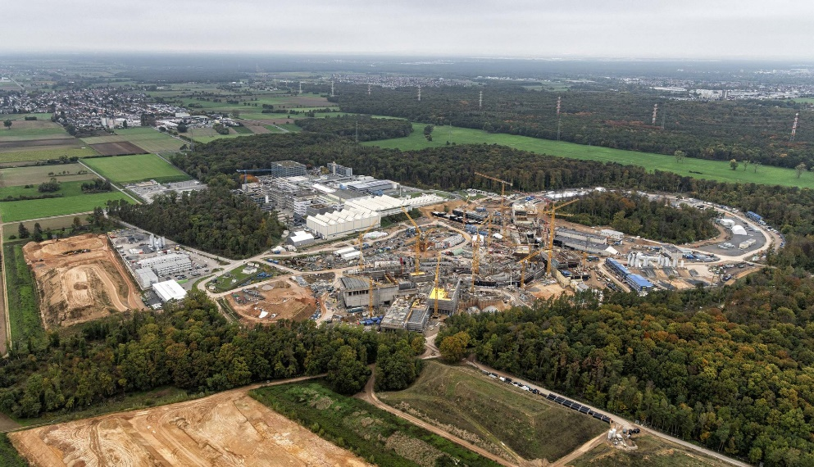
FAIR (Facility for Antiproton and Ion Research)
New accelerator facility
GSI
FAIR
High performance computing (Green cube expansion)
‘FAIR goes FAIR’: commitment to open science
SIS100 accelerator: 1.1km circumference
APPA - Atomic, Plasma Physics and Applications
CBM - Compressed Baryonic Matter
NUSTAR - Nuclear Structure, Astrophysics and Reactions
PANDA - Physics with High Energy Antiprotons
© D. Fehrenz, GSI/FAIR
Expected ‘Early Science’ in 2025+
SIS100 2028
Now: FAIR phase 0

Slide 5


Open Science @ GSI
Research Data – will focus mostly on this
Open Software -> Policy available; Make open whenever possible (Github/gitlab)
Open Access Publications -> Researchers should publish Open Access
Open Infrastructure -> Future goals

Slide 6


GSI/FAIR Involvement in OS projects

Slide 7
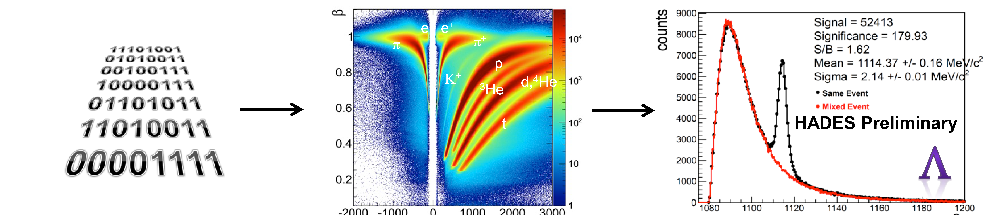
Research Data at GSI: Rich and varied Data Sources
  Raw Data
  Calibrated Data
  Result Data
Experimental:
J. Staudenmaier Research Data Management at GSI/FAIR (2022)
R. Steinhagen Research Data Management at GSI/FAIR (2022)
A.K.Mistry et al. NIM A 1033, 166662, (2022)
Machine
Parameters
Simulation
Theory
Software

Slide 8
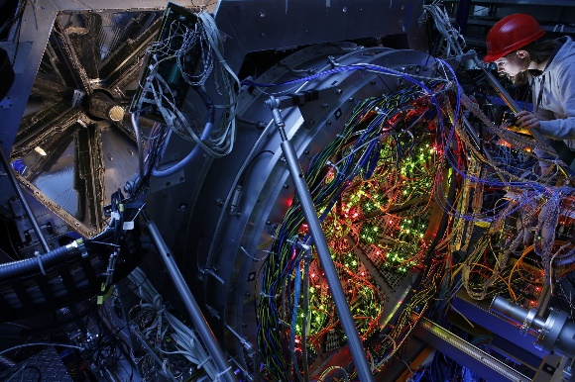
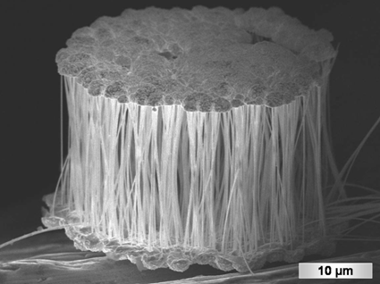
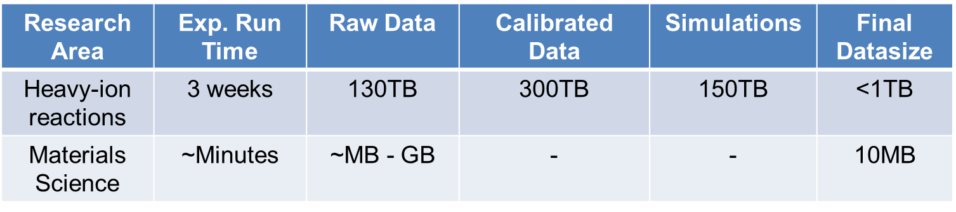
Research Data at GSI: Rich and varied Data Sources
Vastly different metadata/data size and formats

Slide 9
Research Data at GSI: Rich and varied Data Sources
Large metadata: materials research
Online SEM Analysis
  Scan mode
  Acceleration Voltage
  Magnification
Online Electrical Analysis
  Manipulator Type
  Image of contact
  Wire length/Diameter
  I/V-curve
Irradiation
  Ion species
  Charge state
  Flux
  Fluence
  Date
Raw material
  Polymer
  Size
  Finish
  Manufacturer
  Purchase/Fabrication date
Irradiation
  Beamline
  Ion species
  Charge state
  Energy
  Flux
  Fluence
  Date
Pore etching
  Bath
  Duration
  Date
Sputter Coating
  Material
  Parameters
  Date
Back Electrode Deposition
  Material
  Electroplating Bath
  Time
  Current/Voltage
  Date
Wire Deposition
  Material
  Electroplating Bath
  Time
  Current/Voltage
  Date
XRD Analysis
  Scan Type
  Angular Range
  Tube Parameters
  Recorded Intensity
  Date
Dissolution of Template
  etchant
  duration
  drying method
  Date
Offline SEM Analysis
  Scan mode
  Detector Type
  Acceleration Voltage
  Magnification
  Date
  Wire length
  Wire diameter

Slide 10
Research Data Management at GSI
Previously implemented:
Large volume data storage + tape storage
Electronic Logbooks: Elog, (ELabFTW)
Internal publication repository (part of https://join2.de)
Code management system (Gitlab)
Here: Newly implemented concepts and future plans

Slide 11
Research Data Management: Viewpoint
RDM:
Key aspects
Communication
- GSI Open Science webpage
- Attend individual group meetings and explain/discuss
- Contact with PhD students
- Yearly OS Workshop
Strategise
- Open Science Working Group
- Feedback and versioning
- Publishing Data items: Startup
- External Open Data Projects
Documentation
- Instructions prepared
- RDM policy documents due to be published
- Data management plan templates made available
Infrastructure
- RDM management software under testing (RDMO).
- Begin development of suitable internal RD repository
- Establish Metadata Schemas

Slide 12

Open Science working group @GSI
Monthly meetings, started in April 2022
Discuss: open science national/international initiatives, OS progress at GSI, sharing of ideas
Members: researchers, local university representation, CIT services, library personnel, accelerator division, scientific council representation

Slide 13

RDM workshop @ GSI: July 2022
Slides and information available on indico https://indico.gsi.de/event/14680/
=> 70 participants in hybrid meeting, varity of themes dicussed:
Inform and make researchers aware of RDM and efforts in this direction
Open science projects: GSI/FAIR involvement
Talks from individual research groups, Grant office, Helmholtz Open Science Office
Forum of open discussion and ideas sharing
RDM FAQ list drawn up and points addressed
Future plans and updates for RDM

Slide 14
Research Data Management FAQ list generated
What data should I place in a repository? (raw/pre-processed?)
When to publish data to repository?
How long should my data be accessible for?
Who should be able to access my data?
Where should I publish my data? – Which are suitable repositories?
How should researchers be rewarded for publishing data?
How can the time constraints on researchers (e.g. PhD students) be effectively managed?
Where can I find information on RDM at GSI?
What is the best way to inform and teach researchers and collaboration partners on RDM and steps to take?
…

Slide 15
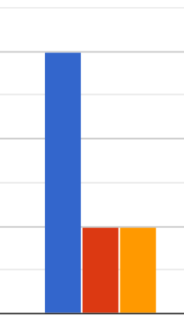
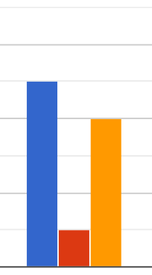

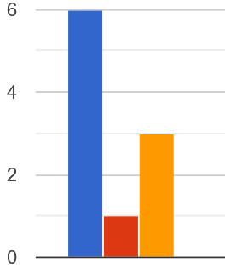
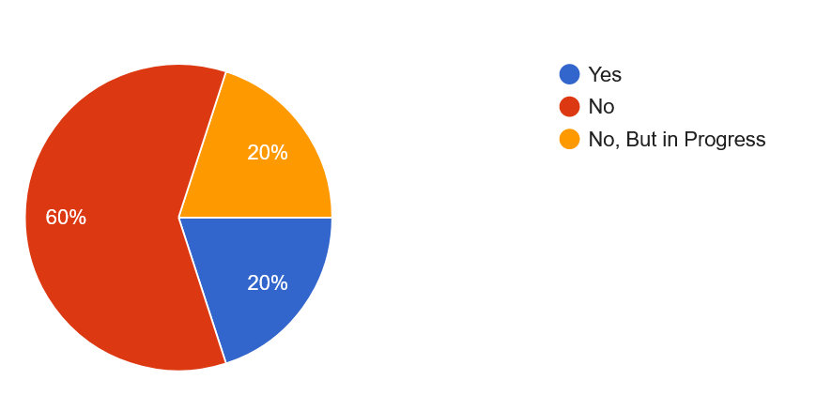
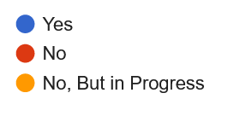
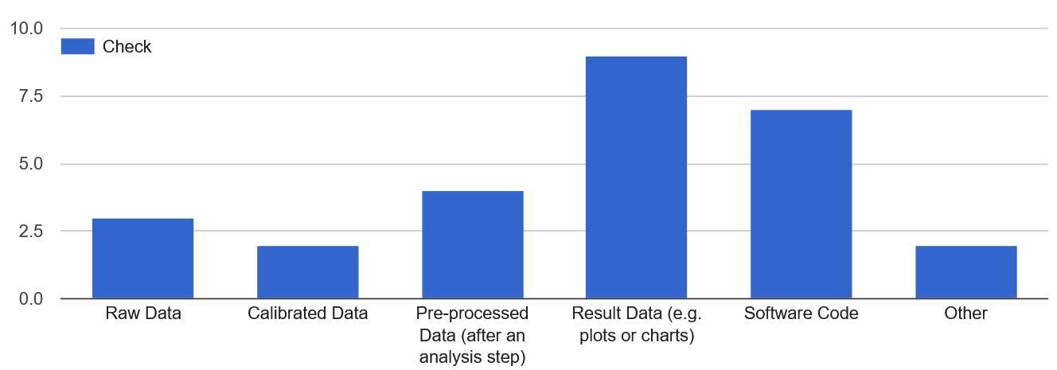

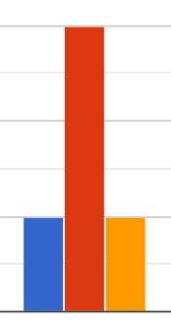
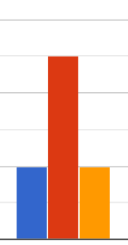
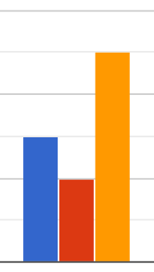
Questionnaire Distributed after the workshop
10 responses from various groups
Does your group need more information on:
Prepared a data management plan?
What RD would your group consider making open?
Documenting RD
Open Data
Data Policies
Points raised: Many RDM policies -> confusion
No metadata schemes used/available
Data storage
ELNs
RD Lifecycle

Slide 16
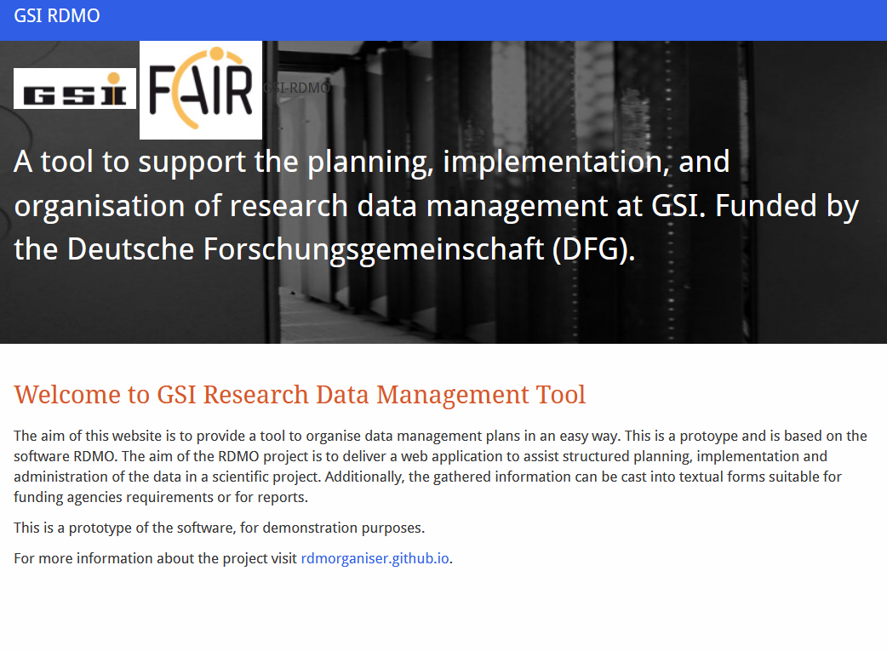
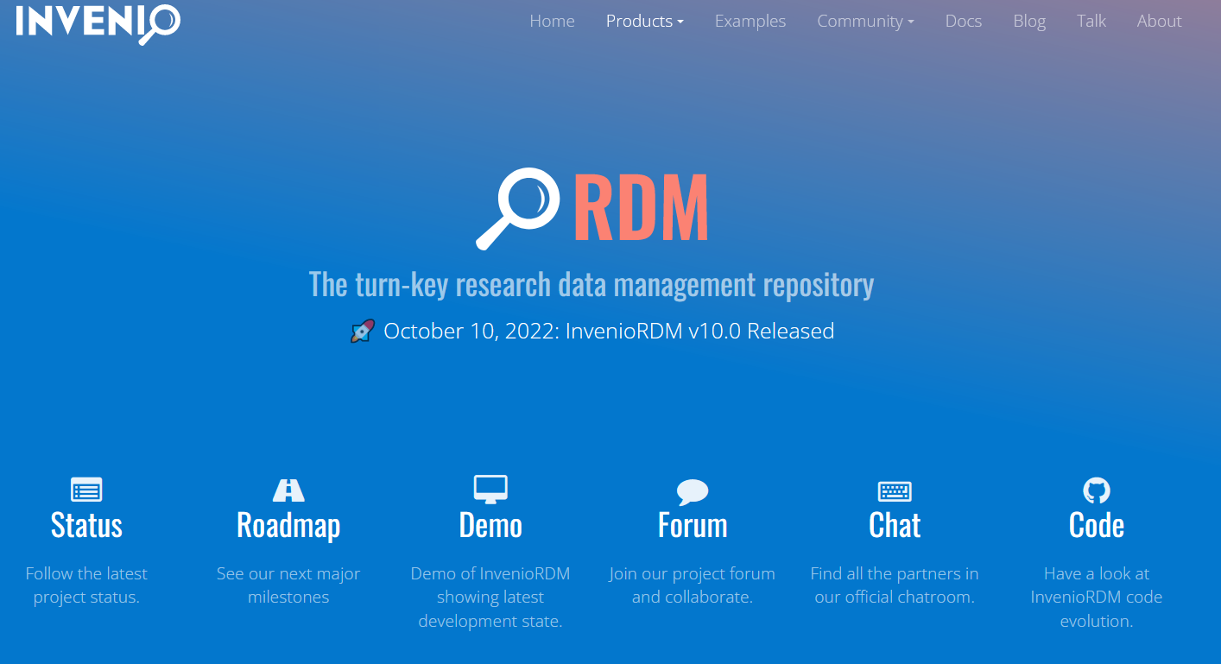
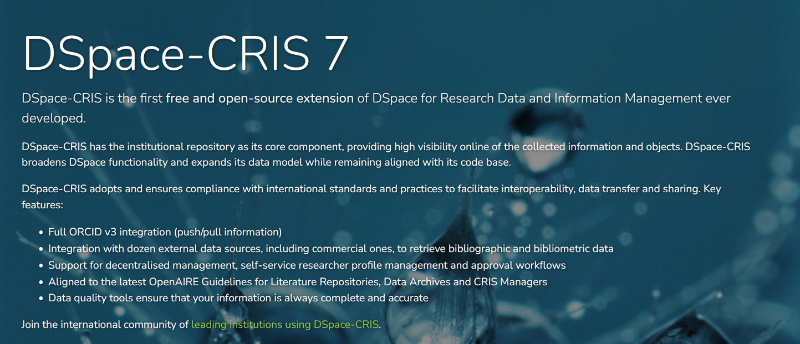
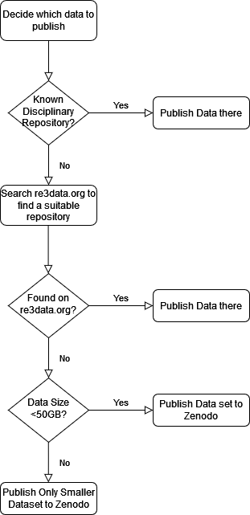
Infrastructure
Data Management with easy to use tool: e.g. RDMO
Plans for GSI data repository underway in collaboration with library and documentation/IT departments
  InvenioRDM
  DSPACE-CRIS
  MyCore
In the meantime using Zenodo/discipline specific repos
Work with other institutions and universities on solutions
In long run; Open Science Projects (e.g. PUNCH4NFDI)

Slide 17
Open Science @ GSI Next Steps
Ultimate goal is to make FAIR-(principles) data – steps needed to achieve this
RDM under development at GSI, a step-wise iterative approach is underway to best suit the research areas
RDM software under testing (RDMO). Data management plan templates made available
Agreement with Helmholtz centres collaboration development of suitable RD repository
Find a suitable global GSI Metadata standardization
Continued contribution to OS projects (e.g. PUNCH4NFDI, ELEMENTS, Eurolabs, EOSC…)
Communication with Researchers feedback, education
Communication with external communities and sharing of ideas and infrastructure developments
Thanks for your attention!
Notes:
Check here

