Slide 1
Rucio / DIRAC integration for CTA
Frederic Gillardo, Agustin Bruzzese, Luisa Arrabito, Cedric Serfon
Lapp/CNRS
September 2022

Slide 2
Rucio / DIRAC integration workflow
Worker Nodes
Jobs
Data
RUCIO
DIRAC

Slide 3
Solution 1 : CLI / python API
Rucio CLI: rucio download <scope>: <file_name>
Rucio Python API: # Attributes of the file and uploading it to the Data Lake
uploadFileSpecs = {'path’ : outputFilePath,'rse' : rse_Onsite, 'did_scope' : scopeName, 'dataset_name' : datasetName,'lifetime' : 86400}
uploaded = upload_client.upload([uploadFileSpecs])

Slide 4
Solution 2 : RucioFileCatalog 1/2
In order to interact with data, DIRAC use an interface : FileCatalogs. The RucioFilesCatalog is one of the implementation.

Slide 5
Solution 2 : RucioFileCatalog 2/2
in yellow : methods implemented
in red are the methods required by CTA that are missing from the Rucio catalog implementation
READ_METHODS
"isFile",
"getFileMetadata",
"getReplicas",
"getReplicaStatus",
"getFileSize",
"isDirectory",
"getDirectoryReplicas",
"listDirectory",
"getDirectoryMetadata",
"getDirectorySize",
"getDirectoryContents",
"getLFNForPFN",
"getLFNForGUID",
"findFilesByMetadata",
"getMetadataFields",
"findDirectoriesByMetadata",
"getReplicasByMetadata",
"findFilesByMetadataDetailed",
"findFilesByMetadataWeb",
"getCompatibleMetadata",
"getMetadataSet",
"getDatasets",
"getFileDescendents",
"getFileAncestors",
"getDirectoryUserMetadata",
"getFileUserMetadata",
"checkDataset",
"getDatasetParameters",
"getDatasetFiles",
"getDatasetAnnotation",
"getSEDump",
Pros of the solution using Rucio Catalog
DIRAC can use the replica location information to make scheduling decisions. In particular, the default policy is to submit jobs to the closest Site with respect to the data location.
Input files are downloaded by the DIRAC Agent running on the worker node before the payload execution.
Output from jobs are uploaded after the payload execution and a failover mechanism can also be activated to reduce the impact of eventual transfer failures.
When the metadata methods will be implemented in the Rucio-catalog, it will be also possible to use the advanced functionalities of the DIRAC Transformation System. The latter will use the metadata information to select the input dataset for a given transformation, which in turn it will submit all the necessary jobs to process the input dataset.

Slide 6
Rucio / DIRAC TestBed
PIC
Worker Nodes
CCIN2P3
Jobs
Data
RUCIO
DIRAC Server
DIRAC Client
dCache-Tape
dCache-Disc

Slide 7
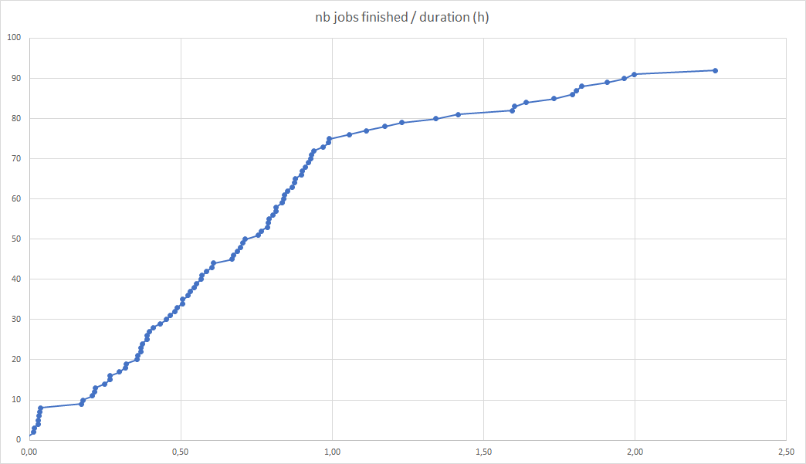
DAC21 CTA use case 2 : reprocessing
Processing Use Case:
DL0 is reprocessed using CTA pipeline software
Ingest the resulting new DL1 data into the data lake
implementation
dirac = Dirac()
job = Prod5Stage1Job()
job.setInputData([filePath])
job.setOutputData(outputSE=rse,outputPath=outputFilePath)
result = dirac.submitJob(job)
fig 4 : nb of jobs finished/ duration (h)

Slide 8
Conclusion : The aim of this document was to provide a state of the art about the Rucio-DIRAC integration. It relies mainly on the work done by the Rucio team for the Belle2 experiment. As we have seen, the integration is not complete, but it is a very good starting point. More details : https://docs.google.com/document/d/16jE-tpU1jdF97pNA8K7-oXJxbAVb52naipTTaNPDE1w/edit?usp=sharing

