Slide 1
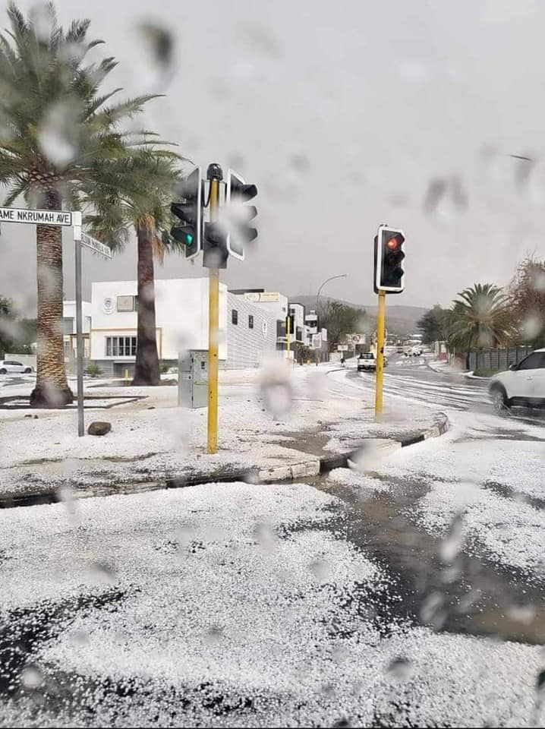
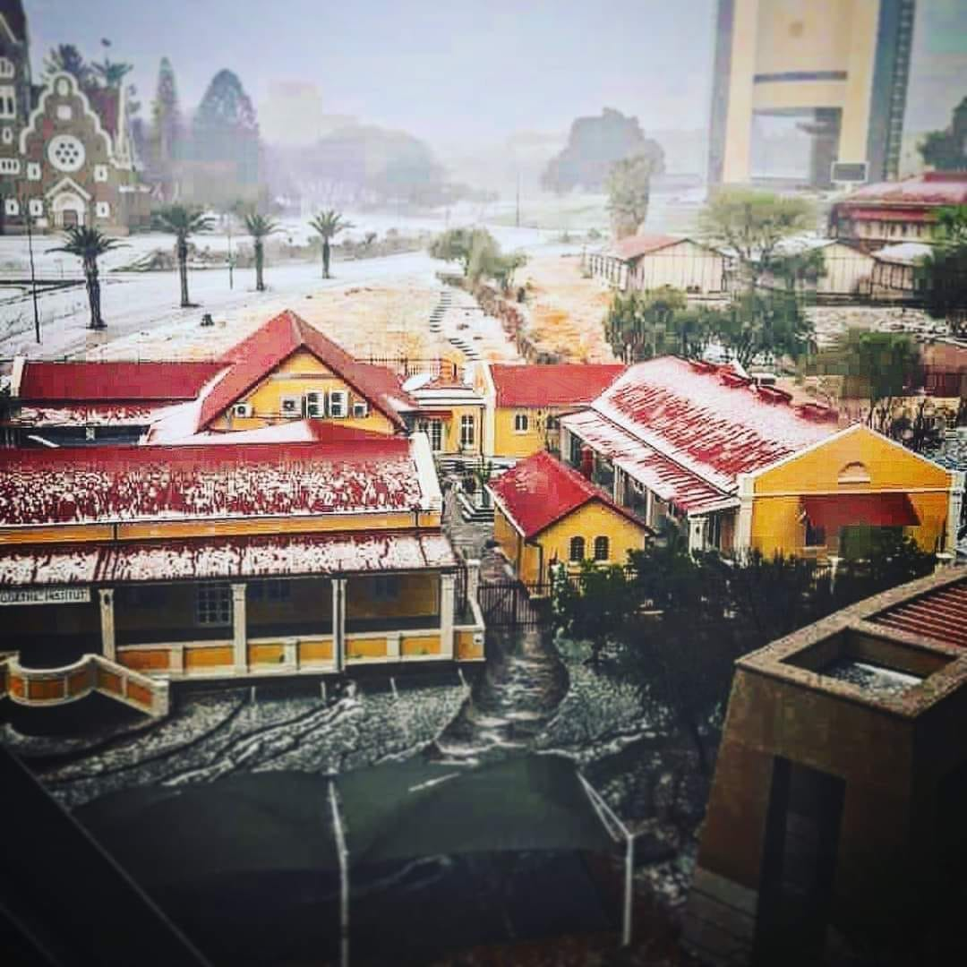
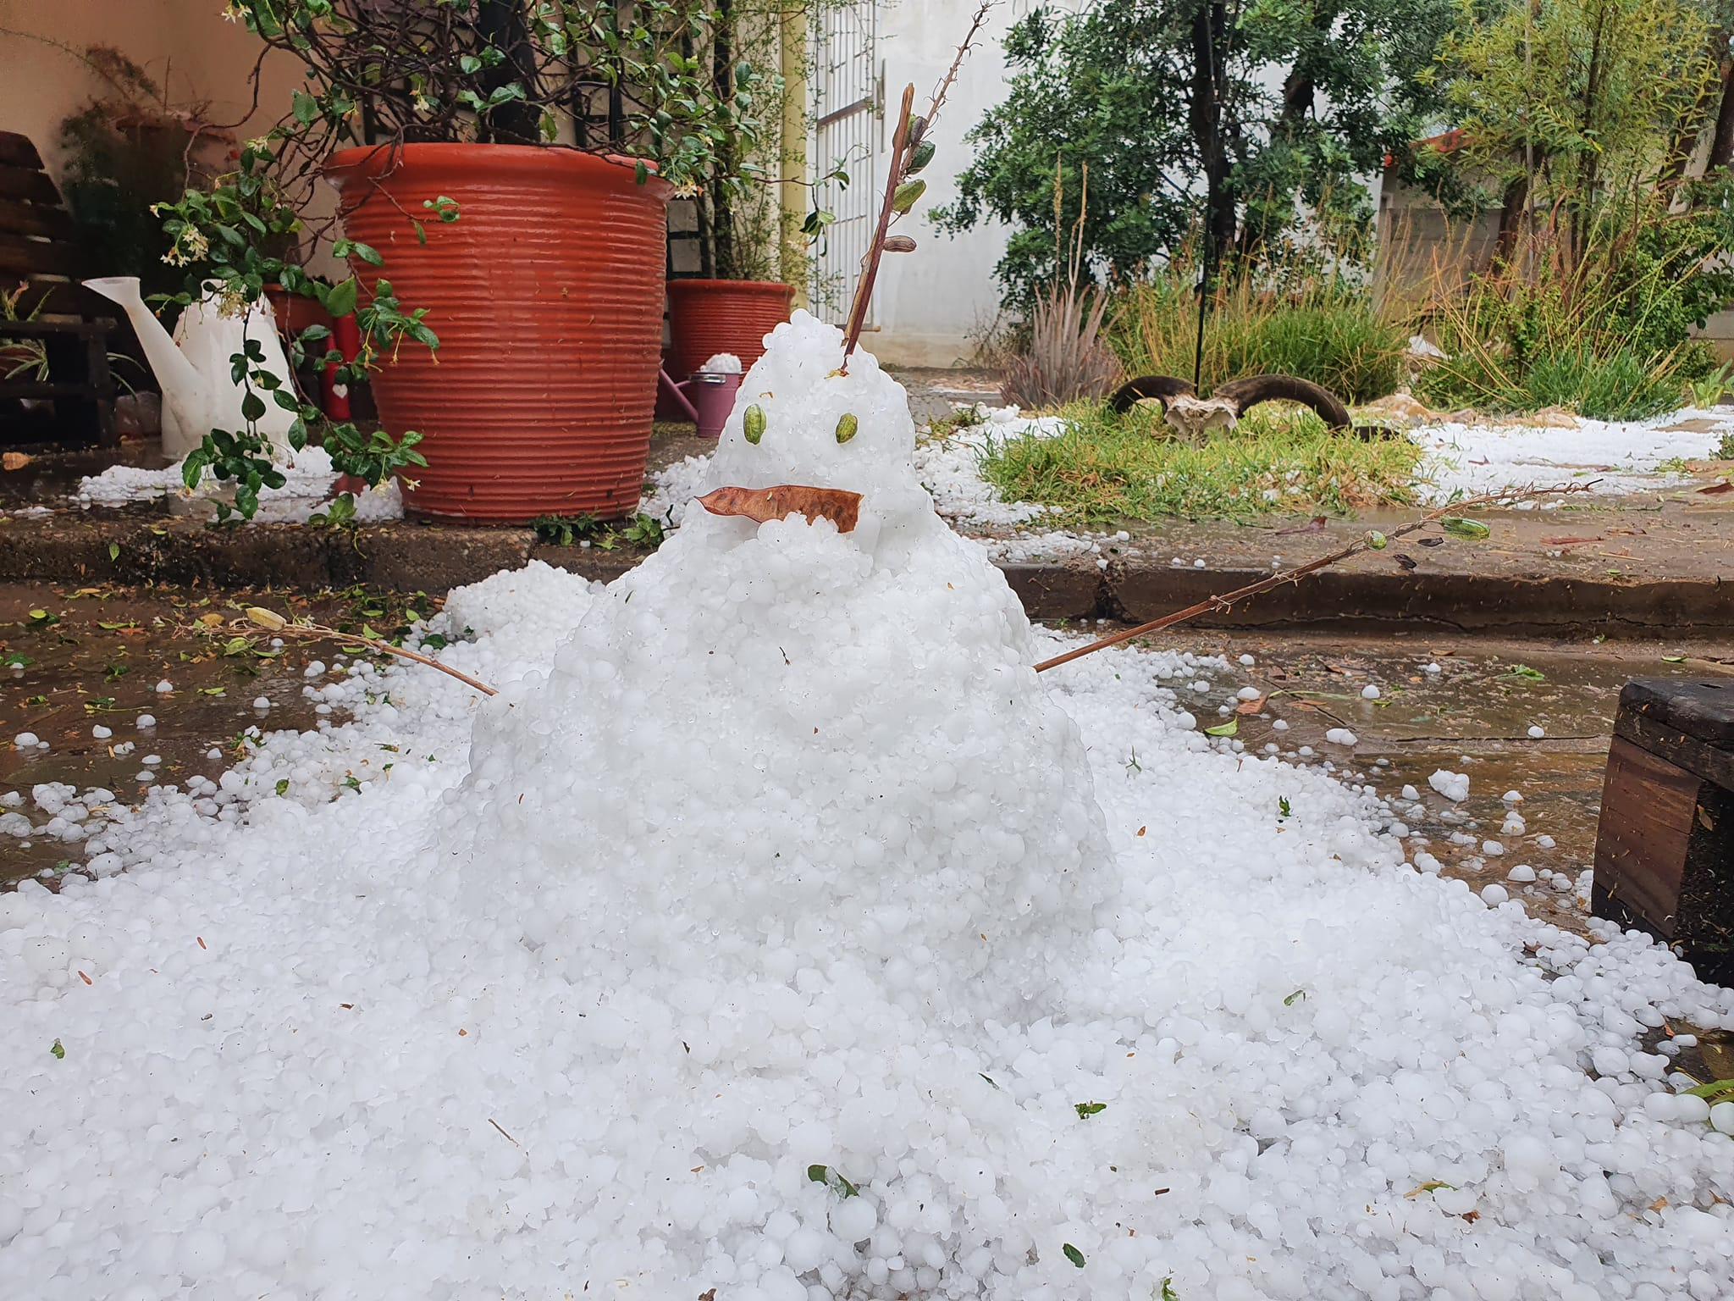
Welcome to Namibia! (16/10/2022)

Slide 2
Current Status and Future Impact of the Africa Millimetre Telescope
Michael Backes University of Namibia, Dept. of Physics, Chemistry & Material Science
North-West University, Centre for Space Research
Oct 2022

Slide 3
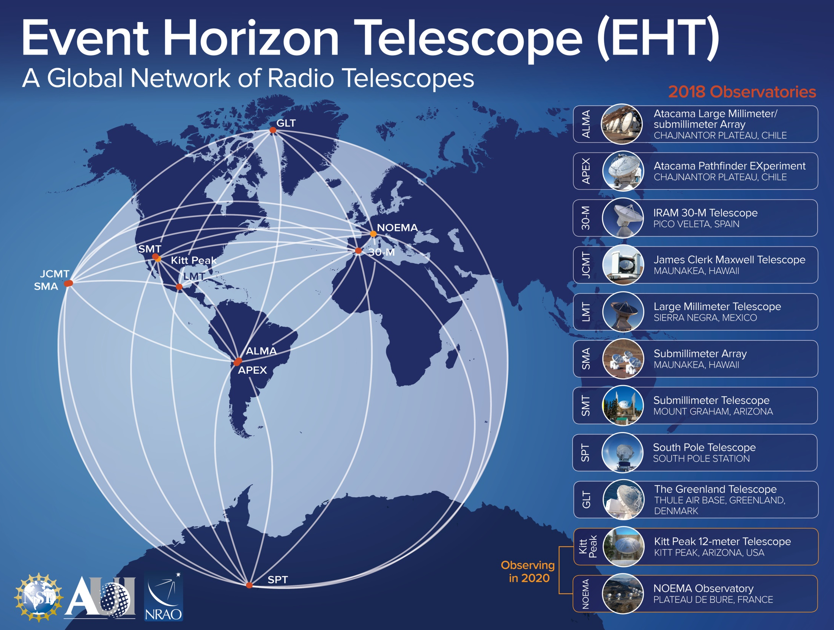
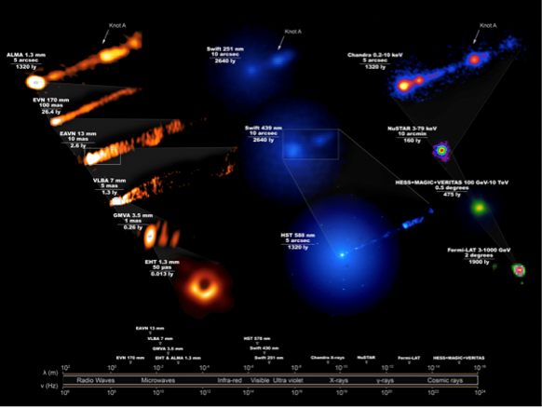
Event Horizon Telescope (also see SS13)
EHT: M87*
(2019)
EHT: Sgr A*
(2022)

Slide 4
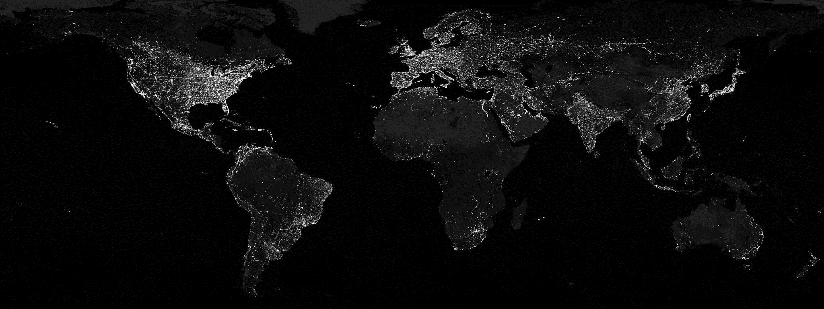
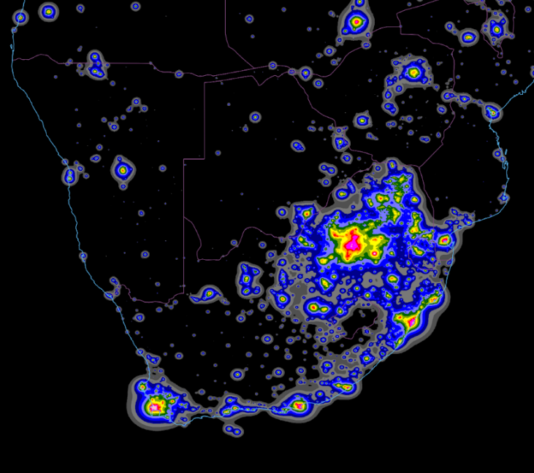
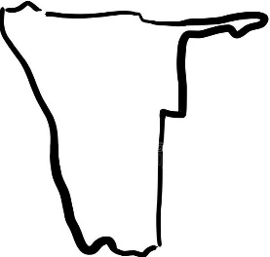
Why Astronomy in Southern Africa?
Dark skies
Dark skies
[Fabio Falchi, priv. com.]
Credit: J. Stevens (NASA Earth Observatory), M. Román (NASA Goddard Space Flight Center), Suomi NPP VIIRS

Slide 5
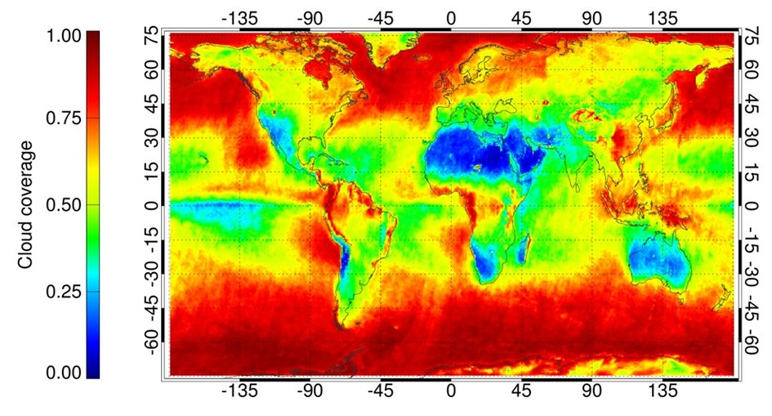
Why Astronomy in Southern Africa?
Average annual cloud cover
[http://www.esa.int/spaceinimages/Images/2013/09/Cloud_cover]

Slide 6
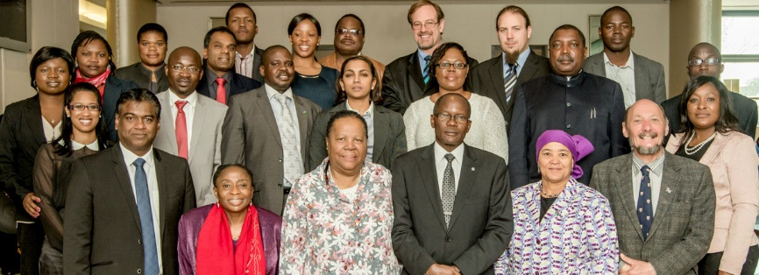
Why Astronomy in Southern Africa?
“Astronomy is one such disciplines where Africa enjoys a considerable comparative advantage, due to the excellent conditions for observation on our continent. (…) We must exploit this geographic advantage for the maximum benefit of our people.”
Hon. Naledi Pandor
(then) Minister of Science and Technology (RSA)
Windhoek, 12 August 2014

Slide 7
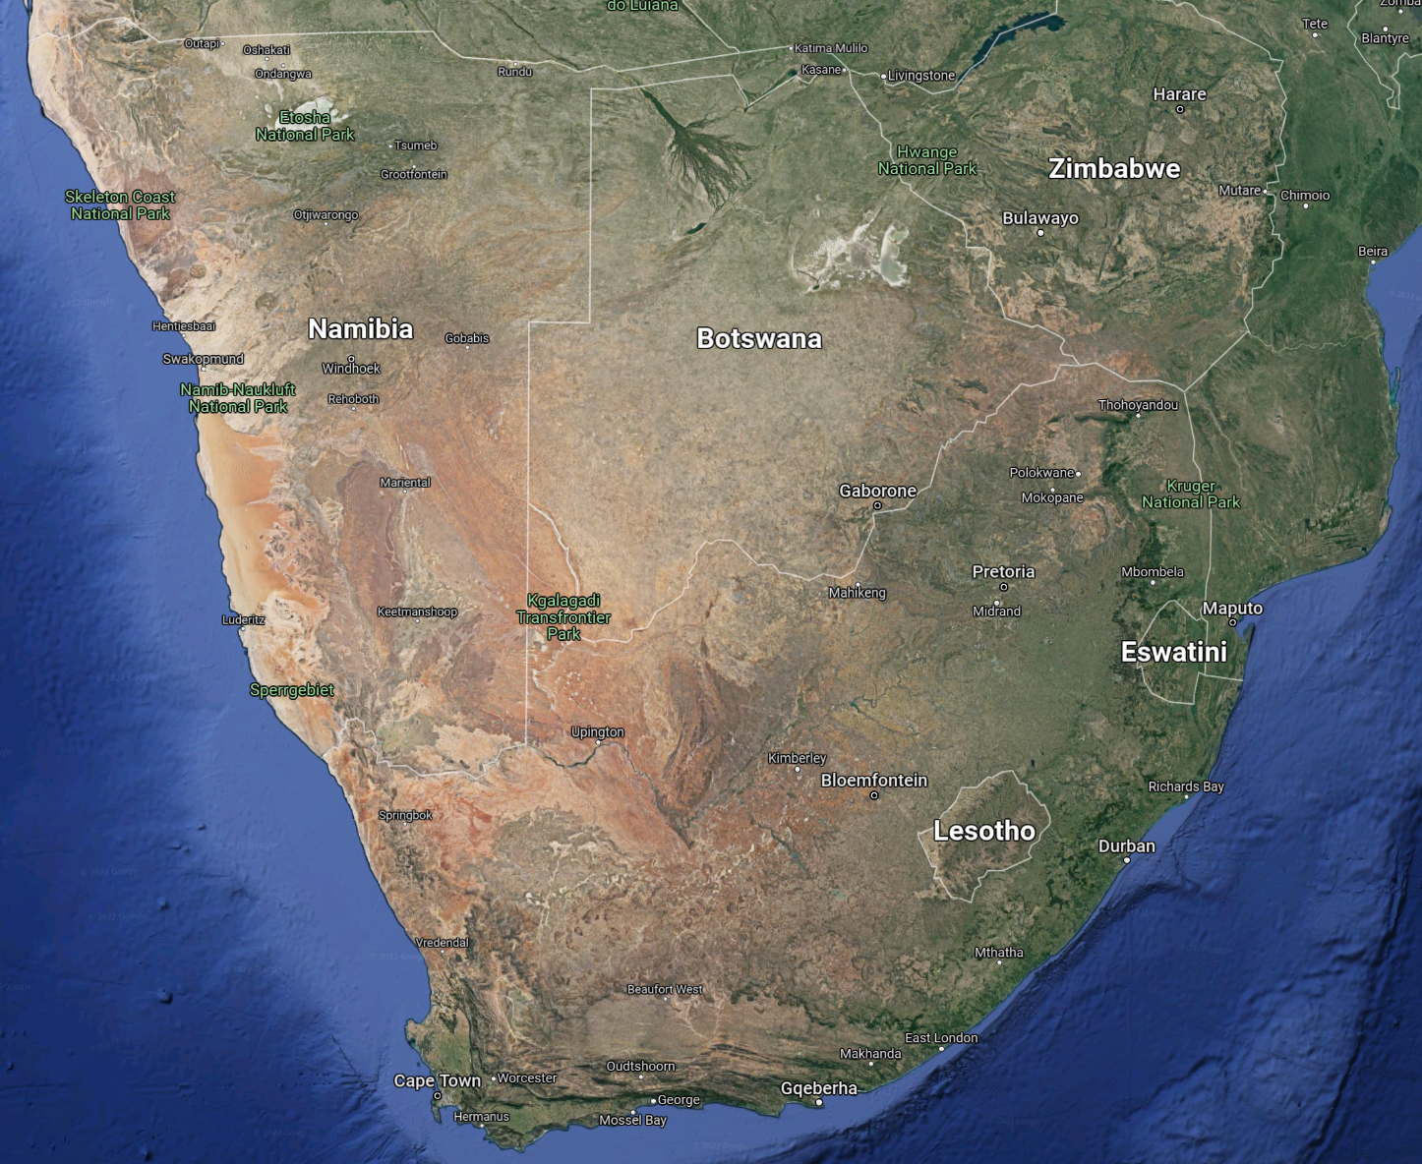
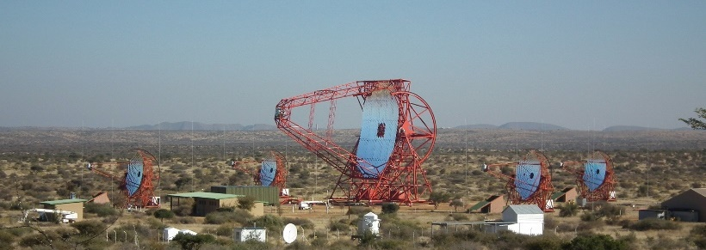
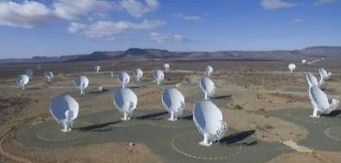
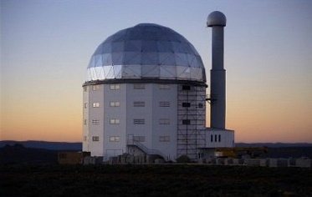
Astronomy in Southern Africa
H.E.S.S.
H.E.S.S.
Mt. Gamsberg
MeerKAT
SALT

Slide 8
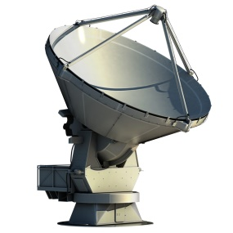
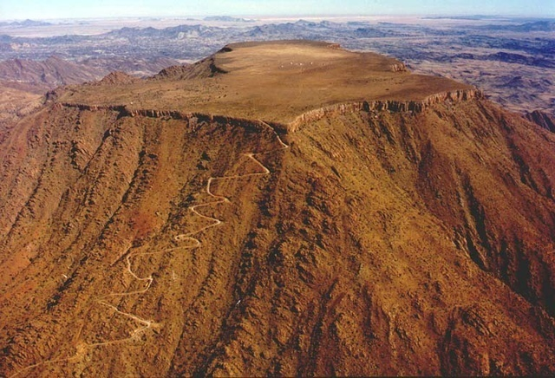
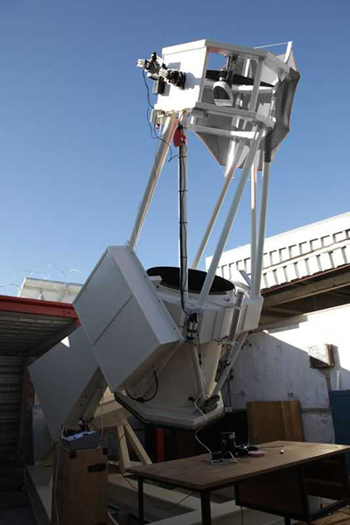
Mt. Gamsberg (2,347 m)
(not to scale!)
71cm International Amateur Observatory (IAS)

Slide 9
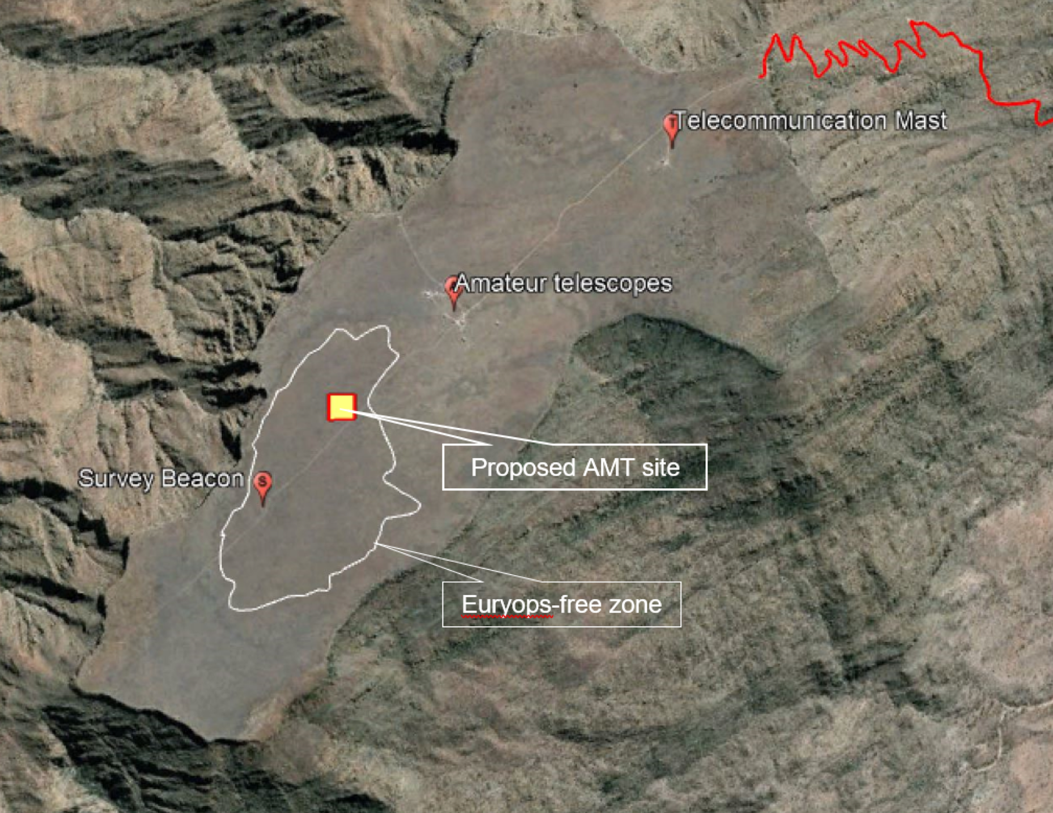
Mt. Gamsberg (2,347 m)

Slide 10
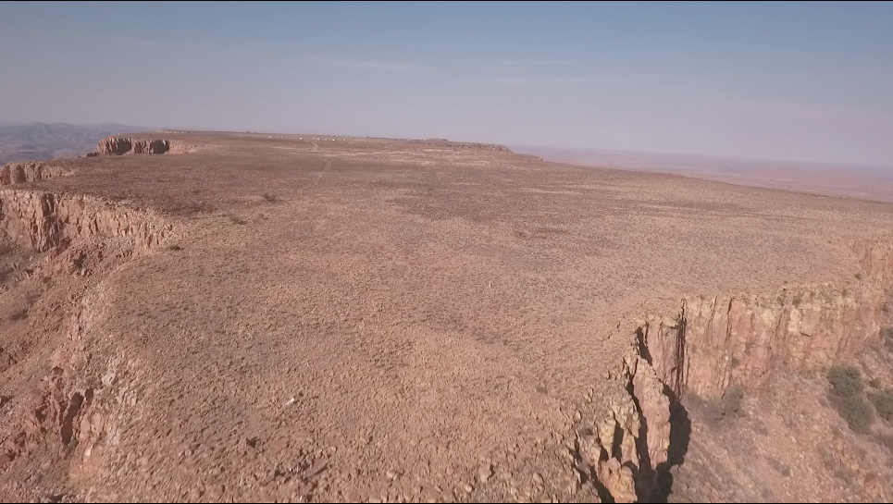
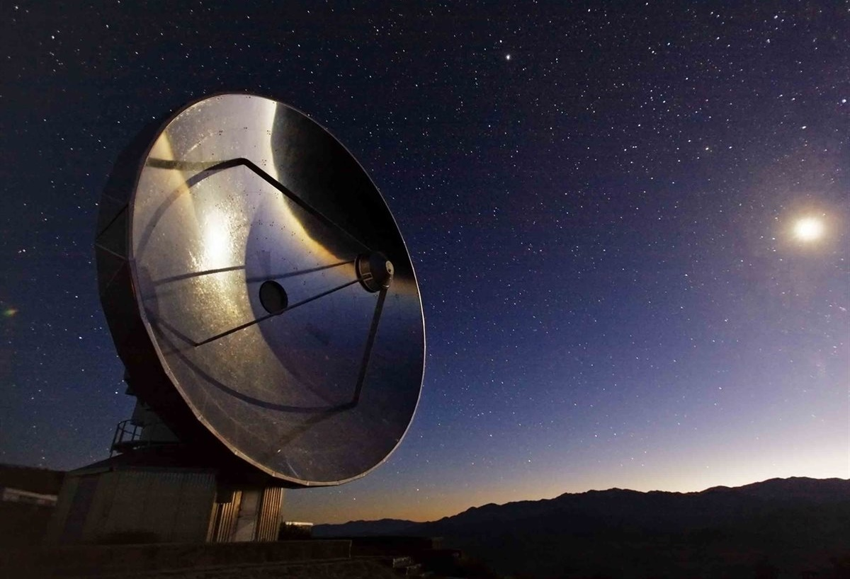
Africa Millimetre Telescope (AMT)
[Backes⁺ PoS(HEASA2016)029, Backes⁺ Galaxies 7(2019)66]
PI: Heino Falcke
Co-PI: M. Backes
Director: Marc Klein Wolt
Site quality being tested
SEST to be refurbished (electronics, surface acc., sun avoidance, etc.)
Preliminary Design Review passed in mid-2019
Int. Science Committee formed (RU, UNAM, Wits, NWU, Metsähovi , Turku, Oxford, CEA, ASTRON, Grenoble Alpes, MIT, …)
SEST @ ESO
European Research Council

Slide 11
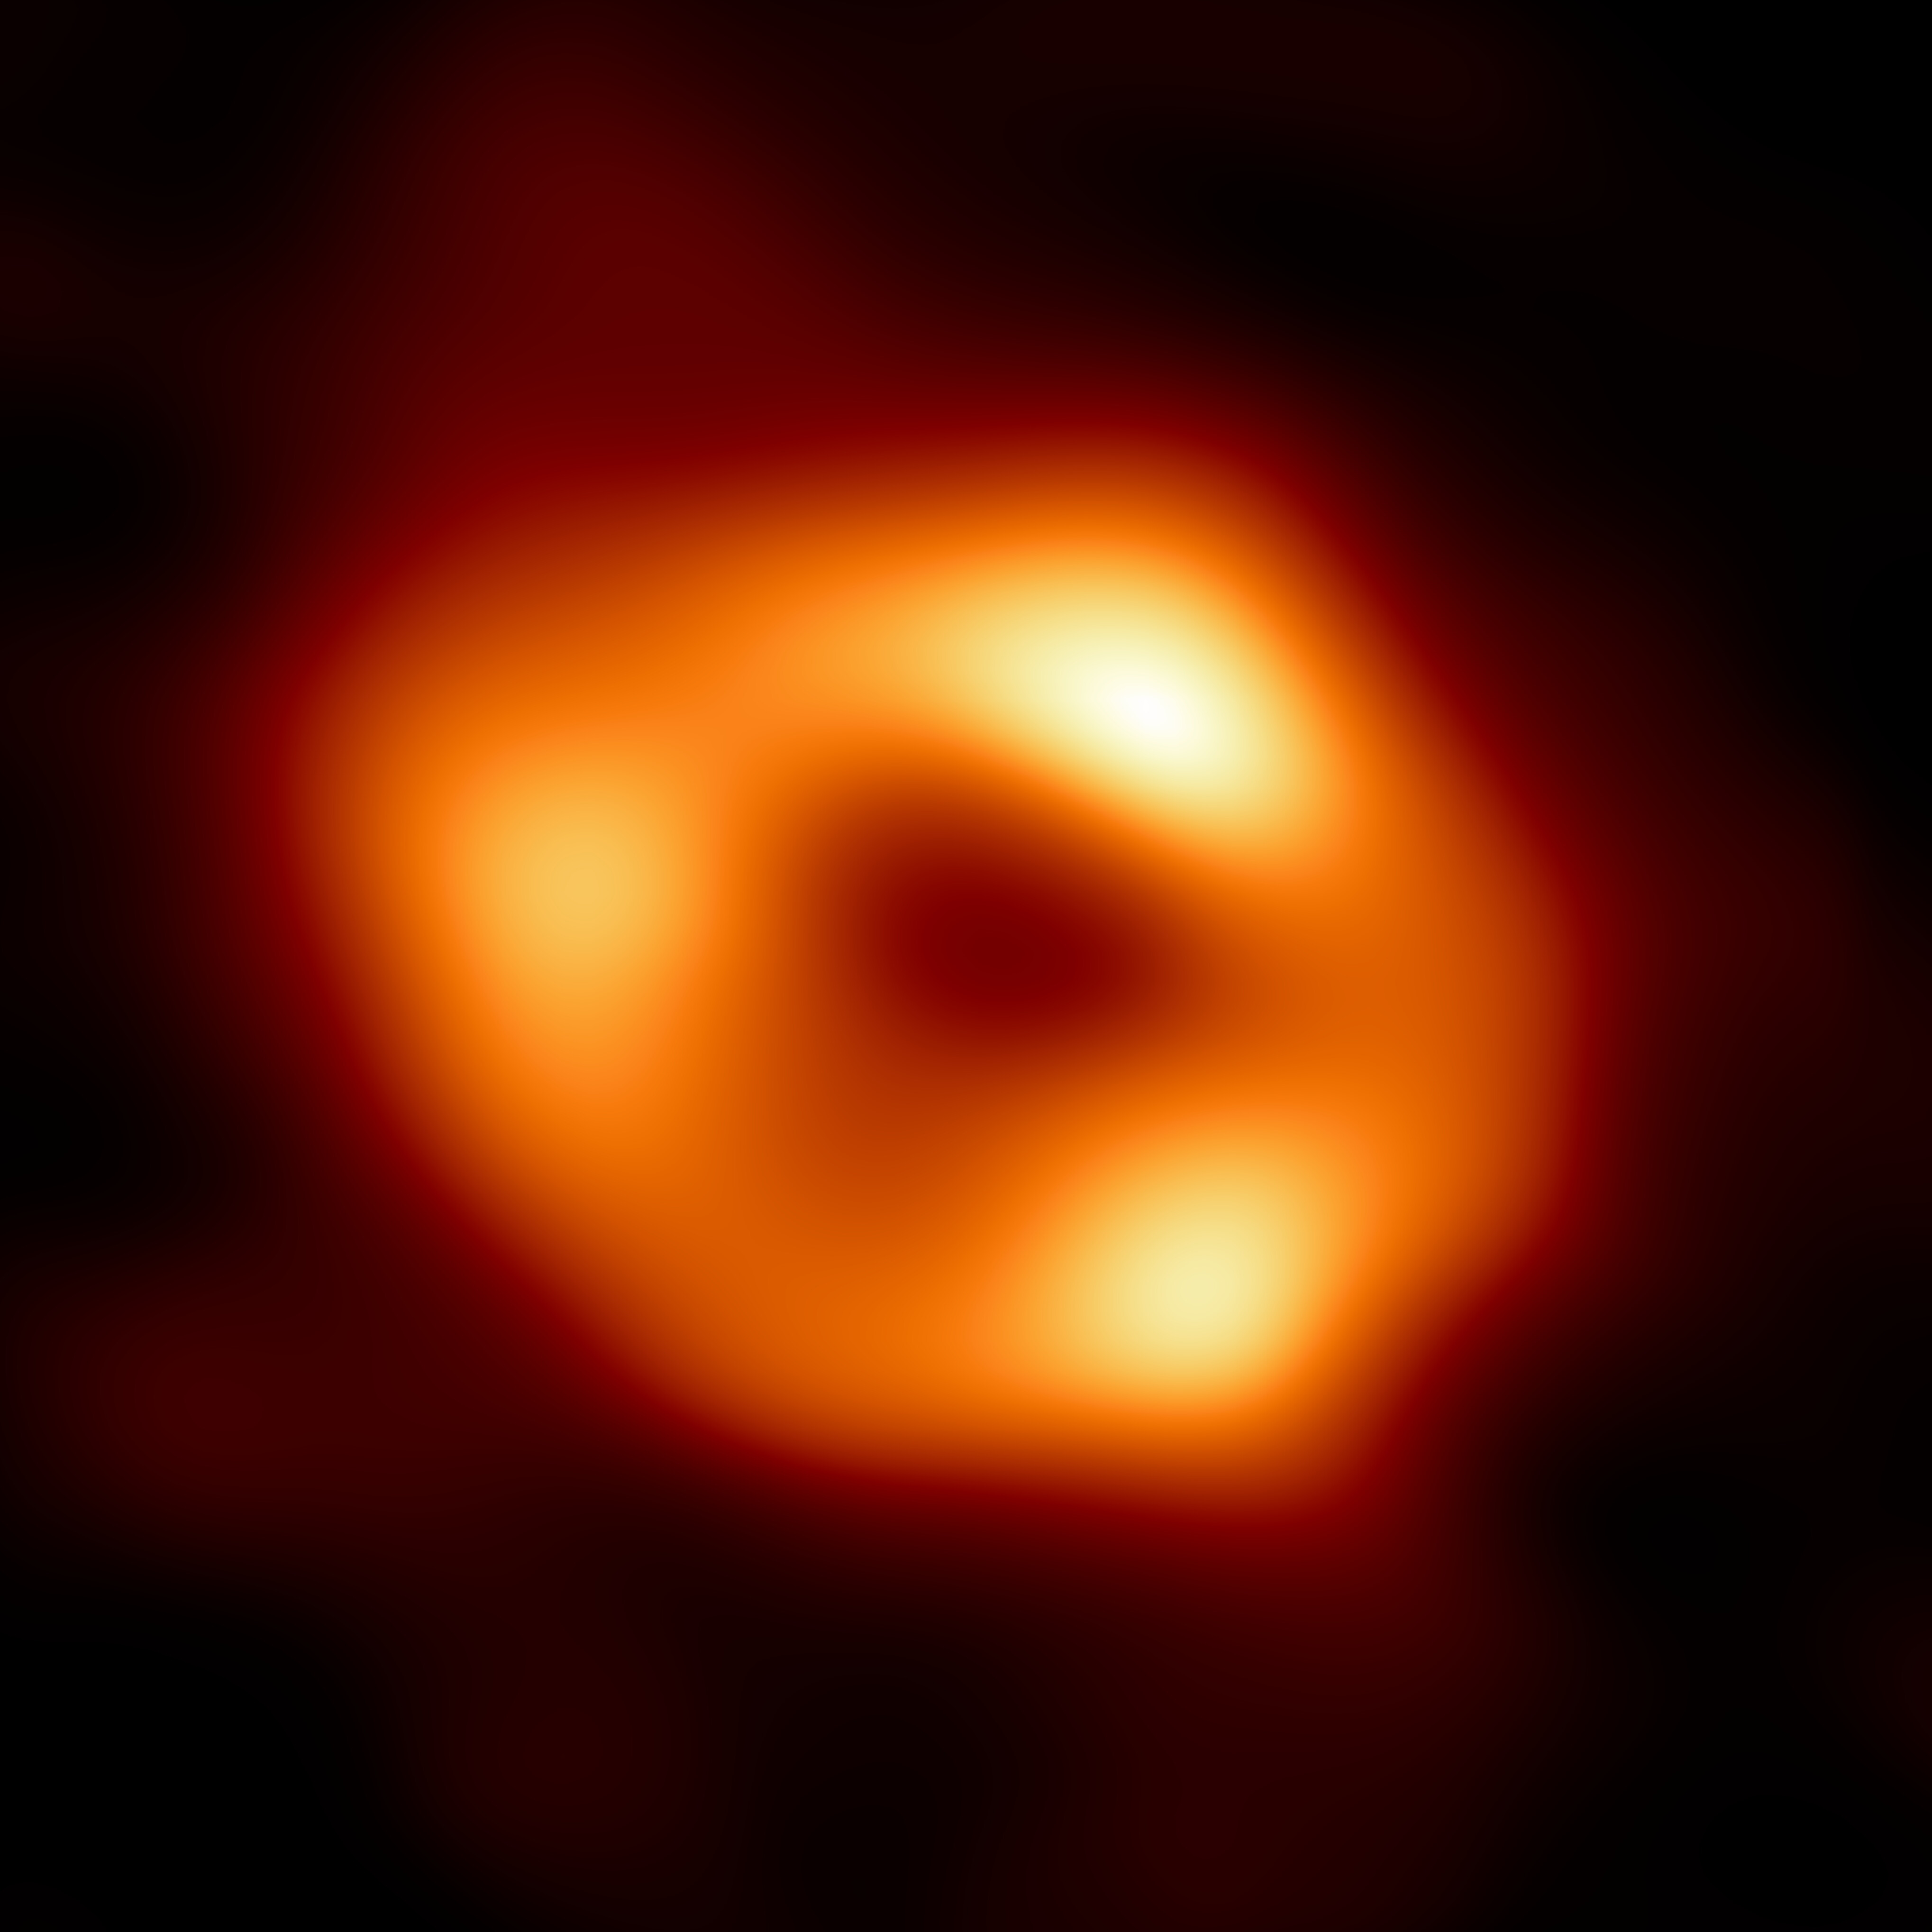
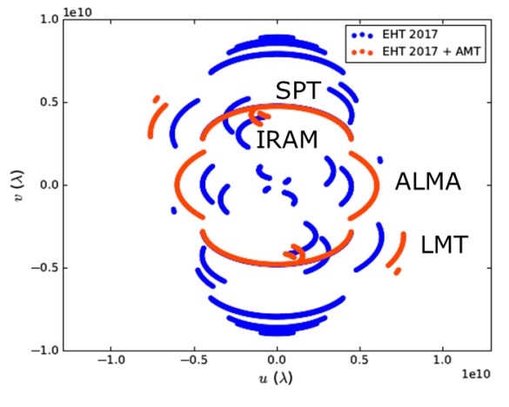
Africa Millimetre Telescope (AMT)
[Backes⁺ PoS(HEASA2016)029, Backes⁺ Galaxies 7(2019)66]
Earth as seen from Sgr A*

Slide 12
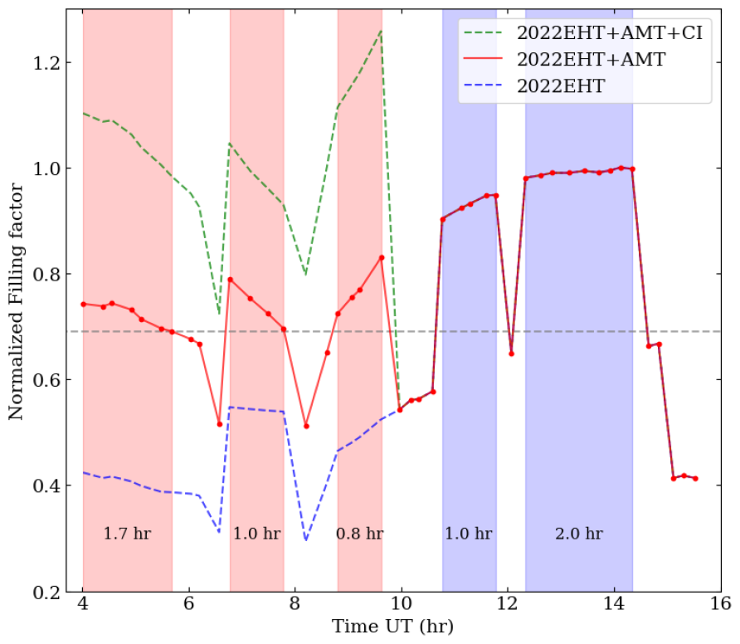
EHT + AMT imaging
[Backes⁺ PoS(HEASA2016)029, Backes⁺ Galaxies 7(2019)66], [La Bella⁺ (2022), in prep.]
Earth as seen from Sgr A*
×
Work in preparation. No pictures, no tweets!

Slide 13
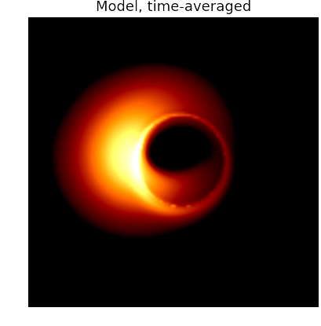
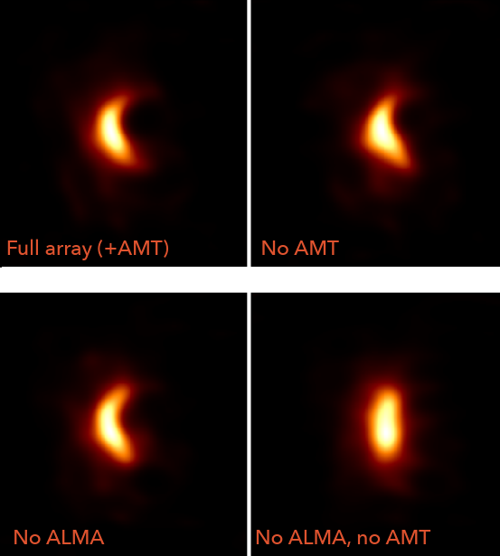
EHT + AMT imaging II
[Freek Roehlofs, Radboud Univ.]
No ALMA
No AMT, No ALMA

Slide 14
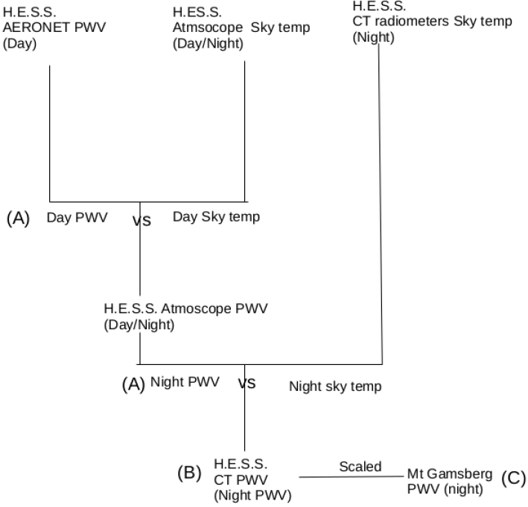
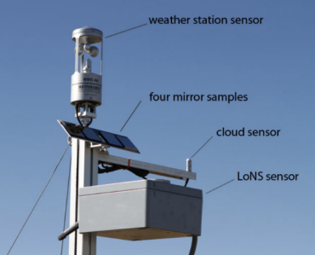
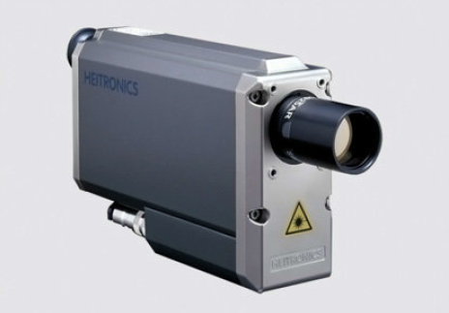
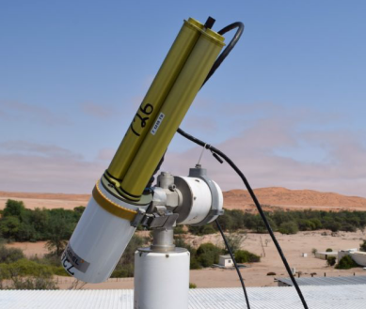
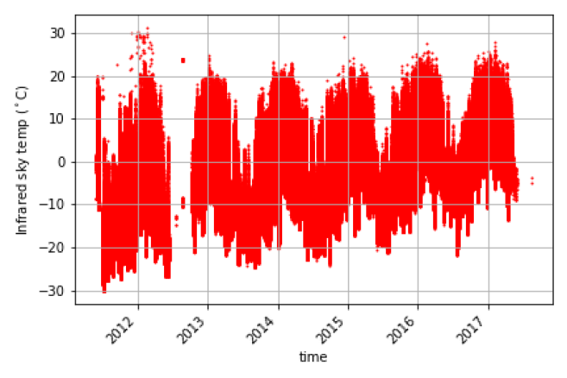
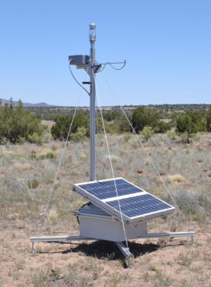
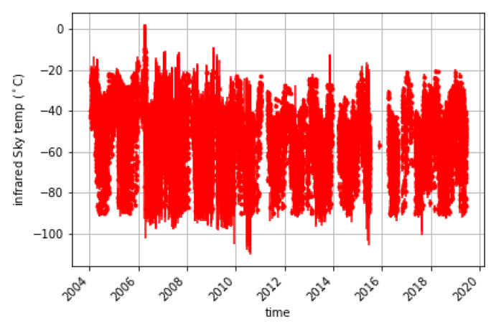
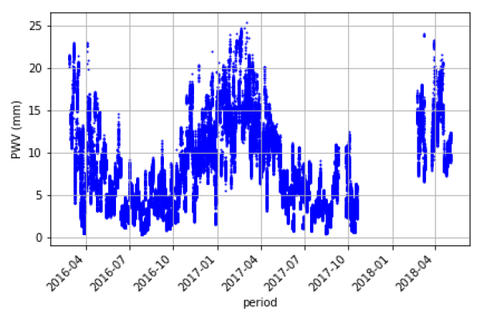
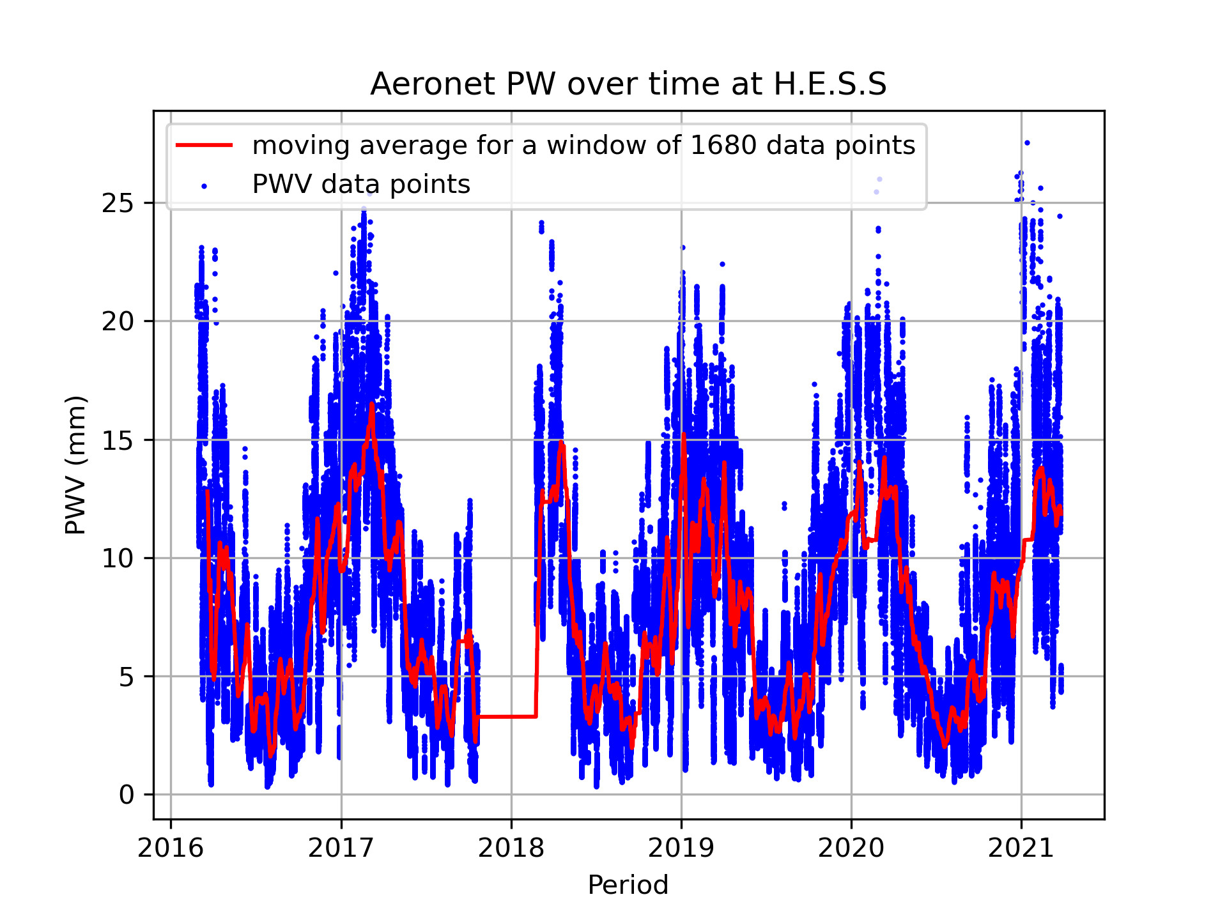
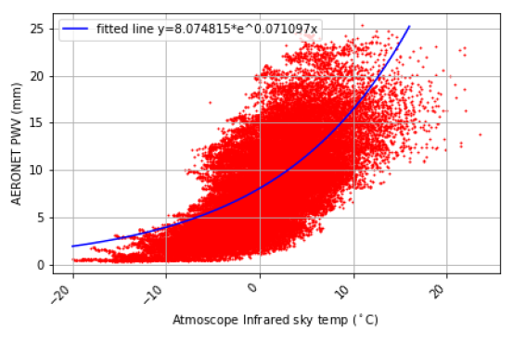
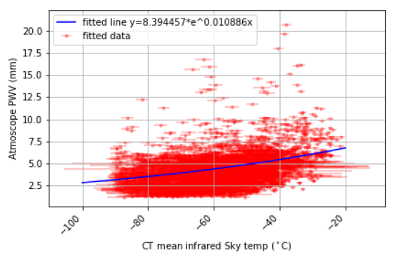
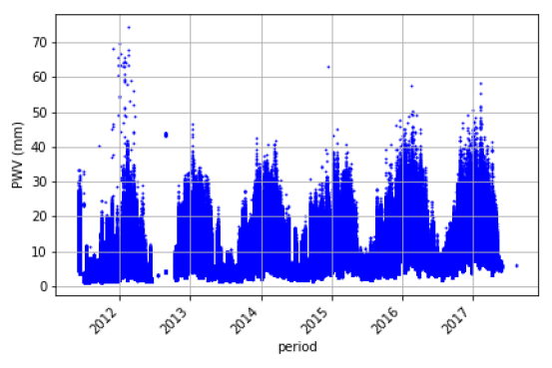
Precipitable Water Vapour I
Lott Frans

Slide 15
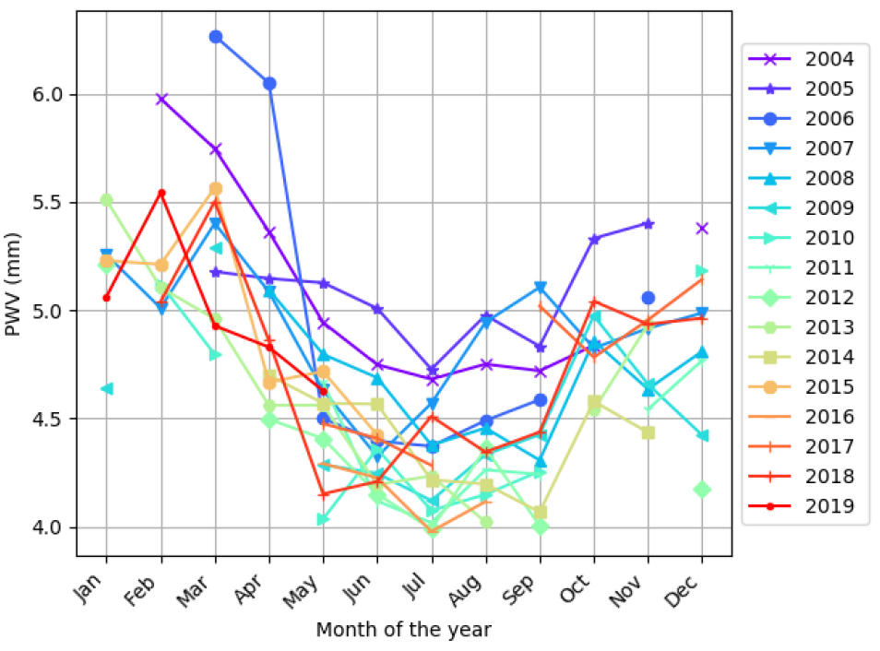
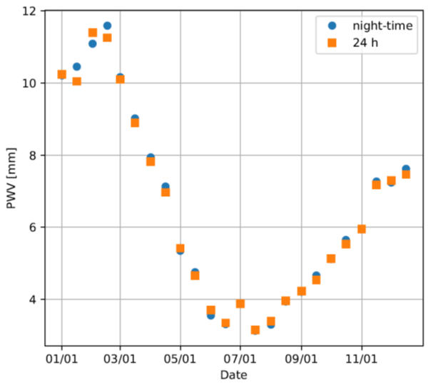
Precipitable Water Vapour II
Lott Frans
Indirect ground measurements
Scaled satellite-based model

Slide 16
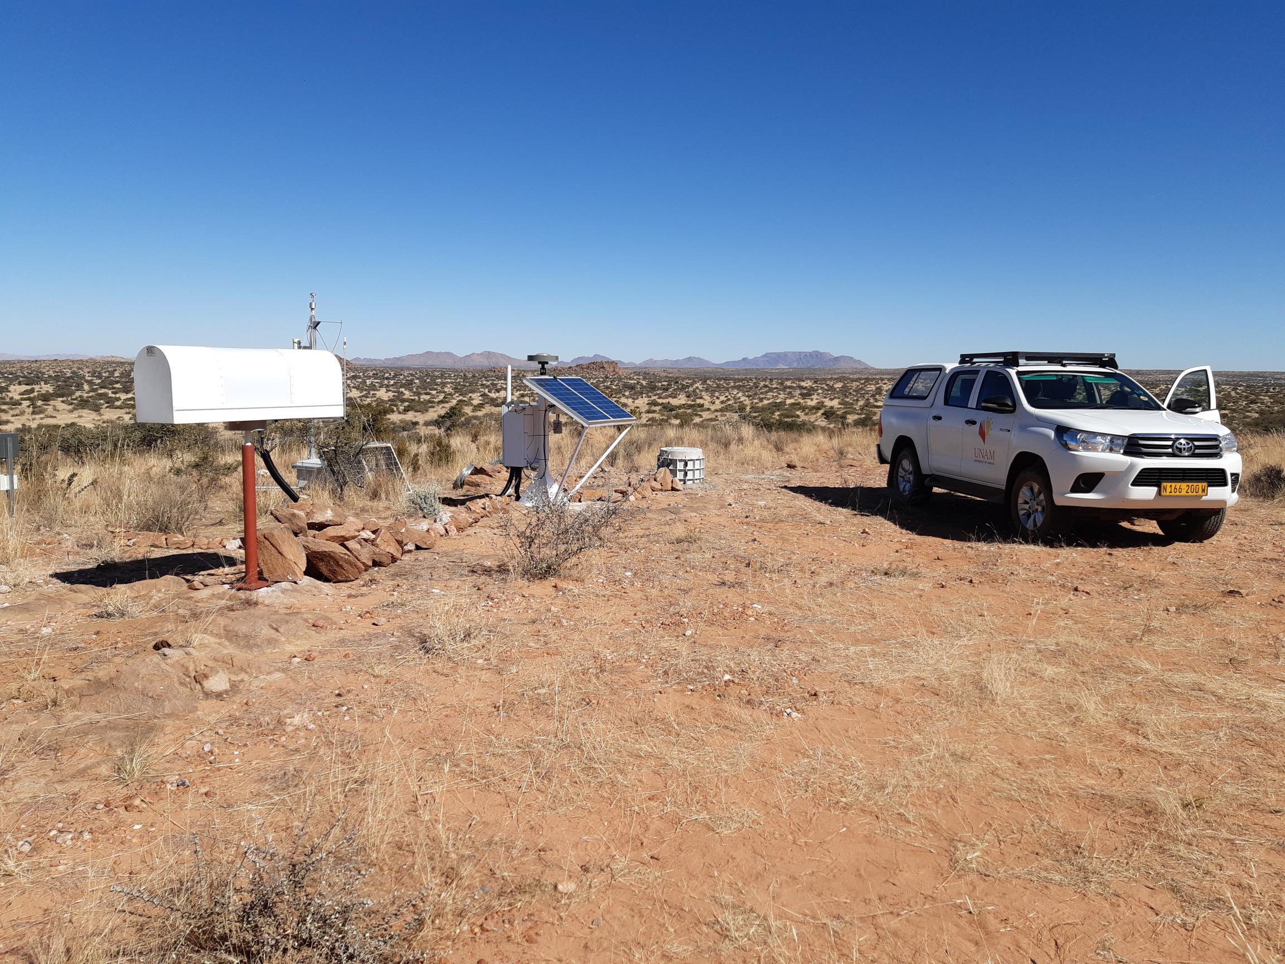
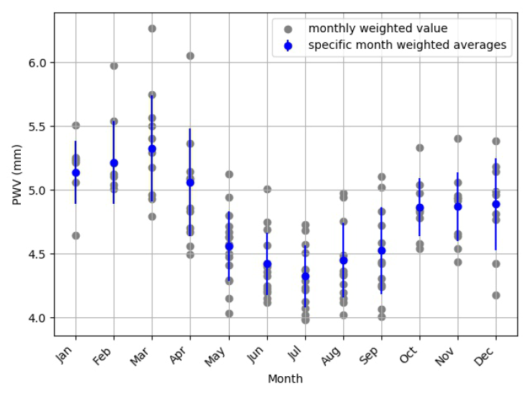
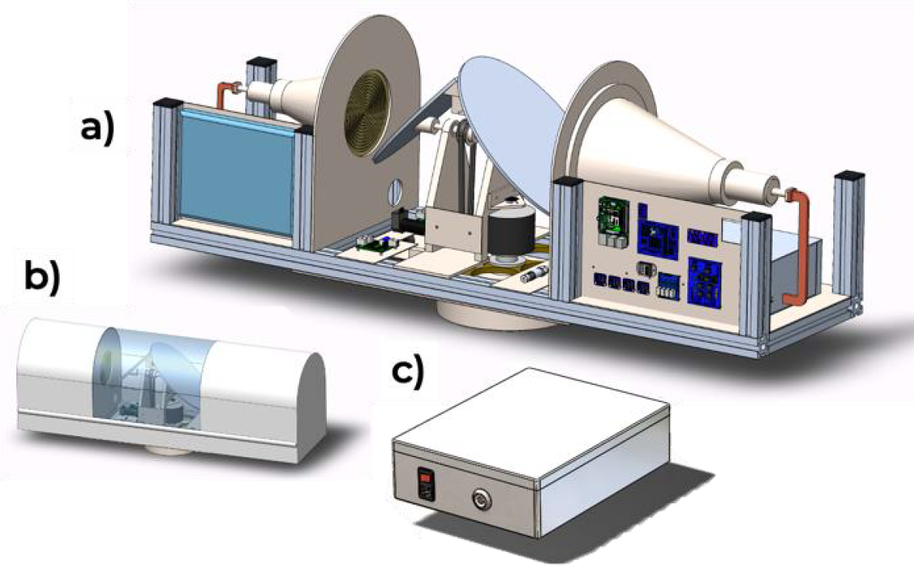
Site Testing: Precipitable Water Vapour
[L. Frans, MSc: https://repository.unam.edu.na/handle/11070/2766]
Indirect ground measurements
Scaled satellite-based model
Thermopile (indirect)
WV radiometer
GNSS receiver

Slide 17
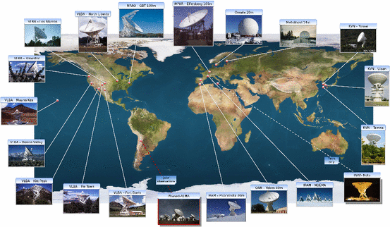
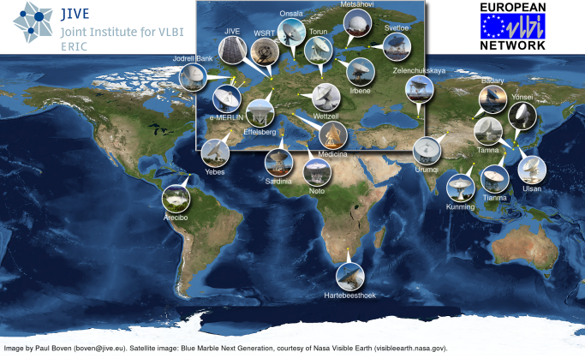
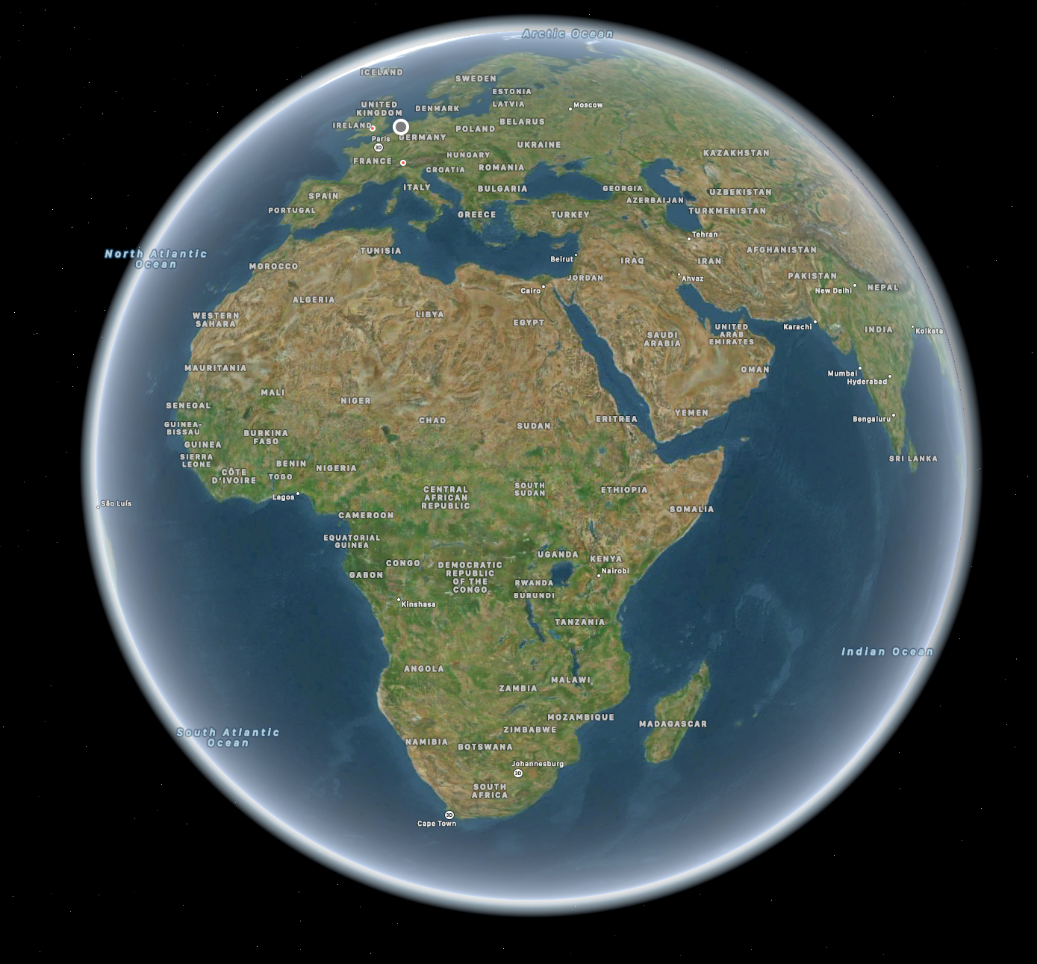
AMT Science Cases
VLBI
1mm Event Horizon Telescope (EHT) VLBI
3mm Global mm-VLBI Array (GMVA)
[7mm European VLBI Network (EVN)]
[6cm Africa VLBI Network (AVN)]
Single dish
Monitoring of Active Galactic Nuclei
mm transients

Slide 18
AMT Science Cases
VLBI
1mm Event Horizon Telescope (EHT) VLBI
3mm Global mm-VLBI Array (GMVA)
[6cm Africa VLBI Network (AVN)]
Single dish
Monitoring of Active Galactic Nuclei
mm transients

Slide 19
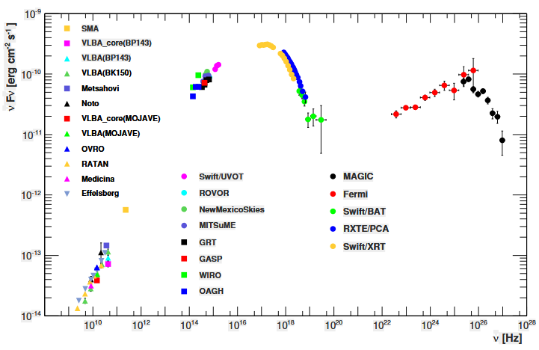
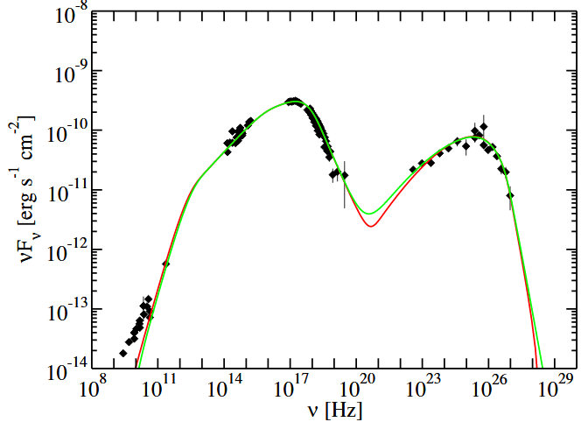
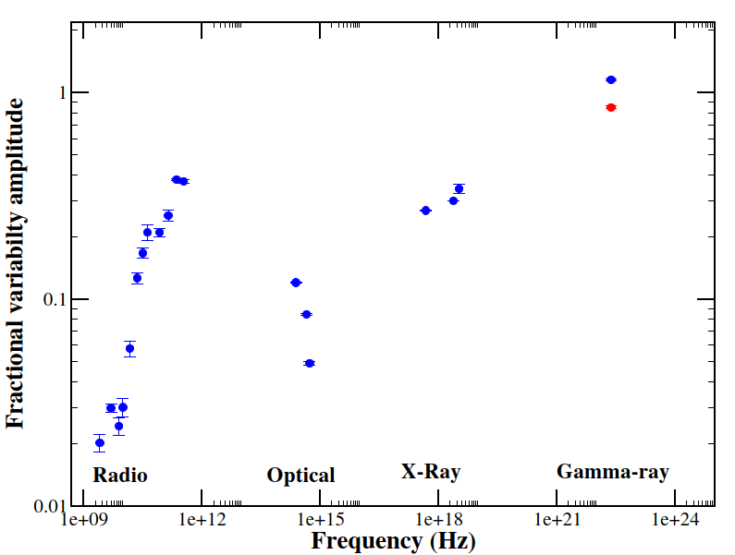
Monitoring of Blazars
Abdo et al., APJ 736:131 (2011)
[Chidiac et al., A&A 590, A61 (2016)]
Multi-wavelength monitoring with AMT - mm-radio - Gamma Rays - Xray - nearIR (together with H.E.S.S., CTA, MAGIC, JWST, Chandra) at < weekly cadence over years to test detailed particle physics models + campaigns

Slide 20
AMT Science Cases
VLBI
1mm Event Horizon Telescope (EHT) VLBI
3mm Global mm-VLBI Array (GMVA)
[6cm Africa VLBI Network (AVN)]
Single dish
Monitoring of Active Galactic Nuclei
mm transients

Slide 21
mm transients
Unique mm-Transients facility: single dish detection of few mJy within minutes at 3mm (submm leads cm radio!) can trigger SKA/VLBI/EHT, also the EHT/AMT can even image XRBs & Namibian node to the AVN and connection to EVN
Figure 1: Comparison of mm-wave and cm-wave frequencies of the outburst in the X-ray binary V404 Cygni (R. Fender, based on Tetarenko, A. J. et al. 2017, MNRAS 469, p. 3141). Outbursts are much more pronounced at mm-waves.

Slide 22
mm transients detection rate for AMT
Table 1: Estimated number of transient sources detectable by the AMT for a 5 mJy limit, based on standard lightcurve evolution models from Eftekhari, T. et al. (2022, ApJ 935, p. 16).

Slide 23
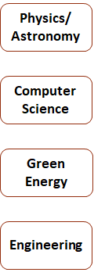
AMT: Social Impact programme I

Slide 24
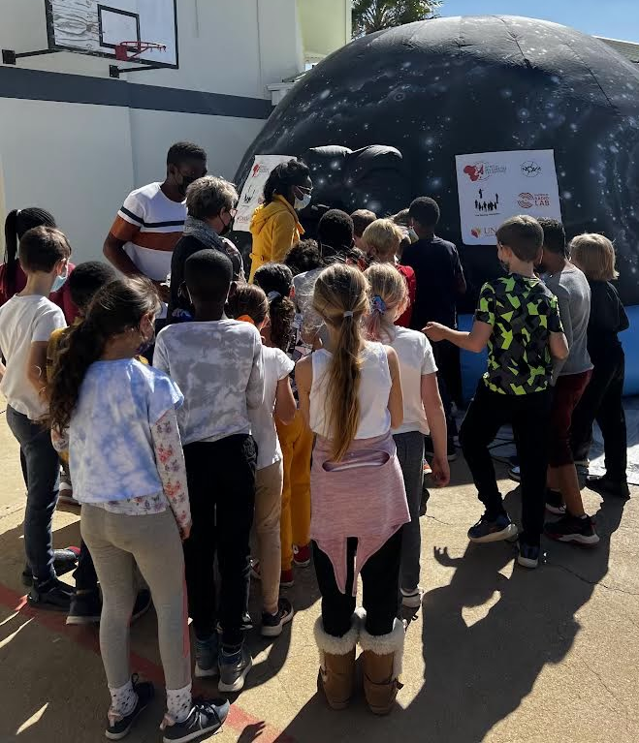
AMT: Social Impact programme II
Mobile planetarium to every school in Namibia
Training teachers in astronomy
Providing low cost and durable astronomy resources to schools

Slide 25
AMT: Social Impact programme III
Thermopile (indirect)
WV radiometer
GNSS receiver
Lott Frans
1st AMT PhD Fellowship (from 2022)
supported by
- Radboud University
- Univ. of Amsterdam
- INAF IRA
- JIVE
- Univ. of Namibia

Slide 26
AMT in the Media
https://www.popsci.com/space/africa-millimeter-telescope-astronomy/
Full array with AMT
No AMT
No ALMA
No AMT, No ALMA
[DOI: 10.1038/d41586-022-00205-4]

Slide 27
AMT in the Media

Slide 28
AMT: Support

Slide 29
Further supported by members of
Metsähovi Radio Observatory

Slide 30
Thank You

