Slide 1
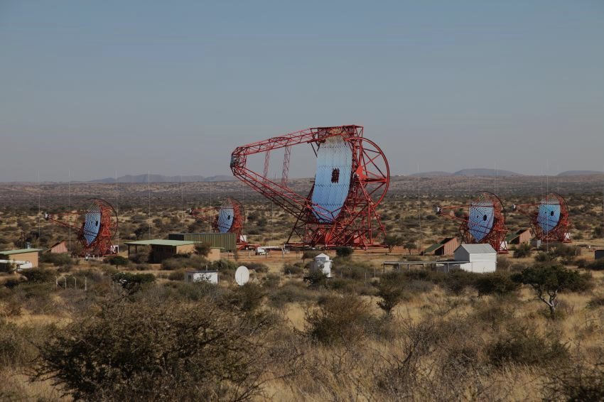



The Physics of AGN Jets
0
Markus Böttcher
North-West University
Potchefstroom
South Africa
Supported by the South African Research Chairs Initiative (SARChI) of the Department of Science and Innovation and the National Research Foundation of South Africa (grant no. 64789).

Slide 2
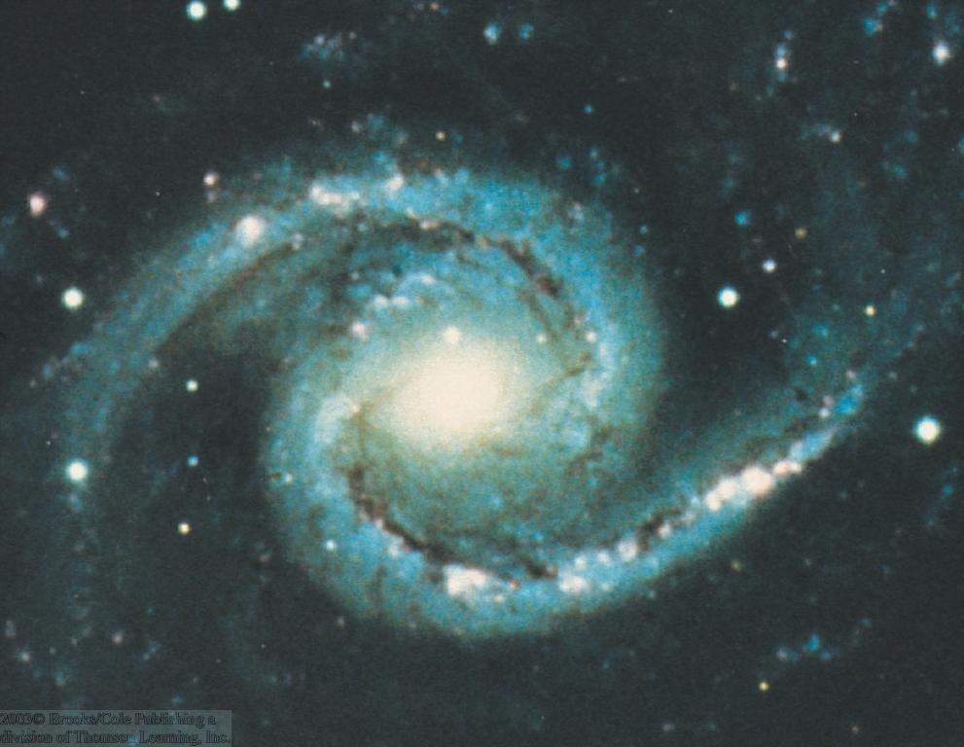
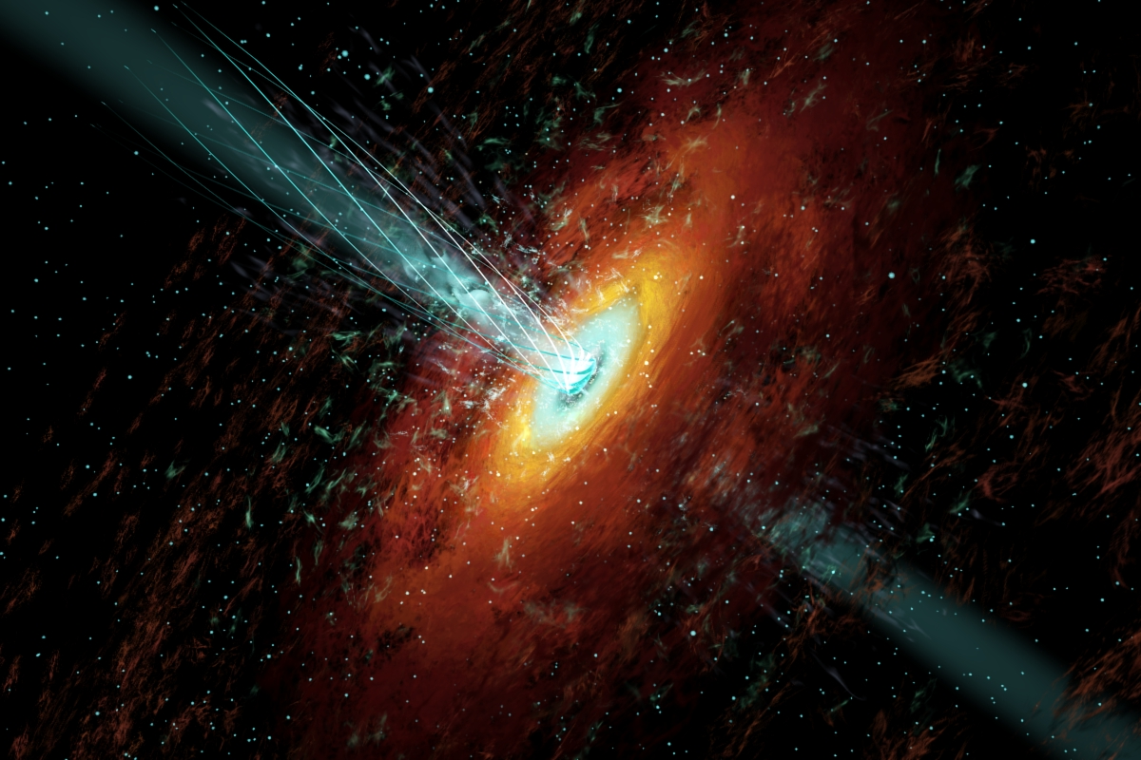
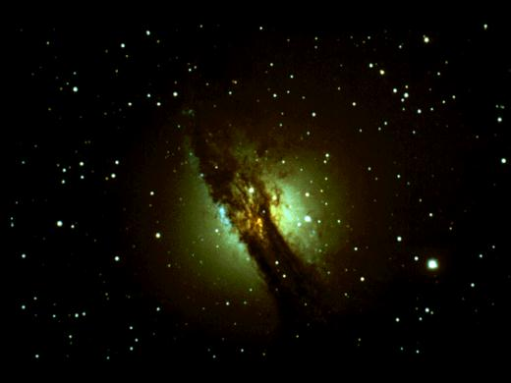
Active Galactic Nuclei (AGN)
0
Nuclei of galaxies with peculiar properties:
Extremely bright nuclei
Variability
High-Energy (X-/γ-ray) emission
Emission lines
Polarization
Relativistic outflows (jets)

Slide 3
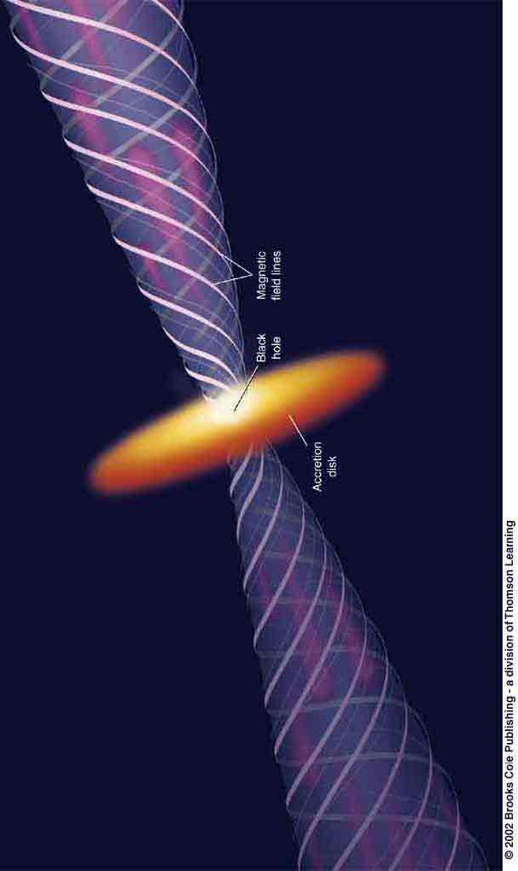
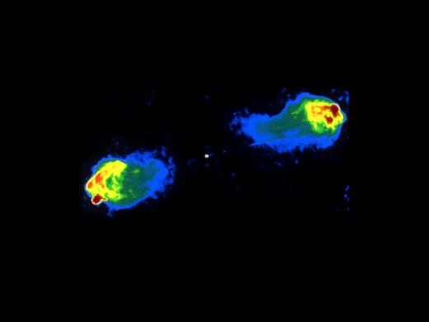
Types of radio-loud AGN and
AGN Unification
0
Observing direction
Cyg A (radio)
Radio Galaxy:
Powerful radio lobes at the end points of the jets, where kinetic jet power is dissipated.

Slide 4
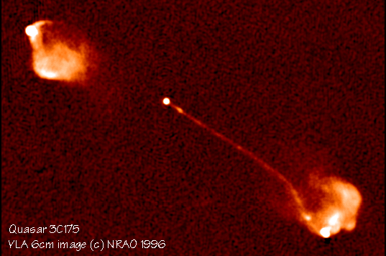
Types of radio-loud AGN and
AGN Unification
0
Flat-Spectrum Radio Quasar or BL Lac object
Emission from the jet pointing towards us is Doppler boosted compared to the jet moving in the other direction (“counter jet”).
Observing direction

Slide 5
Blazars
0
Class of AGN consisting of BL Lac objects and gamma-ray bright quasars with relativistic jets pointing close to our line of sight
Rapidly (often intra-day) variable
Strong gamma-ray sources
Radio knots often with superluminal motion
Radio and optical (and X-ray?) polarization

Slide 6
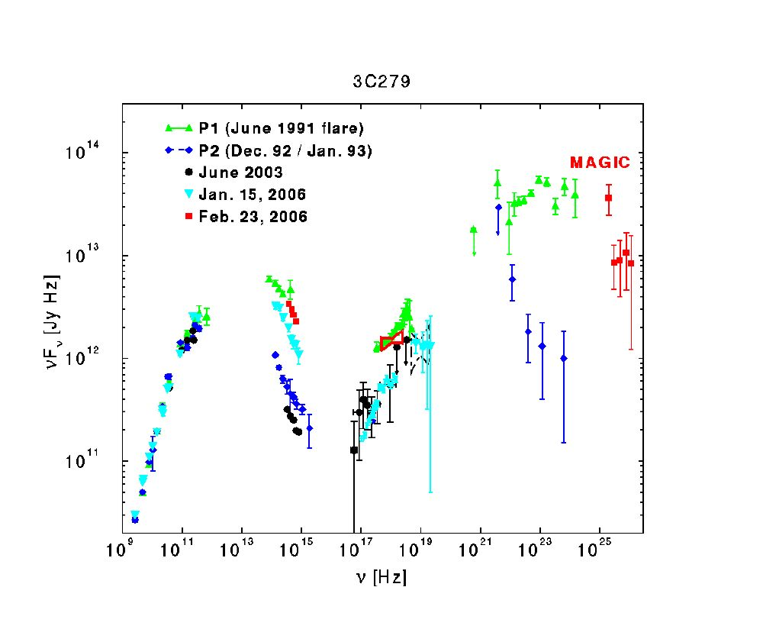
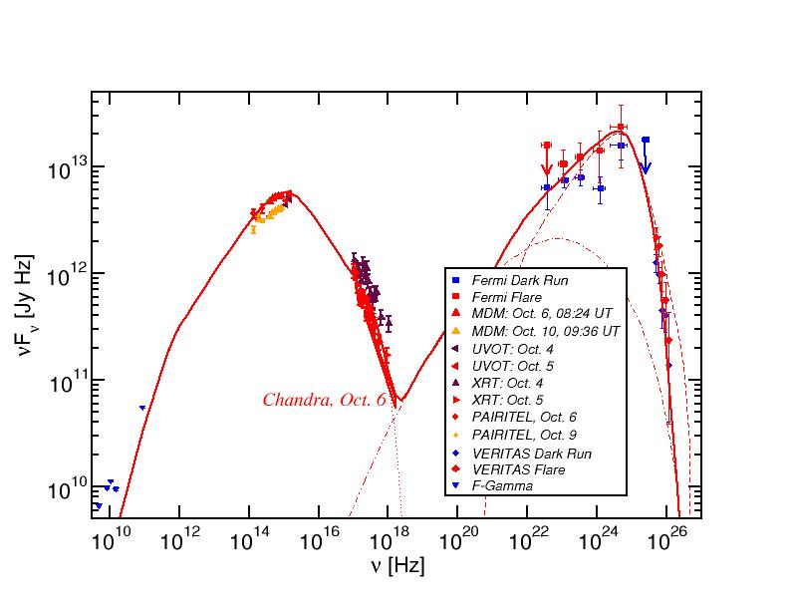
Blazar Spectral Energy Distributions (SEDs)
3C66A
Non-thermal spectra with two broad bumps:
Low-energy (probably synchrotron):
radio-IR-optical(-UV-X-rays)
High-energy (X-ray – γ-rays)

Slide 7
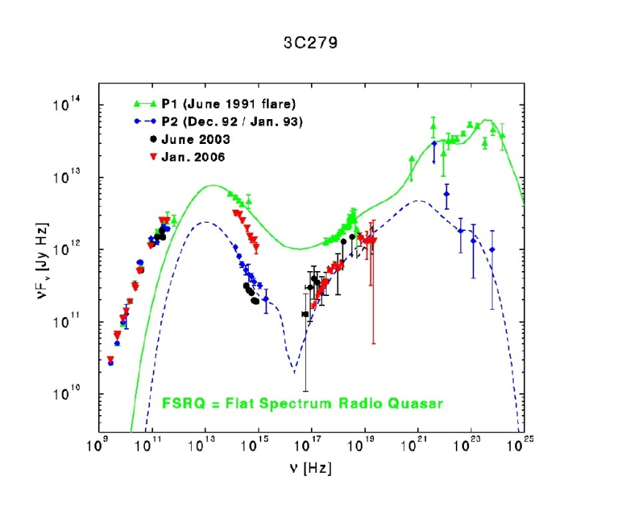
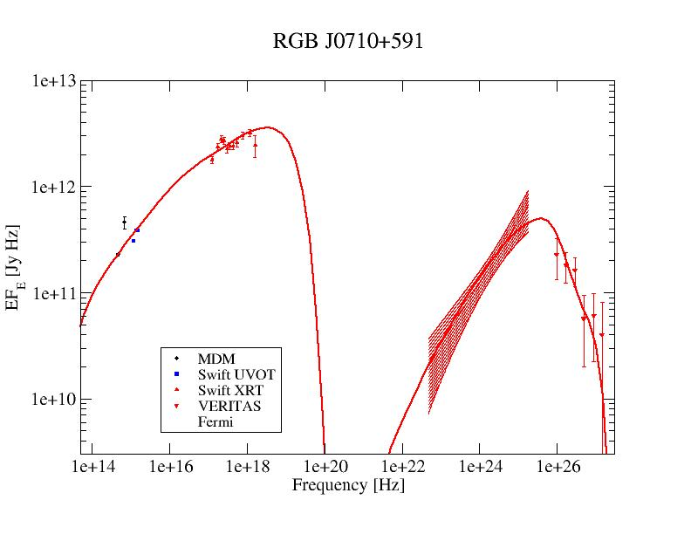
Blazar Classification
0
3C66A
(Abdo et al. 2011)
(Acciari et al. 2009)
(Hartman et al. 2000)
High-Synchrotron Peaked (HSP): High-frequency peaked BL Lacs (HBLs):
Low-frequency component from radio to UV/X-rays,
ν_{sy} > 10¹⁵ Hz
often dominating the total power
High-frequency component from hard X-rays to high-energy gamma-rays
Low-Synchrotron Peaked (LSP): Quasars (FSRQs)/ Low-frequency peaked BL Lac Objects (LBLs)
Low-frequency component from radio to optical/UV,
ν_{sy} ≤ 10¹⁴ Hz
High-frequency component from X-rays to γ-rays, often dominating total power
Intermediate-Synchrotron Peaked (ISP): Intermediate BL Lacs (IBLs):
Peak frequencies at IR/Optical and GeV gamma-rays,
10¹⁴ Hz < ν_{sy} ≤ 10¹⁵ Hz
Intermediate overall luminosity
Sometimes γ-ray dominated

Slide 8
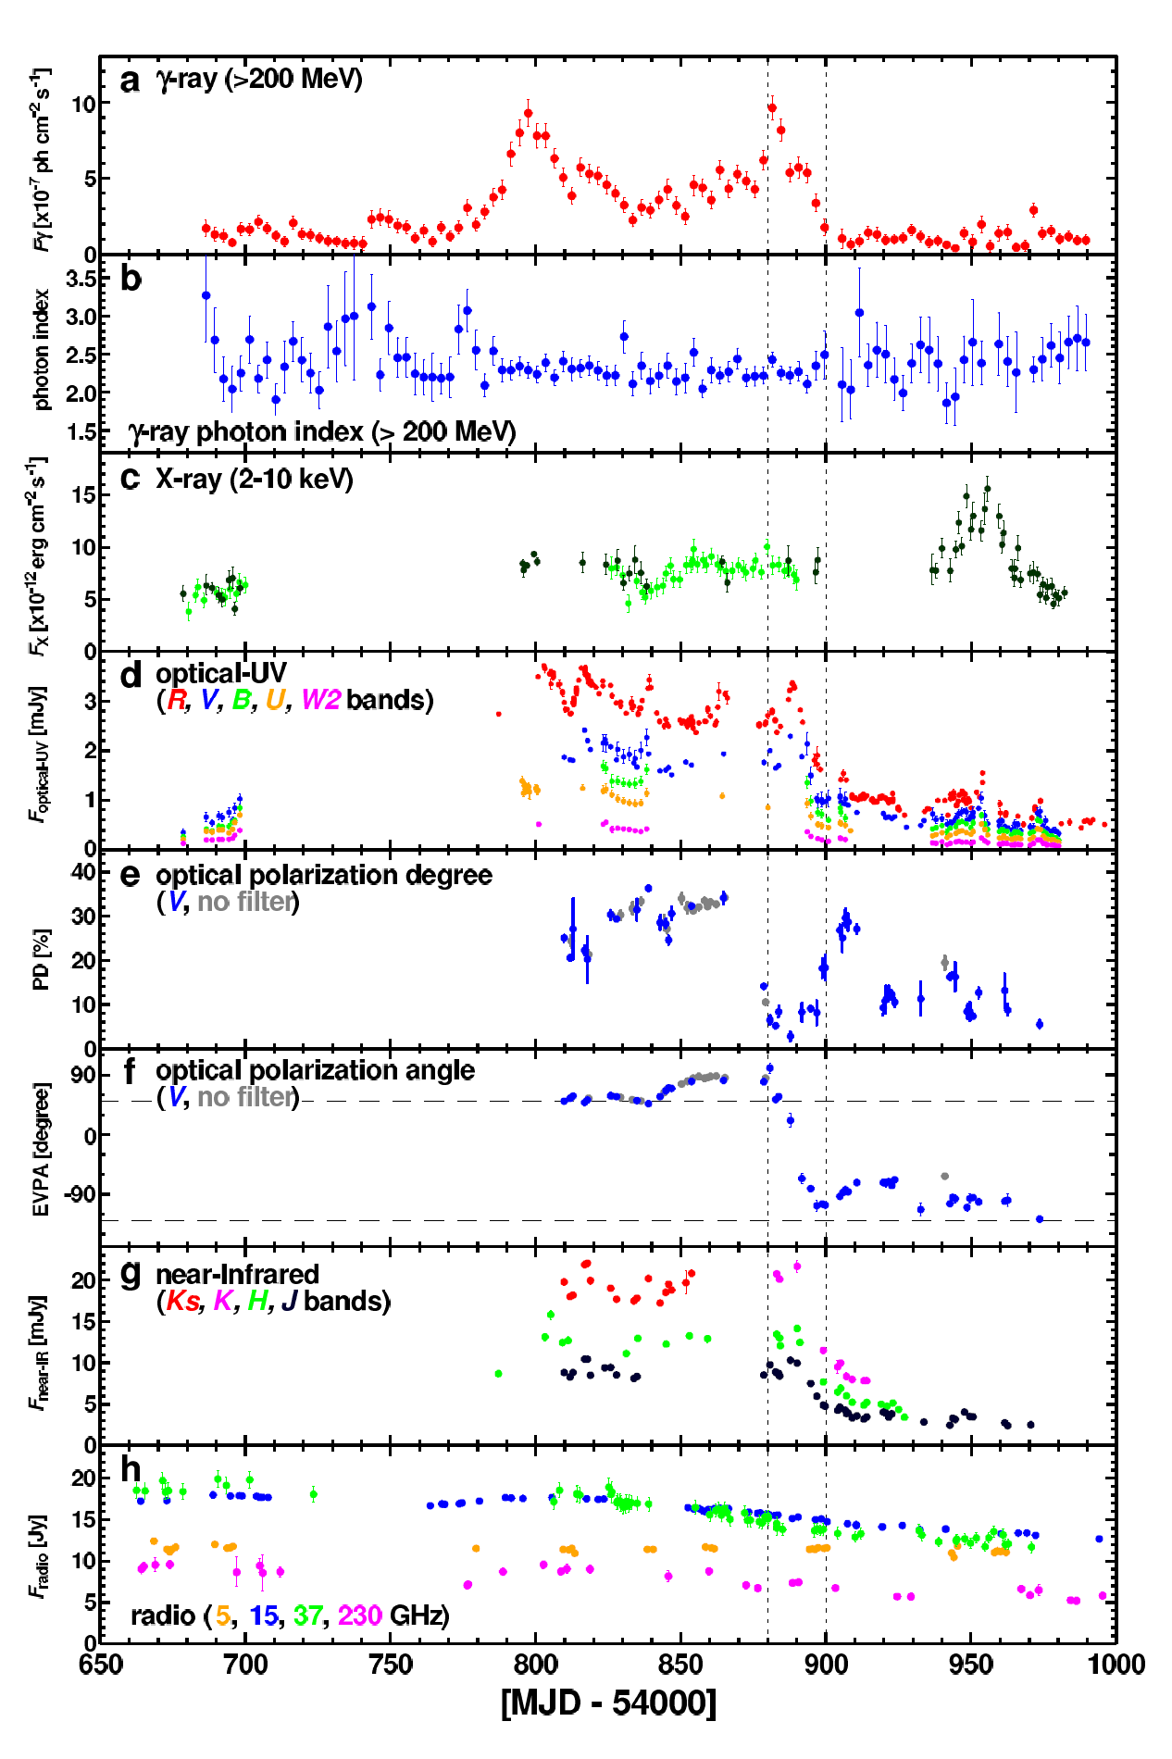
Flux and Polarization Variability
Multi-wavelength variability on various time scales (months – minutes)
Sometimes correlated, sometimes not
Observed optical polarization degrees
Π_{opt} <~ 30 %
Both degree of polarization and polarization angles vary.
Swings in polarization angle sometimes associated with high-energy flares!
(3C279: Abdo et al. 2010)

Slide 9
Open Physics Questions
Source of Jet Power (Blandford-Znajek / Blandford-Payne?)
Physics of jet launching / collimation / acceleration – role / topology of magnetic fields
Composition of jets (e⁻-p or e⁺-e⁻ plasma?) – leptonic or hadronic high-energy emission?
Mode of particle acceleration (shocks / shear layers / magnetic reconnection?) - role of magnetic fields
Location of the energy dissipation / gamma-ray emission region

Slide 10
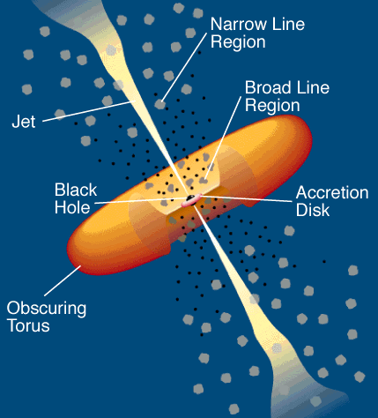
Leptonic Blazar Model
0
Synchrotron emission
Injection, acceleration of ultrarelativistic electrons
Relativistic jet outflow with Γ ≈ 10
νF_{ν}
Q_{e} (γ,t)
γ^{-q}
ν
γ₁
γ₂
γ
Compton emission
Radiative cooling ↔ escape =>
νF_{ν}
γ^{-q} or γ⁻²
Q_{e} (γ,t)
ν
γ^{-(q+1)}
Seed photons:
Synchrotron (within same region [SSC] or external sources, e.g., accretion disk, BLR, dust torus (EC = External Compton)
γ₁
γ_{b}
γ₂
γ
γ_{b}:
τ_{cool}(γ_{b}) = τ_{esc}
γ_{b}
γ₁
γ₂

Slide 11
Hadronic Blazar Models
0
Injection, acceleration of ultrarelativistic electrons and protons
Proton-induced radiation mechanisms:
Relativistic jet outflow with Γ ≈ 10
νF_{ν}
γ^{-q}
ν
Q_{e,p} (γ,t)
Proton synchrotron
γ₁
γ₂
γ
pγ → pπ⁰ π⁰ → 2γ
Synchrotron emission of primary e⁻
pγ → nπ⁺ ; π⁺ → μ⁺ν_{μ}
μ⁺ → e⁺ν_{e}ν_{μ}
νF_{ν}
→ secondary μ-, e-synchrotron
ν
Cascades …

Slide 12
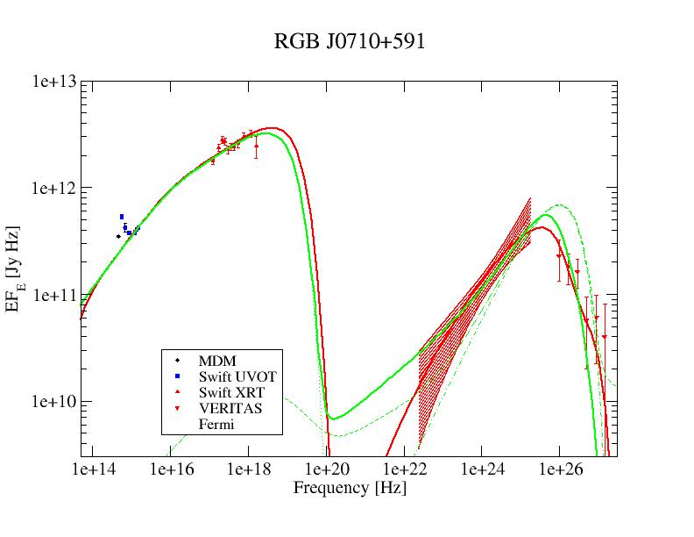
Lepto-Hadronic Model Fits to Blazar SEDs
(HBL)
Red = leptonic
Green = lepto-hadronic
In many cases, leptonic and hadronic models can produce equally good fits to the SEDs.
Possible Diagnostics to distinguish:
Neutrinos
Variability
Polarization

Slide 13
The IceCube Neutrino Detector at the South Pole
Fully operational since 2010.

Slide 14
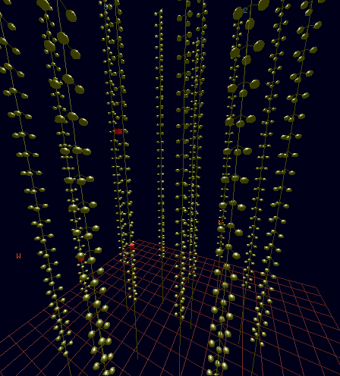
High-Energy Neutrino Detectors
IceCube:
E_{ν} ∼ 100 TeV – few PeV
ν-matter scattering, followed by particle cascades in ice/water → Cherenkov light detection.

Slide 15
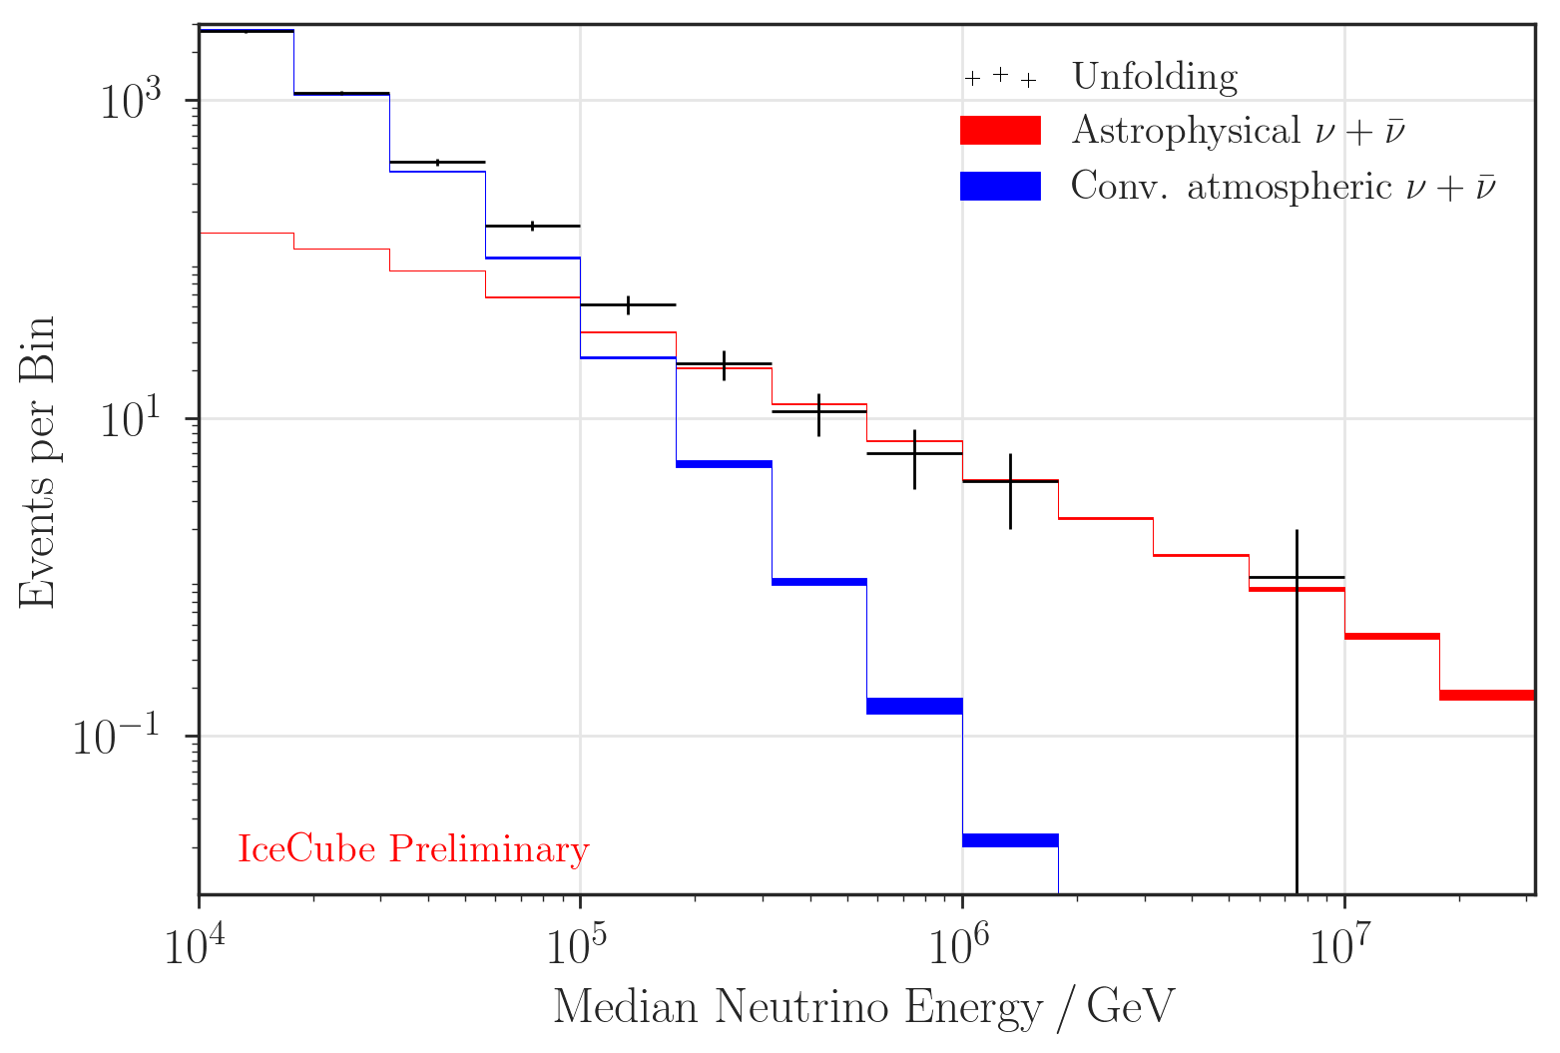
The IceCube Neutrino Spectrum
E_{ν} >> 100 TeV => Likely of astrophysical origin
Large background of atmospheric neutrinos from cosmic-ray interactions with the atmosphere.
First evidence for astrophysical neutrinos published in 2013.

Slide 16
Origin of IceCube-Detected Neutrinos
(Buson et al. 2022)
Significant correlation of IceCube neutrinos with blazars (chance coincidence p = 6∙10⁻⁷) – but can not be responsible for all IceCube neutrinos (e.g., Murase et al. 2018)

Slide 17

Photo-pion induced neutrino production in relativistic jets
pγ → p π⁰
n π⁺
θ
Earth
$$δ= \frac{1}{Γ (1 − β cosθ)}$$
Γ
E_{obs} = δ E’

Slide 18
Photo-Pion Production Cross Section
Δ⁺ resonance
σ(pγ→pπ⁰) : σ(pγ→nπ⁺) = 2:1
(Morejon et al. 2019)

Slide 19
Photo-Pion Production
Spectral index (n[ε] ~ ε^{−α}) of target photon field
Interaction Probability
(Mücke et al. 1999)
Center-of-Momentum energy
For realistic target photon fields, most interactions occur near threshold (at Δ⁺ resonance).

Slide 20
Photo-pion production - Energetics
At Δ⁺ resonance:
s = E’_{p} E’_{t} (1 – β_{p}’ μ) ~ E’_{p} E’_{t} ~ E_{Δ+}² = (1232 MeV)²
and E’_{ν} ~ 0.05 E’_{p}
To produce IceCube neutrinos (~ 100 TeV → E_{ν} = 10¹⁴ E₁₄ eV):
(i.e., E’_{ν} = 10 E₁₄ δ₁⁻¹ TeV)
Need protons with E’_{p} ~ 200 E₁₄ δ₁⁻¹ TeV
and target photons with E’_{t} ~ 1.6 E₁₄⁻¹ δ₁ keV
=> X-rays!

Slide 21
Photo-pion production –
Origin of Target Photons
To produce IceCube neutrinos (~ 100 TeV → E_{ν} = 10¹⁴ E₁₄ eV):
Need protons with E’_{p} ~ 200 E₁₄ δ₁⁻¹ TeV
and target photons with E’_{t} ~ 1.6 E₁₄⁻¹ δ₁ keV
(At least) two possible scenarios for target photons:
Co-moving with the emission region
E_{t}^{obs} ~ 16 E₁₄⁻¹ δ₁²/(1+z) keV
Observed as hard X-rays
Doppler boosted into observer’s frame
Stringent constraints on co-moving energy density
Typically large proton power requirements!
Stationary in the AGN frame
E_{t}^{obs} ~ 160 E₁₄⁻¹/(1+z) eV
Observed as UV / soft X-rays
Doppler boosted into co-moving frame
Strongly relaxed constraints on energy density
Much lower proton power requirements!

Slide 22
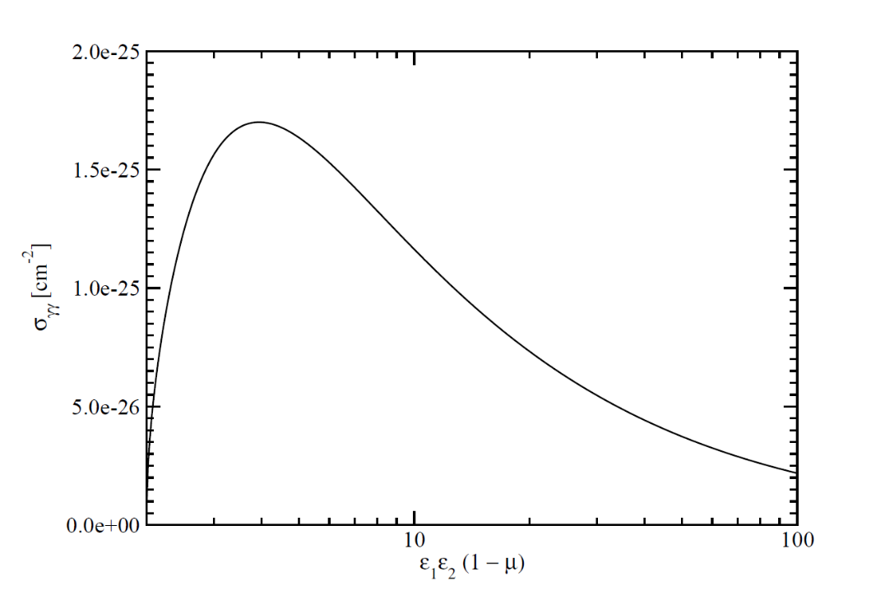
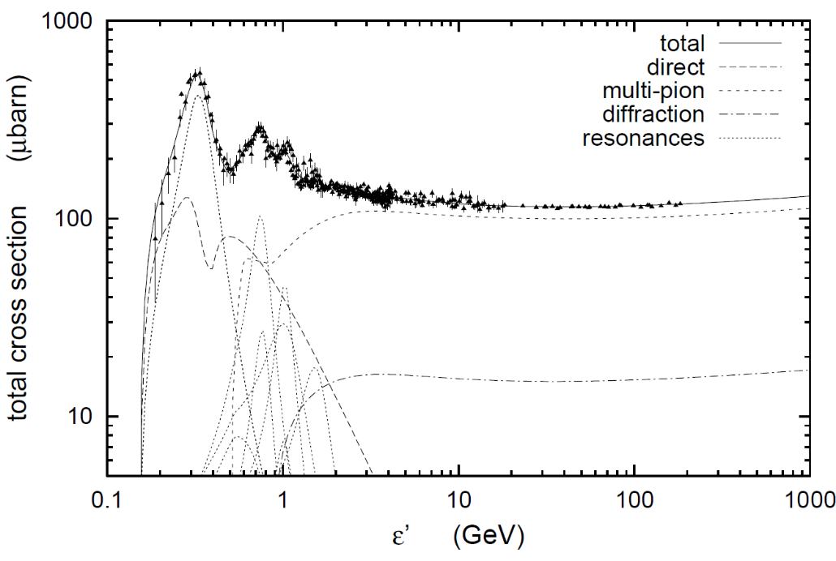
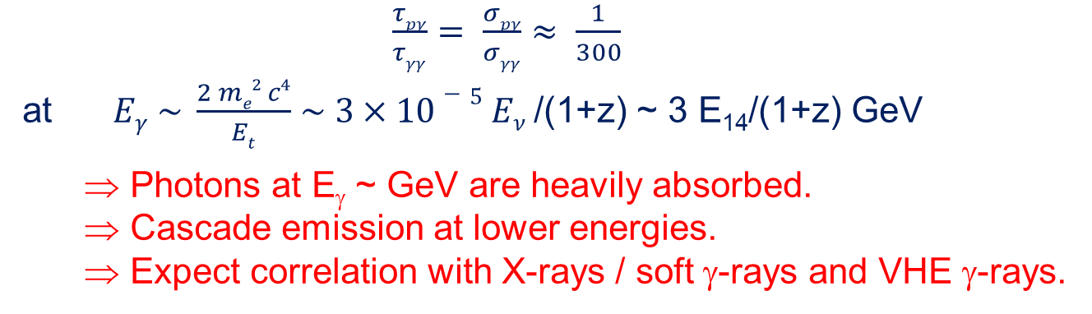
The pγ Efficiency Problem
Efficiency for protons to undergo pγ interaction ~ τ_{pγ} = R σ_{pγ} n_{ph}
Likelihood of γ-ray photons to be absorbed ~ τ_{γγ} = R σ_{γγ} n_{ph}
σ_{pγ}
σ_{γγ}
$\frac{τpγ}{τγγ}= \frac{σpγ}{σγγ}$ $≈ \frac{1}{300}$
at $Eγ \sim \frac{2 me2 c4}{Et}$ $\sim 3×10−5 Eν$/(1+z) ~ 3 E₁₄/(1+z) GeV
  Photons at E_{γ} ~ GeV are heavily absorbed.
  Cascade emission at lower energies.
  Expect correlation with X-rays / soft γ-rays and VHE γ-rays.

Slide 23
Example: BLR Target Photon Field
(Finke 2016)
Opacity decreases towards multi-TeV energies
=> H.E.S.S. follow-up program on potential IceCube neutrino counterpart blazars

Slide 24

Summary
0
Many open questions concerning jet acceleration / collimation / composition / …
VHE γ-ray observations of blazars may probe PeV cosmic-ray acceleration in AGN jets through
  Characteristic spectral signatures
  Characteristic variability signatures
  Correlation of VHE γ-ray activity (not necessarily Fermi-LAT GeV γ-ray activity!) with IceCube neutrino alerts.
Supported by the South African Research Chairs Initiative (SARChI) of the Department of Science and Innovation and the National Research Foundation of South Africa (grant no. 64789).

Slide 25
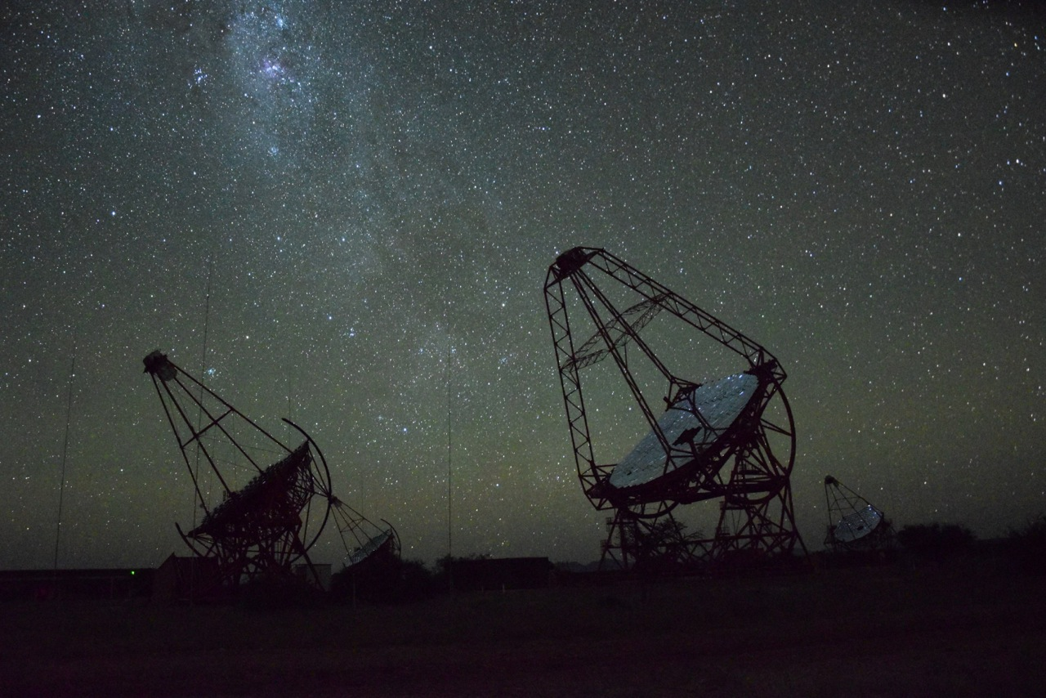
Thank you!
Any opinion, finding and conclusion or recommendation expressed in this material is that of the authors and the NRF does not accept any liability in this regard.

