Slide 1
Transnational Access to GSI
Yvonne Leifels

Slide 2
GSI – Science while realizing FAIR
Strong response of scientific community, more than 1500 scientists involved, demand largely exceeding the available beam time, confirming the attractiveness of the experimental opportunities
up to 90 % speed of light
Ion species: H⁺,..., U⁹²⁺
heavy-ion synchrotron
SIS 18
linear accelerator
UNILAC
PHELIX
M-branch
  beam time 2022 lasted from February 2nd to June 30th, a total of 116 days of user beamtime have been provided
  beam time has been performed as planned; two experiments could not be fully served
  beam times in 2023/24 were assigned in a G-PAC Meeting in September 2022
Z6
Fragment Separator
HHT
Ion
sources
storage ring ESR
8 % - 15 % speed of light
SHE
X0
HITRAP
HADES
Cave A
miniCBM
CRYRING
R3B

Slide 3
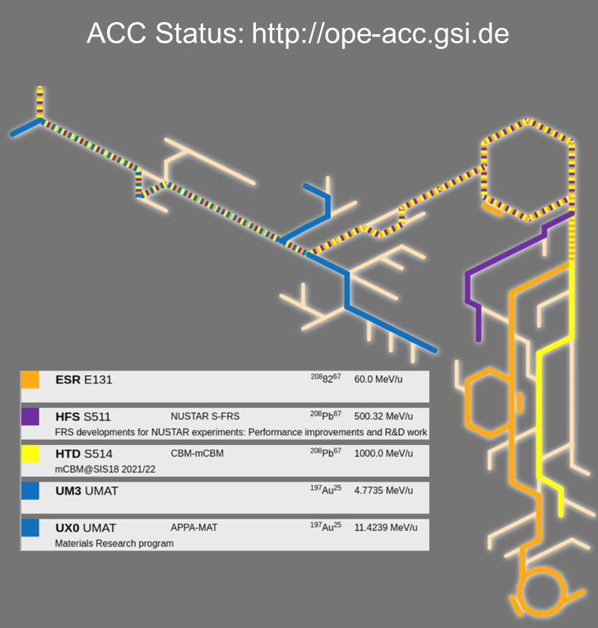
Beam time 2022
General remarks
  2nd run under COVID restrictions
  1st run during the Russian invasion in Ukraine
  long delivery times of specific materials
  rising costs for energy and materials
    electricity costs higher ~70-80%
Accelerator progress
  Operation of 3 parallel beams including U, with overall parallel factor 2.3
  Long CH³⁺ run with optimum performance
  Booster mode for SIS18 established
  Operation parameters of pulsed hydrogen gas-stripper verified
WASA@FRS
HADES
miniCBM
R3B

Slide 4
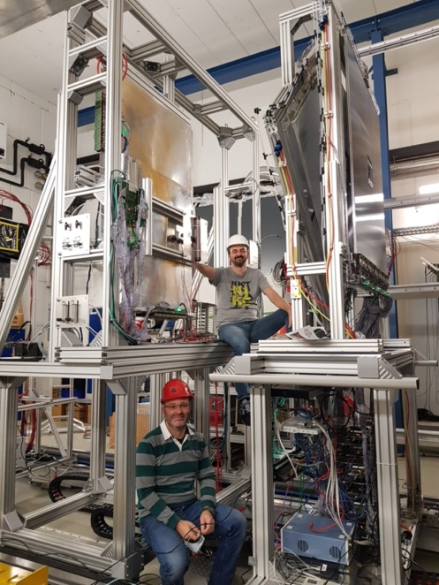
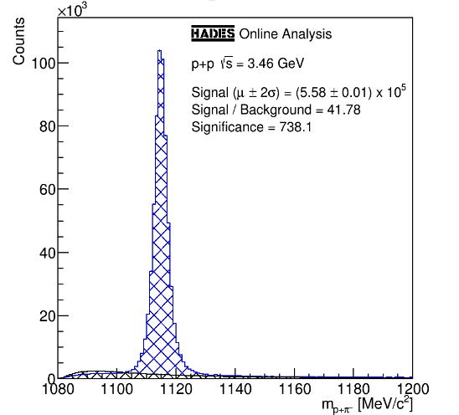
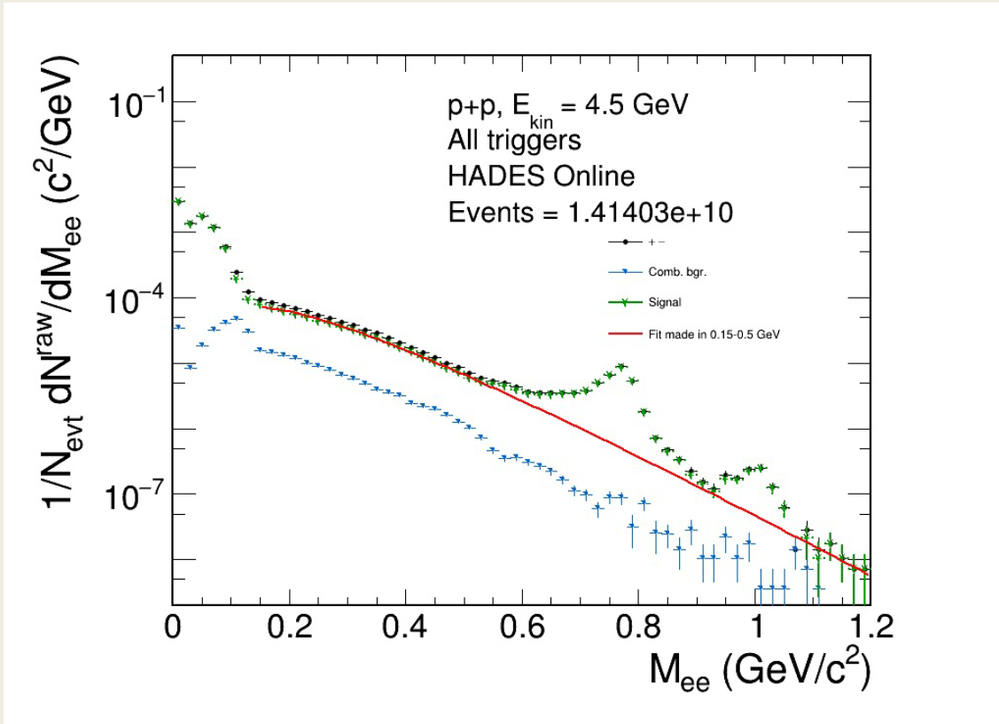
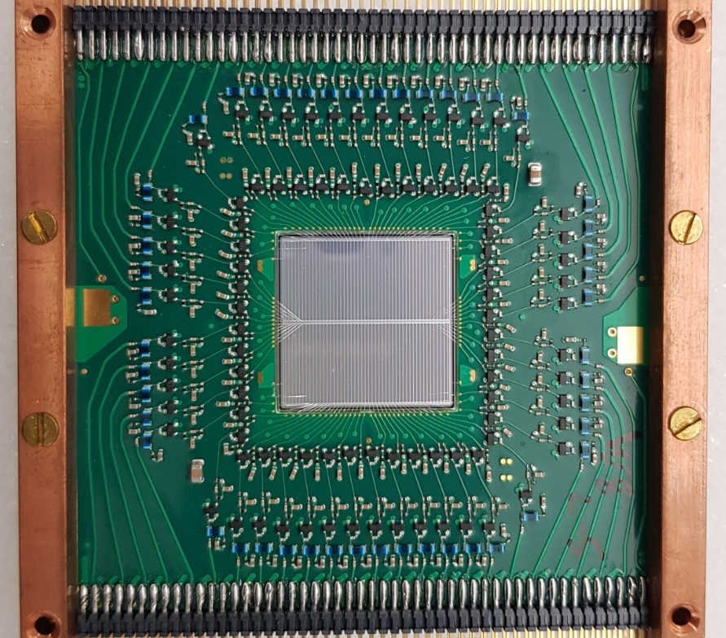
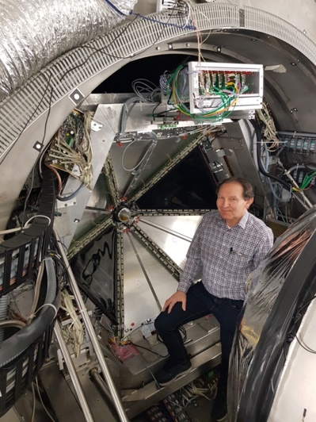
HADES p+p@4.5 GeV
STS1
TransFAIR, Jülich
STS2
Jagiellonian Univ.
Forward RPC
LIP Coimbra
Production and decay of strange resonances: eTFF‘s Λ, Σ
PANDA Forward Tracker →HADES Straw tube tracker for improved HYPERON acceptance in forward direction
Complete installation in Nov. 2021 for beam time 2022
Collected statistics might not be sufficient for all anticipated physics goals
pπ⁻
online
T0
GSI, TU Darmstadt
iTOF
TransFAIR, Jülich
Λ invariant mass
dielectrons
invariant mass
Notes:
Dalitz decays of hyperons is an experimentally unexplored process, which can be studied for the first time by using the excellent capabilities of HADES to measure rare dilepton decays. Such measurements will provide complementary information on hyperon structure and the role of strange quarks in baryons. The latter will be investigated by comparing these results to those transitions recently measured for non-strange baryons of same spin and parity (i.e. Σ(1385)0 vs Δ(1232) and Λ(1520) vs N∗(1520)).
Production cross sections of the higher mass hyperon resonances investigated here are unknown in the energy range of future FAIR experiments. Hence, the proposed measurements will provide an essential input for the understanding of the production mechanism in proton–proton interaction in this energy regime and will also establish an important reference for p+A and A+A collisions. In particular, the production of double strangeness offers a unique opportunity to study strangeness production close to the threshold, where only few production channels are expected to contribute. In this regime, characterized by a small relative momentum between the produced hadrons, final state interactions are expected to play a significant role. Therefore, hyperon-hyperon and nucleon-hyperon correlation studies are very promising tools to measure their interaction potential.

Slide 5
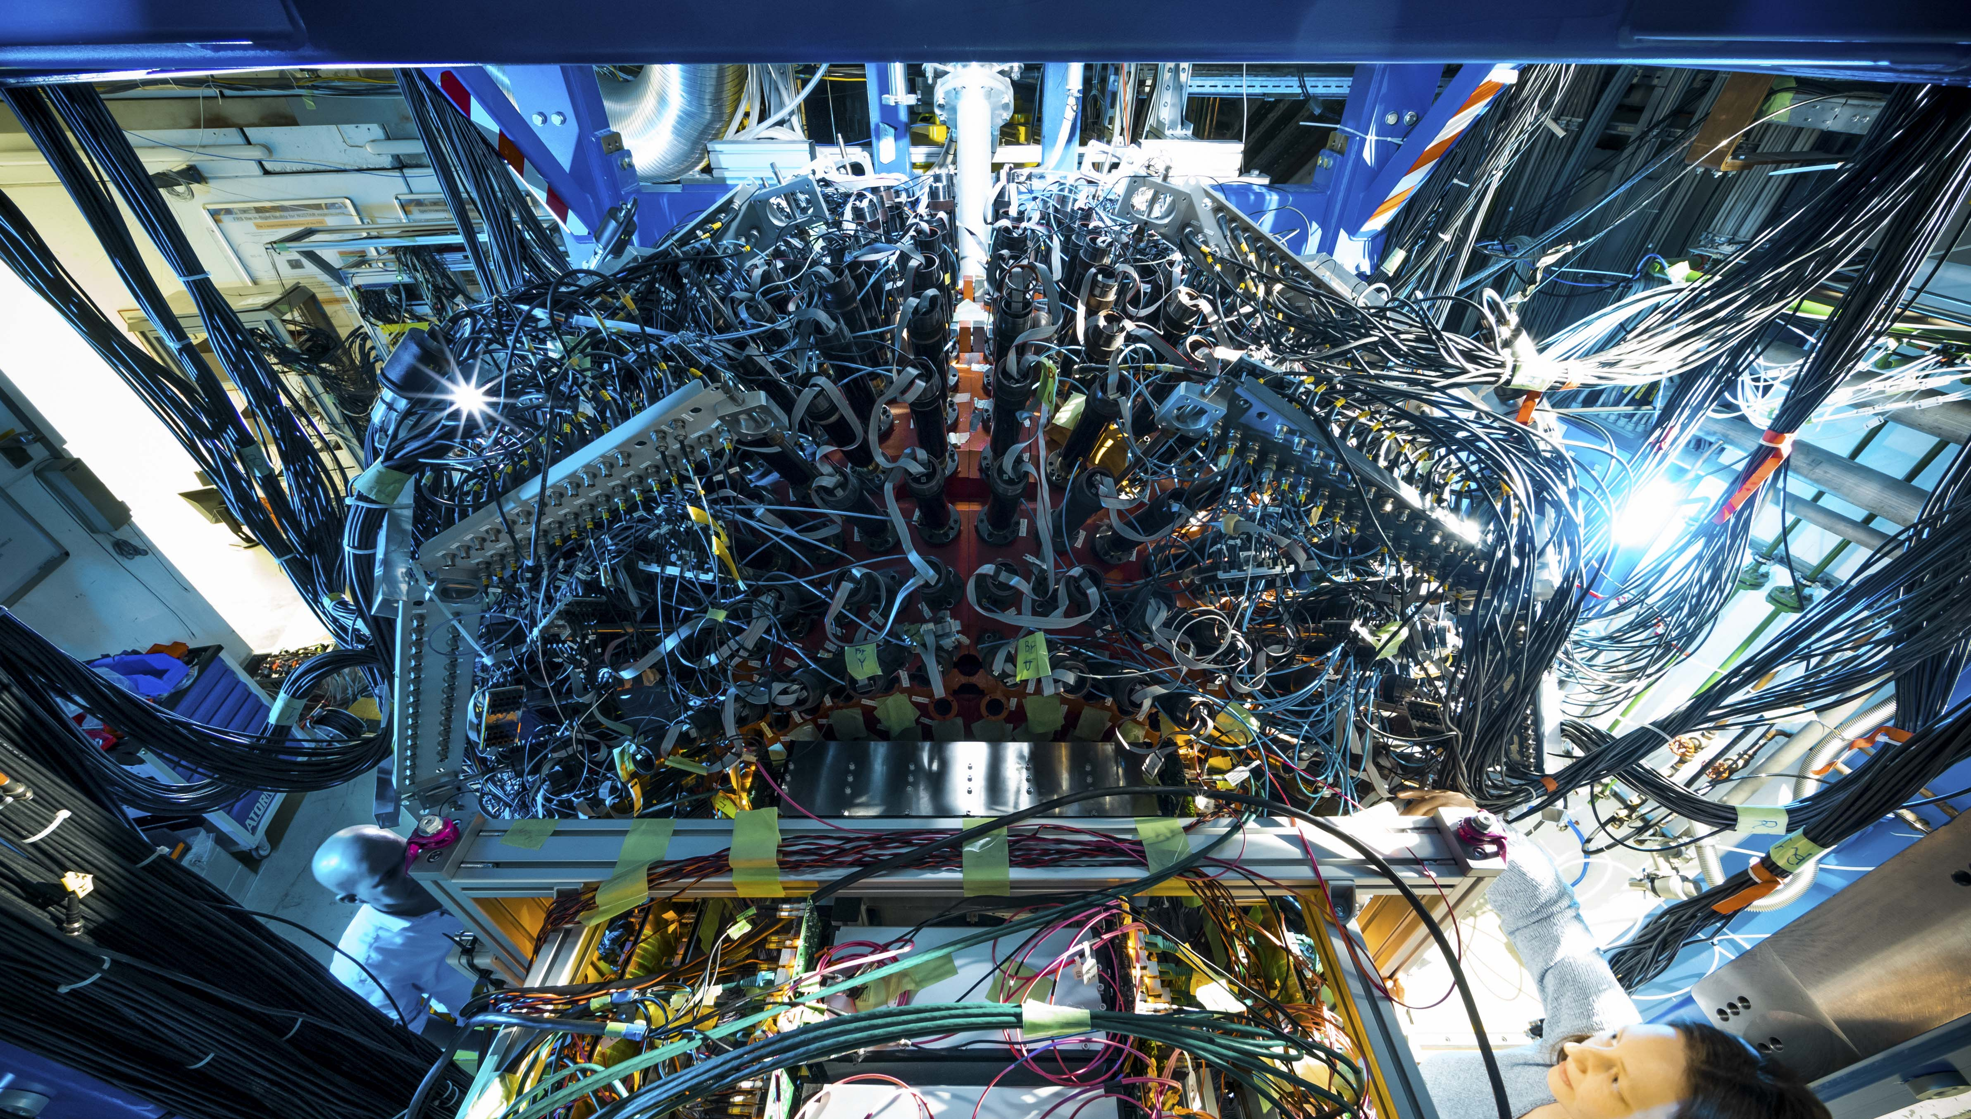
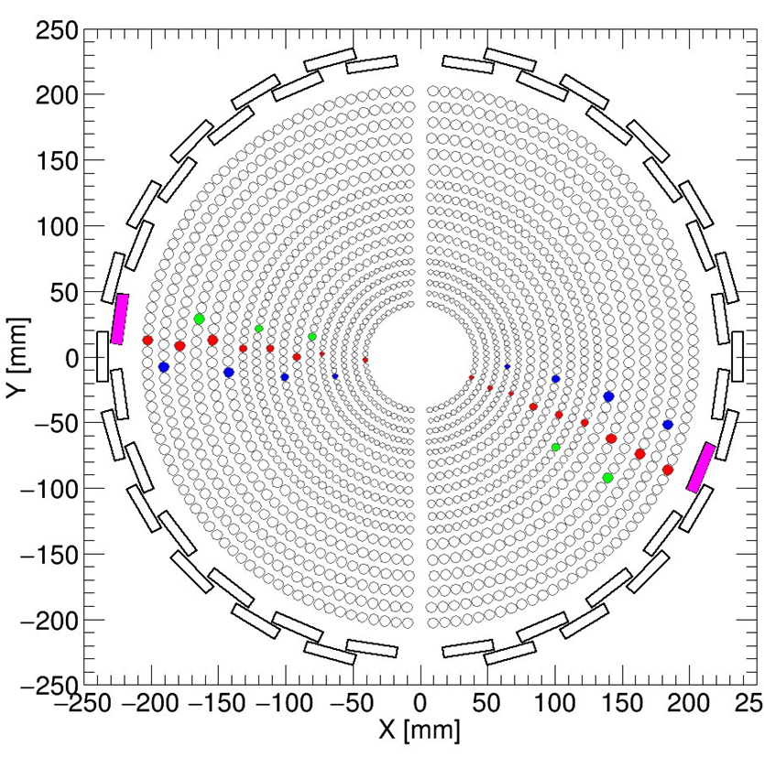
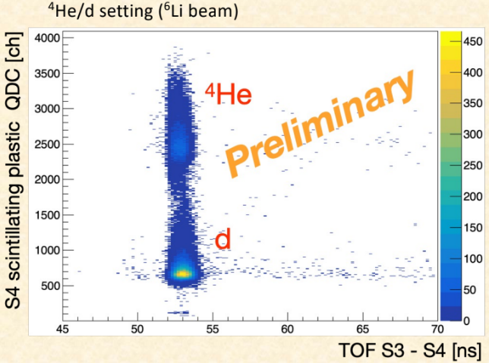
WASA@FRS
WASA detector:
  18 tons of weight
  s.c. solenoid magnet (700 A, 1.0 Tesla)
  ~10.000 electronic channels
  installation work: July 2021 – January 2022
Data stream:
  up to 300 MB/second
  50 TB recorded in 1 week of beamtime
Main detectors:
  Scintillator barrel
  Mini Drift chambers
  CsJ calorimeter
  Fiber tracking detectors
photo credit:
© J. Hosan/GSI/FAIR
Novel spectroscopic techniques are explored to
study exotic nuclei and exotic atoms
For the first time a calorimeter is coupled to a high-resolution spectrometer for relativistic beams
Experiments:
Search for eta’-mesic nuclei (S490, K. Itahashi et al., 22.-28. February)
Hypernuclei spectroscopy (S447, T. Saito et al., 10.-19. March)
Characteristics of baryonic resonances (J. Benliure, could not be performed)
Notes:
WASA/KAL: One of the major goals of this project (S447) is the investigation of characteristics of light hypernuclei. Nuclei, where a neutron is replaced by a lambda hyperon, are produced in reactions of light heavy nuclei most probably created by a coalescence like process. The lambda is produced in the course of high energetic heavy ion collision in the dense overlap zone by NN collision and then re-scattered into the spectator nucleons, where relatively heavy hypernuclei are formed, or – in a more direct way – form hypernuclei with the surrounding nucleons from the participant zone. The combination of the WASA detector and the Fragment Separator allows to measure the pionic decays of hypernuclei (e.g. ³_{Λ}H →π⁻ +³He) with high precision. one focus of the experiment is the lifetime of the hypertriton, since in previous experiments rather short lifetimes have been reported by various groups which cannot explained by theory, and the other to solve the question whether a neutral hypernucleus Λnn is existing.
Main achievements and difficulties encountered: Aside from normal difficulties, the main challenge during the measurements was the liquid-helium consumption for the super-conducting magnet of WASA, which was more than predicted. With the purchase of extra liquid helium and a careful planning and the dedication of the cryogenic department at GSI, enough liquid helium was produced with which the whole campaign was carried out very successfully. Several publications are expected from this campaign.
WASA/SKUR: The large mass of the η’ meson is theoretically understood by an interplay of the UA(1) anomaly and chiral symmetry breaking. Thus, the mass of the η’ might be reduced at finite nuclear matter density due to partial restoration of chiral symmetry. Such a mass reduction would induce an attractive η’-nucleus potential and could lead to the existence of η’-mesic nuclei. The goal of this project was to participate in the S490 experiment: Search for '-mesic nuclei in ¹²C(p,dp) reaction. The aim is to perform an experimental search for bound systems of an η′ -meson and a nucleus using ¹²C(p,dp) reactions by measuring excitation spectra of ¹¹C near the η′ -production threshold. Semi-exclusive measurement of ¹²C(p, dp) reaction, combining a missing-mass measurement by ¹²C(p, d) reaction and identification of a proton emitted from the reaction product, was performed with a large solid angle detector WASA and a forward high-resolution spectrometer FRS, using 2.5 GeV proton beam provided by SIS18 beam facility.
Main achievements: The beamtime was performed in the period 22-28 February 2022. The planned measurements have been successfully accomplished. According to a preliminary estimation more than 100% of requested statistics (proposal) was accumulated. The data analysis is in progress.

Slide 6
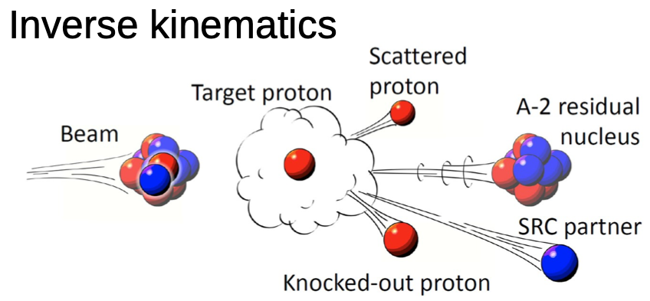
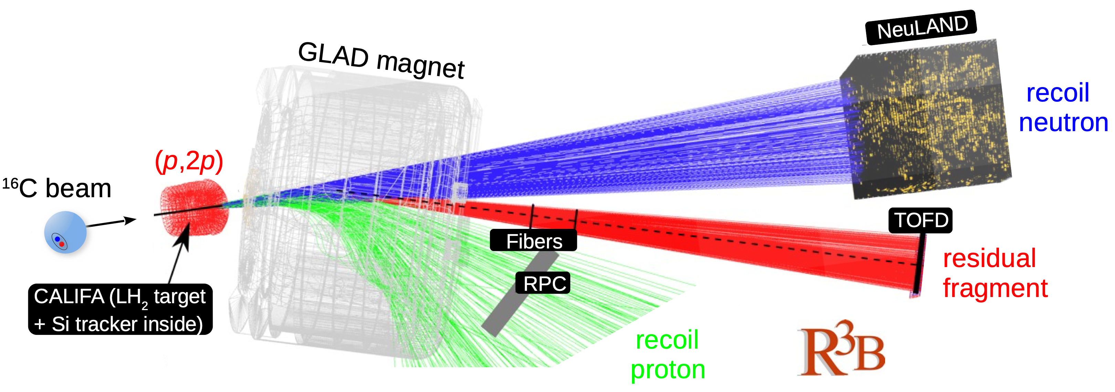
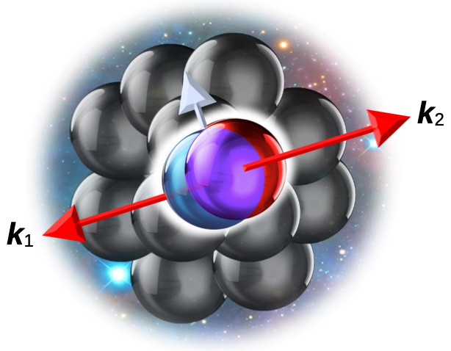
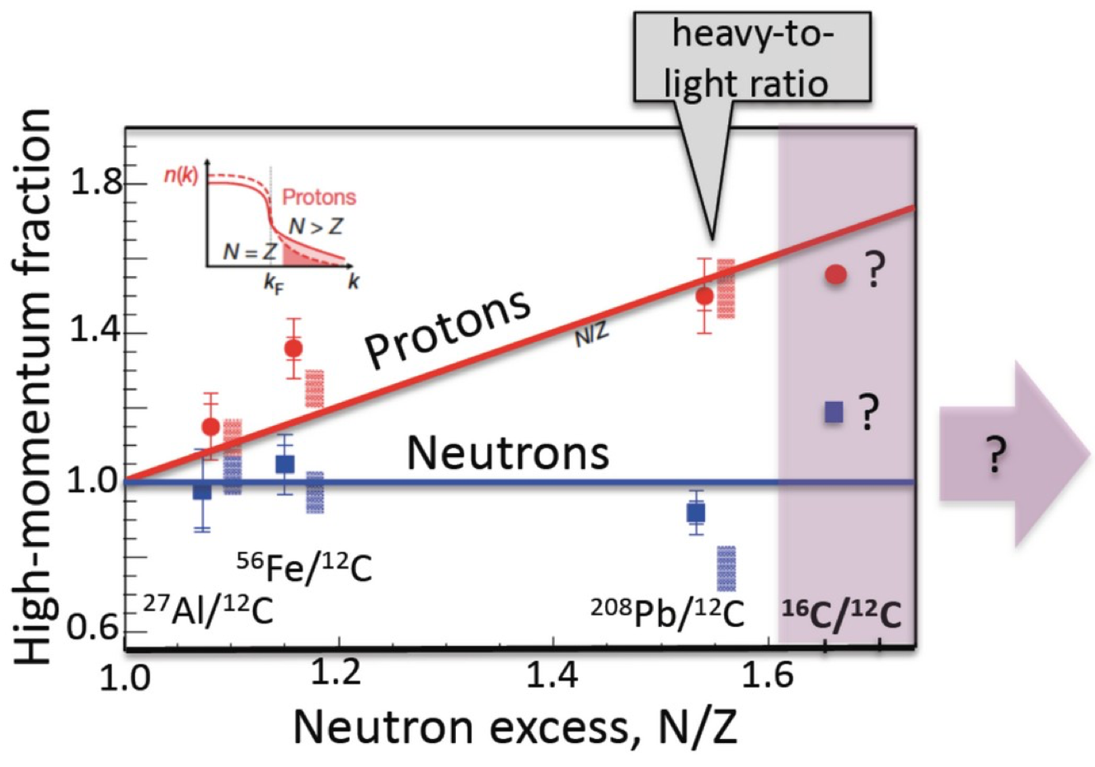
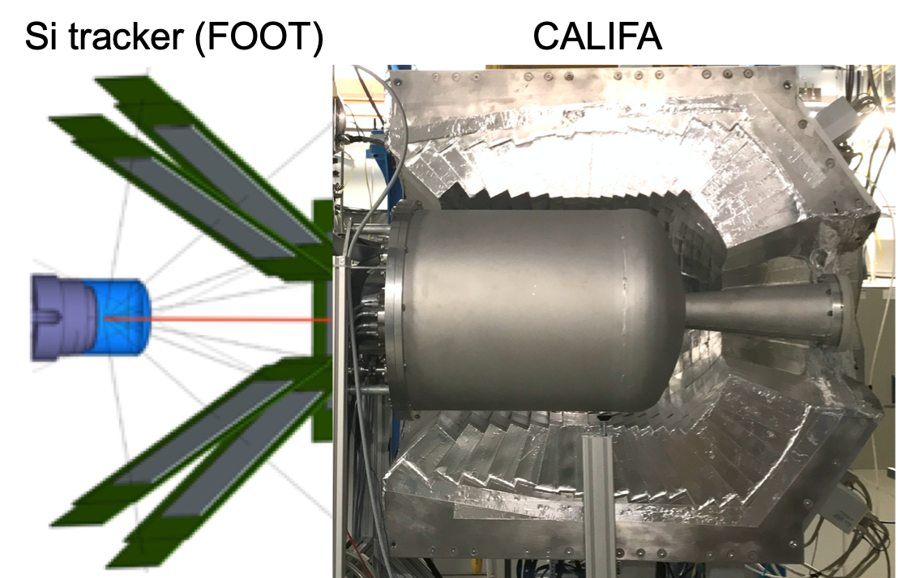
Short-range correlations in exotic nuclei
JLAB (e+A) conclusion: Protons more correlated in neutron-rich, stable nuclei
Open questions
effect of mass ratio or asymmetry?
development towards large N/Z
FAIR Phase-0 experiment at R3B
changing N/Z at similar mass
kinematically complete measurement using ¹²C, ¹⁶C beams
A. Corsi et al.

Slide 7
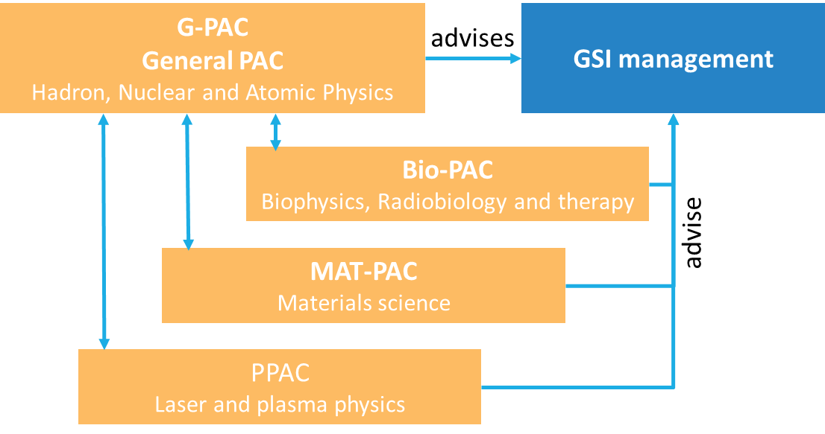
General Program Advisory Committee G-PAC
G-PAC met on September 28th - 30th
Evaluated 59 proposals asking for more than 2700 shifts
Request 1832 shifts* for SIS18 operation
Beam time 2023/24
  allocation of 744 shifts for SIS18 operation for hadron, nuclear and atomic physics experiments
Approved STRONG-2020 experiments:193 shifts
  heavy ion reactions
  hadron physics
Next user selection panel meeting will take place in December 2022
Organization:
Sub-PAC Chairs report to G-PAC;
PACs recommend granting beam time to the directorate
*1 shift = 8 hours

Slide 8
Actual quantity of access provided
As reported in the Periodic Report 2 with numbers from end of April:
many travel cost requests have not been processed due to lack of man power in the relevant department
accounting of beamtime (BOT) has not been finalized
 | Estimated / delivered hours of beam time | Estimated / supported number of days spent in infrastructure | T&S / Euro
Month 1-18 | 500 / 0 | 660 / 0
Month 30-36 | 900 / 860 | 800 / 409 | 52.436 Euro
Month 1-54 | 1450 / 860 | 1760 | 165.0000

Slide 9
Actual quantity of access provided
Current status
not all travel cost requests have been processed
accounting of beamtime has been finalized
 | Estimated / delivered hours of beam time | Estimated / supported number of days spent in infrastructure
Month 1-18 | 500 / 0 | 660 / 0
Month 30-36 | 900 / 1025 | 800 / 710
Month 1-54 | 1450 | 1760

Slide 10
Outlook 2022 / 23
supernumerary
G-PAC meeting
9./10. December
regular G-PAC
meeting for beam time 2023/24
Beam time
Beam time
Beam time
2022
2023
2024
end of project

Slide 11
Outlook 2023 / 24
supernumerary
G-PAC meeting
9./10. December
regular G-PAC
meeting for beam time 2023/24
Beam time
Beam time
Beam time
Beam time
Engineering Run
Beam time
2022
2023
2024
end of project

Slide 12
Summary and Conclusions
Outlook
Rising costs for electricity/gas and consequently rising costs for materials (and personnel) led to a difficult financial situation:
reduction of the beamtime in 2023-25 despite the fact that the beamtime is already overbooked
  working group evaluating different scenarios
shift of beamtime 2023 to 2024
in addition to other saving measures....
Conclusion
Facing the current situation GSI will not be able to provide enough beam time for TA
Another project prolongation would certainly help but is a matter of discussion

