Slide 1
ConCORDIA CORSIKA Containers
ESFRIs: KM3NeT Collaboration and CTA Observatory
Presenter: L.A. Fusco – University of Salerno and INFN
On behalf of the ConCORDIA team (see last slide)
E-OSSR Onboarding Presentation
December 1st 2022

Slide 2
Introduction
Science case:
Simulation of Cosmic Rays for neutrino and gamma-ray observatories
Background for cosmic sources/fluxes searches
Targets for studies on cosmic ray physics
User’s view:
Provide portable and reliable sources for the simulation of cosmic rays
Implement it for GRID jobs usage
E-OSSR Onboarding Presentation

Slide 3
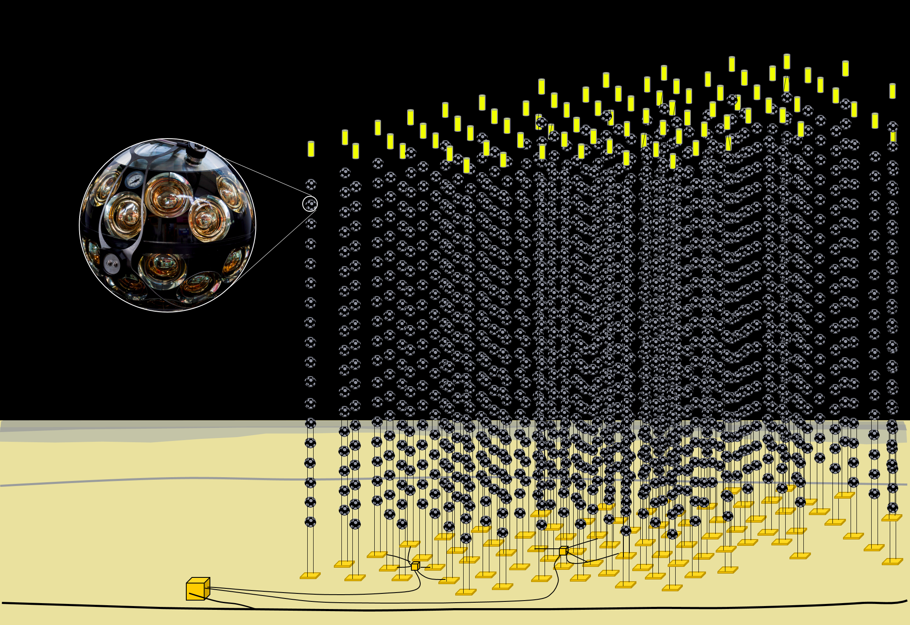
Science case
KM3NeT
High energy Neutrino Astrophysics (KM3NeT-ARCA) and Neutrino Oscillation Physics (KM3NeT-ORCA)
Cosmic ray muons are the most abundant background in both searches
https://www.km3net.org/
Journal of Physics G: Nuclear and Particle Physics,
43 (8), 084001, 2016, arXiv:1601.07459 [astro-ph.IM]
E-OSSR Onboarding Presentation

Slide 4
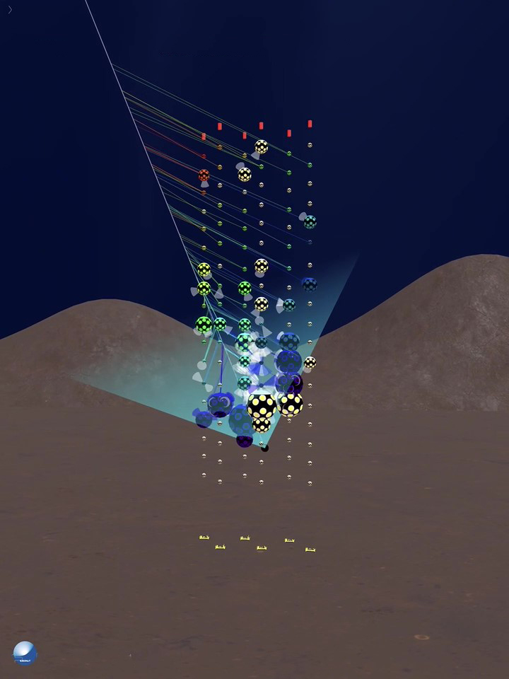
Science case
KM3NeT
Atmospheric muons are also the main target for cosmic rays searches
Composition of the CR spectrum
Prompt leptons from charmed hadrons decays
E-OSSR Onboarding Presentation

Slide 5
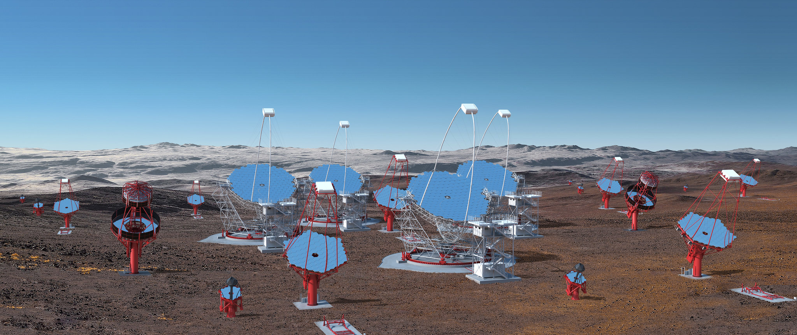
Science case
CTAO
Next-generation Imaging Atmospheric Cherenkov Telescope
Cosmic ray-induced air shower cascades are the main background in searches for high-energy gamma rays
www.cta-observatory.org
Science with CTA: arXiv:1709.07997
E-OSSR Onboarding Presentation

Slide 6
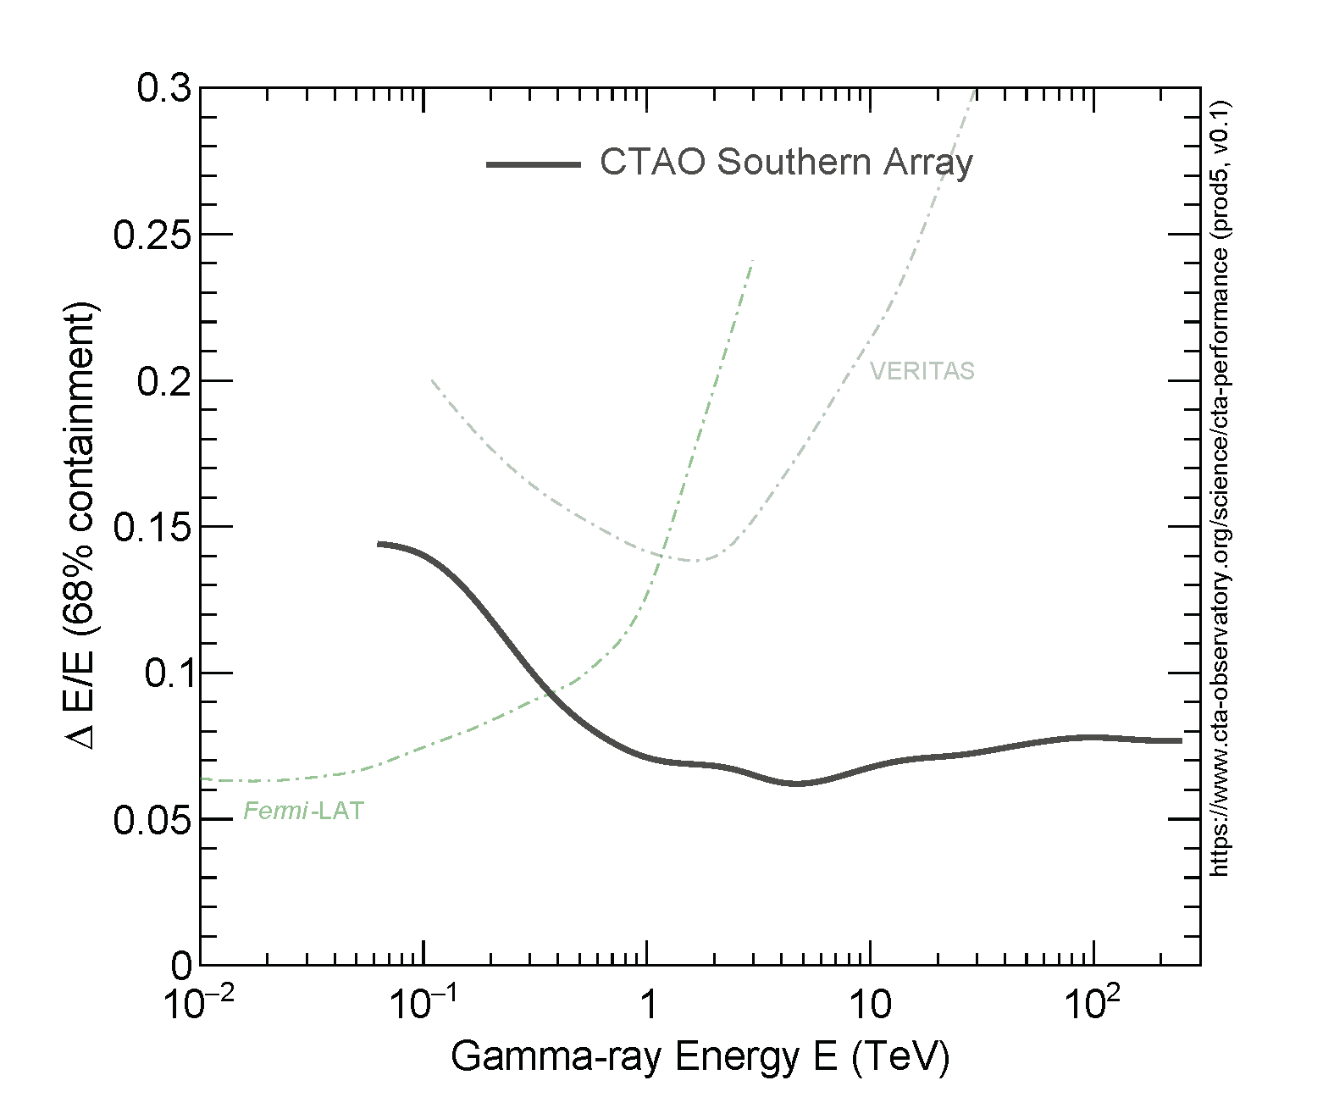
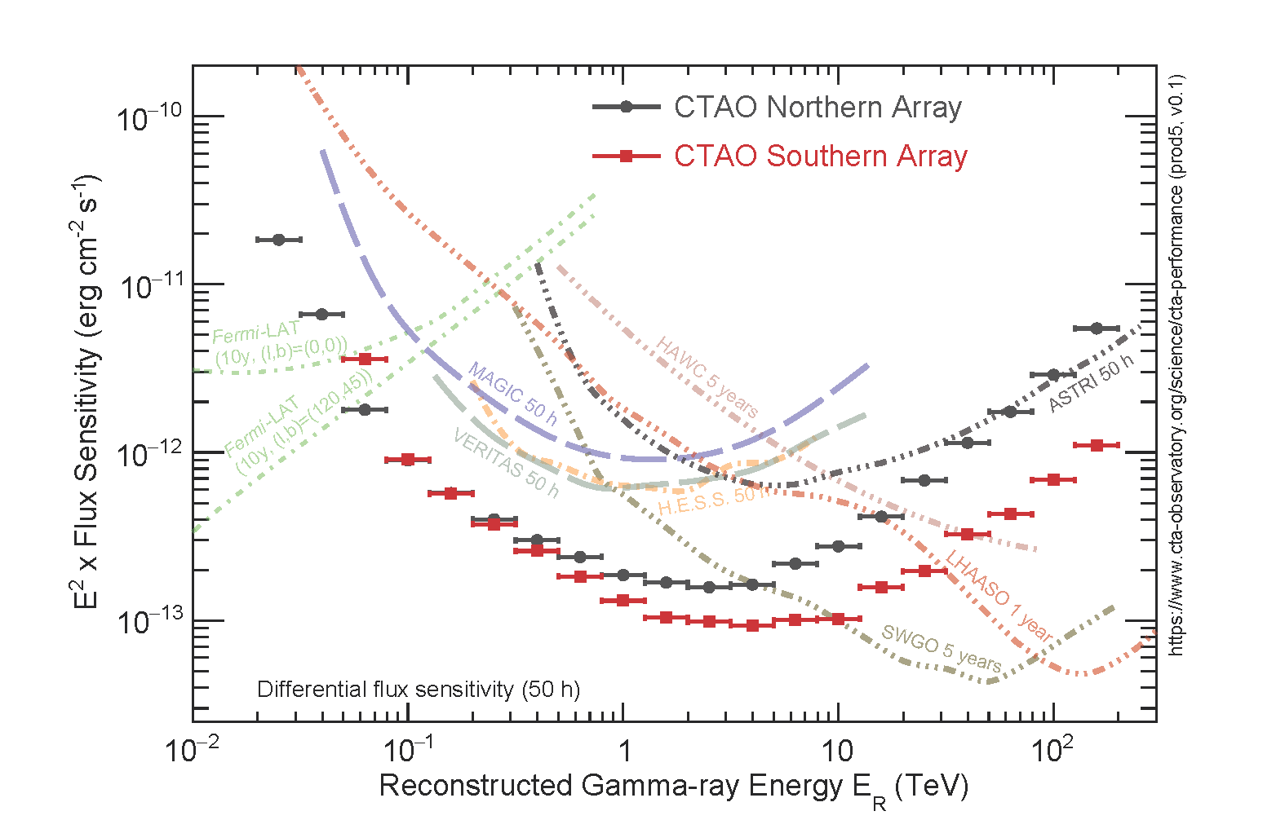
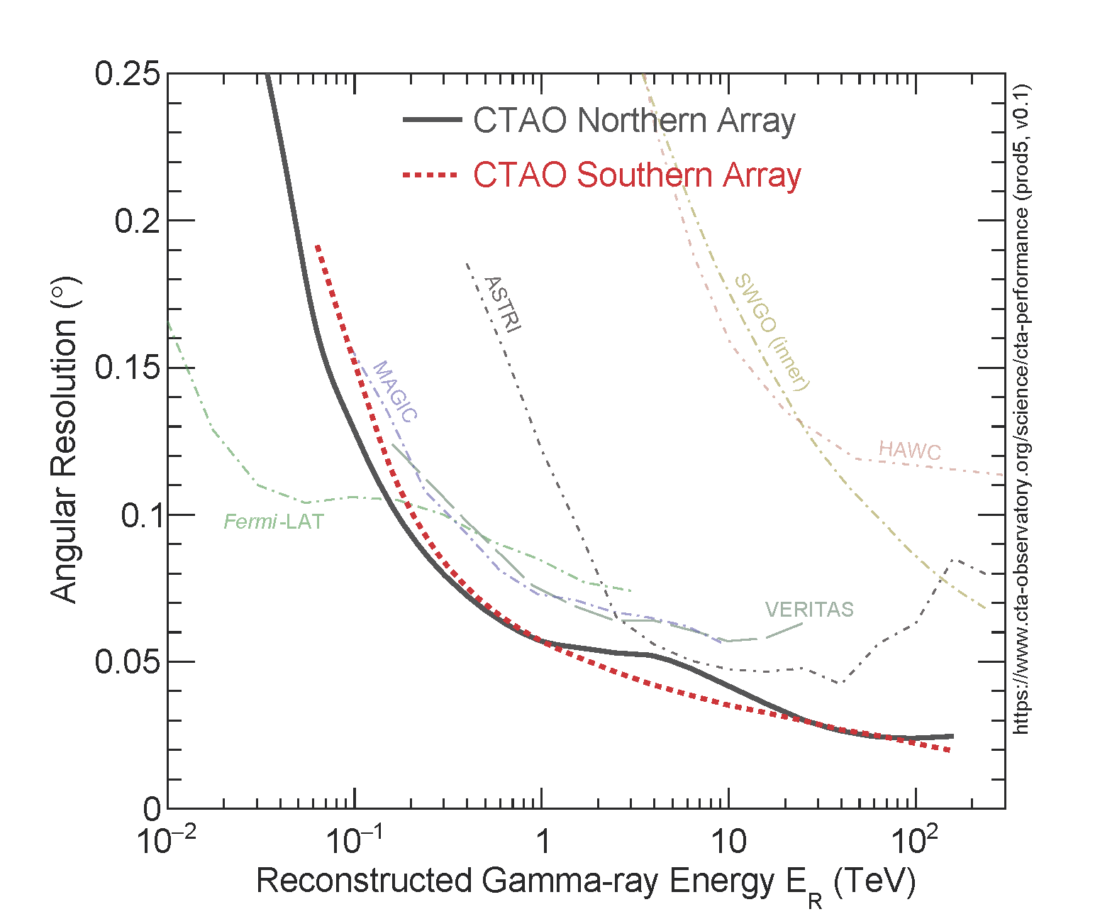
Science case
CTAO
Understanding of the response of the detector is crucial in predicting its capabilities
Angular resolution
Sensitivity
Energy resolution
E-OSSR Onboarding Presentation

Slide 7
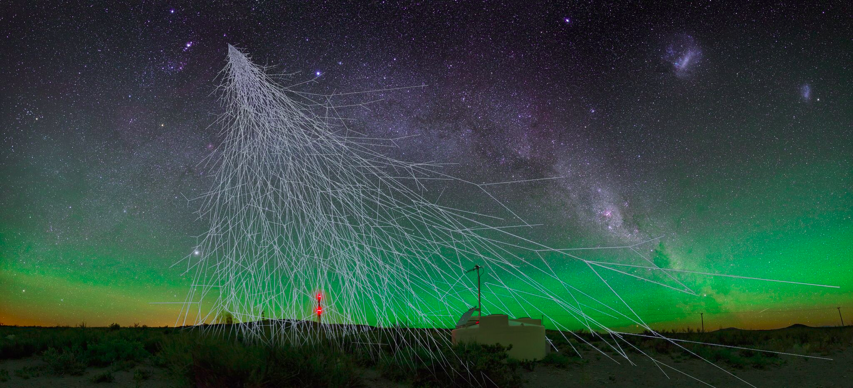
Science case
CORSIKA
State of the art cosmic rays simulation code
Used by most indirect cosmic ray experiments
E-OSSR Onboarding Presentation

Slide 8
Science case
CORSIKA
Provides a particle and light simulation in the atmosphere
Yields particles at ground level for different types of experiments
E-OSSR Onboarding Presentation

Slide 9
Service Development
1st step: Java GUI + scripts for container generation
2nd step: scripts for GRID job steering using DIRAC
3rd step: DIRAC integration
Mainly Java, bash, python3
E-OSSR Onboarding Presentation

Slide 10
Service Development
Testing
Container tests done with KM3NeT and CTAO specific configurations
KM3NeT: see next slides. Also tested perfomance with different options for neutrinos (“IceCube” mode)
CTAO: standard mass production (“Production4”) setup
The CTAO software pycorsikaio also used for testing
E-OSSR Onboarding Presentation

Slide 11
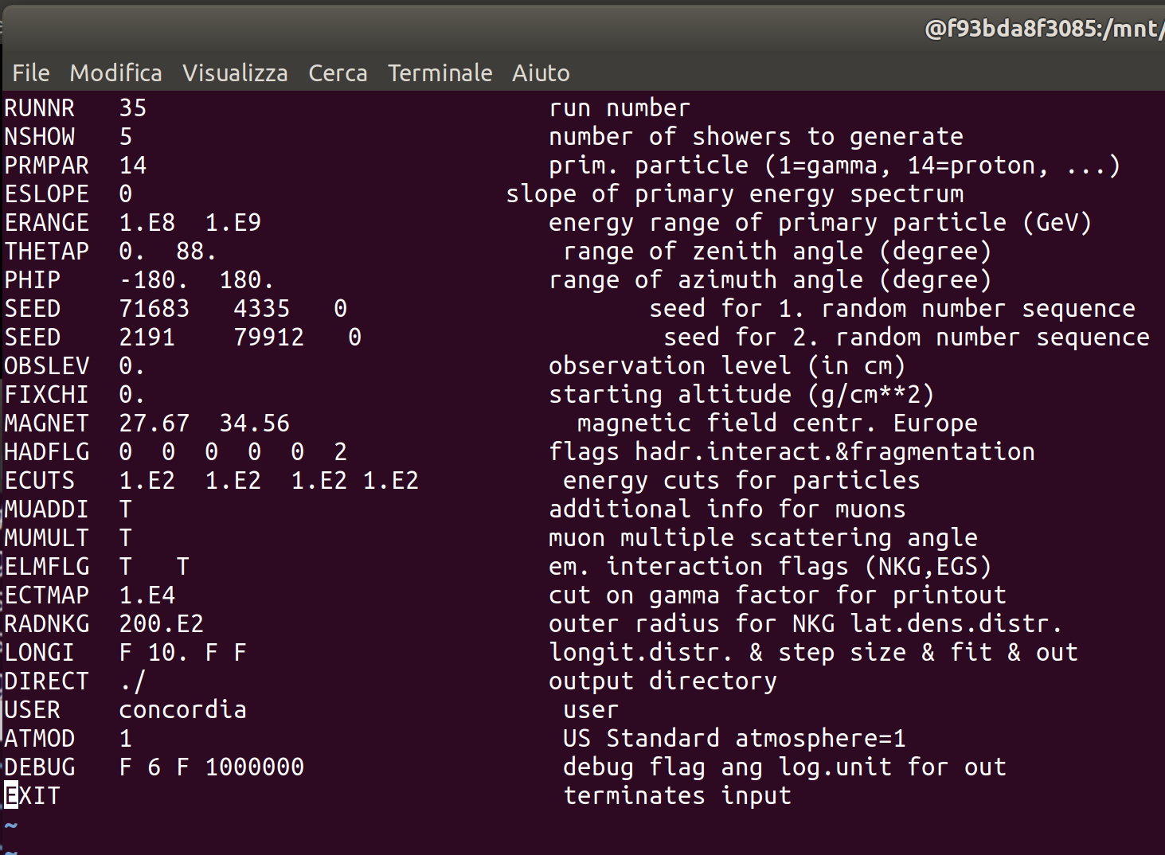
Test results (KM3NeT)
Heavy parallel submission tested the for 2 containers.
Energy Models: GHEISHA/SYBILL
About 40000 x2 events
Protons as primary
Flat spectrum
Zenith angle between 0 to 88 degrees
Energy cut : 100 GeV
Energy Range (GeV) | Numbers of events
1E2 - 1E3 | 10000
1E3 - 1E4 | 10000
1E4 - 1E5 | 5000
1E5 - 1E6 | 5000
1E6 - 1E7 | 1000
1E7 - 1E8 | 5
1E8 - 1E9 | 5
The events was divided among 35 parallel jobs
Notes:
1

Slide 12
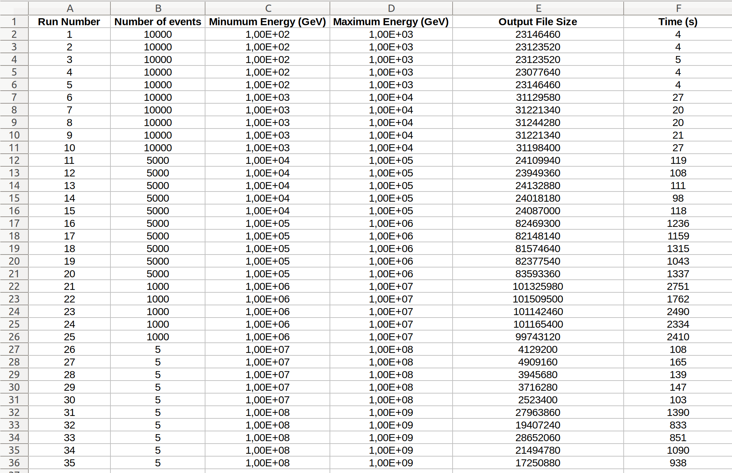
Summary Table (time from submission to the end )
Notes:
1

Slide 13
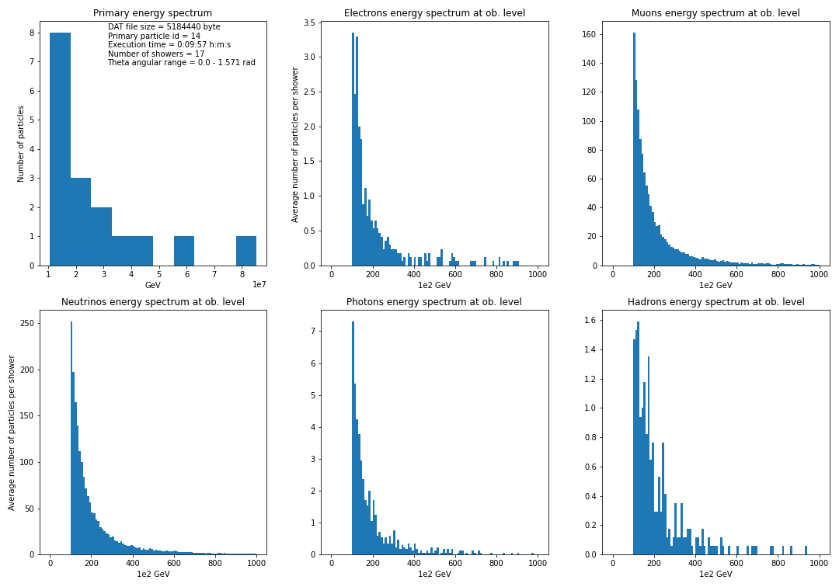
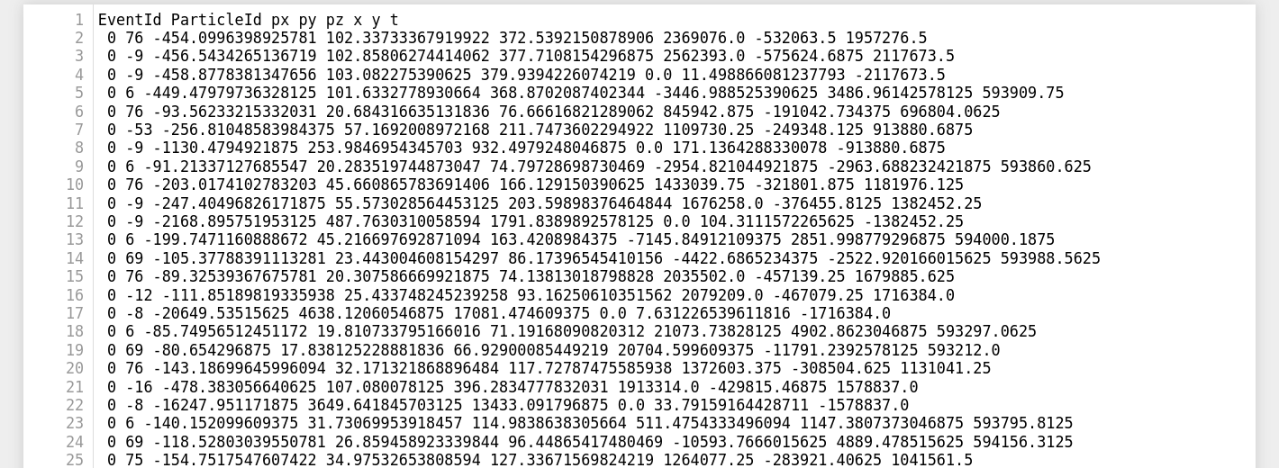
A plot script and a basic binary to ASCII converter are supplied
Notes:
<number>

Slide 14
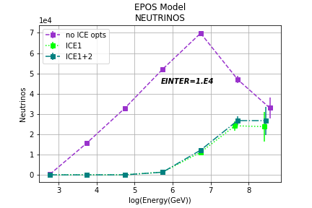
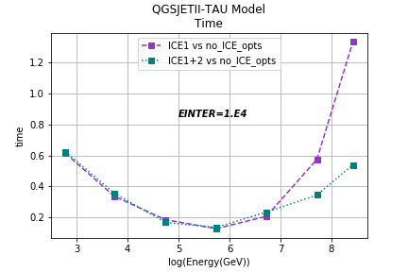
“IceCube” mode performance test
Notes:
<number>

Slide 15
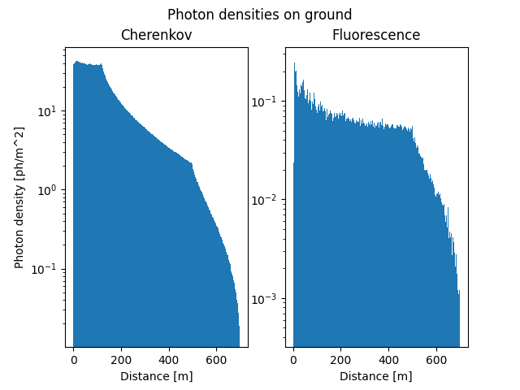
Tests results (CTAO)
Modest production run on the EGI
Example plot
E-OSSR Onboarding Presentation

Slide 16
Service Requirements
Linux OS
Tested on Ubuntu and CentOS7
Singularity version > 2
DIRAC
E-OSSR Onboarding Presentation

Slide 17
OSSR Integration
Available:
GUI and command line for container production
20 pre-compiled containers with general implementations
Also with KM3NeT and CTAO specific configurations
Guide for full options
Containers and source codes for generation will be onboarded together with their documentation
Also test cases scripts for running the container
E-OSSR Onboarding Presentation

Slide 18
OSSR Integration
The CONCORDIA containers are the first step of a Monte Carlo simulation chain.
To be used to simulated in a reliable and reproducible way results across different computing centers.
The users can retrieve already existing containers or create new ones according to their necessities
The CR air shower generation can be launched on the GRID using the DIRAC interface
E-OSSR Onboarding Presentation

Slide 19
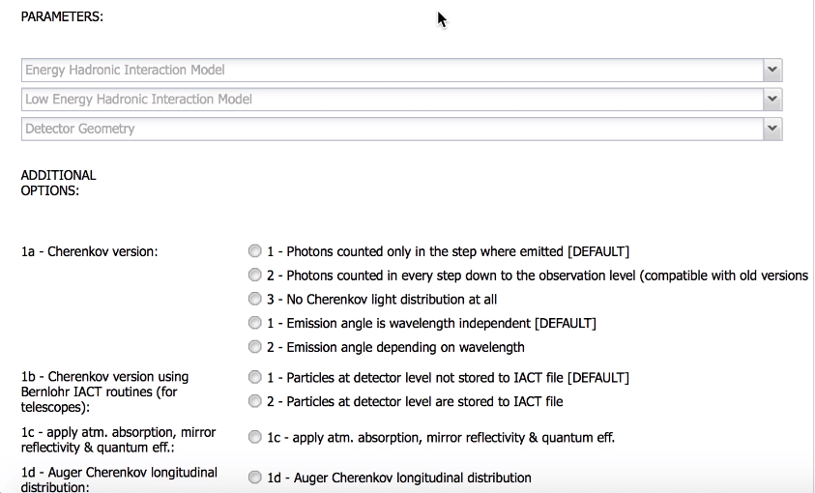
Overview demo
Web GUI for container generation
Also ported to
DIRAC WebGUI
E-OSSR Onboarding Presentation

Slide 20
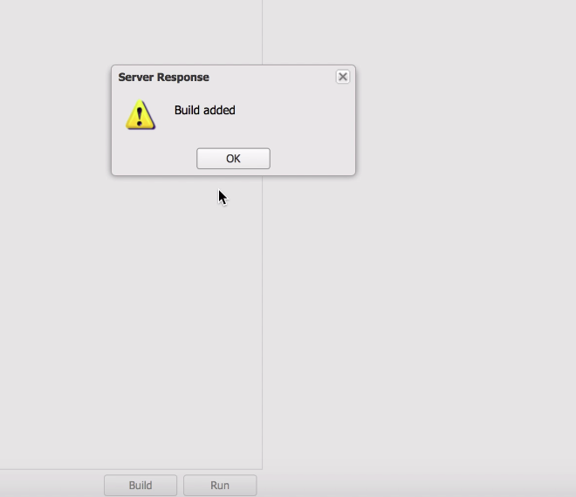
Overview demo
Web GUI for container generation
Also ported to
DIRAC WebGUI
E-OSSR Onboarding Presentation

Slide 21
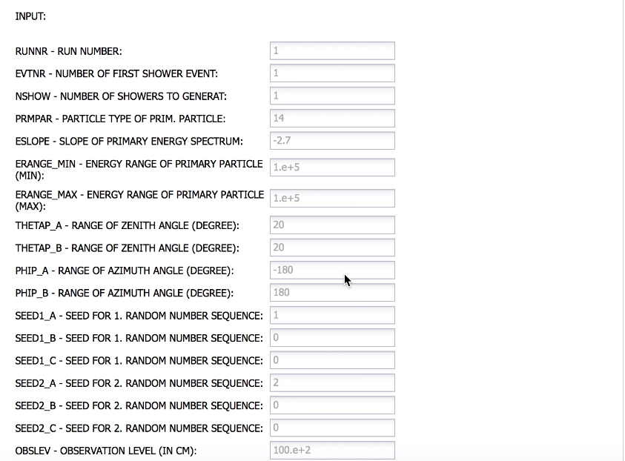
Overview demo
Web GUI for container execution
Also ported to
DIRAC WebGUI
E-OSSR Onboarding Presentation

Slide 22
Overview demo
Web GUI for container execution
Also ported to
DIRAC WebGUI
E-OSSR Onboarding Presentation

Slide 23
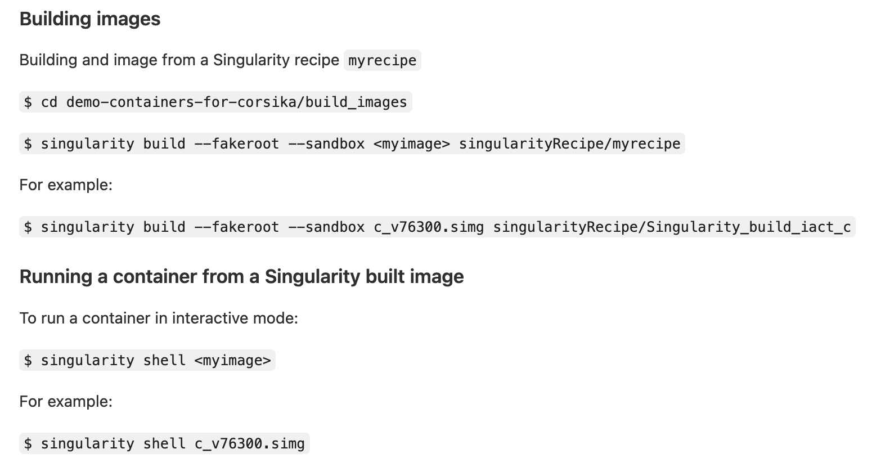
Overview demo
Scripts for container generation/execution
User needs a working Singularity installation
E-OSSR Onboarding Presentation

Slide 24
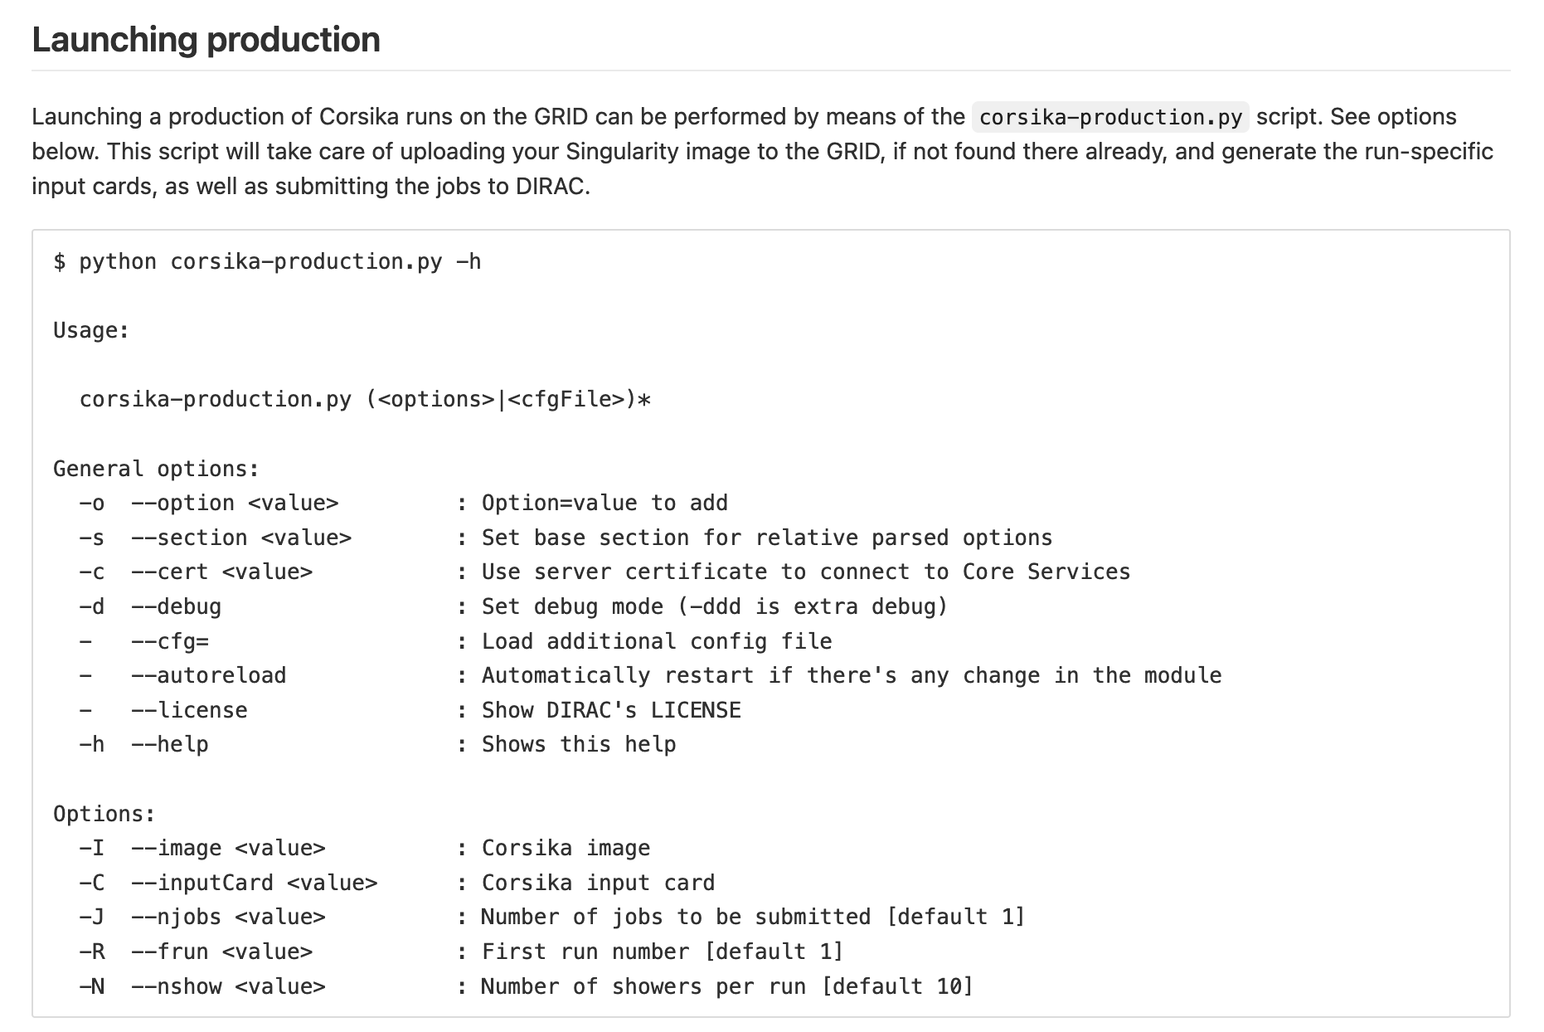
Overview demo
User needs a working DIRAC client and configured proxy
E-OSSR Onboarding Presentation

Slide 25
Overview demo
Production status
User needs a working DIRAC client and configured proxy

Slide 26
Overview demo
Python job launcher corsika.py $CONTAINER_ID $CORSIKA_RUN_INPUT corsika.py -h returns the help, with the ID description
E-OSSR Onboarding Presentation

Slide 27
Open Points and Discussion Time
The CONCORDIA containers will be uploaded on zenodo together with the material described here
The DIRAC release including these developments is being prepared
ESAP – DIRAC integration available
E-OSSR Onboarding Presentation

Slide 28
Table of Contents of the Technical Report
Context
The ConCORDIA project
The CORSIKA Containers library
Developments
Requirements and software dependencies
Workflow integration and Input/Output Data
User’s story
Onboarding
E-OSSR Onboarding Presentation

Slide 29
The ConCORDIA group
C. Bozza (INFN and University of Salerno) – KM3NeT Collaboration
J.L. Contreras (Universidad Complutense de Madrid) – CTA Observatory
L.A. Fusco (CNRS-CPPM, currently at University of Salerno) - KM3NeT Collaboration
G. Hughes – CTA Observatory
D. Nieto Castaño (Universidad Complutense de Madrid) – CTA Observatory
B. Spisso (INFN-Napoli) - KM3NeT Collaboration
S.M. Stellacci (University of Salerno) - KM3NeT Collaboration
A. Tsaregorodtsev (CNRS-CPPM) - DIRAC
D. Zito (INFN- LNS) - KM3NeT Collaboration
E-OSSR Onboarding Presentation

