Slide 1

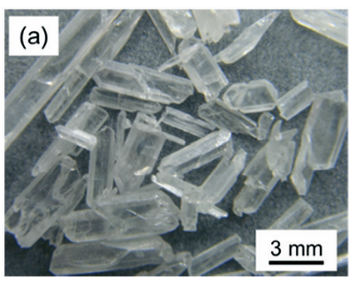



Vers un MP sur la calorimétrie à haute résolution en énergie et temps à cristaux , pour un concept de détecteur à ‘double lecture ‘ (Dual Readout) [FCC-ee]
Powder-0➔GRAiNITA
Remerciements: R. Aleksan, E. Auffray-Hillemanns, C. Dujardin, C. Morel, A. Iyer, K. Lebbou, J. Lefrancois, M.T. Lucchini, C. Tully, G. Gaudio
Suzanne GASCON-SHOTKIN
Reunion FCC-Contacts
17 juin 2022

Slide 2
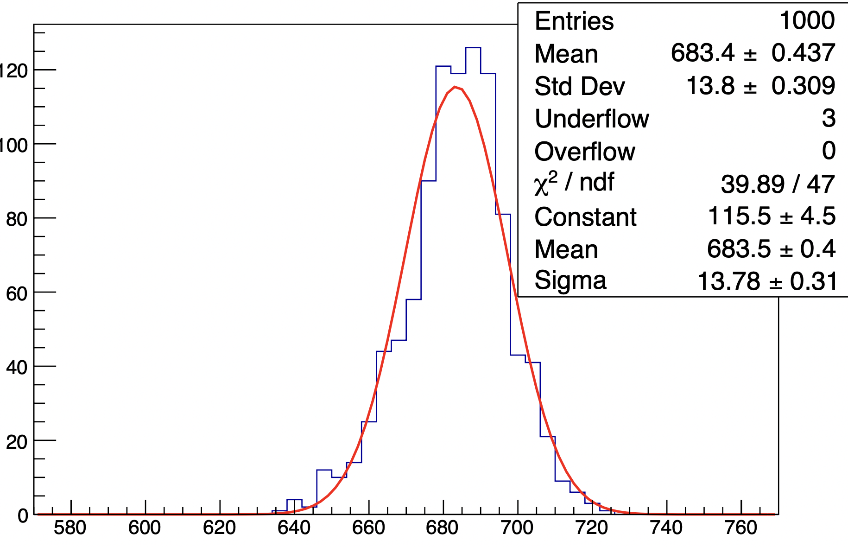
Two possible facets for an IN2P3 MP (1)
High-resolution crystal or crystal-fiber calorimeter (EM-only or EM+Had) with dual readout capability (scintillation and Cerenkov) e.g. SCEPCal
Conserves EM/Had compensation
High transverse granularity (Θ 1cm ² down to Θ mm²)
Energy resolution possible σ(E)/E~3%/sqrt(E) + 0.5%
Precision timing possible down to Θ 10 ps
Scintillating opaque mini-crystals/grains avec diffusion (GRAiNITA) :
Energy resolution possible σ E(E)/E~1.5-3%/sqrt(E) + ~1%
Possible cost advantage vis-à-vis bulk crystals or crystal fibers (processing)
For both: Envisaging possibility for dual readout via Pulse Shape Discrimination (PSD)
Goals:
Production de prototypes
pour valider ces performances (e.g. Spacal LHCb UG):
Domaines de travail: Cristaux, photodétection,
Electronique de lecture, mécanique, simulation
En parallèle: Simulations, études de
grandeurs fondamentales (ids, reco. masse de recul..)
+ jalons
π⁰ assignment for jet reconstruction
GRAiNITA
CERN EP-RD WG3
Alternating cubes 2mm 𝜎E/E = 2.0%
S. GASCON-SHOTKIN FCC-Contacts 17/6/2022
2

Slide 3
Two possible facets for an IN2P3 MP (2)
IN2P3 Master Projects:
Typical length: ~3 years (2023-2025, perfectly coincident with the FCC ‘feasibility study’ time frame)
Typical financing: Θ 100keuros/year
What could we hope to achieve in 3 years?
‘Proof of principle’ for the 2 facets: Energy and time resolutions, e/h compensation, PSD, calibration strategy, ‘infrastructure’ and high-level physics performance predictions
Follow integration possibilities in detector concepts (e.g. IDEA..)
With simulations, prototypes, lab measurements, test beam
Follow and learn from technological ‘test benches’ like LHCb SPACAL
Short- and medium-term ‘deliverables’?
Requesting what resources?
Material, equipment (‘chiffrage’)
HR (postdocs, PhD students..)
Favor activities complementary to or in synergy with those of IT and USA colleagues
π⁰ assignment for jet reconstruction
GRAiNITA
CERN EP-RD WG3
Alternating cubes 2mm 𝜎E/E = 2.0%
S. GASCON-SHOTKIN FCC-Contacts 17/6/2022
3

Slide 4
Intérêts possibles (FR+international)
France/IN2P3 (Pas encore d’engagement formel sur cette proposition de MP) : Discussions en cours (13/5/22)
IP2I Lyon (S. Gascon): Experience in R&D, production, test and operation of large homogeneous high-resolution calorimeters: (L3 BGO, CMS PbWO4….), development and characterization of photodetection devices and readout electronics (including ASICs), expertise recente en imprimerie 3D.
CPPM (C. Morel) et IRFU (D. Yvon): imXgam group, members of Crystal Clear Collaboration, particular interest in timing, photodetection
ILM (UMR 5306, UCB Lyon 1/ INP-CNRS), Luminescence group: (C. Dujardin, K. Lebbou) Bulk crystal, crystal fiber and nanomaterial scintillator production and characterization, large-scale fiber production capabilities with French industrial partners.
LPC (S. Monteil) : Interest in heavy-flavor physics requiring high resolution
IJCLab (J. Lefrancois, M-H.Schune, G. Hull, S. Barsuk): GRAiNITA
International:
CERN: EP-CMX-DA group + Crystal Clear Collaboration (E. Auffray-Hillemanns): crystals
U. Milano Bicocca (M. Lucchini et al): Algorithmes Pflow pour DR, integration dans key4hep.
US community (colleagues from L3/CMS, C. Tully, S. Eno et al): ‘CALVISION’ Consortium DoE proposal (CALorimetry using cerenkoV and Inorganic Scintillation InnOvatioN): electronique de lecture…
➔Au moins 1 concept de détecteur existe déjà (IDEA). Retours sur demandes de financements italiens et US pour cette année/l’année prochaine, il est encore temps pour nous d’avoir un rôle significatif.
S. GASCON-SHOTKIN FCC-Contacts 17/6/2022
4
Notes:
Add financement CALVision obtained

Slide 5
Intérêts (FR+international)
France/IN2P3 (Pas encore d’engagement formel sur cette proposition de MP) : 1st meeting this morning (17/6)
IP2I Lyon (S. Gascon…): development and characterization of photodetection devices, mechanics, (discussions started with instrumentation service), PSD, simulation (fundamental quantities)
CPPM (C. Morel, M. Dupont) et IRFU (D. Yvon): photodetection devices, simulation (fundamental quantities)
ILM (UMR 5306, UCB Lyon 1/ INP-CNRS), Luminescence group: (C. Dujardin, K. Lebbou) Bulk crystal, crystal fiber and nanomaterial scintillator production and characterization
LPC (S. Monteil) : Lab measurements/test benches (LPC cosmic muon tracker), Simulations PSD (G4) and HF analysis
IJCLab (J. Lefrancois, M-H.Schune, G. Hull, S. Barsuk, I. Boiaryntseva): Crystal grains & heavy liquids, PSD
International:
CERN: EP-CMX-DA group + Crystal Clear Collaboration (E. Auffray-Hillemanns): crystals
U. Milano Bicocca (M. Lucchini et al): Algorithmes Pflow pour DR, integration dans key4hep, prototype
US community (colleagues from L3/CMS, C. Tully, S. Eno et al): ‘CALVISION’ Consortium DoE proposal grant [$1.6million over 3 years] (CALorimetry using cerenkoV and Inorganic Scintillation InnOvatioN): electronique de lecture…
➔Au moins 1 concept de détecteur existe déjà (IDEA). Retours sur demandes de financements italiens pour cette année/l’année prochaine, il est encore temps pour nous d’avoir un rôle significatif.
S. GASCON-SHOTKIN FCC-Contacts 17/6/2022
5

Slide 6
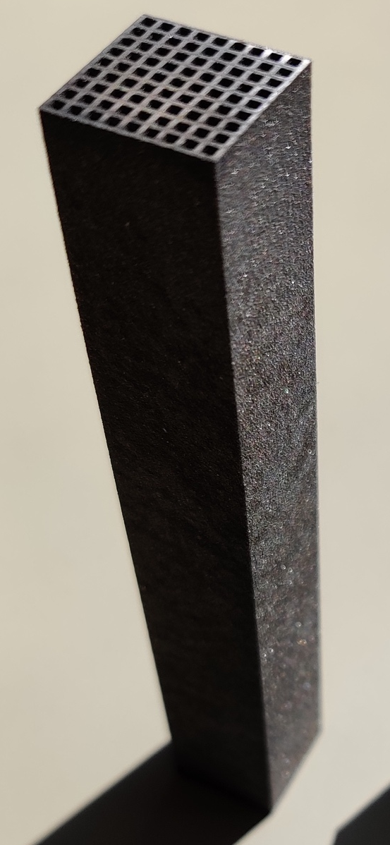
Areas of work (1)
Crystal/crystal fiber evaluation (materials, dimensions, growth/production, caracterisation) : PWO, BSO..Challenges: <~100ns decay time (multiple components for PSD), dual emission (C+S) [ILM…. ]
Crystal grains & heavy liquids evaluation (materials, caracterisation) ZnW0₄… Challenges: <~100ns decay time (multiple components for PSD)…[IJCLab…. ]
Photodetection evaluation and photodetector optimization: WLS, SiPMs/dSiPMs, SPAD, PMT… Challenges: self-absorption, 2-light separation [CPPM, IP2I]
E. Auffray, CERN-EP-RD-WG3
J. Lefrancois, FCC Wk , May 2022
Mechanics: alveolar/support structures, processes (3d printing?) Challenges: reflectivitiy, <~200μ..[IP2I..]
G. Gaudio, ECFA Roadmap Symposium TF6 , May 2021
3D printed W-absorber, LHCb Spacal-W option
15x15x100 mm³
Readout electronics (including ASICs)
S. GASCON-SHOTKIN FCC-Contacts 17/6/2022
6
Notes:
Challenges for each

Slide 7
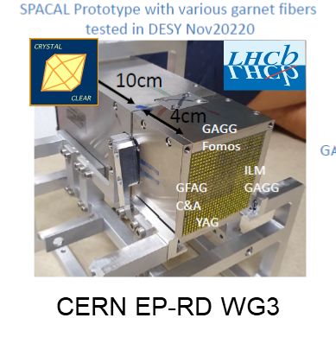
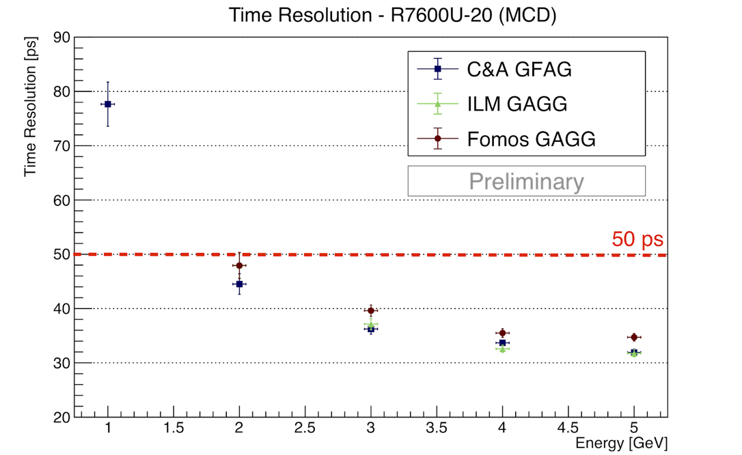
Areas of work (2)
Lab measurements/test benches, PSD [IJCLab, IP2I] integration in detector concept/Test beams, Data Acquisition, Calibration (E, t)
Fundamental quantity (timing, etc. ) [CPPM, IP2I] + Physics ‘infrastructure’ + high-level simulations
Time resolution: Example SPACAL
R&D with W/GAG fibers (New! <20ps arXiv:2205.02500)
π⁰ assignment for jet reconstruction
Recoil mass resolution
DESY 2020,
5 GEV e-
LHCb SPACAL R&D Group, CERN-EP-RD-WG3
M.T. Lucchini, ECFA Roadmap Symposium TF6 , May 2021
S. GASCON-SHOTKIN FCC-Contacts 17/6/2022
7

Slide 8
Supporting slides
S. GASCON-SHOTKIN FCC-Contacts 17/6/2022
8

Slide 9
Improving the DR concept with a crystal or crystal-fiber ECAL: advantages/disadvantages
PWO from CMS ECAL
Bulk crystals or high-density crystal fibers for one or both ECAL layers. Advantages:
Dual-readout capability remains: Bulk or fibers : Materials emitting both scintillating and Cerenkov radiation Fibers: ‘panachage’ of Cerenkov-emitting and scintillating fibers (different dopings)
Energy resolution: Excellent stochastic term ~3%/sqrt(E) typical of homogeneous ECALs
High-precision timing (10s of ps)
SiPM or PMT readout (limited noise and degradation of resolution)
Fibers: Much higher transverse granularity (almost 1 order of magnitude: O(cm) vs O(mm))
Challenges: Fibers: Mechanical ‘alveolar’ structure would have to be developed. Bulk: Need R&D to study best way to separate 2 components, problem of self-absorption, Cost
Crystal fibers developed in Crystal Clear Collaboration, ‘bundle’ concept for illustration; fiber diam 2mm
S. GASCON-SHOTKIN FCC-Contacts 11/6/2021
9

Slide 10
Interested people (FR+international)
Interested people so far (Note: No formal commitment from any European lab yet at this point!):
France:
IP2I Lyon (S. Gascon): Experience in R&D, production, test and operation of large homogeneous high-resolution calorimeters: (L3 BGO, CMS PbWO4….), in particular development and characterization of photodetection devices and readout electronics (including ASICs)
CPPM (C. Morel): imXgam group, member of Crystal Clear Collaboration, particular interest in timing
LPC (S. Monteil) : Interest in heavy-flavor physics requiring high resolution
ILM (UMR 5306, UCB Lyon 1/ INP-CNRS), Luminescence group: (C. Dujardin, K.
Lebbou) Cutting-edge research in bulk crystal, crystal fiber and nanomaterial scintillator production and characterization, large-scale fiber production capabilities with French industrial partners.
International:
CERN: EP-CMX-DA group and Crystal Clear Collaboration (E. Auffray-Hillemanns)
U. Milano Bicocca (M. Lucchini)
US community (colleagues from L3/CMS, C. Tully, S. Eno et al): ‘CALVISION’ Consortium DoE proposal (CALorimetry using cerenkoV and Inorganic Scintillation InnOvatioN)
➔Some work started in the contexts of IDEA, Crystal Clear, EP-RD, AIDAInnova (Task 8.3.1)
CERN EP-RD WG3
S. GASCON-SHOTKIN FCC-Contacts 11/6/2021
10

Slide 11
Next steps…. (1)
Goal is to form an R&D consortium of interested groups/individuals, eventually request support from IN2P3 and envision requests for EU and other funding.
Areas of work (subject to machine constraints and physics goals):
Crystal and crystal fiber evaluation including ray-tracing simulations, production processes and capacity
Photodetection evaluation and photodetector optimization: SiPMs/dSiPMs, PMT…
Readout electronics (including ASICs)
Mechanics: requirements and processes (3d printing?)
E. Auffray, CERN-EP-RD-WG3
G. Gaudio, ECFA Roadmap Symposium TF6 , May 2021
3D printed W-absorber, LHCb Spacal-W option
15x15x100 mm³
S. GASCON-SHOTKIN FCC-Contacts 11/6/2021
11

Slide 12
Next steps…. (2)
Goal is to form an R&D consortium of interested groups/individuals, eventually request support from IN2P3 and envision requests for EU and other funding.
Areas of work (subject to machine constraints and physics goals):
Performance (timing, etc. )+ Physics simulations
Time resolution: Example SPACAL
R&D with W/GAG fibers
π⁰ assignment for jet reconstruction
Recoil mass resolution
DESY 2020,
5 GEV e-
LHCb SPACAL R&D Group, CERN-EP-RD-WG3
M.T. Lucchini, ECFA Roadmap Symposium TF6 , May 2021
S. GASCON-SHOTKIN FCC-Contacts 11/6/2021
12

Slide 13
The physics case for a high-resolution calorimeter for FCC (-ee): Measurements
Study of CP with
multiple-neutral modes
What’s behind it: Pairing of photons to accurately reconstruct π₀
M.T, Lucchini 4th FCC Workshop, Nov 2020
R. Aleksan, FCC-France Jan 2021
High-resolution calorimeter needed to
see signal
S. GASCON-SHOTKIN FCC-Contacts 11/6/2021
13

Slide 14
The physics case for a high-resolution calorimeter for FCC (-ee): Searches
Low-mass ALPs : Poor recoil mass resolution could fake a signal
R. Aleksan, FCC-Physics March 15 2021
What’s behind it: Brem recovery enabling Z→ee to achieve 80% of Z→mumu resolution
M.T, Lucchini 4th FCC Workshop, Nov 2020
PNGB close in mass to Z (background from ee fakes)
A. Iyer, FCC-France Jan 2021
S. GASCON-SHOTKIN FCC-Contacts 11/6/2021
14
Notes:
.

Slide 15
Improving the DR concept with a crystal or crystal-fiber ECAL (context: IDEA)
M.T, Lucchini 4th FCC Workshop, Nov 2020
S. GASCON-SHOTKIN FCC-Contacts 11/6/2021
15

Slide 16
Improving the DR concept with a crystal or crystal-fiber ECAL (context: IDEA)
M.T, Lucchini 4th FCC Workshop, Nov 2020
S. GASCON-SHOTKIN FCC-Contacts 11/6/2021
16

Slide 17
Improving the DR concept with a crystal or crystal-fiber ECAL: Readout with SiPMs
M.T, Lucchini 4th FCC Workshop, Nov 2020
S. GASCON-SHOTKIN FCC-Contacts 11/6/2021
17

Slide 18
Improving the DR concept with a crystal or crystal-fiber ECAL: Readout with SiPMs
M.T, Lucchini IAS2021, Jan 2021
S. GASCON-SHOTKIN FCC-Contacts 11/6/2021
18

Slide 19
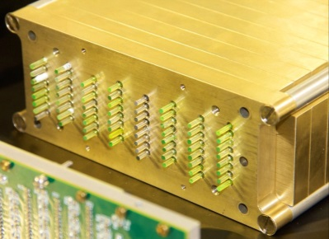
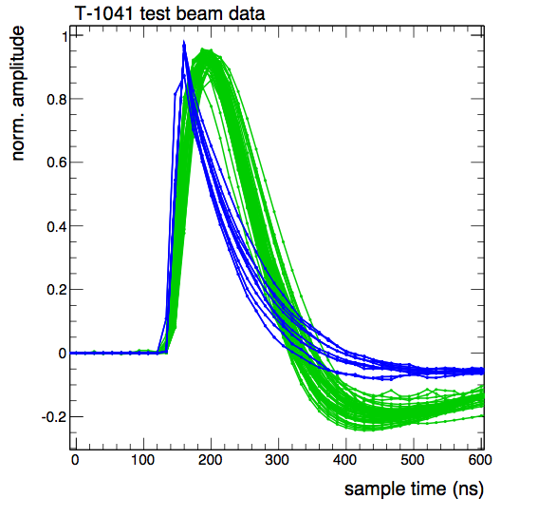


R&D Efforts at CERN (1) and in France
R&D on scintillating/Cerenkov fibers in the framework of the Crystal Clear Collaboration (RD18)
Dual Readout developments
Beam
Cerenkov
(LuAG)
Scintillation (LuAG:Ce)
E. Auffray, FCC-France January 2021
Good separation of
Scintillation & Cerenkov
S. GASCON-SHOTKIN FCC-Contacts 11/6/2021
19

Slide 20
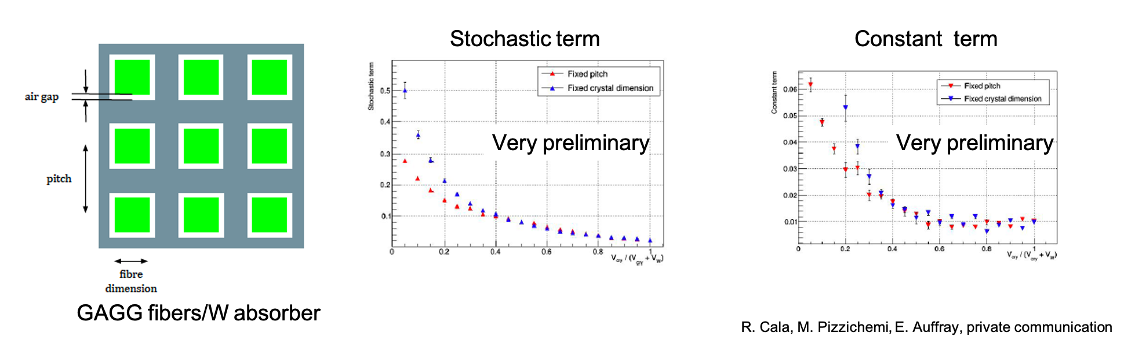
R&D Efforts at CERN (2) and in France
LHCb SPACAL R&D
Timing developments
R. Poeschl, ECFA Roadmap TF6 Symposium Summary @Muon Collider Physics & Detector Workshop, June 2021
LHCb
E. Auffray, FCC-France January 2021
R&D in CERN EP-RD WG3 calorimetry for LHCb calorimeter phase II upgrade
Simulation,
S. GASCON-SHOTKIN FCC-Contacts 11/6/2021
20

Slide 21
R&D Efforts at CERN and in France
Institut Lumiere-Matiere (UMR 5306, UCBL-CNRS), Luminescence group: Dr. Kheirreddine LEBBOU (DR), responsible for Crystal Growth activity, and Prof. C. DUJARDIN, responsible for Scintillators & Phosphors characterisation activity
Cutting-edge research in bulk crystal, crystal fiber and nanomaterial scintillator production and characterization, large-scale fiber production capabilities with French industrial partners.
Historical collaboration within Crystal Clear Collaboration, most recenty on DR and SPACAL developments, ANR INFINHI (2010-2014) + ScintLab’ IRP Laureate (2020-2025)
S. GASCON-SHOTKIN FCC-Contacts 11/6/2021
21

Slide 22
Going forward: Possible FR participations
Historically much expertise in certain French HEP labs in R&D, production test and operation of large homogeneous high-resolution calorimeters: (L3 BGO, CMS PbWO₄….)
IP2I: Development and characterization of photodetection devices and readout electronics (including ASICs)
LLR: Development of mechanical structures and thermal sensors
CEA IRFU: Development of sophisticated crystal transparency monitoring systems with lasers
Already a strong history of collaboration with E. Auffray-Hillemanns (CERN-EP-CMX-DA group) on CMS and within Crystal Clear Collaboration (interest in timing from CCC member C.Morel (CPPM))
could join with:
ILM (UMR 5306, UCBL-CNRS), Luminescence group: C. Dujardin and K.
Lebbou, a unique national resource, very interested in participating (invitation wkshp)
Discussions with consequential US community (colleagues from L3/CMS): ‘CALVISION’ Consortium DoE proposal (CALorimetry using cerenkoV and Inorganic Scintillation InnOvatioN)
Note IHEP group from Beijing (mostly working on bulk crystals currently)
S. GASCON-SHOTKIN FCC-Contacts 11/6/2021
22

Slide 23
A homogeneous HCAL?
M.T. Lucchini, ECFA Roadmap Symposium TF6 , May 2021
S. GASCON-SHOTKIN FCC-Contacts 11/6/2021
23

Slide 24
Crystal Calorimetry: resume
High-resolution crystal or crystal-fiber calorimeter (EM-only or EM+Had) with dual readout capability (scintillation and Cerenkov) e.g. SCEPCal
Conserves EM/Had compensation
High transverse granularity (Θ 1cm ² down to Θ mm²)
Energy resolution possible σ(E)/E~3%/sqrt(E) + 0.5%
Precision timing possible down to Θ 10 ps
Scintillating opaque mini-crystals/grains avec diffusion (Powder-0) :
Energy resolution possible σ E(E)/E~1.5-3%/sqrt(E) + ~1%
σ E(had)/E~15%/sqrt(E) (see previous slide, for homogeneous HCAL)
Envisaging possibility for dual readout
S. GASCON-SHOTKIN FCC-Contacts 11/6/2021
24

