Slide 1
Proposition pour un développent de senseurs CMOS monolithiques à l’IP2I
Physique des particules pour l’avenir à l’IP2I, 24 Juin 2022
D. Contardo

Slide 2
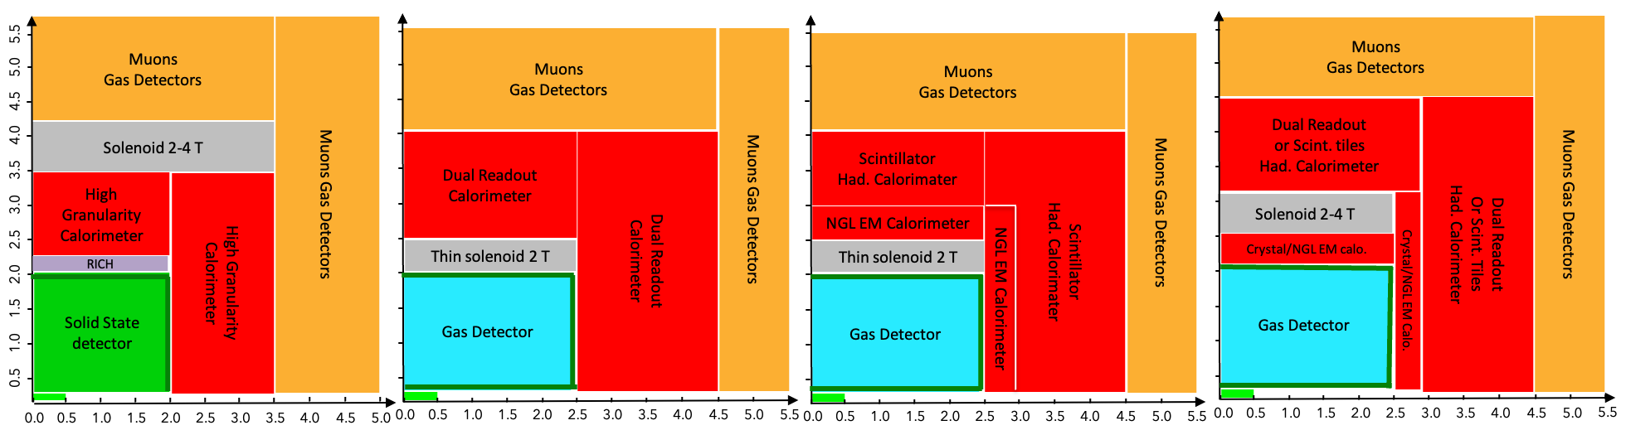
FCC-ee Detector Conceptual Designs
System options for « Senseurs CMOS monolithiques » = Monolithic Active Pixel Sensors (MAPS)
High Granularity Calorimeter electromagnetic section (HGC)
    Could be pads with analog readout or pixels for particle counting (à la SDHCAL)
      Central Tracker (CT) (including wrap-up layer surrounding DC/TPC in Gas Detector CDs
        Granularity can also be reduced compared to pixels particularly in z
          Timing Layer(s) for π/k/p PID
            Could be part of the Central Tracker (with appropriate σ_{hit})
Vertex Detector
  Most constraining, but very small number of sensors
2

Slide 3
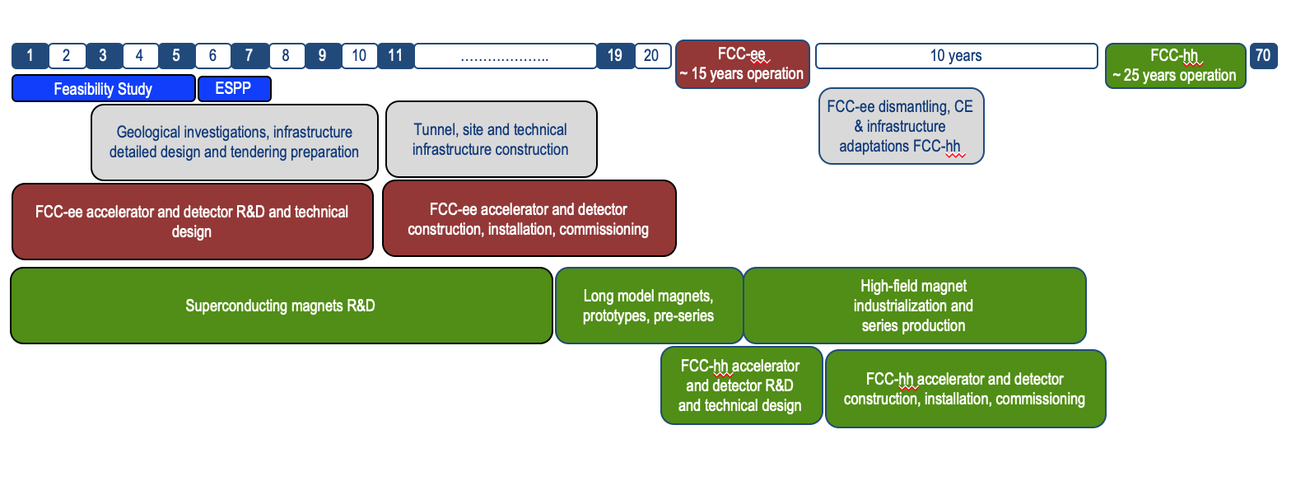
Timeline of the FCC program
technologies R&D
conceptual design
final system
engineering
FCC-ee detector preparation
production
Instal.
2021
2026-27
2032
2035
18
2043-45
Intermediate experiment upgrades for the High Luminosity LHC
      ALICE ITS3 in LS3 2026-2028
              ALICE-3, LHCb Phase-2 in LS4 2033-2034
3

Slide 4
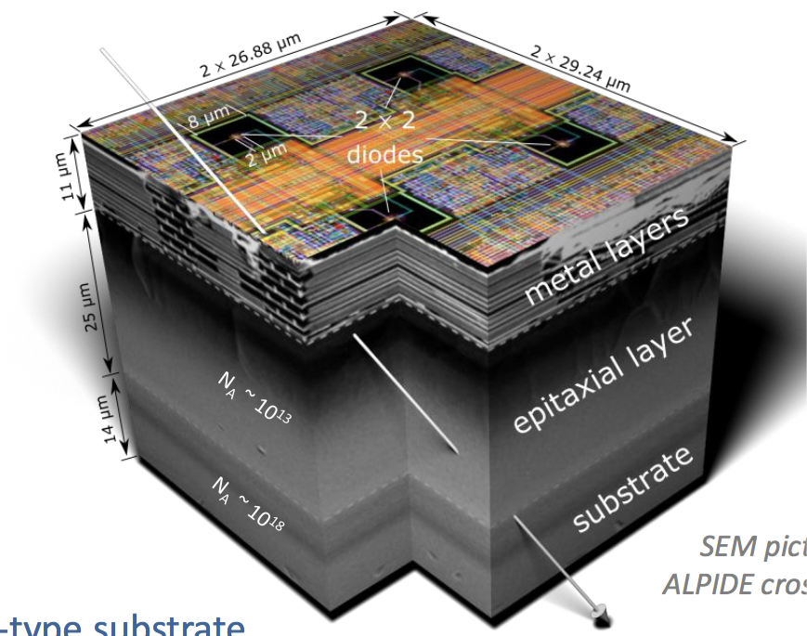
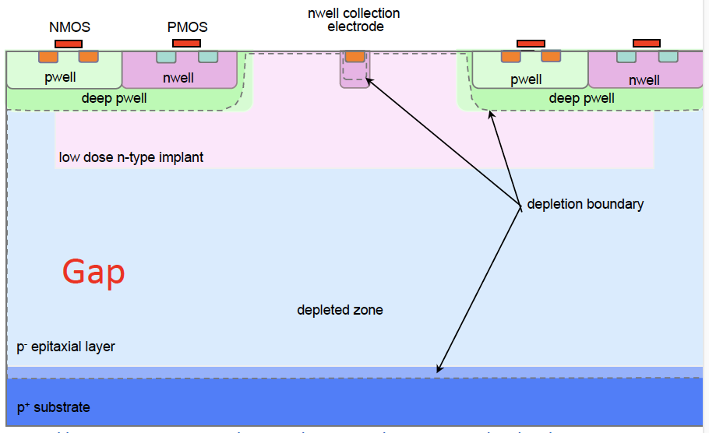

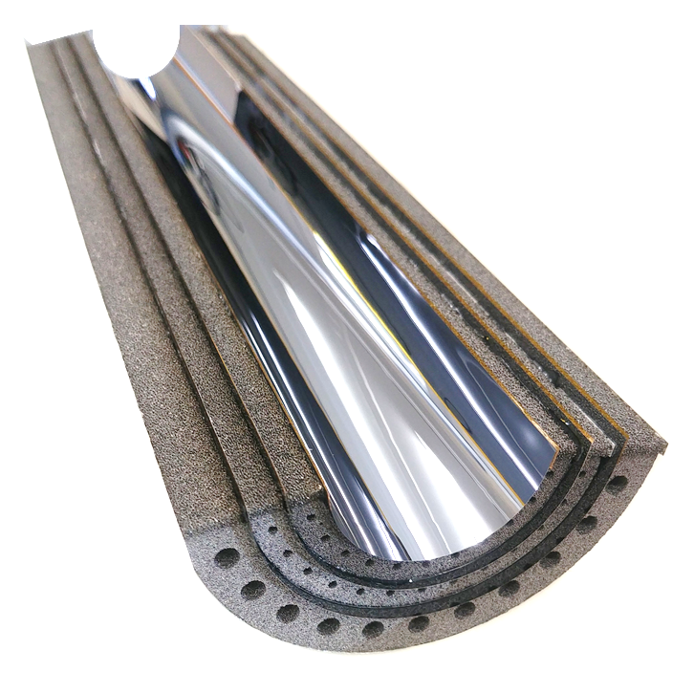

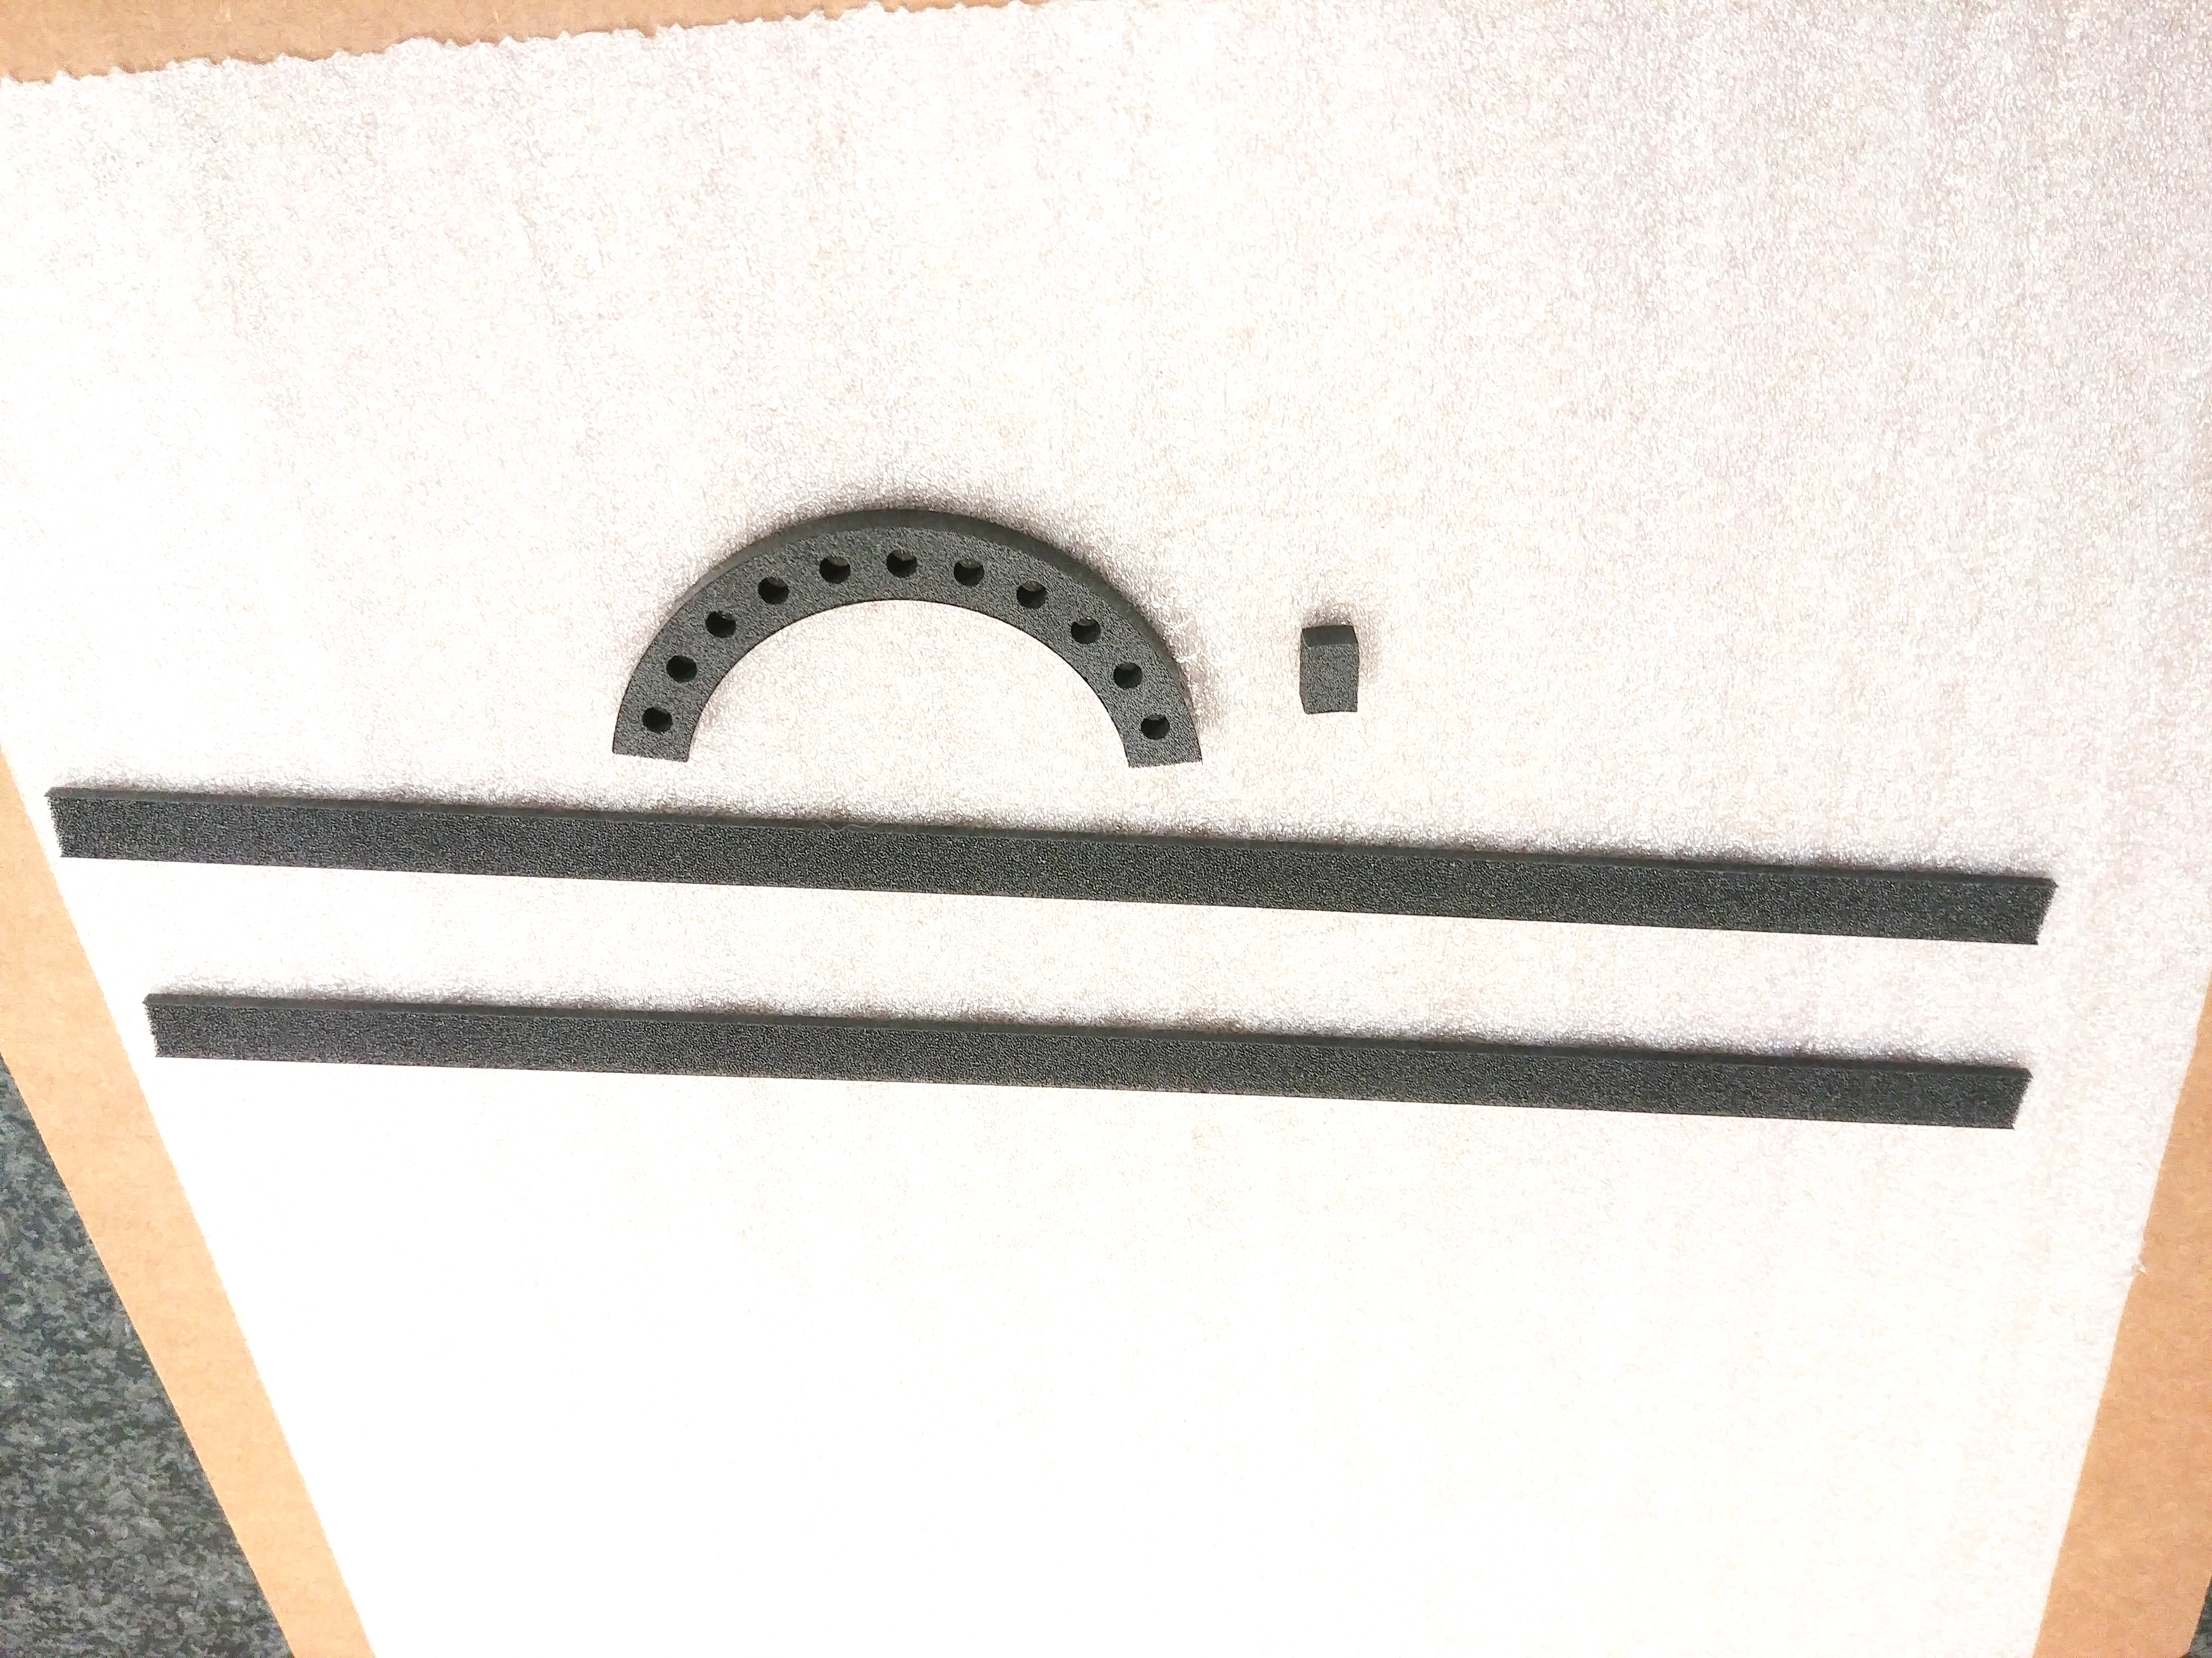
FCC-ee tracking must measure particle origin (Vertex Detector) with
O(10) μm precision & transverse momenta (Central Tracker) to O(10⁻³)
Monolithic devices with very small pitch and large area are the best candidates for σ_{hit} ≲ 3 μm and best transparency, with deep node technology to minimize power dissipation
O(20) mW/cm² (for gas flow cooling in VD)
Modified process for full depletion
faster, more radiation tolerant
Mask stitching on 12’’ wafers
Bent sensors for system transparency
MAPS 180 nm MicroSemi/Intel
ALICE MAPS 180 nm MicroSemi/Intel
Being ported to TPSCO CIS process 65nm
for pitch< 20 µm
16

Slide 5
Useful simulation studies and engineering modeling
Full simulation of physics benchmarks and background for rates
  Prepare realistic event inputs for architecture simulation → all (VD, CT, TL, HGC)
  Study asymptotic impact of σ_{hit} on σ_{d0/z} (p_{T}, η) - considering overall configuration, X/X₀… → VD
  Study asymptotic effect of σ_{hit} on σ_{pT} (p_{T}, η) considering overall configuration, X/X_{0…} → CT
  Study electrode pitch (grouping in r-z) → CT, TL, HGC
    Including comparing analog vs counting → HGC
  Study improvements of energy resolution with sensor thickness and benefit of large MAPS for compactness, uniformity → HGC
  Study benefit of timing precision on energy resolution… → HGC
Develop a model of power consumption scaling in matrix & periphery → all
  According to #channels & gemoetry (electrode size/capacitance), FE speed/noise, rates
    w/o and w/ precision timing ToA/ToT implementation
Simulate/evaluate architecture options performance with realisitc simulation inputs → all
Develop a model of power consumption impact on cooling to estimate
  X/X₀ → VD, CT, TL
  Effect on energy resolution → HGC

Slide 6
R&D possible lines and relevance to systems
Sensitive area
  Large area sensors with stitching → all systems
  Small pitch, thin active layer for ultimate σ_{hit} and σ_{t} → all systems
  Pads vs small electrode and grouping for S/N, in thin/thick sensors for ultimate σ_{t} → CT, HGC, TL
    Sensor simulations (TCAD) could guide optimisation of parameters(also for b)
  3D or amplification monolithic designs for ultimate σ_{t} → all systems
Readout
  Low power architecture adapted to FCC-ee rates → all systems
    Readout concept, synchronous vs asynchronous…
    Timing implementation FE and ToA/ToT
      FE O(25) ns for σ_{t} O(1) ns → HGC – FE O(1) ns for σ_{t} O(10) ps → TL, possibly HGC
      TDC implementation and granularity (depending on rates…)
  Investigate implementation in 3D integration
    On detector clustering and data reduction

Slide 7
R&D opportunity at IP2I and status of MAPS R&D proposal
Engineers becoming available following completion of the CIC tracker poject
  With experience in new complex electronics design implementation techniques (Digital on Top)
Expertise in tracking devices and MAPS expertise
Proposal to join DICE IN2P3 MP on MAPS R&D in TJ 65 nm technology submited to IP2I management and presented to CS 01/03/2022
  Got agreement to start initial work and to further investigate deliverables
Discussions on-going to identify contribution in context of 65 nm CERN EP WP1.2 RD
  Sort term goal is 2nd Engineering Run (ER2) Oct. 2023
    Possible initial contribution in preparation of compact manufacturing libraries for Priority Encoder blocks with IPHC – this will be part of the mainstream objective of ER2 to produce a 1st full size ITS3 (ALICE) sensor
    Investigation of possible implementation of other features at perifhery of ITS3 sensor – being discussed with IPHC and CERN (will depend on specs of the ITS3 sensor and overall ER2 goals not yet fully defined)
    IP2I internal discussion ongoing to profit from existing TDC developments for precision timing
  Beyond ER2, a new framework should be put in place in implementation of ECFA RD roadmap
    This set a time scale O(1) year to define specific demonstrator goals toward FCC (international context)
Further ressource needs
  Missing RH for simulations, testing and modelling of ReadOut architecture (verilog), reduce the potential to integrate the ongoing activities – we need to prepare requests (one on going for a PhD in microelectronics service in the framework MICHRAU pole)

