Slide 1
Prospects on the ILC project
I.Laktineh, UCBL-IP2I

Slide 2
Outline
ILC Machine: Site, accelerator, beams, performance
ILC Detectors: SiD, ILD
ILC Physics potential: Higgs, Top, new physics, etc.

Slide 3
ILC machine
Several staging options
To reduce the project cost a scenario with 250 GeV is chosen.
BDS and main dumps are designed to allow running up to 1 TeV

Slide 4
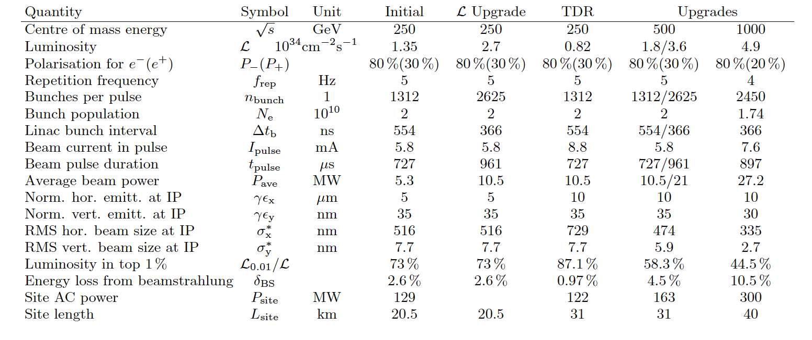

Slide 7
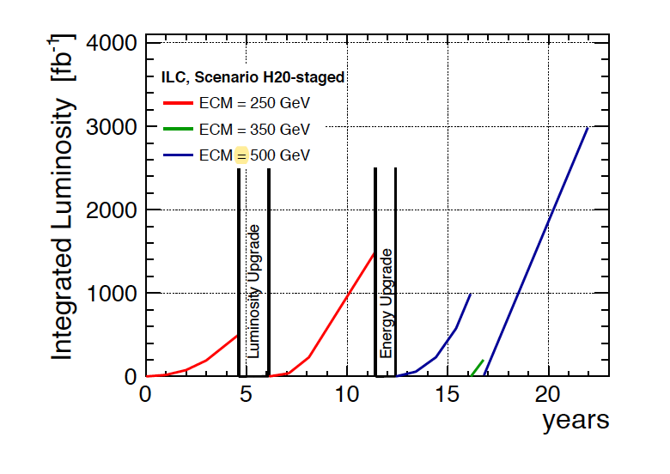
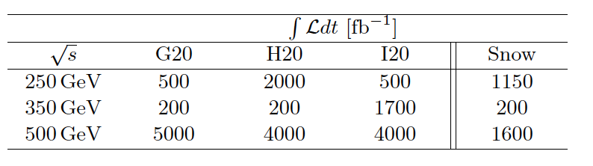
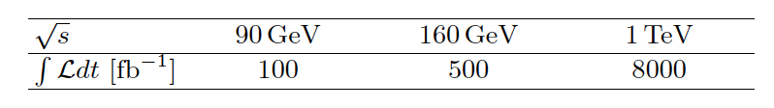

Slide 8
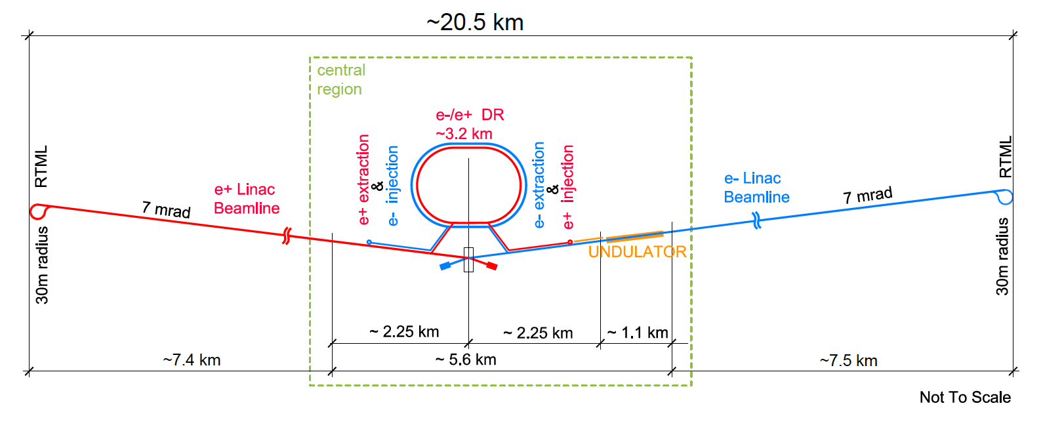
Electron&positron sources: to produce polarized beam
Damping rings: to accelerate electrons and positrons to 5 GeV in the
required paquets
Main linacs: to accelerate electrons/positrons from 5 to 125 GeV.

Slide 9
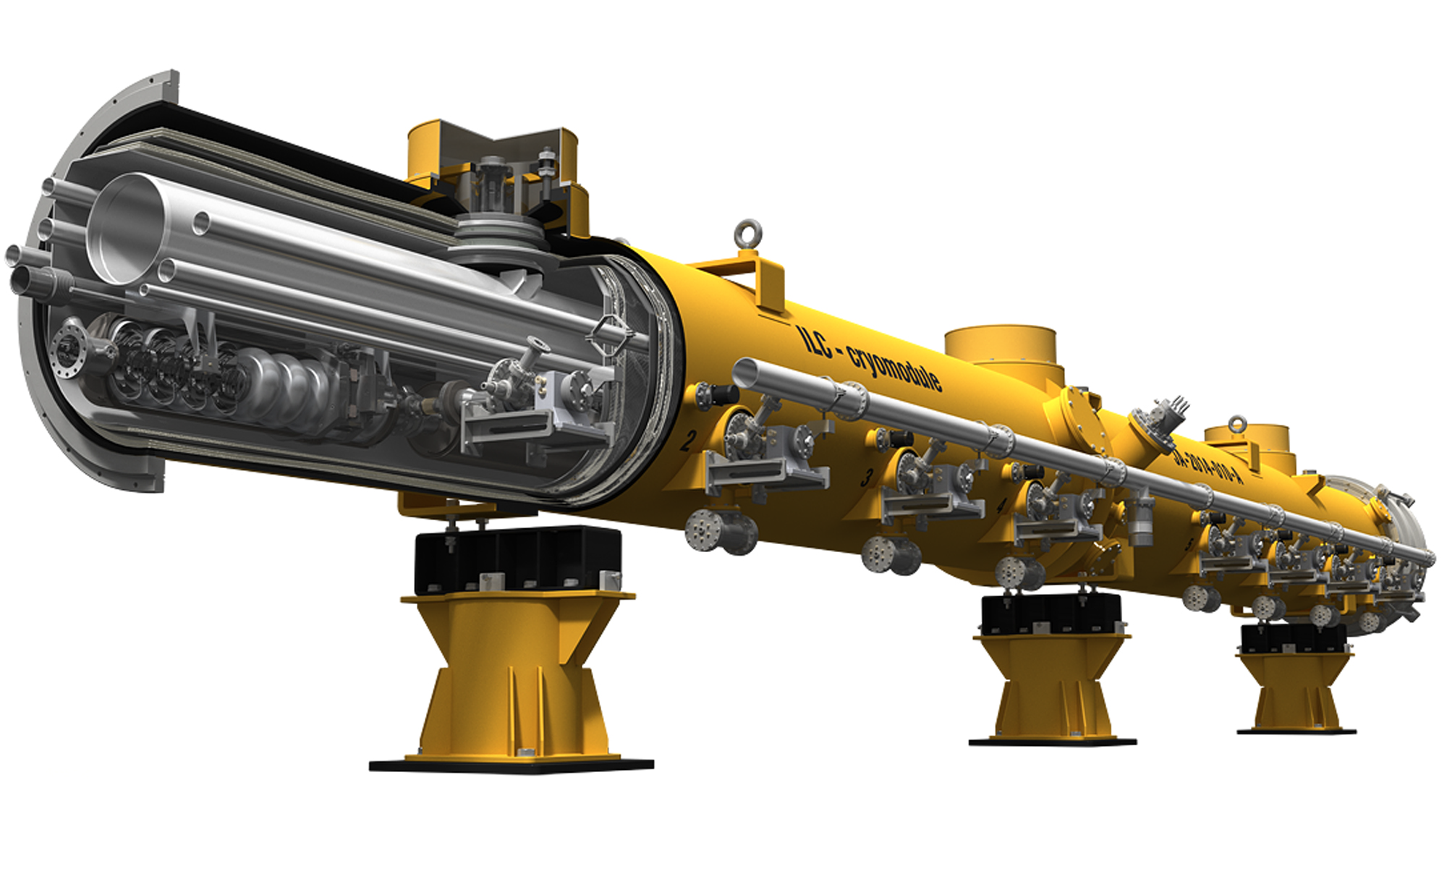
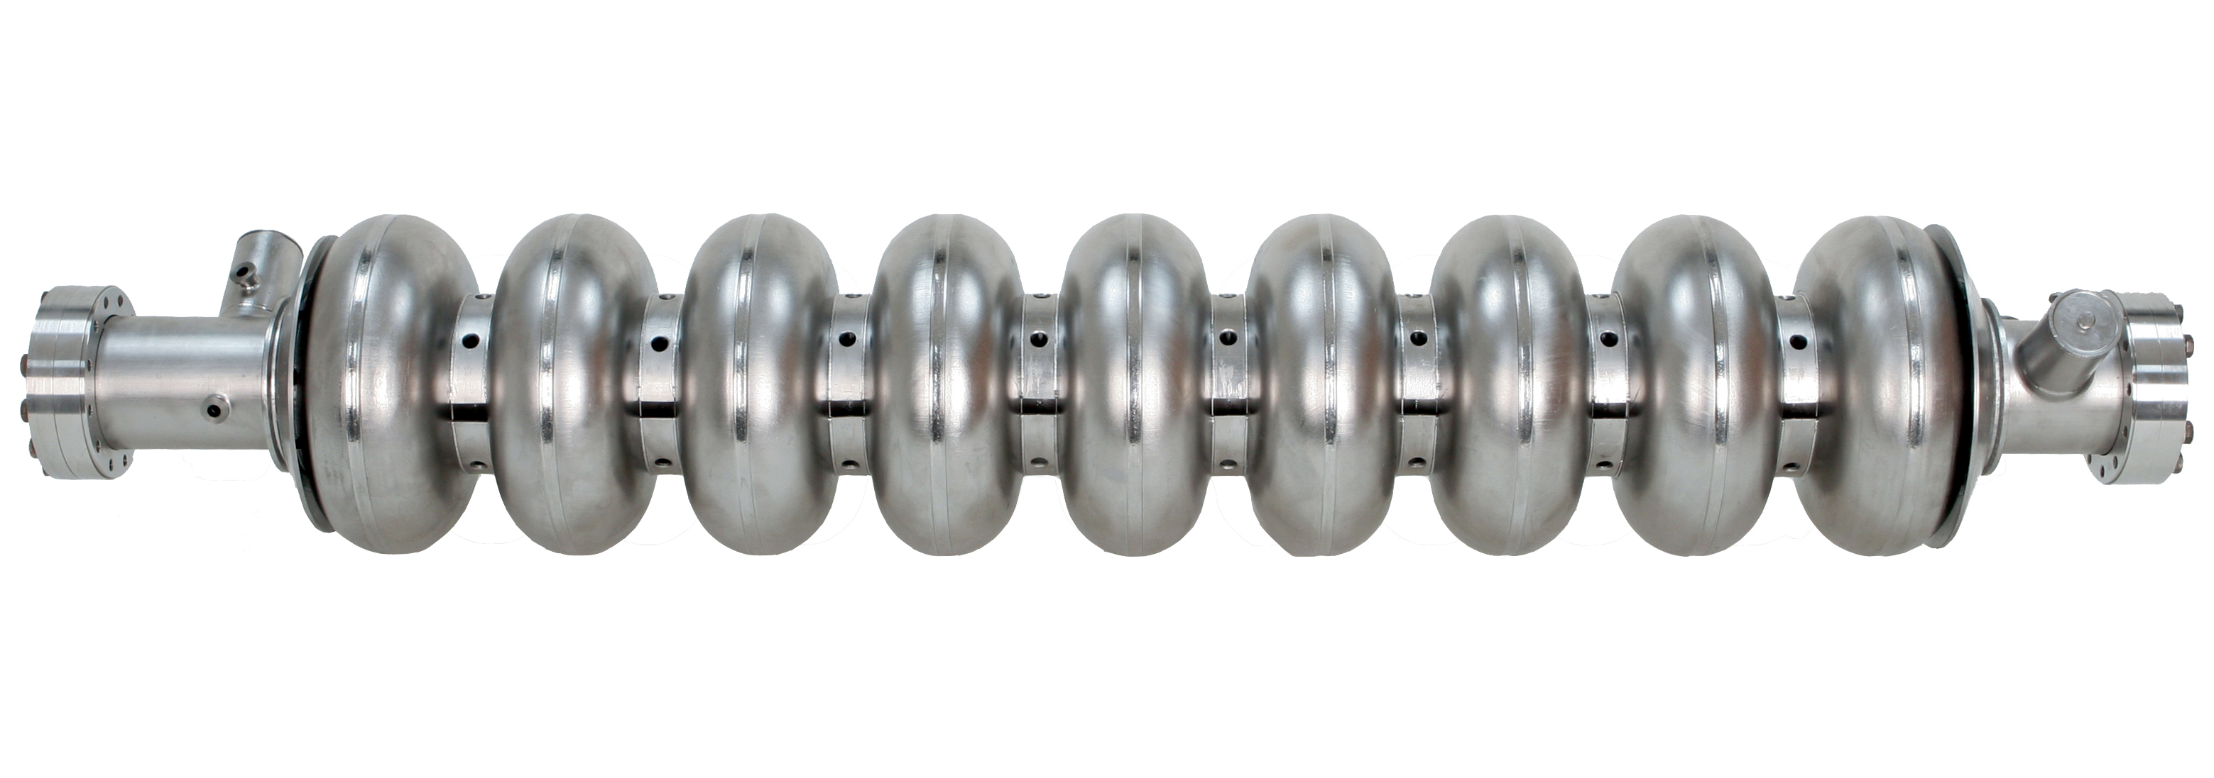
Main Linac is made of cryomodules equipped with RF Klystrons:
Each cryomodules is made of 9 cavities or 8 cavities+ QP/corrector.
Each cavity is a 1.3 GHz nine-cell niobium operated at 2 K (>31.5 MV/m)

Slide 10
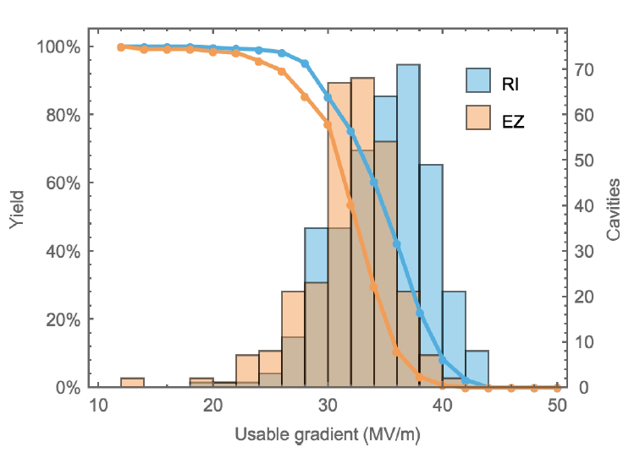
Main Linac is made of cryomodules equipped with RF Klystrons
Each cryomodules is made of 9 cavities or 8 cavities+ QP/corrector.
Each cavity is a 1.3 GHz nine-cell niobium operated at 2 K (>31.5 MV/m)
Cavity performance for XFEL
XFEL best value is 44.6 MV/m (not far from the expected theoretical value of 48).
Ongoing improvement on cavities: Nitrogen infusion at 120°C could
Improve Q0
Reach ILC required value
Simplify the cavity production and reduce the cost.

Slide 11
Electron & positron beam
Electron source is based on the SLC polarized source scheme.
TI:saphhire laser impinging on photocathode made of GaAa/GaAsP strains
85% polarized electrons
Positron source:
baseline: Hard circularly polarized photons are produced by the electron beam of the main Linac in a helical undulators. They are converted into electrons-positrons on a rotating target. Positrons are at 30% longitudinally polarized.
cons: Target heating, photon dumping..
pros: up to 10 Hz (determined by the damping time)
Electron driven scheme. An independent electron beam of 3 GeV is used on rotating target to produce the positron.
cons: limited to 5 Hz (positron time production)
pros: limited target heating, less risky
30% polarization is reachable at 250 GeV and up to 60% at 500 GeV.

Slide 12
Electron & positron beam
Electron source is based on the SLC polarized source scheme.
TI:saphhire laser impinging on photocathode made of GaAa/GaAsP strains
85% polarized electrons
Positron source:
baseline: Hard circularly polarized photons are produced by the electron beam of the main Linac in a helical undulators. They are converted into electrons-positrons on a rotating target. Positrons are at 30% longitudinally polarized.
cons: Target heating, photon dumping..
pros: up to 10 Hz (determined by the damping time)
Electron driven scheme. An independent electron beam of 3 GeV is
used on rotating target to produce the positrons.
cons: limited to 5 Hz (positron time production)
pros: limited target heating, less risky
30% polarization is reachable at 250 GeV and up to “60%” at 500 GeV.

Slide 13
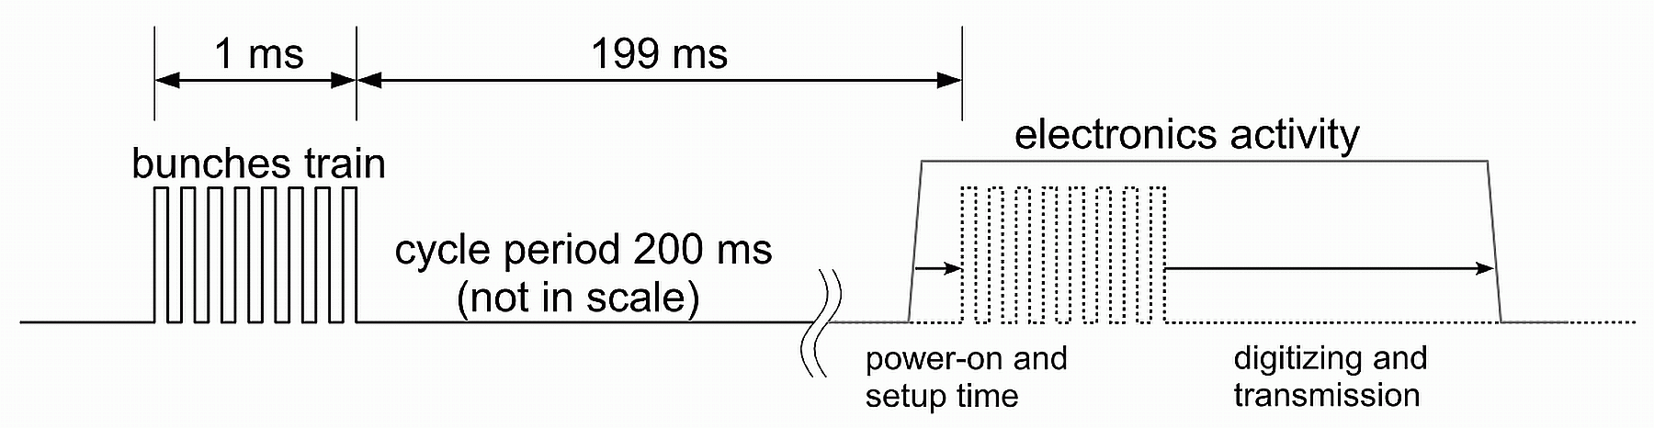
Bunch Crossing structure
Train of 1ms duration every 200 ms (5 Hz), 1312 BC/train
Readout electronics is conceived to read out all the events (triggerless mode) during the bunch crossings, store them and then transfer them just after.
Electronics is switched off after data transfer until a new train
(a factor 100 of power reduction)
→ almost no cooling →low material budget

Slide 14
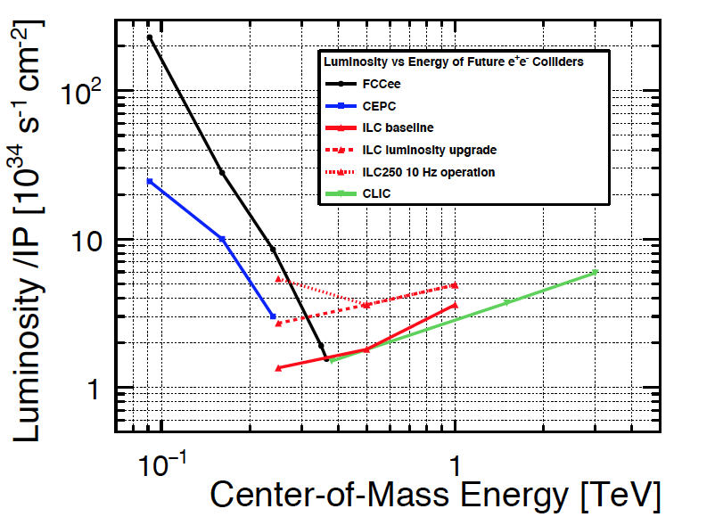
Luminosity upgrade scenario:
1312 BC/train → 2624/train
5 Hz→ 10 Hz
This will increase the luminosity
by a factor of 4
A possible increase to 15 Hz is
under study to get an increase of a factor 6.
The ILC luminosity increase by a factor of 6 has a moderate cost increase
5.5 B→ 5.5+1.9 B€$
Cost increase is due to additional klystrons and cryo modules
By using more cavities (3000) with improved Q₀= 2 x 10¹⁰
380 GeV scenario is possible with additional 1.5 B$

Slide 15
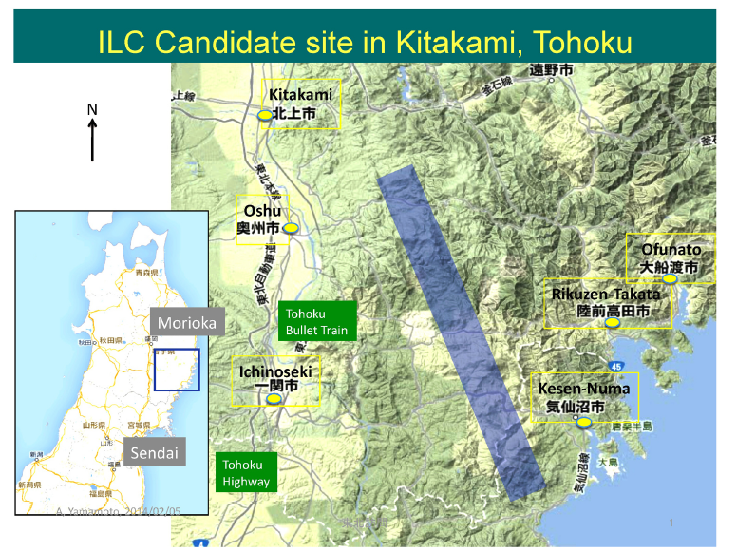
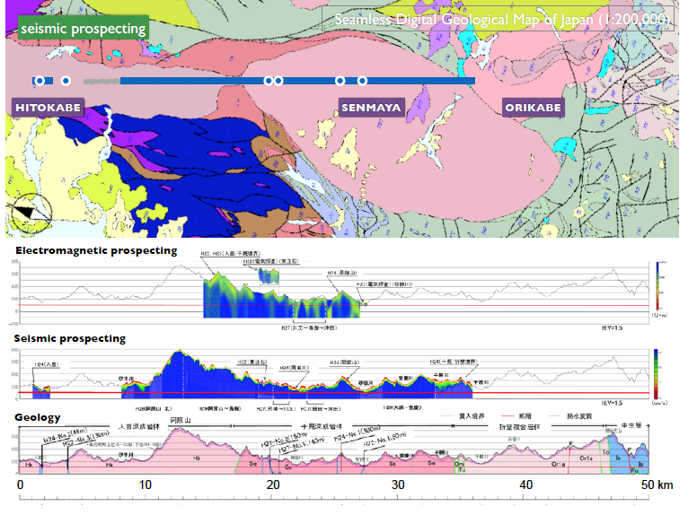
ILC candidate site
Earthquakes are to be taken into account even though the granite bloc is very robust.
Vibration outside the tunnel will have no impact on the accelerator.

Slide 16
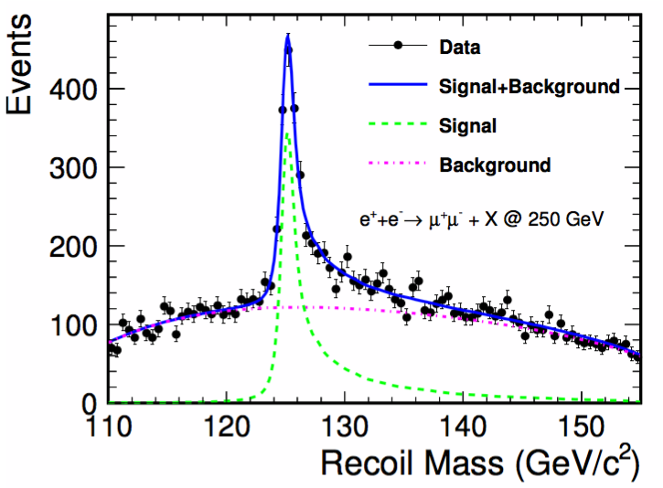
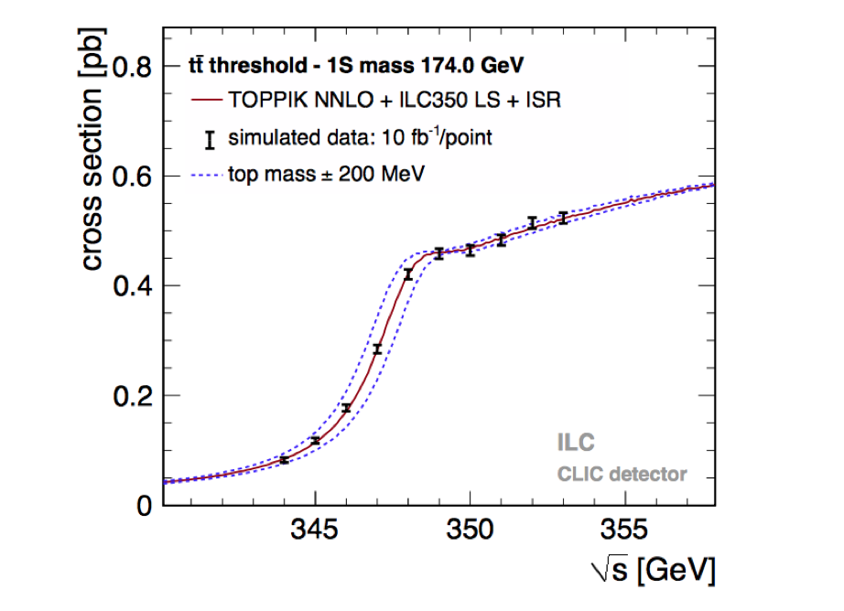
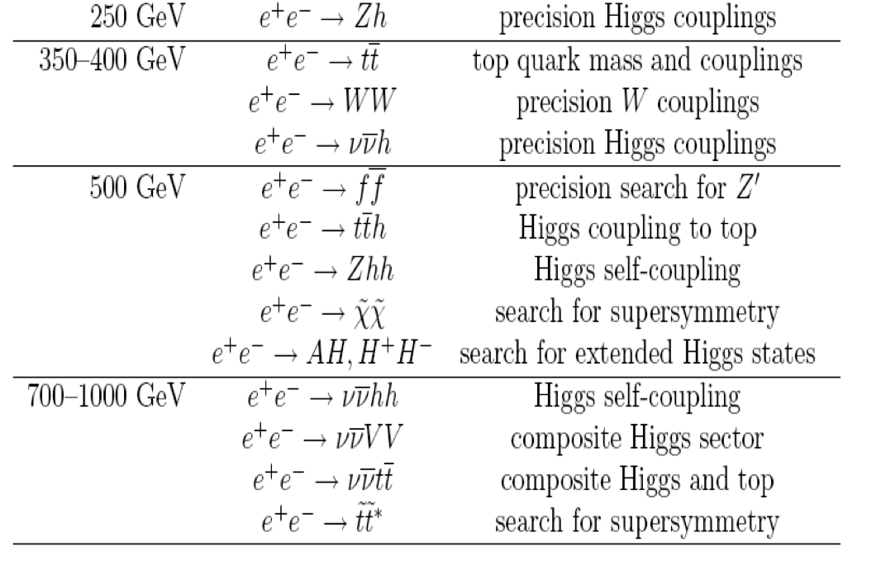
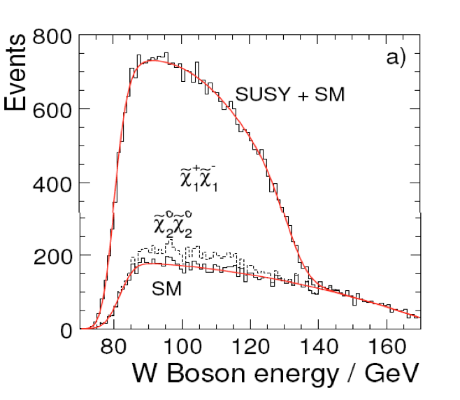
Philosophy of the ILC detectors
Detectors should be a precision and discovery
tool beyond the LHC scope.
Relevant Physics phenomena in the TeV energy range
are associated to multi jet final states
→ Jet energy measurement is the most important item.

Slide 17
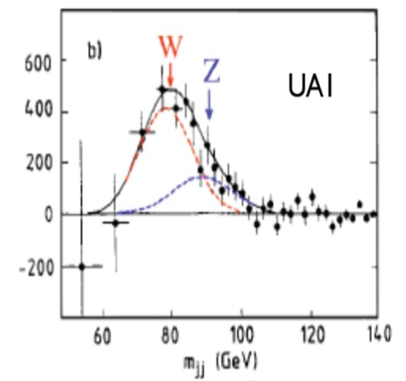
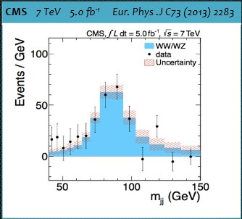
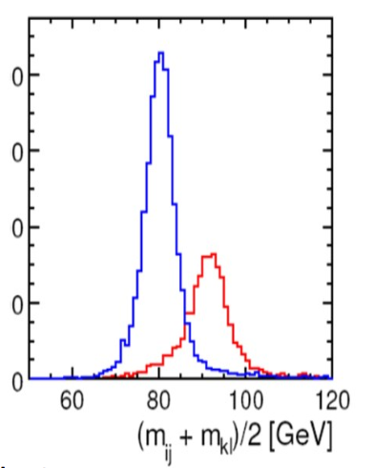
Philosophy of the ILC detectors
Detectors should be precision and discovery
tools beyond the LHC scope.
Relevant Physics phenomena in the TeV energy range
are associated to multi jet final states
→ Jet energy measurement is the most important item.

Slide 18
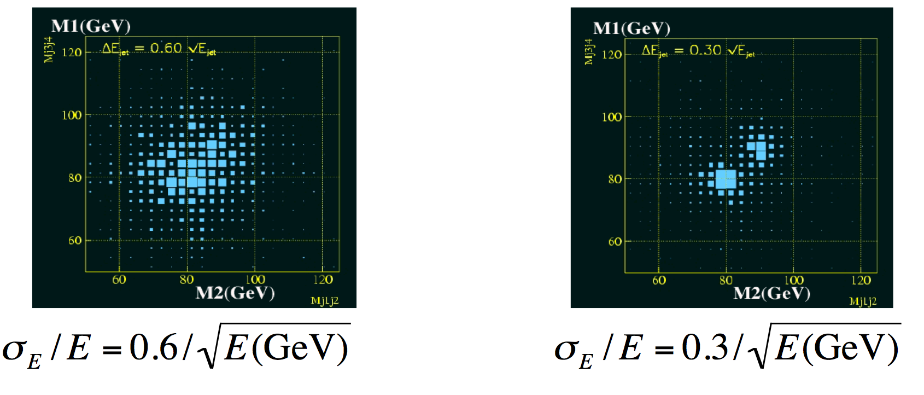
Philosophy of the ILC detectors
Detectors should be precision and discovery
tools beyond the LHC scope.
Relevant Physics phenomena in the TeV energy range
are associated to multi jet final states
→ Jet energy measurement is the most important item.

Slide 19
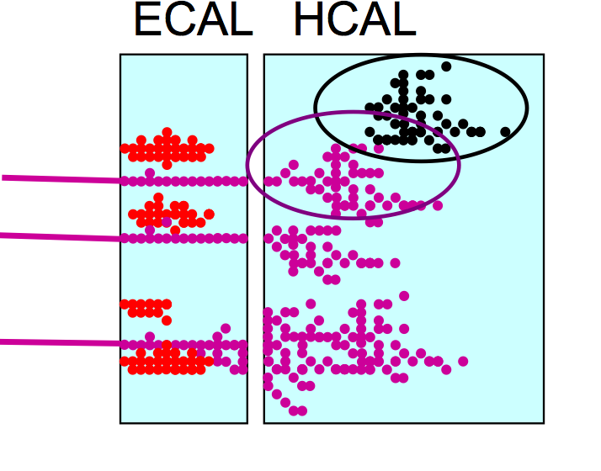
Philosophy of the ILC detectors
Detectors should be precision and discovery
tools beyond the LHC scope.
Relevant Physics phenomena in the TeV
energy range are associated to multi jet
final states → Jet energy measurement
is the most important item.
Particle Flow Algorithm is adopted in both
SiD and ILD concepts. PFA: Construction of individual
particles and estimation of their energy/momentum
in the most appropriate sub-detector.

Slide 20
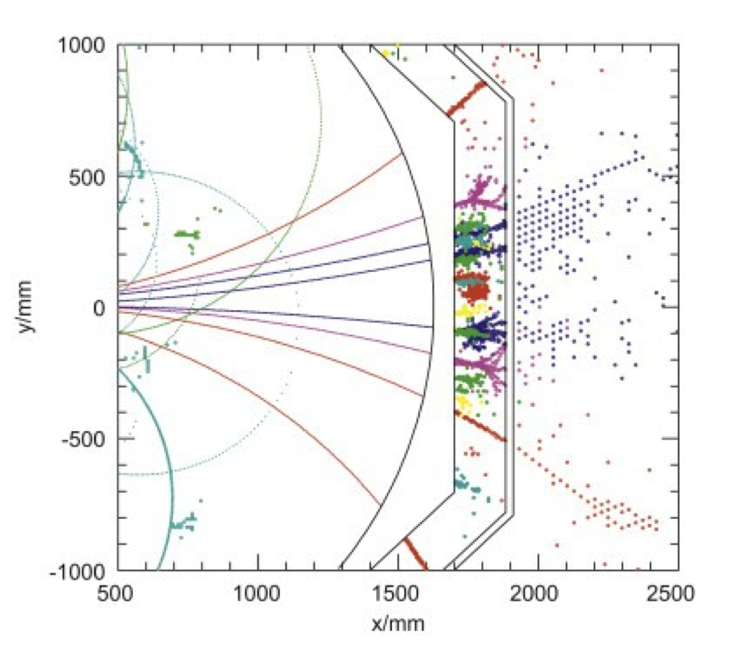
Philosophy of the ILC detectors
Detectors should be precision and discovery
tools beyond the LHC scope.
Relevant Physics phenomena in the TeV
energy range are associated to multi jet
final states → Jet energy measurement
is the most important item.
Particle Flow Algorithm is adopted in both
SiD and ILD concepts. PFA: Construction of individual
particles and estimation of their energy/momentum
in the most appropriate sub-detector.
PFA requires the different sub-detectors including calorimeters to be highly granular.
PFA uses their granularity to separate neutral from charged contributions and exploits
the tracking system to measure with precision the energy/momentum of charged particles.

Slide 21
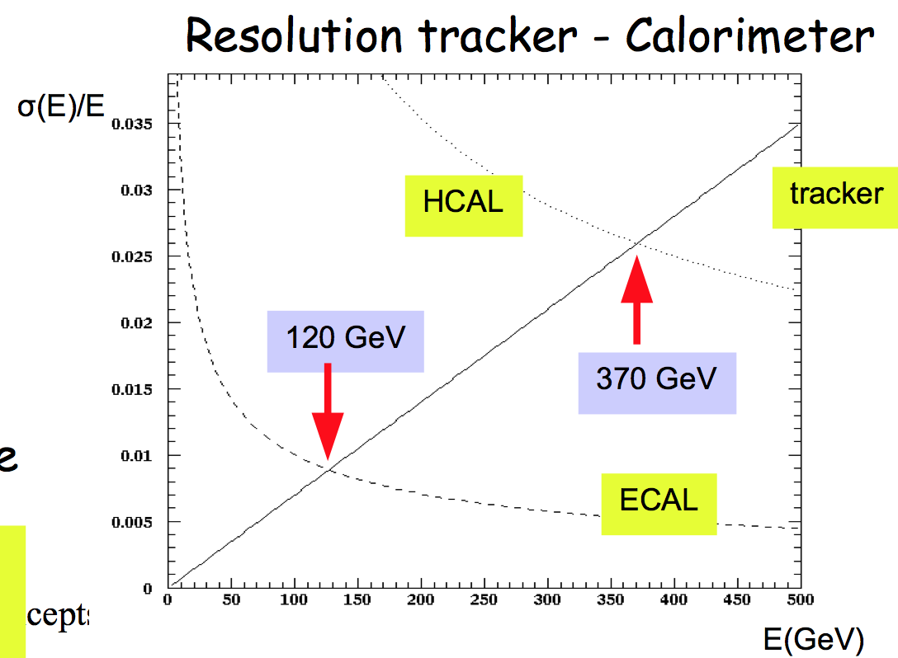
Why tracking is so important?
E_{jet} = E_{charged t} + E_{γ} + E_{h0}
fraction 65% 26% 9%
Charged tracks resolution ∆p/p ~ few10⁻⁵
Photon(s) energy resolution ∆E/E ~ 12% / √E
Neutral hadrons energy resolution ∆E/E ~ 45% / √E

Slide 22
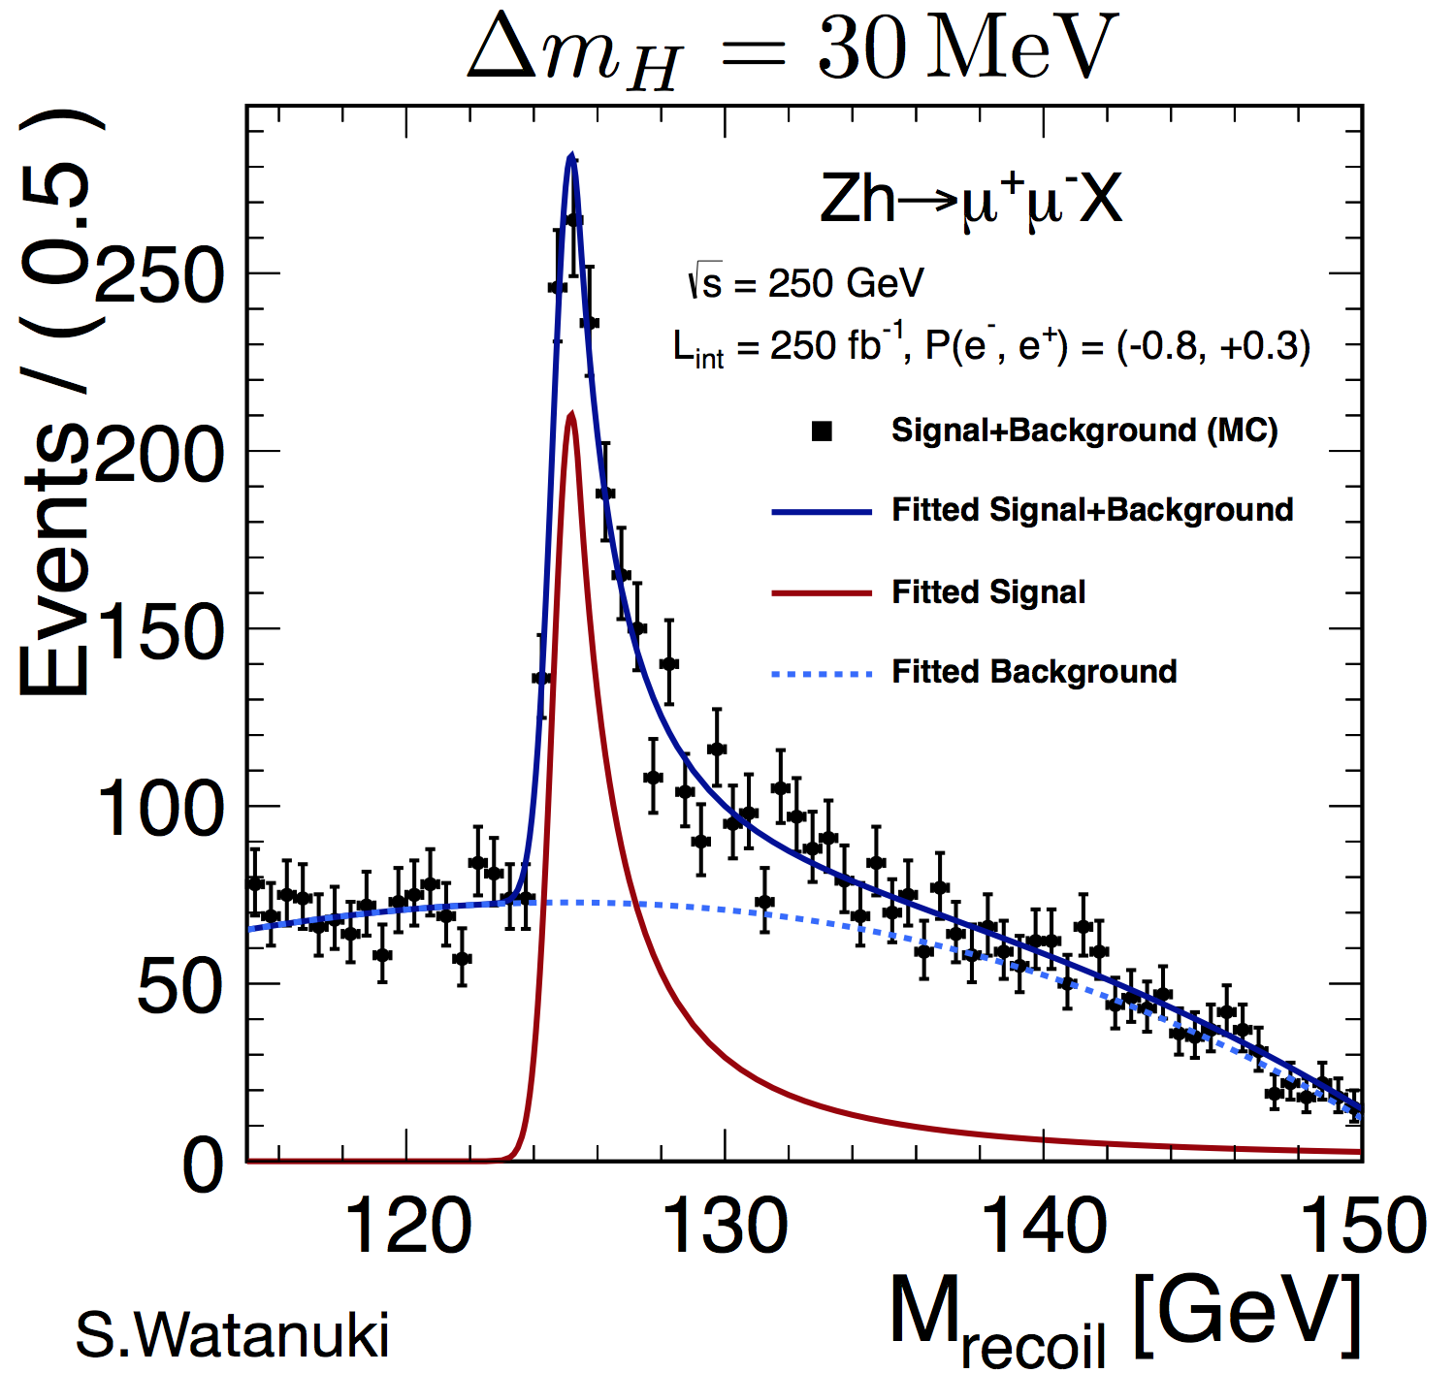
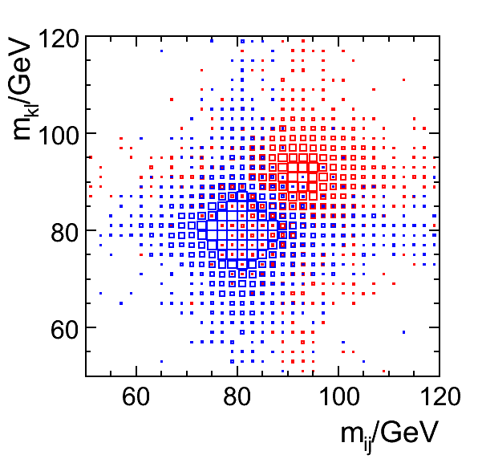
Philosophy of the ILC detectors : Requirements
Vertex detector : excellent resolution
σ_{IP}(rφ) = 5+10/(p sin^{2/3}(θ)) μm
b-tag, c-tag,… for H → bb, cc, ττ studies
Τracker : excellent precision measurement of p_{t}
σ(1/p_{t}) =10⁻⁵ GeV⁻¹
H mass recoil, e⁺ e⁻ → H Z→ μ⁺ μ⁻ + anything
Calorimeters : highly granular but still providing
good measurement of neutrals
σ_{E}/E = 30%/√E
The whole detector should be hermitic, compact
with moderate power consumption
30%/√E

Slide 23
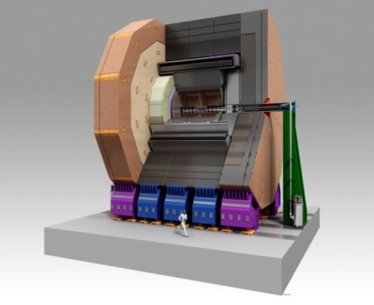
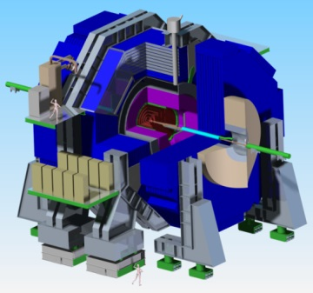
ILD SiD

Slide 24
ILD SiD
Precision vertex detectors
CMOS MAPs, FPCCD, DEPFET 3D, chronopixel,DEPFET, MAPs
Tracker
TPC (GEM,MMEGAS,MAPs) Silicon
many measurement points Few points but very precise
Calorimeters
ECAL: Si-W, Sc-W ECAL: Si-W
AHCAL: Sc-Steel, SDHCAL-GRPC,.. DHCAL-GRPC
Size&Magnet
Large size, 3.5 Tesla Compact, 5 tesla

Slide 25
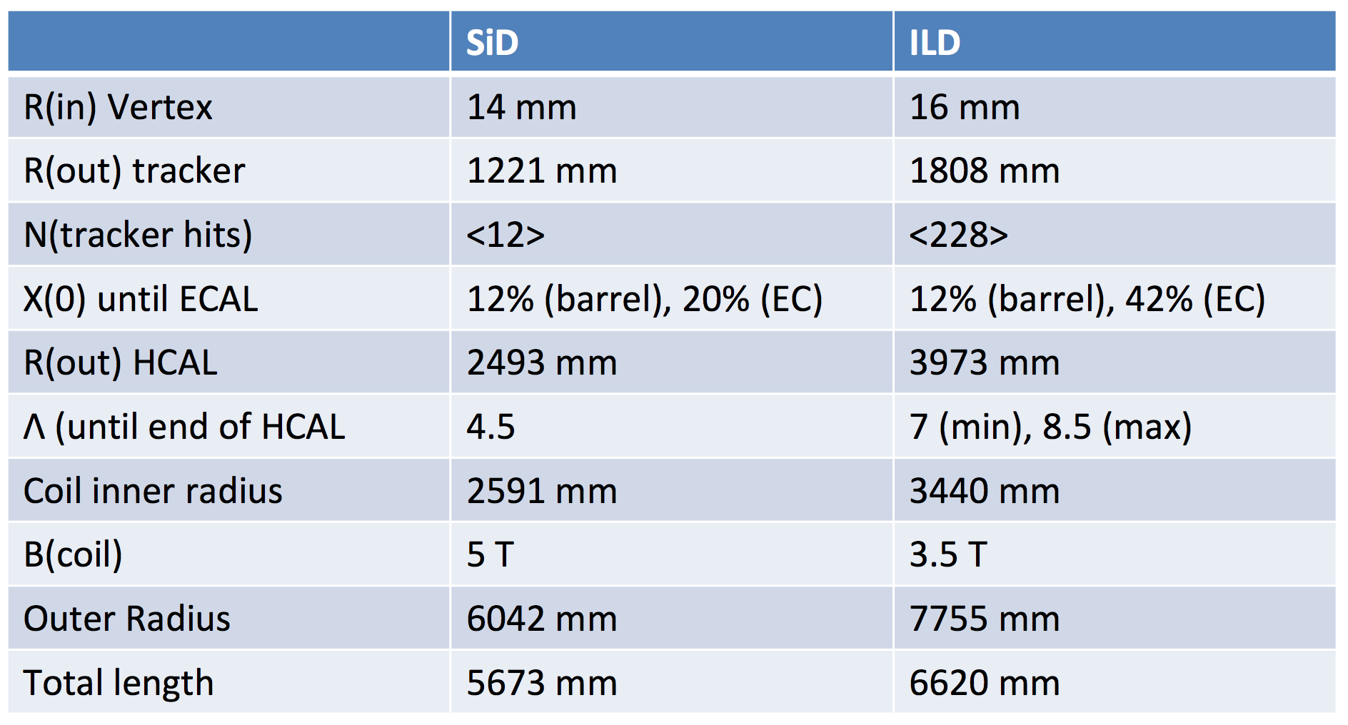
)

Slide 26
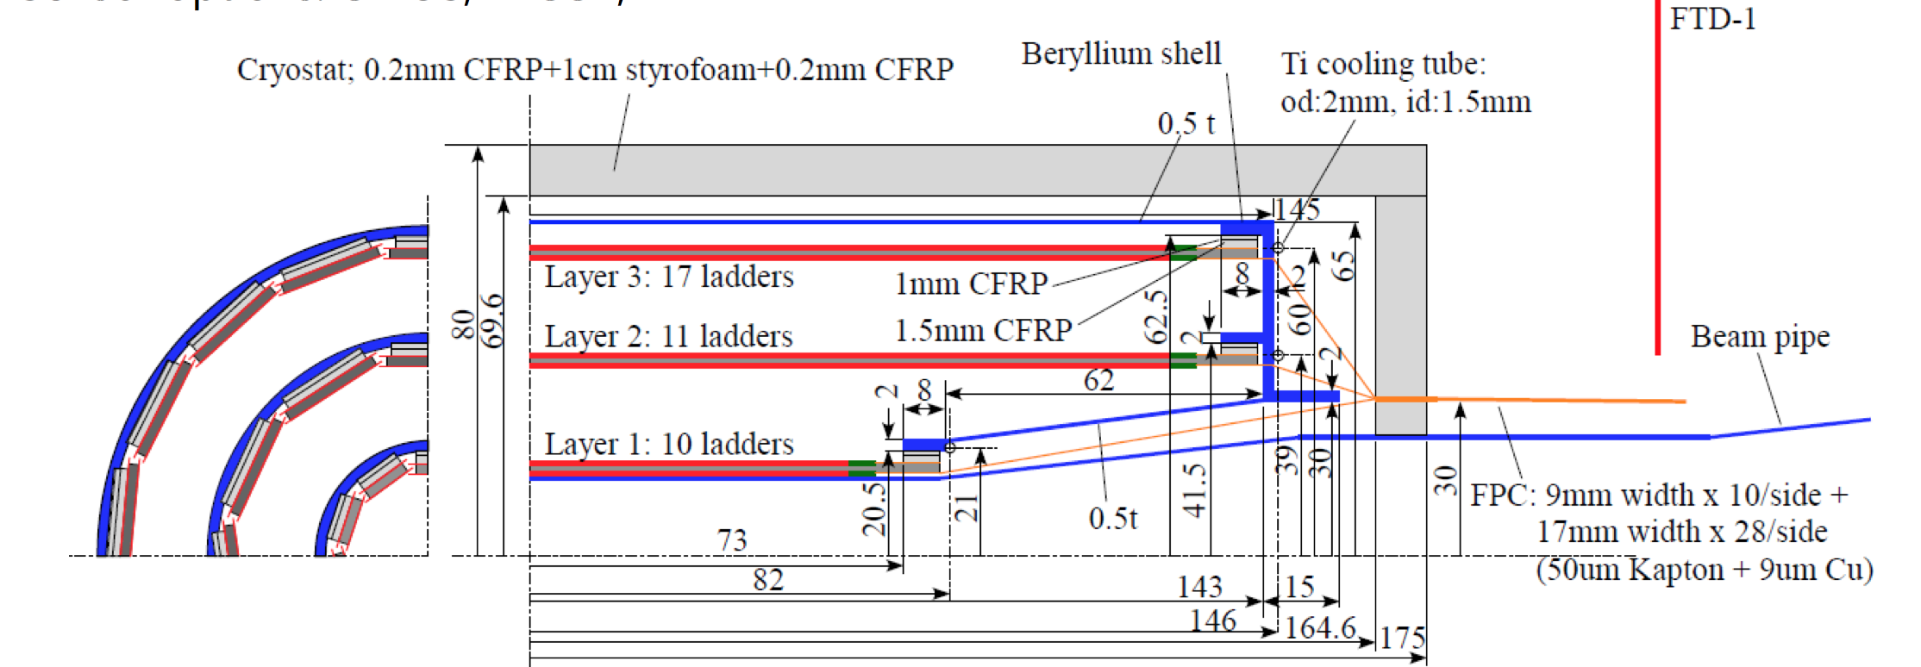
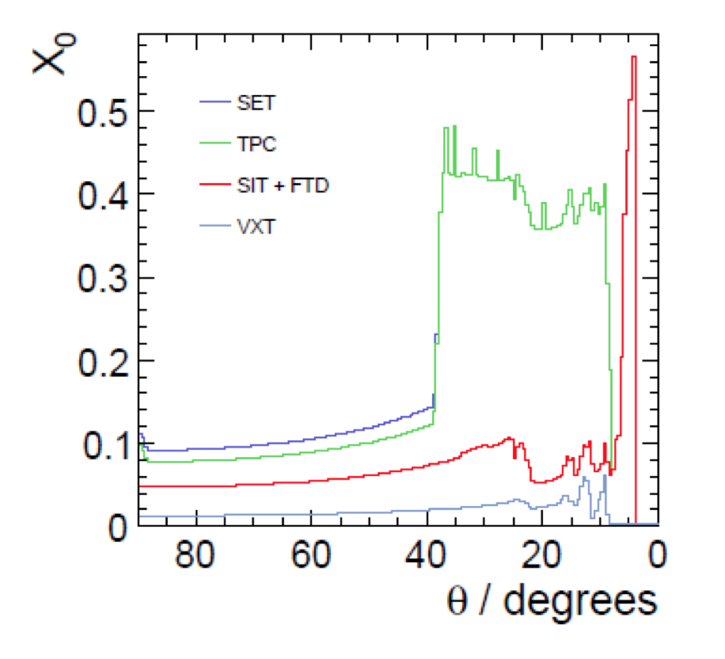
Tracker Silicon detectors : ILD
Central Si Tracker System (vertex detector)
3 ladders of double layers (6 pixel layers)
|cos(θ)| <.97 for inner layer, |cos(θ)| <.9 for outer layer
Inner radius ~1.6 cm, outer radius ~ 6 cm
3μm resolution in the inner layer
Material budget ~ 0.3%X₀/ladder layer : light support and genuine cooling system.
A pixel occupancy not exceeding a few %

Slide 27
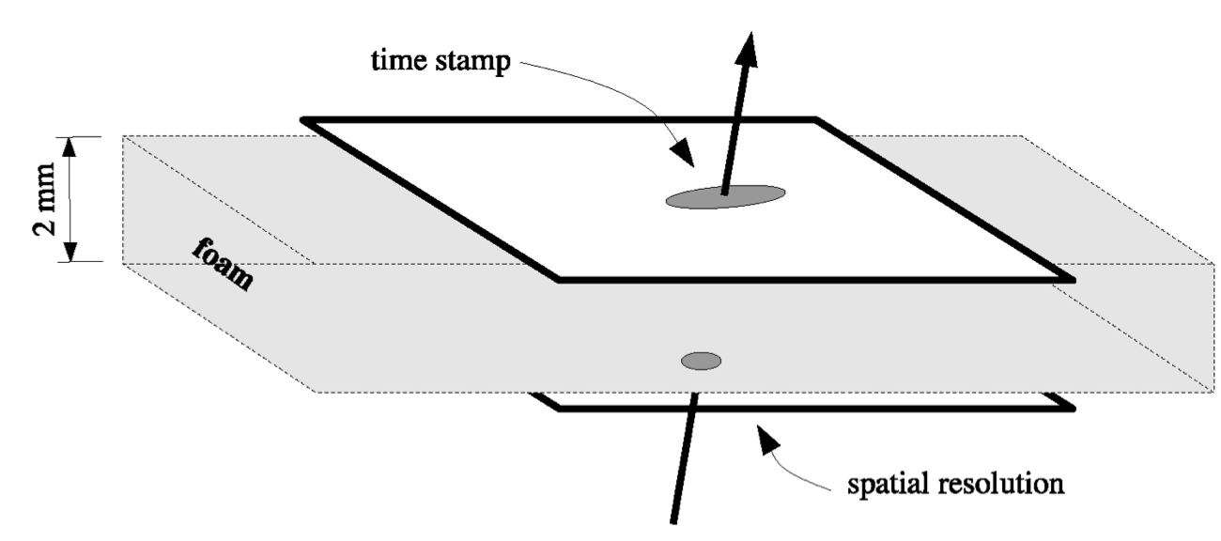
Tracker Silicon detectors : ILD
Central Si Tracker System (vertex detector)
3 ladders of double layers (6 pixel layers)
|cos(θ)| <.97 for inner layer, |cos(θ)| <.9 for outer layer
Inner radius ~1.6 cm, outer radius ~ 6 cm
3μm resolution in the inner layer
Material budget ~ 0.3%X₀/ladder layer : light support and genuine cooling system.
A pixel occupancy not exceeding a few %
Time stamping
Proposed technologies: CPS, FPCCD, DEPFET,MAPs

Slide 28
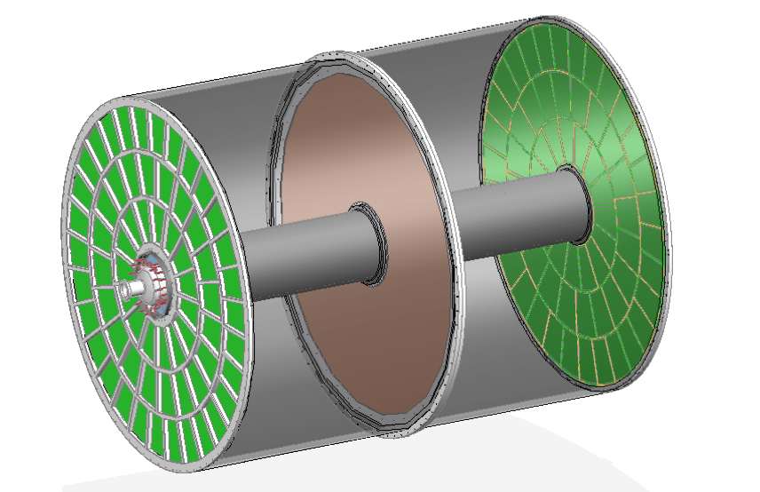
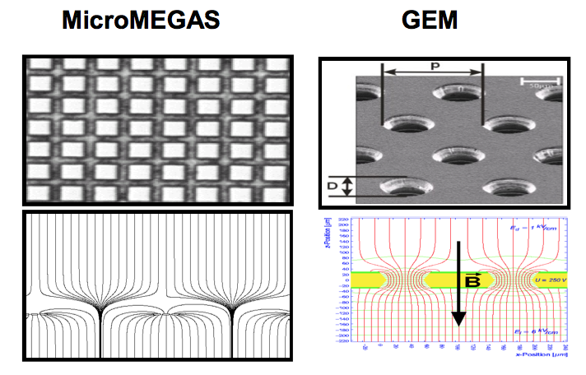
ILD TPC tracker
Time Projection Chamber (TPC) is chosen as the
central tracker of ILD
3D tracks (rφz) can be built thanks to many
hits (∼200/Track)
σ(rφ) of 100 μm (60 μm at z=0) is expected
σ(z) of 1400 μm (400 μm at z=0) is expected
σ(1/p_{t}) ∼10⁻⁴ GeV⁻¹
dE/dx information is provided (particle identification)
Readout pad size ∼ 1x6 mm² → 10⁶ pads/side
Material budget : 5%X₀ in central region and less
than 25%X₀ in the endplate region
Cooling is needed: two-phase CO₂ is a possibility.
Two main options for gas amplification are considered :
GEM, Micromegas
0.4m <R< 1.8m
|z|< 2.15 m

Slide 29
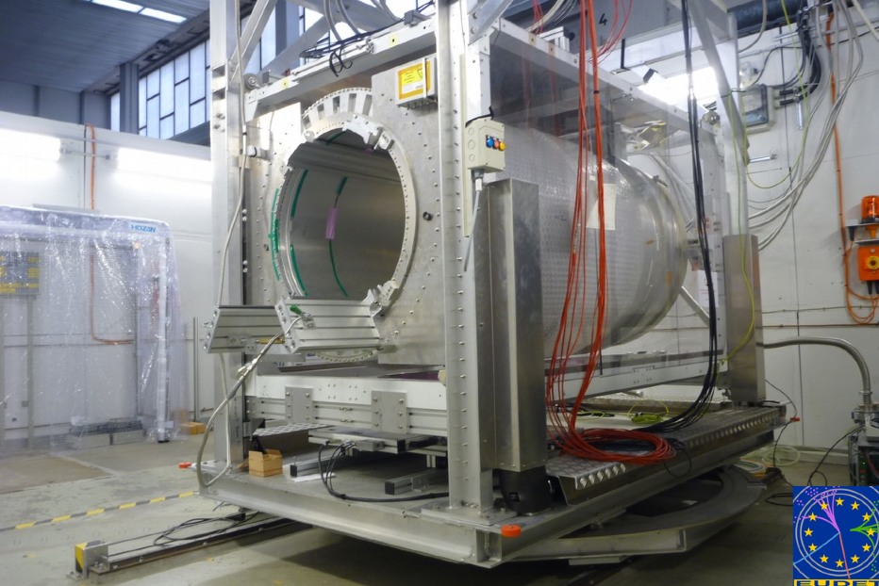
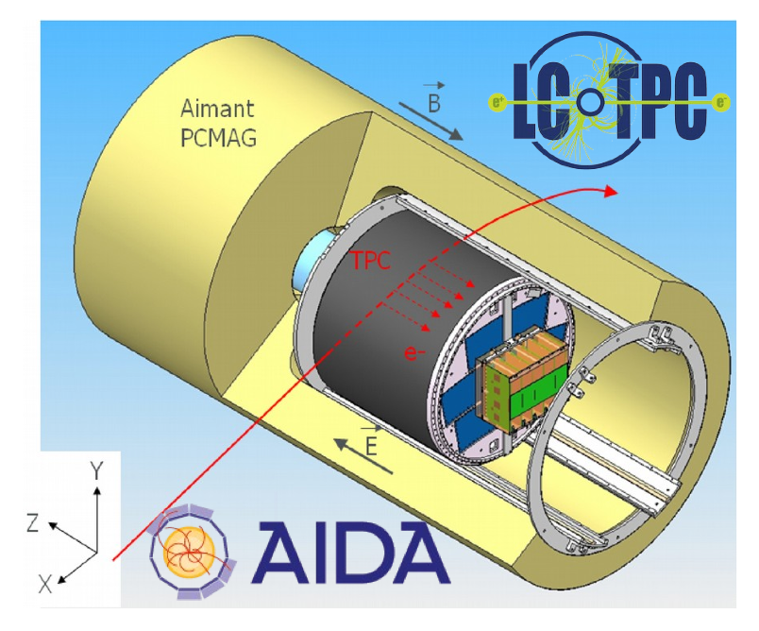
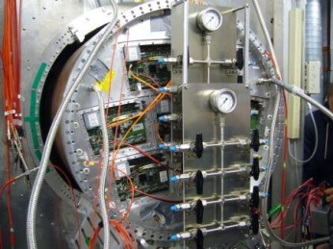
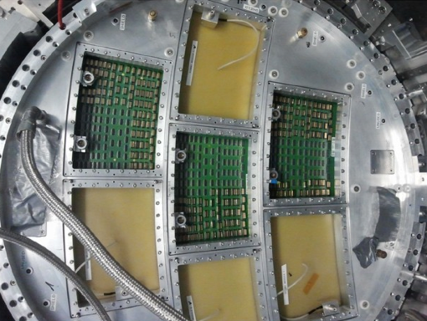
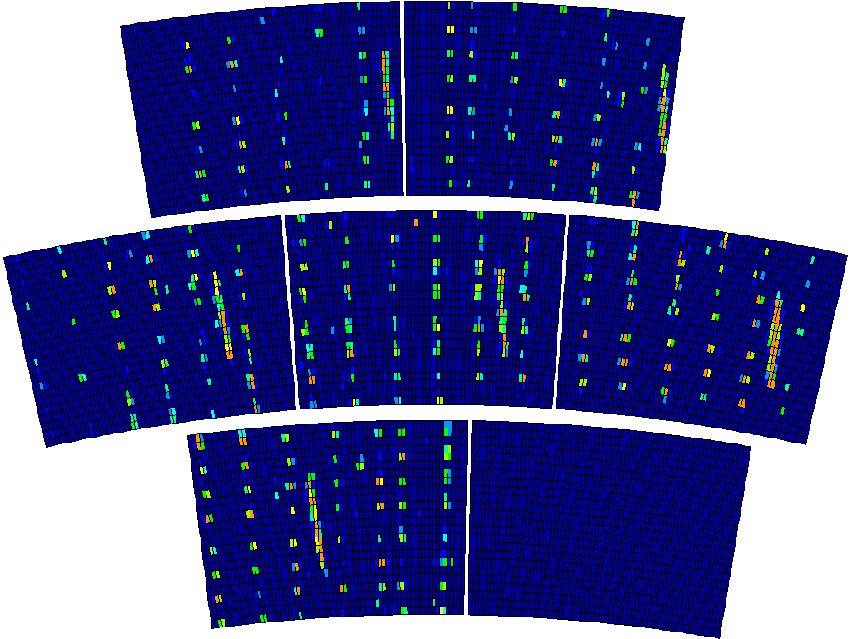
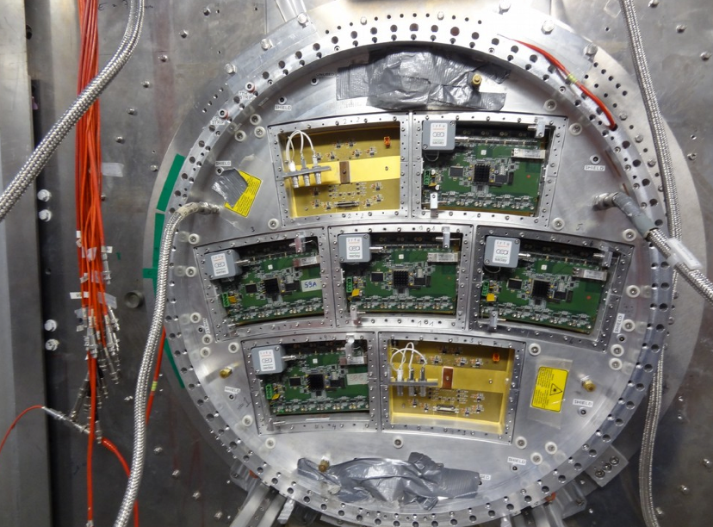
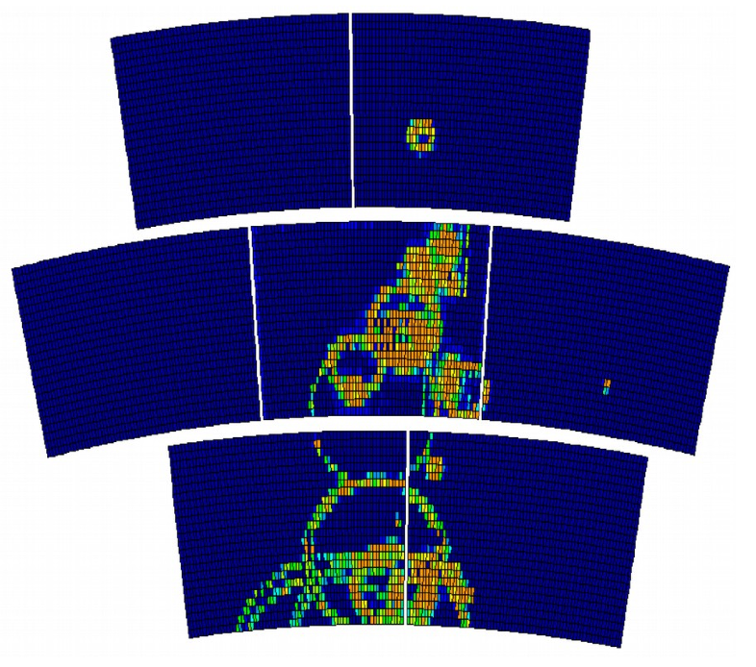
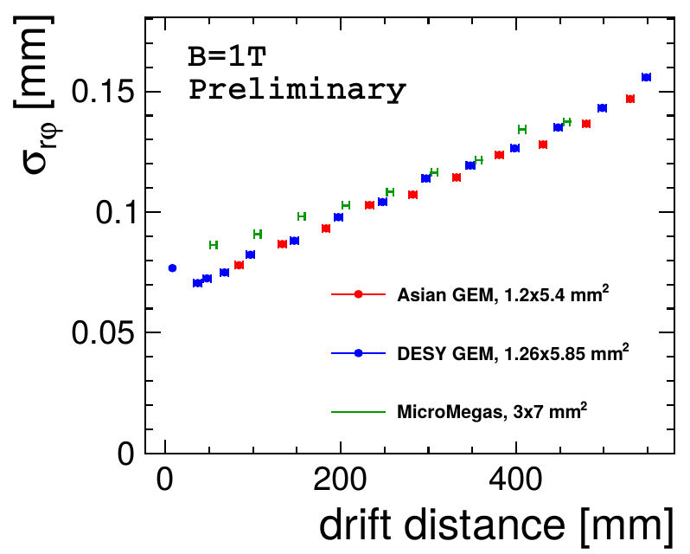
Test Beam measurements
using PCMAG@desy
= 72 cm, L = 58 cm, B=1T
A TPC prototype with:
Modular End Plate : Up to 7 modules
(similar in size to the ILC final ones)
HV, gas and slow control system
Cosmic&beam trigger
Laser calibration system
Cooling system TRACI 2PCO2
2 TimePix octoboards:
1 mounted on MM& 1 on GEM
3 modified GEM modules tested
7 MM modules tested
Similar results obtained with the different technologies
Ongoing R&D :
New electronics with Power-Pulsing to be tested
Mechanics and low budget material

Slide 30
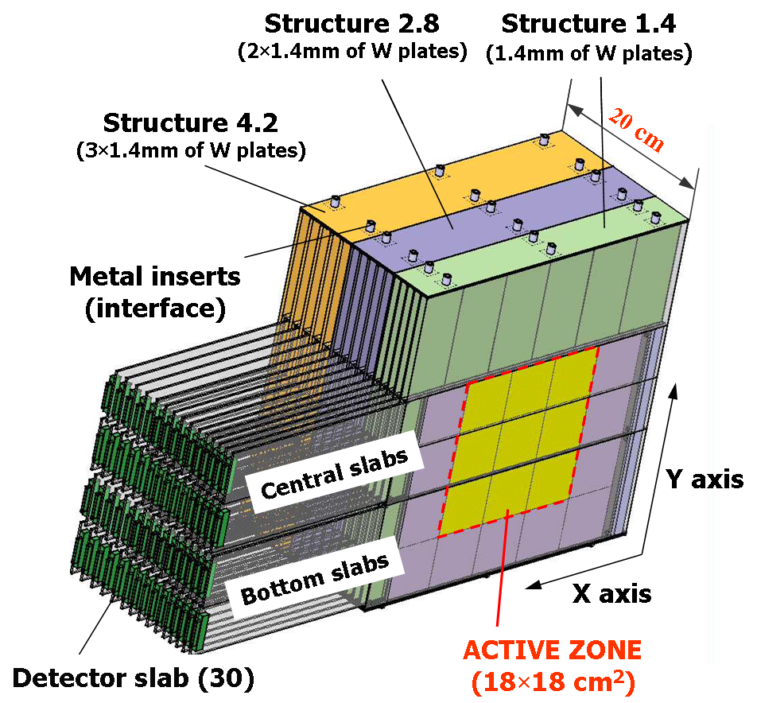
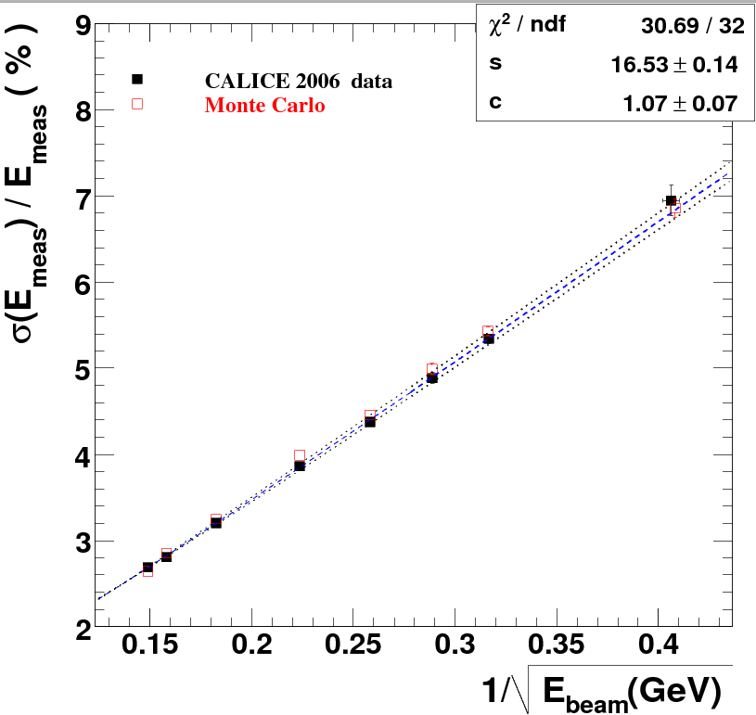
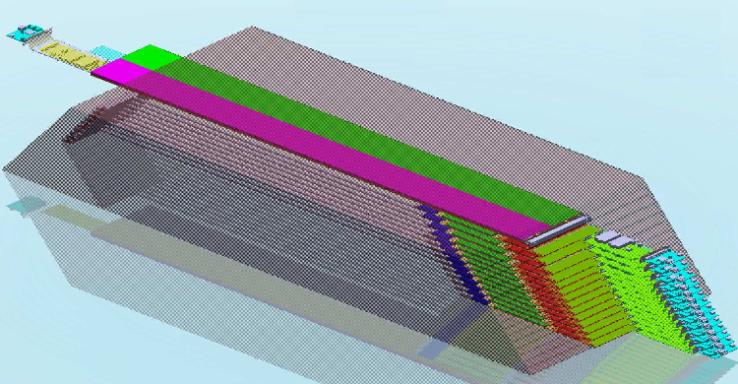
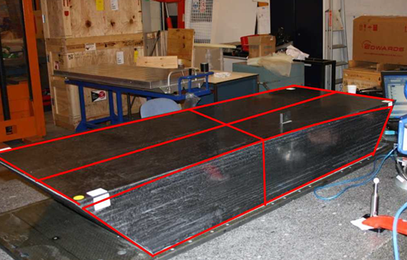
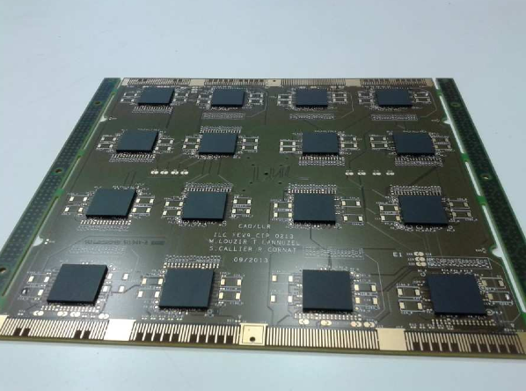
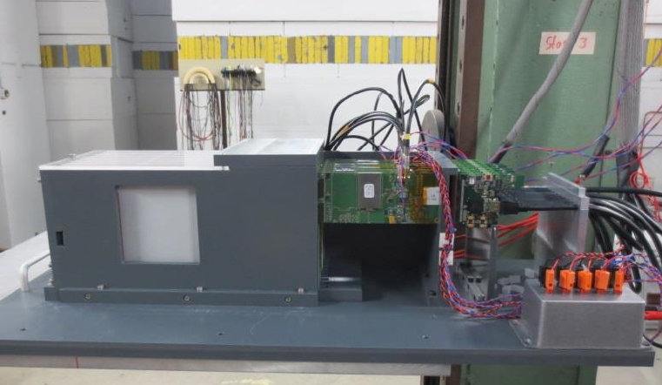
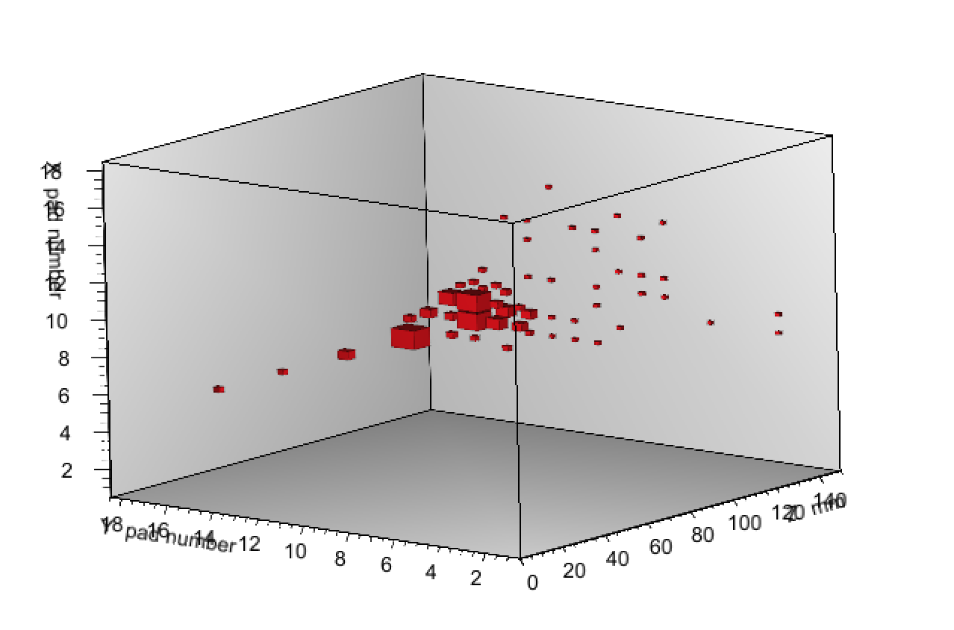
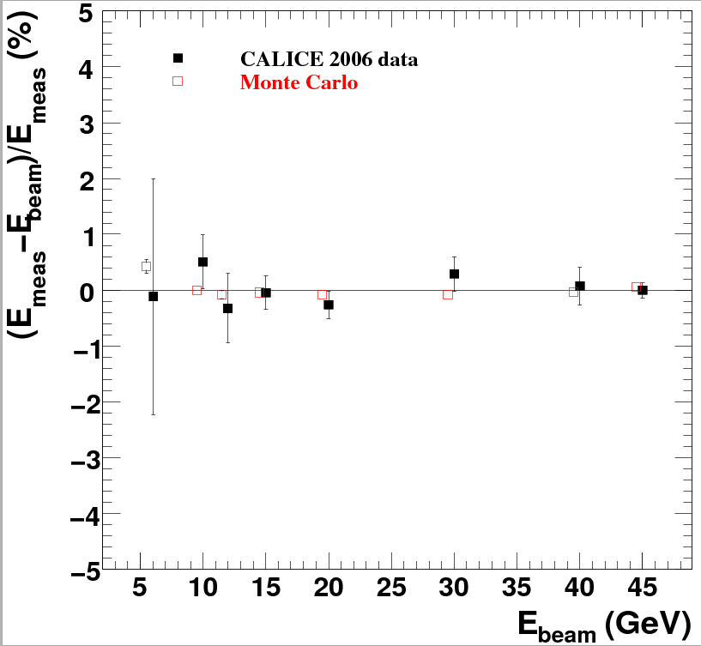
Technologies proposed for ILD&SiD calorimeters
ECAL for ILD
Energy resolution =
16.5/sqrt(E)+1.1%
30 layers of tungsten (24X₀) interleaved with
-Pixellated Silicon of 5x5 mm²,
A physics prototype (1x1 cm² cell size) with a deported electronics was built and successfully tested.
A technological prototype fulfilling the ILD DBD requirement is being developed :
Self-supporting structure (alveolar)
Embedded power-pulsed electronics
Large surface detector
Linearity <1%
Several TB took place at DESY
and now at CERN
electron data (2006)
MOKKA (geant4) simulation
electron data (2006)
MOKKA (geant4) simulation
non-linearity<1%
non-linearity<1%
Ebeam
Ebeam

Slide 31
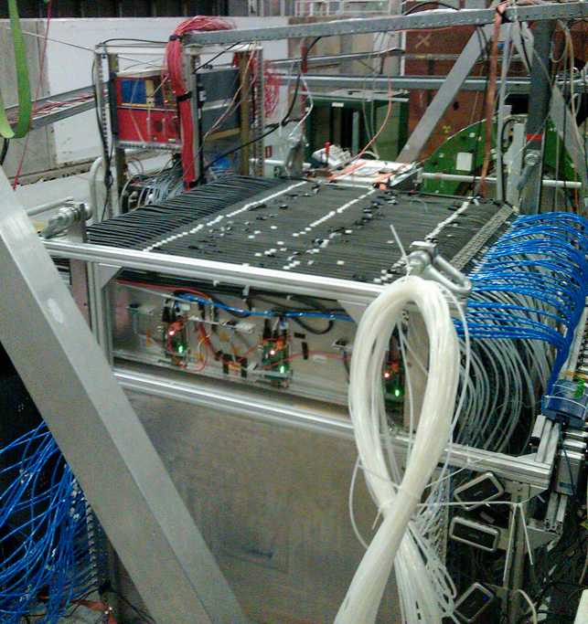



Technologies proposed for ILD&SiD calorimeters
HCAL for ILD
48 layers of 2 cm stainless steel (6 λ) interleaved with
planes made of Glass RPC and their embedded readout 2-bit electronics allowing a lateral segmentation of 1 cm²
A technological prototype of 48 fulfilling almost all the ILD requirements of compactness and power consumption was built with a self-supporting mechanical structure. It ws successfully tested with
Triggerless mode
Power-pulsing mode
Last step is to build very large GRPC and equip them with the last generation of the readout electronics
The GRPC was also successfully tested in a magnetic field of 3 T using the power-pulsing mode
electron data (2006)
MOKKA (geant4) simulation
electron data (2006)
MOKKA (geant4) simulation
non-linearity<1%
non-linearity<1%
Ebeam
Ebeam

Slide 32
Physics potential at ILC
Higgs boson:
Studying the coupling constants and additional decay modes
Top quark
Determine the Top mass and its coupling to Higgs
New particles

Slide 33
Decoupling theorem:
If new particles are present beyond the SM with masse M then their impact on the Higgs coupling will be of the order of
F = a m²_{H}/M²
with a of the order of 1.
For instance models with first-order electroweak phase transition predict a mixing between the Higgs and a heavy scalar particle S. The model predicts
g(HWW) ≈2m²_{W}/v (1-1/2 m²_{H}/m²_{S})
Since the new particles are not seen at LHC in the mass range up to 1 TeV
F is of a few % at most. Testing the SM requires measuring the Higgs coupling constants with a precision of the order of 1% to test the BSM.

Slide 34


The Kappa framework:
Study deviation of Higgs coupling constants through Br with respect to the expected SM.
Allow the extension to invisible Higgs decay (Br_{inv}) as well as untagged process (Br_{unt}).
Higgs boson total width is determined in this framework from:

Slide 35




Slide 36
Effective Field Theory (EFT):
A Lagrangian with all the terms respecting the SU_{c}(3)x SU_{L}(2) X U(1) symmetry
Only even terms remain when baryonic and leptonic numbers are conserved independently.
The advantage of such framework is the possibility to:
Go beyond the decay rate measurements and use additional variables such as
the angular distribution and polarization asymmetry in e e → Z H
Associate deviation of Higgs couplings in e e → Z H and other processes such
e e → WW, ZZ to the nature of the associated operators and thus to the BSM
physics models.
Operator contributions have different energy-dependence. Some increase substantially with energy. Runs at different energy is very useful.

Slide 37
Higgs couplings study:
Hbb, H𝜏𝜏 are sensitive to models with two-Higgs-doublets (SUSY,..)
Hbb sensitive to the presence of heavy SUSY particles
HWW, HZZ are sensitive to composite Higgs or mixing with singlet
Hgg, H𝛾𝛾 are sensitive to models with vector-like fermions (« Little Higgs »,..)
Htt is sensitive to composite Higgs and top quarks

Slide 38

Higgs study@ILC

Slide 39




e e → Z H
This is the principle process. Using the recoil mass
Technique, one can measure the Higgs mass
Z → µ µ/ e e: golden channels allowing
studying Higgs branching rations in
model independent ways.
σ_{tot} = σ_{vis} + σ_{inv}
The background ( e e → Z Z, W W, ϒ Z) can be reduced to less than 0.1% (0.2%)
At ILC250 by requiring 2 isolated muons (electrons) with opposite charge with invariant mass compatible with Z mass with additional cuts on E_{vis} and P^{ll}_{T} and using
Z→ qq,ττ is more challenging due to jets confusion at ILC250 but better at ILC500

Slide 40



e e → ν ν H, e e H
Small cross sections (14, 0.7 fb resp.)
but provide precious and direct
information on HWW, HZZ coupling constants.
For the ν ν H, the selection is based on looking for two b-tagged jets (H→ b b) and
missing mass > 20 GeV
Remaining background are ν ν Z and ϒ Z with Z→ bb but also Z H.
MVA techniques using the dijet polar angle as well as the angle between the two jets
Efficiency of the selection is around 36% and S/B≈ ¼ → resolution on σ . Br(bb) is 8.1%
250 GeV
For the e e H even with a ridiculous cross section one expects at least a significance
of 9 at ILC250 and 60 at ILC500

Slide 41

Using the e e → Z H with Z→ ll, qq and νν, the different H decay modes are then determined:
H → bb/ cc/ gg
For Z→ µµ, ee
H→ bb and H→ cc will benefit from the excellent precision provided by the ILC detectors to tag b and c quarks → g_{Hbb}, g_{Hcc}
H→ gg is complementary to LHC
For the Z→qq the dominating background is the qqqq from WW, ZZ. A chi2 is used to select one configuration after applying angular cuts.
Z→ νν sensitivity is much higher than Z→ qq even though its BR is 3 times less

Slide 42



Using the e e → Z H with Z→ ll, qq and νν, the different H decay modes are then determined:
B) H → τ τ
This channel is expected to be the most
precise thanks to its relatively large Br and
limited Bkg (e e → Z Z→ q q τ τ).
Efficiency of 36% and S/B around 2 are expected.
This channel is also interesting to study the Higgs CP proprieties.
The τ polarization could be determined,
in τ→ leptons and πν/ρν
The angle between the transvers spin of the
two τ will indicate if the Higgs is a pure CP-even
or a mixed with a resolution on Ψ_{CP} down to 4.3°

Slide 43

Using the e e → Z H with Z→ ll, qq and νν, the different H decay modes are then determined:
C) H → WW* , ZZ*
These decays can also be studied from the ν ν H and e e H production modes.
For the W W* mode with many possible configurations the major background contribution comes from e e → W W in both ν ν H and Z H (Z→ ν ν)
Using right-handed beams reduces significantly this contribution.
ILC500 provides better measurement than ILC250 thanks to the e e → ν ν H
For the Z Z* the same strategy of combining many analyses will be used but the small cross section of e e → ee H and the small branching ratio of H→ Z Z* makes it difficult to have a good resolution at 250 and 500 GeV.

Slide 44

Using the e e → Z H with Z→ ll, qq and νν, the different H decay modes are then determined:
D) H →µ µ, ϒϒ, ϒ Z
ILC measurements of the associated coupling constants is not competitive with the expected measurements from HL-LHC.
E) H → invisible/exotic
This study is possible thanks to the recoil technique used in e e → Z H
The main backgrounds are from ZZ→ νν q q and WW → qqlν
Using right-handed beams could
improve the sensitivity to this mode
by a a factor of 1.4
Other exotic decays could also be
studied using the excellent
Performance of the ILC detectors

Slide 45


e e → W W
Presence of new physics enhances
the cross-section by a factor s/m²_{W}
(anomalous couplings)
It is then very important to measure
e e → W W cross-section accurately to obtain the Triple Gauge Couplings (TGC) : g¹_{Z} , κ_{g} ,λ_{g} through the measurement of the polar angle of one of the W (cos θ_{W}) and the angles of the decay of each W
ILC with its polarized beams provides the best measurement taking into account the different configurations. At ILC250 the precision of g¹_{Z}(κ_{g}) will be 5 (30) better than at HL-LHC.

Slide 46

e e → f f
Deviation from SM will reveal the presence of new physics
Composite higgs→ composite t_{L} or/and t_{R} → composite b_{L} or/and b_{R}
ee → b b cross section different with respect to the SM expectation.
Polar angle distribution can reveal the presence of new particles such Z’ or dark matter candidates..
Coupling to Z and ϒ can be extracted by measuring the polar fermion angle
Asymmetries A_{LR}, A_{FB} will be also measured
ILC will provide much better sensitivity (> 60) with respect to LEP.
P_{e+=} 100%
P_{e-=} -100%
P_{e+=} -100%
P_{e-=} +100%

Slide 47

Including all these measurements in EFT framework

Slide 48


Slide 49
Top@ILC
Measuring the top mass and its coupling to Higgs is of the utmost importance. Its high mass and its coupling may hide the truth about the origin of the EW symmetry breaking.
Pair production is the best place to measure the top mass, its width and its Yukawa coupling. The large width of the Top makes it insensitive to the non-perturbative contribution of the confining part of QCD.
Still the best way to extract the Top related information is through a threshold production scan. In this case the Top mass is close to the MS top mass.
The statistical uncertainty at ILC with a scenario of 10 points of 20 fb⁻¹ each is expected to be bellow 20 MeV
While the theoretical one is 50 MeV
The pair production at 500 GeV provides also precious information on the Top but due to the radiative correction the theoretical uncertainty is about 200 MeV

Slide 50


Top@ILC

Slide 51
Top@ILC
Several studies are foreseen at ILC
Search for flavour changing neutral current
e e → t c can already be tested at ILC250 but t→ H c and t→ ϒ c
at the production threshold will provide the best sensitivity.
Anomalous tZc, tHc and tϒc will be measured.
The measurement of top A_{FB} and the different polarized-related differential cross sections will be precisely measured. CP-conserving terms can be measured with 1% precision and CP-violating terms can be constrained.
tth will allow a direct measurement of the Yukawa coupling. A precision of 2.8% could be reached if the ILC runs at 550 GeV reaching several fb for the tth channel. This to be compared with the 30% precision to be achieved by the LHC program.

Slide 52



Trilinear Higgs coupling
Measurement of the trilinear Higgs coupling is important to determine the shape of the Higgs potential and thus to provide a clue on its origin

Slide 53

ee→ χ x ϒ
The major background is ee→ ν ν ϒ. The (80%, -30%) beam polarization configuration reduces the background contribution and thus improves on the discovery reach.
1.6 ab⁻¹ with polarized beam achieves much better than 4 ab⁻¹ of unpolarized beams.

Slide 54



ee→ χ⁺ x⁻ , stau⁺ stau^{-,..}
With Δm < a few GeV
LHC is limited for this kind of searches.
ILC will allow looking for such scenarios
reaching the kinematic limit of √s/2.
ILC will outperform LEP with high
granular detectors providing excellent
tools for detecting displaced vertex
e e → Z X
The same recoil technique used in e e → Z H
study will be used to look
for non-standard Higgs (nMSSM model,..)

Slide 55
Beam polarization impact
Polarized beam is of interest only for lepton beams
Only linear e⁺ e⁻ colliders could provide adequate longitudinal polarization
Using polarized beams brings substantial improvement in:
Measurement of helicity-dependent constants
Suppression of backgrounds
Systematic studies

Slide 56
Beam polarization impact
P_{e-}, P_{e+} being the electron and positron polarization with
P_{e} = -1 for left handed and 1 for right-handed beam
σ_{O} is the unpolarized cross-section

Slide 57
Beam polarization impact
e e → H Z
For P_{e-} =-80% and P_{e+}= + 30% and using A_{LR}=0.151 (asymmetry of the interaction)
P_{eff} = 90% → L_{eff}/L_{eff0} ≈ 1.4
e e → f f
By using different beam polarization configurations one can separate ϒ and Z s-channel contributions and then measure the different couplings more efficiently.
e e → WW
is a background for several process but for this process
σ_{LR}/σ_{RL} ≈ 30 By using (e⁻_{R},e⁺_{L}) beam configuration this background
is almost turned off
Systematic uncertainties could be reduced by measuring the same quantity with independent configurations

Slide 58
Conclusion
ILC is a mature project
Well-known acceleration technology with expertise in large scale cavities production
All of the detectors proposed for ILC have their prototypes and many their technological/engineering ones
The physics case is clear. First to test the SM and then to investigate beyond it. With the H20 its performance is similar to the most ambitious project.
The luminosity can be enhanced in a cost-effective way. An increase of up to a factor of 4-6 is feasible at affordable cost so its performance should outperform the other projects at lower cost.
Having polarized beam is a big asset not only to increase the effective luminosity (≈2) but to reduce the systematics substantially

Slide 59

Personal point of view

Slide 60

Personal point of view

Slide 61

Personal point of view
HL-LHC may be not the best choice for HEP but it is very useful and its input is very important.
For the future, two possible scenarios could be successful:
ILC followed by FCChh
This scenario is the optimal one. It gets benefit from the readiness of ILC. It exploits the results from HL-LHC. It keeps CERN as the reference lab for at least 30 years ahead.
CEPC followed by SPPC. This is the only realistic scenario if ILC is not approved.

