Slide 1
IP2I-Particle Physics Intra-Axis Meeting June 24 2021
Agenda
Introduction generale et introduction FCC (Suzanne)
Introduction ILC +SDHCAL, Tricot.. (Imad)
Proposition pour un développement de senseurs CMOS monolithiques à l’IP2I (Didier)
Vers un MP sur la calorimétrie à haute résolution en énergie et temps à cristaux , pour un concept de détecteur à ‘double lecture ‘ (Suzanne)
Higgs Properties and Supersymmetry: Constraints and Sensitivity from the LHC to an e+e- Collider (Nazila)
Round table of interests (and availabilities?), Q&A (Tous)
More theory (Giacomo, Aldo)
Discussion generale: Possibilites de synergies, place de la physique des particules au labo, etc. (tous)
Mini-apero!

Slide 2
Motivations for Particle physics ‘Intra-axis’ meetings
Since some time, with Imad we have been discussing planning a first meeting for all actors at IP2I involved in the particle physics discipline: members of the current CMS, CALICE, and Theory groups
This meeting would have as its focus activities touching the future of particle physics: HL-LHC, Higgs Factory/ILC/CEPC/FCC R&D and physics studies, and related theory
The goal would be to discuss common concerns, strategies and actions in a coordinated way: for example RH requests, answers to project calls (ANR, ERC…). In this way we could advance together on projects or at the very least inform each other, thus favoring the reinforcement and strengthening of the position of the particle physics discipline at IP2I, now and for the future.

Slide 3

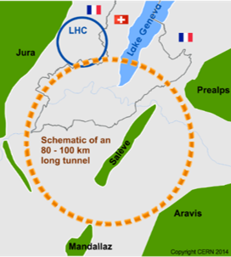
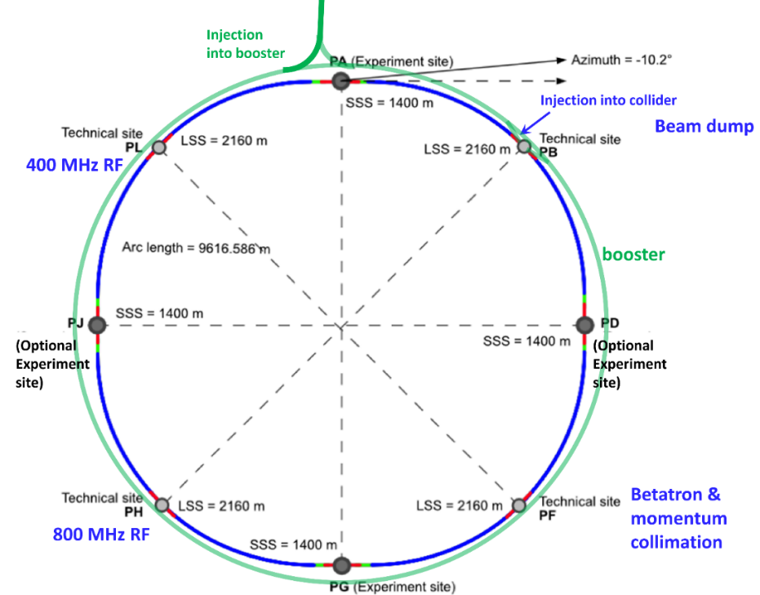
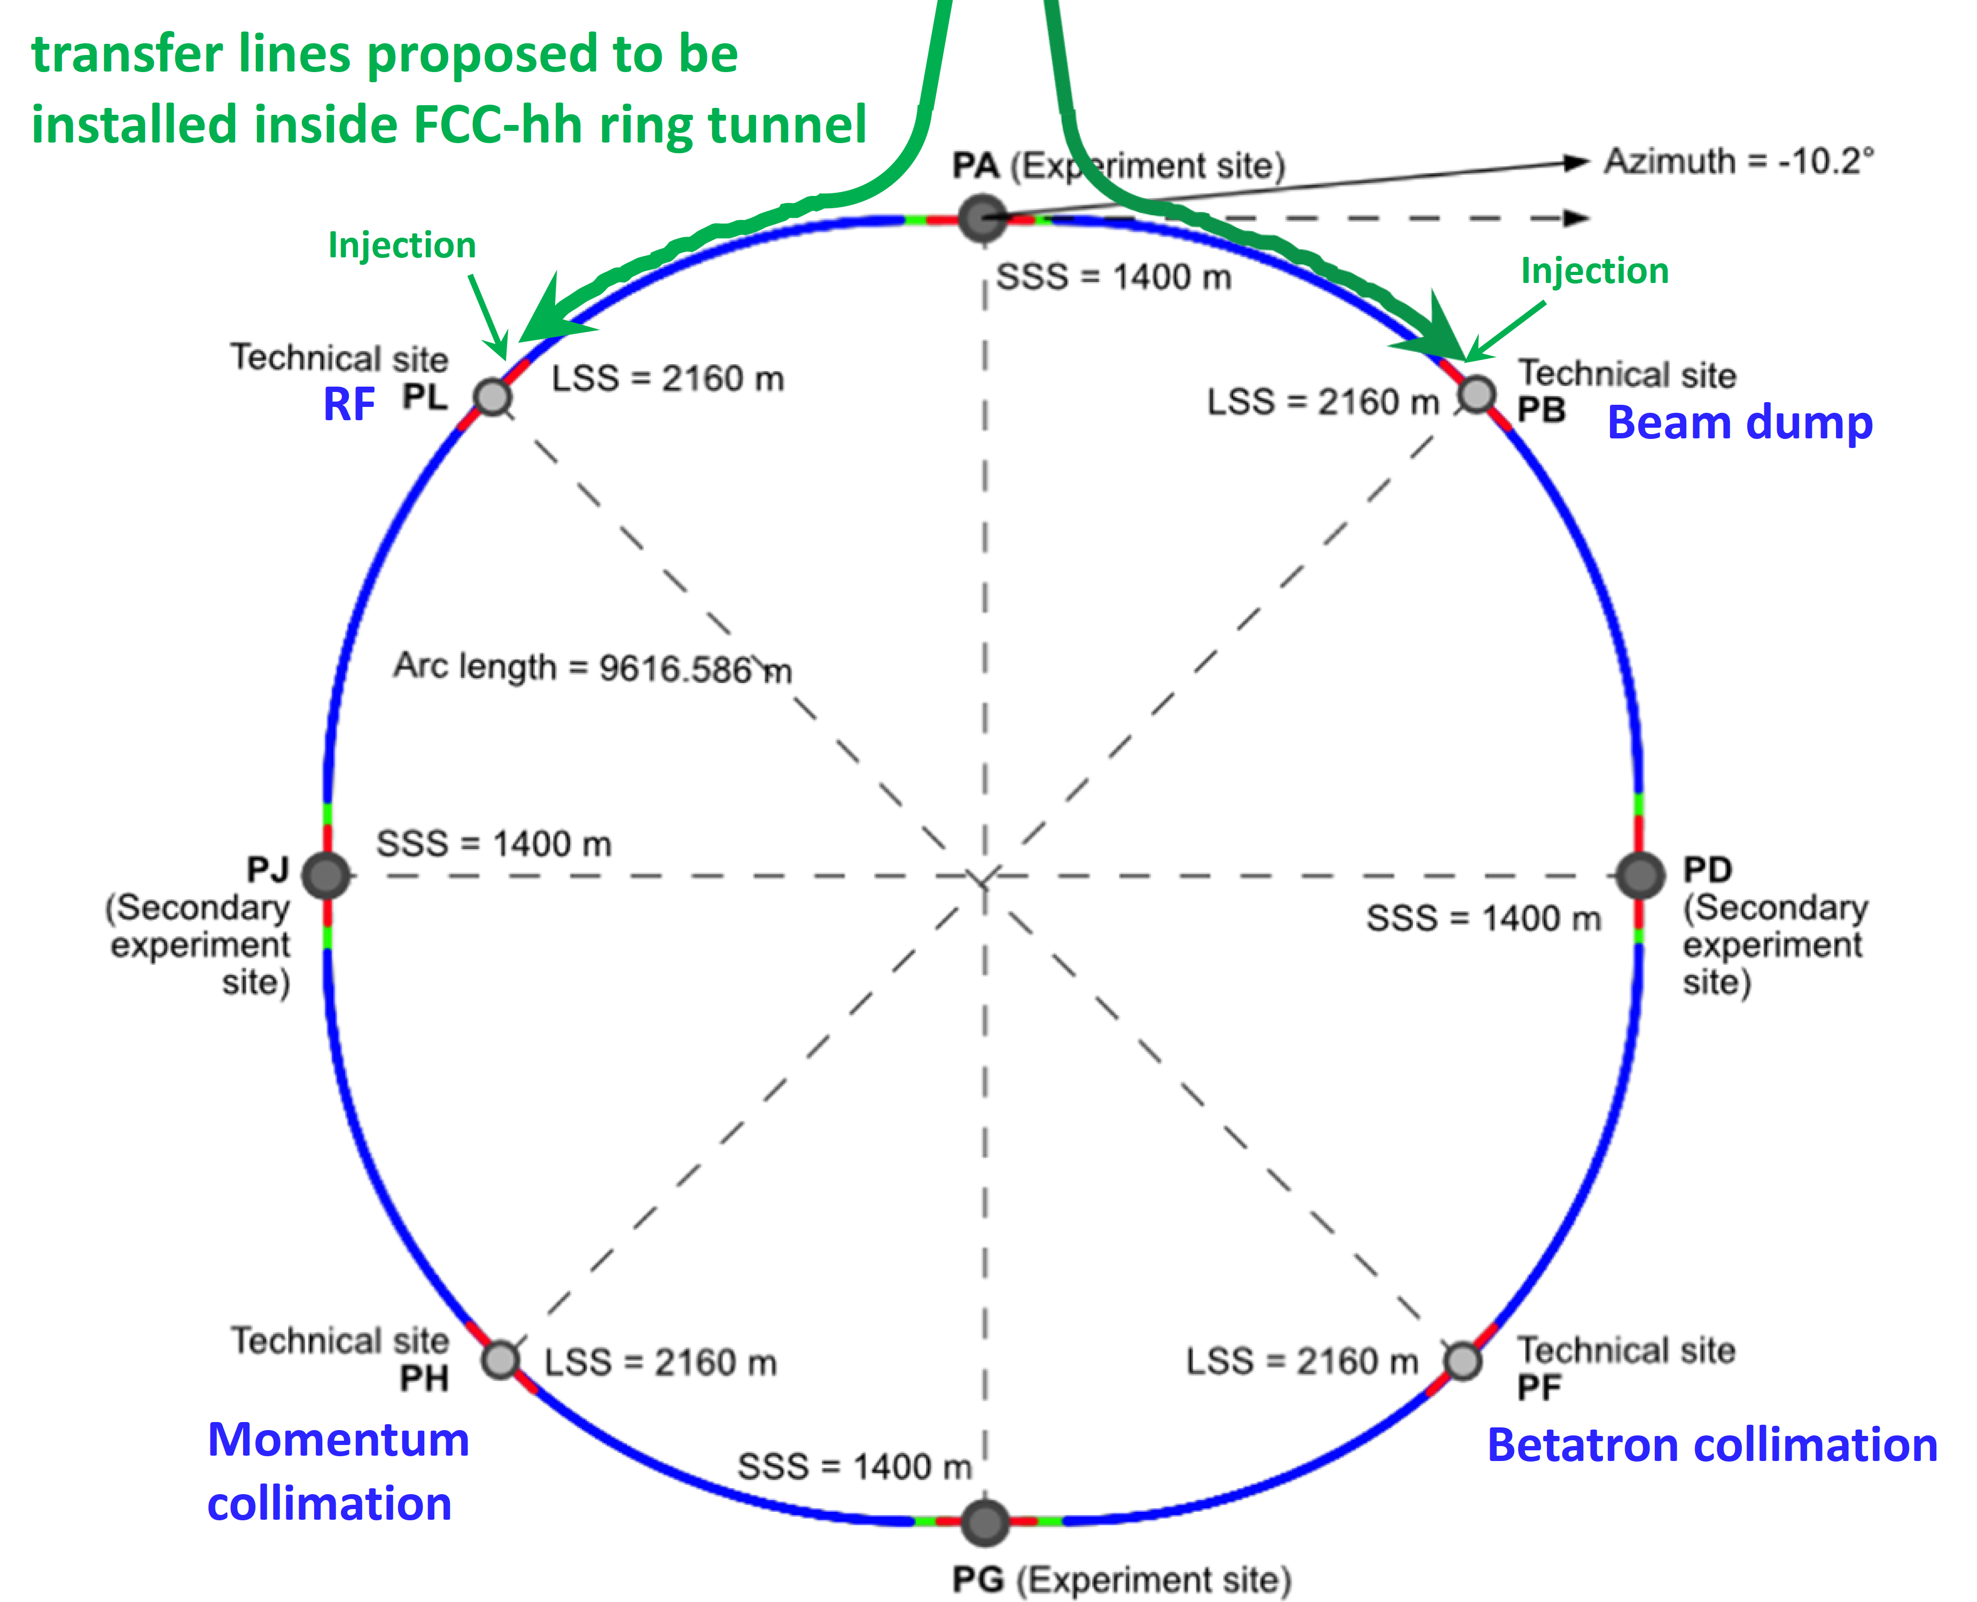
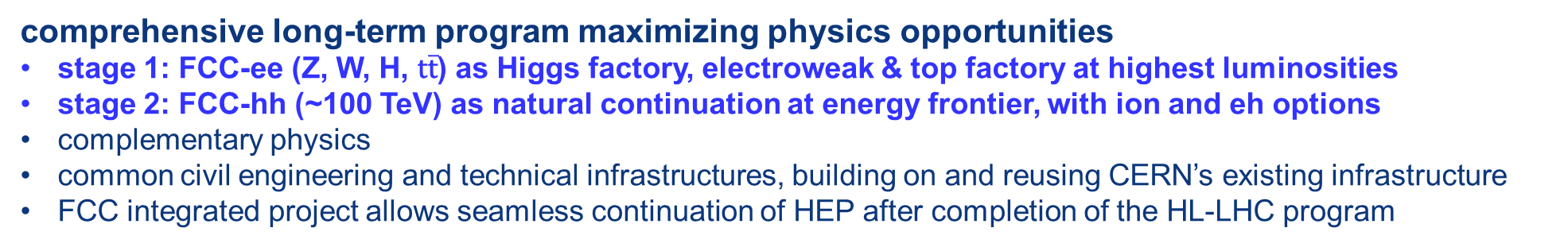
The FCC integrated program
inspired by successful LEP – LHC programs at CERN
comprehensive long-term program maximizing physics opportunities
stage 1: FCC-ee (Z, W, H, $\text{t}\overline{\text{t}}$) as Higgs factory, electroweak & top factory at highest luminosities
stage 2: FCC-hh (~100 TeV) as natural continuation at energy frontier, with ion and eh options
complementary physics
common civil engineering and technical infrastructures, building on and reusing CERN’s existing infrastructure
FCC integrated project allows seamless continuation of HEP after completion of the HL-LHC program
FCC-ee
FCC-hh
2020 - 2040
2045 - 2060
2070 - 2090++

Slide 4
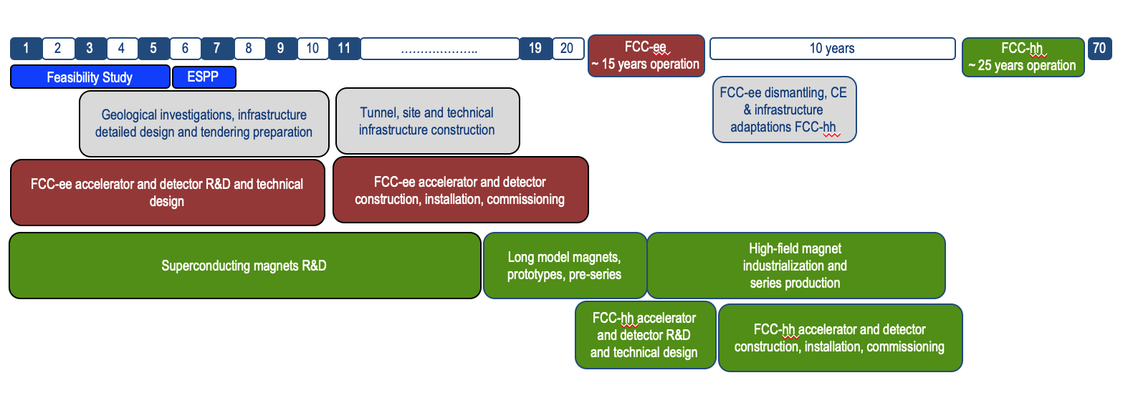
Timeline of the FCC integrated programme
Feasibility Study: 2021-2025
If project approved before end of
decade → construction can start
beginning 2030s
FCC-ee operation ~2045-2060
FCC-hh operation 2070-2090++
F. Gianotti

Slide 5
Feasiblity study goals and
roadmap towards first e⁺e⁻ collisions
Highest priority goals:
Financial feasibility
Technical and administrative feasibility of tunnel: no show-stopper for ~100 km tunnel
\
Technologies of machine and experiments: magnets; minimised environmental impact; energy efficiency & recovery
Gathering scientific, political, societal and other support
Fabiola Gianotti: “CERN vision and goals until next strategy update” FCCIS Kick-Off, 9 Nov. 2020
>2038
machine
installation
>2045 first
ee collisions
>2030
start tunnel
construction
~2028 approval
2026/7
ESPPU
>2030 - 37
element production
2025/26
Feasibility proof
>2026 - 30 full
technical design
2014 FCC
study kickoff
2020
ESPPU
2020 FCCIS
kickoff
2025/26
Financing model
Operation concept
2013
ESPPU
2018 FCC CDR
today
2020-25
FCC Feasibility Study
FCCIS H2020 DS
2012 Higgs discovery announced
2011 circular Higgs factory proposal

Slide 6
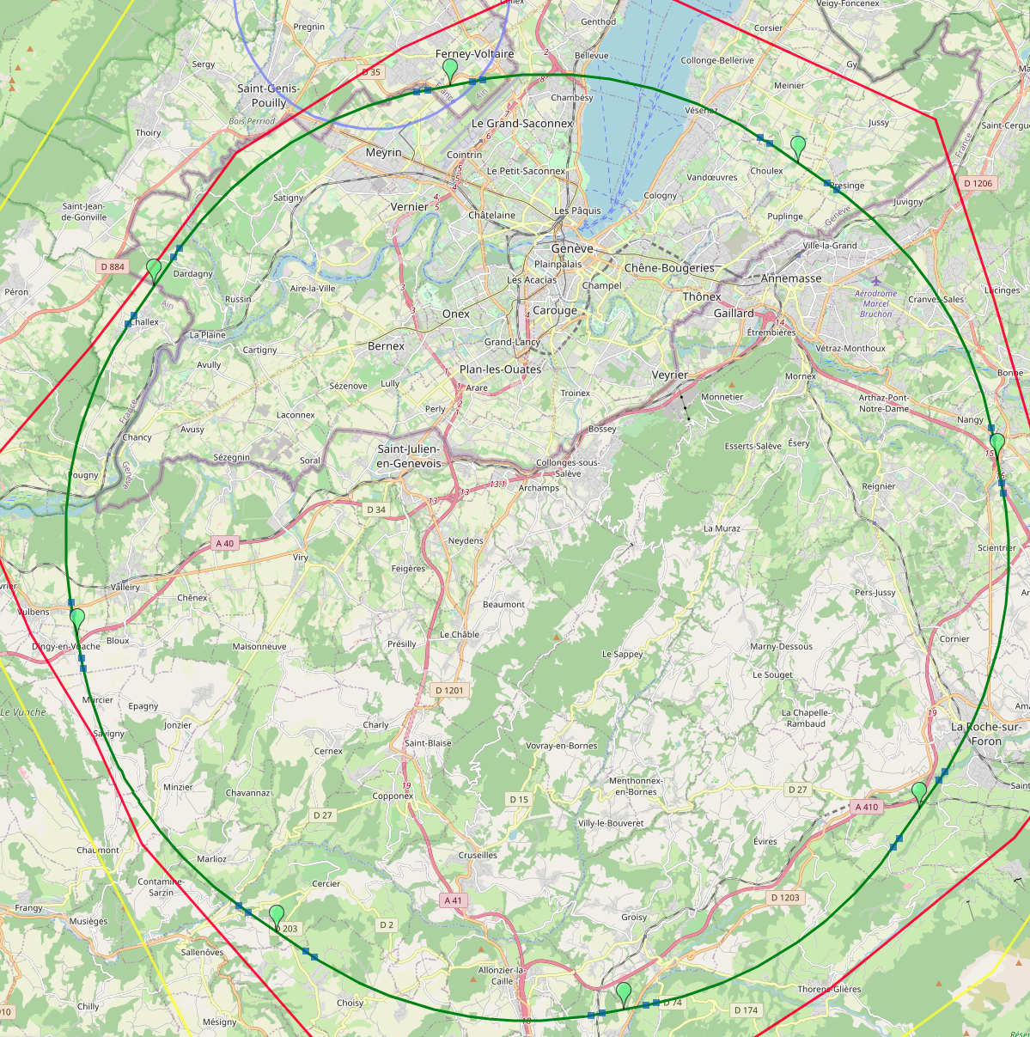
8-site baseline ”PA31”
PA: Experiment
Number of surface sites | 8
LSS@IP (PA, PD, PG, PJ) | 1400 m
LSS@TECH (PB, PF, PH, PL) | 2143 m
Arc length | 9.6 km
Sum of arc lengths | 76.9 m
Total length | 91.1 km
PB: technical
PL: technical
PD: experiment
8 sites – less use of land, <40 ha instead 62 ha
Possibility for 4 experiment sites in FCC-ee
All sites close to road infrastructures (< 5 km of new road constructions for all sites)
Vicinity of several sites to 400 kV grid lines
Good road connection of PD, PF, PG, PH suggest operation pole around Annecy/LAPP
PJ: experiment
PF: technical
PH: technical
PG: experiment
J. Gutleber

