Slide 1
Status of the Hyper-Kamiokande’s
Time Distribution System Proposal
IN2P3-INFN-IRFU
stefano russo for the time synchronization group
23/06/2022

Slide 2
HK Clock Distribution Scheme
Cavern
/
/
2
Time data and UTC (ethernet)
DAQ
network
WR
Network
Slow control
WR switch
WR switch
FE
PPS/10MHz
Commands and data
2nd distribution stage
…
10MHz, PPS & Data
Time Ref/
fanout
125MHz &
data
PPS/125MHz
1st distribution stage
FE
GNSS
GNSS
5MHz
Clk and data
(redounded link)
5MHz
Slow
control
…
Time/
Freq comp.
Atomic Clock
Sync commands
125MHz &
data
FE
Calibration
/
10
2nd distribution stage
…
5MHz
WR
Network
FE
WR switch
WR switch
Clk and data
(redounded link)
Time Ref/
fanout
PPS/10MHz
10MHz, PPS & Data
1st distribution stage
GNSS
Atomic Clock
GNSS
5MHz
PPS/125MHz
Redundancy

Slide 3
Time Base and UTC Characterization
The work on the time base characterization continues and an extensive test campaign is ongoing (thanks mainly to Lucille Mellet, Vincent Voisin and Mathieu Guige).
Most of the results are summarized here:
https://indico-sk.icrr.u-tokyo.ac.jp/event/7332/contributions/22011/attachments/20557/26254/LPNHE_timingsystem_R%26D.pdf
I give just a quick recap:

Slide 4
LPNHE Test equipment
At our lab we have:
2 SRS SF725 Rubidium atomic clocks
1 Septentrio PolaRx5TR + antenna
2 clock and Frequency counter Keysight 53220
Plus (ordered but not yet arrived)
1 PH1008 Passive Hydrogen Maser Atomic clock
1 Septentrio PolaRx5TR + antenna
We have also a copy of the UTC(OP) PPS and 10MHz clock sent via white Rabbit link from the SYRTE laboratory (where it is produced).

Slide 5
Kind of Test Performed
We basically perform 2 kind of tests:
Local time base characterization. Test our proposed concept on real hardware
Time transfer via common view: a method to measure two local time bases using the GNSS data. This method is implemented using the files published regularly by UTC(k) labs (Syrte in our case).

Slide 6
Local Time Base Characterization
For this test we use 1Rb clock sending 1 PPS and 10 MHz clock to the Spetentrio receiver. Thanks to the time transfer algorithm, we can estimate the drift of our local time base with respect to GNSS time (only GPS in this case)
PPS
Rb clk
GNSS
10 MHz
CGGTTS
CGGTTS file with time distance
Between local time and GPS time

Slide 7
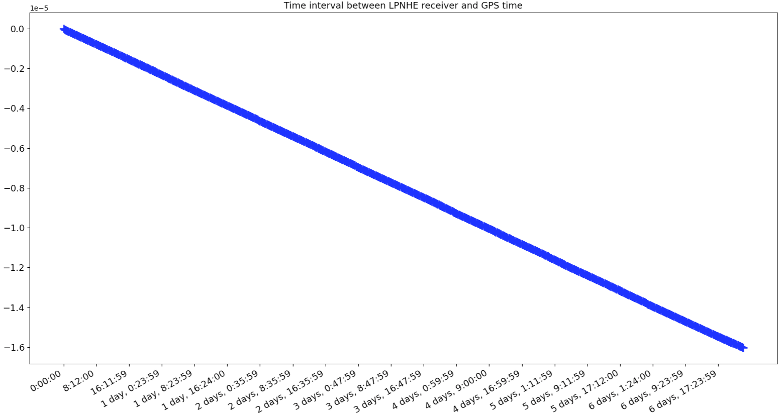
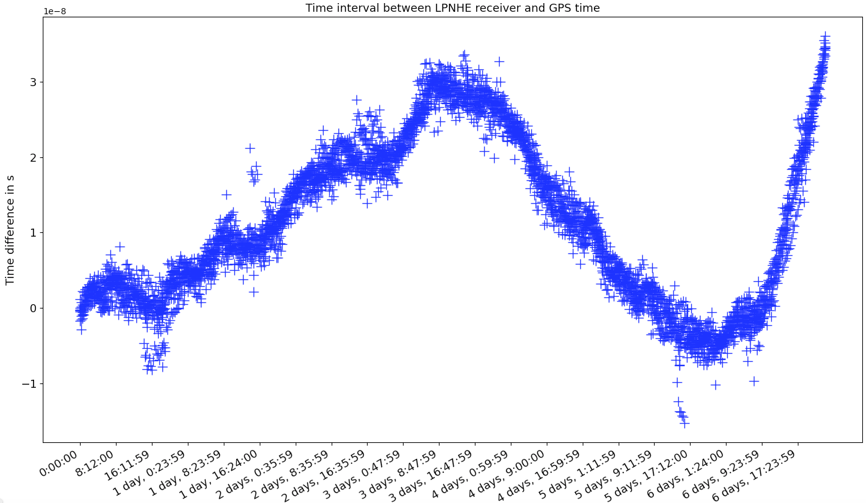
Local Time Base Characterization
The “raw” plot (left), as produced from the receiver, shows a liner drift, as expected for the Rb clock. Once removed we can see that the clock “noise”.
(from Lucille’s talk cited before)

Slide 8
What Do We Do With It?
Extracting the drift from the left plot will allow us to precisely correlate the local time base (used to time tag the events) to GNSS time. Once done we can calculate the uncertainty on it (right plot). In this case is about 4 ns over 6 days (random walk).
(from Lucille’s talk cited before)

Slide 9

How Accurate Is This Method?
Freq/Time cnt
WR switch
PPS
PPS
Rb clk
GNSS
10 MHz
PPS
10 MHz
WR switch
UTC(OP)
Time distance between
local Rb and UTC(OP)
PPS 10 MHz
GNSS
CGGTTS
CGGTTS file with time distance
Between local time and GPS time
CGGTTS
SYRTE
To evaluate our drift estimation method, we have done the following measure:
- We have created a CGGTTS form the GNSS steered by Rb clock (as before).
Then we have used the time transfer technique to measure the time distance between our Rb clock to SYRTE UTC(OP) via common view method.
Finally, we have compared this time distance with the one measured via the counter.
Vincent Voisin work

Slide 10
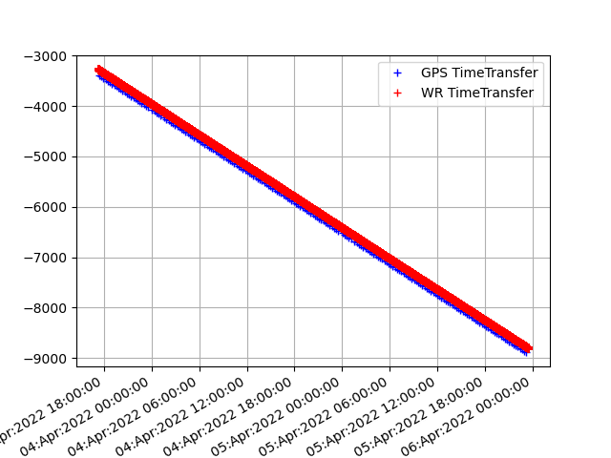
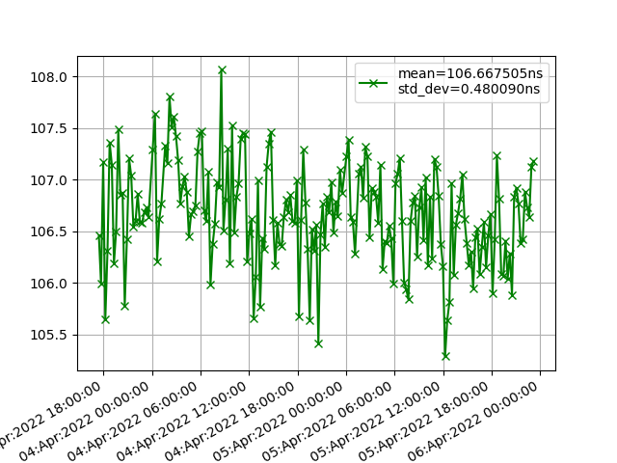
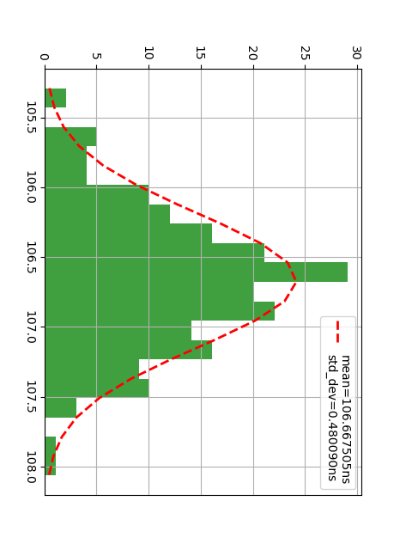
How Accurate Is This Method?
Time distance between local Rb and UTC(OP): Common view vs White Rabbit
Local time base/ UTC(OP)
Via common mode (blue)
Local time base/ UTC(OP)
Via white rabbit (red)
(same slope as before)
Common view method/WR method difference
+/- 3 ns max
Histogram of the difference
Sigma = 0.48 ns
3 days of data. X axis: local time Y axis: ns
Vincent Voisin work

Slide 11
Few More Updates
Work on the time base characterization continues thanks to Lucille Mathieu and Vincent. More results to come soon.
The second stage time distribution board is almost ready to be fab’ed. Great synergy with CEA. We are getting great advantage from the debug done by Denis Calvet!
Firmware and embedded software development on EVB continue. Linux (Petalinux kernel + CentOS 7 rootfs) has been installed.

Slide 12
Time Distribution System conclusions
The time base generation scheme has been finalized.
The instruments have been tested and calibrated. The full time base generation test is started. We keep working on characterization.
We would like to go to Japan to test our second station (purchased) as soon as the travels reopen.
The work on the distribution part is ongoing.

Slide 13
Backup

Slide 14
Clock Generation & UTC - Connections
The local time is generated (by a precise atomic clock) in the form of PPS and 10MHz in synch to each other (HK local time).
The time reference point custom board receives the frequencies and distributes it to the GNSSs and the first distribution stage. It has extra ports to compare the main and spare base cadence.
GNSSs use the input cadence to sync the outputs and have a reference frequency more stable than the internal oscillator

Slide 15
Clock Generation & UTC - Connections
2 GNSSs receivers (connected to the same antenna) get information from the satellites and measure the time distance between the local PPS and UTC.
The result of this measure is sent to DAQ and used to transform the local tag to UTC
The DAQ monitors the status of the GNSSs and select which one to use

Slide 16
Clock Generation & UTC - Redundancy
The full chain (atomic clock, GNSSs (x2), and first distribution stage) is replicated for redundancy
Having a total of 4 GNSS receivers will allow the DAQ to identify if one is malfunctioning
The time distance between the 2 chains will be constantly measured and the result sent to DAQ. This info will be used in case of switch to one chain to the other

Slide 17
Clock Generation & UTC - Reliability
Scheduled interventions on components will be performed to reduce the risk of failures
In case of PHM, the atomic clock “physics package” will be replaced within 10 years (at productor’s site in CH). In case of rubidium the clock will be changed (SK?)
A third atomic clock will be available at far detector site and periodically turned on. It will serve as cold spare used if the main or the hot spare needs maintenance
All the atomic clocks will be measured against the so-called travelling station every 3 / 4 years.
The GNSS receivers will be changed before the end of life.
The maintenance cost will be included in the budget request

