Slide 1
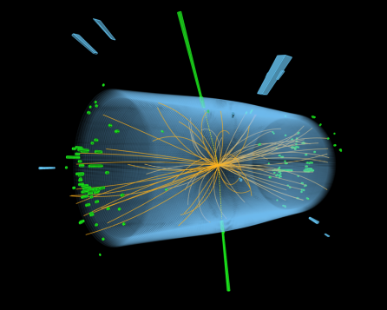
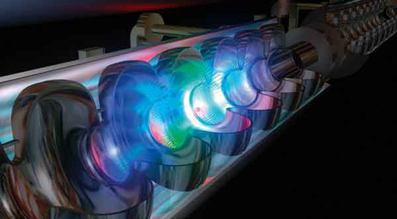
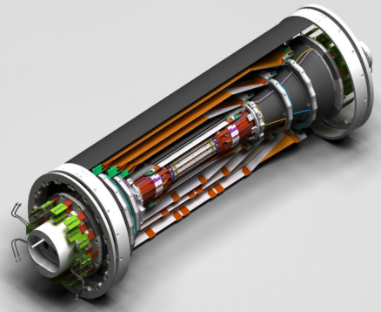
„DMLab“ International Research Lab
… between IN2P3 – HGF-Matter
Thomas Schoerner (DESY) and Dirk Zerwas (IJCLab)
Meeting of the DMLab Steering Committee and Scientific Projects Board
13 July 2022

Slide 2
Today
Common meeting SC + SPB
Report on recent developments
Status of Memorandum of Understanding
Open questions
Meeting of SPB
Organisation of next scientific SPB meeting
Organisation of secondments from France to HGF partners
Open questions, e.g. money etc.

Slide 3
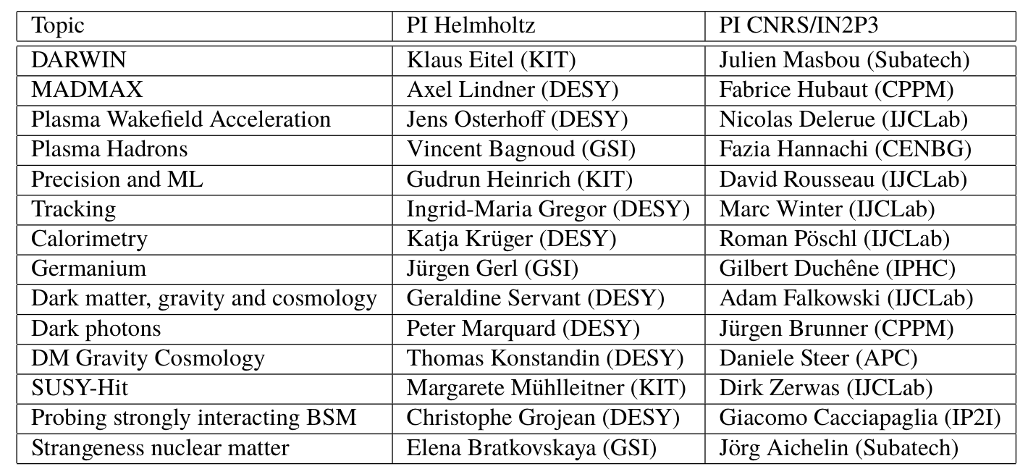
The DMLab SPB – Recap
Mandate and members
Jean-Loic Kneur (L2C)

Slide 4
The DMLab SC – Recap
Mandate and members
Name | Institution | Function
Reynald Pain / Berrie Giebels | IN2P3 | Director
Patrice Verdier (co-chair) | IN2P3
Vincent Poireau | IN2P3
Laurent Vacavant | IN2P3
Beate Heinemann | DESY | Director of particle physics
Hans Ströher (co-chair) | FZ Jülich | Director of IKP2
Yvonne Leifels | GSI | Deputy research director
Marc Weber | KIT | Head of division V

Slide 5
Common Meeting SC and SPB
Recent developments and status
September 2021: change in DESY legal department with some inactivity before (K. Paulat → C. Runge-Siegle)
Somewhat slow convergence of MoU discussions, with version in 3/2022 from DERCI somewhat of a step back
Series of very constructive meetings in 2022, the latest on 27 June.
Hopefully all stumbling blocks cleared by now (tax legislation, legal character of IRL, intellectual property etc.)
Next steps (and questions)
CNRS internal meeting on 7 September
Signatures of MoU (how – in series and via mail? All but the final two signatures (see next point)?
Scientific follow-up meeting in autumn together with formal inauguration – or two separate events in order to increase chances to have relevant people around?
Format (+ time, place, …) of meeting to be discussed in SPB meeting next. Opinions?
AOB for SC + SPB
First publication with DMLab co-authorship: R. El-Kosseifi et al., The Higgs Boson Mass as Fundamental Parameter of the Minimal Supersymmetric Standard Model, https://arxiv.org/pdf/2202.06919.pdf (accepted for publication)
Ph.D. position at CPPM for work on MADMAX (Pascal Pralavorio and Fabrice Hubaut) from CNRS special fund for IRLs
Formally end of SC meeting; next moving to SPB matters (SC welcome to stay).

Slide 6
Topics for DMLab SPB
Format, place and date of next scientific meeting
Reminder: Last meeting 9/10 December 2 pm – 4 pm.
Veto dates?
Our proposal:
Between 24 Oct and 11 Nov
Same format and duration as last year, or extended by ½ day?
Probably this time still DESY – hope for Karlsruhe and Darmstadt in future years?

Slide 7
Topics for DMLab SPB
Funding issues
Travel F to Germany for the annual scientific meeting:
Money will be transferred from the IJCLab account by CNRS lab-to-lab transfer to the labs
Please send us an estimate for your project (French PI) for whom (affiliation) and which amount (no details, we trust your estimates)
Thomas and Dirk will sum the requests so that we have 1 transfer per French lab, identify a single contact person per lab and then this persons receives and distributes the money if several people in different groups are involved
Additional funds may be available, contact us with your ideas……
Questions?

Slide 8
Topics for DMLab SPB
Sabbaticals F → D
Overview of intentions in the next two years: Please check with your colleagues in your projects:
Who in your project is interested?
Which period?
Procedure:
Attached to the INDICO page (you can give it to the interested people)
Eligibility: restricted to CNRS personnel (researchers and ITA). The notion CNRS personnel is defined by which organization pays the salary. French University personnel can be affiliated with DMLab, but the financial benefits of working abroad have to be shouldered by the home University.
Duration: Long-term stays in DMLab are for a minimum of one year, they may be renewed. Contact the DMLab directorate as soon as possible.
Approval authority: The long term stays (in French “expatriation”) are budgeted annually by the central administration. The director of the IN2P3 takes the decision for the members of the IN2P3. If you are a member of another CNRS Institute (INP,...) , the director of the corresponding institute will take the decision and this institute will have to set aside the corresponding budget.

Slide 9
Topics for DMLab SPB
Change of lab for individual researchers
A long term stay at DMLab is formally a change of lab affiliation, in French “changement d’affectation”, therefore it is advisable to talk to your lab director about your plans. Returning to your old lab is again a change of lab.
Financial benefits: The CNRS foresees financial compensation for personnel working in its labs abroad. These benefits are calculated individually. You may contact the local CNRS administration (délégation régionale) to get an estimate of the additional support you may expect to receive.
Time scale: Count typically 6 months between start of the procedure and your move. The IN2P3 usually works on human resources questions for year N+1 in September and October of year N.
Procedure:
Discuss your scientific project and plan with:
your group leader
your lab director
the DMLab directors
the IN2P3 Deputy Scientific Director
You need:
Letter of support from the current lab director to the IN2P3 director
Letter of support from the DMLab directors to the IN2P3 director
the CNRS section (01, 02, ...) is informed
Notification of the financial support by the CNRS
Questions?

