Slide 1
Supernova Wind Breakout
By: Tal Wasserman
Advisor: Prof. Eli Waxman
Weizmann Institute, Israel

Slide 2
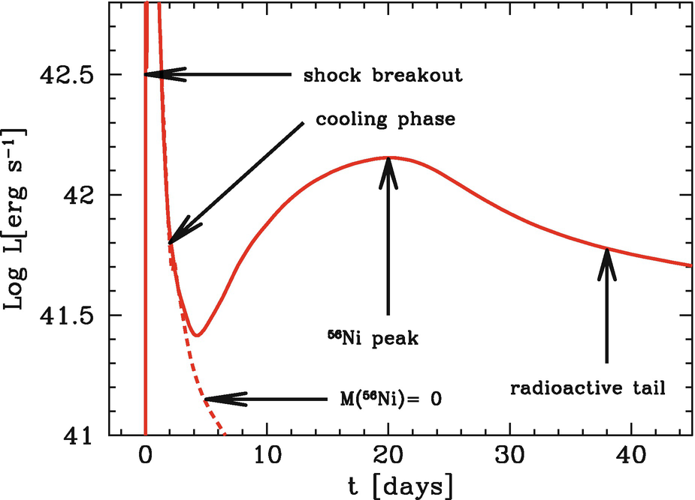
SN Lightcurve
Information
Time
There are still many open questions:
Exact explosion mechanism? What are the progernitors? Their mass? Type? Radius? Mass-loss history?

Slide 3
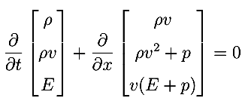
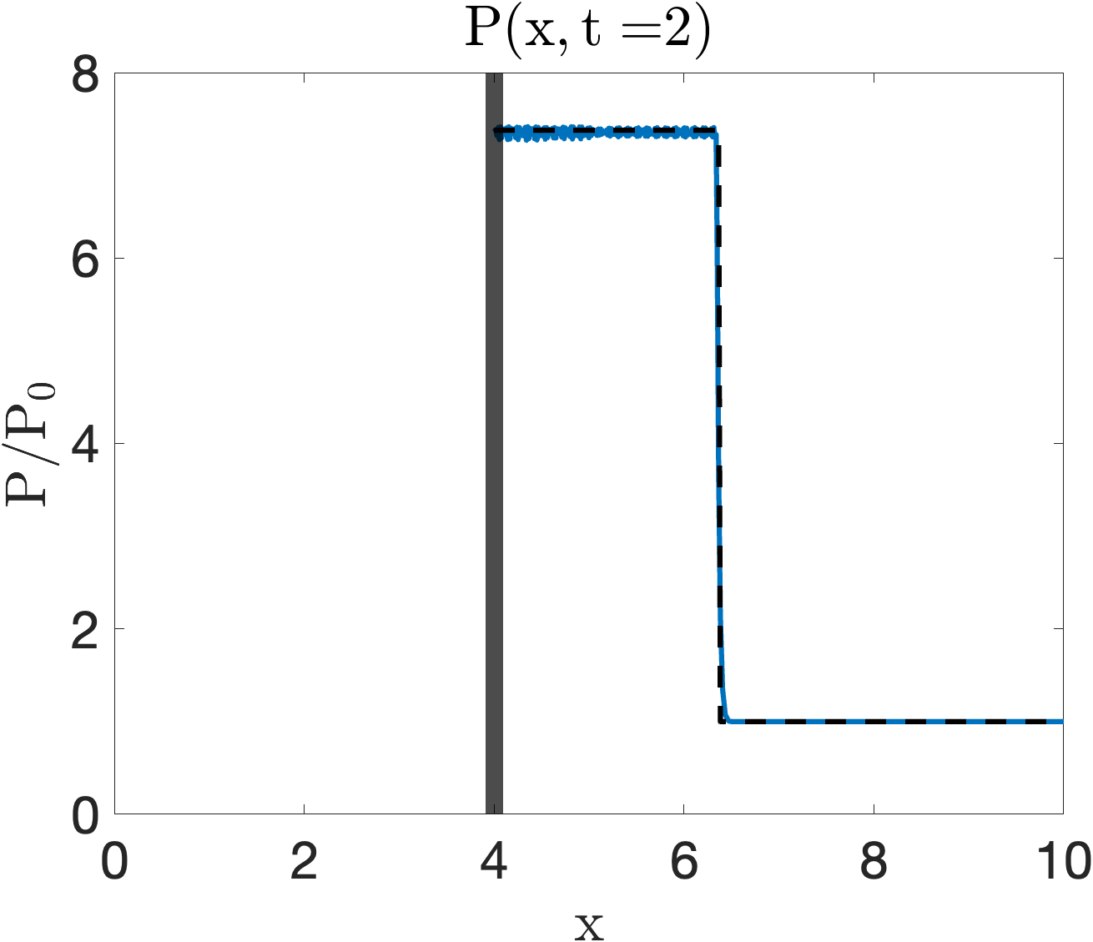
Reminder - Shock Hydrodynamics
$$v_{p}$$
$$v_{s}$$

Slide 4
Radiation Mediated Shock (RMS)
$$v_{p}$$
$$v_{s}$$
High velocity
Optically thick
$⟹$ Energy
$$v_{s}≫{\left(\frac{ρ}{a_{BB}m_{p}^{4}}\right)}^{\frac{1}{6}}\sim 10\frac{km}{s}$$
$$L≫\frac{1}{ρκ_{T}}\frac{c}{v_{s}}\sim {10}^{5}km>R_{earth}$$
$$E≫ρv_{s}^{2}L^{3}\sim {10}^{39}{erg\sim 10}^{20} atom bombs$$
Typicaly $v_{s}\sim 10,000\frac{km}{s}$
at the edge of a star $ρ\sim {10}^{−9}\frac{g}{cm^{3}}$
Katz et al. 2010

Slide 5
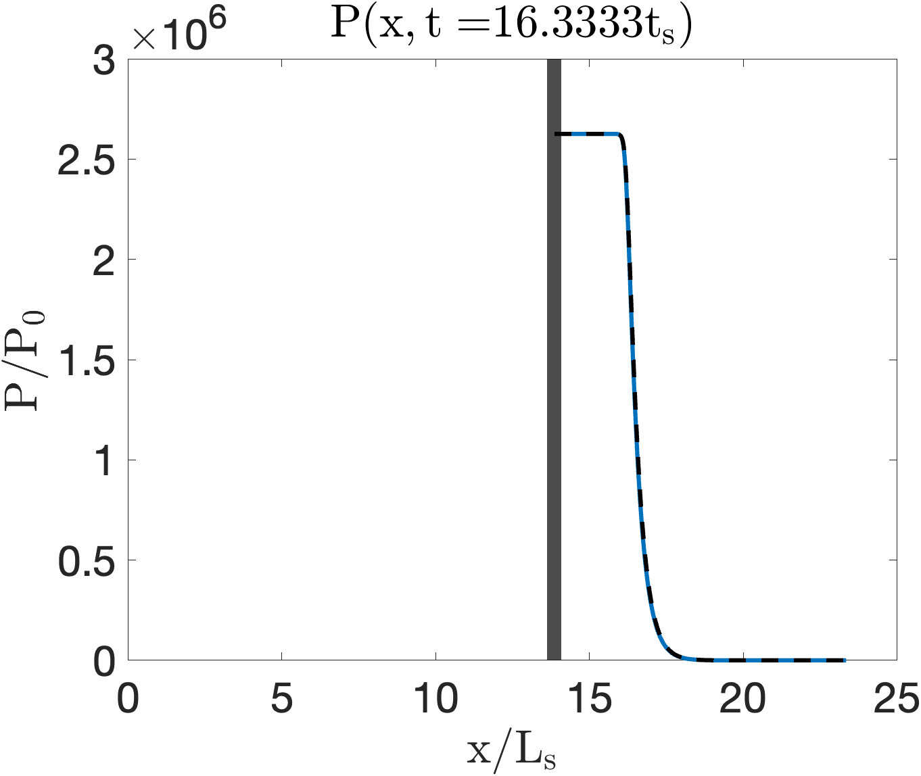
Breakout
$$τ\sim \frac{c}{v_{s}}$$
?
Katz et al. Sapir et al. 2011,2012,2013

Slide 6
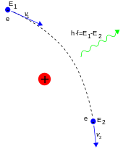
Shock Temperature
$ρv_{s}^{2}\sim a_{BB}T^{4}⟹T\sim {\left(\frac{ρv_{s}^{2}}{a_{BB}}\right)}^{\frac{1}{4}}\sim 100eV⟹$ UV
Thermal Equilibrium:
Non-Thermal:
$v_{s}>0.1c⟹T_{s}\sim v_{s}^{8}\sim 1keV⟹$ X-ray
Bremsstrahlung:
$$v_{p}$$
$$v_{s}$$

Slide 7
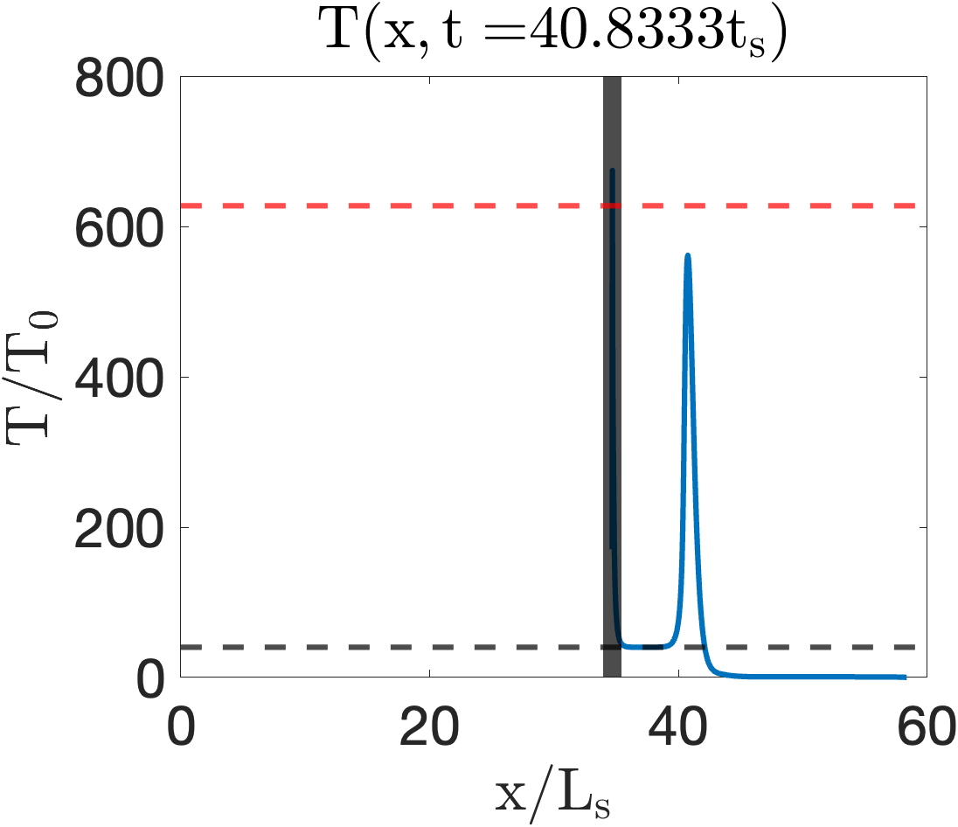
~X-ray
~UV

Slide 8
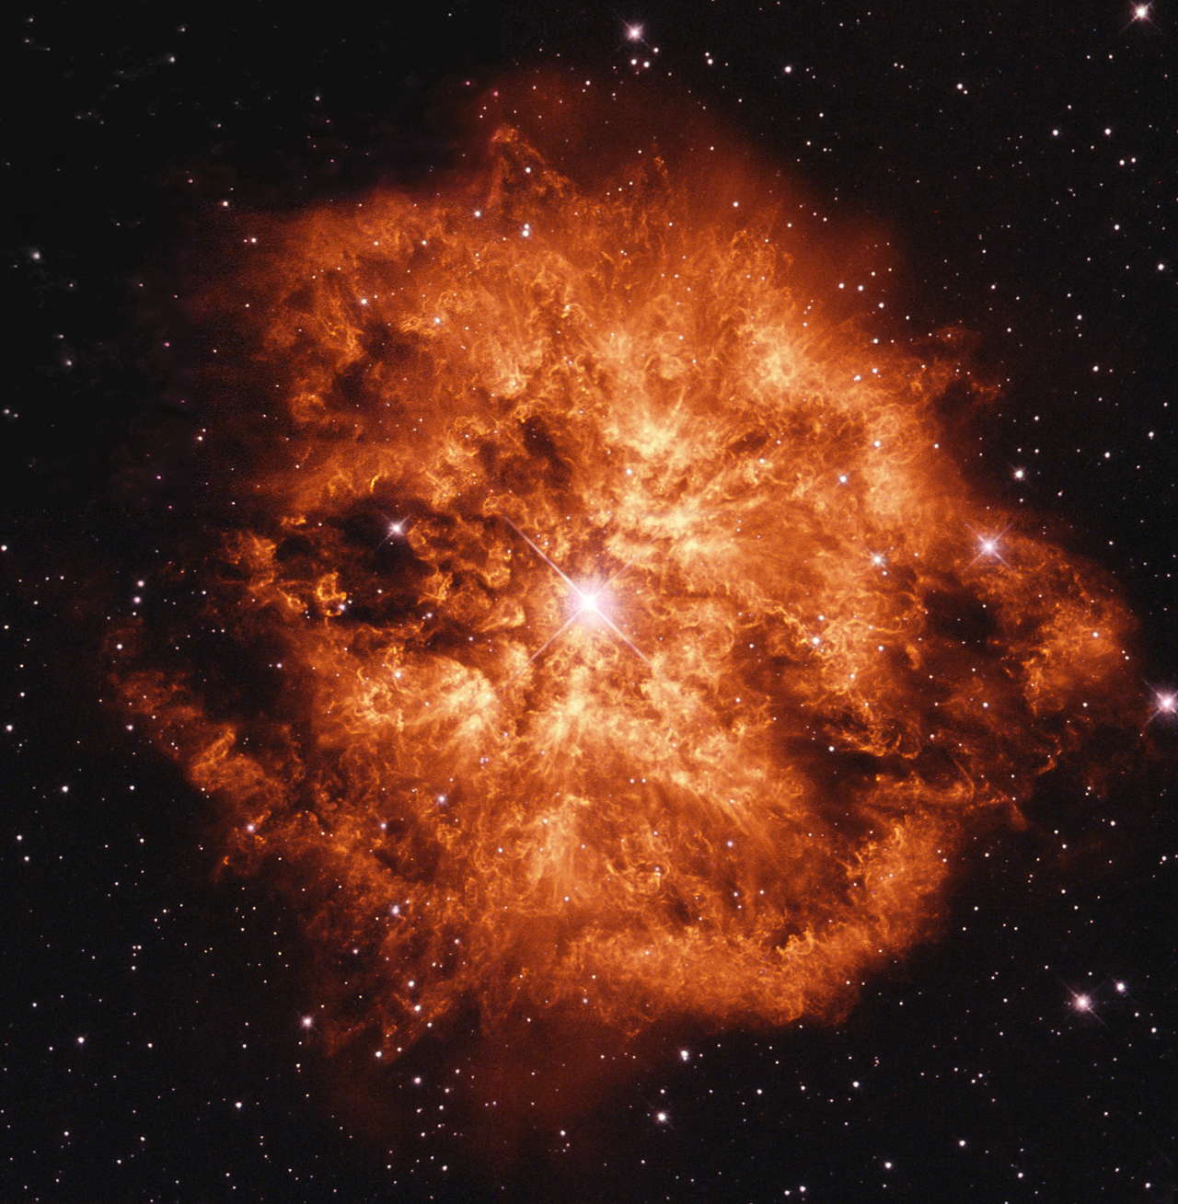
Stellar Wind
$$τ=c/v$$
Massive stars eject mass
Stellar
$$τ$$
$$R_{∗}$$
$$\sim minutes$$
$$R_{br}≡r\left(τ=\frac{c}{v}\right)$$
$$R_{br}$$
$$τ$$
Wind
WR124 by HST, 1997
$$R_{∗}$$
$$\frac{R_{br}}{v}\sim days$$
$$\dot{M}>{10}^{−3}\frac{M_{⊙}}{yr}⟹τ>c/v$$

Slide 9
Shock Transition
For a sufficiently extended wind, there exists a radius of transition from RMS to different Shock
$$\frac{4πr^{2}}{σ_{T}}m_{p}v_{max}\left(r\right)=E_{γ}\left(r\right)/c$$
$$E_{γ}(r)<\frac{1}{2}M\left(r\right)v^{2}$$
$$⇒r(v_{max})=\frac{1}{2}R_{br}$$
$$v_{max}\left(r\right) <\frac{1}{2}\frac{R_{br}}{r}v$$
$$E_{γ}(r)<2πm_{p}\frac{R_{br}cv}{σ_{T}}r$$
$$E_{γ}\left(r\right)$$
$$v$$
Constant mass-loss:
$$M\left(r\right)$$
$$\dot{M}\sim const⇒ρ\left(r\right)∼r^{−2}⇒ρ\left(r\right)=m_{p}\frac{R_{br}c/v}{σ_{T}}r^{−2}$$
$$M\left(r\right)=4πm_{p}\frac{R_{br}c/v}{σ_{T}}r$$
Katz et al. 2012

Slide 10
Collisional/less?
$$ω_{p}={\left(\frac{4πρe^{2}}{m_{p}^{2}}\right)}^{1/2}\sim {10}^{9}s^{−1}\left(v_{9}^{−1/2}R_{14}^{−1/2}\right)$$
$$ν_{C}=ρσ_{C}v/m_{p}\sim {10}^{−3}s^{−1}\left(v_{9}^{−4}R_{14}^{−1}\right)$$
Collisionless Shock
Width: $c/ω_{p}\sim 30cm\left(v_{9}^{3/2}R_{14}^{1/2}\right)$
Waxman & Leob 2001

Slide 11
Transients Interpreted with Wind Interactions
Wind breakouts may be the sources of several classes of powerful transients:
Type-IIn SN (e.g., PTF09uj, Ofek et al. 2010)
Double-Peaked SN (e.g., LSQ14bdq, Nicholl et al. 2015)
SLSN (e.g., SN 2006gy Woosley et al. 2012)
XRF (e.g., XRO080109 Soderberg et al. 2008)
LLGRB (e.g., GRB060218 Campana et al. 2006)

Slide 12
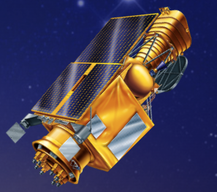
ULTRASAT 2025

