Slide 1
A Blind Search for Transients in ACT Data
Emily Biermann, Yaqiong Li, Arthur Kosowsky, Sigurd Naess, and the ACT Collaboration
act.princeton.edu
Notes:
Today I am going to be talking about searching for astrophysical transient events using ACT millimeter wavelength data. This brand new topic of research in astrophysics as CMB searches have only recently acquired the resolution necessary to pick up these events, opening the transient sky to a never before seen frequency band.

Slide 2
Collaborators
Yaqiong Li
Cornell University
Sigurd Naess
Universitetet i Oslo, Norway
Arthur Kosowsky
University of Pittsburgh
Emily Biermann
University of Pittsburgh
Notes:
Before I begin I’d like to acknowledge my collaborators, Yaqiong Li, Sigurd Naess, and Arthur Kosowsky. I am speaking today on behalf of these folks as well as the ACT collaboration.

Slide 3
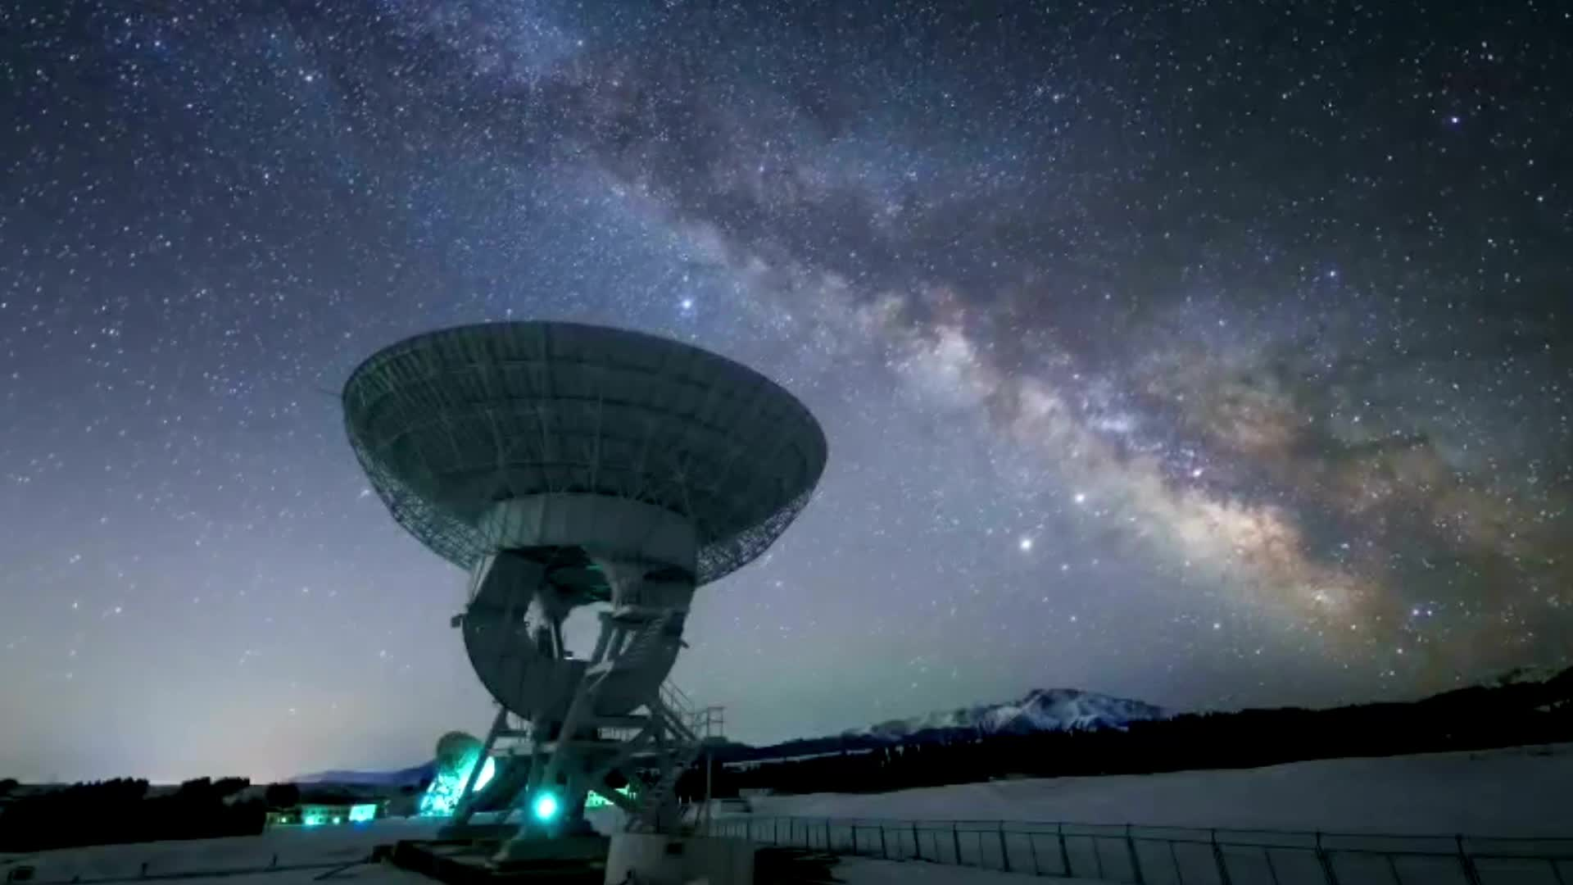
Decadal Survey on Astronomy and Astrophysics 2020
“It is essential that CMB-S4 produce transient alerts, as well as calibrated maps in all bands and on all angular scales that are openly usable and accessible on as rapid a cadence as practical”
Notes:
Priority work within the astronomy community!
Wait! I’ve never hear of this before! Why is this so important? What’s CMB-S4? Why do we need it to produce rapid alerts?

Slide 4
Millimeter Transients
Short Gamma Ray Bursts
Produced from neutron star mergers
Fast Blue Optical Transients
We don’t know what these are but they have been observed in mm
NSMs with a Stable Magnetar Remnant
Magnetar transfers energy to surrounding merger ejecta
Ejecta reaches relativistic speeds, emission peaks in microwave and radio
Tidal Disruption Events
gamma-ray/X-ray transient Sw J1644 +57 → evidence of jets from TDEs
Long Gamma Ray Bursts
Massive star collapses into black hole
Fireball model, jets interact with medium producing forward and reverse shocks
Unbiased probe of reverse shock
Synchrotron emission peaks in millimeter in early times
Emission peaks in early times
See Eftekhari et al., 2022 and references therein

Slide 5
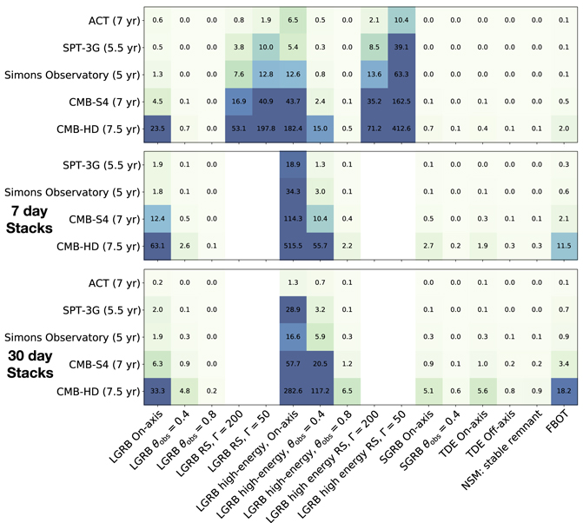
Observation Predictions
Eftekhari et al., 2022
Simulated synchrotron transients
Will see many extragalactic transient events
We have to know how to look for and identify them!
Notes:
- CMB surveys cover large sky area, can see many transients

Slide 6
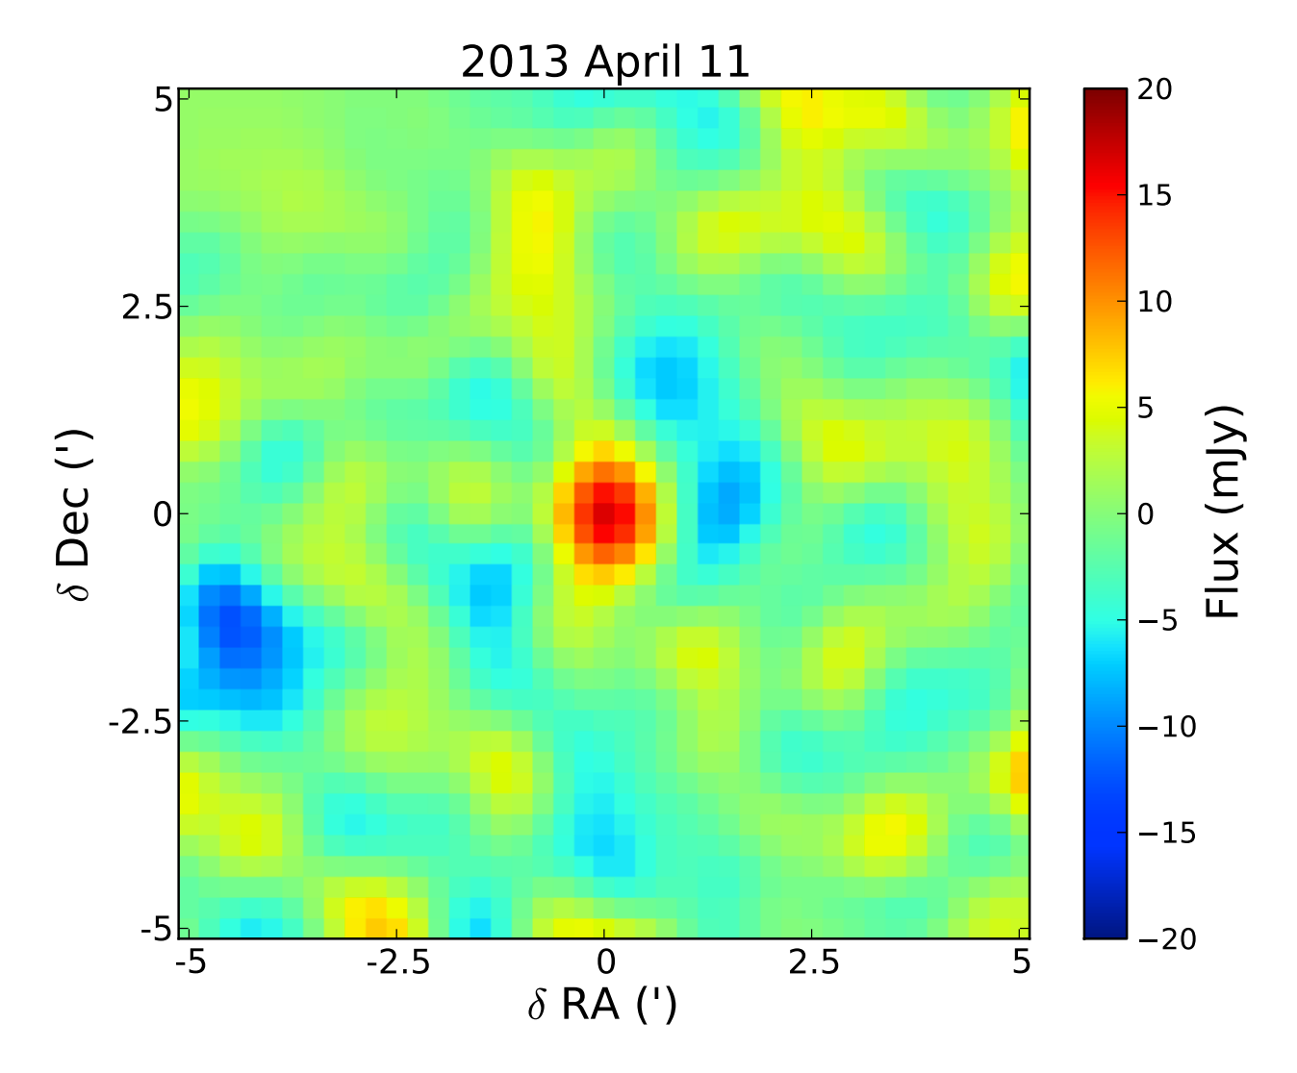
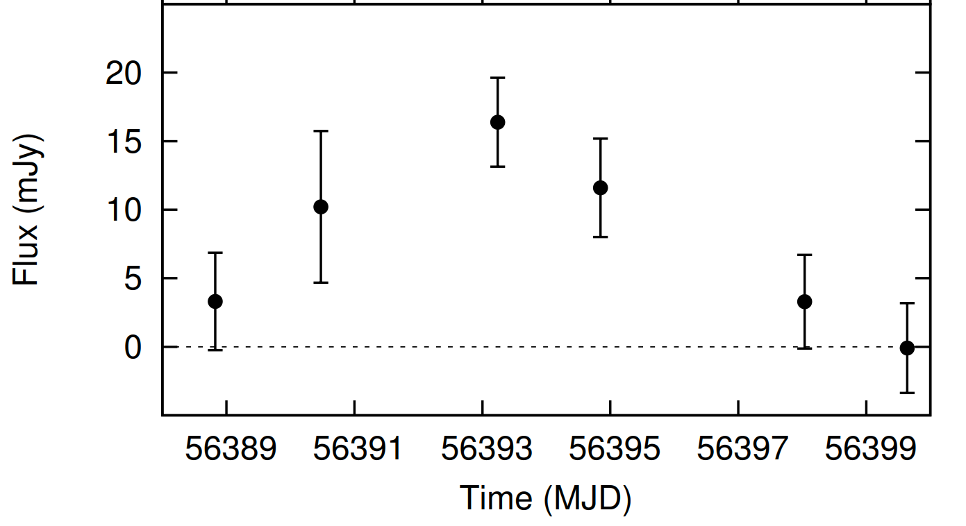
SPTpol: Whitehorn et al. 2016
One possible transient event
Broadly consistent with GRB orphan afterglow
Whitehorn, N., Natoli, T., Ade, P. A. R., et al. 2016
Notes:
- Only a blind search could detect orphan afterglow (α > 1.5, self-absorbed synchrotron emission)

Slide 7
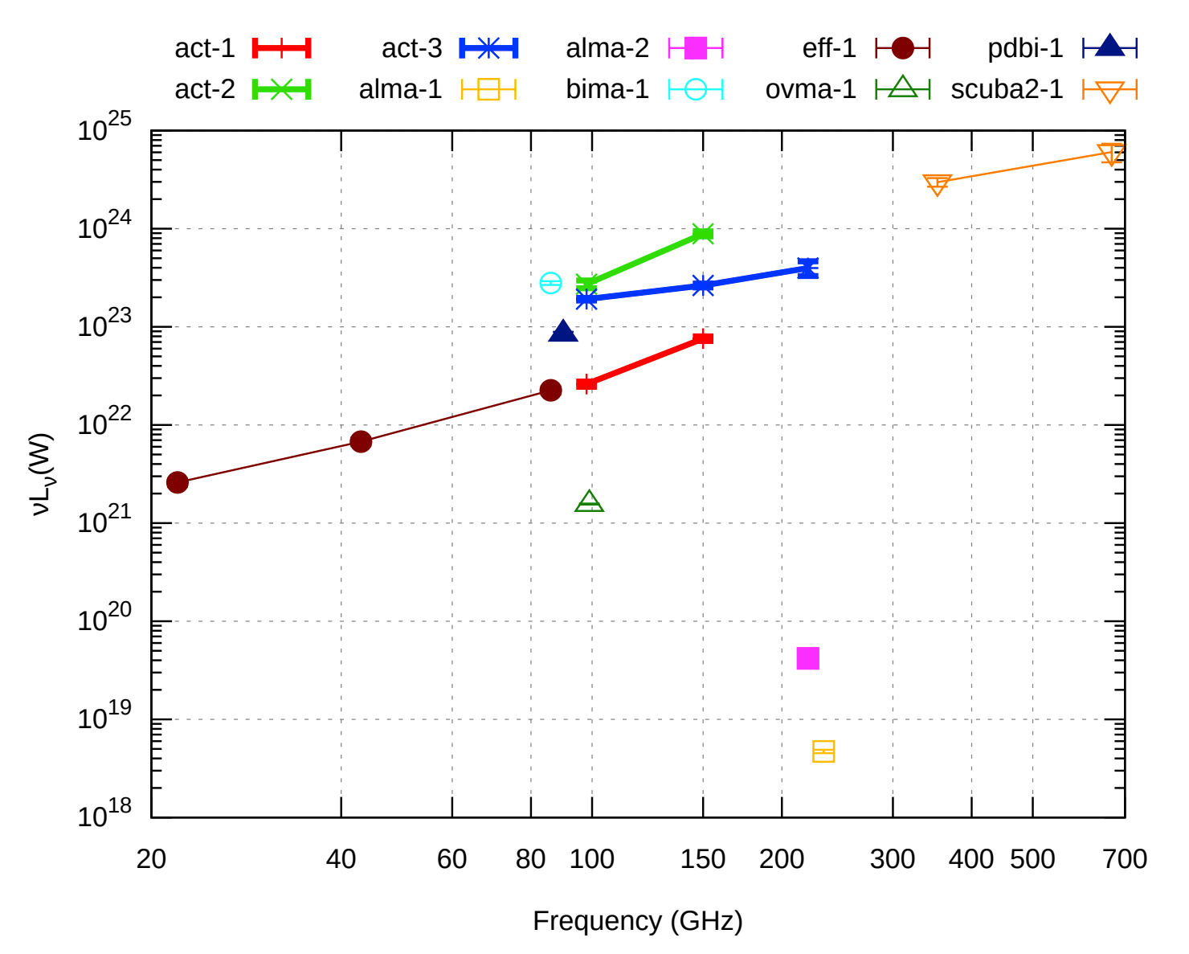
ACT: Naess et al 2020a
Serendipitous discovery of three bright transients
3-day maps for Planet 9 search
All have stellar counterparts with active coronas
May be caused by magnetic recombination
Naess, S., Battaglia, N., Richard Bond, J., et al. 2021a

Slide 8
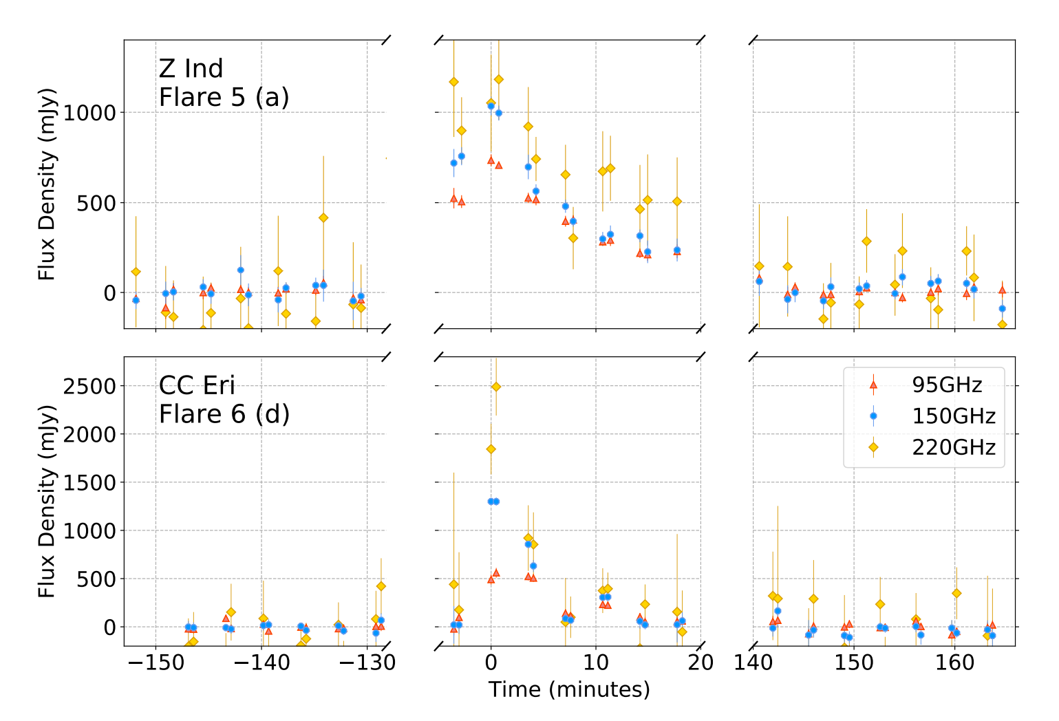
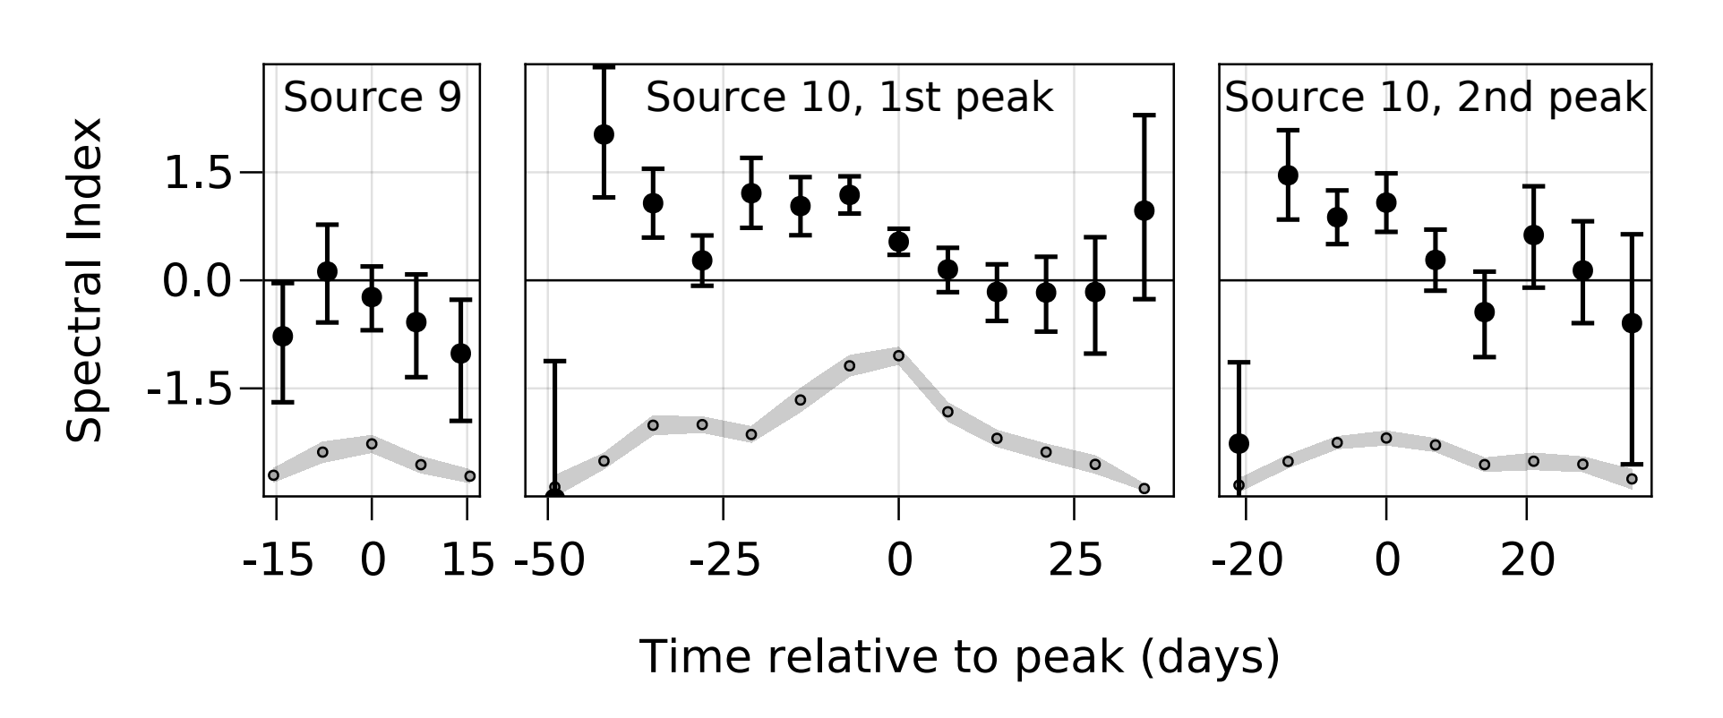
SPT-3G: Guns et al 2021
2 Possible Extragalactic Events
Longer duration (~weeks)
No obvious counterparts
Spectrum evolves
Consistent with newly formed jet

Slide 9
Atacama Cosmology Telescope
ACT (2008-2022) was a 6 meter microwave telescope covering 3 frequency bands across three arrays with arcminute-scale angular resolution
Surveyed 40% of the sky with roughly a weekly cadence
Allows us to conduct the largest systematic transient search in this band to date
act.princeton.edu
Notes:
The Atacama Cosmology Telescope, located in Chile is perhaps better known for doing work in well, cosmology.
We survey 40% of the sky, 3 frequency bands across three arrays with arcminute-scale resolution.
amazing work with Cosmology which was discussed earlier this week,
but it also allows us to conduct the largest systematic transient search in the microwave to date
1,500 vs 17,000, about order of magnitude

Slide 10
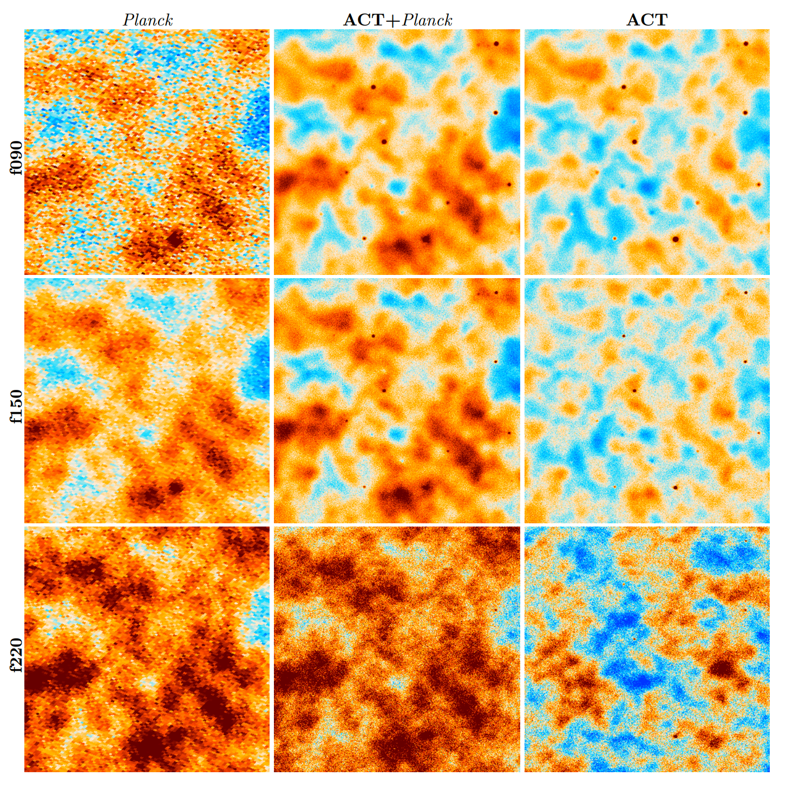
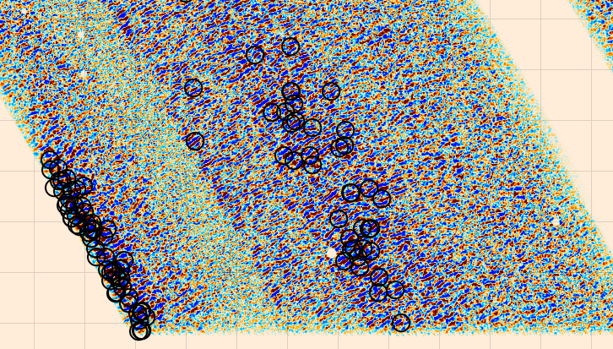
3-Day Maps
s17-19
Split data into 3-day mean subtracted, matched filtered maps
1 arcmin resolution
Find sources with SNR >5
Apply geometric data cuts
Naess 2020b et al
Notes:
So if you are a cosmologist, and you think of ACT or Planck data, you probably think of something like this.
Beautiful maps taken from ten or more years of data, incredible high depth measurements of CMB
Frequency range of 90-220 GHz.
But what if we could see the microwave in a new way?

Slide 11
Analysis
Initial detection
Array/Frequency
Require sources appear in at least 2 frequency/array combination
Geometric cuts
Characterization
Search for known counterparts
Find pixels with SNR>5 in three day maps
Edges, clustered sources, zero variance contours
Light Curves
Verify transients by inspecting light curve
Notes:
Note: found 8 events coincident with asteroids

Slide 12
Li Y., Biermann E., et al. 2023

Slide 13
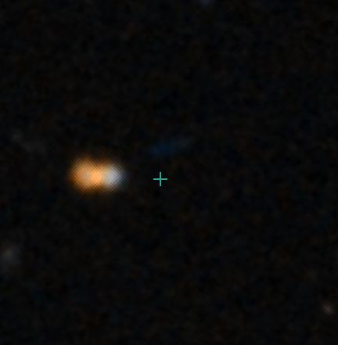
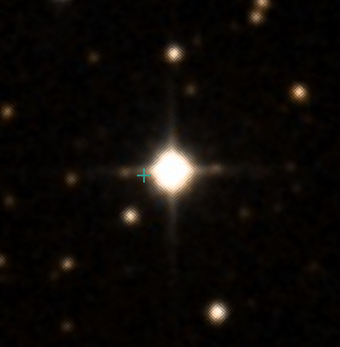
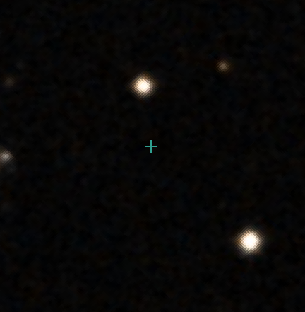
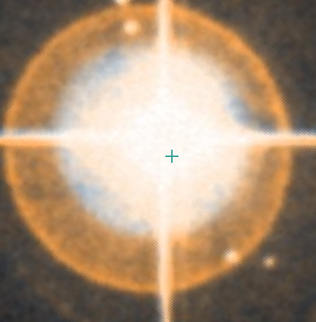
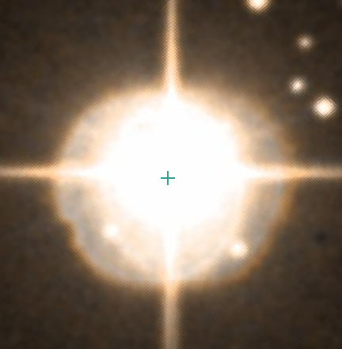
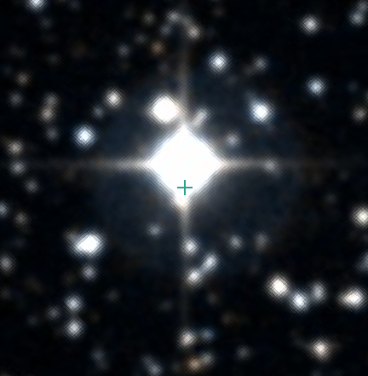
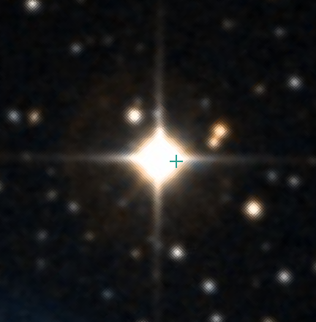
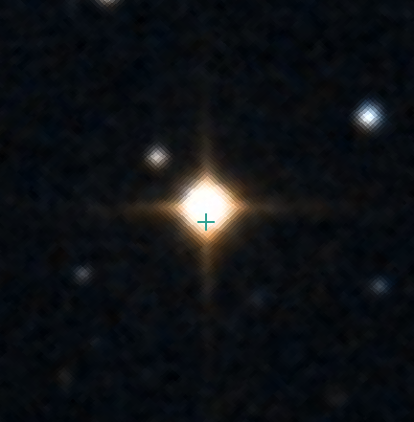
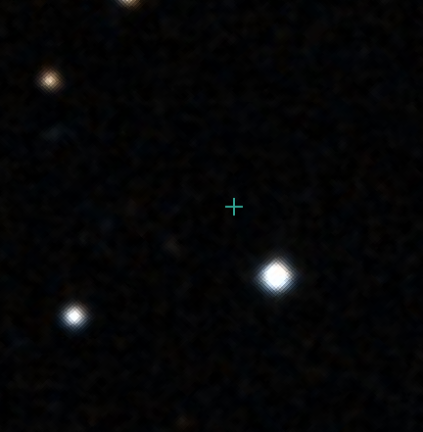
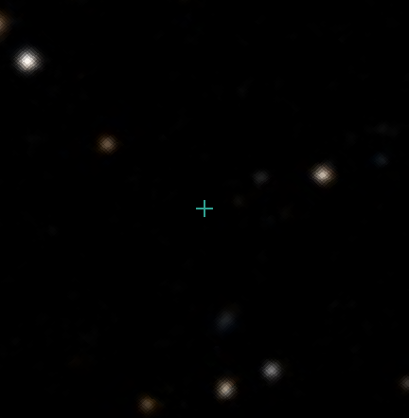
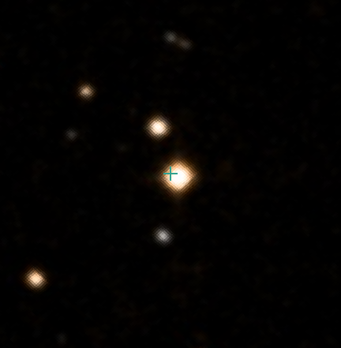
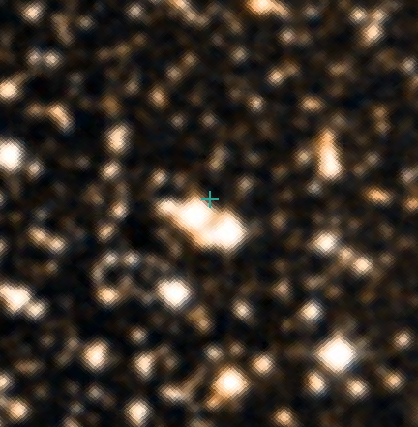
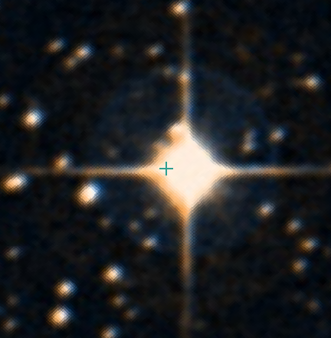
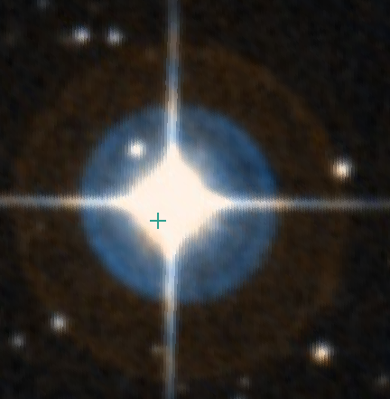
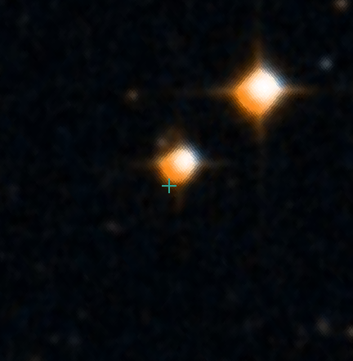
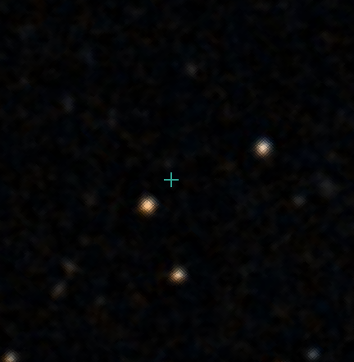
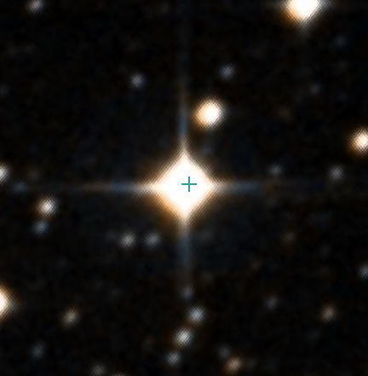
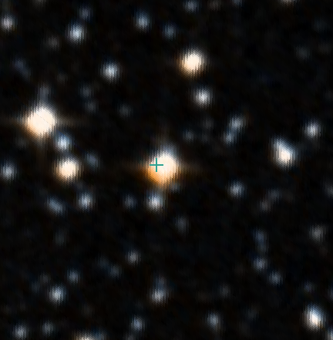
Possible Counterparts
Eclipsing Binary
RSCVn
RSCVn
Spec. Binary
Rotating Variable
M-Star
7
1
13
12a/b
4a/b
N3
15
8
9
10
14
6
N2
11
3
2
5a/b
N1
K-Star
Eruptive M-Star
RSCVn
Rotating Variable
Li, Biermann, et al. 2023

Slide 14
Future Work
Perform search on single observation maps
Years worth of data yet to be analyzed!
Event rate for flaring stars in ACT
Lessons for future surveys
Simulations for Simons Observatory
Identify transients and counterparts in real time
How to differentiate flaring stars from extragalactic transients
Follow-up observations
Notes:
Not only transient work begin done in ACT.
AGN variability and polarization from Adam Hincks.
Looking forward to transient work Simons Observatory.
ACT not optimized for transients
same sky area, greater sensitivity, and,
ten times faster mapping speed.
synchronously with the Rubin Observatory, expect many transient observations

Slide 15
Transients in ACT Data
Blind searches of millimeter transients have recently become possible
ACT search yields 14 galactic transient events coincident with flaring stars
More data is available to search within depth-1 maps
Necessary to build pipelines for real-time detection
Emily Biermann
University of Pittsburgh
emily.biermann.@pitt.edu

Slide 16
Bonus Slides

Slide 17
Millimeter Transient Events
Eftekhari et al., 2022
Notes:
Normalized flux density models of simulated events at 100GHz
High energy, relativistic → bright peak, shorter duration
Lower energy, nonrelativistic (Sne) → lower peak, longer duration

Slide 18
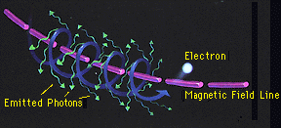
Synchrotron Millimeter Transients
Nasa.gov
Particles radiate when accelerated by magnetic field
Emits across the spectrum but high flux in radio
See Rybicki and Lightman, 2004

Slide 19
What we can learn from a blind search
RS emission in GRB
Unbiased probe of RS emission
Build statistical sample of GRB observations with blind searches
Learn about jet and ambient energies from targeted searches
TDEs Relativistic Jets
Fraction of TDEs that produce jets is unknown
FBOTs
More detections in mm and radio will determine if these produce jets
Four detections in radio so far allow us to be optimistic we’ll be able to study these events in the microwave
Notes:
Also, follow-up!

Slide 20
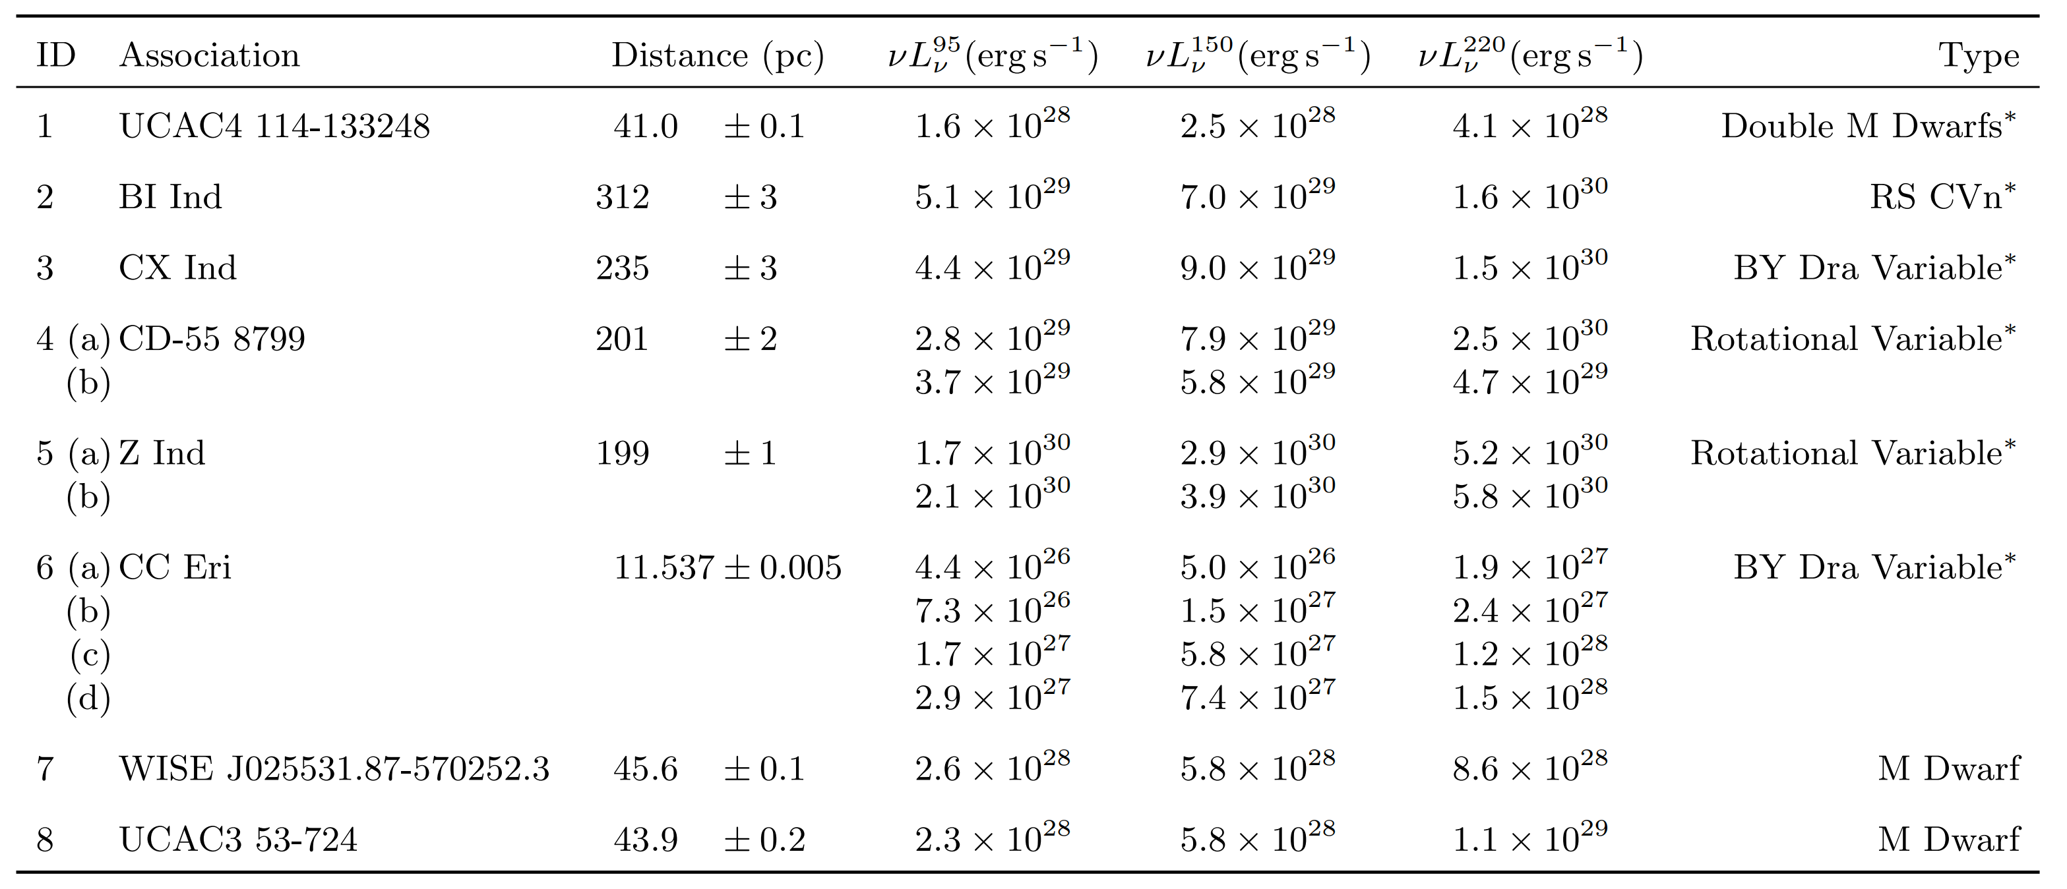
SPT-3G: Guns et al 2021
Blind search yielded 13 galactic events at 8 locations
~min – hour duration
Guns, S., Foster, A., Daley, C., et al. 2021
Notes:
Flat Spectra ➔ Synchrotron Emission
Lack of polarization ➔ optically thick or inhomogenous emission region
X-ray emitters except for M dwarfs

Slide 21
ACT DR5 Maps [1]
Data from 2008-2018
3 square deg cutouts
0.5 arcmin resolution
depths of 8/8/30 µK-arcmin at f090/f150/f220 in this region
Naess 2020 et al
Notes:
So if you are a cosmologist, and you think of ACT or Planck data, you probably think of something like this.
Beautiful maps taken from ten or more years of data, incredible high depth measurements of CMB
Frequency range of 90-220 GHz.
But what if we could see the microwave in a new way?

Slide 22
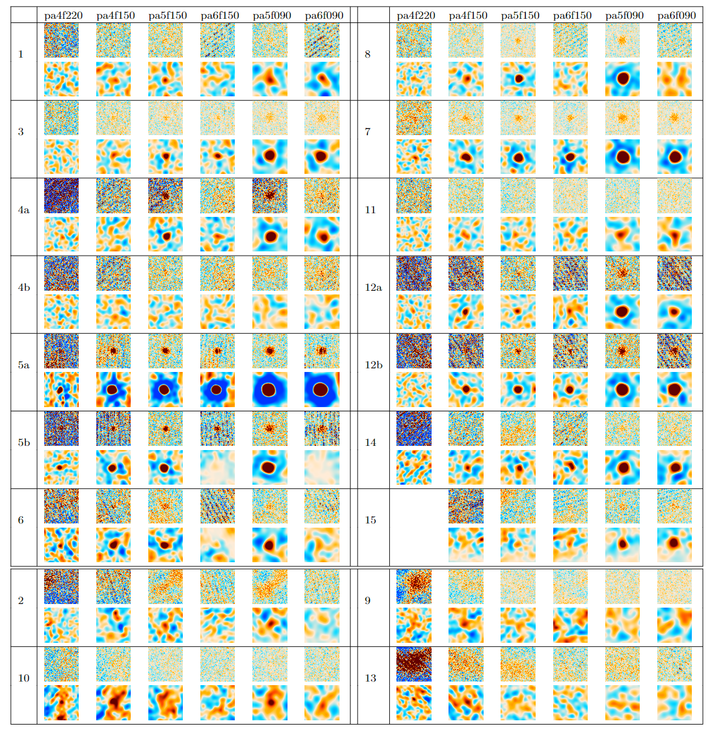
Remaining Candidates
Notes:
Events 2, 9, 10, and 13 are poor quality

Slide 23
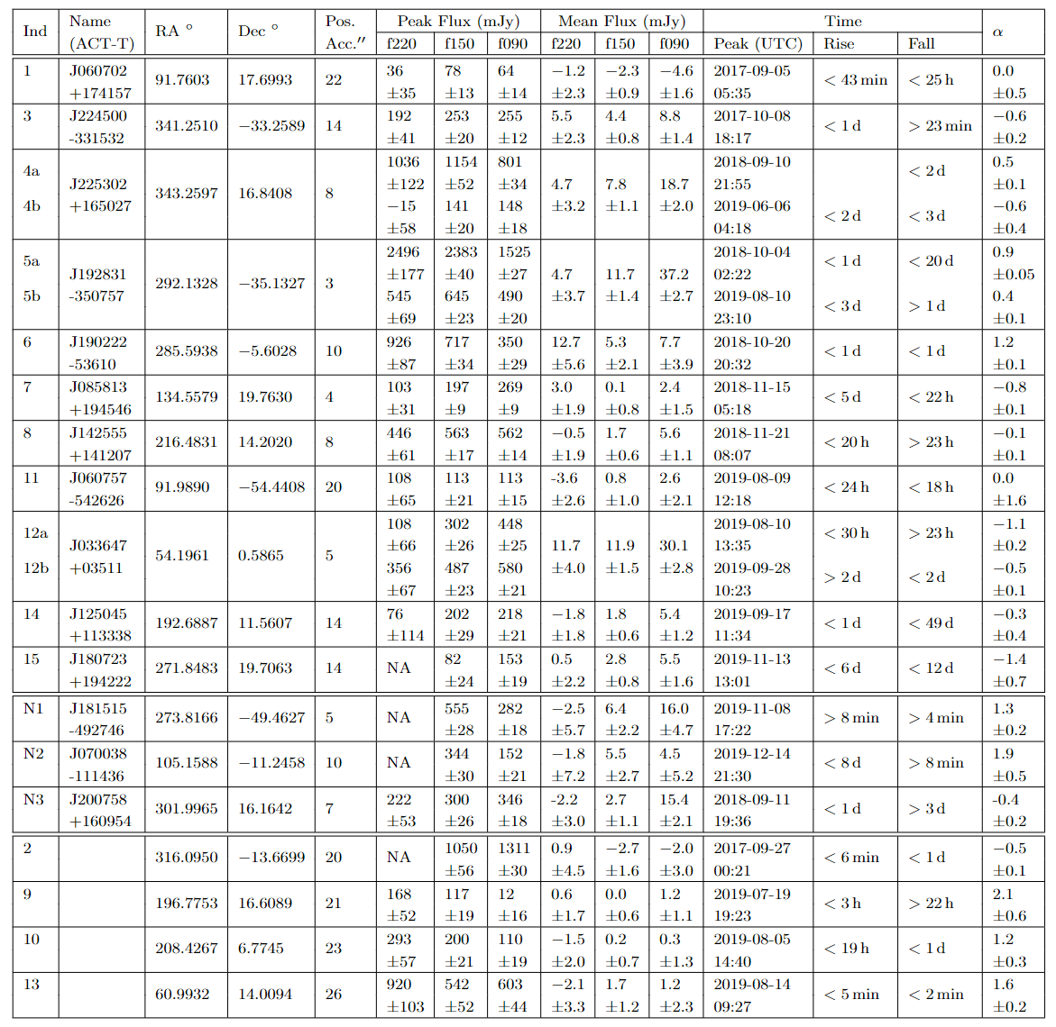

Slide 24
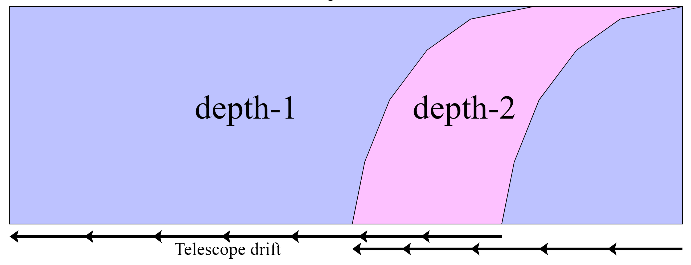
Depth-1 Maps
Single Scan maps
Maximum cadence and precise event timing
Ideal for transient detection!

Slide 25
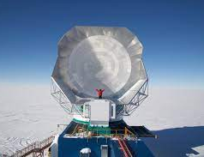
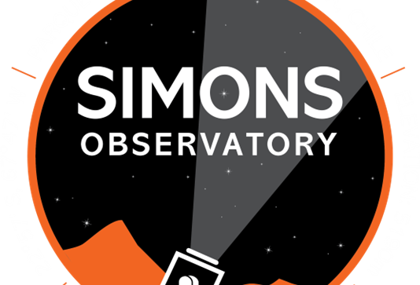
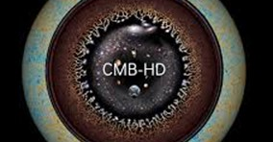
Current and Future CMB Surveys
Past/Current Surveys
ACT
SPT
Near Future
Simons Observatory
Looking ahead
CMB-S4 (2029)
CMB-HD (Proposed)
Notes:
CMB surveys have a wide field of view, will see many transient events

