Slide 1



Optical spectroscopic analysis of the Black Hole MAXI J1305-704
Carlotta Miceli
Universita’ degli studi di Palermo/iac canary islands
Supervisor: tiziana di salvo and Melania del santo
In collaboration with Teo munoz-diarias and Daniel mata sanchez
Cargese, 08/06/2023

Slide 2
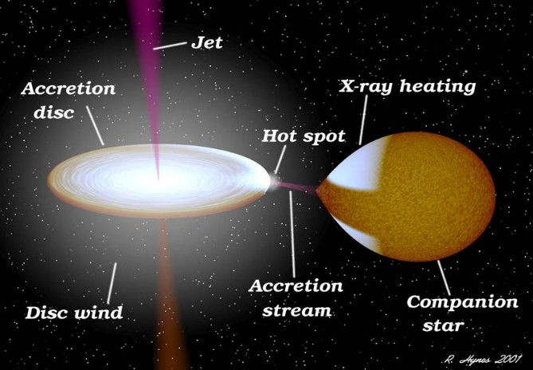
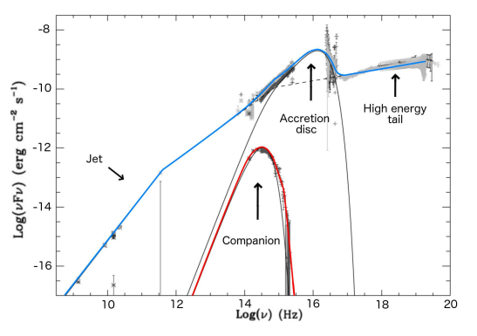
Introduction
LMXB
Transient sources
Accretion Disc
Photons cm² s⁻¹
5/04/12-13/07/12
Chaty et al. 2003
Notes:
Maxi J1305-704 è una LMXB con BH dinamic confermato, è transiente ha esibito un outburst nel 2012 e nada mas, curva di luce da me prodotta e che ho studiato il contributo nell'ottico derivante principalmente dal accretion disk
X-ray binaries are formed by a compact object (either a stellar-mass black hole or a neutron star) and a donor star, which transfers mass onto the former via an accretion disc. . I will focus on Low mass X-ray binaries (LMXBs): those with a late spectral type companion (which means with mass∼< 1M⊙). To understand the accretion process in this case, one needs to consider the gravitational equipotential surfaces of a binary system, [[whose most noticeable features are the Lagrangian points (L1 to L5), spatial locations in the binary rest frame where a small mass could maintain a stable position relative to the two binary components.]] Among the equipotential surfaces, the most relevant are the Roche lobes, which confine the regions of space gravitationally bounded to either main body (as we cann see in the figure). In LMXBs, mass transfer occurs when the donor star overflows its Roche lobe and its outermost parts are ripped off by the gravitational attraction of the compact object. In order to conserve angular momentum, the transferred material forms an accretion disc around the NS or BH after leaving the inner Lagrangian point (L1). Among LMXBs, those known as transient systems, experience outbursts, epochs where their accretion discs brighten a few orders of magnitude in a range of wavelengths from optical to X-rays. During the outburst state they typically exhibit fast and strong variability over relatively short timescales (from months to few years) before returning to quiescence. Most of LMXBs contain neutron stars, probably due to the higher ratio of low mass to high mass stars as a result of stellar evolution. Within the known population of LMXBs, only a third have been proposed as candidates to harbour stellar-mass black holes (BHs), over 60 systems. This preliminary classification is mostly based on their X-ray properties during the outburst. We expect a gradient of the temperature in the disc. When we look at the system in the X-ray range, we are looking at the innermost region of the disc ( T =10^6- ́7K) where High-energy photons are produced. In the optical band we are looking at the outer parts of the disc (T „ 4000K). We can then detect hydrogen at different temperatures, because we are assuming that the disc is mainly composed of it. In regions where the ionisation temperature of the hydrogen is reached, the disc will be composed of ionised hydrogen, but still in the outer parts of the disc there will be a part of no ionised hydrogen. This is the region in wich emission lines of this element are produced, because the electrons are still bound and able to do transitions to a lower energy states, emitting photons. The quantity of the helium is lower than that of the hydrogen but, during the outburst, the whole disc starts to become hotter and much regions of the disc will become ionised. Before we detect HeI, then , when the system becomes brighter, we start to see HeII
Something about the other picture

Slide 3
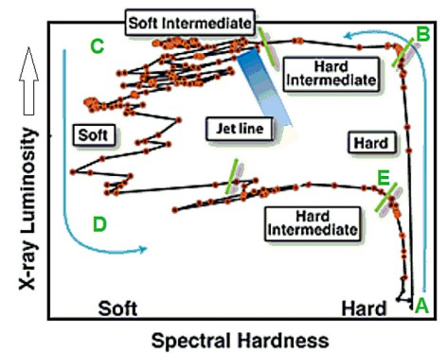
Hardness Intensity Diagram (HID)
HR=L(3-20keV)\L(0.3-3 keV)
Hard state: radio jet, optical wind, hard X-ray component
Soft state : x-ray wind, no jet, thermal component
Hardness ratio
Notes:
dico solo dei jet e venti. il grafico è per studiare l'evoluzione spettrale della sorgente
Thanks to X-ray missions, X-ray spectral variations have been observed during the outburst of most of the BHT, allowing the identification of different accretion states. They can be characterized using the HID, i.e. the hardness ratio vs X-ray luminosity. The hardness ratio is defined as the ratio between the X-ray luminosity integrated over a “hard” band (e.g. 3-10 keV) to that of a “soft” band (e.g. 0.3- keV): in this case the diagram has a q-shape (see the picture). It has been shown that X-ray transients (XRT) in outburst typically show two types of outflow: collimated radio-jets and highly-ionised X-ray winds, whose properties are coupled with those of the X-ray states. We can define 3
main states :
Hard state: this state is characterised by a high ratio of hard to soft X-rays, high levels of
fast variability and comptonised emission dominating the spectral energy distribution (SED).
Quasi-steady radio emission showing a flat spectrum is also found, revealing the presence of a
compact jet. This is observed at the initial rise of an XRT, as well as during the decay. In 2016 it was detected by Munoz Diarias et al. in the BHT V404 Cygni, an optical wind, observed in hydrogen (Balmer) and helium (He I) emission lines as deep P-Cygni profile throughout the outburst in hard state, and extremely broad wings once the X-ray and radio fluxes decay.(I will talk later about these features)
• Intermediate state: typically above 10% of the Eddington luminosity, a brief phase of discrete
ejections is observed in radio and then the source progresses to the soft state.
• Soft state: a lower ratio of hard to soft X-rays is observed, as well as slower fast variability
levels. A thermal component that can be modelled by the accretion disc dominates the SED.
No radio emission (and therefore, no jet) is detected, but instead, a hot accretion disc wind is
observed in the X-rays. No optical wind has been detected in this state until now.

Slide 4
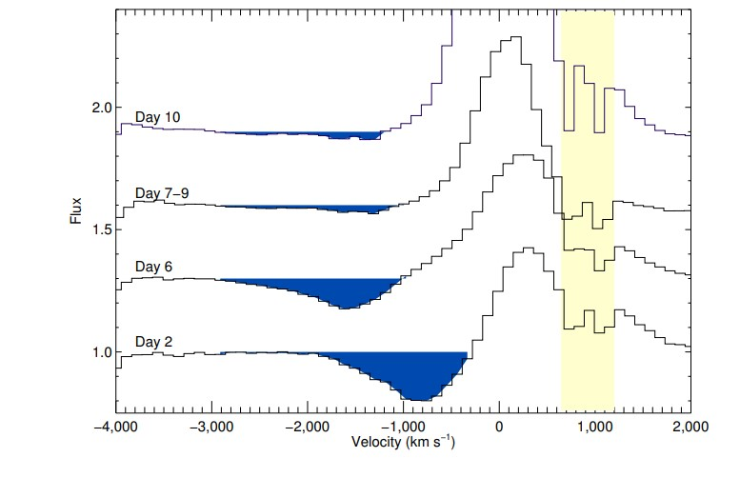
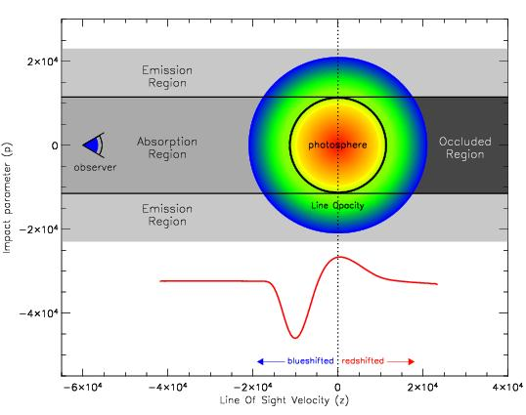
Optical wind
P-Cygni profile
Relation with optical thickness and ionization
Regulation of black-hole accretion by a disk wind during a violent outburst of V404 Cygni (T. Muñoz-Darias et al. 2016)
Notes:
As I was saying before an optical wind was detected by Munoz diarias et al. as deep P-Cygni profile throughout the outburst in hard state, and extremely broad wings once the X-ray and radio fluxes decay. P-Cygni profiles have been previously observed in massive stars, and associated with the presence of stellar winds expelling material away from the star. The material moving towards the observer produces a net absorption at blue-shifted wavelengths, while gas receding from the observer produces an excess of flux at red-shifted wavelengths. The evolution of the p-cygni is related with the variability of the illuminating source in the soft X-ray , for example if the X-rays become stronger, the atoms in the wind could be exposed to them and become fully ionized. In this case they will not produce the blue-shifted absorption on the h-alpha line, because the electron is not bound to the proton in H nuclei. This is also related with the concept of optically thick and thin layers. If the gas ejected as wind is not fully ionized. It will be able to absorb some of the photons, blocking partially the light arriving at the observer. In that case, we say that layer Is optically thick. If it is so ionized that if does not absorb many photons, then we say it is optically thin. In this case. The blue-shifted absorption is not visible anymore (even if the wind itself is still there). On the other hand, it can produce broad emission lines as the atoms start to recombine. This has been observed before in supernovae and referred as “nebular phase”. In the picture we see that p-cygni profiles are present before flares dissapear when the the system becomes too luminous , and sometimes even produce broad emission wings when the flare ends and the atoms recombine.
Accretion of matter onto black holes is universally associated with strong radiative feedback and powerful outflows . In particular, black hole transients show outflows whose properties are strongly coupled to those of the accretion flow. This includes X-ray winds of ionized material, expelled from the accretion disc encircling the black hole, and collimated radio jets. Very recently, a distinct optical variability pattern has been reported in the transient black hole transient V404 Cyg, and interpreted as disrupted mass flow into the inner regions of its large accretion disc7 . Here, we report on the discovery of a sustained outer accretion disc wind in V404 Cyg, which is unlike any seen previously. We find that the outflowing wind is neutral, has a large covering factor, expands at 1% of the speed of light and triggers a nebular phase once accretion sharply drops and the ejecta become optically thin. The large expelled mass (> l0-8 M¤) indicates that the outburst was prematurely ended when a sizeable fraction of the outer disc was depleted by the wind, detaching the inner regions from the rest of the disc. why?The luminous, but brief, accretion phases shown by transients with large accretion discs imply that this outflow is most likely a new fundamental ingredient regulating mass accretion onto black holes. The X-ray binary V404 Cyg (GS 2023+338) is a confirmed stellar-mass BH8 with a precisely determined distance of 2.4 kpc9 . Following 25 years of quiescence, the Swift mission detected renewed activity on Jun 15, 201510 , initiating a 2-week period of intensely violently variable emission across all wavelengths. Our high signal-to-noise GTC optical spectra covering the entire X-ray/radio active phase (~15 days) show that, contemporaneously with radio jet emission, continuous ejections of neutral material at ~0.01c are present from low-level accretion phases to the Xray pea). These are observed in hydrogen (Balmer) and helium (He I) emission lines as deep P-Cyg profiles throughout the outburst13 , and extremely broad wings once the Xray and radio fluxes decay. P-Cyg profiles result from resonant scattering in an expanding outflow with a spherical geometry or at least sustaining a large solid angle14, 15 (Methods). Among a dozen transitions showing this feature, the deepest are seen in the He I-5876 emission line, The strongest P-Cyg profiles are witnessed during days 1 to 6 (Fig. 1 and Fig. 2 for the evolution of the profiles during day 2; Methods), when the X-ray luminosity is typically 103 times fainter than the ~LEDD flares displayed later in the outburst7,11 (ED Fig.1). Blue-shifted absorptions are as deep as 30% below the continuum level and we measure terminal velocities in the range VT =1,500 – 3,000 km s -1 (Fig. 1, Fig 2, ED Fig 2; ED Fig. 3). Symmetric red-shifted (i.e. positive velocity) outflow emission, completely detached from the accretion disc line component, is sometimes evident (see Fig. 2 from minute 60 onwards). In order to trace the ionization state of the outer disc we computed the line flux ratio IRatio = He II-4686 / Hβ and find IRatio <0.5 when P-Cyg absorptions are deepest (ED Fig.1; Methods). Through the outburst, both the X-ray and optical emission are characterized by the presence of short and long flaring activity7,11 . During these flaring episodes IRatio increases while the P-Cygni profiles become weaker, subsequently recovering their pre-flare strength when the X-ray flux and IRatio drop (Fig. 2). This indicates that the detection of P-Cyg absorptions is driven by ionization effects. Indeed, on days 7 to 10 much shallower absorptions (only ~2 % below the continuum level) are witnessed as the system enters the brightest phase of the outburst and IRatio always becomes larger than unity (Fig. 1 and ED Fig.1). Furthermore, we note that the Hα profile is very asymmetric during the whole outburst providing further indication of the ubiquitous presence of wind outflows during our observations. The low temperature (T) required to have both neutral hydrogen (T < 3×104 K) places the wind-launching radius (Rl ) at the outer accretion disc regardless of the wind-launching mechanism. On the other hand, the low luminosity associated with the deepest P-Cyg profiles rules out radiation pressure winds driven by Thomson scattering. The thermal wind scenario16 , in which VT roughly corresponds to the escape velocity at Rl , is able to reproduce our observations. Using VT=1,500 – 3,000 km s-1 , we obtain Rl = 1.5 – 6 × 105 km, which corresponds to disc temperatures in the range ~5,000 – 30,000 K for mass accretion rate within 0.001 – 0.1 LEDD, respectively. The second signature of the high-velocity wind is a short nebular phase witnessed at the end of the outburst. Following a sharp drop by a factor of ~103 in the X-ray, optical and radio luminosity from the major flares ending the brightest phase of the outburst on days 9—10, the Balmer lines became unprecedentedly intense for a black hole, showing equivalent widths up to ~ 2,000 Å (Hα because the ionization is higher and we are in the optically thin phase). They sit on extended wings reaching similar velocities to the VT observed in the P-Cyg profile

Slide 5
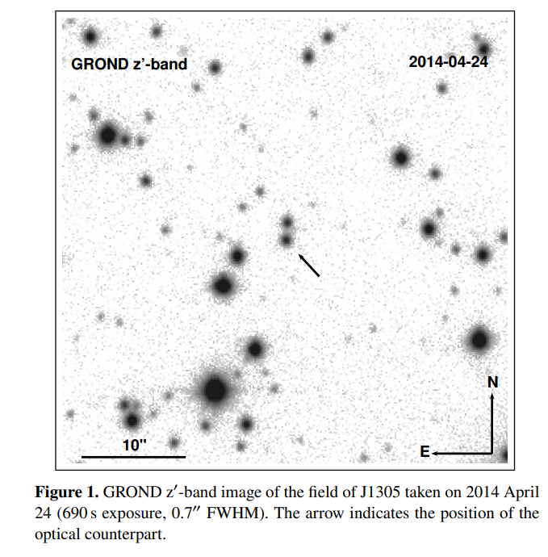
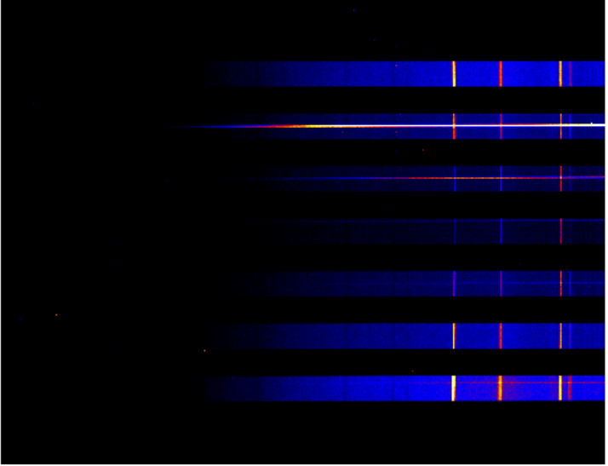
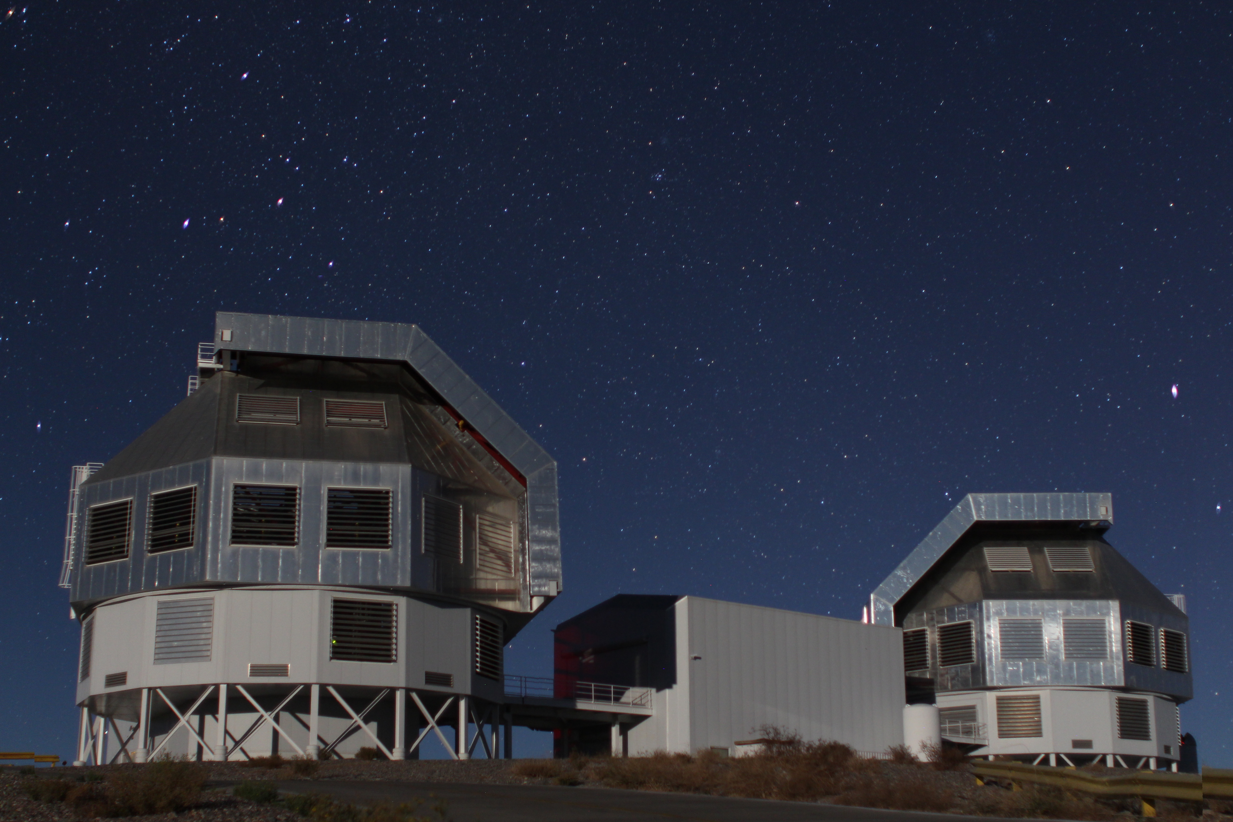

MAXI J1305-704
Mata Sanchez et al. (2021 study in quiescence) found:
Compact object of ∼ 7 $M_{⊙}$ (black hole)
Orbital inclination of ∼ 72°
Exhibited an outburst in 2012 and was observed by Magellan telescope (Las Campanas, Chile)
My work:
Data reduction & calibration
Spectral extraction
Line modeling
Notes:
MAXI J1305-704 has been proposed as a high-inclination candidate black hole X-ray binary in view of its X-ray properties and dipping behavior during outburst. Its BH nature was dynamically confirmed in 2021, thanks to photometric and spectroscopic observations of the source in quiescence by Mata Sanchez et al. in 2021. (they used grond telescope in chile for photometry, Very Large Telescope Unit Telescope in chile for spectroscopy).
MAXI J1305-704 exhibited an outburst in 2012 and was observed by Magellan telescope the same year for two nights, May 2nd and 3rd, in soft state. The spectral resolution of a spectrograph, or, more generally, of a frequency spectrum, is a measure of its ability to resolve features in the electromagnetic spectrum. It is usually denoted by Delta lambda, and is closely related to the resolving power of the spectrograph, defined as deltalambda/lambda, where Delta \lambda } is the smallest difference in wavelengths that can be distinguished at a wavelength of lambda.
Regarding my project I started with the reduction of optical spectroscopic data using the standard software IRAF (bias, flat and calibration with Neon Lamps). For the normalisation I used the software molly, which provides convenient tools to inspect the spectra, and python. I searched for observables such as very specific line profiles and asymmetries, which allow us to establish the presence/absence of optical winds as well as the main properties of the outflow (if present) and the state of the accretion disc (in any case).
An image of the telescope , something about the reduction and normalisation

Slide 6
HID of MAXI J1305-704
The source was in soft state
Any winds?
Notes:
Th first 2 points are hard state then hard intermediate state, soft and soft intermediate
La domanda che ci siamo posti è se ci possono essere venti nell’ottico nello stato soft
from 56034
Stars at 56049-56050
In particular we searched for winds features , so we wondered if there were winds

Slide 7
Average spectra
First epoch
Second epoch
Notes:
I analysed six spectra for each day. In particular I focused on the study of the emission lines present in the extracted spectra:,
heII which togheter with C and O form the Bowen Blend
then Hb
and I focused on Halfa
Zoom sulle varie righe

Slide 8
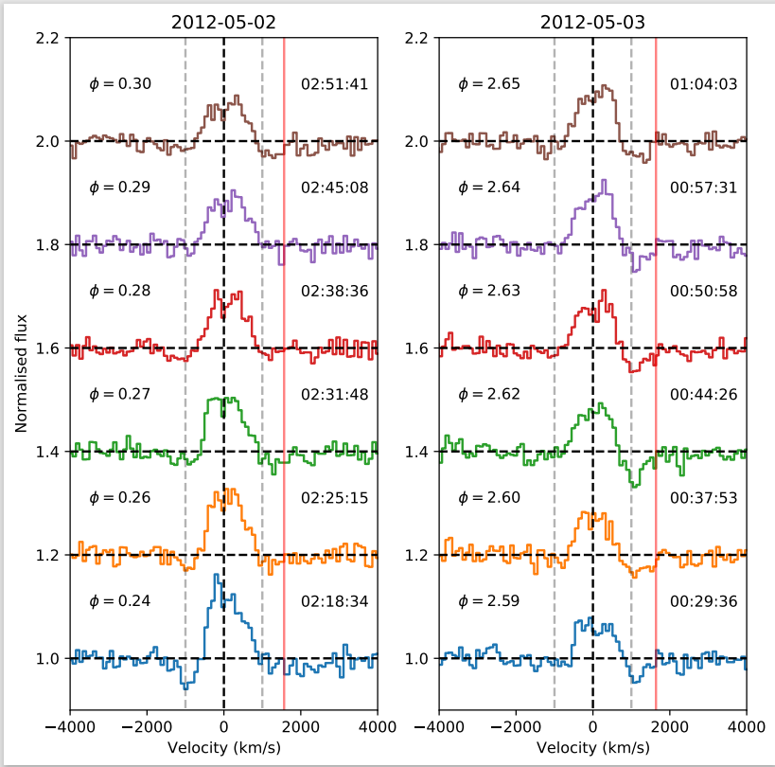
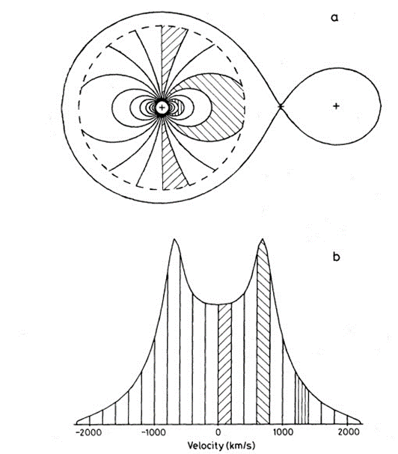

Data analysis and results
$H_{α}$ Emission line
Double pick
Relation with the inclination
Horne & Marsh, 1986
Orbital period: 0.4 days
Notes:
Spettri in fase- dire qual è la fase- periodo orbitale
Disegnino con le fasi ....
we mainly expect to detect hydrogen emission lines, and eventually some helium lines. I focused the analysis on the study of the Hα emission line. In the optical band we are looking at the outer parts of the disc (T „ 4000K). We can then detect hydrogen at different temperatures, because we are assuming that the disc is mainly composed of it. In regions where the ionization temperature of the hydrogen is reached, the disc will be composed of ionised hydrogen, but still in the outer parts of the disc there will be a part of no ionised hydrogen. This is the region in wich emission lines of this element are produced, because the electrons are still bound and able to do transitions to a lower energy states, emitting photons. The quantity of the helium is lower than that of the hydrogen but, during the outburst, the whole disc starts to become hotter and much regions of the disc will become ionised. Before we detect HeI, then , when the system becomes brighter, we start to see HeII. (decide if to say here or in the intro slide)
Description of the graphics (day 1 and 2,)
This presented a double peak profile, typical from rotating accretion discs. Emission lines from accretion discs are broadened primarily by Doppler shifts, due to orbital motion of the material in the disc around the massive object at its centre. The emission in each velocity bin thus arises from a different region of the disc surface.
The disc instead of being perfectly uniform, could have hotspots because the flow from the companion hits the disc and in this point it will become hotter. The projected velocity of this component being different at different orbital phases, so that the extra contribution could be a 0 (in the centre of the line), min (red-shift), max (blue-shift) velocity. The intensity of the extra contributions depends also on the fact that the region at positive values of velocity is larger because , by looking at the projected velocity , we have more contribution, because we are going to inner parts of the disc, whose projected velocity is that particular. If there is an outflow, the most common related features are P-cygni profile, boxy profile, and broad absorption. During the outburst Hα emission line it’s usually quite narrow because the regions which are producing these lines, are moving slower. Assuming a keplerian disc, the peak to peak separation is approximately the outer disc velocity and we can see this effect only at high inclination. In fact in edge on geometry the radial velocity (the one we measure) is maximum so we can see the double peak, otherwise, in face on, the radial velocity is 0 and so we won’t see the double peak.
Regarding the absorption: Narrow absorption means material moving at a particular velocity to produce it, so they are typically associated with outflows, which are seen only at particular outburst phases. Instead, broad absorptions are produced by a distribution of velocities, which points more naturally to a larger region of the accretion disc (e.g., the atmosphere of the disc), and they are observed more ubiquitly. In my case Hα line presented a broad absorption the nature of which is still subject of discussion. The fact that, as I found, this absorption velocity is similar to the terminal velocity of the Hα emission line (or sligthly larger) seems to favour a radius for the absorbing material similar to that emitting the Hα line. An alternative explanation could be given in terms of a P-cygni profile that as I mentioned above, indicates the presence of optical wind. Nevertheless we don’t expect this kind of profile in the state (soft-state) in which I analysed the system. In fact optical winds, have been only seen so far in the hard state, simultaneous to the radio jet. That’s why we do not expect seen them in the soft state but it does not mean they cannot appear there, it is just an observational fact. The reason of this is still debated, a possible interpretation, could be that, winds during the bright soft state, are expected being too ionised so that they would appear only at higher energies, i.e. in X-rays.
the spectra is a flat onbe

Slide 9
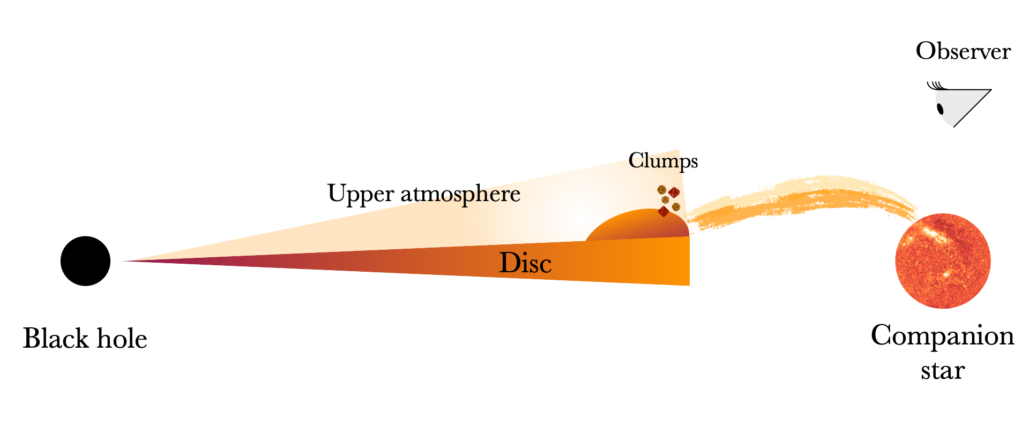
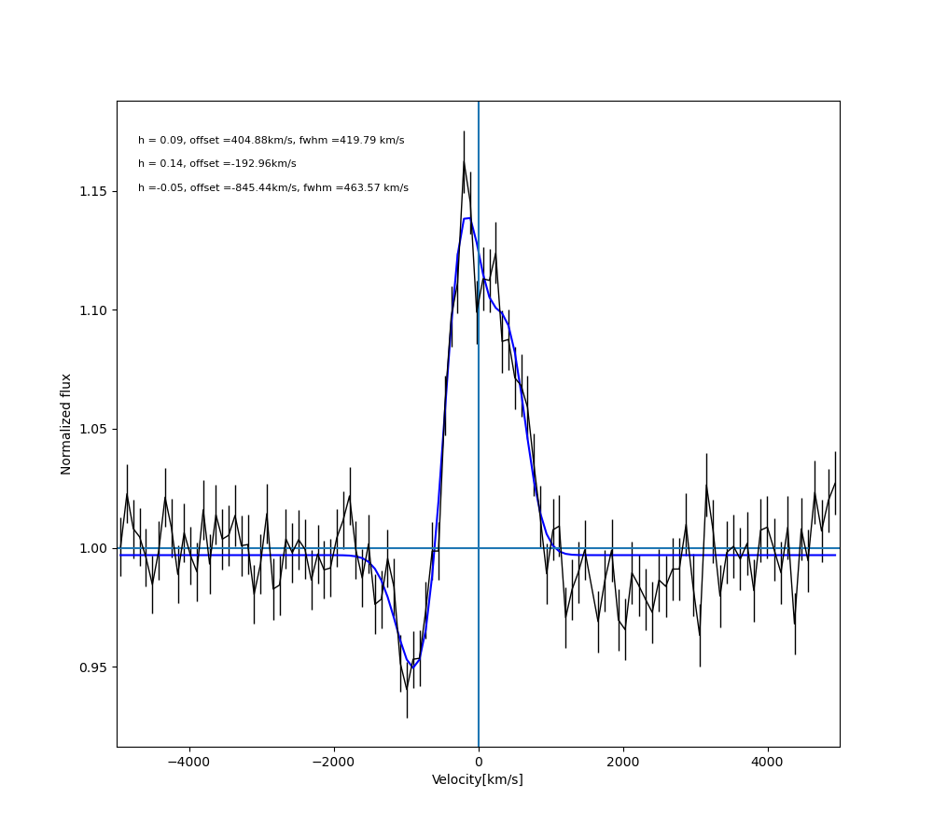
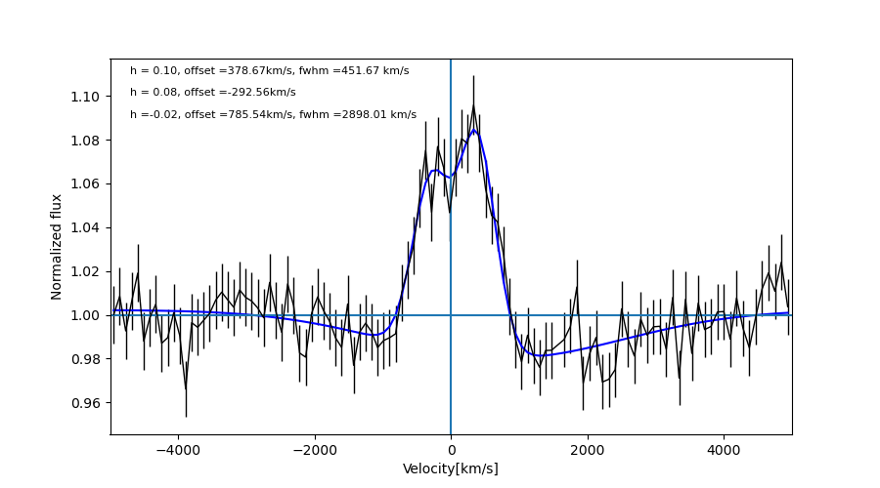
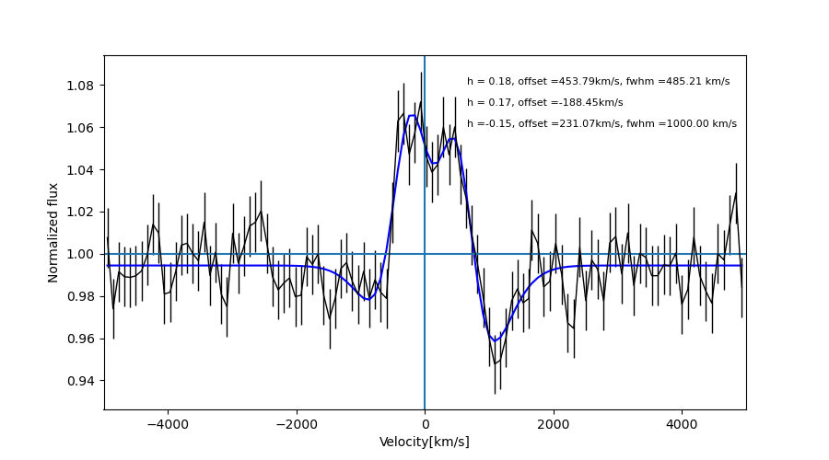
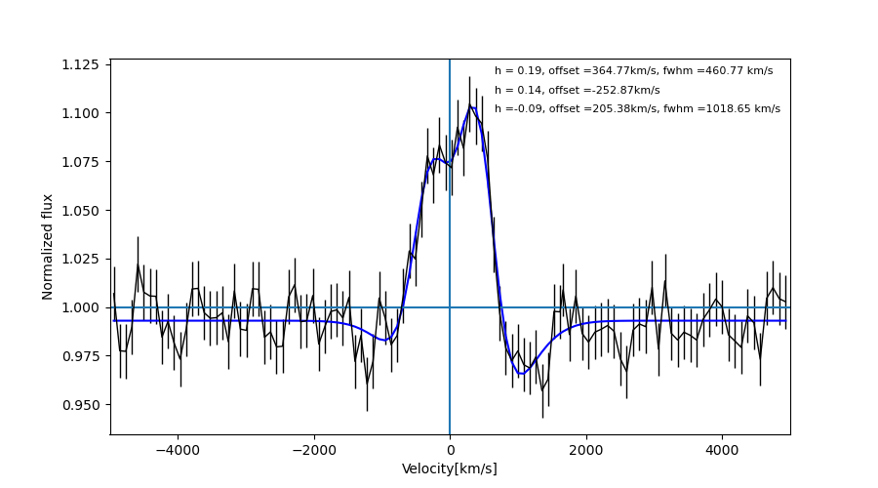
Modelling of the data
1 spectrum_1day
3 narrow gaussians
Line centroid variability 🤔 uneven atmosphere
Shifted absorption lines 🤔 high inclination
Last spectrum_1day
1 spectrum_2day
Last spectrum_2day
2 NARROW
+1 BROAD GAUSSIANS
2 NARROW
+1 BROAD GAUSSIANS
2 NARROW
+1 BROAD GAUSSIANS
Notes:
We performed a multi-gaussian fit
but unfortunatly I cannot publish on nature, for now/yet
wider distrbution of velocity
some regions thicker
Guardando bene le righe … si vede contributi in assorbimento. Mentre per l'emissione l'interpretazione è stata abbastanza semplice per l'assorbimento vi anticipo che è ancora oggetto di discussione. le ho modellizzate/fittate con due righe in emissione e una in assorbimento…ecc la componente di assorbimento é piú larga. Vediamo l’assorbimento spostarsi per effetto doppler. Complex line shape, diverse regioni di emission e di assorbimento, asimmetria dell’emission (hotspots, atmosfera già precedentemente vista in altre osservazioni). Assorbimento doppler shiftato si puo vedere solo ad alte inclinazioni.
Riquadro in rosso, scrivere “righe strette”. Dire di più sul modello. Atmosfera disuniforme, densità diversa. Clumps sono regioni a più alta densità, dovuta a materiale che cade sul disco. Redshift in assorbimento è dovuto a materiale che assorbe si muove away from me (insegue il disco).
Lo spostamento della riga in assorbimento è dovuto a doppler shift
Osservatore all’Altezza dei clumps seguendo
Maybe here the fit with the broad absorption and that of a quite P-Cygni.
By looking at these fits we cannot for sure go to one or another explication, the Test chi Quadro can’t tell anything. Moreover if we think at the physical meaning, by looking at only one spectrum we could say it’s a P-cygni profile. But then considering the all spectra, and also that in some of the spectra the particular feature seems to disappear and instead a broad absorption appear. The best explanation would be then that this is caused by the presence of the atmosphere around the accretion disc, as Dubus et al. say in their paper.

Slide 10
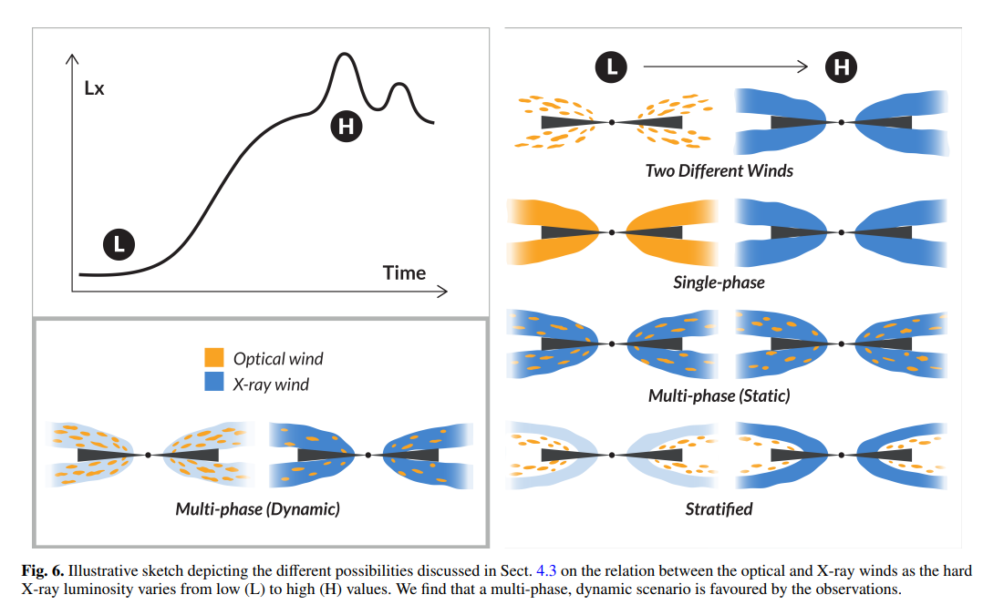
Conclusion
The discovery and modelling of optical lines during the soft state of the MAXI J1305-704 outburst unveiled the complex structure of the system
Avg Bowen blend day 1-2
Muñoz-Darias & Ponti 2022
Investigate the connection between optical (hard spectral states) and X-ray winds (soft state)
UVOT light-curve
Notes:
The remarkably similar emission line properties derived ruled out (esclude) this scenario.
This scenario is ruled out because optical observations seem to indicate the cold wind is always active (red-shifted optical emission lines broader than during quiescence).
This is ruled out as we see variability in the observational properties of the wind as a function of the luminosity.
Constant density and resulting launching wind radius are not consistent with the observable.
I know it's not an exhaustive explanation but...available data, no future outburst.
the results are interesting because for example...
Come animazione il thank you. Struttura complessa del disco é l’atmosfera e presenza dei clums
X surriscaldano il gas, con velocita Maggiore a velocita di fuga e se ne va
Scrivere heii, per trovare temperature di ionizzazione
E compararlo con quello da me studiato
Venti : Trovare risposta alla loro natura , qual è la connessione tra I due venti. (meccanismo di lancio: termico, se vale per entrambi). Remark che è ancora stato dell’arte!!
I analysed optical spectroscopic data of the BHT MAXI J1305-704, searching for observables such as specific line profiles and asymmetries, in order to find optical winds features when the system is in the soft spectral state. The non-detection of conclusive outflow features in MAXI J1305 in soft state is consistent with the current picture built over the past few years (Panizo-Espinar et al. 2022). The non-detection of optical winds is expected since in soft state the sources are very bright, so that the outflows can be strongly ionized and emitting only in the X-ray band. However, this is still matter of debate. Muñoz-Darias et al. (2018) discuss the connection between optical (observed in hard spectral states) and X-ray winds and whether or not they are different faces of the same phenomena or just different outflows from e.g. different regions of the accretion flow. So that, it would be useful to observe in optical other similar sources when in soft state and to look for any feature as signature of these winds. What Teo at al. found is While the vast majority of the hot X-ray wind detections were found during soft states (note that the state classification is only qualitative in several cases), that is, when the jet is not observed (e.g. Neilsen & Lee 2009; Ponti et al. 2012), the V404 Cyg observations clearly showed that accretion disc winds and jets can coexist (MD16; Munoz-Darias et al. ˜ 2017) and further evidence was presented in Homan et al. (2016). The results presented in this paper provide additional evidence for this picture and show that hard state, cold (i.e. optical/infrared) winds simultaneous with the radio jet do occur, and at least for these two systems seem to be very common. This raises several important questions, such as the connection between optical and X-ray winds and whether or not they are different faces of the same phenomena or just different outflows from e.g. different regions of the accretion flow. In this regard, Bianchi et al. (2017) showed that the apparent absence of hot X-ray winds in the hard state (once they have been observed in the soft state) could be related to photoionization instability (see also Chakravorty, Lee & Neilsen 2013). Interestingly, one of the hard state allowed solutions is a cold (∼neutral) phase of the wind (the other is a very hot phase). The nature and characteristics of this tentative cold outflow need further investigation. ((The properties of the optical wind observed in V4641 Sgr are very similar to those of V404 Cyg. Both are observed predominately in H and He I recombination lines, show velocities in the range ∼1000– 3000 km s−1 and display at least two distinctive phases, as implied by the detection of P-Cygni/blue-shifted absorptions and strong emission lines with broad wings. There is a likely causal connection between these two phases, with the latter, so-called nebular phase, being the expanding (optically thin) phase of a previously launched and thicker ejecta that produces the former phase (we direct the reader to Mata Sanchez et al. ´ 2018 where a study on the relation between these two wind phases is presented).))
We don’t have other lines to compare with

Slide 11






Thank you!

Slide 12
Avg H𝛼 day 1-2
Avg H𝛽 day 1-2

Slide 13
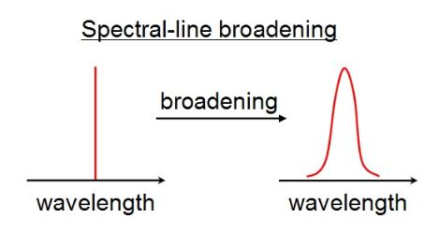
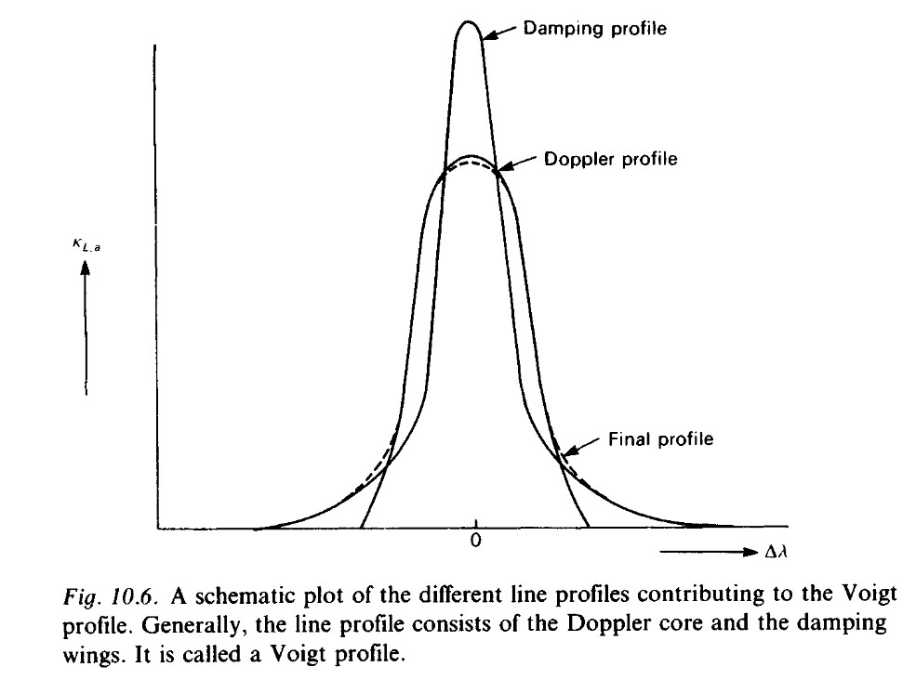
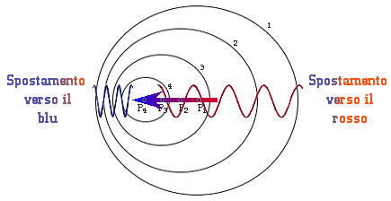
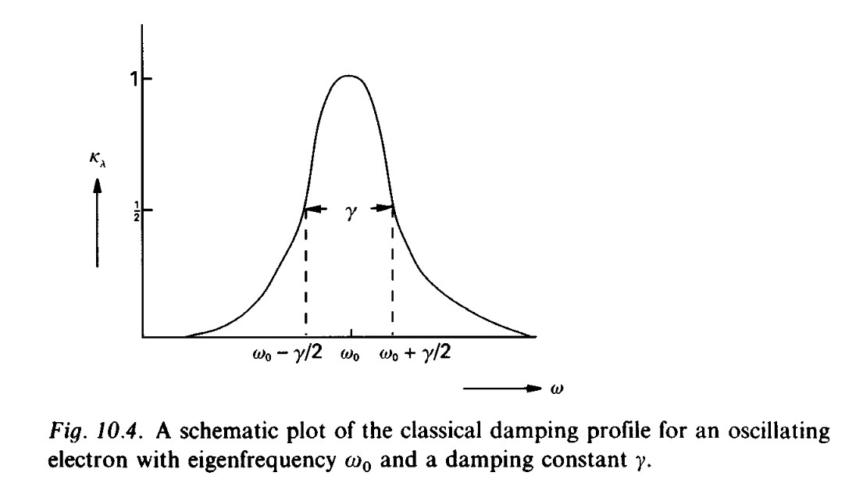

Allargamento di riga
Naturale (lorentziano) $2∆ω\left(1/2\right)=γ$ ${(10}^{−5}\dot{A})$
Doppler (gaussiano) $\frac{∆λ}{λ}=\sqrt{\frac{kT}{mc^{2}}}≅3∙{10}^{−5}$ (se $λ=4∙{10}^{3}\dot{A}→ ∆λ≈{10}^{−2}\dot{A})$
Profilo di Voight
Notes:
Nel primo caso > la quantità di radiazione più ampia la riga, si può trovare anche da indeterminazione di Heisenberg. Gli atomi che emettono o assorbono si muovono e questo causa un doppler shift >> rispetto al naturale (ma di più lo stark ha effetto). Il voight è combinazione dei due, al centro il damping è trascurabile e domina alle ali

