Slide 1
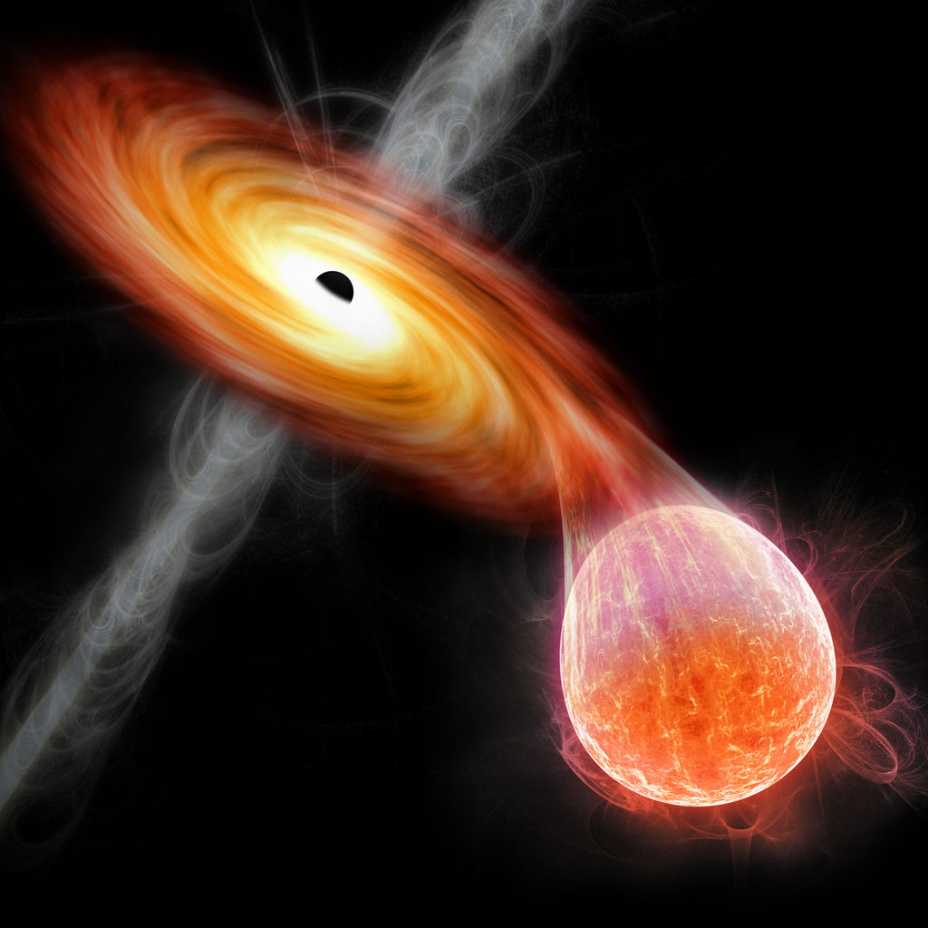
Optical and NIR Spectroscopy of the
Black Hole Transient GX 339-4
Cargèse Alessandra Ambrifi - aambrifi@iac.es 1

Slide 2
Transient Low Mass X-ray Binaries (LMXBs)
What makes a LMXB:
black hole
low mass star
accretion disc
Phenomenology:
accretion
X-ray outbursts
jets
winds
Cargèse Alessandra Ambrifi - aambrifi@iac.es 2

Slide 3
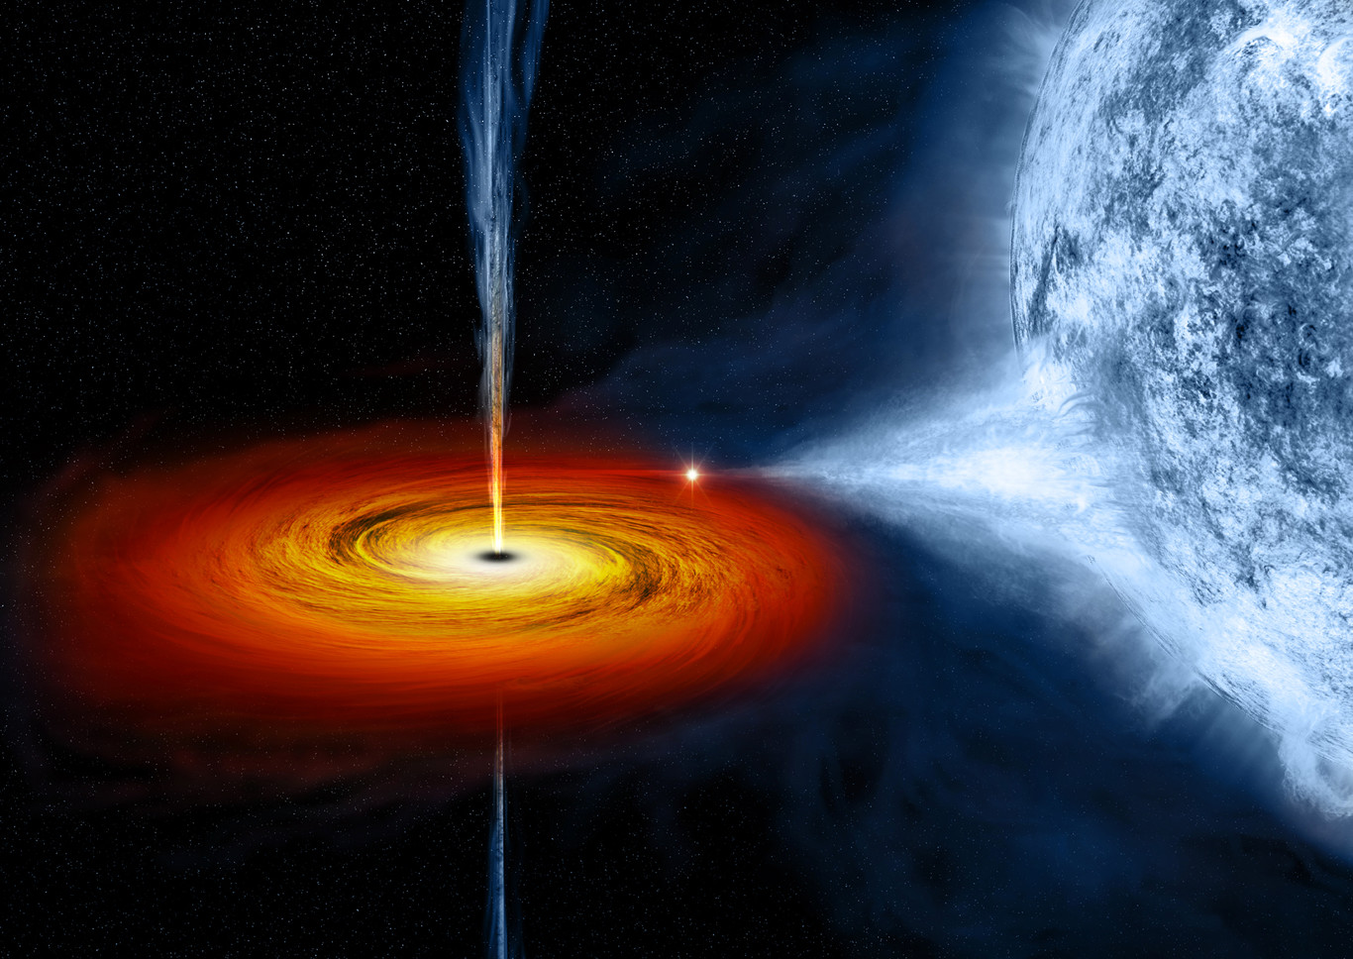
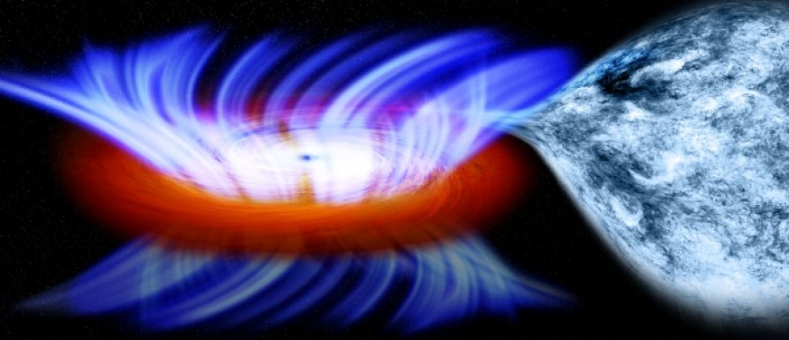
X-Ray States
Hard state:
hard component dominates the X-ray spectrum
radio jet
cold winds (optical)
Soft state:
soft component dominates the X-ray spectrum
hot winds
cold winds (near-infrared)
Cargèse Alessandra Ambrifi - aambrifi@iac.es 3

Slide 4
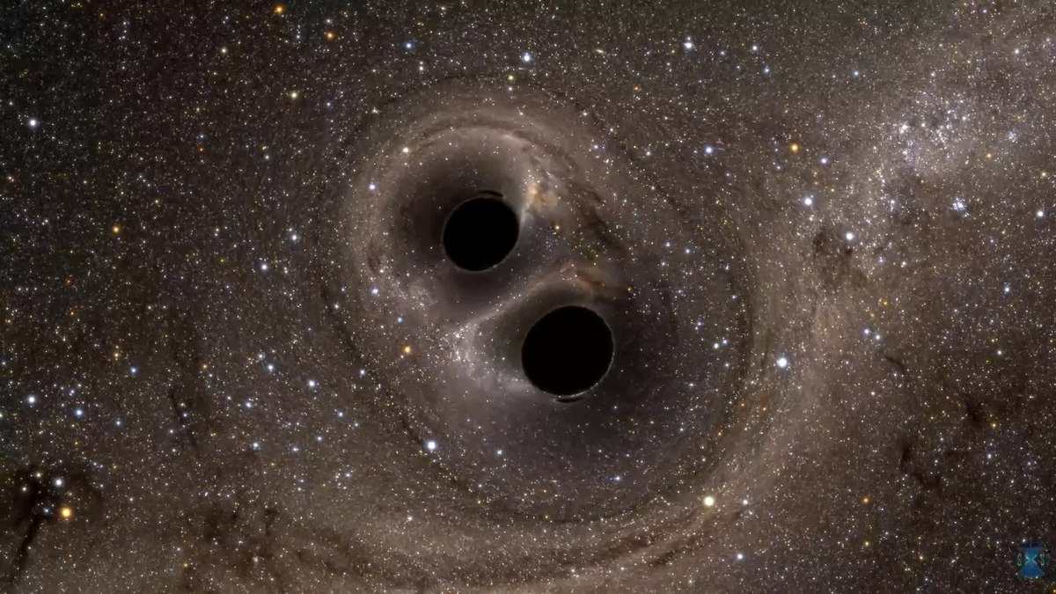
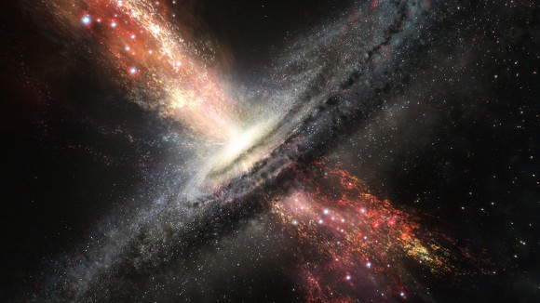
Importance of Studying Outflows
Accretion
Evolution of binaries
Feedback
Connection with AGN
Cargèse Alessandra Ambrifi - aambrifi@iac.es 4

Slide 5
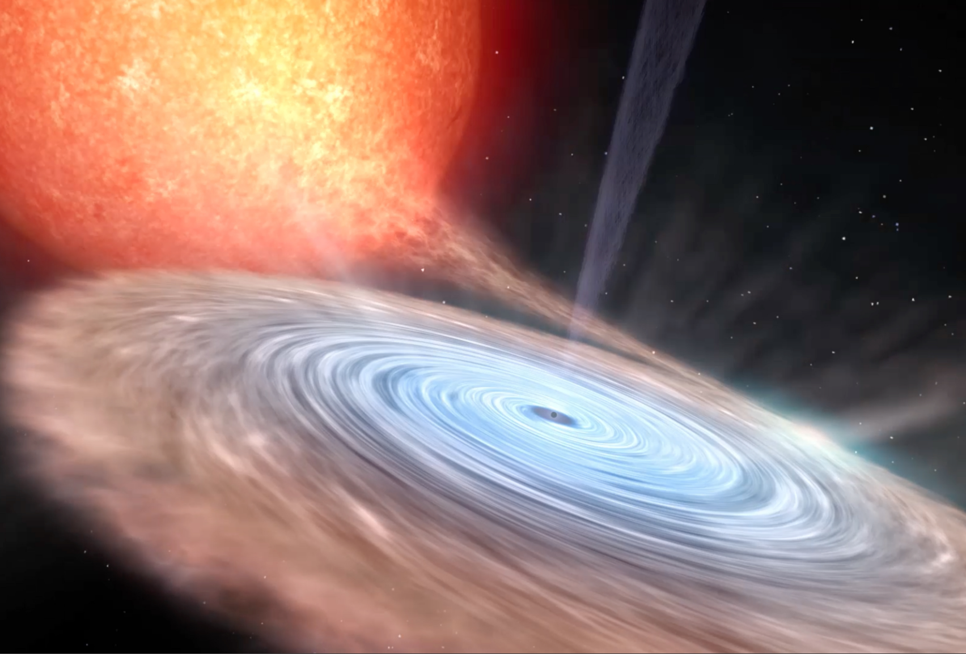
GX 339-4
Low to intermediate inclination
P = 1.76 days
2.3 M☉ < M_{BH}< 9.5 M☉
K type companion
(Heida et al. 2017)
Jet (e.g. Fender, Belloni, Gallo 2004)
What about winds ?
Cargèse Alessandra Ambrifi - aambrifi@iac.es 5

Slide 6
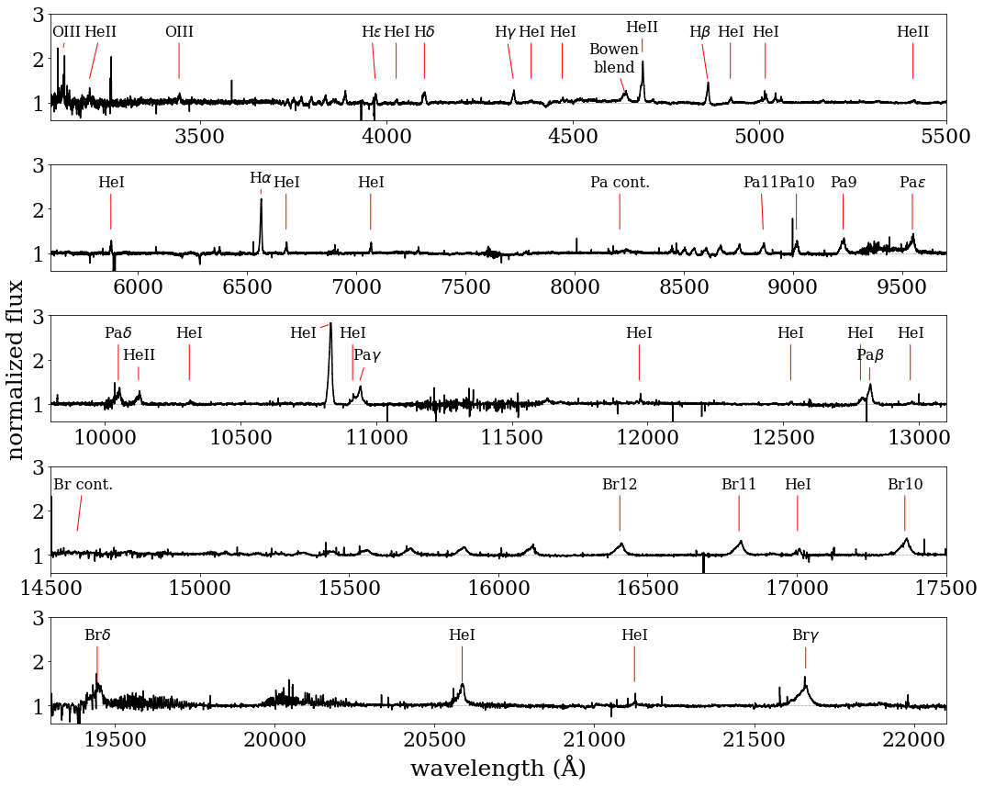
Soft-State Optical and NIR Spectrum
Cargèse Alessandra Ambrifi - aambrifi@iac.es 6

Slide 7
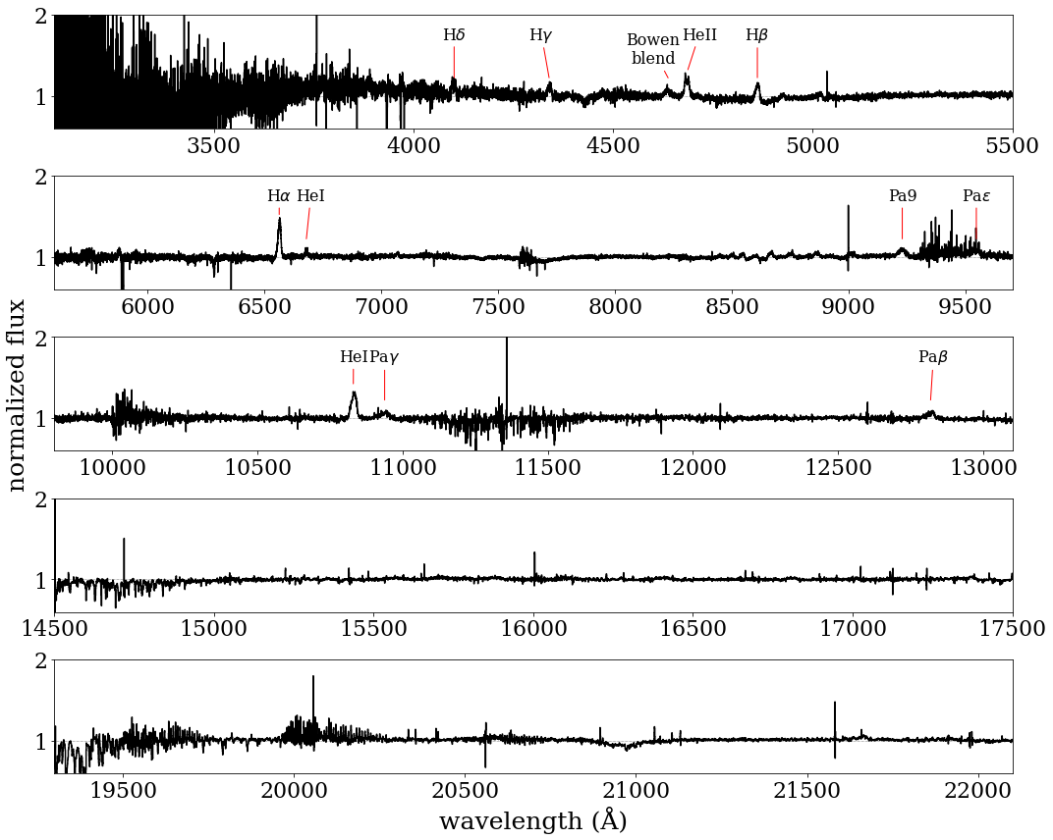
Hard-State Optical and NIR Spectrum
Cargèse Alessandra Ambrifi - aambrifi@iac.es 7

Slide 8
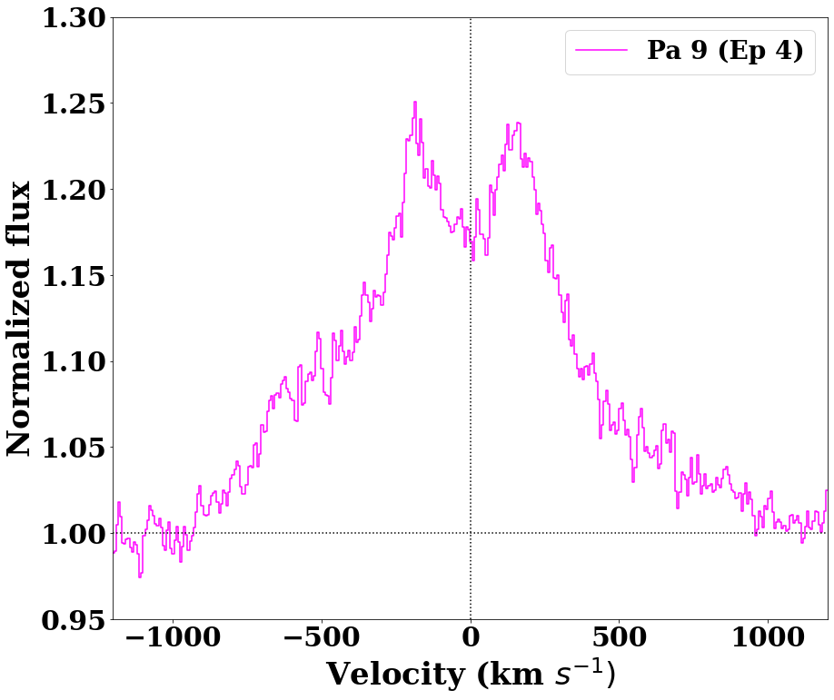
Expected Line Profiles and…
Typical accretion disc emission line profile
Low mass
star
Accretion disc
Horne & Marsh, 1986
Cargèse Alessandra Ambrifi - aambrifi@iac.es 8

Slide 9
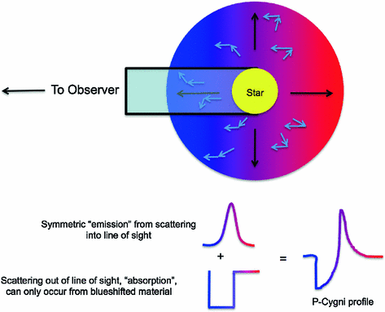
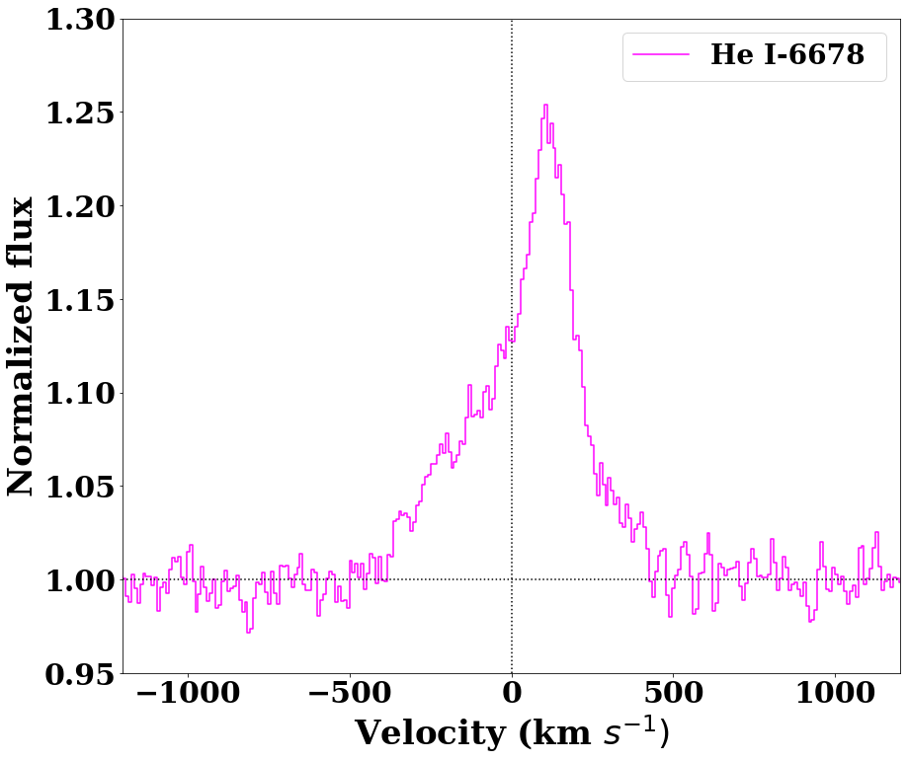
…Potential Outflow Signatures!
Line showing outflow signature
Scattering
Emission
Absorption
Matthews, 2017
Cargèse Alessandra Ambrifi - aambrifi@iac.es 9

Slide 10
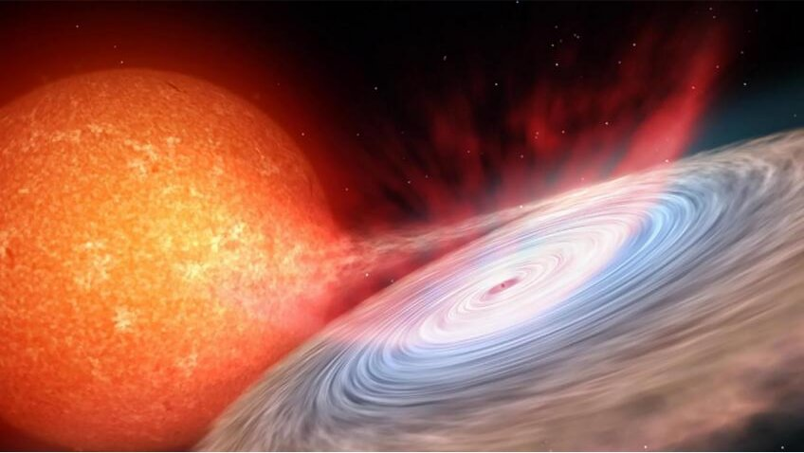
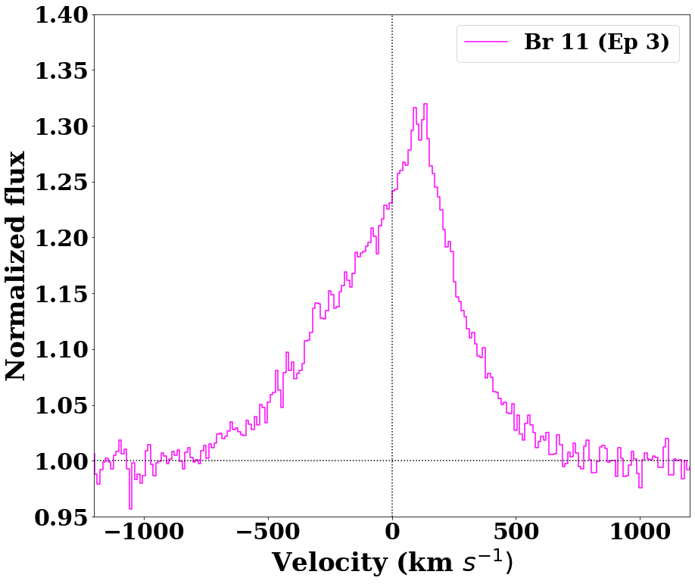
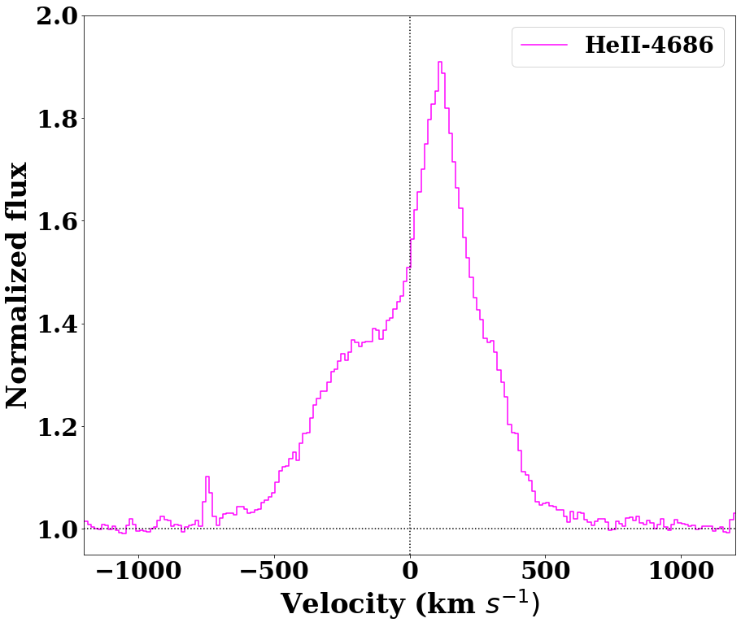
GX 339-4 potentially hosts outflows
Cargèse Alessandra Ambrifi - aambrifi@iac.es 10

Slide 11
Thank you for your attention!
Cargèse Alessandra Ambrifi - aambrifi@iac.es 11

