Slide 1
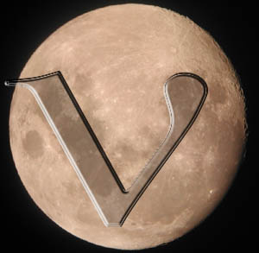
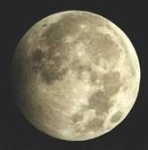
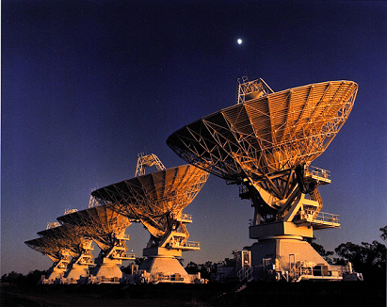
The Lunar Cherenkov Technique: Answering the Unanswered Questions
Clancy W James
Radboud University Nijmegen
Presented at ARENA, Nantes, 2010
LUNASKA
NuMoon

Slide 2
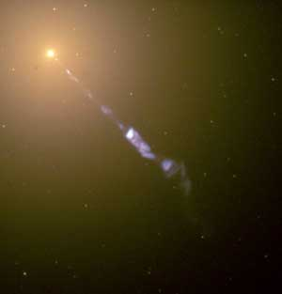
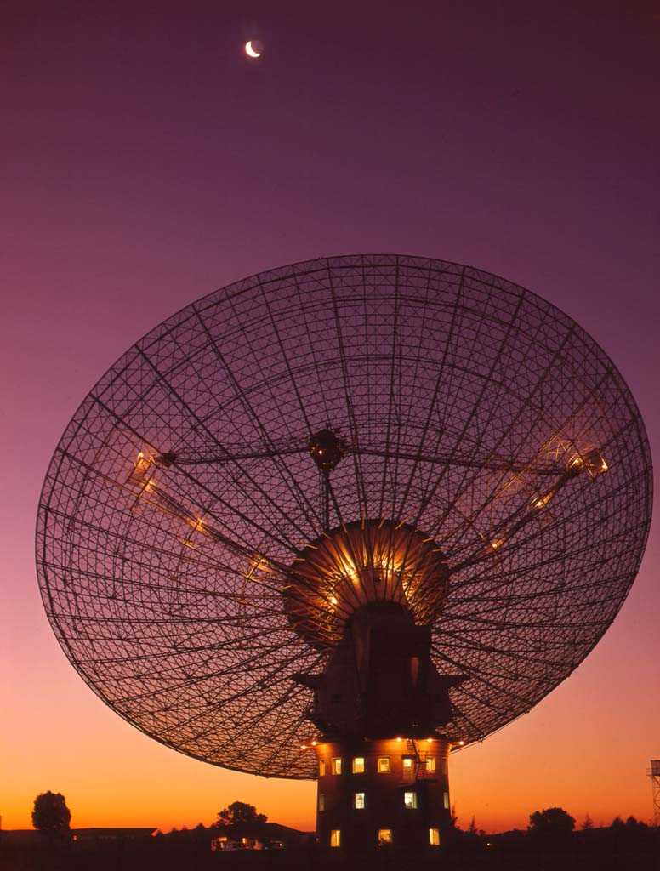
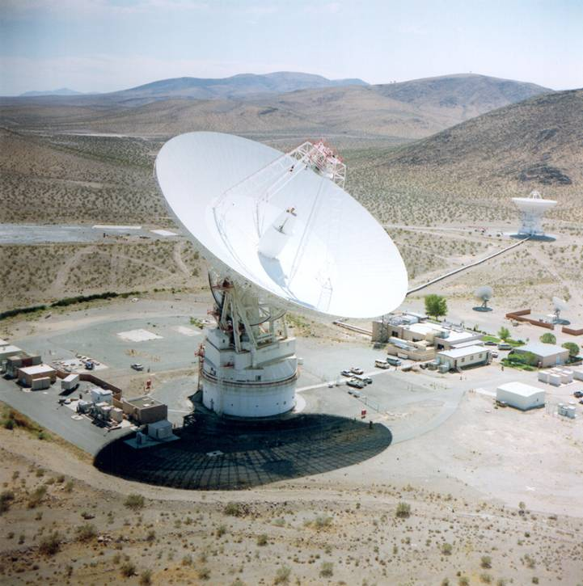
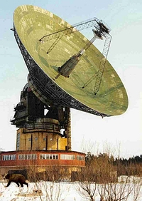
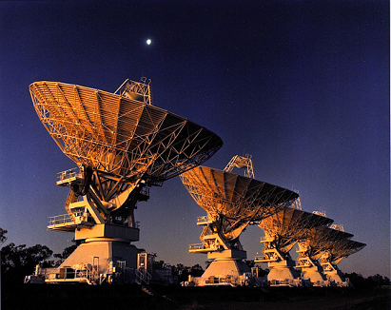
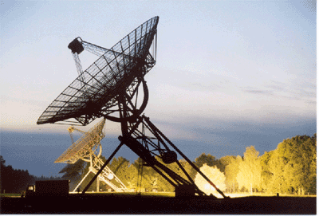
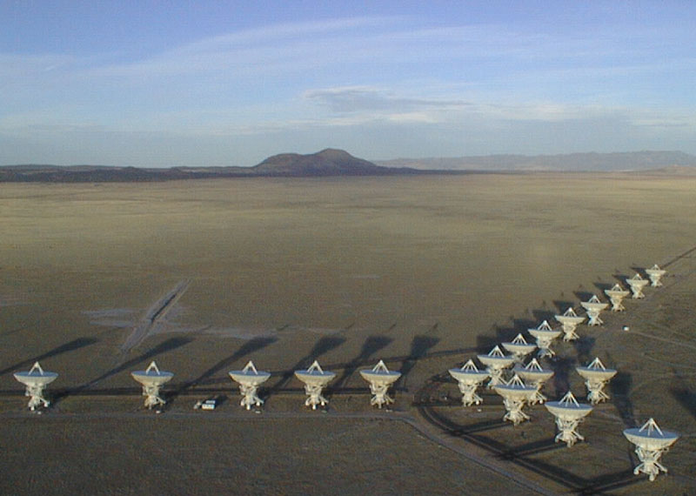
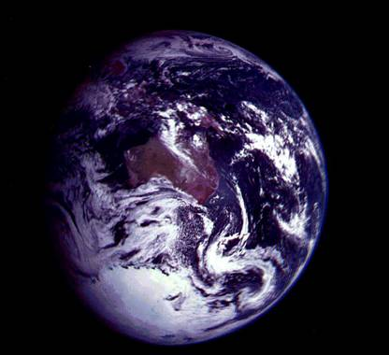
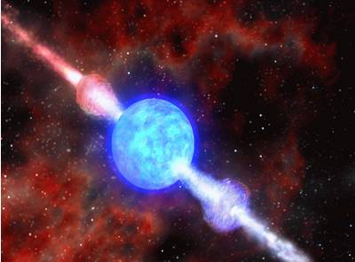
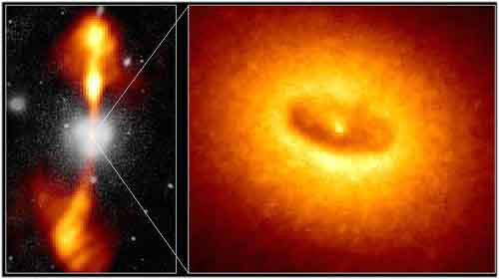
The Lunar Cherenkov Technique
Dagkesamanskii & Zheleznykh (1989)
neutrino
Parkes
Goldstone
Kalyazin
ATCA
WSRT
VLA
cosmic ray
radio waves
(coherent Cherenkov radiation)
shower
Radio telescope
Lunar orbiter
“A radio method to determine the origin of the highest-energy neutrinos and cosmic rays."
GRB?
AGN?
DM?

Slide 3
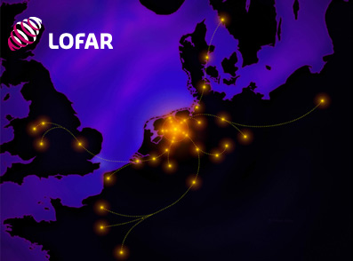
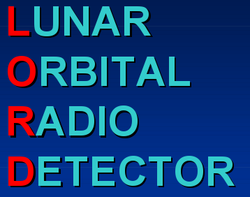
The Lunar Cherenkov Technqiue at ARENA 2010
RESUN – experiment at the VLA (R. Mutel)
2 Results from…
0.5 Status of…
2 Planning for…
1.5 Methods to…
NuMoon at Westerbork
(O. Scholten)
LUNASKA observation strategies at Parkes
(J. Bray)
NuMoon at LOFAR
(M. Mevius)
Status of LORD (G. Gusev)
Ionospheric Calibration (R. McFadden)

Slide 4
Important Questions
Unanswered
What is producing UHE cosmic rays, and is there an what is the associated high-energy neutrino flux?
(0 contributions)
(Yet!)
What are the UHE neutrino interaction cross-sections?
- Depth of the regolith – what is the detection volume?
- Lunar surface roughness (does the pulse stay coherent?)
- Formation-zone effects (can we see cosmic rays?)
In this talk:
- Discuss these issues
- Review/Present latest results
- Attempt to answer them!
(1 contribution)
What is the nature of the detection volume (the Moon), and how does radiation escape it?
(0 contributions)
How do particle cascades develop, and what radiation does this produce?
(2 contributions)
How do we detect lunar Cherenkov pulses?
(2 contributions)

Slide 5
Accurate modelling: why care?
Revision of limit from GLUE (James et al 2009a; Gayley et al 2009)
Accurate limits are scientifically important
Essential for comparison with other experiments
Affects choice of observation parameters
Low frequencies (100 Mhz) now more competitive than high frequencies (~1 GHz) (Scholten et al 2007)
You might find something unexpected
Possible effects of small-scale roughness (James et al 2009b)

Slide 6
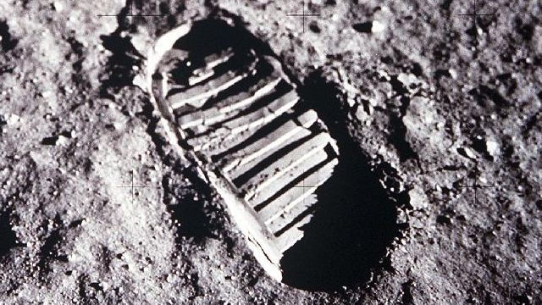
Problem 1: Regolith depth – what is the detection volume?
The lunar regolith:
Surface layer of fine sand/dust/ ‘soil’.
Churned debris from micro-meteor impacts.
Low radio absorption (O~10m at 1 GHz, 100m at 100 MHz).
Nominal detection volume for lunar Cherenkov experiments
The Problem: Assumed/measured depth of ~10m much less than low-frequency absorption length!
Direct measurements few: we need to understand what shaped the lunar surface!
Useful ‘regolith’
Reflective boundary layer?
Radio-absorbent material?

Slide 7
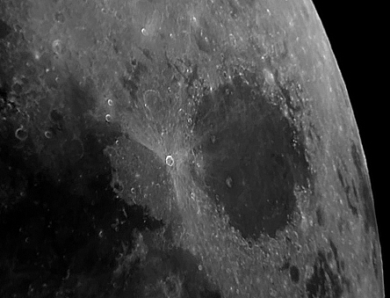
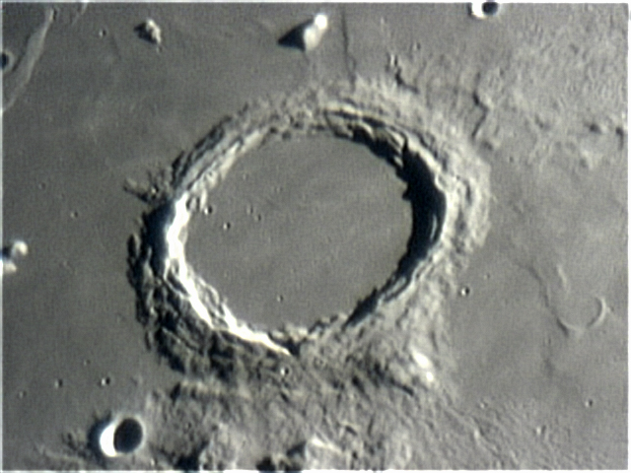
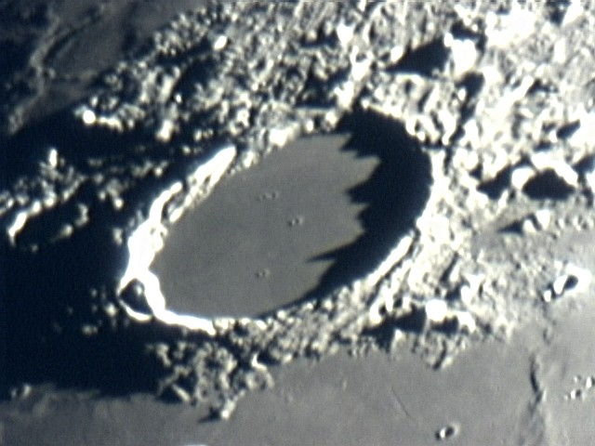
‘Classical’ regolith
Micrometeorites pulverise surface material. The resulting fine material is the ‘classical’ regolith.
Estimates of the resulting layer thickness produce a few metres to a few tens of metres.
BUT: Micrometeorites did not produce these!
micrometeorites
time
surface rocks
regolith

Slide 8
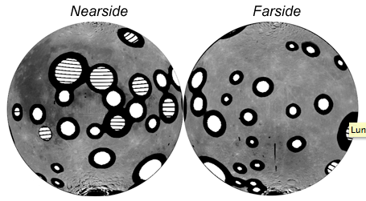
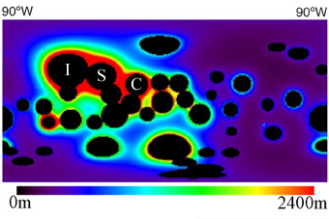
Megaregolith
Composed of successive ejecta blankets from giant impactors.
E.g. South-Pole Aitken Basin: 13km deep, 2500km wide.
Material spread over the lunar surface.
Simulation results:
Highly variable depth.
1-2 km average expected.
Mare: ‘recent’ lava flows cover ancient ejecta blankets.
Layers highly mixed.
Petro and Pieters (2008)
Simulations excluding SPA
Petro and Pieters (2008)

Slide 9
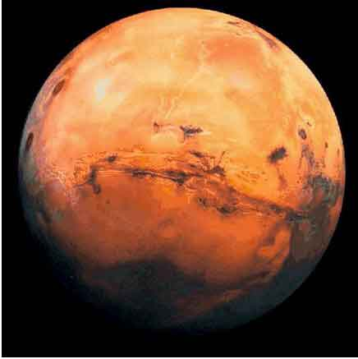
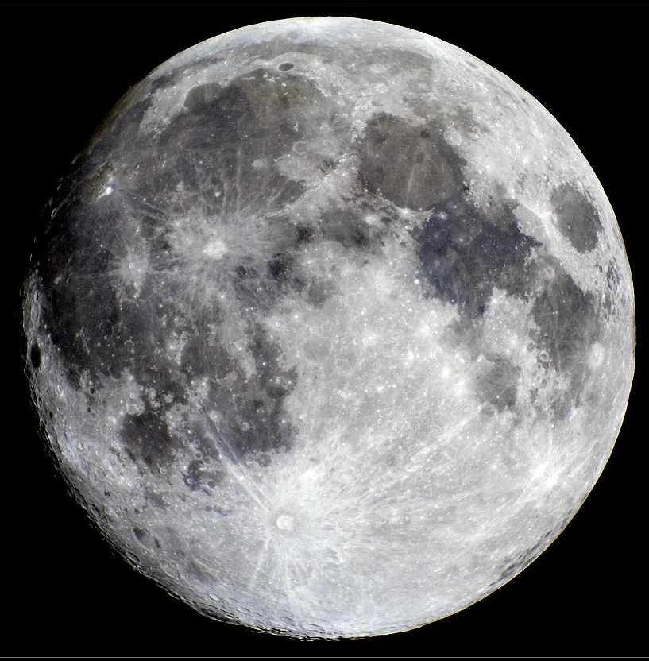
Lunar History
Warning:
standard models only!
Formed from Mars-sized impact on the Earth.
Lunar ‘magma ocean’ gradually cooled to produce an extremely uniform, differentiated crust (>20km depth).
The solid crust is subjected to a late, heavy bombardment, forming huge impact basins.
Nearside basins fill with lava to form mare.
Local surface pulverised to form regolith…
+
=
+

Slide 10
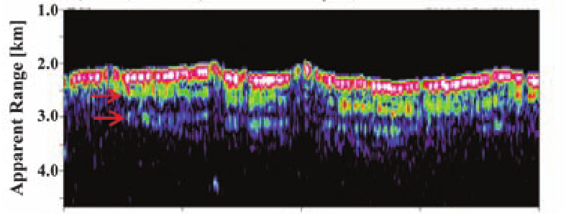
What can we guess?
Highlands (white bits):
No strong radio-absorbency
No sharp boundaries
Increased density w depth?
Mare (grey bits):
Strong(er) radio absorbency
Dense subsurface rock
Possible multiple subsurface layers
SELENE Radar Sounder: Ono et al (2008)
Subsurface
reflective
layers

Slide 11
The picture:
‘Useful’ regolith
Reflective boundary layers?
Arise from density contrasts & compositional changes.
Sharp changes occur only in Mare regions (few metres depth)
Cherenkov radio observations will not probe deep layers.
Radio-absorbent material?
Mare basalts (but not strongly)
These have been sampled by Apollo missions!
Data incorporated into simulations (Alvarez-Muniz et al 2008; James et al 2008)
Reflective boundary layer?
Radio-absorbent material?

Slide 12
Q: How deep is the regolith? What is the detection volume?
A1: Regolith depth is:
Effectively infinite in the highlands
Shallow in the mare (average order 5m)
A2: Detection volume is:
~Infinite low-radio-absorbency highland (mega) regolith.
Shallow mare regolith (slightly higher absorbency).
Single upper layer of denser, more absorbent mare basalt.
Conclude:
We can simulate these effects perfectly well now.
Require more lunar data to pin down numbers.

Slide 13
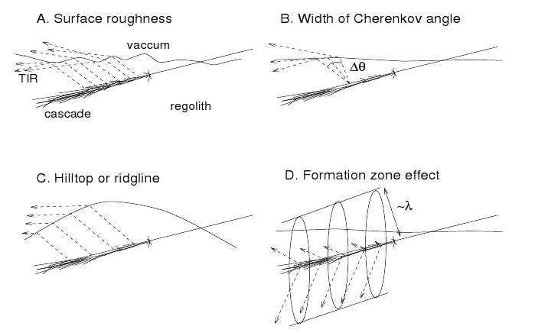
Surface Effects
4 Problems: summarised in 2001. Unsolved pre-2010!
‘Simple’ Refraction
P.W. Gorham et al. 2001

Slide 14
What are the effects of lunar surface roughness?
Large-Scale roughness
Slope constant over signal transmission region
Changes pulse direction
Increases escape probability
Unambiguously good… ?
Small scale roughness
Slope varies over signal transmission region
Reduces signal coherence
Unambiguously bad…?
IS THIS PICTURE CORRECT?
Messy, incoherent signal
Nice coherent geometry
Effects assumed negligible for low (100 MHz) frequencies.

Slide 15
Current Treatment of Roughness
Roughness dependent on wavelength
Model large-scale roughness only
Assume point-like source
Deviate surface
Refract as spherical wave
Minimal effect of roughness only
Rougher surfaces –> more signal! (A. Beresnyak 2006)
local surface
mean lunar surface

Slide 16
Extreme roughness case
Developed for LUNASKA Australia Telescope Compact Array (ATCA) experiment (James et al 2009b)
Goal: Make a ‘worst-case’ roughness estimate
Different parts of the shower see different surfaces
Treat these segments independently
Deficiencies: Many!
Used far-field refraction
Refracted all b/w identically
‘sub-signals’ independent
BUT: quick!
What did we find?

Slide 17
Results!
Decreased sensitivity – and increased aperture!
As if we observed at lower frequencies!
E.g. 1/10th cascade visible
1/10th peak emission
x10 angular spread

Slide 18
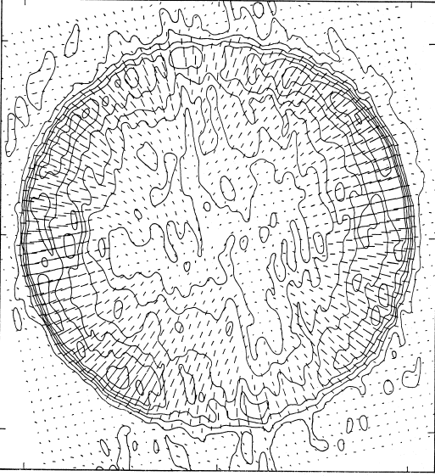
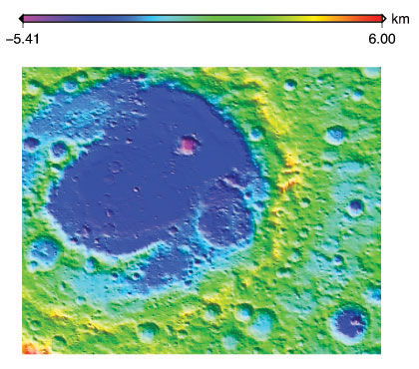
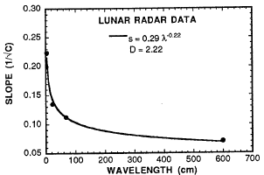
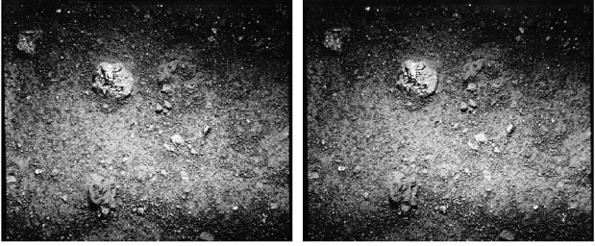
Can we do better? We have the data…
Stereo photography (1mm-10 cm)
Satellite laser altimeters
1994: Clementine (40km min res)
2008: SELENE (Kaguya) (10 km min res)
2009/10: Lunar Reconnaissance Orbiter (500 m min res)
Indirect (statistical model fitting):
Arecibo radar backscatter
Radio polarisation at the limb
P.H.Moffat, MNRAS 160, 139 (1972)
Credit: NASA/LRO/LOLA (2010)
http://lunar.gsfc.nasa.gov/
Helfenstein & Shepard, Icarus 141, 107 (1999)
Shepard et al, J. Geo.Res. 100 E6 11709 (1995)

Slide 19
… and we have the models.
‘Complete’ Model:
Facet model for a rough surface.
Calculate radiation incident on each facet from each piece of the cascade.
Solve diffraction problem (surprisingly uncommon!).
Integrate over all facets for each frequency and angle of interest.
Stratton-Chu Equations
(integrate over surface):

Slide 20
First Preliminary Result
Q: Can low-frequency radiation be affected by surface roughness?
A: Yes!
PRELIMINARY!

Slide 21
Q: Lunar surface roughness: does the pulse stay coherent?
A: We can not yet be certain. But:
Positives:
Small-scale roughness does NOT reduce the total power transmitted!
Any loss of coherence MUST imply increased angular spread.
May increase the total experimental aperture!
Negatives:
Detection threshold energy must increase.
Roughness will be a problem at all frequencies.
Reconstruction of shower properties will be much harder.
We are very close to developing a complete model of surface roughness effects! Stay tuned…

Slide 22
Formation Zone Effect
What happens when a particle cascade occurs close to the lunar surface?

Slide 23
The Formation-Zone Effect
What happens to Cherenkov radiation when the particle producing it travels near an interface?
Experimental results (inverse problem):
CONCLUSION: Cherenkov radiation depends on the bulk properties of the surrounding medium (within the radiation formation zone).
Electron bunches
Dielectric material
~λ
Dielectric material
Cherenkov radiation observed: Power ~ exp(-d/λ)

Slide 24
Application to Lunar Cherenkov Technique
What happens when a particle cascade is close to the surface?
As the cascade approaches the surface, the bulk material properties become that of vacuum.
Cherenkov radiation is not observed in a vacuum.
No Cherenkov radiation is expected for a cascade at the surface!
Radiation strongly suppressed
Incident cosmic ray
(or more rarely a neutrino)
Negligible affect
λ
particle cascade
Cascade: ~infinite
particle track
Dielectric material: the Moon!
BUT: this is the situation!

Slide 25
Do we see Cherenkov radiation?
Cherenkov radiation: characterised by Frank & Tamm (1937) as radiation from an infinite particle track.
Tamm (‘39): Radiation from a finite track.
Contribution from ‘classical’ Cherenkov radiation.
Contribution from acceleration at endpoints.
Accelerated charged particles radiate perfectly well in a vacuum and near dielectric boundaries!
Initial acceleration event (t=t₁)
Final deceleration event (t=t₁+δt)
Particle motion
`Cherenkov radiation formula’ (e.g. Zas Halzen Stanev 1992)

Slide 26
Q: Formation-zone effects: can we see cosmic rays?
Radiation from finite cascades comes from Cherenkov radiation + endpoint contribution.
Formation-zone effects excluding Cherenkov radiation from being seen for shallow showers.
Dominant contribution to the radiation will be from particle acceleration even for deep cascades.
Current simulations account for particle acceleration (endpoint) contribution. We do not have a problem!
A: Yes, we can (in theory…) see cosmic rays!
Similar radiation theory questions for
air showers - see talks by:
O. Scholten
A. Romero-Wolf
T. Huege
M. Ludwig

Slide 27
Brief Aside: How do particle cascades develop, and what radiation does this produce?
Cascades from nuclear jets:
Smooth profile
Sharp pulse
Carries ~20% available energy
What about the leptons?
Multiple peaks in LPM-elongated cascades from e±?
τ cross-section with nucleons - `double-bang’ events?
Hadronic sub-showers in ‘pure’ EM cascades?
Be Warned!
Increase detection probability
Produce ‘messy’ signals
Do not use stringent shape criteria!
- EM only : ✓ Alvarez-Muniz et al 2009
- Hadronic: ✓ poster by W. Carvalho
- Mixed: ✗ ???
field
time

Slide 28
Summary
Experimentally, the Lunar Cherenkov technique is progressing rapidly
Theoretically, progress has been slow… until now!
New data + new ideas: understanding and new perspectives *should* follow shortly.
New data must be incorporated into simulations / accounted for in experimental techniques.
Now we just need to observe a neutrino…

