Slide 1
The SPIRAL2 project
For more information see “GANIL-SPIRAL2” presented by A.K. Orduz at
Ecole IN2P3 Avril 2022 : Introduction aux accélérateurs de particules

Slide 2

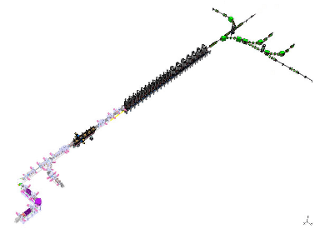
OUTLINE
  The SPIRAL2 project
    The Facility
    Physics Applications
  The SPIRAL2 Accelerator
    The Injector
    The MEBT
    Medium Energy Beam Transport
    The Superconducting LINAC
    THE HEBTs
    High Energy Beam Transport
  Beam commissioning results

Slide 3
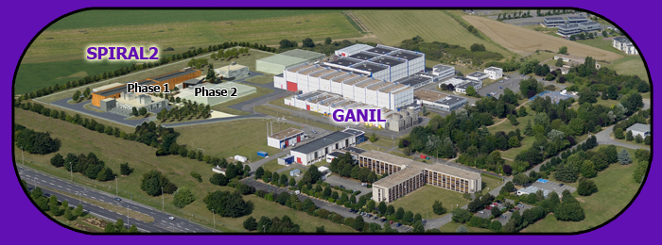
THE SPIRAL2 FACILITY
SPIRAL2 (Système de Production d'Ions RAdioactifs en Ligne de 2ème génération)
is an exotic ion beam accelerator facility for studies in
fundamental nuclear physics and interdisciplinary research
GANIL was already producing exotic ions with SPIRAL(1) and LISE,
using 2-5 kW cyclotron beams.
SPIRAL2 enlarges this capability and adds neutron facility

Slide 4
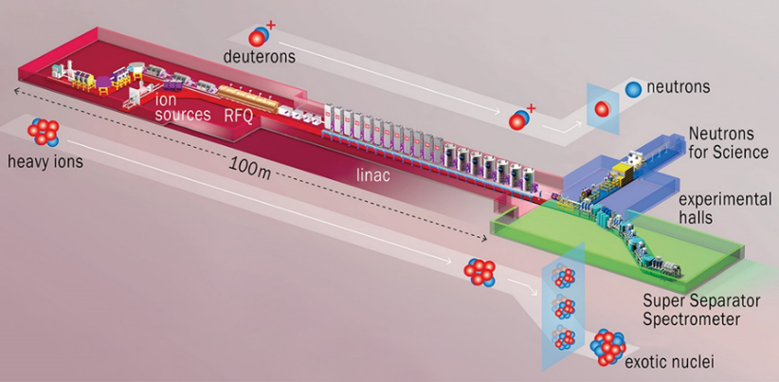

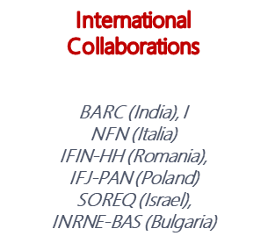
THE SPIRAL2 facility
BUDGET
Building, ancillaries and accelerator : ~130 M€
NFS scientific equipment : ~0.5 M€
S3 scientific equipment : ~23 M€ (17M€ EquipEx 20… )
NEWGAIN equipment : ~14 M€ (EquipEx 2021)
Particles | H⁺ | D⁺ | IONS
A/Q | 1 | 2 | 3 | 7
Max I (mA) | 5 | 5 | 1 | 0.5
Max energy (MeV/A) | 33 | 20 | 14 | 7
Max beam power (kW) | 165 | 200 | 44 | 25

Slide 5
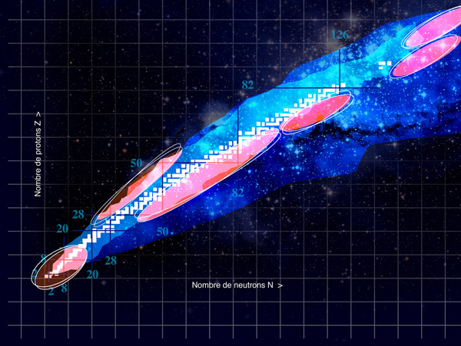
THE SPIRAL2 facility: Physics Applications
Exploration of Terra Incognita
Colored dot and area legend:
White dots : 291 natural nuclides
Sky blue : 2000 nuclides already produced in laboratory
Green : nuclides produced
with the SC LINAC + S3
Red (+ Green) : nuclides
produced with the original
SPIRAL2 facility
Spiral
LISE

Slide 6
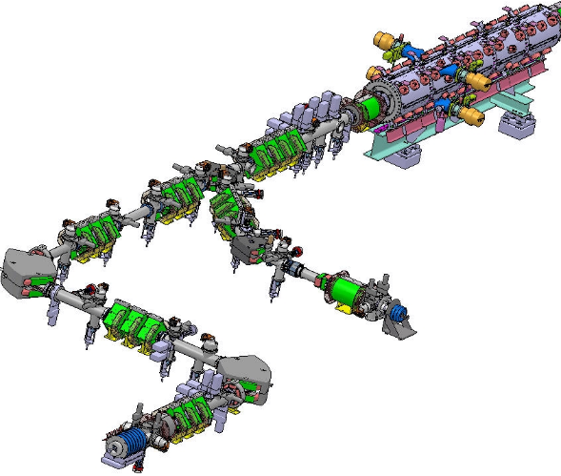
The SPIRAL2 accelerator
Injector 1
2 Sources
  proton/deuterons (> 5 mA, 20 and 40kV plateform)
  and light ions (q/A<1/3, 1mA, 60kV)
Low Energy Beam Transport (LEBT)
  Ion selection,
  Matching to RFQ entrance
  Vacuum and Diagnostics
  Beam power control
RFQ1
  From CW to bunched beam (88MHz)
  High transmission
  Focusing and acceleration
~ 5 m
~ 16 m
Beam axis level : 1500mm
Standard aperture of beam pipes ~ ∅160mm
~ 5 m

Slide 7
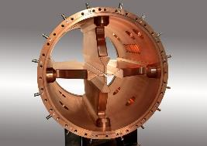
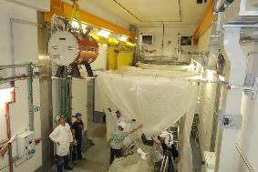
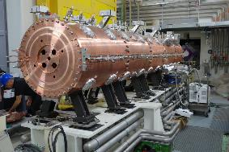
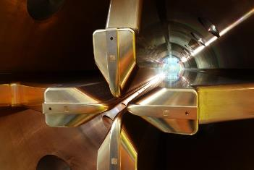
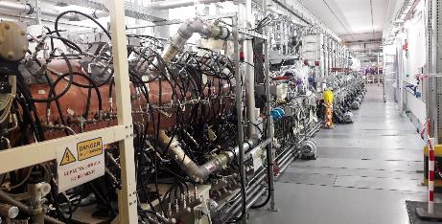
The SPIRAL2 accelerator
RFQ1
Transforms the CW beam coming from the LEBT into a bunched beam as required for RF acceleration, with ~100% current transmission.
Accelerates the bunches at 0.735 MeV/A (input CW beam Energy: 20 keV/A)
Prototype
Ready for operation !

Slide 8
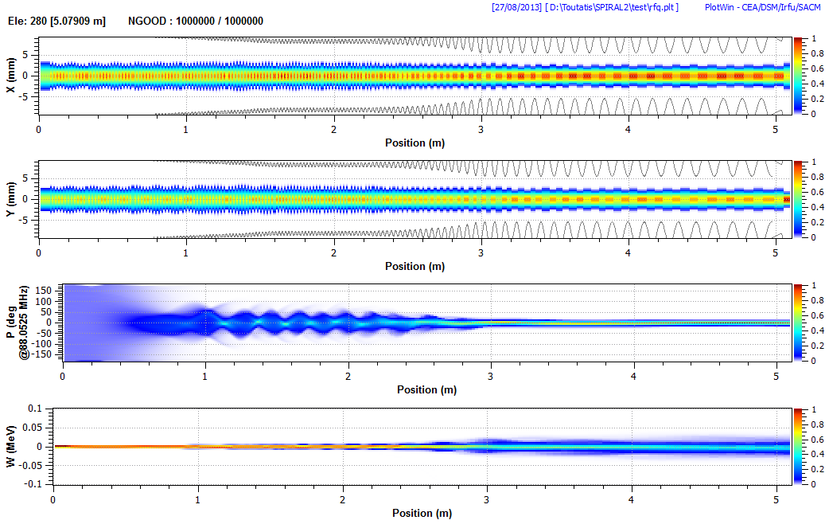
The SPIRAL2 accelerator
RFQ1 Beam SIMULATIONS
Shaper
Gentle Buncher
Accelerator

Slide 9

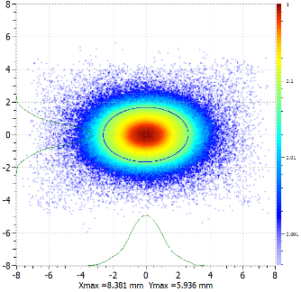
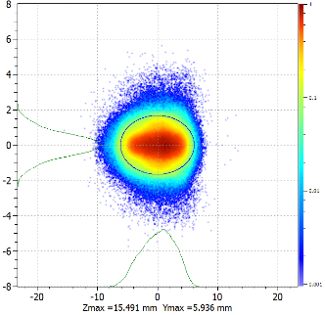
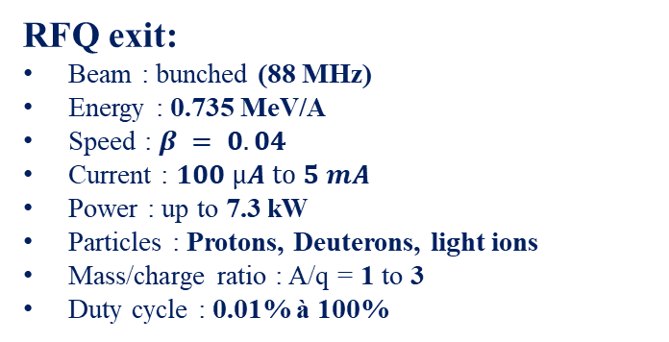
The SPIRAL2 accelerator
Beam characteristics after the RFQ
RFQ exit:
Beam : bunched (88 MHz)
Energy : 0.735 MeV/A
Speed : $β = 0.04$
Current : $100 µA \text{to} 5 mA$
Power : up to 7.3 kW
Particles : Protons, Deuterons, light ions
Mass/charge ratio : A/q = 1 to 3
Duty cycle : 0.01% à 100%
Z is the beam direction
(longitudinal axis, mm)
Transversal plane
Example: Deuterons
at 5 mA
Longitudinal plane
Y (mm)
Y
X (mm)
Z
Notes:
Cycle utile = duty cycle

Slide 10
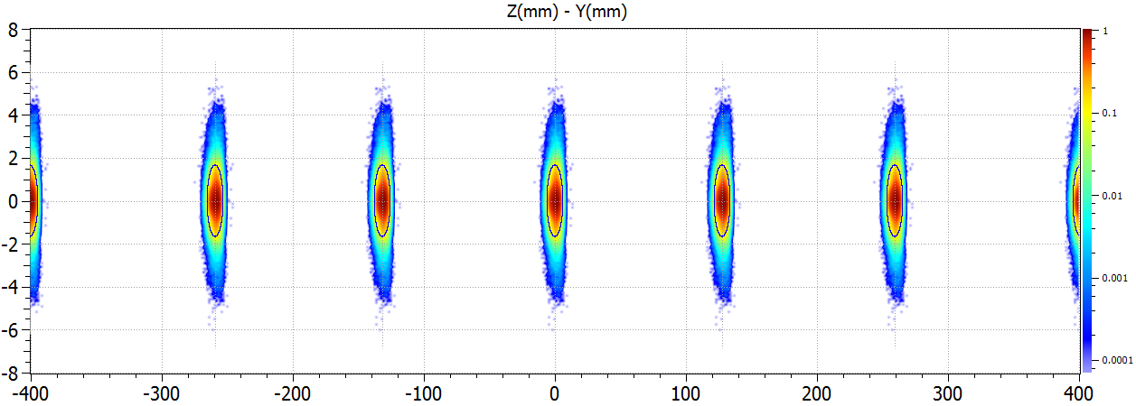
The SPIRAL2 accelerator
Beam characteristics : time structure
Micro Structure: bunches (for RF acceleration)
Y (mm) = vertical axis
Z (mm) = longitudinal axis
Bunch frequency: 88 MHz ⇒ time (distance, phase) between pulses = ~11.4 ns or ~136 mm or 360°
Macro Structure : beam pulses (for power control)
beam pulse length : 200µs to T
T = 0.1 to 1 second
duty cycle : 0.02% to 100% (the duty cycle is the ratio between time with and without bunches)

Slide 11
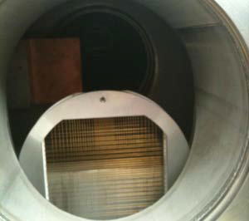
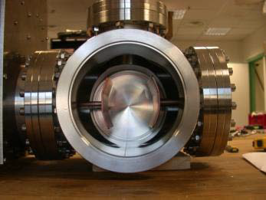
The SPIRAL2 accelerator
Beam power control
Crucial role for a high power machine
  Machine Protection, safety, radioprotection
  Machine Commissioning
  Power ramp on targets
Control of duty cycle
  Pulsed electrostatic field to provide a pulsed beam
  V and f max : 10 kV, 1.5 kHz
  Duty cycle : typically for the first linac beams : 0.1%
  (500µs @2Hz)
Phases of the power increasing during the commissioning
Deviated beam dump (Scraper)
Lebt chopper chamber and electrodes
Profiler

Slide 12
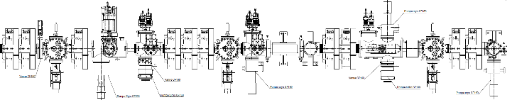
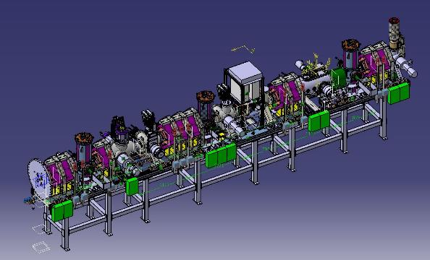
The SPIRAL2 accelerator
the MEBT
RFQ
SC LINAC
7.7 m
Single bunch selector
Deviated beam dump
MEBT main functions:
Match the beam to the SC linac
Clean the halo
Measure beam characteristics
Provide single bunch selection
Accept beam from Injector2
Room for INJ2 injection
LME
R3
R2
R1
Notes:
Medium energy beam transport (MEBT)= Ligne Moyenne-Energie (LME)

Slide 13
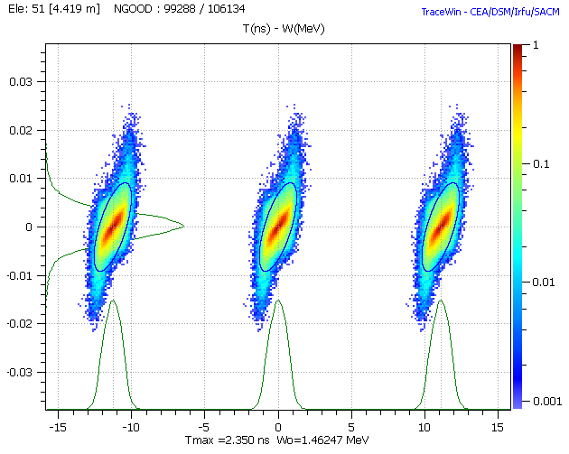
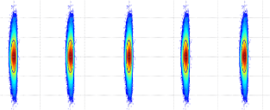
The SPIRAL2 accelerator
Single bunch selection
Some physics experiments requires much lower bunch frequency :
1 bunch over 100 to 10000
+V
R
E
-V
-V
R
6 ns
6ns
Magnetic dipole to deviate all the beam to the beam dump,
Travelling wave, pulsed electric field to keep the selected bunch on the beam axis
  Meander strip line to match the beam velocity (v_{beam} = 4% c)
  HV rise/fall time : < 6 ns

Slide 14
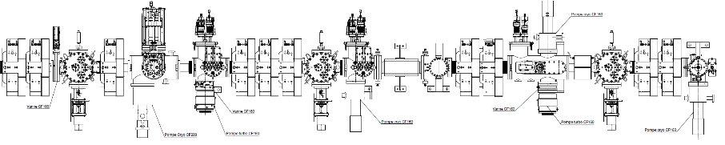
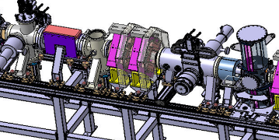
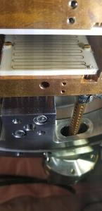
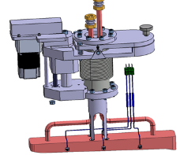
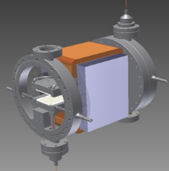
The SPIRAL2 accelerator
Single bunch selection
Deviated Beam Dump (~7.5 kW)
Single
Bunch
Selector
Dipole

Slide 15
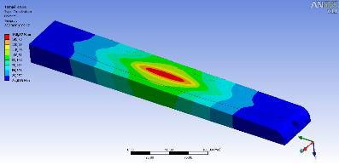
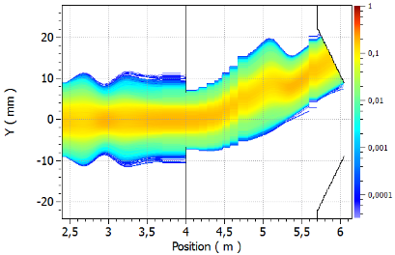
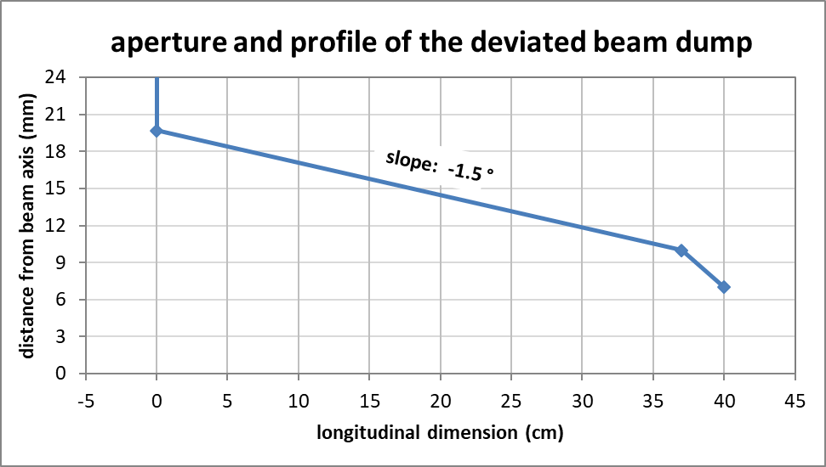
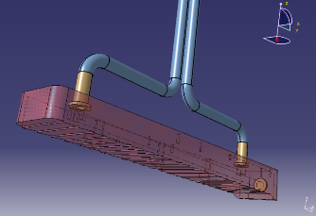
The SPIRAL2 accelerator
SINGLE bunch selection
<150W/cm2
<170°C
Deviated beam power : 7.3 kW
Light slope to reduce power densities
Three thermocouples to control beam position
Small steps to avoid retro-diffusion (2021)

Slide 16

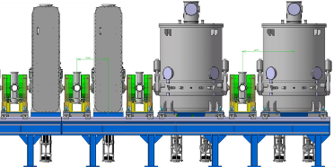
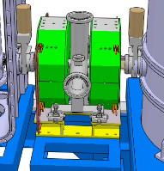
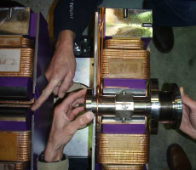
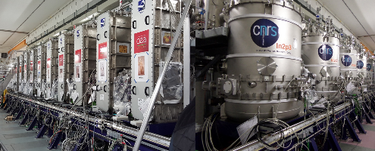
The SPIRAL2 accelerator
the SC LINAC (4.3K)
Protons to A/q=7 ions
Variable energy : from 2 MeV/A to 33 MeV/A
⇒ cavities with independent phase and voltage
~30m
Short cryomodules (CMA and CMB)
Periodic structure
Transversal focusing, Diagnostics and vacuum pumps in the warm sections (WS)
Beam extension monitors in the first five WS
Beam position monitors in all WS
WS with Qpoles
and Diag box
BPM position
Notes:
Régulière=fair and square

Slide 17
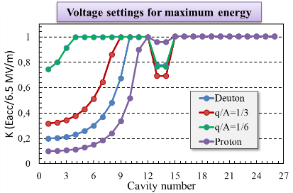
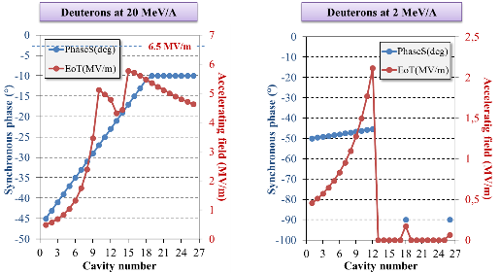
The SPIRAL2 accelerator
independent Phase and RF field
Phase #1: Channel definition :
  Transverse focusing
  Field law and synchronism phase of cavities
Phase #2: Tuning of the structure (at 1st order) :
  Transverse position
  Field and phase of cavities
Phase #3: Beam tuning (2nd order) :
  Transverses and longitudinal sizes
Phase #4: Power increasing :
  Power increase with the increasing of the duty cycle
Cavities have to work on a wide range of field amplitudes
Required field stability is 1%
Required phase stability is 1°

Slide 18
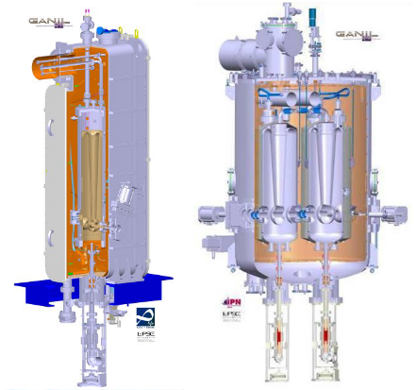
The SPIRAL2 accelerator
Characteristics of the SPIRAL2 cavities
Cavity | A | B
Number of cavities | 12 | 14
∅ cavity diameter (mm) | 238 | 380
∅ Beam pipe diameter (mm) | 38 | 44
f [MHz] | 88.05 | 88.05
β_{optimum} | 0.07 | 0.12
E_{peak}/E_{acc} | 5.36 | 4.76
B_{peak}/E_{acc} (mT/MV/m) | 8.70 | 9.35
L_{acc} [m] | 0.24 | 0.40
V_{acc} (MV) at 6.5 MV/m & β_{opt} | 1.55 | 2.66
G [Ω] | 22 | 37
r/Q [Ω] | 600 | 515
Q₀ (P_{cav}= 10W* @ 6.5 MV/m) | 3.5 10⁸ | 1.4 10⁹
Same power coupler
*10W @ 4K ≈ 5 kW @ 300K

Slide 19
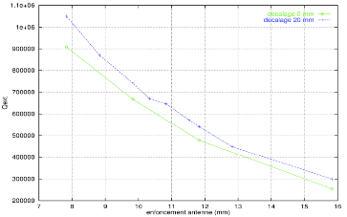
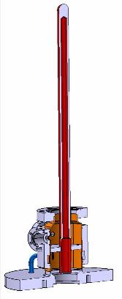

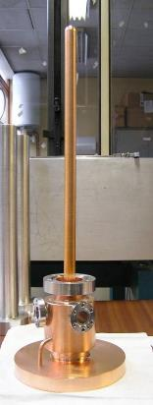
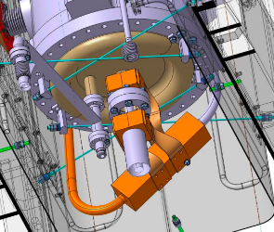
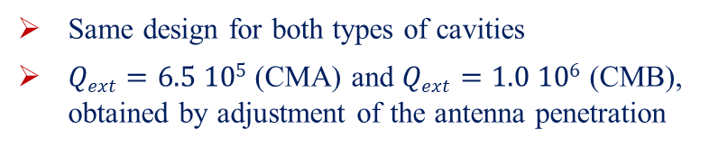
The SPIRAL2 accelerator
20 kW Power coupler
Same design for both types of cavities
$Qext=6.5 105$ (CMA) and $Qext=1.0 106$ (CMB), obtained by adjustment of the antenna penetration
Hollow antenna
Ceramic window (without TiN)
Pumping port
Electrons Pickup
Ceramic air cooling circuit
Notes:
Antenne creuse = hollow antenna
Port de pompage = port of pumping

Slide 20
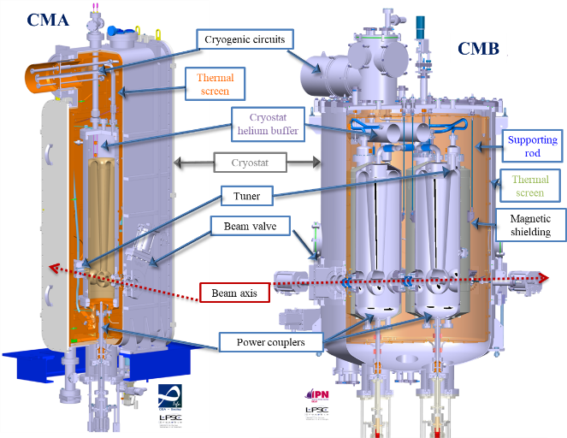
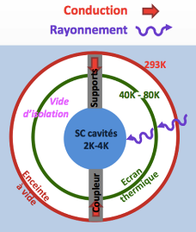
The SPIRAL2 accelerator
Cryo-moduleS
Notes:
Plongeur = plunger

Slide 21
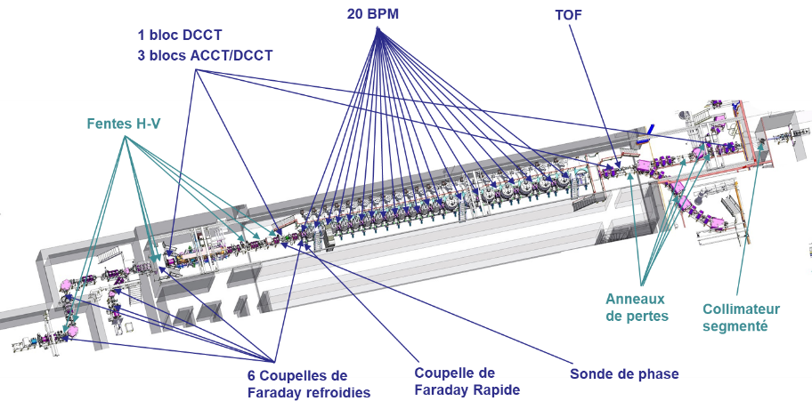
The SPIRAL2 accelerator
DiagnosticS de l’accélérateur

Slide 22
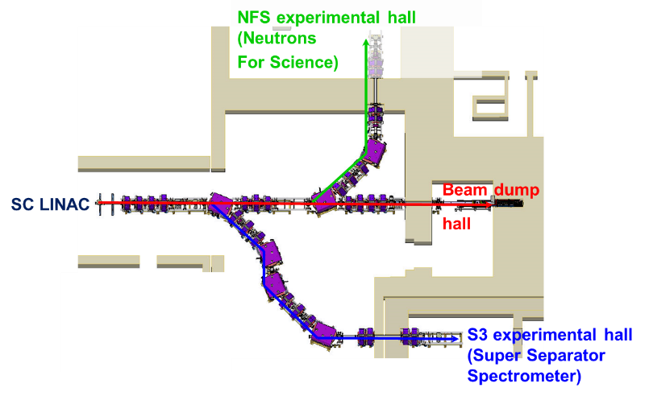
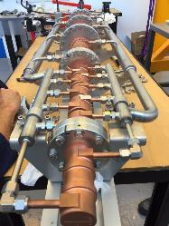
The SPIRAL2 accelerator
High energy Beam transport (HEBT) LAYOUT
200 kW
Beam dump
3 lines (total length = 54.5m) :
LHE1 : from LINAC to Beam-dump. L=21.3m.
LHNFS : from dipole LHNFS-D11 to neutrons converter. L=14m.
LHS3N : from dipole LHE2-D11 to S3 target area. L=19.2m.

Slide 23
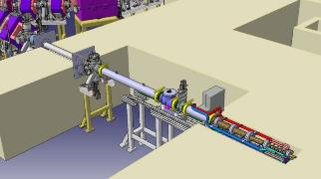
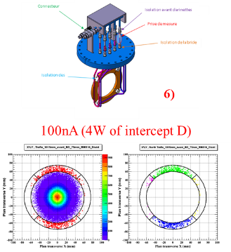





The SPIRAL2 accelerator
The SPIRAL2 beam-dump
Use : LINAC beam commissioning and tuning at the beginning of experiments
(or retuning during experiment)
Designed to stop a 5 mA, 40 MeV deuteron beam (P=200kW)
Internal shape designed for a flat power density profile
Beam must be defocused (~x3) at beam dump entry $(σx=σy=14mm)$
Independent demineralized water cooling circuit for safety monitoring (activated water)
Segmented collimator located 1m before the beam-dump (4 Cu sectors): intercepts a small halo beam fraction to measure beam centering at dump entry
1) + 2)
3)
4)
5)

Slide 24

The SPIRAL2 accelerator
Commissioning time line

Slide 25

The SPIRAL2 accelerator
Commissioning time line
2014
ECRIS 2
first H⁺ beam:
2 mA.
December.
2015
ECRIS1: Phoenix V2
first beam,
Ar⁹⁺ 230 µA
July.
RFQ:
first H⁺ beam
Décembre.
2018
Injector and Diags commissioning end
April-November
D plate Dismantling and MEBT installation
2019
MEBT @5 mA H⁺.
SBS* @ 0.2 mA H⁺
LINAC @ 0.2 mA H⁺
33 MeV H⁺
July – December
2020
SBS @ 5 mA H⁺. July
SBS @1.3 mA ⁴He²⁺
LINAC @ 5 mA H⁺
16 kW H⁺
July - December
2021
LINAC @1.3 mA ⁴He²⁺
SBS @ 5 mA D⁺
LINAC @ 5 mA D⁺
40 MeV D⁺
July - September
^{* SBS= Single Bunch Selection}

Slide 26





The SPIRAL2 accelerator
BEAM COMMISSIONING RESULTS
RFQ transmission
SC linac transmission and beam power
+ ⁴⁰Ar¹⁴⁺
(25µA)
Single bunch selection (H⁺)
First physics experiences
July 2021

Slide 27


Thank you for your attention

Slide 28

The SPIRAL2 accelerator
Vacuum pressure
1.2 10⁻⁵ mbar
(Argon)
Vacuum level has be carefully controlled
Between 10⁻⁶ and few 10⁻⁵ mbar for Protons/Deuterons particles
Between 10⁻⁸ and few 10⁻⁷ mbar when working with heavy ions

Slide 29






The SPIRAL2 accelerator
Diagnostics
DCCT
Shielding : (µ-métal + Armco + copper)
B.W.: 0 – 10 kHz ; Noise: 1 µA / Hz ^{½}
C.W. + Low Duty Factor Pulsed Mode Operation
Profiler
Secondary emission monitor
47 Tungsten wires ø 150 μm
Maximum beam size: 80 mm
Imax: 0.1-1 mA cw
Emittance-meter
Allison scanner
Max. diameter beam: 80 mm
Max measurable angle: ± 100mrad
H.V. max: 2.8 kV
Max Beam power: 300 W
Faraday Cup
Water cooled
P max: 1,2 kW ( 250°)
P density max: 2120 W/Cm²
Beam Loss Monitor (BLM)
20 detecteurs le long du Linac,
7 pour les LHE
5 mobiles

