Slide 1
Search for T’→ top+H in Dilepton Final State
Motivation& Estimating production rates
Di Wang (Tsinghua University)
Group Meeting, Apr. 22th, 2022

Slide 2
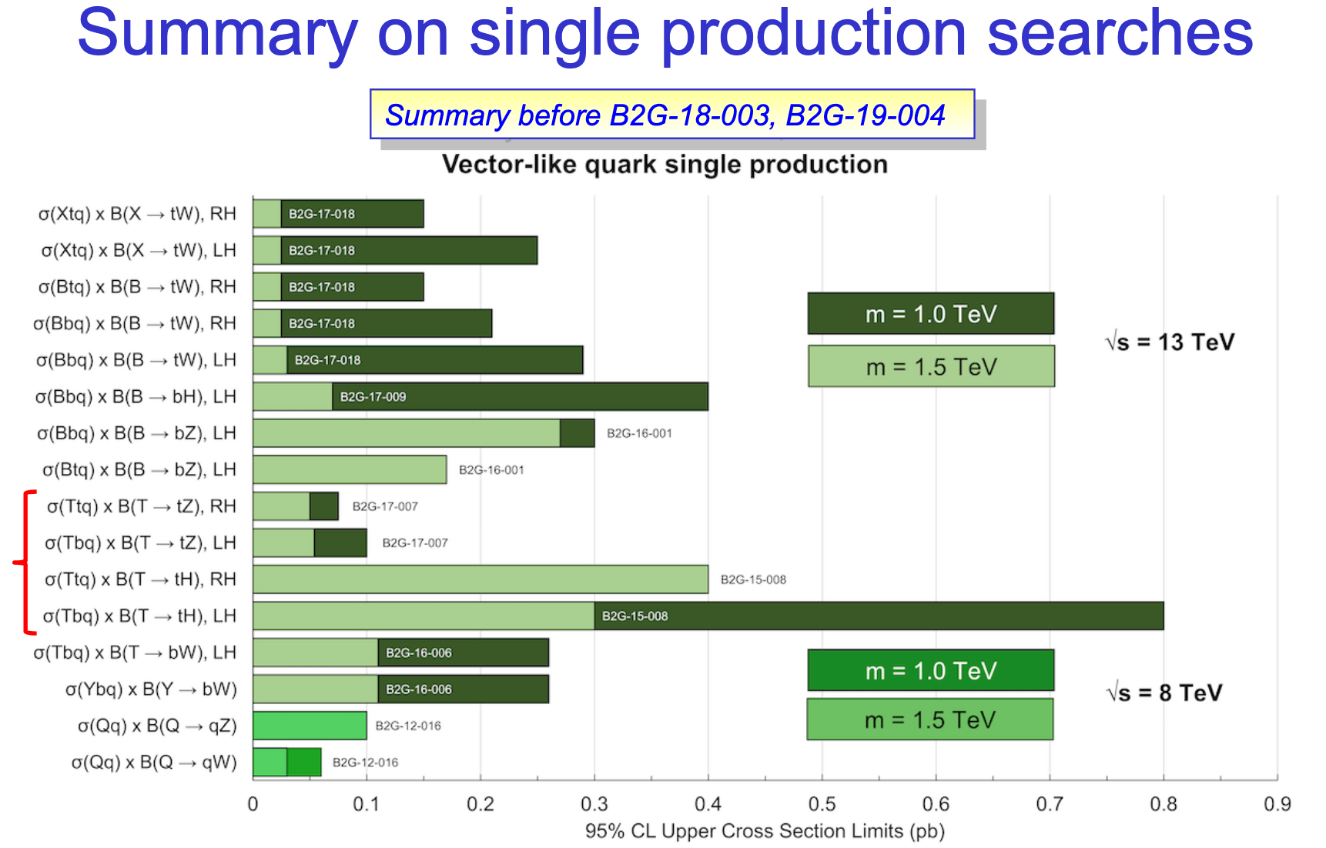
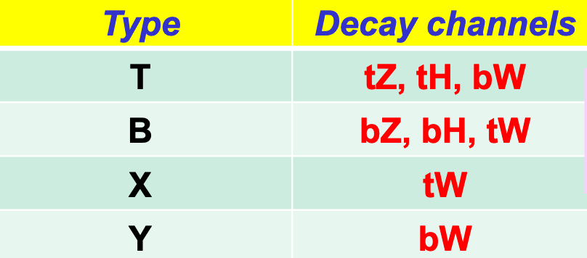
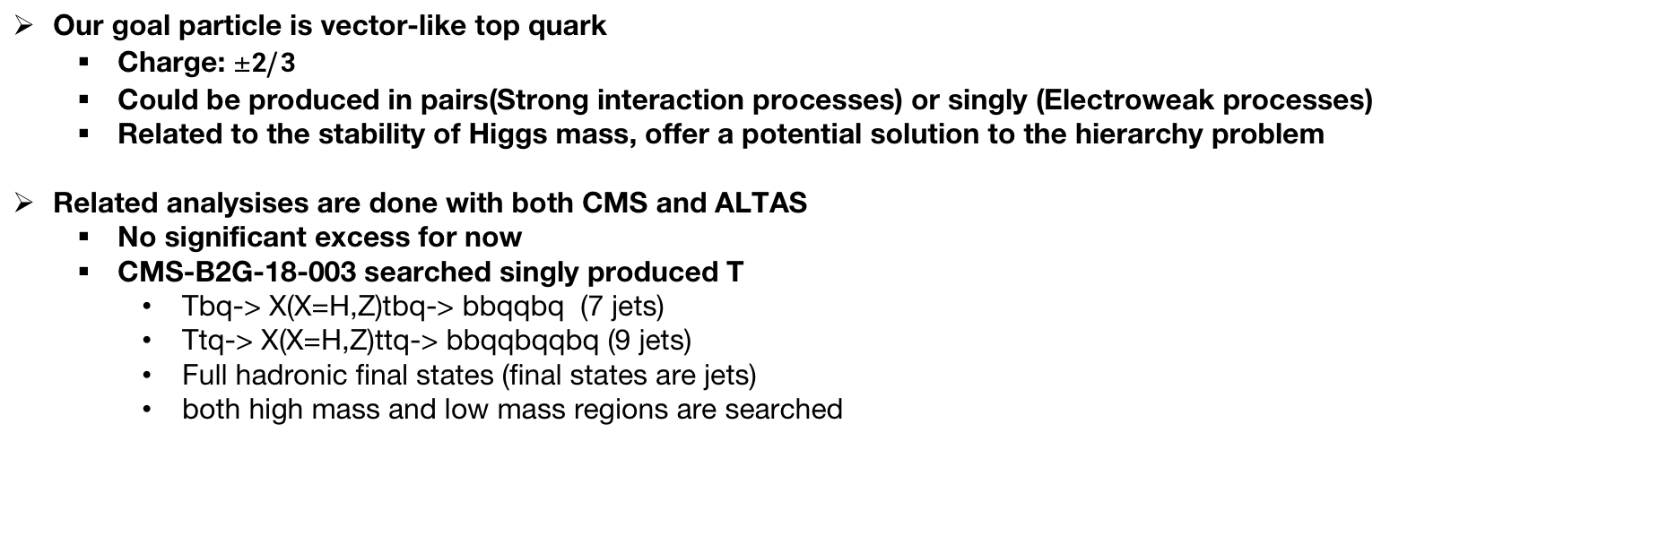
Motivation
Our goal particle is vector-like top quark
Charge: $±2/3$
Could be produced in pairs(Strong interaction processes) or singly (Electroweak processes)
Related to the stability of Higgs mass, offer a potential solution to the hierarchy problem
Related analysises are done with both CMS and ALTAS
No significant excess for now
CMS-B2G-18-003 searched singly produced T
Tbq-> X(X=H,Z)tbq-> bbqqbq (7 jets)
Ttq-> X(X=H,Z)ttq-> bbqqbqqbq (9 jets)
Full hadronic final states (final states are jets)
both high mass and low mass regions are searched
Our channel
From Search for vector-like quarks at CMS, Francesco Fabozzi,Pheno 2021

Slide 3
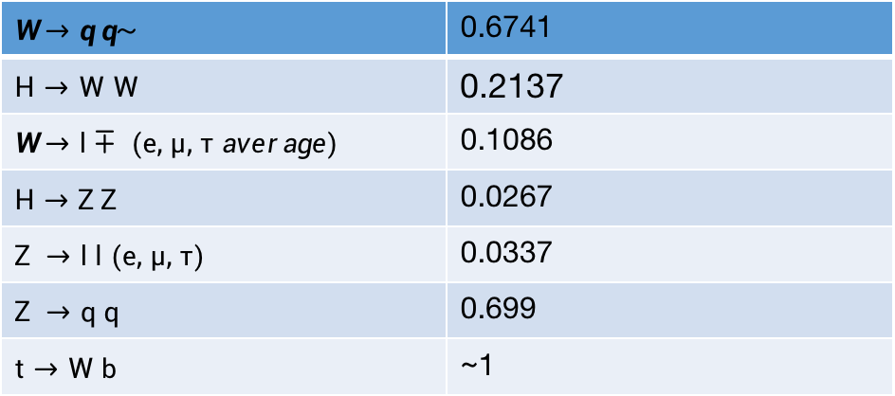
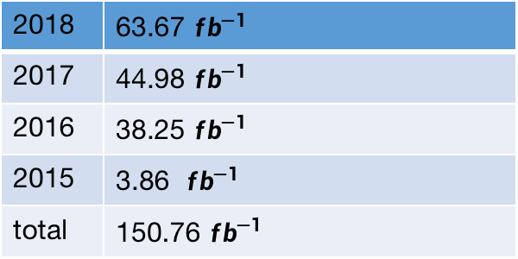
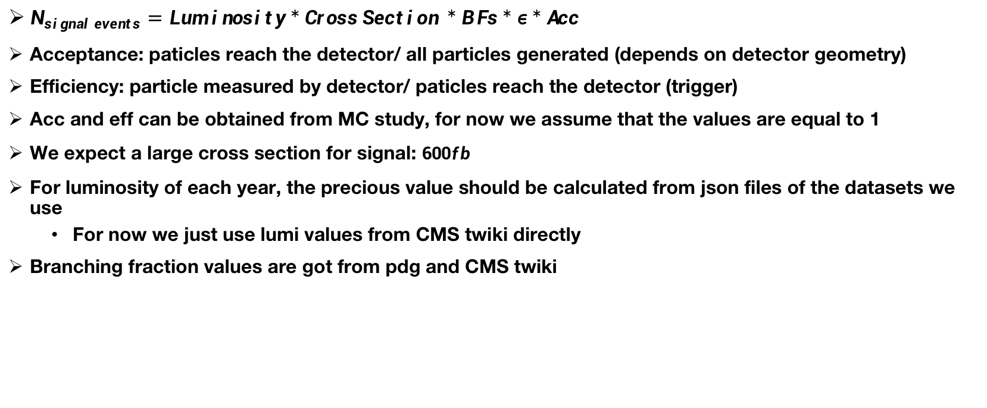
Expected Signal Events Number
$N_{ signal events}=Lum inosity*Cross Section *B Fs*ε*Acc$
Acceptance: paticles reach the detector/ all particles generated (depends on detector geometry)
Efficiency: particle measured by detector/ paticles reach the detector (trigger)
Acc and eff can be obtained from MC study, for now we assume that the values are equal to 1
We expect a large cross section for signal: $600{fb}^{}$
For luminosity of each year, the precious value should be calculated from json files of the datasets we use
For now we just use lumi values from CMS twiki directly
Branching fraction values are got from pdg and CMS twiki
BFs from pdg & twiki
Lumi from CMS twiki
$$W →q q\sim$$ | 0.6741
$$H→W W$$ | 0.2137
$$W →l∓ (e, μ, τ average)$$ | 0.1086
$$H→Z Z$$ | 0.0267
$$Z →l l (e, μ, τ)$$ | 0.0337
$$Z →q q$$ | 0.699
$$t→W b$$ | ~1
2018 | 63.67 ${fb}^{−1}$
2017 | 44.98 ${fb}^{−1}$
2016 | 38.25 ${fb}^{−1}$
2015 | 3.86 ${fb}^{−1}$
total | 150.76 ${fb}^{−1}$

Slide 4
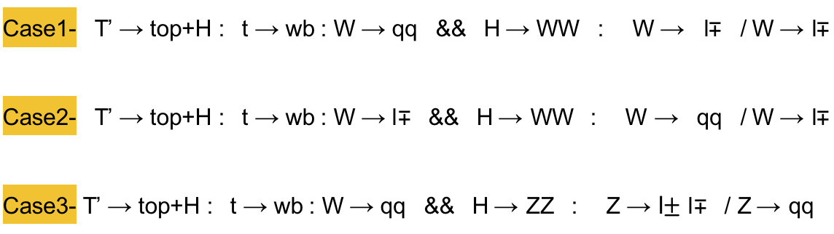


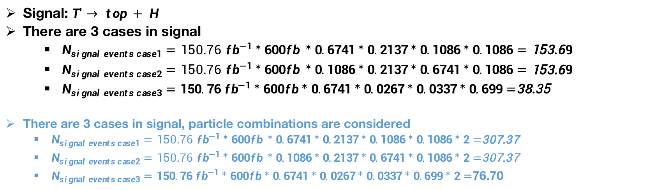
Expected Signal Events Number
Signal: $T'→ top + H$
There are 3 cases in signal
$N_{ signal events case1}=150.76 {fb}^{−1}*600{fb}^{ }*0.6741*0.2137*0.1086*0.1086=153.69$
$N_{ signal events case2}=150.76 {fb}^{−1}*600{fb}^{ }*0.1086*0.2137*0.6741*0.1086=153.69$
$N_{ signal events case3}=150.76 {fb}^{−1}*600{fb}^{}*0.6741*0.0267*0.0337*0.699=$38.35
There are 3 cases in signal, particle combinations are considered
$N_{ signal events case1}=150.76 {fb}^{−1}*600{fb}^{ }*0.6741*0.2137*0.1086*0.1086*2=$307.37
$N_{ signal events case2}=150.76 {fb}^{−1}*600{fb}^{ }*0.1086*0.2137*0.6741*0.1086*2=$307.37
$N_{ signal events case3}=150.76 {fb}^{−1}*600{fb}^{}*0.6741*0.0267*0.0337*0.699*2=$76.70
$$final state: l^{+}l^{−} 3 jets$$
$$final state: l^{+}l^{−} 3 jets$$
$$final state: l^{+}l^{−} 5 jets$$

Slide 5
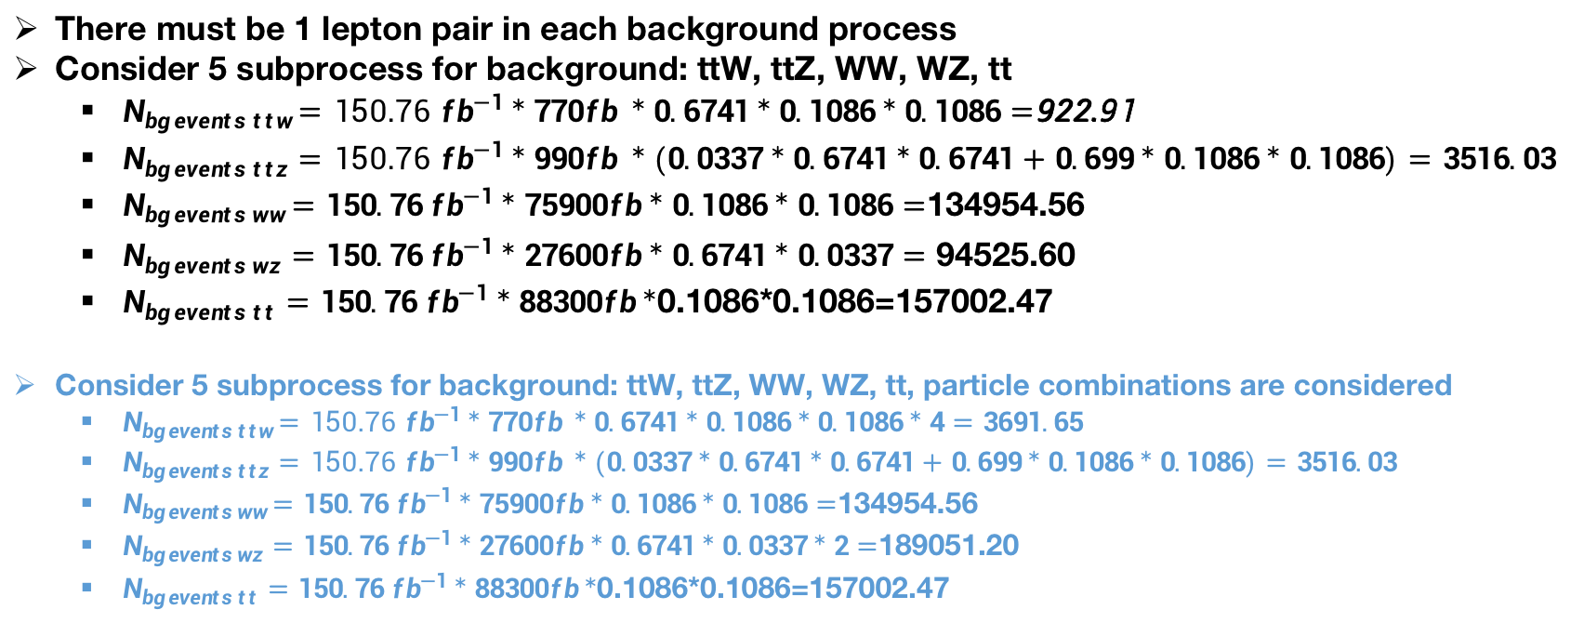
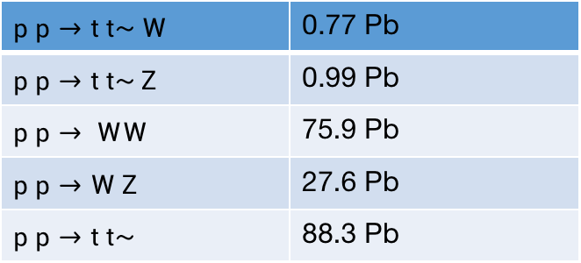
Expected Background Events Number
There must be 1 lepton pair in each background process
Consider 5 subprocess for background: ttW, ttZ, WW, WZ, tt
$N_{ bg events ttw}=150.76 {fb}^{−1}*770{fb}^{ }*0.6741*0.1086*0.1086=$922.91
$N_{ bg events ttz}=150.76 {fb}^{−1}*990{fb}^{ }*(0.0337*0.6741*0.6741+0.699*0.1086*0.1086)=3516.03$
$N_{ bg events w w}=150.76 {fb}^{−1}*75900{fb}^{}*0.1086*0.1086=$134954.56
$N_{ bg events w z}=150.76 {fb}^{−1}*27600{fb}^{}*0.6741*0.0337=94525.60$
$N_{ bg events tt}=150.76 {fb}^{−1}*88300fb*$0.1086*0.1086=157002.47
Consider 5 subprocess for background: ttW, ttZ, WW, WZ, tt, particle combinations are considered
$N_{ bg events ttw}=150.76 {fb}^{−1}*770{fb}^{ }*0.6741*0.1086*0.1086*4=3691.65$
$N_{ bg events ttz}=150.76 {fb}^{−1}*990{fb}^{ }*(0.0337*0.6741*0.6741+0.699*0.1086*0.1086)=3516.03$
$N_{ bg events w w}=150.76 {fb}^{−1}*75900{fb}^{}*0.1086*0.1086=$134954.56
$N_{ bg events w z}=150.76 {fb}^{−1}*27600{fb}^{}*0.6741*0.0337*2=$189051.20
$N_{ bg events tt}=150.76 {fb}^{−1}*88300fb*$0.1086*0.1086=157002.47
$$p p→t t\sim W$$ | 0.77 Pb
$$p p→t t\sim Z$$ | 0.99 Pb
$$p p→ WW$$ | 75.9 Pb
$$p p→W Z$$ | 27.6 Pb
$$p p→t t\sim$$ | 88.3 Pb
Cross Section Values from ANs
https://twiki.cern.ch/twiki/pub/CMSPublic/PhysicsResultsCombined/CMSCrossSectionSMPSummaryBarChart.pdf

Slide 6
Expected Background Events Number
Take S/Sqrt(B+S) as significance
Significance value:
Significance value, particle combinations are considered:
$$\frac{S_{total}}{\sqrt{{S_{total}+B}_{total}}}=\frac{(153.69*2+38.35)}{\sqrt{(134954.56 +94525.60+157002.47+922.91 +3516.03+153.69*2+38.35)}}=0.553$$
$$\frac{S_{total}}{\sqrt{{S_{total}+B}_{total}}}=\frac{(307.37*2+76.70)}{\sqrt{(134954.56+189051.2+157002.47+3691.65+3516.03+307.37*2+76.70)}}=0.989$$

