Slide 1
TPA meeting
Jean Soudier
Director: Jérôme Baudot , Supervisor: Frédéric Morel
Thèse technique IN2P3 (CDD CNRS)

Slide 2
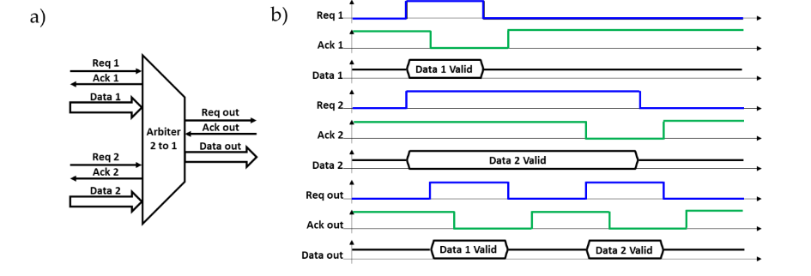
Global overview of the project
Notes:
F,D,TPA

Slide 3
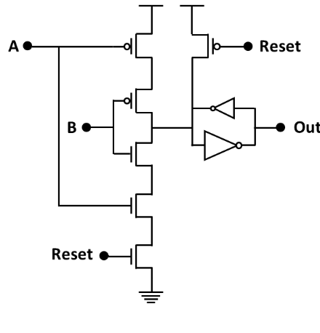
C gate

Slide 4
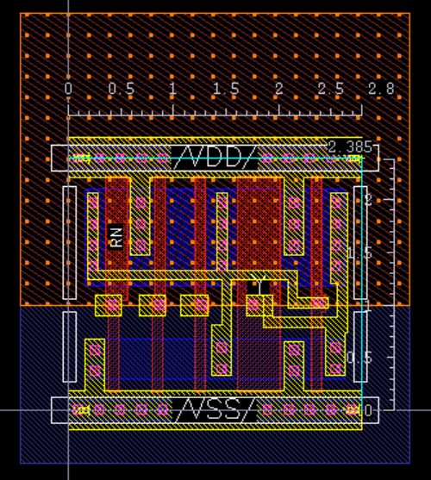
C gate layout

Slide 5
RTL design
TPA_CASCADED
TPA
(CTRL_CASCADED)
CTRL
MUX_REG

Slide 6
Tanks you for your attention
Notes:
Merci pour votre attention, je suis prêt à répondre à vos questions.

Slide 7
TPA plan
Design of the RTL (July – August)
Estimation with Joules (September)
Power, leakage
Area by level
Time to read after synthesis
Timing constraint elaboration (October)
Measure on the design of Icube (?)
Layout for a run (December – July 23)
Notes:
plan

