Slide 1
Status CE65V2_xx chip
Andrei DOROKHOV,
on behalf of C4Pi and PICSEL,
IPHC, Strasbourg
8/06/2022

Slide 2
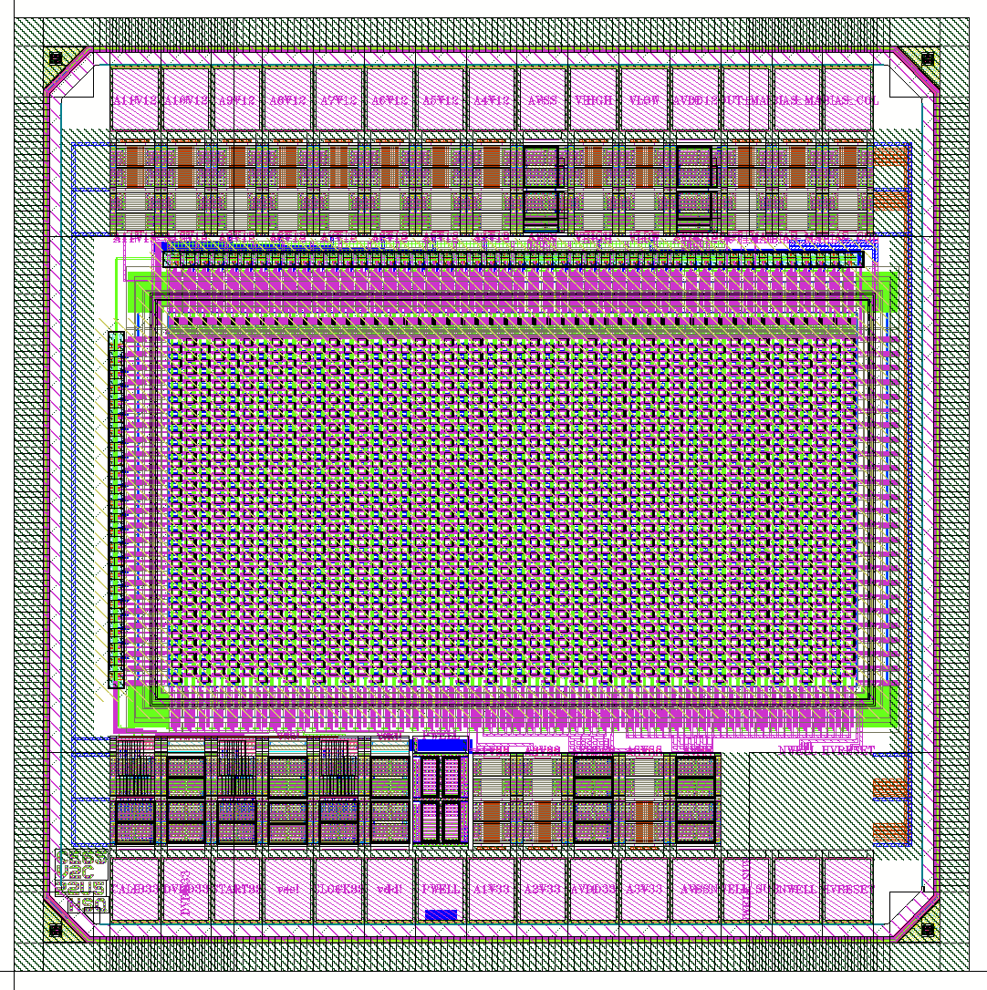
CE65V2_xx (1.5mm x 1.5mm)
Versatile exploratory chip using matrix of pixels (48 col x 24 row) output is multiplexed to one analogue channel (matrix rolling shutter readout mode):
share common pads structure, carrier and proxy boards
4 power domains: 3.3V analogue, 1.2 analogue, 3.3 digital, 1.2 digital
3.3 analog and 1.2 analog share same ground AVSS
3.3 digital and 1.2 digital share same ground DVSS
one column reserved for precise charge collecting diode capacitance measurements
Power:
digital (3.3V IO/1.2V CORE): DVDD33, DVDD12,DVSS
analogue (3.3V): AVDD33, AVSS
analogue (1.2V): AVDD12, AVSS
3 digital input pulses (3.3V): clock, start, calib
4 unprotected pads: HV, NWELL ,NWELLSUB, PWELL
Output is in 1.2V analogue domain
2 calibration voltages: VHIGH, VLOW
2 biases for output buffer
11 biases for pixel front-end:
8 X 1.2 analogue biases
3 x 3.3 analogue biases
8/6/2022 andrei.dorokhov@iphc.cnrs.fr , IPHC, Strasbourg

Slide 3
Different modifications / chips of CE65V2_xx / design status
Modification | Purpose | Pitch, um | Comment | N | status
CE65V2_C_xx | Charge collection (“_C_”) measurements, rolling shutter readout (AC pixel from CE65 is implemented) | 15, 18, 22.5, 18_{hexsq}, 22.5_{hexsq} | For lab and beam test, charge collection node, techno, optimization | 5 chips ( x 3 flavors: no n-implant Blanket n-implant n-implant with gaps) | DRC, LVS are OK for all chips 5 chips x 3 pixel flavors ready : sent to CERN
CE65V2_A_xx | Precise measurements of multiplexed analogue or digital output of pixel FE (“_A_”): pulse duration, gain, FPN, noise, RTS.. | 18 (or 22.5) | For lab only, possibility to explore waveform with oscilloscope: FE optimization/tuning. | 1 (existing FE from MOSS) + versions?.. | If that chips is relevant for tests and not redundant to other chips: need to define which FE (or versions) for precise measurements
GDS sent to CERN, but would be useful to cross-check the designs of all chips by other person, some layers has to be checked by hand, re-verify the simulations
I have already asked that (in mail sent on 1st June to Jerome, cc: to Christine, Claude, Frederic): “It would be very useful to crosscheck what is going to be submitted, I do that from my side. However, obviously, 15 chips are too many to loose, if something went wrong and all are not usable for a "small" mistake -> so better not to
neglect the verification by other person...”
8/6/2022 andrei.dorokhov@iphc.cnrs.fr , IPHC, Strasbourg

