Slide 1
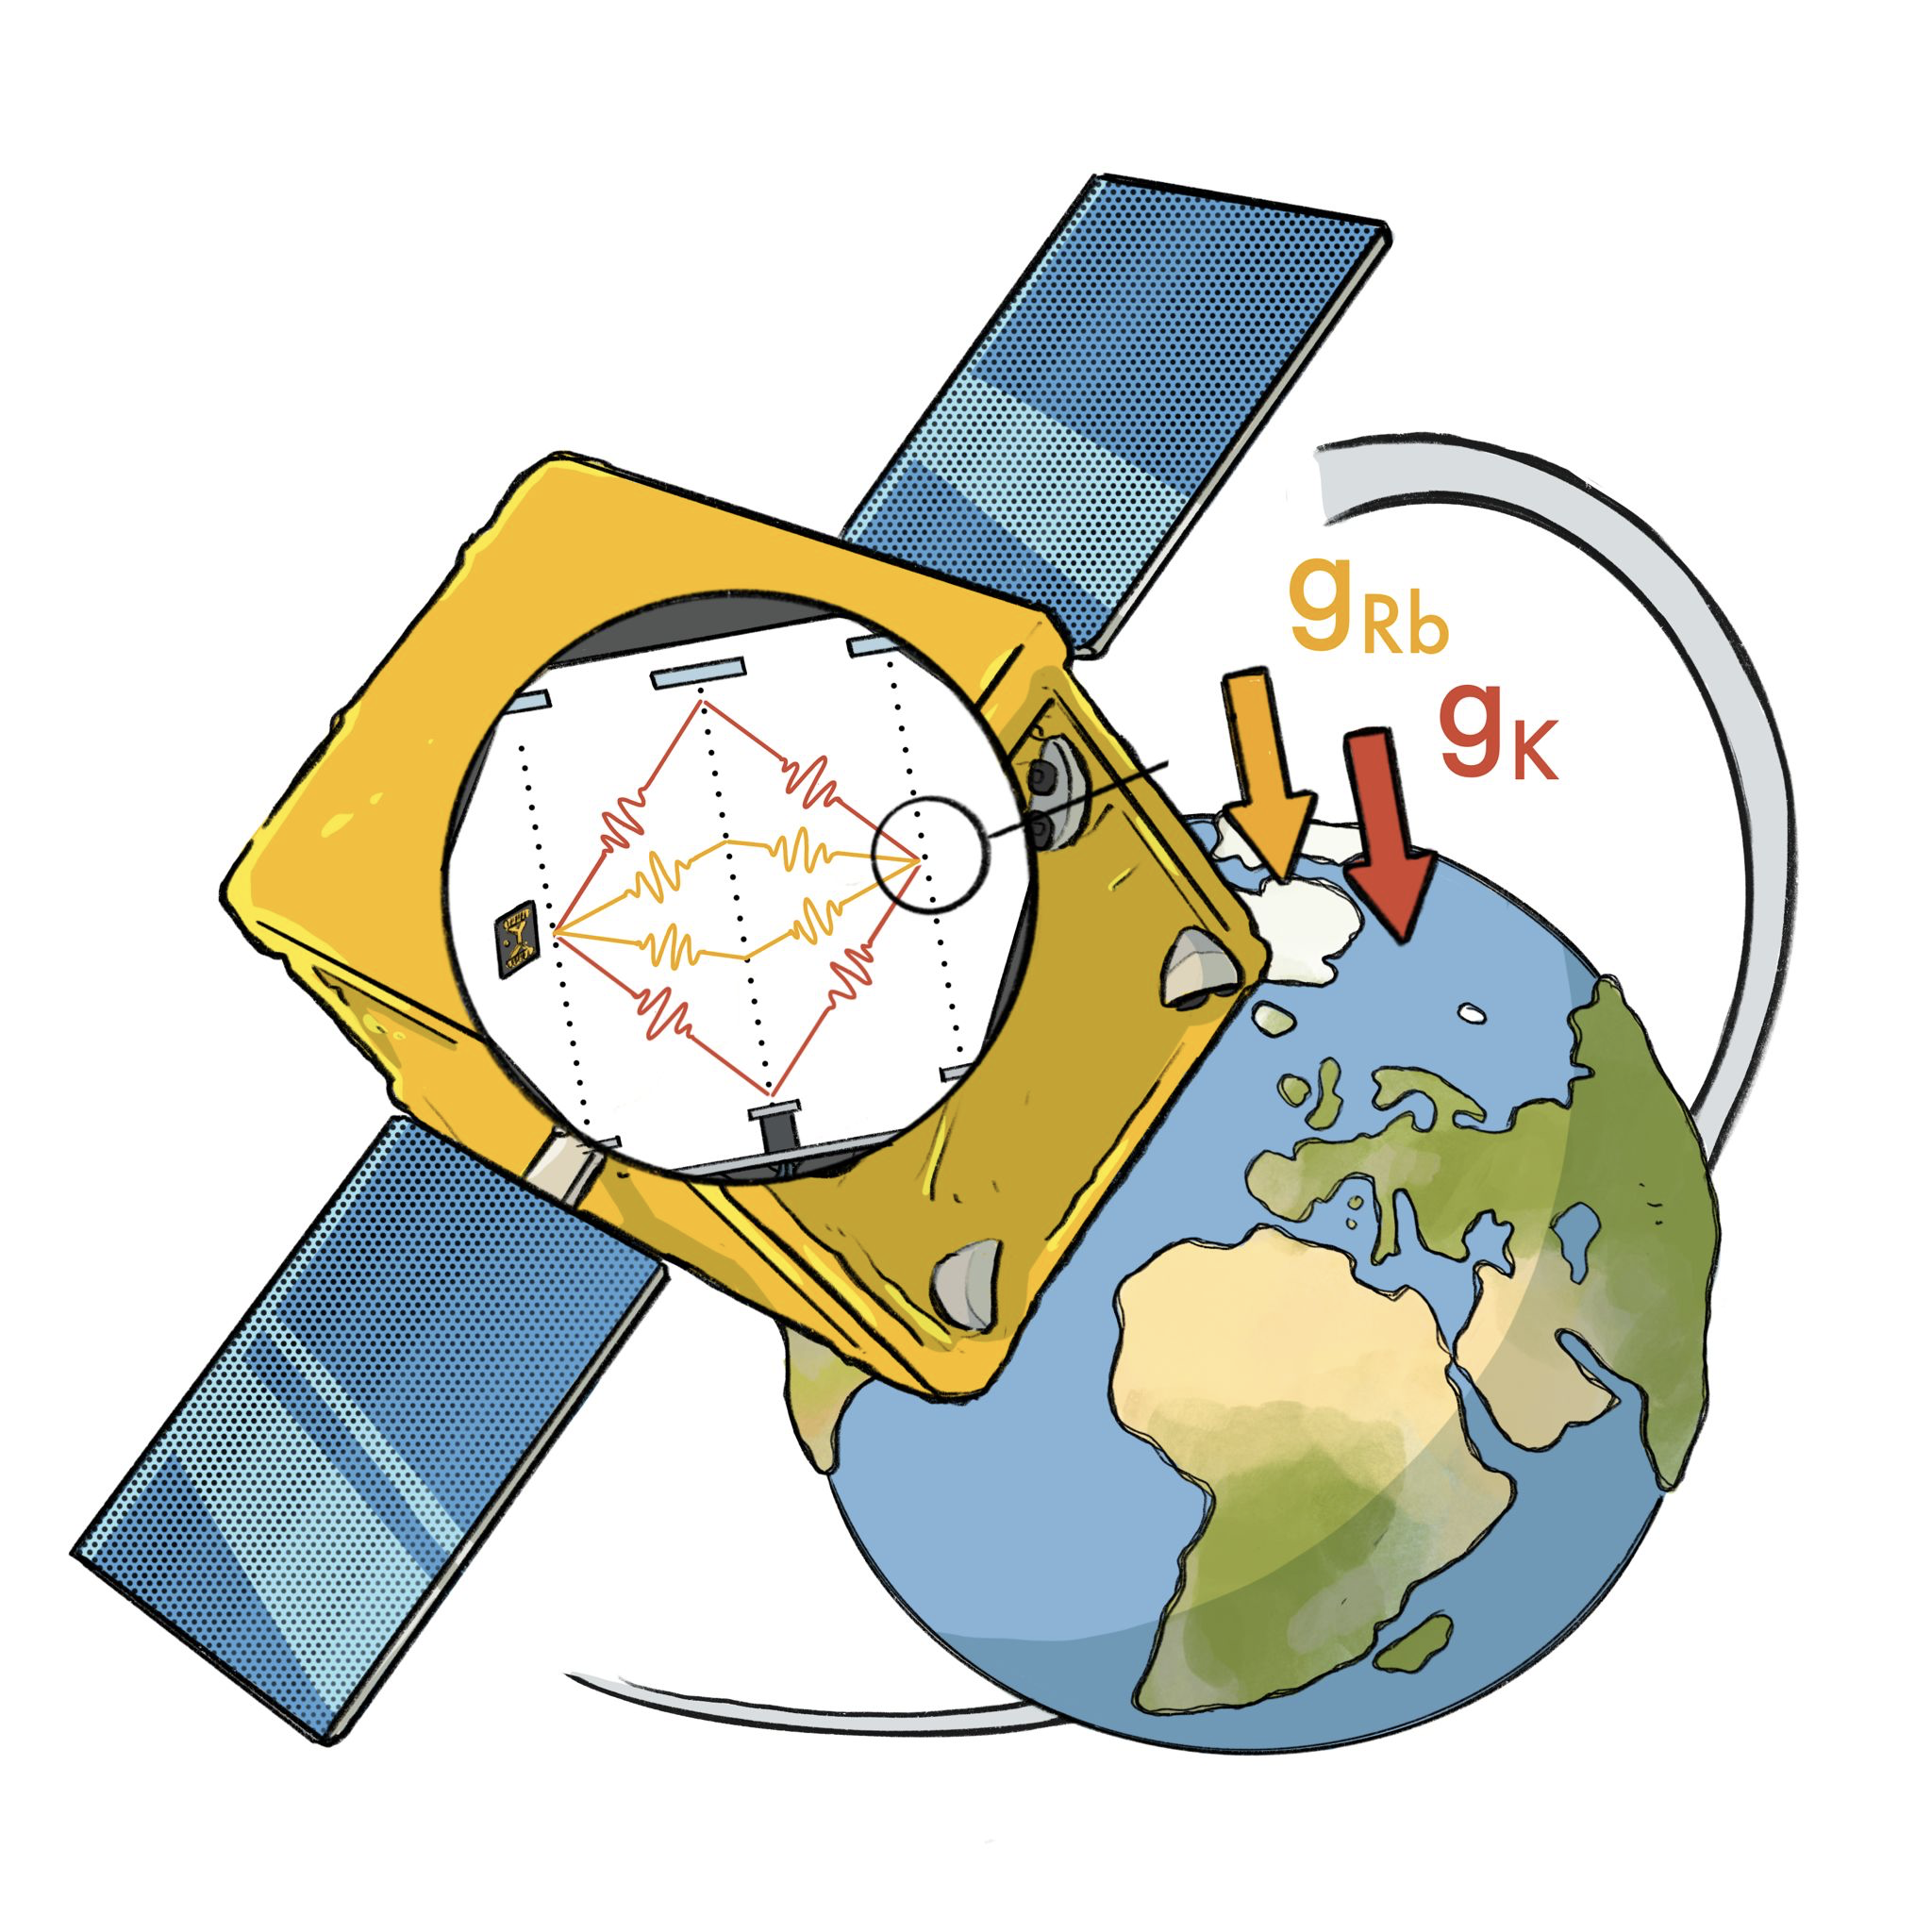

Space Time Explorer and QUantum Equivalence principle Space Test ⎯ STE-QUEST
A M-class mission proposal to test the equivalence principle at the 10⁻¹⁷ level
A. Hees, SYRTE
B. Battelier, Institut d’Optique Bordeaux
R. Corgier, SYRTE
J. Gué, SYRTE
G. Métris, OCA
P. Wolf, SYRTE
Credit: S. Loriani
TUG workshop
October 4th, 2022

Slide 2
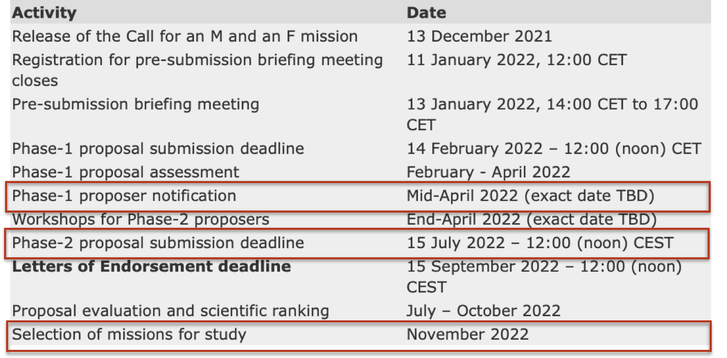
STE-QUEST is competing for the M7 ESA call
Call for Medium Size and Fast Mission opportunity in ESA’s science program (opened in December 2021)
STE-QUEST passed the phase 1 screening (April 2022)
10 proposals competing in the phase 2 selection process. 1 to 3 will be selected in November for a 3-years phase A study
1 selected for a launch around 2037

Slide 3
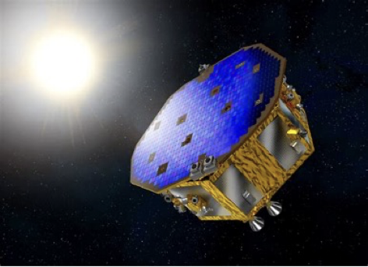
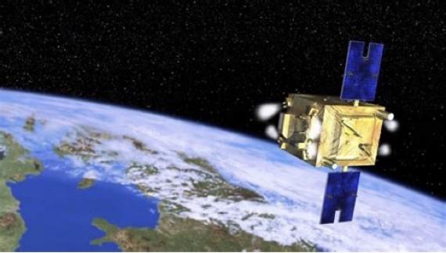
Mission concept
Test the Equivalence Principle (Universality of Free Fall – UFF) using ⁴¹Rb and ⁸⁷K atoms in quantum superposition
Main goal: measure the Eötvos parameter 𝜼 @10⁻¹⁷, i.e. improve by more than 2 orders of magnitude on the recent MICROSOPE results
Other scientific objectives: search for UltraLight Dark Matter and test of the quantum superposition principle
see Touboul et al, PRL 129, 121102, 2022
Single payload S/C, Earth orbit, ~ 1400 km elevation
Inertial attitude, drag-free, cold-gas control (GAIA, MICROSCOPE, LISA-PF)
⁴¹Rb-⁸⁷K double interferometers already used on-ground and in rocket experiments (ICE, QUANTUS, MAIUS, (BEC)CAL)
LISA-PathFinder
MICROSCOPE

Slide 4
What is the Equivalence Principle?
What are the motivations to test it?

Slide 5
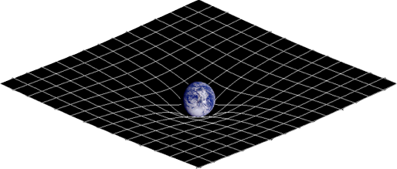

The Equivalence Principle is one of the building blocks of General Relativity
All types of mass/energy are universally coupled to gravitation, i.e. the gravitational interaction is independent of composition, charge, flavor, etc… Very different from all other known interactions!
It makes gravitation universal and it allows gravitation to be described as a geometrical phenomenon: space-time curvature
But it’s a heuristic hypothesis based on observations (bodies fall with the same acceleration in a gravitational potential) not based on any underlying theoretical principle (fundamental symmetry)

Slide 6
Why would the Equivalence Principle be violated?
It does not rely on any fundamental theoretical principle (like e.g. the gauge principle in the Standard Model) and the universal character of gravitation seems anomalous compared to the other interactions (does not rely on any internal charge). Why is gravitation so different?
Several models of Dark Matter and Dark Energy explicitly break the EP: new fields that are expected to non-universally couple to SM
Several unification scenarios (strings, branes, …) lead to the introduction of new fields that are expected to break the EP
Some attempts to develop a quantum theory of gravitation lead to a breaking of Lorentz symmetry, one facet of the EP
A breaking of the EP can provide an explanation to the values of some arbitrary constants of the SM
For a detailed discussion, see T. Damour, Class. And Quantum Grav., 2012

Slide 7
So the natural question is not “why should the EEP be violated?” but rather “why haven't we seen a violation yet, and to what extent does it hold?”
For a detailed discussion, see T. Damour, Class. And Quantum Grav., 2012

Slide 8
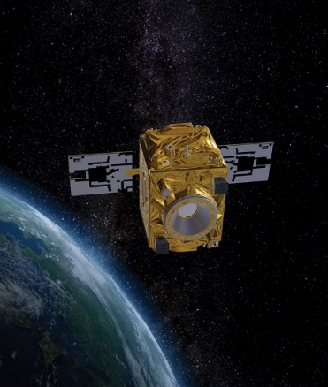
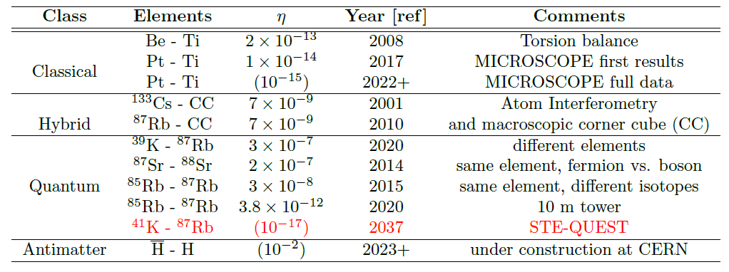
The Universality of Free Fall is currently tested at the level of 10⁻¹⁵
Space tests offer a longer interrogation time and quieter environment
2 orders of magnitude improvement with STE-QUEST

Slide 9
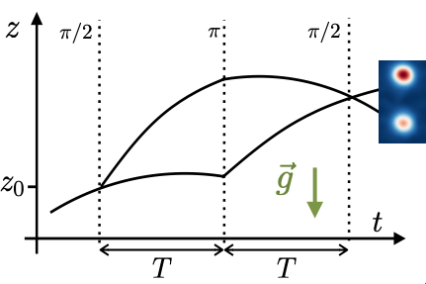
Atom interferometry provides a measurement of the gravitational acceleration
The measured output:
with the phase difference
Credit: N Gaaloul

Slide 10
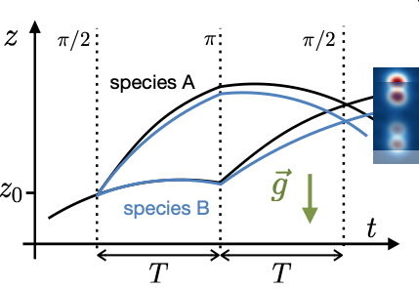
Double Atom interferometry provides a measurement of the UFF
The measured output:
with the phase difference
Acceleration
of each species:
UFF:
Space offers a longer interrogation time and quieter environment
Credit: N Gaaloul

Slide 11
M7 mission summary

Slide 12
Main Instrument: ATI
Double species Rb-K atom interferometer.
Standard 3-pulse atomic interferometry sequence
Atomic shot noise limited.
More relaxed requirements compared to previous STE-QUEST proposal due to the development of a new technique Gravity Gradient Cancellation which allows to significantly reduce the main noise limitation: this is why 10⁻¹⁷ is now reallistically reachable
Roura PRL2017, d’Amico PRL2017, Asenbaum PRL2018,2020, Loriani PRD2020

Slide 13
Preliminary study has shown that the platform requirements are realistic
performed for Phase 2 proposal
Evaluate impact of S/C control on the measurements (systematics) and infer platform requirement
The S/C requirements to reach a 10⁻¹⁷ UFF measurement are already met for existing S/C (to be refined during possible phase A study)

Slide 14
STE-QUEST will push the limit of fundamental physics by 2 orders of magnitude
2-3 orders of magnitude improvement in test of the Equivalence Principle: pushing the limit of fundamental physics into a totally unexplored region with possible groundbreaking discovery or stringent constraints for various theoretical scenarios
There are no theoretical firm predictions at which level the EP violation is expected to arise
but…
several theoretical arguments make the exploration of the EP violation at this level exciting:
  Dilaton least coupling principle: string inspired model, EP@10⁻¹²-10⁻²²
  Runaway dilaton (inflation): EP@ 10⁻¹²-10⁻¹⁹
  SUSY additional U(1) gauge boson EP @ 10⁻¹²-10⁻¹⁶
see e.g. Damour and Polyakov, PLB, 1994
see e.g. Damour et al, PRL, 2002
Damour and Donoghue, PRD, 2010
see e.g. Fayet, PRD, 2018 and 2019

Slide 15
STE-QUEST will allow to extend then search for Ultra Light Dark Matter
Models of light DM (m < eV), needs to be bosonic (scalar field, axion, vector field, …) motivated by the current lack of DM detection @LHC
Observational phenomenology depends on the specific model: Yukawa 5th force, oscillatory behavior of the constants of Nature, screening/scalarization mechanism, ….
see e.g. Hees et al, PRD, 2018
Scalar DM, linear coupling to quarks
~ 1.5 orders of mag. improvement over a 10 orders of magnitude mass range

Slide 16
STE-QUEST and Ultra Light Dark Matter
Scalar DM, quadratic coupling to quarks
Vector DM, U boson / Dark photon (B-L coupling)
~ up to 2 orders of mag. improvement over a large mass range
Similar exploration for the axion currently on-going (J. Gué’s PhD)

Slide 17
STE-QUEST is sensitive to a breaking of Lorentz symmetry
Lorentz symmetry is naturally broken in models of quantum gravity, non-commutative geometry, etc, …
The Standard Model Extension (SME) framework aims at systematically parametrizes all possible violations of Lorentz symmetry in all sectors of physics
STE-QUEST is expected to be sensitive to the matter-gravity sector SME coefficients: 3 orders of magnitude improvement wrt to current constraints
work from Kostelecky and colleagues
Current best constraint from MICROSCOPE, see Pihan-Le-Bars et al, PRL, 2019
This is an exciting level: if Lorentz symmetry breaking occurs at Planck scale and if it suppresses by M_{electroweak} / M_{Planck} , then one can expect a violation of the EP @10⁻¹⁵-10⁻¹⁷.
General argument presented in Kostelecky and Potting, PRD, 1995

Slide 18
STE-QUEST is a mature concept
STE-QUEST: a space test of the UFF @ 10⁻¹⁷ level using atom interferometry
Scientific objectives: - test the UFF (Eötvos parameter)
- search for a breaking of Lorentz symmetry
- search for ULDM
- test of the quantum superposition principle
- other ideas are welcome !
STE-QUEST science is highly rated (CNES-Séminaire de Prospective Scientifique ; ESA Space Science Advisory Committee ; ESA « Roadmap for Fundamental Physics in Space » ; …)
Mature mission and payload concepts (due to M3 and M4 studies)
Strong heritage from LISA Pathfinder, MICROSCOPE, LISA-studies
Part of a large road-map “Cold Atoms in Space” cosigned by ~250 scientists (fundamental physics, cold atom, Earth observations, GW, …)
[arXiv: 2201.07789]

Slide 19
Thank you for your attention
Credit: S. Loriani

Slide 20
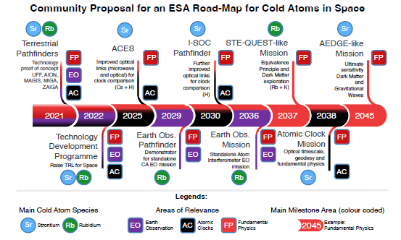
STE-QUEST will provide a quantum space test of the UFF at 10⁻¹⁷
Double atom interferometer with Rb and K “test masses” in non-classical states (quantum superpositions).
Optimized for UFF test. Assume 700 km circular orbit.
Apply recent results on controlling gravity gradient shifts by offsetting laser frequencies, thus relaxing atom positioning requirements by factor >100.
Reaches 10⁻¹⁷ target after 18 months of operation.
There has been tremendous technology development over the last decade to ready atom-interferometry for space.
Stepping stone for future more ambitious missions, and integral part of the recent community roadmap for cold atoms in space [arXiv: 2201.07789]

Slide 21
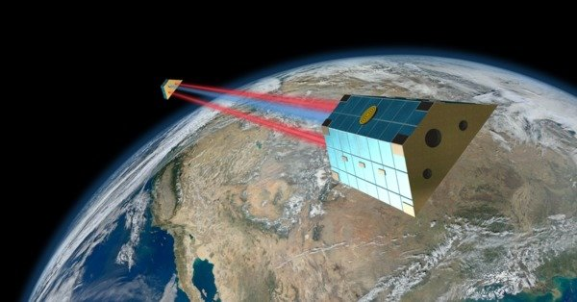
The next generation of Universality of Free Fall tests will be in space
Space offers long free fall times and a quiet, well controlled environment. Demonstration: MICROSCOPE and LISA-Pathfinder missions
Ground experiments: ultimately limited by local gravity gradients and uncertainties in the positioning of the test masses. Not the case in space as demonstrated by MICROSCOPE
Europe has a clear lead in the field (MICROSCOPE, LISA-Pathfinder, ACES/PHARAO)
Space-accelerometers (classical or cold-atoms) offer rich technological heritage for applied fields like gravity field recovery (e.g. GRACE, GOCE, GRACE-FO), navigation, planetary and lunar exploration.

Slide 22
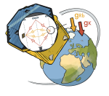
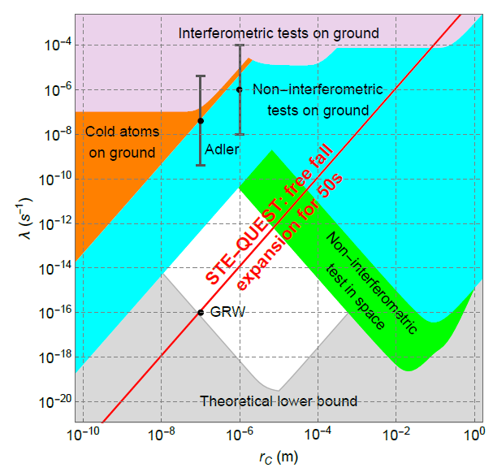
Test of Quantum Mechanics
The collapse mechanism of quantum mechanical superpositions remains an unsolved fundamental riddle.
Continuous collapse models modify the Schrödinger dynamics by adding (parametrized) collapse terms. E.g. CSL or DP (Diosi-Penrose).
STE-QUEST measures the evolution of a free QM wave-packet over long evolution times (≥ 50 s), allowing a sensitive detection of any deviation from standard QM-evolution.
Improvement on present knowledge by ~2 orders of magnitude. And potential for a major discovery!

Slide 23
Overall management/cost
Note: All AIVT (BB, E(Q)M, FM) carried out by responsible entity for system and sub-systems (following M4-feedback).

Slide 24





Payload

