Slide 1
Search for dark matter through Stark effect measurement with Rydberg atoms in microwave cavities
J. Gué, A. Hees, R. Le Targat, J. Lodewyck, P. Wolf
SYRTE
SYstèmes Références Temps-Espace, CNRS, Observatoire de Paris, Université PSL, Sorbonne Université, LNE
Théories Univers et Gravitation, Montpellier
October 6th 2022
1
Notes:
Thank the organizers
Talk centered on one DM model : DP
Proposition of an experiment for the detection of DP, modelled with the team, at SYRTE This is a proposal and not the description of an experiment already done.

Slide 2
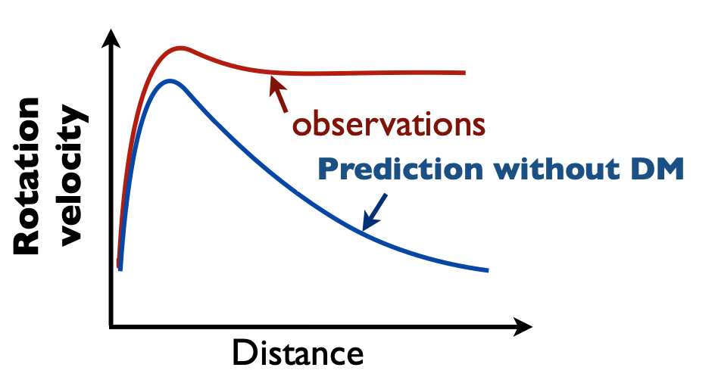
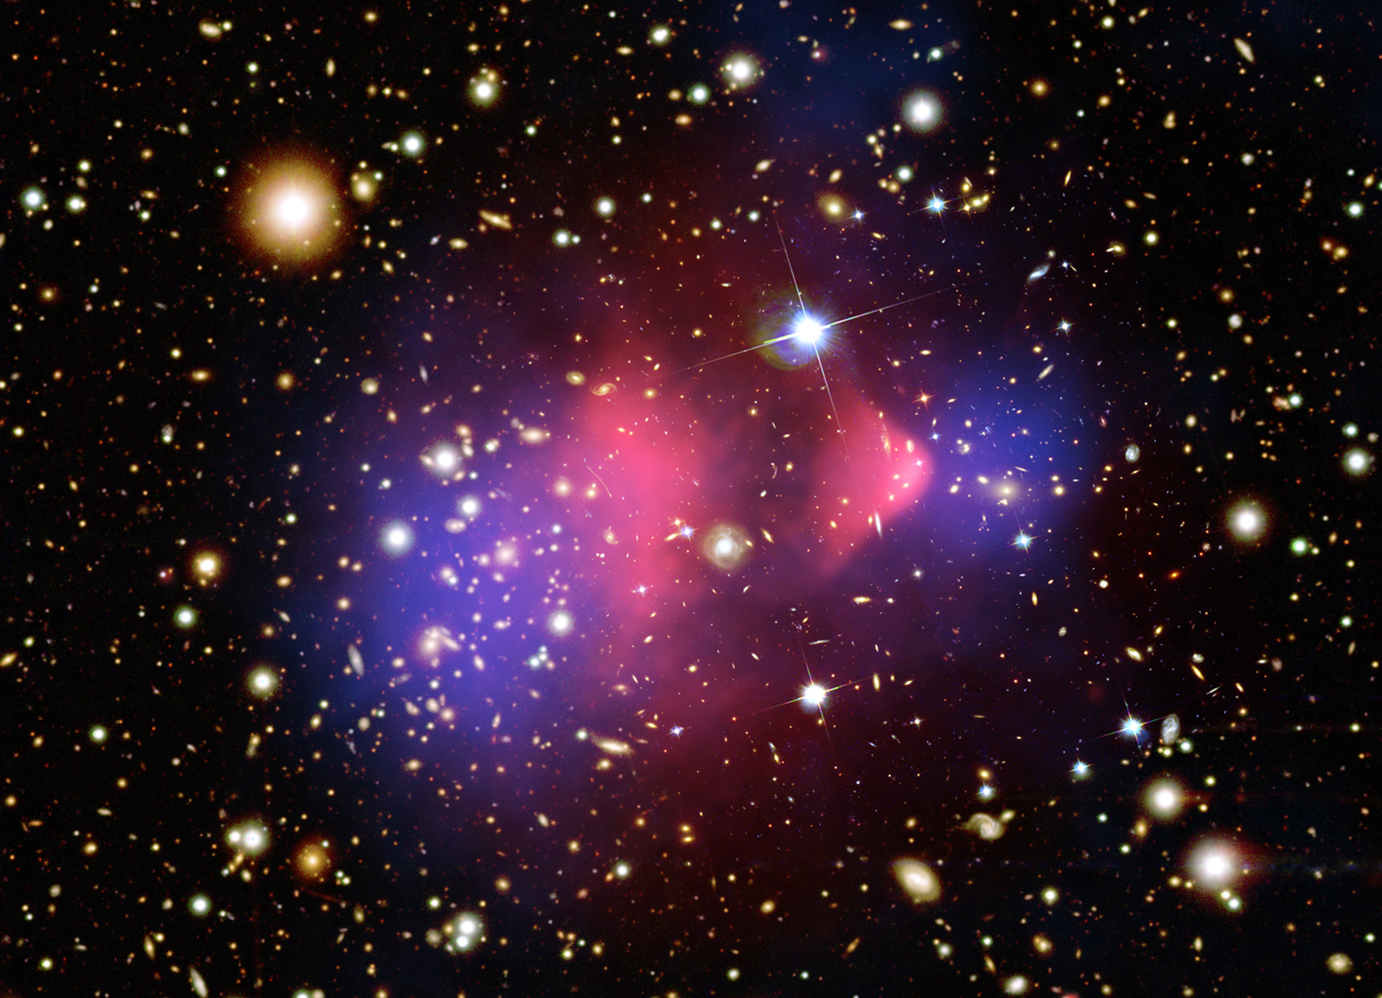
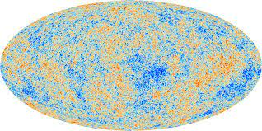
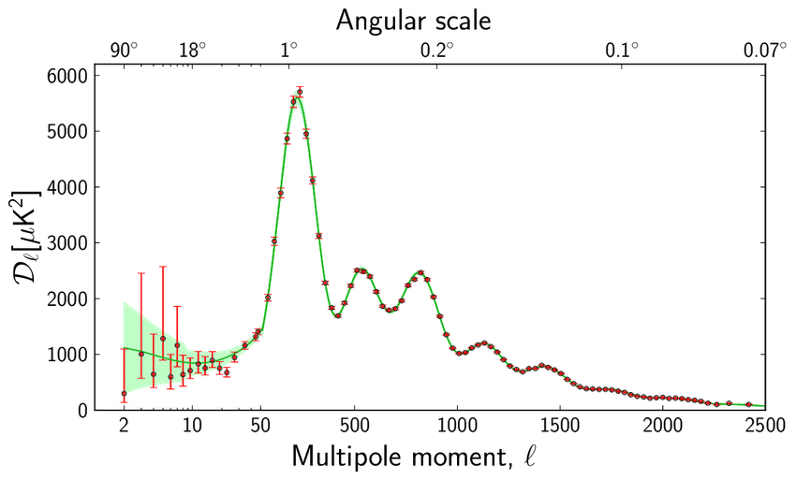
Why do we need Dark Matter ?
Explains astrophysical observations at different scales :
Galactic scale (velocity rotation curves, weak lensing,…)
Galactic cluster scale (bullet cluster, strong lensing,…)
Cosmological scale (CMB, structure formation,…)
ESA
Non Baryonic Matter
or Dark Matter with $Ω_{DM} \sim 0.259$
2
Notes:
Different astroophysical observation need DM such as :
Galactic scale :example :Rotation velocity curves of stars around center of gaalxies (which appear to be too fast for the amount of luminous matter)
Galactic cluster scale : example :gravitational lensing (does not follow the gas but something else (bullet cluster))
Cosmo scale : example : Power spectrum of CMB shows that around 26% of energy density of universe is non baryonic
→ We know the macroscopic (gravitational) interaction of DM but Interests in knowing what would be its microscopic nature and interactions

Slide 3
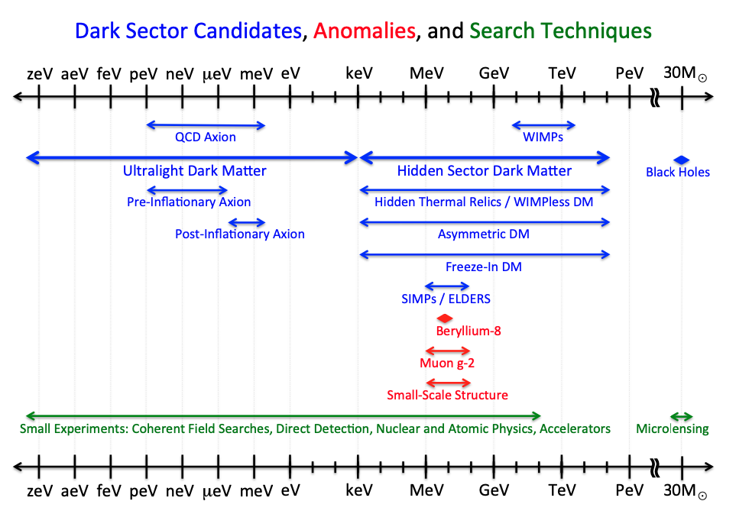
Classes of DM
ULDM mass interval
Fig. 1 from US cosmic vision : new idea for Dark Matter 2017, Arxiv:1707:04951
3
Notes:
Different classes of DM following the mass
Most famous one is WIMP (supersymmetric theories with mass around GeV) → massive enough to be detected in particle accelerators through recoiling
Another interesting class of DM is ULDM with masses much smaller (lower than keV) → need other kind of experiments to detect it
We will be interested in ULDM models with mass around the microeV range (shown in orange)

Slide 4
Ultralight Dark Matter (ULDM) models
$$\sim 0.3 GeV/{cm}^{3}$$
$$\frac{n}{n_{k}}\sim \frac{6π^{2}ℏ^{3}}{c^{2}}\frac{ρ_{DM}}{m^{4}v_{max}^{3}}>1$$
ULDM (with $m<10 eV$) has to be bosonic (Pauli exclusion principle)
When $m≪eV → \frac{n}{n_{k}}≫1→$ the field can be treated classically.
We classify the different ULDM models from their nature
Occupation number
in phase space
$$\sim {10}^{−3}c$$
$$<10 eV$$
Inspired from Tourrenc et al, Arxiv:quantum-ph/0407187, 2004
Scalar field (Dilatons,...)
Pseudo-scalar field (Axions,…)
Vector field (Dark photons (DP),...)
4
Notes:
ULDM models : Here, occupation number in phase space as function of mass, density, velocity
With DM parameters and considering mass < 10 eV → occupation number > 1 meaning that the particle has to be bosonic
Additionnally of m << eV (which is our case in the microeV range), occupation number >> 1, meaning that the field can be treated classically (interactions etc…)
What are the different ULDM models : scalar fields, pseudo scalar fields, and vector fields, such as DP

Slide 5
Does DP induce oscillating electric field ?
Kinetic mixing coupling
EM field
$$ℒ=−\frac{1}{4}F^{μν}F_{μν}+j^{μ}A_{μ}−\frac{1}{4}φ^{μν}φ_{μν}−\frac{1}{2}m^{2}φ_{μ}φ^{μ}−\frac{χ}{2}F^{μν}φ_{μν}$$
Cosmologically, DP field oscillates at its Compton frequency $\vec{φ}={\vec{φ}}_{0}\cos{ωt}$
This mixing generates a standard electric field filling the whole space
$${\vec{E}}_{DP}≈−iχω\vec{φ}e^{−iωt}$$
which we would like to detect ! Or, constrain $χ$ on a given range of DP masses.
Additionally, if DP field accounts for the whole DM, ${|\vec{E}}_{DP}|=χ\sqrt{2ρ_{DM}}$
EM strength tensor
DP strength tensor
DP field
Horns et al. JCAP, 2013
$$ω=m (k=0)$$
5
Notes:
In this model DP coupled to photons through kinetic coupling chi
modifies field equations of photons and generates standard electric field filling the whole space with this form. Oscillates at the compton freuqnecy of the DP field which in our case correpsonds to the mass.
This electric field we want to detect or constraint chi
Amplitude of electric field related to DM energy density.
(Basically, a non zero amplitude of DP and coupling to photon chi will induce a non zero oscillating electric field)

Slide 6
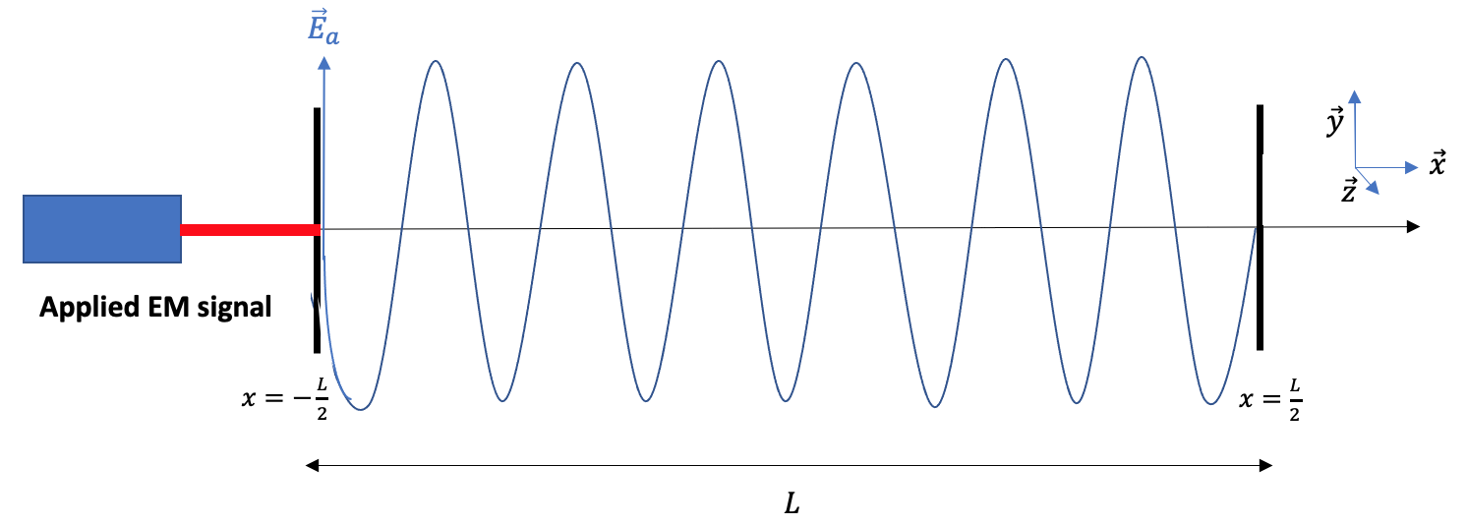
Resonant cavity and why using it in this context ?
Microwave cavity : Resonator confining EM signal with frequencies in the microwave range $(𝒪\left(GHz\right))$
In real cavities, loss of energy characterized by quality factor, Q.
The larger Q is, the higher electric field amplitude will be inside the cavity → Q is the amplitude amplification factor
In the context of DP, ${\vec{E}}_{DP}$ acts as another initial wave which might enter in resonance.
Fig. 2 : Signal applied inside a microwave cavity, with the appropriate frequency such that a resonance occurs.
6
Notes:
Device with metallic mirrors where EM waves with appropriate frequency in the microwave range can enter in resonance inside it, in which case a standing wave is created
boundary conditions required at the mirrors edge so that the total field cancels.
Explanation of the scheme : here we have the resonant conditions -> standing wave Ideal cavity : photons never absorbed bounced back inside the cavity and energy goes to infinity. In reality, loss of energy characterized by Q. Cavity is simply a resonator with amplitude amplification factor Q In the context of the DP theory, the additional electric field present everywhere will act as another initial wave and might produce resonance inside the cavity if it has the appropriate frequency → founding idea of the experiment

Slide 7
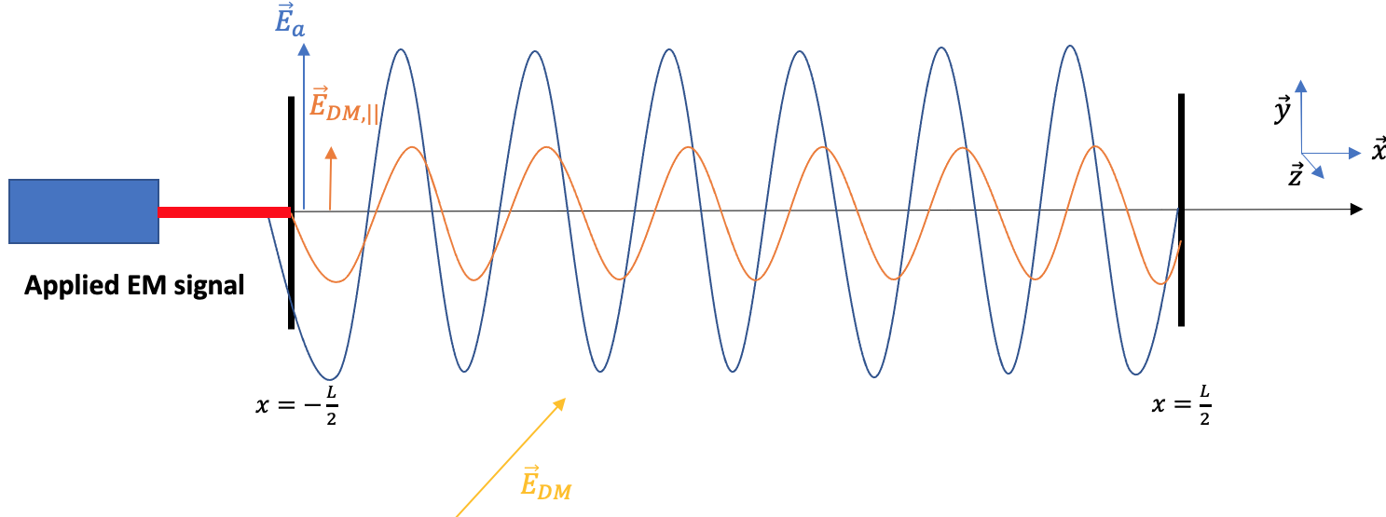
The experiment : Setup using microwave signal
We can either measure the DM electric field directly…
…or measure the square of the total electric field
$${ \vec{E}}_{T} =A\left({{\vec{X}}_{DM},ω}_{DM}\right)e^{−iω_{DM}t}+B\left({{\vec{X}}_{a},ω}_{a}\right)e^{−iω_{a}t}$$
→ Oscillate too fast $(𝒪(GHz))$ to be detected
DM field contrib. (small)
Applied field contrib.
$$ω_{a}+ω_{DM}$$
Fig. 3 : A microwave signal sent inside a resonant cavity, with a frequency close to the one of the hypothetical DP.
$${|\vec{E}}_{T}|^{2}∝ X_{a}X_{DM}\left[cos⁡{(∆ωt+φ_{a})}+\cos{(Σωt+φ_{a})}\right]+X_{DM}^{2}\cos{(2ω_{DM}t)}+X_{a}^{2}\cos{(2ω_{a}t+φ_{a})}$$
✓
$$ω_{a}−ω_{DM}$$
Oscillation too fast/Amplitude too small
The DM frequency we look for is such that $∆ω<f_{s}$, the sampling frequency of the apparatus
In addition, we take advantage of the possible high injected power contained in ${\vec{X}}_{a}$
Notes:
So let’s look at it : same scheme as before with applied frequency+electric field induced by the mirrors due to the DP field.
Different measurement possible : the total electric field inside the cavity,which is not interesting to study as different terms which oscillate quickly so not detectable for the resolution we want (Rydberg) + amplitude of DP electric field supposed extremely small However, amplitude squared, terms oscillating at twice the DM and applied frequencies but also cross terms, in particular one oscillating at difference of frequencies that can be detected.
We need Dm frequency such that delta < sampling freq.
This term can be possibly super high in amplitude since it is propto amplitude of applied electric field or injected power.
ajouter que pour chaque méthode, la detection est soit antenne soit atomes
peut etre enlever le tableau
écrire d'abord E_T avec juste DM dire trop petit puis dire on ajouter E_a et parler de E^2

Slide 8
The experiment : Setup using microwave signal
7
Notes:
So let’s look at the experiment specifically : what we can do if we consider the DP field is to try to detect this field directly. What we can do is apply an external field E_a and measure the square of the total electric field inside the cavity (DM and applied field contributing)
Scheme : blue, contribution from the applied field and orange from the DP electric field. This way, we still have trms oscillating too fast/amplitude too small but also cross terms, in particular one oscillating at difference of frequencies that can be detected.
The applied field which works as an amplificator for the DM field.

Slide 9
The experiment : Setup using microwave signal
We can either measure the DM electric field directly…
$${ \vec{E}}_{T} ∝{{\vec{X}}_{DM}e}^{−iω_{DM}t}$$
Oscillate too fast $(𝒪(GHz))$
Amplitude too small $(𝒪(χ))$
DM field contrib. (small)
7
Notes:
So let’s look at the experiment specifically : what we can do if we consider the DP field is to try to detect this field directly. What we can do is apply an external field E_a and measure the square of the total electric field inside the cavity (DM and applied field contributing)
Scheme : blue, contribution from the applied field and orange from the DP electric field. This way, we still have trms oscillating too fast/amplitude too small but also cross terms, in particular one oscillating at difference of frequencies that can be detected.
The applied field which works as an amplificator for the DM field.

Slide 10
The experiment : Setup using microwave signal
We can either measure the DM electric field directly…
$${ \vec{E}}_{T} ∝{{\vec{X}}_{DM}e}^{−iω_{DM}t}$$
Oscillate too fast $(𝒪(GHz))$
Amplitude too small $(𝒪(χ))$
DM field contrib. (small)
…or apply an external field and measure the square of the total electric field
Fig. 3 : A microwave signal sent inside a resonant cavity, with a frequency close to the one of the hypothetical DP.
$$ω_{a}−ω_{DM}$$
$$ω_{a}+ω_{DM}$$
$${|\vec{E}}_{T}|^{2}∝ X_{a}X_{DM}\left[cos⁡{(∆ωt+φ_{a})}+\cos{(Σωt+φ_{a})}\right]+X_{DM}^{2}\cos{(2ω_{DM}t)}+X_{a}^{2}\cos{(2ω_{a}t+φ_{a})}$$
✓
Oscillation too fast/Amplitude too small
7
Notes:
So let’s look at the experiment specifically : what we can do if we consider the DP field is to try to detect this field directly. What we can do is apply an external field E_a and measure the square of the total electric field inside the cavity (DM and applied field contributing)
Scheme : blue, contribution from the applied field and orange from the DP electric field. This way, we still have trms oscillating too fast/amplitude too small but also cross terms, in particular one oscillating at difference of frequencies that can be detected.
The applied field which works as an amplificator for the DM field.

Slide 11
The experiment : Setup using microwave signal
We can either measure the DM electric field directly…
$${ \vec{E}}_{T} ∝{{\vec{X}}_{DM}e}^{−iω_{DM}t}$$
Oscillate too fast $(𝒪(GHz))$
Amplitude too small $(𝒪(χ))$
DM field contrib. (small)
…or apply an external field and measure the square of the total electric field
Fig. 3 : A microwave signal sent inside a resonant cavity, with a frequency close to the one of the hypothetical DP.
$$ω_{a}−ω_{DM}$$
$$ω_{a}+ω_{DM}$$
$${|\vec{E}}_{T}|^{2}∝ X_{a}X_{DM}\left[cos⁡{(∆ωt+φ_{a})}+\cos{(Σωt+φ_{a})}\right]+X_{DM}^{2}\cos{(2ω_{DM}t)}+X_{a}^{2}\cos{(2ω_{a}t+φ_{a})}$$
✓
Oscillation too fast/Amplitude too small
The DM frequency we look for is such that $∆ω<f_{s}$, sampling frequency of the apparatus
In addition, we take advantage of the possible high injected power contained in ${\vec{X}}_{a}$
7
Notes:
So let’s look at the experiment specifically : what we can do if we consider the DP field is to try to detect this field directly. What we can do is apply an external field E_a and measure the square of the total electric field inside the cavity (DM and applied field contributing)
Scheme : blue, contribution from the applied field and orange from the DP electric field. This way, we still have trms oscillating too fast/amplitude too small but also cross terms, in particular one oscillating at difference of frequencies that can be detected.
The applied field which works as an amplificator for the DM field.

Slide 12
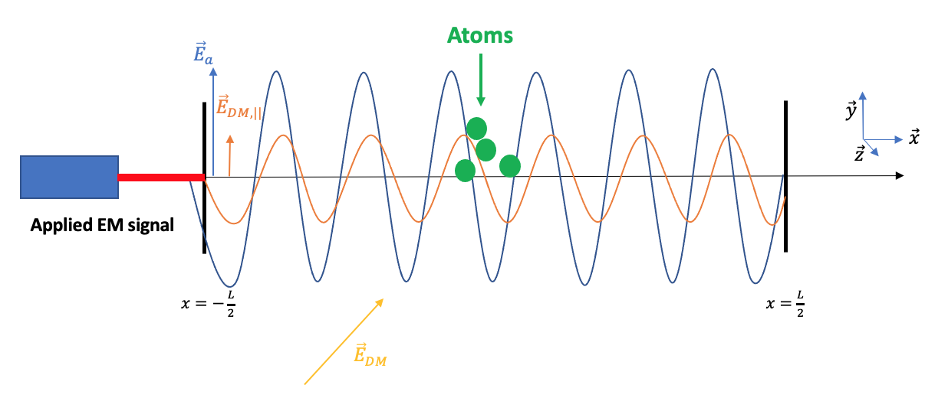
The experiment : Detection using Rydberg atoms
Best way of measuring the square of the electric field strength is through Stark effect
$$Δν=\frac{1}{2h}∆α{\left\langle E\right\rangle }^{2}$$
Measurement of transition frequency of an atom and look for $ν\left(t\right)=ν_{0}+Δν\cos{(Δωt+φ_{a})}$
With Rydberg atoms :
High accuracy on $Δν$ from ${\left\langle E\right\rangle }^{2}$
Large polarizability $∆α$
Good resolution on${ \left\langle E\right\rangle }^{2}$ (with small $T_{obs}$)
Fig. 4 : Atoms at the center of the cavity to measure the Stark effect induced by ${\left\langle E_{T}\right\rangle }^{2}$
→ Better sensitivity on ${\left\langle E\right\rangle }^{2}$
8
Notes:
observable to try to detect the DM electric field but how to measure it ? Stark Effect which characterizes the frequency shift of an atom from the application of electric field.
(Use of stark effect because this effect is sensitive to E^2.)
To do so, w could use regular atomic clocks which have a very good resolution but not high sensitivity on E^2. Another possibility is to use of rydberg atoms for this purpose which are atoms with high principal quantum number n, implying that electrons are usually not as much bounded to the nucleus as regular atoms. One of the consequences of that is an exaggerated response to electric field.
They have lot of advantages
The experimental method is simple :
This way, large window of mass scanable

Slide 13
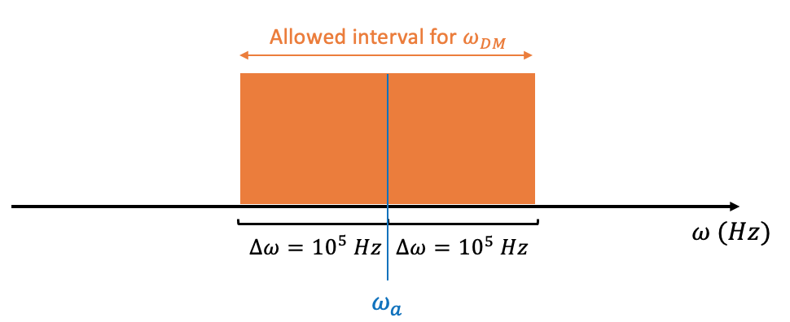
The experiment : Experimental methodology
Apply electric field with initial frequency $ω_{a}$ during $T_{obs}$ → scan possible DM signals with $Δω<f_{s}$
Shift applied frequency by ${2 × 10}^{5} Hz$ for another $T_{obs}$
→ Large window of DM masses scanable $(=2Nf_{s})$
Fig. 5 : Allowed interval for $ω_{DM}$ for a given applied frequency $ω_{a}$
N times
$$f_{s}$$
9
Notes:
observable to try to detect the DM electric field but how to measure it ? Stark Effect which characterizes the frequency shift of an atom from the application of electric field.
(Use of stark effect because this effect is sensitive to E^2.)
To do so, w could use regular atomic clocks which have a very good resolution but not high sensitivity on E^2. Another possibility is to use of rydberg atoms for this purpose which are atoms with high principal quantum number n, implying that electrons are usually not as much bounded to the nucleus as regular atoms. One of the consequences of that is an exaggerated response to electric field.
They have lot of advantages
The experimental method is simple :
This way, large window of mass scanable

Slide 14
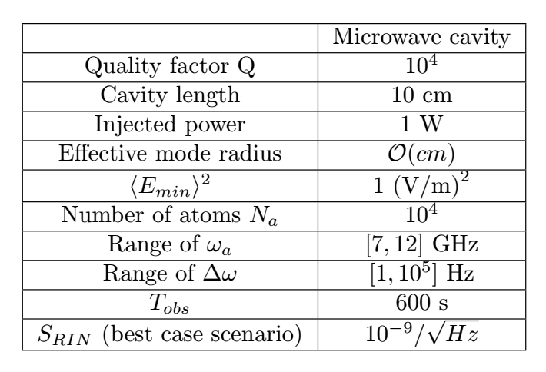
Rough estimation of the experiment’s sensitivity
Statistical noise: Measurement uncertainty of the electric field squared from the atoms.
→ Minimal detectable field power ${\left\langle E_{min}\right\rangle }^{2}=1 (V/m)^{2}$
→ $χ(ω_{DM})=f({Q,X}_{a},X_{DM},…)$
10
Notes:
Now, what is the experiments sensitivity ? different sources of noise and how do they impact the sensitivity of the experiment.
First source of noise is statistical noise For Rydberg Sr atoms, this noise is equivalent to a minimal detectable field power of 1 (V/m)^2
plots : exclusion plots of current dark photons searches through chi coupling with photons. Different experiments : indirect ones (cosmo in blue and astro in green) and direct ones (lab experiments in red).
Now if we zoom in this part, we have different experiments and we see the constraint on chi from this experiment Small remark : two different constraints related to 1st and 3rd cavity resonance.
I will now show only the constraints from lab experiments and I discard the CMB constraint on purpose. We see that at this point, experiment allows to scan new regions of the plot compared to other lab experiments.

Slide 15
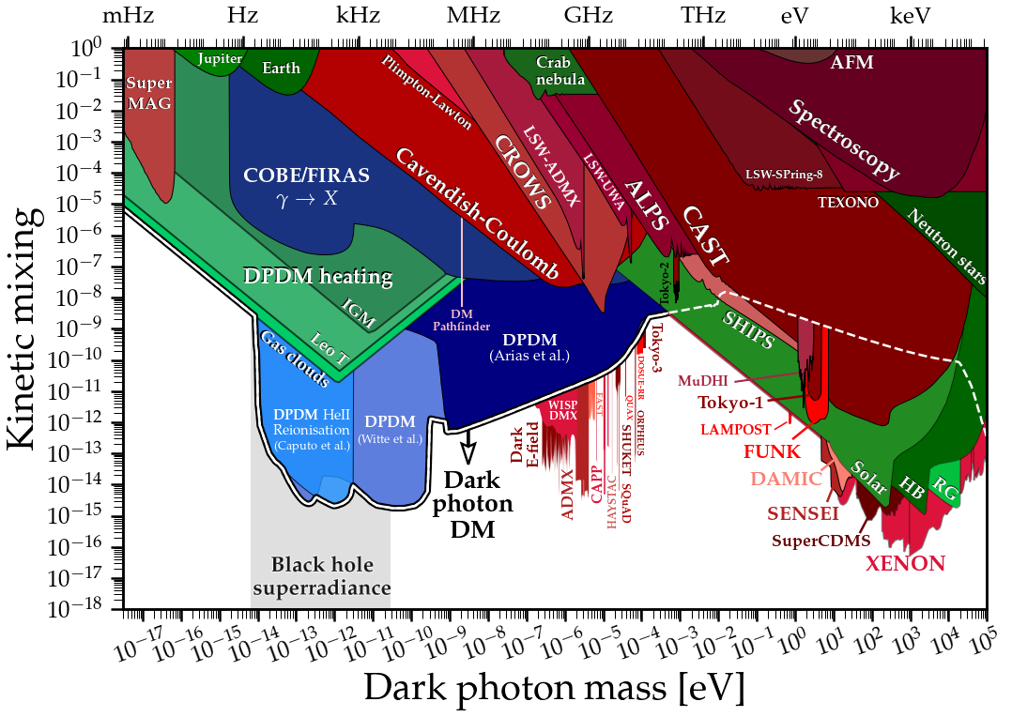
Rough estimation of the experiment’s sensitivity
Statistical noise: Measurement uncertainty of the electric field squared from the atoms.
→ Minimal detectable field power ${\left\langle E_{min}\right\rangle }^{2}=1 (V/m)^{2}$
→ $χ(ω_{DM})=f({Q,X}_{a},X_{DM},…)$
From C. O’Hare : https://github.com/cajohare
10
Notes:
Now, what is the experiments sensitivity ? different sources of noise and how do they impact the sensitivity of the experiment.
First source of noise is statistical noise For Rydberg Sr atoms, this noise is equivalent to a minimal detectable field power of 1 (V/m)^2
plots : exclusion plots of current dark photons searches through chi coupling with photons. Different experiments : indirect ones (cosmo in blue and astro in green) and direct ones (lab experiments in red).
Now if we zoom in this part, we have different experiments and we see the constraint on chi from this experiment Small remark : two different constraints related to 1st and 3rd cavity resonance.
I will now show only the constraints from lab experiments and I discard the CMB constraint on purpose. We see that at this point, experiment allows to scan new regions of the plot compared to other lab experiments.

Slide 16
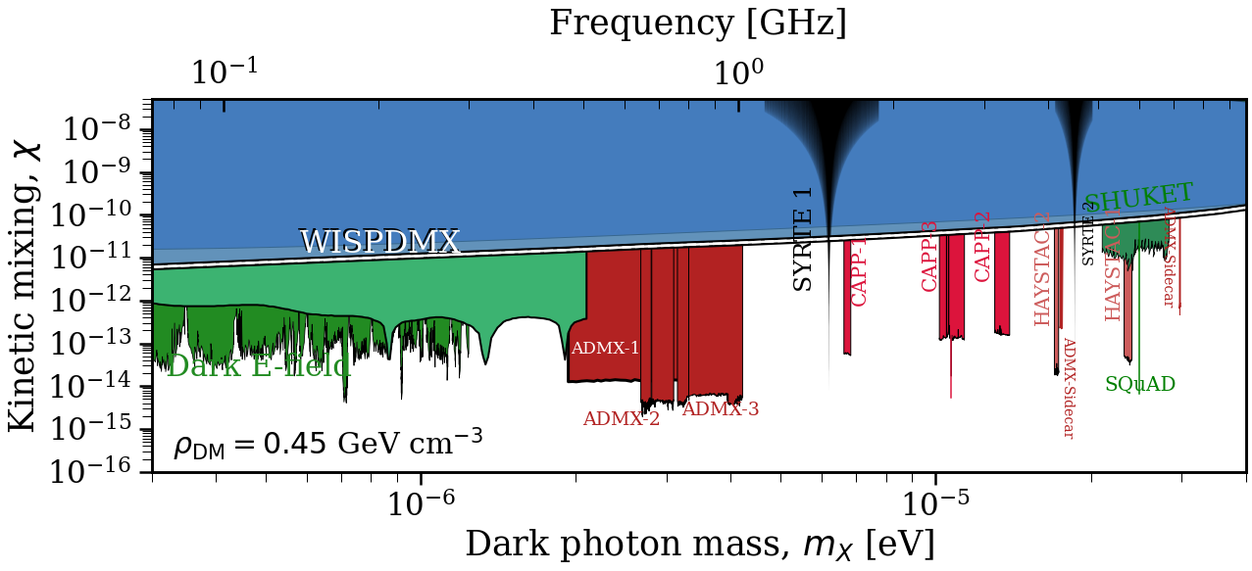
Rough estimation of the experiment’s sensitivity
Statistical noise: Measurement uncertainty of the electric field squared from the atoms.
→ Minimal detectable field power ${\left\langle E_{min}\right\rangle }^{2}=1 (V/m)^{2}$
→ $χ(ω_{DM})=f({Q,X}_{a},X_{DM},…)$
From C. O’Hare : https://github.com/cajohare
10
Notes:
Now, what is the experiments sensitivity ? different sources of noise and how do they impact the sensitivity of the experiment.
First source of noise is statistical noise For Rydberg Sr atoms, this noise is equivalent to a minimal detectable field power of 1 (V/m)^2
plots : exclusion plots of current dark photons searches through chi coupling with photons. Different experiments : indirect ones (cosmo in blue and astro in green) and direct ones (lab experiments in red).
Now if we zoom in this part, we have different experiments and we see the constraint on chi from this experiment Small remark : two different constraints related to 1st and 3rd cavity resonance.
I will now show only the constraints from lab experiments and I discard the CMB constraint on purpose. We see that at this point, experiment allows to scan new regions of the plot compared to other lab experiments.

Slide 17
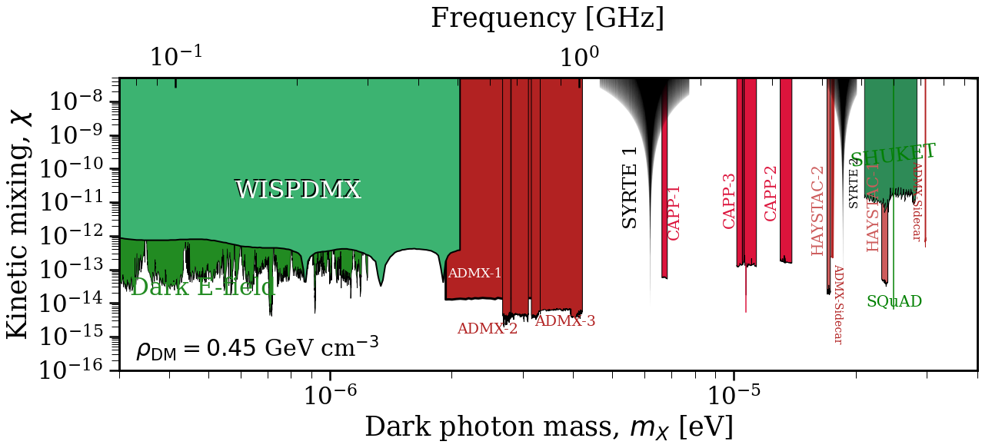
Rough estimation of the experiment’s sensitivity
Statistical noise: Measurement uncertainty of the electric field squared from the atoms.
→ Minimal detectable field power ${\left\langle E_{min}\right\rangle }^{2}=1 (V/m)^{2}$
→ $χ(ω_{DM})=f({Q,X}_{a},X_{DM},…)$
From C. O’Hare : https://github.com/cajohare
Fig. 6 : Constraint on $χ$ obtained with this setup. The exclusion plot on the right shows only lab experiments and omit cosmological ones such as CMB.
10
Notes:
Now, what is the experiments sensitivity ? different sources of noise and how do they impact the sensitivity of the experiment.
First source of noise is statistical noise For Rydberg Sr atoms, this noise is equivalent to a minimal detectable field power of 1 (V/m)^2
plots : exclusion plots of current dark photons searches through chi coupling with photons. Different experiments : indirect ones (cosmo in blue and astro in green) and direct ones (lab experiments in red).
Now if we zoom in this part, we have different experiments and we see the constraint on chi from this experiment Small remark : two different constraints related to 1st and 3rd cavity resonance.
I will now show only the constraints from lab experiments and I discard the CMB constraint on purpose. We see that at this point, experiment allows to scan new regions of the plot compared to other lab experiments.

Slide 18
Rough estimation of the experiment’s sensitivity
Systematic noise: RIN (Relative Intensity Noise) of a signal describes the fluctuation of its power.
$$\frac{{∆X}_{a}}{X_{a}}=RIN=\sqrt{\frac{2S_{RIN}}{T_{obs}}}$$
Close to resonances, the applied field amplitude is enhanced a lot (with its fluctuation) → The experimental limit becomes the systematic effect and
$$χ≈\frac{{∆X}_{a}}{X_{a}}$$
No dependence on Q or any other cavity parameters.
$⇒ ↘S_{RIN}$ or $↗$ $T_{obs}⟹$ Better constraint on $χ$
→ ${ \vec{E}}_{T} =A\left({{\vec{X}}_{DM},ω}_{DM}\right)e^{−iω_{DM}t}+B\left({{\vec{X}}_{a},ω}_{a}\right)e^{−iω_{a}t}+$syst. noise
$$∝Δ{\vec{X}}_{a}$$
11
Notes:
Another source of noise, a parasitic effect which acts as a systematic effect, related to the applied field amplitude fluctuation from the antenna.
To characterize it, we use the RIN (Relative Intensity Noise) Basically, we add a component propto Delta X_a in the total E field inside the cavity.
This noise term oscillates with the same frequency as the applied field, meaning that close to resonances, its amplitude is enhanced in the same way as the applied field amplitude X_a. then ,the experimental limit is the systematic effect and we have approximately chi = RIN. No dependence on Q factor.
This means that we can either decrease the PSD of the noise or increase the experimental time to get a better constraint on chi

Slide 19
Rough estimation of the experiment’s sensitivity
12
Notes:
Now let’s see the impact on the sensitivity. Previously, we has this, if we take into account this noise and taking an optimistic value for the PSD to be 10^-9/sqrt(Hz) with experimental time of 600s per individual applied frequency. We see not a dramatic difference, mainly, the sharp peak on the resonance is lost. Additionally, we now require the experimental time to be 600s to lower enough the RIN , while previously we could decrease T_obs as much as to 1 second, because Rydberg atoms are fast enough to make the measurement of E^2 in 1 second. This of course means that we need much more time to scan a significant window of masses.
But, all things considered, we still see an improvement on the current constraints compared to other lab experiment. For example, When taking into account everything, we could scan a window of masses from 5.9 to 6.5 micro eV in a month, what I shown in blue on the plot.

Slide 20
Rough estimation of the experiment’s sensitivity
12
Notes:
Now let’s see the impact on the sensitivity. Previously, we has this, if we take into account this noise and taking an optimistic value for the PSD to be 10^-9/sqrt(Hz) with experimental time of 600s per individual applied frequency. We see not a dramatic difference, mainly, the sharp peak on the resonance is lost. Additionally, we now require the experimental time to be 600s to lower enough the RIN , while previously we could decrease T_obs as much as to 1 second, because Rydberg atoms are fast enough to make the measurement of E^2 in 1 second. This of course means that we need much more time to scan a significant window of masses.
But, all things considered, we still see an improvement on the current constraints compared to other lab experiment. For example, When taking into account everything, we could scan a window of masses from 5.9 to 6.5 micro eV in a month, what I shown in blue on the plot.

Slide 21
Rough estimation of the experiment’s sensitivity
Without systematics
12
Notes:
Now let’s see the impact on the sensitivity. Previously, we has this, if we take into account this noise and taking an optimistic value for the PSD to be 10^-9/sqrt(Hz) with experimental time of 600s per individual applied frequency. We see not a dramatic difference, mainly, the sharp peak on the resonance is lost. Additionally, we now require the experimental time to be 600s to lower enough the RIN , while previously we could decrease T_obs as much as to 1 second, because Rydberg atoms are fast enough to make the measurement of E^2 in 1 second. This of course means that we need much more time to scan a significant window of masses.
But, all things considered, we still see an improvement on the current constraints compared to other lab experiment. For example, When taking into account everything, we could scan a window of masses from 5.9 to 6.5 micro eV in a month, what I shown in blue on the plot.

Slide 22
Rough estimation of the experiment’s sensitivity
Without systematics
12
Notes:
Now let’s see the impact on the sensitivity. Previously, we has this, if we take into account this noise and taking an optimistic value for the PSD to be 10^-9/sqrt(Hz) with experimental time of 600s per individual applied frequency. We see not a dramatic difference, mainly, the sharp peak on the resonance is lost. Additionally, we now require the experimental time to be 600s to lower enough the RIN , while previously we could decrease T_obs as much as to 1 second, because Rydberg atoms are fast enough to make the measurement of E^2 in 1 second. This of course means that we need much more time to scan a significant window of masses.
But, all things considered, we still see an improvement on the current constraints compared to other lab experiment. For example, When taking into account everything, we could scan a window of masses from 5.9 to 6.5 micro eV in a month, what I shown in blue on the plot.

Slide 23
Rough estimation of the experiment’s sensitivity
Without systematics
12
Notes:
Now let’s see the impact on the sensitivity. Previously, we has this, if we take into account this noise and taking an optimistic value for the PSD to be 10^-9/sqrt(Hz) with experimental time of 600s per individual applied frequency. We see not a dramatic difference, mainly, the sharp peak on the resonance is lost. Additionally, we now require the experimental time to be 600s to lower enough the RIN , while previously we could decrease T_obs as much as to 1 second, because Rydberg atoms are fast enough to make the measurement of E^2 in 1 second. This of course means that we need much more time to scan a significant window of masses.
But, all things considered, we still see an improvement on the current constraints compared to other lab experiment. For example, When taking into account everything, we could scan a window of masses from 5.9 to 6.5 micro eV in a month, what I shown in blue on the plot.

Slide 24
Rough estimation of the experiment’s sensitivity
Without systematics
12
Notes:
Now let’s see the impact on the sensitivity. Previously, we has this, if we take into account this noise and taking an optimistic value for the PSD to be 10^-9/sqrt(Hz) with experimental time of 600s per individual applied frequency. We see not a dramatic difference, mainly, the sharp peak on the resonance is lost. Additionally, we now require the experimental time to be 600s to lower enough the RIN , while previously we could decrease T_obs as much as to 1 second, because Rydberg atoms are fast enough to make the measurement of E^2 in 1 second. This of course means that we need much more time to scan a significant window of masses.
But, all things considered, we still see an improvement on the current constraints compared to other lab experiment. For example, When taking into account everything, we could scan a window of masses from 5.9 to 6.5 micro eV in a month, what I shown in blue on the plot.

Slide 25
Rough estimation of the experiment’s sensitivity
Without systematics
With systematics
12
Notes:
Now let’s see the impact on the sensitivity. Previously, we has this, if we take into account this noise and taking an optimistic value for the PSD to be 10^-9/sqrt(Hz) with experimental time of 600s per individual applied frequency. We see not a dramatic difference, mainly, the sharp peak on the resonance is lost. Additionally, we now require the experimental time to be 600s to lower enough the RIN , while previously we could decrease T_obs as much as to 1 second, because Rydberg atoms are fast enough to make the measurement of E^2 in 1 second. This of course means that we need much more time to scan a significant window of masses.
But, all things considered, we still see an improvement on the current constraints compared to other lab experiment. For example, When taking into account everything, we could scan a window of masses from 5.9 to 6.5 micro eV in a month, what I shown in blue on the plot.

Slide 26
Rough estimation of the experiment’s sensitivity
Without systematics
With systematics
12
Fig. 7 : Constraint on $χ$ obtained with this setup for $T_{obs}$= 600 s , $S_{RIN}=10^{−9}/\sqrt{Hz}$
Notes:
Now let’s see the impact on the sensitivity. Previously, we has this, if we take into account this noise and taking an optimistic value for the PSD to be 10^-9/sqrt(Hz) with experimental time of 600s per individual applied frequency. We see not a dramatic difference, mainly, the sharp peak on the resonance is lost. Additionally, we now require the experimental time to be 600s to lower enough the RIN , while previously we could decrease T_obs as much as to 1 second, because Rydberg atoms are fast enough to make the measurement of E^2 in 1 second. This of course means that we need much more time to scan a significant window of masses.
But, all things considered, we still see an improvement on the current constraints compared to other lab experiment. For example, When taking into account everything, we could scan a window of masses from 5.9 to 6.5 micro eV in a month, what I shown in blue on the plot.

Slide 27
Rough estimation of the experiment’s sensitivity
Without systematics
Not dramatic change in sensitivity
Need to consider $T_{obs}=600$s
With systematics
12
Fig. 7 : Constraint on $χ$ obtained with this setup for $T_{obs}$= 600 s , $S_{RIN}=10^{−9}/\sqrt{Hz}$
Notes:
Now let’s see the impact on the sensitivity. Previously, we has this, if we take into account this noise and taking an optimistic value for the PSD to be 10^-9/sqrt(Hz) with experimental time of 600s per individual applied frequency. We see not a dramatic difference, mainly, the sharp peak on the resonance is lost. Additionally, we now require the experimental time to be 600s to lower enough the RIN , while previously we could decrease T_obs as much as to 1 second, because Rydberg atoms are fast enough to make the measurement of E^2 in 1 second. This of course means that we need much more time to scan a significant window of masses.
But, all things considered, we still see an improvement on the current constraints compared to other lab experiment. For example, When taking into account everything, we could scan a window of masses from 5.9 to 6.5 micro eV in a month, what I shown in blue on the plot.

Slide 28
Rough estimation of the experiment’s sensitivity
Without systematics
Not dramatic change in sensitivity
Need to consider $T_{obs}=600$s
Nb of times we switch $ω_{a}$
With systematics
Total experiment time $T_{tot}=NT_{obs}$
$T_{tot} \sim 1$ month $≡$scan DM masses $∈$[5.9 ; 6.5]$μeV$
12
Fig. 7 : Constraint on $χ$ obtained with this setup for $T_{obs}$= 600 s , $S_{RIN}=10^{−9}/\sqrt{Hz}$
Notes:
Now let’s see the impact on the sensitivity. Previously, we has this, if we take into account this noise and taking an optimistic value for the PSD to be 10^-9/sqrt(Hz) with experimental time of 600s per individual applied frequency. We see not a dramatic difference, mainly, the sharp peak on the resonance is lost. Additionally, we now require the experimental time to be 600s to lower enough the RIN , while previously we could decrease T_obs as much as to 1 second, because Rydberg atoms are fast enough to make the measurement of E^2 in 1 second. This of course means that we need much more time to scan a significant window of masses.
But, all things considered, we still see an improvement on the current constraints compared to other lab experiment. For example, When taking into account everything, we could scan a window of masses from 5.9 to 6.5 micro eV in a month, what I shown in blue on the plot.

Slide 29
Rough estimation of the experiment’s sensitivity
Without systematics
Not dramatic change in sensitivity
Need to consider $T_{obs}=600$s
Nb of times we switch $ω_{a}$
With systematics
Total experiment time $T_{tot}=NT_{obs}$
$T_{tot} \sim 1$ month $≡$scan DM masses $∈$[5.9 ; 6.5]$μeV$
12
Fig. 7 : Constraint on $χ$ obtained with this setup for $T_{obs}$= 600 s , $S_{RIN}=10^{−9}/\sqrt{Hz}$
Notes:
Now let’s see the impact on the sensitivity. Previously, we has this, if we take into account this noise and taking an optimistic value for the PSD to be 10^-9/sqrt(Hz) with experimental time of 600s per individual applied frequency. We see not a dramatic difference, mainly, the sharp peak on the resonance is lost. Additionally, we now require the experimental time to be 600s to lower enough the RIN , while previously we could decrease T_obs as much as to 1 second, because Rydberg atoms are fast enough to make the measurement of E^2 in 1 second. This of course means that we need much more time to scan a significant window of masses.
But, all things considered, we still see an improvement on the current constraints compared to other lab experiment. For example, When taking into account everything, we could scan a window of masses from 5.9 to 6.5 micro eV in a month, what I shown in blue on the plot.

Slide 30
Conclusion
DP is a serious DM candidate → numerous lab experiments trying to detect it.
Proposal of a new kind of experiment looking for DP using atoms inside a microwave cavity. As a resonant device, it acts as a narrow band DM detector.
With the current technology in quantum optics, competitive constraints on the coupling constant $χ$compared to other lab experiments.
Next step : How to mitigate the experimental limiting factor, the systematic effect?
13
Notes:
To conclude, I think the home take messages are that dark photon as a massive vector field is a serious DM candidate and that numerous lab experiments arise to try to detect it.
Here, we propose a new kind of experiments based on atoms inside microwave cavity. The cavity acts as a narrow band DM detector. With the current technology, we obtain competitive constraints on chi compared to other lab experiments.
The next step now is to study more the systematic effect which limits this constraint and try to mitigate it, by for example measuring it as an output of the cavity to substract it from the data.

Slide 31
Thank you for your attention !

Slide 32
Back-up : Cavity parameters
Resonance conditions : $λ=\frac{2L}{n} or kL=nπ$
Detection at the center from atoms → we require n odd (antinode at the center)
Reflectivity coeff of mirrors r is related to quality factor as
$$Q=\frac{2π}{λ(1−r^{2})}$$
This relation is valid only around resonances.
Finesse of a cavity defined as
$$ℱ=2πN_{e}→ℱ≈Q$$
Notes:
Ne = average number of round trips before the energy inside the cavity drops to 1/e of its initial value

Slide 33
Back-up : Atomic clock
From http://hyperphysics.phy-astr.gsu.edu
Atoms inside a cavity, excited by a laser.
The closer the frequency of the laser is to the energy difference between the 2 levels, the more excited atoms there will be
Assessment of the frequency of the laser to be closest possible to the energy difference.
→ Wave with appropriate frequency and need to count oscillations to give time

Slide 34
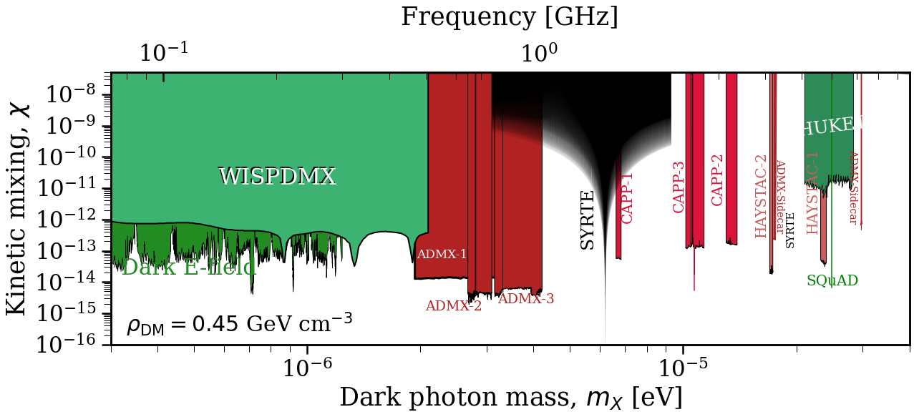
Back-up : How does Q impacts the sensitivity ?
$$Q={10}^{6}$$
Without systematics
$$Q={10}^{4}$$
Without systematics
Notes:
This might look irrelevant but there are two aspects to take into account. First, as I said before, the quality factor is not a relevant parameter around the resonances anymore, while it still was without the systematic noise. To illustrate it, this is the difference of sensitivity achieved when we go from Q=10^4 to Q=10^6 without this noise, while the constraint with the systematic noise does not change with Q.

Slide 35
Back-up : why microwave cavity and not optical ?
${\vec{E}}_{DP}≈−iχω\vec{ϕ}e^{−iωt}$valid if we neglect k. To do so, we require $L≪λ$ (L, size of experiment considered (< 10 cm)) → ok in microwave range → in optical range, $k \sim {10}^{6} m^{−1}≫\frac{2π}{λ}$
Optical frequency $≡$ eV mass → QFT required for DP field

Slide 36
Back-up :DP cosmo evolution + field equations
Free Klein-Gordon equation of each DP space component $φ^{i}$
$${\ddot{φ}}^{i}+3H{\dot{φ}}^{i}+m^{2}φ^{i}≈0$$
whose solution is oscillatory.
Additionally, $p_{ij} \sim \left\langle T_{ij}\right\rangle =0$ and the field behaves as pressureless fluid or CDM
In the microwave regime and considering $v_{DM}\sim {10}^{−3}$ in Earth’s frame, the DP field can be approximated by a standing wave in a cavity of length $L \sim 10$cm. Then,
$ω=m$ ; $φ^{0}=0$
The DP mixes with the SM photon as
$$∂_{μ}∂^{μ}A^{ν}=−χφ^{ν}$$
$$(∂_{μ}∂^{μ}+m^{2})φ^{ν}=−χ∂_{μ}∂^{μ}A^{ν}$$
Nelson, Scholtz, PRD, 2011
Notes:
Field spatially uniform after inflation so no spatial derivative in KG

Slide 37
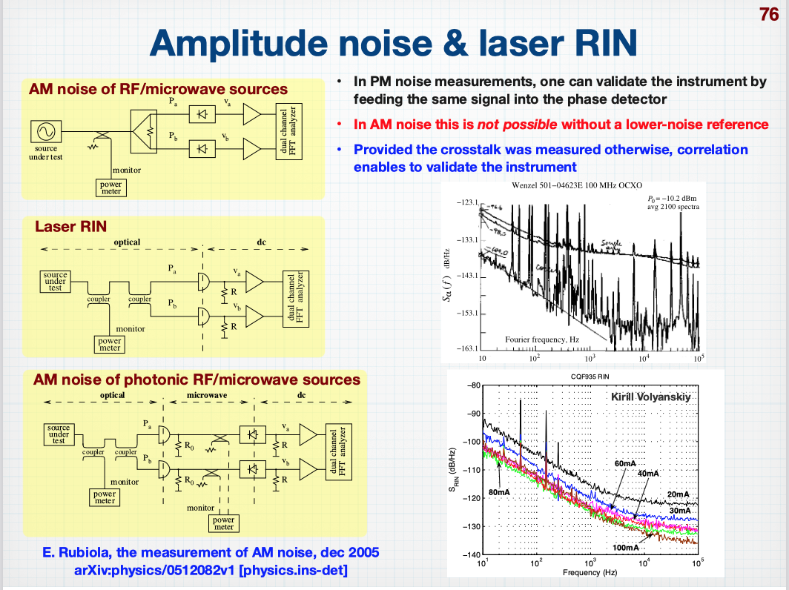
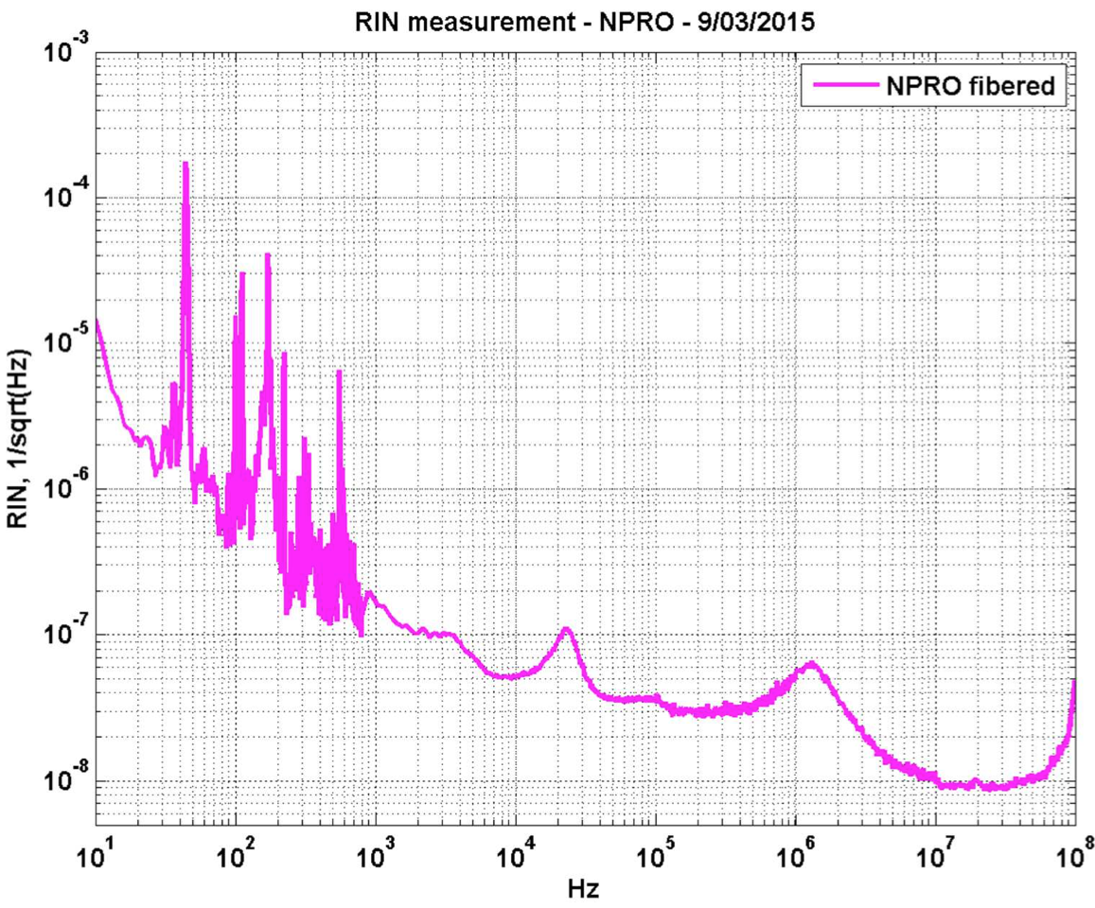
Back-up : Systematic noise and Data analysis
`
With RIN noise $∝f^{−1}$, the $S_{RIN}={10}^{−9}/\sqrt{Hz}$ works at frequencies $f \sim {10}^{4}−10^{5}$ Hz
$\sqrt{S_{RIN}}$of different sources (arXiv : Rubiola, 2005)
$\sqrt{S_{RIN}}$of a Nd laser, measurement
provided by Artemis lab.

