Slide 1
Identifying galaxies with tidal features using self-supervised machine learning
Alice Desmons, UNSW Australia

Slide 2
Identifying galaxies with tidal features using self-supervised machine learning
Alice Desmons, UNSW Australia
Prof. Sarah Brough
UNSW Australia
Dr Francois Lanusse
CEA Saclay

Slide 3
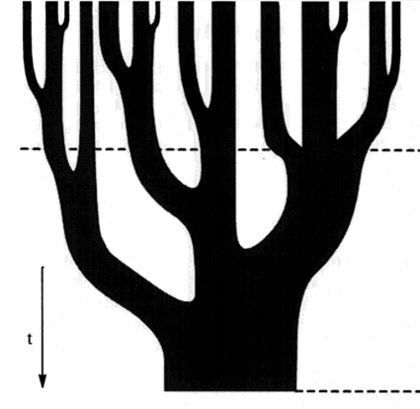
The Hierarchical Merger Model
Some time in the past
Time
Today
Originally Figure 6 in Lacey and Cole (1993)

Slide 4
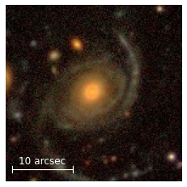
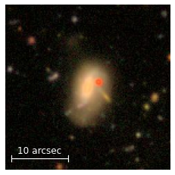
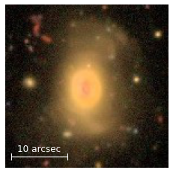
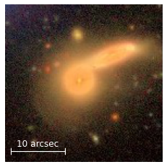
Tidal Features
Tidal Feature Surface Brightness:
$$μ_{r} ≥ 27 \text{mag} {\text{arcsec}}^{−2}$$
SDSS brightness limit:
$$μ_{r} \sim 23.5 \text{mag} {\text{arcsec}}^{−2}$$
Hyper Suprime-Cam Subaru Strategic program
Vera C. Rubin Observatory’s Legacy Survey of Space and Time:
2024 – 2034
∼60 petabytes of images

Slide 5
Machine Learning - The Basics
Supervised
Unsupervised
Labelled training data
Un-labelled training data
Learns to map inputs to corresponding outputs
Learns to find patterns in its input
Self-Supervised
Good for classification
Good for clustering
Mostly un-labelled training data
Pattern finding and classification

Slide 6
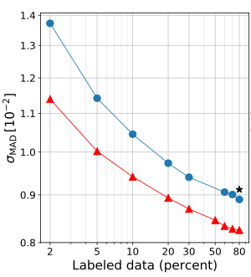
Inspiration
Originally Figure 4 in Hayat et al. (2021)
Chen et al. (2020)
Self-Supervised Model Architecture
Hayat et al. (2021)
1.2 Million SDSS galaxies
Stein et al. (2021)
3.5 Million DECaLS galaxies
Classify galaxy morphology
Estimate photometric redshift
Identify strong gravitational lens candidates
Check against Galaxy Zoo 2 labels
Check against SDSS spectroscopic redshifts
Originally Figure 3 in Stein et al. (2021a)

Slide 7
The Model
5 bands (grizy)
$×$ 45,000
128
128
Encoder
Our Augmentations
Rotation
Flipping
Blurring each band
Gaussian noise
Zoom 90-110%
Originally Figure 1 in Hayat et al. (2021)

Slide 8
The Model
$$z_{input}$$
$$y_{input}$$
$$x_{input}$$
Linear
Classifier
Classifier
No tidal features
Tidal features
0
1
$$y_{output}$$
$$z_{output}$$
$$x_{output}$$

Slide 9
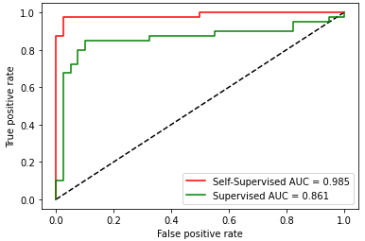
Evaluating the Classifier
Threshold
- output
+ output
0
1
No tidal features
Tidal features
Galaxies correctly identified as having tidal features
Galaxies incorrectly identified as having tidal features

Slide 10
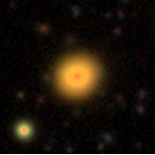
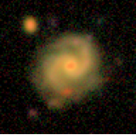
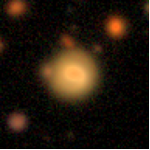
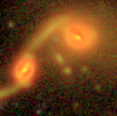
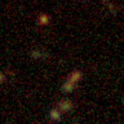
Classifier Results
No tidal features
Tidal features
0
1

Slide 11
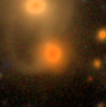
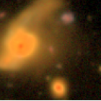
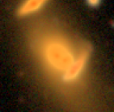
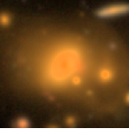
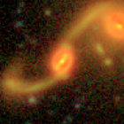
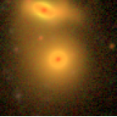
New Tidal Feature Candidates

Slide 12
Summary
Using self-supervised learning to identify galaxies with tidal features
An essential tool for sorting through massive datasets (e.g. Vera C. Rubin Observatory’s LSST Survey)
Using this tool to identify sets of galaxies with tidal features and deepen our understanding of galaxy evolution.

Slide 13
Any Questions?
Thank You!
Alice Desmons, UNSW Australia

