Slide 1




Projet ARPENTONS
Comportement mécanique de l'argilite à travers les échelles :
effet de la température et de la non-saturation
Pierre Bésuelle , Edward Ando, Nicolas Zalamea, Stefano Dal Pont, Alice Di Donna, Jacques Desrues
Université Grenoble Alpes & CNRS
Laboratoire 3SR
Philippe Cosenza, Stephen Hédan, Dimitri Prêt
Université de Poitiers & CNRS
IC2MP
Laurent Brochard, Matthieu Vandamme
ENPC & CNRS & IFSTTAR
Institut Navier

Slide 2
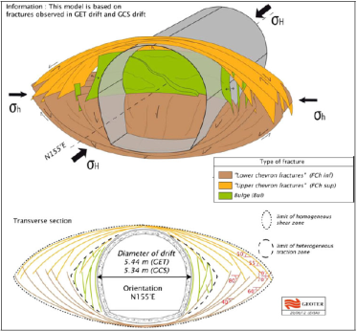
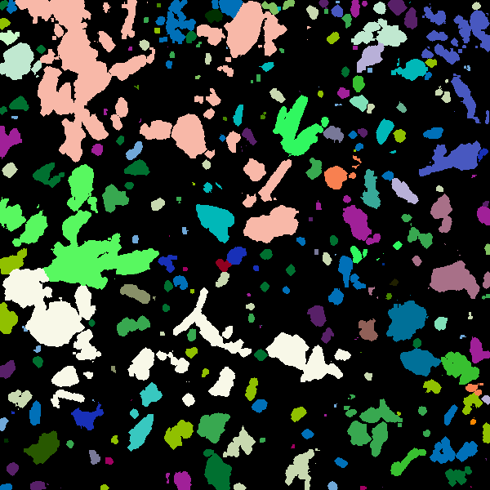
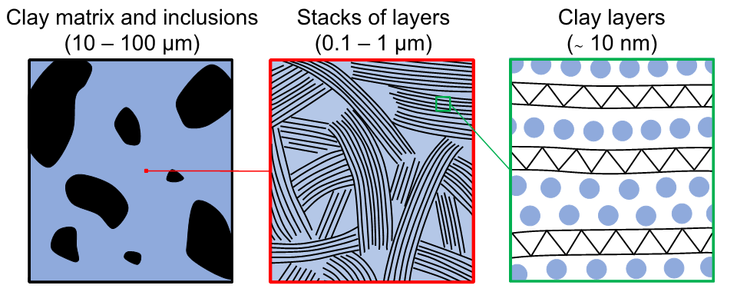
MOTIVATIONS
Roche argileuse, le dialogue entre les échelles et les couplages
De quelles échelles parlent-on ?
Échelle macro
(ingénieur)
Échelle méso (inclusion)
Échelle micro (agrégat d’argile)
Échelle nano (moléculaire)
Couplages multiphysiques :
Mécanique (déformation, endommagement)
Hydro (pression interstitielle, perméabilité, gonflement)
Température (endommagement, déformation, surpressurisation)
Hygro/Partiellement saturé (déformation, gonflement)

Slide 3
MOTIVATIONS
Roche argileuse, le dialogue entre les échelles et les couplages
Quelles approches ?
Échelle macro
(ingénieur)
Échelle méso (inclusion)
Échelle micro (agrégat d’argile)
Échelle nano (moléculaire)
Caractérisation de la déformation sous sollicitations T et HR
mesures de champs surfaciques en 3D
échantillons centimétriques
Caractérisation de la déformation sous sollicitations T
mesures de champs volumique (nano CT et DVC)
échantillons millimétriques
caractérisation
(Poitiers)
(Grenoble)
Modélisation double échelle (température)
Homogénéisation numérique (FEM²) (extérieur à NEEDS / EURAD HiTec)
Poromécanique
Modélisation moléculaire
(température et saturation partielle)
Modélisation du statut de l’eau confinée
  Mécanique moléculaire (nano)
  Mécanique granulaire (micro)
modélisation
(Grenoble et Poitiers)
(Navier)

Slide 4
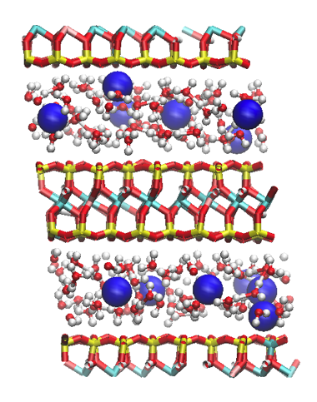
1. Nanoscale
Navier
Thin mineral layer (≈1 nm) with adsorbed/bound water
  Experimental measurement of deformation by XRD
  Theoretical prediction by molecular simulation
Sodium Wyoming montmorillonite
Na⁺
Al-> Mg
Si -> Al
TOT mineral with substitutions
Interlayer
(H2O + cations)

Slide 5
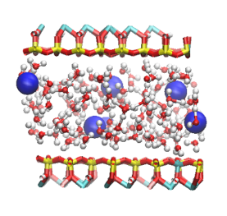
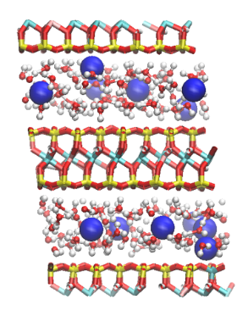
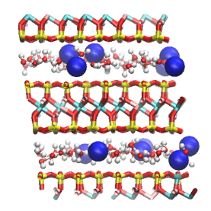
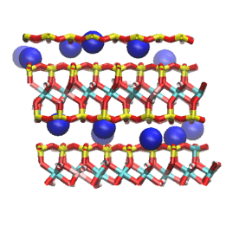
Crystalline swelling
‘Crystalline’ because swelling stepwise with RH
Each plateau = discrete nb of H₂O layers
0W = 0 layers, 1W = 2 layers etc…
XRD measurements – Na montmorillonite

Slide 6
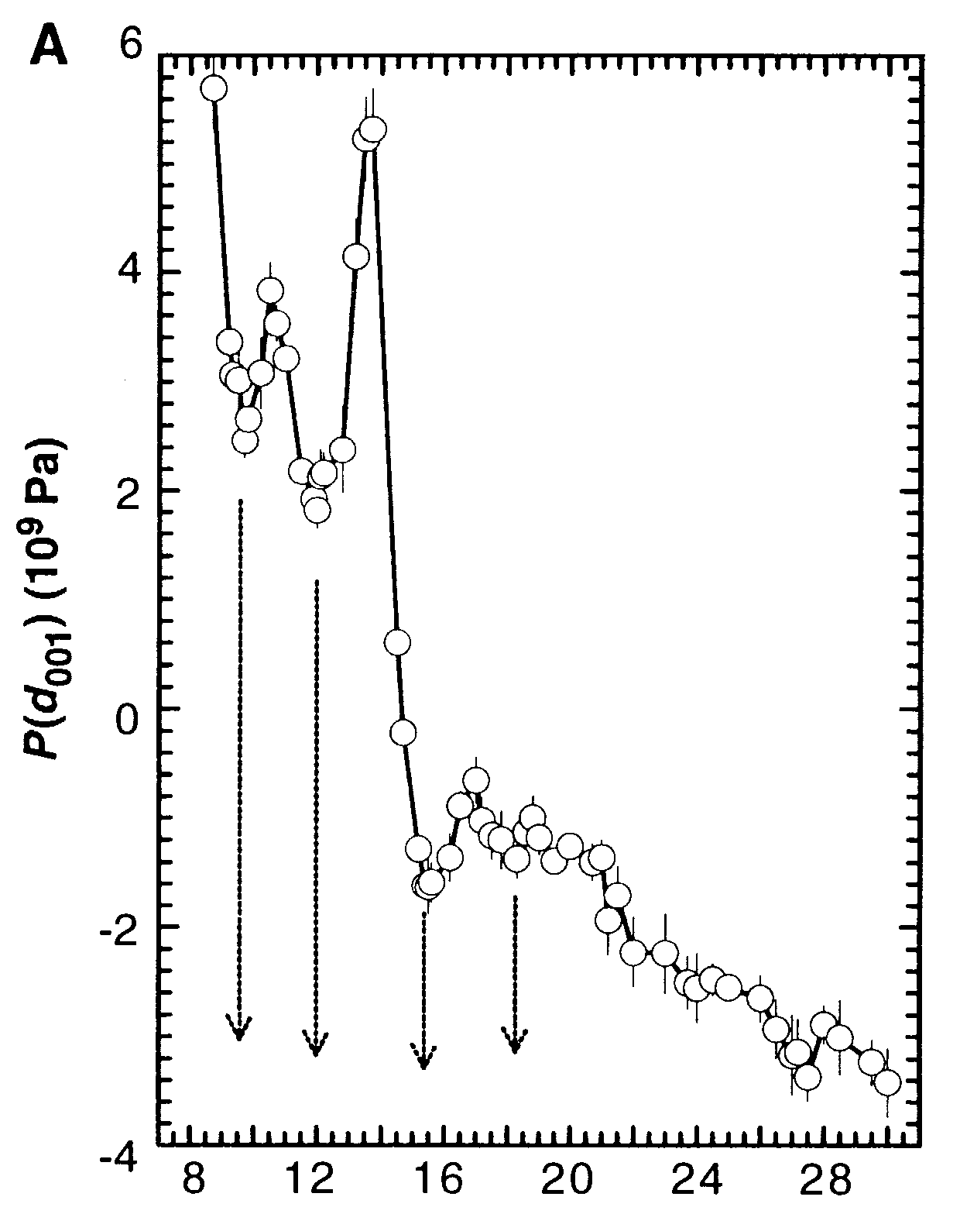
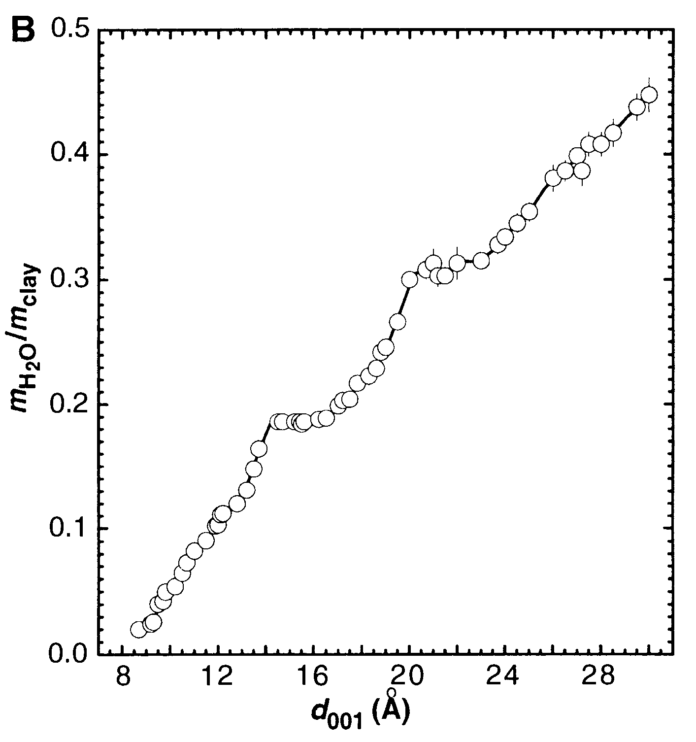
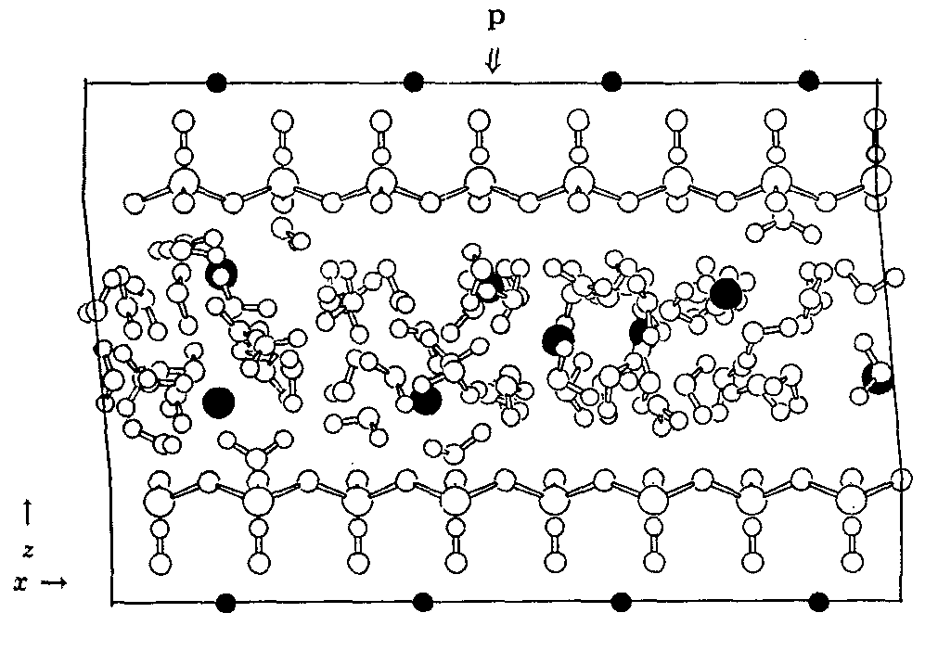
Molecular simulation of clay hydration
Historical perspective
  First all-atom simulations: Skipper et al. (1991), Delville (1991)
  Fixed water content: Boek et al. (1995), Smith (1998)
    xW layering
    Stepwise spacing
  Grand Canonical simulation to relate to RH: Karaboni et al. (1996)
    Usual GCMC too inefficient: need for improved algo
    Early works limited to 1 RH
GC pressure isotherm
GC water content isotherm
﻿Skipper et al. (1991). JCP, 94(11), 7434
﻿Karaborni et al. (1996) Science, 271(5252), 1102

Slide 7
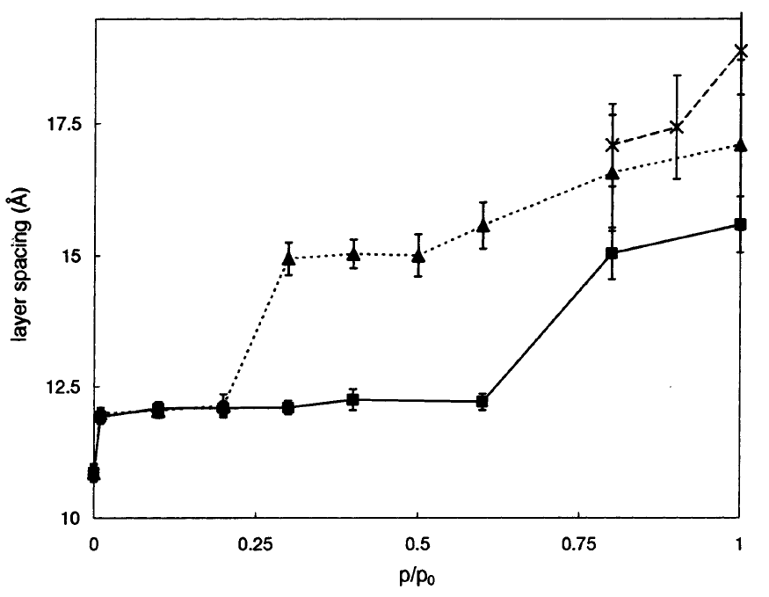
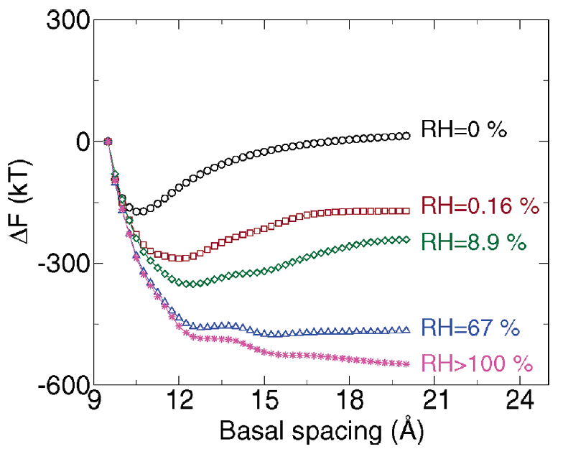
Molecular simulation of clay hydration
Historical perspective
  First swelling prediction: Hensen and Smit (2002)
    μPT ensemble : issue of large hysteresis
  Stable hydration transition: Shroll and Smith (1999), Tambach et al. (2004)
    μVT + thermodynamic analysis
﻿Hensen and Smit (2002) JPC B, 106(49), 12664
﻿Tambach et al. (2004). JPC B, 108(23), 7586

Slide 8
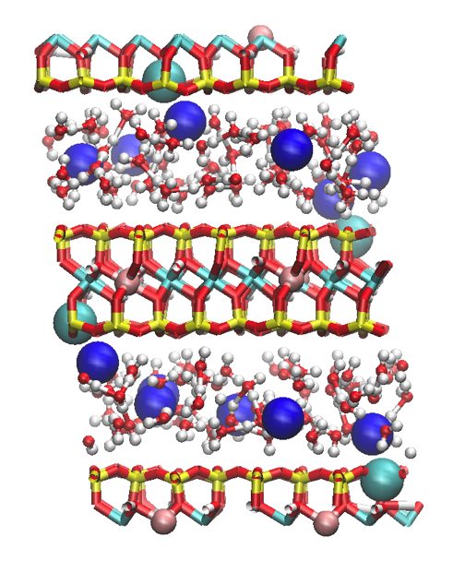
Approach in this work
    μVT + thermo analysis
  Wide range of spacing and RH to provide complete hydration diagram (stability and metastability)
  Constitutive description of each hydration state
  Full stable swelling curve & confrontation with XRD
Molecular model:
  Wyoming Montmorillonite
  M_{0.75}(Si_{7.75}Al_{0.25})(Al_{3.5}Mg_{0.5})O₂₀(OH)₄ + n H2O
Atomic potential:
  ClayFF + water SPCE
Algorithm:
  Configurational Bias Monte Carlo (inspired by Hensen et al., 2001)

Slide 9
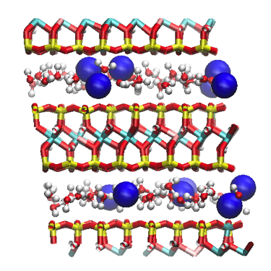
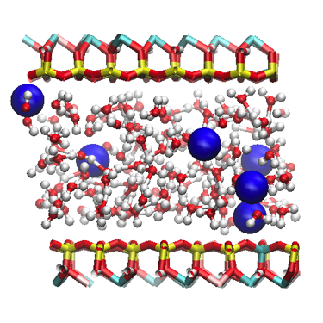
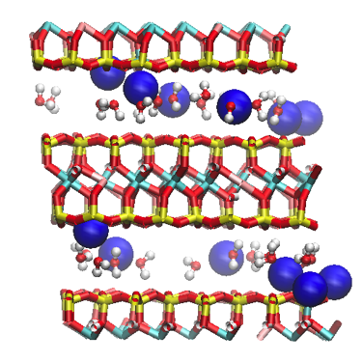
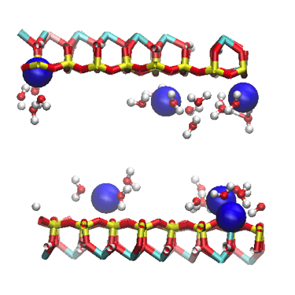
Pressure/density isotherms
Domains of decreasing pressure = xW states
Bulk liquid pressure/density recovered above cavitation (RH > 30%) for e > 19Å

Slide 10
Thermodynamic stability analysis
Unjacketed: P_{ext} = P_{vapor}
Integration of the pressure isotherm provides the grand potential
A system under pressure control minimizes the swelling free energy
Stability analysis
  Unstable = non convex
  Stable states = convex envelop
  Metastable states = convex but not part of convex envelop

Slide 11
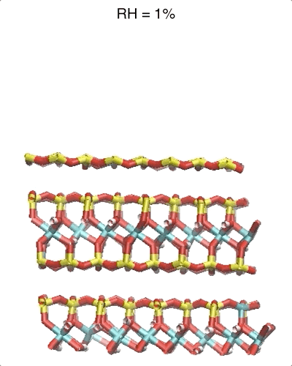
Free swelling : prediction vs. XRD

Slide 12
Full hydration diagram
Plain lines = stable hydration transition
Dashed lines = metastable limit of the xW states

Slide 13
On-going and perspectives
Other cations (K⁺, Ca²⁺), mixtures
Other temperatures (300K to 400K)
Open database

Slide 14
2. From nano to micro
Navier
Continuum mechanics
Granular mechanics
Molecular mechanics

Slide 15
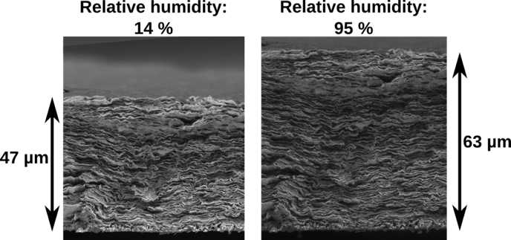
Sub-micron scale poorly known
< 0.1-1 µm almost inaccessible to direct imaging
>1-10 nm inaccessible to mol sim
In-between :
  Microstructure/behavior can only be inferred (small angle, adsorption, porosimetry, indentation)
  Only coarse-grained modeling possible
Carrier (2013) PhD University Paris Est

Slide 16
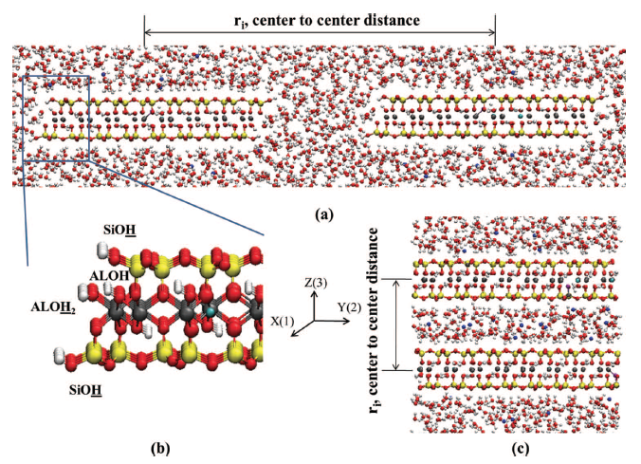
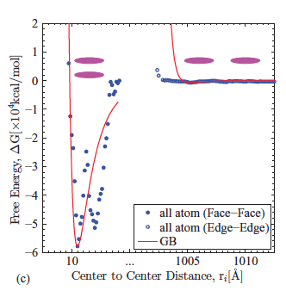
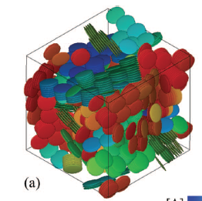
Granular models of clays
Two types of contact law
  ‘diffuse double layer’ (continuum theory valid for large distances → clay suspension)
  ‘mean force potential’ from molecular simulation (valid for short distances → clay matrix)
Hydration transitions and layer flexibility not addressed
Source: Ebrahimi et al. (2014). The Journal of Chemical Physics, 140(15), 154309.

Slide 17
Proposed bottom-up granular model (2D)
Inter-layer potential
Calibration on 1W – 2W domain
Clay layer = chain of particles
  Intra-layer harmonic interaction (bonds and angles)
  Calibration on bending and extension elasticity
  Inter-layer interaction : W potential
  Calibration on disjoining pressure and shear strength (1W and 2W states only)

Slide 18
Microstructure generation
Simple procedure to control the degree of local order
  Start from suspension
  Brownian dynamics with constant compaction rate
  T small enough to avoid 2W-1W transition

Slide 19
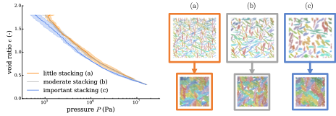
Mechanical behavior
Quasi-static isotropic compression
  Typical e-log(P) behavior
  At P < 1MPa, bending negligible and 2W hydration only
  At P ≈ 10 Mpa, 20% of 1W, elastic modulus controlled by bending (15% of energy)
CIGEO

Slide 20
2W-1W hydration transition

Slide 21
De-hydration / re-hydration
2W-1W transition simply modeled by modulating one parameter (F₀ ≈ P_{capillary})

Slide 22
Critical role of consolidation state
Normally consolidated: current confining pressure is the maximum of the loading history
Over-consolidated: current confining pressure is not the maximum of the loading history
Irreversible compaction : NC >> OC
Consistent with drained heating exp

Slide 23
Perspectives
Detailed characterization
  deviatoric behavior
  rheology / creep / fracture
  local fields / pore size distr.
  adsorption
Refined model
  combine mean force and double layer
  quantitative RH/T evolution
  3D

Slide 24
3. Mesoscale deformation
3SR
Échelle macro
(ingénieur)
Échelle méso (inclusion)
Échelle micro (agrégat d’argile)
Échelle nano (moléculaire)
Caractérisations des mécanismes de déformation à l’échelle méso
Modèle de comportement double échelle méso ---> macro

Slide 25
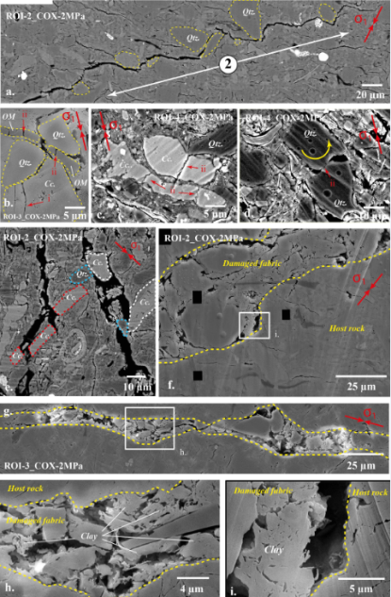
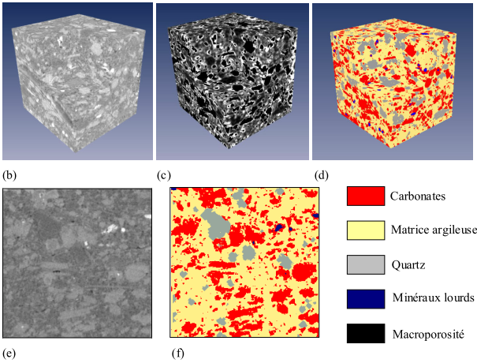
MESOSCALE DEFORMATION
BIB-SEM
Mechanisms of deformation
Evaluation des modes de déformations à l’échelle méso
BIB-SEM post-mortem
Nano-tomographie RX in operando
J.-C. Robinet, 2008
10µm
G. Desbois et al., 2017

Slide 26
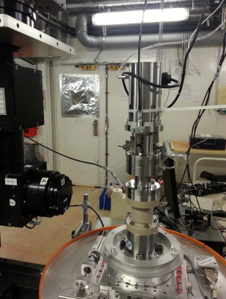
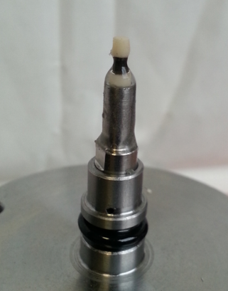
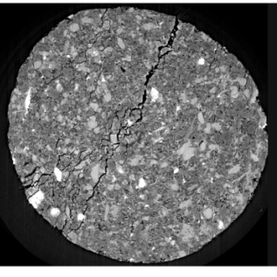
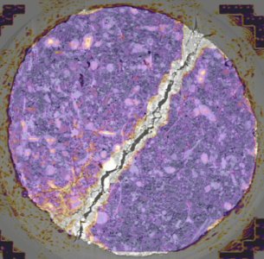
MESOSCALE DEFORMATION
Mechanisms of deformation
in situ test + η-X-ray CT + DIC
Evaluation des modes de déformations à l’échelle méso
BIB-SEM post-mortem
Nano-tomographie RX in operando
1 mm
100µm

Slide 27
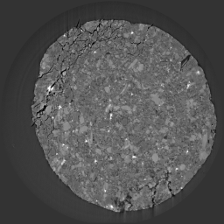
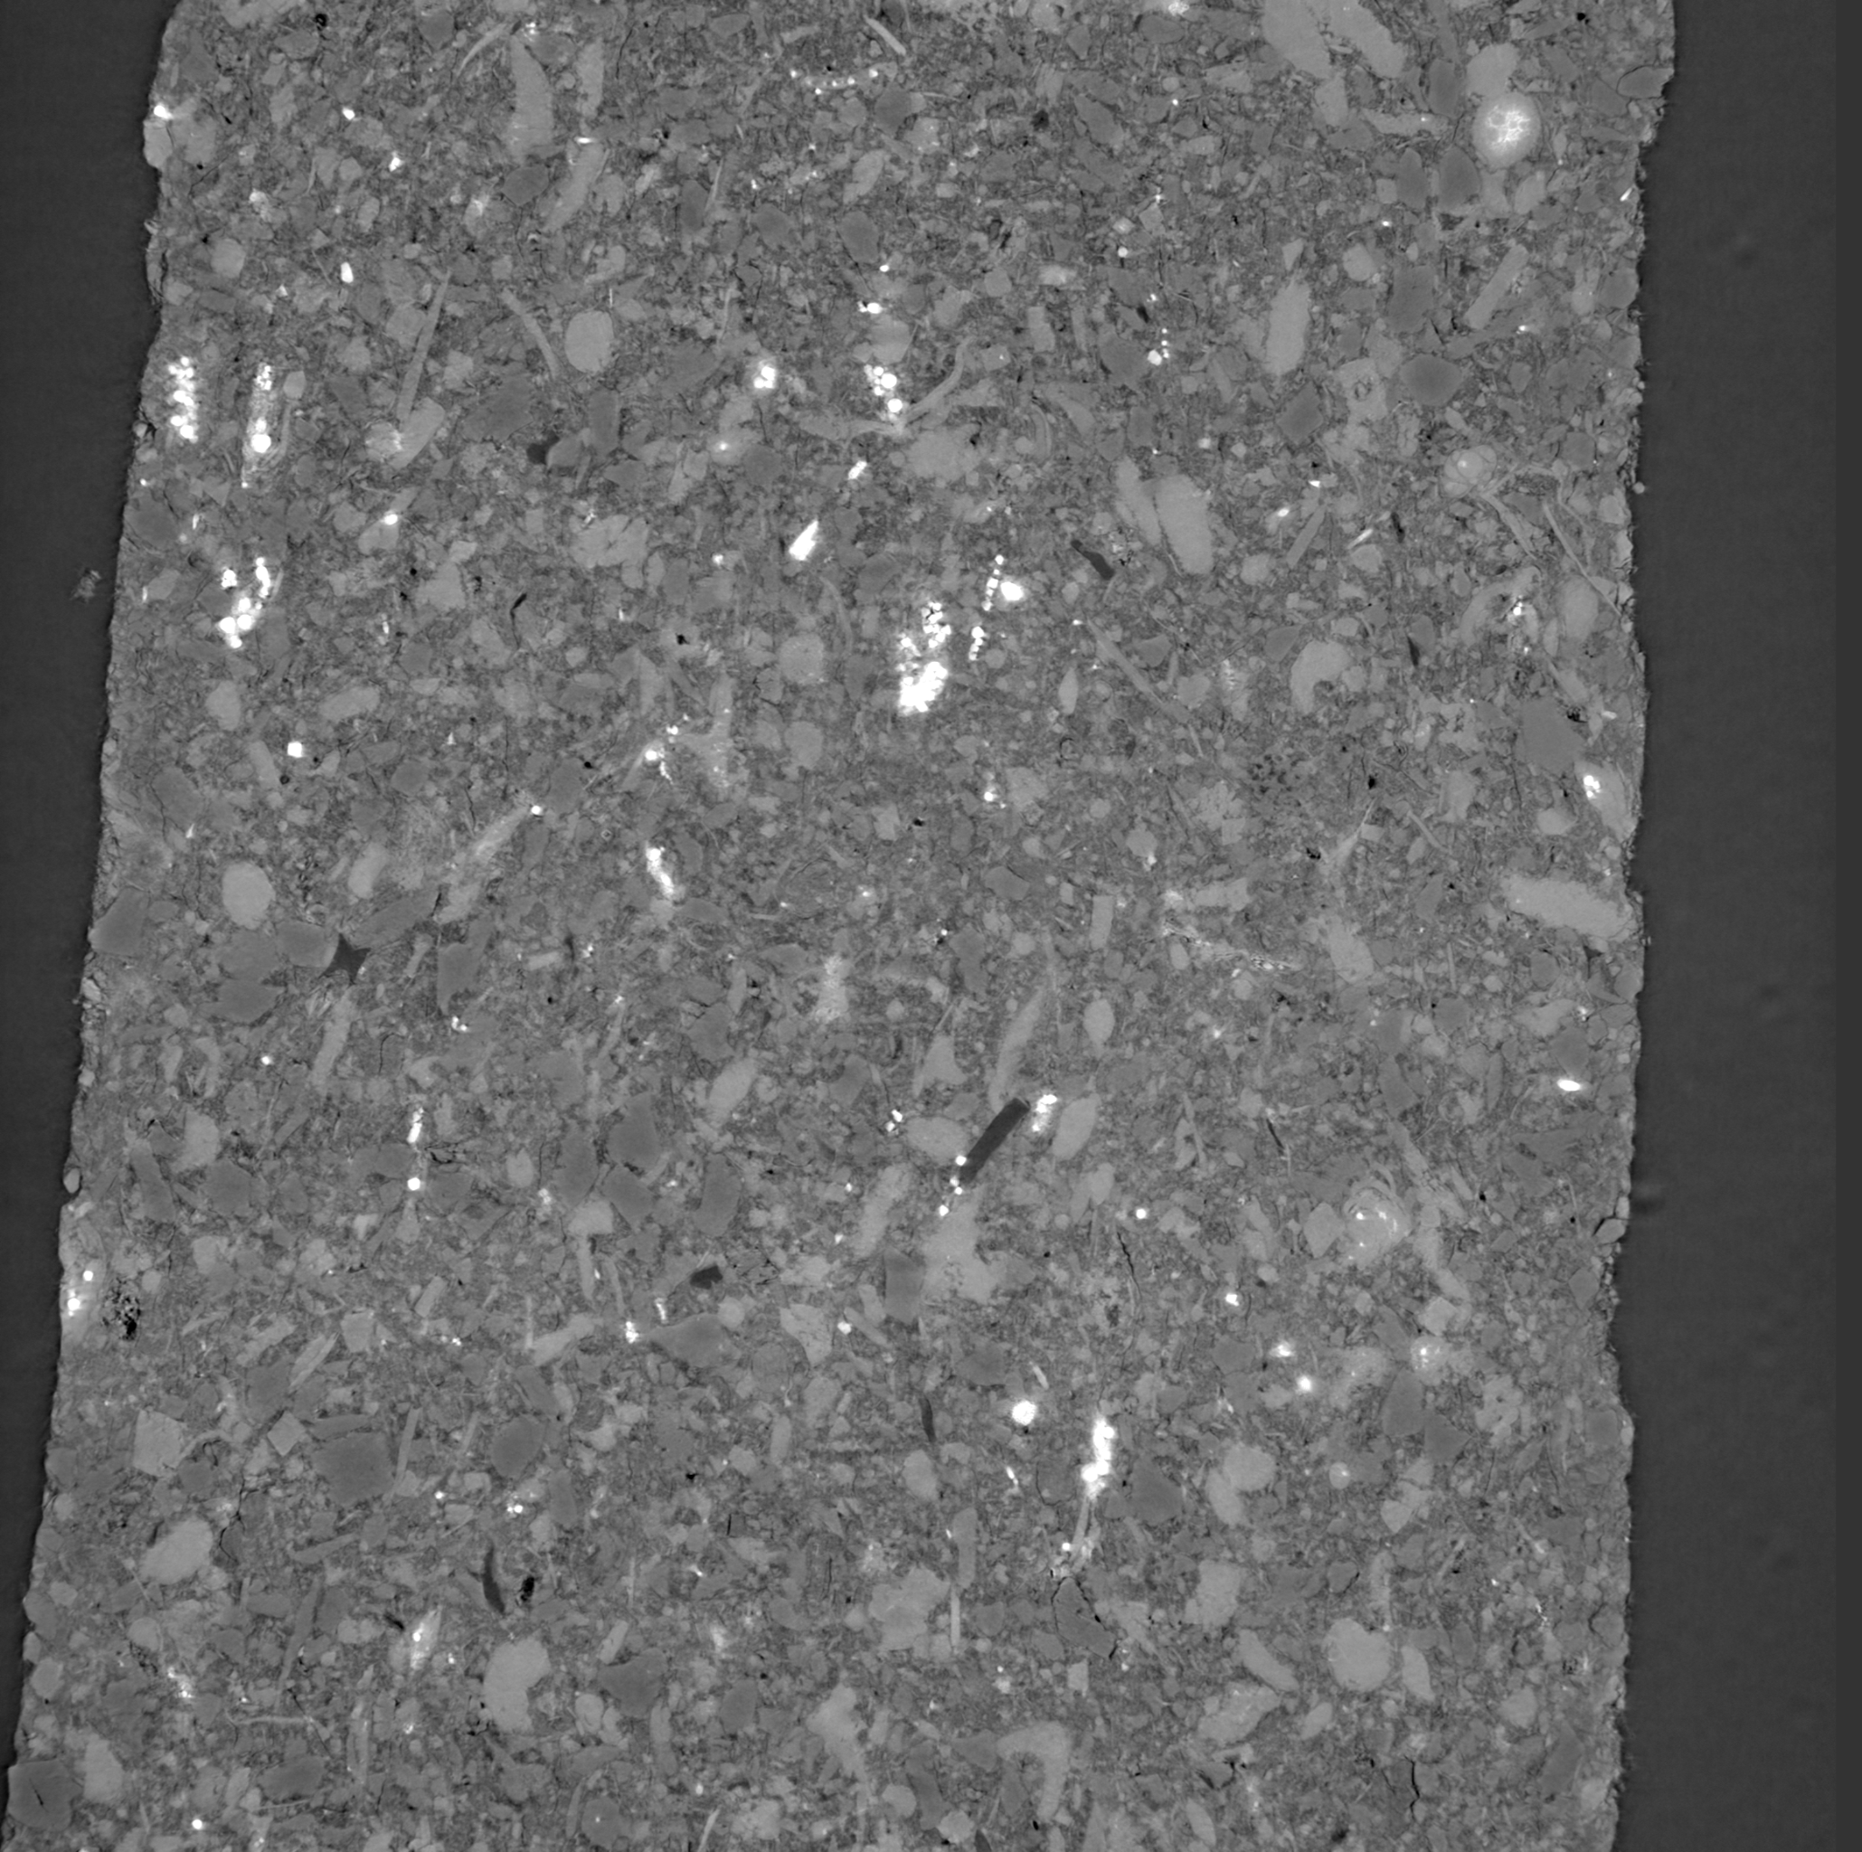
MESOSCALE DEFORMATION
Mechanisms of deformation
Evolution of a vertical slice during loading
3D+T microscale images

Slide 28
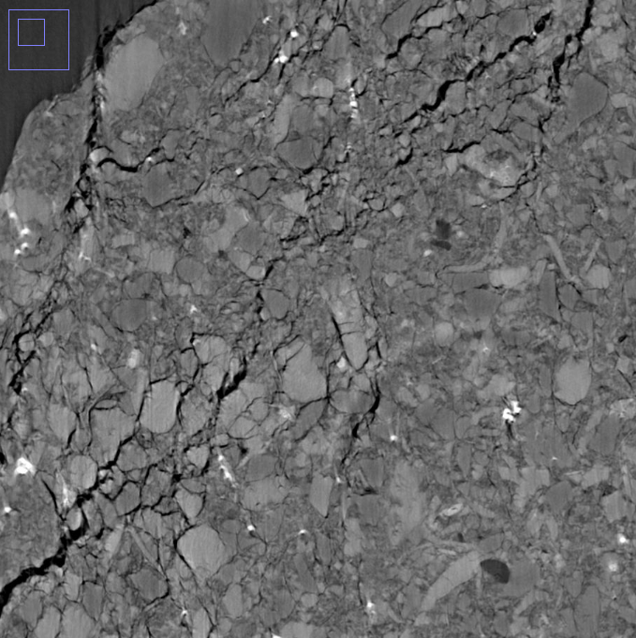
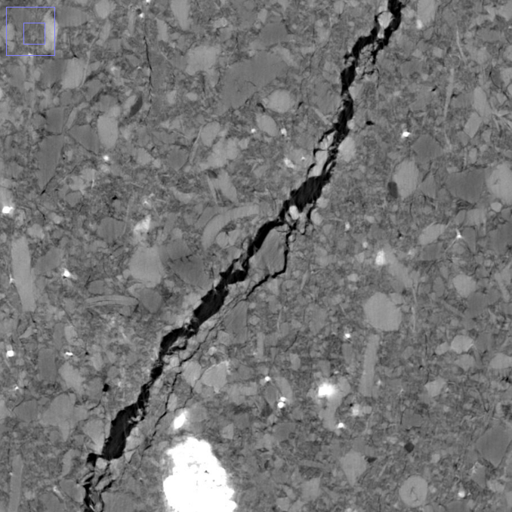
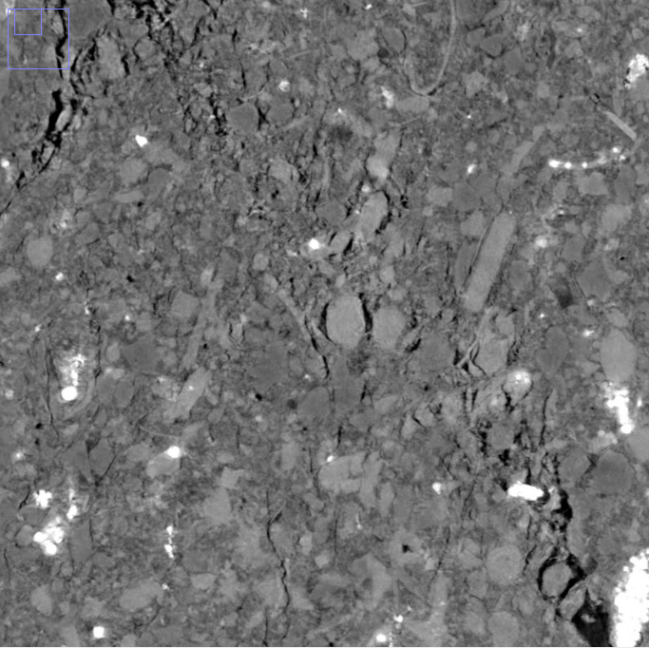
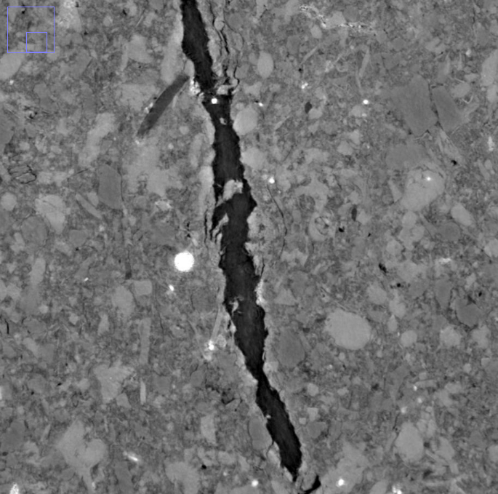
MESOSCALE DEFORMATION
Mechanisms of deformation
Zoom in horizontal slice
In a same specimen, several mechanisms
Decohesion of inclusions
Crushing of clay matrix
Some hard inclusion breakings
Faulting
Zoom in vertical slice

Slide 29
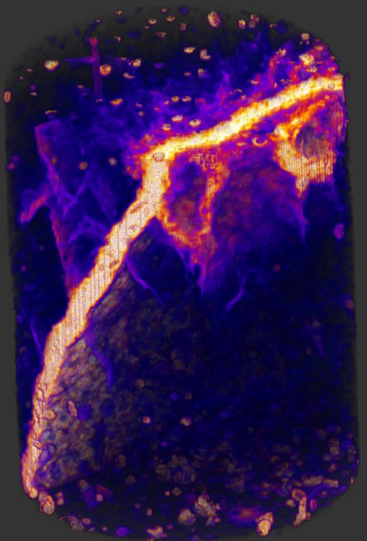
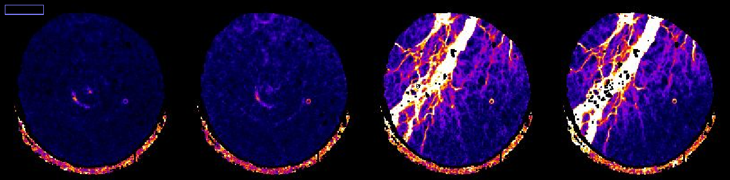
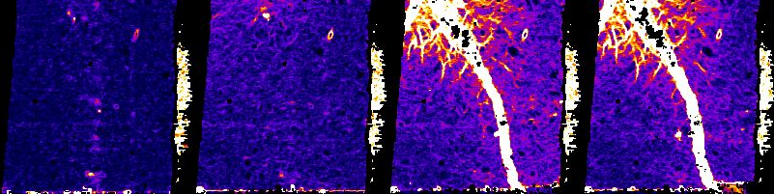
MESOSCALE DEFORMATION
Strain measurement
Combined DIC analysis
Mineralogies decomposition (quartz, carbonate, pyrite, other)
Discrete-DIC for inclusions
Continuous DIC for ‘other’
Merging

Slide 30
MESOSCALE DEFORMATION
Mechanisms of deformation
Perspectives: different kind of loadings
Effect of mean stress level ongoing
Effect of RH evolution (driying, wetting) ongoing
Effect of thermal loading expected (ESRF proposal)

Slide 31
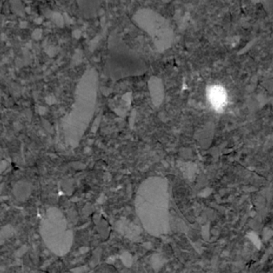
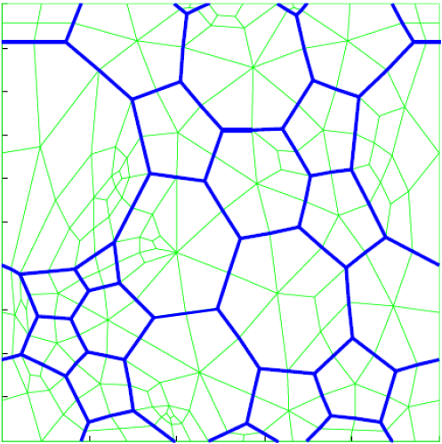
MODEL DOUBLE SCALE BETWEEN MESO & MACRO
Microstructure of the clay-rock
Representative elementary volume (REV)
inclusion
clay matrix
interface inclusion/clay
potential cracks in clay

Slide 32
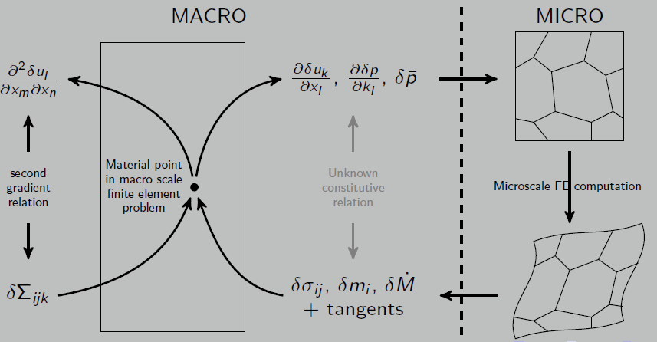
4. Meso to Macro model
3SR
Double scale FEM² model
  Macro field equations
  Macro-to-micro
  Microscale model
  micro-to-Macro

Slide 33
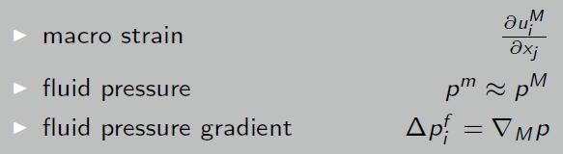
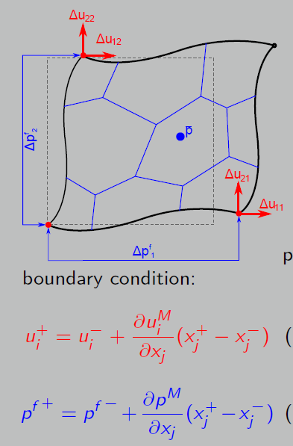
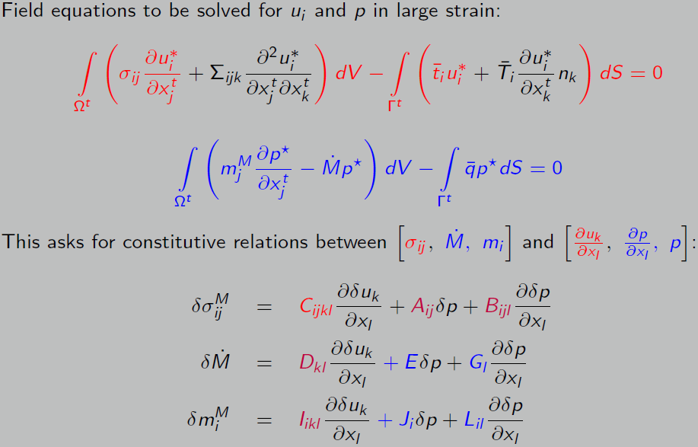
MACRO to MICRO transition
Micro REV: boundary value problem (Macro --> micro)
Periodic boundary conditions:
w ^{f +} + w ^{f -} = 0 (flux)
Frey et al., 2012
Van den Eijnden, 2015

Slide 34

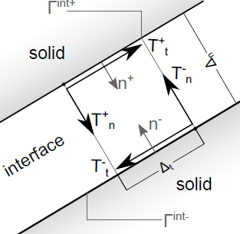
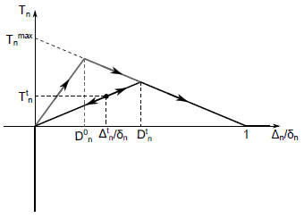
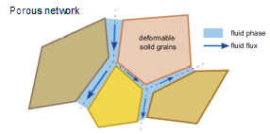
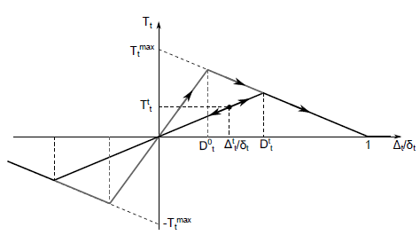
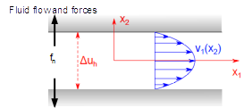

MICROSCALE PROBLEM
Micro REV: mechanical model (constitutive laws)
Mechanics
Fluid flow
Cohesive interfaces (coupling M → H)
  Interface opening defines channel hydraulic conductivity ( $κ ∝ ∆h^{3} )$
Flow assumptions
  Laminar flow between smooth parallel platens
  Network of 1D channels between grains
  System of equations for flow in an element
Fluid forces (coupling H → M)
  Fluid pressure acting normally on solids boundaries
Grains: linear elastic solid phases
Cohesive interfaces: damage laws
Normal
Tangential

Slide 35








MODEL DOUBLE SCALE BETWEEN MESO & MACRO
Microstructure of the clay-rock
Example of realistic microstructures
Mimic of microstructure: density, elongation, orientation, etc…
Model calibration
Macroscale simulations
ε₂₂
1%
2%
2.75%
3%
3.2%
1%
4.6%
Numerical EV, 250 grains
18% quartz, 30% calcite, 2% pyrite, 50% clay
2.4%
Shear strain
Shear strain
rate
Grains elongation
(circumscribed ellipse)
Grains orientation
(circumscribed ellipse)

Slide 36



MODEL DOUBLE SCALE BETWEEN MESO & MACRO
THM coupling
Introduction of THM couplings
Thermal-deformation (solid, fluid)
Energy transport (conduction, convection, advection)
Improvement of porosity description (ongoing/EURAD)
Interface porosity
Meso porosity (new)
Nano porosity inside clay matrix (new)
Menaceur et al, 2016
Meso porosity
Improvement of thermal effect in clay (perpective)
Braun et al, 2019

Slide 37

5. Macro Deformation (centimetric)
IC2MP
Sample 5x5x5 cm³ submitted to thermal load (25°C to 90°C) and a constant relative humidity (RH=62%)
  Free surface in deformation
  Measurement of one face by Digital image Correlation of the cubic sample (called ‘DIC’ sample)
  Measurement of the mass of the second cubic sample (called ‘mass’ sample)

Slide 38

3. Centimetric scale
Sample 5x5x5 cm³ submitted to thermal load (25°C to 90°C) and a constant relative humidity (RH=62%)
  Free surface in deformation
  Measurement of one face by Digital image Correlation of the cubic sample (called ‘DIC’ sample)
  Measurement of the mass of the second cubic sample (called ‘mass’ sample)
Displacement fields
Climatic chamber

Slide 39


Experimental setup
Δm[g]
T [°C], RH [%]
period 2 (8.7 days)
period 1 (0.21 days)
Time [days]
Climatic chamber
RH, T -> each 30 seconds
w [%]
‘Mass’ sample
Water content (w)
Time [days]

Slide 40


DIC measurements
each 15 minutes
Images
H-DIC algorithm
5 cm
displacement fields (u,v)
jump fields (u’,v’)
strain fields (ε_{xx},ε_{yy},ε_{xy})
crack kinematic fields (o,s)
crack area (CA)
bulk strains (ε_{S ROI})
surface strains (ε_{s})
direct crack porosity (φ_{crack-d})
Classical approach
enrichissment

Slide 41








DIC results
Horizontal displacement [mm]
Vertical displacement [mm]
strain fields (ε_{xx},ε_{yy},ε_{xy})
surface strains (ε_{s})
surface 1
finite differences
(grains, clay, interstitial water )
Bedding plane
43.37 mm
surface 2
bulk strains (ε_{S ROI})
One marker at each corner
0
0.2
-0.28
0
Opening crack [mm]
shear crack [mm]
New surface generate by the aperture of the desiccation crack
direct crack porosity (φ_{crack-d})
$$φ_{crack−d}=CA/ROI$$
with $CA\left(t\right)=\sum_{i=0}^{N}{o_{i}\left(x,y,t\right).γ× l_{f}\left(x,y,t\right).γ}$
0.067
0.14
-0.045
0.06
Distribution of local aperture and sliding

Slide 42


Results
[%]
T [°C]
[%]
RH [%]
Time [days]
Time [days]
φ_{crack-d} [%]
Bulk strain ε_{S ROI}
Crack porosity φ_{crack-d}
Block strain ε_{s}
1
ε_{S ROI} - ε_{s} [%]
1

Slide 43

Observations/comments
Close to w = 2,5% corresponding the change of temperature (25°C to 90°C in one hour) the bulk strain is only due to the dilatation of grains, clay, water
[%]
After we observe a diminution of ε_{s} value to the suction
Bulk strain ε_{S ROI}
Crack porosity φ_{crack-d}
surface strain ε_{s}
When w is lower than 2%,
φ_{crack-d} is dominant in the bulk strain ε_{S ROI}
T
When w is lower than 1%,
the dilatation of solid phase (grains, clay, water) is constant ε_{s} (≈1 E-4) and the dilatation of the sample (ε_{S ROI} ) is only due to the crack aperture φ_{crack-d}
w [%]
ε_{s} corresponding to the final thermal dilatation of grains, clay, water is close to 1 E-4

Slide 44


Perspectives
At the centimetric scale
    Confirm these experimental results by a second test (25->90°C)
    Other thermal load (25->60->90°C)
    Numerical model (FEM (CodeAster©)
NOW
NOW
NOW
Pre-existing crack

Slide 45


Perspectives
NOW
At the microscopic scale
  Developement of a new procedure to measure the deformation at the interfaces grain/grain or grain/clay matrix
Not speckle on grains
(Backseattered electrons)
No results on grains and on interfaces
Argillaceous rock
MEBE, Wang et al. 2013
PhD Mammadi Y. (2020)
No results on grains and interface
Sample preparation
(cutting, polishing)
SEM images
(secondary electrons)
FIB patterning
PhD Fauchille AL (2015)
PhD Mammadi Y. (2020)
Speckle by FIB patterning

Slide 46
CONCLUSIONS
Approches multiéchelles des couplages thermo-hygro/hydro-mécaniques
Echelle des feuillets d’argile (modèle moléculaire)
  Caractérisation complète de Na-, K- et Ca-Mnt en fonction de RH
  En bon accord avec le gonflement cristallin obtenu par DRX
Echelle des agrégats d’argile (modèle granulaire)
  Construction d’un modèle granulaire bottom-up valide pour les états denses
  Caractérisation comportement HM de l’échelle ‘matrice argileuse’
Echelle méso (modes de déformation)
  Essais in operando avec imagerie 3D+t haute résolution
  Mesure de la cinématique (DIC) par algorithme ad hoc
Passage méso-macro (modèle FEM²)
  Prise en compte d’une microstructure dans la modélisation macro
  Ajout des couplages THM + porosité réaliste à l’échelle méso
Echelle macro (mode de déformation)
  Quantification des processus de séchage et fissuration

Slide 47
PERSPECTIVES
Approches multiéchelles des couplages thermo-hygro/hydro-mécaniques
Echelle des feuillets d’argile (modèle moléculaire)
  Caractérisation à d’autres températures (300K - 400K)
  Base de donnée publique
Echelle des agrégats d’argile (modèle granulaire)
  Poursuite caractérisation : fluage/rhéologie/fracture, porosité/microstructure
  Modèle raffiné : THM précis, DLVO, 3D
Echelle méso (modes de déformation)
  Extension aux effets de la température (endommagement thermique)
  Analyse comparative nano-tomographie et SEM (nano gravage)
Passage méso-macro (modèle FEM²)
  Prise en compte plus fine du comportement de la phase argileuse sous T
  Application à des calculs à grande échelle (benchmark)
Echelle macro (mode de déformation)
  Exploration des chemins de sollicitation RH et T

