Slide 1

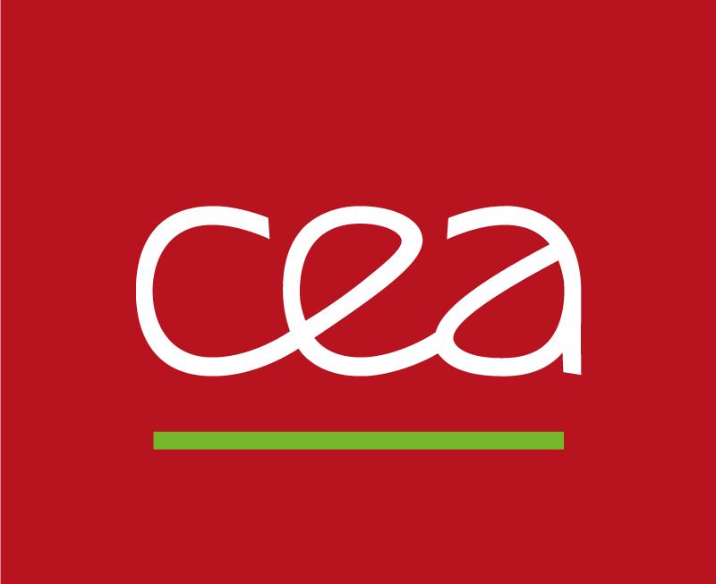

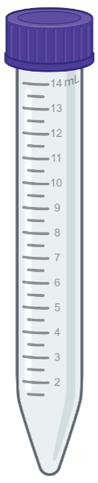
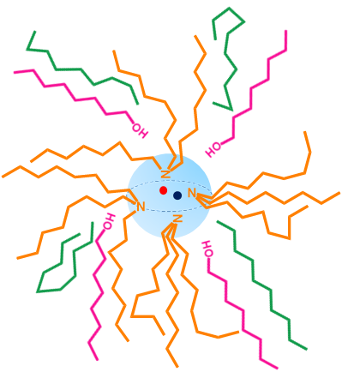
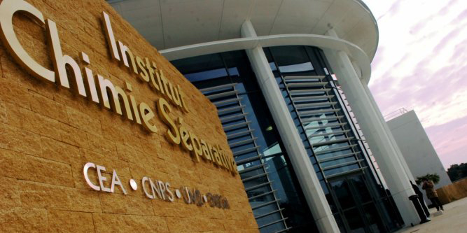

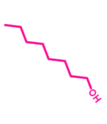
FORMICA 3D
FORmulation et MécanIsmes d’un système d’extraCtion de l’uranium par des Amines tertiaires pour minimiser les verrous de 3ème phase et de Dégradation des extractants
NEEDS Ressources
LTSM – Laboratoire Tri ionique par les Systèmes Moléculaires auto-assemblés
Elise Guerinoni, Sandrine Dourdain, Zijun Lu, Stéphane Pellet-Rostaing
23-25/05/2022

Slide 2
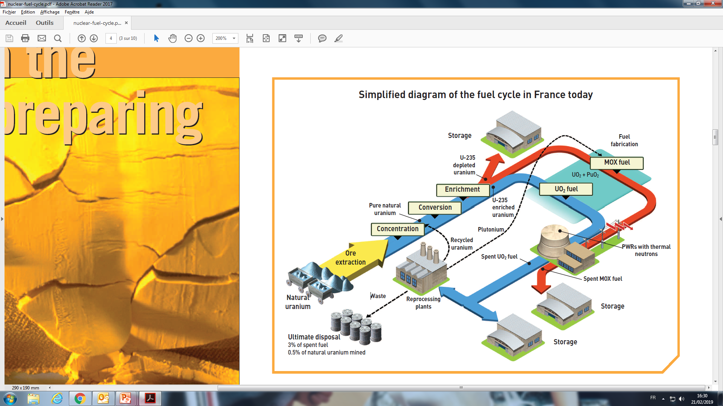
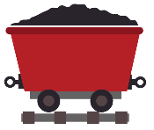
Uranium production & AMEX process
COMMINUTION
PRE-CONCENTRATION
Mined ore
Oxidant
Ore extraction
LEACHING
Lixiviant
Wash water
TAILS
TO WASTE
SOLID/LIQUID SEPARATION
SOLVENT EXTRACTION
ION-EXCHANGE RESIN
YELLOW CAKE PRECIPITATION AND DRYING
https://assets.rte-france.com/prod/public/2020-06/bilan-electrique-2019_1_0.pdf
IAEA, “Uranium 2018: Resources, Production and Demand.”

Slide 3
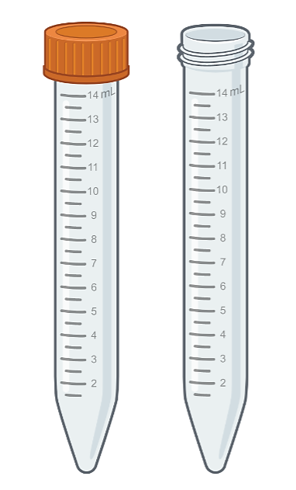




AMEX process and solvent extraction
Extractant : tertiary amine
Diluent : linear alcane
Phase modifier : 1-octanol
Common Name | Composition |  | Nature of the amine
Alamine 336 | Di-n-octyl monodecylamine | 44 % | R₁, R₂ R₃
 | Tri-n-octyl-amine | 28 % | R₁, R₂, R₃
 | Mono-octyl di-decyl-amine | 23 % | R₁ R₂, R₃
 | Tri-n-decyl-amine | 3 % | R₁, R₂, R₃
Alamine 308 | Tri-isooctyl-amine | 100 % | R₁, R₂, R₃
Alamine 304 | Tri-n-dodecyl-amine | 95-100 % | R₁, R₂, R₃
Leaching containing :
Uranium sulfate
Impurities : Fe, Zr, Mo, V
Sulfurique acid
Ammonium sulfate
Problem:
Non selective extraction
3rd phase formation
Amines degradation due to combined presence of octanol and vanadium
C. Boirie, “Extraction of uranyl sulfate with amines,” Bull. soc. chim. France, vol. No. 8-9, 1958
A. Chagnes et.al., Solvent Extraction and Ion Exchange, vol. 30, no. 1, pp. 67–76, 2012
Notes:
Purifier l’urnanium et on fait de l’extraction liquide liquide
Et amex description
Premier etape est la protonation et comparable aun ammonium quaternaire

Slide 4
FORMICA 3D
FORmulation et MécanIsmes d’extraCtion de l’uranium par des Amines tertiaires pour minimiser les verrous de 3ème phase et de Dégradation des extractants
Extractant : tertiary amine
Diluent : linear alcane
Phase modifier : 1-octanol
Aggregate
Polar core
Apolar shell
Extractant = Amphiphilic molecule
Polar head
Apolar chain
¹ Sato, T., Watanabe, H., & Suzuki, H. (1986). Liquid-liquid extraction of molybdenum(VI) from aqueous acid solutions by high-molecular weight amines Solvent Extraction and Ion Exchange, 4(5), 987‑998.
² Chagnes, A., & Cote, G. (2018). Chemical Degradation of a Mixture of tri-n-Octylamine and 1-Tridecanol in the Presence of Chromium(VI) in Acidic Sulfate Media. Metals, 8(1), 57.
Notes:
A l’echelle moléculaire on considère que c’est que la complexation
qui joue selon le mécanisme d’extration echnage anionique

Slide 5
Objectives
Formulating new systems to optimize the AMEX process and to avoid 3rd phase problems:
    Effect of extractant alkyl chains
    Effect of diluent alkyl chains
Aggregate
Polar core
Apolar shell
5

Slide 6

Effect of extractant alkyl chains length
Increasing $l_{alkyl chain}$
C6 THA
C7 THA
C8 TOA
C9 TNA
C10 TDA
On phase stability?
On extraction?
On extraction mechanisms?

Slide 7
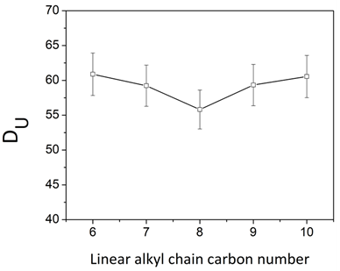
Effect of extractant alkyl chains length
[amine] = 0.2 M
[1-octanol] = 0.316 M
dodecane
[U] = 10.5 M
[H₂SO₄] = 0,1 M
[(NH₄)₂SO₄] = 1 M
Increasing $l_{alkyl chain}$
C6 THA
C7 THA
C8 TOA
C9 TNA
C10 TDA
On phase stability?
On extraction?

Slide 8
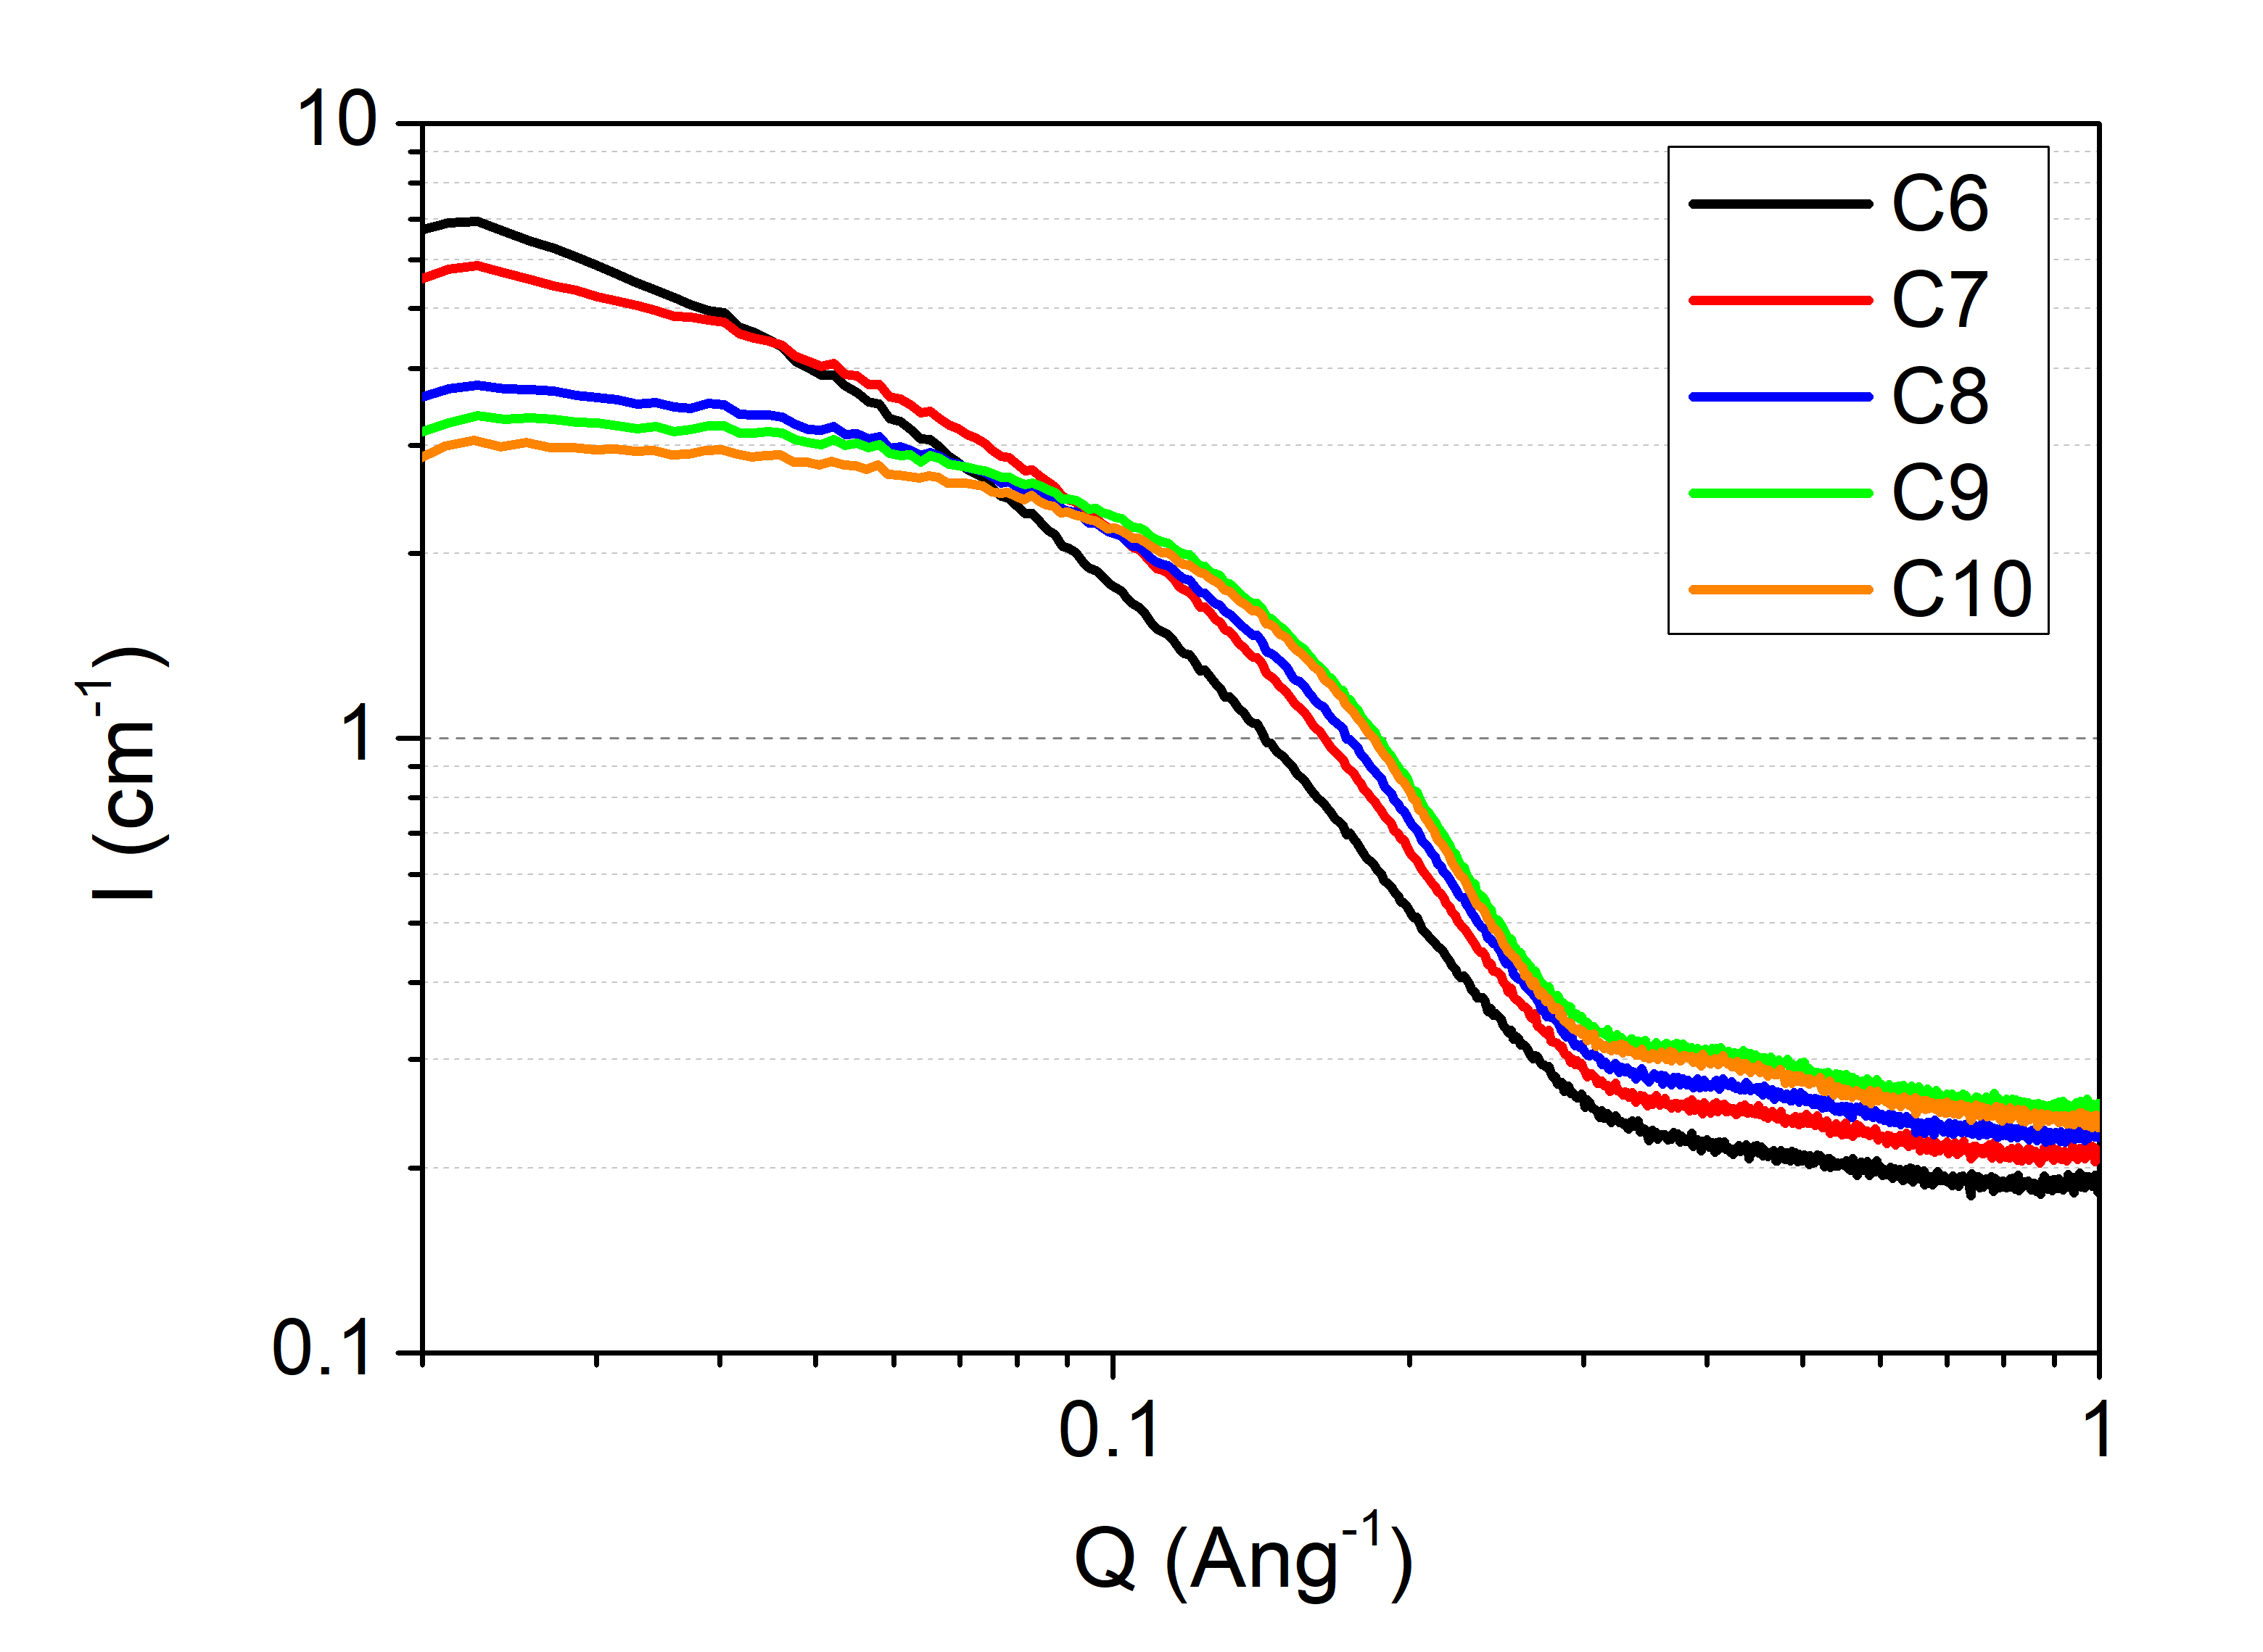

Effect of extractant alkyl chains length
Increasing $l_{alkyl chain}$
C6 THA
C7 THA
C8 TOA
C9 TNA
C10 TDA
On extraction mechanisms? Chelation
On extraction mechanisms? Aggregation
SANS
EXAFS
No effect of alkyl chain on chelation mechanisms
Presence of aggregates – differents shape, size & interactions

Slide 9

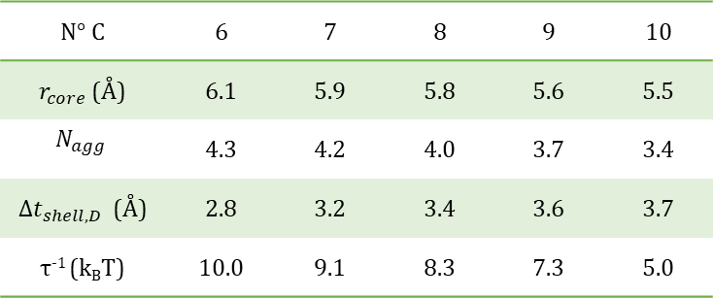
Effect of extractant alkyl chain on aggregation
Supramolecular scale
SANS fitting Core shell model + Sticky hard Sphere
C6
C7
C8
C9
C10
N° C | 6 | 7 | 8 | 9 | 10
$r_{core}$ (Å) | 6.1 | 5.9 | 5.8 | 5.6 | 5.5
$$N_{agg}$$ | 4.3 | 4.2 | 4.0 | 3.7 | 3.4
${∆t}_{shell,D}$ (Å) | 2.8 | 3.2 | 3.4 | 3.6 | 3.7
τ⁻¹ (k_{B}T) | 10.0 | 9.1 | 8.3 | 7.3 | 5.0
With $l_{alkyl chain}$ increasing
Aggregates with smaller polar core;
Aggregates with thicker apolar shell;
Attractive interactions between aggregates less important →less 3rd phase.
Notes:
2 échelle rond vert et rond gris
Modifier configuration chaines alkylesmais même tete polaire pour montrer que agrégation est importante et pas seulment complexation
Pourquoi la tete polair ec’est l’amine et les premiers carbones et pas autre chose ?

Slide 10
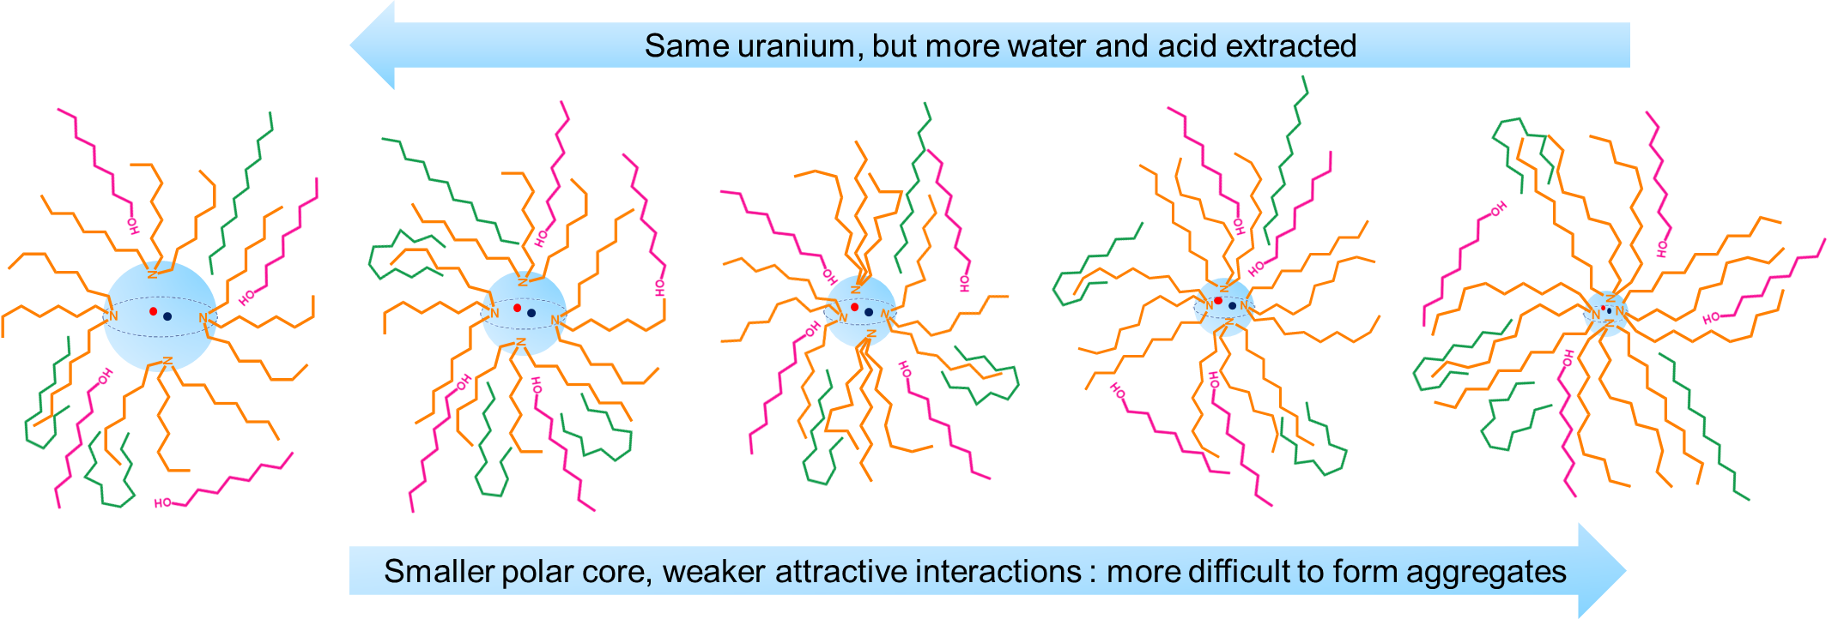
Aggregation and 3rd phase formation mechanism
Supramolecular scale
More 3rd phase
Less 3rd phase
All data was rationalized with the
thermodynamic ienaic approach
Z. Lu, S. Dourdain, B. Demé, J.F. Dufrêche, T. Zemb, S. Pellet-Rostaing, Journal of Molecular Liquids, 349, 118409, 2022
Z. Lu, S. Dourdain, B. Demé, J.F. Dufrêche, T. Zemb, S. Pellet-Rostaing, Journal of Molecular Liquids, Journal of Molecular Liquids, 349, 118487, 2022
Notes:
2 échelle rond vert et rond gris
Modifier configuration chaines alkylesmais même tete polaire pour montrer que agrégation est importante et pas seulment complexation
Pourquoi la tete polair ec’est l’amine et les premiers carbones et pas autre chose ?

Slide 11
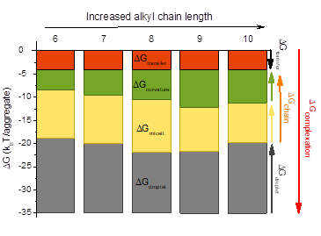
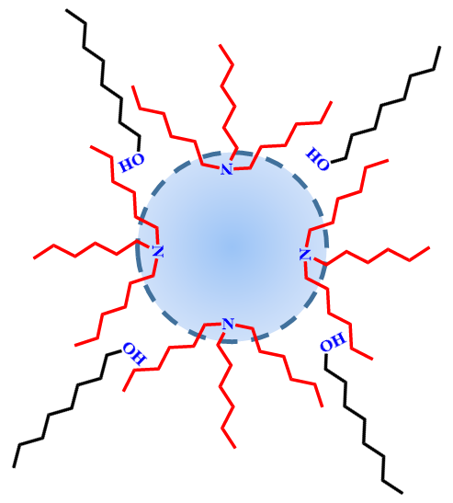
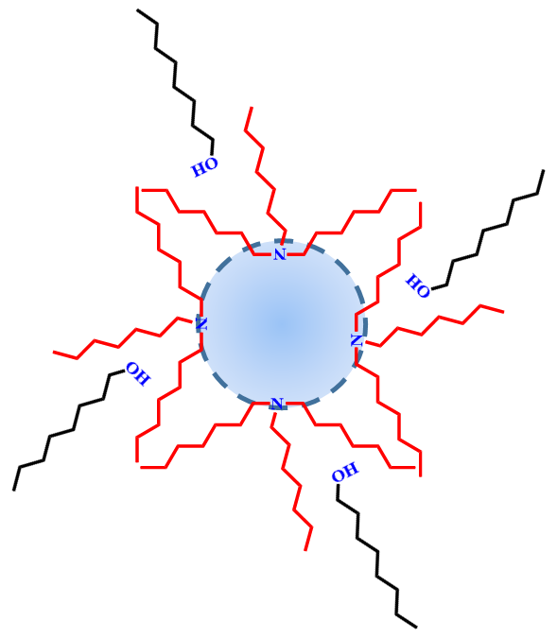
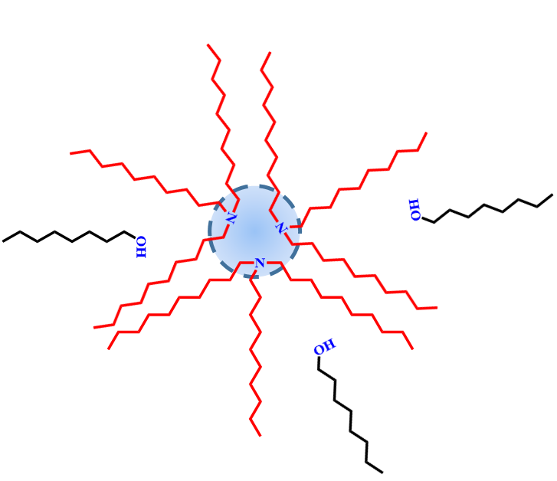
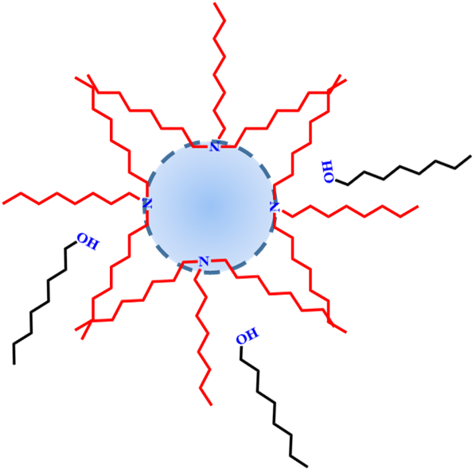
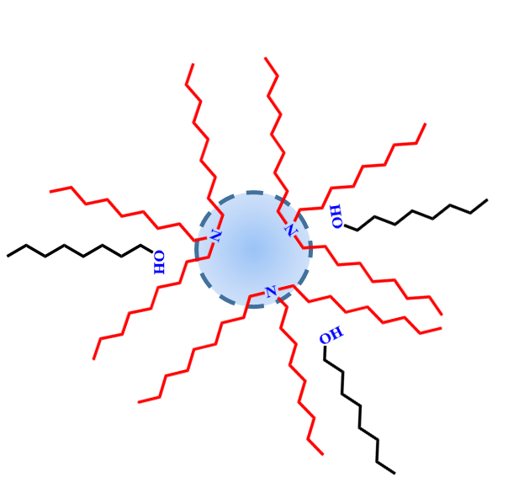
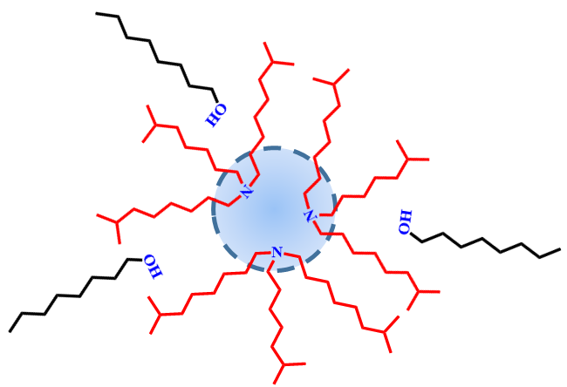
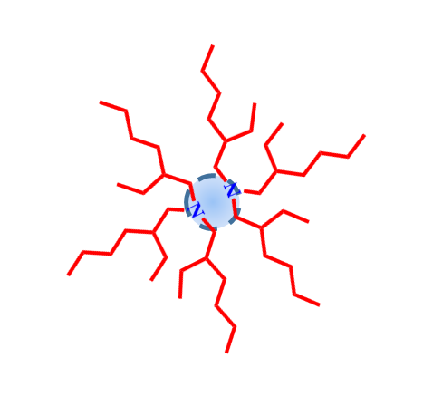

Thermodynamic balance of the extraction – Ienaic
$$p=\frac{V}{al_{c}}$$
$$ΔG_{transfer}= ΔG_{complexation}+ΔG_{droplet}+ΔG_{chain}$$
$$ΔG_{chain}=ΔG_{micellisation}+ΔG_{curvature}$$
More 3rd phase
Less 3rd phase
To avoid 3rd phase, optimal system: long or branched chains !
Notes:
Bulk : mettre en paquet les cations stoechimoetrique de chacun des composé hydrophiles
Micellisation ; mettre en paquet les agregats
Rayon cœur de cœur et de couronne necessaire pour calculer l’energie de courbure
Energie de courbure la plus impacté
Packing de la molécule equation à mettre dans diapo
V is the volume of the hydrophobic part of the extractant, lc the alkyl chains length (which
is usually 80 % of the extended chains length) and a the area per head group.

Slide 12
Objectives
Formulating new systems to optimize the AMEX process and to avoid 3rd phase problems:
    Effect of extractant alkyl chains
    Effect of diluent alkyl chains
Aggregate
Polar core
Apolar shell
12

Slide 13

Effect of diluent chain length
[amine] = var
[1-octanol] = var
alkane
Effect of diluent chain length
[U] = 10.5 M
[H₂SO₄] = 0,1 M
[(NH₄)₂SO₄] = 1 M
Increasing $l_{diluent }$
C5 C6 C7 C8 C10 C12 C14 C16
On phase stability?
On extraction?

Slide 14
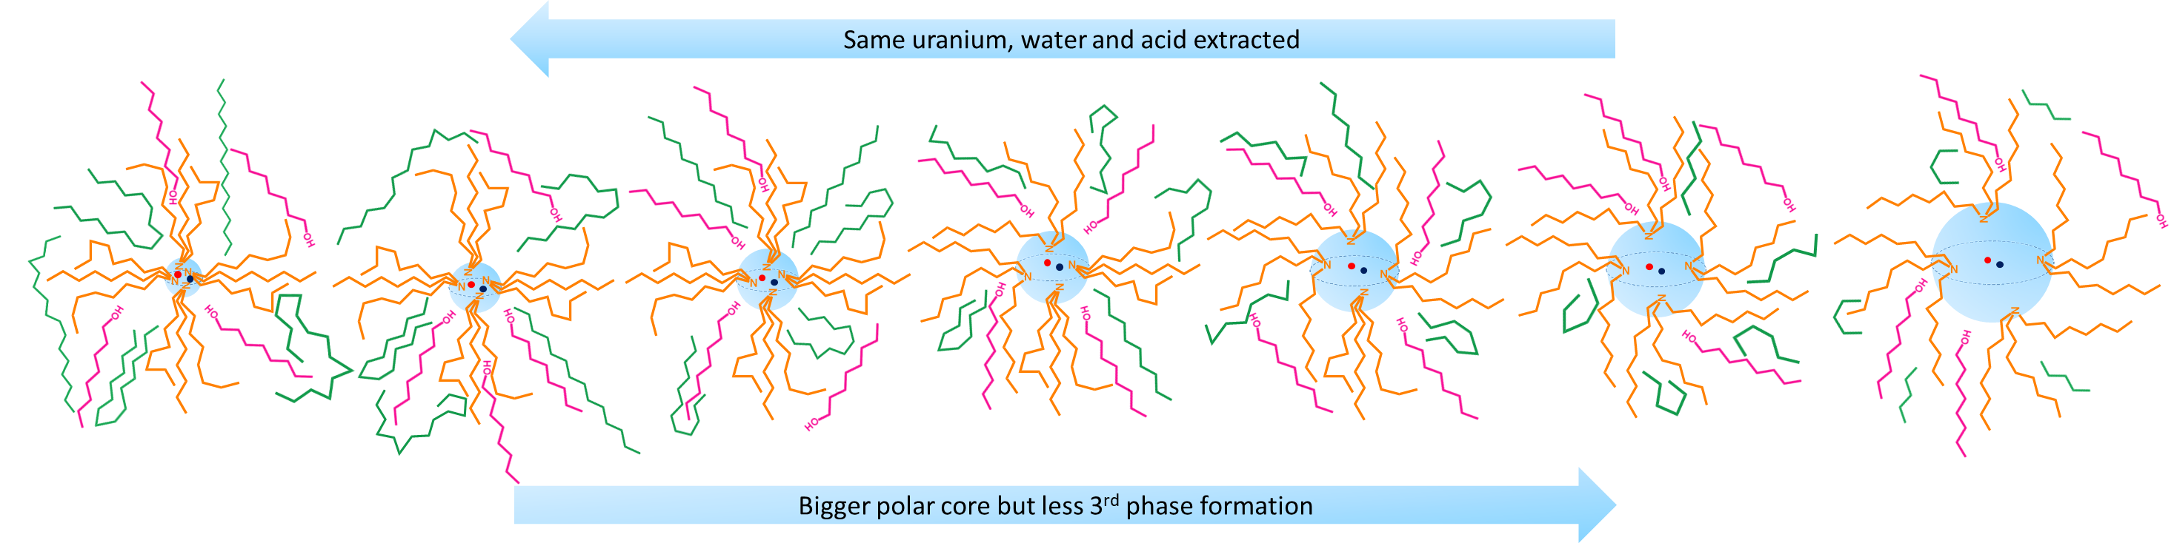
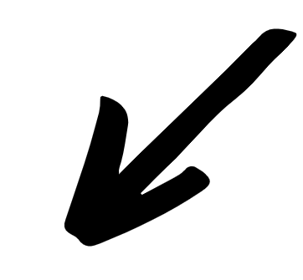

Effect of diluent chain length
Effect of diluent chain length
Increasing $l_{diluent }$
C5 C6 C7 C8 C10 C12 C14 C16
On aggregation:
SAXS
With $l_{alkyl chain}$ increasing
Aggregates with smaller polar core;
But with more 3rd phase ?
→ origin of interaction ?
Notes:
Modele de baxter
Mecanimse de foramtion de troisème phase

Slide 15
Origin of the third phase ?
Extractant
More 3rd phase
with bigger core
Less 3rd phase
with smaller core
Diluent
More 3rd phase
with smaller core
Less 3rd phase
With bigger core??
New mechanism for third phase formation ?
Hypothesis: depletion forces generated by diluent around agregates to be studied with neutron scattering

Slide 16

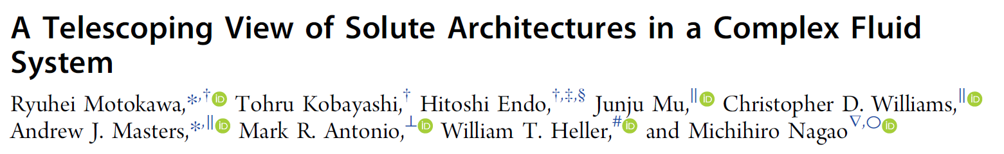

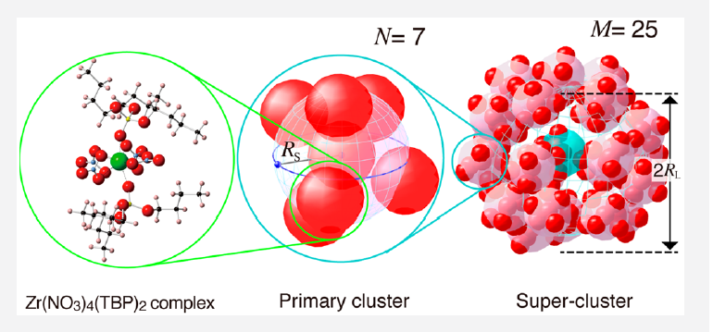

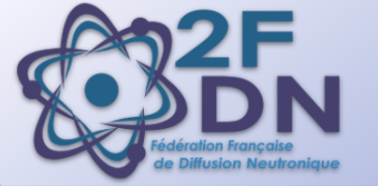


Perspectives
Understanding diluent effect and origin of the third phase formation:
- Full characterization of the third phase
- SANS of the extraction to test new structure factors
taking into account depletion effects
Framework of Elise Guerinoni Thesis: ILL
Proposal submission for SANS measurement
on JRR-3 in Japan in 2022 with Ruihey MOTOKAWA
2FDN funding
NEEDS project : FORMICA
JSPS fellowship application
NEEDS
Motokawa, R., Kobayashi, T., Endo, H., Mu, J., Williams, C. D., Masters, A. J., Antonio, M. R., Heller, W. T., & Nagao, M. (2019). ACS Central Science, 5(1), 85‑96.

Slide 17
Selectivity

Slide 18
Effect of diluent chain length
[TOA] = 0.1 M
[1-octanol] = 0.063 M
Linear alcane
[U] = 10.5 M
[H₂SO₄] = 0.1 M
[(NH₄)₂SO₄] = 1 M
Quand on s’approche de la troisème phase
Berthon, L., Martinet, L., Testard, F., Madic, C., & Zemb, Th. (2007). Solvent Penetration and Sterical Stabilization of Reverse Aggregates based on the DIAMEX Process Extracting Molecules : Consequences for the Third Phase Formation. Solvent Extraction and Ion Exchange, 25(5), 545‑576

Slide 19
Quand on s’approche de la troisème phase
HEXANE
OCTANE
DECANE
DODECANE
HEXADECANE

Slide 20
Caractérisation de la troisième phase
2M TOA 1pc oct light et heavy

Slide 21
Résultats var TOA dans la light phase et dosage de la light phase
[TOA] = 1.8 M SAXS light phase
Obs : remontée plus important quand y a octanol -> normalement octanol devrait empecher la remontée ?? Ou alors il permet que y ai des agregats quand meme mais qu’ils ne collapsent pas
remontée pour tous les diluants même dans la phase legère
La TOA phase orga dans dodecane remonte droit, qu’est ce qu’on a dans la phase légère ?
[TOA] = 1.8 M SAXS 3rd phase
Obs : remontée plus important quand y a octanol
remontée pour tous les diluants même dans la phase legère
La TOA phase orga dans dodecane remonte droit, qu’est ce qu’on a dans la phase légère ?
TOA (mol/L) | 1.8 | 1.8 | 1.8 | 1.8
Diluent | hexane | dodecane | dodecane | hexadecane
% oct | 1 | 1 | 0 | 1
eau (mol/kg) | 0.41037222 | 0.25533333 | 0.04251111 | 0.22816944
% erreur | 0.01092235 | 0.0009271 | 0.00062854 | 0.00269093
TOA (mol/L) | 1.8 | 1.8 | 1.8 | 1.8
Diluent | hexane | dodecane | dodecane | hexadecane
% oct | 1 | 1 | 0 | 1
eau (mol/kg) | 3.40547778 | 4.00086296 | 5.38393333 | 3.97770556
% erreur | 0.02423805 | 0.09293236 | 0.09868908 | 0.02700362

Slide 22
On double et triple la quantité d’extractant au dessus de la frontière 3rd phase
Dosage de l’eau 3rd phase
TOA (mol/L) | 0.6 | 1.2 | 1.8
% oct | 1 | 1 | 1
Diluent | hexadecane | hexadecane | hexadecane
eau (mol/kg) | 3.68309167 | 4.00755 | 3.97770556
% erreur | 0.03084164 | 0.09409991 | 0.02700362
TOA (mol/L) | 0.6 | 1.2 | 1.8
% oct | 1 | 1 | 1
Diluent | hexadecane | hexadecane | hexadecane
eau (mol/kg) | 0.267475 | 0.23434722 | 0.22816944
% erreur | 0.00144171 | 0.00429371 | 0.00269093

Slide 23
Comparaison liquid ionique et 3ème phase

Slide 24
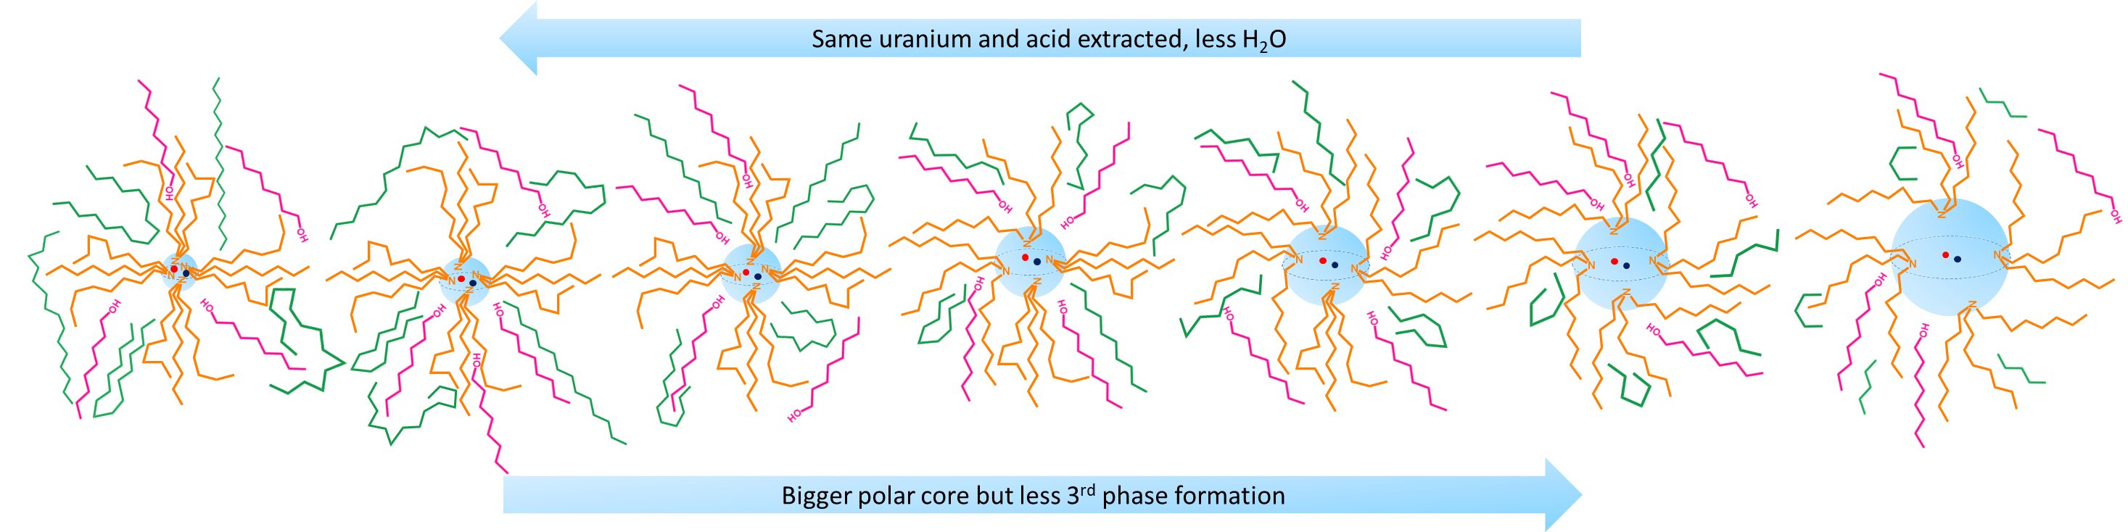
Effect of diluent chain length
New mechanism of third phase formation controlled by:
        depletion forces
        diluent penetration
Notes:
Modele de baxter
Mecanimse de foramtion de troisème phase

Slide 25
Perspectives
Proposal submission for SANS measurement
on JRR-3 in Japan in 2022 with Ruihey MOTOKAWA
2FDN funding
NEEDS project : FORMICA
JSPS fellowship application
Thank you for
your attention
Motokawa, R., Kobayashi, T., Endo, H., Mu, J., Williams, C. D., Masters, A. J., Antonio, M. R., Heller, W. T., & Nagao, M. (2019). A Telescoping View of Solute Architectures in a Complex Fluid System. ACS Central Science, 5(1), 85‑96.
Notes:
Cœur tout est petit donc dificile de fitter le saxs et du coup le modèle est pas toujours verifier car l’eau n’est peut etre pas en rond sére
Le sans fit otu l’agrégat et le contraste est plus fort
On peut s’amuser à deuterer une parrtie pour voir ou est l(‘octnaol par exemple

Slide 26
Objectives
Formulating new systems to optimize the AMEX process and to avoid 3rd phase problems:
    Effect of amines and diluent alkyl chains
    Applying quaternary ammonium ionic liquids

Slide 27
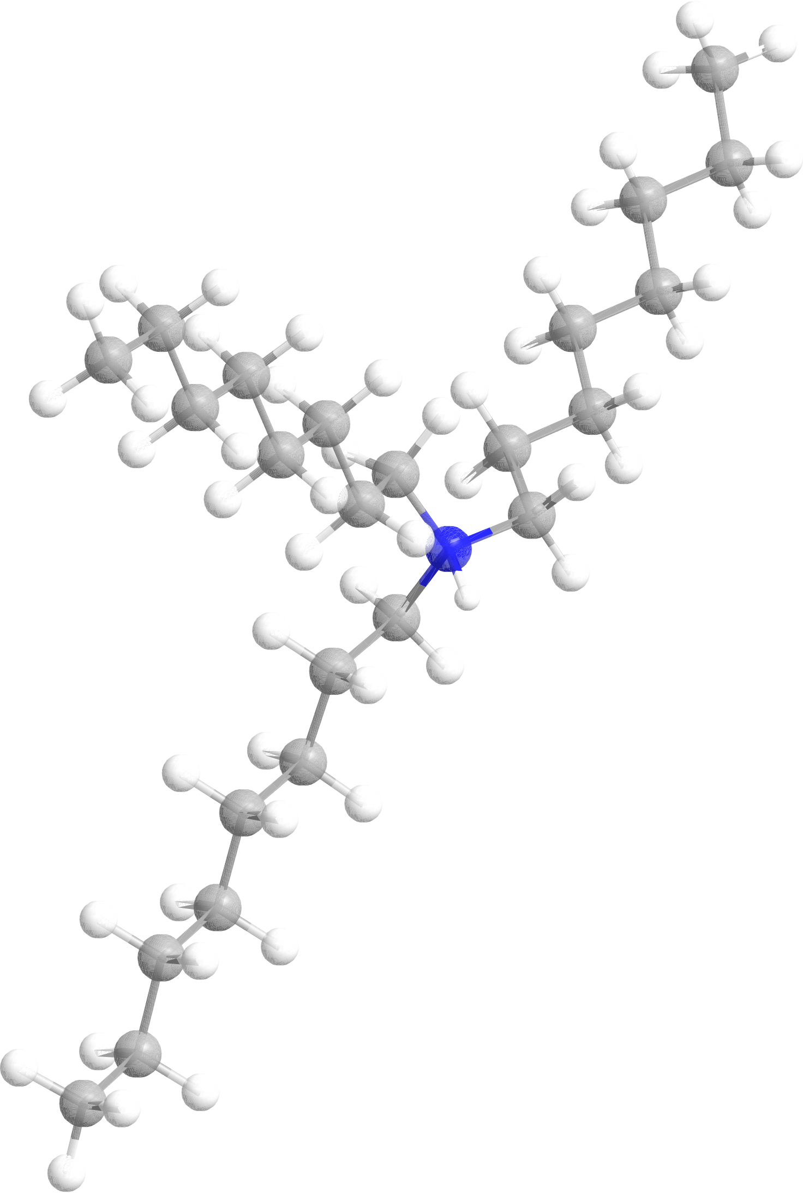
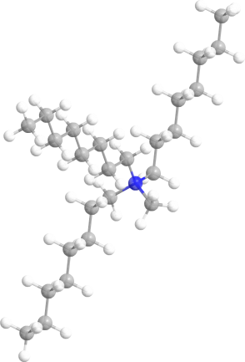
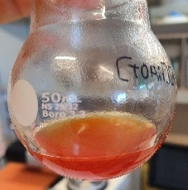
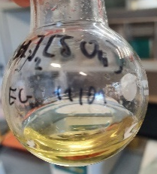
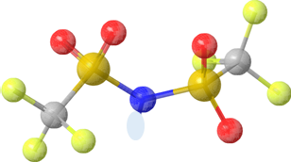
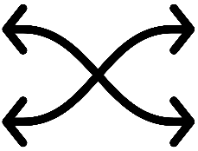
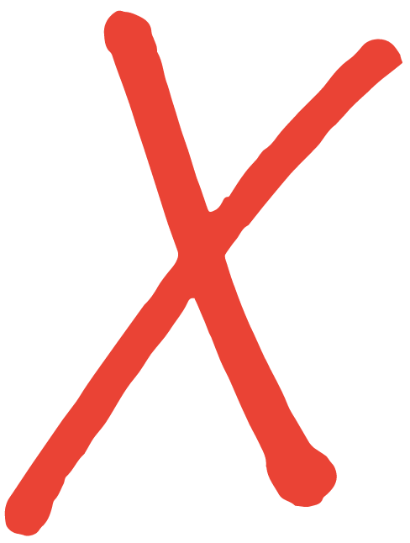
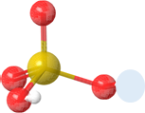
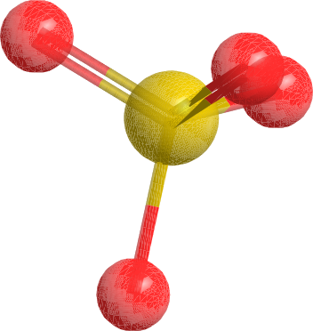
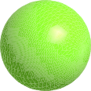












Ionic liquids
Step 1: trialkylamine protonation
Ammonium-based Ionic Liquids
Step 2: uranyl extraction by anionic exchange
[TOAH][NTf₂]
[TOAH]₂[SO₄]
Trioctylammoniums ($TO{AH}^{+}$)
Methyltrioctylammoniums ($MTOA^{+}$)
$${NTf}_{2}^{−}$$
$${HSO}_{4}^{−}$$
$${SO}_{4}^{2−}$$
D_{U} = 0
D_{U} = 100
$${SO}_{2}$$
$${Cl}^{−}$$
viscous
$$N$$
$${CF}_{3}$$
Dodecane
Replace organic phase
No dilution, no 3rd phase
$${CF}_{3}$$
$${SO}_{2}$$
1-octanol
Notes:
An ionic liquid (IL) is a salt in the liquid state. In some contexts, the term has been restricted to salts whose melting point is below some arbitrary temperature, such as 100 °C (212 °F). While ordinary liquids such as water and gasoline are predominantly made of electrically neutral molecules, ionic liquids are largely made of ions.

Slide 28
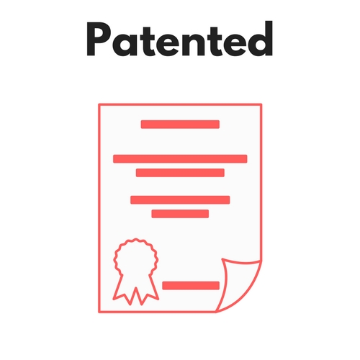

Synergistic mixture of anions
Mixtures with same anions and different cations
Mixtures with same cations and different anions
Organic phase
Mixtures of two ammoniums
Objectives:
Comparisson of conventionnal and ionic liquid media for:
      Extraction capacity
      Extraction mechanism
      Explain the anionic synergy, not investigated in literature
Aqueous phase
0.1 M $H_{2}SO_{4}$ and 0.1 M${(NH}_{4})_{2}SO_{4}$ + 250 ppm U(VI) and 250 ppm Fe(III)
A/O = 2
Citer brevet
Notes:
The first chemical equilibrium is controlled by the solubility of IL cationic part in the aqueous
phase, which is highly dependent on the chemical structure of the cation and may vary
tremendously with the ILs nature. Given the fact that ILs are very hygroscopic, large amount
of water are dissolved in IL phase along with acids[5, 38, 39] and neutral salts,[40, 41, 42] after
equilibrium with aqueous phases.
Decrire le process de recherche
Ccl : synergie anionique sulfate ntf2 à comprendre

Slide 29
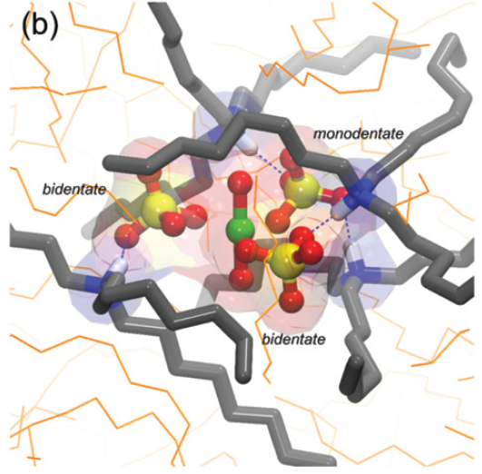
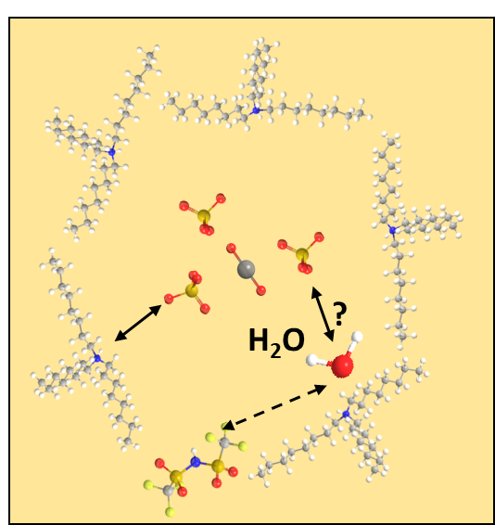

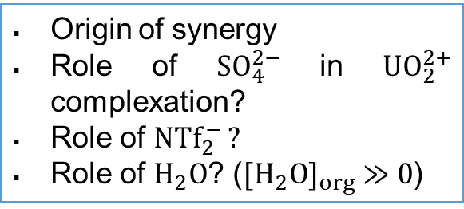
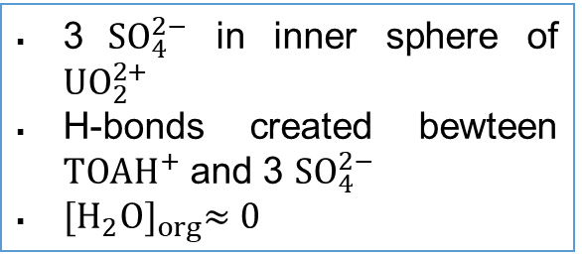
Uranyl complexe caracterization
What we know:
What we don’t know:
$${SO}_{4}^{2−}+{NTf}_{2}^{−}$$
TOA + dodecane
MD work in literature
3 ${SO}_{4}^{2−}$ in inner sphere of ${UO}_{2}^{2+}$
H-bonds created bewteen $TO{AH}^{+}$ and 3 ${SO}_{4}^{2−}$
${[H_{2}O]}_{org}≈0$
Origin of synergy
Role of ${SO}_{4}^{2−}$ in ${UO}_{2}^{2+}$ complexation?
Role of ${NTf}_{2}^{−}$ ?
Role of $H_{2}O$? (${[H_{2}O]}_{org} ≫0$)
T. Sukhbaatar et. al., Chemical Communications, vol. 55, no. 53, pp. 7583–7586, 2019
Notes:
A qui ont peut se raccrocher et comparer
Système de référence
Quest ce qu’on sait sur la TOA mais on doti le valider sur le liquide ionique
Comment l’uranium est complxé

Slide 30
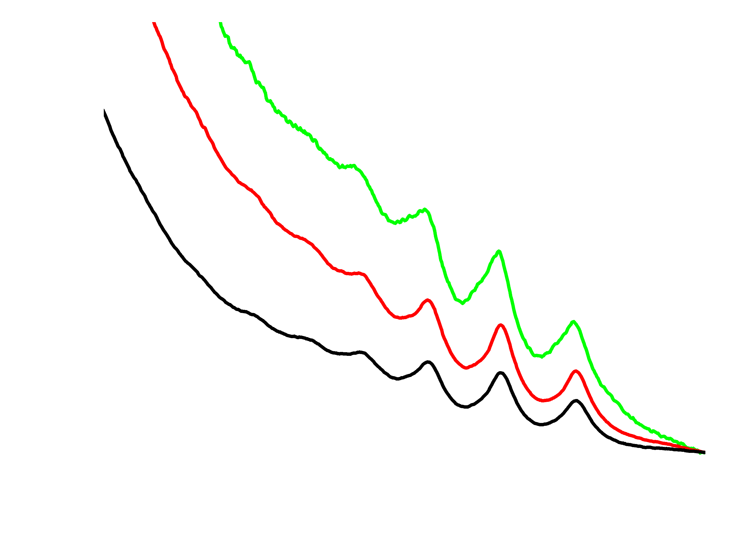
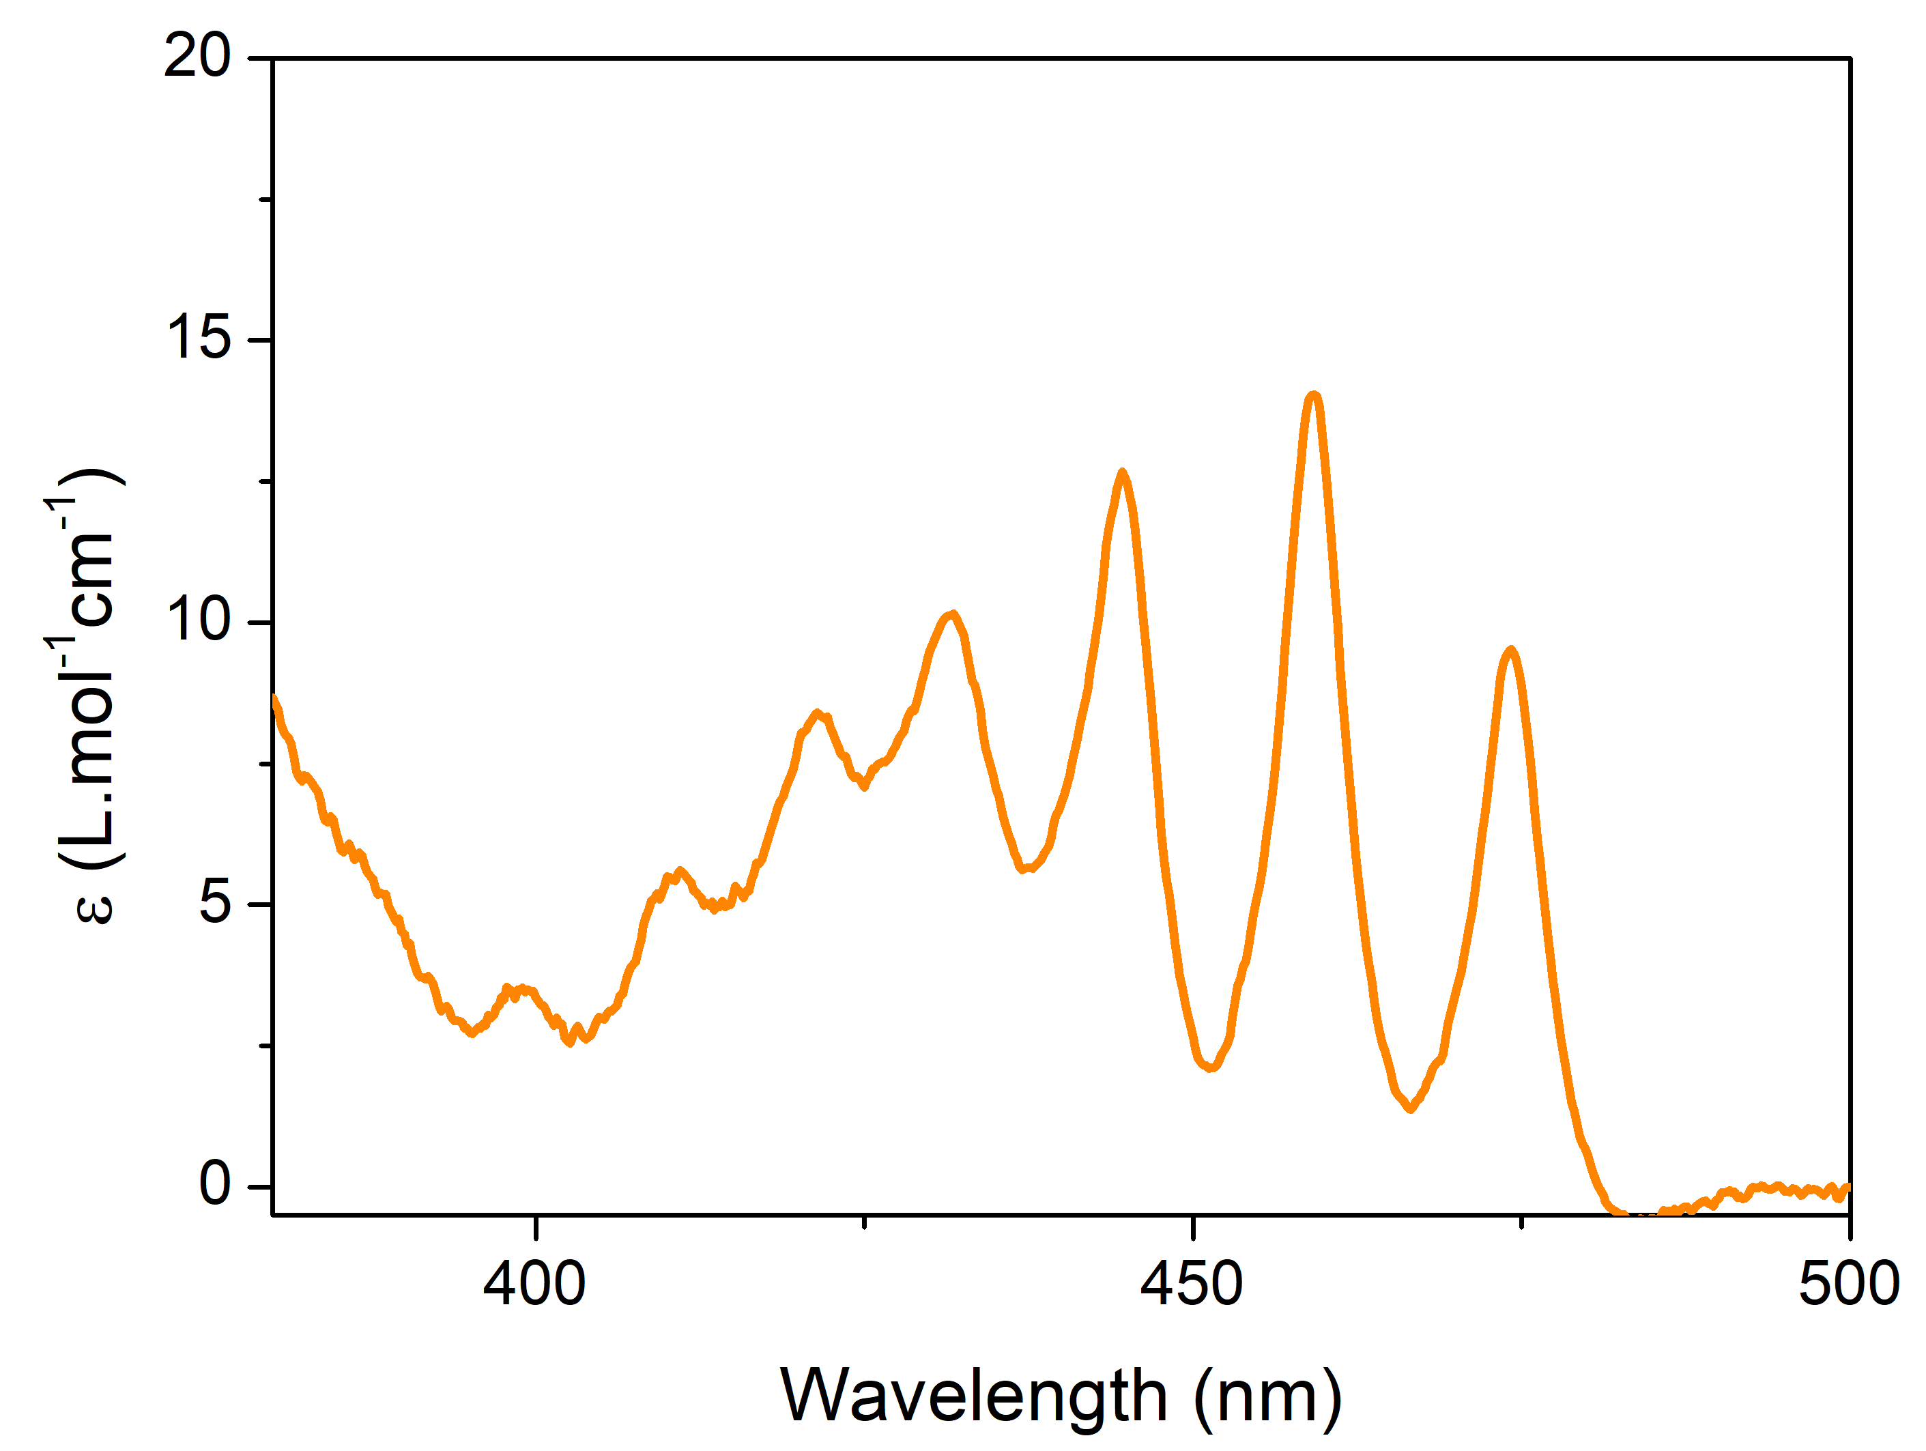
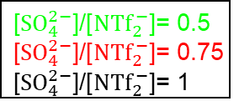
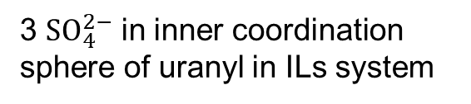

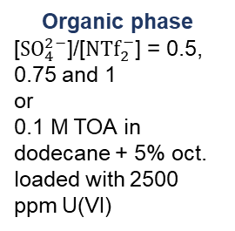
Uranyl complex in ILs mixture
Role of SO₄²⁻
UV-vis
TOA in dodecane
$${SO}_{4}^{2−}+{NTf}_{2}^{−}$$
$\text{[}{SO}_{4}^{2−}\text{]/[}{NTf}_{2}^{−}\text{]}$= 0.5
$\text{[}{SO}_{4}^{2−}\text{]/[}{NTf}_{2}^{−}\text{]}$= 0.75
$\text{[}{SO}_{4}^{2−}\text{]/[}{NTf}_{2}^{−}\text{]}$= 1
Organic phase
[${SO}_{4}^{2−}$]/[${NTf}_{2}^{−}$] = 0.5, 0.75 and 1
or
0.1 M TOA in dodecane + 5% oct. loaded with 2500 ppm U(VI)
Similar $D_{3h}$ trigonal symmetry*
3 ${SO}_{4}^{2−}$ in inner coordination sphere of uranyl in ILs system
*K. Servaes et. al., European Journal of Inorganic Chemistry, no. 32, pp. 5120–5126, 2007

Slide 31
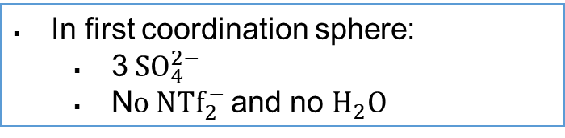
Uranyl complex in ILs mixture
EXAFS
Run EXAFS
Synchrotron Soleil
Mars beamtime
2 days - April 2021
U-O_{yl}
U-O_{SO4}
U-S_{SO4}
In first coordination sphere:
  3${SO}_{4}^{2−}$
  N$o {NTf}_{2}^{−}$ and no $H_{2}O$
Synergy origin?
Notes:
Pas de chgt avec synergie
((Même mode de complexation de l’U dans TOA et dodécane, contrairement au TBP + milieu nitrique ))
Ca se passe comme dans milieu conventionnel
Auncune différence entre les ratio ce qui veut dire pas de complxation synergique
Ntf2 ne rentre pas dans la premiere sphère de coordination?

Slide 32
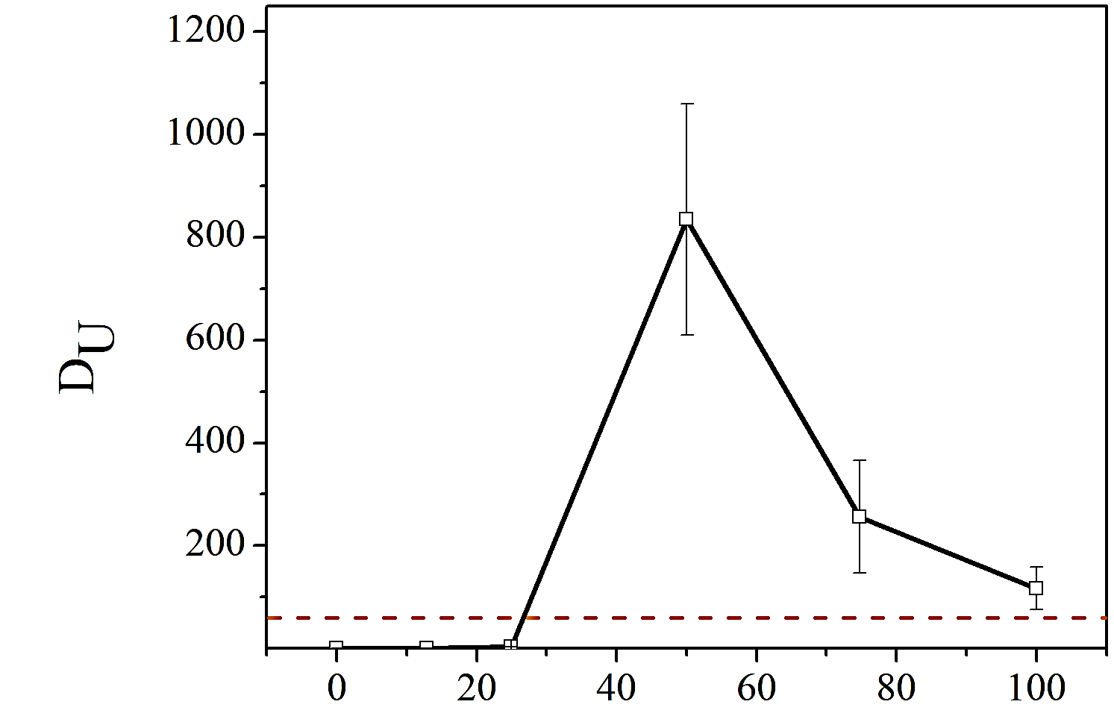










Role of water on synergistic extraction?
${SO}_{4}^{2−}$ ${UO}_{2}^{2+}$
${SO}_{4}^{2−}$ ${UO}_{2}^{2+}$
$${{[H}_{2}O]}_{org}$$
$$H_{2}O$$
Reference:TOA + dodecane [H₂O]_{org} = 0.2 mol/L
$${{[H}_{2}O]}_{org}$$
${NTf}_{2}^{−}$ > ${SO}_{4}^{2−}$
${SO}_{4}^{2−}$ > ${NTf}_{2}^{−}$
${NTf}_{2}^{−}$ > ${SO}_{4}^{2−}$
${SO}_{4}^{2−}$ > ${NTf}_{2}^{−}$
Different V_{A}/V_{O} ratio
Different concentration[(NH₄)₂SO₄]
32
Notes:
Sulfates viennt complxer mieux l’eau que l’u et on perd de l’u
Interraction privilégiée
Mais quand y a trop d’eau extraite les sulfates viennent complexer l’eau et plus l’uranium et donc on perd de l’U
Viscosité augmente
Role de l’eau

Slide 33
Conclusions / perspectives
No dilution, no third phase
Synergistic extraction of U
NTf₂ not involved
Role of water?
Indentification of$ν({SO}_{4})$ link with UO₂ and $ν({SO}_{4})$ link with H₂O in FT-IR (DFT calculations)
Thank you for your attention

