Slide 1
A step change in european joint collaboration towards safe radioactive waste management
23/05/2022 • NEEDS; Bernd Grambow

Slide 2



A leap forward
“A step change in European collaboration towards safe radioactive waste management (RWM), including disposal, through the development of a robust and sustained science, technology and knowledge management programme that supports timely implementation of RWM activities and serves to foster mutual understanding and trust between participants.”

Slide 3
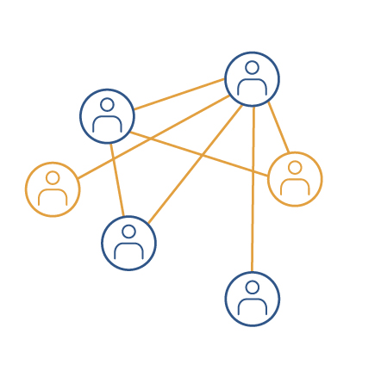

EURAD’s ambition
Complement the national Programmes
  Support compliance with European regulations
    Waste directive from 2021
  Foster efficient use of RD&D resources at the EU level
  Support RWM innovation and optimisation
Ensure the sustainability of the knowledge considering >40 yr programme duration
  Developing and consolidating existing knowledge
  Enhancing knowledge management and transfer between organisations, MS and generations
Act as a platform
  Foster mutual understanding and trust
  Exchange and cooperation with international organisations and expert networks

Slide 4



Objectives
  Implement a robust and sustained state-of-the-art science and technology programme
  Consolidate efforts across Member-States, organisations and generations on Knowledge Management
  Elaborate upon complex issues and identify emerging ones by bringing together all interested actors to jointly conduct Strategic Studies
Foster mutual understanding / trust between participants as well as other stakeholders, incl. from Civil Society

Slide 5
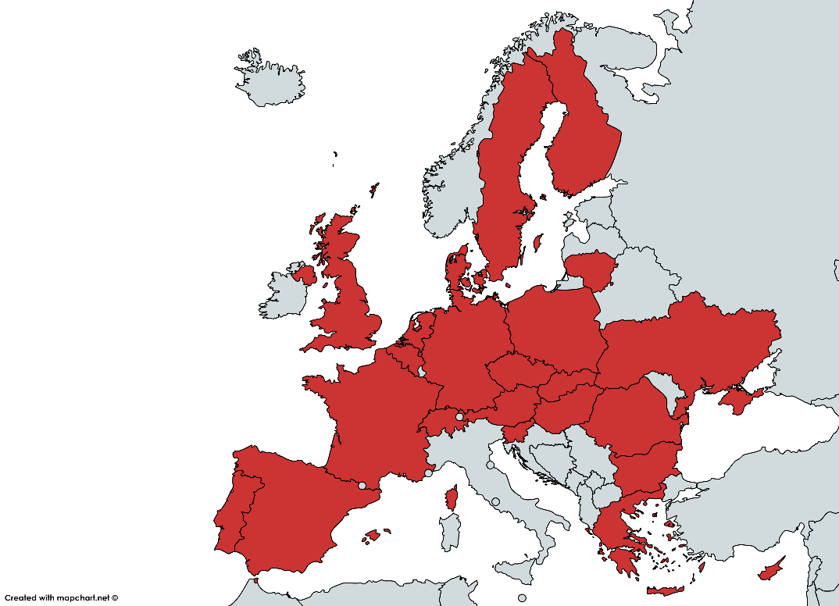
EURAD is a community
51 Mandated actors from 23 European countries representing the following Colleges :
    Mandated by their governments
      Waste Management Organisation (WMO)
      Technical Support Organisation (TSO)
      Research Entity (RE)
      In FRANCE: ANDRA, IRSN, CEA, CNRS
62 Linked Third Parties (mostly universities and research centres) and 3 International Partners
Groups of Civil Society organisations

Slide 6




EURAD’s governance
GENERAL ASSEMBLY
External Advisory Board
4 members
WMOs
college
TSOs college
REs college
EURADScience
BUREAU of the General Assembly
3 WMOs repr.
elected by
WMOs college
3 TSOs repr.
elected by
TSOs college
3 Res repr.
elected by
REs college
Coordinator
Programme Management Office
Work Package Boards
RD&D ACED
WP Leader
Task Leaders
RD&D CORI
WP Leader
Task Leaders
RD&D DONUT
WP Leader
Task Leaders
RD&D FUTuRE
WP Leader
Task Leaders
RD&D GAS
WP Leader
Task Leaders
RD&D HITEC
WP Leader
Task Leaders
RD&D SFC
WP Leader
Task Leaders
RD&D ConCorD
WP Leader
Task Leaders
RD&D MAGIC
WP Leader
Task Leaders
RD&D MODATS
WP Leader
Task Leaders
SS ROUTES & extension
WP Leader
Task Leaders
SS UMAN & extension
WP Leader
Task Leaders
KM SoK
WP Leader
Task Leaders
KM Guidance
WP Leader
Task Leaders
KM Training
WP Leader
Task Leaders

Slide 7
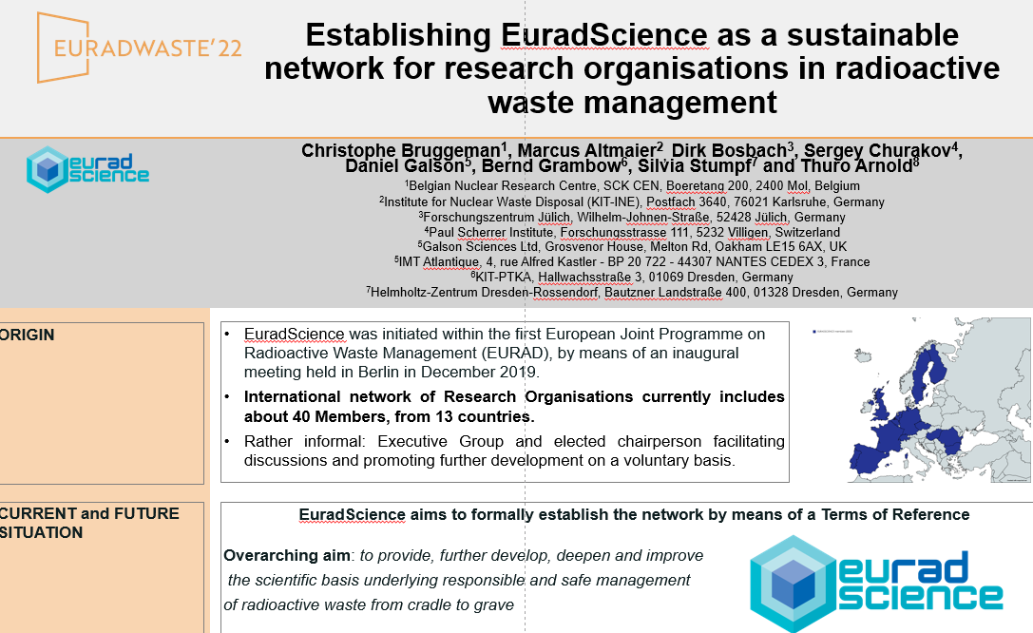

Slide 8
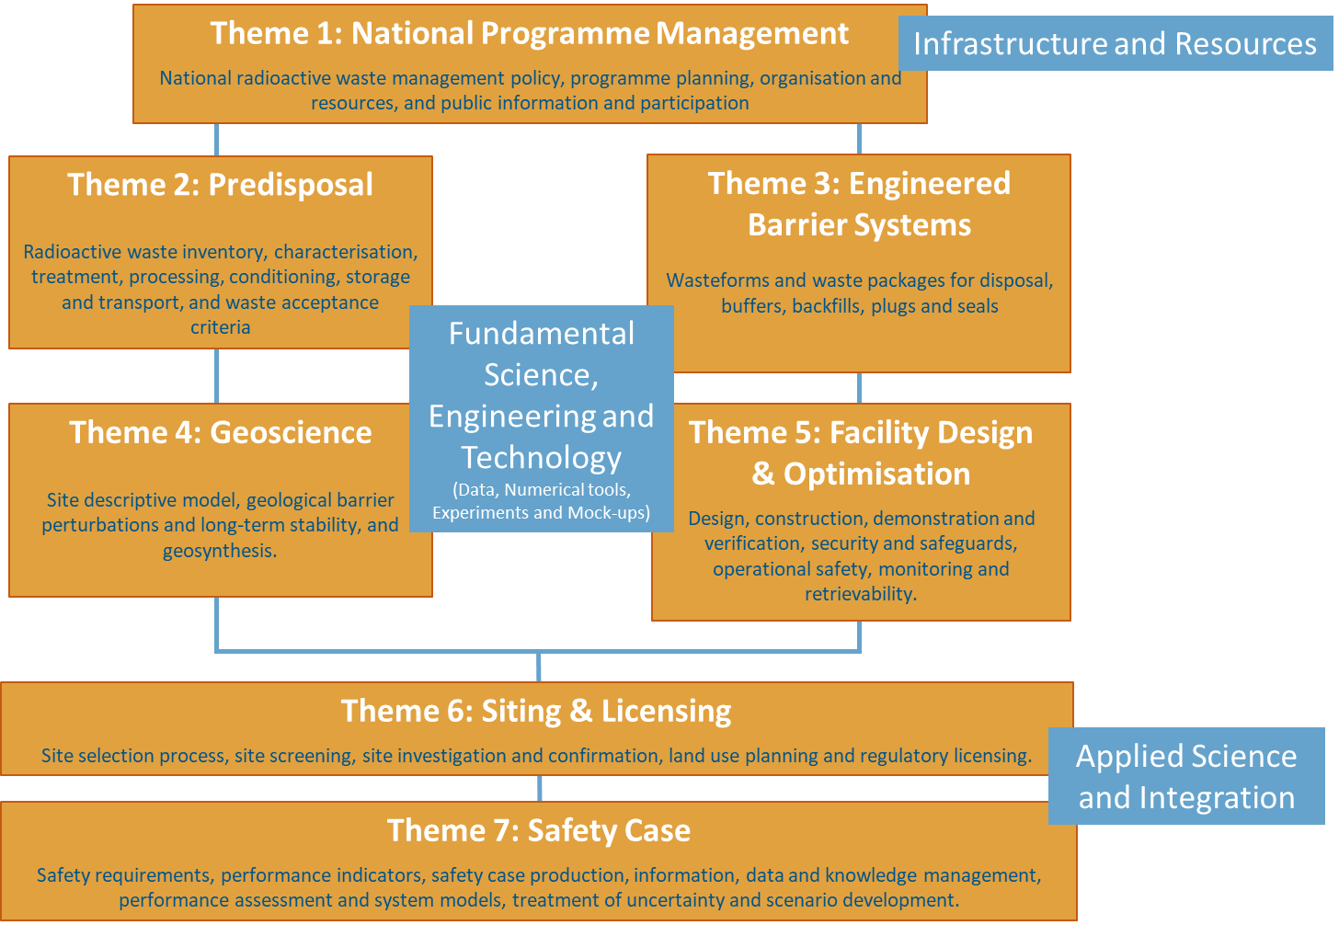
EURAD Strategic Research Agenda (since 2017)
  Shared
  Living and dynamic
  With a broad spectrum
    Frames research and knowledge management objectives
    Covers RWM activities from cradle to grave (does not cover decommissioning)
An update is ongoing, orgainzed by the EURAD BUREAU and the Colleges
Integrating as well predisposal activities from PREDIS

Slide 9
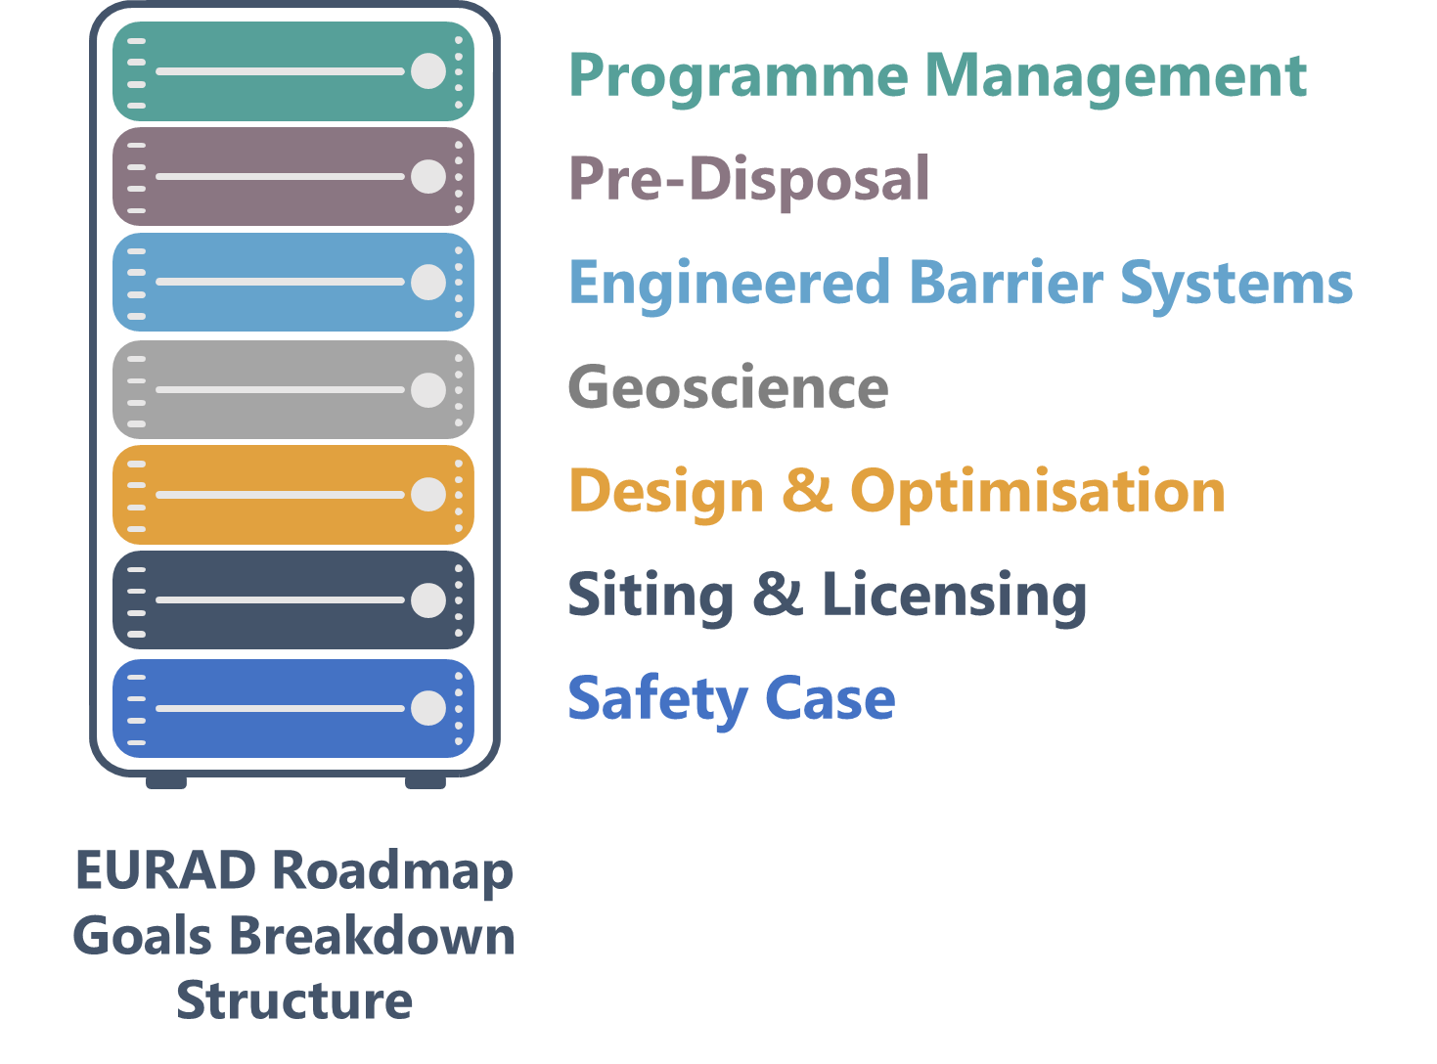
EURAD Roadmap
Hierarchical breakdown: 7 Themes > 20 Sub-themes > ~ 70 Domains
  A framework based on goal-oriented breakdown …
  to transfer existing information & knowledge
  to assess existing information & knowledge
  to identify needs for additional RD&D (→ SRA)
  to identify issues to be collectively explored
  to help achieving clarity on scope definition

Slide 10
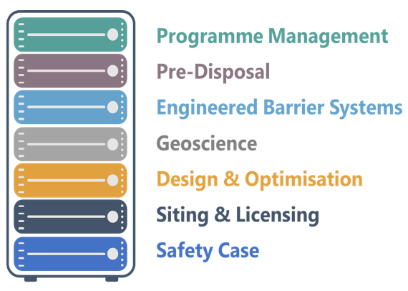
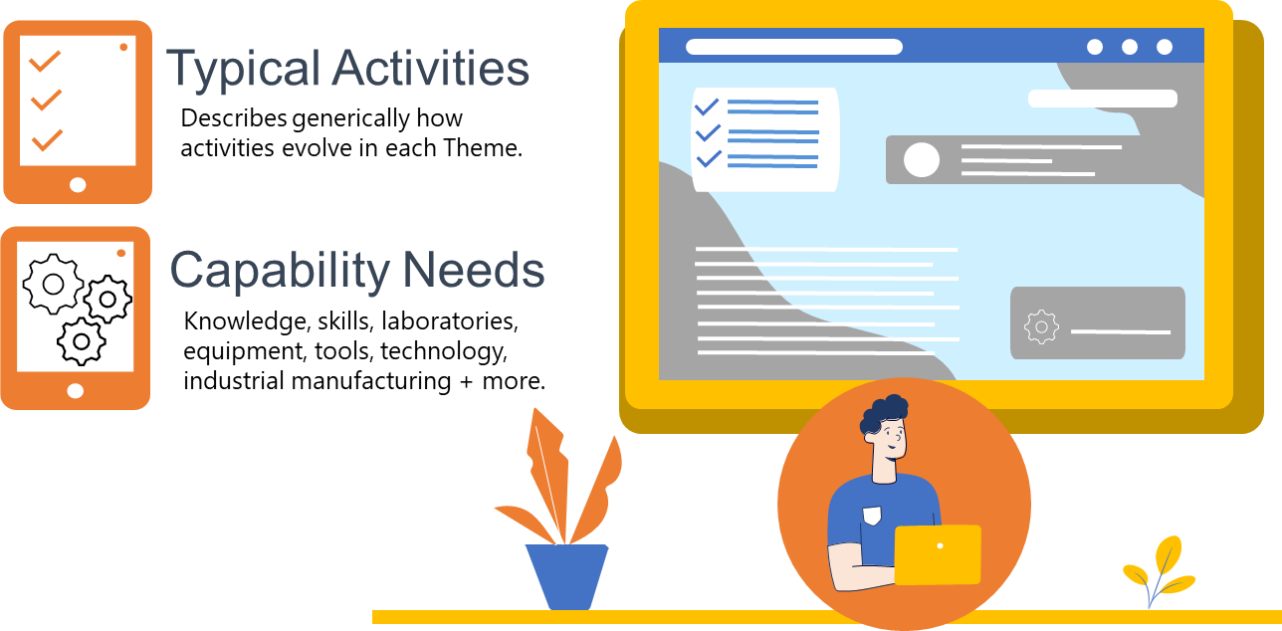
EURAD Roadmap – Theme Overviews

Slide 11
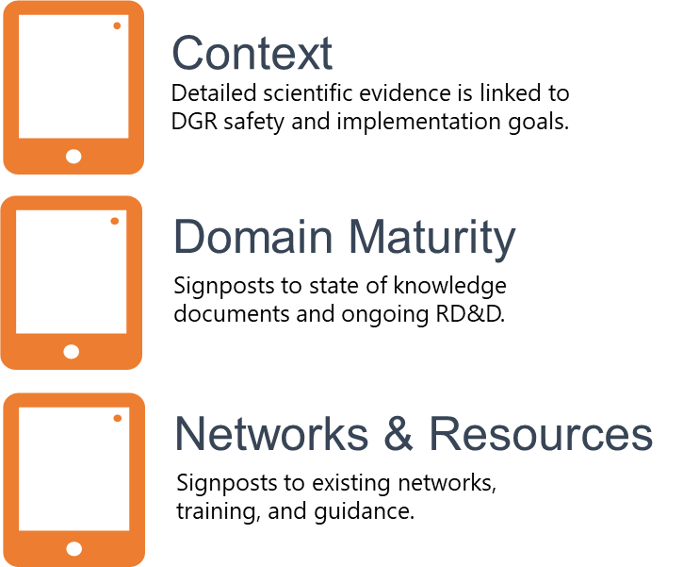
EURAD Roadmap – Domain Insights (70 domains like « spent fuel », « container »)

Slide 12
Deployment – EURAD workpackages
Research and Development – 10 workpackages
  developing and consolidating scientific and technical knowledge
Strategic Studies – 2 workpackages
  enabling experts and specialists to network on methodological / strategical issues and advance significant challenges in direct link with scientific and technical issues
Knowledge Management – 3 workpackages
  developing State of Knowledge, developing descriptive methodological guidance and developing/delivering training modules and mobility measures
Coordination/Dissemination – 1 workpackage
Civil society engagement

Slide 13
10 R+D Work packages (each about 5 M€)
ACED: Assessment of Chemical Evolution of ILW and HLW Disposal Cells involving interacting components/materials and thermal, hydraulic and/or chemical gradients
CORI: Cement-Organic-Radionuclide-Interactions which can accelerate the radionuclide migration
DONUT: Development and Improvement of numerical methods and Tools for modelling coupled processes
FUTURE: Fundamental Understanding of Radionuclide Retention in granite and clay rock
GAS: Mechanistic understanding of gas transport in engineered barrier clay materials and clay rock
HITEC: Influence of temperature on clay-based material behavior, can one increase the maximal temperature?
SFC: Spent Fuel Characterization and Evolution Until Disposal
CONCORD: Optimisation of container performance and its understanding in complex/coupled interfacial systems addressing irradiation-accelerated corrosion, microbial activity and degradation during transients
MAGIC: Mechanical properties of cementitious materials and impacts of simultaneous chemical (hydrolysis, multi-ionic attack, carbonation) and microbial processes.
MODATS: Monitoring equipment and data treatment for safe repository operation and staged closure

Slide 14
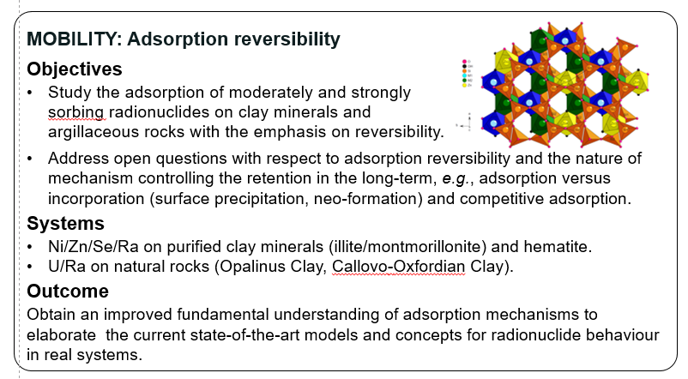
Some selected Themes
WP FUTURE

Slide 15



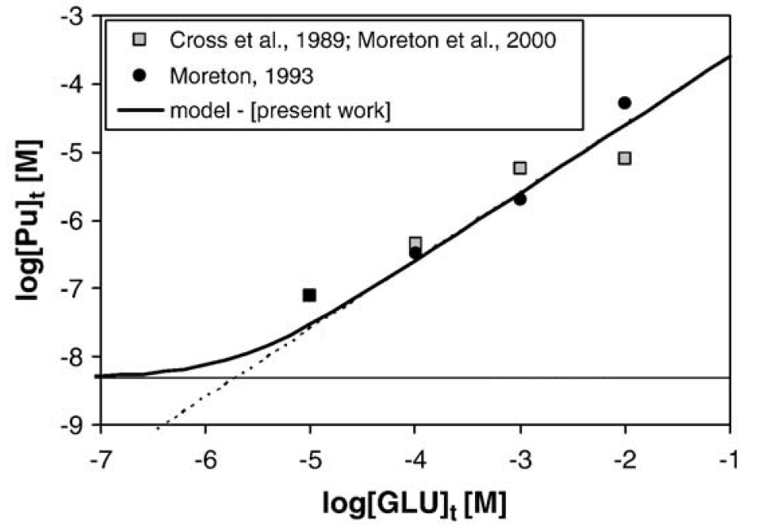
Some more themes
The effect of the organic molecules on the radionuclide behavior
Increase of the solubility
Decrease of the sorption
Pu solubility vs GLU
Th sorption vs ISA
Ochs et al. (2014)
Gaona et al. (2008)

Slide 16
Strategic studies
ROUTES: Waste management routes in Europe from cradle to grave
UMAN: common understanding among the different categories of actors (WMOs, TSOs, REs & Civil Society) on uncertainty management and how it relates to risk & safety

Slide 17

EURAD Knowledge Management & Networking Programme
1
Roadmap
A common framework to structure knowledge
2
State of Knowledge
What we know and why it is important
3
Guidance
Best practice and lessons learned
4
Mobility & Training
Transfer of experience and know-how
5
Networking & Tools
Connecting people to people, and people to content

Slide 18
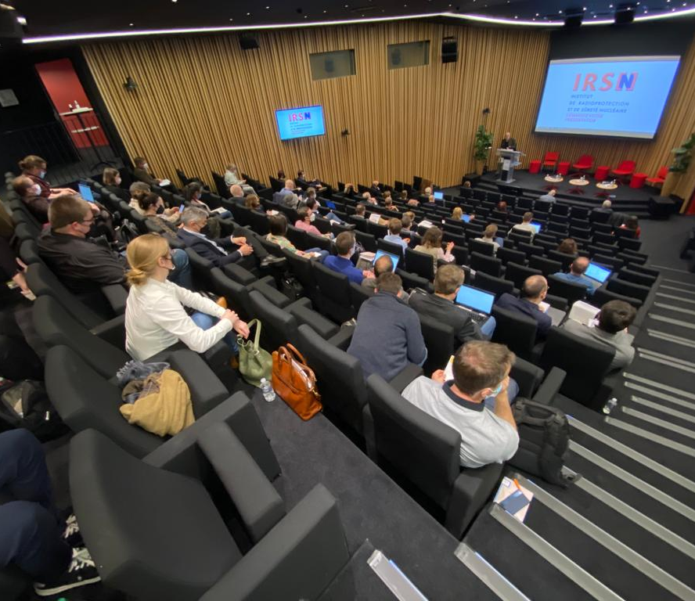
Key achievements
Scientific excellence
  6 state of the art
  80+ publications
Support transfer of knowledge
  KM and Networking Programme
  Population of the roadmap
  School of RWM promoting students networking through trainings and mobility
  Production of guidance documents
Strategic Research Agenda
  All waste types;
  Pre-disposal & Disposal
Foster mutual understanding
  Monthly ‘Lunch-and-learn sessions’
  Lively interactions with international organisations
  Regular exchanges and workshops with civil society
“EURAD also provides a platform for researchers from different disciplines to interact and to learn from other areas what is important for the safe disposal of different types of radioactive waste and for making the safety assessment for these.”
Extract mid-term review report

Slide 19





Status at mid-term
RDD& Strategic Studies WPs 'on track'
“The project, which is very large and has a strong administration is providing excellent results and also provides an excellent platform for all actors involved in radioactive waste management and disposal. The project is step by step becoming one integrated project, instead of a collection of different projects.”
Extract mid-term review
Strong learning-curve with Knowledge Management (a lot of experience with practicalities) and importance of connection to Roadmap
EURAD supports & encourages interaction between WPs & with external bodies, including participation of end- users
Joint Programming – lively interaction between colleges (WMO, TSO, RE) and with Civil Society also leading to increased mutual understanding
Strong & successful cooperation with PREDIS

Slide 20
Looking Ahead
“It is important to ensure continuity of the work and the organization built up and be prepared
for development of a second step of EURAD, EURAD2, as early as possible.”
Extract mid-term review report
Mesures taken to successfully complete WPs
Prepare EURAD2
  Integrate PREDIS (predisposal research)
    Joint communication EURAD-PREDIS on steps towards a EURAD-2 future EJP programme
  Closed Workshop with the European commission, EURAD management and national representatives
    EURADWASTE, LYON 2022
  Update of the SRA (final version early 2023) will serve two purposes:
    Take stock and reflect on progress made since 2019 and capture emerging needs
    Prepare as guide for a potential future EC joint programme
  Interests of research entities shall be represented by EURADSCIENCE:
    christophe.bruggeman@sckcen.be

Slide 21
Thank you for your attention
https://www.ejp-eurad.eu/
LinkedIn: https://www.linkedin.com/showcase/ejp-eurad
Twitter : @EJP_EURAD
Coordination : ANDRA (France)
For more information please contact :
secretariat@ejp-eurad.eu

