Slide 1
WAVEFIER
A framework for multimessenger astronomy in real time

Slide 2
WAVEFIER: PHILOSOPHY
WAVEFIER aims to set up a framework for analysis of different types of astrophysical data, paving the way to real time Multi-Messenger astronomy studies. This is done leveraging the newest available software technologies.
KEY POINTS
Setup a prototype for a real time pipeline for the detection of transient signals and their automatic classification.
Best practice for software management.
Software architecture solutions to prototype a scalable pipeline for big data analysis in GW context.
Interoperability and access to data and services.
ICT services supporting research infrastructures.
Use of data in network infrastructures and service.
IN COLLABORATION WITH:

Slide 3
Multi-Messenger
WAVEFIER: GOAL
Multi-Messenger Astronomy!
DATA
stream
WAVEFIER
ML ANALYSIS
Gravitational Wave
Neutrino
GRB
attach
PIPELINES
(e.g. WDF for GW data)

Slide 4
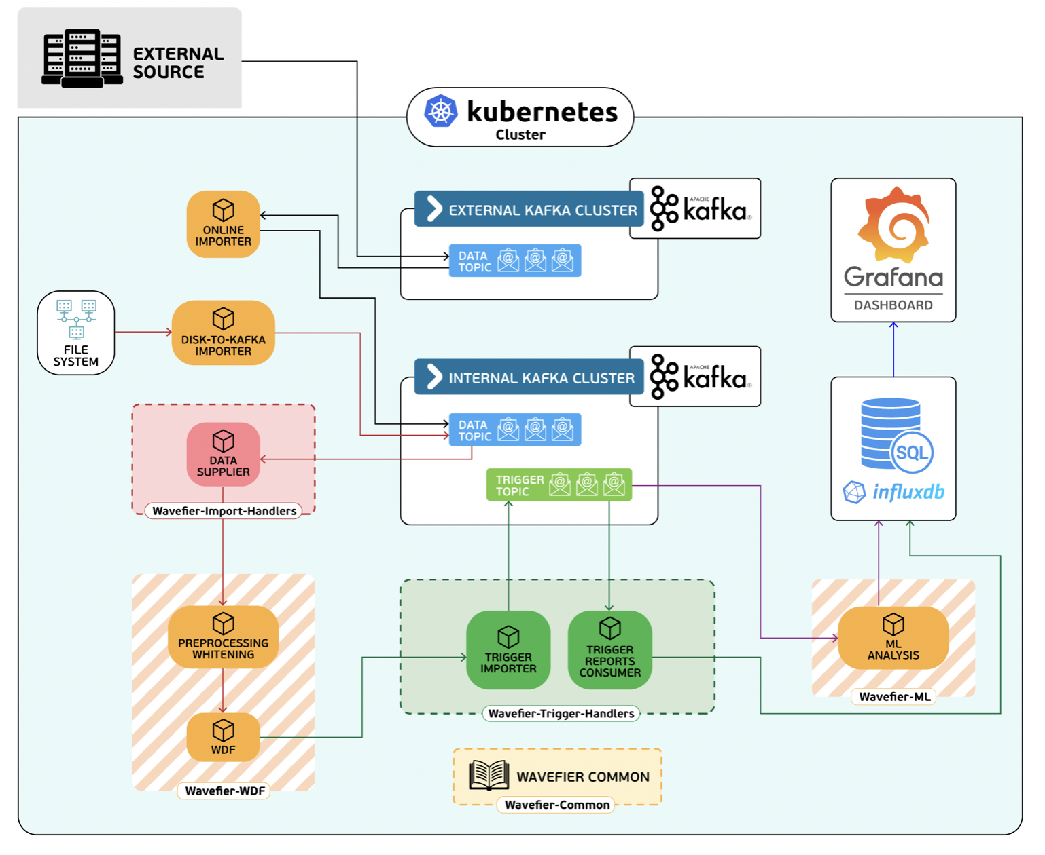
WAVEFIER: CURRENT ARCHITECTURE (tuned for GW data analysis)

Slide 5
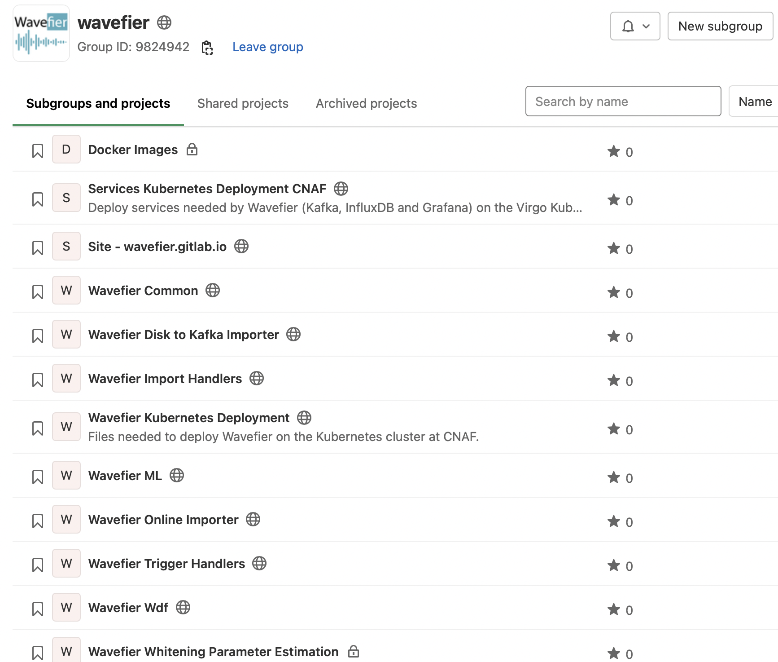
WAVEFIER: CURRENT ARCHITECTURE (tuned for GW data analysis)
WAVEFIER’s structure is composed of modules:
Dedicated gitlab repository for each module.
Continuous integration to build docker images
Docker Compose
portability!

Slide 6
WAVEFIER: CURRENT ARCHITECTURE (tuned for GW data analysis)
ONLINE IMPORTER
Imports data within the WAVEFIER pipeline from external KAFKA cluster.

Slide 7
WAVEFIER: CURRENT ARCHITECTURE (tuned for GW data analysis)
DISK-TO-KAFKA IMPORTER
Imports files within the WAVEFIER pipeline reading from filesystem files.

Slide 8
WAVEFIER: CURRENT ARCHITECTURE (tuned for GW data analysis)
WAVEFIER-IMPORT-HANDLERS
Library to retrieve the files from topics in internal KAFKA cluster.

Slide 9
WAVEFIER: CURRENT ARCHITECTURE (tuned for GW data analysis)
WAVEFIER PREPROCESSING
WHITENING (GW specific!)
Continuously computes the whitening parameters for GW data and sends them to internal KAFKA cluster.

Slide 10
WAVEFIER: CURRENT ARCHITECTURE (tuned for GW data analysis)
WAVEFIER-WDF (GW specific!)
Grabs updated whitening parameters and raw data, whitens GW data, searches for transient signals with a wavelet-based method and estimates relevant parameters of the detected signals.

Slide 11
WAVEFIER: CURRENT ARCHITECTURE (tuned for GW data analysis)
WAVEFIER
TRIGGER-HANDLERS
Contains all the code used to send and retreive the triggers and related information in the WAVEFIER framework.

Slide 12
WAVEFIER: CURRENT ARCHITECTURE (tuned for GW data analysis)
WAVEFIER COMMON
Contain all the common code used by different modules of the WAVEFIER project.

Slide 13
WAVEFIER: CURRENT ARCHITECTURE (tuned for GW data analysis)
WAVEFIER ML
Responsible for the application of Machine Learning algorithms on the list of triggers generated by WAVEFIER WDF or similar consumers.

Slide 14
WAVEFIER: CURRENT ARCHITECTURE (tuned for GW data analysis)
INFLUXDB
Database for storage of the triggers produced by WDF.
Open-source, suited for timeseries analysis.
has SQL-like query language for interacting with it.

Slide 15
WAVEFIER: CURRENT ARCHITECTURE (tuned for GW data analysis)
GRAFANA DASHBOARD
Provides interactive web visualization of trigger data.
Native support for influxDB.

Slide 16
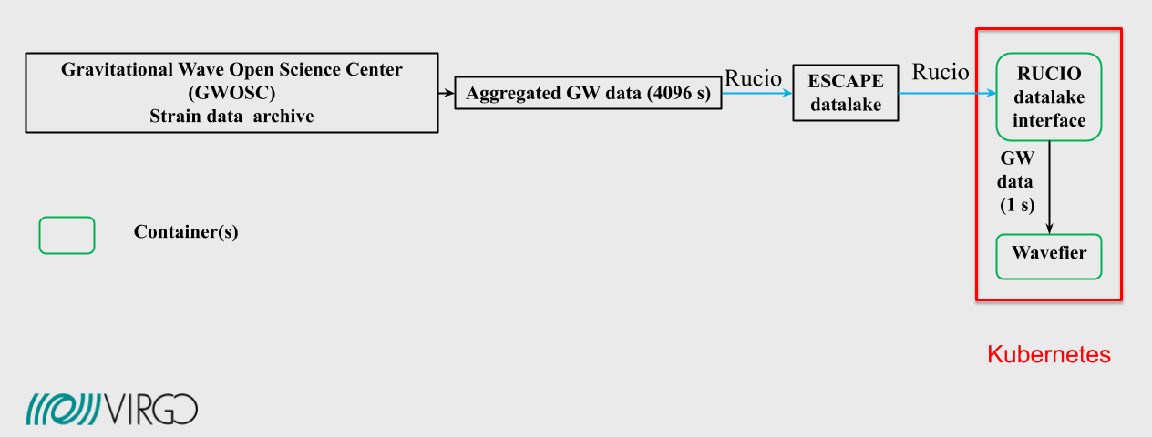
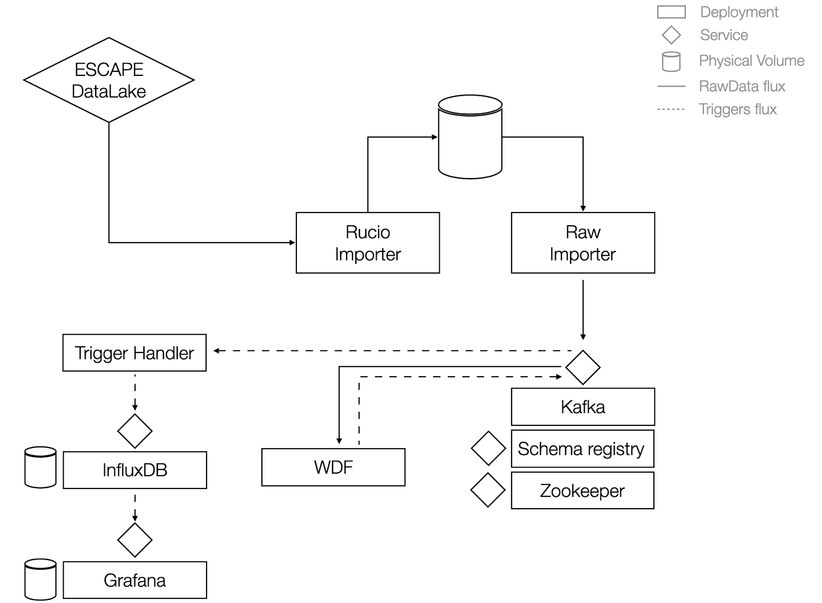
WAVEFIER SCIENCE CASE: ESCAPE DATA LAKE
Successfully tested attaching to ESCAPE data lake with Gravitational Wave Open Science Center (GWOSC) data.
GW specific implementation at CNAF cloud (region Tier1) on shared Virgo Kubernetes cluster.
Currently testing on O3 science data replay.
Notes:
The cluster is managed via Rancher and counts 12 schedulable nodes, for a total of 48 cpu cores, 92 GiB of memory and about 2 TiB of gross storage. These resources are shared among Wavefier and other test deployments of LVK low-latency services: GraceDB, LValert and GWCelery. All Wavefier components are installed as Kubernetes deployments via Helm charts. A helper script is provided in order to create the secrets required to pull the Wavefier Docker images from the GitLab repository.

Slide 17
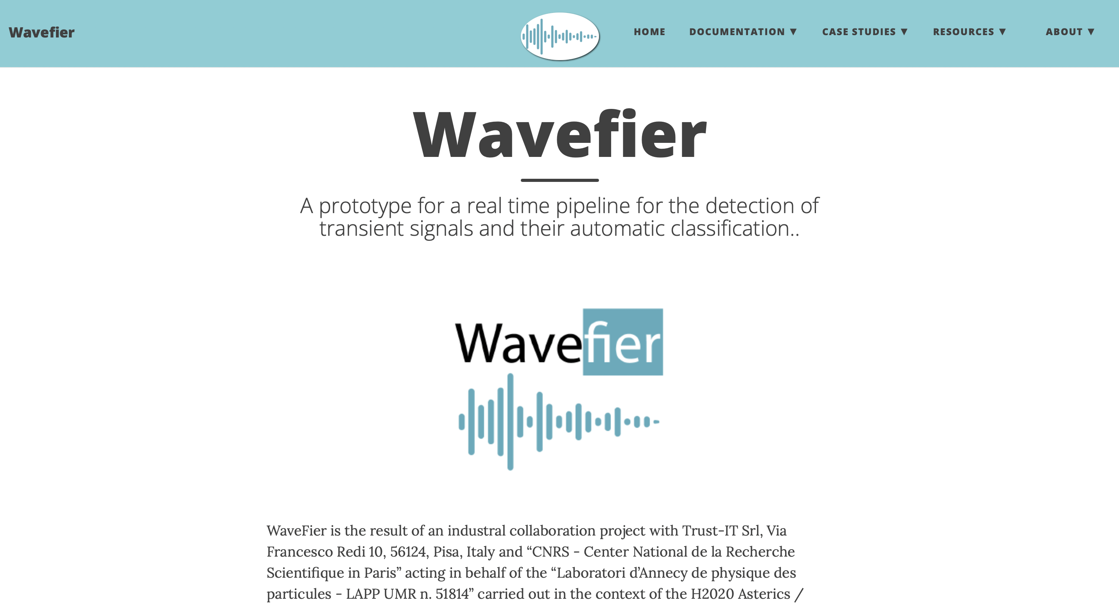
WAVEFIER: UPDATES
DOCUMENTATION
Currently being updated, available at:
https://wavefier.gitlab.io
Sphinx ReadTheDocs API documentation automatically generated at pipeline continuous integration for each component module.

Slide 18
WAVEFIER: ACTION ITEMS
Gravitational Wave
GRB
Neutrino
Test on O3 replay, finalize WDF continuous whitening and machine learning output.
Test on simulations/real data (??), attach dedicated docker containers for data analysis.

