Slide 1
TSP Preparation: ESCAPE & EOSC-Future
Ian Bird; LAPP
23rd March 2022

Slide 2
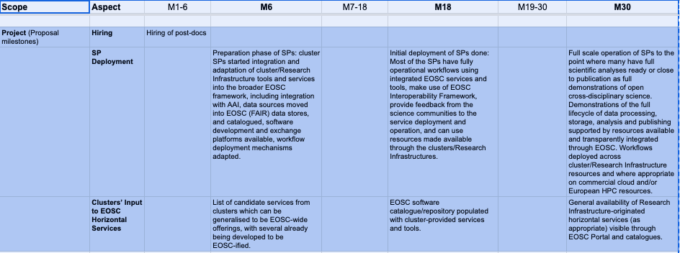
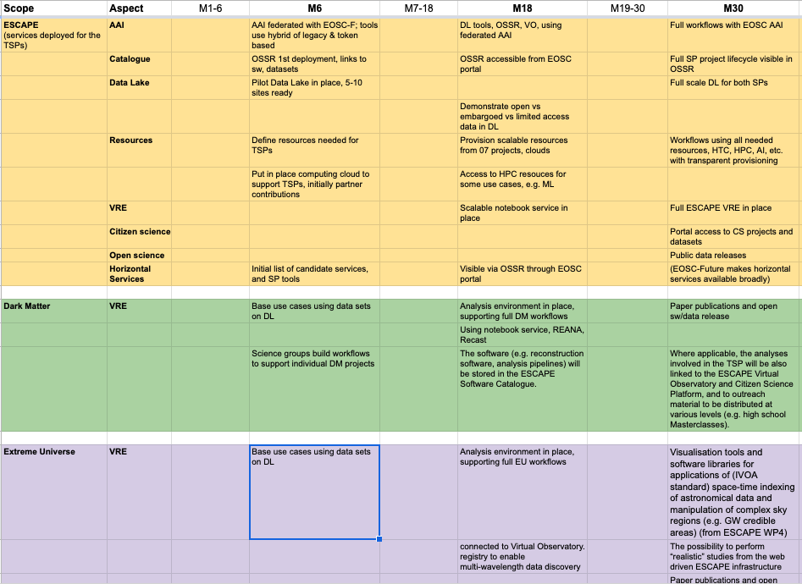

Slide 3
Next steps for ESCAPE
Firm up timelines - see spreadsheet;
add clear and realistic milestones (that we need for ourselves)
Produce a good estimate of the resource needs for each project and sub-project:
compute - cluster, HPC, specific needs?
storage - with specific QoS if necessary
other needs?
Then we need within ESCAPE to address what resources we can provide from our ESCAPE partners;
intention is to add other resources from
a) ESCAPE procurment funds,
b) EOSC-Future brokered resources through INFRAEOSC-07 projects
ESCAPE will organise a meeting on the TSP’s very soon;
we should try and have the above planning complete by then

Slide 4
Resources
Potential sources:
Our ESCAPE partners
‘07 projects: procurement, they are mandated to provide EOSC resources to EOSC-Future
Funding in EOSC-Future (and ESCAPE) for procurement
Discussion in DM TSP + similar from ASTRON for EU-TSP, we have asked EOSC-Future for a pool of resources:
500 cores with 4 GB RAM/core, 50 GB/core local disk
500 TB storage that should accept incoming data transfers

Slide 5
Use case discussion in EOSC-Future
Science clusters trying to get infrastructure and resources to implement use cases and not keep discussing requirements
ESCAPE proposes the following generic use case:
A) user workflow on provisioned resources; pull data from Data Lake using DL tools; create output data set; store back in DL
B) simulation or AI training job submitted to HPC using ESCAPE AAI; create output/simulated data; store in Data Lake
C) Analysis: ESCAPE user uses Jupyter notebook environment, access data sets & simulated data in Data Lake (or stream/cache locally); make plots; store state of notebook (analysis, algorithms, plots); publish results to ESCAPE Zenodo; make accessible from EOSC portal

Slide 6
Other activities
Make ESCAPE resources available via EOSC portal
publish OSSR (sw, services) – connect to EOSC-Future
make HEP Open Data portal visible and searchable
same for the Virtual Observatory resources
Eventually will want the same for the TSP outputs
once we understand how to achieve it
Pre-conditions – for all of the previous items
ESCAPE AAI federated with EOSC AAI (1st version in April)
Resource pool made available – science clusters pushing this as urgent within EOSC-Future
In principle the ‘07 projects should be able to make resources available quickly

