Slide 1

The Zwicky Transient Facility
Bright Transient Survey
Daniel Perley
(Liverpool John Moores University)
Christoffer Fremling (Caltech),
Shri Kulkarni (Caltech),
Adam Miller (Northwestern),
Jesper Sollerman (Stockholm),
Aishwarya Dahiwale, Yashvi Sharma, Don Neill,
Xander Hall (Caltech), K-Ryan Hinds (LJMU),
Mat Smith, Melissa Graham (Washington),
Jakob Nordin (Humboldt), Steve Schulze (Stockholm),
Ido Irani, Erez Zimmerman (Weizmann),
Kishore Patra, Shaunak Modak, Andrew Hoffman,
Alex Filippenko (UCB)

Slide 2


Two Types of Study
Case studies: lots of data/time/attention on one (or a few) objects
Population surveys: a small(er) amount of data, gathered uniformly for a huge number of objects

Slide 3
Population studies for optical transients
Needed to address:
How common things are (rates)
How events group into classes ("phase space")
What does not exist (rate limits)
Where things happen (host galaxies)
Anything systematics-limited (e.g. cosmology)

Slide 4
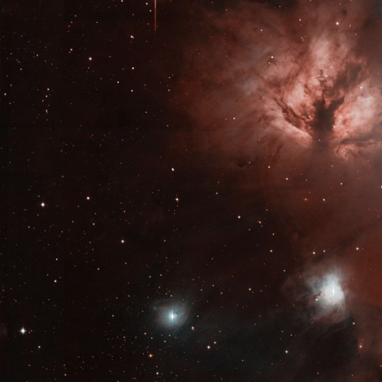
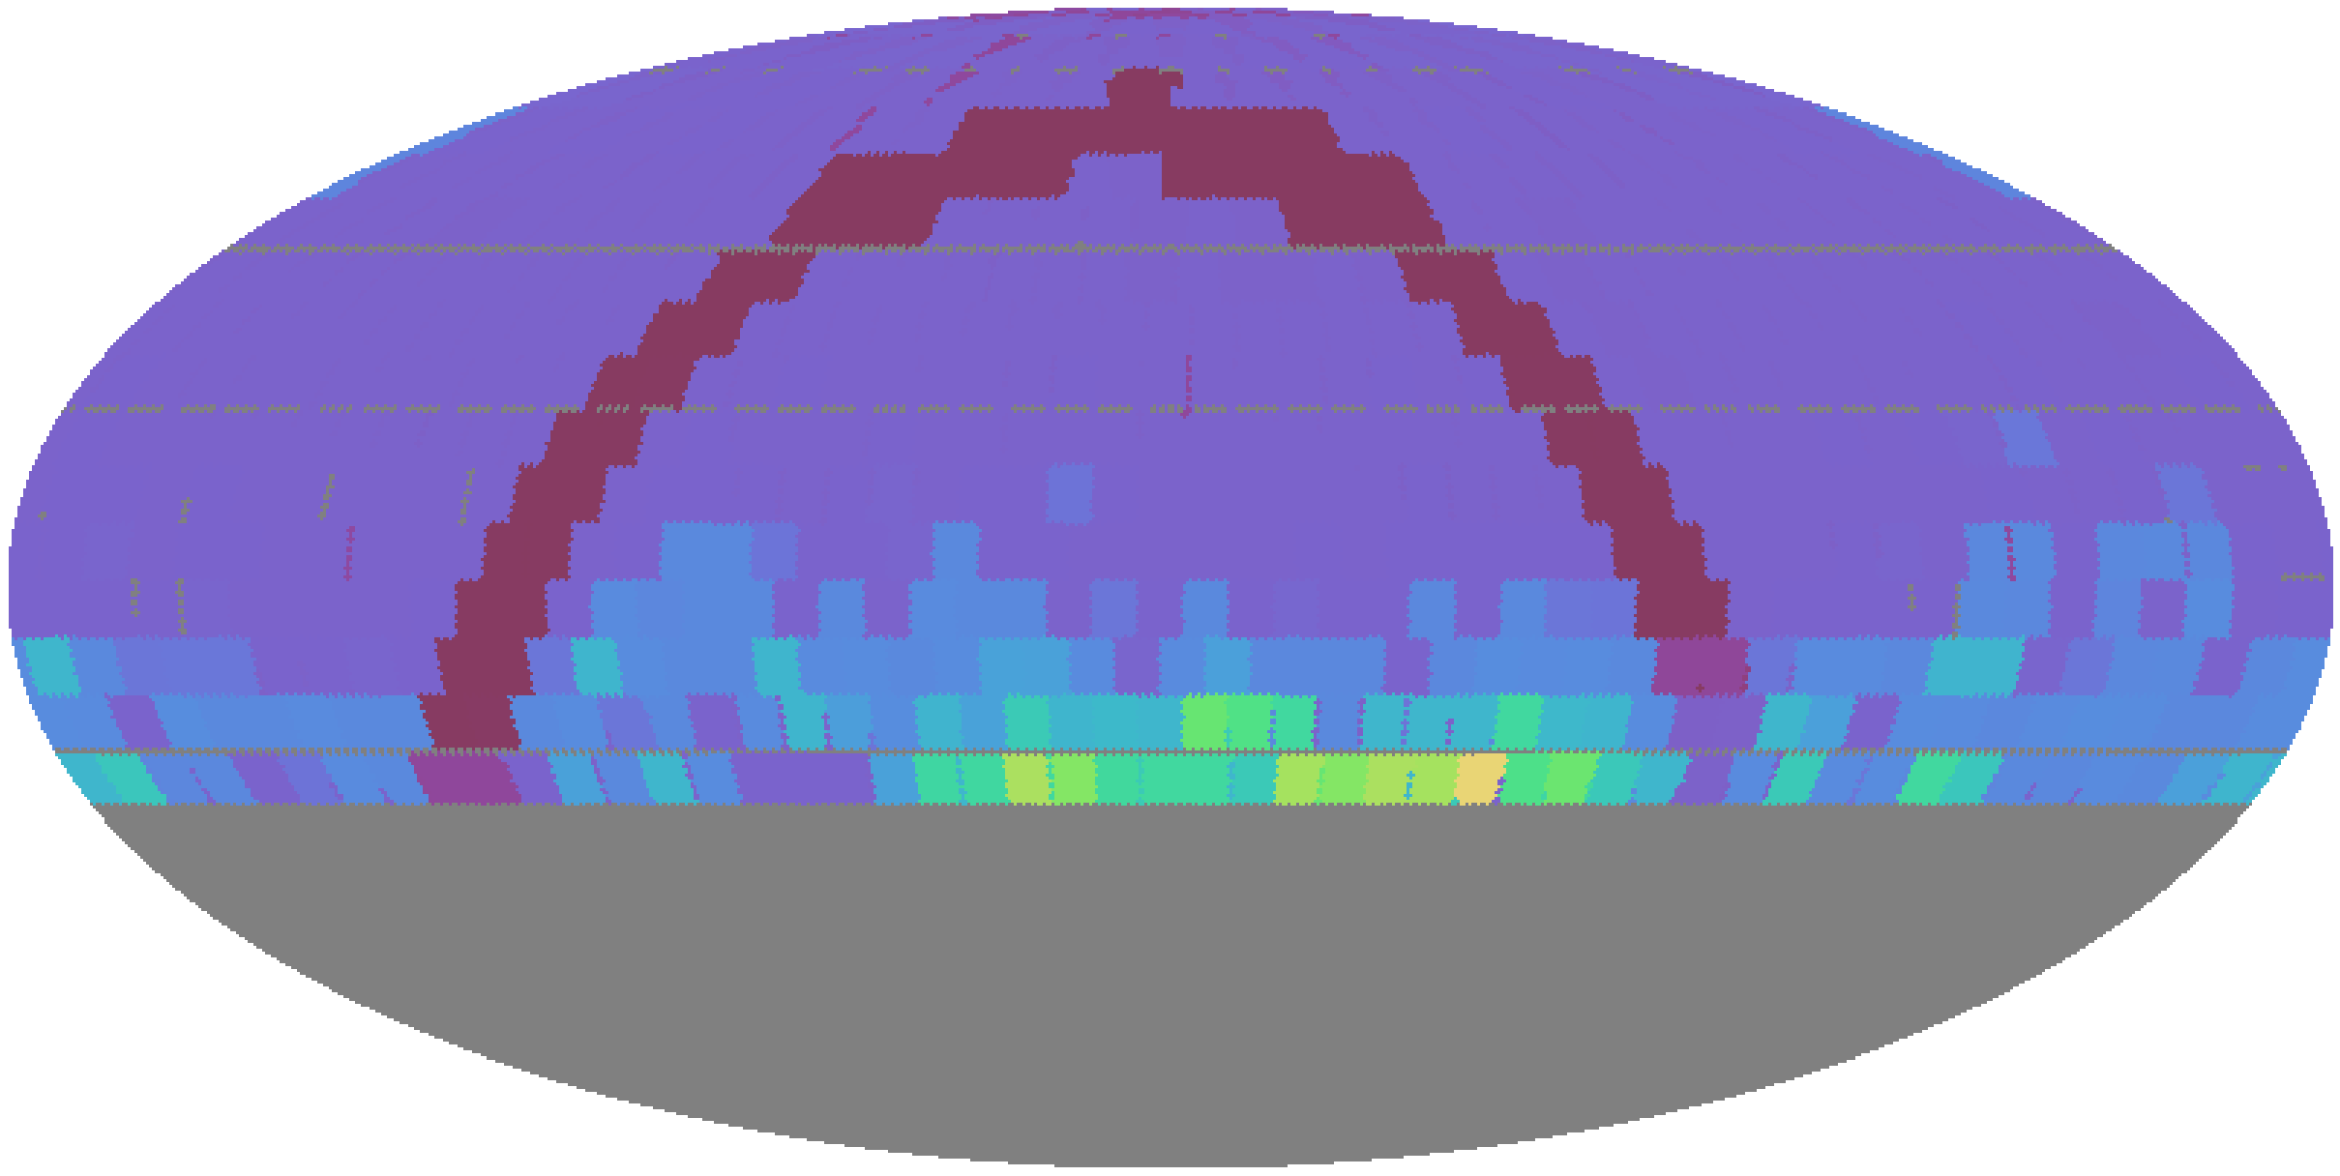
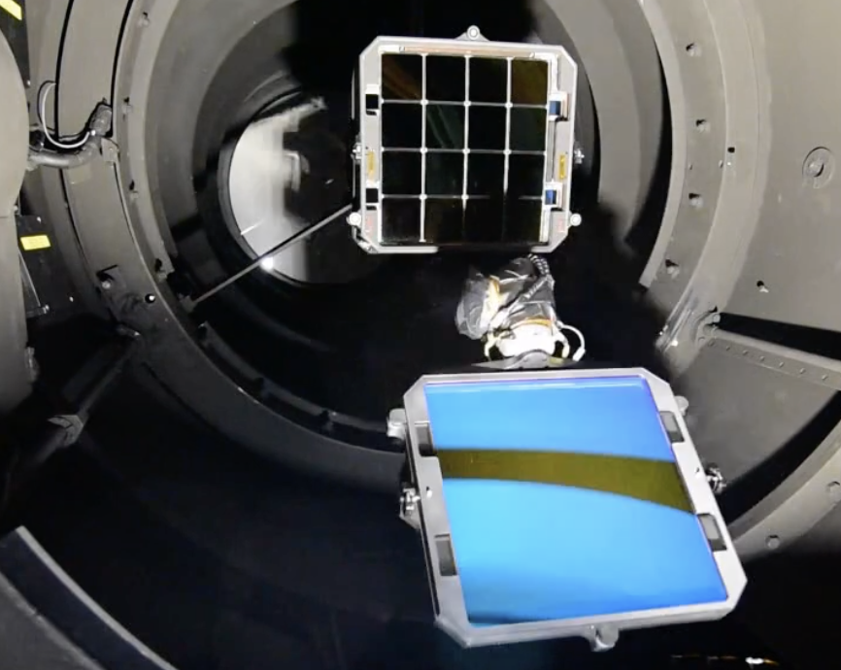
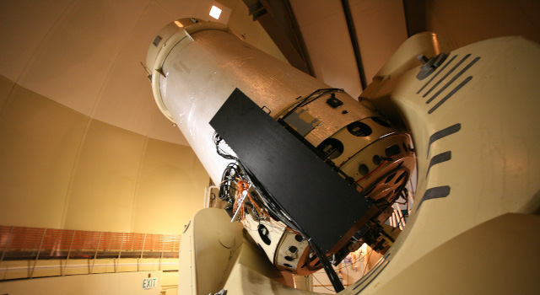
ZTF: The ideal transient population survey
Wide footprint
(~40% of sky)
@ high cadence
(2-3 days)
Significant
depth
(20 mag)
Multiple filters
Dedicated
spectroscopy

Slide 5
BTS: ZTF's mag-limited transient survey
Mag limit | Predicted SNe/year
17 | 155
17.5 | 300
18 | 585
18.5 | 1130
19 | 2220
19.5 | 4370
20 | 8500
20.5 | 16500
Catalog all (public, extragalactic) ZTF transients to m < 19*
Classify all ZTF transients to m < 18.5, unless setting or peak missed ("statistical sample")
Catalogue to m=19
Classify to m=18.5
(deeper when possible!)
(deeper since 2021)
* Now being extended to m < 19.8

Slide 6

Selection in Practice
ZTF public alert stream
(10⁵ alerts/night)
Classified SN
(~3/day sent to TNS)
Real, not moving, no long-term history,
not by a bright star, <19 mag, |b|>7
classify
filter
Other spectrographs
(LT, P200, etc.)
Candidates list
(~100 alerts/night)
Unambiguous
classification
reassign
Ambiguous
m_{peak} < 18.5, and fading?
Ambiguous
and m<18.5?
scan
Not obviously stellar/AGN/bogus
assign
Saved event list
(~10/night sent to TNS)
m < 18.5,
not CV
SEDM queue
(~5 requests/night)

Slide 7
Selection in Practice
ZTF public alert stream
(10⁵ alerts/night)
Classified SN
(~3/day sent to TNS)
Real, not moving, no long-term history,
not by a bright star, <19 mag, |b|>7
classify
filter
Other spectrographs
(LT, P200, etc.)
Candidates list
(~100 alerts/night)
Unambiguous
classification
reassign
Ambiguous
m_{peak} < 18.5, and fading?
Ambiguous
and m<18.5?
scan
Not obviously stellar/AGN/bogus
assign
Saved event list
(~10/night sent to TNS)
m < 18.5,
not CV, not
setting
SEDM queue
(~5 requests/night)

Slide 8
Selection in Practice
ZTF public alert stream
(10⁵ alerts/night)
Classified SN
(~3/day sent to TNS)
Real, not moving, no long-term history,
not by a bright star, <19 mag, |b|>7
classify
filter
Other spectrographs
(LT, P200, etc.)
Candidates list
(~100 alerts/night)
Unambiguous
classification
reassign
Ambiguous
m_{peak} < 18.5, and fading?
Ambiguous
and m<18.5?
scan
Not obviously stellar/AGN/bogus
assign
Saved event list
(~10/night sent to TNS)
m < 18.5,
not CV, not
setting
SEDM queue
(~5 requests/night)

Slide 9
Selection in Practice
ZTF public alert stream
(10⁵ alerts/night)
Classified SN
(~3/day sent to TNS)
Real, not moving, no long-term history,
not by a bright star, <19 mag, |b|>7
classify
filter
Other spectrographs
(LT, P200, etc.)
Candidates list
(~100 alerts/night)
Unambiguous
classification
reassign
Ambiguous
m_{peak} < 18.5, and fading?
Ambiguous
and m<18.5?
scan
Not obviously stellar/AGN/bogus
assign
Saved event list
(~10/night sent to TNS)
m < 18.5,
not CV
SEDM queue
(~5 requests/night)

Slide 10
Selection in Practice
ZTF public alert stream
(10⁵ alerts/night)
Classified SN
(~3/day sent to TNS)
Real, not moving, no long-term history,
not by a bright star, <19 mag, |b|>7
classify
filter
Other spectrographs
(LT, P200, etc.)
Candidates list
(~100 alerts/night)
Unambiguous
classification
reassign
Ambiguous
m_{peak} < 18.5, and fading?
Ambiguous
and m<18.5?
scan
Not obviously stellar/AGN/bogus
assign
Saved event list
(~10/night sent to TNS)
m < 18.5,
not CV
SEDM queue
(~5 requests/night)

Slide 11
Selection in Practice
ZTF public alert stream
(10⁵ alerts/night)
Classified SN
(~3/day sent to TNS)
Real, not moving, no long-term history,
not by a bright star, <19 mag, |b|>7
classify
filter
Other spectrographs
(LT, P200, etc.)
Candidates list
(~100 alerts/night)
Unambiguous
classification
reassign
Ambiguous
m_{peak} < 18.5, and fading?
Ambiguous
and m<18.5?
scan
Not obviously stellar/AGN/bogus
assign
Saved event list
(~10/night sent to TNS)
m < 18.5,
not CV
SEDM queue
(~5 requests/night)

Slide 12
Selection in Practice
ZTF public alert stream
(10⁵ alerts/night)
Classified SN
(~3/day sent to TNS)
Real, not moving, no long-term history,
not by a bright star, <19 mag, |b|>7
classify
filter
Other spectrographs
(LT, P200, etc.)
Candidates list
(~100 alerts/night)
Unambiguous
classification
reassign
Ambiguous
m_{peak} < 18.5, and fading?
Ambiguous
and m<18.5?
scan
Not obviously stellar/AGN/bogus
assign
Saved event list
(~10/night sent to TNS)
m < 18.5,
not CV
SEDM queue
(~5 requests/night)

Slide 13
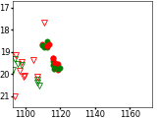

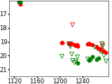
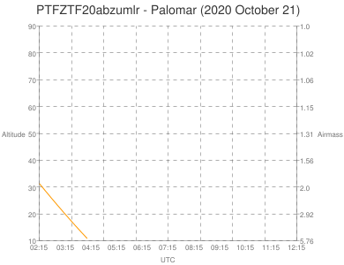
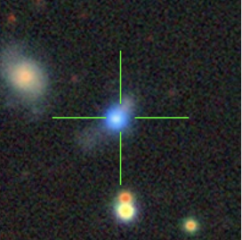
Variables, Setting Transients, Bad Weather...

Slide 14
The Statistical Sample: Quality Cut
Ensure transient was observable to P60 and has a useable light curve by requiring both:
Pre-peak and post-peak P48 coverage of field
(1 week before, 1 week after)
- and -
Field is not setting (remains above 30 degrees >1 hour per night, 30 days post-peak)
+ Not taken immediately after the end of reference building

Slide 15
The Statistical Sample: Purity Cut
Remove AGNs and CVs (even without spectroscopy) by requiring either:
Coincidence with a galaxy (and not nucleus)
- or -
A light curve "similar to" a supernova (per half-to-peak rise and fade times)

Slide 16
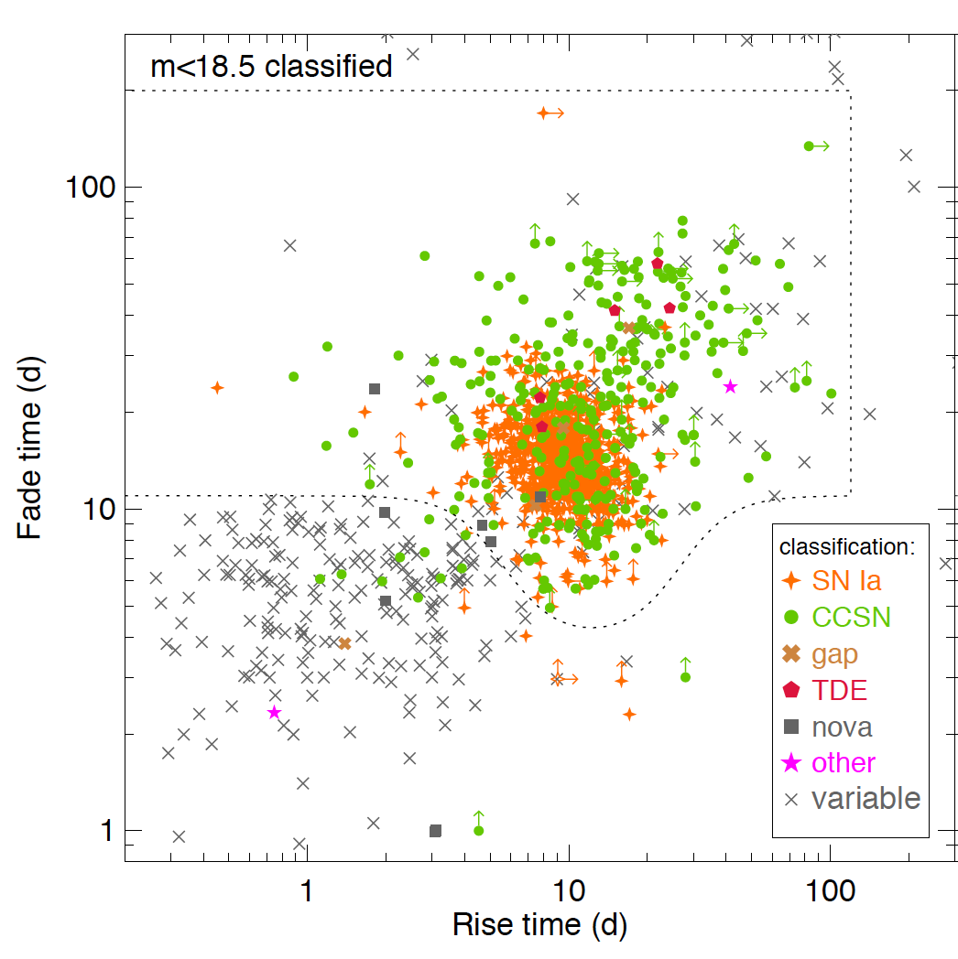
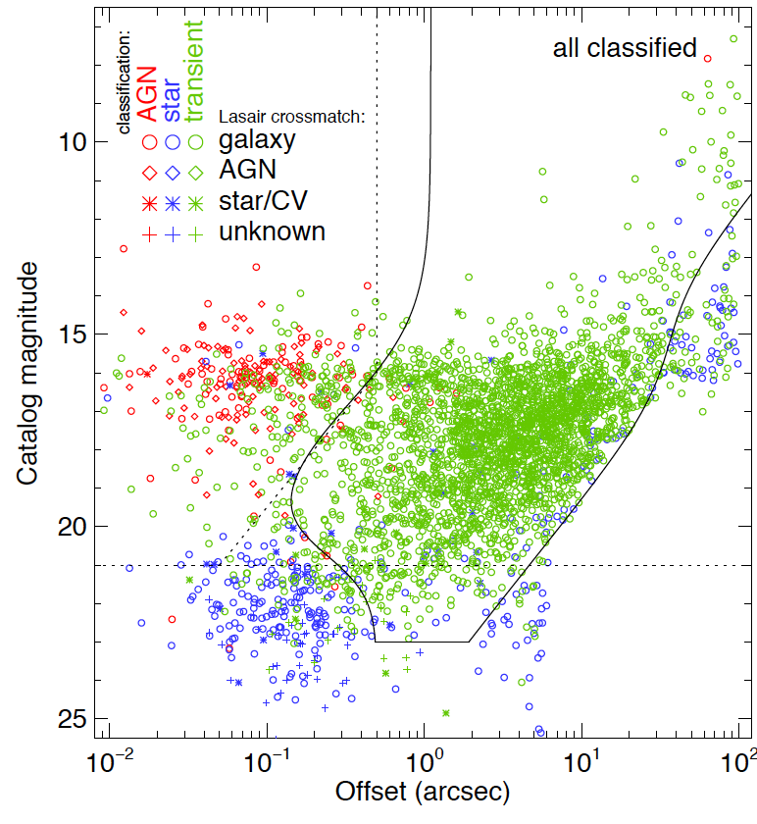
The Statistical Sample: Purity Cut
- or -
pass
suspect AGN
pass
suspect AGN
Rise time (days)
Host magnitude
suspect CV
suspect CV
Rise time (days)
Offset (arcsec)

Slide 17
Classifications to Date
6218 classified transients
2416 in
m<18.5 statistical sample
>95% complete
http://sites.astro.caltech.edu/ztf/rcf/status.php

Slide 18
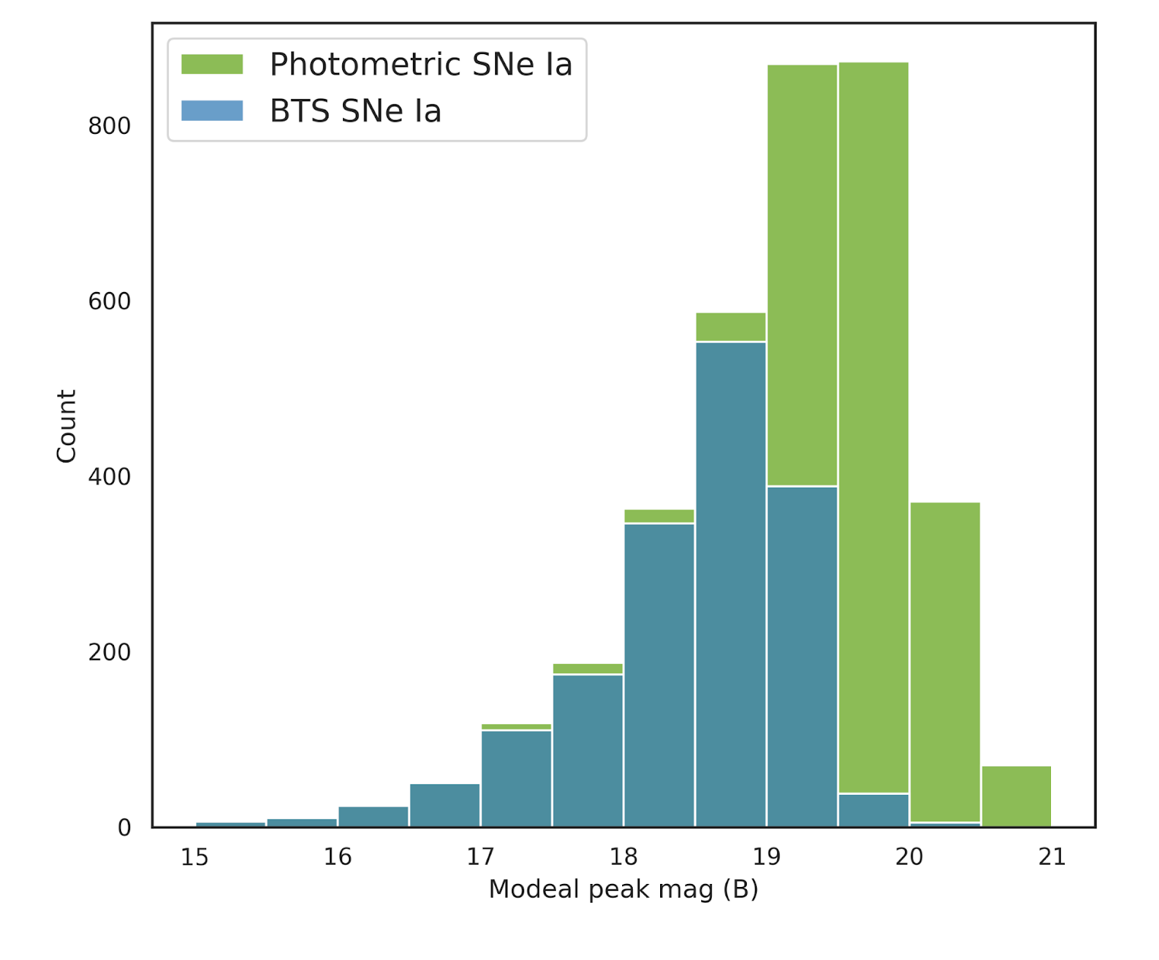
Completeness
+ TNS/Marshal crossmatch exercises, etc...

Slide 19
Classified SN Count (2018-2021)
Spectroscopically
m < 19 (incomplete)
6129 supernovae
4413 Ia
incl. 16 Iax, 11 Ia-CSM
325 Ib/c
incl. 23 Ibn, 47 Ic-BL, 56 SLSN-I
1155 II
incl. 81 IIb, 153 IIn, 34 SLSN-II
+ 38 TDEs, + 31 novae
+ 19 "other" (ILRTs, FBOTs, GRBs)
m < 18.5 passing cuts
2385 supernovae
1768 Ia
incl. 6 Iax, 3 Ia-CSM
135 Ib/c
incl. 12 Ibn, 26 Ic-BL, 16 SLSN-I
413 II
incl. 31 IIb, 63 IIn, 10 SLSN-II
+ 7 TDEs, + 18 novae
+ 6 "other"
+ 2962 unclassified (34%)
+ 114 unclassified (5%)

Slide 21
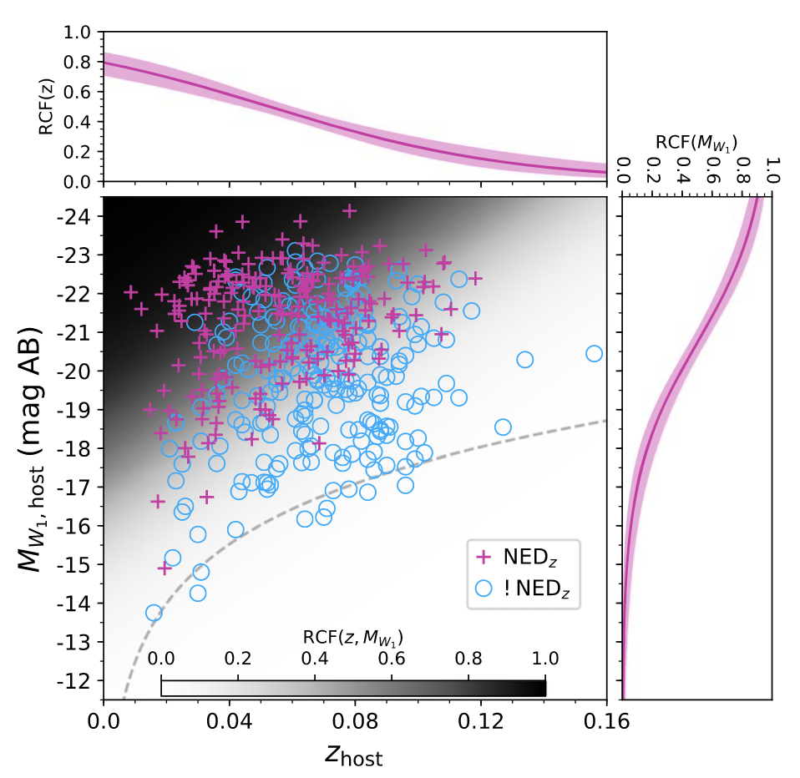
Redshift Completeness Factor
What proportion of transients are in galaxies of known redshift?
63 %
(to z=0.05 / 200 Mpc)
Fremling+2020

Slide 22
Redshift Completeness Factor (3D)
Chu, Fremling in prep.

Slide 23
Transient Parameter Space
m < 18.5
m > 18.5
SN Ia
SN Iax
SN II
SN IIb
SN IIn
SN Ibn
SN Icn
SN Ibc
SN Ic-BL
SLSN-I
SLSN-II
TDE
LBV
Ca-rich
ILRT
Other
Nucleosynthesis
Radius /
CSM /
Engine
Velocity
Peak absolute magnitude (AB)
Mass
Opacity
Distance errors
Dust
Rest-frame duration (days)
Perley+2020

Slide 24
Transient Parameter Space
m < 18.5
m > 18.5
"Featureless TDE"
SN Ia
SN Iax
SN II
SN IIb
SN IIn
SN Ibn
SN Icn
SN Ibc
SN Ic-BL
SLSN-I
SLSN-II
TDE
LBV
Ca-rich
ILRT
Other
SLSN-I
SLSN-II
FBOT
Nucleosynthesis
Ibn
Ia
IIn
II
w/SBO
Ib/c
Radius /
CSM /
Engine
Ib/c
II
Velocity
Peak absolute magnitude (AB)
ILRT
Mass
Opacity
Distance errors
nova
Dust
Rest-frame duration (days)
Perley+2020

Slide 25
Supernova Luminosity Functions
uncorrected for host extinction
core collapse
core collapse
Ia
SN Ia LF is unimodal – constrains progenitor models
(Sharon & Kushnir 2022)
"Normal" SN Ic LF extends to -19
(Sollerman et al. 2022)
Perley+2020

Slide 26
Supernova Rates
core collapse total rate
CCSN: 7.8 × 10⁴ Gpc⁻³ yr⁻¹
Ia: 2.4 × 10⁴ Gpc⁻³ yr⁻¹
Ia total rate

Slide 27
CCSN Rates by Subtype
SN II: ~75% of CCSN rate
SN Ib/c: 22% (±6%) of CCSN rate
IIn: 2-5%
Ic-BL: 1-4% (5-20% of Ib/c)
Ibn: 0.05-0.5%
SLSN I: 0.01-0.05%
SLSN II: 0.01-0.03%
Also: Ia-CSM, afterglows, FBOTs,
Icn, kilonovae...

Slide 28
Host Galaxies
Perley+2020

Slide 29
A Public Resource
Public sample explorer (uses TNS classifications):
http://zwicky.tf/mwa
"Internal" version (more classifications & features):
http://sites.astro.caltech.edu/ztf/rcf/explorer.php
user: bts
pass: rcf

Slide 31
Ongoing Efforts
Forced photometry light curves
Final spectra, classifications, and redshifts
Detailed light curve processing (explosion times, plateau times, phot types, clustering, double peaks...)
Improved automation
"Deep Transient Survey":
Scanning/saving all transients to 19.8 mag
Host galaxy populations in detail
(Even) more completeness checks

Slide 32
Upcoming Opportunities
Synergy with ATLAS (+others)
Stacking, rebuilt references
SEDM2 : Twice the classification capability
(Go deeper? Multi-phase?)
DESI : Host galaxy redshifts en masse
ZTF-III : More of the same (consistency)?
More colors? 1-day cadence?

